Slide 1
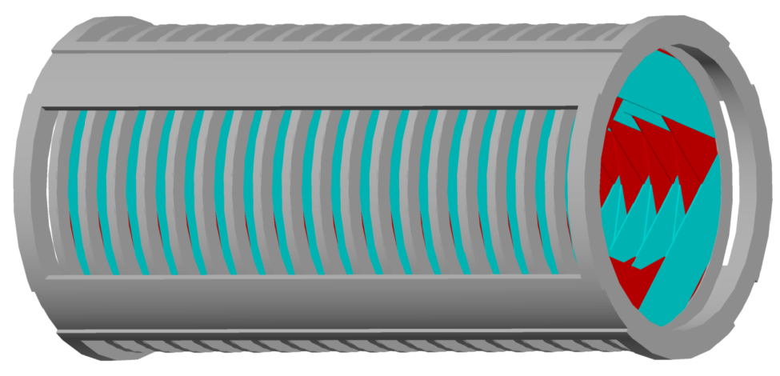
Tracker for the mu2e Experiment at Fermilab
Aseet Mukherjee
Bob Wagner

Slide 2
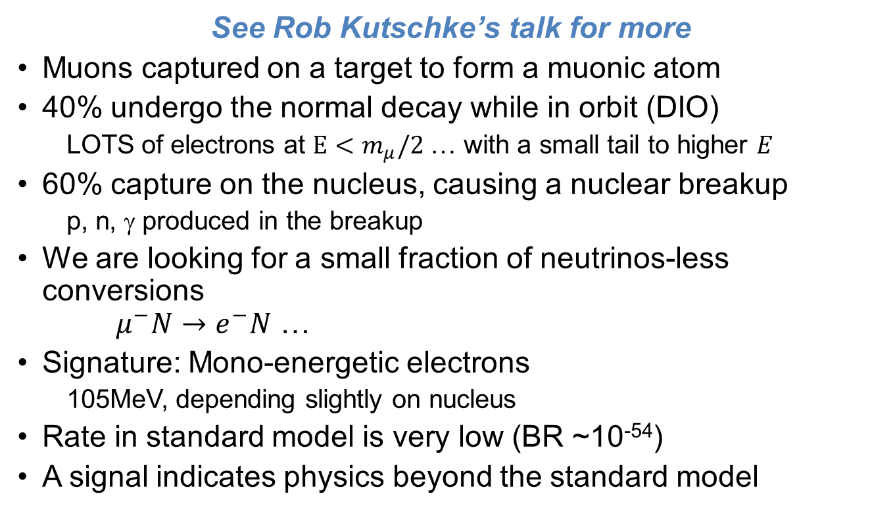
Why µ→e?
See Rob Kutschke’s talk for more
Muons captured on a target to form a muonic atom
40% undergo the normal decay while in orbit (DIO)
  LOTS of electrons at $E<m_{μ}/2$ … with a small tail to higher $E$
60% capture on the nucleus, causing a nuclear breakup
  p, n, γ produced in the breakup
We are looking for a small fraction of neutrinos-less conversions
$μ^{−}N→$ $e^{−}N$ …
Signature: Mono-energetic electrons
  105MeV, depending slightly on nucleus
Rate in standard model is very low (BR ~10⁻⁵⁴)
A signal indicates physics beyond the standard model

Slide 3
Why mu2e?
Far from the first such search! So how do we do better?
More intense beam
Pulsed beam with excellent extinction
(fraction of protons out of time)
Expect 10⁴× better than previous limit
Distributions simplified for illustration
Selection Window
at detector

Slide 4
Beam Line
Production Target
Collimators
Uniform 1T field
Proton Beam
Graded field,
2T → 1T
Production Solenoid
Transport Solenoid
Detector Solenoid

Slide 5
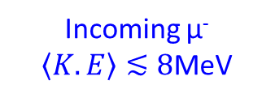
Detector Solenoid
Calorimeter
Stopping Target
Tracker
Incoming µ⁻
$\left\langle K.E\right\rangle ≲8$MeV
Cosmic Ray Veto (CRV, not shown) surrounds detector solenoid and much of the transport solenoid.

Slide 6
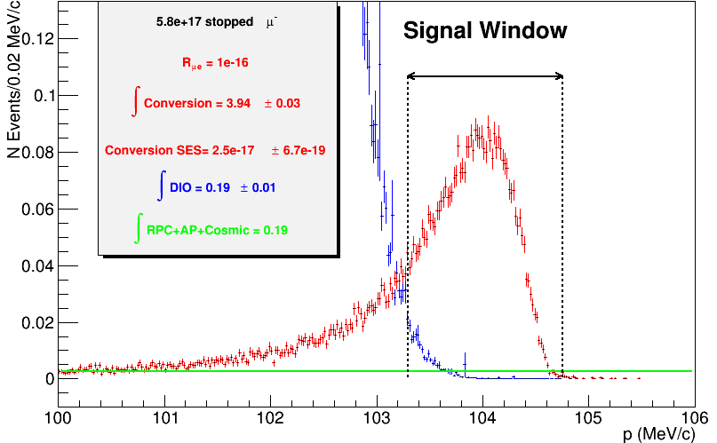
Importance of Resolution
Steeply falling
DIO background
Signal
The narrower the signal window, the better the signal to background
Other Backgrounds ~flat
Reconstructed Momentum

Slide 7
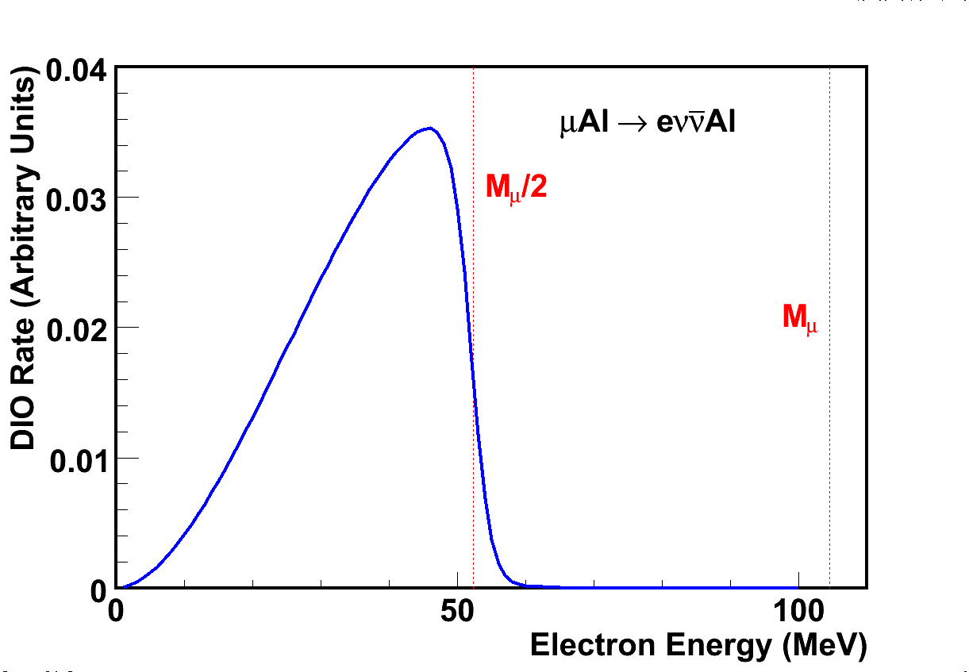

Why annular?
Reconstructable
Some hits but limited acceptance & reduced efficiency
r>700mm: Mass OK
$$m_{μ}$$
Decay in Orbit (DIO)
No Hits
Minimum mass at r<380mm
→ Vacuum

Slide 8
Tracker Design
No mass at r<380mm
  Ambient vacuum
  → Detector most handle ~15psi pressure differential
Very light active region, 400<r<700mm
Partial coverage for 380<r<400mm
Light, inactive region for 700<r<720mm to reduce hits from photon conversion and stopped neutrons decaying
Move mass out to r>720mm
Selected Solution: Straw tracker
  18 Stations distributed along beam direction
  Optimization of number of stations in progress
  A Station has 2 Planes.
  A Plane has Panels with varying rotation for stereo reconstruction
  Each Panel has 96 Straws of varying length

Slide 9
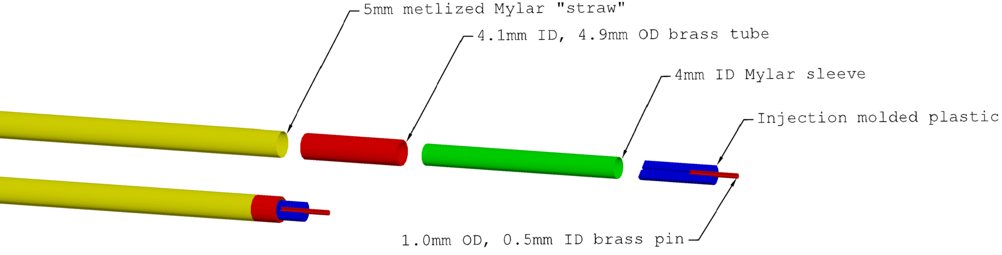
Straw
5mm OD, 15µm thick metalized Mylar tube as cathode
  Metalized on inner & outer surface
  400Å Aluminum outer surface
  400Å Aluminum + 200Å Gold inner surface
  25µm gold-plated tungsten wire as anode
Notes:
Fixed brass pin dimensions (previously labeled as 2mm OD)

Slide 10
Leak Tests
Conventional methods
Using CO2 sensor
In air, straw at 15psig
  Test time: several days
In vacuum, straw at 15psia
  Measures exactly what we want
  Test time >1day
  Test setup too expensive to make many
Can do large batches but lose sensitivity
CO2 leaks through plastic faster than most gases
Fill straw with Ar-CO2 (80:20), purge test vesel with N2, and monitor CO2 level
Test time to required sensitivity: <1hour
Test setup cost: <$100, can have many setups
Needs to be calibrated against vacuum method

Slide 11
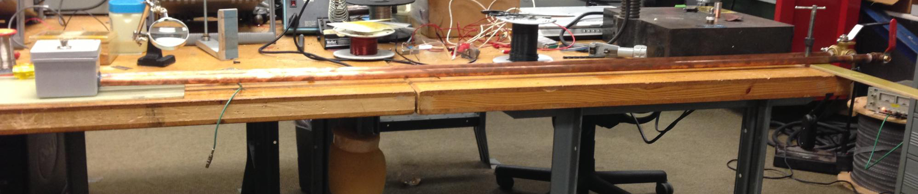
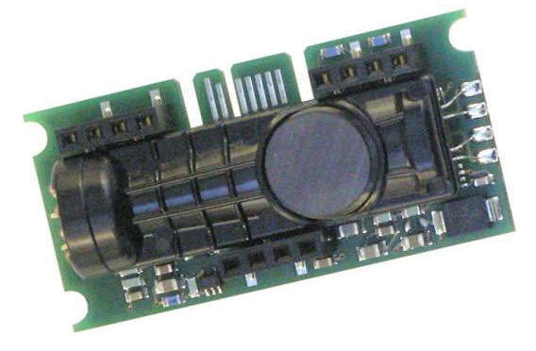
CO₂ Leak Test
Container for CO₂ sensor and circulation fan
Copper pipe for straw
Another in back (not seen) for circulation

Slide 12
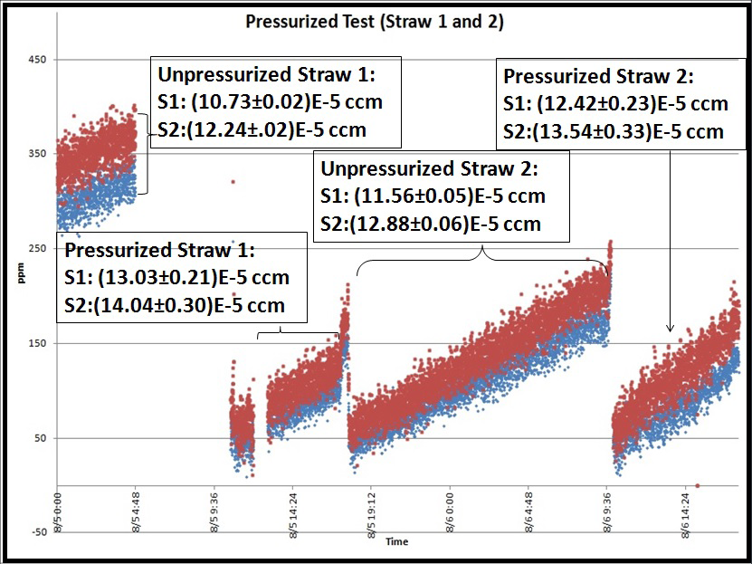
CO₂ Leak Tests
Sample results for straws with and without being pressurized
Leak rates well below limit of 3.5e-4 ccm

Slide 13
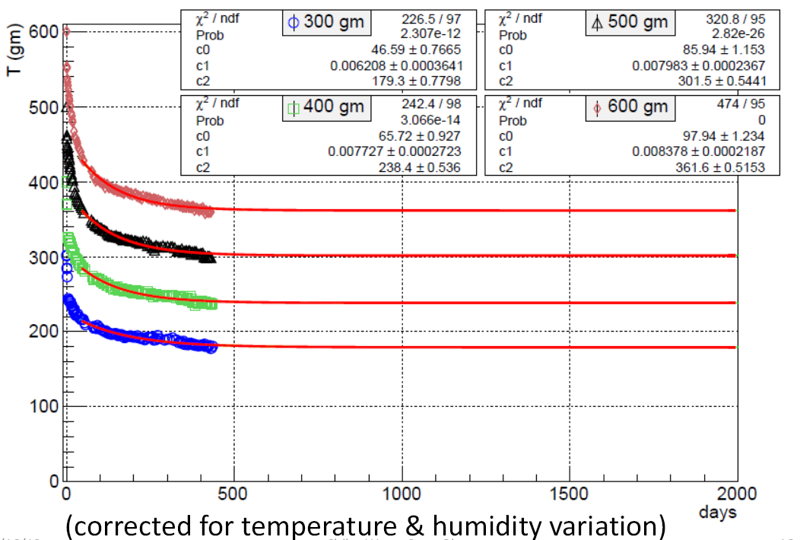

Straw Creep
Like all plastics, the Mylar straws creep: loose tension over time
Our best fit, extrapolated to several years, shows detector is fine (over 200g) indefinitely if we install at 700g tension
Fit: $c_{0}e^{−t/c_{1}}+c_{2}$

Slide 14
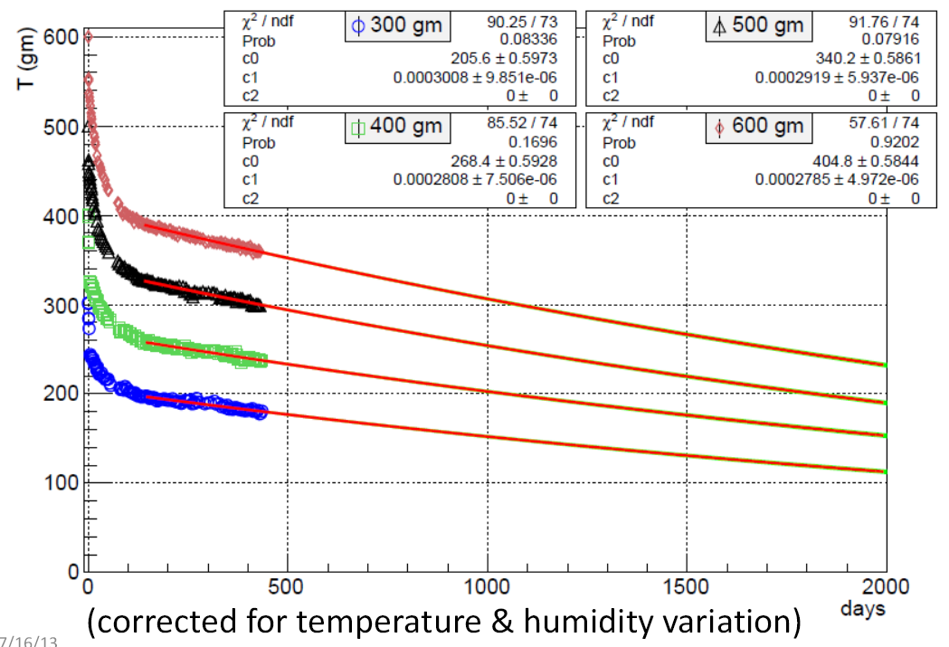

Straw Creep
Extrapolation from <1year to many years is tricky
Alternative fits indicate a lifetime of >6years
Fine for mu2e … maybe not mu2e-II
Alternative: Add a stiffening carbon fiber line radially across the panel
Fit: $c_{0}e^{−t/c_{1}}$

Slide 15
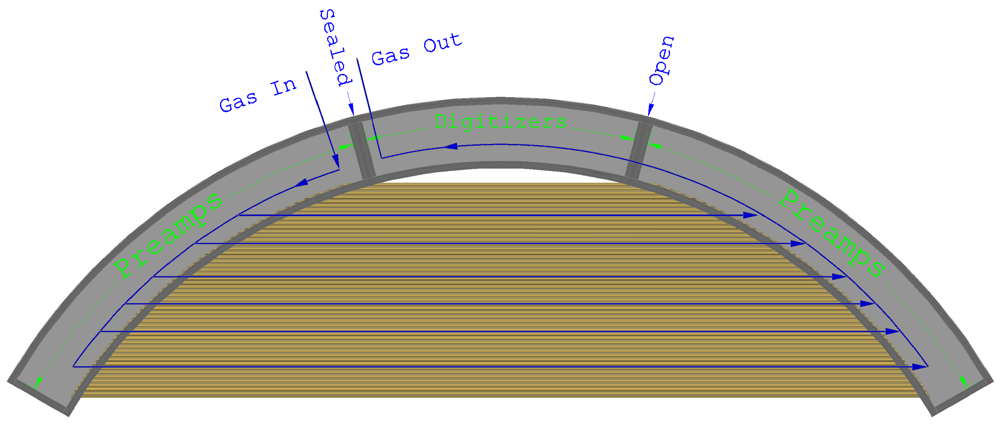
Panel
All electronics are in drift gas to simplify cooling
Preamps to be tested for gas contamination, and may need coating
Digitizers are in the exhaust gas → don’t need to worry about outgassing
Digitizer region can be accessed while operating straws
(not in the vacuum, of course)

Slide 16
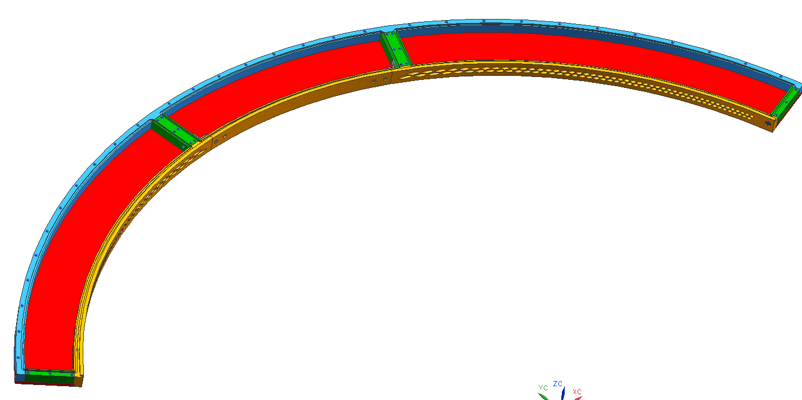
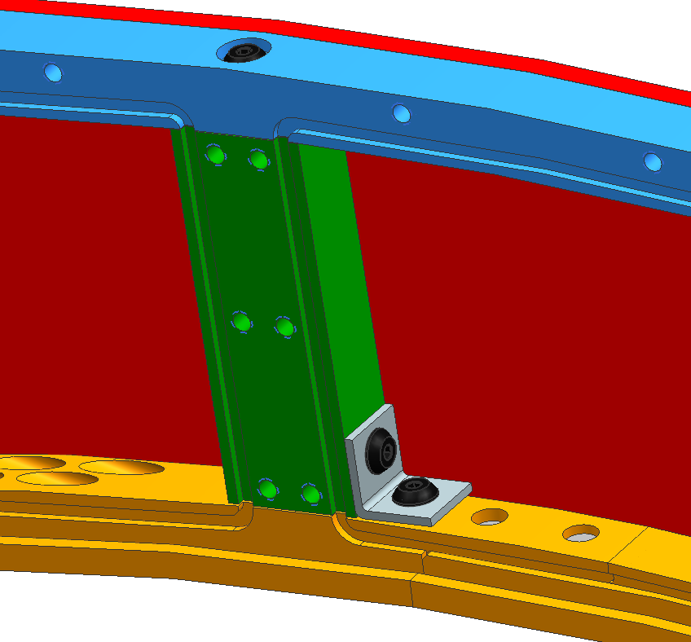
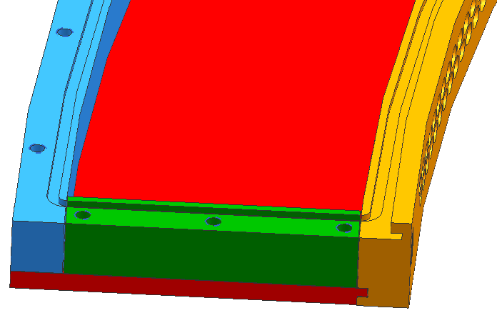
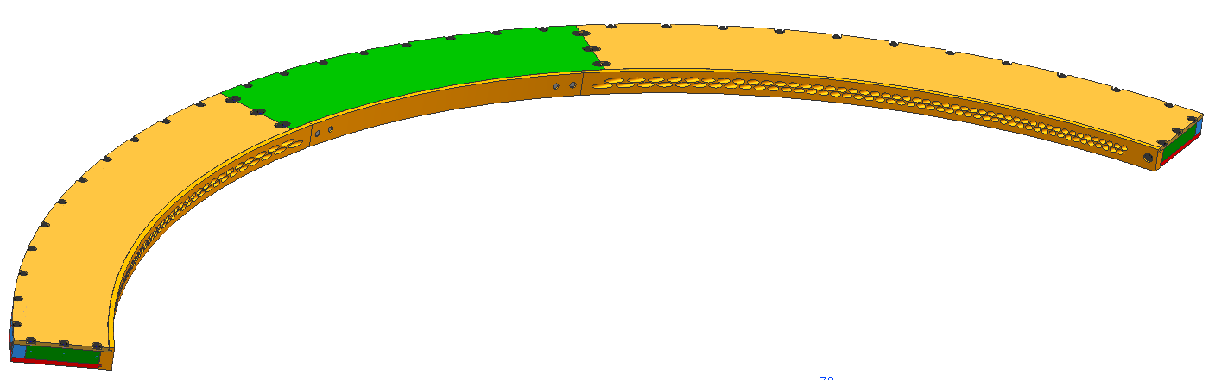
Gas Manifold
Gas tight while allowing access to electronics
Three separate covers, one each for preamps and one for digitizers

Slide 17
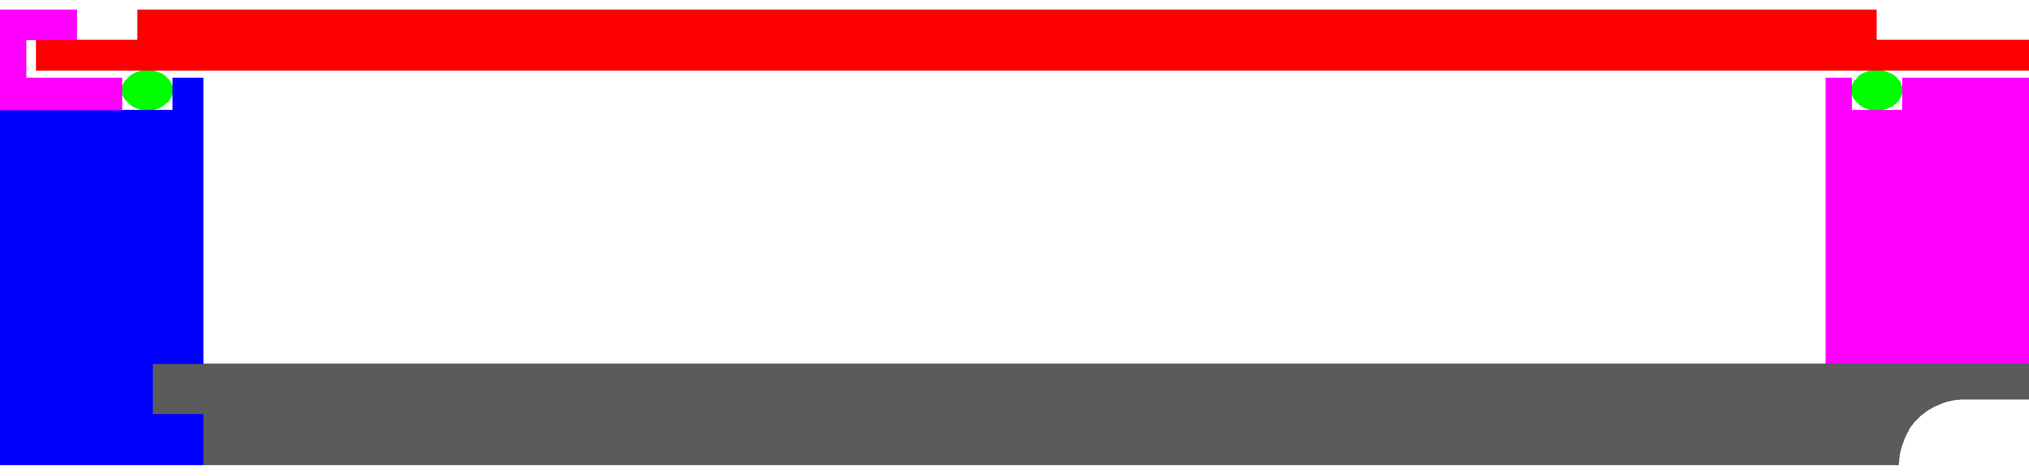
Gas Manifold
Latch on this side
(no room for screws)
Prototype had <0.24ccm leak rate
Small compared to allowed total of 7ccm
O-ring
Screws on this side
Brass Cover
Stainless Steel Outer Ring
Composite Inner Ring
Aluminum plate for thermal and electrical conductivity
Refrigerant

Slide 18
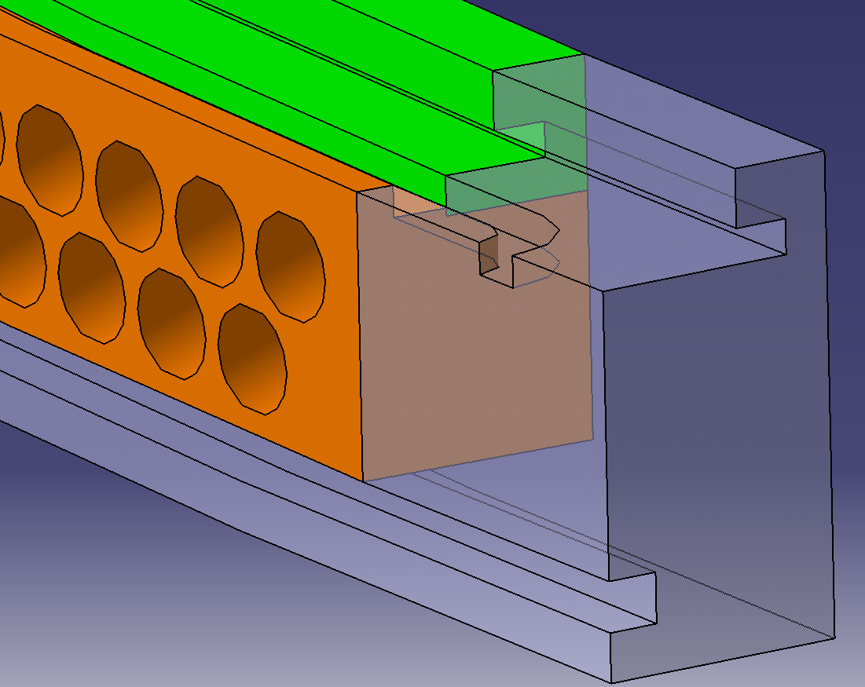
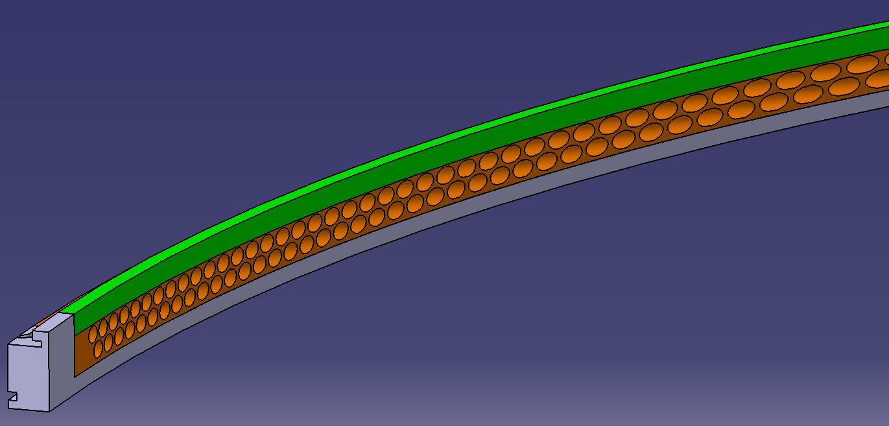
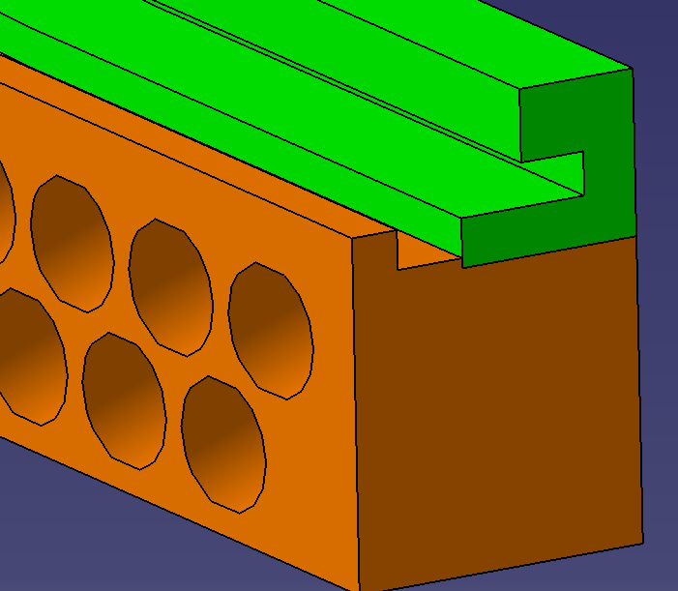
Gas Manifold Inner Ring
96 straws/panel ×6 panels/plane × 36 planes
→ ~20K straws → 40K precision holes
Alternative: Mold the holes in carbon fiber
O-ring groove
Carbon Fiber
Stainless Steel

Slide 19
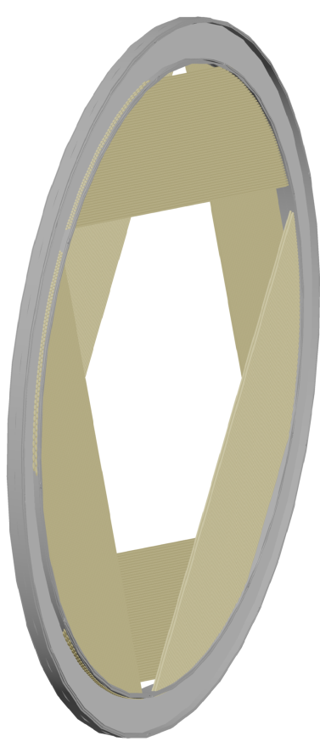
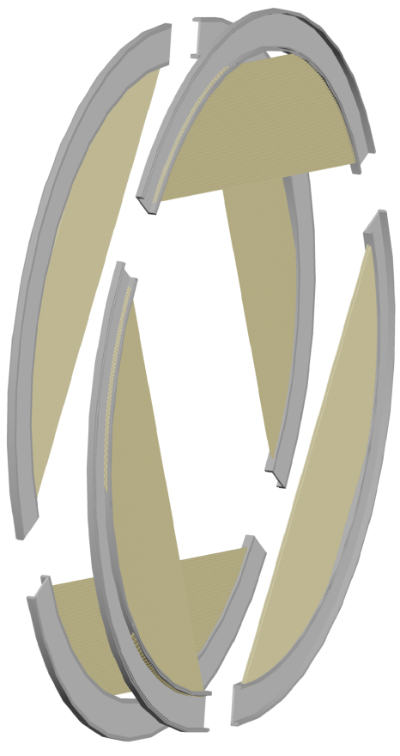
Plane
Self-supporting panels assemble into a plane

Slide 20
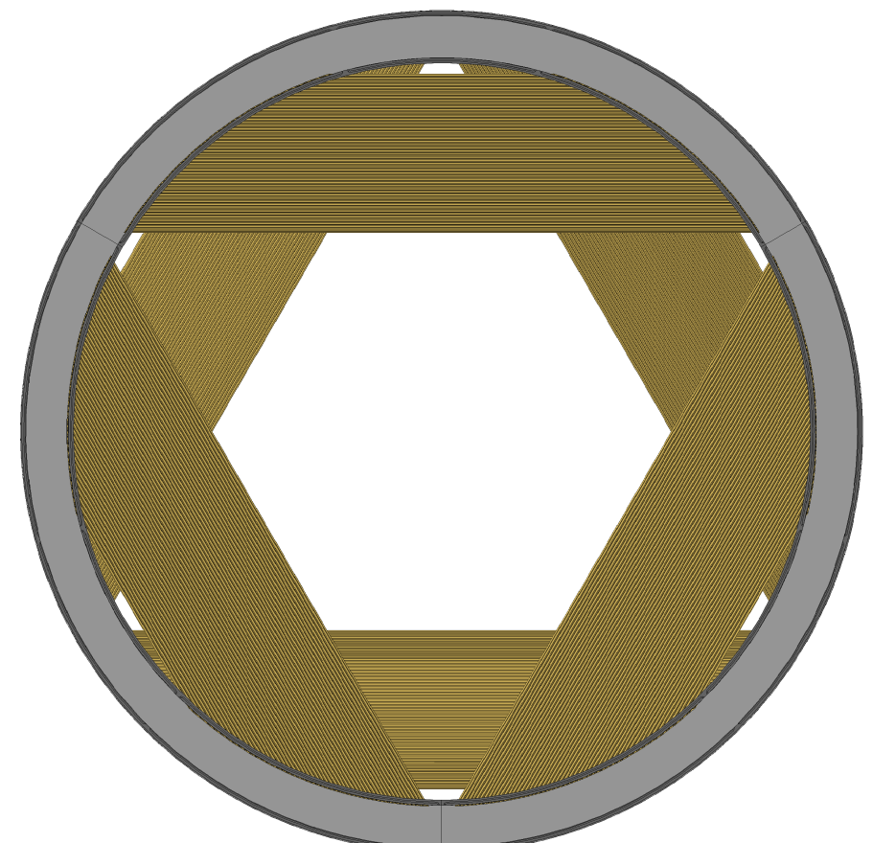
Plane

Slide 21

Plane
Switch to simpler representation

Slide 22

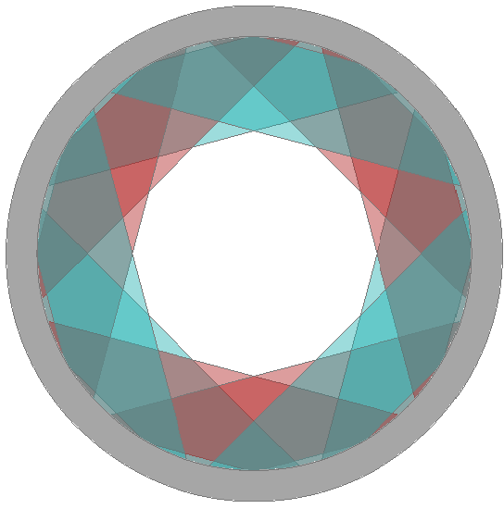
Station
Two planes back-to-back

Slide 23
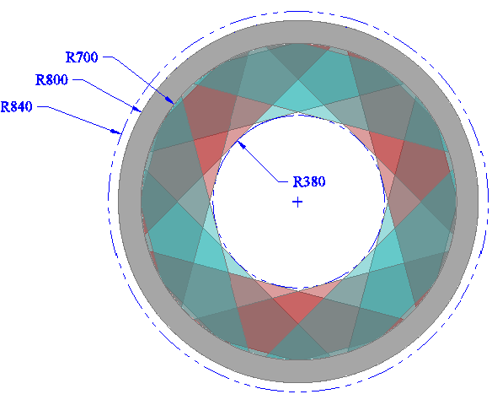
Station
Optimal Stereo order still under study

Slide 24
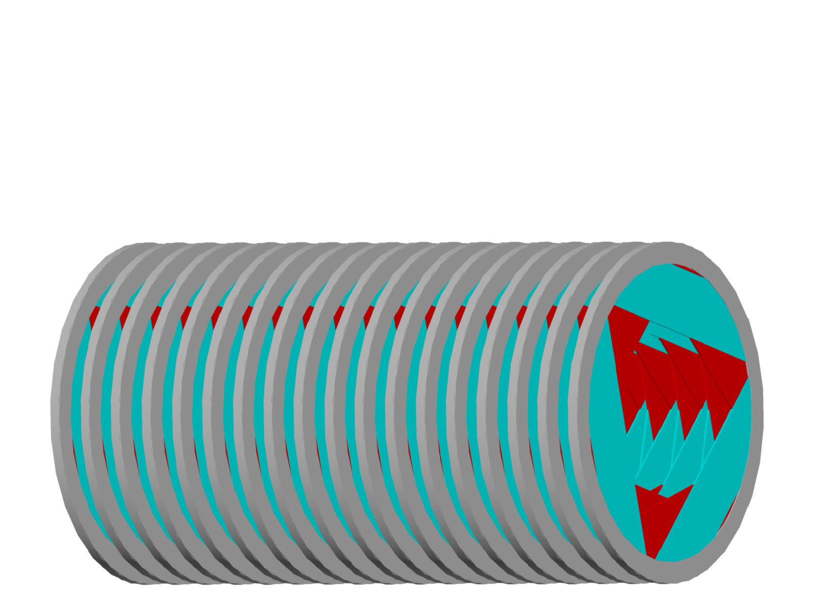
Tracker
18 stations
tentative … optimal number being studied

Slide 25
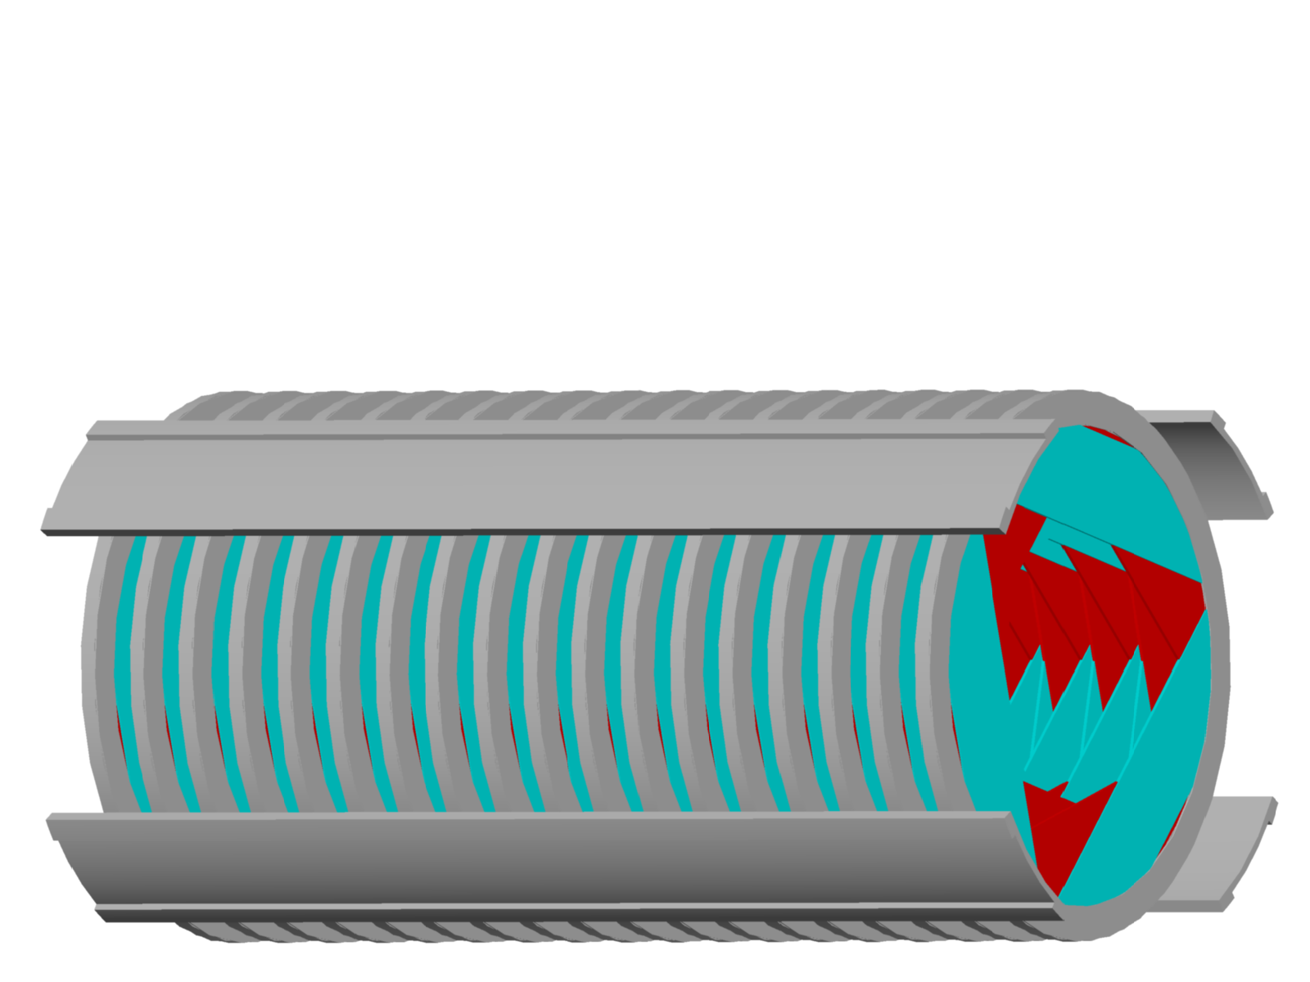
Tracker
18 stations + Support Structure

Slide 26

Tracker
18 stations + Support Structure

Slide 27
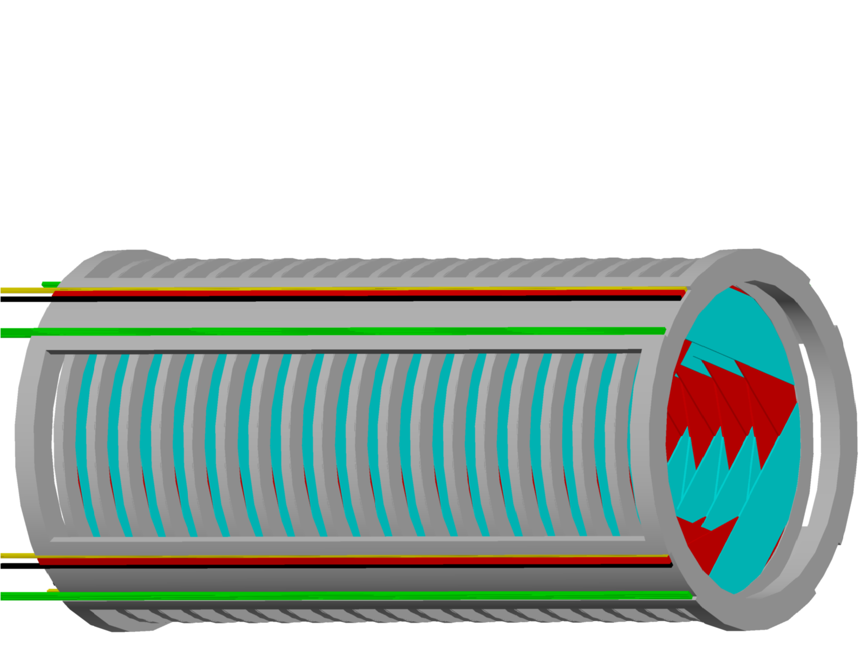
Tracker
18 stations + Support Structure
Support beams also serve as cable trays

Slide 28
Front End Electronics
Discrete ⁽¹⁾
ASIC ⁽¹⁾
FPGA
Baseline
Preamp
TDC
PCB transmission line
Straw
Readout Controller
TDC
DAQ
Output Control & Buffer
∑ & ∫
Preamp
Commercial Analog ICs
ADC
Alternate
Discrete
FPGA
FPGA

Slide 29
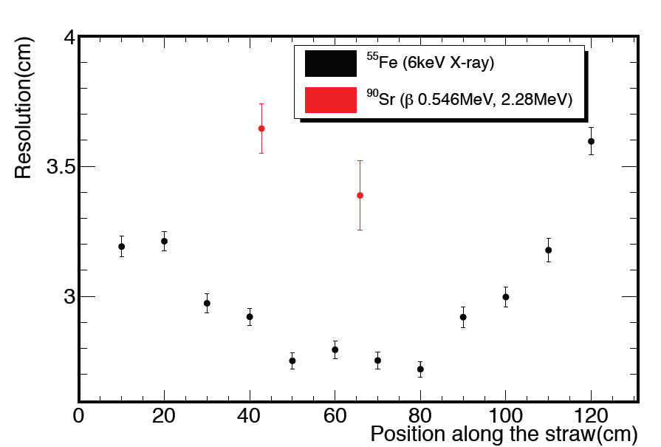
Time Division
Use difference in signal arrival time at straw ends to estimate position along wire
Resolution much worse than stereo (<1mm)
Needed for stand-alone pattern recognition (not using calorimeter for timing)
Difference caused by noise and large pulses from ⁵⁵Fe, while ⁹⁰Sr pulses are close to what we expect.
Continuing to work on reducing noise to bring the two closer together

Slide 30
Mu2e Tracker & Project X
Mu2e-II: 10× rate increase
  3× instantaneous rate
    Affects performance directly (higher occupancy)
    Can study via simulations
    Already studied up to ×4 background rates as part of understanding mu2e robustness
  3× duty factor
    No direct affect on performance
    Concern is radiation damage (aging)
Mu2e-III: 100× rate increase
  Unlikely this tracker can survive

Slide 31
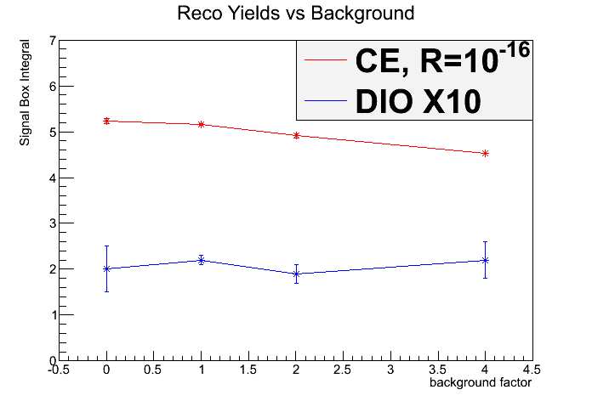
Efficiency
Mu2e
Mu2e-II
<5% loss in efficiency

Slide 32
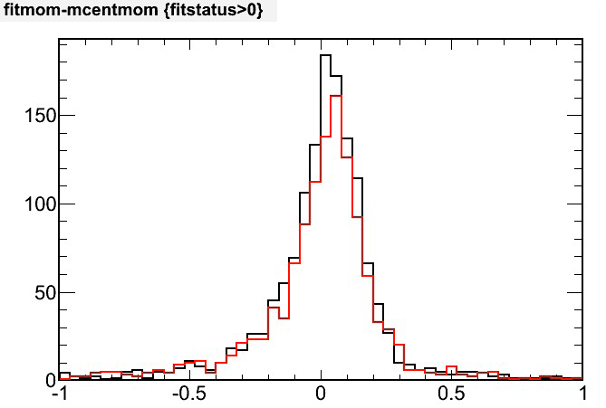
Resolution
Mu2e-II
No change in apparatus
Mu2e
Loose cuts … not resolution used for most analysis
Key point: No significant change

Slide 33
Rebuild
Thinner walls
  8µm instead of 15µm
  Less scattering
  Fewer conversions
  & δ-rays
Run sub-atmospheric
  8µm unsafe for 15psid
  Fine for 8psid
Side benefit: shorter ion drift time
  Less space charge
Cannot operate at nominal gas density in air
Harder to test
But … by then we’ll have more experience

Slide 34
Summary
Mu2e has a tracker design well suited for operation starting ~2019
For mu2e-II, the detector is expected to continue to operate adequately, but rebuilding with thinner straws may be better
Mu2e-III will require an entirely different design

