Slide 1
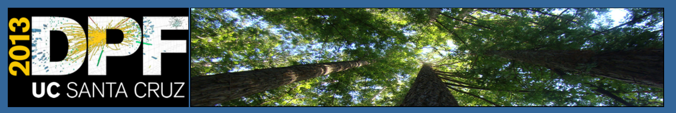


Particle Physics Projects
in Asia
Atsuto Suzuki

Slide 2
Outline
Projects in Japan
  Particle Physics Strategy
  Intensity Frontier
    SuperKEKB/BELLE-II, J-PARC/T2K, KOTO, COMET
  Energy Frontier: ILC
  Underground Physics at Kamioka
2. Projects in China
  Accelerator-based
  Reactor-based
  Project-list outside China
3. Projects in Korea
  Accelerators
  Reactor-based
  Underground Physics
4. Projects in India
  Underground Physics
  ILC Activity
5. Summary

Slide 3

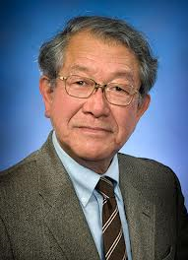
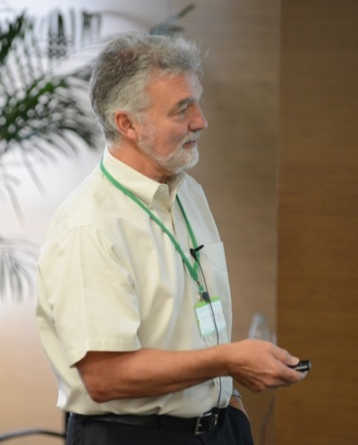
Projects in Japan
  Particle Physics Strategy
2008 - 2012
Roadmap
Dr. H. Weerts
(ANL)
Dr. S. Ozaki
(BNL)
After 2013 – 2017
Roadmap

Slide 4
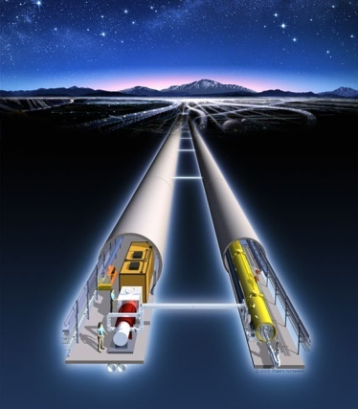
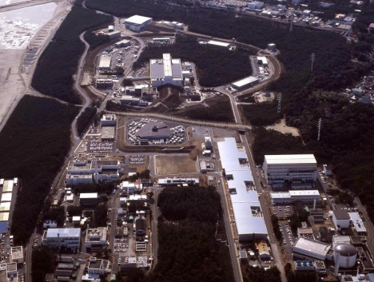
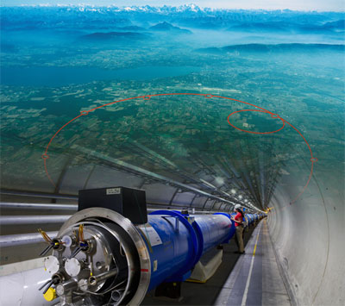
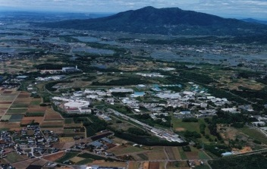
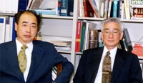
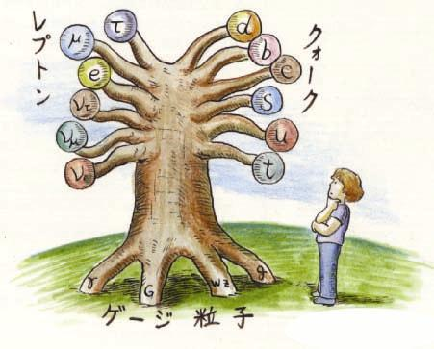
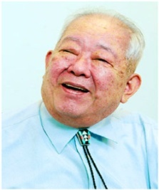
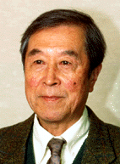
Quest for
Birth-Evolution
of Universe
Quest for Unifying
Matter and Force
International Linear Collider（ILC）
Scientific Activities
Technology Innovations
Talented Human Resources
Lepton CP Asymmetry
Beyond Standard Physics
Power-Upgrade
SuperKEKB
J-PARC
KEK-B
Quark CP Asymmetry
LHC
Lepton
Quark
ν_{τ}
[Origin of Matter]
ν_{μ}
Quest for Neutrinos
ν_{e}
Quest for 6 Quarks
[Origin of Force]
Higgs Particle [Origin of Mass]

Slide 5
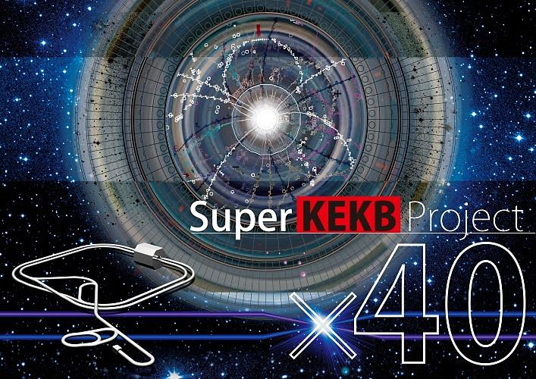
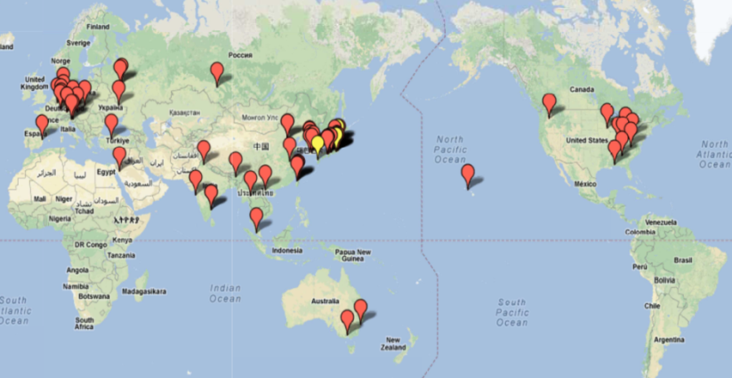
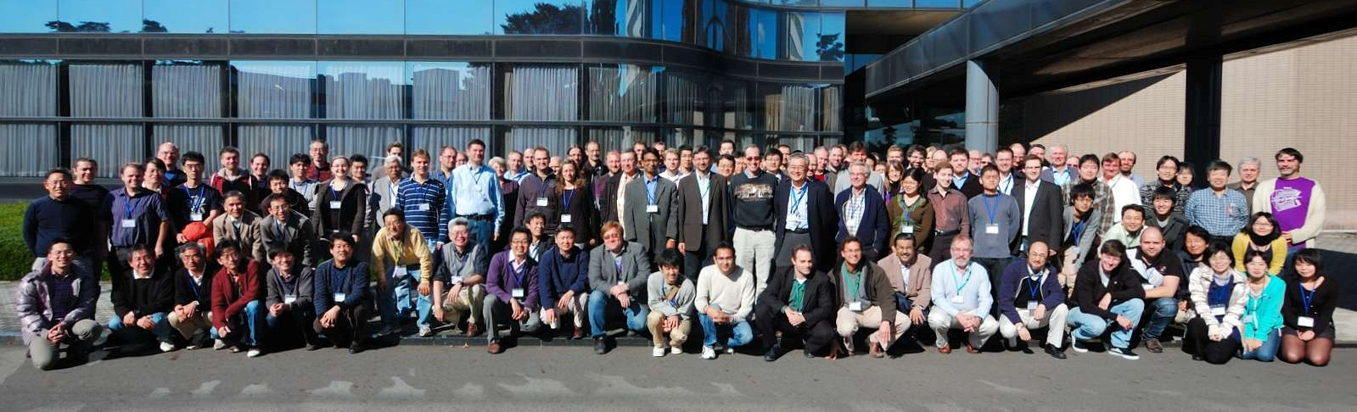
Projects in Japan
  Intensity Frontier
    SuperKEKB/BELLE II
~500 collaborators from 76 institutions in 21 countries

Slide 6
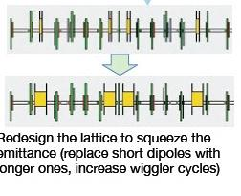
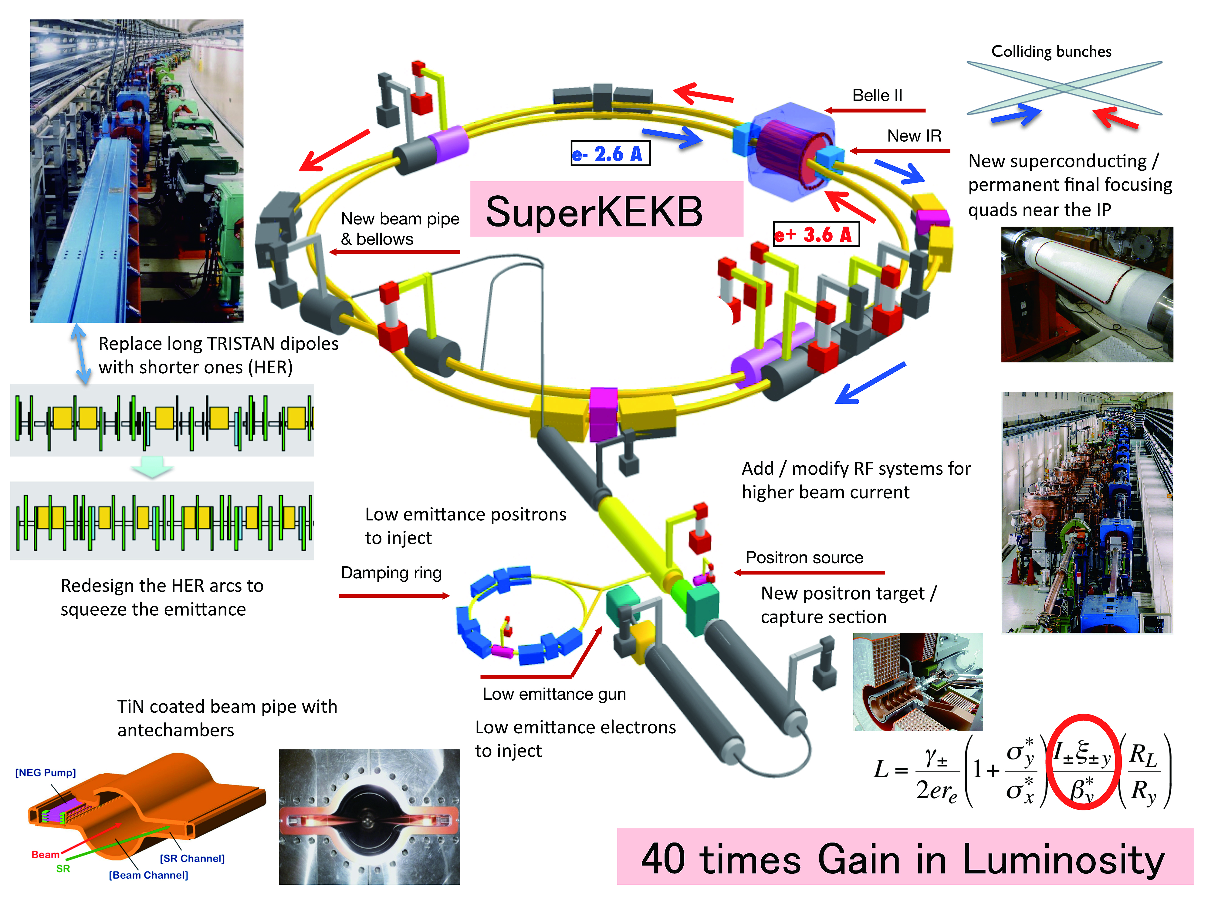
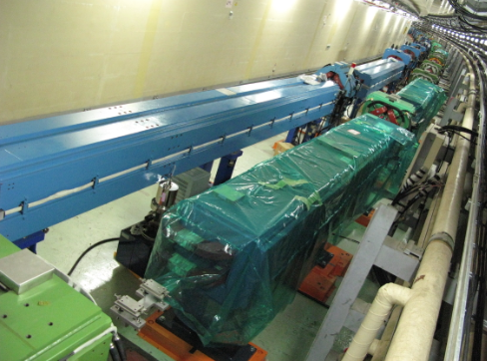
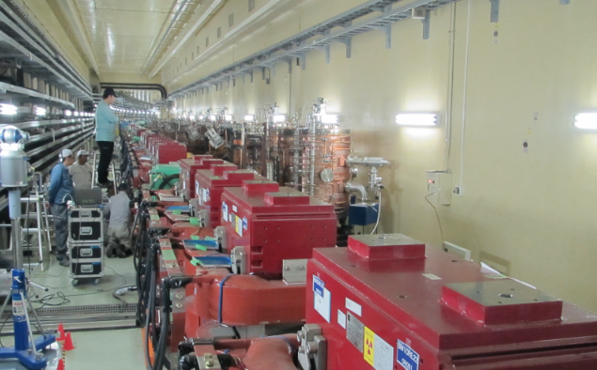
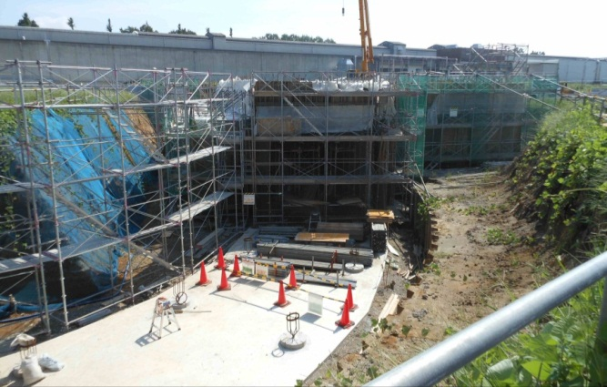
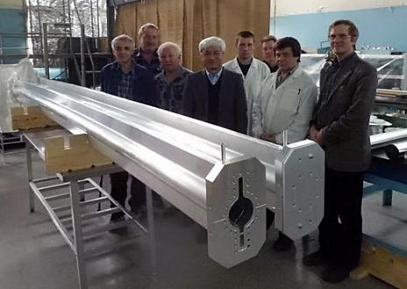
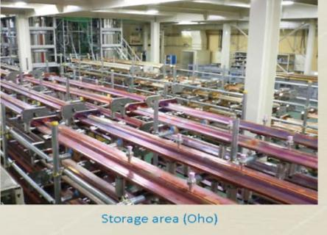
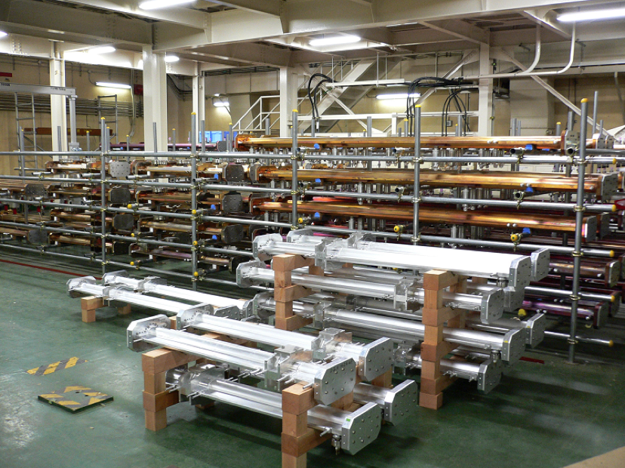
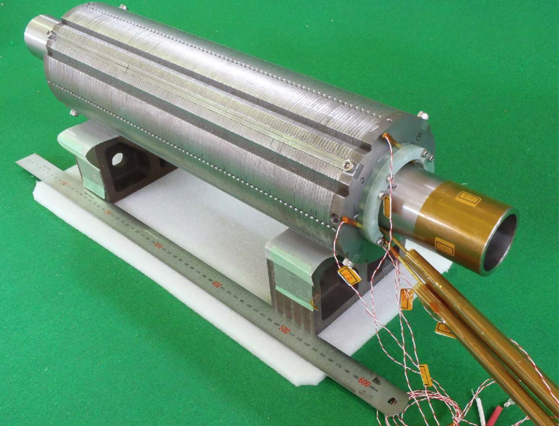
SC final focus: Successfully tested without any quench up to 2157A, well over the design value for nominal operation.
Installation of 100 new LER
dipole magnets completed.
ARES cavities moved from HER to LER, and wiggler magnets for HER installed in D5 Oho straight section.
Beam pipe production
at BINP
Beam pipes after baking and TiN coating
in a stock area.

Slide 7
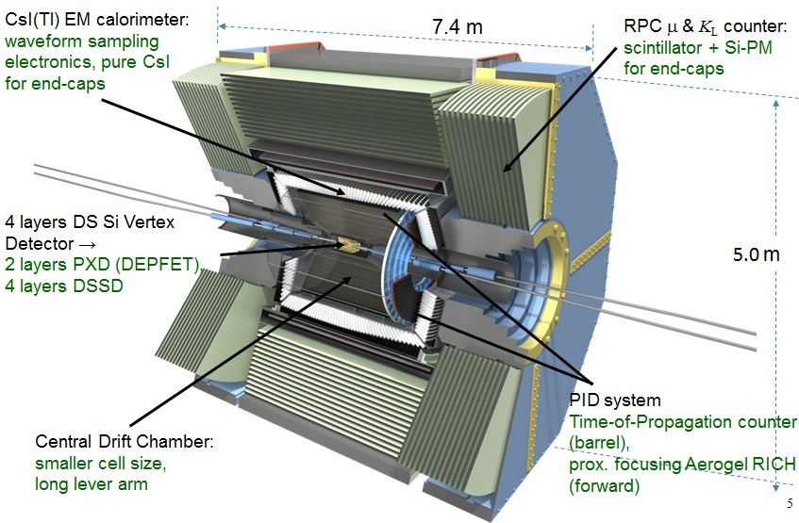
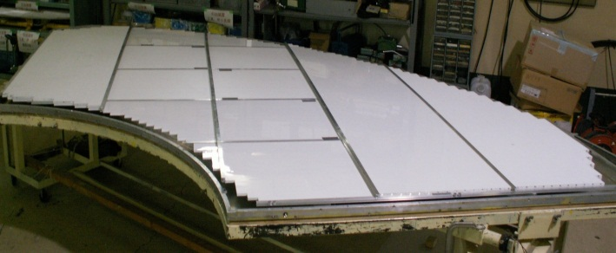
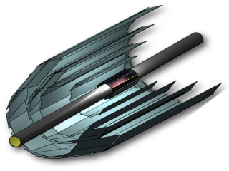
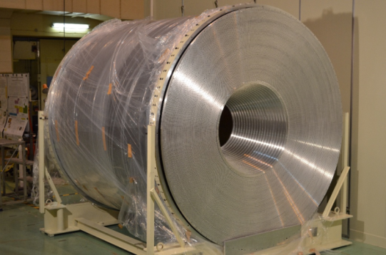
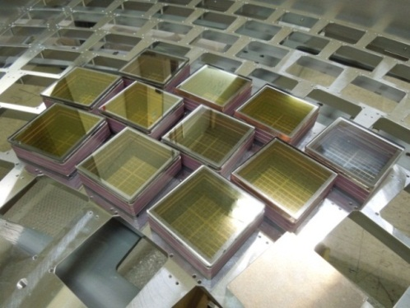
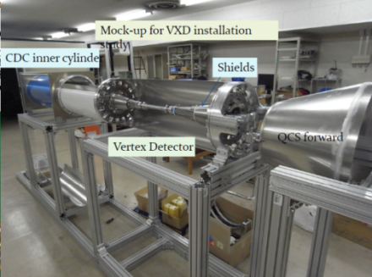
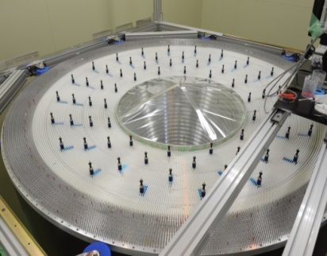
BINP, KEK, Nara
Taiwan, Hanyang, …
ITEP, Virginia, KEK,
Hawaii, Indiana,
Wayne state, …
MPI, Bonn, Heidelberg, Valencia, Karlsruhe, Charles, DESY, Vienna,
KEK, IPMU U-Tokyo, Tohoku, TIFR, Melbourne, Krakow
Nagoya, Toho, Chiba, Niigata, Hawaii, Cincinnati, PNNL,KEK, Tokyo metro, Ljubljana, …
KEK, Taiwan, RCNP,
Viet Nam, Malaya, Chiang Mai, …

Slide 8

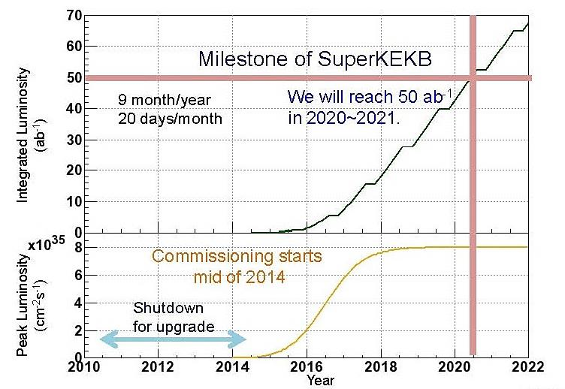
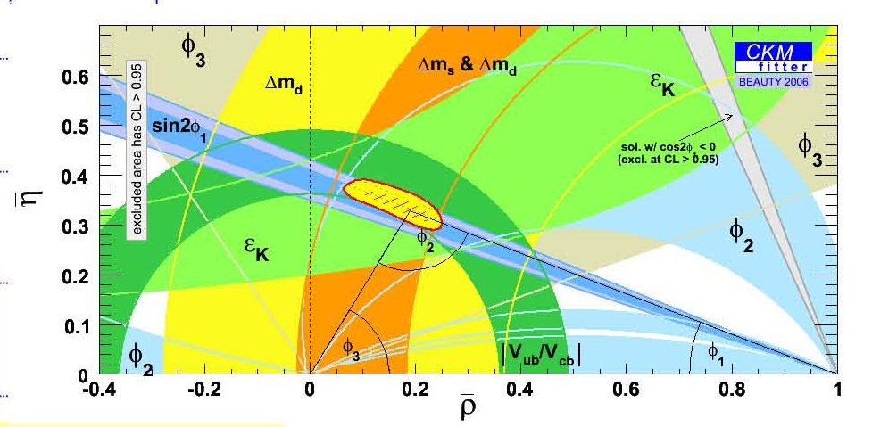
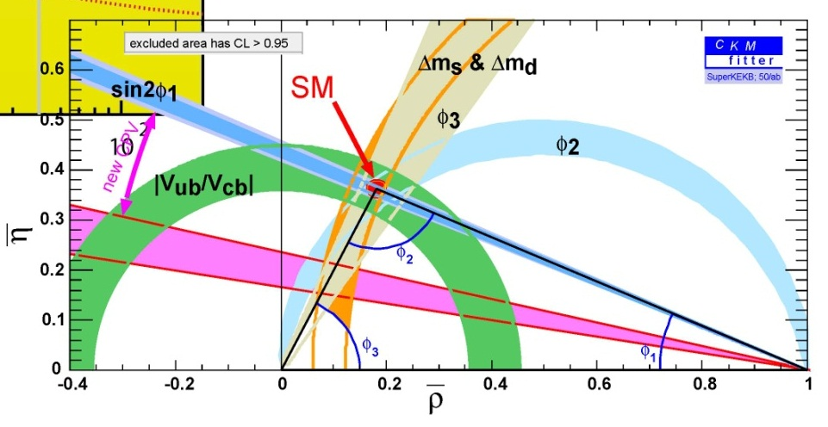
SuperKEKB luminosity projection
Inconsistency in unitarity triangle?
B -> φK_{s}

Slide 9
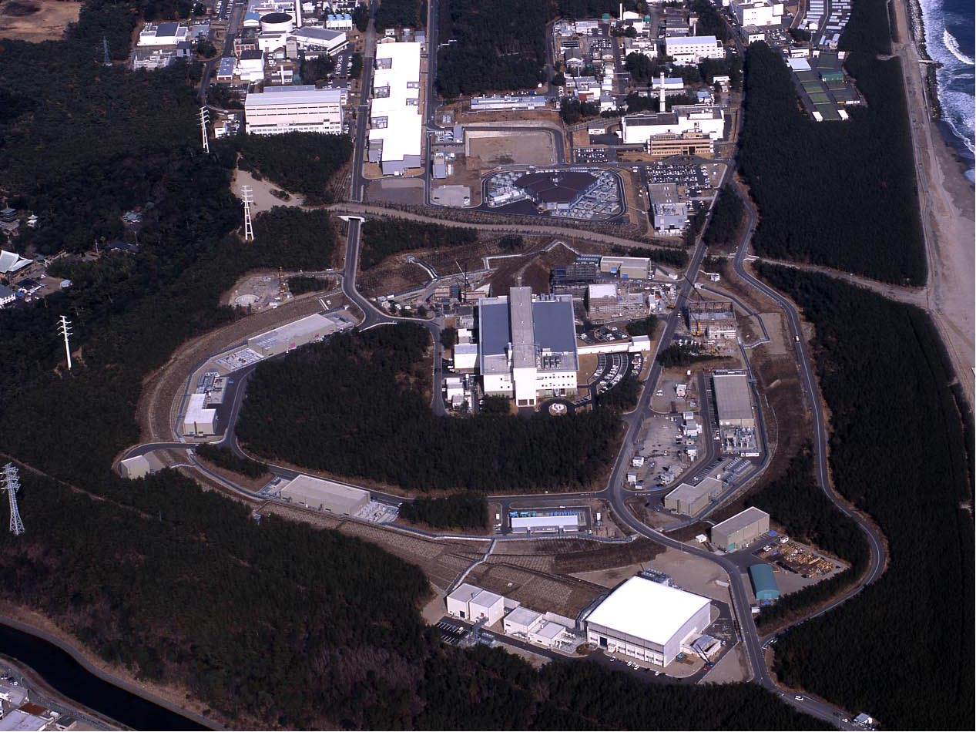
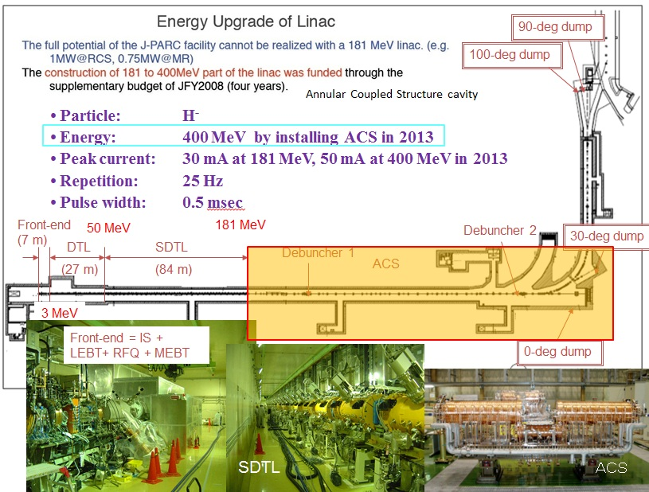
Projects in Japan
  Intensity Frontier
    J-PARC
Linac
RCS
Neutrino beams to SK
MLF (Material and Life science experimental Facility)
ＭＲ
Hadron experimental hall

Slide 10
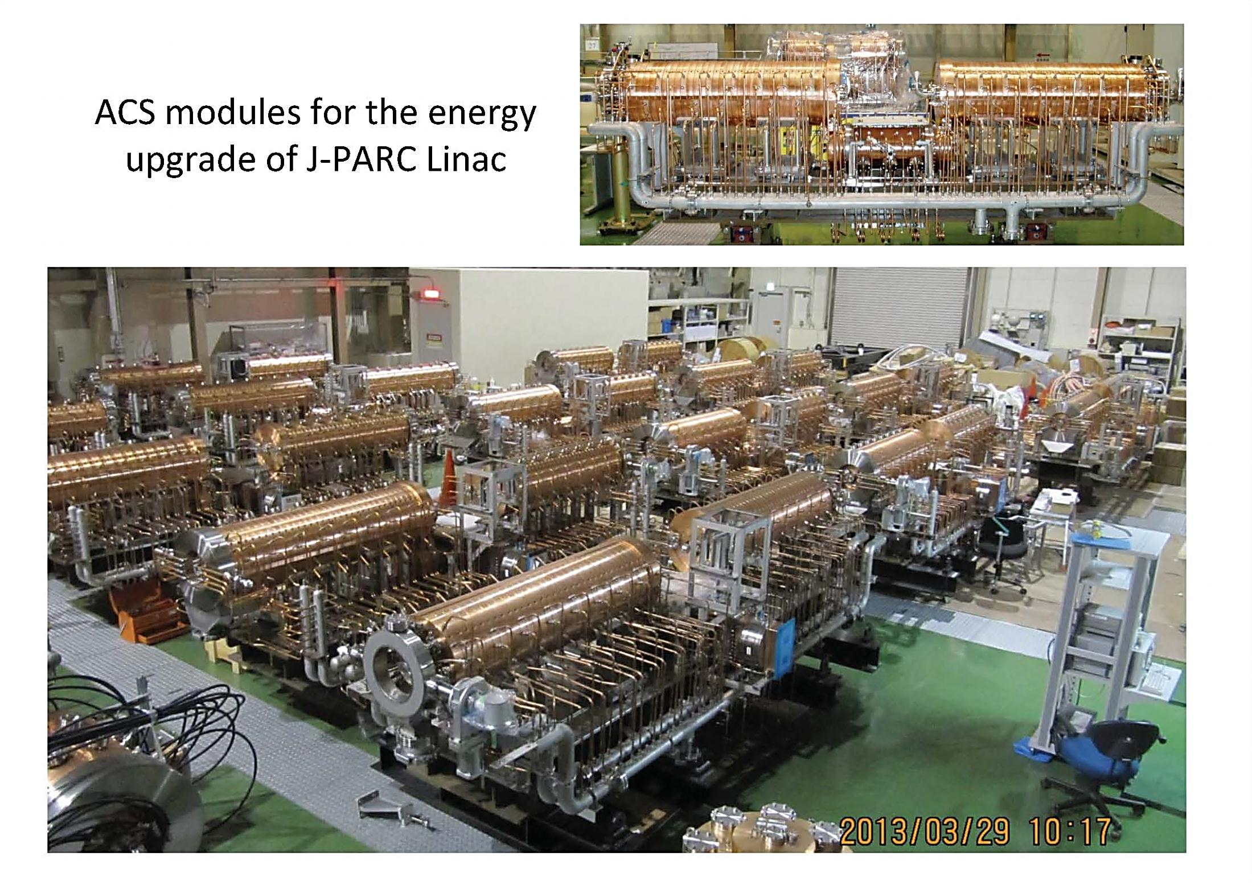
Annular Couple Accelerator

Slide 11
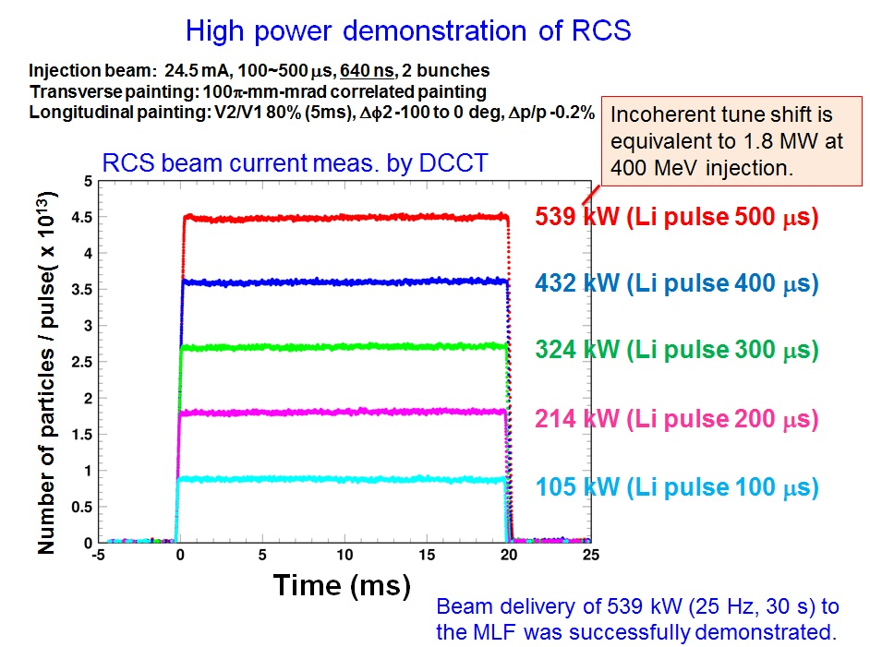
Linac
RCS
Neutrino beams to SK
MLF (Material and Life science experimental Facility)
ＭＲ
Hadron experimental hall

Slide 12
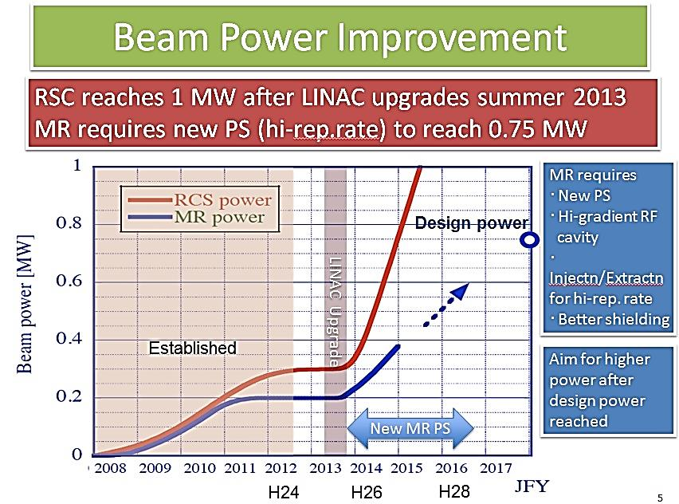

Slide 13
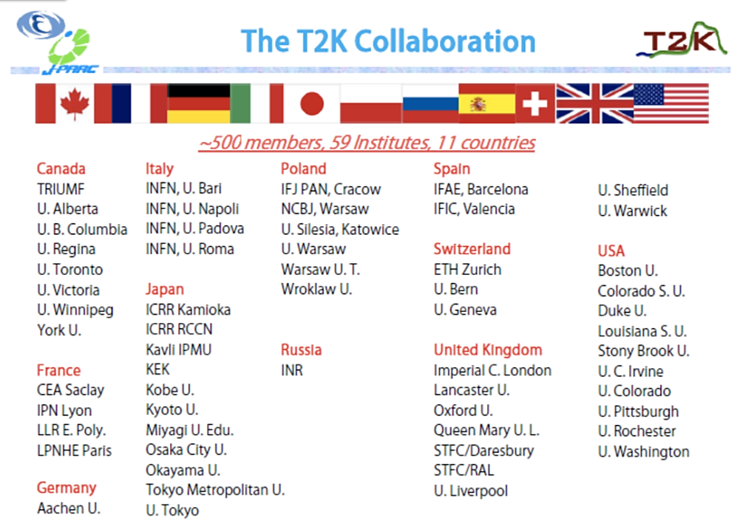
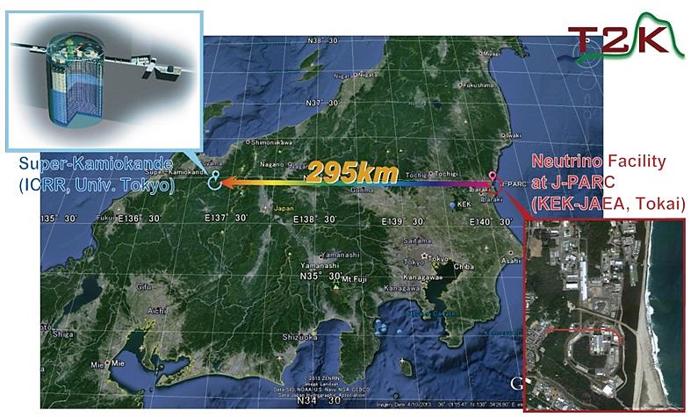
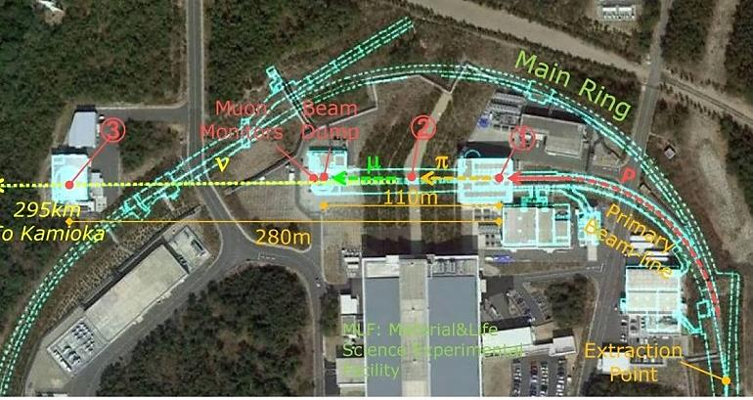
Projects in Japan
  Intensity Frontier
    J-PARC/T2K

Slide 14
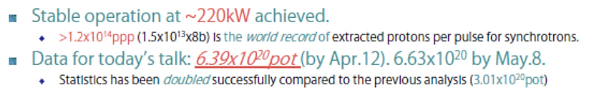
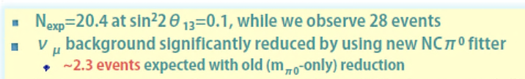
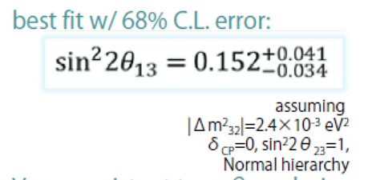
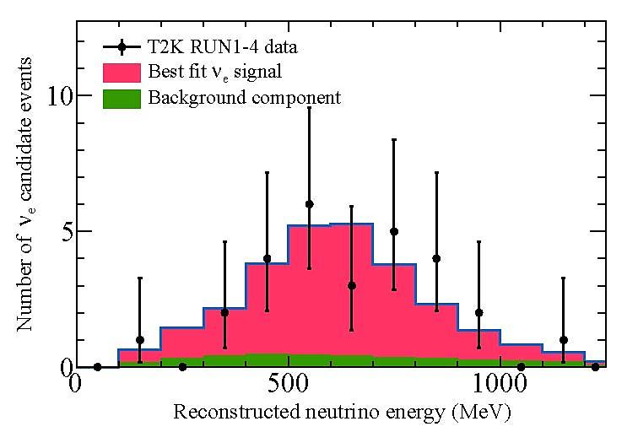
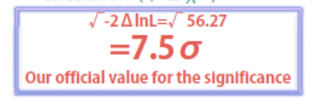

Slide 15
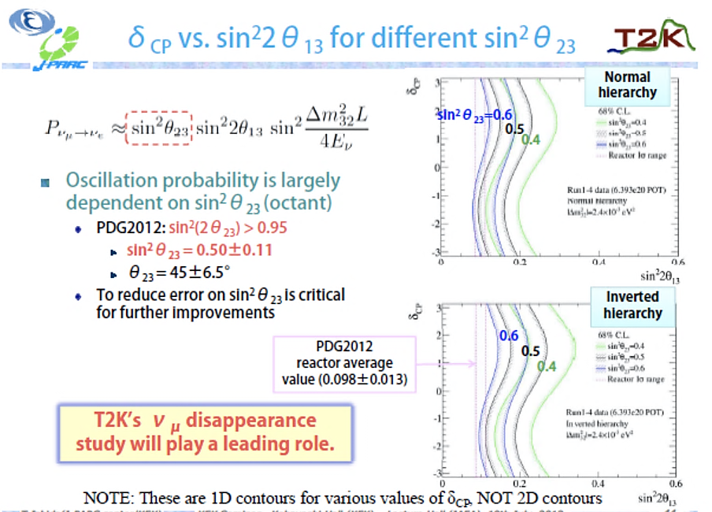

Slide 16
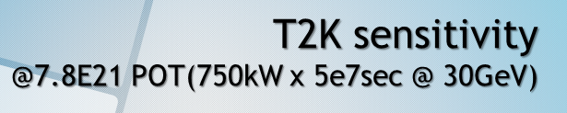
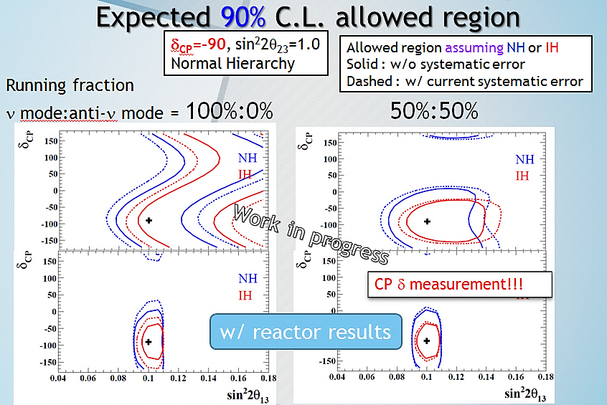
May 2012 | 2014 | 2018
190kW | 300kW 500kW | 750kW

Slide 17
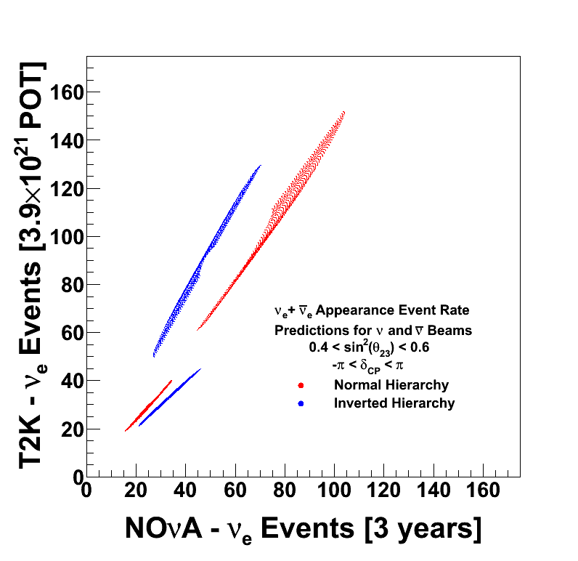

Assuming
beam and anti-ν beam = 1:1 for both experiment
Expected number of events distributed by unknown CP δ (-π<δ<π) and θ₂₃ (0.4<sin²θ₂₃<0.6)
ν-beam
anti-ν-beam

Slide 18









Projects in Japan
  Intensity Frontier
    J-PARC/ KOTO, COMET
COMET: μ → e Conversion
Signal : μ- + (A,Z) → e- + (A,Z)
～ 10⁻¹⁶

Slide 19



Projects in Japan
  Energy Frontier: ILC
Barry Barish and Sakue Yamada handing over the TDR to ILCSC chair Jon Bagger. Image: Nobuko Kobayashi
The handover was followed by a panel discussion.

Slide 20


Possible Time-Sequence of Processes toward Realization

Slide 21







Geological Survey and
Common-Subject Study, going on, in Japan
KEK
Tohoku U.
G. Survey
Kyushu U. G. Survey.
Kitakami
Sefuri
-150m
August
-300m
Reports to be available in July, 2013

Slide 22





～150 menbers
Feb. 1, 2013
Big-Bang
of Japan Revitalization Strategy
Science/Technology/Innovation
Investigating Meeting
Feb. 19, 2013
Policy Report on Promotion
of
ILC Construction
August, 2013
March 26, 2013

Slide 23








Slide 24

Reviewing by Japan Science Council
Panel-chair’s personal view ???
There are uncertain elements to be removed.
He also concerns about possible cuts in outlays for other research field and difficulty securing more than 1,000 scientists and technicians for the project.
Clear Possitive Message for Scientific Value
No Clear Scientific Evaluation !
It is essential to start investigating the reliability on hosting the ILC in Japan, taking 2~3 years.
my understanding: “go-sign” of ILC pre-Jlab

Slide 25

Projects in Japan
  Underground Physics at Kamioka
m_{ββ} < (120-250) meV
at 90% C.L. (2013)

Slide 26




XMASS
Dark Matter Search: Xe-loaded Sci.
High Scalability
1st → 2nd → 3rd
1 10
kg ton ton

Slide 27





Slide 28



TAMA
I-LCGT
Virgo
Sensitivity [1/√Hz]
Adv. LCGT
Adv. LIGO

Slide 29


2. Projects in China
  Accelerator-based
BEPCII/BESIII:
Operational since 2009

Slide 30


Please note: There is no proposal for the ring Higgs factory.
It is just a feasibility study.
Yifang

Slide 31


Daya Bay: A new type of neutrino oscillation
2. Projects in China
  Reactor-based
Sin²2θ₁₃ = 0.092 ± 0.016(stat) ± 0.005(syst)
χ²/NDF = 4.26/4, 5.2 σ for non-zero θ₁₃
F.P. An et al., NIM. A 685(2012)78; Phys. Rev. Lett. 108, (2012) 171803
Sin²2θ₁₃=0.089± 0.010 (stat)±0.005(syst)
χ²/NDF = 3.4/4, 7.7 σ for non-zero θ₁₃
F.P. An et al., Chin. Phys.C 37(2013) 011001

Slide 32


Slide 33


New site：Kaiping county, Jiangmen city

Slide 34




Physics reach of DYBII
arXiv:1303.6733
20 kt LS
Mass Hierarchy
Mixing parameters
Supernova neutrinos
Geoneutrinos
Sterile neutrinos

Slide 35

3. Projects in Korea
  Accelerators
Current Accelerator Activities in Korea (2013)
Full operation:
at the end of 2014
Ground-breaking Ceremony: May, 2013
Project period : 2011.12-2018.02
Budget : 460BWon (1BWon~1M$)
Commissioning
June, 2013

Slide 36




3. Projects in Korea
  Reactor-based
RENO Status

Slide 37
Overview of RENO-50
RENO-50 : An underground detector consisting of 18 kton ultra- low-radioactivity liquid scintillator & 15,000 20” PMTs, at 50 km away from the Hanbit(Yonggwang) nuclear power plant
Goals : - Determination of neutrino mass hierarchy - High-precision measurement of θ₁₂, Δm²₂₁ and Δm²₃₁ - Study neutrinos from reactors, the Sun, the Earth, Supernova, and any possible stellar objects
Budget : $ 100M for 6 year construction (Civil engineering: $ 15M, Detector: $ 85M)
Schedule : 2013 ~ 2018 : Facility and detector construction 2019 ~ : Operation and experiment
not yet approved

Slide 38



3. Projects in Korea
  Underground Physics
YangYang Underground Laboratory(Y2L)
(Power Plant)
Y2L
Minimum depth : 700 m
Access to the lab by car (~2km)
Experiments:
KIMS: DM search exp. in operation
AMORE: DBD Search exp. in preparation

Slide 39


KIMS+ Projects
KIMS-CsI : Upgrade of CsI(Tl) crystal detector
  Lower threshold ~ 1.5keV, <1dru, counts/(keV kg day).
  This will help to clear issues about the modulation signals of DAMA.
KIMS-NaI : new NaI(Tl) detector
  Duplicate DAMA experiment with ultra-low background NaI(Tl) crystals.
  200kg run in 2015-2016
KIMS-CMO
  ^{nat}Ca^{nat}MoO₄ crystals ~ 200 kg year.
  High sensitivity in low mass WIMP.
  2019-2022
Notes:
KIMS-Upgrade is the upgraded KIMS-CsI experiment.
KIMS-CMO is low temperature version of KIMS using 200 kg of CaMoO4 crystals at around 50 mK temperature.
KIMS-NaI sensitivity is not drawn yet. We expect lower threshold than DAMA with similar background rate.

Slide 40




AMoRE – 0νββ experiment
Detector : 200 kg of ⁴⁰Ca¹⁰⁰MoO₄ scintillating bolometer.
Reach “zero background” for 3 years data.
<m_{ee}> ~ 30-50 meV
AMoRE-10kg (2016-2017) → 200kg (2019-2022)
2nd phase
200 kg
setup
AMoRE
-200
CaMoO₄ Bolometer
4cm(D)x4cm(L), 211g
Energy resolution
10 keV(2013) → 5 keV (2015)
Effective Neutrino mass (eV)
AMoRE 10
AMoRE 200
Toward lower neutrino mass
200kg
CaMoO₄
1st phase
10 kg setup
AMoRE-10
Lightest neutrino mass (eV)

Slide 41





4. Projects in India
  Underground Physics
INO : India-based Neutrino
Observatory
50 kton magnetized iron module(s) with
30,000 channel RPC
1000 m

Slide 42



Slide 43


Slide 44





4. Projects in India
  ILC Activity

Slide 45


5. Summary
Particle Physics Activity in Asia
LHC
ILC
Top-Down
SuperKEKB
J-PARC
BEPCII
Physics
Beyond SM
Bottom-Up
XMASS
KIMS
AMoRE
INO
Daya Bay RENO

