Slide 1


DOE HEP Perspectives
DPF 2013 – UC Santa Cruz
August 14, 2013
Alan L. Stone
Program Manager
Office of High Energy Physics
Office of Science, U.S. Department of Energy

Slide 2
Message from “The Funding Frontier”
DPF 2013 – UC Santa Cruz
August 14, 2013
Alan L. Stone
Program Manager
Office of High Energy Physics
Office of Science, U.S. Department of Energy

Slide 3
Outline
Program Overview
Snowmass
Budget
Strategic Planning
Summary

Slide 4
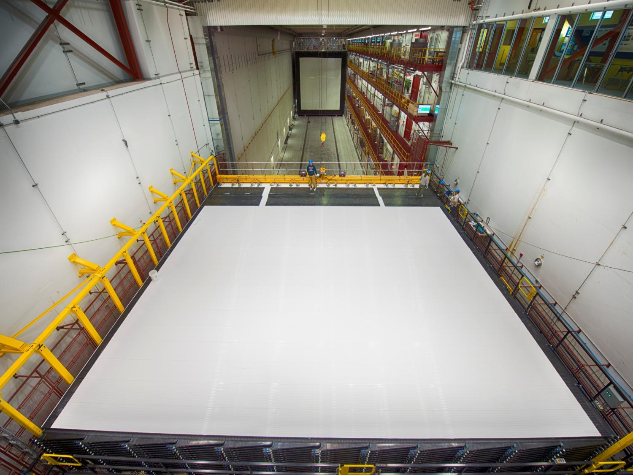
Program Overview

Slide 5
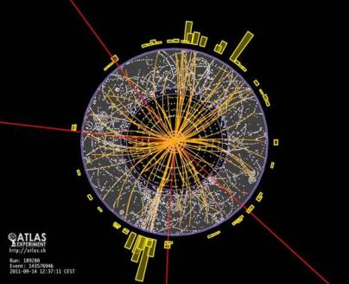
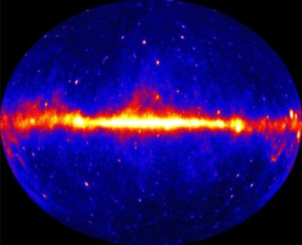
From Deep Underground to the Tops of Mountains, HEP pushes the Frontiers of Research
Research at the Energy Frontier — HEP supports research where powerful accelerators such as the LHC are used to create new particles, reveal their interactions, and investigate fundamental forces, and where experiments such as ATLAS and CMS explore these phenomena.
Research at Intensity Frontier — Reactor and beam-based neutrino physics experiments such as Daya Bay, NOvA and LBNE may ultimately answer some of the fundamental questions of our time: why does the Universe seem to be composed of matter and not anti-matter?
Research at the Cosmic Frontier — Through ground-based telescopes, space missions, and deep underground detectors, research at the cosmic frontier aims to explore dark energy and dark matter, which together comprise approximately 95% of the universe.
Theory and computation — The interplay between theory, computation, and experiment is essential to the lifeblood of High Energy Physics. Computational sciences and resources enhance theory and enable data analysis, detector and accelerator development.
Accelerator Science — Supports R&D at national labs and universities in beam physics, novel acceleration concepts, beam instrumentation and control, high gradient research, particle and RF sources, superconducting magnets and materials, and superconducting RF technology.

Slide 6
The Common Goal
A realistic, coherent, shared plan for US HEP:
Enabling world-leading facilities and experiments in the US while recognizing the global context and the priorities of other regions
Recognizing the centrality of Fermilab while maintaining a healthy US research ecosystem that has essential roles for both universities and multi-purpose labs
Articulating both the value of basic research and the broader impacts of HEP
Maintaining a balanced and diverse program that can deliver research results consistently

Slide 7
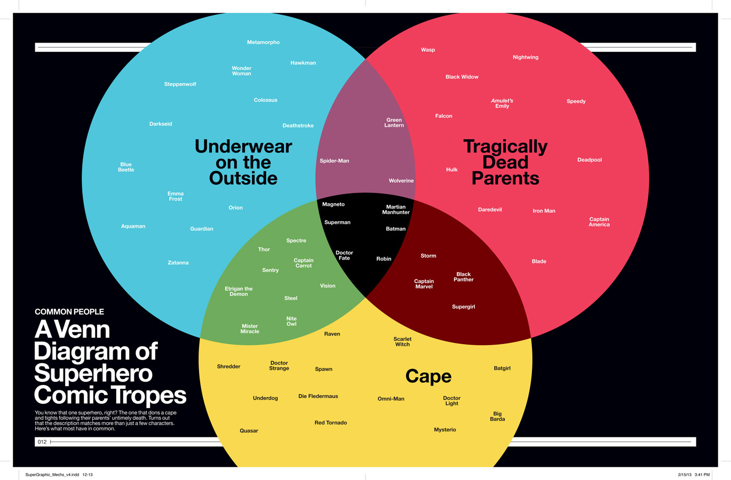
A Venn Diagram

Slide 8
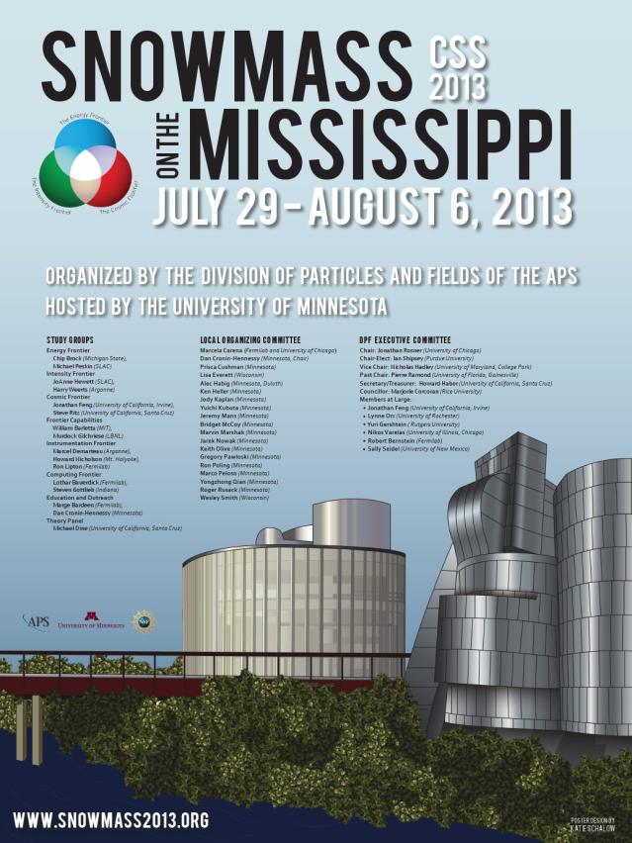
SNOWMASS or How I Spent My Summer Vacation
Well-attended sessions, high quality presentations, lively discussions and panels!
Congratulations to the American Physical Society Division of Particles and Fields, Chair Jonathan Rosner, past and future chairs, and the too-many-to-name committee members and conveners.
Kudos to the University of Minnesota for hosting Snowmass, and to Dan, Marvin, and a small army of energetic students who were central to a successful workshop.

Slide 9

The 17 Physicists with Legible Handwriting

Slide 10
SNOWMASS OBSERVATIONS (I)
Conference travel rules are onerous, but are unlikely to be relaxed
  Which headline would you rather see make the news?
    “DOE spending millions of dollars on a three-week conference at a ski resort.”
    “600 particle physicists came together at the University of Minnesota.”
  Take a proactive approach. Task Force?
    Submit VERY early for conference approval & funding support
    Coordinate with international hosts in setting registration deadlines
Construction around University of Minnesota
  Third trip since 2010. When are they going to finish the light rail?
Program managers need to get out of Germantown more often
  PI Meetings: Energy, Cosmic, Theory, Computing, Detector R&D
  University site visits are rare due to shrinking DOE travel budgets
  Ad-hoc meetings, lunch and dinner discussions
  Young Snowmass presentation, Q&A
  And trips to Ash River to inspect NOvA construction!
Aisle seats are a commodity
  Charge a premium?

Slide 11
SNOWMASS OBSERVATIONS (II)
The Frontier depiction of the HEP experimental research program
  We have established a recognized brand & aligned the budget to the brand
  Program managers responsible for defending their budgets
  The voices of dissatisfaction are hard to quantify or qualify
    Correlated with reduction (loss) in funding?
    What alternatives are being suggested that would bring more money to HEP?
    What opportunities are lost due to the “restrictions” of the Frontiers?
  Silent majority do not have many complaints
    Correlated with satisfaction with funding?
    Overwhelming majority of HEP research falls within a single thrust or frontier
    For Cosmic or Intensity, physicists may be on multiple experiments, e.g. dark energy or neutrinos, but they are usually staged and complementary
  HEP does not discourage work or proposal to work in more than one research area
    Uncommon: Research with shared software or technology development is a good example, e.g. Dark Matter/LAr R&D
    Rare: Researchers working on orthogonal efforts, e.g. LHC and X
    Many of the current post-docs in Intensity Frontier experiments did their thesis on a Tevatron or LHC experiment
    Theory is not a frontier.
  Peer review provides input on who is or who is not active or credible
Healthy interaction between Frontiers
  Plenary and joint sessions; Tough Questions; Panel Discussions
  Parallel sessions

Slide 12
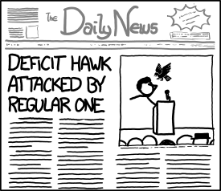
HEP Budget
xkcd.com/1062/

Slide 13
Recent Funding Trends
Trading projects for more research
Ramp up ILC and SRF R&D programs
In the late 90’s the fraction of the budget devoted to projects was about 20%.
  Progress in many fields require new investments to produce new capabilities.
The projects started in 2006 are coming to completion.
New investments are needed to continue US leadership in well defined research areas.
Possibilities for future funding growth are weak. Must make do with what we have.

Slide 14
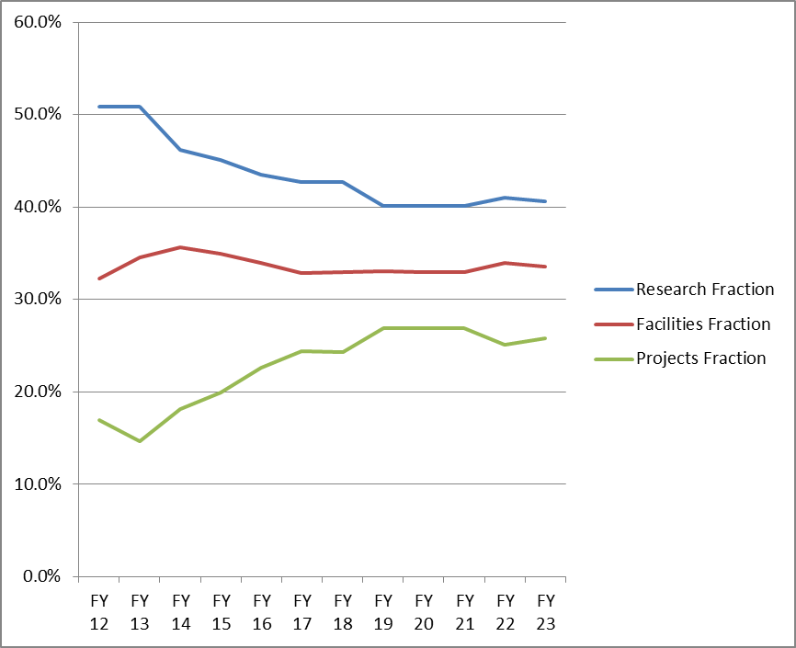
One Possible Future Scenario
Trading research for more projects
About 20% (relative) reduction in Research fraction over ~5 years.
  In order to address priorities, this will not be applied equally across Frontiers.
This necessarily implies reductions in scientific staffing.
  Some can migrate to Projects but other transitions are more difficult.
We have requested labs to help manage this transition as gracefully as possible.

Slide 15
FY 2014 High Energy Physics Budget
(Dollars in thousands)
Description | FY 2012 Actual | FY 2013 July Plan | FY 2014 Request | Explanation of Change [FY14 Request vs. FY12 Actual]
Energy Frontier Exp. Physics | 159,997 | 148,164 | 154,687 | Tevatron ramp-down offset by R&D for LHC detector upgrades
Intensity Frontier Exp. Physics | 283,675 | 287,220 | 271,043 | Completion of NOνA (MIE), partially offset by Fermi Ops
Cosmic Frontier Exp. Physics | 71,940 | 78,943 | 99,080 | Ramp-up of LSST-Camera
Theoretical and Computational Physics | 66,965 | 66,398 | 62,870 | Continuing reductions in Research
Advanced Technology R&D | 157,106 | 131,885 | 122,453 | Completion of ILC R&D
Accelerator Stewardship | 2,850 | 3,132 | 9,931 | FY14 includes Stewardship-related Research
SBIR/STTR | 0 | 0 | 21,457
Construction (Line Item) | 28,000 | 11,781 | 35,000 | Mostly Mu2e; no LBNE ramp-up
Total, High Energy Physics: | 770,533 ^{(a)} | 727,523 ^{(b,c)} | 776,521 | wrt FY13: Up +3.6% after SBIR correction wrt FY12: Down -2% after SBIR correction
Ref: Office of Science (SC): | 4,873,634 | 4,621,075 ^{(c)} | 5,152,752
^{(a)} The FY 2012 Actual is reduced by $20,327,000 for SBIR/STTR.
^{(b)} The FY 2013 July Plan is reduced by $20,791,000 for SBIR/STTR. ^{(c)} Reflects sequestration.
SBIR = Small Business Innovation Research
STTR = Small Business Technology Transfer

Slide 16
Note on HEP Research Funding
The FY 2014 Request for HEP Research was $384M, about a 6% increase compared to FY 2013, but $26 million of this is planned to go to R&D for Dark Matter G2, MS-DESI, and LHC upgrades.
Our current FY 2014 planning is based on the House markup of the Energy and Water Appropriation which is overall slightly below the Request
  The House mark directed HEP to move $8 million to LBNE PED, $2 million to SURF, and lower the overall HEP budget by $4 million. The choice was made to take all of these reductions from Research due to our priority to increase Project spending.
These two effects reduce Research to $343M, about a 5% reduction w.r.t. FY 2013
At the beginning of the year it is necessary to hold back funds for decisions to be made later in the year, such as the Early Career Program and other needs.
  This results in an approximately 6% reduction relative to FY 2013 for the initial distribution of funds. This is the average effect on initial HEP research funding.
There is some small variation in the impact to individual HEP subprograms, and program managers have the authority to provide more or less than the average reduction based on program priorities and the results of merit review.
The House mark is a budget indicator but not the final word on FY 2014. When Congress passes a budget, there could be either an increase or a decrease in HEP research funding.

Slide 17
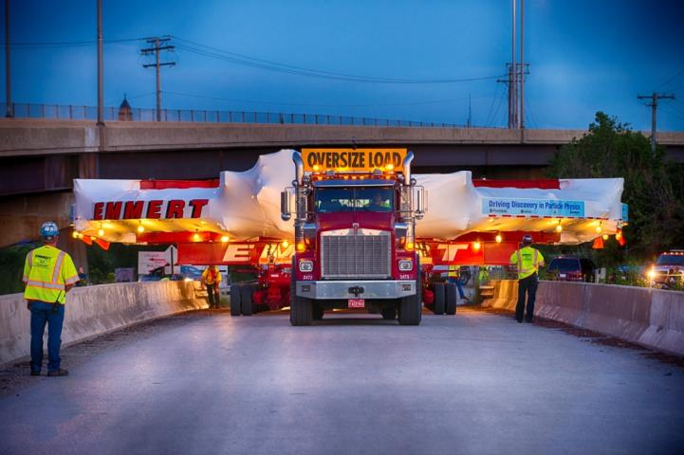
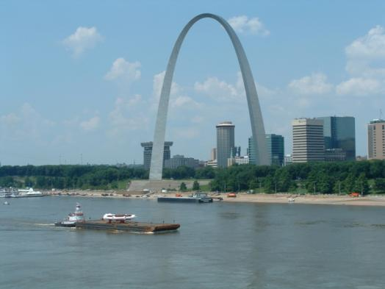
Major Item of Equipment (MIE) Issues
We were not able to implement [most] new MIE-fabrication starts in the FY14 request
  Muon g-2 experiment is the only new start in HEP that was not requested in FY13
  LSST-Camera and Belle II, which did not receive approval in FY13, are requested again in FY14
This upsets at least 2 major features of our budget strategy:
  Strategic plan: “Trading Research for Projects”
  Implementation of facilities balanced across Frontiers

Slide 18
Current LBNE Strategy
We are trying to follow the reconfiguration [phased] plan for LBNE, though it has hit some snags
  Out-year budgets are challenging
  Some members of the community objected that the phased LBNE was not what the previous P5 (or they) had in mind
The plan, as it currently stands:
  Use time before baselining to recruit partners (international and domestic) that expand scope and science reach
We also take note of the House language on LBNE:
  “The Committee recognizes the importance of this project to maintaining American leadership in the intensity frontier and to basic science discovery of neutrino and standard model physics. However, the Committee also recognizes that LBNE construction must be affordable under a flat budget scenario. As such, the Committee supports the Office of Science’s challenge to the High Energy Physics community to identify an LBNE construction approach that avoids large out-year funding spikes or to identify viable alternatives with similar scientific benefits at significantly lower cost.”

Slide 19
HEP Project Status
Subprogram | TPC ($M) | CD Status | CD Date
INTENSITY FRONTIER
Long Baseline Neutrino Experiment (LBNE) | TBD | CD-1 | December 10, 2012
Muon g-2 | 40 | CD-0 | September 18, 2012
Muon to Electron Conversion Experiment (Mu2e) | 249 | CD-1 | July 11, 2012
Next Generation B-Factory Detector Systems (Belle II) | 16 | CD-3a | November 8, 2012
NuMI Off-Axis Electron Neutrino Appearance Exp’t (NOνA) | 278 | CD-3b | October 29, 2009
Micro Booster Neutrino Experiment (MicroBooNE) | 19.9 | CD-3b | March 29, 2012
Main INjector ExpeRiment for ν-A (MINERνA) | 16.8 | CD-4 | June 28, 2010 [Finished]
Daya Bay Reactor Neutrino Experiment | 35.5 | CD-4b | August 20, 2012 [Finished]
ENERGY FRONTIER
LHC ATLAS Detector (Phase-1) Upgrade | TBD | CD-0 | September 18, 2012
LHC CMS Detector (Phase-1) Upgrade | TBD | CD-0 | September 18, 2012
COSMIC FRONTIER
Dark Matter (DM-G2) | TBD | CD-0 | September 18, 2012
Mid-Scale Dark Energy Spectroscopic Instrument (MS-DESI) | TBD | CD-0 | September 18, 2012
Large Synoptic Survey Telescope (LSST) | 173 | CD-1 | April 12, 2012
Dark Energy Survey (DES) | 35.1 | CD-4 | June 4, 2012 [Finished]
ADVANCED TECHNOLOGY R&D
Accelerator Project for the Upgrade of the LHC (APUL) | 11.5 | CD-2/3 | July 29, 2011
Berkeley Lab Laser Accelerator (BELLA) | 27.2 | CD-4 | January 17, 2013 [Finished]
Facility for Advanced Accelerator Experimental Tests (FACET) | 14.5 | CD-4 | January 31, 2012 [Finished]

Slide 20
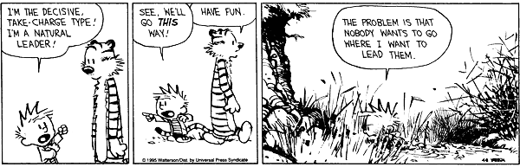
Strategic Planning
Calvin & Hobbes. 1995

Slide 21
Implementation of 2008 Advisory Panel (P5)
The HEP budget puts in place a comprehensive program across the three frontiers.
  In five years:
    NOvA, Belle II, Muon g-2 will be running on the Intensity Frontier
    Mu2e will be commissioning for first data taking
    The CMS and ATLAS detector upgrades will be installed at CERN
    DES will have completed its science program and new mid-scale spectroscopic instrument and DM-G2 should begin operation
    The two big initiatives, LSST and LBNE, will be well underway
Need to start planning now for what comes next.
  We have been engaging with the DPF community planning process starting at Fermilab in Oct 2012 and culminating in Minneapolis just last week
  Will set up a prioritization process (a new P5) using that input.

Slide 22
Customized Implementation Strategies
Energy Frontier
  US has a leading role in LHC physics collaborations but does not own the facility
    The issue is the scope and scale of US involvement. Requires US-CERN negotiation.
    Could also be true for Japanese-hosted Linear Collider
Intensity Frontier
  US is the world leader and needs new facilities and/or upgrades of existing facilities to maintain its position
    Has the potential to attract new partners to US-led projects
    Portfolio of experiments and science case is diverse. This complicates the case. The scale of the projected investments is a big challenge
Cosmic Frontier
  US HEP has a leading role in a competitive, multidisciplinary environment
    HEP component of the physics case is simple and compelling. Key issues are what levels of precision and sensitivity can be achieved and scientifically justified
    DOE is a technology enabler, not a facilities provider (see NSF, NASA)
      Analogous to LHC but the HEP physics goals are not those of the facility owners
    DOE supports particle physics goals and HEP-style collaborations
      Astronomy and astrophysics is not in our mission nor our modus operandi

Slide 23
Snowmass / P5 Interface
Some of what we heard at Snowmass:
  What are the most compelling science questions in HEP that can be addressed in the next 10 to 20 years and why
  What are the primary experimental approaches that can be used to address them? Are they likely to answer the question(s) in a “definitive” manner or will follow-on experiments be needed?
  What are the “hard questions” (science, technical,…) that a given experiment or facility needs to answer to respond to perceived limitations in its proposal?
These topics (and more) will be covered in the Snowmass reports and white papers. P5 will use these reports and white papers as its starting point.
  We expect to have the P5 panel selected and a formal charge issued by the time of the September 5-6 HEPAP meeting at NSF

Slide 24
Goals For The P5 Process
DOE/NSF agree on the goals:
The P5 process will use the science goals of the community to construct a plan that is feasible and executable over a 10-20 year timescale.
HEP MUST have a planning and prioritization process that the community can stand behind and support once the P5 report is complete.
We also need a process that repeats at more less regular intervals (5 years?)
  We also want to allow for less comprehensive updates and modest course corrections to the plan along the way (a la P5 updates in 2009, 2010)
Key elements and outcomes envisioned for the P5 process:
  Revisit the questions we use to describe the field (e.g. Quantum Universe, updated and corrected)
  Decide on the science and project priorities within budget guidance (in detail for the next 10 years, in broad outline beyond that)
  Crisply describe the impact of HEP research on other sciences and society
  Build on the investment in Snowmass process and outcomes

Slide 25
What P5 Is
  P5 will articulate the vision for U.S. particle physics in a global context.
It will prioritize HEP projects over a 10-20 year timeframe within reasonable budget assumptions.
  Discussion will include such issues as: The role of domestic HEP facilities in the context of the worldwide particle physics program; and US leadership roles and their importance.
  Prioritization will necessarily involve consideration of technical feasibility as well as plausible timescales and resources for future projects.
Fundamental questions for the field and how to unify/connect the Frontiers framework will also be discussed.
  Input from the Theory community will be especially important in this area.

Slide 26
What P5 Is Not
Technology support will NOT be a main focus of P5, but the panel will benefit from wisdom in the community in this area.
  E.g., Do we have a coherent technology R&D plan that dovetails with the science opportunities? If not, how do we get there?
  Note that ‘Accelerator Stewardship’ is an Office of Science wide initiative managed by the HEP office, so should be discussed for information, but will not be modified by P5.
Other issues will be addressed by HEPAP in the future, such as:
  Agency review processes
  Roles, responsibilities and funding of labs versus universities
Working with HEPAP Chair to identify the key topics to review
  We welcome input and discussion on what you think are the pressing structural issues for HEP

Slide 27
Moving Forward With The P5 Process
P5 composition:
  P5 will be chaired by Steve Ritz (UC Santa Cruz).
  The target size for P5 will be approximately same as in past, i.e. ~20+
    Chosen after considerable input and discussion
  Nominations have been sought from HEP and related communities through a “Dear Colleague” letter.
Community input:
    P5 will build on the investment in the Snowmass process and output,
      But P5 may solicit additional material as needed.
    Community input and interaction will not stop with Snowmass.
    Process will include public presentations and town hall meetings.
    Including inputs on prioritization criteria and other issues
    Including open discussion of issues so the community can better understand the consideration and constraints, and hopefully reach broader agreement.
  Send input by email to sritz@ucsc.edu & andrew.lankford@uci.edu

Slide 28
More About The P5 Process
Publicizing and explaining the outcome is an important function.
We are considering breaking out important “supporting” work:
  Two separate (non-P5) working groups:
    Science Connections, highlighting the scientific areas where HEP advances, informs, and benefits from other DOE/SC programs. See e.g., 1998 National Academy EPP Decadal Survey (Winstein)
      Co-chairs Shamit Kachru (Stanford/SLAC) & Curt Callan (Princeton)
    HEP Impact, developing a potential list of messages for the U.S. HEP community to use in communicating the broad impact of HEP in technology, workforce development, and other societal benefits
      Interested parties are strongly encouraged to engage with the Education and Outreach group at Snowmass
    These groups would produce short reports to HEPAP/P5 by the end of the calendar year in order to provide timely input that can be integrated by P5

Slide 29
Evolving P5 Timeline
May 2013: DOE and NSF agree on outlines of P5 process and inform community via presentations and “Dear Colleague” letter
Jun 2013: Call for nominations to P5
Jul 2013: Agencies draft P5 charge. HEPAP Chair reviews P5 nominations and begins selection process
Aug 2013: Snowmass meeting. P5 charge sent to HEPAP Chair. (The budget guidance to P5 will be public as part of its charge.)
Sep 2013: HEPAP Meeting (Sep 5-6 at NSF). Snowmass reports issued. P5 charge and membership formally announced. Timeline for P5 meetings announced.
Fall 2013: Public Meetings (number, venues and topics TBD)
  Planning of meetings to derive from the charge
Fall 2013 to Spring 2014: P5 meetings (phone in and face to face)
Spring/Summer 2014: P5 report(s) due. Exact dates and deliverables to be spelled out in P5 charge.

Slide 30
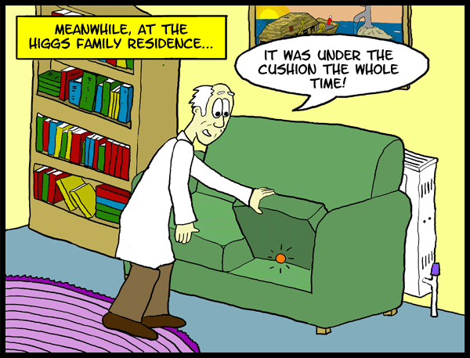
SUMMARY
Lukesurl.com. 2008

Slide 31
Take-Away Messages
The U.S. HEP program is following the strategic plan laid out by the previous HEPAP/P5 studies
Though some of the boundary conditions have changed, we are still trying to implement that plan within the current constraints
  FY2014 request generally supports this, though funding constraints have led to delays in some key projects
  Need to maintain progress with projects currently “on the books”
  Working to attract partnerships that will extend the science impact
Actively engaged with community in developing new strategic plan
Increased emphasis on broader impacts via accelerator stewardship
Leadership in the long-term will be through excellence in innovation and unique capabilities
  Focus on areas where U.S. can have leadership
  “High-risk, high-impact” as opposed to incremental advances
  Note this is not an either/or proposition, we need both with appropriate balance

Slide 32
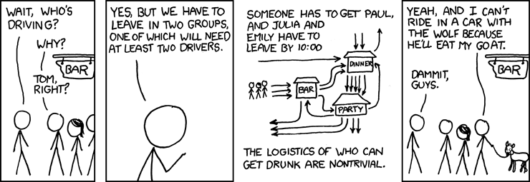
Thank you.
Questions?
Food and Drink!
xkcd.com/589/

Slide 33
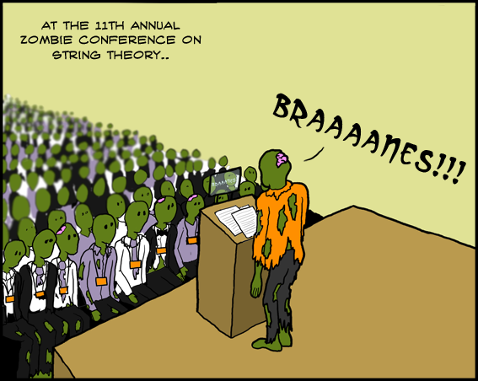
BACKUP
Lukesurl.com. 2010

Slide 34

Office of
High Energy Physics
Fundamental
to the
Frontiers of
Discovery
HEP’s Mission: To explore the most fundamental questions about the nature of the universe at the Cosmic, Intensity, and Energy Frontiers of scientific discovery, and to develop the tools and instrumentation that expand that research.
HEP seeks answers to Big Questions:
How does mass originate?
Why is the world matter and not anti-matter?
What is dark energy? Dark matter?
Do all the forces become one and on what scale?
What are the origins of the Universe?
HEP offers high-impact research opportunities for small-scale collaborations at the Cosmic and Intensity Frontiers to full-blown international collaborations at the Energy Frontier. More than 20 physicists supported by the Office of High Energy Physics have received the Nobel Prize.

Slide 35
HEP Physics and Technology
Experimental
Theory
Simulation
The Energy Frontier
Origins of Mass
Matter/Anti-matter
Asymmetry
Dark matter
Neutrino Physics
Proton Decay
The Intensity
Frontier
Dark energy
Cosmic Particles
The Cosmic
Frontier
Origin of Universe
Unification of Forces
New Physics
Beyond the Standard Model
Along Three Paths
Accelerators
Detectors
Computing
  Enabled by
  Advanced Technologies in:
Update?
Physics Frontiers

Slide 36
Issues and Questions
Issues and questions we need to deal with when laying out longer term plan –
and to be able to execute & defend the program
Which are the most important science areas &/or projects that need to be emphasized to make significant advances towards HEP goals? Which areas of phase space do we emphasize? Are there efforts that need to be ramped down or terminated?
In addition to looking for next steps following current program, are there gaps in the current program or other projects that need to be done in the future to fully exploit our program?
Are there branch points where we choose a certain direction?
How far do we need to go in precision &/or setting limits in each area, i.e. when do we stop going in a certain direction?
What are other theory, computational resources and simulations needed?
Need to build case with other Frontiers for the importance and priority of funding

Slide 37
HEP Energy Frontier Experiments
Experiment | Location | CM Energy; Status | Description | # Institutions; # Countries | #US Institutions | #US Coll.
DZero | Fermilab Tevatron Collider [Batavia, Illinois, USA] | 1.96 TeV; Operations ended: Sept. 30, 2011 | Higgs, Top, Electroweak, SUSY, New Physics, QCD, B-physics | 74 Institutions; 18 Countries | 33 Univ., 1 National Lab | 192
CDF (Collider Detector at Fermilab) | Fermilab Tevatron Collider [Batavia, Illinois, USA] | 1.96 TeV; Operations ended: Sept. 30, 2011 | Higgs, Top, Electroweak, SUSY, New Physics, QCD, B-physics | 55 Institutions; 14 Countries | 26 Univ., 1 National Lab | 224
ATLAS (A Toroidal LHC ApparatuS) | CERN, Large Hadron Collider [Geneva, Switzerland / Meyrin, Switzerland] | 7-8 TeV; 13-14 TeV Run 1 ended: Dec. 2012 Run 2 start: 2015 | Higgs, Top, Electroweak, SUSY, New Physics, QCD, B-physics, and Heavy-Ion | 174 Institutions; 38 Countries | 40 Univ., 4 National Labs | 556
CMS (Compact Muon Solenoid) | CERN, Large Hadron Collider [Geneva, Switzerland / Cessy, France] | 7-8 TeV; 13-14 TeV Run 1 ended: Dec. 2012 Run 2 start: 2015 | Higgs, Top, Electroweak, SUSY, New Physics, QCD, B-physics, and Heavy-Ion | 179 Institutions; 41 Countries | 46 Univ., 1 National Lab | 676
Collaboration data as of May 2013.
US-ATLAS comprises ~21% of the international ATLAS Collaboration
US-CMS comprises ~33% of the international CMS Collaboration

Slide 38
Energy Frontier Issues
Discussions with CERN about follow-on to LHC Agreement proceeding
  Necessary precursor to planning for “Phase-II” upgrades; US scope for “Phase-II” TBD
Energy Frontier science plan will require high-energy, high-luminosity LHC running
  What is the real physics of the TeV scale?
    This will likely take a few years to sort itself out
  US Snowmass/P5 process is an important element, along with European and
  Asian HEP strategies
Significant collaborations with other regions on future colliders will require a
high-level approach between governments
  Modest ground-level R&D efforts can continue as funding allows
  We support an international process to discuss future HEP facilities that respects the interests of major national and regional partners as well as realistic schedule
  and fiscal constraints
  Once Snowmass/P5 studies and the community input are complete, we will be in a better position to evaluate future US priorities for the HEP program in detail
  We encourage active engagement by all interested parties

Slide 39
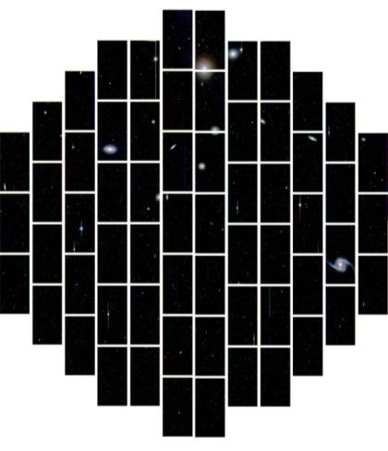
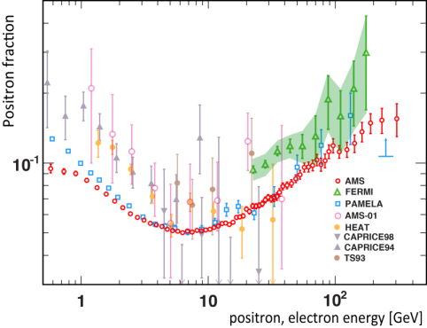
HEP Cosmic Frontier Experiments
Current program
Several operating experiments studying high-energy cosmic & gamma rays:
  Fermi/GLAST, VERITAS, Auger, AMS
Several 1st generation (G1) dark matter direct detection experiments operating:
  ADMX, LUX, CDMS-Soudan, DarkSide
  High Altitude Water Cherenkov (HAWC) starts operations in 2014
Several dark energy experiments are operating:
  BOSS, Supernova surveys; Dark Energy Survey (DES) is starting 5-year survey in Sept. 2013
Other areas: SPTpol (CMB), Holometer
Planned program
Large Synoptic Survey Telescope will make definitive ground-based Stage IV DE measurements
  CD-1 for LSST-camera approved in April 2012
  HEP requested an MIE fabrication start for LSST-camera in FY2014 President’s Request budget
Dark Matter 2nd-Generation (DM-G2) experiments to probe most of preferred phase space
  CD-0 approved in September 2012
  FY13 R&D awards announced at March HEPAP meeting:
    ADMX-Gen2, LZ, SuperCDMS-SNOLab, DarkSide-G2, COUPP-500
  Down-selection for expt’s to move into fabrication phase expected to occur in late 2013
  FY14 President’s Request - R&D continues; planning to request an FY15 start
Mid-scale Dark Energy Spectroscopic instrument to complement DES/LSST
  CD-0 approved in September 2012
  FY13: HEP is working with NSF-AST to determine if preferred site to host the instrument is
  available in the timescale needed
  FY14 President’s Request - R&D continues; planning to request an FY15 start
DES First Light – Sept. 2012
AMS First Results

Slide 40

Cosmic Frontier Issues
The HEP component of the physics case is simple & compelling
→Key issues are what levels of precision and sensitivity can be achieved and scientifically justified
HEP has a leading role in a competitive, multidisciplinary environment:
  Make significant, coherent contributions to facilities/experiments selected for the program, including instrumentation, computing, and bring the tradition of science collaborations to all stages of the experiment
  Form partnerships or use other agency’s facilities when needed (e.g. we don’t build telescopes); our science goals are often a subset of those of the facility owners
Program Guidance:
FACA panels – official advice to the government:
  High Energy Physics Advisory Panel (HEPAP): PASAG subpanel 2009 has been the main guidance for planning the program
  Astronomy and Astrophysics Advisory Committee (AAAC): Reports to NASA, NSF and DOE on areas of overlap
Other Input:
  National Academies of Science - Astronomy & Astrophysics Decadal survey (New Worlds New Horizons 2010)
  Specific studies, e.g. Dark Energy science group in summer 2012→ Science case for a HEP dark energy program developed by a task force at HEP request (Rocky Kolb, chair). This was seen as a good model for the different science areas
Future Directions
Dark Matter & Dark Energy – We have a path forward for next steps
Science case and role of other particle astrophysics areas needs to be better articulated
Will further develop and optimize program starting with input from the Snowmass → P5 process

Slide 41
HEP Intensity Frontier Experiments
Experiment | Location | Status | # Institutions | #Collaborators | #US Inst. | #US Coll.
Belle II | KEK, Tsukuba, Japan | Physics run 2016 | 70 | 508+ | 10 Univ, 1 Lab | 55
BES III | IHEP, Beijing, Ching | Running | 50 | 363 | 6 Univ | 26
CAPTAIN | Los Alamos, NM, USA | R&D; Neutron run 2015 | 6+ | 20+ | 5 Univ, 1 Lab | 20+
Daya Bay | Dapeng Penisula, China | Running | 38 | 229 | 13 Univ, 2 Lab | 76
Heavy Photon Search | Jefferson Lab, Newport News, VA, USA | Physics run 2015 | 17 | 63+ | 8 Univ, 2 Lab | 47
K0TO | J-PARC, Tokai , Japan | Running | 16 | 66 | 3 Univ | 12
LArIAT | Fermilab, Batavia, IL | R&D; Phase I 2013 | 18 | 45+ | 11 Univ, 3 Lab | 38
LBNE | Fermilab, Batavia, IL & Homestake Mine, SD, USA | CD1 Dec 2012; First data 2023 | 65 | 366+ | 48 Univ, 6 Lab | 336
MicroBooNE | Fermilab, Batavia, IL, USA | Physics run 2014 | 19 | 108 | 15 Univ, 2 Lab | 101
MINERvA | Fermilab, Batavia, IL, USA | Med. Energy Run 2013 | 21 | 65 | 13 Univ, 1 Lab | 48
MINOS+ | Fermilab, Batavia, IL & Soudain Mine, MN, USA | NuMI start-up 2013 | 27 | 75 | 15 Univ, 3 Lab | 53
Mu2e | Fermilab, Batavia, IL, USA | First data 2019 | 26 | 139+ | 15 Univ, 4 Lab | 106
Muon g-2 | Fermilab, Batavia, IL, USA | First data 2016 | 27 | 100+ | 13 Univ, 3 Lab, 1 SBIR | 75+
NOvA | Fermilab, Batavia, IL & Ash River, MN, USA | Physics run 2014 | 34 | 144 | 18 Univ, 2 Lab | 114
ORKA | Fermilab, Batavia, IL, USA | R&D; CD0 2017+ | 17 | 48+ | 6 Univ, 2 Lab | 26
Super-K | Mozumi Mine, Gifu, Japan | Running | 35 | 121 | 7 Univ | 29
T2K | J-PARC, Tokai & Mozumi Mine, Gifu, Japan | Running; Linac upgrade 2014 | 56 | 500+ | 10 Univ | 70
US-NA61 | CERN, Geneva, Switzerland | Target runs 2014-15 | 27 (NA61/SHINE) | 144 (NA61/SHINE) | 4 Univ, 1 Lab | 15
US Short-Baseline Reactor | Site(s) TBD | R&D; First data 2016 | 11 | 28+ | 6 Univ, 5 Lab | 28

Slide 42
Intensity Frontier Research & Development
Intensity Frontier R&D activities reviewed case by case
  Target of opportunities: fast, cheap and compelling (discovery potential)
What constitutes Intensity Frontier R&D?
  Perform simulations and physics studies in support of the conceptual and preliminary design of a future experiment or project
  Develop and demonstrate the technical feasibility of novel detectors or systems
  Design, construct, commission, and operate a prototype experiment
What are the ground rules?
  Start at home. Seed support from Univ. start-up, LDRD, private foundation, etc.
  There is not a separate pot of money. All funding comes out of research. Be thrifty. Be reasonable. R&D proposals should be mainly for technical support.
  Form a strong & credible collaboration. Partnerships with labs and universities are preferred. International participation is encouraged.
  Socialize with the funding agencies AND lab management at the earliest opportunity.
    Briefings to DOE (or NSF). PAC(s) should have a voice.
    How and when does this activity fit within the HEP mission and Intensity Frontier portfolio?
  Technical proposal will be reviewed. Research will be reviewed. Separately.

Slide 43
Current Intensity Frontier R&D Efforts
Experiment | Location | Status | Description | #US Inst. | #US Coll.
CAPTAIN | Los Alamos, NM, USA | R&D; Neutron run 2015 | Cryogenic apparatus for precision tests of argon interactions with neutrinos | 5 Univ., 1 Lab | 20
Heavy Photon Search | Jefferson Lab, Newport News, VA, USA | Physics run 2015 | Search for massive vector gauge bosons which may be evidence of dark matter or explain g-2 anomaly | 8 Univ., 2 Lab | 47
LArIAT | Fermilab, Batavia, IL | R&D; Phase I 2013 | LArTPC in a test beam; develop particle ID & reconstruction | 11 Univ., 3 Lab | 38
ORKA | Fermilab, Batavia, IL, USA | R&D; CD0 2017+ | Precision measurement of K⁺→π⁺νν to search for new physics | 6 Univ., 2 Lab | 26
US-NA61 | CERN, Geneva, Switzerland | Target runs 2014-15 | Measure hadrons production cross sections crucial for neutrino beam flux estimations needed for NOvA, LBNE | 4 Univ., 1 Lab | 15
US Short-Baseline Reactor | Site(s) TBD | R&D; First data 2016 | Short-baseline sterile neutrino oscillation search | 6 Univ., 5 Lab | 28
Heavy Photon Search: Feb 2013 DOE Briefing; July 11, 2013 DOE Panel Review
  Determine whether to fund the design, construction, commissioning, and operation of the first phase of the experiment for period of FY14-FY16
nEXO R&D: Monthly DOE HEP/NP Phone Calls; July 12, 2013 DOE Panel Review
  Determine whether to fund the 5 ton LXe TPC R&D program for period of FY13-FY16
US Short-Baseline Reactor: Monthly DOE Phone Calls; Apr 2013 DOE Briefing
LArIAT: Monthly DOE Phone Calls; Apr 2013 DOE Briefing; Jul 2013 NSF Briefing
ORKA: May 2012 DOE Briefing; FNAL Stage 1
CAPTAIN: Feb 2013 LANL Review (DOE Observer); Monthly DOE Phone Calls
nuSTORM: Monthly DOE Phone Calls; Proposal to FNAL PAC in Jun 2013; FNAL Stage 1
US-NA61: Aug 2013 DOE Briefing
And more in pipeline to be considered: OscSNS, CHIPS, LAr1 Phase 1…
Planning a LBNE-related R&D review in Spring 2014

Slide 44
Detector R&D Program
Develop the next generation of detectors for particle physics and supports research leading to fundamental advances in the science of particle detection and instrumentation.
  “Generic” research on the physics of particle detection that has potential for wide applicability and/or high impact.
  Provide graduate and postdoctoral research training, equipment for experiments and related computational efforts
  Support for engineering and other technical efforts and equipment required for experimental detector R&D and fabrication
Establish Detector R&D Test Facilities at National Labs
  Fermilab: ASIC Development and Testing Facility, Cryogenics and Vacuum Instrumentation Facility, Fixed Target Test Beams, Thin Film Support Facility, etc.
  SLAC: ESTB Test Beam Facility
Innovation through Partnerships
  Fruitful collaboration already seen at Laboratories and Universities
Many Suggestions from the HEP Community
  Grand Challenges – Focused R&D; LAPPD as an example
  Plans for better education of students and post-docs
  EF/IF/CF support for the technical staff between Projects
  Improved access to Lab engineering facilities
  Work will continue via Coordinating Panel for Advanced Detectors (CPAD)

Slide 45
Instrumentation Summary Strategic Themes
Instrumentation Area | Possible Technology | Energy F. | Intensity F. | Cosmic F. | Nucl. Phys. | BES | Applied
Photodetectors | LAPPD or SiPM | ✓ | ✓ | ✓ | ✓ | ✓ | ✓
Spectral Sensitive Pixels | MKID or Tiered Silicon |  |  | ✓ |  | ✓ | ✓
Calorimetry | Crystal EM calorimetry, compensating | ✓ | ✓ |  | ✓ | ✓
Low Background Techniques | Neutron veto detectors Photodetectors, materials |  |  | ✓ | ✓ |  | ✓
Intelligent Tracking | 3D Silicon | ✓ | ✓ |  | ✓
Custom Electronics | Waveform sampling ASIC Cold electronics | ✓ | ✓ | ✓ | ✓ | ✓ | ✓
Low-mass tracking | Carbon, G-pixel Si, power delivery | ✓ | ✓ |  | ✓
DAQ | ATCA, high-speed optical links | ✓ | ✓ | ✓ | ✓
 | ... more this week ...

Slide 46
HEP Theory Program
Topics studied in theoretical high energy physics research include, but are not limited to: phenomenological and theoretical studies that support experimental HEP research at the three frontiers, both in understanding the data and in finding new directions for experimental exploration; development of analytical and numerical computational techniques for these studies; and construction and exploration of theoretical frameworks for understanding fundamental particles and forces at the deepest level possible.
The program is centered across several research areas:
  Standard Model Phenomenology, which involves high precision calculations of Standard Model predictions such as Monte Carlo simulation, higher order calculations of particle production rates and distributions, radiative corrections, and extraction of parton distribution functions;
  Beyond the Standard Model Phenomenology, which studies the experimental consequences of extensions of the Standard Model as well as the search for new particles given their signatures in collider and astrophysical sources, and in rare processes;
  Cosmology and Astroparticle theory, which studies the early universe, inflation scenarios, large scale structure formation, particle models for Dark Matter and prospects for its detection, Dark Energy and its theoretical consequences, quantum gravity and black holes;
  Lattice Field Theory, which involves the study and simulation of lattice models of quantum field theory and its phenomenology;
  Theoretical and phenomenological studies of neutrino physics; and
  Formal and mathematical aspects of quantum field theory, including string theory.

Slide 47
HEP Theory Issues
Role of theory in DOE-supported research
HEP mission at the frontiers
  Intensity Frontier leadership → is the theory effort adequate?
  Energy Frontier co-leadership → is the US effort comparable and competitive with the European one?
  Cosmic Frontier co-leadership → DM and DE, relationship with astrophysics, active role of theorists in experimental collaborations
Relationship with other sectors/agencies and fitting it within our budget envelope
  Nuclear Physics→ neutrino physics at low/medium energy; Heavy Ions Physics (holography applications); IF synergies
  BES and Condensed Matter → the re-branding of String Theory?
  Computational aspects of HEP theory →Cosmology initiatives; Lattice ( HEP vs. NP); Monte Carlo simulation

Slide 48
Computational HEP Program
HEP SciDAC focuses on partnership projects:
SciDAC 3 Projects – (part of the Office of Science SciDAC Program)
  In partnership with Office of Advanced Scientific & Computing Research (ASCR), DOE
Transforming GEANT 4 to multicore systems –
  A pilot project in partnership with ASCR Research Division
Open Science Grid (OSG)
  In partnership with National Science Foundation and Office of Nuclear Physics
Other Pilot Projects with various partnerships including ASCR Facilities
Scientific Computing: Community Data Tools, codes, Frameworks, Distributed Computing, Networks, Software, data workflow and analytics portals. Includes pilot projects to help kick off specific activities like transitioning LHC software to HPC machines and data initiatives

Slide 49
Computing HEP Issues
Computing in the DOE program is organized and funded largely through large projects (ATLAS, CMS…) and labs (FNAL, SLAC…), with a modest “Computational” HEP program.
  Most of computing is not managed as a whole
  Are “cross-cutting” solutions or efficiencies missed through this organization?
Would HEP benefit from a computing R&D program aimed at our specific needs? If so:
  What initial topics could be addressed?
  Why would they not be addressed as well within individual projects?
Does HEP support and develop common tools (used across the field) appropriately?
  What are the common tools that are most important to the field?
  Are there tools that are needed but somehow not being developed?
Would some of these issues be addressed by establishing a Virtual Center for HEP Computing, consisting of distributed experts in different aspects of computing made available broadly to the HEP community?
How long must data be preserved and what are the technical and intellectual challenges involved?
How do we best make use of “new” technology (and what happens if we don’t)?
  Highly parallel supercomputers, Highly parallel processor chips (multicore), GPUs, Cloud computing
Is there a software strategy to handle any (likely) computing architecture of the next several years.
  Cannot rewrite software for each hardware change.
Lattice Gauge Theory teams have been at the forefront of evolving computing architectures for years and continue to work with industry and advanced prototypes

Slide 50
HEP Accelerator R&D Mission
Support world-leading research in the physics of particle beams and in accelerator R&D
Mapped into three broad categories:
  Near- to mid-term directed R&D for specific facilities or technologies in support of DOE projects (sometimes captured in project TPC)
  Mid-term, facility-inspired R&D focused on specific concepts or technologies to demonstrate feasibility and engineering readiness
  Long-term, proposal-driven research on the fundamental science underlying particle accelerators and beams to enable breakthroughs in size, cost, beam intensity, beam energy, and control
The HEP Accelerator Stewardship Program will spin off from the third category

Slide 51
Accelerator R & D – Classification
Accelerator Research Explore concepts for future accelerators Applies to both HEP and non-HEP Support generic accelerator science of highest quality Understand limitations of present accelerators Investigate how to circumvent or mitigate these Develop next generation of accelerator scientists Accelerator R&D Stewardship Support accelerator research that benefits a broader community: Discovery science, industry, medicine, defense and security, energy and environment | Accelerator Development Improve facility performance; Develop accelerator technology for use at HEP facilities Magnets, RF devices, feedback systems, diagnostics,…
 | Program specific/directed R&D SRF Technology/Infrastructure; Muon Accelerator Program LHC Accelerator Research Program Accelerator Facilities ATF; AWA; BELLA, FACET, HBESL Test beds for new concepts

Slide 52
Stewardship Recent Activities and Plan
Workshops organized to assess needs in identified target areas
  Ion Beam Therapy Workshop (co-sponsored by NIH/NCI)
    January 9-11, 2013 in Bethesda, MD
  Laser Technology for Accelerators Workshop
    January 23-25, 2013 in Napa, CA (Organized by LBNL)
Both meetings were small and tightly focused
  Attendance by invitation only
    Limited number of industrial “observers” accommodated
FY2014 Request identified a modest “start-up” program that redirects or relabels existing efforts that have broader impacts beyond HEP
HEP Program managers generating proposals for new stewardship programs based on 2013 workshop outcomes
  These would be vetted with SC partners and then (if successful) put into FY2015 Request

Slide 53
SBIR/STTR Program
Small Business Innovation Research (SBIR) and Small Business Technology Transfer (STTR) programs
  Established in 1982 to award federal research grants to small businesses
    To spur technological innovation in the small business sector
    To meet the research and development needs of the federal government
    To commercialize federally funded investments
Success stories: Symantec, Qualcomm, Genentech, ...
  Qualcomm (Market Cap: $115 B) in SBIR Hall of Fame;
    10 SBIR awards (7 Phase I and 3 Phase II) between 1987 to 1990 for a total of $1.3 M
Reauthorization in 2011 for 5 more years; $2B /year
Office of SBIR and STTR Program at DOE (http://science.energy.gov/sbir/)
  Section, Preparing a DOE SBIR/STTR Phase I Grant Application
SBIR/STTR Program in Office of HEP ($21.5 M in FY2014)
  Project Officer (K. Marken)
  Technical Topic Managers: Computing (L.Price), Accelerator (E.Colby, K.Marken), Detector (P. Kim)
FY13 SBIR/STTR/TTO Grants Awarded:
  SBIR Phase I ($150K – one year) : 5
  SBIR Phase II ($500K/year – two years): 2 new + 3 old continuing from last year
  TTO Phase I ($450K – one year): 1 - LAPPD Technology Transfer

Slide 54
SBIR/STTR Review Process - FY14
Phase I Topics released by DOE SBIR/STTR Office (July 15, 2013)
http://science.energy.gov/sbir/funding-opportunities/
Topics are chosen by HEP TTMs after consulting with HEP community
“All grant applications must clearly and specifically indicate their relevance to present or future programmatic activities as described in the Energy, Intensity, and Cosmic Frontiers.”
Funding Opportunity Announcement: August 12, 2013
  Must submit both Letter of Intent (LOI) and Application
  LOI Due Date: September 3, 2013
  Application Due Date: October 15, 2013
Each application is reviewed by 3 or 4 reviewers in respective area of expertise
HEP SBIR Project Manager submits recommendations to the DOE SBIR/STTR Office
Awards notified: Early January, 2014.
Award Start Date: Late February, 2014.
FY14 Phase II has a slightly later timeline (See the above FOA web page).

Slide 55
Digital Data Management
Effective with all solicitations and invitations for research funding issued on or after October 1, 2013.
The DOE Office of Science Statement on Digital Data Management will require a Data Management Plan with all proposals submitted for Office of Science research funding.
See March 12, 2013 HEPAP presentation by Laura Biven:
http://science.energy.gov/~/media/hep/hepap/pdf/march-2013/2013_Spring_HEPAPBriefing_v3_NoBackup_LBiven.pdf
More information will also be available in the FOAs, via the DOE Office of Science website, and on the High Energy Physics webpage.
Note: Proposals submitted to the FY14 HEP Comparative Review FOA [DE-FOA-0000948] or to the FY14 Early Career Research Program FOA [DE-FOA-0000958] that have already been posted will not require Data Management Plans.

Slide 56

Budget Reference Slides

Slide 57
HEP Budget – FY14
The President’s Request (PR) budget usually comes out ~ February each year
  HEP FY14 PR budget submitted ~ November 2012; released ~ April 2013
  The ACTUAL budget that we get for the FY is usually different – following the House, Senate process & budget approval.
  Our budget that we plan to at the beginning of each FY is usually lower than the PR; if we get increased funds after the budget is approved, we can make changes to the program.
In developing the FY2014 PR budget, HEP philosophy was to enable new world-leading HEP capabilities in the U.S. through investments on all three frontiers

Slide 58
HEP Budget Overview
FY2014 budget philosophy was to enable new world-leading HEP capabilities in the U.S. through investments on all three frontiers
  Accomplished through ramp-down of existing Projects and Research
  When we were not able to fully implement this approach, converted planned project funds to R&D: Research → Projects → Research
  Therefore the FY14 Request shows increases for Research which are driven by this R&D “bump”, while Construction/MIE funding is only slightly increased
Impact of these actions:
  Several new efforts are delayed:
    LBNE, LHC detector upgrades, 2nd Generation Dark Matter detectors, MS-DESI
  US leadership/partnership capabilities will be challenged by others
  Workforce reductions at universities and labs
Key areas in FY2014 Request
  Maintaining forward progress on new projects via funding lines for Construction and Research (including R&D for projects)

Slide 59
HEP Physics Funding by Activity
Funding (in $K) | FY 2012 Actual | FY 2013 July Plan | FY 2014 Request | Explanation of Change wrt FY12
Research | 391,329 | 362,284 | 383,609 | Reduction mostly ILC R&D
Facility Operations and Exp’t Support | 249,241 | 265,305 | 271,561^{(a)} | NOνA ops start-up and Infrastructure improvements
Projects | 129,963 | 99,934 | 99,894
Energy Frontier | 0 | 3,000 | 0 | Phase-1 LHC detector upgrades
Intensity Frontier | 86,570 | 62,794 | 37,000 | NOνA ramp-down, start Muon g-2
Cosmic Frontier | 12,893 | 19,159 | 24,694 | LSST
Other | 2,500 | 3,200 | 3,200 | LQCD hardware
Construction (Line Item) | 28,000 | 11,781 | 35,000 | Mostly Mu2e; no LBNE ramp-up
SBIR/STTR | 0 | 0 | 21,457
TOTAL, HEP | 770,533 | 727,523^{(b)} | 776,521
^{(a)} Includes $1,563K GPE.
^{(b)} Reflects sequestration.

Slide 60
FY 2014 Request Crosscuts

Slide 61
HEP Physics MIE Funding
Funding (in $K) | FY 2012 Actual | FY 2013 July | FY 2014 Request | Description
MIE’s | 55,770 | 45,687 | 39,000
Intensity Frontier | 41,240 | 19,480 | 0 | NOνA ramp-down
Intensity Frontier | 6,000 | 5,857 | 0 | MicroBooNE
Intensity Frontier | 500 | 0 | 0 | Reactor Neutrino Detector at Daya Bay
Intensity Frontier | 1,030 | 5,000 | 8,000 | Belle II
Intensity Frontier | 0 | 5,850 | 9,000 | Muon g-2 Experiment
Cosmic Frontier | 1,500 | 1,500 | 0 | HAWC
Cosmic Frontier | 5,500 | 8,000 | 22,000 | Large Synoptic Survey Telescope (LSST) Camera
TOTAL MIE’s | 55,770 | 45,687 | 39,000

Slide 62
HEP Physics Construction Funding
Funding (in $K) | FY 2012 Actual | FY 2013 July | FY 2014 Request
Construction - TPC | 53,000 | 28,388 | 45,000
Long Baseline Neutrino Experiment | 21,000 | 17,888 | 10,000
TEC | 4,000 | 3,781 | 0
OPC | 17,000 | 14,107 | 10,000
TPC | 21,000 | 17,888 | 10,000
Muon to Electron Conversion Experiment | 32,000 | 10,500 | 35,000
TEC | 24,000 | 8,000 | 35,000
OPC | 8,000 | 2,500 | 0
TPC | 32,000 | 10,500 | 35,000
TEC = Total Estimated Cost (refers to Capital Equipment expenses)
OPC = Other Project Costs
TPC = Total Project Cost

Slide 63
HEP Energy Frontier
Funding (in $K) | FY 2012 Actual | FY 2013 July Plan | FY 2014 Request | Comment
Research | 91,757 | 86,172 | 96,129 ^{(a)} | Tevatron ramp-down offset by R&D for LHC detector upgrades
Facilities | 68,240 | 61,992 | 58,558
LHC Detector Ops | 64,846 ^{(b)} | 56,912 | 56,774 | LHC down for maintenance
LHC Upgrade Project | 0 | 3,000 | 0 | LHC detector upgrades (OPC)
Other | 3,394 | 2,080 | 1,784 | IPAs, Detailees, Reviews
TOTAL, Energy Frontier: | 159,997 | 148,164 | 154,687
OPC = Other Project Costs
^{(a)} Includes $12M (= $6M CMS + $6M ATLAS) Phase-1 detector upgrades [R&D];
Therefore, Energy Frontier Core Research FY14 Request = 84,129k
^{(b)} Per interagency MOU, HEP provided LHC Detector Ops funding during FY12 CR
to offset NSF contributions to Homestake de-watering activities.

Slide 64
HEP Intensity Frontier
Funding (in $K) | FY 2012 Actual | FY 2013 July Plan | FY 2014 Request | Comment
Research | 53,261 | 52,108 | 53,562 | Ramp-down of B-factory research offset by increased support for new initiatives
Facilities | 143,844 | 172,318 | 180,481
Expt Ops | 6,615 | 7,354 | 7,245 | Offshore and Offsite Ops
Fermi Ops | 119,544 | 143,128 | 156,438 | Accelerator and Infrastructure improvements
B-factory Ops | 10,031 | 5,654 | 4,600 | Completion of BaBar D&D
Homestake* | 5,478 | 14,000 | 10,000
Other | 2,176 | 2,182 | 2,198 | GPE and Waste Mgmt
Projects | 86,750 | 62,794 | 37,000
Current | 73,770 | 52,794 | 27,000 | NOνA + MicroBooNE ramp-down
Future R&D | 12,880 | 10,000 | 10,000
TOTAL, Intensity Frontier | 283,675 | 287,220 | 271,043
*Per interagency MOU, HEP provided LHC Detector Ops funding during FY12 CR to offset NSF contributions to Homestake
dewatering activities.

Slide 65
HEP Cosmic Frontier
Funding (in $K) | FY 2012 Actual | FY 2013 July Plan | FY 2014 Request | Comment
Research | 47,840 | 48,836 | 62,364 | R&D for G2 Dark Matter
Facilities | 11,207 | 10,948 | 12,022 | Offshore and offsite Ops
Projects | 12,893 | 19,159 | 24,694
Current | 9,153 | 9,500 | 23,200 | LSSTcam fabrication begins
Future R&D | 3,380 | 9,659 | 1,484 | Dark energy and dark matter projects move to conceptual design
TOTAL, Cosmic Frontier | 71,940 | 78,943 | 99,080

Slide 66
HEP Theory and Computation
Funding (in $K) | FY 2012 Actual | FY 2013 July Plan | FY 2014 Request | Comment
Research | 64,465 | 63,198 | 59,670
HEP Theory | 55,929 | 54,621 | 51,196 | Follows programmatic reductions in Research
Computational HEP | 8,536 | 8,577 | 8,474
Projects | 2,500 | 3,200 | 3,200 | Lattice QCD hardware
TOTAL, Theory and Comp. | 66,965 | 66,398 | 62,870

Slide 67
HEP Advanced Technology R&D
Funding (in $K) | FY 2012 Actual | FY 2013 July Plan | FY 2014 Request | Comment
Research | 134,006 | 111,888 | 105,303
General Accel. R&D | 59,280 | 61,791 | 57,856 | Selected long-term R&D moves to Accelerator Stewardship
Directed Accel. R&D | 46,587 | 22,692 | 23,500 | Completion of ILC R&D
Detector R&D | 28,139 | 27,405 | 23,947 | Funding for liquid argon R&D is reduced
Facility Operations | 23,100 | 19,997 | 17,150 | Completing SRF infrastructure at Fermilab
TOTAL, Advanced Technology R&D | 157,106 | 131,885 | 122,453
$24M originally set aside for Generic Detector R&D
FY10-FY13 higher with infusion from ARRA, CDRD, Liquid Ar R&D
Fraction of the University grants = ~1/8 of Det R&D over recent years
  Plan is to try keeping it near last year’s level of $3.2M.

Slide 68
Accelerator Stewardship
Funding (in $K) | FY 2012 Actual | FY 2013 July Plan | FY 2014 Request | Comment
Research | 0 | 82 | 6,581 | Recast of Accelerator R&D activities relevant to broader impacts
Facility Operations | 2,850 | 3,050 | 3,350 | Incremental FACET ops for stewardship research
TOTAL, Accel. Stewardship | 2,850 | 3,132 | 9,931

Slide 69
DOE HEP Organization

Slide 70
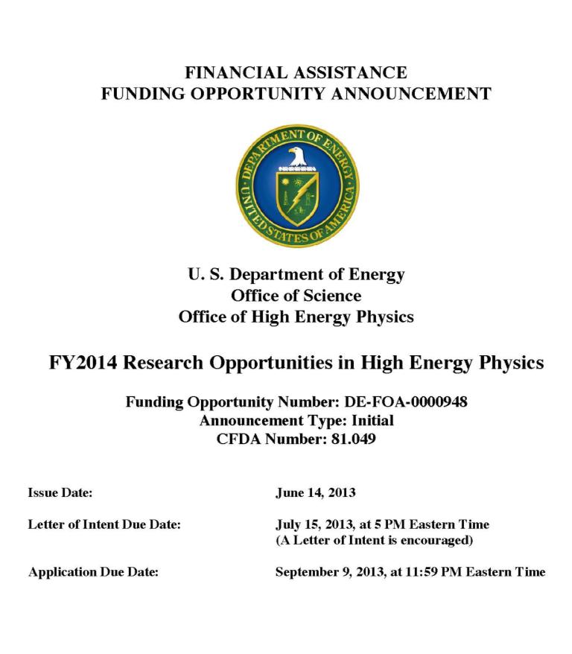
FY14 HEP Comparative Review FOA
DE-FOA-0000948
  Issued June 14, 2013
Six HEP research
subprograms
  Energy, Intensity, and
  Cosmic Frontiers
  HEP Theory
  Accelerator Science and Technology R&D
  Particle Detector R&D
Letter of Intent due July 15, 2013 by 5 PM Eastern Time
  Strongly encouraged
Final Proposal (i.e., Application) deadline Sept. 9, 2013 by
11:59 PM Eastern Time
http://science.energy.gov/hep/funding-opportunities/

Slide 71
Early Career: Next Round in FY14
FY14 FOA [DE-FOA-0000958] posted on July 23, 2013 at the Early Career website:
  http://science.energy.gov/early-career/
Read the FY14 FAQ, also on above web site
  Addresses most of the common Q&A collected over the last 4 years
Features of FY14
  Entering 5th year
    Some population of candidates will no longer be eligible due to the “3-strikes rule”
  Mandatory Pre-application requirement. Two pages.
    Deadline: September 5, 2013, 5 PM Eastern
    All interested PIs encouraged to register as soon as possible in DOE SC Portfolio Analysis and Management System (PAMS) for submission [link provided in EC website]
  Full proposals due: November 19, 2013, 5 PM Eastern
    Candidates will have more than 3 months to develop a plan, write a narrative, and submit an application
Presidential Early Career Awards for Scientists and Engineers (PECASE)
  PECASE-eligible candidates are selected from the pool of Early Career awardees
    http://science.energy.gov/about/honors-and-awards/pecase/

Slide 72
FY13 HEP Early Career Awards
Theory
Stefan Hoeche (SLAC) “High Precision Event Simulation for the LHC”
Clifford Cheung (California Institute of Technology) “The Higgs Frontier”
Andrew Tolley (Case Western Reserve University) “Exploring the Fundamental Origin of Cosmic Acceleration”
Cosmic
Clarence Chang (ANL) “Exploring Fundamental Physics through New Measurements of the Cosmic Microwave Background Polarization”
Adam Bolton (University of Utah) “Integrating Advanced Software and Statistical Methods for Spectroscopic Dark-Energy Surveys”
Accelerator
Matthew Jewell (University of Wisconsin Eau Claire) “Mechanical Performance of HTS Superconductor for HEP Applications”
Energy
Toyoko Orimoto (Northeastern University) “Search for the Higgs and Physics Beyond the Standard Model with the CMS Electromagnetic Calorimeter”
Andrew Ivanov (Kansas State University) “Quest for a Top Quark Partner and Upgrade of the Pixel Detector Readout Chain at the CMS”
Intensity
Jelena Maricic (University of Hawaii) “Resolving Reactor Antineutrino Anomaly with Strong Antineutrino Source” [funded by HEP and DOE Experimental Program to Stimulate Competitive Research (EPSCoR)]

Slide 73
Snowmass Young: Redux (I)
Review criteria for HEP Comparative Review and Early Career includes “leader within the proposed effort and/or potential future leader in the field”
  Important to seek out and/or volunteer for roles and responsibilities which increase visibility and provide career advancement opportunities
  Editorial Boards, Sub-detector systems, Physics Working Groups, Run Coordinator, etc.
  Service work for community is also valued, e.g. co-chairing a conference committee or serving on an NSF review panel
When asked to review, co-chair, attend, speak, etc. try NOT to say no!
  You need the experience
  Ask for feedback (if possible)
  Respond promptly to all communication
HEPAP: High Energy Physics Advisory Panel
  Meets ~3 times/year
  Open meeting in DC area
    Sept 5-6 2013 @ NSF
  Prof. Andy Lankford (Chair)
  Know your reps!
P5. Particle Physics Project Prioritization Panel
  Nomination period ended and selection process begins
  Stay informed. Follow the town halls. Learn the membership. Ask questions. Provide feedback.
Demographics.
HEP Organization

Slide 74
Snowmass Young: Redux (II)
Timescales for HEP projects from conception to first data will only get longer in the continued pursuit of discovery science due to cost, size and complexity
HEP academic research track (Univ. or Lab) would benefit from developing a short-, mid- and long-term research plan
  Balance research between ongoing experiment, upgrades and R&D with future experiment
Starting Assistant Prof. at University will most likely continue research from most recent post-doc position
  Will you be working on that same experiment in 5 years? How about 10 years?
  Optimize your start-up funds by expanding your research portfolio
Are you up to the challenge to get involved early and help deliver projects like LBNE and LSST to successful completion?
  Don’t expect people to come knocking on your door.
  Sometimes it is about showing up.
  Often you have to earn trust and gain credibility.
This is HARD work!
  You are doing cutting edge high energy particle physics
  The competition for jobs at all levels in HEP is still very high.
  It is not about the money.
  It’s about the SCIENCE!

Slide 75
Major Recommendations of
2008 Advisory Panel (P5)
The panel recommends that the US maintain a leadership role in world-wide particle physics. The panel recommends a strong, integrated research program at the three frontiers of the field: the Energy Frontier, the Intensity Frontier and the Cosmic Frontier.
The panel recommends support for the US LHC program, including US involvement in the planned detector and accelerator upgrades (highest priority)
The panel recommends a world-class neutrino program as a core component of the US program, with the long-term vision of a large detector in the proposed DUSEL and a high-intensity neutrino source at Fermilab.
  LBNE CD-0 received Jan 2010, and CD-1 received Dec 2012.
The panel recommends funding for measurements of rare processes to an extent depending on the funding levels available… (Mu2e at FNAL, U.S. Belle II detector upgrade).
  Mu2e CD-0 received Nov 2009, and CD-1 received July 2012.
  Belle II CD-0 received Aug 2011, and CD-1 received July 2012.
The panel recommends support for the study of dark matter and dark energy as an integral part of the US particle physics program.
The panel recommends a broad strategic program in accelerator R&D, including work …, along with support of basic accelerator science.
These are still relevant, and this is still the plan.

Slide 76
Joint Agency Letter to the Community
Fundamentally…[planning] is a multi-step process with several important milestones over the coming year, and each step will inform and prepare for the next.
  HEP Facilities Subpanel: Advise DOE/SC mgmt. on the scientific impact and technical maturity of planned and proposed SC Facilities, in order to develop a coherent 10-yr SC facilities plan
    Subpanel can add or subtract from initial facilities list
    Does not exclude/pre-empt later additions
  DPF/CSS2013 “Snowmass”: identify compelling HEP science opportunities over an approximately 20 year time frame.
    Not a prioritization but can make scientific judgments
  HEPAP/P5: Develop new strategic plan and priorities for US HEP in various funding scenarios, using input from #1 and 2 above (among others)

Slide 77
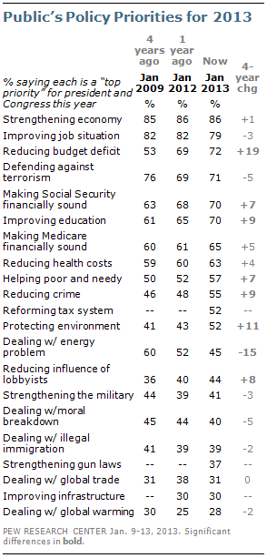
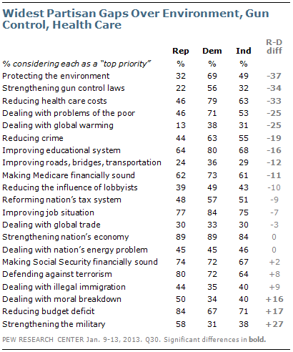
Public Policy Priorities for 2013

Slide 78

Peanuts. Nov 1956.

