Slide 1
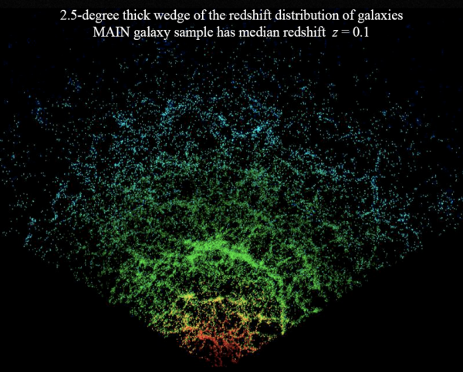
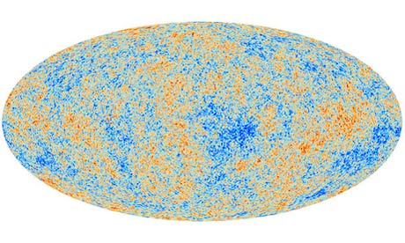
Particle Physics from Cosmic Surveys
Cosmic Frontier Sub-group: Dark Energy and CMB

Slide 2
Three epochs, each dominated by new physics, are required to explain cosmological data
t~10⁻³⁵ sec: Early acceleration, Inflation
300,000 years < t < 7.7 Byrs: Growth of Structure, fueled by Dark Matter
t > 7.7 Byrs: Acceleration, caused by Dark Energy

Slide 3
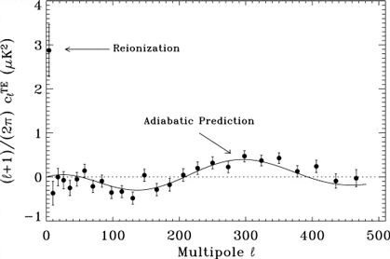
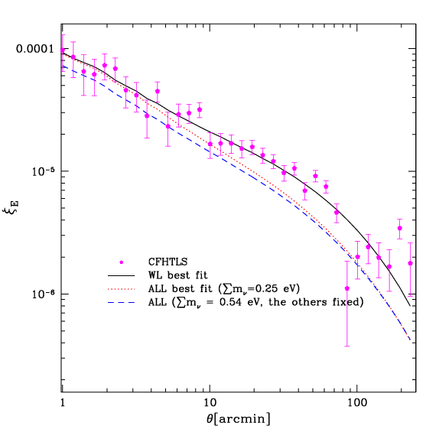
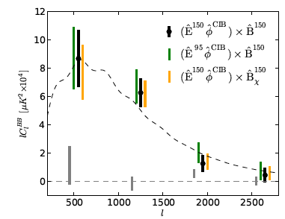
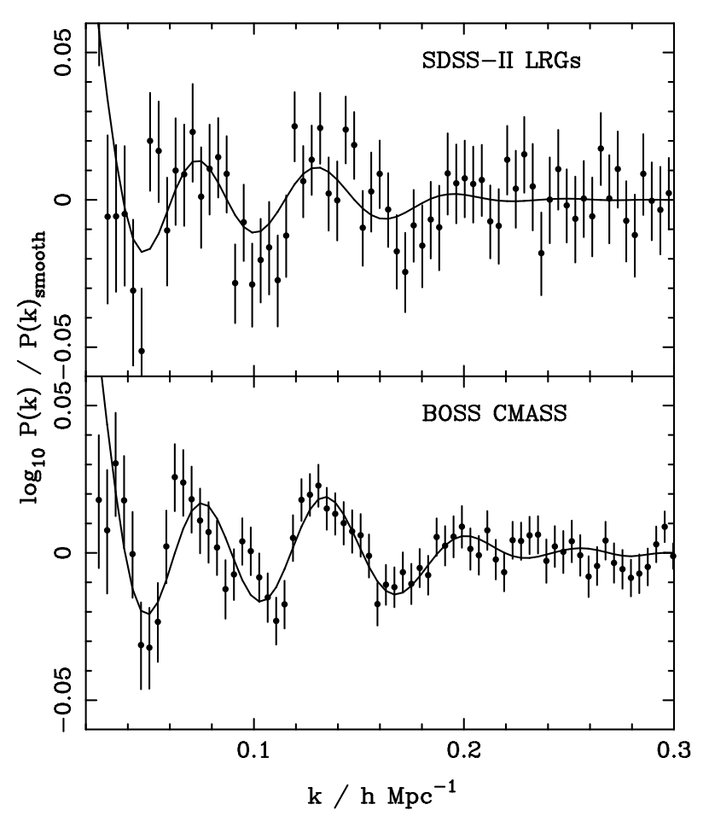
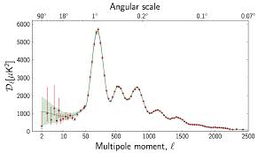
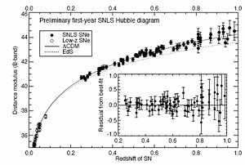
Stunning Agreement with a wide variety of observations
Gravitational Lensing
CMB Polarization
Lensing of CMB[!]
CMB Temperature
Galaxy clustering
Supernovae

Slide 4
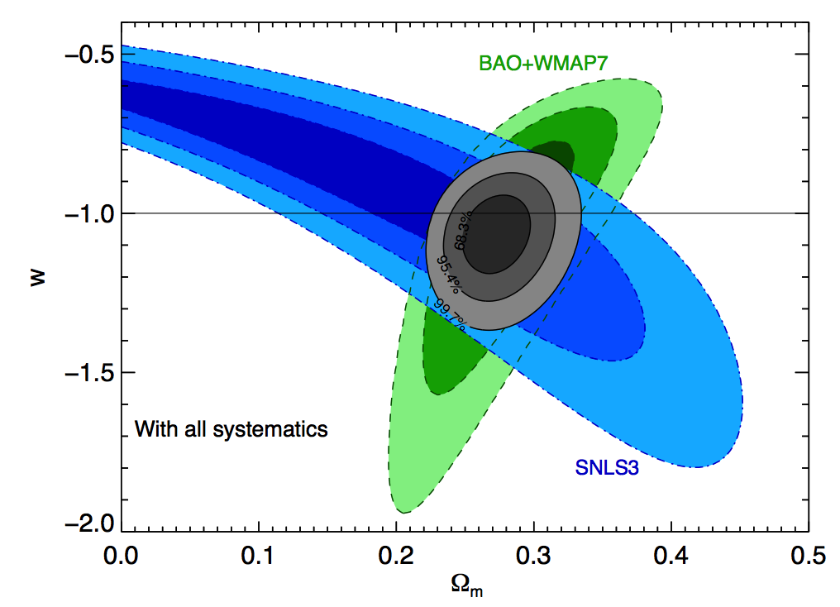
Particle Physics from Cosmic Surveys
Robust evidence for dark matter
Dark energy equation of state
10-sigma detection of neutrinos produced when t<1 sec
Tight constraints on neutrino mass
Evidence for inflation; constraints on physics driving inflation via primordial perturbation measurements
Zhao et al 2013
Sullivan et al. 2011

Slide 5
Example: Neutrino Mass from Galaxy Survey
Data: Power spectrum from a galaxy survey
Likelihood:
Typically sampled at millions of points in the ~10-dimensional parameter space
Covariance Matrix:
C[P(k),P(k’)]
Theory: Prediction for P(k) as a function of cosmological and nuisance parameters

Slide 6
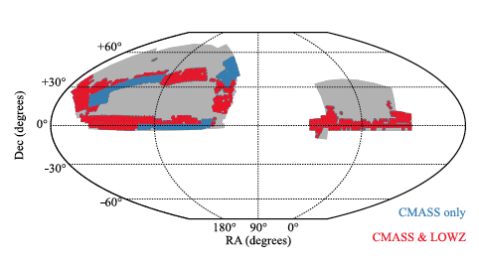
Example: CMASS galaxies from BOSS
Ross et al. 2012

Slide 7
Estimating Power Spectrum
Pixelize the survey and, for each pixel, compute the over-density Δ=(n-n^{exp})/n^{exp}, where n^{exp} is the expected number of galaxies in the pixel

Slide 8
Estimating Power Spectrum
Pixelize the survey and, for each pixel, compute the over-density Δ=(n-n^{exp})/n^{exp}, where n^{exp} is the expected number of galaxies in the pixel
Form a quadratic estimator A simple guess might be but there are many other options, many of which account for masks, edge effects more carefully and have better noise properties

Slide 9
Covariance Matrix and Window Function
Estimate covariance matrix by running 600 mocks

Slide 10
Covariance Matrix and Window Function
Estimate covariance matrix by running 600 mocks
The power spectrum estimate is sensitive to a range of P(k); W follows from M

Slide 11
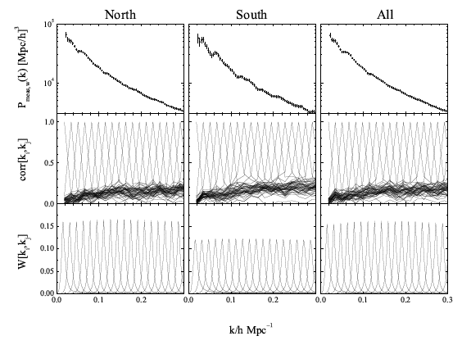
Power Spectrum, Covariance Matrix, & Window Function
Zhao et al 2013

Slide 12
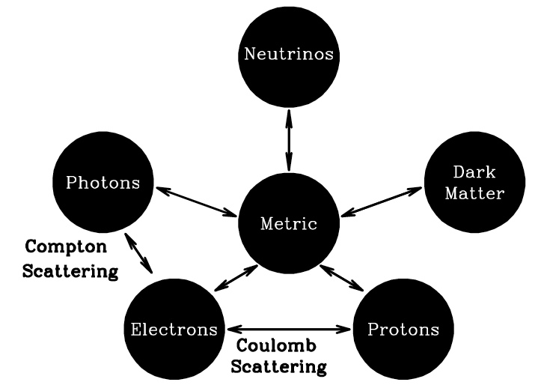
Theory

Slide 13
Theory
Determine zero order cosmology using Einstein equations and energy-momentum conservation

Slide 14
Theory
Determine zero order cosmology using Einstein equations and energy-momentum conservation
On large scales (small k) perturbations are small, so solve linear perturbation theory using coupled Einstein- Boltzmann equations
Perturbed f can be used to compute δ(k,t); the predicted power spectrum is |δ(k,t)|²

Slide 15
Zero order calculation: Standard Model neutrinos are produced in the early universe
Alpher, Herman, & Gamow 1953
Even if no neutrinos initially when the temperature is much larger than m_{e}, rate for producing them via, e.g.,
Z

Slide 16
Zero order calculation: Standard Model neutrinos are produced in the early universe
Alpher, Herman, & Gamow 1953
Even if no neutrinos initially when the temperature is much larger than m_{e}, rate for producing them via, e.g.,
Z
is

Slide 17
Compare this to the expansion rate
the universe is radiation dominated at early times
ratio of neutrino production rate to expansion rate

Slide 18
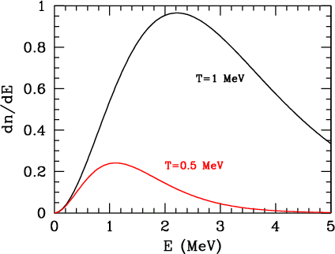
Above 5 MeV, neutrinos are in equilibrium with the rest of the cosmic plasma
Fermi-Dirac distribution with temperature T equal to the electron/photon temperature.
After the neutrinos decouple from the rest of the plasma (T<MeV), they still maintain Fermi-Dirac distribution with T~1/a.

Slide 19
Calibrate off the well-known photon temperature to get the prediction
Number of species of weakly interacting neutrinos (3)
a hundred quadrillion cosmic neutrinos passing through this screen every second

Slide 20
Evolution of Perturbations
Growth of structure delicate balance between gravitational instability and expansion
Potentials remain constant if all matter participates
Potentials decay if some of the matter (e.g., relatively hot neutrinos) does not cluster
So clumpiness in the universe is very sensitive to the total mass density of all neutrinos:
Cold Dark Matter
Colombi, Dodelson& Widrow 1995
Cold+ Hot Dark Matter

Slide 21
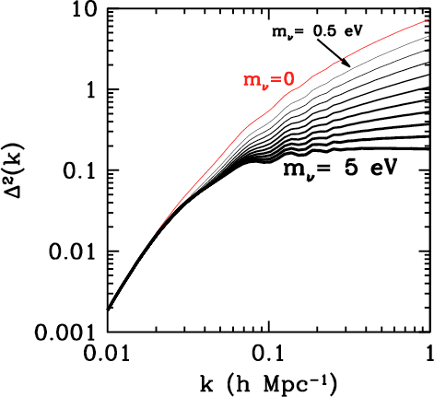
Impact on the Power Spectrum
Suppression on small scales
When the dimensionless k³P(k)/2π² is less than one, inhomogeneities are linear and predictions agree at the sub-percent level

Slide 22
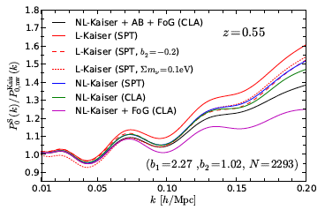
Three Theoretical Systematics
Nonlinearities
Bias
Redshift space distortions

Slide 23
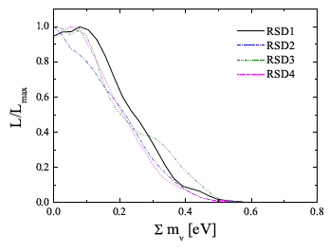
Particle Physics from Cosmic Surveys
Zhao et al. 2013

Slide 24
What assumptions are made?
Within the simple (hyper-successful) cosmological ΛCDM model, theoretical assumptions are: standard weak interactions, general relativity, statistical mechanics
Zhao et al 2013

Slide 25
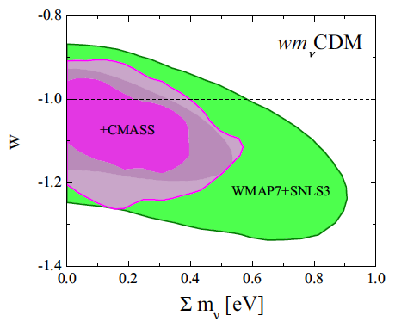
What assumptions are made?
Within the simple (hyper-successful) cosmological ΛCDM model, theoretical assumptions are: standard weak interactions, general relativity, statistical mechanics
Relaxing priors on the model lead to looser constraints
Zhao et al 2013

Slide 26
Snowmass: Particle Physics from Cosmic Surveys
Summary (Dodelson, Honscheid, et al.)
Cosmic Distances (Kim, Padmanabhan et al.)
Growth of Structure (Huterer, Kirkby, et al.)
Novel Probes (Jain, et al.)
Cross-correlations (Rhodes, et al.)
Inflation (Carlstrom, Lee, et al.)
Neutrinos (Abazajian, Carlstrom, Lee, et al.)
Facilities (Weinberg, et al.)

Slide 27
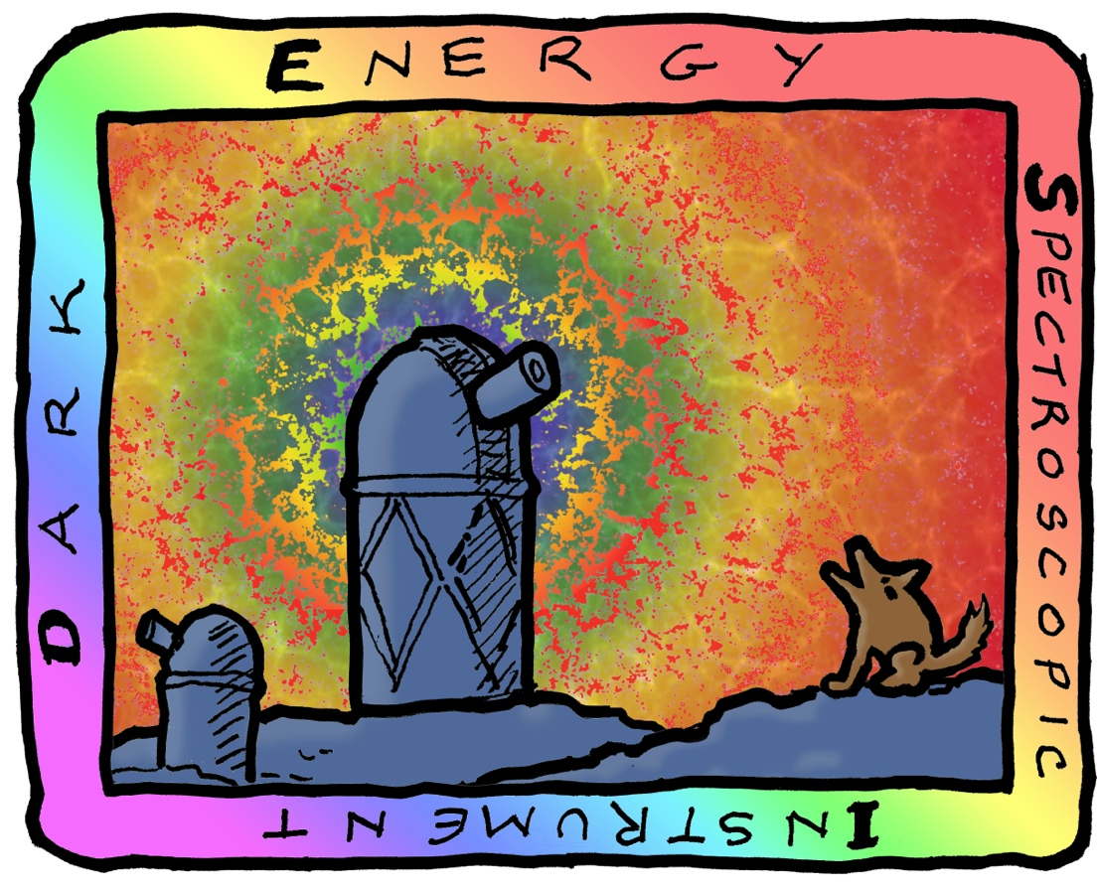
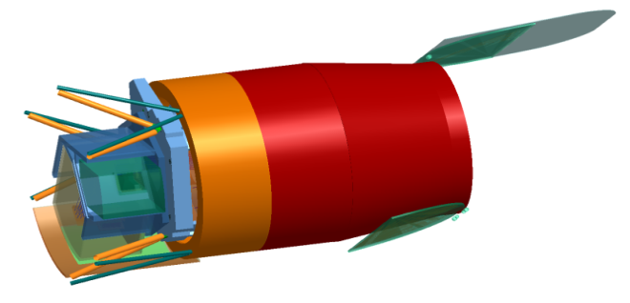
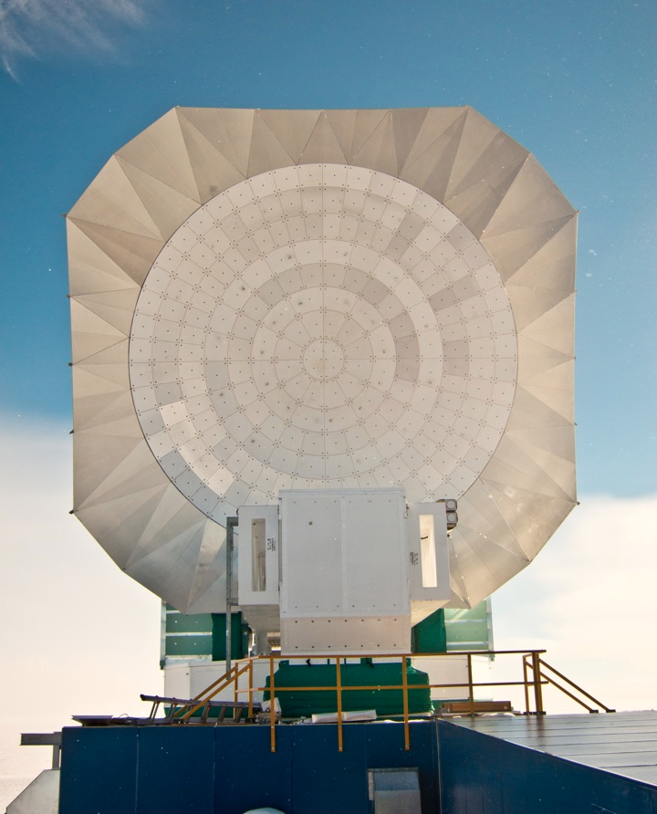
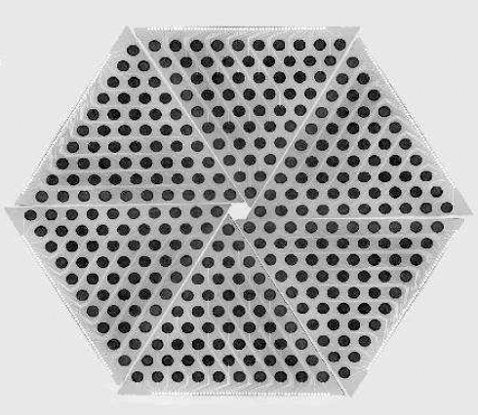
Consensus plan, international and across agencies, often with US leadership
Photometric
Spectroscopic
CMB
HSC
WFIRST
Euclid
eBOSS
SPTPol
Stage IV

Slide 28
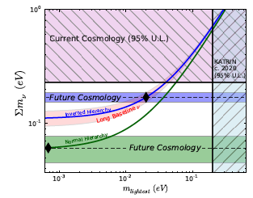
Neutrino Mass
Cosmological constraints from both Stage IV dark energy experiments and Stage IV CMB experiment

Slide 29
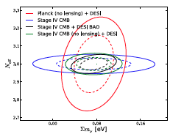
Number of cosmic neutrinos
2-sigma determination of N_{eff} = 3.046 (incomplete decoupling when T~1 MeV)
Sterile neutrinos

Slide 30
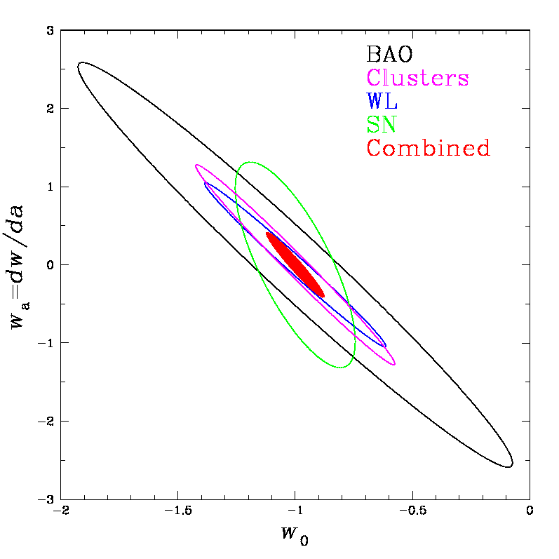
Dark Energy
Expect tight constraints on equation of state from 4 (+) probes
This is DES, Stage III; Stage IV is even better, close to cosmic variance limit
Powerful consistency checks

Slide 31
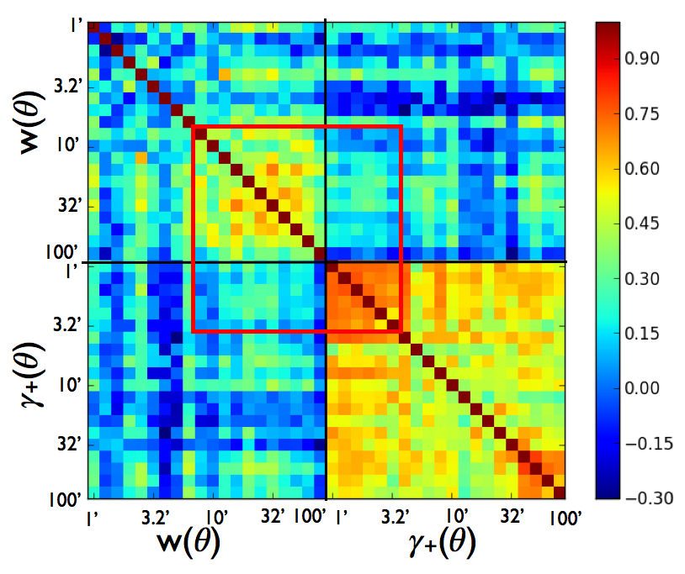
Dark Energy
Probes correlated in fascinating ways. Here (courtesy Elisabeth Krause) correlations between galaxy clustering and gravitational lensing

Slide 32
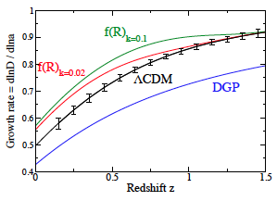
Dark Energy vs. Modified Gravity
Fix model by measuring distances (Supernovae, Baryon Acoustic Oscillations, Weak Lensing, Galaxy Clusters)
Modified gravity models make different predictions for structure growth than do DE models. Measure structure (Weak Lensing, Redshift Space Distortions, Galaxy Clusters)
All these models predict identical distance-redshift relation

Slide 33
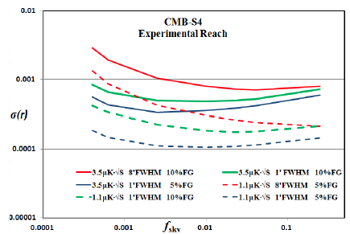
Inflation
Stage IV CMB survey will definitively rule on large field models, opening a window on the Planck scale

Slide 34
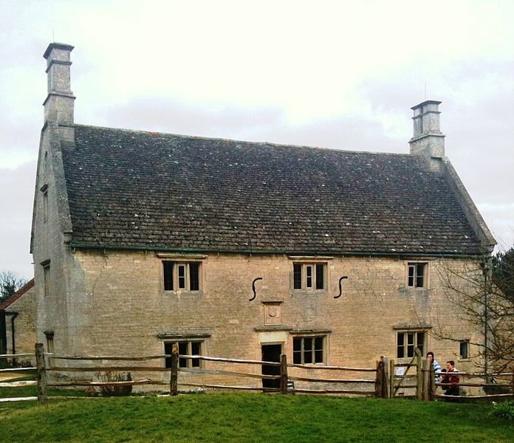
Our Contribution to Civilization
Top Quark
Neutrino Mass
Higgs Boson
Compelling version of cosmic history …
with 3 pieces of new physics
?
Woolsthorpe Manor

