Slide 1
Precision measurement of the D⁰ mass and of the natural line width of the D*⁺ Ray F. Cowan Representing the BABAR Collaboration
DPF 2013
Santa Cruz, California USA
August 12–17, 2013

Slide 2
Outline
BaBar detector and dataset
Motivation for precision D⁰ and D*⁺ mass and width measurements
D⁰ mass
D*⁺ width and D*⁺−D⁰ mass difference
Summary

Slide 3
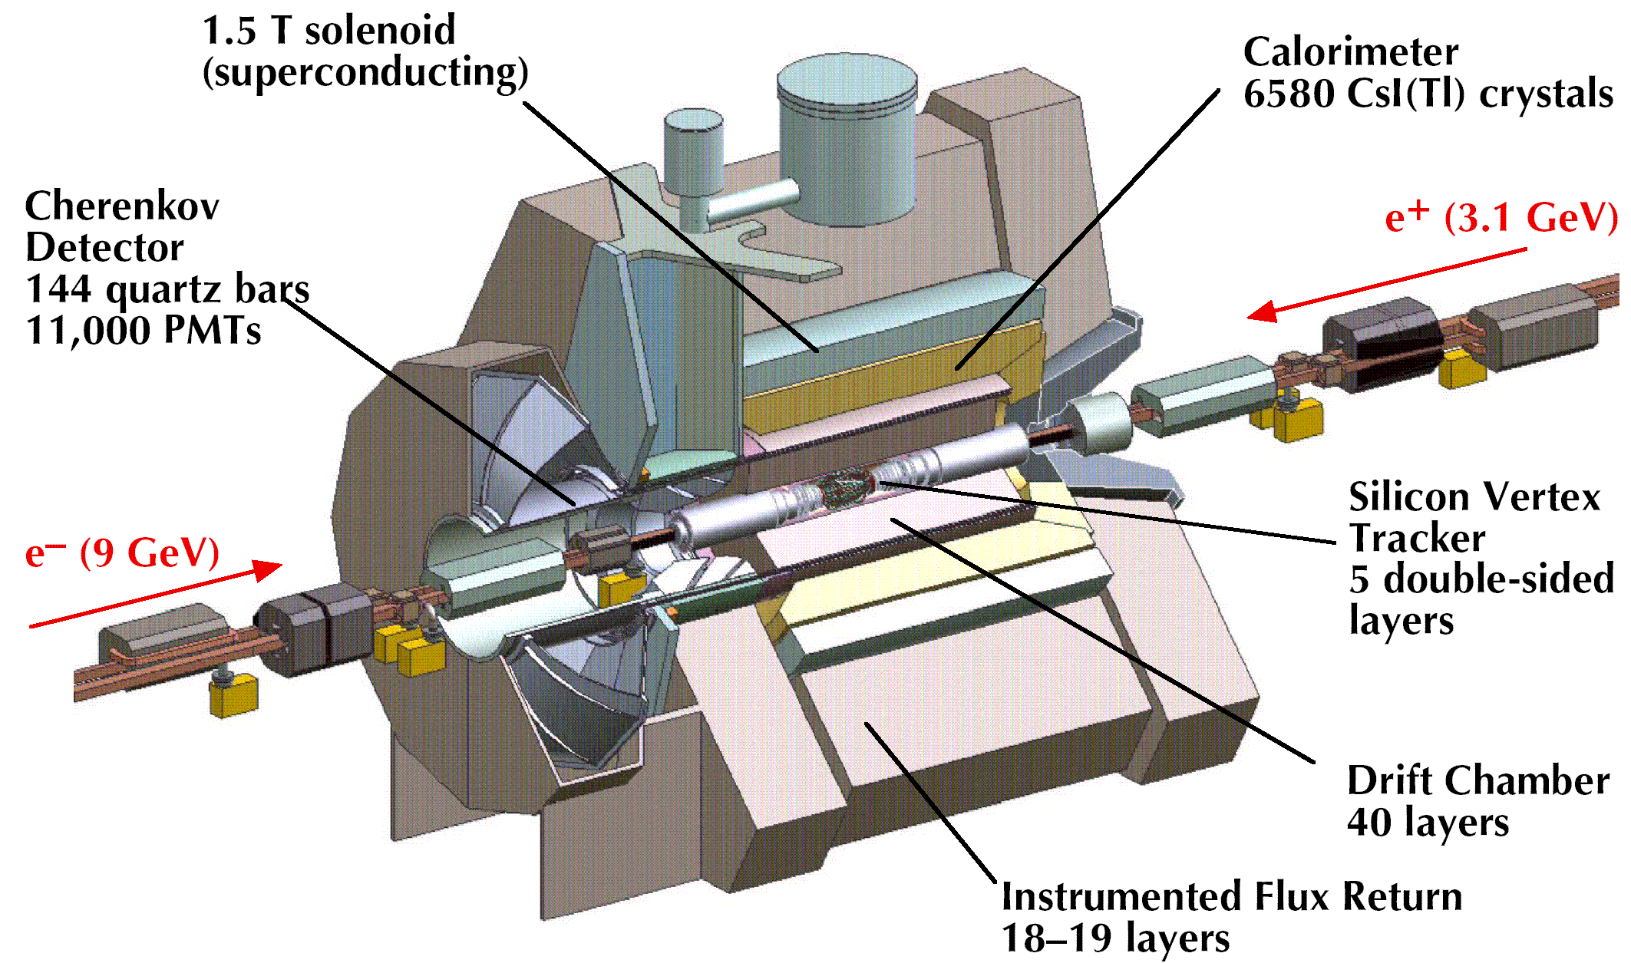
The BABAR detector at PEP-II
Cherenkov
Detector
144 fused silica bars
11,000 PMTs
NIM A479, 1 (2002);
Update: arXiv:1305.3560

Slide 4
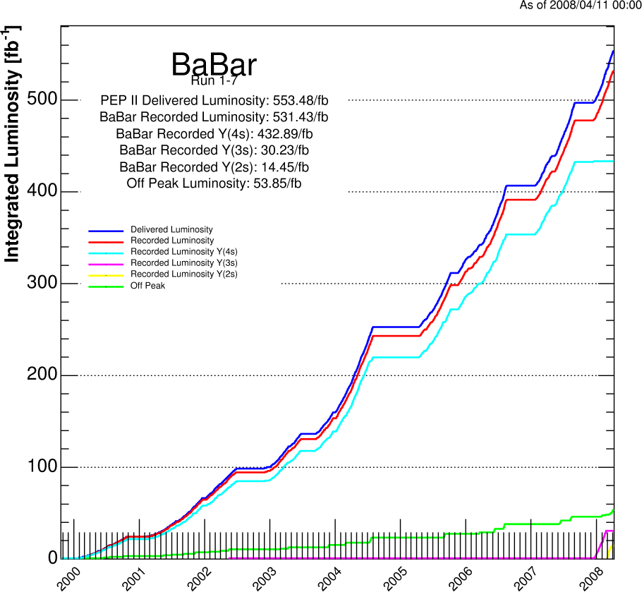
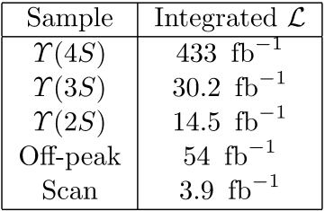
BABAR Datasets
PEP-II at SLAC is not only a B factory but also a charm factory
470 x 10⁶ B anti-B pairs
690 x 10⁶ c anti-c pairs
500 x 10⁶ τ⁺τ⁻ pairs

Slide 5
Motivation — D⁰ mass
D⁰ is a ground state of the charm mesons
Sets the mass scale for higher-mass, excited states
Used in determining D*+ mass
m(D*⁺) = m(D⁰) + Δm(D*⁺ - D⁰)
Used to extract mixing parameters from mass-constrained Dalitz plots in time-dependent amplitude analyses
E.g., D⁰ → K_{S}π⁺π⁻ and K_{S}K⁺K⁻
Precision value of the D⁰ mass is used in detector magnetic field studies
Used to determine D⁰-anti-D*⁰ threshold for studies of the X(3872)
X(3872) binding energy E_{b} = m(X(3872)) − 2m(D⁰) − Δm(D*⁺-D⁰)
D⁰ mass current world average
m(D⁰) = 1864.86 ± 0.13 MeV/c² [1]
Previous most precise single measurement
m(D⁰) = 1864.847 ± 0.150 ± 0.095 MeV/c² [2]
Used (319 ± 18) D⁰ → φK_{s} signal events
This measurement
Uses D⁰ → K⁻K⁻K⁺π⁺ decays
Small Q value (244.2 MeV) minimizes systematic uncertainties and reduces backgrounds
Integrated luminosity 60x larger, 477 fb⁻¹
Data sample 15x previous after cuts, 4345 ± 70 signal events
Reduces overall uncertainty by > 2x
[1] J. Beringer et al. (Particle Data Group), Phys. Rev. D 86, 010001 (2012)
[2] C. Cawlfield et al. (CLEO), Phys. Rev. Lett. 98, 092002 (2007)

Slide 6
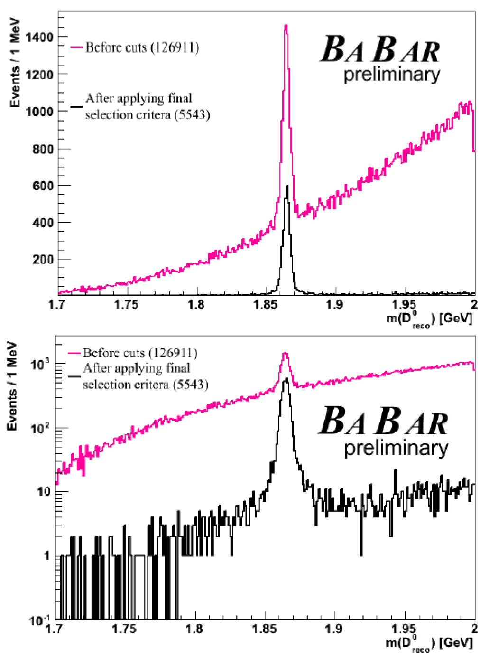
D⁰ mass — event selection
Purity and significance
p_{CM}(D*⁺) > 2.5 GeV/c
Tight particle ID on K and π
Well understood tracking
p_{LAB}(π_{S}⁺) > 150 MeV/c
cos(θ_{LAB}) < 0.89
Tag the D*⁺
Δm ≡ m(KKKππ_{s}) − m(KKKπ)
Δm − Δm_{PDG} < 1.5 MeV/c²
Use a kinematic fit that constrains each vertex to choose best candidate

Slide 7
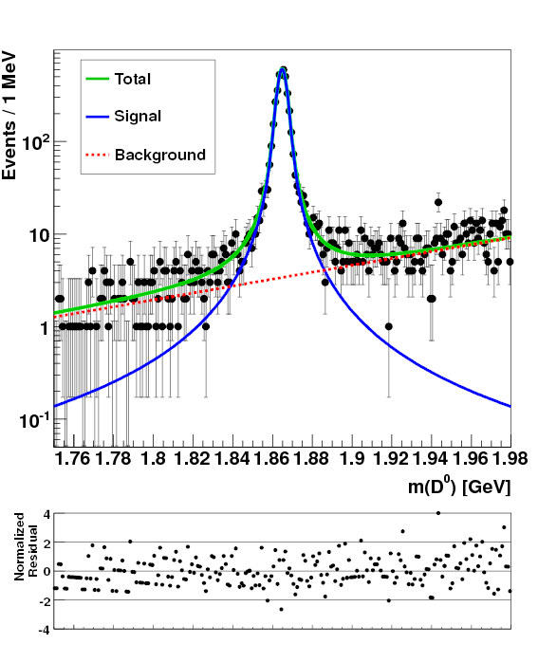
D⁰ mass — fit
Fit function
Signal: Voigtian
Background:
Exponential in m(KKKπ)
Unbinned max. like. fit
Fitted values
m(D⁰) = 1864.841 ± 0.048 MeV/c²
γ = 2.596 ± 0.152 MeV
σ = 1.762 ± 0.086 MeV
Events in signal
4345 ± 70
m(KKKπ) GeV/c²

Slide 8
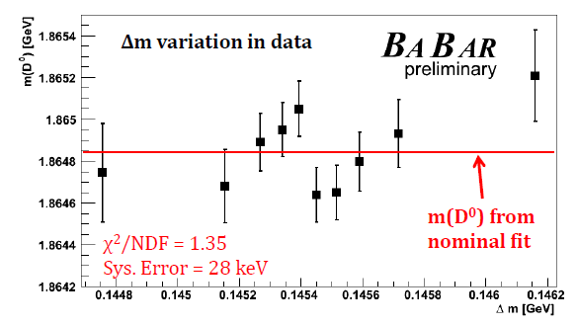
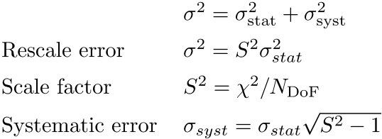
D⁰ mass — systematic uncertainties
Consistency check
Split dataset into 10 disjoint subsamples
Azimuth angle
p_{LAB}(D⁰)
Δm
If χ²/N_{DOF} > 1, use the PDG scale factor method to assign the systematic error

Slide 9
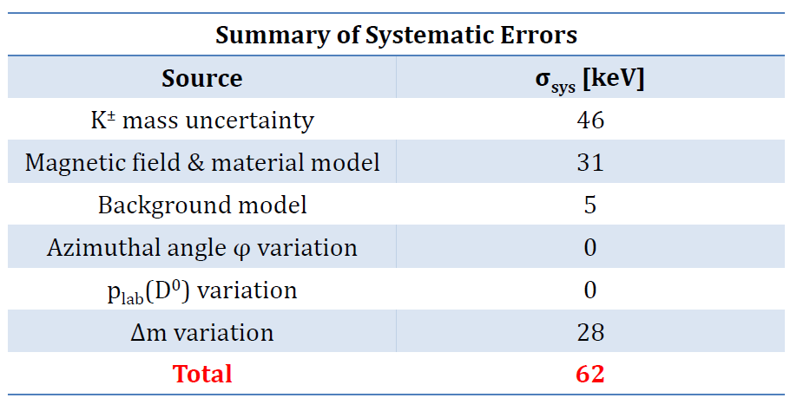
D⁰ mass — systematic uncertainties
The largest systematic: K± mass uncertainty
Reconstruction uses known K± mass
Uncertainty is ± 16 keV/c², but there are 3 kaons
Assess effect by varying within ± 1σ (PDG), refit, and take average

Slide 10
D⁰ mass — results
Dominant systematic error from K⁺ mass uncertainty (16 keV/c²) yields
46 keV/c² (3 kaons)
Magnetic field and energy loss calibration
31 keV/c²
Systematic variation in Δm
28 keV/c²
Q = m(D⁰) − 3m(K) − m(π) = 244.240 ± 0.048 ± 0.041 MeV/c²
m(D⁰) = 1864.841 ± 0.048 ± 0.062 MeV/c²
Can recalculate a more precise D⁰ mass with improved K mass value
Result is approximately twice as precise as the current world average
1864.841 ± 0.078 MeV/c² This measurement
1864.86 ± 0.13 MeV/c² PDG fit
1864.91 ± 0.17 MeV/c² PDG average
1864.847 ± 0.178 MeV/c² CLEO
Binding energy
E_{b} = m(X(3872)) − 2m(D⁰) − Δm(D*⁺-D⁰)
This result: E_{b} = 0.12 ± 0.24 MeV
PDG: E_{b} = 0.16 ± 0.32 MeV

Slide 11
Motivation — D*⁺ line width, Δm(D*⁺-D⁰) mass difference
The D*⁺ line width explores nonperturbative strong physics where the heavy meson involves the charm quark
Provides a check on models of the D-meson mass spectrum
Provides information on the D*⁺ coupling g_{D*Dπ} to the D-π system
Which can be related to g_{B*Bπ} which is not accessible directly (no phase space for B* → Bπ)
Needed for model-independent measurement of |V_{ub}|
And is a large contributor to the theoretical uncertainty of |V_{ub}|
Extracted values of the universal coupling constant g are not consistent with chiral perturbation theory
Previously only one measurement [3]
Γ(D*⁺ ) = 96 ± 4 ± 22 keV
Used D⁰ → K⁻π⁺ decays, 9 fb⁻¹
This measurement uses D⁰ → K⁻π⁺ and D⁰ → K⁻π⁺ π⁻π⁺ decays
And 50x more data
Permits tight event selection to control backgrounds
Permits precision understanding of systematics
[3] A. Anastassov et al. (CLEO Collaboration), Phys. Rev. D65, 032003 (2002).

Slide 12
Γ(D*⁺), Δm(D*⁺-D⁰) — procedure
Use D*⁺ → D⁰π⁺, D⁰ → K⁻π⁺ and D⁰ → K⁻π⁺π⁻π⁺ decays
Describe signal by a relativistic Breit-Wigner (RBW) convolved with a resolution function
RBW:
Resolution function derived from simulation
Describe background by
A threshold function:
Fit the D*⁺-D⁰ mass difference distribution for Γ(D*⁺) and Δm(D*⁺-D⁰)

Slide 13
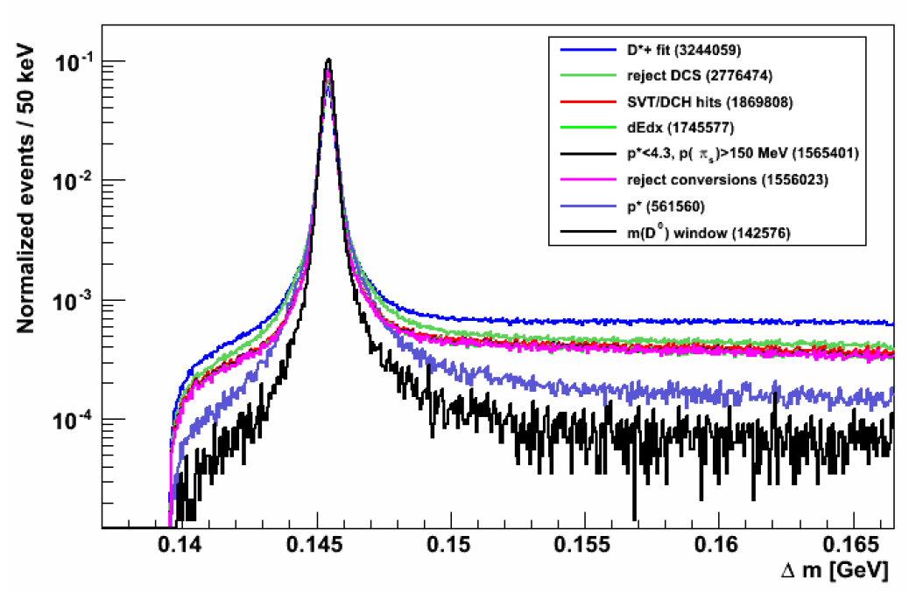
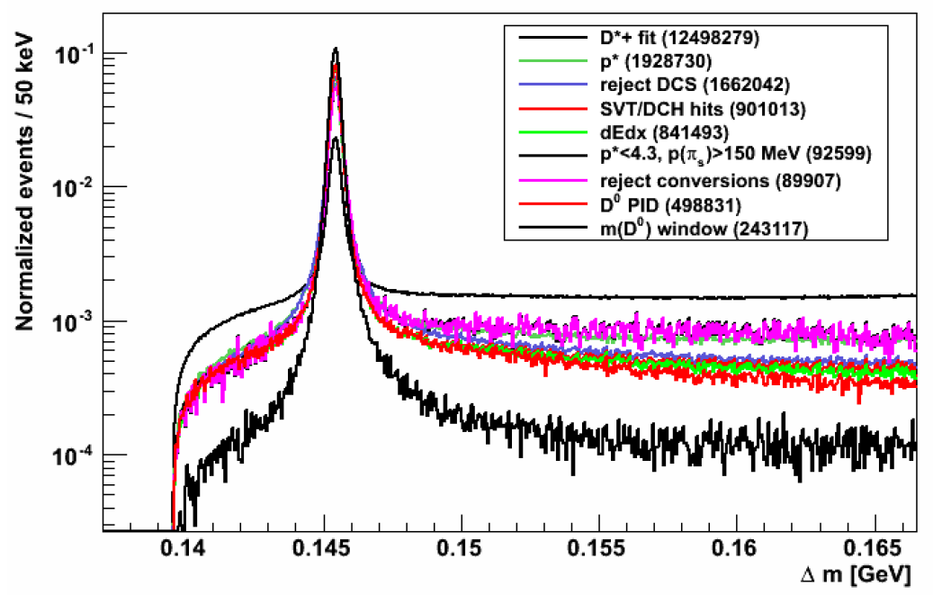
Γ(D*⁺), Δm(D*⁺-D⁰) — event selection
D*⁺ → D⁰π_{s}⁺, D⁰ → K⁻π⁺ and D⁰ → K⁻π⁺π⁻π⁺
Q = 6 MeV, total B.F. = 8%
Cuts for purity and significance
3.6 GeV/c < p_{CM}(D*⁺) < 4.6 GeV/c
Tight particle ID restrictions on K and π daughters
Cuts for highest-quality tracking
p_{LAB}(π_{s}⁺) > 150 MeV/c
cos(θ_{LAB}) < 0.89
D0 selection
1.86 GeV/c² < m(Kπ(ππ)) < 1.87 GeV/c²
Apply kinematic fit to each vertex
Choose best candidate
Kπ
Kπππ

Slide 14
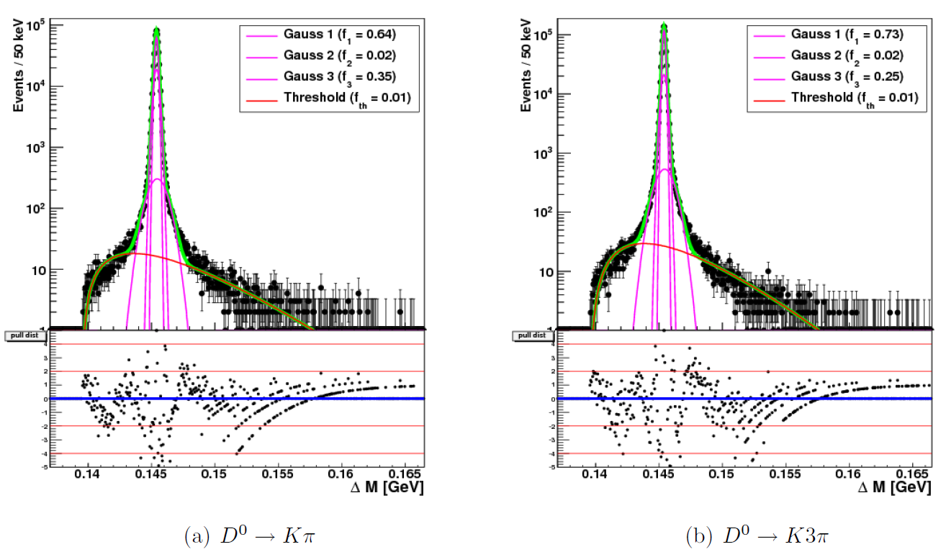
Γ(D*⁺), Δm(D*⁺-D⁰) — resolution function
No control sample from data is available
Use triple Gaussian
Extract parameters from simulation fit
Model slow pion decays π_{s}⁺ → μ⁺ν with a threshold function
Scale widths using scale factor ε
σ → σ (1 + ε)
Monte Carlo
Monte Carlo

Slide 15
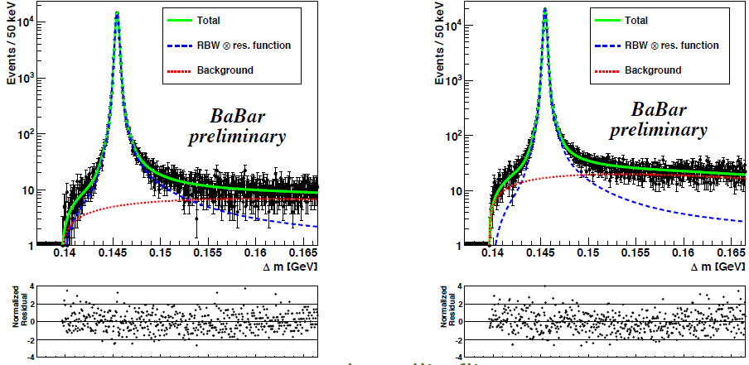
Γ(D*⁺), Δm(D*⁺-D⁰) — fits
Sensitivity to width comes from tails of the distribution
D⁰ → K⁻π⁺
D⁰ → K⁻π⁺ π⁻π⁺

Slide 16
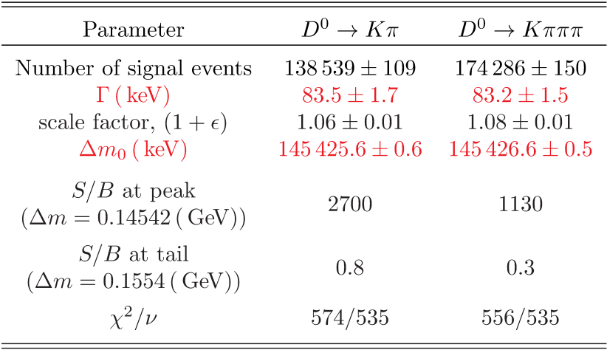
Γ(D*⁺), Δm(D*⁺-D⁰) — fit results
From binned fits

Slide 17
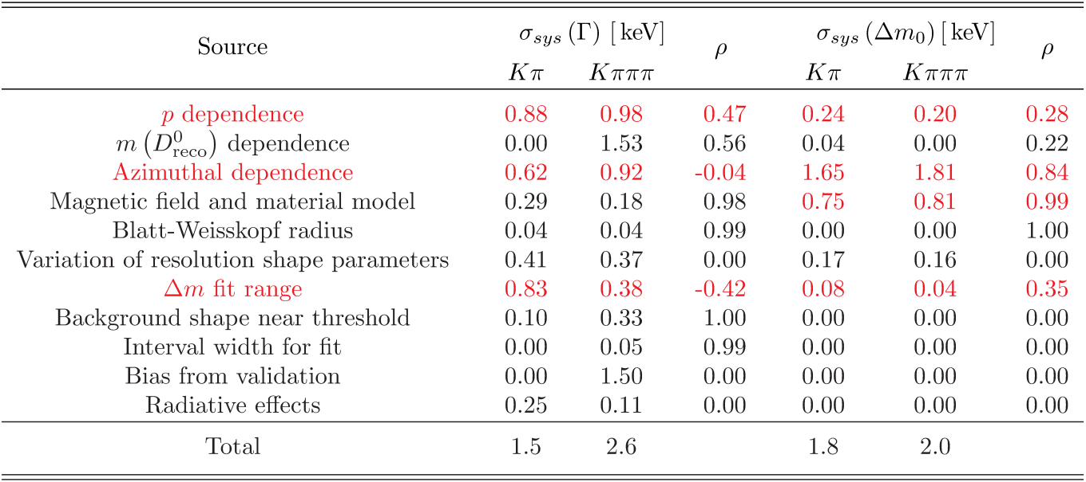
Γ(D*⁺), Δm(D*⁺-D⁰) — systematics
Larger systematics are shown in red
Systematics include correlation factor ρ between the Kπ and Kπππ subsamples

Slide 18
Γ(D*⁺), Δm(D*⁺-D⁰) — results
Combined results from Kπ and Kπππ subsamples
Combined using weighted average taking correlations into account
Δm = m(D*⁺) − m(D⁰) = 145425.8 ± 0.5 (stat.) ± 1.8 (syst.) keV/c²
Contrast with
CLEO: 145.412 ± 0.012 MeV/c²
PDG: 145.410 ± 0.010 MeV/c²
Γ(D*⁺) = 83.3 ± 1.3 (stat.) ± 1.4 (syst.) keV
Contrast with
CLEO: 96 ± 4 ± 22 keV

Slide 19
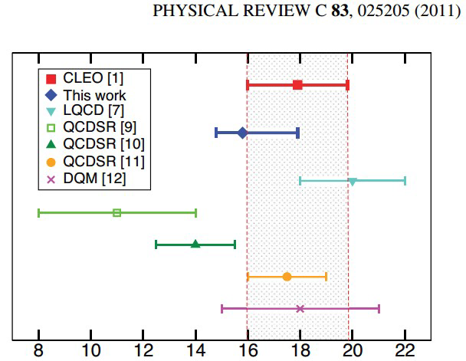
Vector meson coupling to pion
Test predictions of chiral perturbation theory
Use R from Di Pierro and Eichten, PRD 64, 114004 (2001)
Use widths from this measurement and from PRD 82, 111101(R) (2010)
Extracted values of g are not constant for different D meson excited states; this contradicts the prediction of the Di Pierro & Eichten potential model
Measurements are inconsistent with chiral perturbation theory

Slide 20
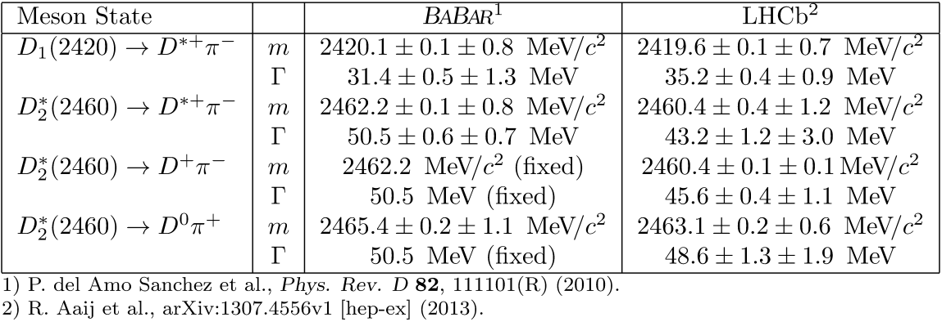
D₁(2420) and D₂*(2460) masses and widths
LHCb and BABAR results are reasonably consistent
Width measurements from LHCb lead to substantial disagreement with calculated values of the coupling constant
And with the model expectation that these values should be the same for the three states
The order of magnitude increase in precision of these measurments confirms the observed inconsistency with the chiral quark model (on previous slide)

Slide 21
Summary
BABAR has made precision measurements in the charm sector
The D⁰ mass
m(D⁰) = 1864.841 ± 0.048 (stat.) ± 0.062 (syst.) MeV/c²
The D*⁺ − D⁰ mass difference
Δm₀ = m(D*⁺) − m(D⁰) = 145425.8 ± 0.5 (stat.) ± 1.8 (syst.) MeV/c²
The D*⁺ line width
Γ(D*⁺) = 83.3 ± 1.3 (stat.) ± 1.4 (syst.) keV
Combining m(D⁰) and Δm yield the most precise value of the D*⁺ mass
Better than PDG in terms of precision
BABAR measured the mass difference Δm(D_{s1}(2536)-D*+) earlier
Using that value, we also have the most precise D_{s1}(2536) mass

Slide 22
Backup slides

Slide 23
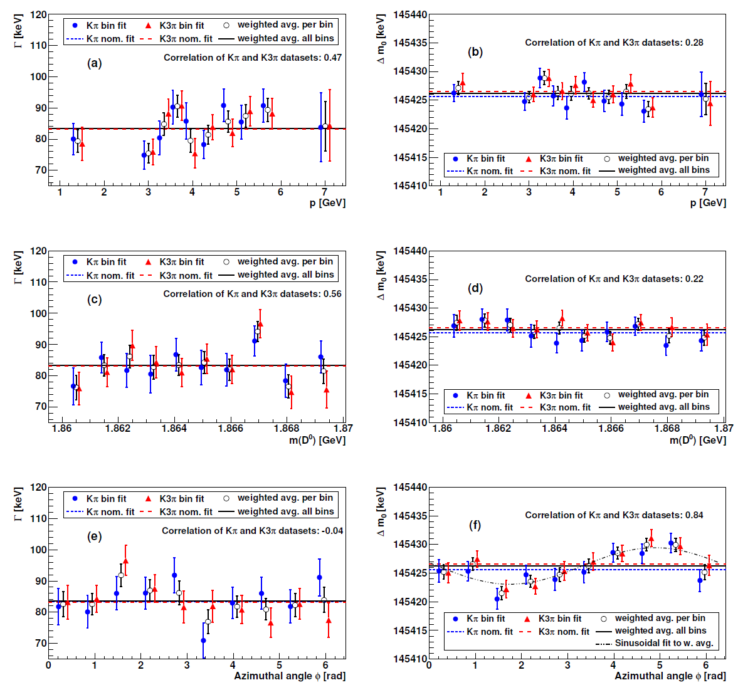
Γ(D*⁺), Δm(D*⁺-D⁰) — checks and systematics
Checks
Split data into 10 disjoint subsamples
Check p_{lab}(D⁰), m(D⁰), azimuthal angle
Systematics
If χ²/N_{DOF} > 1, use PDG scale factor method
Vary energy loss correction based on PDG value for K_{S} mass
Needed for masses, not widths
Vary form, parameters of signal and background PDFs
Small sensitivity to Blatt-Weisskopf radius and most resolution parameters
Width is sensitive to range of fit

Slide 24
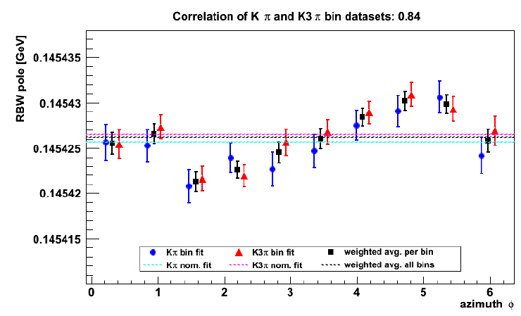
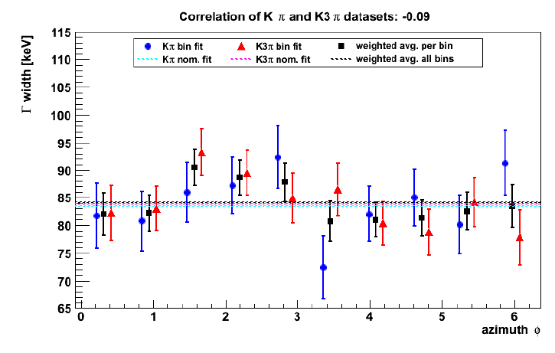
Γ(D*⁺), Δm(D*⁺-D⁰) — checks and systematics
Azimuthal angle variation of RBW pole and width
Sinusoidal variation of Δm with φ, average value is unbiased
Assign as systematic error
Seen in K_{S} calibration, interpreted as a variation of magnetic field with respect to the measured map
Γ shows an insignificant variation

