Slide 1
Implicit Bias, Gender, and You
Sarah Demers
Yale University

Slide 2
Outline
Bias: Explicit and Implicit
The Research
Suggested Practices
Stereotype Threat
Thanks to Yale’s Meg Urry and Jo Handelsman,
and Abigail Stewart (Michigan – haven’t
met her but she recently gave a talk at Yale
and put her slides online for all to see!
Two of her slides (where noted) are in this talk.)

Slide 3
How far things have come . . .

Slide 4
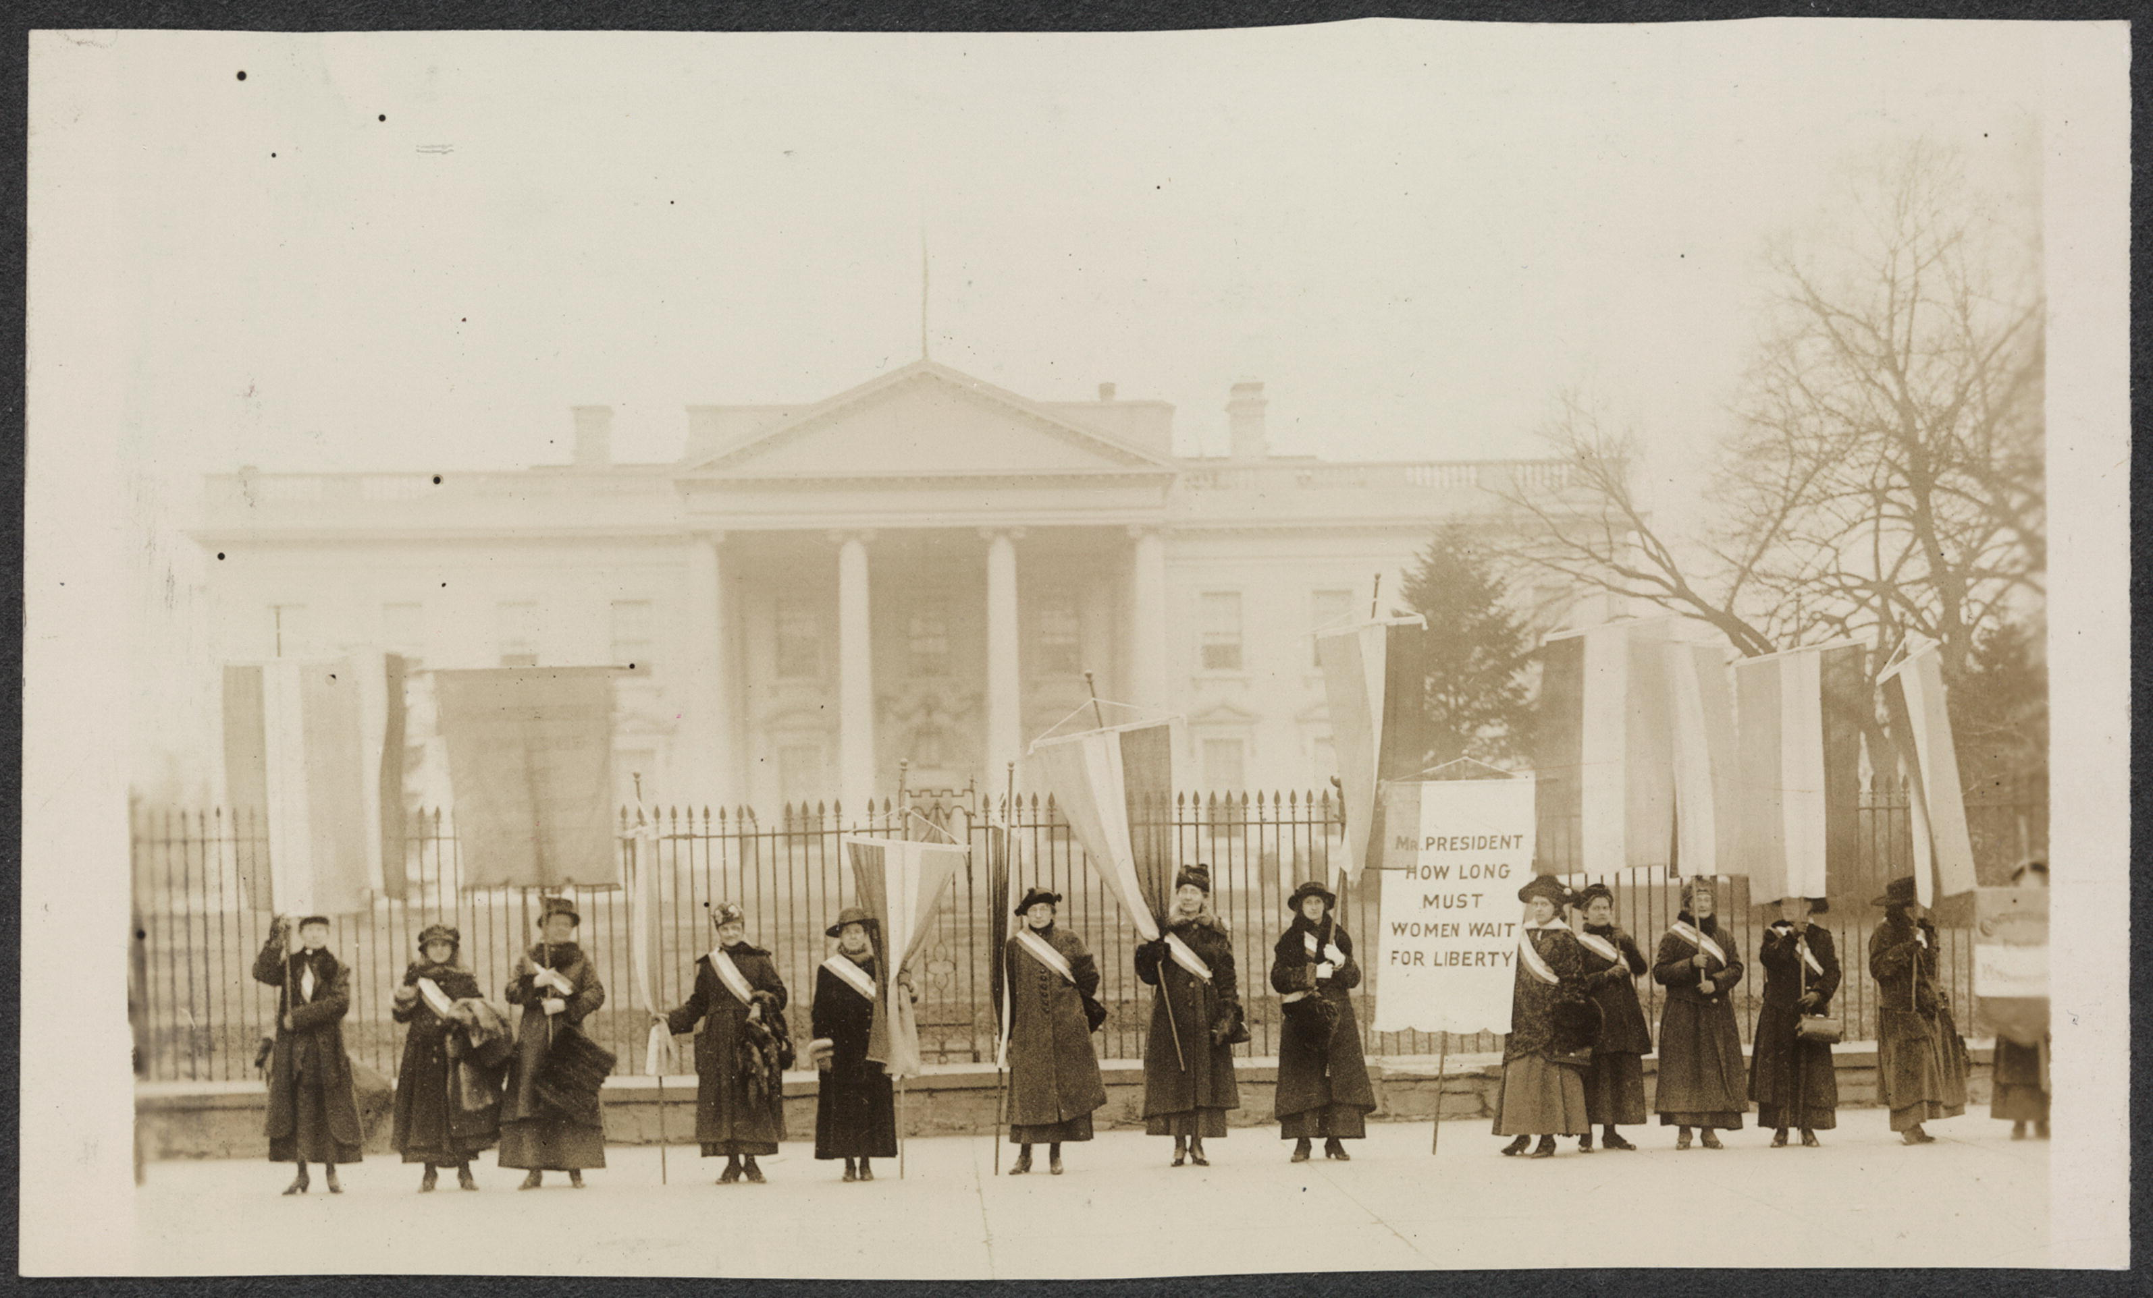
1917: “Mr. President, how long must women wait for Liberty?”

Slide 5
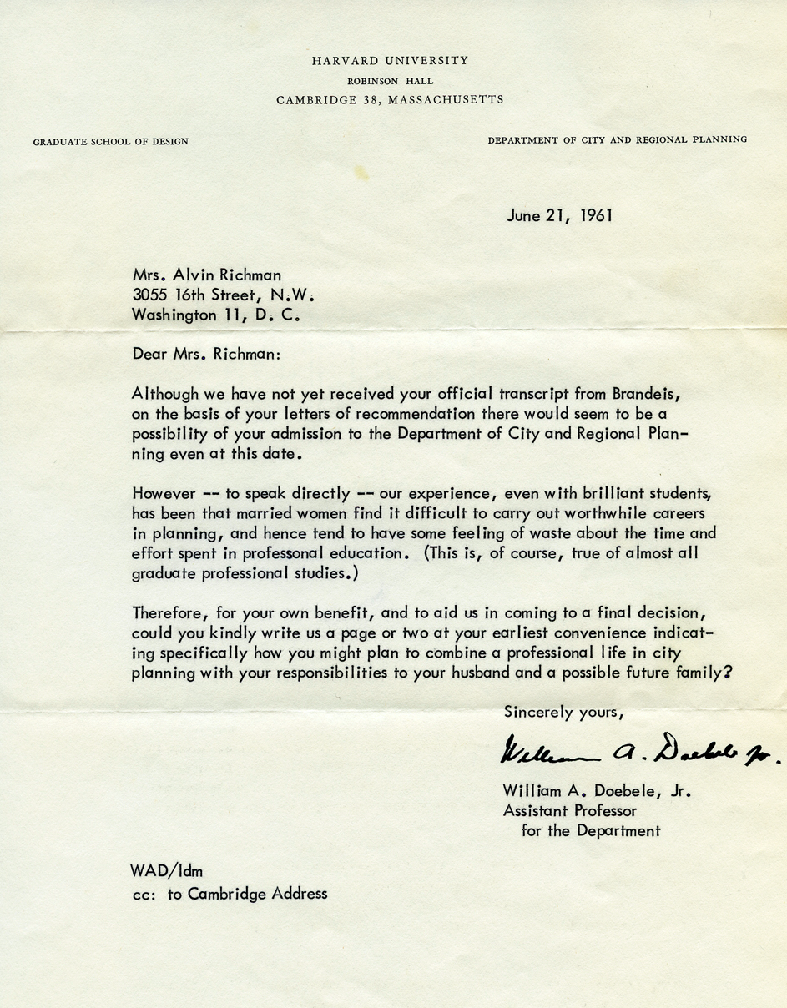

Slide 7
Slide from Abigail Stewart

Slide 8
Slide from Abigail Stewart
Today: I’ll focus on research into unconscious bias (implicit bias) and
some steps that can be taken to mitigate the bias.
I think we may agree that these steps are reasonable, even if we do
not agree that the bias exists and is doing damage.

Slide 9
A nod to explicit bias

Slide 10
Explicit Bias:
“She was a real hot ticket, and” – said with genuine surprise – “she was smart!”
“My female graduate students have it so much harder than the guys. They have to choose between career and family.”
“Men have better spatial and logical
skills and women have better emotional
skills.”

Slide 11
It is very likely that, with affirmative action and similar efforts,
many (but not all) women are getting tenure-track positions for which
they have no hope of achieving tenure. It is a crappy life anyway and yes,
family is far more important than tenure, so they should focus on that instead.
Tenure-track jobs have to be crappy and the tenure process has to be
soul-sucking for various reasons. Those women would be better off not
getting those jobs in the first place, as would the rest of us, because they
ruin the system with their selfish, misplaced priorities.
And then they want to change things rather than live with the
consequences of their choices.
They don't realize how important it is to beat
the other guys, how hard it is to claw your way to the top,
and the sacrifices that must be made in the name of a better life for all.
The world give thanks for the way things are, as gut-crushing as it is;
leave the women out of it.
- anonymous entry in Chronicle of Higher Education forum, August 2013

Slide 12
The Research
“We would like to believe that we publish and fund the best work
and hire the best people. But is there evidence to support this view?
In fact, experimental evidence shows
that we unintentionally apply deep cultural biases that distort
identification of “the best”. If we were able to overcome these biases,
would science be stronger?”
- Jo Handelsman, Yale University

Slide 13
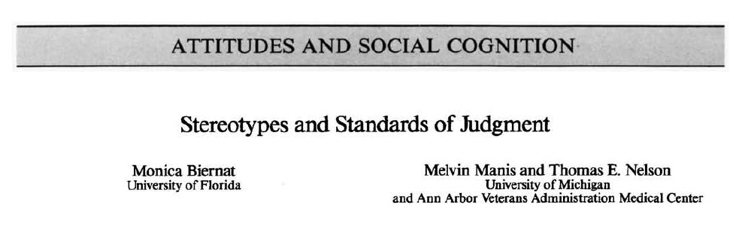
Researchers set out to explore:
What is the link between internal representations (schemas)
and overt assessments?

Slide 14
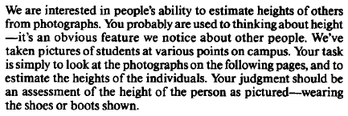
Subjects were shown 44 photos of men and women standing in
front of doorways, near chairs, and other standard-sized objects.
The men and women in the photos were matched for height,
22 women and 22 men, where for each 5’9” woman there was a 5’9’ man.
Each test subject was asked to judge all 44 photos.
Their instructions:
Some subjects were asked to list height in feet and inches
others were asked to rate on a subjective scale:
1 = short, 4 = average, 7 = tall

Slide 15
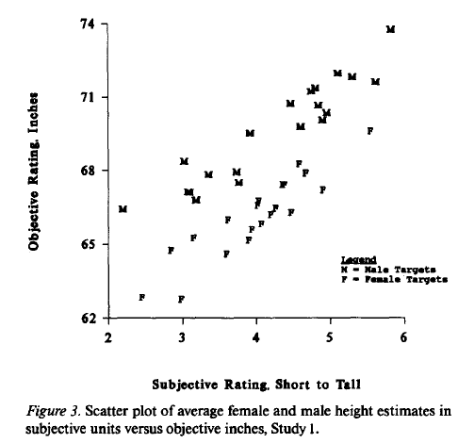

Slide 16
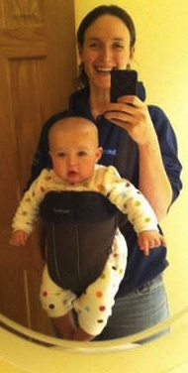
Impact of children on careers
She looks happy,
but she’s also
massively sleep-
deprived and
desperate for a
shower…
She looks so cute and
innocent, but she was
born with a plan, and
we all suffer when that
plan isn’t followed to
the letter…

Slide 17
Impact of children on careers
Women
Men
For identical application packages,
mothers:
rated less competent
rated less committed to paid work
less likely to be recommended
for hire, promotion, management
offered lower starting salaries
called back half as often as
non-mothers
For identical application packages,
fathers:
rated more committed to paid work
offered higher starting salaries
not disadvantaged in the hiring
process

Slide 18
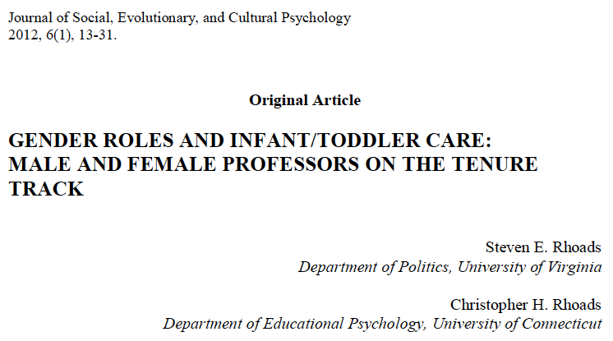
Parental Leave Policies
“While 69 percent of the women in the sample took post-birth parental leave, only 12 percent of the men took advantage of the available leave—even though it was paid. They also learned that the male professors who did so performed significantly less child care relative to their spouses. Worse yet, they report that male tenure-track professors may be abusing paternity leave by using the time to complete research or publish papers, an activity that enhances their careers while putting their female colleagues at a disadvantage. One female participant quoted in the study put it this way: “If women and men are both granted parental leaves and women recover/nurse/do primary care and men do some care and finish articles, there’s a problem.”

Slide 19
A department at a major research university had outside evaluators rate each of its faculty members
Analyzed ratings as a function of salary
a
University of X
Department of Molecular Genetics and Microbiology
2008

Slide 20
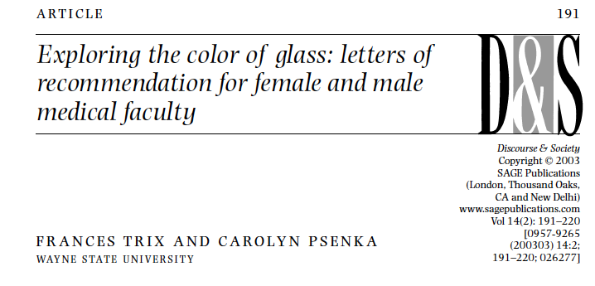
Letters of Recommendation
Examined letters of recommendation for 109 successful
job applicants for faculty positions in medical schools
at request of a large medical school
In 1991, Frances Conley resigned from Stanford Medical School
where she was the only woman in the neurosurgery department due to
“demeaning actions and words for 25 years”, prompting public scrutiny

Slide 21
Letters written 1992 – 1995
312 letters total
29% of the letters were written for women
12% of the letter-writers were women
Women Men
Average length of letters 227 words 246 words
Use of gender terms (lady, woman, 10% 5%
mother, wife, man, gentleman, father)
Use of doubt raisers (“irrelevant statements, 24% 10%
negative statements, hedges, faint praise”)
words “accomplishment” or “achievement” 3% 13%
use of grindstone adjectives like “dependable”, 34% 23%
“hard-working”, “thorough”

Slide 22
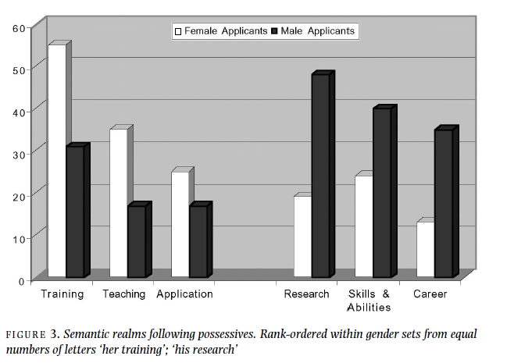
Women portrayed more as students and teachers,
men portrayed more as researchers and professionals.

Slide 23
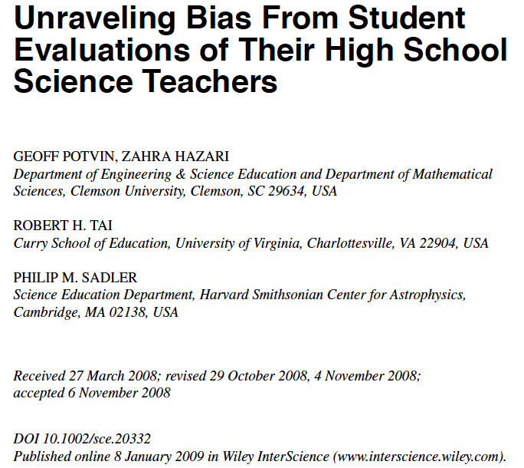
18,000 college students
majoring in physics,
chemistry or biology
Female teachers are rated significantly lower than male teachers by male
students in all three disciplines, whereas female students underrate female teachers only
in physics. Interestingly, physics is also the field that suffers the greatest lack of females
and has been criticized most for its androcentric culture. The gender bias in teacher ratings
persists even when accounting for academic performance, classroom experiences, and
family support. Furthermore, male and female teachers in each discipline appear equally
effective at preparing their students for future science study in college, suggesting that
students have a discipline-specific gender bias.

Slide 24
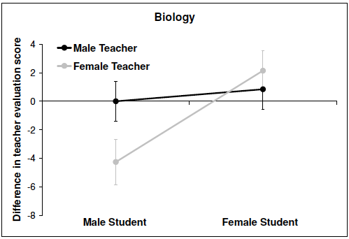
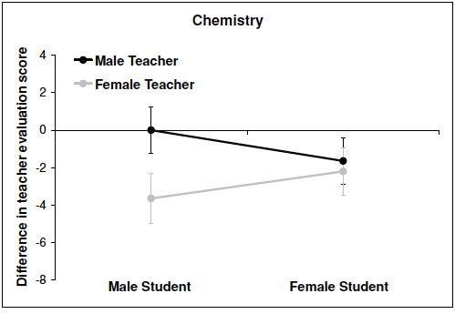
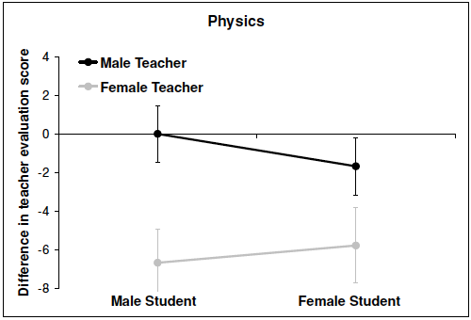

Slide 25

Graduate students were asked to rate the scientific quality of abstracts
in several categories. Men’s names and women’s names were assigned to
three categories of abstracts:
“gender neutral” topic abstracts
“female-typed” abstracts
“male-typed” abstracts
type-casting of abstracts done using work by Knobloch-Westerwick & Glynn, 2013

Slide 26
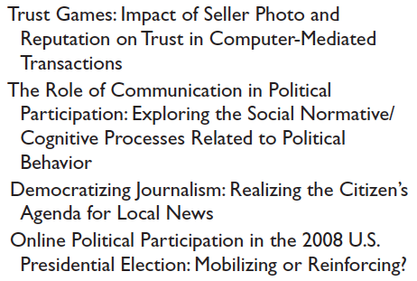
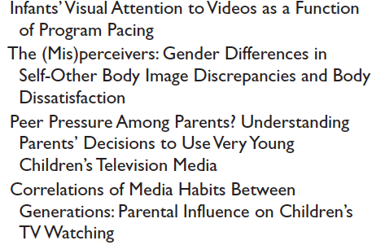
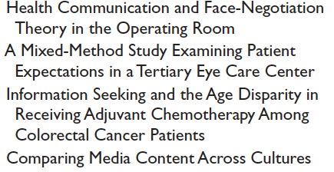
female-typed
male-typed
gender-neutral

Slide 27
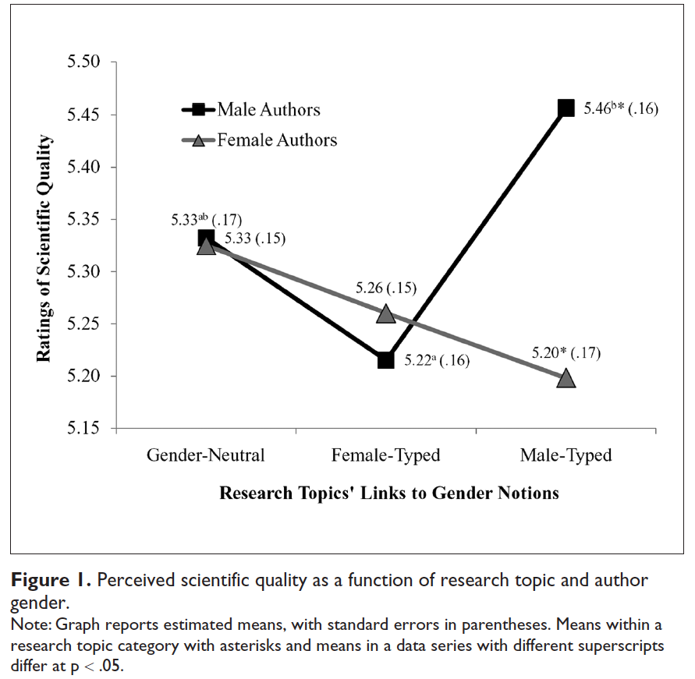

Slide 28

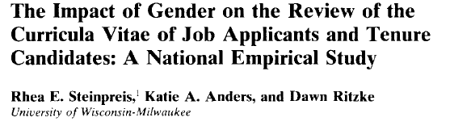
528 questionnaires were sent out to “academicians” listed in the
1997 American Psychological Association picked in random
fashion. Each person was sent one of four CVs:
1 (2): Job application, female (male) name, identical application
3 (4): Tenure packet, female (male) name, identical packet

Slide 29
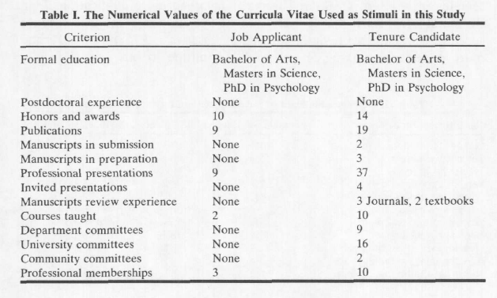
CVs from an actual person at time of
hire and when she went up for tenure
early (successfully)

Slide 30
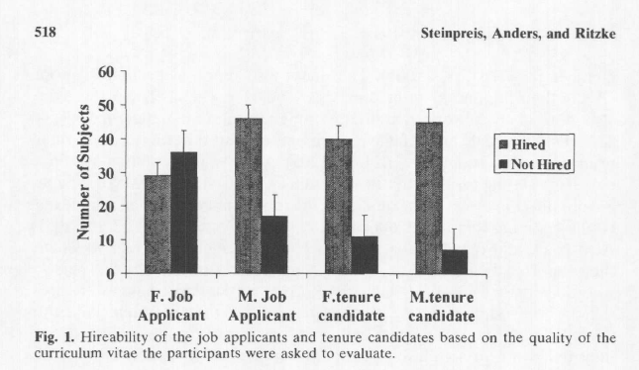
Q1: Would you hire this person?

Slide 31
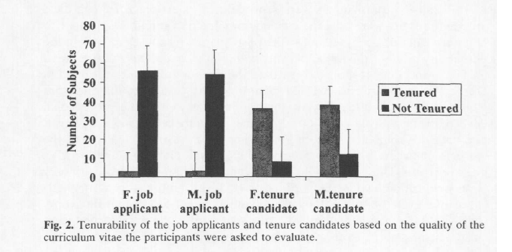
Q2: Would you give this person tenure?

Slide 32
But these studies are often done with undergraduates
or from inside the business world. They do not apply
to what happens today in particle physics, right?
As noted in Time Magazine this past December:
“Physics is a male-dominated field, and the assumption is
that a woman has to overcome hurdles and face down
biases that men don’t. But that just isn’t so.
Women in physics are familiar with this misconception
and acknowledge it mostly with jokes.”

Slide 33
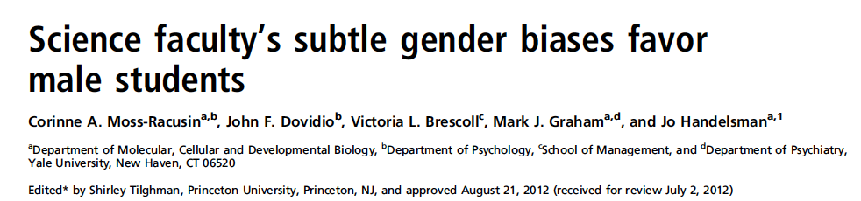
Identical application package with only one difference:
in some cases the name of the applicant was “John”
in other cases the name of the applicant was “Jennifer”

Slide 34
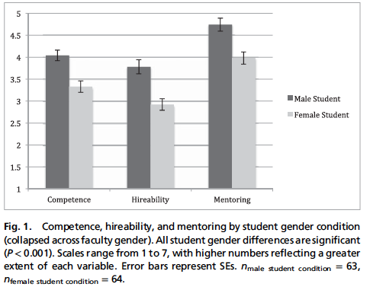

Slide 35
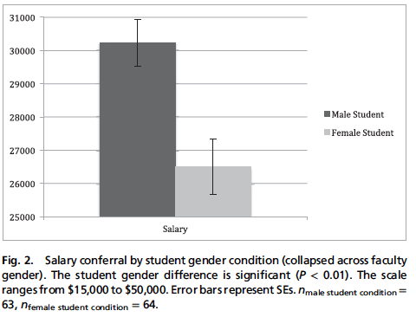
I know that the scale does not start at zero. ☺

Slide 36

What could explain this?
Science is robustly male-stereotyped

Slide 37
What, if anything, to do about all of this?

Slide 38
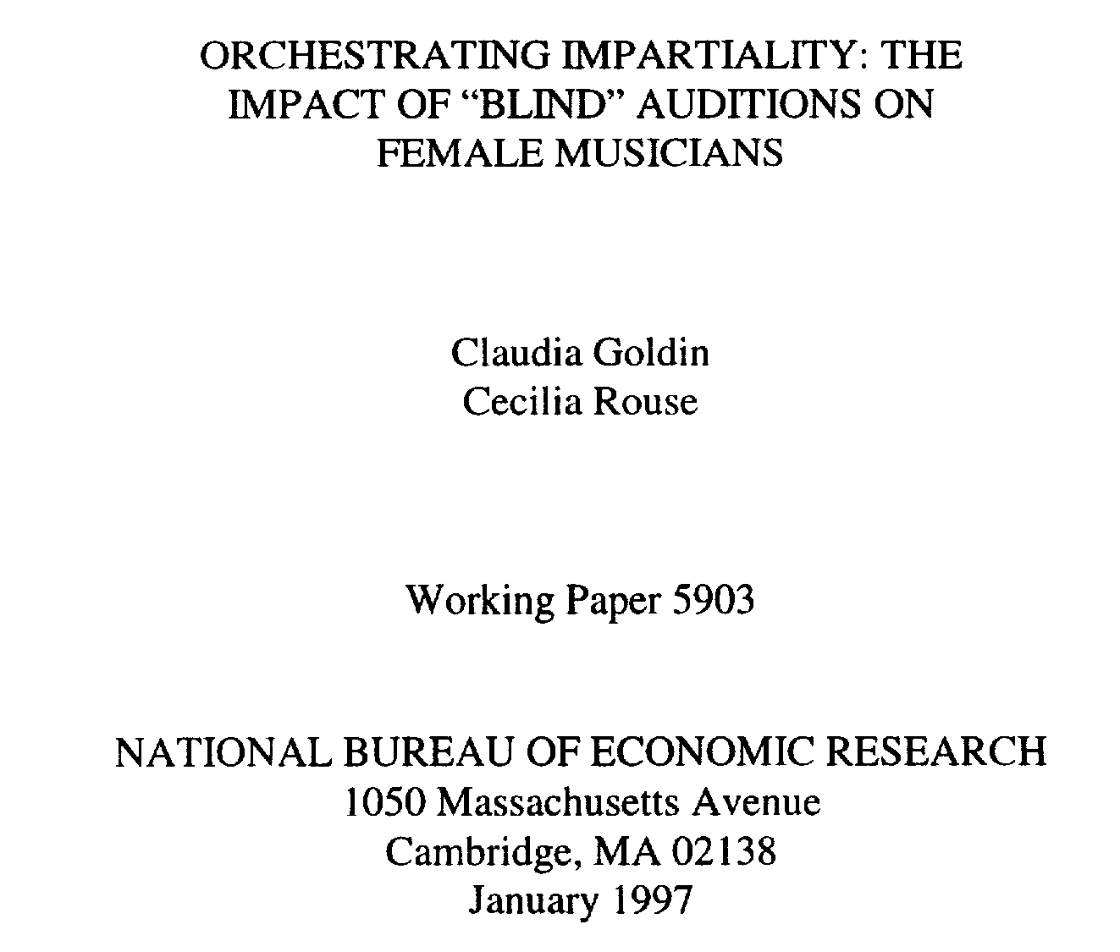
can’t realistically respond the way orchestras do, by
blinding their auditions, where it was found that blind
auditions increased the likelihood of women’s success by 50%

Slide 39
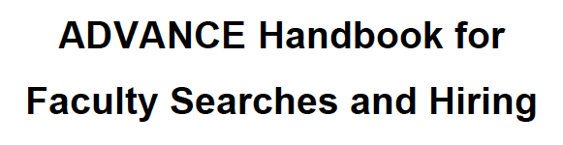
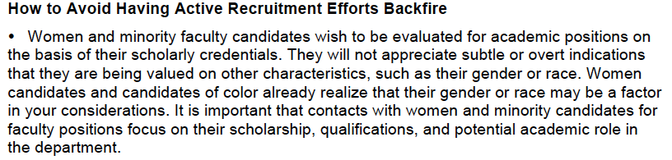
But there are a few plans out there!

Slide 40
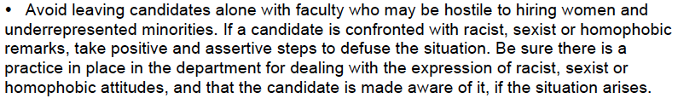
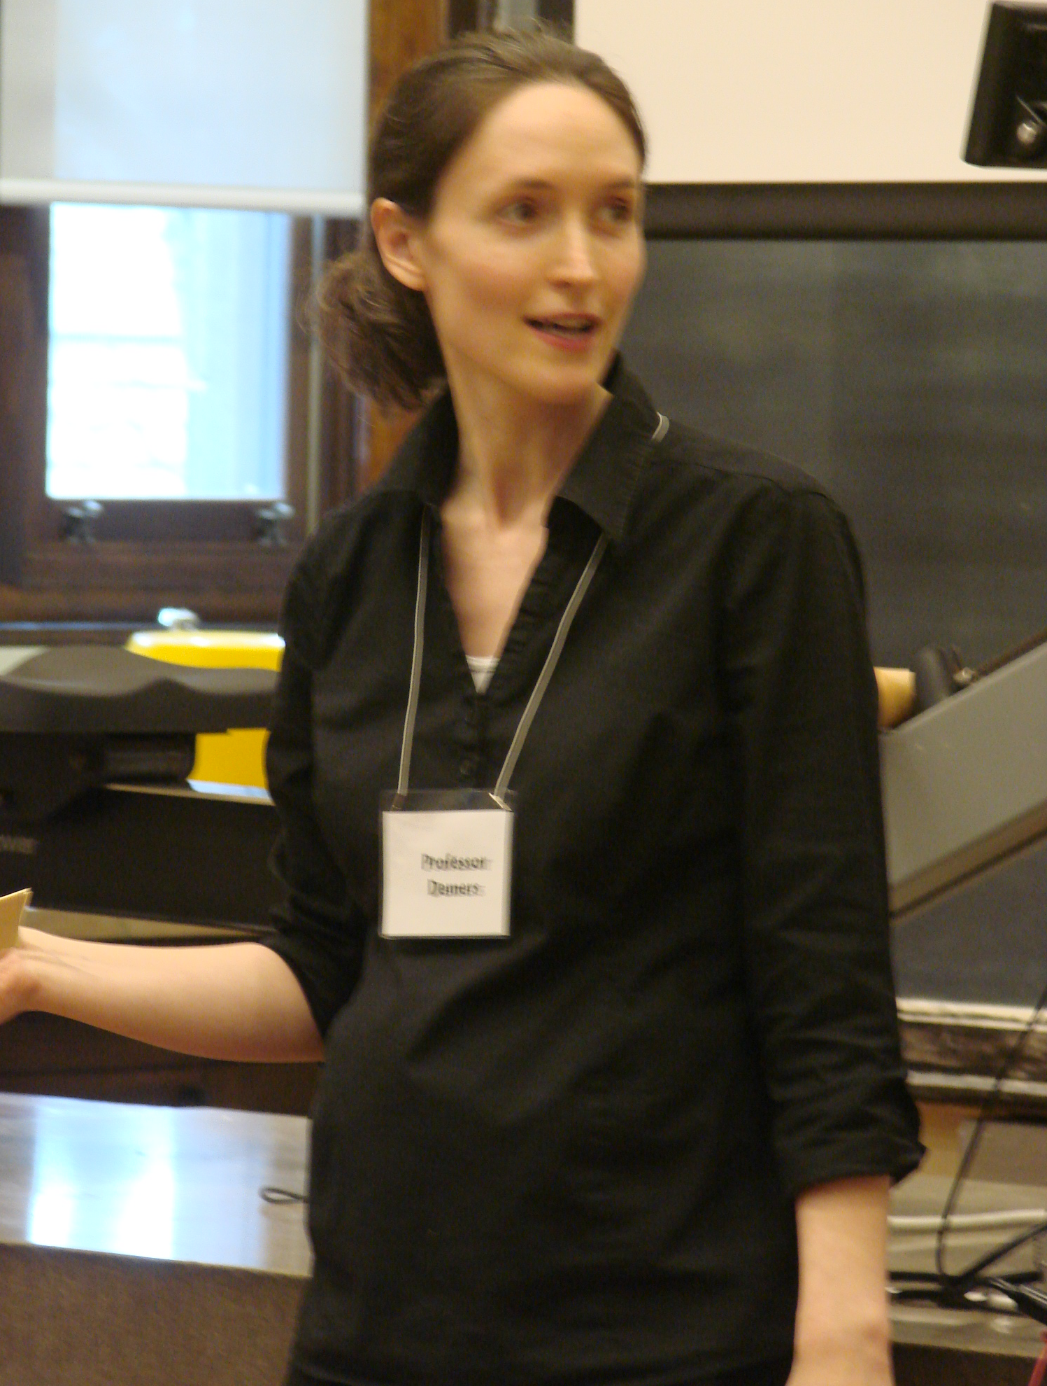

Slide 41

Research shows that we are capable of “unlearning” at least some
fraction of our implicit biases.
And playing tricks like defining the characteristics we are looking
for in advance helps reduce the amount of bias.

Slide 42
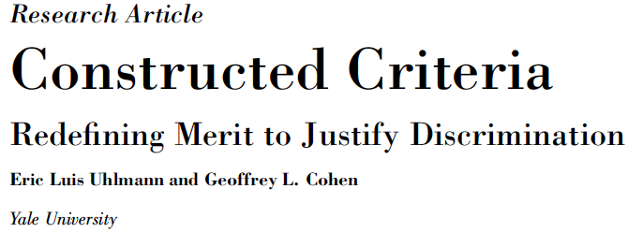
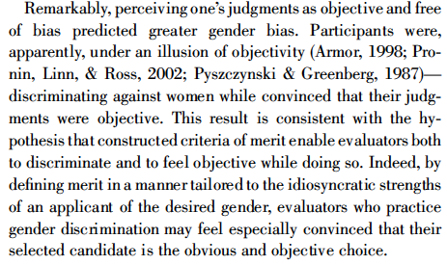

Slide 43
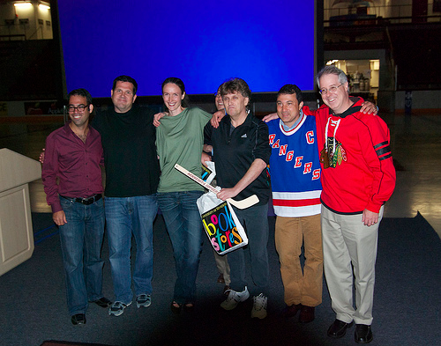
Consider avoiding the “token” woman in an applicant pool
Experiments have shown that increasing the relative pool
of women being evaluated leads to higher ratings for the
women: the critical mass effect.
Token Woman

Slide 44
Consider avoiding the “token” woman in an applicant pool
Experiments have shown that increasing the relative pool
of women being evaluated leads to higher ratings for the
women: the critical mass effect.
Token Woman
Token Theorist

Slide 45
Stereotype Threat

Slide 46
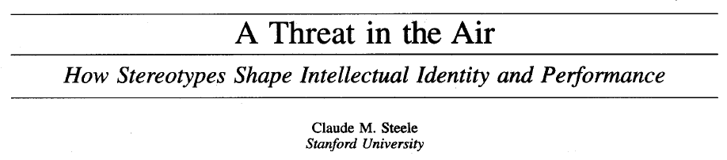
Benbow and Stanley (1980, 1983) suggested a genetic limitation
on women’s mathematics ability. Steele set out to test this, and
examine “stereotype threat” with a series of studies in 1997.
They recruited college sophomores who self-identified as strong math
students. The men and women had equal performance (within uncertainties)
on an excerpt of the math section of the general GRE. The men outperformed
the women on a challenging excerpt of the subject GRE.

Slide 47
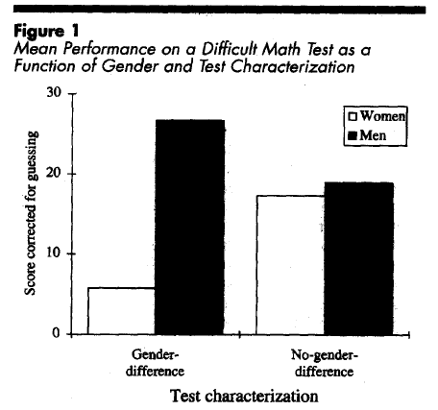
A follow-up study with the math subject test was done in two
circumstances. An announcement was written on the test
either that it showed gender differences (left) or that it was
gender neutral (right).

Slide 48
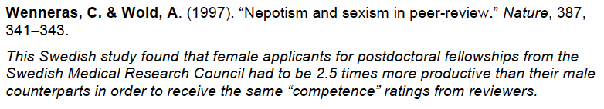
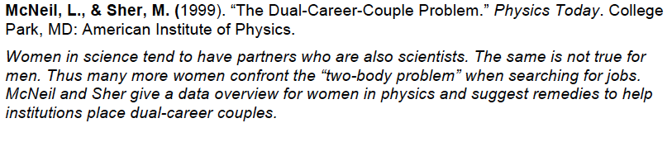
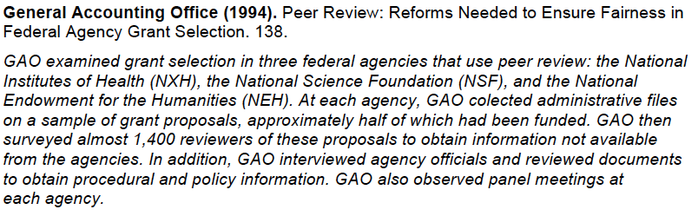
additional reading/research

Slide 49
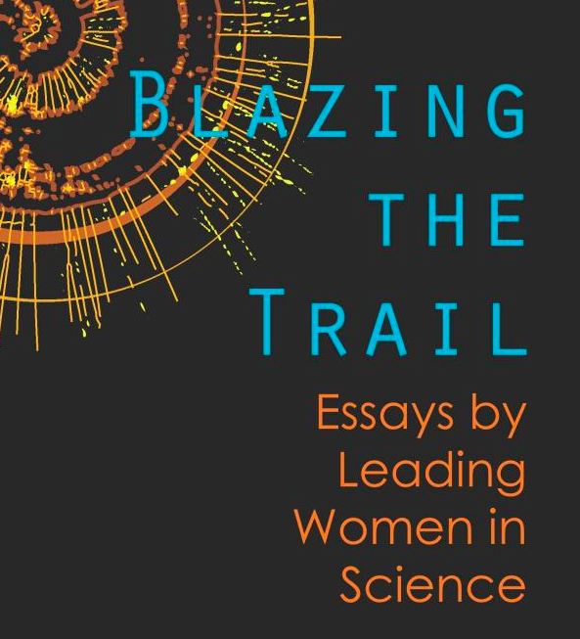
Additional recommended reading, a new book of 35 essays:
Blazing the Trail: Essays by Leading Women in Science
caveat: this book was co-edited by my graduate student
and includes a (very short!) essay by me. All proceeds of
book sales (which are minimal since the book was priced as close to “at cost” as
allowed by Amazon with the option of purchases by bookstores) are received
to the Yale Physics Department and used to buy copies of the book for
US Physics Departments
co-edited by Emma Ideal (Yale) and Rhiannon Meharchand (Los Alamos)

