Slide 1
Holographic Entanglement Entropy and Higher Spin Gravity
Nabil Iqbal
Kavli Institute for Theoretical Physics
In collaboration with Martin Ammon, Alejandra Castro
1306.4338

Slide 2
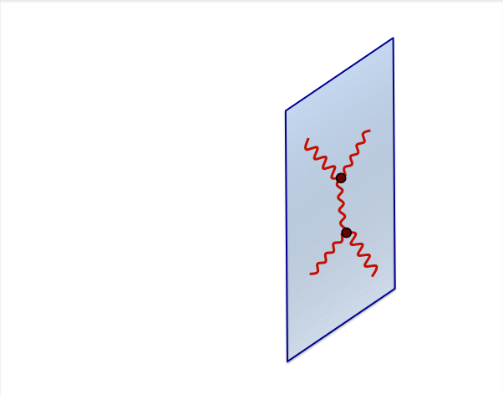
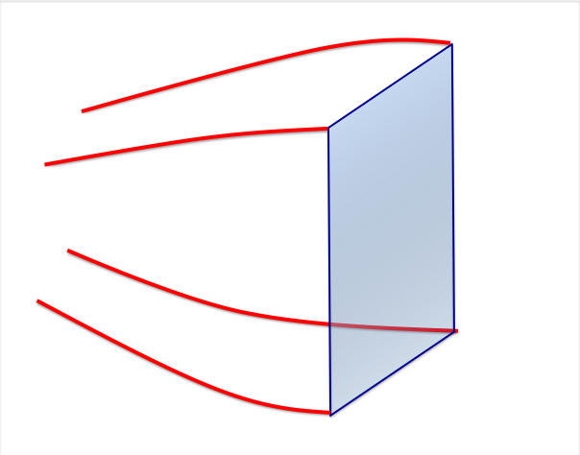
Holography
Some quantum field theories have holographic duals.
=
Certain quantum field theories
(e.g. famously N = 4 Super-Yang-Mills, a Conformal Field Theory)
Theories of gravity in one extra dimension
(e.g. IIB String Theory on AdS₅)
Both useful and profound: called holography, or gauge-gravity duality, or AdS/CFT.

Slide 3
What is geometry?
Fascinating consequence: in the era of holography, this is a question with many answers.
Because of holography, gravity and thus geometry can sometimes be viewed as an emergent phenomenon resulting from different microscopic degrees of freedom.
It is of interest to try to make these notions precise.

Slide 4
Entanglement entropy
As is turns out, we do have some clues.
Consider a general QFT_{d} in some state, and a spatial region A in it.
A
Construct the reduced density matrix by tracing out everything not in A.
The entanglement entropy is:

Slide 5
Entanglement entropy in pure states
In a pure state, this number measures the quantum entanglement between region A and its complement.
A
A
Dominant contribution then comes from short-range correlations: thus usually scales like area of boundary of A.
This area law breaks down in 1+1 CFT. Exact result is available in vacuum (Holzhey, Larsen, Wilczek; Calabrese, Cardy):

Slide 6
Entanglement entropy in mixed states
In a mixed state, this basically measures the “ordinary” entropy contained in A:
A
A
Now scales like the volume of A: we have for large regions
Again, exact result available in 1+1 CFT at finite T:

Slide 7
Holographic entanglement entropy
Consider a QFT with a “normal” gravity dual.
A
Ryu and Takayanagi proposed: the entanglement entropy is equal to the area of the bulk minimal surface ending on A:

Slide 8
Some examples
Focus on 1+1d, AdS₃ bulk: minimal surface is a spatial geodesic.
A
Vacuum: pure AdS₃ , find:
Thermal state: BTZ black
hole, find:
In 1+1d, precise expressions calculated from bulk agree with those from CFT.

Slide 9
Some thoughts:
The RT formula provides a direct connection between a geometric idea (minimal surfaces) and a field theoretical idea (quantum entanglement).
A
=
In some sense, we are building a dual geometry from entanglement (Raamsdonk, Swingle, ….).
Can we extend these ideas to situations where the notion of “geometry” in the bulk is less clear?

Slide 10
Higher Spin Gravity
Recently, there has been a great deal of interest in higher spin theories of gravity (Vasiliev; Klebanov, Polyakov; Sezgin, Sundell; Yin, Giombi; Gaberdiel, Gopakumar…).
These contain massless higher spin fields in addition to the graviton.
Just as string theory in the bulk is dual to gauge theory, higher spin theories in the bulk are thought to be dual to vector-like field theories (e.g. O(N) model).
In three bulk dimensions, there are theories containing spins up to any integer N.

Slide 11
Higher Spin Gravity
These theories have enlarged gauge redundancies that act nontrivially on the metric: they do not leave the geometry invariant.
For example, a black hole in one gauge can look like a traversable wormhole in another gauge, even though they describe the same physics (Ammon, Gutperle, Kraus, Perlmutter; Castro, Hijano, Lepage-Jutier, Maloney).
Our usual notion of geometry is no longer gauge-invariant.

Slide 12
Higher Spin Gravity and Entanglement
However, these theories are still dual to CFTs with a well-defined notion of entanglement.
A
Geodesics will not work: but can we find a bulk object that correctly calculates the entanglement entropy?
What is geometry in higher spin gravity?

Slide 13
Gravity on AdS₃
In three dimensions, gravity has no propagating degrees of freedom; matter does not curve space outside it.
Interestingly, on AdS₃ it still has black holes (Banados, Teitelboim, Zanelli).
There is a convenient language to talk about purely topological theories.

Slide 14
Chern-Simons Formulation of AdS₃ Gravity
Pure gravity in 3d can be described as a doubled Chern-Simons theory (Witten; Achucarro, Townsend).
For AdS₃ , gauge group is SL(2,R) x SL(2,R).
This presentation of gravity generalizes naturally to higher spin theories: we replace 2 with N.
Recover vielbein, spin connection, metric:

Slide 15
BTZ Black Holes in Chern-Simons Language
In this language, a black hole is characterized by a non-contractible φ cycle but a contractible Euclidean time cycle.
The holonomies around the φ cycle
are SL(2,R) matrices that count the charges (i.e. mass, angular momentum) of the black hole.
In this representation the existence of a “horizon” is not terribly obvious: one needs to compute the metric to see it.

Slide 16
Entanglement Entropy in Chern-Simons Formulation
Now I would like to reformulate the RT prescription in Chern-Simons language.
A
Equivalently: what is a geodesic in this formulation?
Seems clear we should think about Wilson lines in some representation R of SL(2,R).
What representation?

Slide 17
Highest Weight Representations of SL(2,R)
Consider the highest weight representations, defined by:
Generate a tower of states by
This forms a unitary, infinite-dimensional representation of SL(2,R).
Representation is labeled by the value of the Casimir:
This is constant for each rep; evaluated on the ground state, we see

Slide 18
Wilson Lines in the Highest Weight Rep
Claim: the appropriate representation for a massive particle is an infinite-dimensional highest weight representation of SL(2,R) (See Witten, Carlip for flat space version).
This rep is characterized by
In AdS/CFT context: these are the conformal dimensions of the dual operator.
In bulk: these are related to the mass and spin of the particle.

Slide 19
Calculating an infinite-dimensional trace
How do we take a trace in an infinite-dimensional representation?
To do this in a physics way: generate the representation as the Hilbert space of an auxiliary quantum mechanical model (Witten).
Find a quantum mechanical system
U(s) with the right global symmetry:
SL(2,R) x SL(2,R)
Have this system live on the worldline: couple it to external gauge fields.
Compute partition function of this gauged system (in practice, by saddle point).

Slide 20
Wilson lines and proper distances
It turns out: the Wilson line measures the geodesic distance between the endpoints.
A
If looped around a black hole, it measures the horizon length and thus the entropy. Thus this is equivalent to the RT formula.
Note: the actual trajectory taken in the bulk does not matter, as all connections are flat.

Slide 21
Recap
We have:
Reviewed formulation of AdS₃ gravity as a 3d Chern-Simons theory with gauge group SL(2,R).
Proposed a specific choice of Wilson line to be related to entanglement entropy, motivated by the idea of a massive particle moving in the bulk.
Told you that this computes proper distance, and so is equivalent to Ryu-Takayanagi prescription.
On to higher spin gravity…

Slide 22
Higher spin gravity in AdS₃ (on one slide)
Recall
Simple presentation of higher spin gravity in 3d: replace
Generically contains fields with spin up to N
We will focus on the simplest case, SL(3,R).

Slide 23
Black Holes in Higher Spin Gravity
Again, a black hole is characterized by a non-contractible φ cycle and a contractible Euclidean time cycle.
The holonomies around the φ cycle
are now SL(3,R) matrices: the black holes can now carry additional higher spin charges.
Higher spin gauge transformations act in a confusing way on these black holes: the horizon involves the metric and can be made to go away.
Our usual notions of geometry have become somewhat confused.

Slide 24
Generalizing the Geodesic
Note however that our previous construction of the Wilson line generalizes naturally:
Proposal: the Wilson line in a highest-weight representation of SL(3,R) is the generalization of the Ryu-Takayanagi formula to higher spin gravity.
Actually implements replica trick approach to computation of entanglement entropy (Lewkowycz, Maldacena).
In the rest of the talk we will discuss some applications of this proposal.

Slide 25
Some higher spin results
AdS₃ vacuum, BTZ black hole; anything living purely in SL(2,R):
Black holes with higher spin charge: exact expressions can be found.
?
Expected structure, but does coefficient match with the thermodynamic entropy?

Slide 26
A Controversy
At the moment, in the literature there are two different answers for the thermodynamic entropy.
“UCLA” Entropy
“Wald” Entropy
Gutperle, Kraus: bulk thermodynamics
Campoleoni et. al: metric formulation, Wald entropy
Kraus, Perlmutter; Hartman, Gaberdiel: CFT calculations (different algebra).
Perez, Tempo, Tronsoco; de Boer, Jottar; Compere, Jottar, Song: bulk thermodynamics.
Kraus, Ugajin: conical singularity
Our entanglement entropy proposal.
There appear to be multiple consistent notions of “energy”, hence different first laws. Our prescription does not know about any of this. Remains to be sorted out.

Slide 27
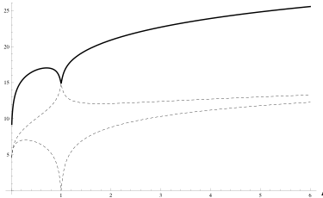
One More Example: RG flow
There is an RG flow solution that interpolates between two CFTs.
S[L]
L
On this solution, peculiar kink at intermediate length scales. Relatedly: violation of strong sub-additivity of entanglement entropy.
Why? The UV CFT is non-unitary. Nevertheless, somewhat perplexing.
Further calculations on related backgrounds are in progress.

Slide 28
Interpretation?
For Einstein theories of gravity, there is a simple way to geometrically interpret the entanglement entropy.
In higher spin theories of gravity, there is a bulk object which computes the same quantity. However it is still difficult to geometrically understand it.
?

Slide 29
Summary
In ordinary theories of gravity, the RT formula relates bulk geodesics to entanglement entropy.
We presented a reformulation of this prescription in the Chern-Simons formulation of 3d gravity.
We then generalized this to higher spin theories of gravity, where we proposed that this Wilson line computes entanglement entropy in the dual theory.
It remains to be seen what insights this gives into the emergence of geometry from field theory.
The End

Slide 30


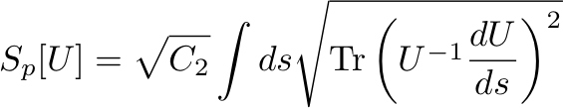
Calculating an infinite-dimensional trace
How do we take a trace in an infinite-dimensional representation?
To do this in a physics way: generate the representation as the Hilbert space of an auxiliary quantum mechanical model (Witten).
Consider a particle moving on the group manifold SL(2,R).
Has a natural action:
Global symmetries:
Hilbert space of this model transforms as the highest weight rep we want!

Slide 31
Calculating an infinite-dimensional trace
We now want to use it to take a trace on the Wilson line along
X^{γ}(s): have U live on this worldline, couple to gauge fields.
Now to find the trace: perform the path integral over U.
For an open Wilson line, must provide boundary conditions at endpoints: U(s_{i} ) = U(s_{f}) = 1.
In practice: evaluate by saddle point.

Slide 32
Holography
Some more details:
In case where the field theory is conformal, the dual bulk geometry is Anti-de Sitter space.
The geometry has a boundary; to calculate field-theory correlation functions, send waves in through boundary.
Finally, to put field theory at nonzero temperature: put a black hole in the bulk.

