Slide 1
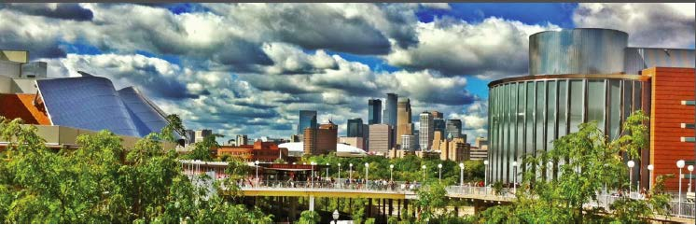
Possibilities for Neutrino Physics
B. Fleming
August 13, 2013
DPF 2013
News from Community Summer Study

Slide 2
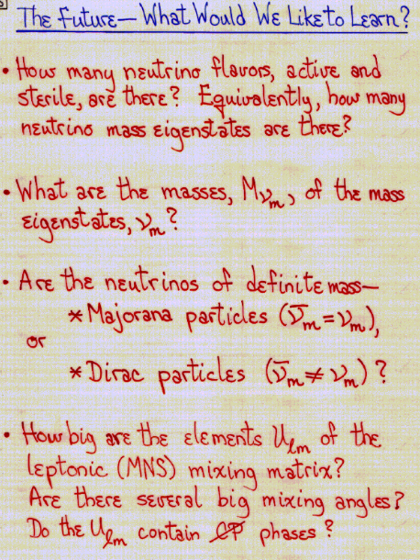
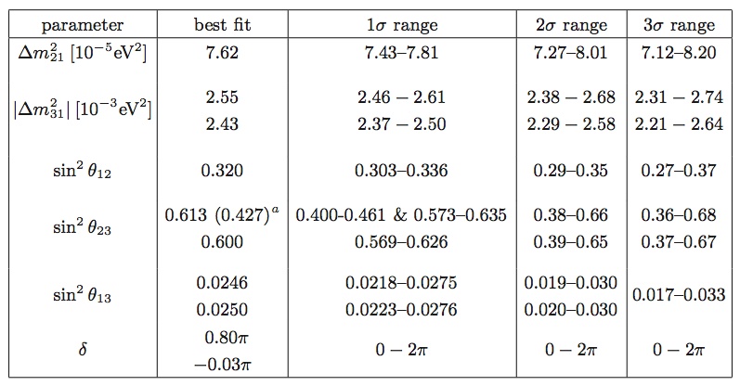
Snowmass 2001
neutrino summary
from Snowmass 2001
(Boris Kayser)
circa Snowmass 2013
(for example: arXiv:1205.4018)

Slide 3
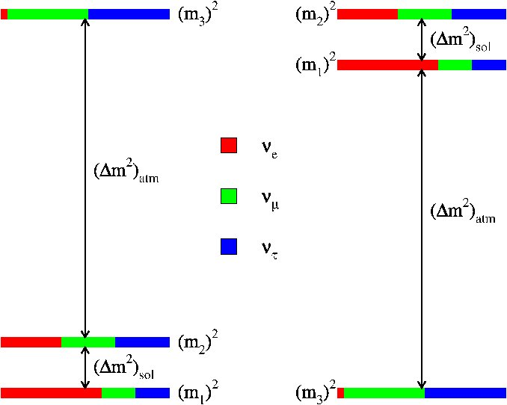
The big questions…..
- what is the absolute neutrino mass scale
- are neutrinos Majorana or Dirac?
- what is the neutrino mass ordering?
- is CP violated in the neutrino sector?
- to what extent does the 3ν paradigm describe nature?
- are there already hints of new physics in existing data?
- what new knowledge will neutrinos from astrophysical
sources bring?
we know this information for every other particle!
Neutrino smmary from Snowmass 2013
Hewitt/Weerts
Many talks at this DPF!

Slide 4
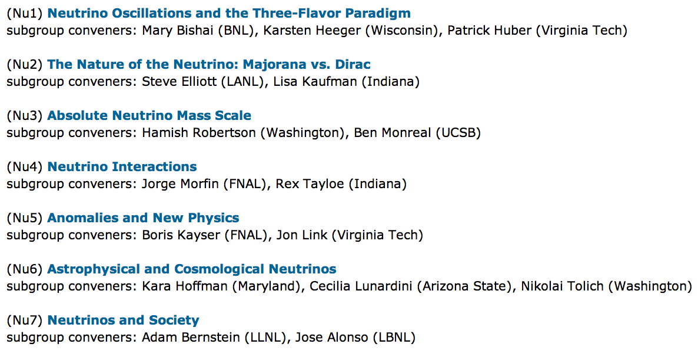
Neutrino Working Group
conveners: André de Gouvêa, Kevin Pitts, Kate Scholberg, Sam Zeller
subgroups and subgroup conveners:

Slide 5
Input From the Community
the response from the ν community has been overwhelming
three very successful neutrino working group meetings:
- Oct 24, 2011 at Fermilab, 120 participants
- Nov 30-Dec 2, 2011, Rockville, 145 ν WG participants
- March 6-7, 2013, SLAC, 97 participants
85 whitepapers received
draft of neutrino report is available on the Snowmass wiki
(http://if-neutrino.fnal.gov/snowmass/neutrinos-v2.0.pdf)
a lot of input!

Slide 6
Neutrino Sources
many sources ➔ many experimental opportunities
Too much to cover in one talk – my apologies for omissions!

Slide 7
Breadth in program
Breadth:
  Physics of neutrinos addressing some of the most compelling questions in particle physics
    About neutrinos
    About the Standard Model and the Universe
    Across traditional subfields
  Many different ways to address questions: source, size, technology
  Questions span understanding observed phenomena to looking for the unexpected
Big experiments, small experiments, different technologies, near term, longer term…
  Lots of opportunities to train young scientistists

Slide 8
The big questions…..
- what is the absolute neutrino mass scale
- are neutrinos Majorana or Dirac?
- what is the neutrino mass ordering?
- is CP violated in the neutrino sector?
- to what extent does the 3ν paradigm describe nature?
- are there already hints of new physics in existing data?
- what new knowledge will neutrinos from astrophysical
sources bring?
we know this information for every other particle!

Slide 9
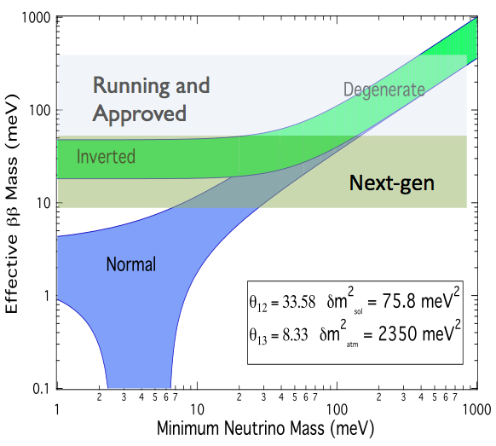
The Nature of the Neutrino
Goals for Next Generation 0νββ
next generation 0νββ
experiments must
cover the entire allowed
region of the inverted
hierarchy
also allows us to pick
a technology for the
future
ideas for probing the
normal hierarchy exist
(Lisa Kaufman)

Slide 10
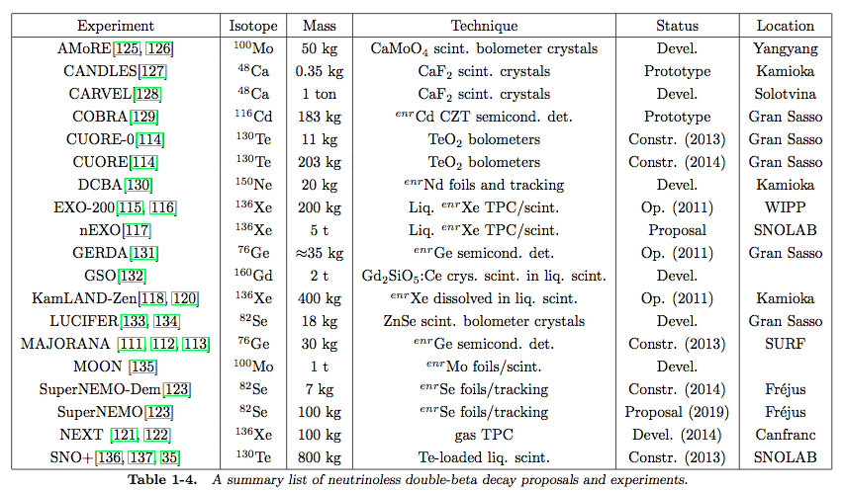
0νββ Experiments and Proposals
multiple isotopes and several complementary experiments
are needed for confirmation of a signal
significant overlap in technologies/facilities with DM community

Slide 11
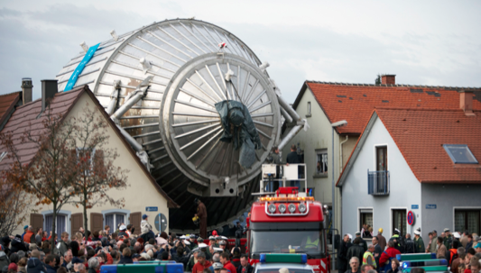
Neutrino Mass
understanding of absolute neutrino mass is vital for
a complete picture of fundamental particle masses, and is
crucial information for cosmology and theories of flavor.
the next generation of
tritium-beta-decay
experiments will directly
probe neutrino masses
a factor of 10 smaller
the best current bounds;
innovative new ideas
may help to go beyond this level of sensitivity

Slide 12
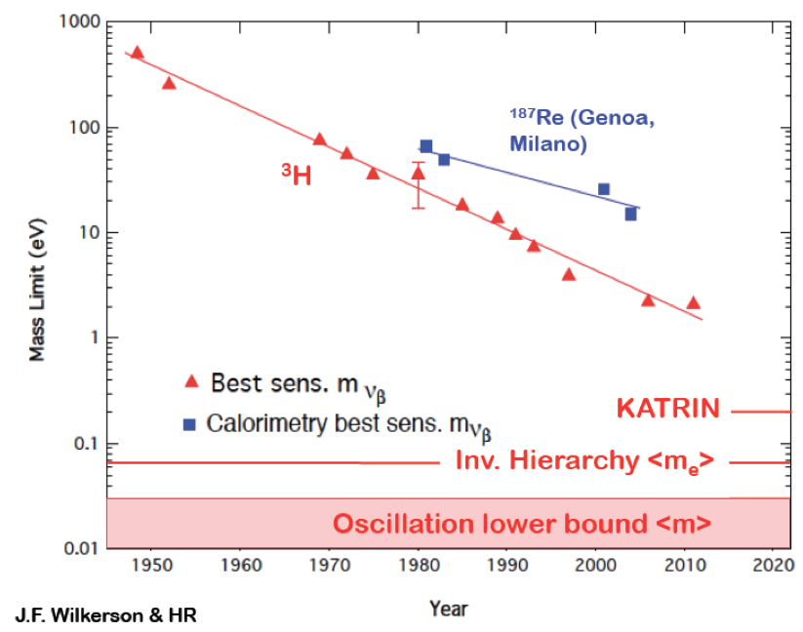
Direct Neutrino Mass Measurements
have been
doing this
since the
1950’s
where we
are headed
(Hamish Robertson)

Slide 13
The big questions…..
- what is the absolute neutrino mass scale
- are neutrinos Majorana or Dirac?
- what is the neutrino mass ordering?
- is CP violated in the neutrino sector?
- to what extent does the 3ν paradigm describe nature?
- are there already hints of new physics in existing data?
- what new knowledge will neutrinos from astrophysical
sources bring?
we know this information for every other particle!

Slide 14
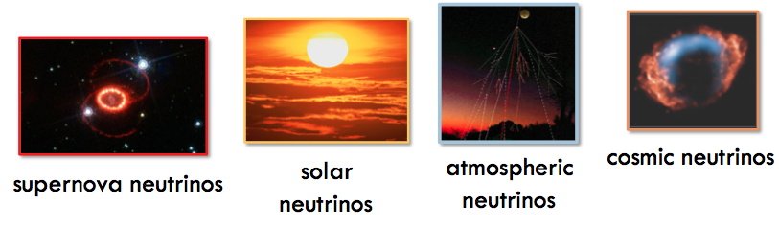
Astrophysical Neutrinos
Neutrinos come from natural sources as close as the Earth and
Sun, to as far away as distant galaxies, and even as remnants
from the Big Bang. They range in kinetic energy from less than
one meV to greater than one PeV, and can be used to study
properties of the astrophysical sources they come from, the
nature of neutrinos themselves, and cosmology.
low energy
high energy

Slide 15
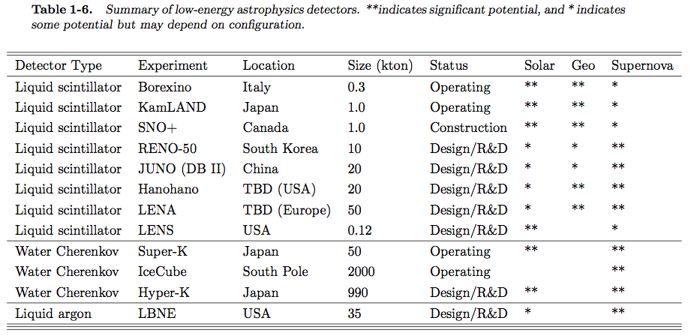
Low Energy Astrophysical Neutrino Detectors

Slide 16
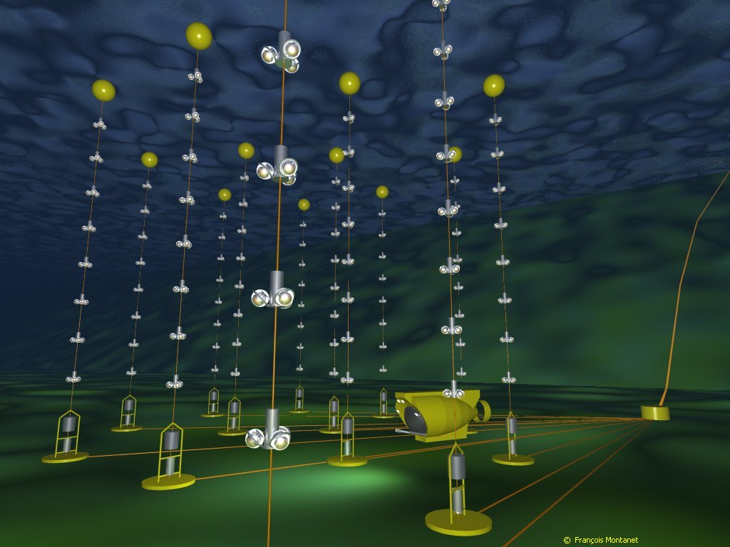
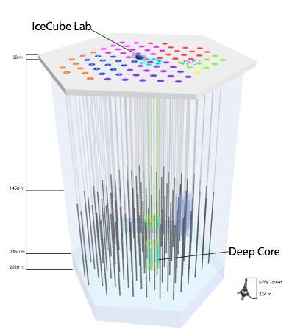
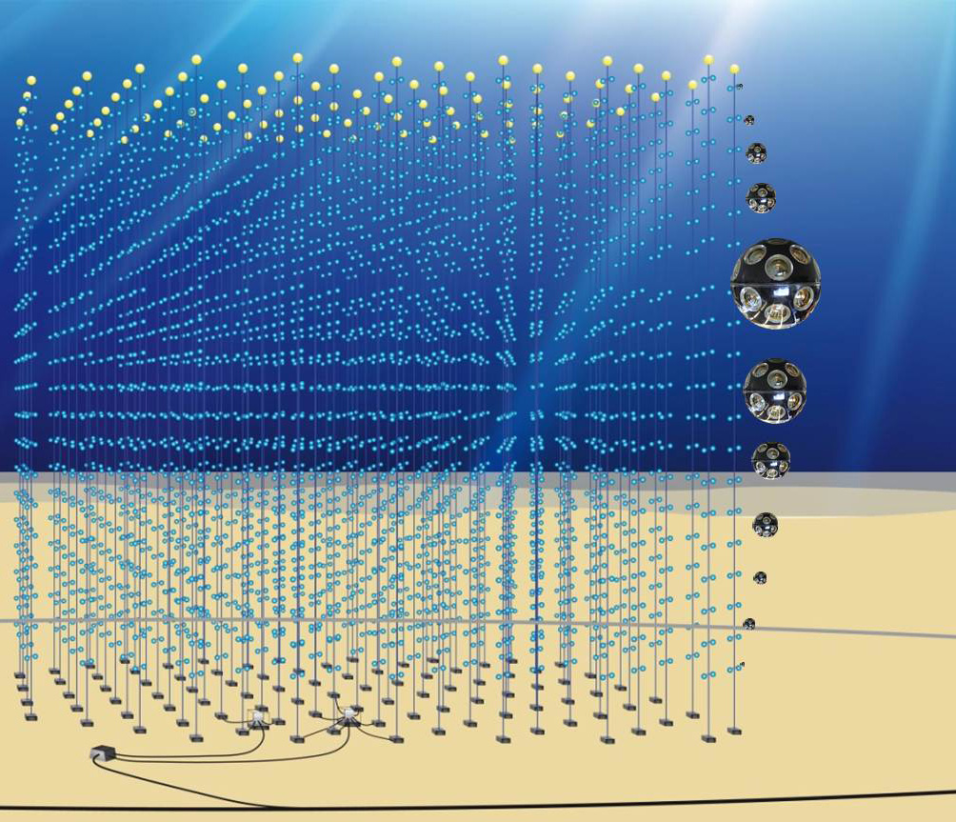
High Energy Astrophysical Neutrino Detectors
ANTARES
IceCube/PINGU
KM3NeT
See talks 8/16: Whitehorn/Williams

Slide 17
The big questions….
- what is the absolute neutrino mass scale
- are neutrinos Majorana or Dirac?
- what is the neutrino mass ordering?
- is CP violated in the neutrino sector?
- to what extent does the 3ν paradigm describe nature?
- are there already hints of new physics in existing data?
- what new knowledge will neutrinos from astrophysical
sources bring?
we know this information for every other particle!

Slide 18
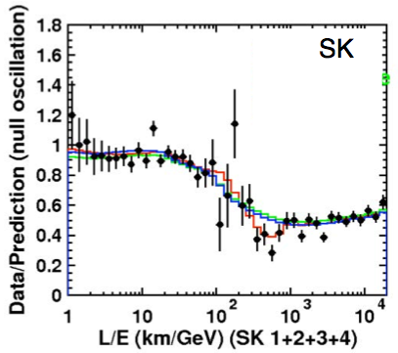
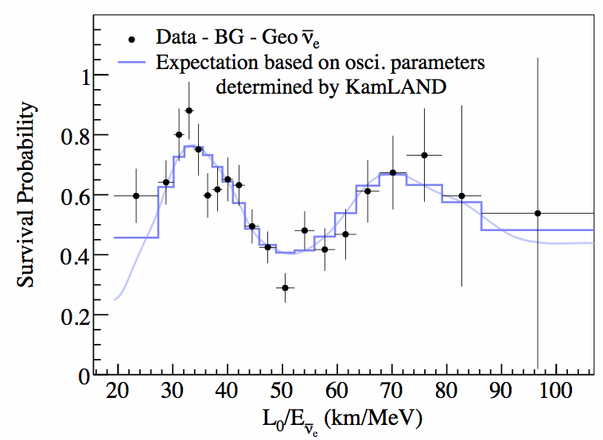
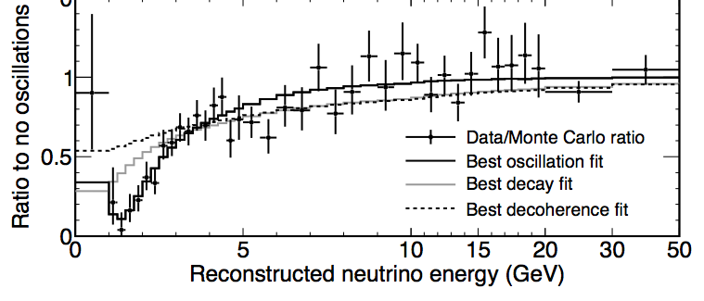
Neutrino Oscillations
we have made a lot of progress …
Super-K
atmospheric ν’s
experiments with solar, atmospheric,
accelerator, and reactor ν’s have
clearly demonstrated that ν’s oscillate
we see the characteristic L/E pattern
with multiple sources & experiments
KAMLAND
reactor ν’s
MINOS
accelerator ν’s

Slide 19
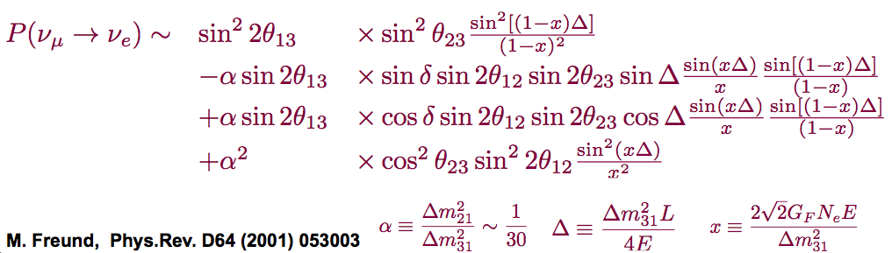
3-Flavor Mixing Picture
probability of ν_{μ} ν_{e} (and ν_{μ} ν_{e}) over long distances:
- δ_{CP} and CP violation
(appears in combination with sin2θ₁₃, sin2θ₁₂, sin2θ₂₃)
- neutrino mass hierarchy (through matter effects)
- θ₂₃ octant (which tells us about the nature of ν₃)
gives a measure of several very important things:
effects
are all
entangled

Slide 20
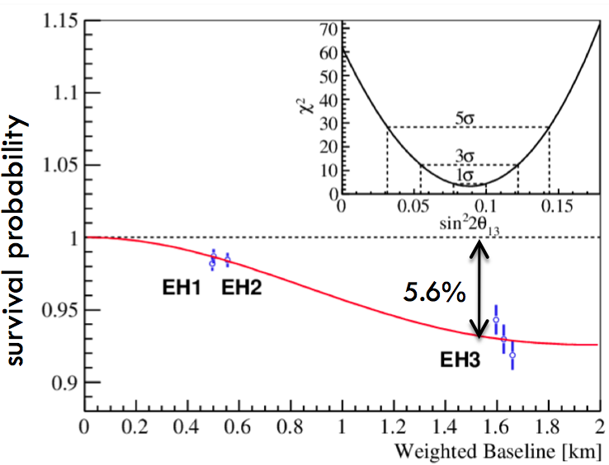
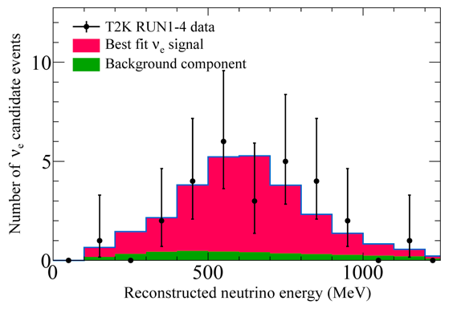
Precision Era
we are entering an era of precision neutrino physics
the very successful measurement of the smallest mixing angle
(θ₁₃) has also recently provided some important clarity
we know where we want to go
See talk 8/16:
Worchester
Daya Bay: ν_{e} disappearance
T2K: ν_{e} appearance

Slide 21
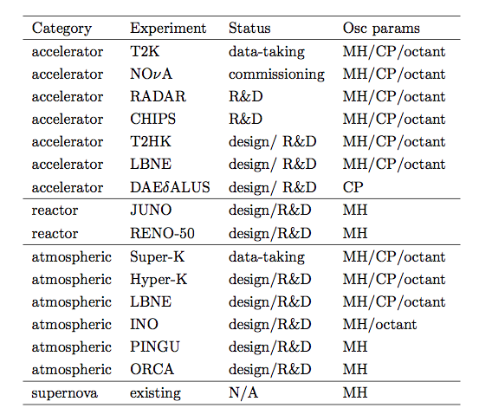
Many experiments measuring neutrino oscillations – running, in planning, in proposal stage

Slide 22
Many experiments measuring neutrino oscillations – running, in planning, in proposal stage
Experiments I’ll focus on -> US based LBL program

Slide 23
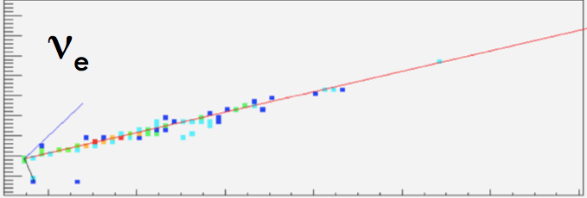
NOvA
See talks 8/16:
Bian
Sachedev
Baird
2nd generation long-baseline ν oscillation experiment coming online soon
will study ν_{μ} ν_{e} add
ν_{μ} ν_{e} transitions over
a distance of 810 km using
an off-axis, narrow beam
world’s most intense accelerator
based ν beam (700 kW)
close to the U.S./Canada border
810 km
Notes:
One of the flagships of the U.S.-based neutrino program. Can achieve an order of magnitude improvement over MINOS.
Upgraded beam from 350 kW to 700 kW.

Slide 24
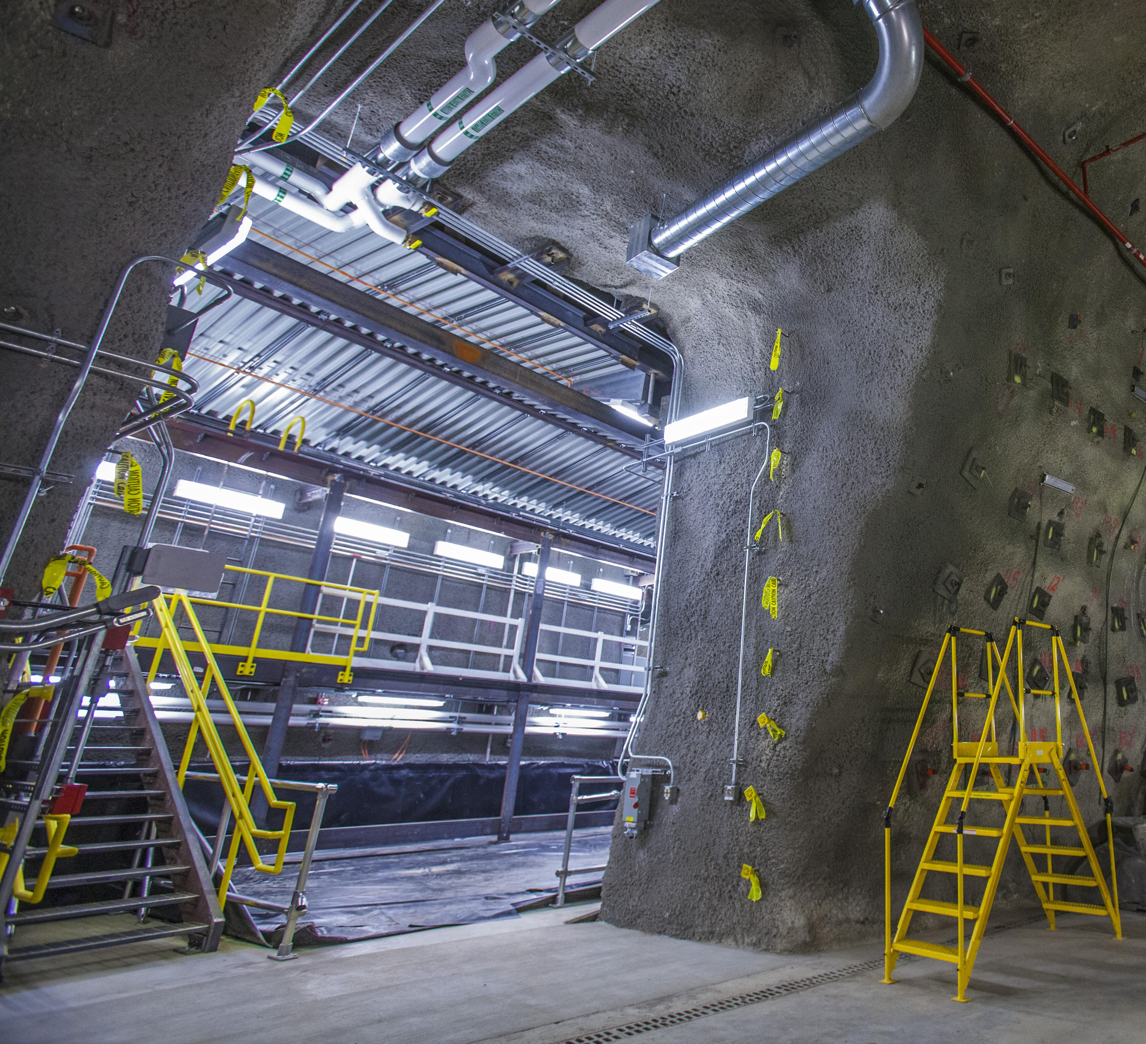
Near Detector
NOvA near detector
cavern completed
near detector assembly
starts this month
goal: ½ of near detector
complete by end of year
NOvA near detector cavern
MINOS Tunnel
Notes:
.

Slide 25
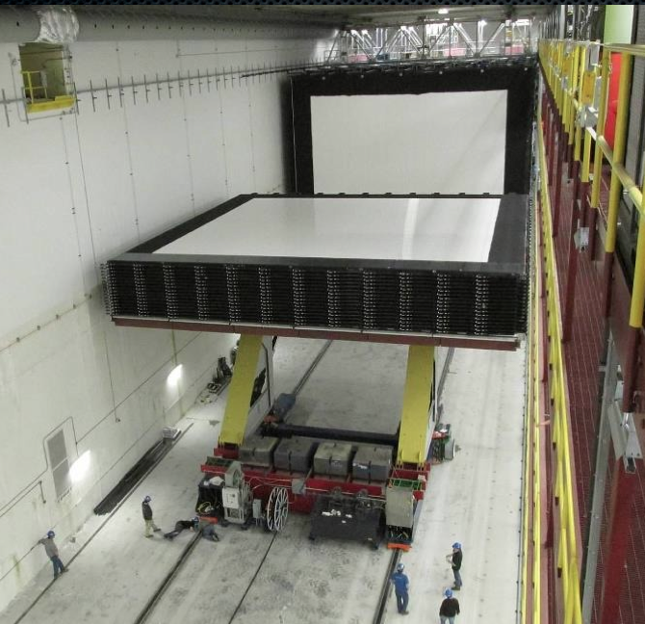
Far Detector
site at Ash River was
completed last year
NOvA is in steady production
mode getting this detector
built
- 54% of the blocks
have been installed
- 33% of the detector
has been filled
- 1.4 kton instrumented
(status as of June 24, 2013)
Notes:
They fill about a ½ a kton every 2 weeks.
The size of the detector that is currently instrumented catches about 1,000 cosmic rays per second.

Slide 26
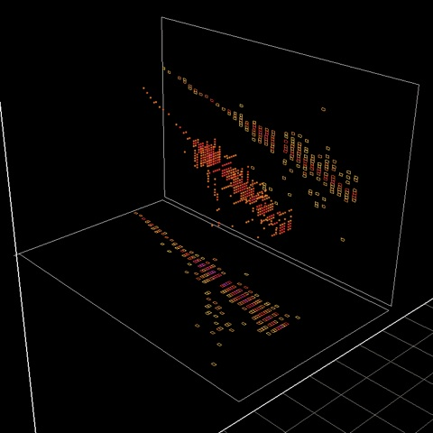
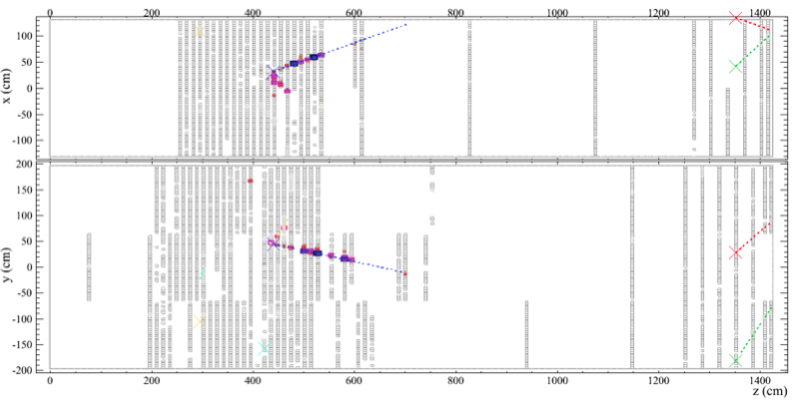
Ready for Neutrino Beam!
3D image of a cosmic ray in instrumented
portion of the NOvA far detector
(M. Betancourt)
also, extracting 1st physics from the
Near Detector On Surface (NDOS)
(March 28, 2013)
Notes:
.

Slide 27
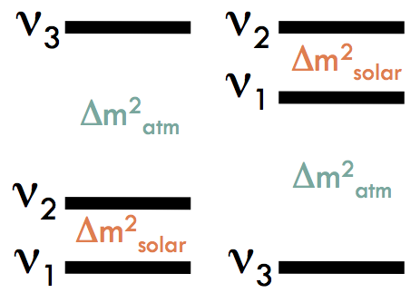
NOvA ν_{e} Appearance
resolving the neutrino mass hierarchy
will get the world’s
best look at this
in a hurry
NOvA
Notes:
MH = a long standing question. This is the first time this is possible since are sending neutrinos across large enough distances where we hope this will be observable.
This data is highly anticipated..

Slide 28
NOvA ν_{e} Appearance
resolving the neutrino mass hierarchy
will get the world’s
best look at this
in a hurry
T2K data is very
important in
combination!
NOvA + T2K
also, some new ideas for measuring this with atmospheric & reactor ν’s
Notes:
Differences in baselines/matter effects between NOvA and T2K can provide additional information.

Slide 29
NOvA ν_{e} Appearance
may even get a
first glimpse at
CP if we’re lucky
while new data from both NOvA and T2K are highly anticipated, we
know it will be difficult discover CP with current generation experiments
Notes:
.

Slide 30
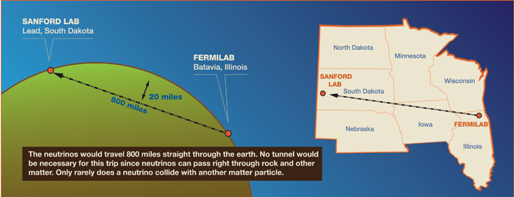
LBNE: Long Baseline Neutrino Experiment
New neutrino beam at FNAL
  700 kW, 60-120 GeV proton beam
  2.3 MW capable
Near detector for neutrinos
34 kton far detector at 1300 km baseline (at Sanford Underground Research Facility, SURF)
  Ultimately positioned underground with 4850’ overburden
See talks 8/15:
Guardincerri
Bass

Slide 31
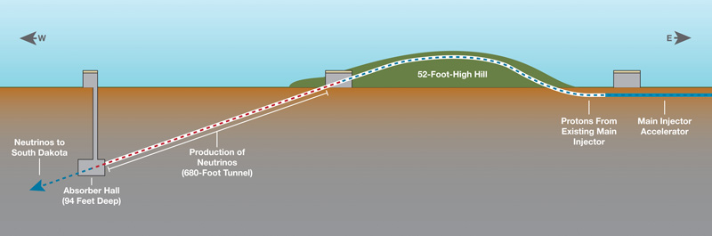
Ingredients For Success
Wide Band Beam
  We know how to build this, based on past experience
  Beamline also capable of handling higher power (2.3 MW)
Baseline
  We know how to send neutrinos long distances (e.g., MINOS, NOvA)
  Many detailed studies show that 1300 km (~800 miles) is optimal for this physics
Detector
  Liquid Argon time projection chamber (LArTPC)
    High signal efficiency, low backgrounds
  Successfully built and operated on small scales
  Now working to demonstrate that it can be done at the massive scale needed for LBNE
Above ground target area with beam pointing towards SD
Notes:
Detector specifically chosen for its superior capabilities

Slide 32
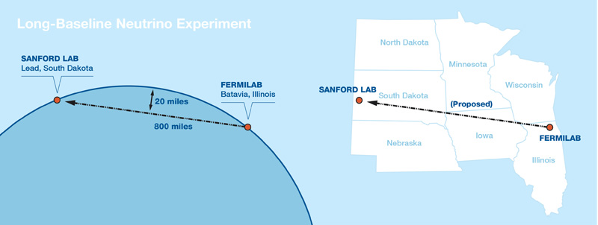
Ingredients For Success
Beam
  We know how to build this, based on past experience
  Beamline also capable of handling higher power (2.3 MW)
Baseline
  We know how to send neutrinos long distances (e.g., MINOS, NOvA)
  Many detailed studies show that 1300 km (~800 miles) is optimal for this physics
Detector
  Liquid Argon time projection chamber (LArTPC)
    High signal efficiency, low backgrounds
  Successfully built and operated on small scales
  Now working to demonstrate that it can be done at the massive scale needed for LBNE
Notes:
Detector specifically chosen for its superior capabilities

Slide 33
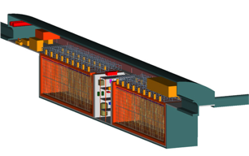
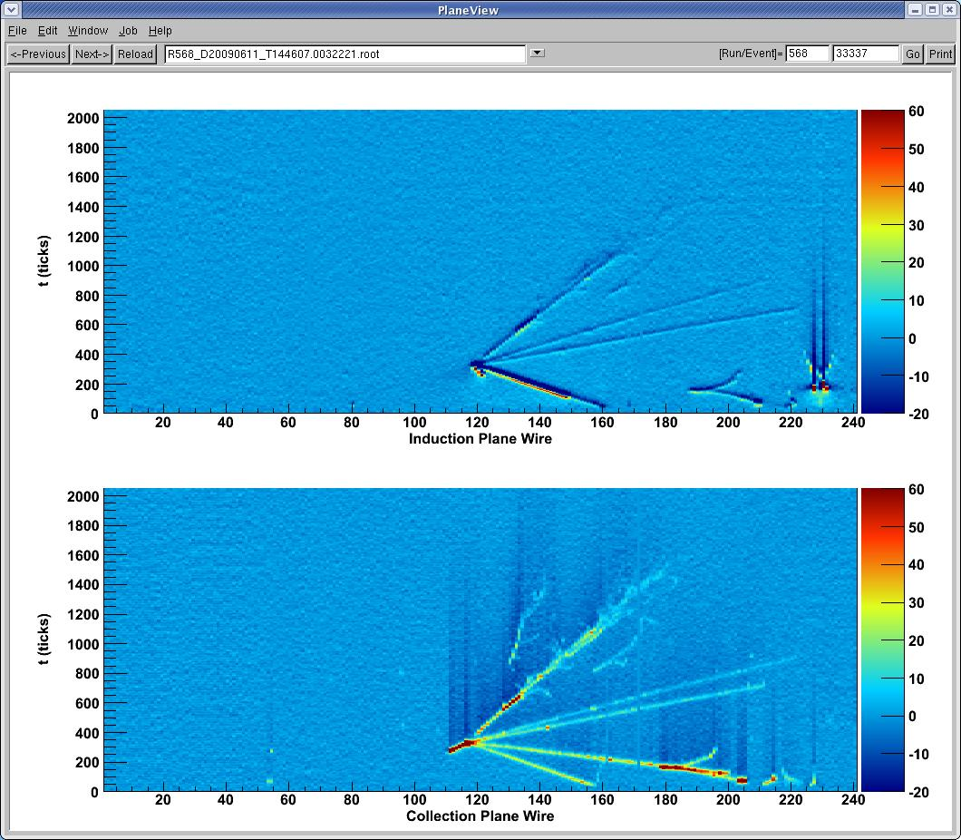
Ingredients For Success
Beam
  We know how to build this, based on past experience
  Beamline also capable of handling higher power (2.3 MW)
Baseline
  We know how to send neutrinos long distances (e.g., MINOS, NOvA)
  Many detailed studies show that 1300 km (~800 miles) is optimal for this physics
Detector
  Liquid Argon time projection chamber (LArTPC)
    High signal efficiency, low backgrounds, excellent resolution
  Successfully built and operated on small scales
  Now working to demonstrate that it can be done at the massive scale needed for LBNE
ArgoNeuT data
34kt LArTPC
Notes:
Detector specifically chosen for its superior capabilities

Slide 34
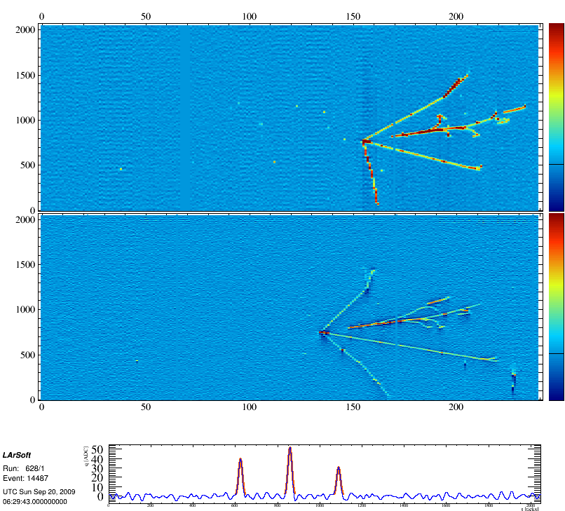
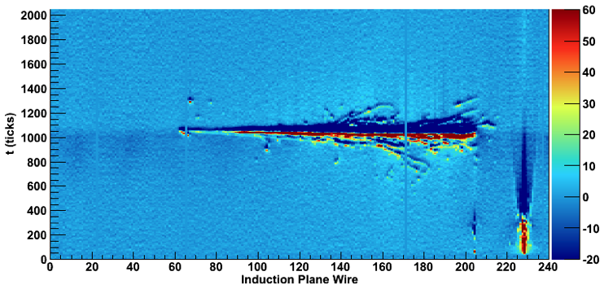
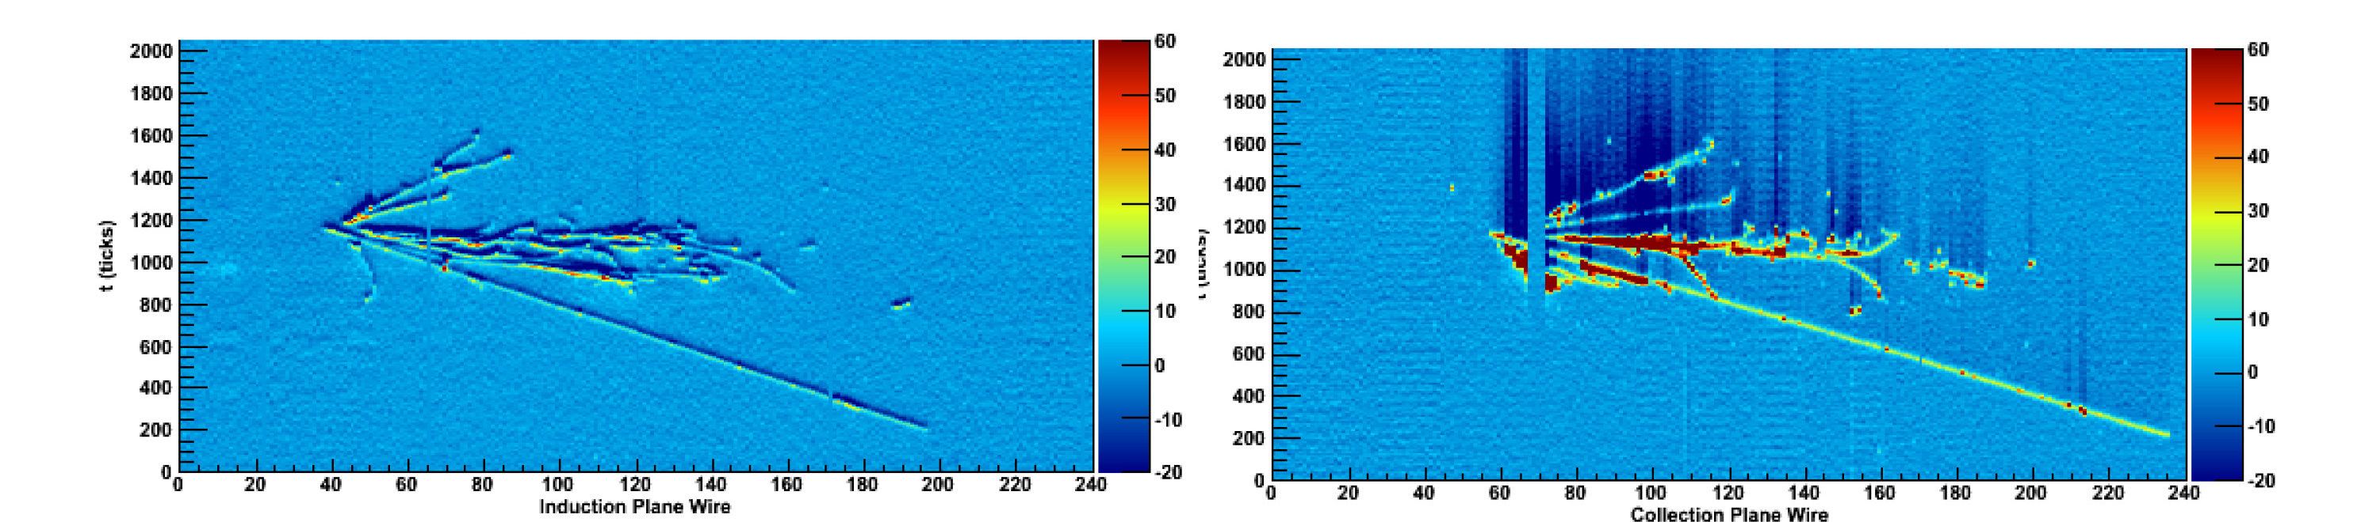
neutrino
Neutrino interactions in LArTPCs
(in ArgoNeuT)

Slide 35
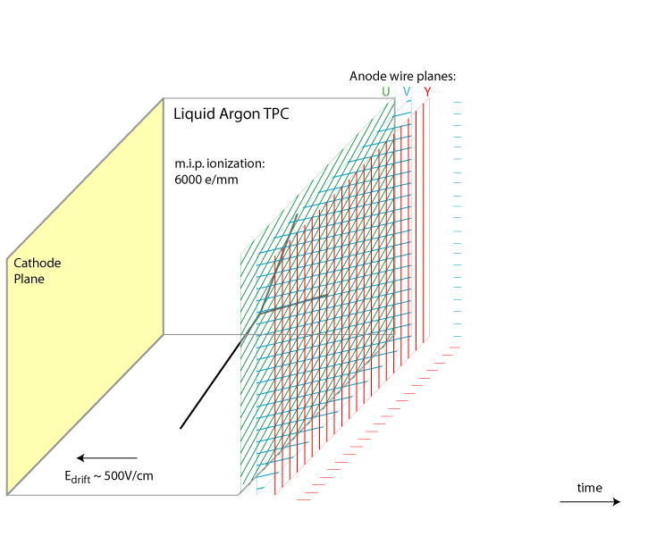
Liquid Argon Time Projection Chambers
Passing charged particles ionize Argon
Electric fields drift electrons meters to wire chamber planes
Induction/Collection planes image charge, record dE/dx
<- 500 V/cm
Need very pure argon, and low noise electronics, also want to collect
The scintillation light produced – cryogenic PMTs

Slide 36
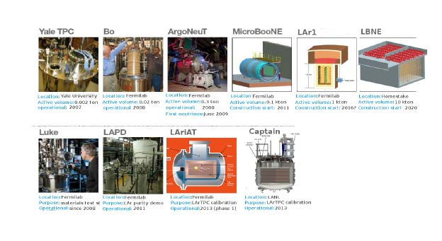
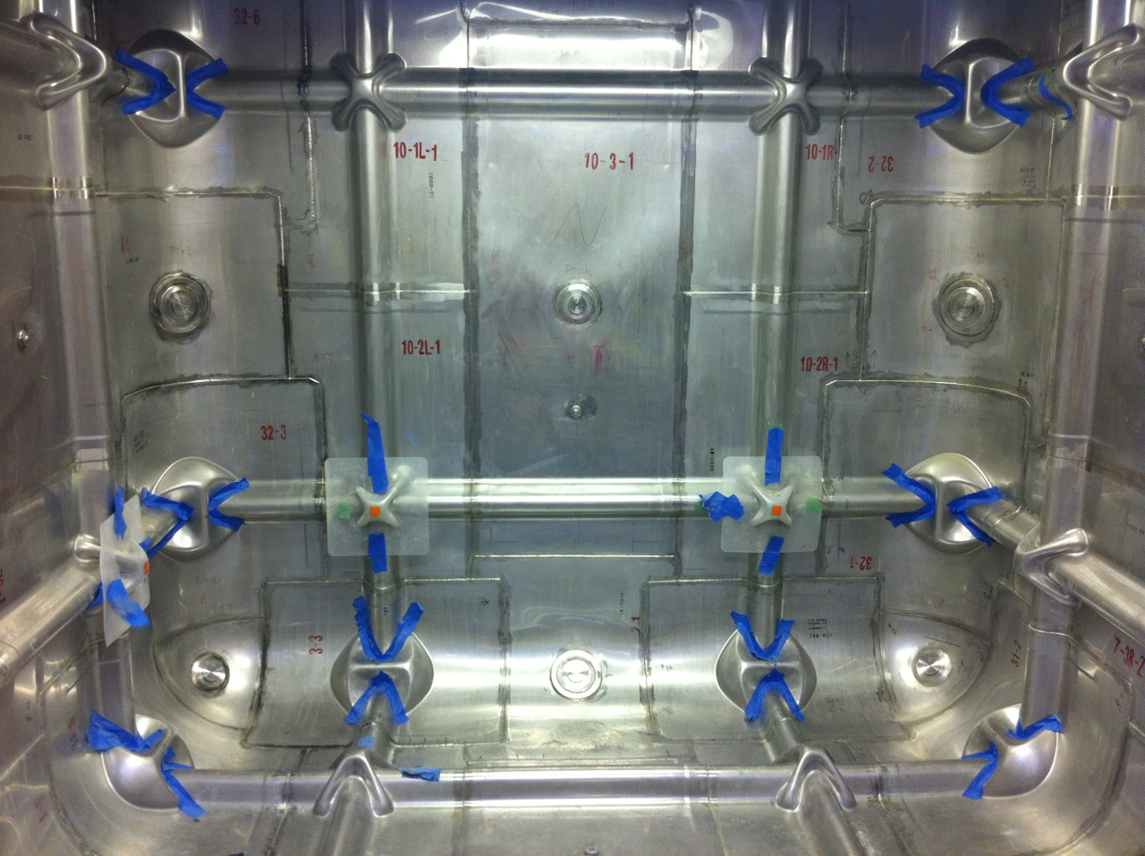
Development Program towards LArTPC detectors
See talks:
Szelc, Carls
Grant, Lockwitz
35 ton
Develop systems for next generation LArTPC detectors:
Cold electronics
Cryostat and cryogenics
High voltage
TPC geometry and readout
Light collection
“Physics R&D”

Slide 37
LBNE
DOE requests a staged program.
Initial approval for a 10 kton on the surface, can be changed before finalized.
Seeking partners to accomplish full LBNE
New neutrino beam at FNAL
  700 kW, 60-120 GeV proton beam
  2.3 MW capable
Near detector for neutrinos
34 kton far detector at 1300 km baseline (at Sanford Underground Research Facility, SURF)
  Ultimately positioned underground with 4850’ overburden

Slide 38
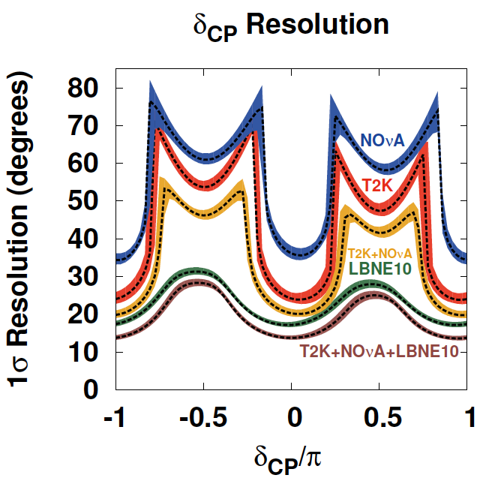
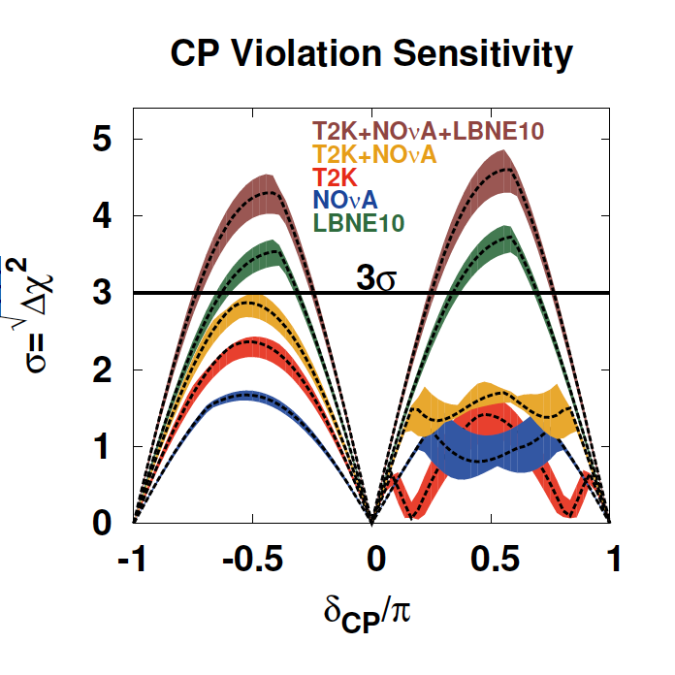
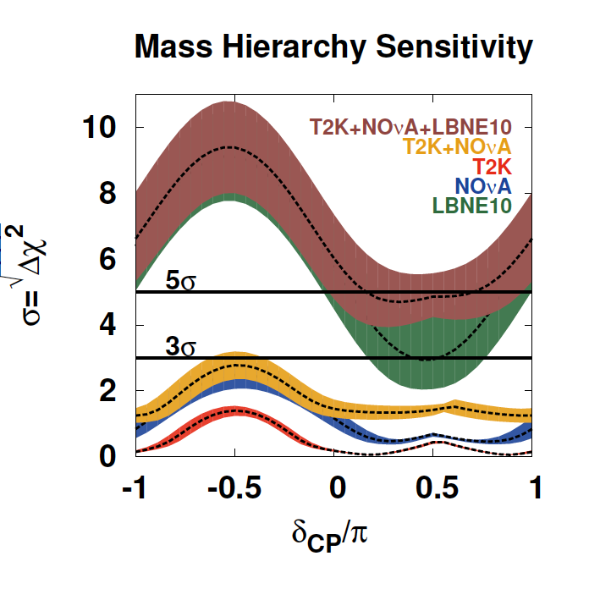
LBNE 10kt Would be a Major Advance
Assumes known (Normal) Mass Hierarchy
Bands: 1σ variations of θ₁₃, θ₂₃, Δm₃₁² (Fogli et al. arXiv:1205.5254v3)
*Improved over CDR 2012 120 GeV MI proton beam
Notes:
See docDB 7199 (M. Bass) for description.
◮ Oscillation parameter values based on Fogli et al, arXiv:1205.5254v3
◮ sin^2(θ_12) = 0.307
◮ sin^2(2θ_13) = 0.094 (1σ range: 0.0845 − 0.1036)
◮ sin^2(θ_23) = 0.386 (1σ range: 0.370 − 0.431)
◮ ∆m^2_21 = 7.54 × 10−5 eV2
◮ ∆m^2_31 = 2.47 × 10−3 eV2 (1σ range: 2.37 − 2.53)
◮ Simple normalization systematics:
◮ T2K: 5%, 10% appearance, 5%, 10% disappearance
◮ NOvA: 5%, 10% appearance, 5%, 10% disappearance
◮ LBNE10: 1%, 5% appearance, 5%, 10% disappearance

Slide 39
LBNE Spectra (34 kton LAr)
ν (5 yrs)
ν (5 yrs)
Appearance
1074 evts
(477 IH)
279 evts
(440 IH)
Disappearance
w/o osc: 25,000
w/ osc: 8,000
w/o osc: 11,000
w/ osc: 3,400
spectra from LBNE PWG Report (2011) - “2010 beam”

Slide 40
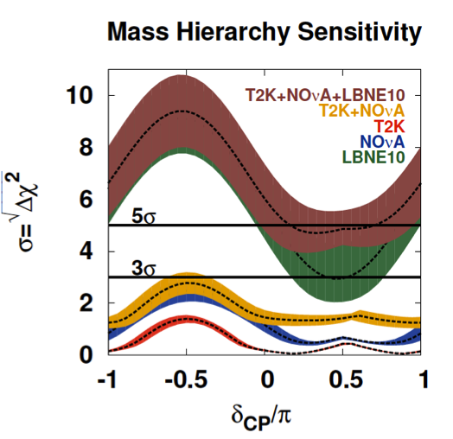
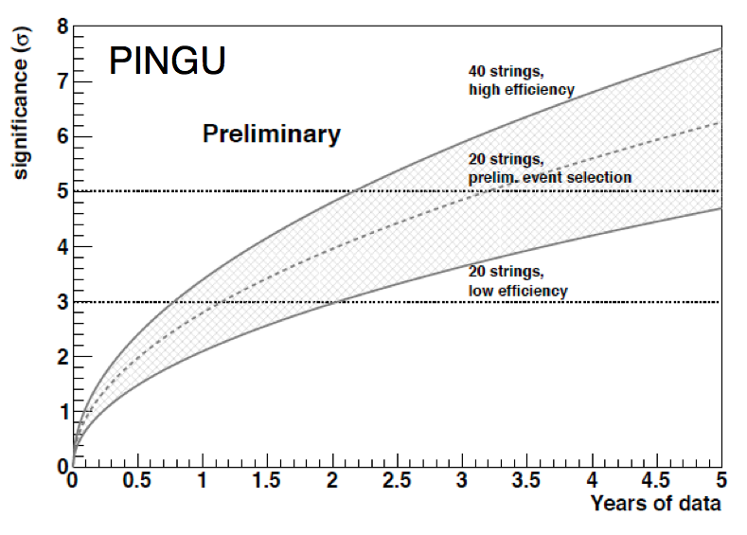
Mass Hierarchy
MH determination by long-baseline neutrino experiments
“guaranteed” with sufficient distance/exposure
other techniques are promising; systematics challenging
- PINGU IceCube infill: atmospheric neutrinos
- JUNO, RENO-50 reactor experiments
there could also be information from cosmology

Slide 41
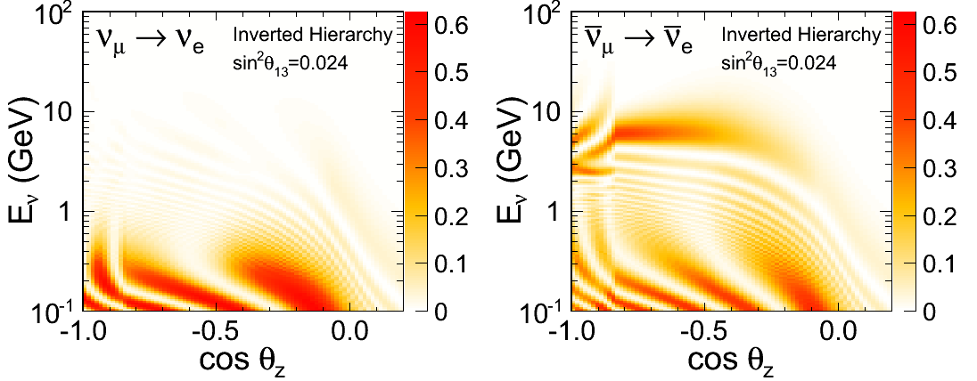
Atmospheric Neutrinos
Excellent source of data for detailed exploration of ν oscillations
  Free! Huge range of energies and baselines
  Complementary dataset; help break degeneracies in beam-only analyses
Mass hierarchy
  Enhancement in 2-10 GeV upward-going ν for normal hierarchy (anti-ν for inverted hierarchy)
Beam

Slide 42
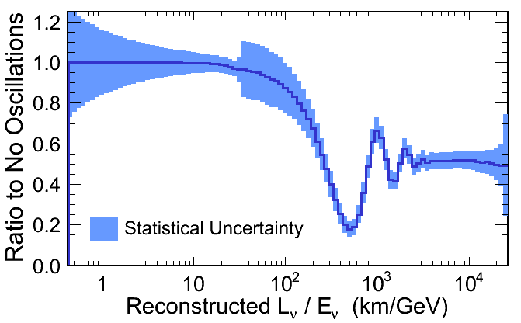
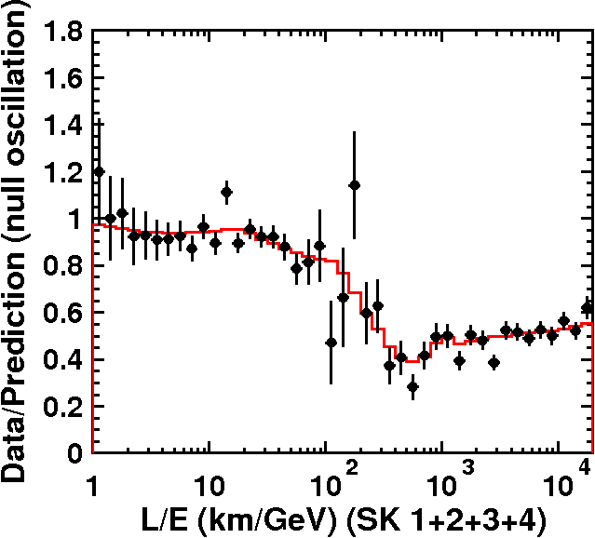
L/E Oscillation Pattern
A. Blake et al., hep-ex/1208.2899
LBNE, 350 kt-yr
Super-K Preliminary 240.4 kt-yr
Select atmospheric events with good energy and angle resolution
  Compare observed data to expectation for no oscillation
Spectacular signature in Super-K water Cherenkov detector, even more distinct in LAr (multiple oscillation dips visible!)

Slide 43
Proton Decay
In a large mass underground detector, look for signatures of proton decay in the data sample of fully-contained ν’s
  Atmospheric ν’s = background to proton decay searches
LAr has high efficiency for detecting SUSY-favored decay modes
  Best for , but also good for many other modes
  Even if no signal is seen, limits place strong constraints on theory
LAr 100 kton
LAr 34 kton
LENA (10 yr)
Hyper-K (10 yr)
LAr 10 kton
23kt WBLSc
(10 yr)
Super-K 260 kt-yr (2013, preliminary)
Assuming
96.5% efficiency
0.1 events BG/100 kton yr

Slide 44
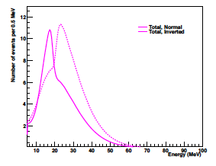
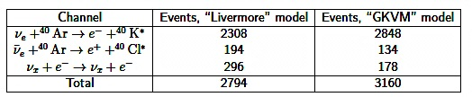
Supernova ν’s
A single time slice for one SN burst model (of many!)
Supernova at the galactic center (10 kpc) would produce thousands of neutrino interactions in 34 kt LAr detector in a very short time (10’s of seconds)
LAr detectors sensitive to ν_{e}’s, water detectors sensitive to anti-ν_{e}’s
  Complementary measurements in LAr & WC elucidate SN burst physics
A supernova will eventually happen (1~few per century per galaxy)
Notes:
not like PDK… one-few per century per galaxy

Slide 45
LBNE Scientific Motivations
Explore 3x3 model of ν mixing
  Broad band beam and high resolution detector
Atmospheric neutrinos
  Independent ν source, can determine mass hierarchy, and others
New ν physics
  Non-standard interactions, sterile ν, others
Proton Decay
  Test fundamental but unexplained conservation of baryon number
  Grand Unified Theories predict specific decay modes, lifetimes, branching ratios
Astrophysics
  Supernova burst ν
Breadth and Diversity of program
Notes:
LBNE has a rich physics program

Slide 46
Beyond LBNE
Next-next generation experiments will require better neutrino beam. Options include increased intensity, neutrinos from muon storage rings (NuMAX) and very intense sources of pion decay at rest (DAEδALUS).
See talk 8/16: Shaevitz

Slide 47
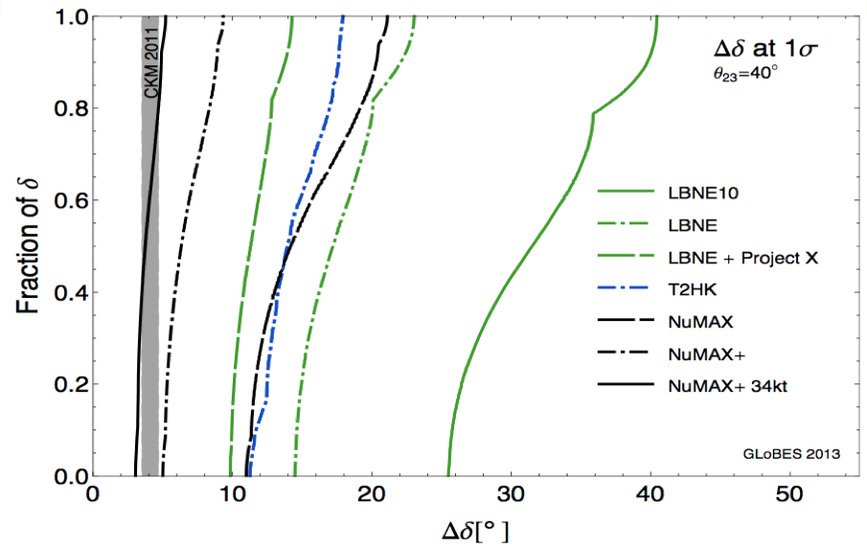
Far Future Precision
(Patrick Huber et al.)

Slide 48
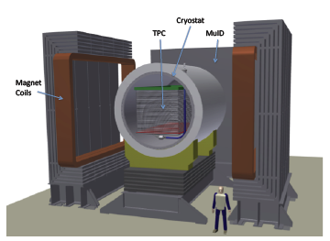






Neutrino Interactions and Cross Sections
Experiments running and in planning will measure neutrino cross sections for neutrino oscillations and for what we learn about the neutrino
These are stand alone experiments, development experiments, or function as near detectors for oscillation programs….
See talks 8/15
Rakotondravohitra
Hansen
Adam
LBNE ND concepts
MicroBooNE
T2K
ND280
NOvA
ND
MINERvA
νSTORM

Slide 49
The big questions….
- what is the absolute neutrino mass scale
- are neutrinos Majorana or Dirac?
- what is the neutrino mass ordering?
- is CP violated in the neutrino sector?
- to what extent does the 3ν paradigm describe nature?
- are there already hints of new physics in existing data?
- what new knowledge will neutrinos from astrophysical
sources bring?
we know this information for every other particle!

Slide 50



Short Baseline Accelerator Anomalies: LSND and MiniBooNE
MiniBooNE “low energy excess” – electron-like events in Cherenkov imaging detector, in neutrino and anti-neutrino mode, consistent with LSND anti-electron neutrino appearance.
Neutrino
mode
L/E Comparison
of LSND & MiniBooNE Antineutrino mode
Anti-
Neutrino
mode
Preliminary
July 2011

Slide 51

Reactor ν_{e} Anomaly
In 2011, updated analysis of reactor anti-neutrino spectrum increased expected flux by 3% (Mueller et al., Huber), + increase in calculated cross-section (new neutron lifetime) changed expected detected rate by ~6%
Lhuillier, EPS HEP 2013
Av. measured/expected =
0.935 ± 0.024 (2.7σ)
E ~ 2–8 MeV,
L ~ 10–100m
L/E ~ 1–50 m/MeV
Zhang et al (arXiv:1303:0900) say that including LBL reactor data reduces significance: 0.956 ± 0.028 (1.4σ). However, others say otherwise (Kopp et al.)

Slide 52

Radioactive Source Anomaly
Gallex: ⁵¹Cr source (750 keV)
Sage: ⁵¹Cr & ³⁷Ar (810 keV)
The solar radiochemical detectors GALLEX and SAGE used intense ⁵¹Cr and ³⁷Ar electron-capture neutrino sources to “calibrate” the ν_{e}Ga cross-section.
The average measurement / theory:
R=0.84 (2.9σ)
+0.054
−0.051
L = O(1) m, E ~ 800 KeV, hence L/E = O(1) m / MeV

Slide 53
INTERPRETATION
AS NEW PHYSICS
Although there are several possibilities (new interactions, violation of fundamental symmetries, sterile neutrinos, …)
The best motivated new-physics interpretation is as evidence for one or more sterile ν states with masses below a few eV: 3+n models have n new sterile ν states.
3+1 models provide good fits for sub-sets of the data (e.g. all the disappearance data, or all the appearance data) but not all of the data. Adding additional sterile neutrinos (3+2, 1+3+1, 3+3, …) does not appear to resolve all of the tensions.

Slide 54


Appearance vs Disappearance
Allowed regions of 3+1 parameter space, 95%CL
Kopp, Machado, Maltoni, Schwetz arXiv: 1303.3011
Subsets of appearance and disappearance data are found to be consistent,
and it is only when they are combined and when, in addition, exclusion limits on ν_{μ} disappearance are included, that tension appears.

Slide 55
Neutrino Anomalies
clarifying the nature of the existing short-baseline neutrino
anomalies is important → we need definitive reactor, source,
and accelerator-based experiments
given the experiments that are already being prepared, we
can anticipate significant progress before the next “Snowmass”
- next 3-5 years: MicroBooNE, MINOS+, radioactive source
experiments, new reactor measurements
if it turns out that any of the anomalies are due to new
physics associated with L/E ~ O(1m/MeV) it will be an exciting
and revolutionary discovery, and will almost certainly motivate
an extensive experimental program

Slide 56

MicroBooNE at Fermilab
170 ton LArTPC at MiniBooNE baseline
Look for MiniBooNE excess with precision detection technique
The first to address MiniBooNE low energy excess with data taking in early 2014

Slide 57







uBooNE under construction
See talk 8/15: Collin

Slide 58


MINOS+ at Fermilab
Search for ν_{μ} and anti-ν_{μ} disappearance
starts this year
Within the 3+1 frame-work, can combine ν_{μ} disappearance and anti-ν_{e} disappearance results to say some-thing about ν_{μ} → ν_{e} transitions.
See talk 8/16: Aurisano

Slide 59

New Initiatives
Many ideas worldwide – US based examples
as listed in neutrino working group paper

Slide 60


US Short-Baseline Reactor Experiment
Objectives
- short-baseline neutrino oscillation search with high sensitivity, probe of new physics
- test of the oscillation region suggested by reactor anomaly and νe disappearance channel
- precision measurement of reactor νe spectrum for physics and safeguards
- develop antineutrino-based reactor monitoring technology for safeguards
2-Detector Oscillation Experiment
Discovery Potential
reactor core
detector 1
~4m
detector 2
~15m
reactors under consideration:
NIST, ATR, HFIR
Technically Limited Schedule
FY13-14 - R&D
FY14-15 - design&construction
FY 2016 - first data?
Scientific Reach:
3σ in 1 year, 5σ in 3 years

Slide 61









US Research Reactors
NBSR, NIST
ATR
HFIR, ORNL
arXiv:1307.2859 (2013)
Mumm, Littlejohn, KMH
NIST

Slide 62

LAr1: MicroBooNE follow-on for near-far comparisons for nu and nubar searches
40
40
Near Detector
(55t fiducial)
Phase 1: Near detector at 100m from target to measure un-oscillated flux: neutrino mode with uboone. Interpret uboone result! Due to oscillations?
Phase 2: Second far detector (1kton fiducial) for anti-neutrino mode

Slide 63


Slide 64



νSTORM
Muon storage ring neutrino source proposed at FNAL (stage 1 approval) & CERN.
At FNAL use 120 GeV MI protons, carbon target, horn focusing, decay channel, storage ring, 2 magnetized detectors … i.e. existing technologies.
Offers advantages of Neutrino Factory without the intensity … OK for SBL experiment & offers a path towards a NF in the longer term.
Impressive sensitivity.

Slide 65
Worldclass, diverse program of neutrino physics
  Physics of neutrinos addressing some of the most compelling questions in particle physics
    About neutrinos
    About the Standard Model and the Universe
    Across traditional subfields
  Many different ways to address questions: source, size, technology
  Questions span understanding observed phenomena to looking for the unexpected

