Slide 1
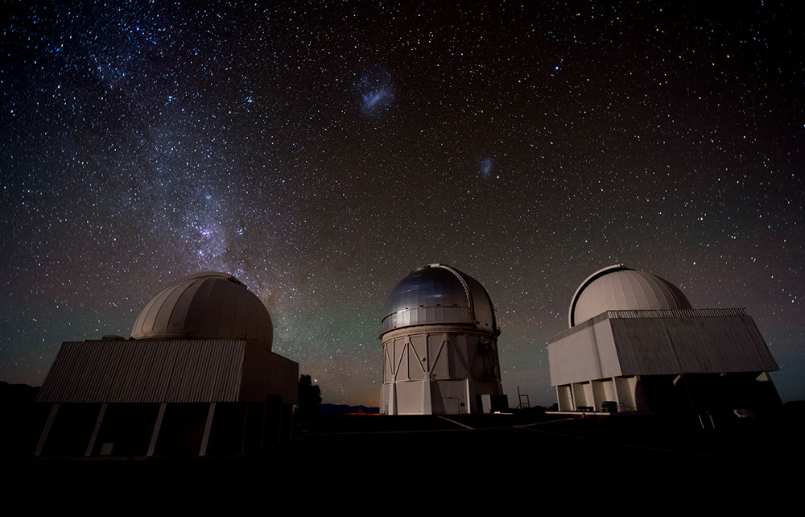
Studies for Dark Energy
Josh Frieman
Fermilab and University of Chicago
APS DPF Meeting
Santa Cruz, August 14, 2013

Slide 2
Related DPF talks on Dark Energy
Particle Physics from Cosmic Surveys
  S. Dodelson, later this morning
Scalar field Dark Energy (Th. 1 pm CF)
  K. Ng, K. Kitazawa
BOSS, BAO, DESI (Fri. 10:30 am CF)
  B. Reid, M. Vargas-Magana, M. Levi
DES (Fri. 2:30 pm CF)
  C. Cunha, M. Soares-Santos, K. Barbary, E. Suchyta, H. Lin

Slide 3
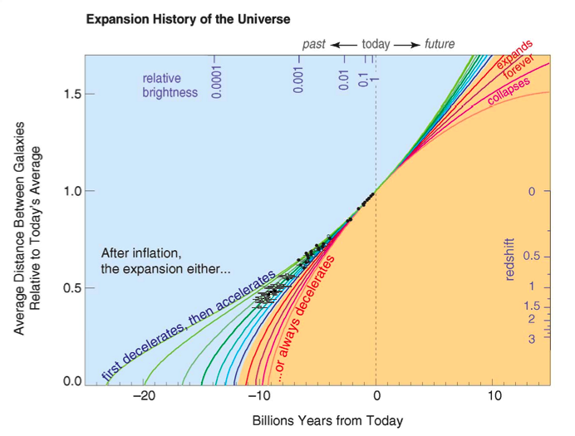
Supernova Data (1998)
Type Ia supernovae that exploded when the Universe was 2/3 its present size are ~25% fainter than expected

Slide 4
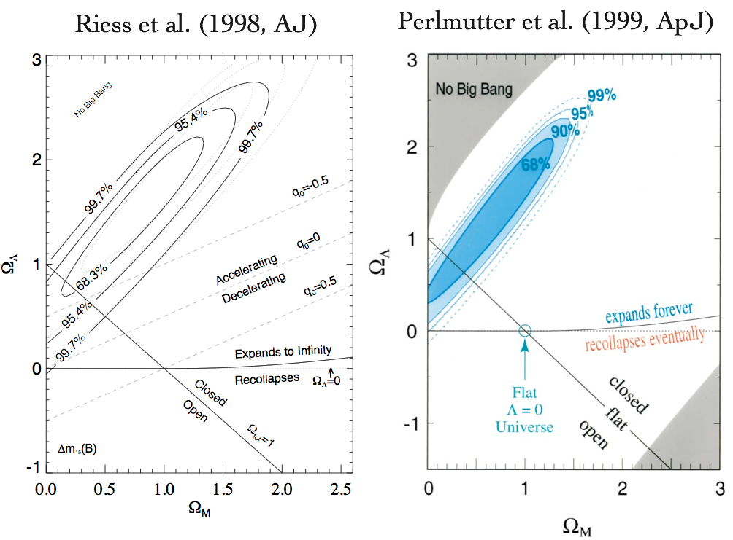
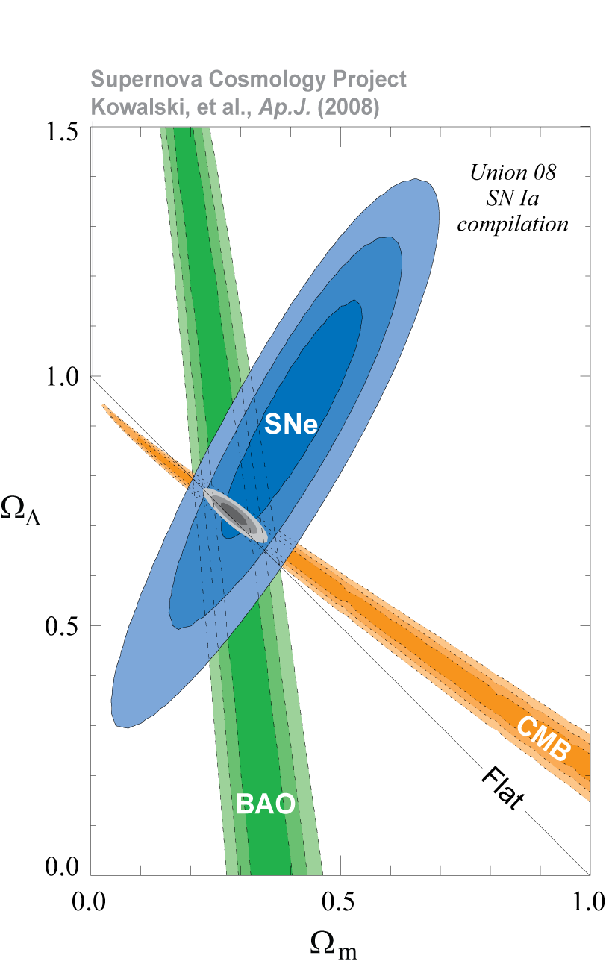
2011 Nobel Prize in Physics

Slide 5
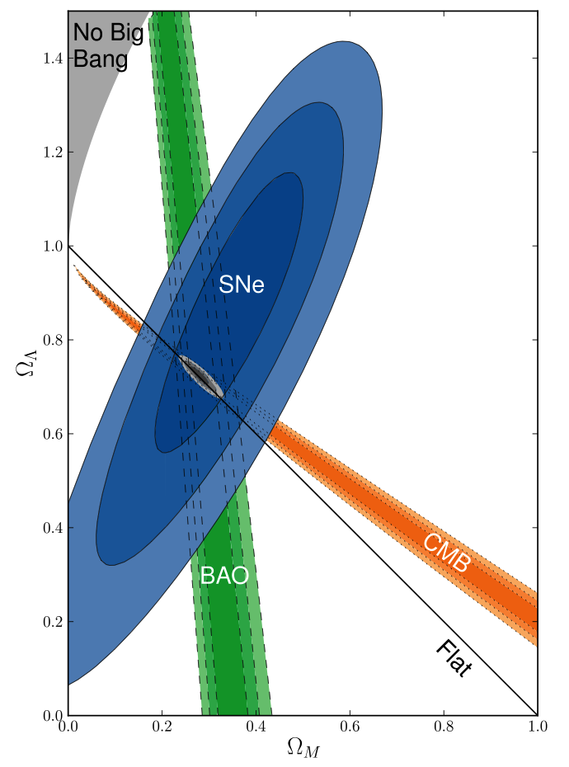
Supernovae
Baryon Acoustic Oscillations
Cosmic Microwave Background
Progress over the last 15 years

Slide 6
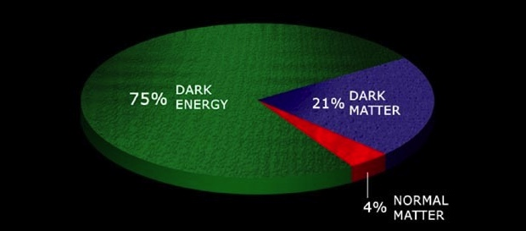
Dark Energy
What is the physical cause of cosmic acceleration?
  Dark Energy or modification of General Relativity?
    If Dark Energy, is it Λ (the vacuum) or something else?
      What is the DE equation of state parameter w and (how) does it evolve?
70%
25%

Slide 7
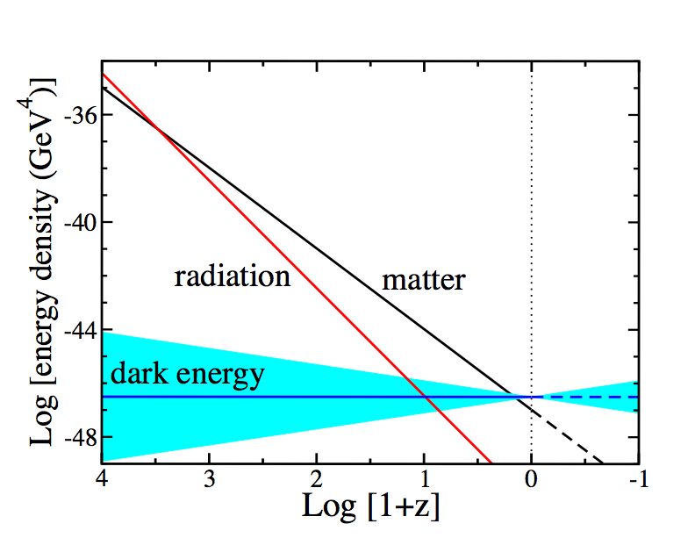
Equation of State parameter w determines Cosmic Evolution
Conservation of Energy-Momentum
w=−1 cosmological constant
=Log[a₀/a(t)]
Notes:
Energy-momentum conservation determines how the densities of different components scale with time. Before a few hundred thousand years after the BB, radiation or relativistic particles dominated, followed by non-relativistic matter, followed at ~8 Gyr by dark energy. In order for dark energy to cause cosmic speed-up, its equation of state must be such that its energy density scales slowly compared to matter and radiation. Thus, we expect dark energy to be important only at recent cosmic epochs.

Slide 8
What can we probe?
Geometry: Distances, Expansion rate vs. Redshift
Growth of
Density
Perturbations
Expansion History Growth of Structure

Slide 9
Testing General Relativity
Fourier space Poisson equation for Modified Gravity:
GR:
Growth of Perturbations:
Need to probe both growth δ(a) and expansion history H(a) to (possibly) disentangle Dark Energy from Modified Gravity

Slide 10
Probes of Dark Energy
Galaxy Clusters
  Counts of Dark Matter Halos with Clusters as Halo Proxies
  Sensitive to growth of structure and geometry
  Also Cluster gas fraction and pressure profiles
Weak Lensing
  Correlated Galaxy Shape and magnification measurements
  Sensitive to growth of structure and geometry
Large-scale Structure
  Baryon Acoustic Oscillations: feature at ~150 Mpc
    Sensitive to geometry
  Redshift-space Distortions due to Peculiar Velocities
    Sensitive to growth of structure
Supernovae
  Hubble diagram: standard candle distance vs. redshift
  Sensitive to geometry
Strong Lensing
  Time Delays sensitive to geometry

Slide 11
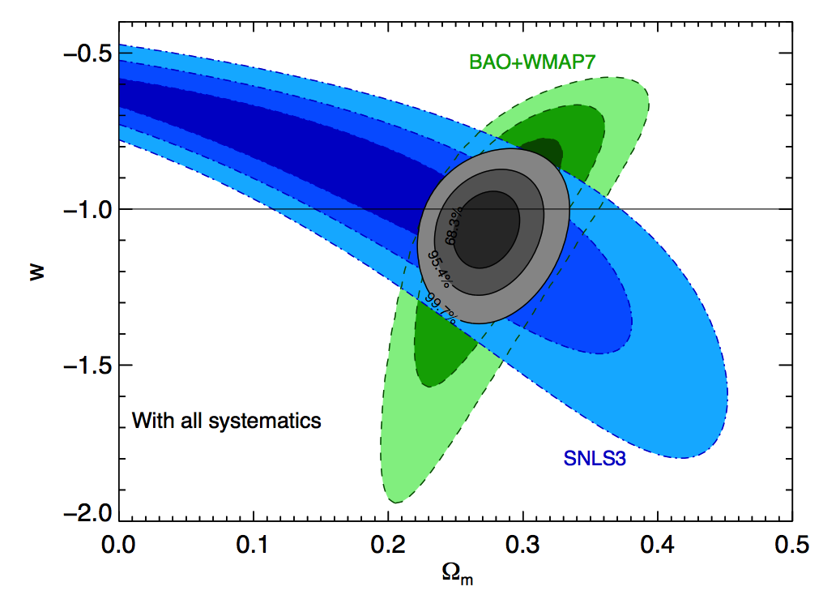
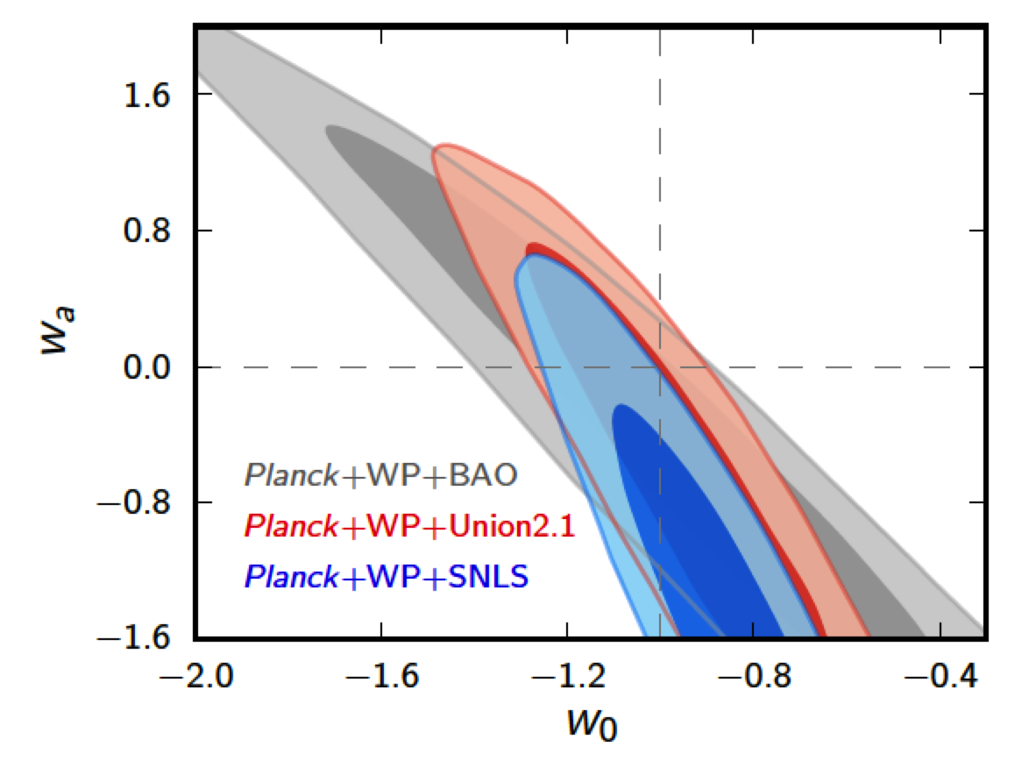
Constraints from Supernovae (SDSS, SNLS), CMB (WMAP, Planck), and Large-scale Structure (SDSS)
Assuming constant w Assuming w=w₀+w_{a}(1-a)
~7% constraint on constant w
Sullivan etal 2011
Ade etal 2013

Slide 12
Theory?
No consensus model for Dark Energy or Mod Grav
Theoretical prejudice in favor of cosmological constant (vacuum energy) with w=−1 was wrong once (Cf. inflation): not a strong argument for it being correct now
Cosmological constant problem (why is vacuum energy density not 120 orders of magnitude larger?) is not necessarily informative for model-building
Some alternatives to Λ (Cf. quintessence) rely on notion that a very light degree of freedom can take ~current Hubble time to reach its ground state.

Slide 13
Scalar Field as Dark Energy
(inspired by inflation)
Dark Energy could be due to a very light scalar field, slowly evolving in a potential, V(ϕ):
Density & pressure:
Slow roll:
V(ϕ)
ϕ
Time-dependence of w can
distinguish models

Slide 14
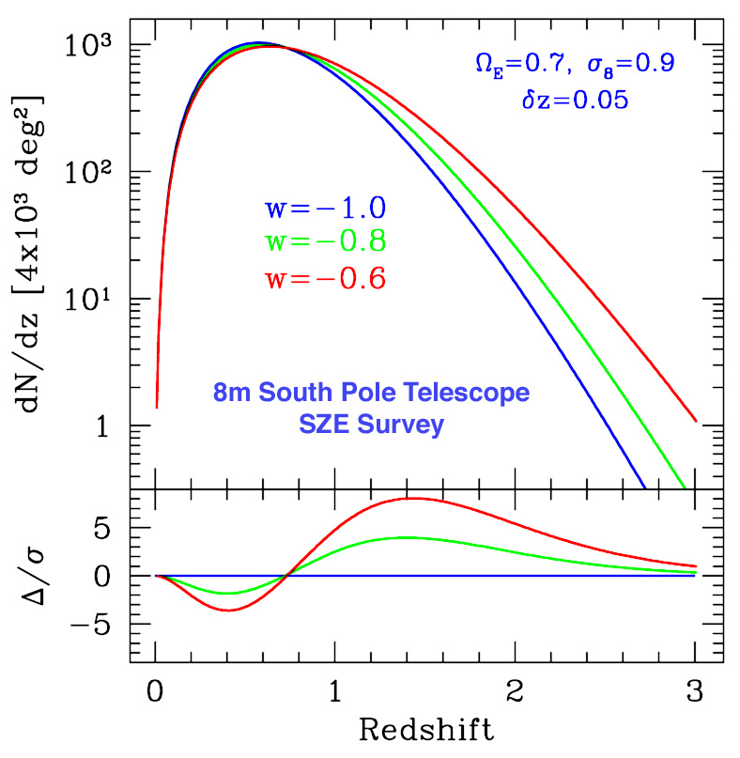
I. Clusters
  Dark Halo abundance predicted by N-body simulations
  Clusters are proxies for massive halos and can be identified optically to redshifts z>1
  Galaxy colors provide photometric redshift estimates for each cluster
  Observable proxies for cluster mass: optical richness, SZ flux decrement, weak lensing mass,
  X-ray flux
  Cluster spatial correlations help calibrate mass estimates
  Challenge: determine mass (M)-observable (O) relation g(O|M,z) with sufficient precision
Number of clusters above mass threshold
Dark Energy
equation of state
Mohr
Volume Growth

Slide 15

I. Clusters
  Dark Halo abundance predicted by N-body simulations
  Clusters are proxies for massive halos and can be identified optically to redshifts z>1
  Galaxy colors provide photometric redshift estimates for each cluster
  Observable proxies for cluster mass: optical richness, SZ flux decrement, weak lensing mass,
  X-ray flux
  Cluster spatial correlations help calibrate mass estimates
  Challenge: determine mass (M)-observable (O) relation g(O|M,z) with sufficient precision
Number of clusters above mass threshold
Dark Energy
equation of state
Mohr
Volume Growth

Slide 16
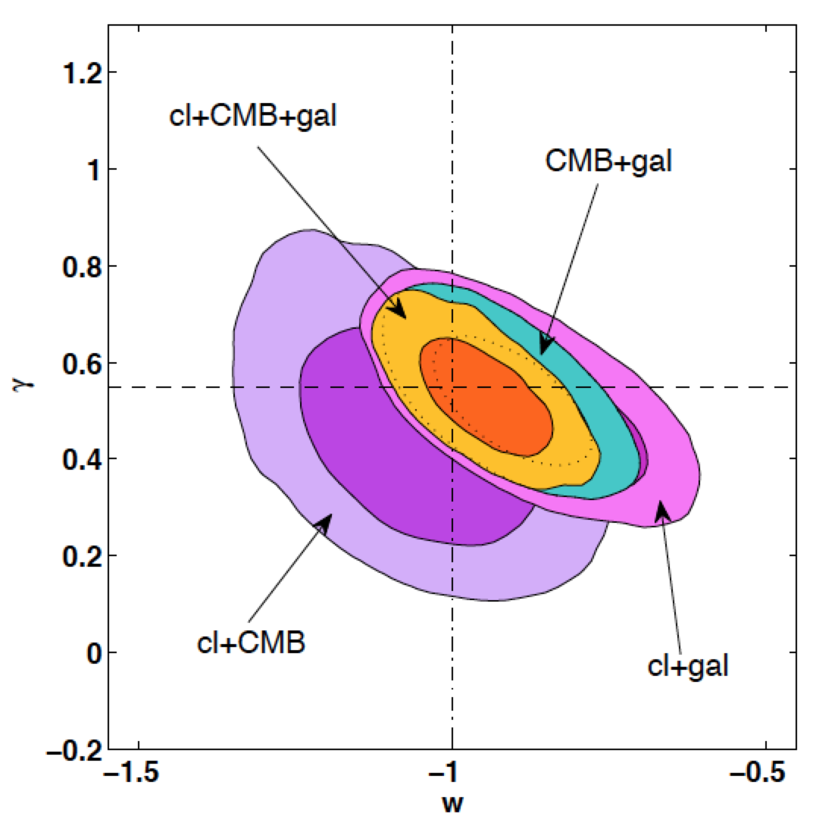
Constraints from Clusters (ROSAT, Chandra), CMB (WMAP), and Large-scale Structure (SDSS, WiggleZ, 6dFGRS)
Assuming constant w
Allowing growth parameter γ to float
Rapetti etal 2012

Slide 17
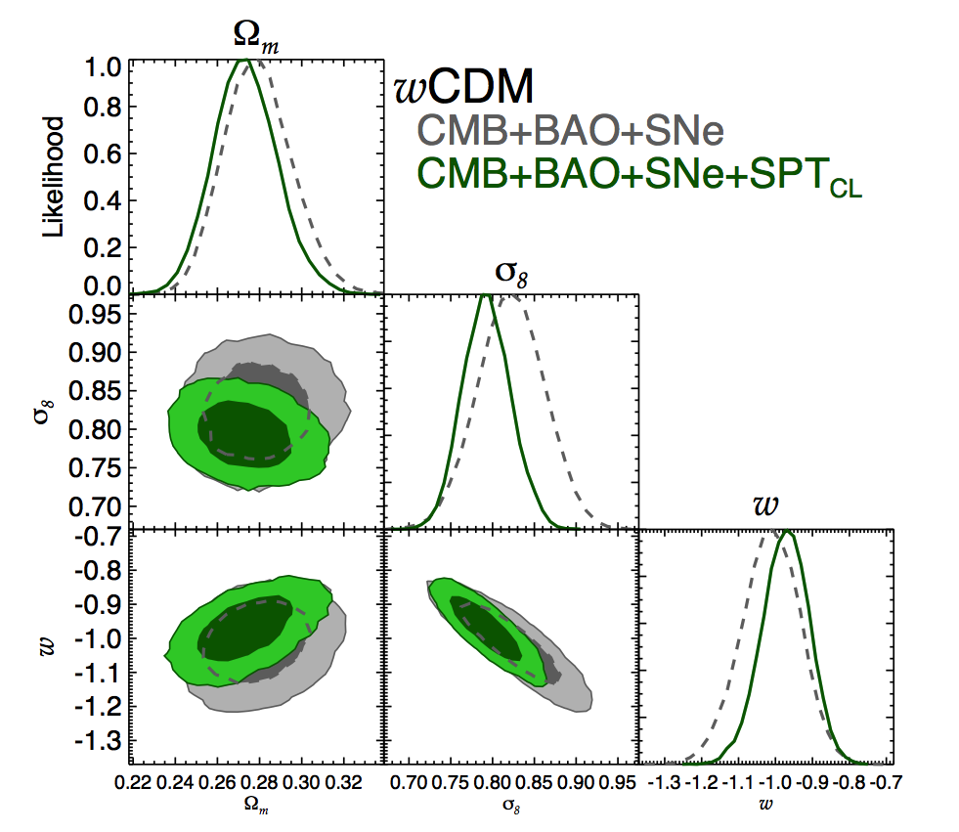
X-ray+Sunyaev-Zel’dovich Clusters
Benson, etal
South Pole Telescope

Slide 18
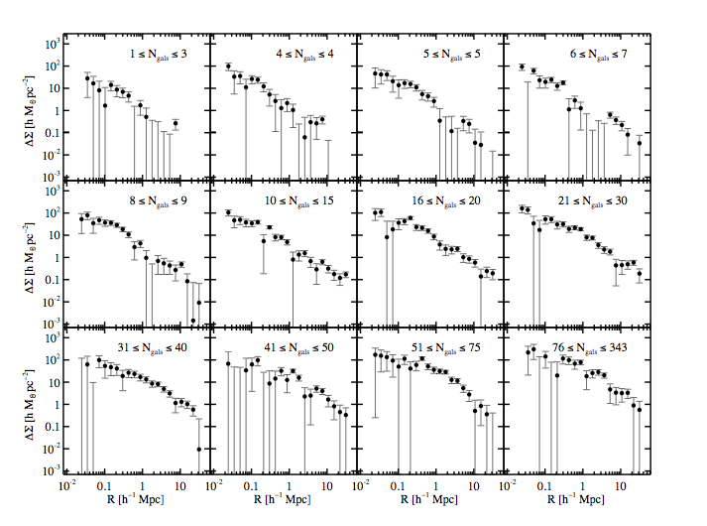
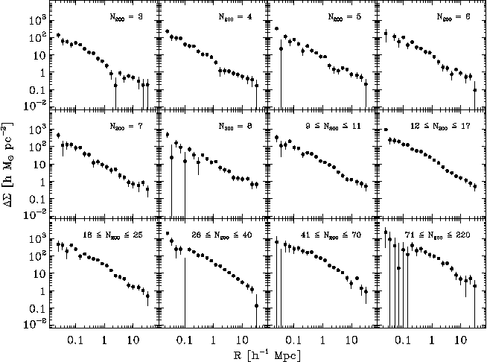
Statistical Weak Lensing by Galaxy Clusters
Mean Tangential Shear Profile in Optical Richness (N_{gal}) Bins to
30 h⁻¹Mpc
Sheldon,
Johnston, etal
SDSS

Slide 19
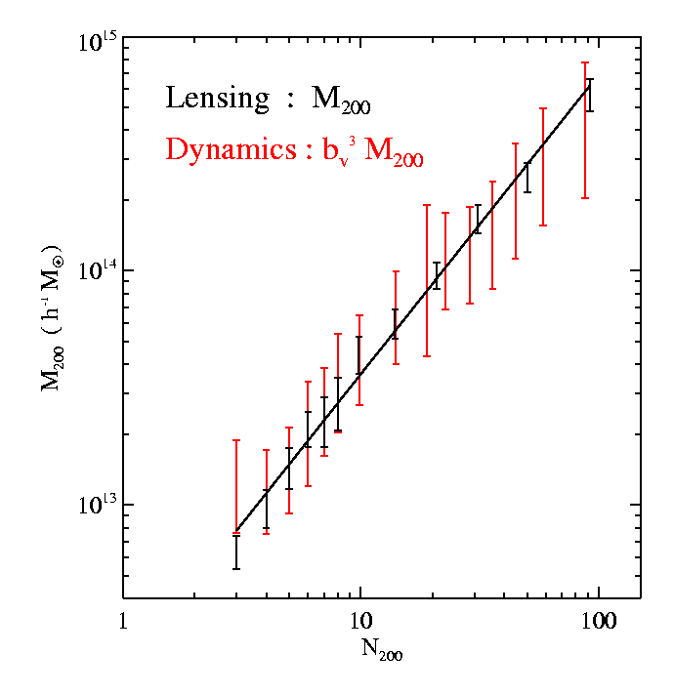
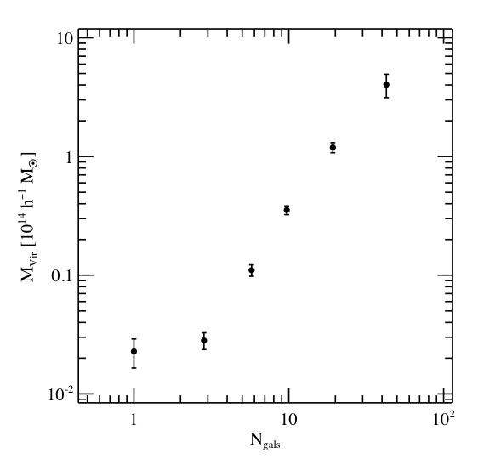
Statistical Weak Lensing Calibrates
Cluster Mass vs. Observable Relation
Statistical
Lensing
controls
projection effects
of individual
cluster mass
estimates
Improved red-sequence richness estimator reduces scatter in mass vs optical richness to ~20-30%
Rykoff etal
SDSS Data
z<0.3
Cluster Mass
vs. Number
of red galaxies they
contain (richness)
Johnston, Sheldon, etal

Slide 20
II. Weak Lensing: Cosmic Shear
Background
sources
Dark matter halos
Observer
Spatially coherent shear pattern, ~1% distortion
Radial distances depend on expansion history of Universe
Foreground mass distribution depends on growth of structure

Slide 21
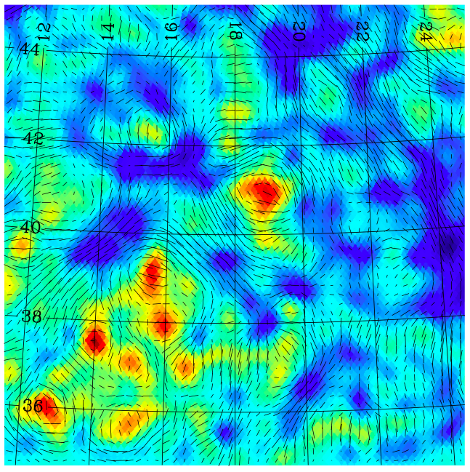
Weak Lensing Mass and Shear
Simulation from Becker, Kravtsov, etal

Slide 22
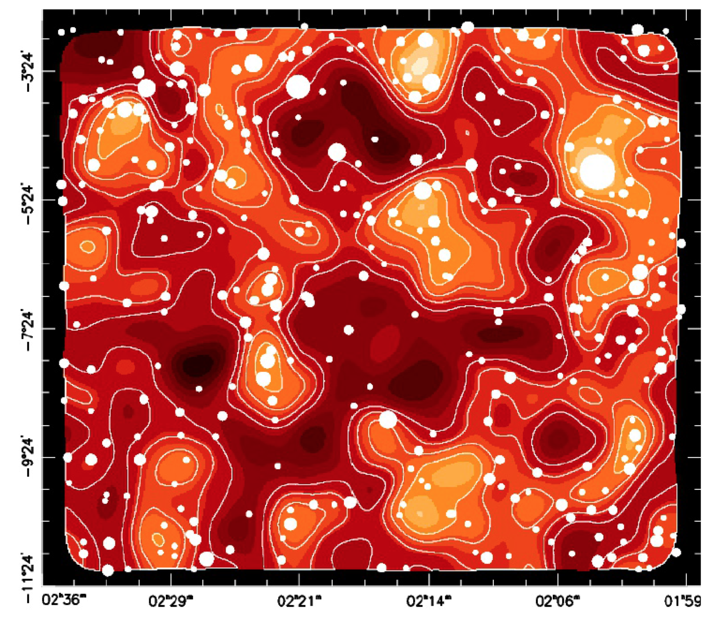
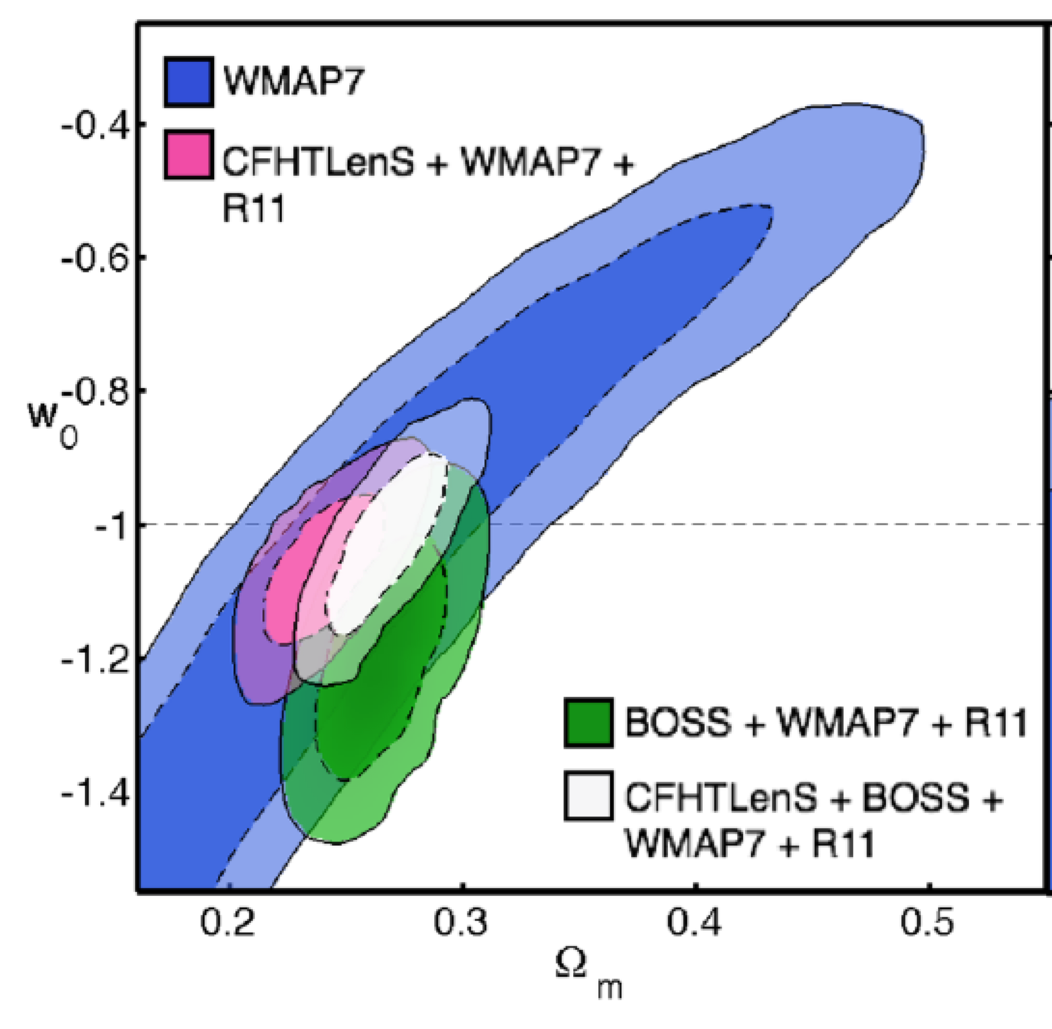
CFHT Lensing Survey Results
150 sq. deg. deep, multi-band imaging survey
Mass map with mass peaks predicted
from galaxy distribution
Van Waerbeke etal 2013
Parameter constraints assuming constant w and flat geometry
Heymans etal 2013

Slide 23
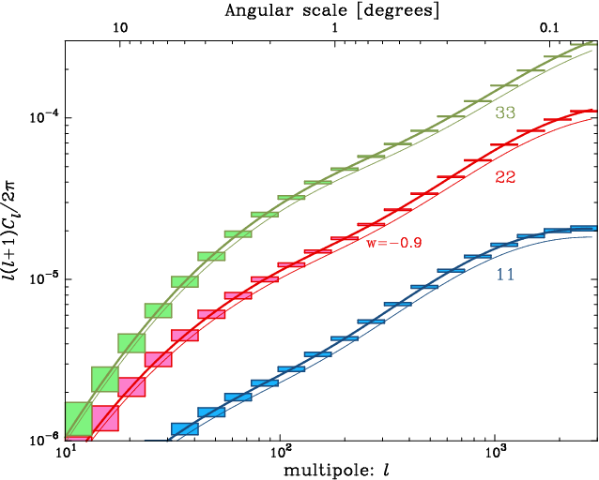
Cosmic Shear Tomography
Weak Lensing
Shear Angular
Power Spectrum
in Redshift Bins
Forecast LSST statistical errors

Slide 24
Weak Lensing Systematics
Shear calibration errors
PSF anisotropy correction errors
Intrinsic alignments
Photometric redshift errors
Baryonic effects on small-scale mass power spectrum

Slide 25
III. Large-scale Structure
Mass distribution in large N-body simulation

Slide 26
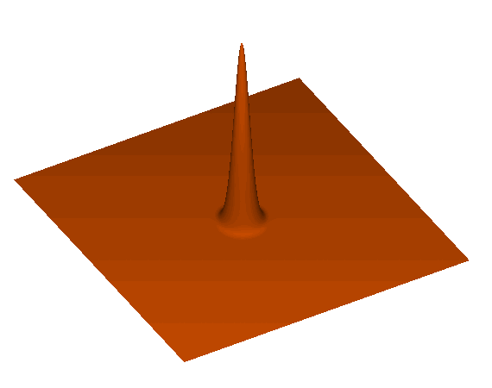
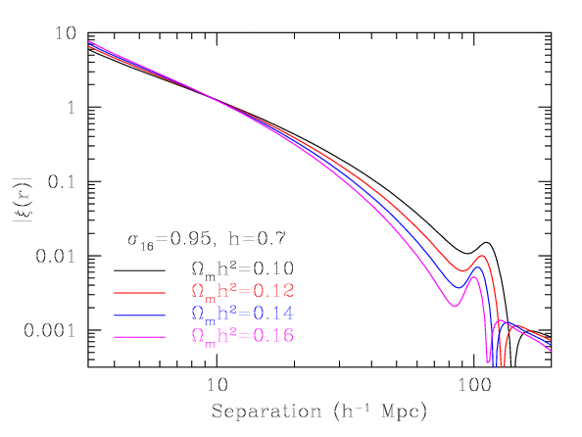
Baryon Acoustic Oscillations
Each initial overdensity (in dark matter & gas) is an overpressure that launches a spherical sound wave.
This wave travels outwards at
57% of the speed of light.
Pressure-providing photons decouple at recombination. CMB travels to us from these spheres.
Sound speed plummets. Wave stalls at a radius of 150 Mpc.
Overdensity in shell (gas) and in the original center (DM) both seed the formation of galaxies. Preferred separation of 150 Mpc.
Galaxy correlation
function
Eisenstein

Slide 27
The BAO Feature in SDSS/BOSS
See talk by Beth Reid
SDSS-II at z=0.35
BOSS at z=0.57
Feature detected at
6.7 sigma
1.7% distance measurement from BOSS
slide from N. Padmanabhan
Anderson et al, 2012

Slide 28
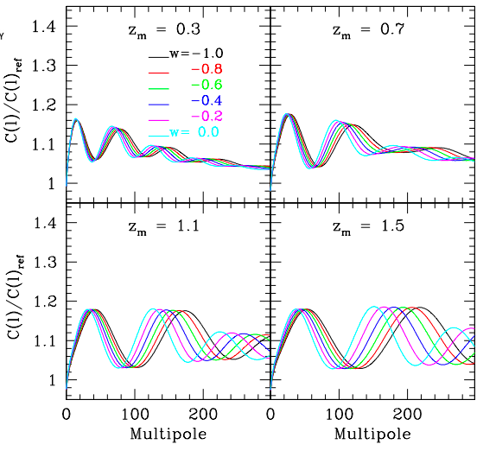
Baryon Acoustic Oscillations
Galaxy clustering angular power spectrum in redshift bins (relative to model without BAO)
Photometric surveys provide this angular measure
Spectroscopic redshift surveys also provide radial information
Fosalba & Gaztanaga

Slide 29
slide from Enrique Gaztanaga
Slide from Enrique Gaztanaga

Slide 30
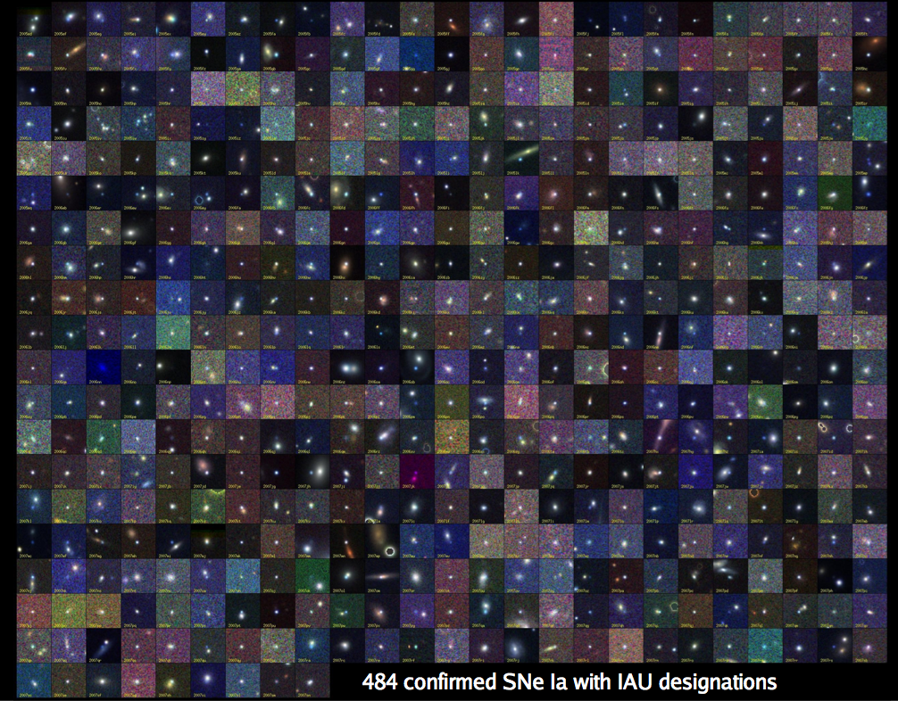
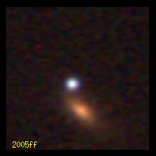
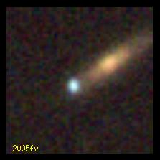
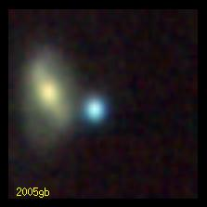
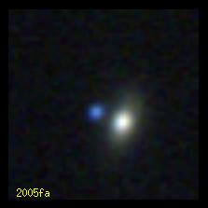
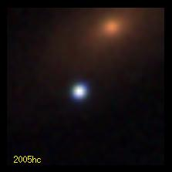
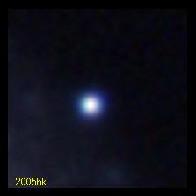
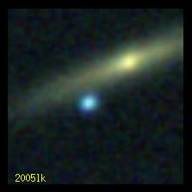
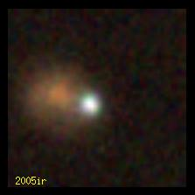
IV. Supernovae
B. Dilday
SDSS-II: 500 spectroscopically confirmed SNe Ia

Slide 31
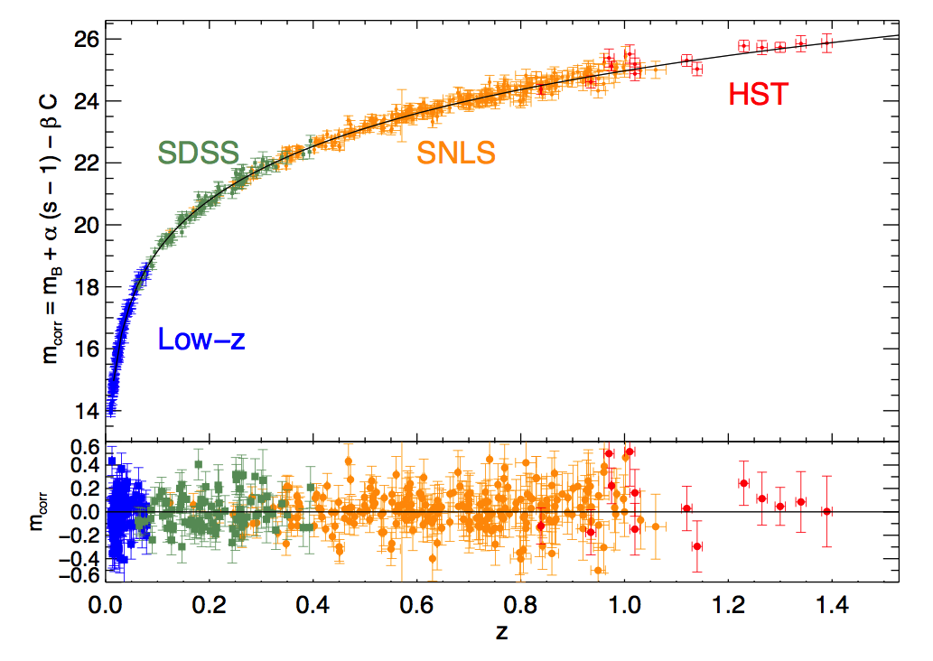
Supernova Hubble Diagram
Today: hundreds
Future: thousands
Conley, etal

Slide 32
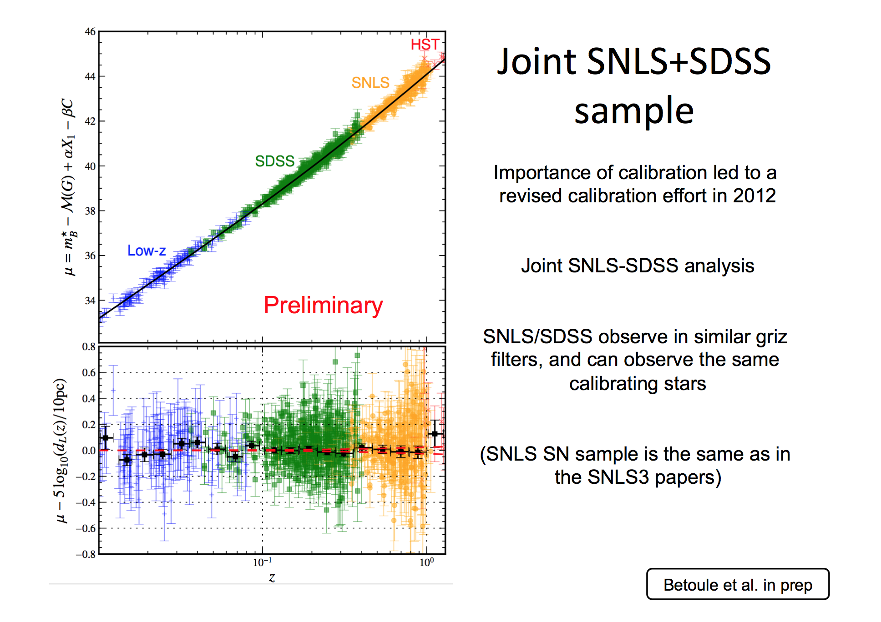

Slide 33
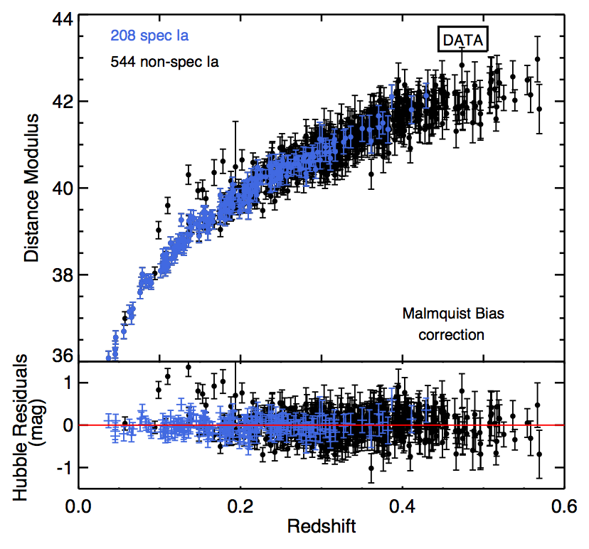
Photometric SN Cosmology
Hubble diagram of SDSS SNe Ia: spectroscopic plus those classified photometrically that have host-galaxy redshifts
DES, LSST will have thousands of SN light curves, SN spectra for only a subsample
Campbell, etal

Slide 34
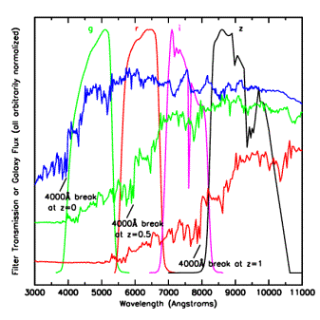
Photometric Redshifts
• Measure relative flux in
multiple filters
• Estimate individual galaxy
redshifts with accuracy
σ(z) < 0.1 (~0.02 for clusters)
• Precision is sufficient
for Dark Energy probes,
provided z-error distributions
well measured.
Challenge: spectroscopic
training & validation sets to
flux limit of imaging surveys
(24th mag DES, 25.5 LSST)
and/or cross-correlation
Elliptical galaxy spectrum

Slide 35
Dark Energy Surveys
Spectroscopic:
  BOSS/SDSS-III (2009-14):
    SDSS 2.5m: 1.5M LRGs to z<0.7, 150,000 QSOs for Lya at z=2.5 for BAO
  WiggleZ, 2dFGRS (completed):
    AAO 4m
  Future: eBOSS (SDSS-IV), HETDEX (HET), PFS (Subaru), DESI (Kitt Peak 4m), 4MOST (ESO 4m),…
Photometric:
  PanSTARRS (1.8m), DES (4m), HSC (8m), KIDS (2.6m)
  Future: LSST (8.4m)
Both:
  Space: Euclid, WFIRST
X-ray:
  XMM, Chandra
  eROSITA
SZ:
  ACT,SPT, Planck

Slide 36
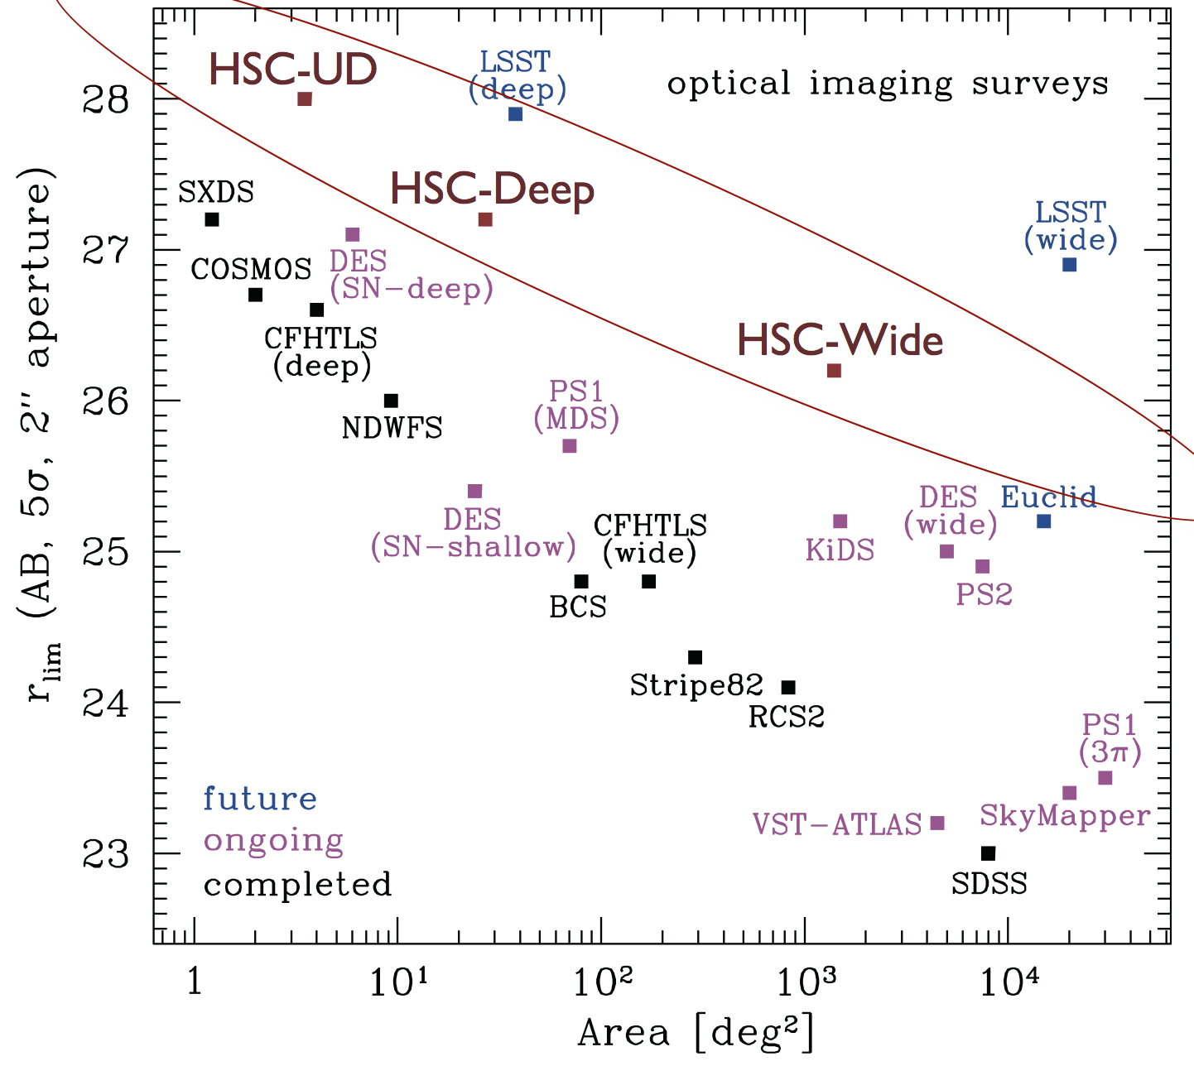
heading toward deep, wide
AFTA NIR
VIS
NIR
adapted from Takada

Slide 37
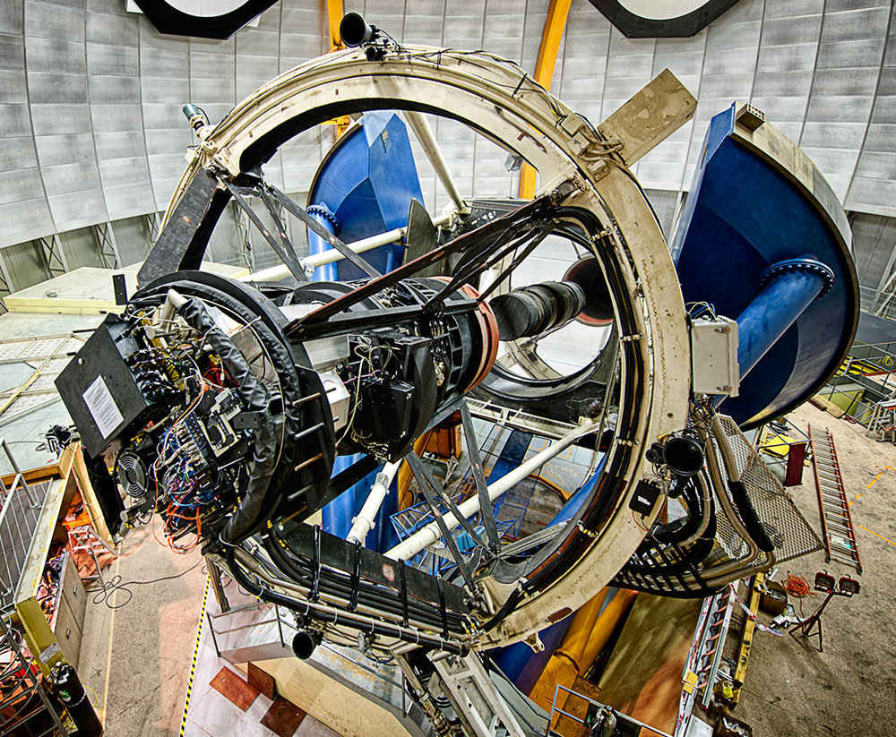
The Dark Energy Survey
DECam on the Blanco 4m at CTIO
Survey project using 4 complementary techniques:
I. Cluster Counts
II. Weak Lensing
III. Large-scale Structure
IV. Supernovae
• Two multiband imaging surveys:
5000 deg² grizY to 24th mag
30 deg² repeat griz (SNe)
• New 3 deg² FOV camera
on the Blanco 4m telescope
Survey 2013-2018 (525 nights)
Facility instrument for astronomy
community (DES 30% time)
Survey starts Aug. 31!
www.darkenergysurvey.org
darkenergydetectives.org

Slide 38
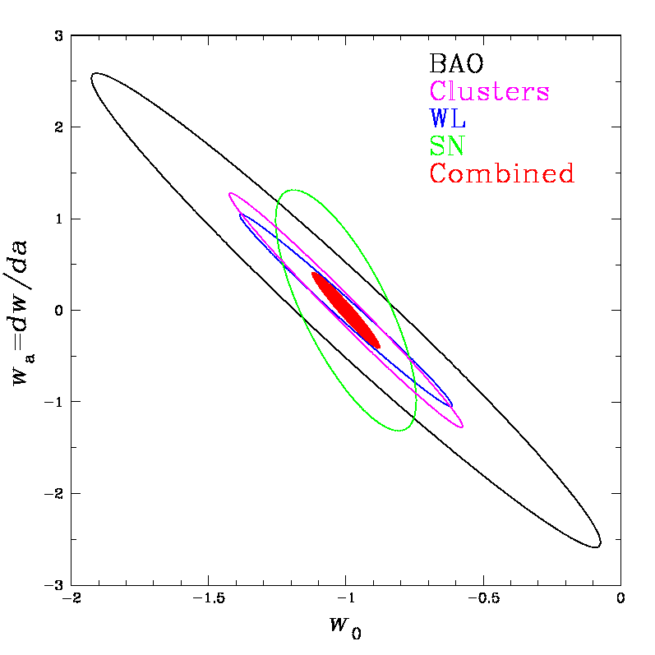
DES Science Summary
Forecast Constraints on DE Equation of State
Four Probes of Dark Energy
Galaxy Clusters
  ~100,000 clusters to z>1
  Synergy with SPT, VHS
  Sensitive to growth of structure and geometry
Weak Lensing
  Shape measurements of 200 million galaxies
  Sensitive to growth of structure and geometry
Baryon Acoustic Oscillations
  300 million galaxies to z = 1 and beyond
  Sensitive to geometry
Supernovae
  30 sq deg time-domain survey
  ~4000 well-sampled SNe Ia to z ~1
  Sensitive to geometry
DES
Planck prior assumed
DETF Stage III Experiment

Slide 39
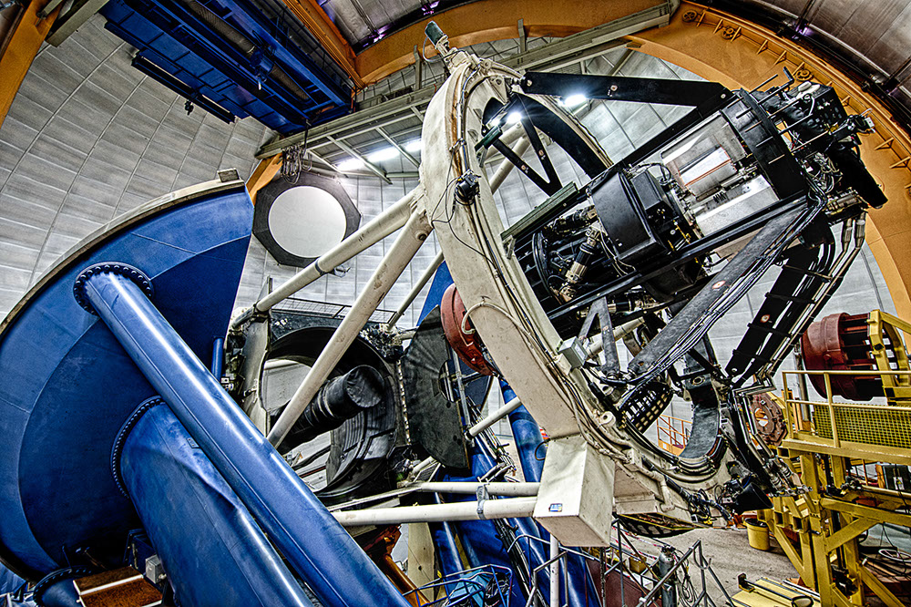
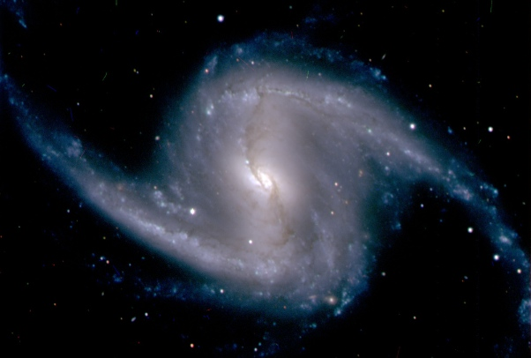
DECam First Light
September 12, 2012
Covered in 258 publications in 36 countries, plus Jay Leno’s monologue

Slide 40
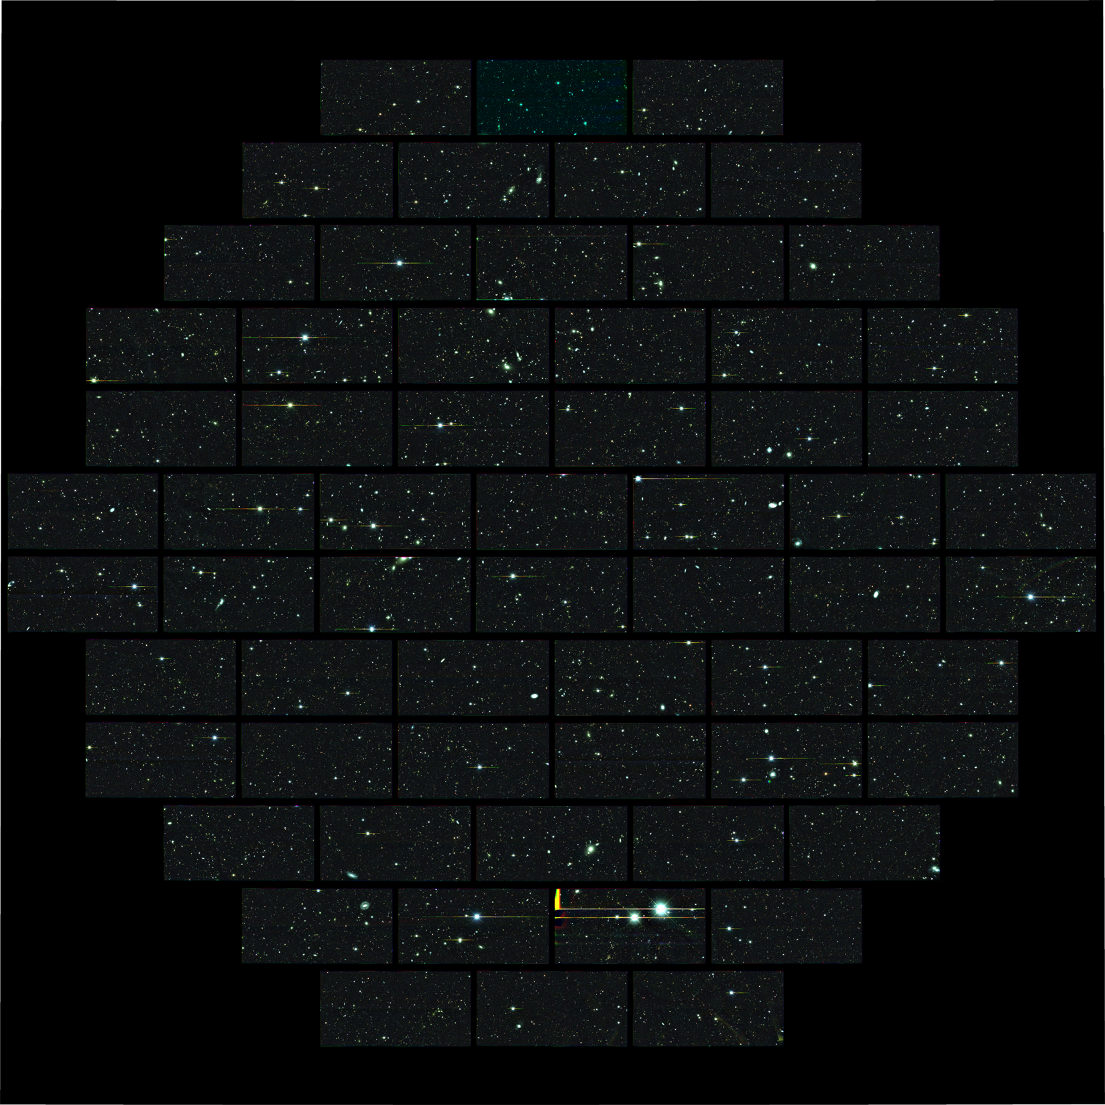
DECam
composite
image of deep
SN field
will be visited many times during survey, resulting in very deep co-add

Slide 41
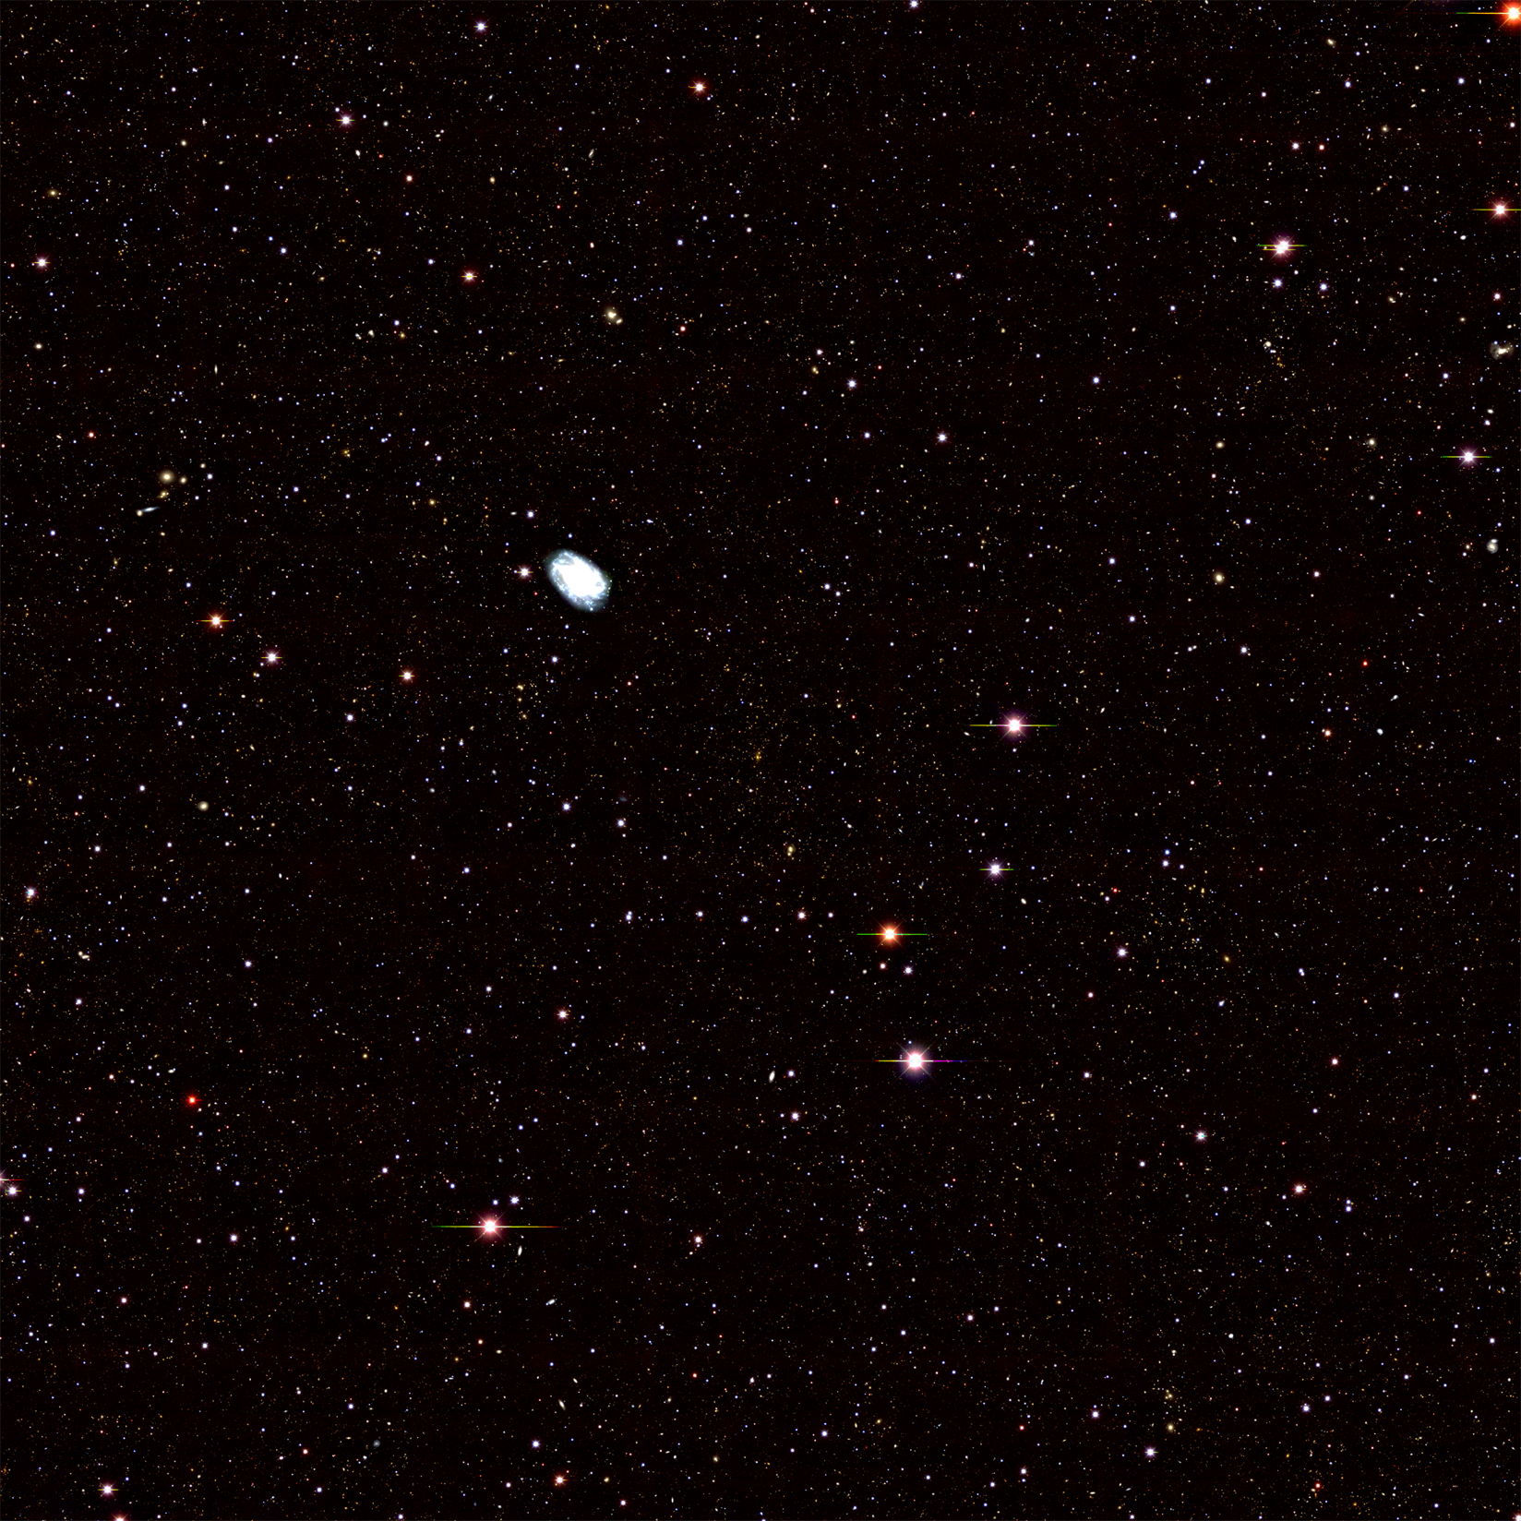
DECam 1x1deg
grizY co-add image of SPT
cluster
z=0.32
~50,000 galaxies in this image

Slide 42
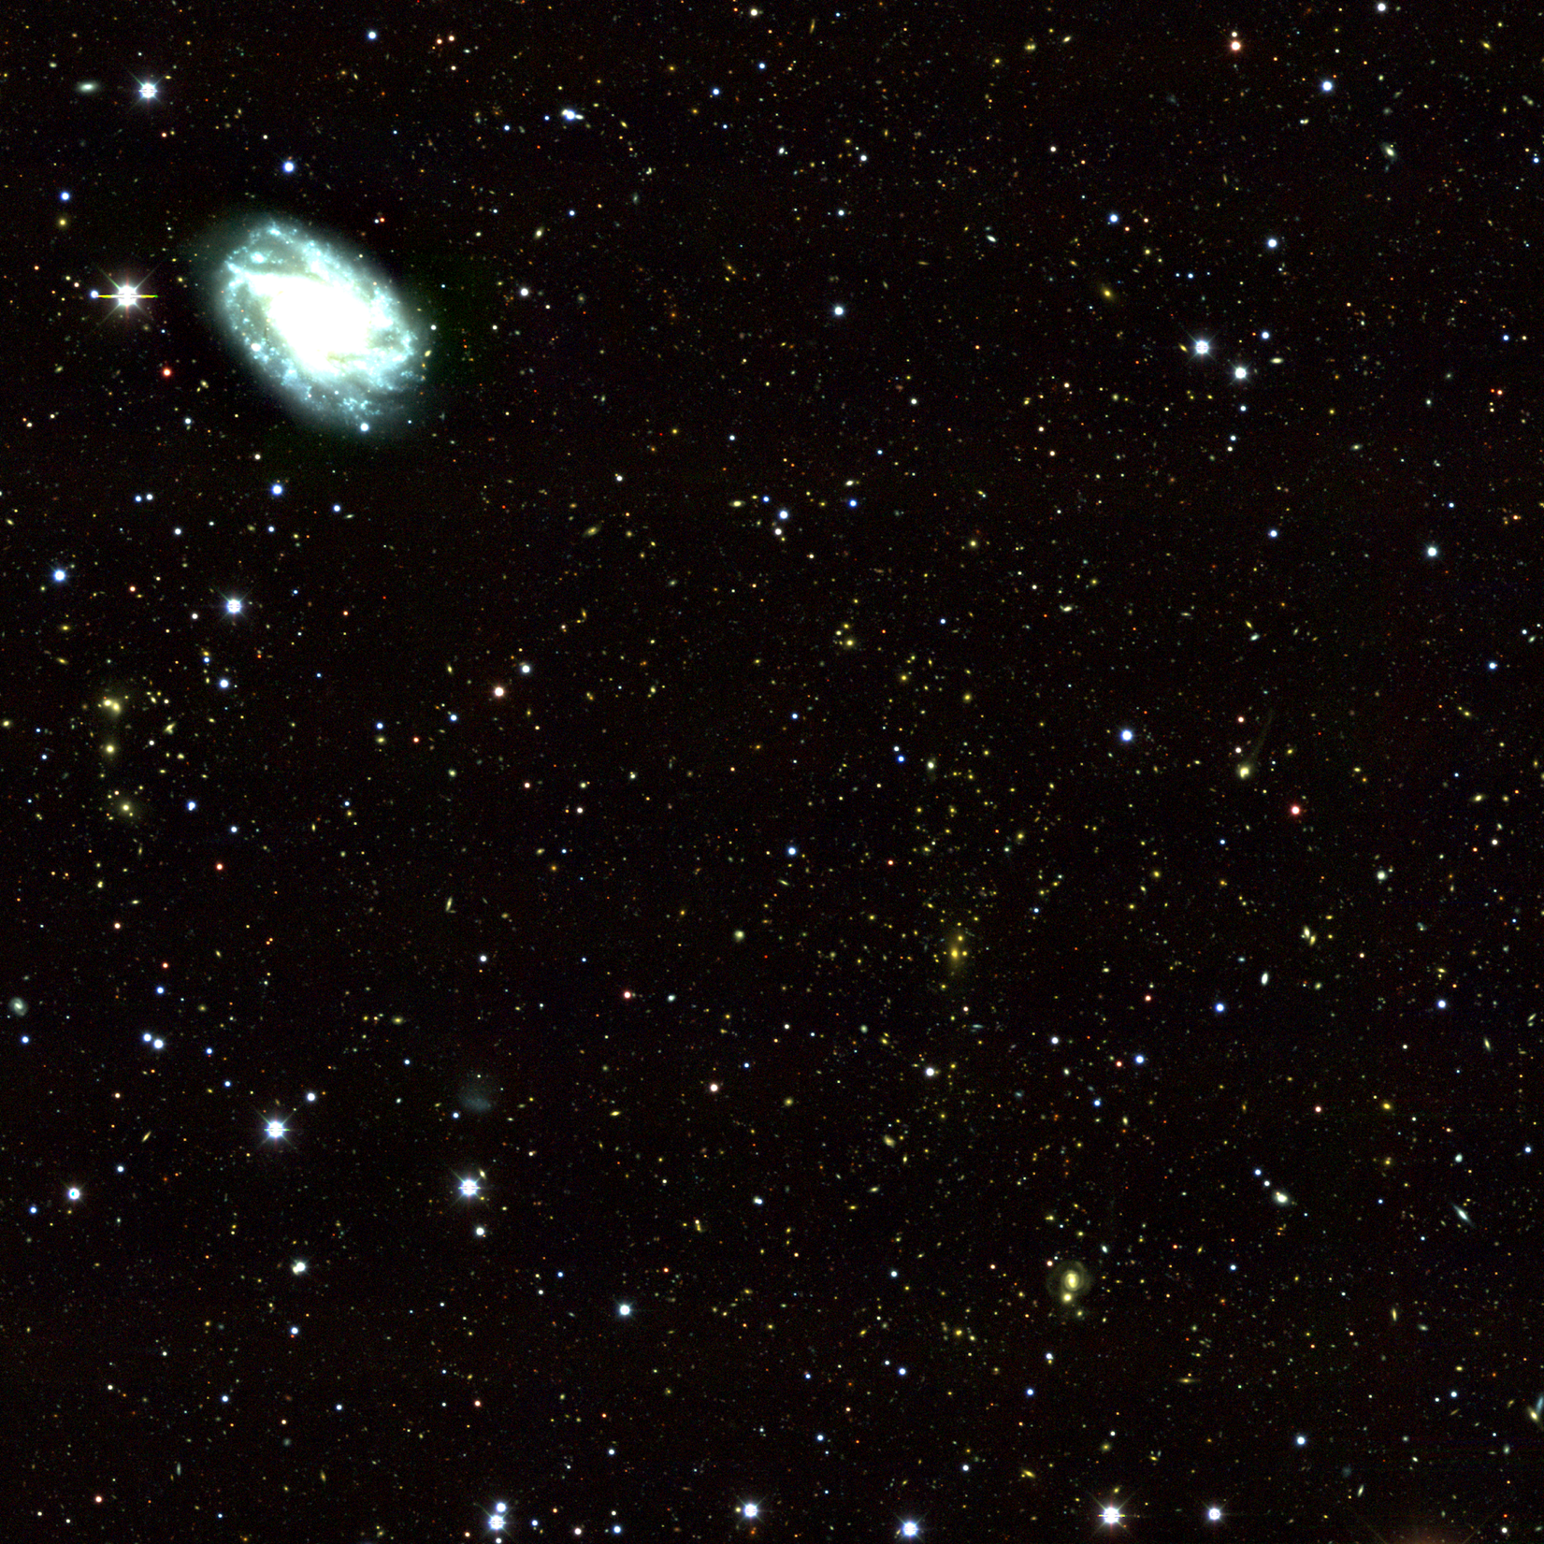
See DES session on Friday afternoon for early results

Slide 43
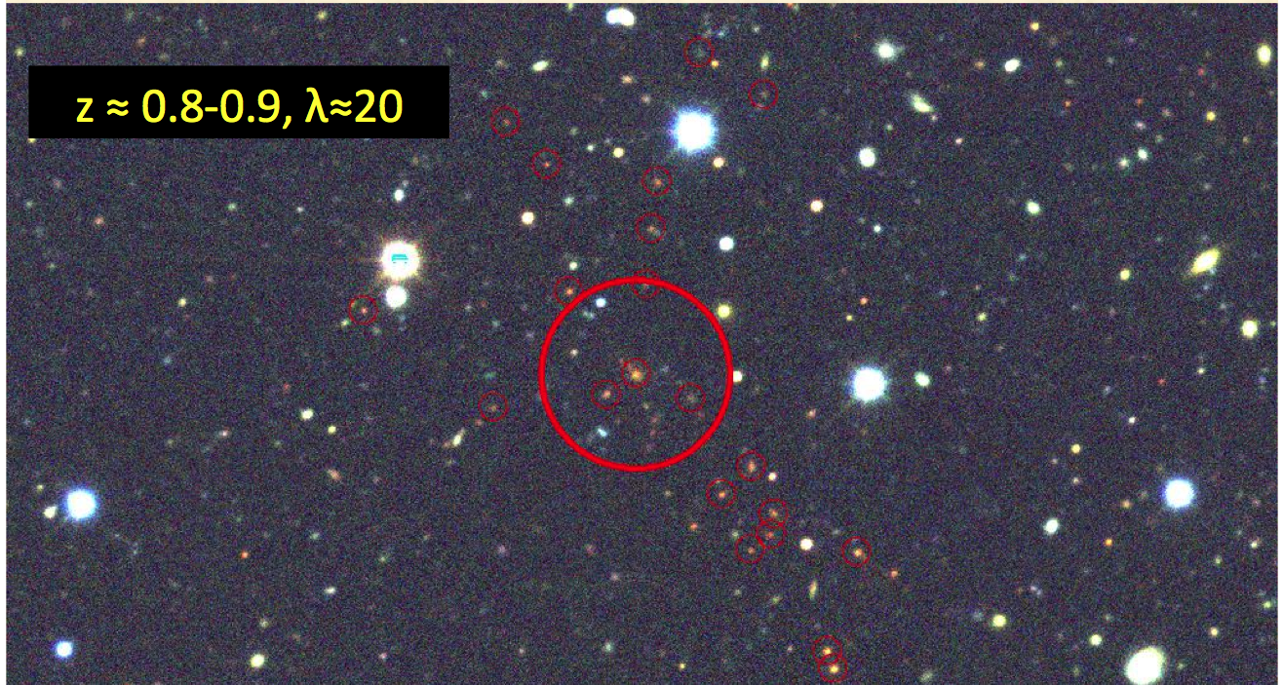
High Redshift Cluster Discovered by DES
from DES Science Verification data last November

Slide 44
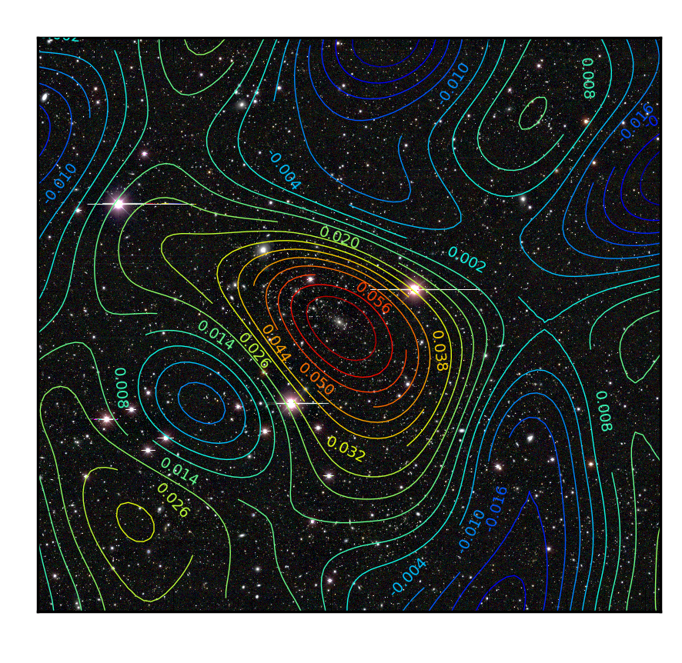
Cluster Weak Lensing
Stacked (statistical) Weak Lensing cluster shear profiles will calibrate cluster mass-observable relations
Preliminary cluster mass map from DES Science Verification data

Slide 45
First Confirmed SNe from DES
Nov. 7 Dec. 15
SN Ia at z=0.2 confirmed at AAO
100 nights on AAO awarded for spectroscopic follow-up (OzDES)

Slide 46
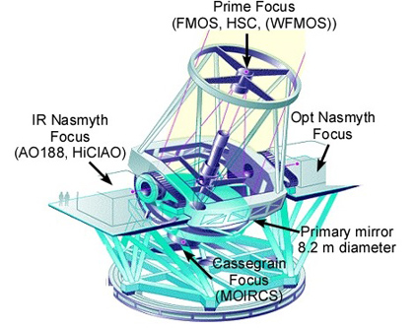
Subaru telescope: SUMIRE
8.2 meter primary mirror
Mauna Kea
Excellent imaging conditions
Hyper suprime-cam (HSC) wide-field imager installed last year: 870 Megapixels, 1.5 deg FOV
Prime-focus spectrograph (PFS) to be built later this decade

Slide 47
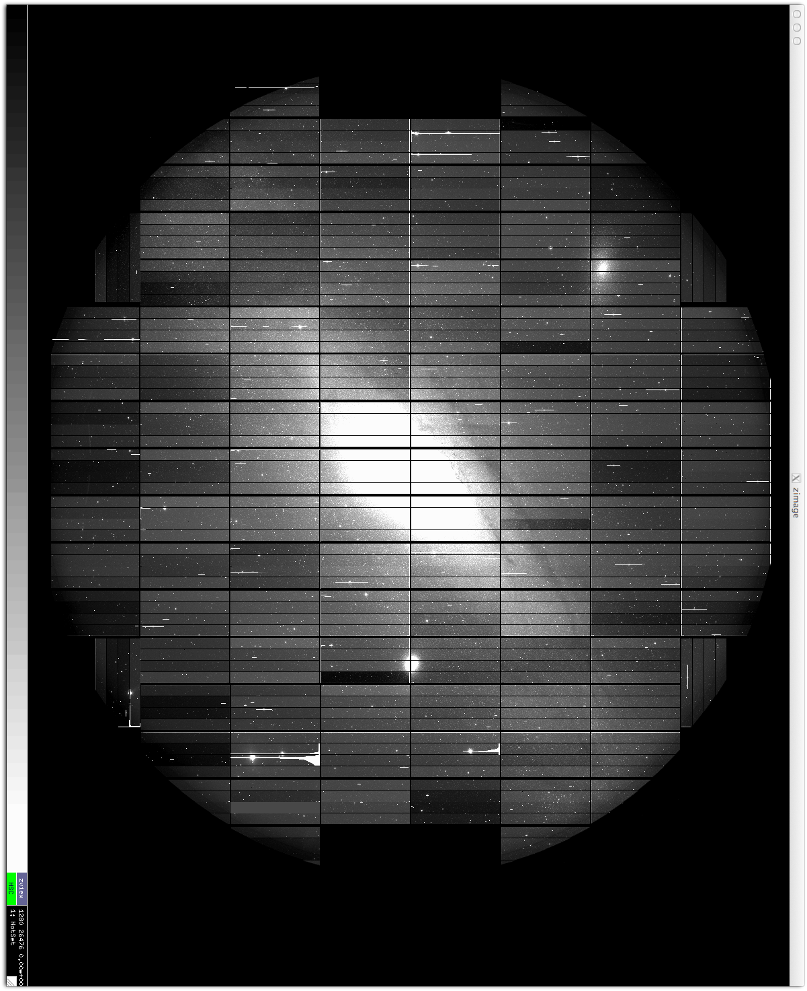
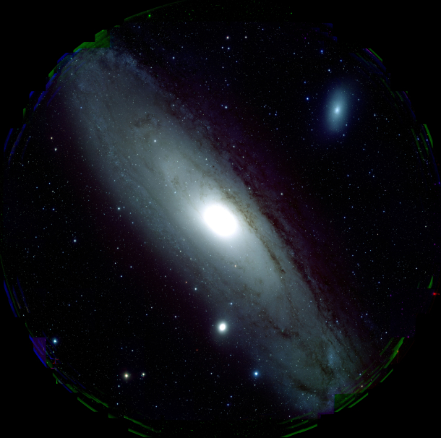
HSC early imaging
Processed image of Andromeda
Raw image of Andromeda

Slide 48
3-layer HSC survey
Wide: ~1400 deg², i<25.8 (grizy)
  Weak lensing, z<1.5 galaxy populations
Deep: ~26 deg², 1 mag deeper, 5 wide+3 NB filters
  Ly-α emitters, quasars, deeper galaxy populations, lensing systematics, …
Ultradeep: 3 deg², 1 mag deeper, 5 wide+6 NB filters
  Supernovae, galaxies to z<7
Important synergies: CMB (ACT+ACTPol), redshifts (BOSS + assorted other), NIR, u band, …
Surveys starting 1st semester of 2014 (300 nights over 5 yrs)

Slide 49

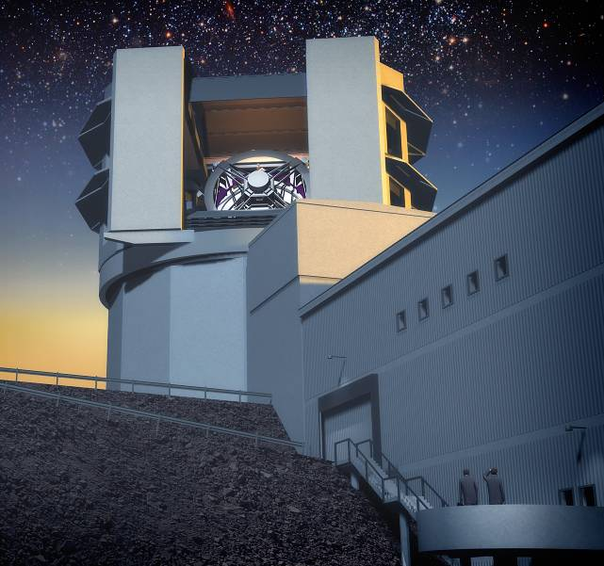

8.4m primary mirror diameter
3.2 Gpix camera with 3.5 deg FOV
Engineered for fast, wide, deep surveys
Cerro Pachon, Chile
LSST slides from S. Kahn

Slide 50
Summary of High Level Requirements
Survey Property | Performance
Main Survey Area | 18000 sq. deg.
Total visits per sky patch | 825
Filter set | 6 filters (ugrizy) from 320-1050nm
Single visit | 2 x 15 second exposures
Single Visit Limiting Magnitude | u = 23.9; g = 25.0; r = 24.7; I = 24.0; z = 23.3; y = 22.1
Photometric calibration | < 2% absolute, < 0.5% repeatability & colors
Median delivered image quality | ~ 0.7 arcsec. FWHM
Transient processing latency | < 60 sec after last visit exposure
Data release | Full reprocessing of survey data annually

Slide 51

Project timeline enables “first light” in 2019, survey start 2022

Slide 52
Spectroscopic BAO Experiments
Survey | Redshift | Years | Precision
2dFGRS | 0.2 | Completed | detection
SDSS-I/II | 0.35 | Completed | 2%
WiggleZ | 0.7 | Completed | 4%
BOSS | 0.35, 0.55, 2.5 | 2009-2014 | 1.7% at z=0.55 today
BOSS | 0.35, 0.55, 2.5 | 2009-2014 | 1% (0.35, 0.55), 1.5% (2.5)
HETDEX | 3.0 | 2013-2015 | 1%
eBOSS | 1.0 | 2014-2018? | 1%
PFS | 0.6-2.4 | 2017 | 1% (6 redshift bins)
MS-DESI | 0.2-1.7 | 2017? | <1% in multiple bins
WFIRST/AFTA | 1.5 – 3.0 | -- | <1% in multiple bins
Euclid | 0.7 – 2.0 | 2020 | <1% in multiple bins

Slide 53
Forecast Distance constraints from spectroscopic surveys
Fractional Distance Error
DESI
From
P. McDonald
Lower is better
Notes:
Distance Error

Slide 54

Growth constraints from Redshift Distortions

Slide 55


ESA Euclid Mission
In ~6 years
15,000 deg²
40 deg²
Shapes + Photo-z of n = 1.5 x10⁹ galaxies
z of n=5x10⁷ galaxies
Weak Lensing Photo-z BAO
Ref: Euclid RB Laureijs et al arXiv:1110.3193
~40 US scientists participating
Euclid slides from Yannick Mellier

Slide 56


Ground Based Data: photo-z
Photometric redshifts with Euclid
Mais ne sont efficaces qu’avec plusieurs filtres dans le domaines visibles et le domaines infra-rouge
Nearinfrared data from Euclid NIR images.
Visible data obtained from ground based telescopes
Requirements: accuracy
= 0.05x(1+z)
4 optical band needed
U-band not needed.

Slide 57



Evolution of WFIRST Concepts to AFTA
DRM1
  1.3 meter off-axis telescope
  150 Mpixels, 0.4 deg²
  5 year mission (15% GO time)
DRM2
  1.1 meter off-axis telescope
  234 Mpixels, 0.6 deg²
  3 year mission (15% GO time)
2.4m AFTA
  2.4 meter on-axis telescope from NRO
  288 Mpixels, 0.3 deg²
  Additional IFU for SN slit spectroscopy
  Additional coronagraph for exoplanet imaging
  5 year mission (25% GO time)

Slide 58


AFTA is a more capable dark energy mission than previous DRMs
Larger telescope + integral field channel enable high S/N spectrophotometry
  More supernovae out to higher redshift
  Systematic errors addressed: eliminate K-correction, improved calibration, measure SN spectral diagnostics.
Deeper weak lensing survey
  3x fainter, 1.9x smaller PSF, 2x n_{eff}
  more accurate lensing maps to higher redshift
  Better sampling for higher-order WL statistics
  Lensing masses for 40,000 M ≥ 10¹⁴M_{sun} clusters in the 2000 deg² area of the high-latitude survey
Much deeper galaxy redshift survey at 1 < z< 2, [OIII] extends redshift range to z =3.
  Can use multiple tracers.
  Improve redshift-space distortion measurements, test systematics.
  Better measurements of high-order clustering.
Notes:
As a supernova cosmology experiment, AFTA is close to ideal, because of the combination of collecting area, resolution, and IFU.* As a machine for WL and z = 1-2 GRS it's also close to ideal, but in 2 years of observing it will do only a fraction of what it's capable of doing. Over that period, the narrow-deep strategy is a good complement to Euclid's (and to some extent LSST's) shallow-wide.At the end of the prime mission, we'll be in a good position to know whether it looks interesting enough to spend more time going wide-deep and what is the best way of doing so; the former depends on whether there are or are not deviations from LCDM, and the latte rdepends on what we then understand about systematics of the methods and about whether exploiting higher-order clustering or smaller scales makes WL or RSD much more powerful than we presently anticipate.The fact that WFIRST-2.4 *can* go deep gives it more flexibility in responding to long-term developments than DRM1, even if it isn't measuring many more WL shapes or galaxy redshifts per unit time.

Slide 59
Frontiers of Knowledge
As envisioned in NWNH, AFTA uses multiple approaches to measure the growth rate of structure and the geometry of the universe to exquisite precision. These measurements will address the central questions of cosmology
Imaging Survey
Supernova Survey
Map over 2000 square degrees of high latitude sky
500 million lensed galaxies (70/arcmin²)
40,000 massive clusters
wide, medium, & deep imaging + IFU spectroscopy
2700 type Ia supernovae
z = 0.1–1.7
Why is the universe accelerating?
What are the properties of the neutrino?
What is Dark Matter?
Measure the Distance Redshift Relationship
Trace the Distribution of Dark Matter Across Time
BAO
Spectroscopic Survey
Red shift space distortions
Multiple measurement techniques each achieve 0.1-0.4% precision
20 million Hα galaxies, z = 1–2
2 million [OIII] galaxies, z = 2–3
Notes:
Much higher surface density of lensing (2-3 times higher than DRM1)
Much larger redshift range for spectroscopic survey (OIII extends reach to z =3)
Significantly improved ability to characterize SN

Slide 60
AFTA and Euclid have complementary strengths for dark energy studies
AFTA:
Deep Infrared Survey (2000 sq. deg)
Lensing:
High Resolution (70 -250 gal/arcmin²)
5 lensing power spectrum
Supernovae:
High quality IFU spectra of 2700 SN
Redshift survey
High number density of galaxies
Redshift range extends to z = 3
Euclid:
Wide optical Survey (15000 sq. deg)
Lensing:
Lower Resolution (30 gal/arcmin²)
1 lensing power spectrum
No supernovae program
Redshift survey:
Low number density of galaxies
Significant number of low redshift galaxies
-
AFTA
10x more sensitive in GRISM mode
Euclid

Slide 61
Dark Energy Program
U.S. roadmap for Dark Energy Surveys:
  BOSS, DES, (eBOSS) → DESI → LSST, AFTA?, (Euclid)
Ground/Space, Imaging/Spectroscopy are complementary and synergistic:
  Ground: wide-area, optical, photo-z’s
  Space: deep, infrared, stable
  Imaging: efficient, 2D info., multiple methods
  Spectroscopy: 3D info. for RSD, BAO
Potentially substantial gains from coordinating operations and data analysis from multiple surveys
Most DE methods likely to be systematics-limited
How far do we need to go?
  Precision/accuracy vs cost

