Slide 1
Observation and coupling measurements of the Higgs boson in the diphoton decay channel in ATLAS
Hongtao Yang
University of Wisconsin-Madison

Slide 2
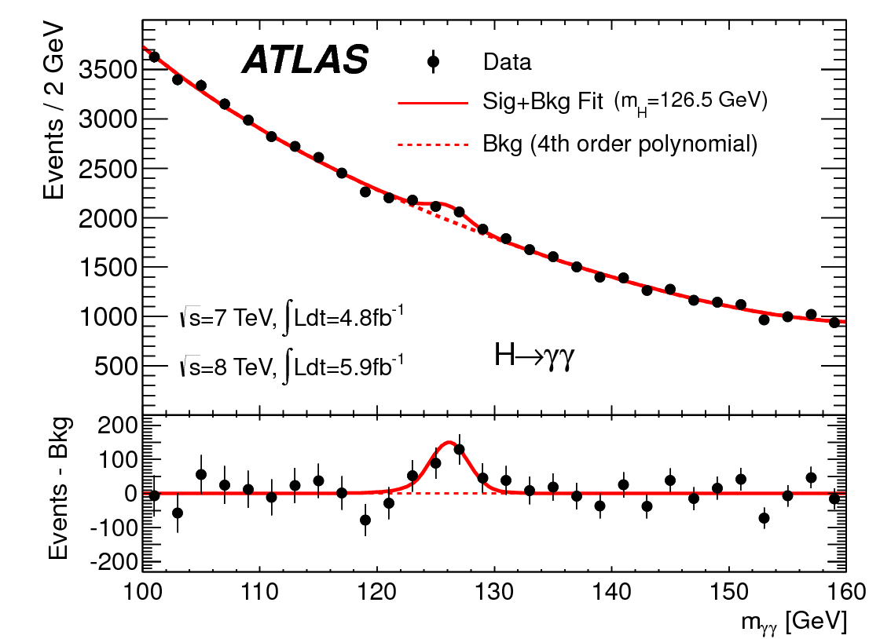
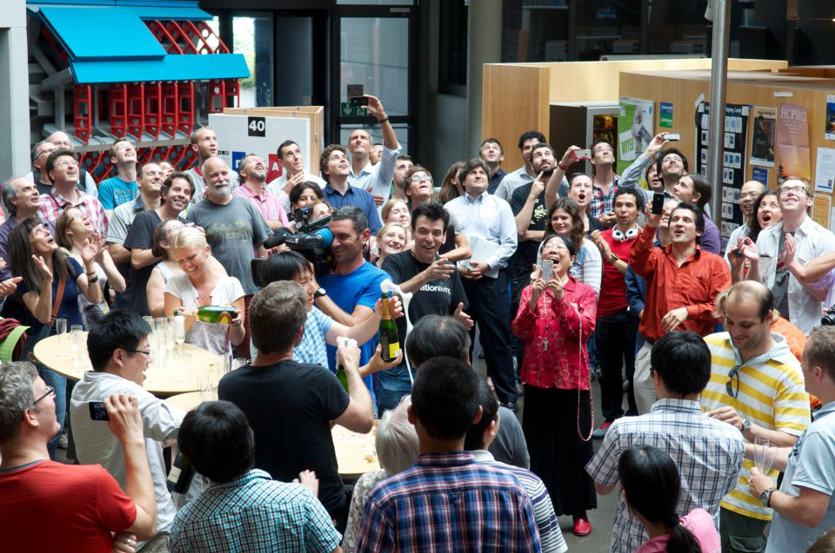
Outline
Present the post discovery results on observation and coupling measurements in $H→γγ$.
The results are based on the 4.8 fb⁻¹ 7 TeV data and 20.7 fb⁻¹ 8 TeV data taken during 2011-2012.
ATLAS Higgs group celebrating the discovery of the Higgs-like boson on July 4th, 2012
$H→γγ$ contributed an excess of 4.5$σ$to the discovery of Higgs boson.
Phys. Lett. B 716 (2012) 1-29

Slide 3
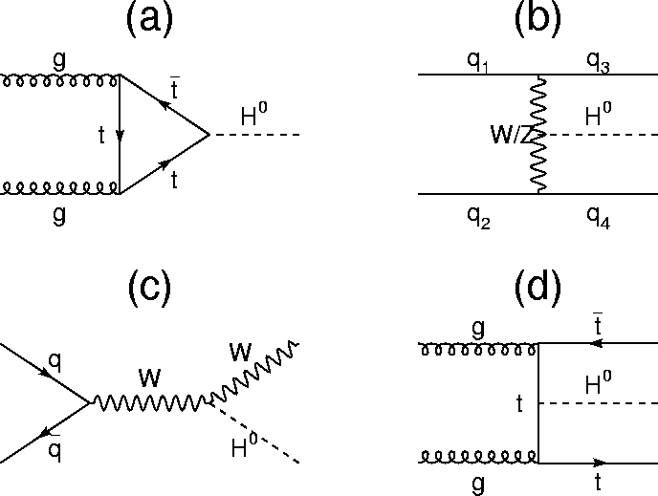
Production and Decay
arXiv:1101.0593, arXiv:1201.3084
Production
Decay
Dominant
 | Luminosity | Higgs produced | Decayed to diphoton | Selected
7 TeV | 4.8 fb⁻¹ | ~83,000 | ~190 | ~80
8 TeV | 20.7 fb⁻¹ | ~458,000 | ~1000 | ~420
SM expectation assuming $mH$ = 125.5 GeV

Slide 4
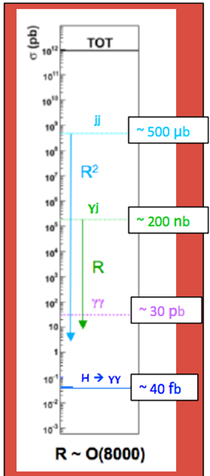
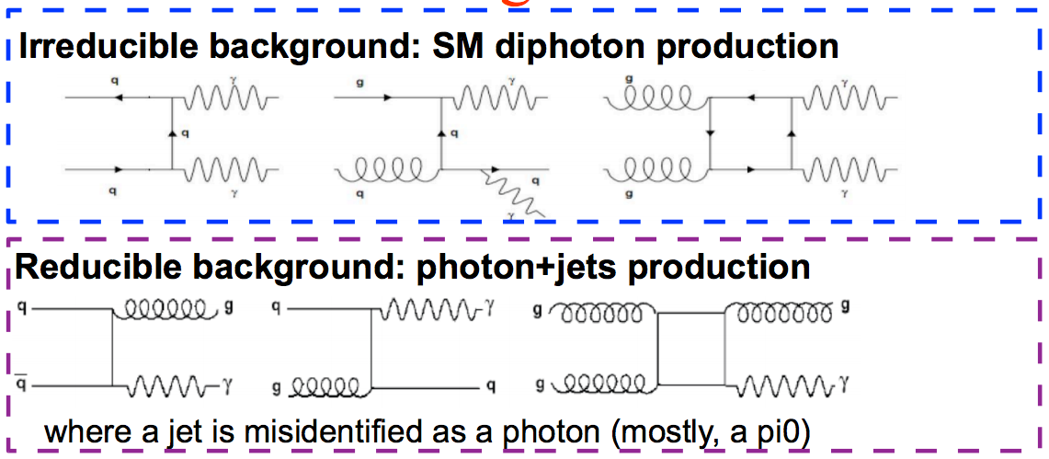
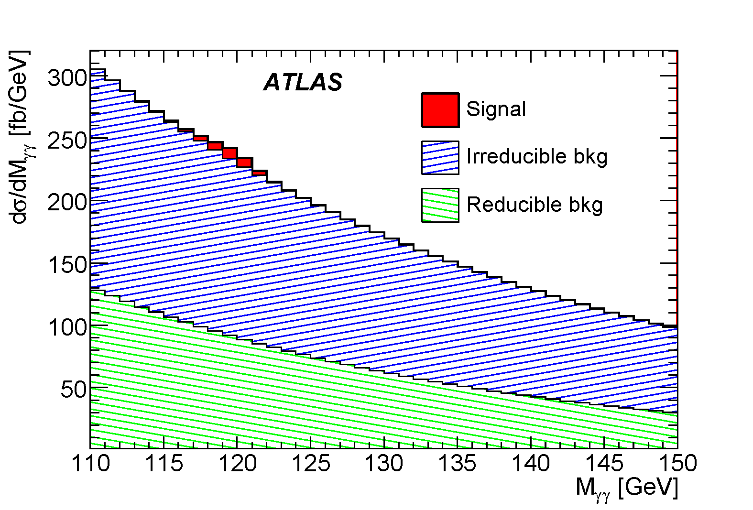
Background
Both photons are not fake
arXiv:0901.0512

Slide 5
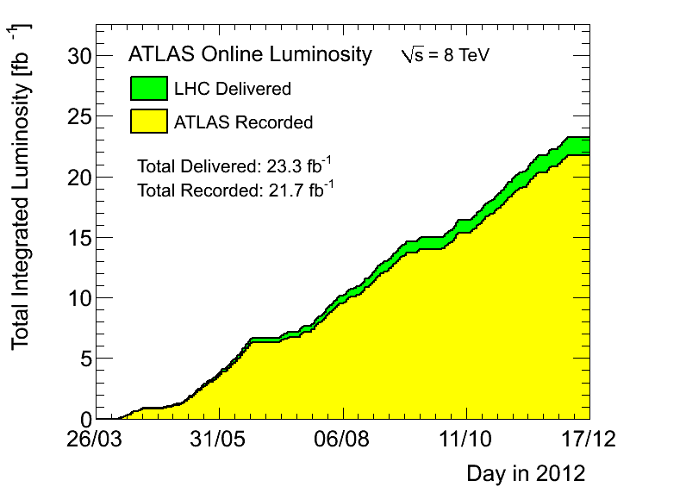
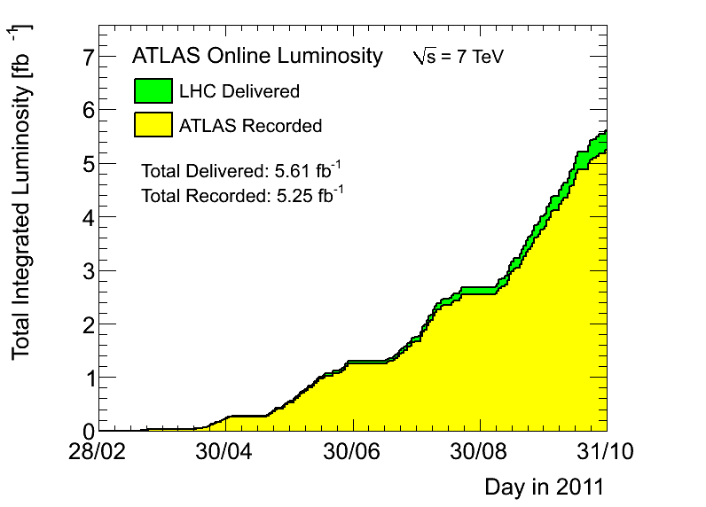
Select $H→γγ$ candidates
Very simple diphoton candidates selection:
$pT$(γ₁,γ₂) > 40, 30 GeV
|η| < 1.37 or 1.56 < |η| < 2.37
Isolated photon, passing photon identification criteria
https://twiki.cern.ch/twiki/bin/view/AtlasPublic/LuminosityPublicResults

Slide 6
Invariant mass spectrum
arXiv:1307.1427

Slide 7
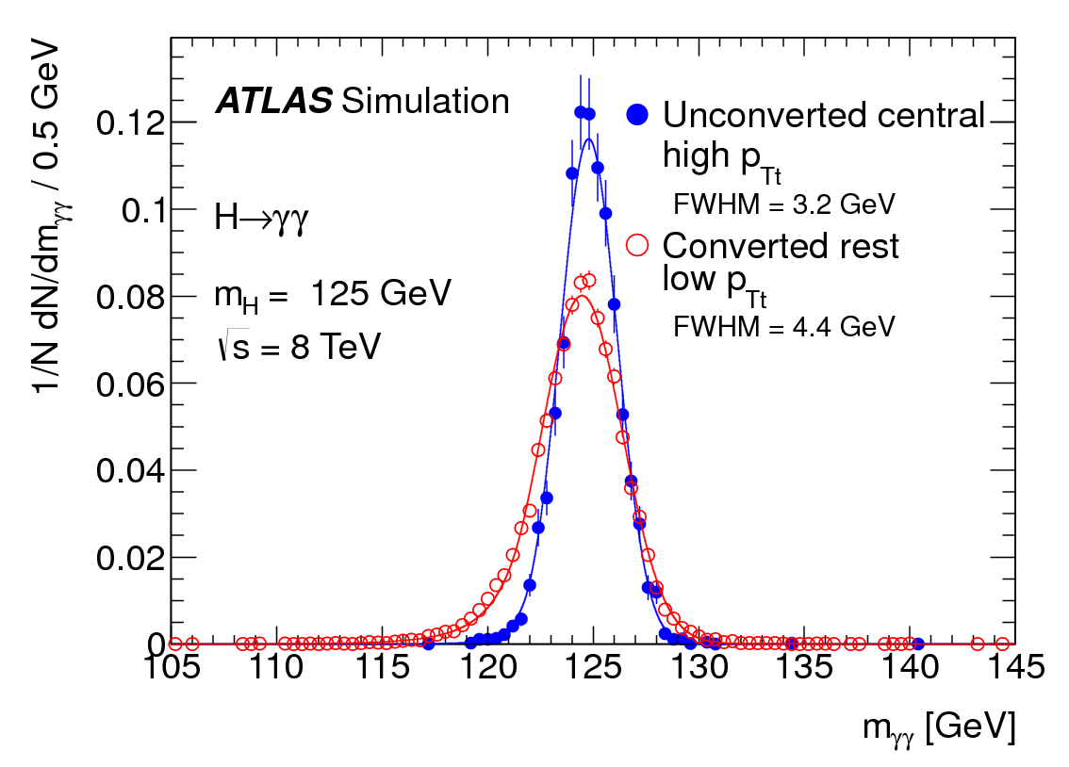
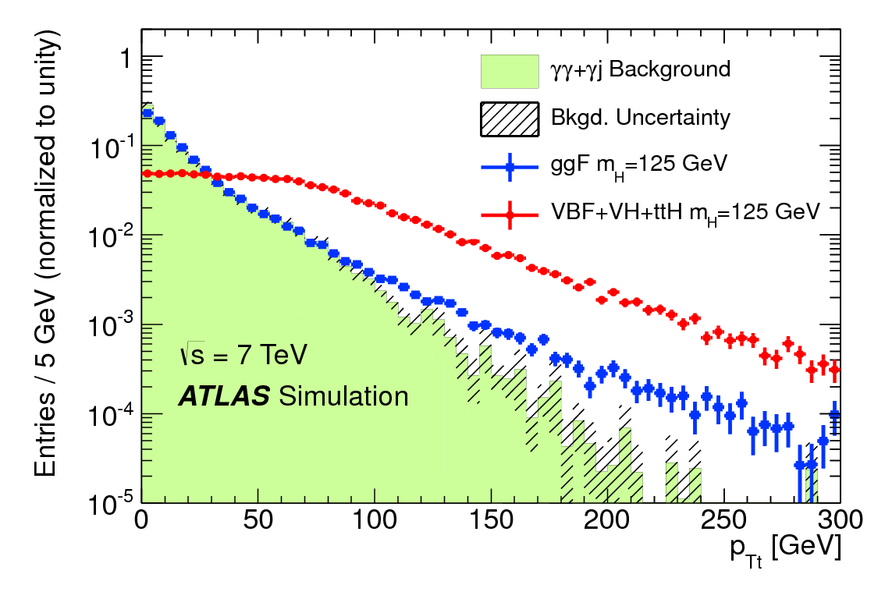
Categorization
Enhance the sensitivity: classifying events to categories with different S/B and resolution.
Using photon $η$, photon conversion status and $p_{Tt}$ to define categories.
Important for the search
Low $p_{Tt}$
High $p_{Tt}$
ATLAS-CONF-2012-091

Slide 8
Categorization
Enhance the sensitivity: classifying events to categories with different S/B and resolution.
Using photon $η$, photon conversion status and $p_{Tt}$ to define categories.
Important for the search
Enhance the sensitivity to particular Higgs boson production modes: isolate events with distinct topologies.
Important for the coupling measurements
ATLAS-CONF-2013-012

Slide 9
Signal decomposition
54.1~76.0% VBF
29.7~63.2% WH 17.2~47.6% ZH
arXiv:1307.1427

Slide 10
Signal significance
arXiv:1307.1427
 | m_{H} (GeV) | Expected Z (σ) | Observed Z (σ)
7 TeV | 126.0 | 1.6 | 3.3
8 TeV | 126.5 | 4.0 | 6.5
Combined | 126.5 | 4.3 | 7.4

Slide 11
Signal strength
Signal strength ($μ$) : number of observed signal events over number of expected signal events.
For the inclusive production: $μ$
For each Higgs production mode: $μ_{i}×BR/BR_{SM}$ ($i=ggH+t\overline{t}H, VBF, VH$…)
Categorization made coupling measurements possible
$N_{i}$: observed signal events in category $i$.
$S_{i,j}:$ SM signal yield in category $i$ for the Higgs boson production mode $j$.
$$\left(\begin{aligned}N_{1} \\ ⋮ \\ N_{i}\end{aligned}\right)≈\left(\begin{matrix}S_{1,1} & ⋯ & S_{1,j} \\ ⋮ & ⋱ & ⋮ \\ S_{i,1} & ⋯ & S_{i,j}\end{matrix}\right)×\left(\begin{aligned}μ_{1} \\ ⋮ \\ μ_{j}\end{aligned}\right)$$
$$N≈μ×S$$
Inclusive
model independent
Categorized
model dependent

Slide 12
Mass measurement
$mH$ is extracted from a fit with both signal position and normalization free.
$mH = 126.8 ±0.2 \left(stat\right)±0.7 \left(syst\right)$ GeV
Dominant uncertainty: mass scale systematics.
ATLAS-CONF-2013-012

Slide 13
Inclusive signal strength measurement
μ= $1.57±0.22 {\left(stat\right)}_{−0.13}^{+0.17}{\left(syst\right)}_{−0.12}^{+0.17}\left(theory\right)$ with $m_{H}$ = 126.8 GeV
Theory uncertainty (theory): QCD scale, PDF and branching ratio uncertainties.
Systematic uncertainty (syst): all the other uncertainties.
The possibility that a SM signal fluctuate to the observation is 3%, corresponding to 1.9$σ$ deviation from the SM S+B hypothesis (@125.5 GeV).
arXiv:1307.1427

Slide 14
Coupling with fermions vs. coupling with bosons
@125.5 GeV
$ggH+t\overline{t}H$: coupling with fermion (top quark)
$VBF+VH$: coupling with vector boson
Consistent with SM within 2σ (Results from $4l$ and $WW$ channels are consistent with SM within $1σ$).
Evaluated @125.5GeV: difference compared with results @126.8GeV is small due to large uncertainty on $m_{H}$ (700 MeV) in this channel.
arXiv:1307.1427

Slide 15
Coupling measurements results
arXiv:1307.1427
μ=${1.57}_{−0.28}^{+0.32}$
$$μ_{ggH+t\overline{t}H}×BR/{BR}_{SM}=1.54{}_{−0.31}^{+0.31}{{\left(stat\right)}_{−0.18}^{+0.28}\left(syst\right)}$$
$$μVBF ×BR/{BR}_{SM}=1.63{}_{−0.71}^{+0.78}{ {\left(stat\right)}_{−0.42}^{+0.53}\left(syst\right)}$$
$$μVH×BR/{BR}_{SM}=1.71{}_{−1.25}^{+1.40}{ {\left(stat\right)}_{−0.27}^{+0.30}\left(syst\right)}$$

Slide 16
Search for $t\overline{t}H$ (New)
Crucial for understanding the Yukawa coupling between the top quark and the Higgs boson
Two channels
Leptonic: $t\overline{t}→W^{+}bW^{−}\overline{b}→lνb+lνb/jjb$
Hadronic: $t\overline{t}→W^{+}bW^{−}\overline{b}→4j+b\overline{b}$
ATLAS-CONF-2013-080
Signal decomposition in the two $t\overline{t}H$ channels

Slide 17
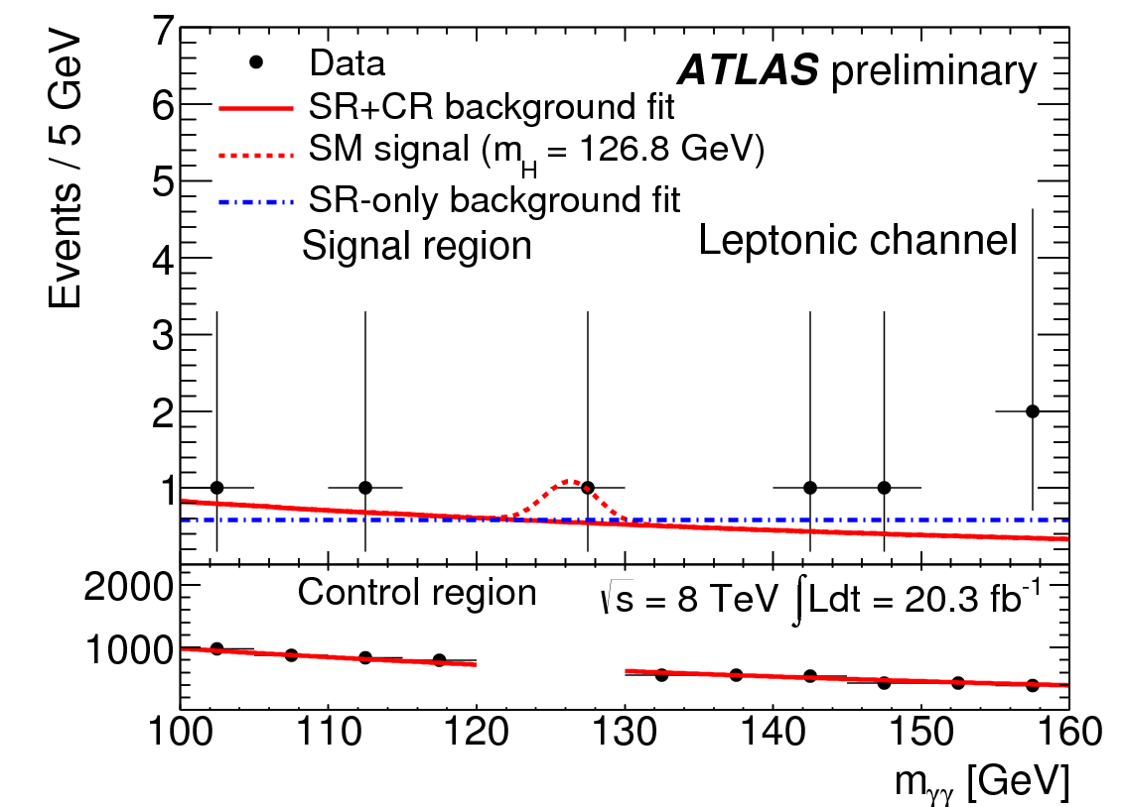
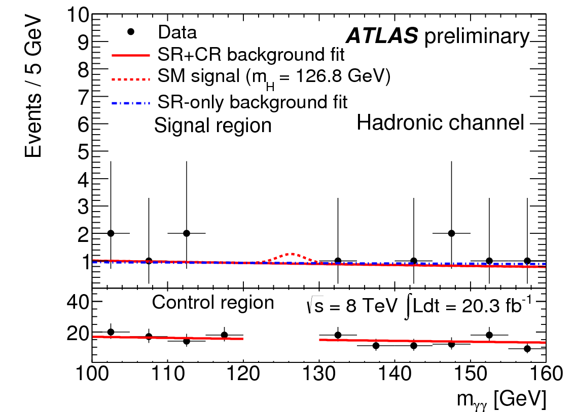
Limit on $t\overline{t}H, H→γγ$ (New)
The exclusion limits @ 95% C.L. on $t\overline{t}H, H→γγ$ production @$mH$=126.8 GeV are
Observed 5.3$×$SM
Expected 6.4$×$SM
ATLAS-CONF-2013-080
One candidate!

Slide 18
Conclusion I
The significance of the newly observed particle in diphoton final state reaches 7.4 σ.
The mass of the particle is measured to be $mH=126.8±0.2\left(stat\right)±0.7\left(syst\right)$ GeV
The signal strength @126.8 GeV is
μ=$1.57±0.22 {\left(stat\right)}_{−0.13}^{+0.17}{\left(syst\right)}_{−0.12}^{+0.17}\left(theory\right)$
Tension between data and SM observed. More data will be needed to confirm or dismiss it.

Slide 19
Conclusion II
The coupling measurements results are
$μ_{ggH+t\overline{t}H}×BR/{BR}_{SM}=1.54{}_{−0.31}^{+0.31}{{\left(stat\right)}_{−0.18}^{+0.28}\left(syst\right)}$
$μVBF ×BR/{BR}_{SM}=1.63{}_{−0.71}^{+0.78}{ {\left(stat\right)}_{−0.42}^{+0.53}\left(syst\right)}$
$μVH×BR/{BR}_{SM}=1.71{}_{−1.25}^{+1.40}{ {\left(stat\right)}_{−0.27}^{+0.30}\left(syst\right)}$
The observed exclusion limit on $t\overline{t}H, H→γγ$ at 95% confidence level @126.8 GeV is 5.3$×$SM prediction. The expected limit is 6.4$×$SM.
More updates expected to come later this year from ATLAS. Stay tuned!

Slide 20
Bonus: Animated Invariant mass spectrum
https://twiki.cern.ch/twiki/pub/AtlasPublic/HiggsPublicResults/Hgg-FixedScale-Short2.gif

Slide 21
References
arXiv:0901.0512: Expected Performance of the ATLAS Experiment, Detector, Trigger and Physics
arXiv:1101.0593: Handbook of LHC Higgs Cross Sections: 1. Inclusive Observables
arXiv:1201.3084: Handbook of LHC Higgs Cross Sections: 2. Differential Distributions
ATLAS-CONF-2012-091: Observation of an excess of events in the search for the Standard Model Higgs boson in the gamma-gamma channel with the ATLAS detector
Phys. Lett. B 716 (2012) 1-29: Observation of a New Particle in the Search for the Standard Moddel Higgs Boson with the ATLAS Detector at the LHC
ATLAS-CONF-2013-012: Measurements of the properties of the Higgs-like boson in the two photon decay channel with the ATLAS detector using 25 fb−1 of proton-proton collision data
arXiv:1307.1427: Measurements of Higgs boson production and couplings in diboson final states with the ATLAS detector at the LHC
ATLAS-CONF-2013-080: Search for ttH production in the H → γγ channel at √s = 8 TeV with the ATLAS detector

Slide 22
Back up

Slide 23
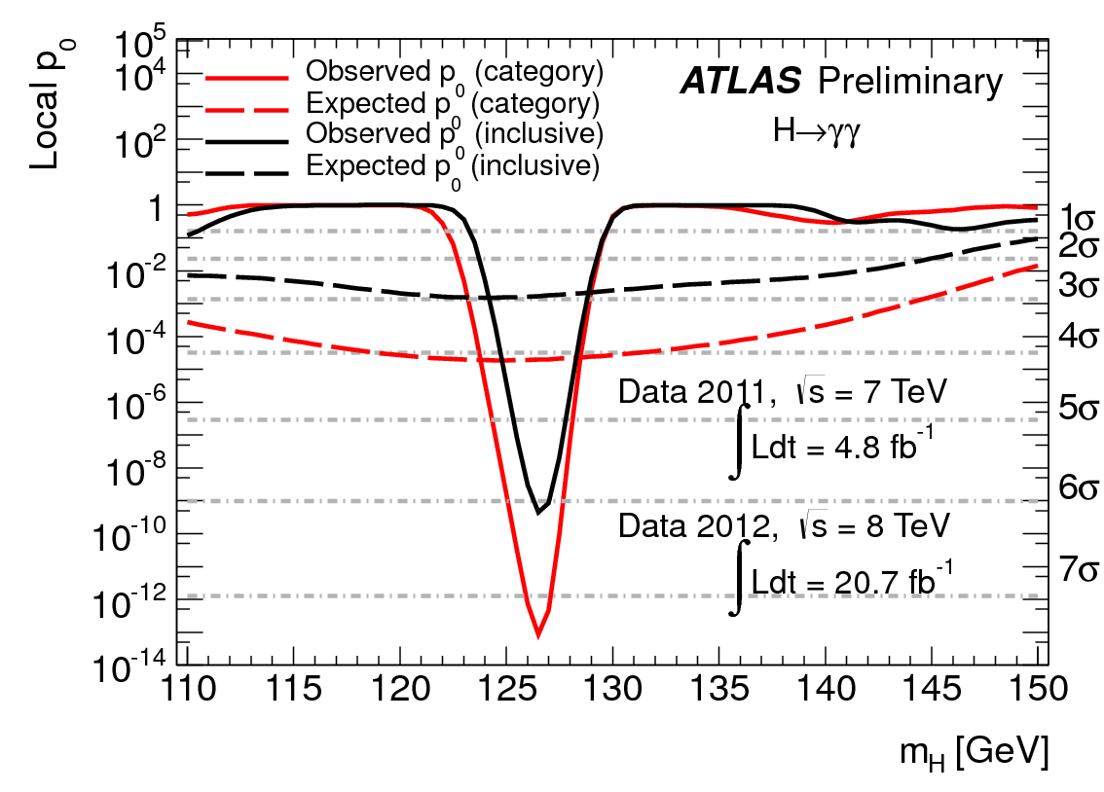
Peak significance in the inclusive spectrum
ATLAS-CONF-2013-012

Slide 24
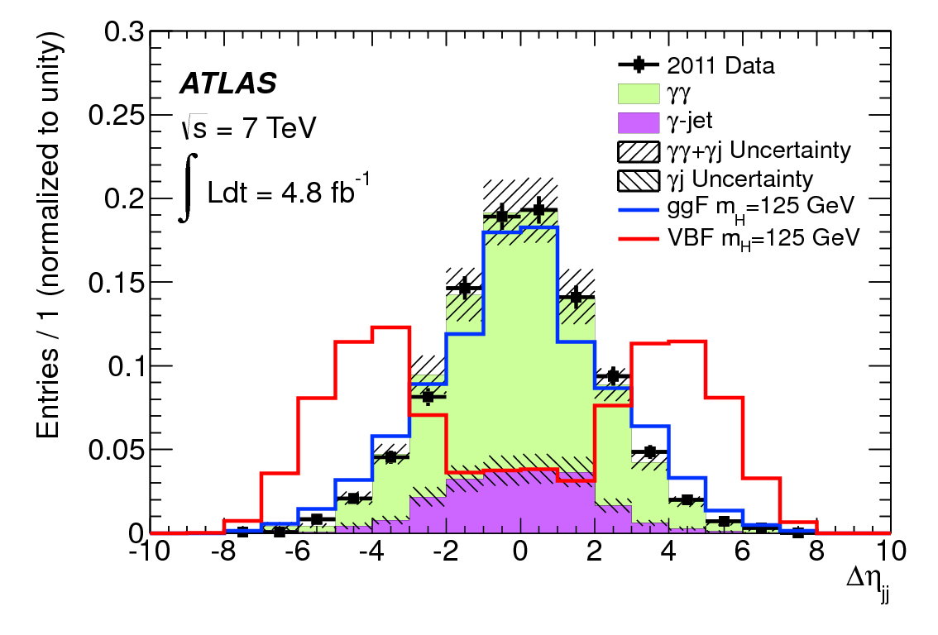
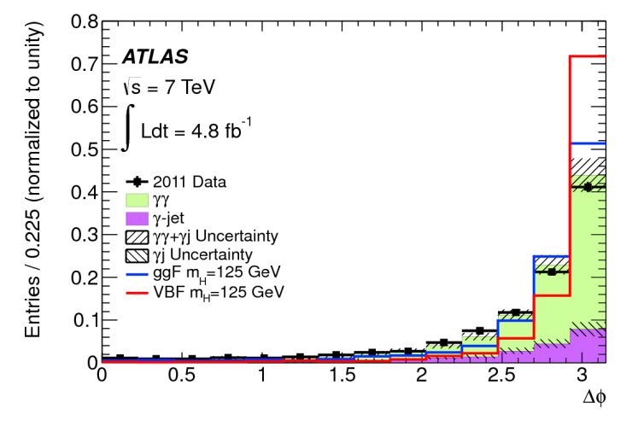
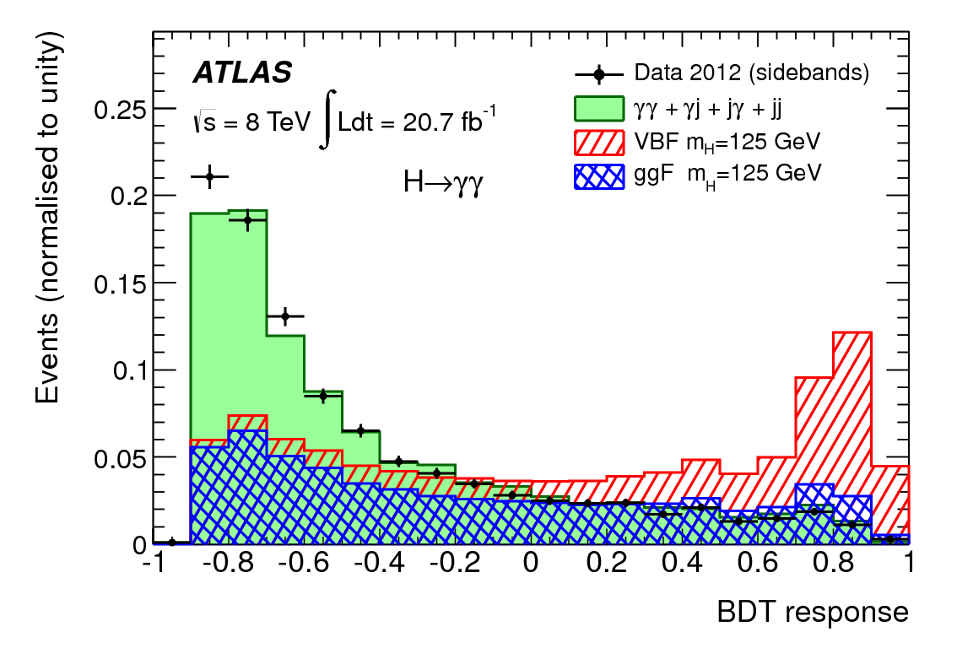
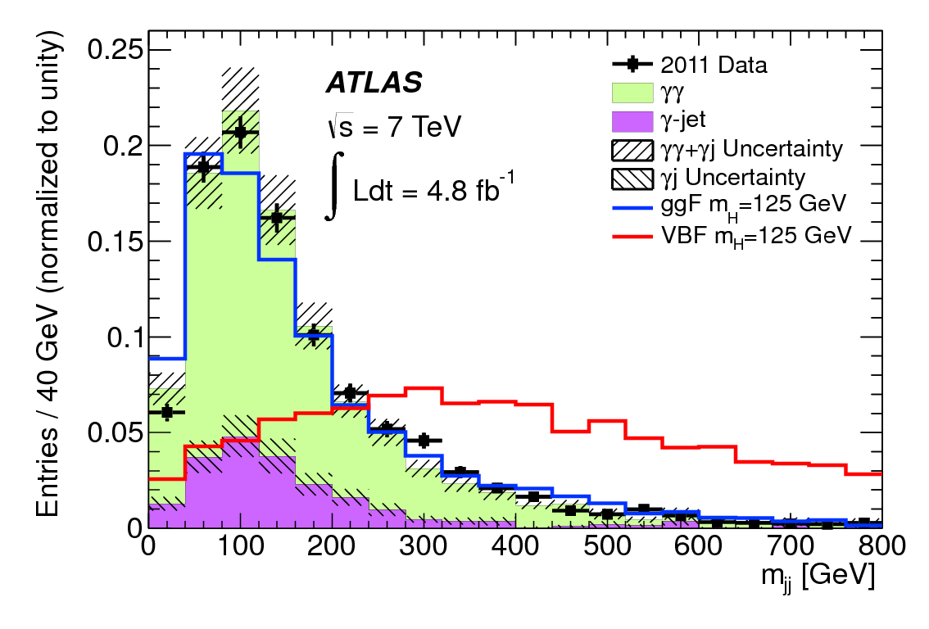
VBF categories
7 TeV: $|Δη_{jj}|>2.8$, $Δφ_{γγ,jj}>2.6$, $m_{jj}>400$ GeV.
8 TeV: Boost Decision Tree (BDT).
Inputs: $η_{j1}$, $η_{j2}$, $Δη_{jj}$, $m_{jj}$, $η^{∗}=η_{γγ}−(η_{j1}+η_{j2})/2$, $Δφ_{γγ,jj}$, $ΔR(γ, j)$
2 categories according to BDT score:
“Loose”: 0.44<BDT<0.74
“Tight”: BDT>0.74
Loose
Tight
Phys. Lett. B 716 (2012) 1-29, arXiv:1307.1427

Slide 25
VH categories
Lepton category (8 TeV only): $VH→lν/llγγ$.
Requiring an isolated electron or muon candidate.
Vetoing events with 84 GeV <$m_{eγ}$<94GeV.
$E_{T}^{miss}$ category (8 TeV only): $VH→lν/ννγγ$.
Requiring $E_{T}^{miss}$ significance (defined as $E_{T}^{miss}/σ_{E_{T}^{miss}}$, where $σ_{E_{T}^{miss}}=0.67GeV^{1/2}√{∑E}_{T}$) larger than 5.
Low-mass two-jet category (8 TeV only):$VH→jjγγ$.
60 GeV < $m_{jj}$ < 110 GeV.
$\left|Δη_{γγ,jj}\right|<1$
$p_{Tt}>70$ GeV
arXiv:1307.1427

Slide 26
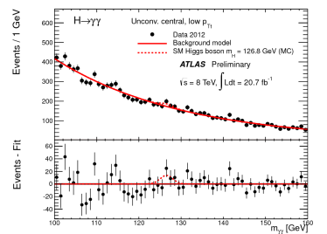
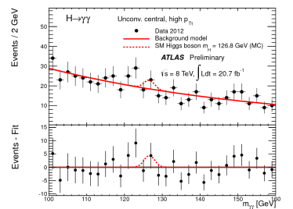
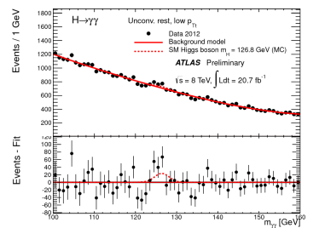
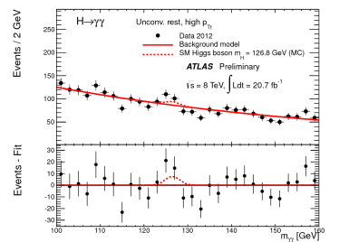
All Categories
Phys. Lett. B 716 (2012) 1-29, ATLAS-CONF-2013-012

Slide 27
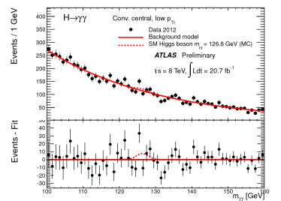
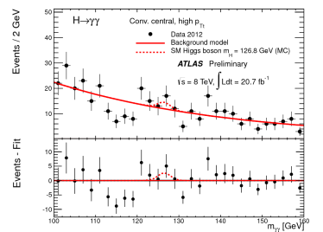
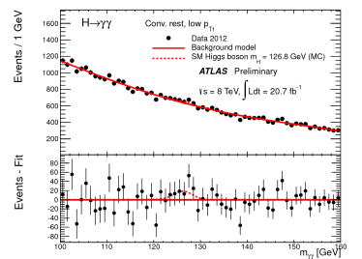
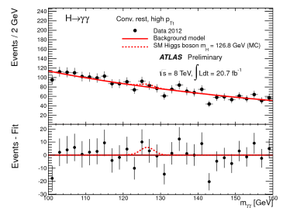
All Categories
Phys. Lett. B 716 (2012) 1-29, ATLAS-CONF-2013-012

Slide 28
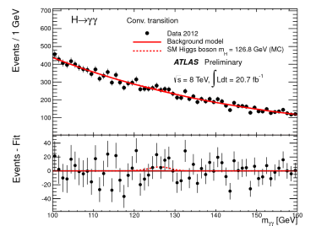
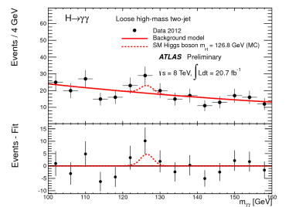
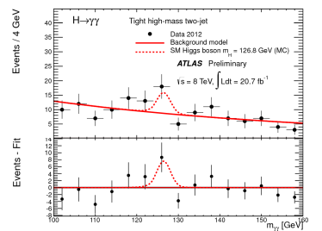
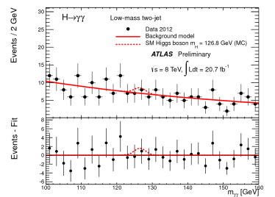
All Categories
Phys. Lett. B 716 (2012) 1-29, ATLAS-CONF-2013-012

Slide 29
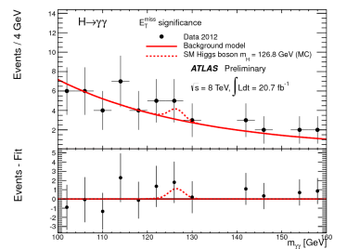
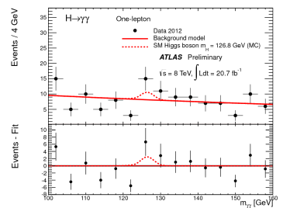
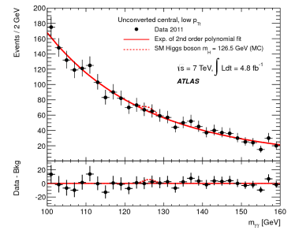
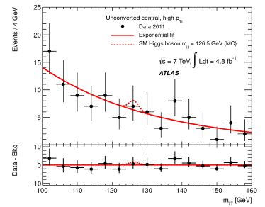
All Categories
Phys. Lett. B 716 (2012) 1-29, ATLAS-CONF-2013-012

Slide 30
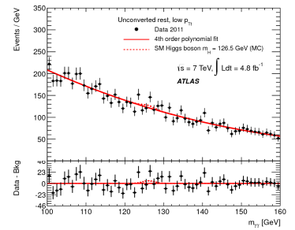
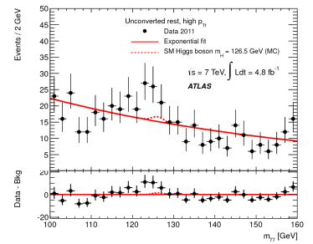
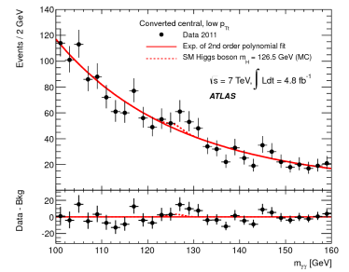
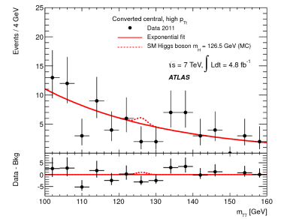
All Categories
Phys. Lett. B 716 (2012) 1-29, ATLAS-CONF-2013-012

Slide 31
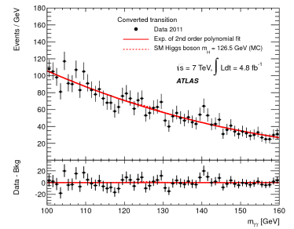
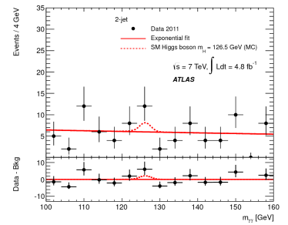
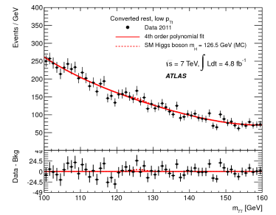
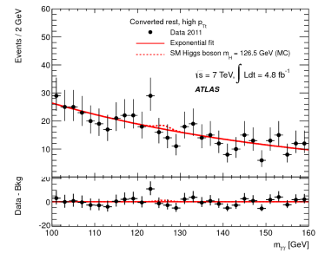
All Categories
Phys. Lett. B 716 (2012) 1-29, ATLAS-CONF-2013-012

Slide 32
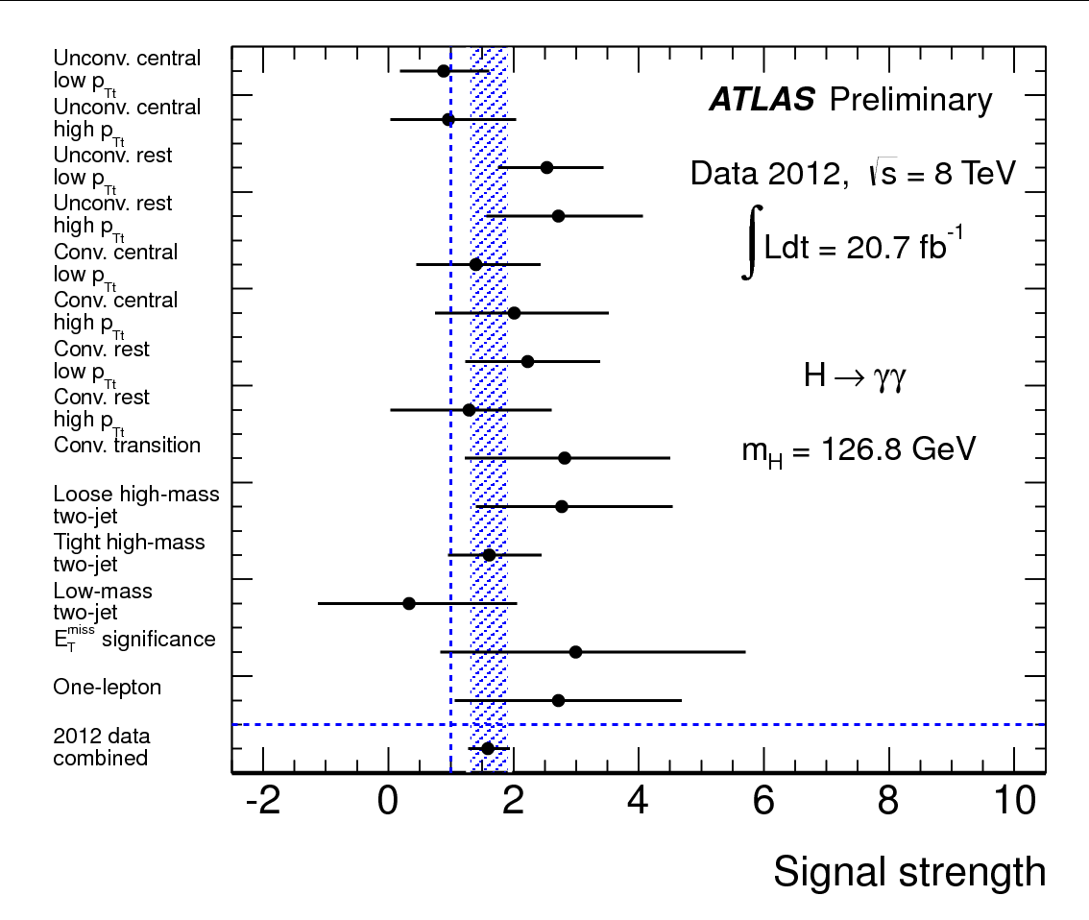
Signal strength in each category (8 TeV only)
ATLAS-CONF-2013-012

Slide 33
126.8 GeV vs. 125.5 GeV
126.8 GeV is the mass of the Higgs boson measured in channel $H→γγ$ alone
125.5 GeV is the mass of the Higgs boson measured combining $H→γγ$ and $H→4l$
Because of the large uncertainty on $m_{H}$ in $H→γγ$ (~700 MeV) channel, using either mass will not result in significant impact on the coupling measurements results
$μ=1.55$ @ $m_{H}=125.5 GeV$
$μ=1.57$ @ $m_{H}=126.8 GeV$
arXiv:1307.1427

Slide 34
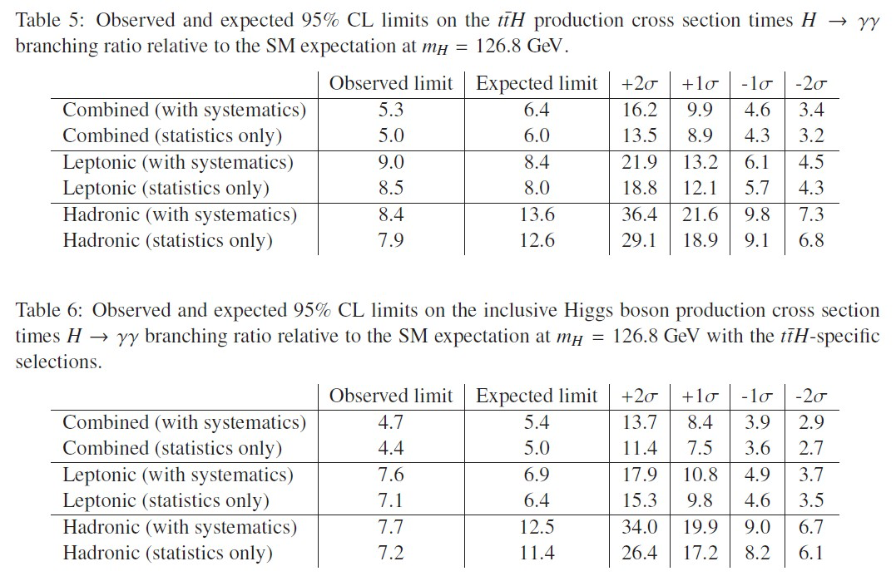
Limit results for $t\overline{t}H, H→γγ$
ATLAS-CONF-2013-080

Slide 35
Information about the $t\overline{t}H$ candidate event
m_{γγ} = 126.6 GeV
Two unconverted photons with transverse momenta of 61 GeV and 39 GeV
Electron with p_{T} = 90 GeV
MET = 43 GeV
Four jets with transverse momenta of 75 GeV, 71 GeV, 50 GeV, and 39 GeV
One of the jets is b-tagged jet (jet no. 2) with an additional soft muon inside the jet (7.2 GeV)
ATLAS-CONF-2013-080

Slide 36
Higgs production cross section @ 7/8 TeV
Cross section (pb) | 7 TeV | 8 TeV
ggH | 14.96 | 19.07
VBF | 1.193 | 1.558
WH | 0.550 | 0.6691
ZH | 0.304 | 0.3794
$$t\overline{t}H$$ | 0.083 | 0.1256
Total | 17.1 | 21.8
https://twiki.cern.ch/twiki/bin/view/LHCPhysics/CERNYellowReportPageAt7TeV2012update
https://twiki.cern.ch/twiki/bin/view/LHCPhysics/CERNYellowReportPageAt8TeV2012update
m_{H} = 126.5 GeV

Slide 37
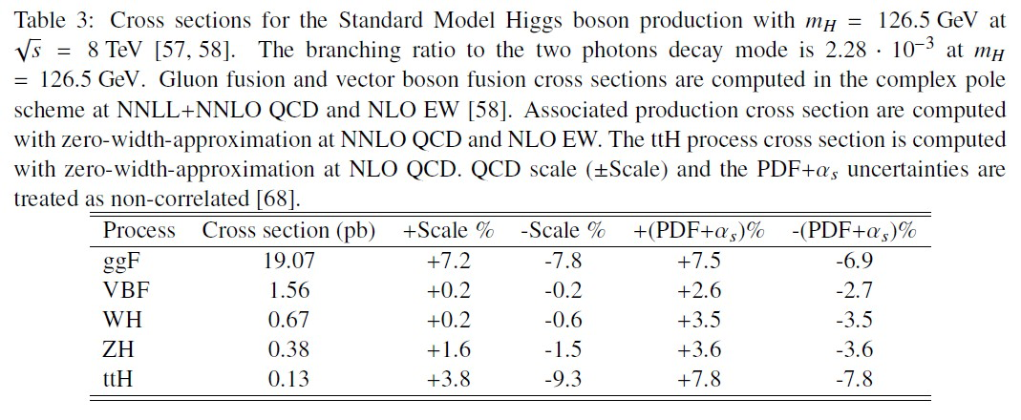
Uncertainty on Higgs cross section
ATLAS-CONF-2013-012

Slide 38
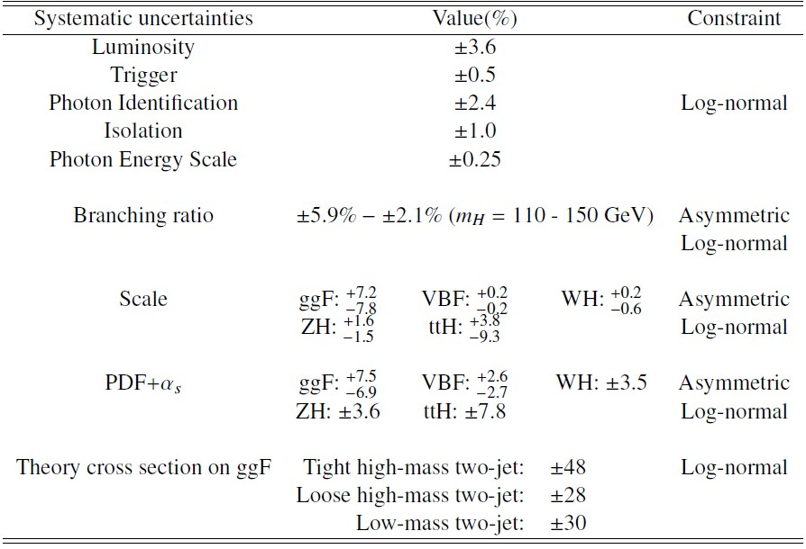
Uncertainties on the signal yield
ATLAS-CONF-2013-012

Slide 39
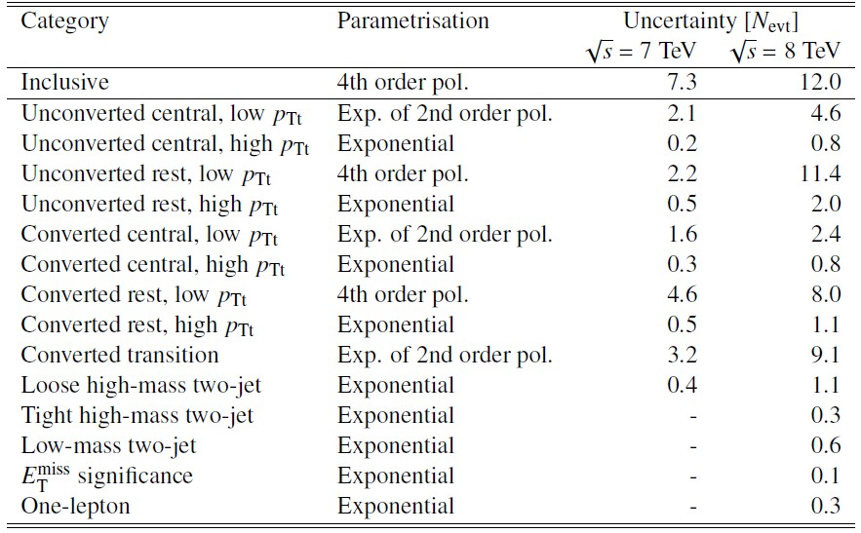
Background model & uncertainty
ATLAS-CONF-2013-012

Slide 40
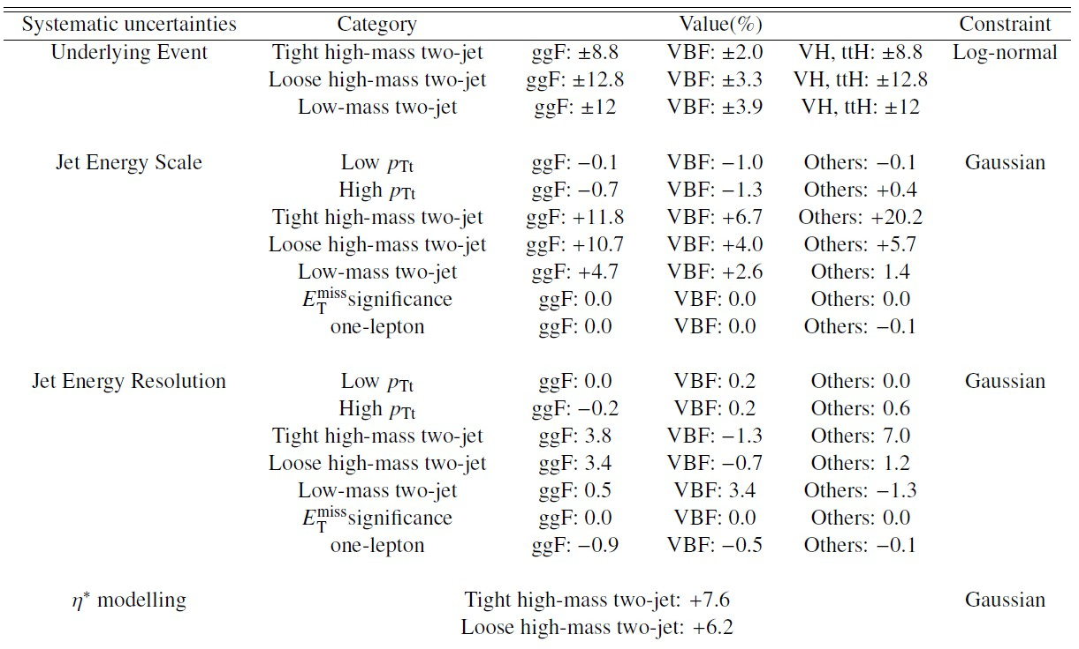
Migration uncertainties I
ATLAS-CONF-2013-012

Slide 41
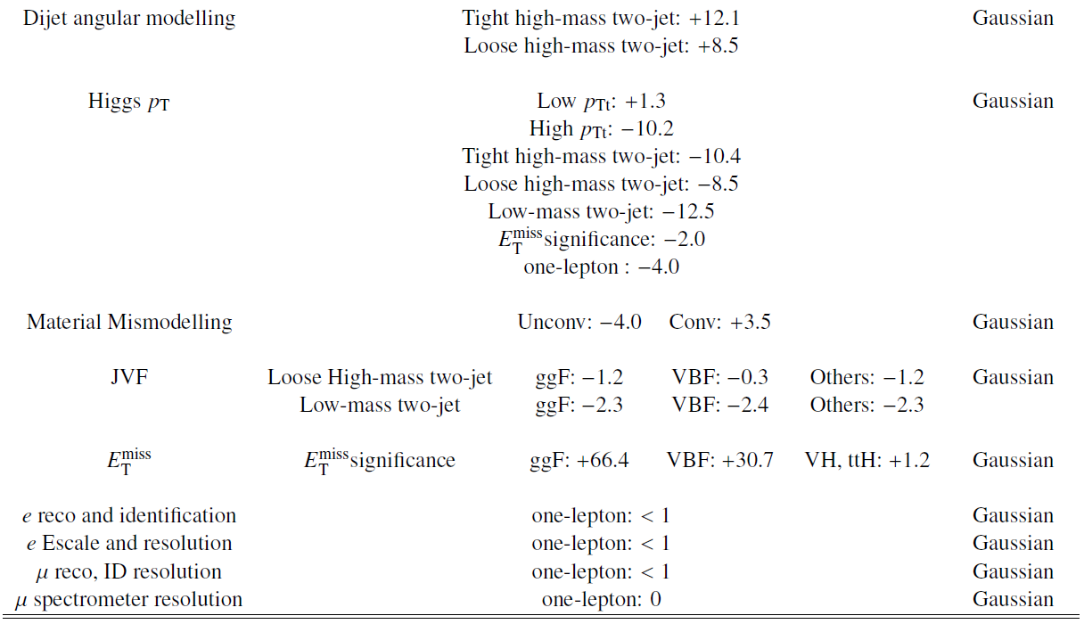
Migration uncertainties II
ATLAS-CONF-2013-012

