Slide 1
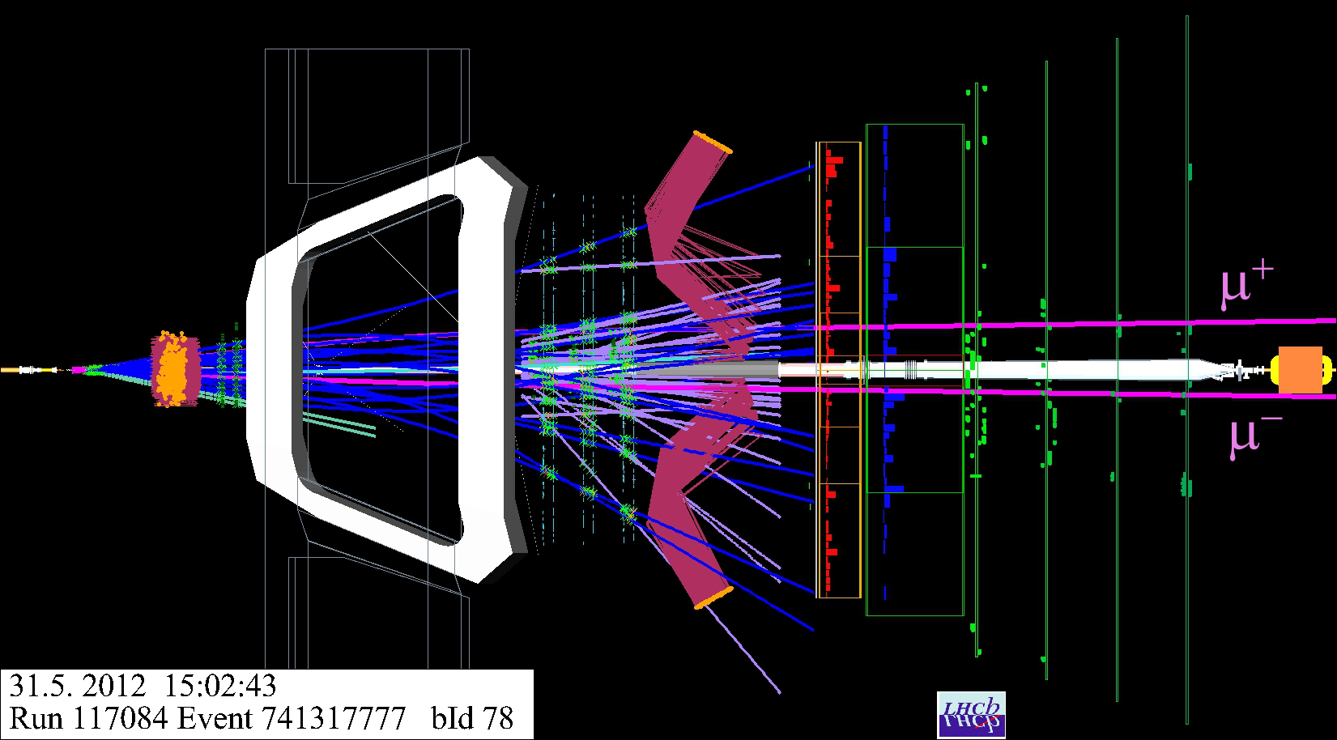
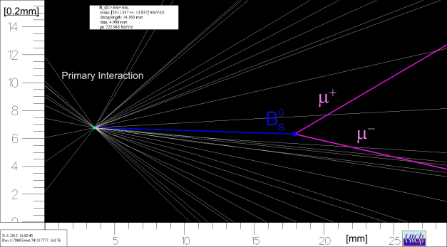
The LHCb Upgrade
Meeting of the American Physical Society,
Division of Particles and Field (DPF)
13-18 August 2013,
UC Santa Cruz, USA
Federico Alessio, CERN
on behalf of the LHCb Collaboration

Slide 2
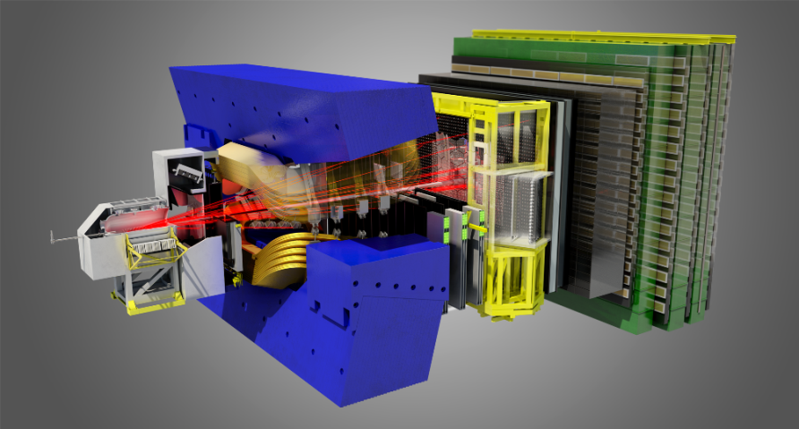
Outline
Introduction to LHCb and current performance
Motivations for an upgrade of the LHCb detector
Detector Upgrade:
  Vertexing
  Tracking
  Particle Identification
Readout Architecture Upgrade:
  Trigger-less electronics
  DAQ technologies
Outlook on plans and future running conditions

Slide 3
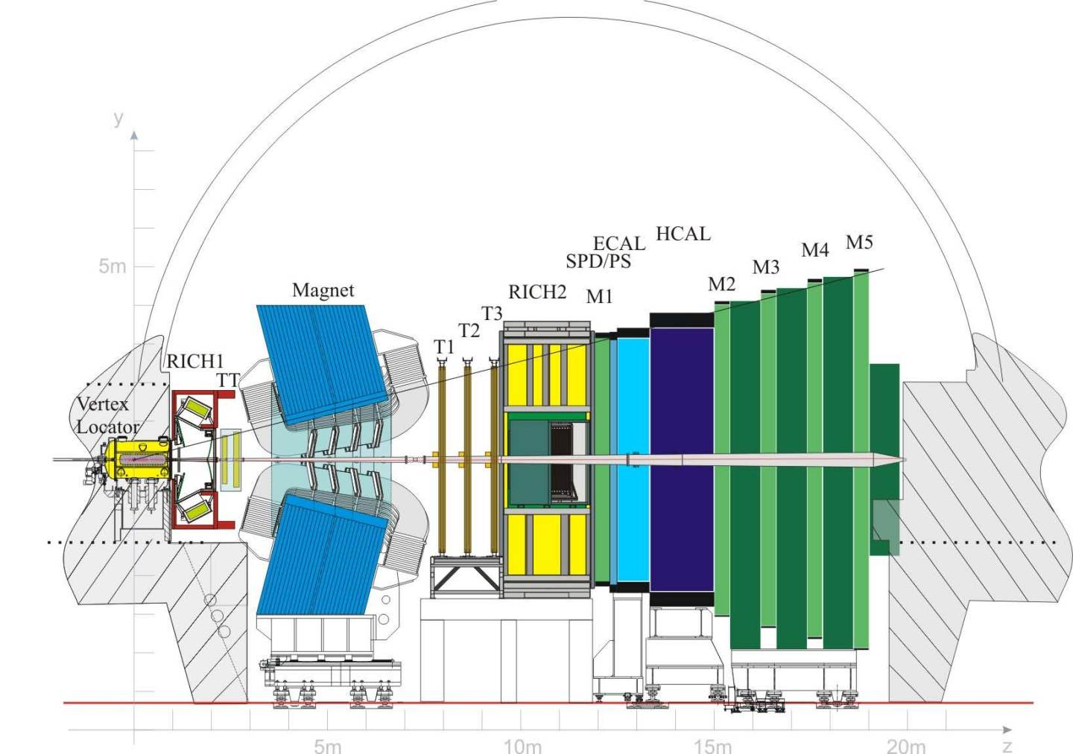
Current LHCb detector
LHCb proved itself to be the Forward General-Purpose Detector at the LHC:
forward arm spectrometer with unique coverage in pseudorapidity (2 < η < 5, 4% of solid angle)
catching 40% of heavy quark production cross-section
precision measurements in beauty and charm sectors
  Δp / p = 0.4% at 5 GeV/c to 0.6% at 100 GeV/c
  impact parameter resolution 20 μm for high-pT tracks
  decay time resolution 45 fs for B_{s} → J/ψ φ and B_{s} → D_{s} π

Slide 4
Current LHCb detector
Calorimeters
First-level HW trigger
Particle ID
Muon
Vertexing
Tracking

Slide 5


LHCb data taking plan
LHCb startup
LHCb collected ~3 fb⁻¹
LHCb to collect 5-7 fb⁻¹
Upgrade!
2010
2011
2012
2013
2014
2015
2016
2017
2018
LHC Run I
E = 7(2010-2011) & 8(2012) TeV (pp) @ 50 ns
+
E = 2.76 TeV (Pb⁺Pb⁺)
+
E = 5 TeV (pPb⁺)
LHC Long Shutdown I
LHC splices repair + consolidation
LHC Run II
E = 13 TeV (pp)
@ 25 ns
+
L_{peak}= 2x10³⁴cm⁻²s⁻¹
+
E = 2.76 TeV (Pb⁺Pb⁺)

Slide 6
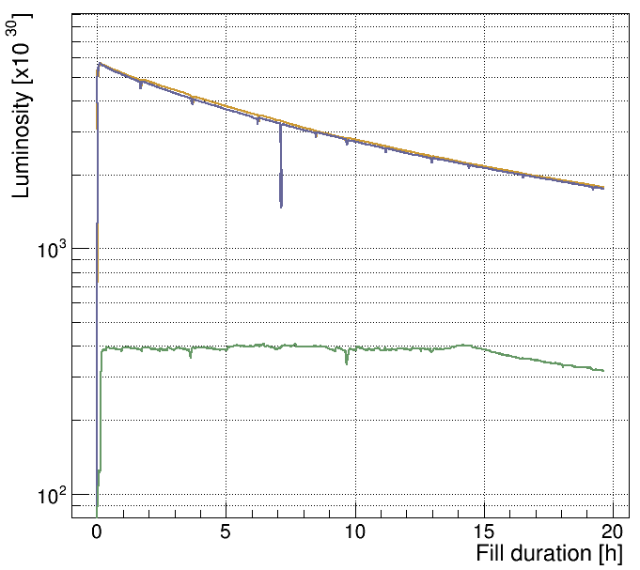

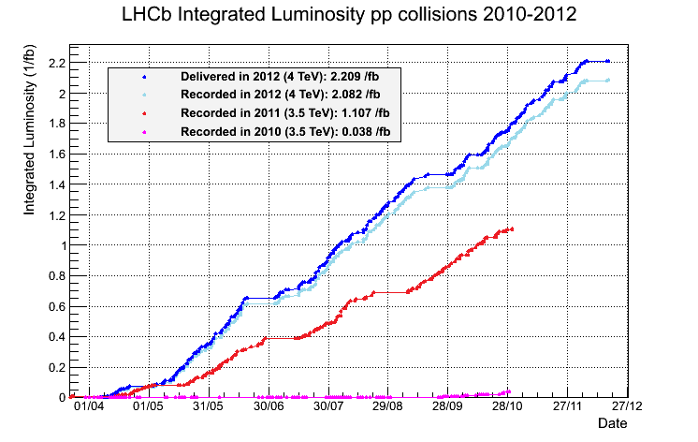
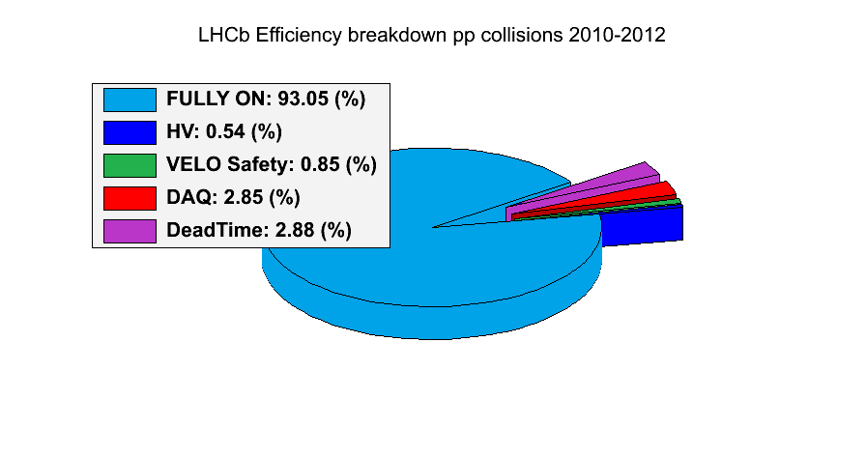
LHCb operation performance
Courtesy
R. Jacobsson
LHCb has excellent performance :
luminosity leveling at constant 4x10³² cm⁻²s⁻¹ with a constant ~1.5 interactions per LHC crossing
  > 2x designed values!
LHC Fill 2651
Luminosity potential exhausted
➔ Beams head-on
>3 fb⁻¹ data recorded with overall efficiency ~93%
>99% detector channels working and operational
>99% of online data good for offline analysis
>96% efficiency for long tracks in track reconstruction
>90% ParticleID efficiencies

Slide 7
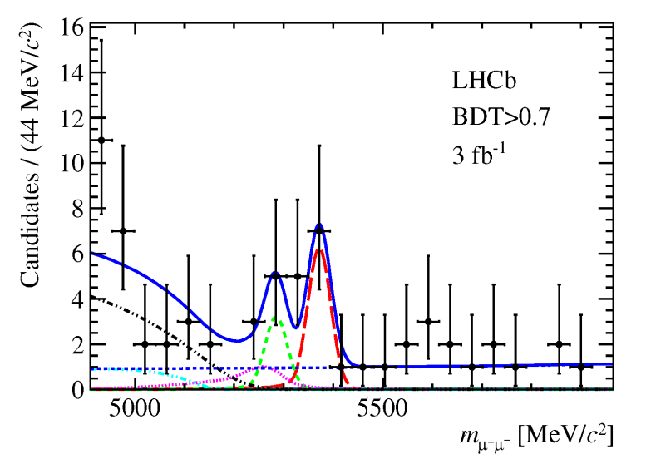
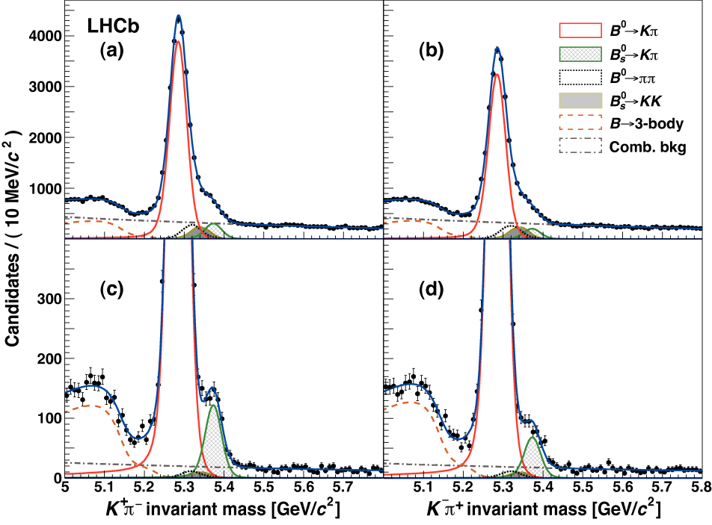
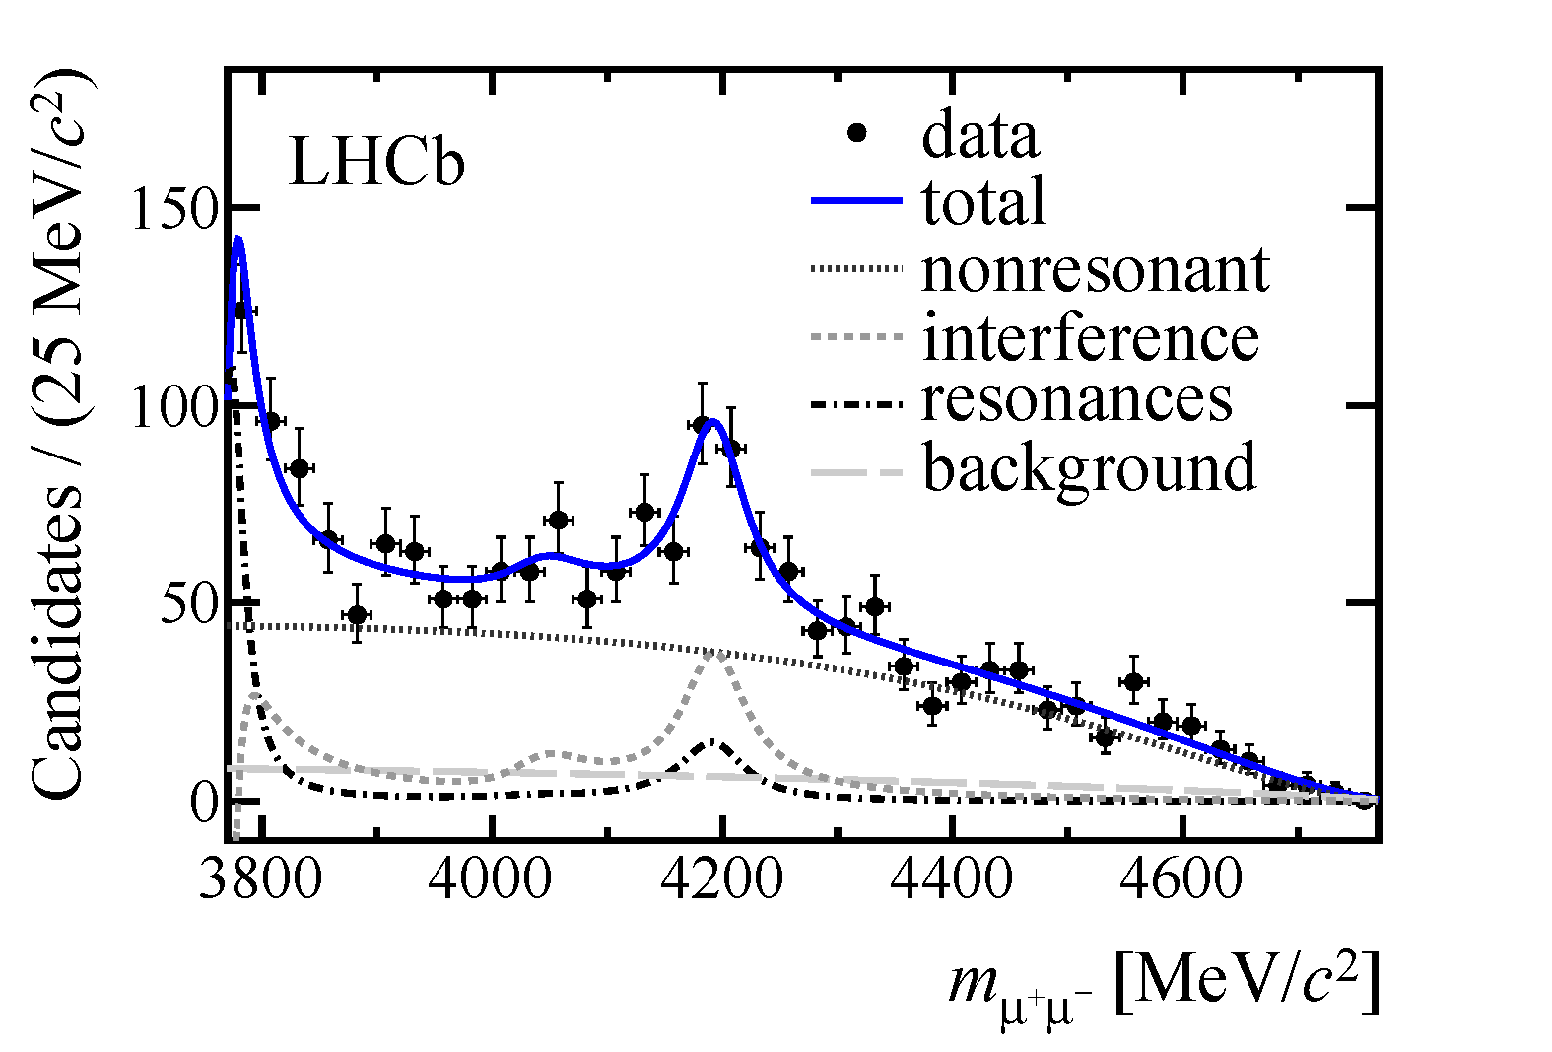
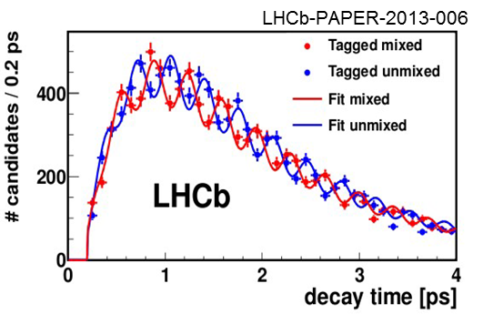
LHCb physics highlights
LHCb is continuously generating excellent physics results :
BR(B_{s} → μ⁺μ⁻) = 2.9^{+1.1}_{-1.0} 10⁻⁹ (4.0σ)
CP Violation in decays of B⁰_{s} mesons
LHCb-PAPER-2013-046
LHCb-PAPER-2013-018
B⁺ → K⁺ μ⁺μ⁻ resonance
LHCb-PAPER-2013-039
Bs mixing
+ >100 papers and high quality results

Slide 8
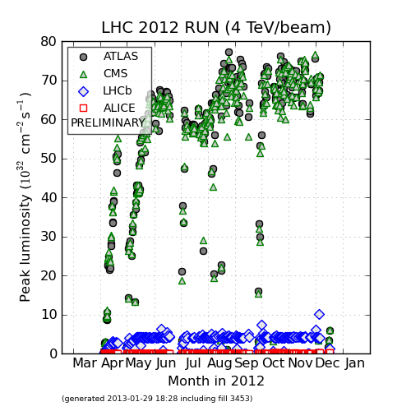
Upgrading LHCb
The amount of data and the physics yield from data recorded by the current LHCb experiment is limited by its detector.
While LHC accelerator will keep steadily increasing …
energy / beam (3.5 → 4 → 6.5 TeV → …)
luminosity (peak 8x10³³ → 2x10³⁴ cm⁻²s⁻¹→ … )
… LHCb will stay limited in terms of
data bandwidth: limited to 1.1 MHz / 40 MHz max
physics yields for hadronic channels at the hardware trigger
detectors degradation at higher luminosities

Slide 9
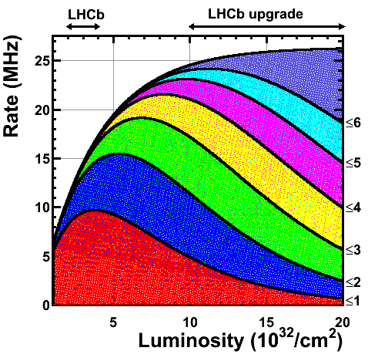
Current limitations
First-level hardware trigger is limited at higher luminosities for hadronic channels:
almost a factor 2 between di-muon events and fully hadronic decays
due to trigger criteria based on p_{T} and E_{T} to reduce trigger rate to the bandwidth limited to 1.1 MHz
Design!
Now!
At higher luminosities → harsher cuts on p_{T} and E_{T}
waste luminosity while not retaining amount of data
increases complexity of track reconstruction
  higher computational times in processing farm
ageing and fast degradation of sub-detectors
  designed to operate 5 yr at 2x10³²cm⁻²s⁻¹

Slide 10
Physics motivations
(to remove the limitations)
Beyond Flavour Physics: exploration studies → precision studies
BR(B_{s} → μ⁺μ⁻) down to ~10% of SM
CKM γ angle to <1˚
2β_{s} to precision <20% of SM value
charm CPV search below 10⁻⁴
but also
search for lepton-flavour violating tau decays
low mass Majorana neutrinos
electroweak physics
long-lived new particles
QCD
…
For an exhaustive list see LHCb Upgrade Framework TDR, CERN/LHCC-2012-007

Slide 11
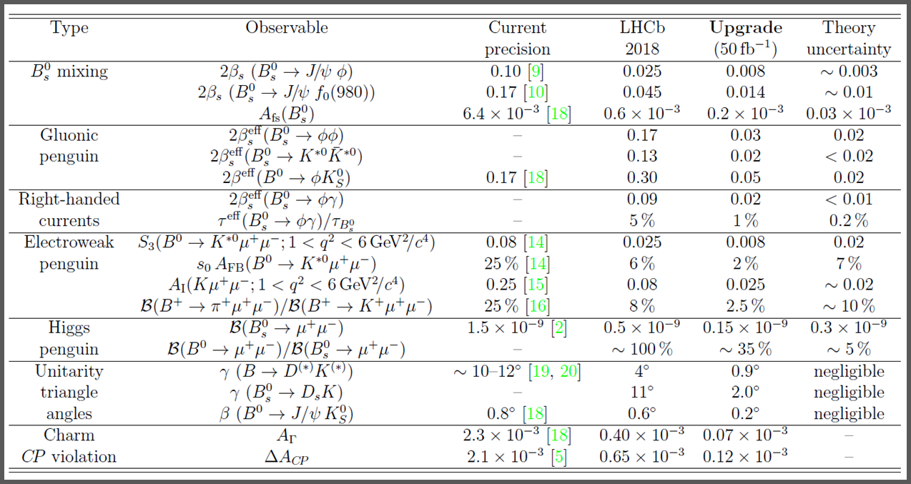
LHCb physics prospects
Expect to collect a total of ~8 fb⁻¹ of data up to 2018
and 50 fb⁻¹ of data after 2018
→ moving towards precision of theory

Slide 12
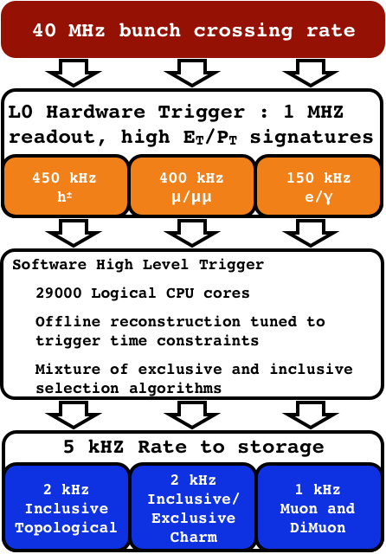
Upgrade strategy
Straightforward idea: remove the first-level hardware trigger!
50000
20 kHz

Slide 13
Implications of upgrade strategy
Removal of first-level hardware trigger implies
read out every LHC bunch crossing
  trigger-less Front-End electronics
  multi-Tb/s readout network
fully software flexible trigger
  full event information available to improve trigger decision
  maximize signal efficiencies at high events rate
now
10 MHz
higher luminosities: redesign (incompatible) sub-detectors for a peak luminosity of 20x10³²cm⁻²s⁻¹
more data by increasing bandwidth: redesign readout architecture to record 40 MHz events

Slide 14
Particle ID
Replace HPDs + electronics
Upgraded LHCb detector
Calorimeters
Reduce PMT gain + new electronics
Muon
new electronics
New Vertex Detector
New Tracking stations

Slide 15
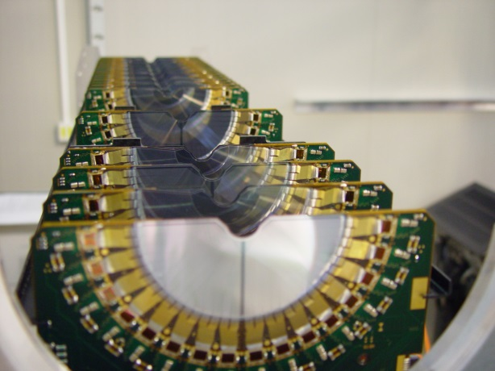

Current LHCb Vertex Detector
Current Vertex Detector (VELO) is at the heart of LHCb tracking, triggering and vertexing
Excellent performance, reliable, cluster efficiency >99.5%, best hit resolution down to <4μm
Movable device! ~50mm to ~5mm close to LHC beams when in collisions (autonomously…)
Si-strips measuring r and ϕ

Slide 16
New LHCb Vertex Detector
Future VELO must maintain same performance, but in harsher conditions
Low material budget, cope with > radiation damage, deal with > multiplicities
Trigger-less readout ASICs and provide fast and efficient reconstruction at HW level
Recent technology reviews favored the choice of a
Si-pixel detector with microchannel cooling
occupancy

Slide 17


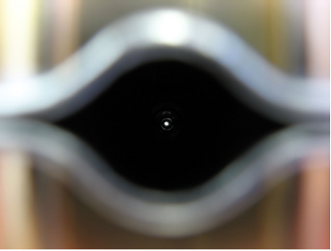
New LHCb Vertex Detector
Pixel Silicon detector modules cooled down with fluid (bi-phase CO₂) which passes under the chips in etched microchannels (ΔT = 4-7 ˚C between fluid and sensor)
Getting closer to beam (agreed with LHC!) to improve IP resolution!
New Proposed Aperture 3.5mm
Current Inner Aperture 5.5 mm

Slide 18
Current LHCb Tracking system
Present Tracking System will be upgraded:
VELO + TT (Si-strip) + DIPOLE (no change) + IT (2% inner area, Si) / OT (Straw Tubes)
Current pattern-recognition based on current tracking system would not be efficient in upgraded scenario
Too high occupancy in central region
R&D for different solutions
  for downstream and upstream tracking
Courtesy JC. Wang
Sidenote: R&D in increasing Dipole field (x1.8 Bdl)

Slide 19
New Upstream Tracking Stations
R&D upstream:
Replace current TT with UT (Upstream Tracker) , also based on Si-strips
  reduced thickness
  finer granularity
  improved coverage (innermost cut-out at 34 mm)
  much less material budget (<5% X₀)

Slide 20
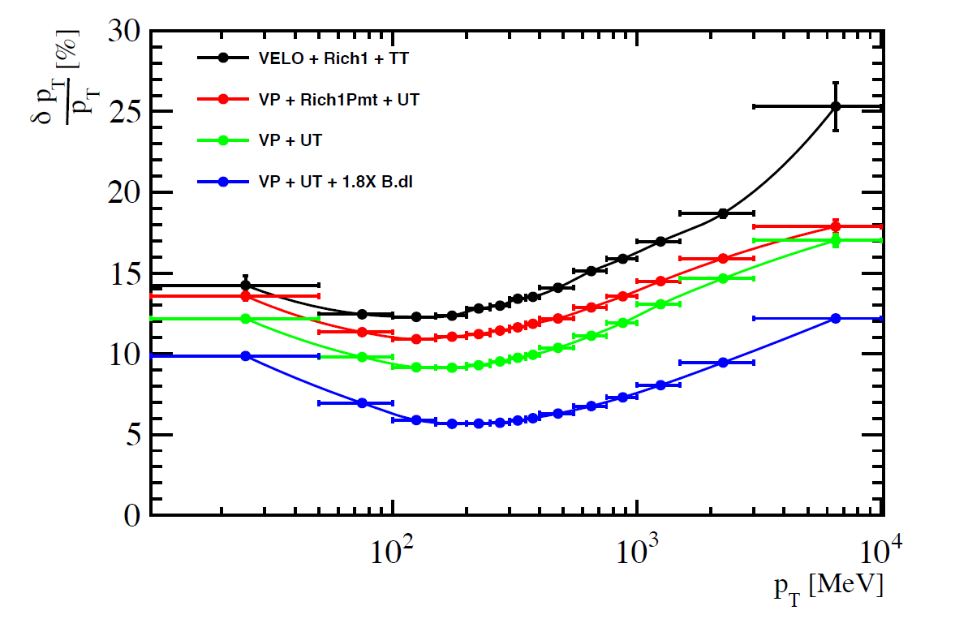
New UT + New VELO
better p_{T} resolution
+
drastic reduction in ghost rate
+
large gain in reconstruction time!

Slide 21
New Downstream Tracking Stations
R&D donwstream:
Various options still on the table
  all aimed at reducing the occupancy in the inner region
Baseline option!
Enlarged, thinner and lighter IT
Based on Si-strip
New OT straw tubes in central region
Replace central region with Central Tracker
(Sci-Fi detector)
→ Based on Scintillating fibers and SiliconPM
Replace entire IT+OT with Sci-Fi

Slide 22
New LHCb Sci-Fi detector
Build a completely new detector based on Scintillating Thin Fibers
Blue-emitting multi clad fibers, laid down as a mat
2.5m long, 250 um diameter (2.8 ns decay time)
12 layers of modules in different layout (x-u-v-x)
read out with SiPM (at -50C): new trigger-less FE

Slide 23
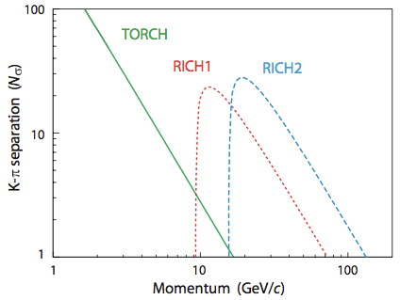
Upgraded Particle ID
Present Ring-Imaging Cherenkov (RICH) detector will be upgraded:
Current RICH1 (aerogel C₄F₁₀) + RICH2 (CF₄)
Main changes:
Remove aerogel radiator
to compensate for increased occupancy
Remove Hybrid-PhotoDetectors (HPD) with Multi-AnodePMTs
Hamamatsu R11265 with 80% active area
Front-End electronics will be redeveloped
R&D:
Add new detector TORCH
1-10 GeV/c

Slide 24
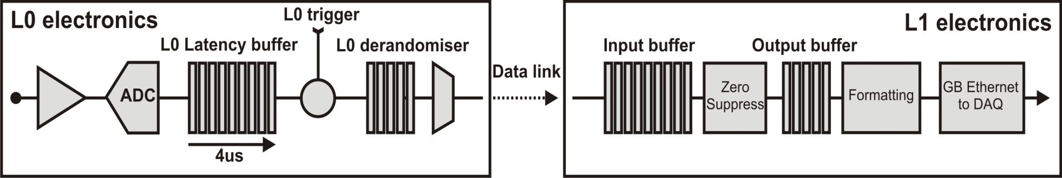

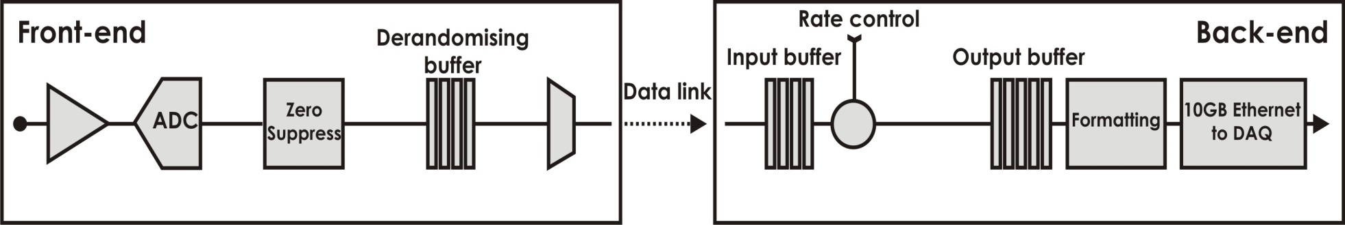
Upgraded Readout Architecture
Reminder: remove the first-level hardware trigger
→ accept all LHC bunch crossing: trigger-less Front-End electronics!
Readout Supervisor
L0 Hardware Trigger
Current
HLT
1MHz
event
rate
~1 Tb/s
Readout Supervisor
Low-level Trigger
Upgrade
HLT++
Low-level Trigger
~50 Tb/s
40MHz
event
rate
Courtesy K. Wyllie

Slide 25
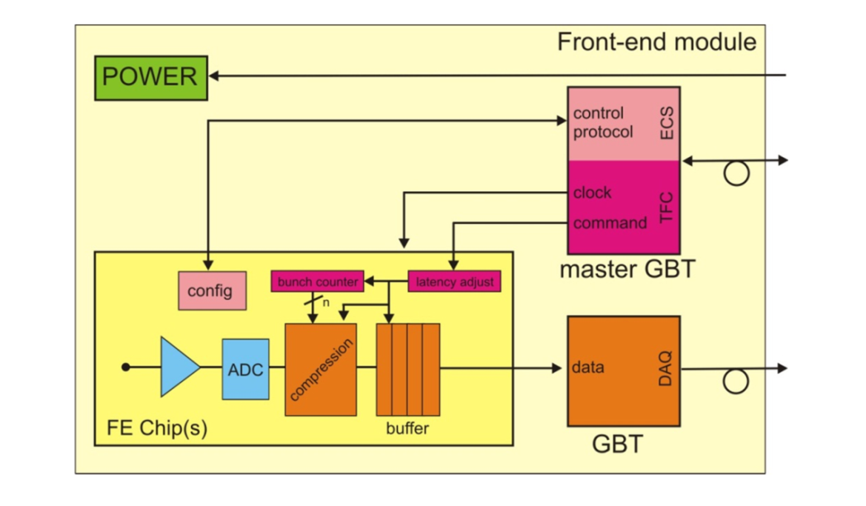
Trigger-less Front-Ends
TFC
TFC
On detector
4.8 Gb/s
Off detector
4.8 Gb/s
ECS
ECS
Data
Off detector
Data
4.8 Gb/s
Need to compress (zero-suppress) data already at the FE to reduce data throughput
  reduce # of links from ~80000 to ~12500 (20 MCHF to 3.1 MCHF)
Use separate link bandwidth efficiently for data
  Pack data across data link continuously with elastic buffer before link
Compact links merging Timing, Fast (TFC) and Slow Control (ECS).
  Extensive usage of the CERN GBT development
→ Support data driven readout (asynchronous) + big latencies!

Slide 26
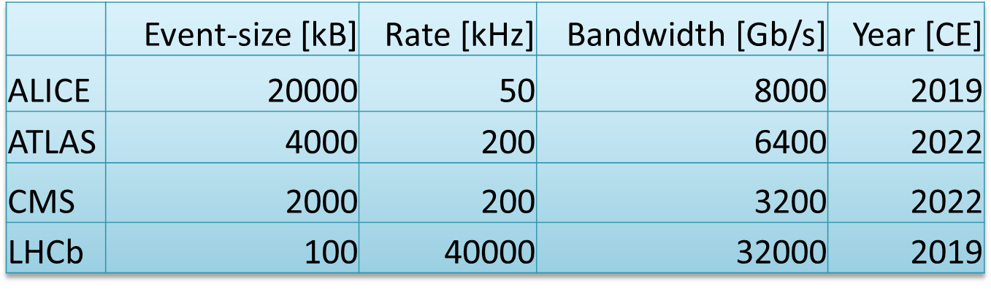
Readout & DAQ
Future LHC DAQs in numbers
Courtesy N. Neufeld
Exploit the economies of scale → try to do what everybody does but smarter!
Some overlapping trends across experiments, at least conceptually
  custom-made Readout Boards with fast optical links and big&powerful FPGAs
    ideally with fast interface to PCs (PCIe Gen3 or future…)
    ideally with some co-processing (GPUs…)
  commercial network technologies following market trends in terms of BW & costs
    distributed vs data-center-like network. Ethernet vs InfiniBand.

Slide 27
Evolution of Network Interface Cards
PCIe Gen4
expected
PCIe Gen3
available
EDR (100 Gb/s) HCA
expected
100 GbE NIC
expected
Chelsio T5 (40 GbE
and Intel 40 GbE
expected
Mellanox FDR
Mellanox 40 GbE NIC
Courtesy N. Neufeld

Slide 28
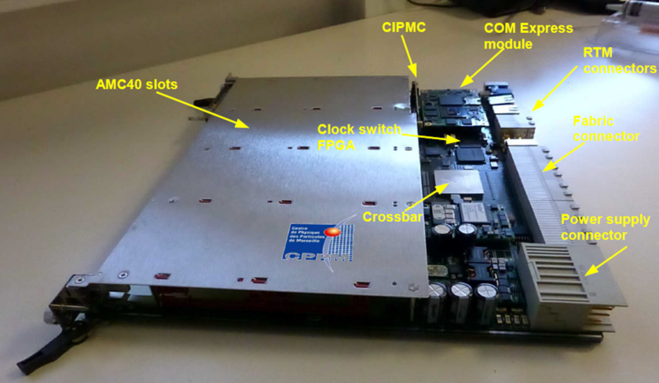
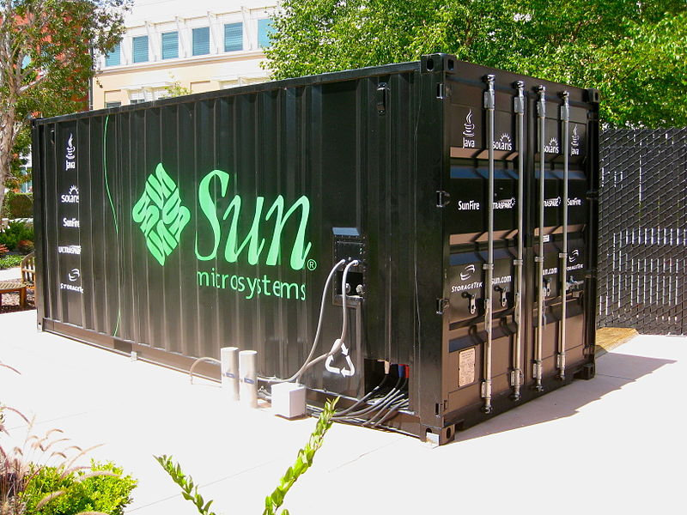

New LHCb DAQ
Currently two options under R&D:
Very compact, high density, FPGAs-based ATCA card
with >0.5 Tb/s throughput onboard (distributed approach)
  Profit from interconnectivity on backplane
  High link density on board
  Technologically-dependent (Ethernet)
  Custom-made
PCIe Gen3 NIC cards, with FPGAs and ~150 Mb/s throughput to host PC (data-center approach)
  Technologically-independent
    host PC acts as FARM PC already: open choice for interface technology as late as possible
  Commercially available
  Put everything in a box, keep distances short, reduce costs for interconnects and network switches
Courtesy JP. Cachemiche
OR

Slide 29
LHCb upgrade plan
Tendering & Serial production
Installation & commissioning upgrade
(18 months to plan!)
Upgrade TDRs
Quality control & acceptance tests
LHCb to collect 15 fb⁻¹!
2014
2015
2016
2017
2018
2019
2020
2021
2022
LHC LSI
LHC Run II
E = 13 TeV (pp)
@ 25 ns
+
L_{peak}= 2x10³⁴cm⁻²s⁻¹
+
E = 2.76 TeV (Pb⁺Pb⁺)
LHC LSII
LHC Run III
E = 14 TeV @ 25 ns
+
L_{peak}= 2x10³⁴cm⁻²s⁻¹
LHC LSIII
Technical reviews &
technology choices
(ongoing now!)
for high-lumi LHC
L_{peak}> 5x10³⁴cm⁻²s⁻¹
NB: LHCb to collect 5 fb⁻¹
+
keep publishing results…

Slide 30
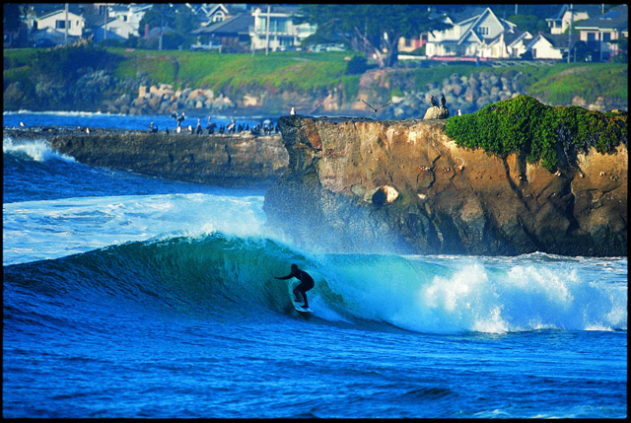
Conclusion
LHCb is taking data successfully and efficiently
  Well-earned title as Forward General Purpose \
  Detector at the LHC
An upgrade plan to increase the amount of data and
physics yield has been laid out
  Aim at collecting 10x more data
  20x more hadronic events
Upgrade is technologically challenging and time wise tight
  It is doable and work is ongoing
  CERN endorsed the LHCb Upgrade by fully approving it!
We have exciting times ahead in LHCb!
Thank you for your attention!

Slide 31
Backup

Slide 32
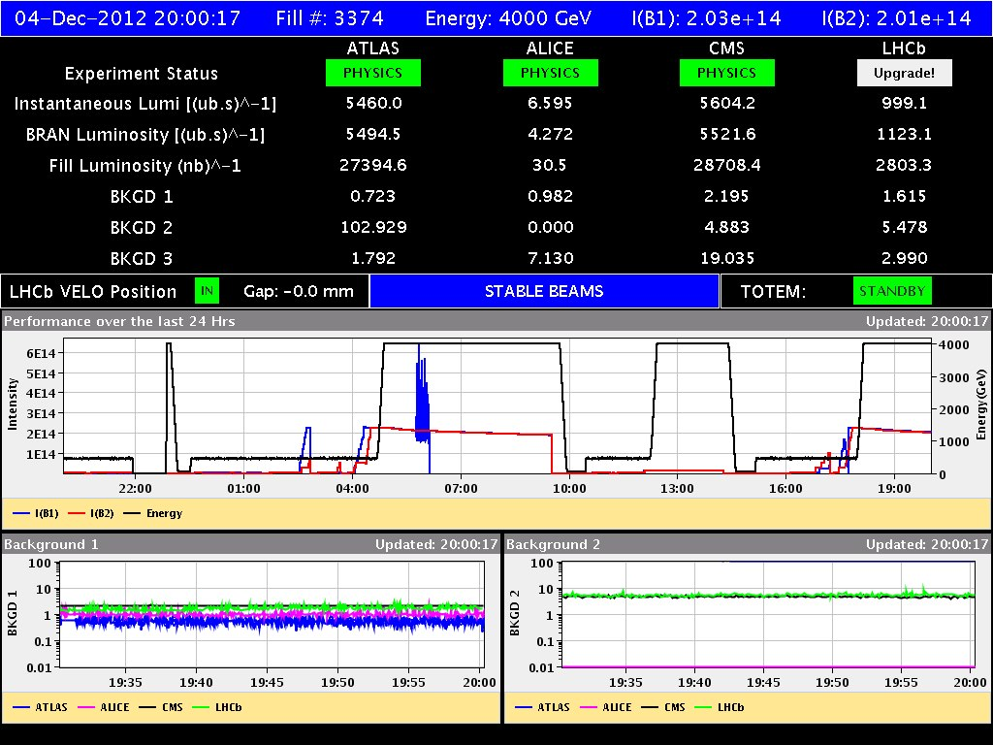
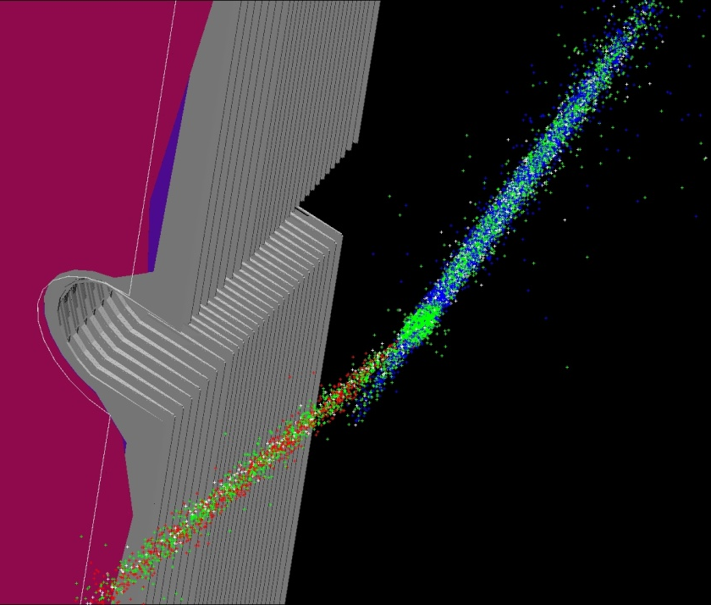
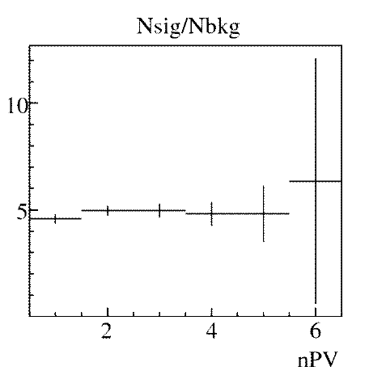
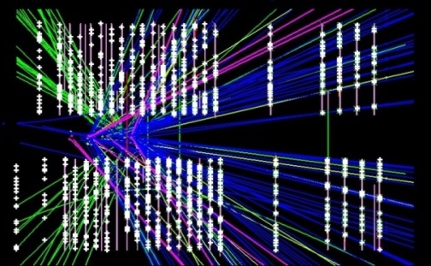
Is it feasible?
YES! We already tried in 2012: took some data at 10³³ (5x designed values)
B →J/ψK
6 primary vertices
B S/N almost independent of pileup
D S/N shows some degradation vs pileup.

Slide 33
Upgraded Calorimeters
HCAL
Present Calorimeters detectors will be kept:
ECAL (Shashlik 25 X₀ Pb + scintillator)
HCAL (TileCal Fe + scintillator)
PreShower / ScintillatingPadDetector (PS/SPD) will be removed
Main changes:
PMT gain will be reduced by a factor 5
to reduce ageing due to higher luminosities
Front-End electronics will be redeveloped
to be compatible with the reduced gain (R&D)
to be compatible with trigger-less readout

Slide 34
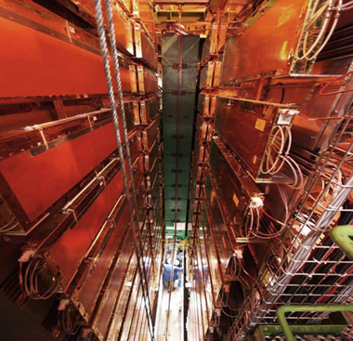
Upgraded Muon Detectors
Present Muon detector will be kept:
4 layers (M2-M5) of Multi-Wire Proportional Chambers (MWPC)
first layer of Muon Detector (M1 – used in first-level trigger, with GEMs) will be removed
Main changes:
Front-End electronics will be redeveloped
to be compatible with trigger-less readout
R&D:
Replace inner part of M2 (closest to IP) with GEMs detectors
to have higher-granularity

Slide 35
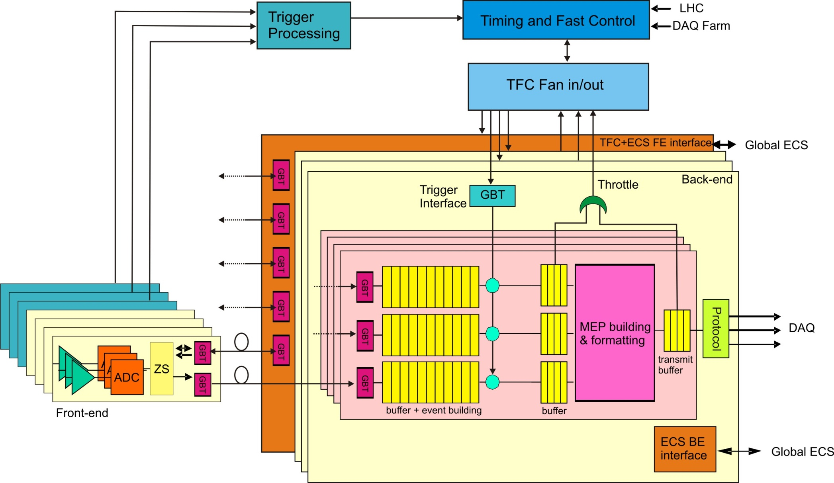
Readout architecture

Slide 36
Trigger-less FE zero-suppression
Channels
0…………..3
51 52 53 54 55 56 57 58
124………127
A-D conversion (6 bits)
Threshold
0 0 0 0 0 0 0 A B C D 0 0 0 0 0
Add 7b | Data 6b
54 | A
55 | B
56 | C
57 | D
128 x 6 = 768 bits
Break-even point
60 hits = 780 bits
(7+6) x 4 = 52 bits
55.8
(7+ n) bits

Slide 37
Data efficient packing mechanism
Average event size
Link bandwidth
Average event size = link bandwidth
0
1
2
3
4
0
1
2
3
4
0
1
2
3
4
Buffer depth
BX0
BX0
BX1
BX1
BX2
BX2
BX
BX3
3
BX4
BX4

Slide 38
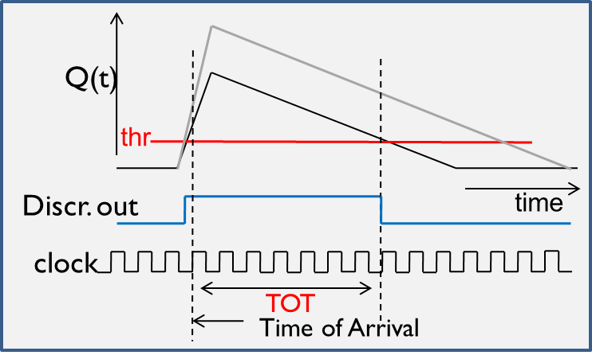
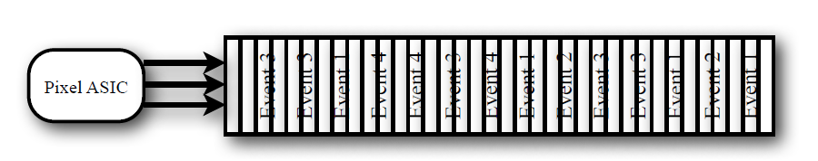
Example: VeloPix
Uses ToT for pluse height from TimePix
  130 nm CMOS, rad-hard, low-power
High occupancy in sensors closer to beam
  factor 10 between innermost and outermost
Very high data throughput
  Single chip output ~13 Gb/s
  Total VELO ~2.5 Tb/s!
Busy events takes longer to compress
  Up to 12 μs latency
  Asynchronous data driven readout! (i.e. events are out-of-order)

Slide 39
Fast & Slow Control to FE

Slide 40
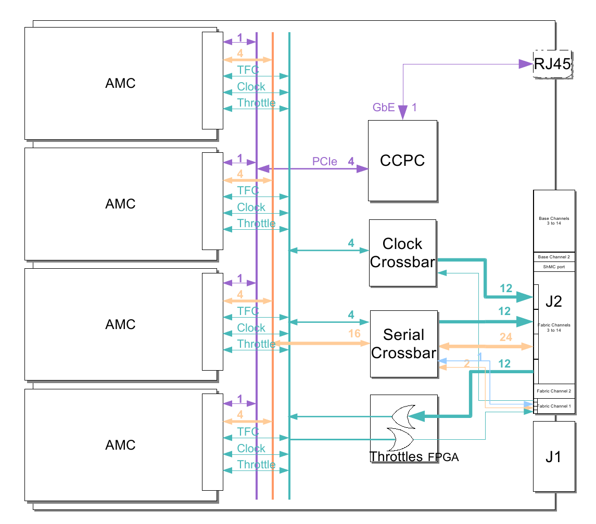
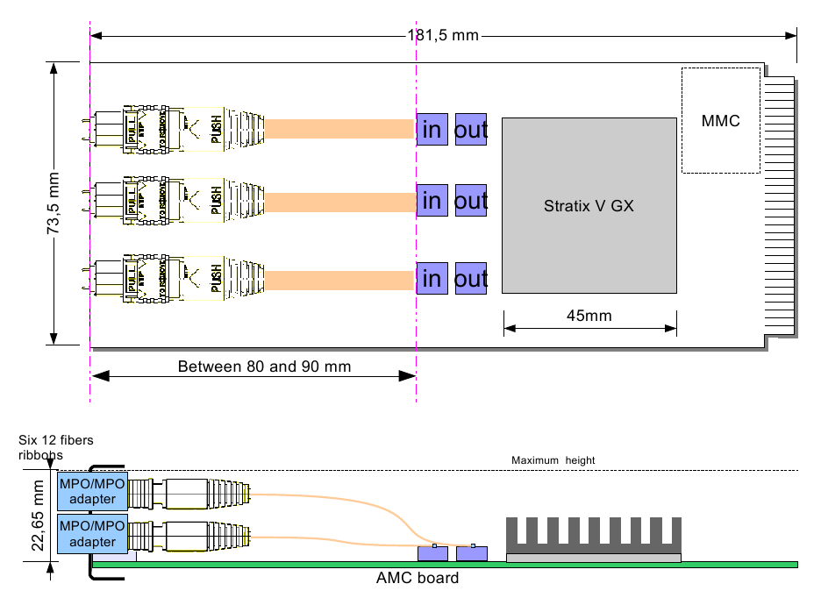
LHCb TELL40
24 inputs
@ 4.8 Gb
GBT format
12 outputs/
inputs
@ 10Gb
ethernet
AMC
96 inputs @ 4.8 Gb processing in FPGA 48 10G ethernet ports

Slide 41
Running Conditions 2010-2012
Courtesy R. Jacobsson
LHCb Design
LHCb Design
Exploratory

Slide 42
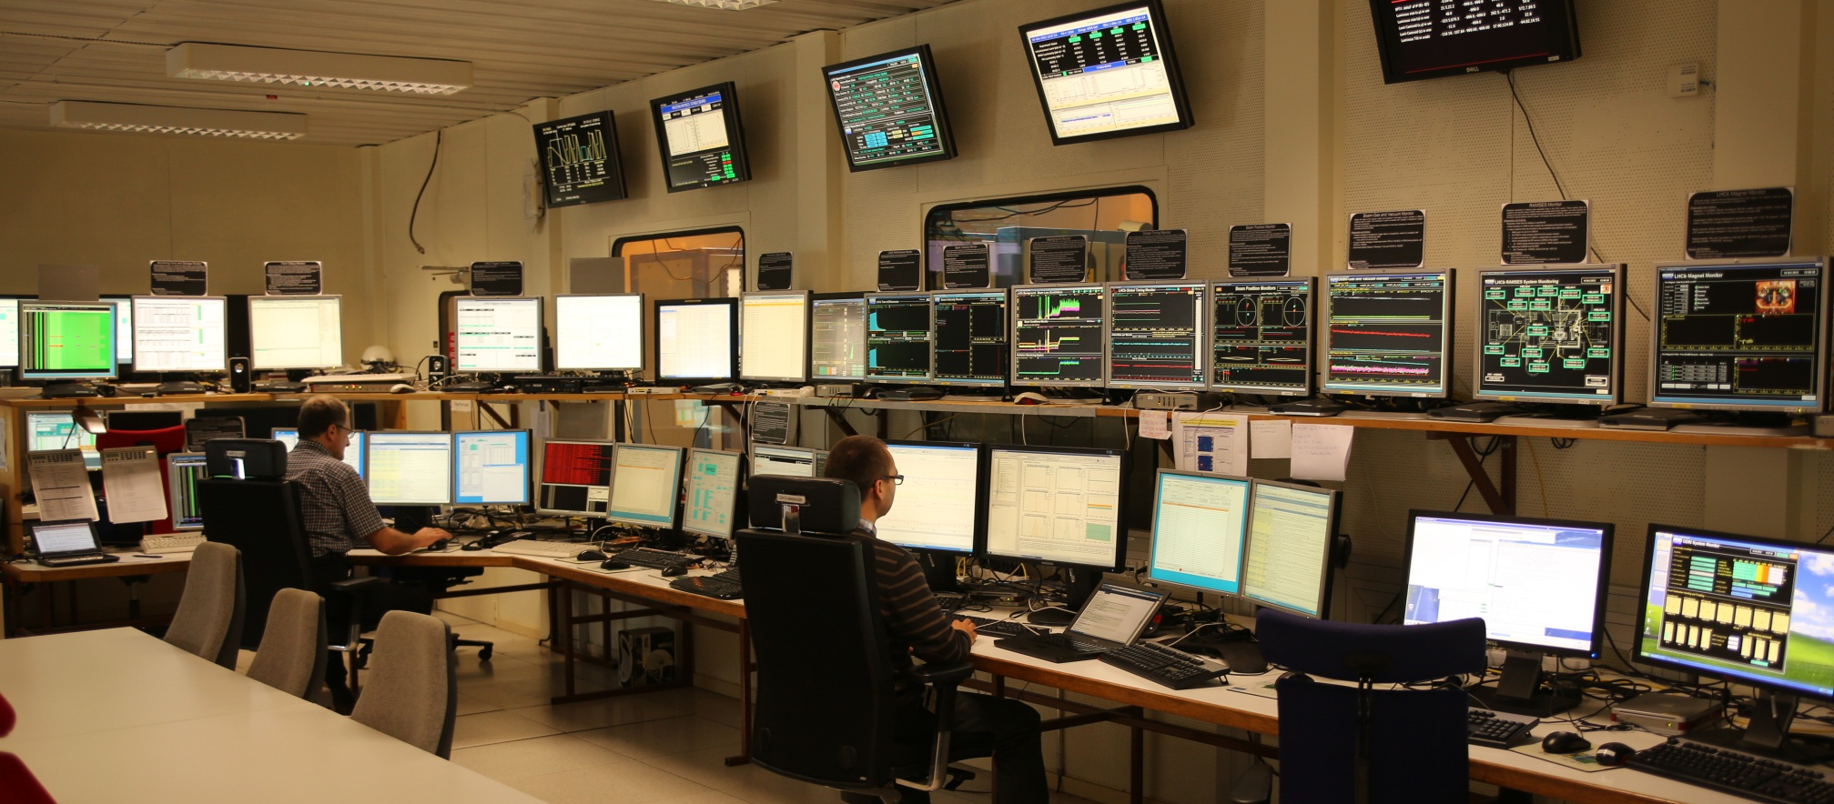
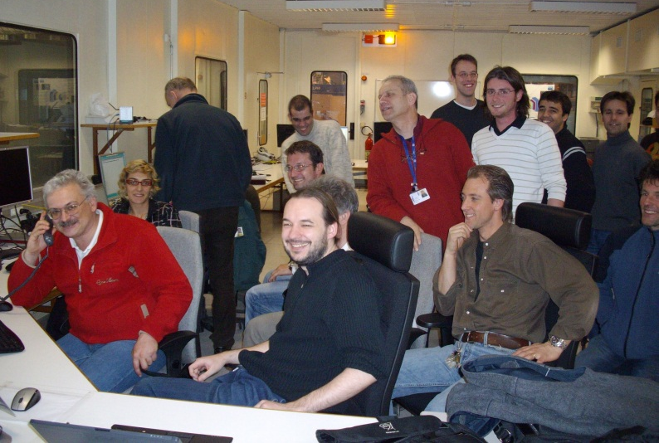
LHCb Control Room
2010 - 2012
Courtesy R. Jacobsson
2008
  2010: Operated with two non-expert shifters plus a VELO closing manager
  2011 – 2012 : Operated with two non-expert shifters
    ➔ Experiment highly automated and computer voice assisted for information, warnings/alarms and instructions

