Slide 1
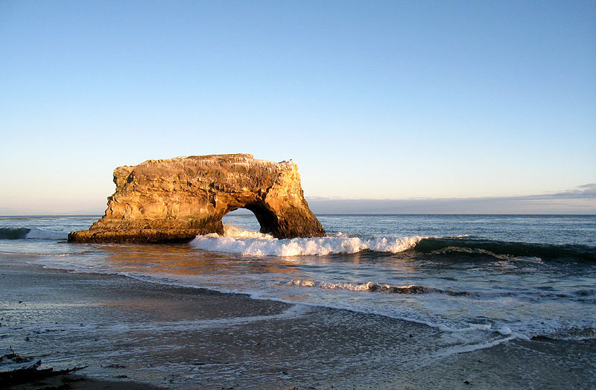
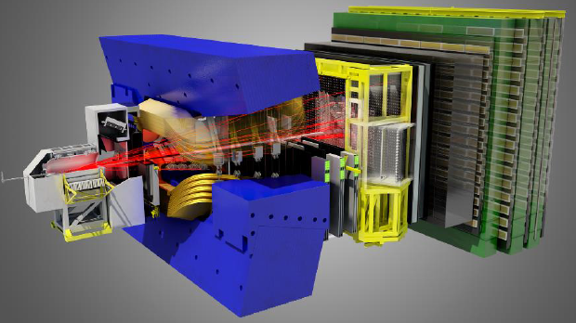
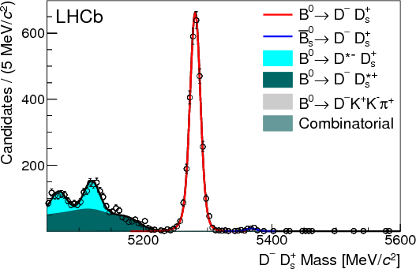
Studies of hadronic B decays to open charm mesons at LHCb
Steven Blusk, Syracuse University (on behalf of the LHCb collaboration)
DPF 2013, UC Santa Cruz, Aug. 13-18, 2013.

Slide 2
Introduction
A number of “firsts” emerging in the study of hadronic B decays to open charm.
Going beyond the “Dh±” modes, we’re exploring 5, 6, and 7 particle final states.
Provide additional probes of CKM parameters
Ultimate precision on γ/φ₃ must take advantage of many b-hadron decays
Study of strong interaction dynamics.
Made possible due to:
large σ_{bb} @LHC, and
excellent capabilities of LHCb to trigger on and fully reconstruct high multiplicity final states.
Here, we discuss some of the recent results from LHCb on B→DX..
All results based on 1 fb⁻¹, unless otherwise noted.

Slide 3
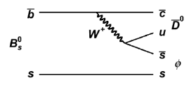
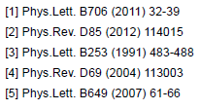
First observation of B_{s} →D⁰φ
Motivation: γ determination using TI (ala B⁻ →D⁰K⁻) or TD (as in B_{s}→D_{s}K) analyses.
Both are theoretically clean.
Start with D⁰→Kπ. More final states needed for TI γ determination.
First goal is to observe the decay and measure rates.
Normalize to B_{s}→D⁰K^{*0}
Also improve measurement of B(B_{s}→D⁰K^{*0}), normalized relative to B(B⁰→D⁰K^{*0}).
All results are preliminary, see LHCb-PAPER-2013-035
→f
c
D⁰
→f

Slide 4
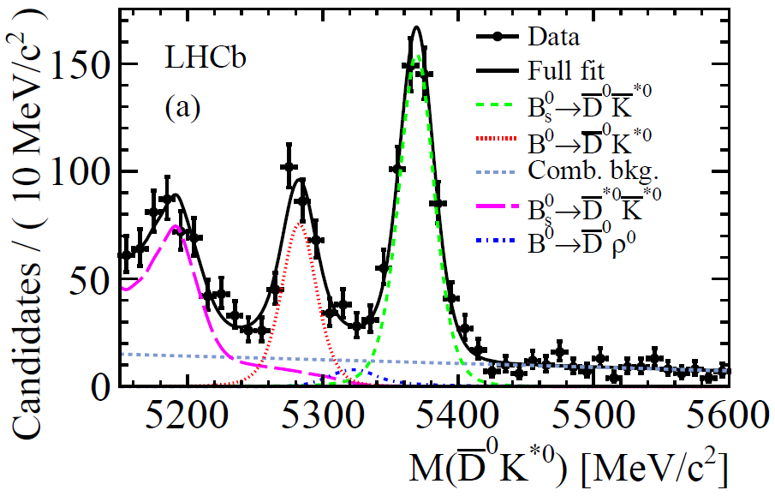
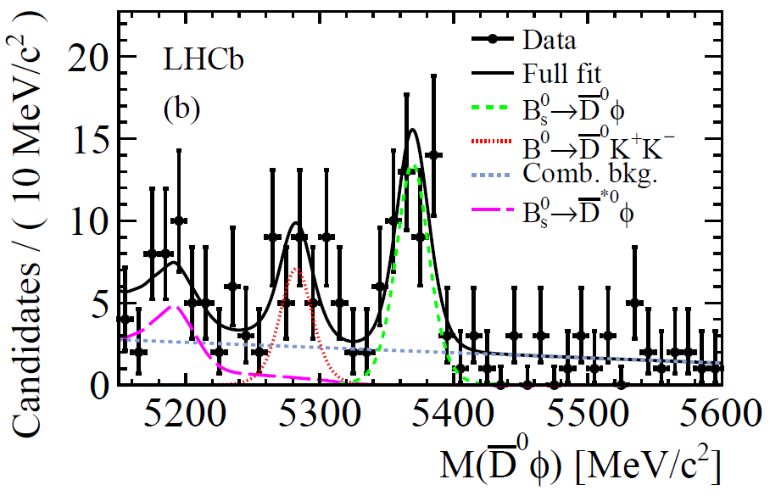
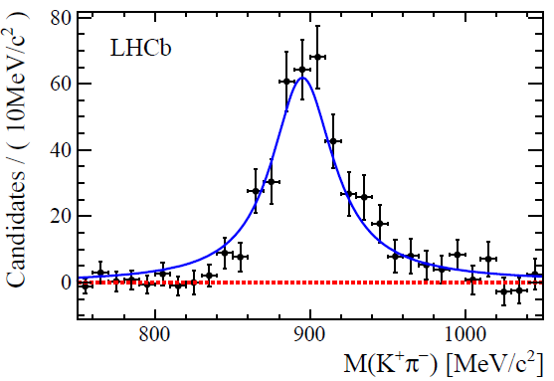
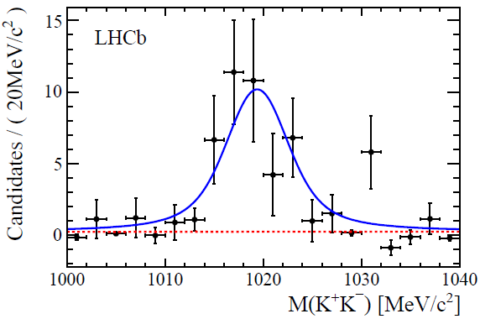
Signals in data
preliminary
preliminary
7.1σ significance

Slide 5
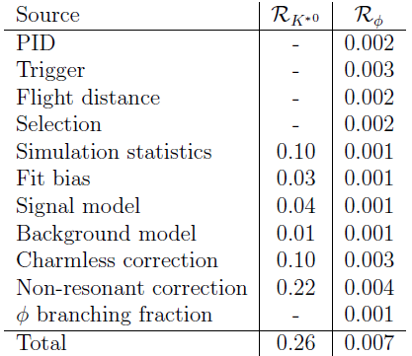
Results on branching fractions
(Consistent with & more precise than previous LHCb measurement)
Also B_{s}→D⁰φ observed & measured for the 1st time:
Leading to the absolute branching fraction:

Slide 6
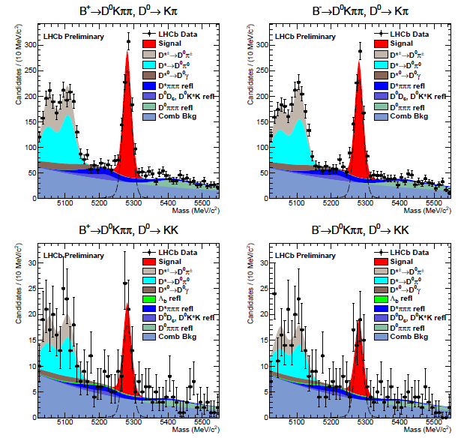
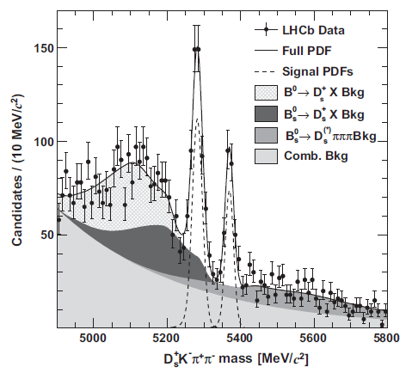
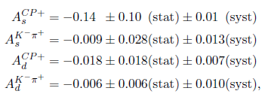
Other interesting modes for γ
Time-independent
B⁻ →DKππ, ADS, GLW
(LHCb-CONF-2012-021)
Time-dependent
B_{s} →D_{s}Kππ, D_{s}→KKπ
(PRD86, 112005, 2013)
B⁺: D⁰→Kπ
B⁻: D⁰→Kπ
B⁺: D⁰→KK
B⁻: D⁰→KK

Slide 7
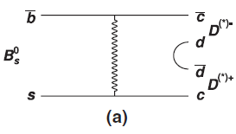
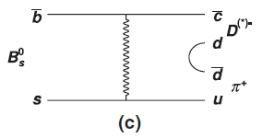
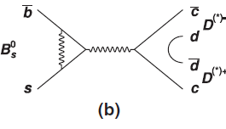
Searches for decays proceeding via W-exchange & penguin annihilation
Weak exchange
Penguin annihilation
Weak exchange
O(λ²)
O(λ²)
O(λ³)
Limited information available on the role of these decays in hadronic B decays.
B⁰ →D_{s}^{(*)}K^{(*)} and B_{s}→π⁺π⁻ are the only other observed decays that proceed through these suppressed diagrams.
Double-charm final states also of interest for CKM angle determinations, such as γ (combine several B→DD’), 2β (B⁰→D⁺D⁻), and 2β_{s} (B_{s}→D_{s}D_{s})

Slide 8
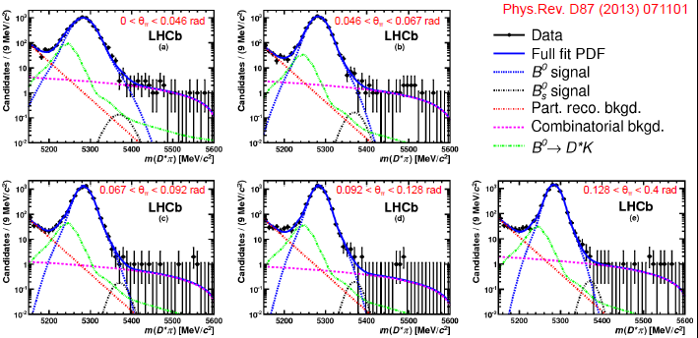
Search for B_{s}→D^{(∗)-}π⁺
LHCb, PRD87 071101 (2013)
Bin in the angle between D* and π in lab frame.
Exploits better mass resolution with larger opening angle.
No signal observed, limits set:
B(B_{s}→D*π) ~ 1x10⁻⁶ expected, from λ² x B(B⁰→D_{s}K).

Slide 9
Double charm final states

Slide 10
Observation of B_{(s)}→D⁺D⁻, D⁰D⁰
PRD87 092007 (2013)
LHCb, PRD87 092007 (2013)
Relative BFs
Absolute BFs
B_{s}→D⁺D⁻, D⁰D⁰ consistent, would expect so.
~10X larger than B⁰→D_{s}K
Consistent with both PQCD predictions, and those based on rescattering, but large theory errors.
Look forward to more on these final states!

Slide 11
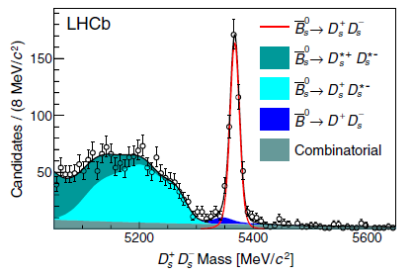
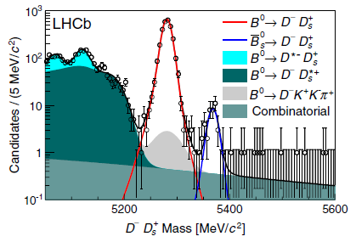
Other B→DD’ signals / observations
PRD87 092007 (2013)
Note log scale, S/B ~ 800:1 at B⁰ peak
First observation of Cabibbo- suppressed B_{s} →D⁻D_{s}⁺
Why is this ratio only ~0.5 ?
If TREE only, expect ratio ≈ 1?
Is this telling us something about PA and E contributions (which contribute to B_{s}→D_{s}D_{s}, but not B⁰→D_{s}D)
≈ tan²θ_{C}! as expected, tree dominant.
Large and clean signals !

Slide 12
Moving up: B_{c}→J/ψD_{s}⁽*⁾
PRD87, 112012 (2013)
3 fb⁻¹
Very little information yet available on B_{c} decays due to their low production rate.
Expect tree diagrams to dominate
D_{s} or D_{s}*
J/ψ
From naïve factorization, would expect…
V. Kiselev hep-ph/0308214
Colangelo et al PRD61 (2000)
Ivanov et al PRD73 (2006)
Dhir et al PRD79 (2009)
C.-H Chang et al PRD49 (1994)

Slide 13
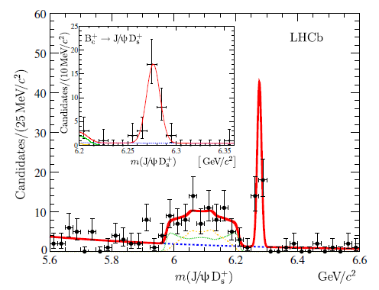
Analysis
PRD87, 112012 (2013)
Use J/ψ→μ⁺μ⁻ triggered events;
J/ψ displaced from PV by > 3σ_{disp.}
Reconstruct D_{s}→φπ, φ→KK candidates.
Combine J/ψ and D_{s} candidates to form B_{c} candidates
J/ψ and D_{s} mass & vertex constraints imposed in fitting the decay.
Excellent mass resolution due to large M(J/ψ+D_{s})
Unbinned maximum likelihood fit
B_{c}→J/ψD_{s}
B_{c}→J/ψD_{s}*

Slide 14
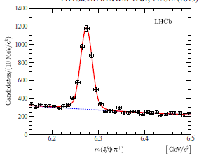
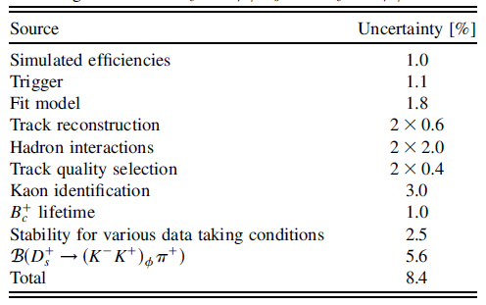
Results on B_{c}→J/ψD_{s}
PRD87, 112012 (2013)
Normalize with respect to B_{c}→J/ψπ
B_{c}→J/ψπ
Closer to B⁰ ratio (see below)
Consistent with factorization…
V. Kiselev hep-ph/0308214
Colangelo et al PRD61 (2000)
Ivanov et al PRD73 (2006)
Dhir et al PRD79 (2009)
C.-H Chang et al PRD49 (1994)

Slide 15
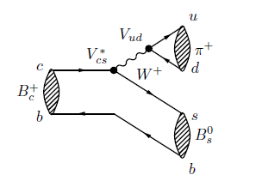
B_{c}→B_{s}π
LHCb-PAPER-2013-034
(Preliminary)
3 fb⁻¹
All B_{c} decays to date obs’d via b→c→ψ⁽‘⁾X
“Easily” triggered on using ψ⁽‘⁾ → μ⁺μ⁻.
c→s mean B_{c} → B_{s}X … more difficult to trigger on and reconstruct..
This analysis reports the first observation of B_{c} → B_{s}π.
Wide range of theoretical predictions for the branching fraction, from a few percent to ~20%.
Strategy is to take fully reconstructed B_{s} decays, add a π⁺ and search for a peak at the B_{c} mass.
Goal is to measure:

Slide 16
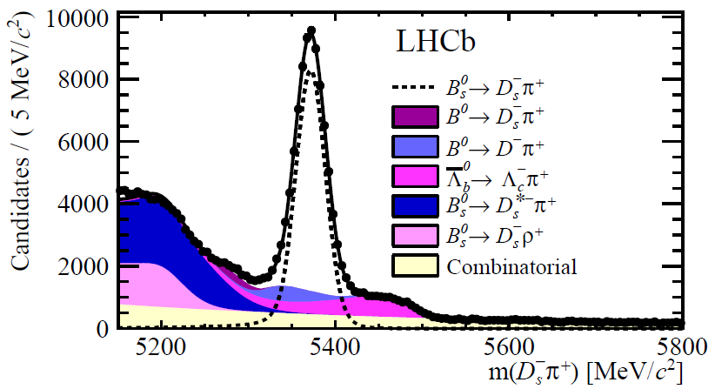
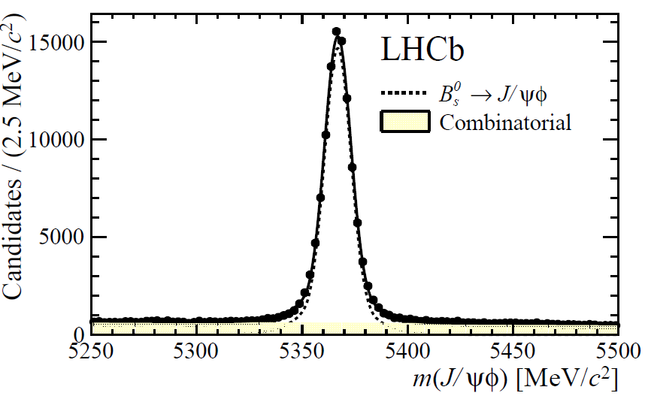
B_{s} candidates
B_{s}→D_{s}π, D_{s}→KKπ
B_{s}→J/ψφ, φ→KK
Preliminary
Preliminary
≈ 74,000 recon. B_{s} → D_{s}π
≈ 104,000 recon. B_{s} → J/ψφ
Form B_{c}⁺ candidates
B_{s} selection: mass windows [5335-5407] for D_{s}π, [5330-5410] for J/ψφ
π⁺: p_{T}>100 MeV, IP χ² > 2 & loose PID
BDT used to distinguish signal from background.
ε(B_{s})/ε(B_{c}) obtained from simulation, except PID (uses D^{*+} calib data)

Slide 17
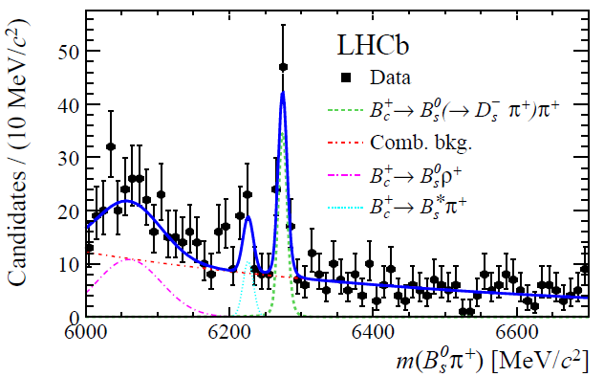
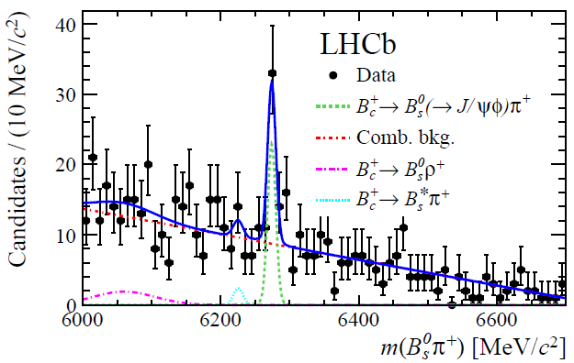
B_{c}⁺ → B_{s}π data
Using B_{s}→D_{s}π, D_{s}→KKπ
Using B_{s}→J/ψφ, φ→KK
Preliminary
Preliminary
7.5σ
(incl. syst)
5.5σ
(incl. syst)
Assuming B_{c}→J/ψπ = 0.15% from Ivanov et al, from theory, leads to B(B_{c}→B_{s}π)~10% but large uncertainty. Well within the wide range of predictions

Slide 18
Summary
Many interesting measurements in b→cX decays performed with 1 fb⁻¹ data sample.
Several aimed at measuring γ or input to the combined γ determination.
Large samples being used to probe Weak exchange, Penguin annihilation decays.
New double-charm final states uncovered..
Promising for CPV and CKM angle m’ments..
New B_{c} decay discoveries, B_{c}→B_{s}π, B_{c}→J/ψD_{s}
Excellent prospects for more B_{c} decay mode discoveries
Stay tuned for full 2011+2012 3 fb⁻¹ results!

