Slide 1



First observation and measurement of single top production in the tW channel in pp collisions
Phil Baringer, University of Kansas
on behalf of the CMS collaboration
DPF 2013, August 13-17, University of California, Santa Cruz

Slide 2
Outline
Introduction
The CMS detector
Multivariate analysis
Cross check analyses
Summary

Slide 3
Introduction

Slide 4
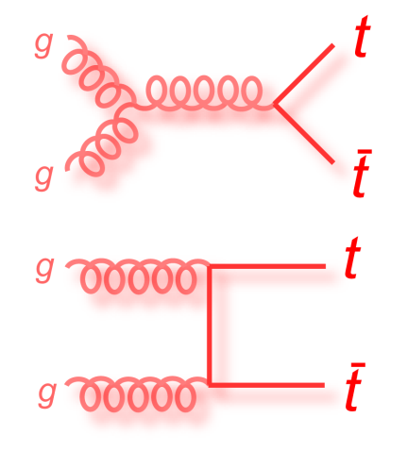
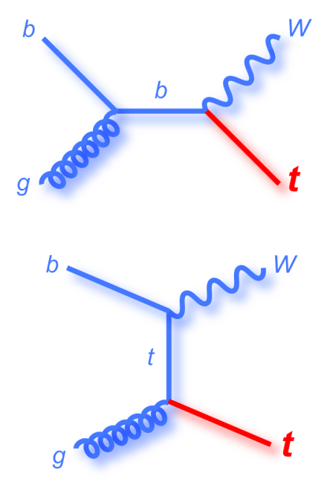
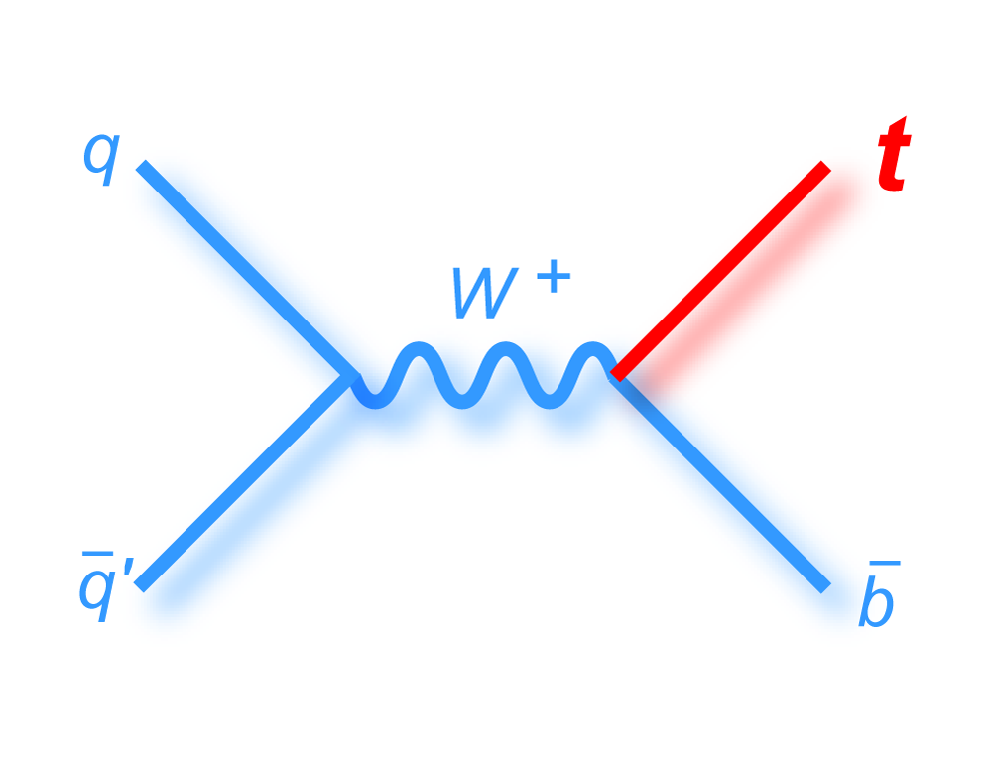
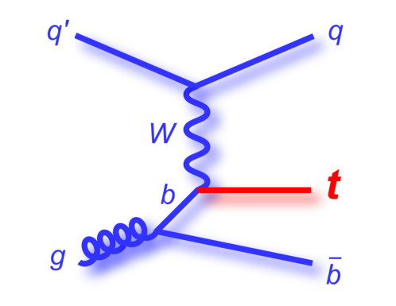
Electroweak production of the top quark
At hadron colliders, top quarks are most commonly produced in pairs via the strong force
Single top quarks can be produced via electroweak interactions
s-channel
t-channel
tW associated production

Slide 5
Single top physics
Test of Standard Model; study W-t-b vertex
Sensitive to new physics, with each channel sensitive to different non-Standard Model processes (like FCNC, extra generations)
Cross sections (for top mass of 173 GeV):
N. Kidonakis arxiv.org/pdf/1205.3453v1 (2012); arxiv.org/pdf/0909.0037
*M. Czakon, P. Fiedler and A. Mitov arXiv.org/pdf/1303.6254
σ(pb) | t-channel | s-channel | tW | t-tbar
Tevatron (1.96 TeV) | 2.08 | 1.05 | 0.22 | 7.08
LHC (7 TeV) | 65.9 | 4.56 | 15.6 | 163
LHC (8 TeV) | 87.2 | 5.55 | 22.2 | 245*

Slide 6
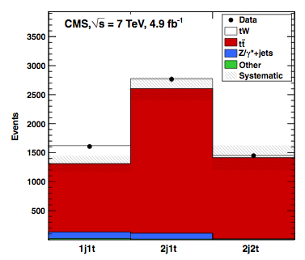
Prior tW results
Channel not accessible at the Tevatron
Evidence for tW from CMS and ATLAS in the 2011, 7 TeV, LHC data sample
CMS: “Evidence for associated production of a single top quark and W boson in pp collisions at 7 TeV” Phys. Rev. Lett. 110, 022003 (2013) – 4.0 σ significance, corresponding to a cross section of 16 +5 -4 pb
ATLAS: “Evidence for the associated production of a W boson and a top quark in ATLAS at √ s=7 TeV,” Phys.Lett. B716 (2012) 142 – 3.3 σ significance, corresponding to a cross section of 16.8±2.9±4.9 pb

Slide 7
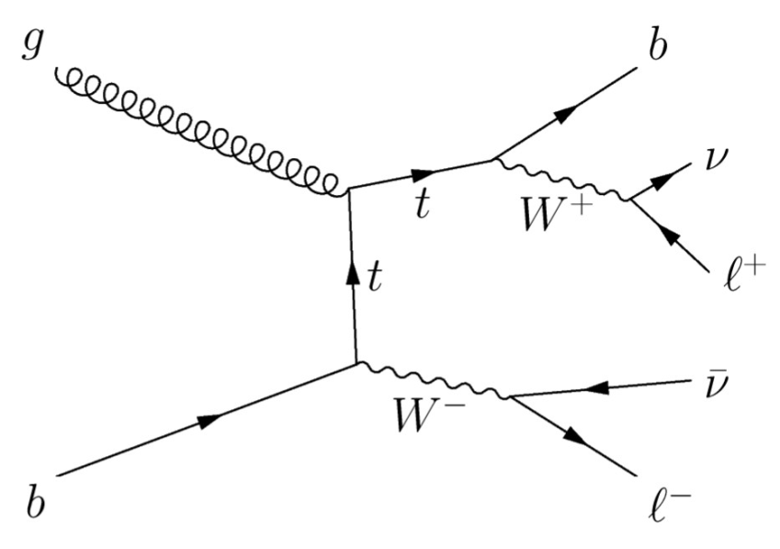
tW Selection Strategy
Look for events where each W decays leptonically
Charged lepton = electron or muon
Final state has:
  Two oppositely charged leptons
  One jet from the b quark
  Missing energy from the neutrinos

Slide 8
The CMS Detector

Slide 9
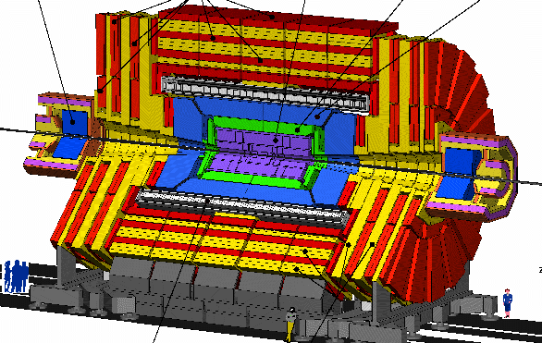
CMS-Compact Muon Solenoid
Physical Parameters:
12,500 tons
21 m long
15 m diameter
Over 100,000,000 individual detecting elements

Slide 10
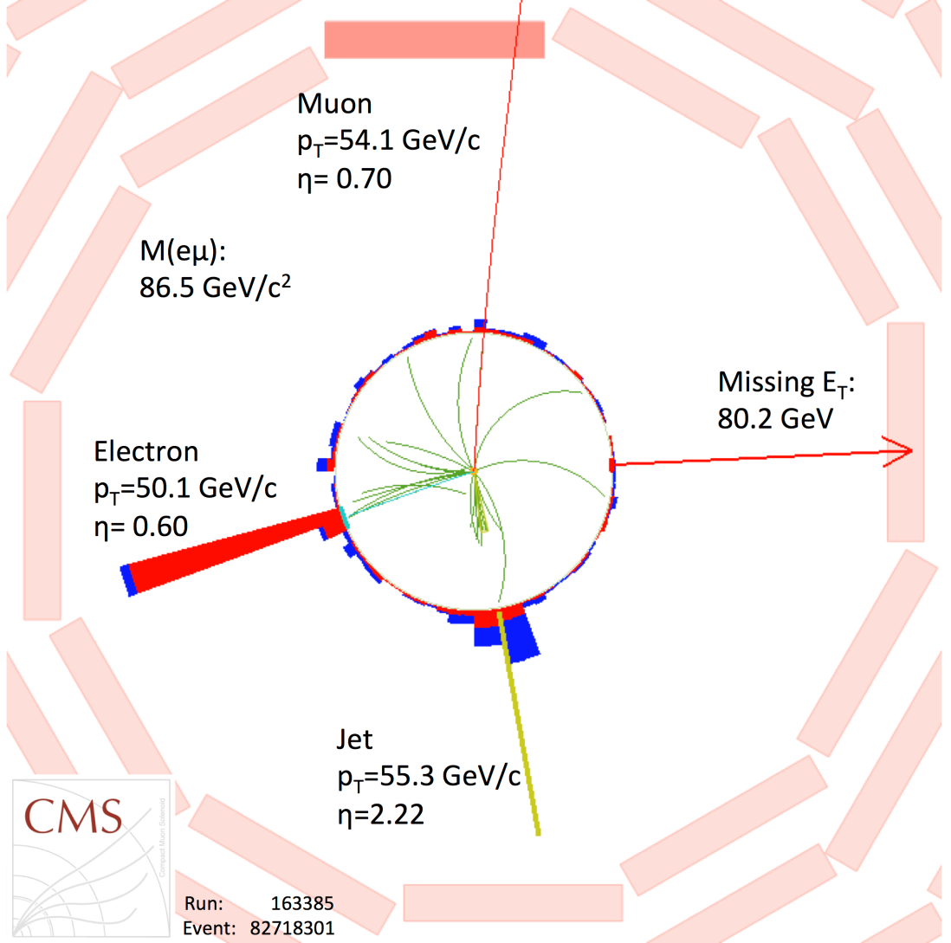
Candidate tW Event from 7 TeV data

Slide 11
Electron Selection
Electrons—energy deposits in EM calorimeter matched to hits in tracker
Isolated
coming from primary vertex
p_{T}>20 GeV
|η|<2.5
“loose electrons”: p_{T}>10 GeV, |η|<2.5

Slide 12
Muon Selection
Muons—reconstructed using particle flow algorithm
Reconstructed in both tracker and muon system
Isolated
p_{T}>20 GeV
|η|<2.4
“loose muon”: p_{T}>10 GeV, |η|<2.5

Slide 13
Jet Selection
Jets– particle flow, anti-k_{T} algorithm with resolution parameter size 0.5
M. Cacciari, G. P. Salam, and G. Soyez, “The Anti-k(t) jet clustering algorithm”, JHEP 0804 (2008) 063, doi:10.1088/1126-6708/2008/04/063, arXiv:0802.1189.
Jet energy corrections applied
“Tight jet”:
  Corrected p_{T}>30 GeV
  |η|<2.4
“Loose jet”:
  fails “tight” cuts
  p_{T}>20 GeV
  |η|<4.9

Slide 14
Multivariate Analysis

Slide 15
Data Selection
pp collisions at =8 TeV at the Large Hadron Collider
Integrated luminosity corresponding to 12.2 fb⁻¹
Triggers requiring two leptons (e or µ), one with p_{T}>17 GeV, the second with p_{T}>8 GeV

Slide 16
Event selection
Well-reconstructed primary vertex (at least 4 tracks, |z|<24 cm, ρ<2.0 cm)
Two oppositely charged leptons
No additional loose leptons
Invariant mass of two leptons (m_{ll})>20 GeV (to remove low mass Z*/γ events)
In ee and μμ events:
  Remove events with 81<m_{ll} <101 GeV (to reduce Z+jets, ZZ and WZ backgrounds)
  Require transverse missing energy of at least 50 GeV

Slide 17
Signal and Control Regions
Signal region has exactly one tight jet that is b-tagged (1j1t)
  b-tagging done with a multivariate algorithm using tracking information
Control regions (dominated by )
  Exactly two tight jets, one of the b-tagged (2j1t)
  Exactly two tight jets, both of them b-tagged (2j2t)

Slide 18
Backgrounds
Dominant background is (~75%)
  Boosted decision tree (BDT) is trained to distinguish tW from
  Shapes of BDT discriminant plots in signal and control regions used to determine cross section and significance
Next largest background is Z+jets (~5%)
  Remaining events after cuts estimated from simulation
  Corrections made to simulation using Z+jets enriched data sample

Slide 19

Boosted Decision Tree (BDT)
TMVA package used
Trained on Monte Carlo: 200k dilepton events from tW and 200k top pair events
POWHEG generator used for signal, MADGRAPH for top pair background
Full detector response simulated with GEANT4
13 kinematic variables used to discriminate signal and background

Slide 20
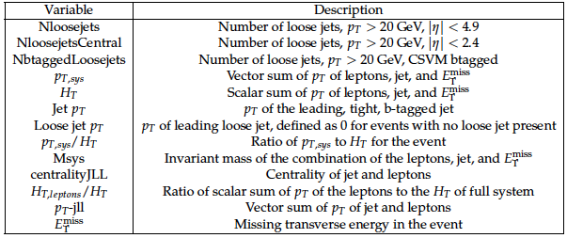
Kinematic variables for BDT
Data/MC agreement checked in several control regions (2j1t, 2j2t, 2j0t, 1j0t)

Slide 21
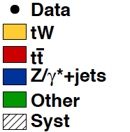
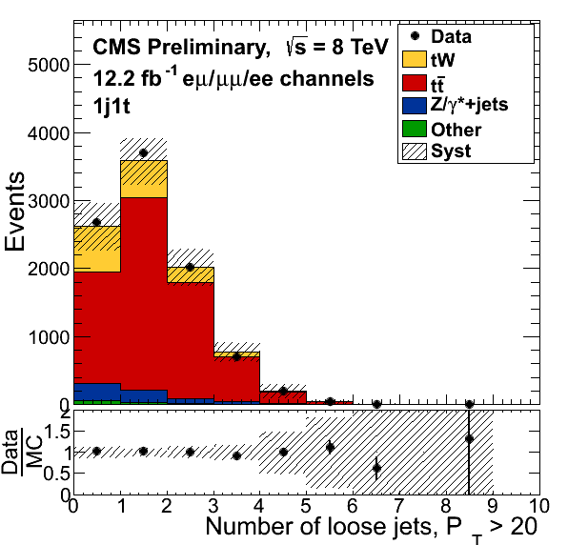
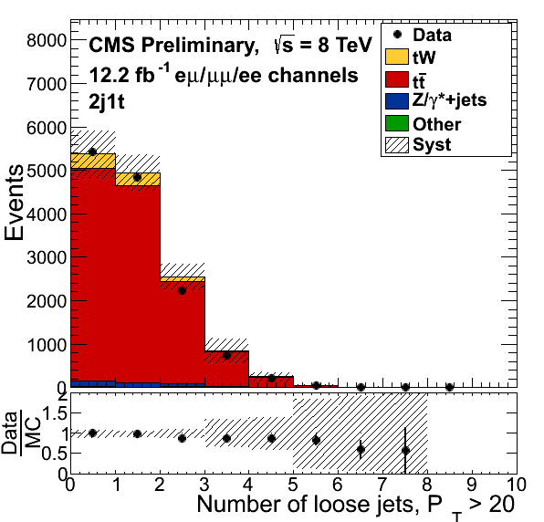
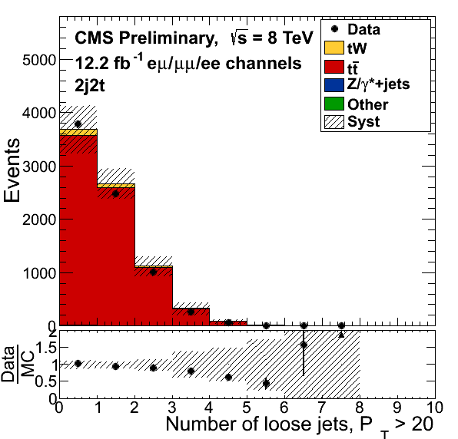
Number of loose jets
“Loose jet” p_{T}>20 GeV, |η|<4.9, fails “tight” cuts
Control regions
Signal region

Slide 22
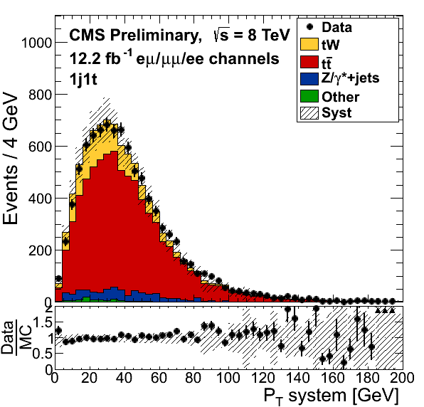
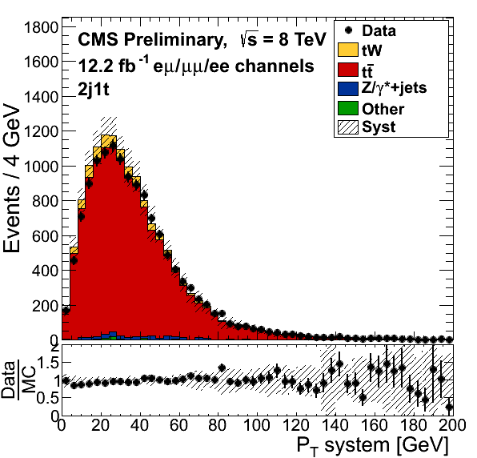
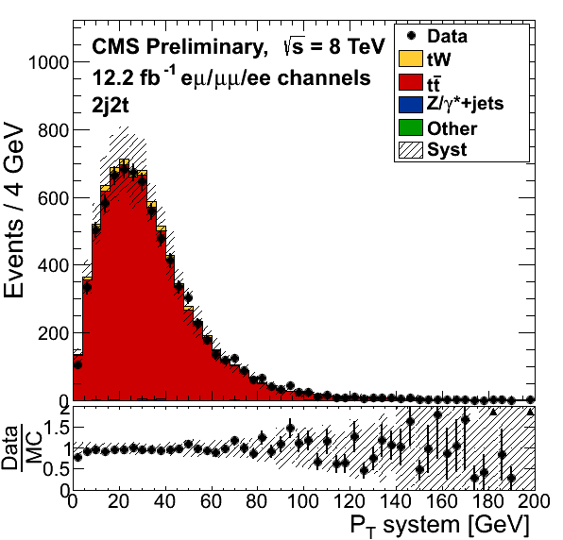
p_{T} of the system
Vector sum of p_{T}’s of leptons, jet and missing E_{T}
Control regions
Signal region

Slide 23
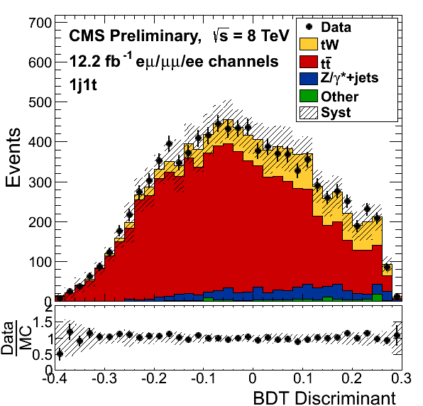
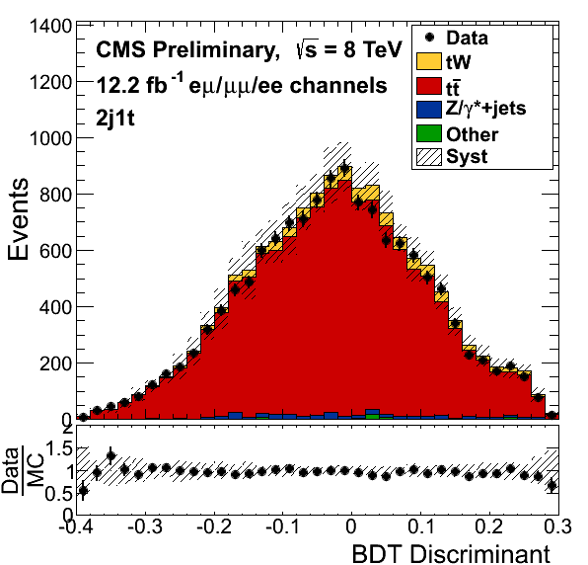
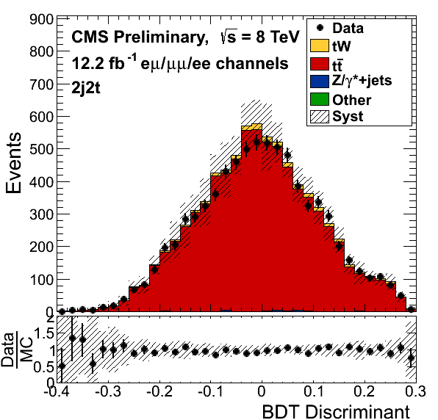
BDT discriminant
Signal-like events positive, background-like negative
Binned likelihood fit done simultaneously for all channels (ee, eμ, μμ), all regions (1j1t, 2j1t, 2j2t)
Control regions
Signal region

Slide 24
Systematics affecting rate only
Luminosity --4.4% uncertainty on CMS measurement
Lepton efficiency -- 1.9-2.3% uncertainty from varying trigger, reconstruction and identification efficiencies
cross section -- 6.8% uncertainty in CMS measured value

Slide 25
Systematics giving shape variations
pile-up multiplicity
jet energy scale
jet energy resolution
b-tagging data/MC scale factors
missing energy modeling
Z + jets scale factors
PDF uncertainties
statistics of simulated data
theory uncertainties (see next two slides)

Slide 26
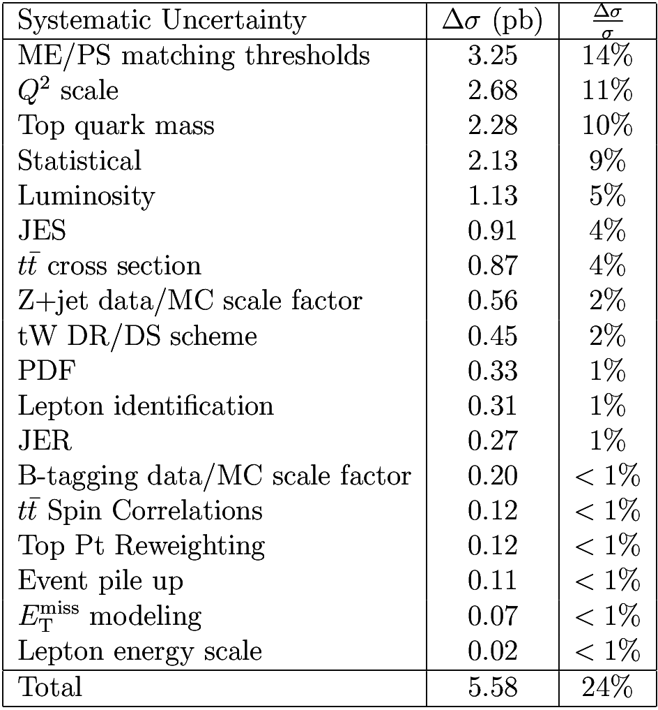
Dominant systematics
Table shows systematic uncertainties extracted by fixing sources one at a time and measuring the difference in the cross section uncertainty

Slide 27
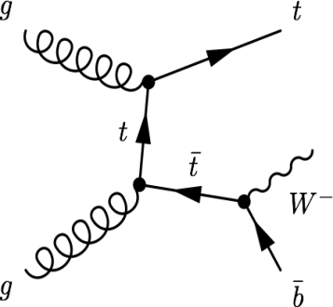
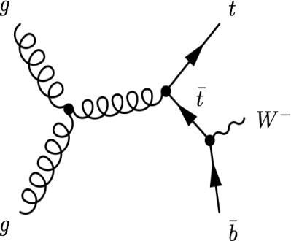
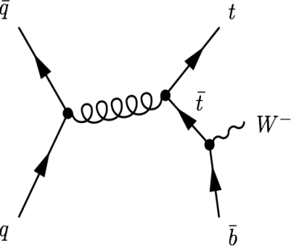
Theory uncertainties
tW mixes with top pair production at NLO. The above diagrams are removed from the signal definition when doubly resonant
Largest systematic uncertainties come from theory uncertainties:
  Jet-parton matching thresholds in top pair simulations
  Q² scale
  Top mass uncertainty
  DR (diagram removal)/DS (diagram subtraction) scheme for separating higher order top pair and tW diagrams
  top pair spin correlations
  top p_{T} reweighting
These uncertainties are externalized in the significance calculation, which gives a more conservative error determination

Slide 28
Statistical analysis
Simultaneous binned likelihood fit of BDT distribution for all channels (ee, eμ, μμ), all regions (1j1t, 2j1t, 2j2t)
Expected yield in bin i:
Templates for signal and background taken from Monte Carlo
Nuisance parameter , θ, introduced for each independent source of systematic uncertainty that changes the template
Theory-based values fixed at central value in likelihood fit, uncertainties included in pseudo-experiments
Test statistic for pseudo-experiments: , where µ is signal strength
Evaluate for background-only and signal + background hypotheses
Profile likelihood fit to get cross section and 68% confidence level, signal and background rates allowed to float

Slide 29
Results
An excess of events is observed compared to a background-only hypothesis based on fitting the shape of the BDT discriminant
Observed significance=6.0σ
Expected significance from MC=5.4σ
Measured tW cross section: 23.4 +5.5-5.4 pb
Standard model: 22.2 ± 0.6 (scale) ± 1.4 (PDF) pb N. Kidonakis arxiv.org/pdf/1205.3453v1 (2012)
CKM |V_{tb}| matrix element (assume|V_{tb}|>>|V_{td}|,|V_{ts}|):
|V_{tb}| = 1.03 ±0.12(exp)±0.04(th)
|V_{tb}|>0.78 at 95% C.L., when constrained to be ≤1

Slide 30
Cross check analyses

Slide 31
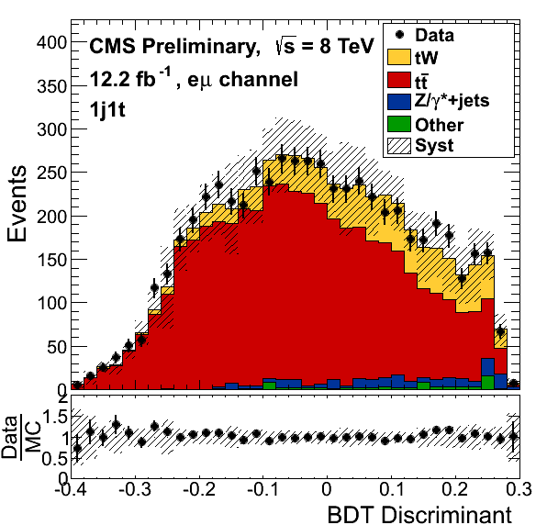
Lepton channel checks
eμ, ee and μμ channels give consistent results
eμ channel alone has:
  Observed significance=5.7σ
  Expected significance from MC=4.4σ
  Measured tW cross section: 29.0 +6.2-6.1 pb

Slide 32
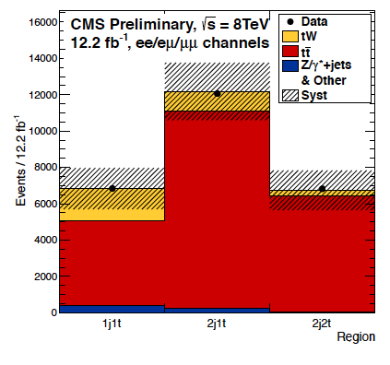
Cut and count
Independent cut-and-count analysis gives observed significance of 3.6 σ
Additional cuts relative to the BDT analysis:
  Veto events with loose b-tagged jets
  Ht>160GeV (eµ final state only)
Fit to event counts only in each region

Slide 33
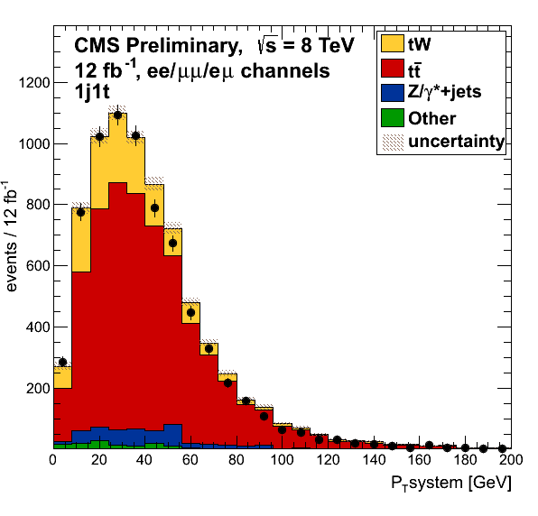
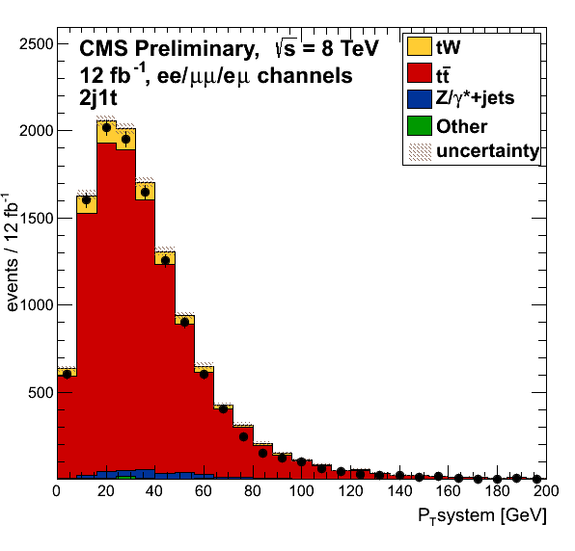
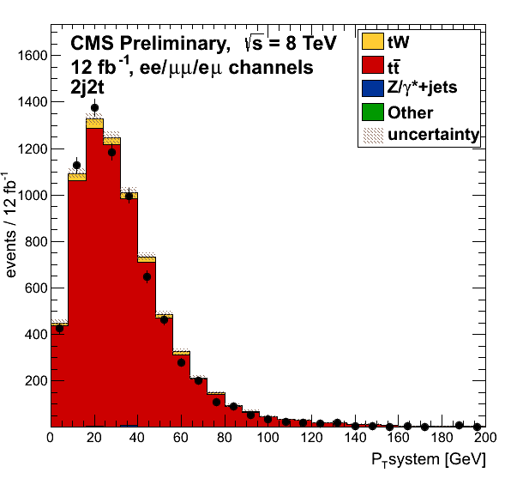
p_{T} system Fit
Same selection as the cut-and-count
Instead of fitting numbers of events, fit the p_{T} of system distribution (vector sum of p_{T}’s of leptons, jet and missing E_{T})
gives observed significance of 4.0 σ
Signal region
Background regions

Slide 34
Summary
single top tW associated production, has been observed in the dilepton channel at > 5.0 σ significance
CMS used 12.2 fb⁻¹ of pp collisions data at 8 TeV in this analysis
Multivariate analysis using kinematic variables in a boosted decision tree (BDT) used to separate tW signal from top pair background
Binned likelihood fit to the BDT discriminant used to measure significance and cross section
Signal region (1j1t) and control regions (2j1t, 2j2t) used in fit
Excess of events above background-only hypothesis is 6.0 σ
Measured tW cross section: 23.4 +5.5-5.4 pb

Slide 35
CMS public results links
https://twiki.cern.ch/twiki/bin/view/CMSPublic/PhysicsResultsTOP12040
http://cds.cern.ch/record/1563135

Slide 36
Backup

Slide 37
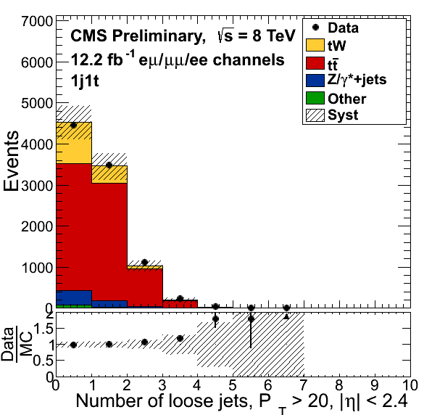
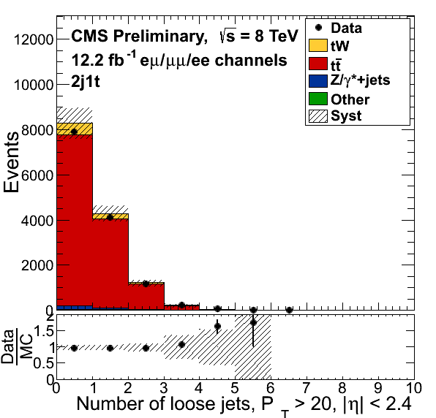
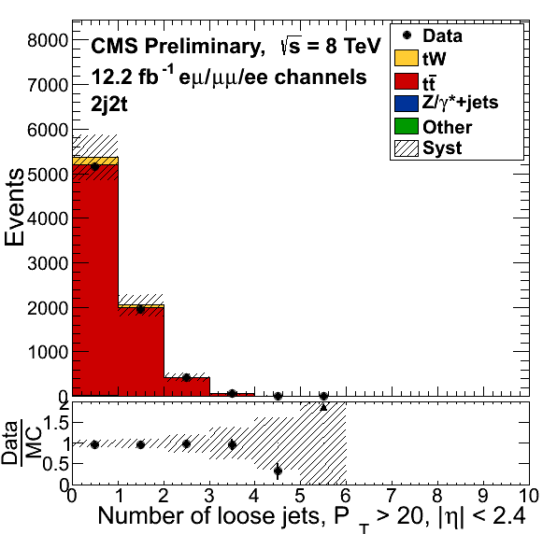
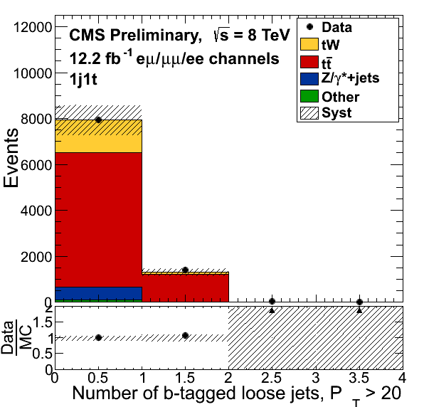
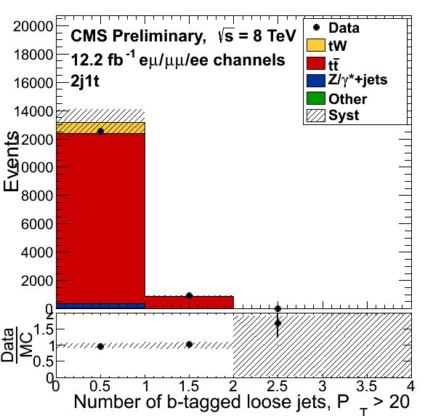
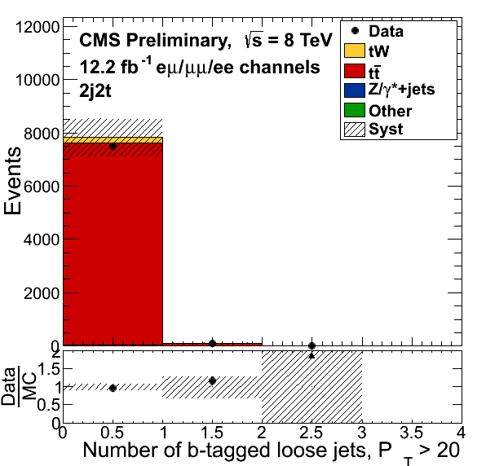
BDT Kinematic variable distributions (1)

Slide 38
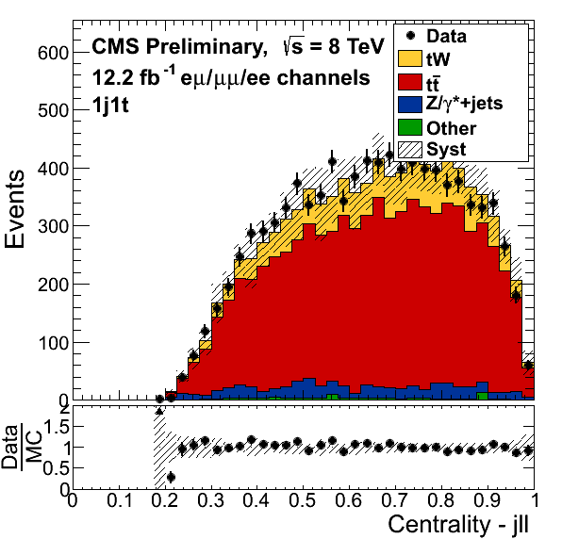
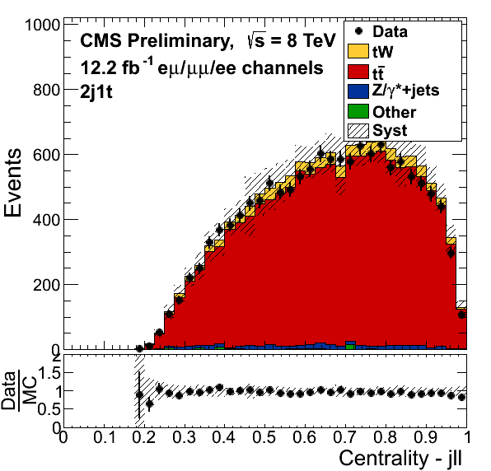
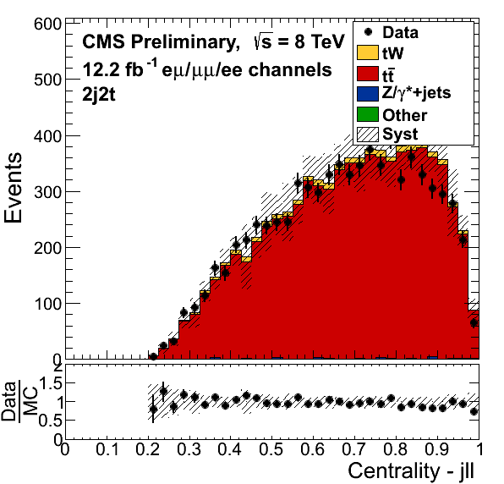
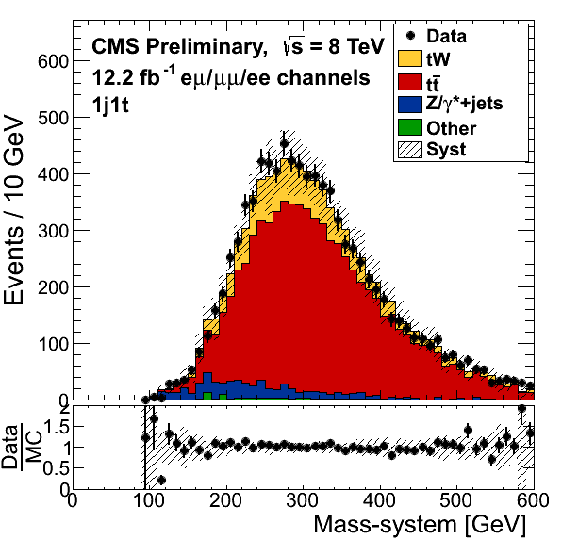
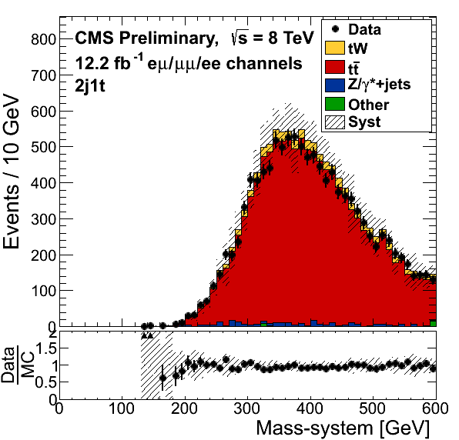
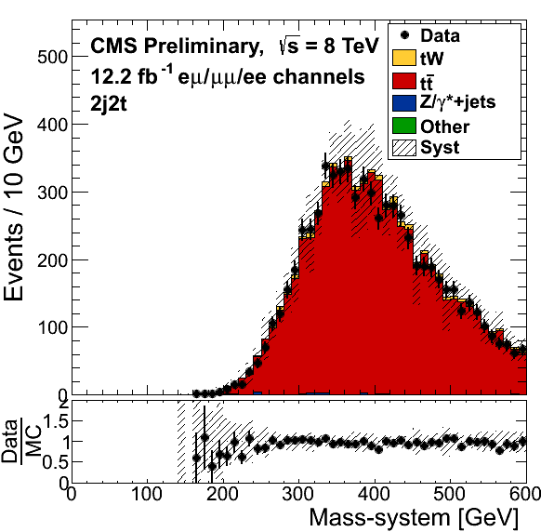
BDT Kinematic variable distributions (2)

Slide 39
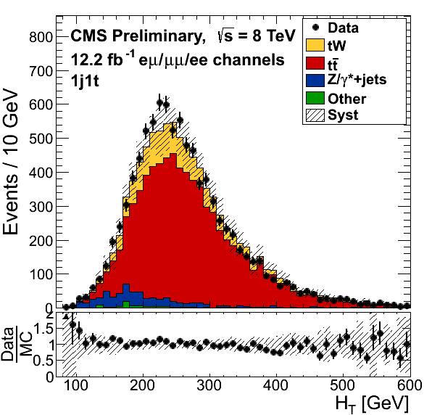
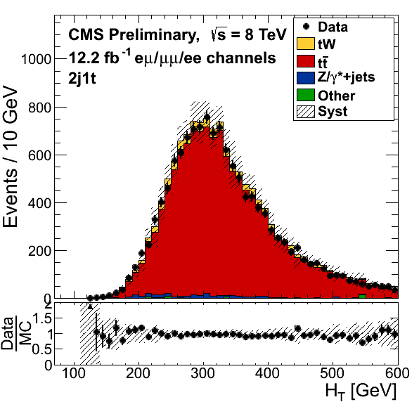
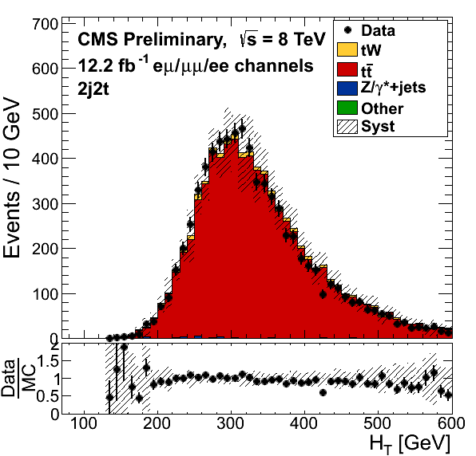
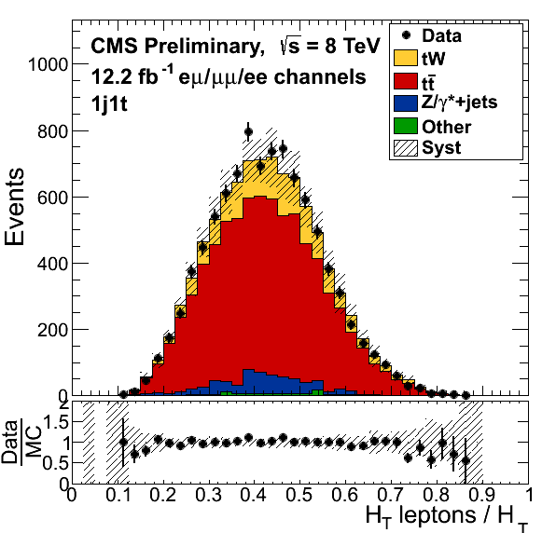
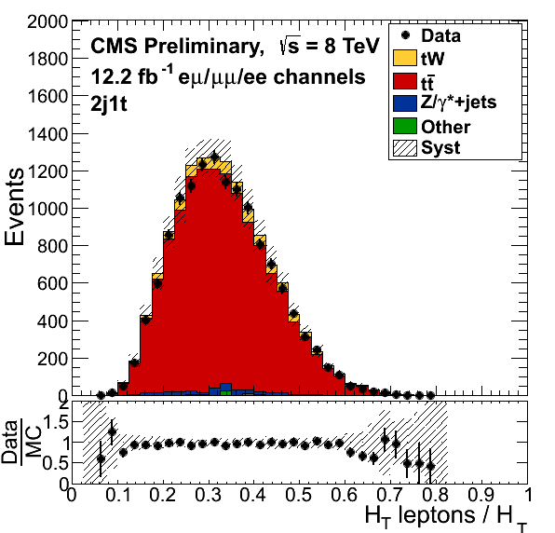
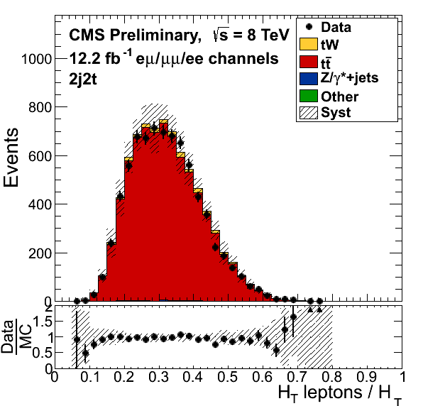
BDT Kinematic variable distributions (3)

Slide 40
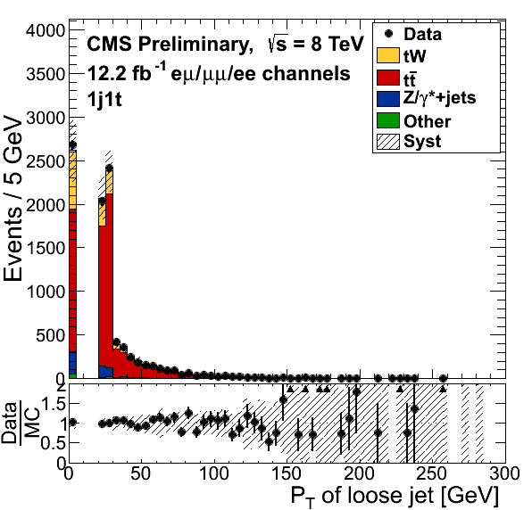
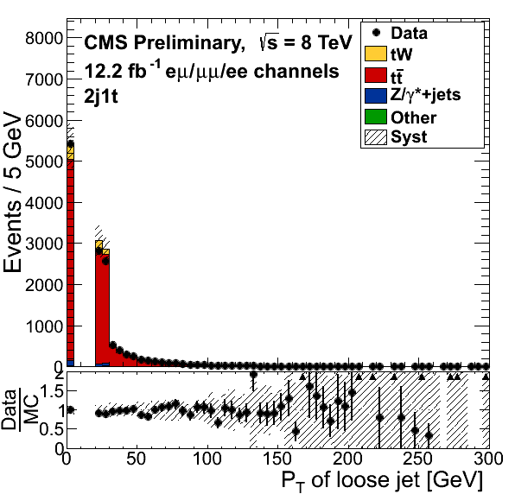
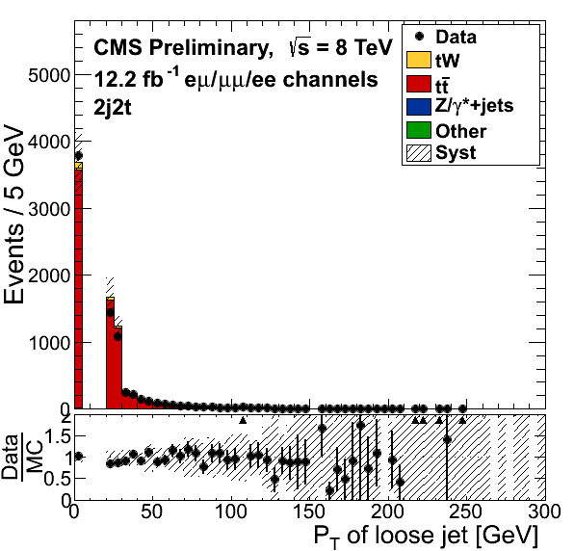
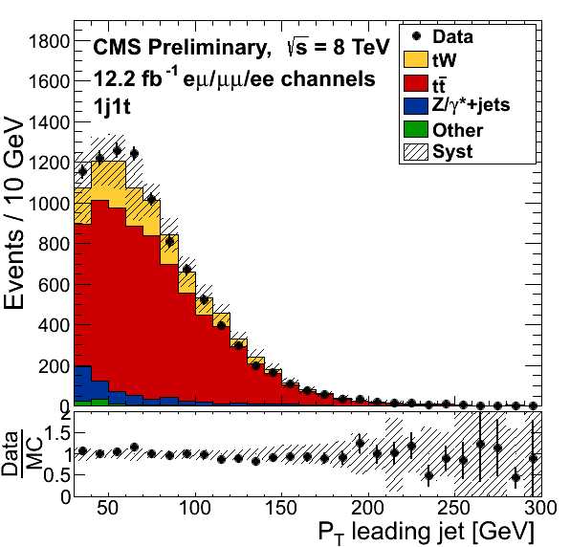


BDT Kinematic variable distributions (4)

Slide 41






BDT Kinematic variable distributions (5)

Slide 42



BDT Kinematic variable distributions (6)

Slide 43


Zero tag control regions
BDT discriminant for events with no b-tagged jets

Slide 44




Event yields in signal and control regions
all
ee
eμ
µµ

