Slide 1


Cathode Strip Chamber Upgrade for the CMS Endcap at the HL-LHC
Indara Suarez Silva
Texas A&M University
DPF 2013
13-17 August 2013
University of California, Santa Cruz
Notes:
High luminosity running

Slide 2
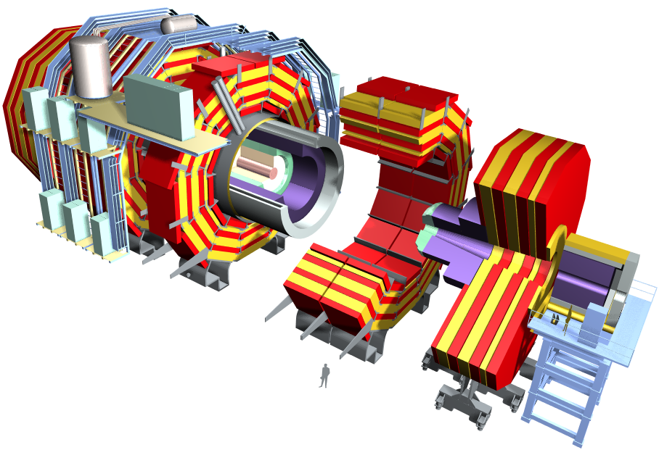
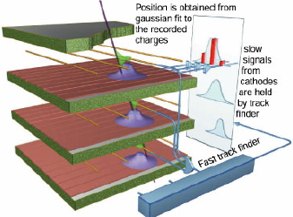
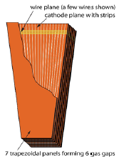
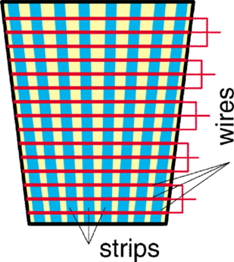
The CMS Detector
Total weight : 12,500 t
Overall diameter : 15 m
Overall length : 21.6 m
Magnetic field : 4 Tesla
6 layer multi-wire proportional chambers
MUON
ENDCAPS
Cathode Strip Chambers
Resistive Plate Chambers
Notes:
MAKE CSCs bigger

Slide 3
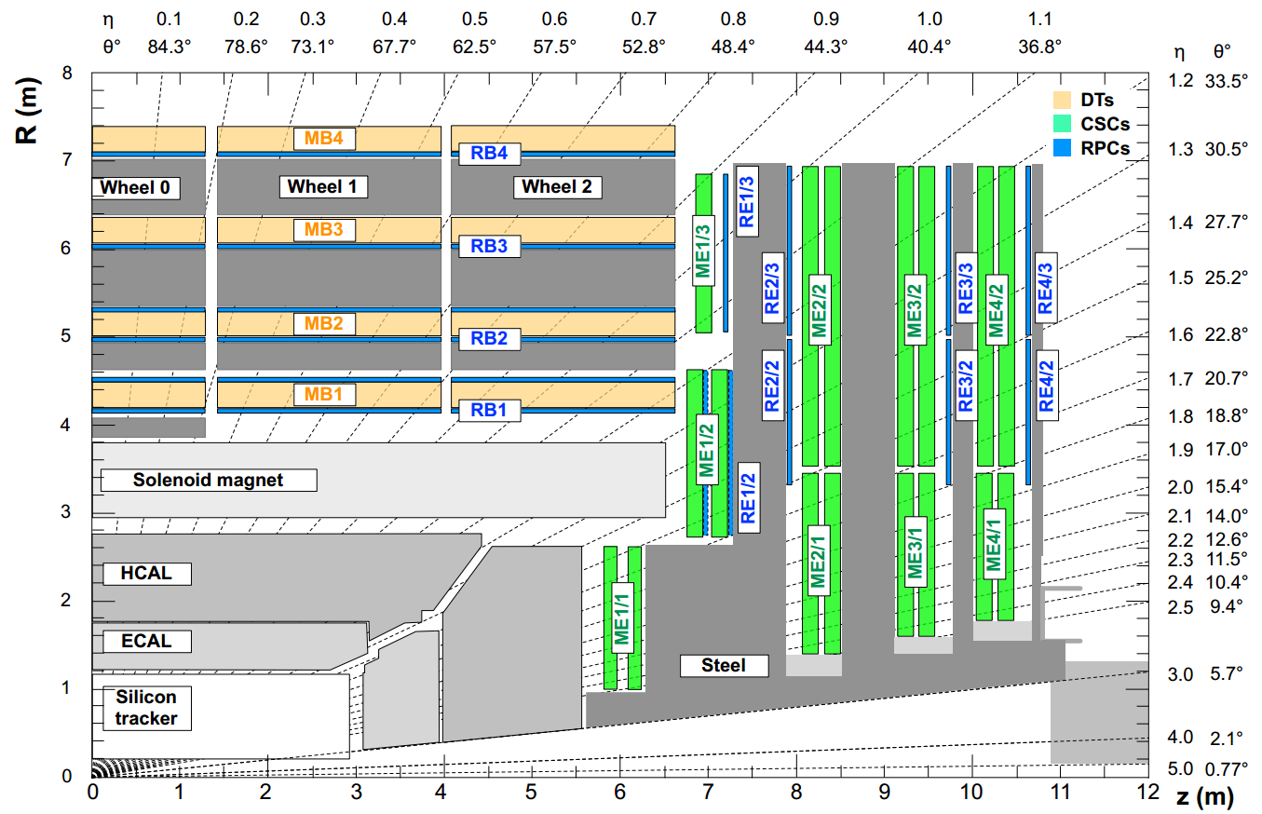
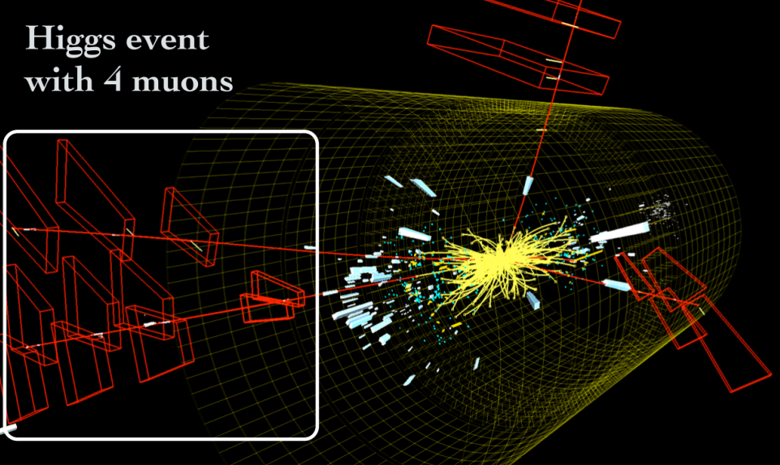
Cathode Strip Chambers (CSC)
The muon endcap currently consists of 468 CSCs
With the upgraded luminosity, we will need to
  Fully Upgrade the electronics for the 72 CSCs belonging to ME-1/1 system (1.6<|η|<2.4)
  Add 72 new CSCs in the 1.2<|η|<1.8 region: ME-4/2
  in order to maintain a robust and efficient muon trigger
The muon trigger plays a crucial role in ongoing studies
  SM Higgs, e.g. H→ZZ→μ⁺μ⁻μ⁺μ⁻
  BSM, ex. SUSY, Z’, W’, …
Notes:
Much nicer version of top plot from tim cox

Slide 4
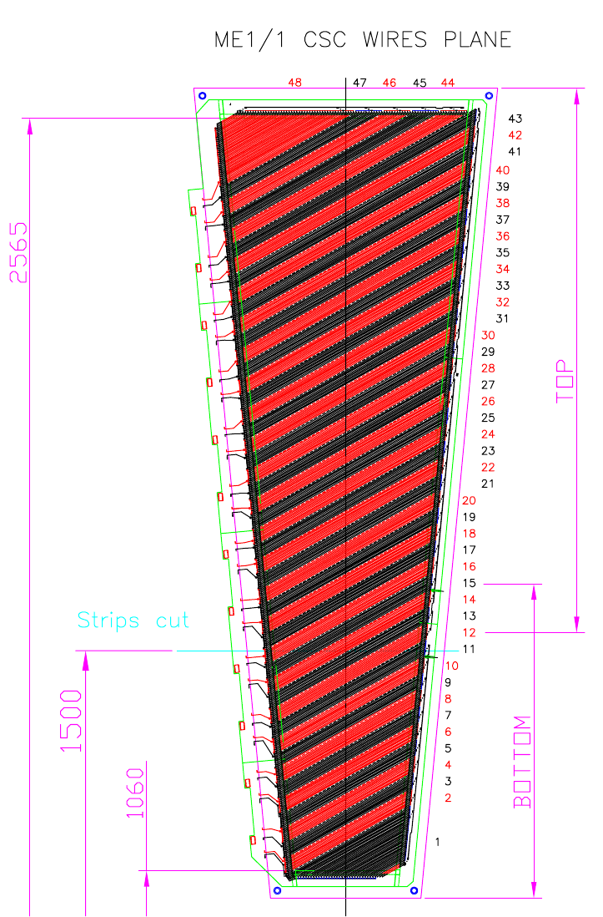
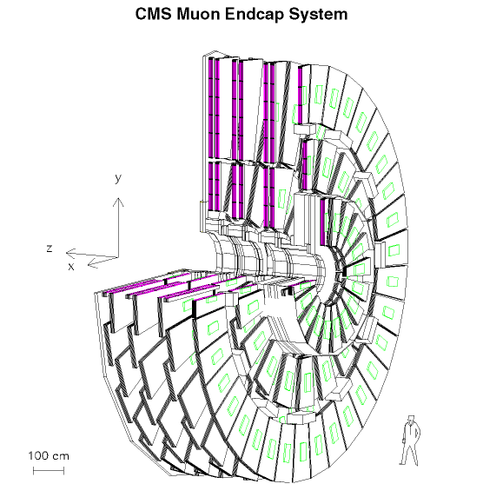
The ME-1/1 System During 7 & 8 TeV runs
ME1/1
Located closest to the point of interaction
CFEB
CFEB
CFEB
CFEB
η=1.55
me-1/1b
LVDB
ALCT
1 of 24
ME1/b
CSC
me-1/1a
CFEB
ME1/a
η=2.09
η=2.43
Strips are split in η
  Effectively two chambers in one
    Inner chamber: ME-1/1a (48 strips)
    Outer Chamber: ME-1/1b (64 strips)
Notes:
Anode readout board for alct
Strips are split in eta and then say effectively 2 chambers in one
ALCT
Remove afebs

Slide 5
The ME-1/1 System During 7 & 8 TeV runs
ME1/1
ME-1/1
  spatial resolution of ME1/1 is 113 micrometer
  5 CFEBs: Cathode Front-End Board (4 CFEBs for ME-1/1b, 1CFEB for ME-1/1a)
    Radial cathode strips for precision measurement in bend direction of magnetic field
    ME-1/1 504x96=~48,384 strips
  1 ALCT: Anode Readout Board
    Anode wires for timing (bunch ID) and for r (θ) coordinate
η=1.55
ME1/b
ME1/a
η=2.09
η=2.43
Notes:
Anode readout board for alct
Strips are split in eta and then say effectively 2 chambers in one
ALCT
Remove afebs

Slide 6
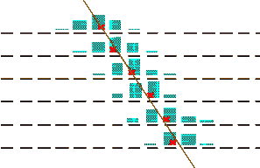
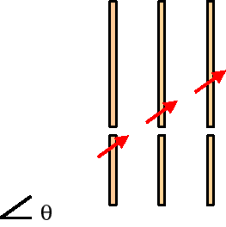
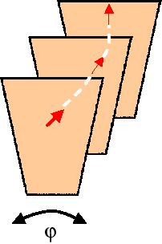
Trigger Primitives Generated in Front End
Local Charged Tracks (LCT) are formed by comparing hits to patterns…
Cathode LCT (CLCT) from strips
Comparator network rapidly determines hits to ½-strip resolution per layer
Measures φ
Pattern → Radius of curvature ∝ momentum
Anode LCT (ALCT) from wire groups
Defines trigger timing
Measures θ, bx
Pattern → envelope pointing to Interaction Point

Slide 7
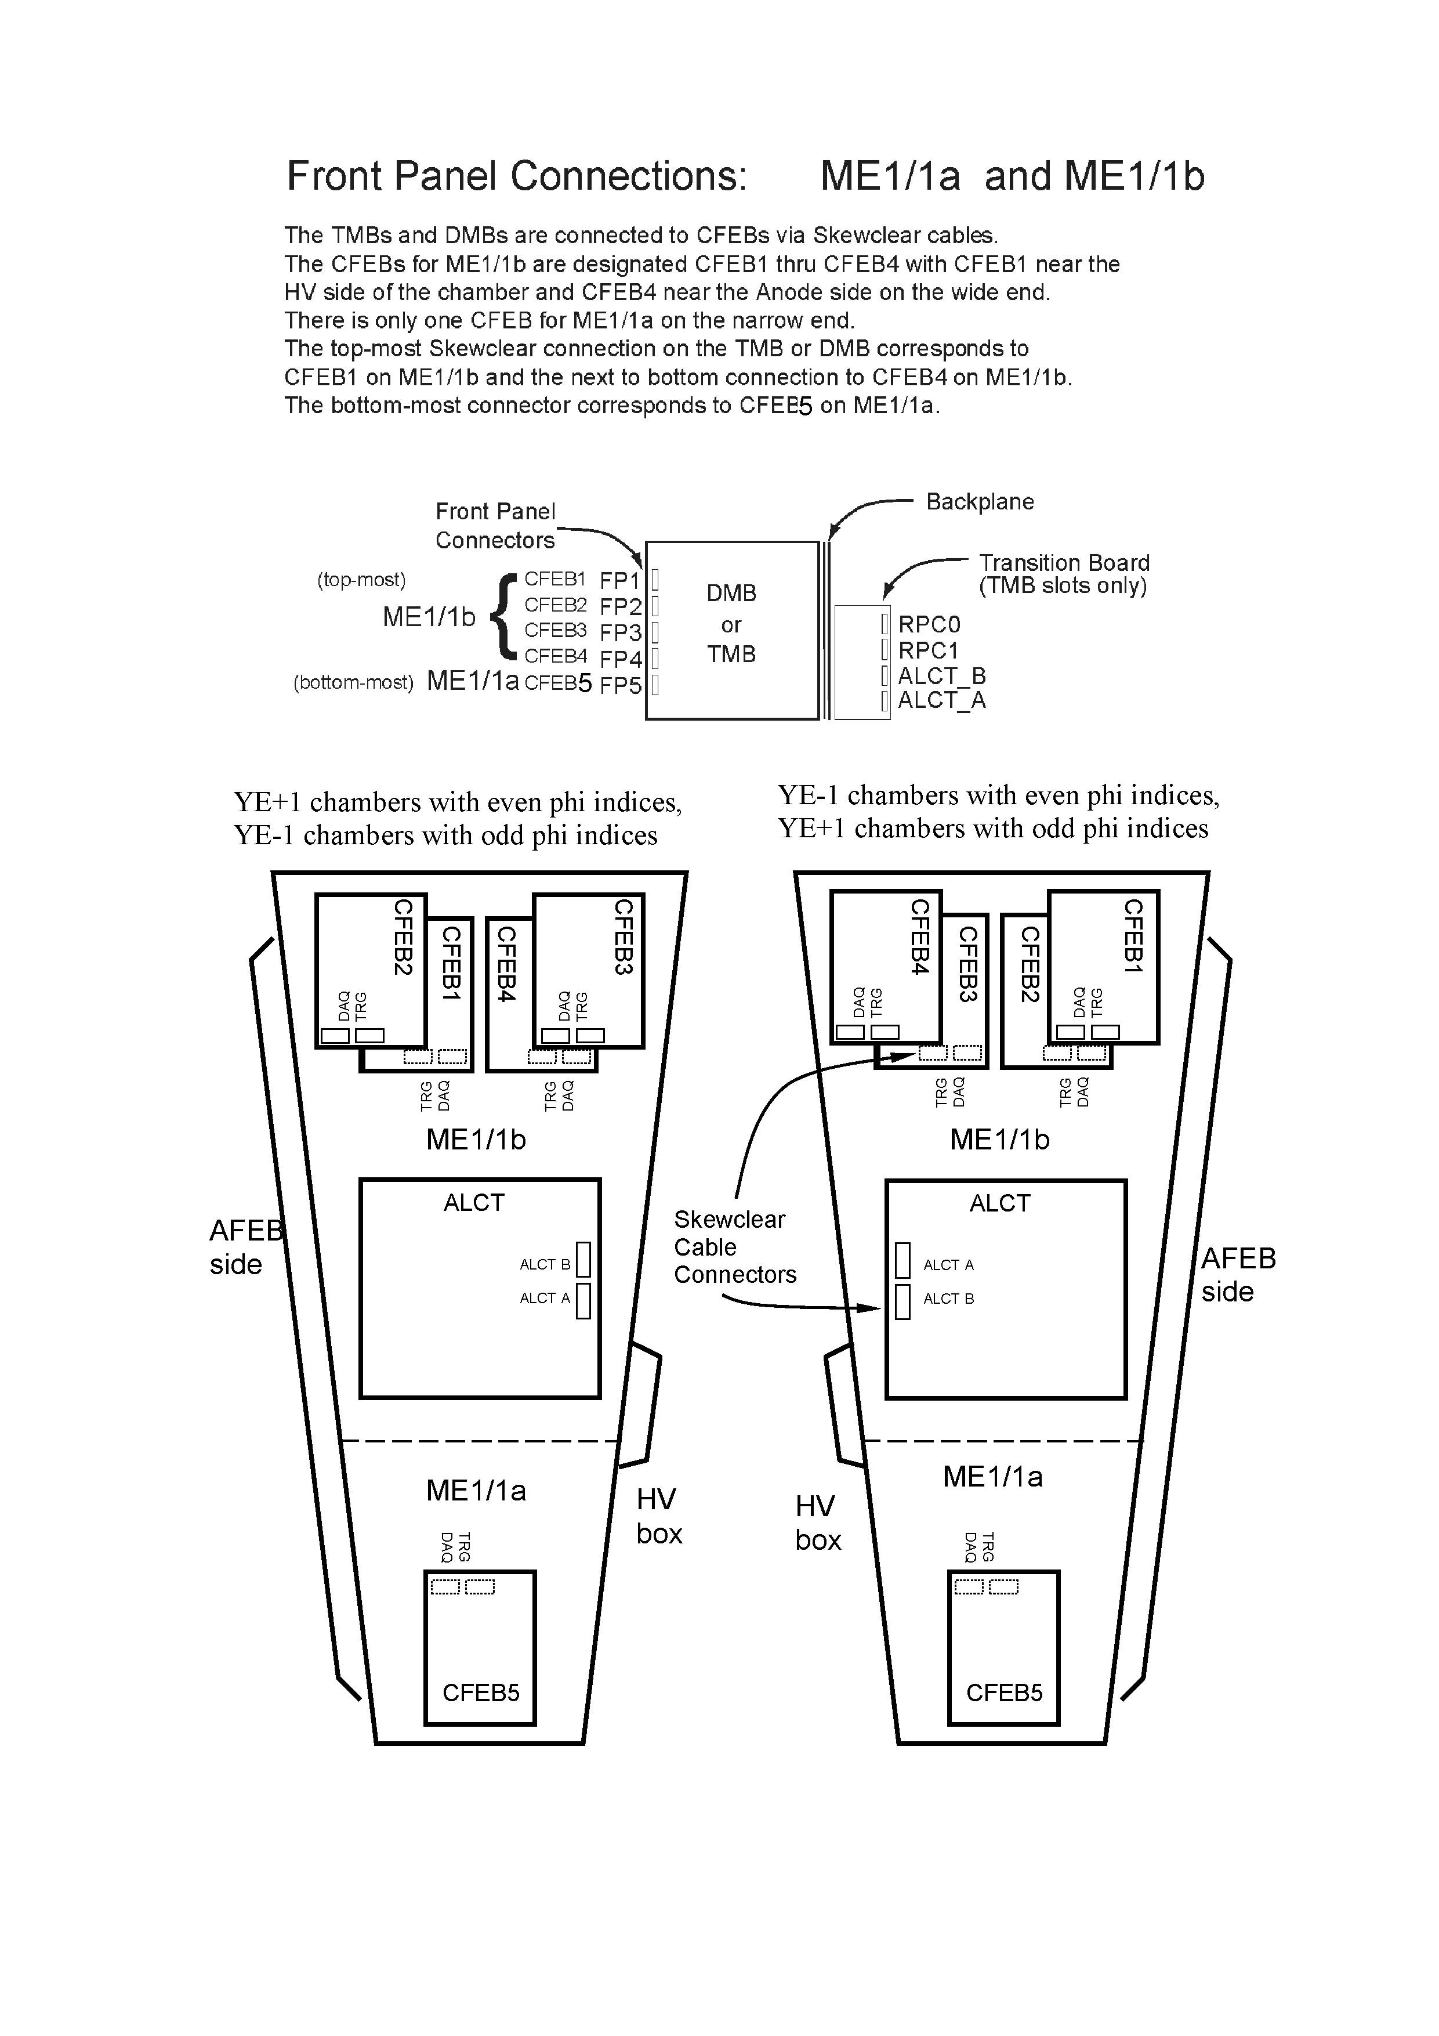
  Triple ganging of ME-1/1 cathode strips
ME-1/1a (2.1<|η|<2.4)
  3:1 cathode strip ganging
  each electronics channel currently has 3 strips connected
  Two ghost hits for each real muon
  Used to reduce channel count
Strips: 1 16 17 32 33 48
…
…
…
Electronics
Channel 1
…
Channel 16
Upgrade will remove triple ganging
Notes:
Every 3 physical strips is connected to one output channel
Remove picture and say originally this was designed to have 3 cfebs instead of one but for many reasons we don’t have that, then returning to original plan in upgrade effort
→out to time pileup issues
→triggering problem that develops

Slide 8
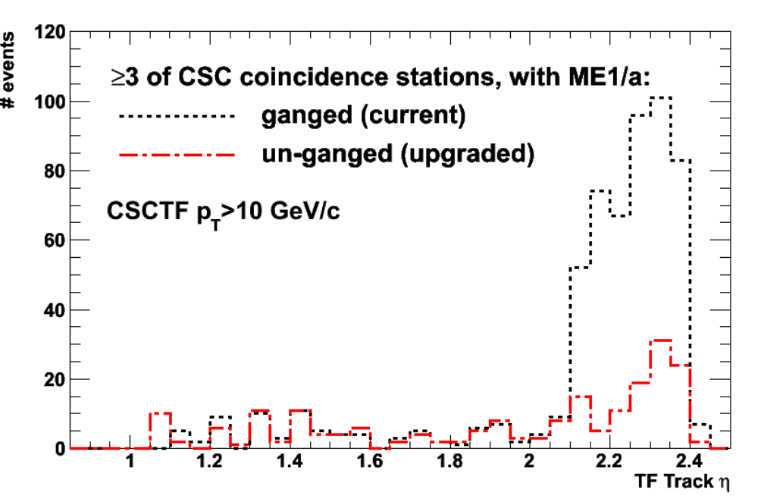
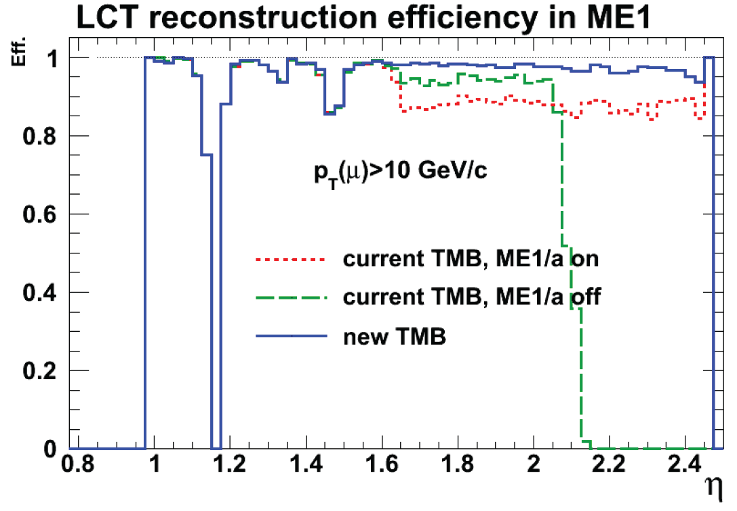
CSC: Frontend Trigger Problem
Triple ganging compromises trigger efficiency – even bigger problem at the HL-LHC
  Improve muon trigger efficiency for |η|>2.1 by removing triple-strip-ganging in ME1/1a region (5→7 CFEB)
Out-of-time Pile-Up induces deadtime at higher luminosity → look at PU100
  Increase capacity for data rate CFEB→Digital CFEB
  Better FPGAs for Trigger Motherboard available for improvement of trigger algorithms
Notes:
→focus on out of time pu....
Bottom plot with and without triple ganging in technical proposal
Cut on text:
Control rate better while still have
Suppress low-p_{T} mis-measured muons
Reduces ambiguities due to combinatorics

Slide 9
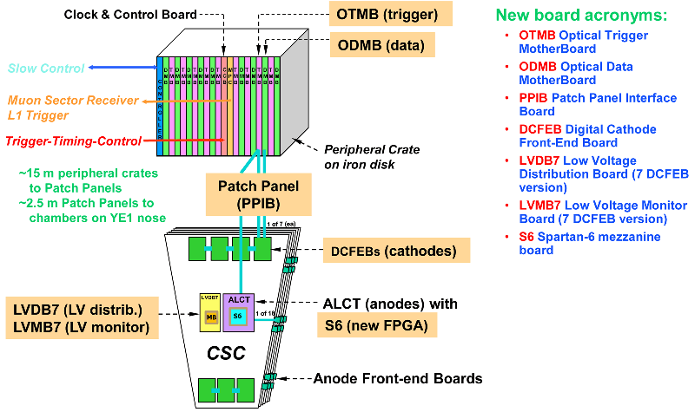
Overview of ME-1/1 Upgrade
Notes:
2.5m → 1.5m

Slide 10
ME-1/1 On-Chamber Electronics Upgrade
Remove triple-strip-ganging in ME1/1a region (5→7 CFEB)
  Suppress low-p_{T} mis-measured muons
  Reduces ambiguities due to combinatorics
ALCT → ALCT(S6): Anode readout board
  FPGA Virtex E → Spartan 6
  New, faster FPGA to handle rates
Low Voltage Distribution Board to supply low voltage to on-chamber electronics and Low Voltage Mezzanine Board is the interface between the LVDB and the readout board ODMB, which we use for monitoring and control
Current
Upgraded
Cathode Front-end Board
CFEB
CFEB
CFEB
CFEB
LVDB
ALCT
1 of 24
Anode LCT Board
CSC
Anode Front-end Board
CFEB
Notes:
Slide 7 – You might as well say that the change in ALCT FPGA is from Virtex E to Spartan 6.
the changes in DAC reference distribution might be too much detail for this presentation. But make it clear the the LVDB’s supply the low voltage power to the boards (not just the reference).

Slide 11
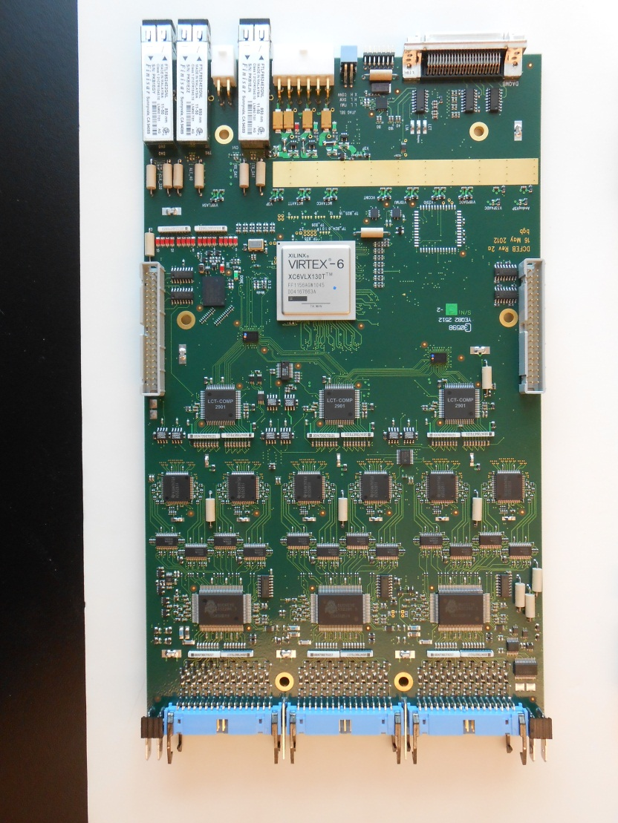
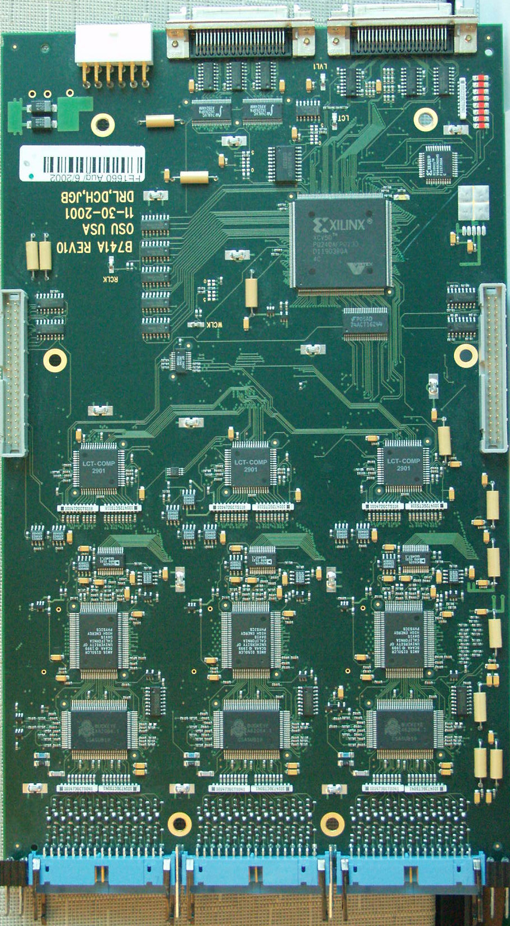

ME-1/1 On-Chamber Electronics Upgrade
11
Cathode Front End Boards → Digital Cathode Front End Boards
Virtex 1 → Virtex 6
Replace the current analog CFEB with SCA and 16:1 multiplexing ADC by digital design with flash ADC for each channel and digital pipeline storage
Optical Data and Trigger Path
CLK,L1A,JTAG...
TMB Path copper
Data Path copper
Virtex I
Trig brd2brd
Comparator ASIC
6 Wilkinson ADCs
Switch Capacitor ASIC
Buckeye Amp/shaper
ASIC
Coupling/Protection
CLK,L1A,JTAG...
TMB Path optical
Data Path optical
Virtex 6
Trig brd2brd
Comparator ASIC
Flash ADCs
Fully Diff Amps
Buckeye Amp/shaper
ASIC
Coupling/Protection
CFEB
DCFEB
Notes:
Copper to optical to increase reliability

Slide 12
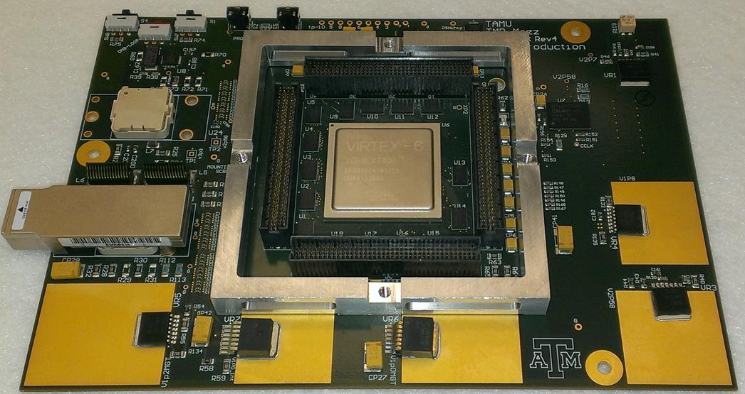
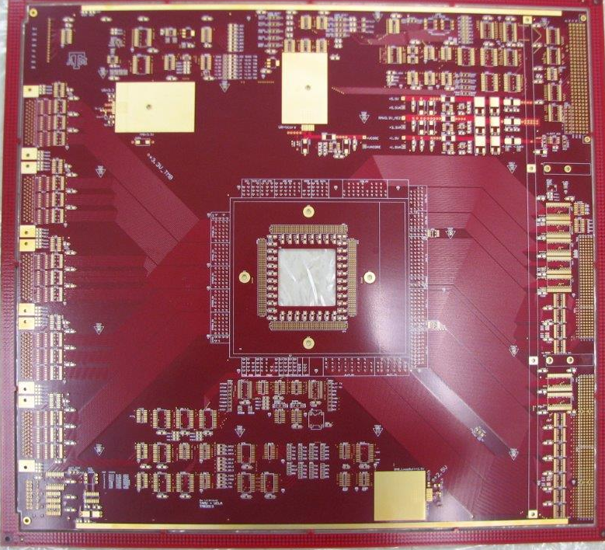

ME-1/1 Readout Electronics Upgrade
Optical Trigger Mother Board (OTMB)
  Replaced Mezzanine card
    Virtex 6 FPGA enhances our capabilities
    memory & speed for improved trigger logic
    Use 7 multi-gigabit serial links for data from DCFEBs
  New Base Board
    A new front panel to make room for optical links
    Modification specifically targets improvement in power distribution
    Full backwards compatibility is maintained
Notes:
Slide 10: We usually refer to the parts of the (O)TMB and “base boards” and “mezzanine” (rather than “main board”).

Slide 13
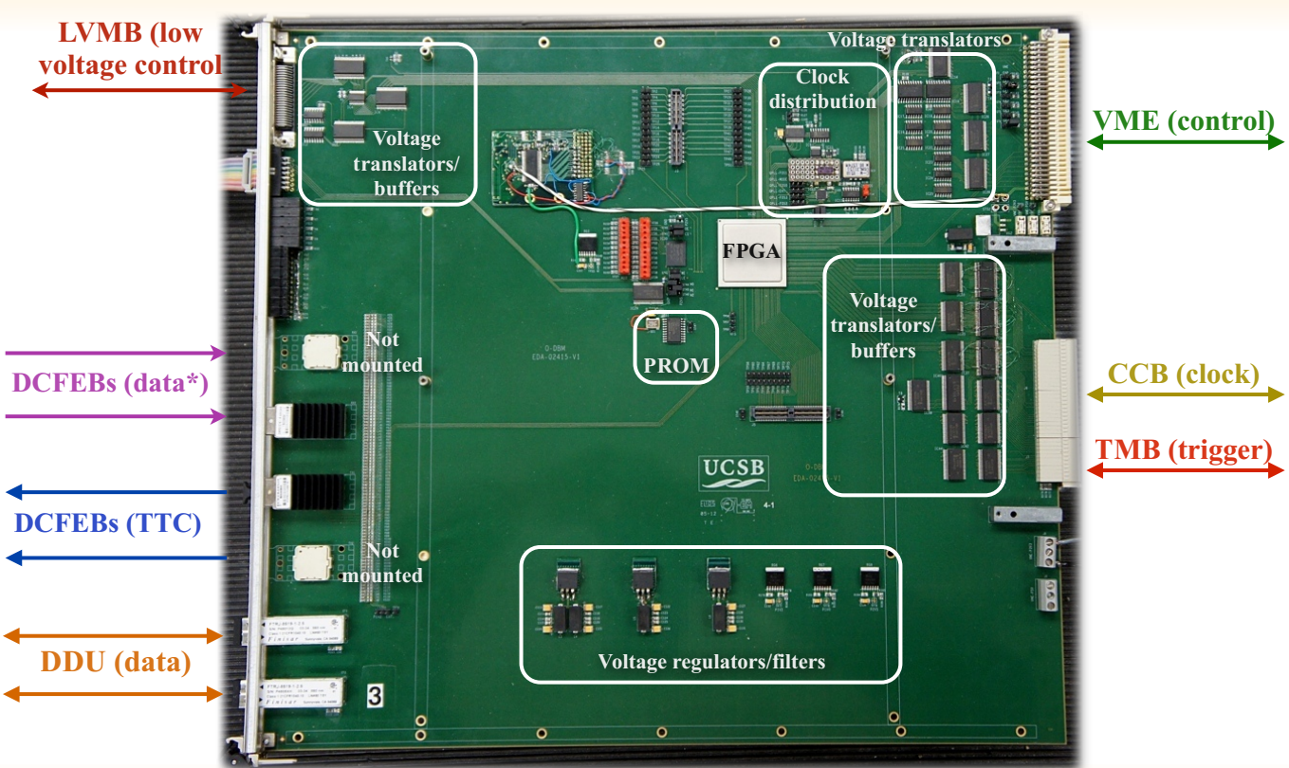

ME-1/1 Readout Electronics Upgrade
Optical Data acquisition Mother Board (ODMB)
  Optical Transceivers
  New Virtex-6 to handle the fiber optic data and optical transmission for 7 DCFEBs
Notes:
Slide 12: Is there a picture of an ODMB with the SNAP12 receivers mounted? If so, I would use that.

Slide 14
Radiation studies
Test components for stability at high radiation levels expected in the HL-LHC environment
Neutrons are the main radiation source in the CMS cavern
Types of radiation damage to electronics:
  Single Event Upset (SEU)/ Short Term
    Digital upsets caused by high energy “hard” neutrons
  Total Ionizing Dose and Displacement Damage/Long Term
    Silicon crystal defects caused by hard and soft neutrons
Operational Stability – the electronics are tested for consistent performance
Temperature Regulation – verify the steady state temperature is within a safe operating range
Radiation Tolerance – determine which electronic circuits survive HL-LHC radiation levels

Slide 15
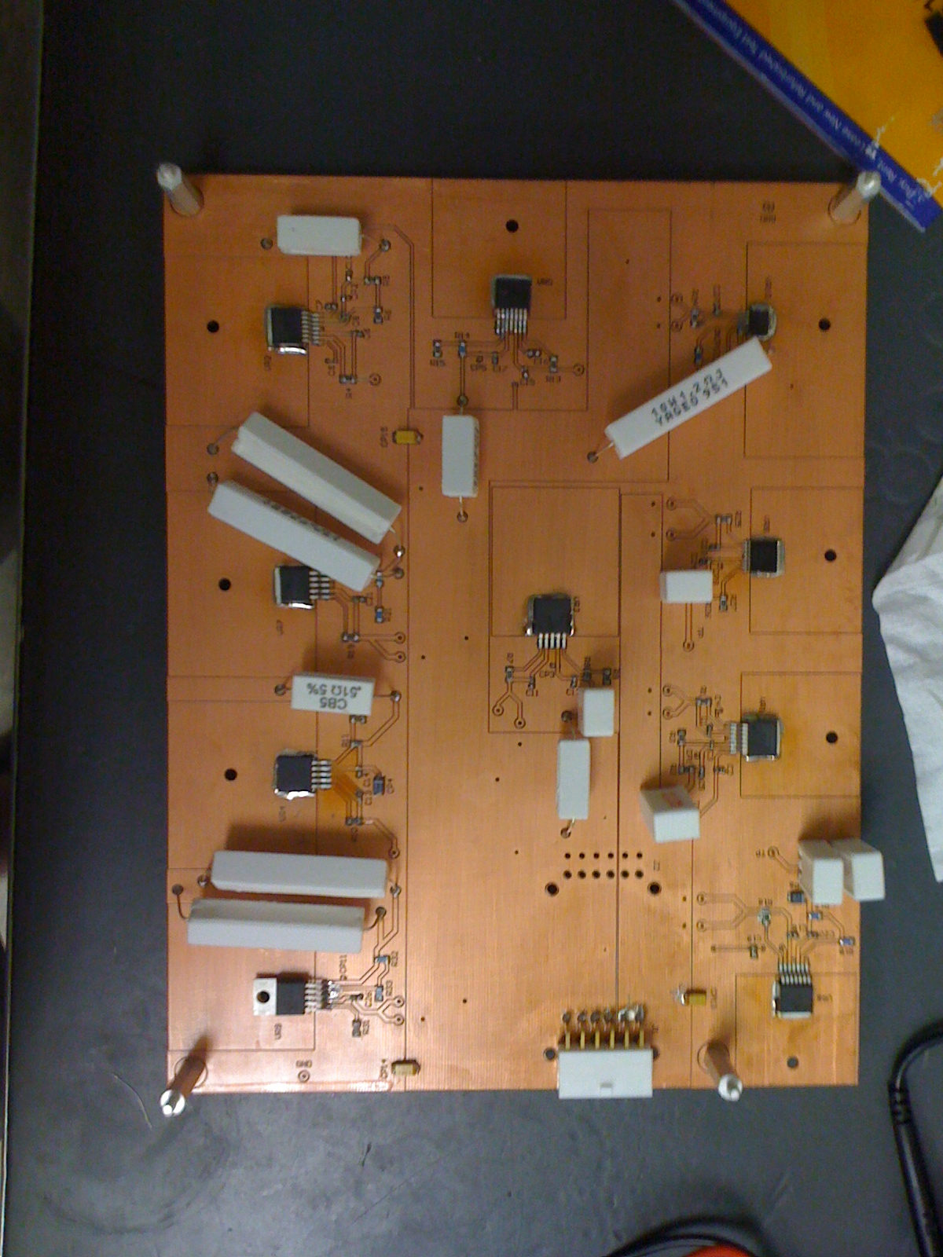
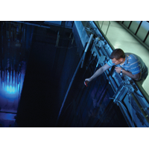
  Total Ionizing Dose and Displacement Damage Tests
Reactor Tests with MeV Neutrons
  performed at the Texas A&M Nuclear Science Center
  1 megawatt reactor operating at 6 kW, provides 9.9 *10⁸ n/cm²s
Multiple samples submitted to two exposures
  ~10 SLHC year and ~20 SLHC years dose, total of 30 year dose
  Regulator performance tested before and after each exposure
Over 30 parts tested
  Parts for all new electronics
  References, Diodes, transistor and sensors
  Found satisfactory parts for all the functions we need for the upgrade
Notes:
1 megawatt reactor operating at 6 kW, provides 9.9 *10⁸ n/cm²s
Reactor testing: ~1mev
Regulators were unpowered during exposure
Reactor tests with mev neutros
Emphasize that youre making
We found satisfactory parts for all the functions we need for the upgrade

Slide 16
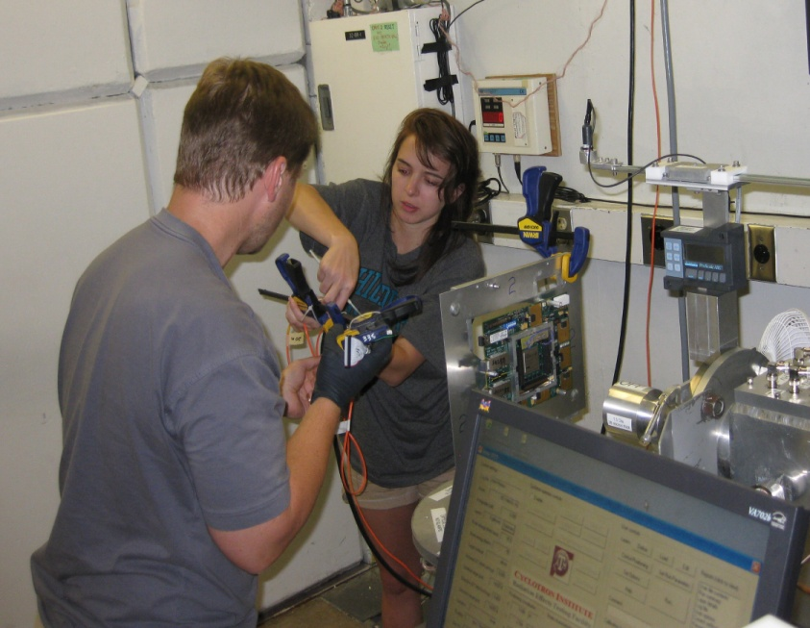
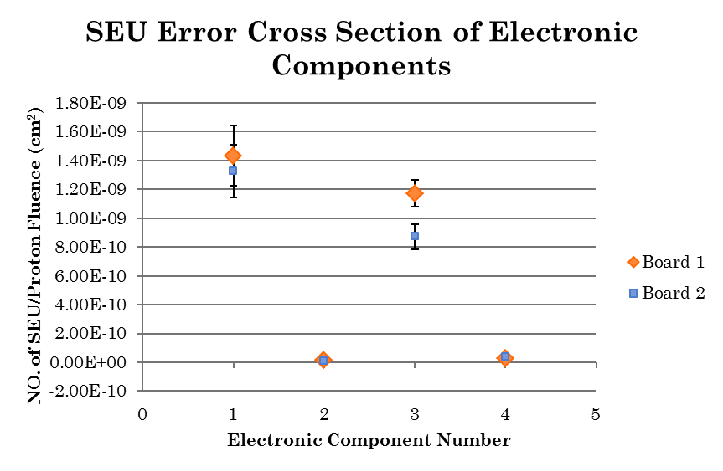
  Single Event Upset Measurements
High Energy Neutron exposure
  Testing at UC Davis Cyclotron: 64 MeV proton beam, flux up to ~1 *10⁹ cm⁻²s⁻¹
How would these cross sections affect CSC operations in HL-LHC?
  All radiation calculations are based on highest radiation point on ME1/1
  Tests were designed to study SEU effects in Virtex-6 and investigate mitigation methods for CMS Endcap
    FPGA: ~ 1 SEU per FPGA per day
Component | SEU Results
Reflex Photonics 3.5 Gbps Snap12 Receiver | 1 SEU per week per link
Emcore 3.3 Gbps Snap12 Receiver | 1 SEU per week per link
Emcore 3.3 Gbps Snap12 Transmitter | 1 SEU per year per link
Finisar Optical Transceiver ftlf8524e2gnl: Transmit side | 10 SEU per link per day
Finisar Optical Transceiver ftlf8524e2gnl: Receive side | 1 SEUs per link per day
TI Bus-Exchange Level-Shifter | no SEUs observed
Notes:
Reflex Photonics 3.5 Gbps Snap12 Receiver: < 1 SEU per week per link
Emcore 3.3 Gbps Snap12 Receiver: ~1 SEU per week per link
Emcore 3.3 Gbps Snap12 Transmitter: ~1 SEU per year per link
Finisar Optical Transceiver ftlf8524e2gnl: Transmit side ~10 SEU per link per day
Finisar Optical Transceiver ftlf8524e2gnl: Receive side ~1 SEUs per link per day
TI Bus-Exchange Level-Shifter: no SEUs observed
Proton beam test ~64mev, make a table! And show all the parts and say we tested them well…..
All the rates of SEU are low enough that it doesn’t present any limitations for operation at HL-LHC rates
Show pics from cyclotron, say something about the kind of damage,
So you get a scale across the different times of damage
Reduce these slides with the studies
Put electronics in places where you cannot get them for 5 years so they need to be robust and extremely radiation rad
Tested them therally
Slides with SEU → make sure those parts that go into our electronics are incredibly tolerant

Slide 17
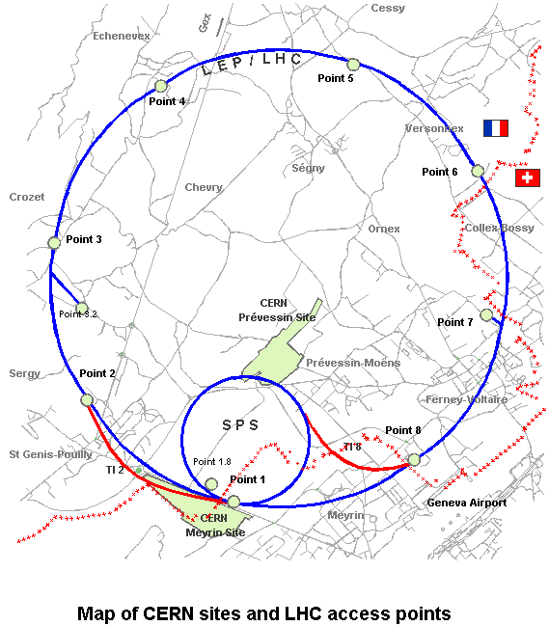
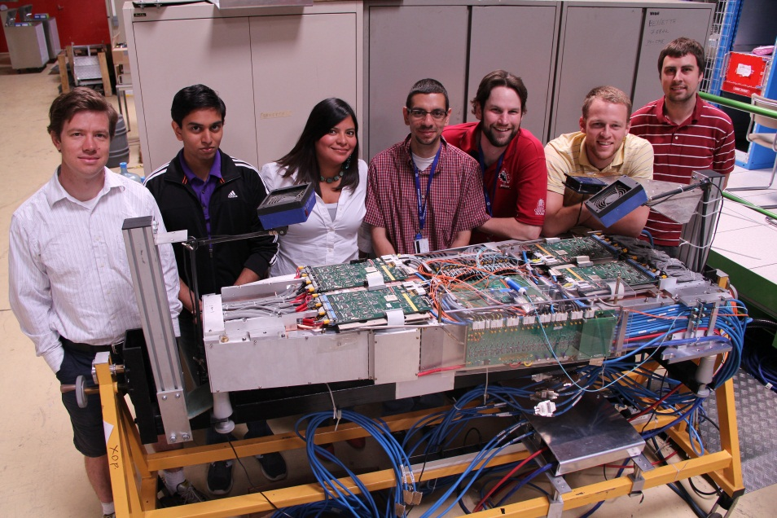
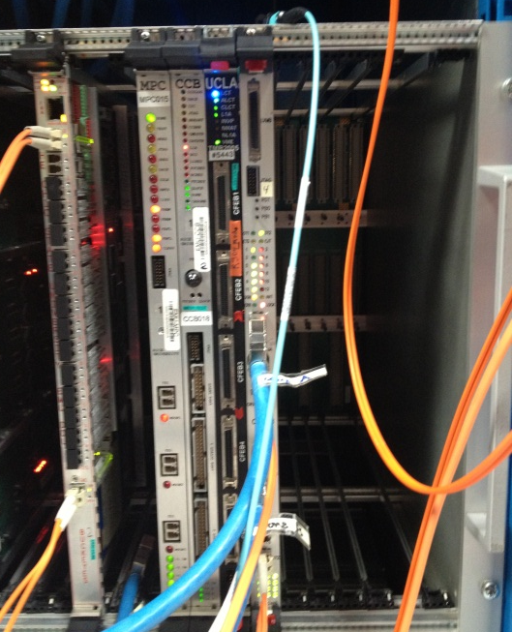
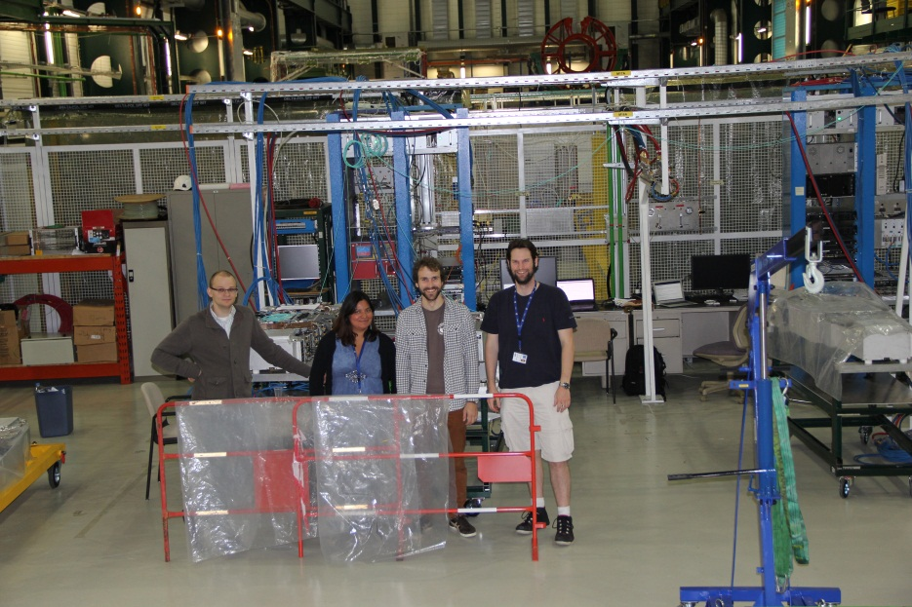
Integration & Commissioning of the new Electronics
SX5
B904
Integration of the new peripheral crate and chamber electronics has been ongoing at the CERN Prevessin site in B904
Undergraduates, graduates, and postdocs from Texas A&M, Ohio State, UCDavis, and Northeastern University stationed at CERN to work on integration
Refurbishing and testing of chambers done at SX5 site in Cessy France (p5)
Notes:
Fine tuning parameters operational performance
Development of Data Acquisition software and Analysis for System Test of Endcap Peripheral Crate and Chamber Electronics (STEP Tests) for upgraded ME-1/1 type chambers
Firmware and Software Tests for upgraded electronics
Doing development each at our lab and then we bring together to cern and
Replace step by standard performance tests……
When you do these tests, the results are really clear and you can see the changes easily

Slide 18
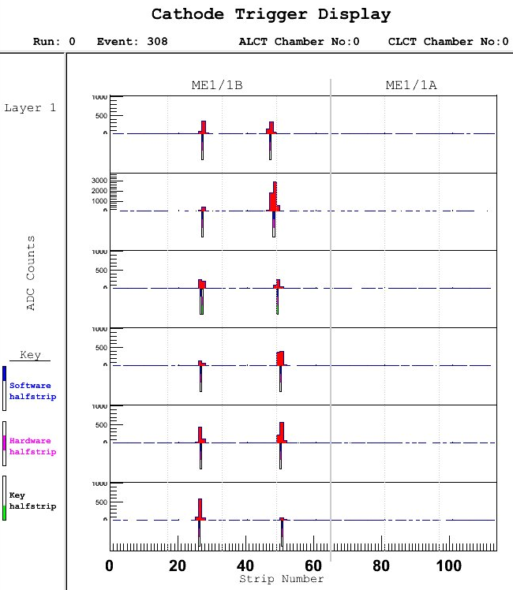
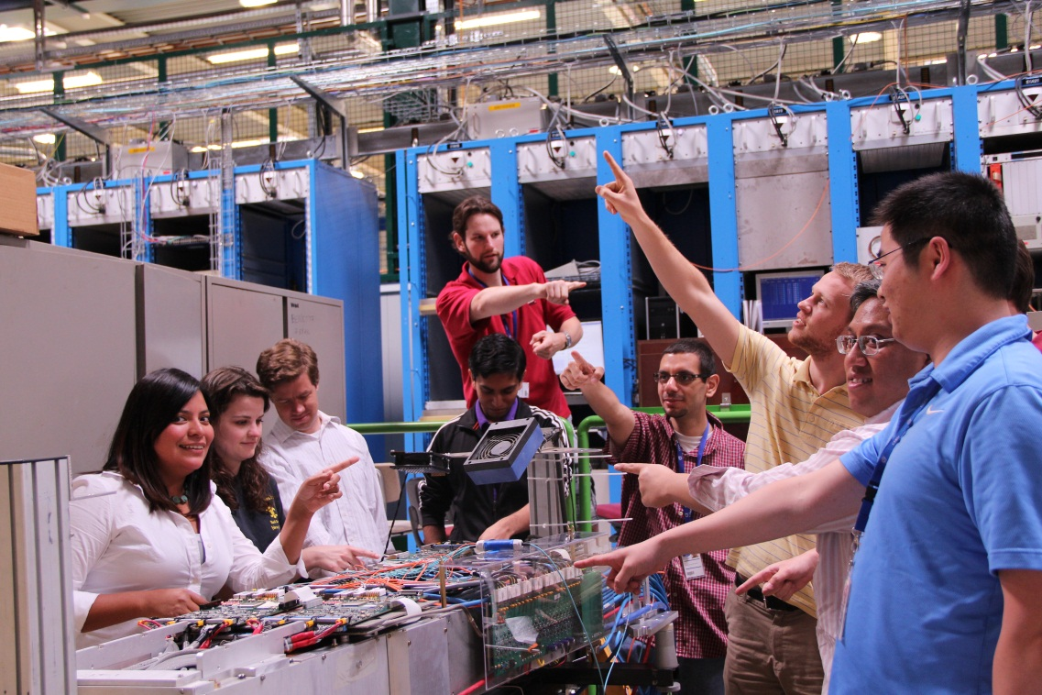
Integration at B904
Rare dimuon
event!
Developed
  Method for fine tuning parameters for operational performance
  data quality monitoring software
  Data acquisition software and analysis for System Test of Endcap Peripheral Crate and Chamber Electronics (STEP Tests) for upgraded ME-1/1 type chambers
Firmware and Software Tests for upgraded electronics

Slide 19
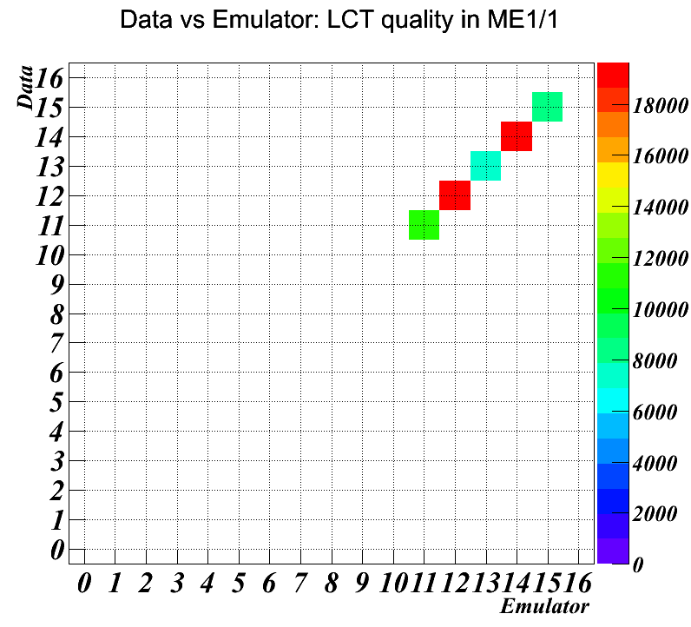
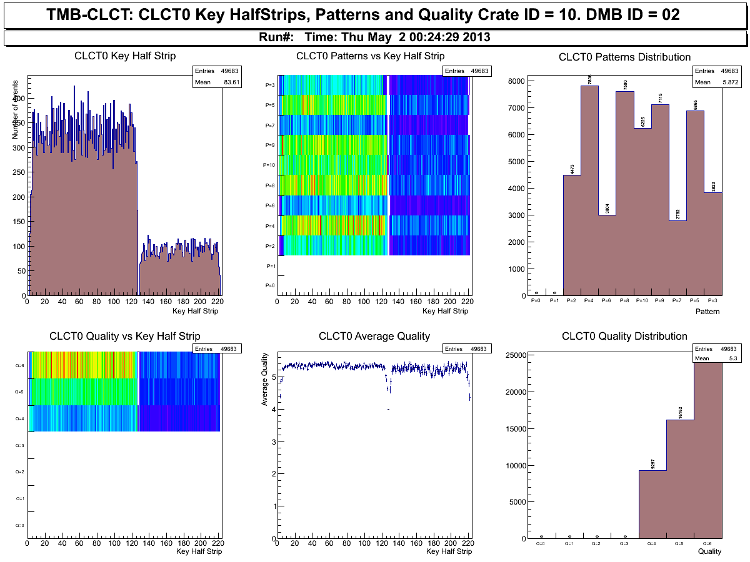
OTMB Firmware Tests
The complete 7-DCFEB trigger firmware released and extensively tested
Performance of electronics as expected
  Excellent agreement with software emulation
  Error rate < 10⁻⁵
Data vs Emulator: LCT quality in ME1/1
CMS Data Quality Monitoring (DQM) software was updated for new setup
Notes:
Target 7-DCFEB firmware works for > 3 months
- Performance of electronics as expected
- Perfect agreement with software emulation
- error rate < 10^-5
- CMS Data quality monitoring is updated for new setup

Slide 20
System Test of Endcap Peripheral Crate and Chamber Electronics (STEP Tests)
A comprehensive tests of the chambers which can help detect problems with connectivity, noise, and electronics firmware
Set of tests below are performed on all me-1/1 chambers being refurbished
All CSC chambers installed on the muon endcap have undergone these tests
STEP tests
Slow Control
Anode Front End Board Threshold and Analog Noise test
Anode Front End Board Noise test
Anode Front End Board Time-delay verification
Pipeline Depth test
Digital Cathode Front End Board Noise test
Digital Cathode Front End Board Connectivity test
Digital Cathode Front End Board DAQ-Path Calibration: Pulse Response and Cross Talks
Digital Cathode Front End Board DAQ-Path Calibration: Amplifier Gain
Digital Cathode Front End Board Comparator Thresholds and Analog Noise
Digital Cathode Front End Board Left/right Comparator Logic test
ALCT self-trigger on cosmics test
High-statistics cosmic test
Chamber gain map
Notes:
Slide 21: I think the “FAST index” column can be dropped. It does not mean anything to the DPF audience, and they might wonder why various integers are skipped. I also would replace “CFEB” with “DCFEB” in the descriptions. And maybe spell out each acronym once.

Slide 21
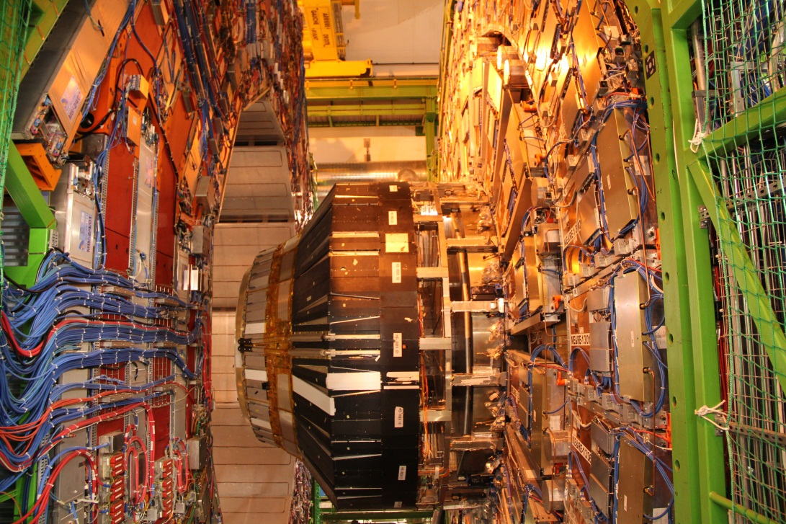
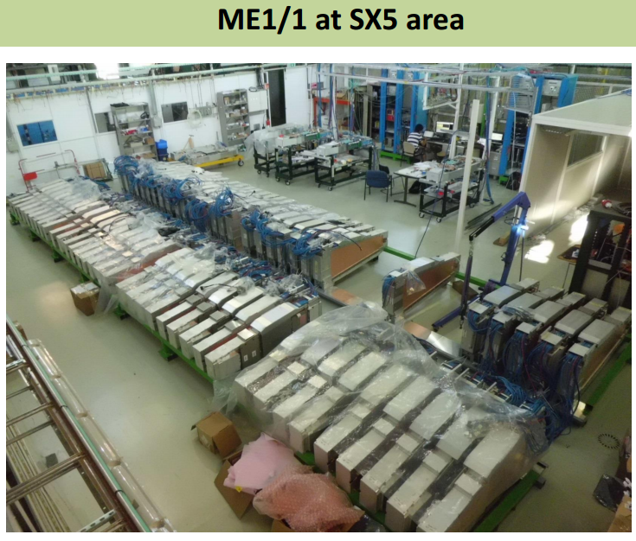
Refurbishment and Testing of Boards
CMS Cavern
All ME-1/1 Chambers have been removed from the Muon Endcap and taken to the SX5 area at the CMS Center
The chambers will be refurbished
    On Chamber electronics will be replaced by the upgraded electronics
    The old electronics will be used for the ME-4/2 system
  Each refurbished chamber undergoes STEP tests with upgraded readout electronics
ME-1/1
Notes:
Slide 22: On the cavern picture, it would be nice to indicate where the slots for the ME1/1 chambers are located.
ME-42 -> ME-4/2.
“STEP” was never defined.
Slide 23: It’s October 2013, not October 2014 (I certainly hope).

Slide 22
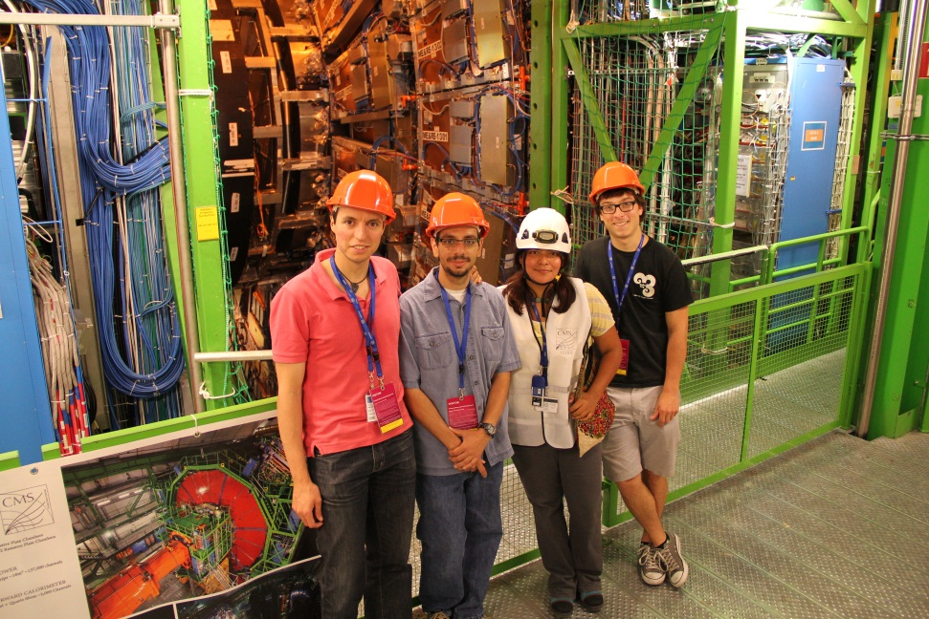
Conclusion
For the past 4 years, we have been designing new on-chamber and readout electronics to deal with HL-LHC problems emerging from high occupancies
The new electronics have been sent to CERN and integrated at the CERN Prevessin site
CSCs belonging to ME-1/1 chambers have been removed from the cavern and are being refurbished and tested at the SX5 site at CERN
Students (ugrads, grads) and Postdocs from all over the world have worked on the integration of these new electronics and refurbishing of chambers
We will begin installation of refurbished chambers and peripheral crate electronics at the CMS Cavern in October 2013
The upgraded electronics will allow us to continue operating CMS at its very best performance
Notes:
In last 4 years weve been focusing on keeping cms as good as it has come up in the past
Lots of work and lots of people
Make it sound friendlier…..scientists from all over the world! Electronics have been built

Slide 23
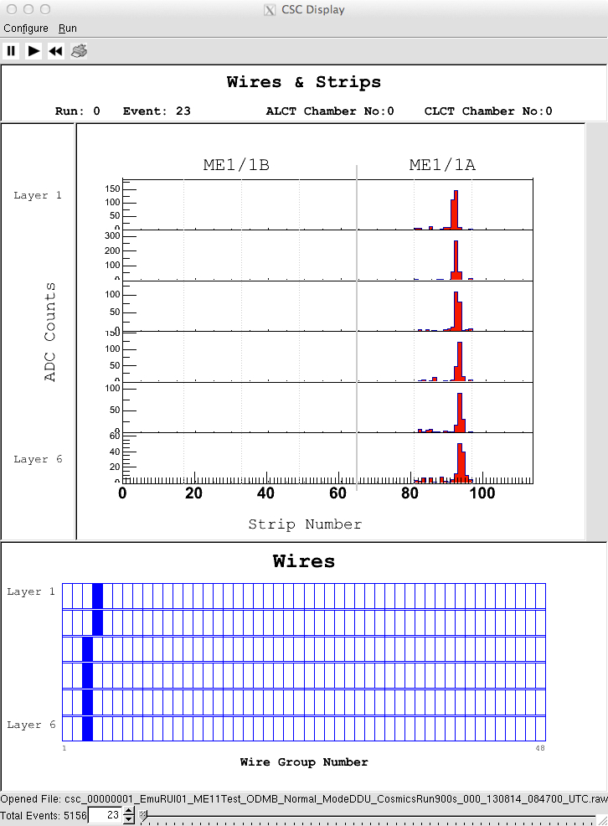
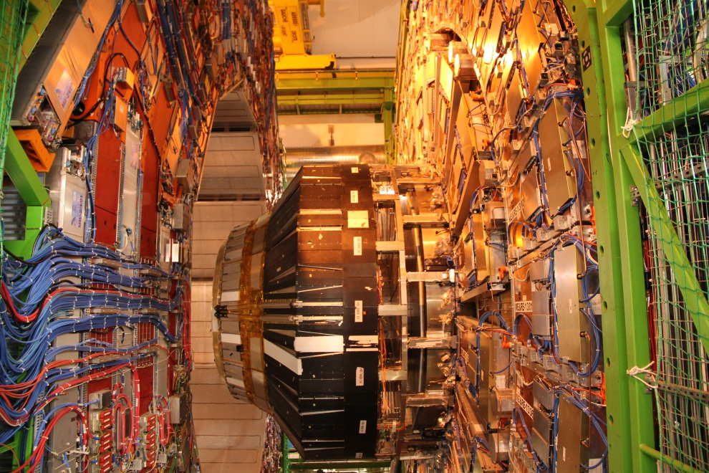
Questions?

Slide 24
Trigger Envelopes in the CSC Front Ends
A CSC Trigger Primitive satisfies a local pattern of hits consistent with a high momentum track from the Interaction Point
Anode Local Charged Track
collision pattern points at the IP:
Cathode Local Charged Track patterns envelope (see next slide):
IP
wire groups (y)
half strips (x)
layers (z)
OXXXOOO
OOXXOOO
OOOXOOO
OOOXXOO
OOOXXXO
OOOXXXO
oxxxxxxxxxxxo
ooooxxxxxoooo
ooooooxoooooo
ooooxxxxxoooo
ooxxxxxxxxxoo
oxxxxxxxxxxxo
Total chamber depth ~ 15cm
layers (z)
μ
x
B-field
μ
Typical wiregroup width ~ 20mm
Typical half-strip width ~ 10mm

Slide 25
Cathode Local Charged Track (CLCT) Patterns in the CSC Front Ends
Muon stubs which match patterns with higher momentum have higher priority to be passed to the CSC Track Finder
Some example patterns:
x
B-field
half strips (x)
oooooxxxooooo
ooooooxoooooo
ooooooxoooooo
ooooooxoooooo
oooooxxxooooo
oooooxxxooooo
ooooooxxxoooo
ooooooxxooooo
ooooooxoooooo
oooooxxoooooo
ooooxxxoooooo
ooooxxxoooooo
oooooooxxxooo
ooooooxxooooo
ooooooxoooooo
oooooxxoooooo
ooooxxooooooo
oooxxxooooooo
ooooooooxxxoo
oooooooxxoooo
ooooooxoooooo
ooooxxooooooo
ooxxxoooooooo
ooxxxoooooooo
layers
(z)
Increasing momentum…
Increasing order of priority…

Slide 26
Schematic of CSC Trigger Data Flow
On Chamber (UXC)
In Peripheral Crate (UXC)
In counting house (USC)
Cathode Strip Front End Boards
Trigger Motherboard
Muon Port Card
CSC Track Finder
CLCT
FE
CSC TF
ALCT
TMB
FE
Wire Local Charged Track Board
Anode Wire Front End Boards
GMT…
The CSC L1 trigger is a fast tracking system

Slide 27
Simplified CSC Geometry
6-layer planar chambers…
Anode wires:
Wires ganged in groups of 5 -16 for r (θ) coordinate
Closely-spaced azimuthal anode wires → fast timing
Cathode strips:
Radial, trapezoidal strips for φ coordinate
Charge induced on strips → precision measurement in bend direction of magnetic field
cathode strips
3 - 16 mm
avalanche
wires
Cathode plane
wires
cathode
strips
cathode
plane
. . . . . . . . . . . . . .
B
avalanche
r
muon
3.1 mm
φ
9.5 mm
The (r,φ) spacepoints in each layer (spaced in z) are combined to form a segment in each CSC → Up to 4 stations per endcap are used to form a standalone muon track

Slide 28
Offline Data Quality Monitoring Plots for Cosmics at B904
Notes:
Don’t explain just say this is what we use to change data quality monitoring

Slide 29
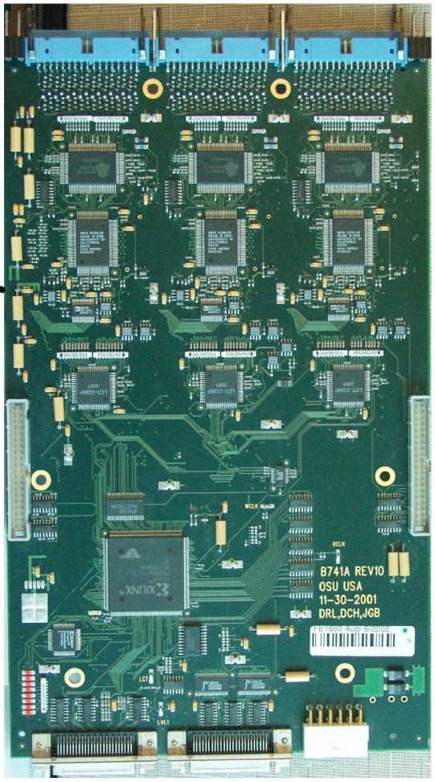
Cathode Front End Board (CFEB)
Optimized for Precision Position Measurement
Input/Output
5 cfebs/chamber, 96 strips/cfeb
96 switch capacitors/strip
system is self triggering
BUCKEYE (ASIC) - amplifies and
shapes input pulse
SCA (ASIC) - analog storage for
20 MHz sampled input pulse
ADC - events with LVL1ACC
digitized and sent to DAQ
Motherboard (25 nsec/word)
Comparator ASIC - generates
trigger hit primitives from shaped
pulse
Controller FPGA - controls SCA
storage and digitization

Slide 30
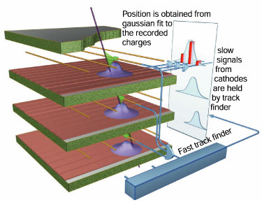
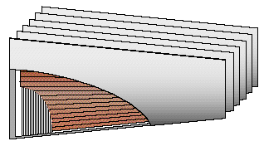
CSC Geometry
  CSC Trivia
  CSC size: 3.3 x 1.5/0.8 m² (trapezoidal)
  Anode wires: d=50 μm, gold-plated tungsten
  Anode-Cathode: h=4.75mm
  Wire tension: T=250 g (60% elastic limit)
  Wire spacing: 3.12 mm
  Readout group: 5 to 16 wires (1.5-5 cm)
  Cathode strips: w=8-16 mm wide (one side)
  Gas: Ar+CO2+CF4=40+50+10
  Nominal HV: 4 kV
Advantages:
  Close wire spacing gives fast response
    Good for high rates
  2D coordinate
  Cathode strips: good spatial resolution in bending direction
  Anode Wires: good timing resolution
  6 layers → good background rejection
    Apply 4/6 coincidence

Slide 31
ME-1/1 On-Chamber Electronics Upgrade:
Digital Cathode Front End Board (DCFEB)
CFEB → DCFEB
BUCKEYE (ASIC) - amplifies and
shapes input pulse
SCA (ASIC) - analog storage for
20 MHz sampled input pulse
Fully Diff Amps –
ADC - events with LVL1ACC
digitized and sent to DAQ
Motherboard (25 nsec/word)
Flash ADC and digital pipeline –
Comparator ASIC - generates
trigger hit primitives from shaped
pulse
Controller FPGA Vertex 1 - controls SCA storage and digitization
Controller FPGA Vertex 6 - controls SCA storage and digitization
Copper Trigger and Data Path-
Optical Trigger and Data Path
Clock, JTAG, …

