Slide 1
A pp and an e+e- Collider in a 100 km ring at Fermilab
VLHC/VLEP
Pushpa Bhat
Fermilab
& C.M. Bhat, W. Chou, E. Gianfiece-Wendt, J. Lykken,
M. Medina (Yale), G.L.Sabbi (LBNL), T. Sen, R. Talman (Cornell)
DPF 2013, UC Santa Cruz
August 13-17, 2013

Slide 2
Outline
The Backdrop
  Higgs Discovery
  Snowmass 2013
  VLHC: Some History
The 2013 Study
  Snowmass summary
  100 TeV pp collider (VLHC) in a 100 km ring
  240-350 GeV e+e- Higgs Factory (VLEP)
Summary

Slide 3
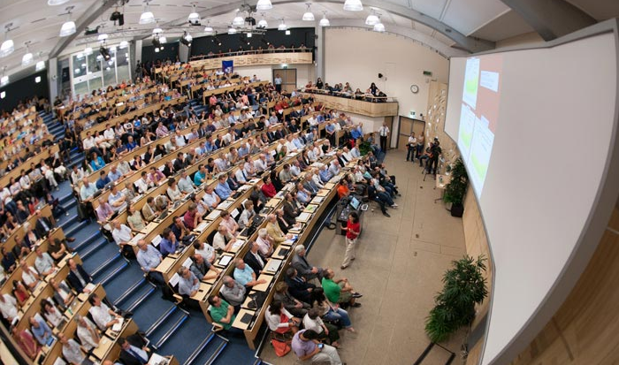
A year ago on July 4th

Slide 4


Notes:
This summer Fabiola Gianotti of ATLAS and JI of CMS announced the simultaneous observations of a new boson in our respective experiments on July 4th.
It appears to be a Higgs boson. It has been 48 years….

Slide 5

Discovery of the new Millennium
The Higgs Boson
Is it the last missing piece? OR
Is it the harbinger of new physics?
Does it fully explain EWSB?
Is it elementary or composite?
Are there more Higgses?
…
5

Slide 6

So far so good.. hoping for better!
Thanks to the discovery, the world HEP community is excited, interest in future energy frontier colliders has been reignited, and some old shelved ideas are finding new life.
The LHC data, so far, indicate that the new particle has properties consistent with a SM Higgs boson. But its measured mass is tantalizingly consistent also with an SM-Higgs-like boson from new physics beyond the SM.
We are where we had suspected to find ourselves – a low mass SM-like Higgs found, and nothing else! So far. But, that could change!

Slide 7
Physics at the Terascale
To fully elucidate EWSB and understand the Terascale landscape
  Study the Higgs boson that has been found (Mass, width, spin-parity, couplings)
  Search for other physical states at higher mass scales
    Evidence for SUSY, extra dimensions, heavier gauge bosons W’, Z’, heavier fermions, ..
  Measure vector boson scattering and couplings
    Longitudinal vector boson scattering and VBF production
An e+e- collider would be a nice complement to the LHC. A hadron collider at ~100 TeV would be a lot more useful!

Slide 8
The Case for a VLHC
Hadron colliders with their broad-band parton collision energies are Discovery Machine, and can make precision measurements!
Historically, each time collision energy of hadrons went up significantly, we have discovered new particles.
Top quark discovered at the Tevatron, after searches at SLC and LEP! And, Higgs discovery came at the LHC.
However, since we have not found any new physics at √s = 8 TeV, if we do find new physics at 13-14 TeV it is likely to be at the limit of LHC reach. (Low hanging fruits?)
“Regardless of what we will ﬁnd at the LHC we will eventually want to have a hadron collider operating in the 100 TeV range.” - U. Baur, HEPAP subpanel, June 2001

Slide 9
The Case for a VLHC
If some new physics is found at the LHC at 13-14 TeV, then it makes a lot more sense to take a big jump in energy (~an order of magnitude) rather than a small one (~x2)
  If some heavy “partner” particles are found, VLHC can find the full suite of partners (SUSY)
  If exotic resonances are found, VLHC can fill out the “tower” of resonances, confirming extra dimensions
  Complete measurements of vector boson scattering, explore fully the mechanism of EWSB, and SUSY breaking if SUSY is found
Higgs Boson:
  VLHC would enable precision measurements of the Higgs including Higgs self-coupling, and rare decays of the Higgs!
VLHC has direct discovery potential in 10’s of TeV range

Slide 10
Some History
US HEP/AP Community has been through some phases of “design” and “construction” for 80 – 500 km machines, in the past three decades.
  SSC was going to be 87.1 km in circumference, and √s = 40 TeV. 23 km tunnel bored and 17 shafts in Texas. $2B spent!
    Conception: Snowmass 1983, Design: 1988-90; Construction initiated: 1988, Halted: 1993.
  “VLHC”(1995 -2005) in various incarnations – Primarily 233 km; E_{CM} from 40 TeV (Stage 1) – 200 TeV (Stage 2) . http://vlhc.org/
  Also considered VLLC (Very Large Lepton Collider) in VLHC tunnel
  Pipetron: Low Cost Approach to a VLHC, To achieve > 100 TeV E_{CM} collider at the lowest possible $/TeV
Many workshops, machine/physics/detector studies, HEPAP, VLHC steering committee, etc., R&D for magnets and many other aspects.

Slide 11
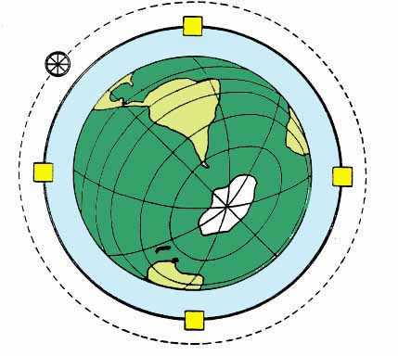
Very Large Hadron Collider at Fermilab
Design Study for a two-stage Very Large Hadron Collider
vlhc.org
FNAL-TM-2149
(2001)

Slide 12
VLHC in 2001
Take advantage of the space and excellent geology near Fermilab.
  Build a BIG tunnel.
  Fill it with a “cheap” 40 TeV collider.
  Later, upgrade to a 200 TeV collider in the same tunnel.

Slide 13
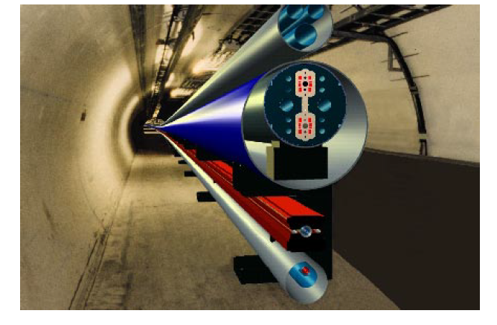
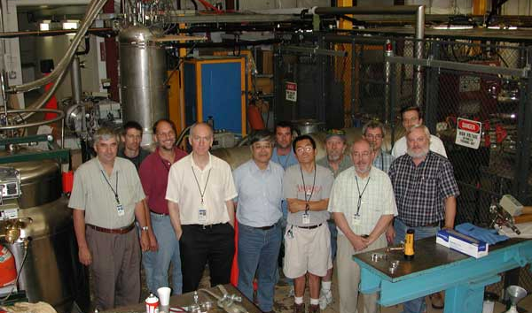
VLHC designs (2001)
Circumference = 233km
Stage 1 ring: (1 to 20) TeV/beam
Stage 2 ring : (20 to 87.5) TeV/beam
Super-ferric magnets for the 2 T low field, stage 1, Injection from Tevatron
Nb₃Sn magnets for 10-12 T high field, stage 2. Injection from Stage 1
Modular design: IRs, utilities, dispersion suppressors etc had lengths in integer units of a half cell.
Very high beam stored beam energy (~ GJ) in both cases
Fermilab-TM-2149, Fermilab-TM-2158
A VLLC in the VLHC tunnel was also considered
T. Sen, J. Norem
http://prst-ab.aps.org/pdf/PRSTAB/v5/i3/e031001

Slide 14
233 km VLHC
Lake
Michigan
90-150 m deep
73km
Illinois Galena-Plattville dolomite layer is excellent geology for TBMs
Chicago

Slide 15
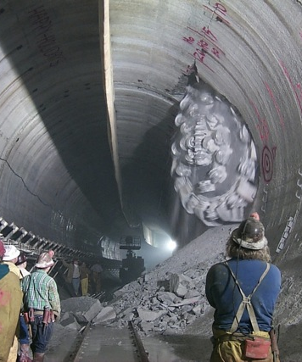
Site studies in Illinois
We know a lot about the geology and tunneling in Illinois.
  Thick, homogeneous dolomite at a depth of 300 – 500 ft
  The Chicago TARP (Tunnel and Reservoir plan): 176 km of tunnel (9 - 33 ft in dia, up to 350 ft underground) completed
  Studied for SSC, VLHC, ILC,..
Many siting options for large rings have been studied.

Slide 16
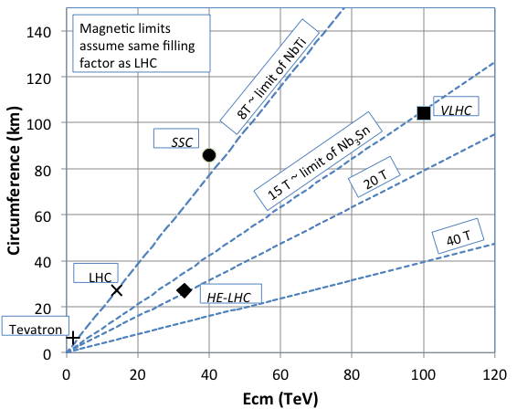
VLHC (2013)
Snowmass Whitepaper
http://arxiv.org/pdf/1306.2369v1.pdf
Use high field (~15 T)
Superconducting magnets
in a 100 km ring for a
100 TeV pp collider
And/OR host a 240-350 GeV
VLEP in 100 km tunnel
We proposed to combine the efforts: TLEP/VHE-LHC/VLHC/VLEP

Slide 17
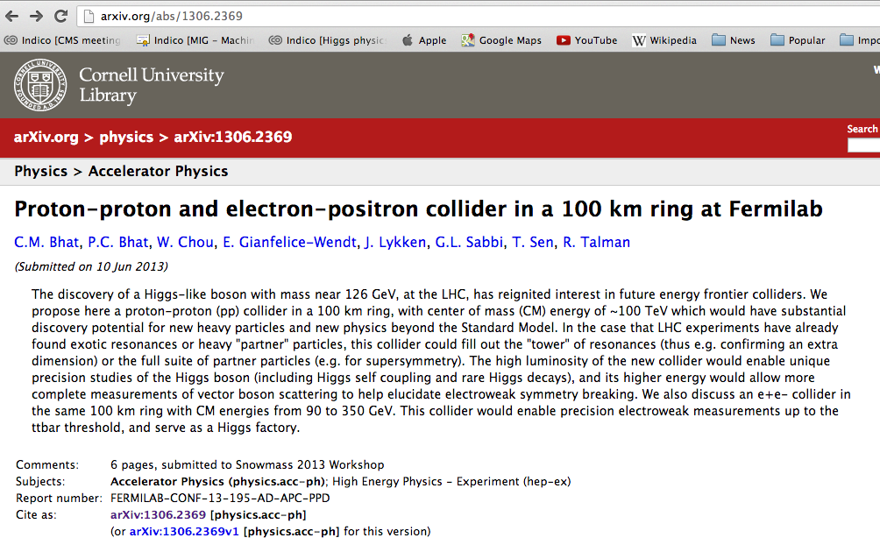
VLHC (2013)
Whitepaper Submitted to Snowmass 2013
A very preliminary Study

Slide 18
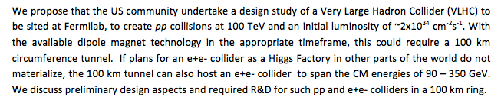
arXiv:1306.2369
We also presented the work at the TLEP workshop at Fermilab
July 25 -26, 2013 (days before Snowmass)
PB & T. Sen

Slide 19
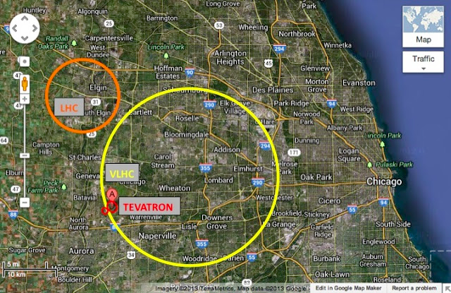
100 km ring for VLHC/VLEP
http://arxiv.org/pdf/1306.2369v1.pdf
PhysicsCentral Blog
http://www.physicscentral.com/buzz/blog/index.cfm?postid=4835100616060881541
19

Slide 20
What are long term “big questions” regarding accelerator-based HEP capabilities
Snowmass CSS2013 Summary on Frontier Capabilities
How would one build a 100 TeV scale hadron collider?
How would one build a lepton collider at >1 TeV?
How would one generate 10 MW of proton beam power?
Can multi-MW targets survive? If so, for how long?
Can plasma-based accelerators achieve energies & luminosities relevant to HEP?
Can accelerators be made 10x cheaper per GeV? Per MW?
These are issues for the long term future

Slide 21
Proton colliders beyond LHC
Snowmass CSS2013 Summary on Frontier Capabilities
US multi-lab study of VLHC is still valid (circa 2001);
  Snowmass has stimulated renewed interest/effort in US
    2013 Snowmass white paper
We recommend participating in international study for colliders in a large tunnel (CERN-led)
Study will inform directions for expanded U.S. technology reach & guide long term roadmap
  Beam dynamics, magnets, vacuum systems, machine protection, …
Extensive interest expressed in this possibility
???

Slide 22
Hadron Colliders (Past and Present)
 | ISR | SPS | Tevatron | RHIC (pp) | LHC (2012)
Circumference [km] Energy [GeV] Number of bunches Bunch spacing [ns] Bunch intensity [x10¹¹ ] Particles/beam [x 10¹⁴] Trans. rms Emitt [ μm] Beam-beam tune shift Luminosity [x10³² cm⁻²s⁻¹] # of events/crossing Stored beam energy [MJ] | 0.94 31 dc - - 9.8 0.0035x8 1.3 0.005 | 6.9 315 6 1150 2.75 7.8/4.2 1.5/0.15 0.005x3 0.06 0.04 | 6.3 980 36 396 (3.1/1 ) 112/36 (3/1.5) 0.013x2 4.0 12 1.75/0.57 | 3.8 255 107 108 2.0 143 3.3 0.007x2 2.3 0.57 | 26.7 4000 1380 50 1.7 3089 2.5 0.01x2 77 37 140

Slide 23
VLHC 2013: The Challenges
The main technological challenge –
  Superconducting high field magnets 15 -20 T (Nb₃Sn ?)
Design Challenges:
  IR optics, Collimation system, ..
Operational Challenges
  Machine protection to cope with many GJs of beam energy
    Would require novel techniques in collimation
  Protecting SC magnets from high doses of synchrotron radiation
    R&D in Photon stops, vaccum chamber design
  Beam dynamics: Electron Cloud mitigation, Beam-beam
    Experience from Tevatron, LHC
  Beam monitoring/diagnostics
Of course –
  The BIG tunnel, COST, Logistics

Slide 24
Design Parameters
 | VLHC (2013) | LHC (design)
Circumference [km] Top Energy [TeV] Peak Luminosity [x10³⁴ cm⁻² s⁻¹] Bunch Intensity [x10¹¹] Number of Bunches | 100 50 4.6 0.15 17255 | 26.7 7 1 1.15 2808
β*_{x}/β*_{y} (m) | 0.5 / 0.05 | 0.55 / 0.55
Norm. rms. (ε_{x},ε_{y} ) [μm] | 1.5 , 1.5 (initial) | 3.75 , 3.75
Beam size at IP (x,y) [μm] | (3.8, 1.2) | 16.7, 16.7
Bunch length, rms (cm) Crossing angle [ μrad] | 2.7 90 | 7.5 255
Beam Current (A) Beam lifetime from pp [h] | 0.12 11.3 | 0.58 18.4
Stored energy (MJ) # of interactions/crossing | 2073 132 | 362 19 (37 in 2012 )
x2 for
HL-LHC

Slide 25
pp design Parameters - 2
Synchrotron Radiation
Intra-beam scattering
 | VLHC (2013) | LHC (design)
Energy loss per turn [keV] Power loss /m in main bends [W/m] Synchrotron radiation power/ring [kW] Critical photon energy [eV] Longitudinal emittance damping time [h] Transverse emittance damping time [h] | 4424 7.9 549 4074 0.55 1.1 | 6.7 0.21 3.6 44.1 13 26
 | VLHC (2013) | LHC (design)
Rms beam size in arc [mm] Rms energy spread [x10⁻⁴] Longitudinal emittance growth time [h] Transverse emittance growth time [h] | 0.07 0.37 149 198 | 0.3 1.1 61 80

Slide 26
Luminosity limits
Constant: ξ = 0.012/IP, β_{y}* = 0.05 m
 | LHC Value | Assumed Value | Beam current[A} | Luminosity [ x 10³⁴ cm⁻²s⁻¹ ]
Stored beam energy Radiation power density in dipoles Interactions/crossing IR debris power | 362 MJ 0.21 W/m 20 1 kW | 5 GJ 10 W/m 150 50 kW | 0.59 0.16 - - | 15 8.1 5.2 4.1

Slide 27
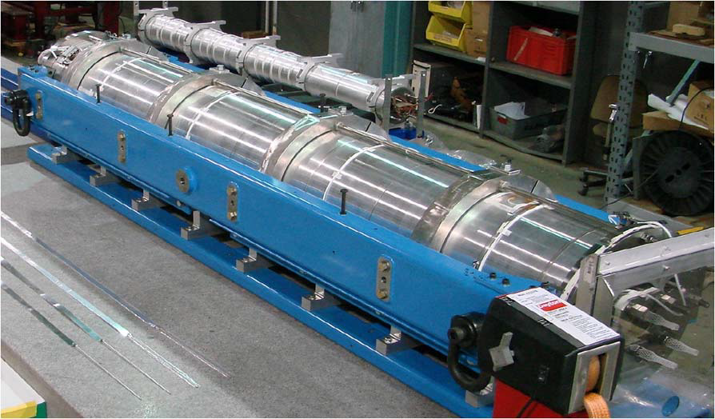
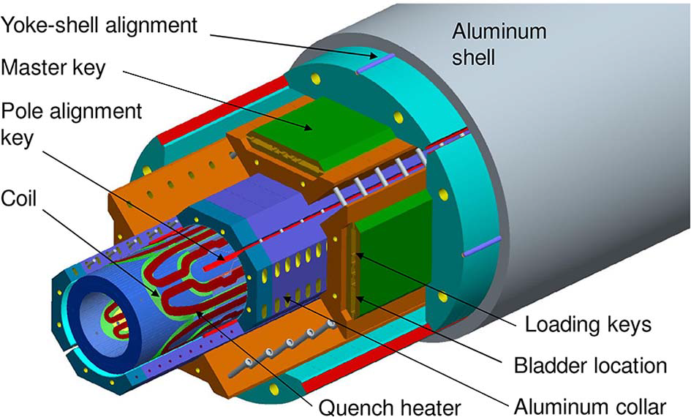
LARP Magnet Development
G.L. Sabbi
Building IR magnets using Nb₃Sn coil for HL-LHC
Dipoles with 16T fields have been built (LBNL, FNAL, BNL – US LARP)
Large aperture (120 mm) quads with 12T pole tip fields achieved in July 2013.
R&D continuing on hybrid NbTi, Nb₃Sn and HTS cable to achieve 20 T in dipoles.

Slide 28
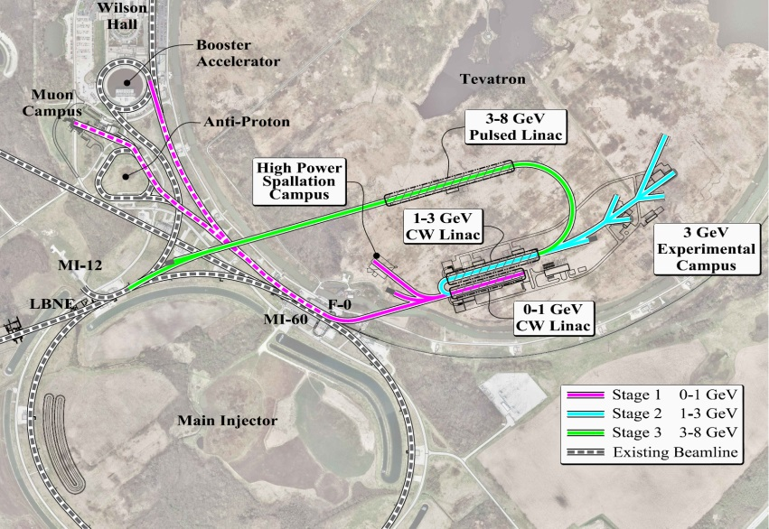
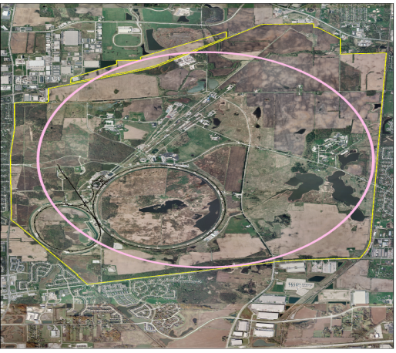
Injectors for the collider
Project X high intensity low emittance 8 GeV beam
Main injector to deliver 150 GeV beam
New injector to accelerate from 150 to ~ 3 TeV
- Reuse Tevatron tunnel with 16 T
magnets
- Build a site filler tunnel (~ 16 km)
with lower field magnets

Slide 29
e⁺e⁻ Collider (VLEP)

Slide 30
VLEP Design Issues
RF Power!
  Assume rf power available to be 100 MW
  R&D needed to improve efficiency of wall plug power to beam power conversion
Field quality in low field dipole magnets
  Dipole magnets in the arcs: 0.001 – 0.05 T
Vacuum system
  to cope with high radiation load and photons in MeV range
Top-up injection
Beam dynamics
30

Slide 31
Design parameters
Parameter | Units | Value
Circumference Energy Luminosity ( βx*, βy* ) Particles/bunch Number of bunches Emittance (εx, εy) Beam-beam tune shifts Bremsstrahlung lifetime | km GeV 10³⁴ cm⁻² s⁻¹ cm 10¹¹ nm min | 100 120 1.8 20, 0.2 7.9 34 (16, 0.08) 0.095, 0.135 101
Rf parameters
Parameter | Units | Value
Energy lost/turn Rf voltage Rf acceptance Synchrotron radiation power/beam Rf power per beam | GeV GV MW MW | 1.5 3.9 0.03 19.5 50
Injectors: top-up injector in the same tunnel, 12 -120 GeV;
Current Fermilab complex for up to 12 GeV

Slide 32
Summary
To fully elucidate EWSB and to explore the Terascale physics, a 100 TeV pp collider would be the machine to build!
An e+e- Higgs factory would be complementary to Hadron Collider studies of the Higgs boson.
In the context of Snowmass community study, we have explored some design parameters of a VLHC (pp) and VLEP (e+e-) colliders in a 100 km ring.
We propose a US-led multi-lab design study, and R&D for these colliders that could be sited at Fermilab.
In the meantime, let us keep up with Accelerator R&D, and hope for some breakthroughs!
32

Slide 33
100 km ring for VLHC/VLEP
http://arxiv.org/pdf/1306.2369v1.pdf
PhysicsCentral Blog
http://www.physicscentral.com/buzz/blog/index.cfm?postid=4835100616060881541
33

Slide 34
Back-up

Slide 35
VLHC

Slide 36
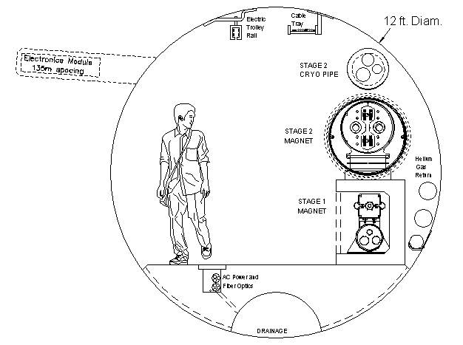
VLHC (2001) Tunnel Cross Section
A lot of experience from Chicago Deep Tunnel project (~90 mi of deep tunnels) and TARP project
Summarized by CMA firm in cost and schedule estimate
12’ dia tunnel 233km + shafts+EDIA, no cont =2B$ (9k$/m)
16’/12’=1.25 in cost
~60 wks construction (4m/hr 16 TBMs)
R&D proposed to redu-ce the cost (roboTBM)

Slide 37
What’s done by 2005
Tunnel cost and schedule exercise by CMA firm
Transmission line design
100kA power supply and HTS leads built, QPS
104kA transmission line test in MP6
Superferric magnets designed & optimized
14 m of SF magnets built and tested
Good accelerator quality B-field measured at inj energy up to 1.96T
Collider Phase I designed (ZDR)
Many AP issues addressed (e.g.instabilities)
Thorough bottoms-up cost estimate
Shiltsev
2007

Slide 38
Transmission Line Magnet
vacuum chamber
SC transmission line
warm iron and vacuum system
superferric: 2T bend field
100kA Transmission Line
alternating gradient (no quads)
65m Length
30cm support tube/vacuum jacket
100kA return bus
cryo pipes

Slide 39
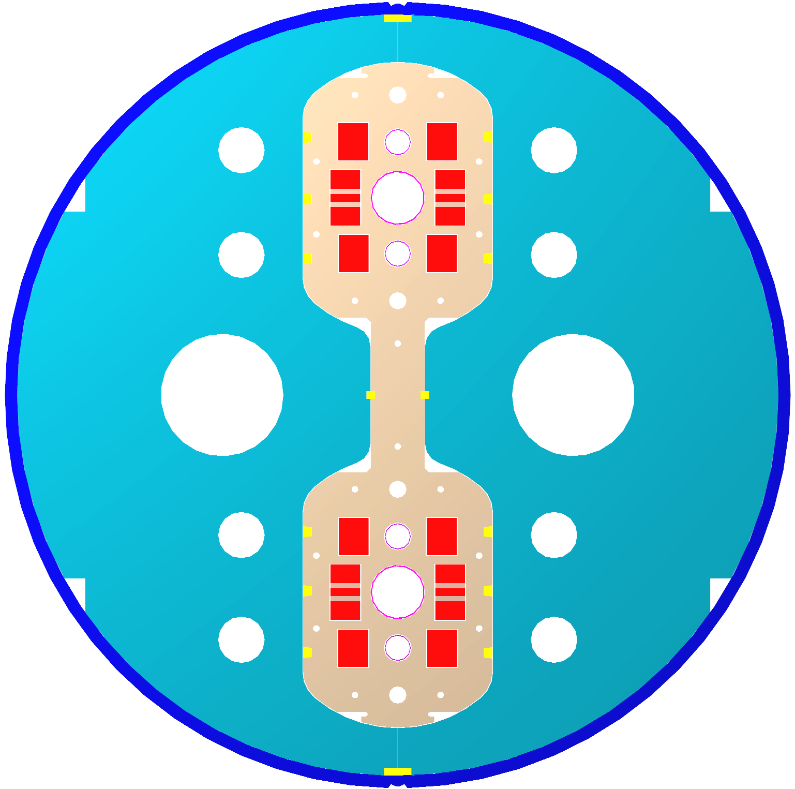
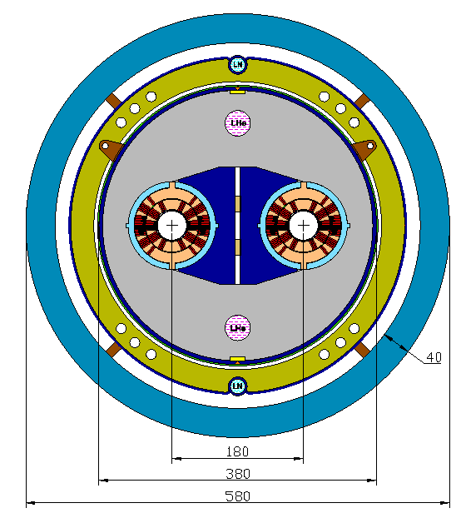
Stage-2: 10T+ Magnets
There are several magnet options for Stage 2. Presently Nb₃Sn is the most promising superconducting material, e.g. LHC IR Upgrade magnets are being developed by US LARP
Stage-2 Dipole Single-layer common coil
Stage-2 Dipole Warm-iron Cosine Θ

Slide 40
Design parameters
Use similar principles as VLHC design in 2001
Rf frequency: integer mulitple of 53 MHz rf in the Main Injector and Tevatron (easier transfers)
Low bunch intensity for small emittance
  Upgrades to injectors can provide higher bunch intensities

Slide 41
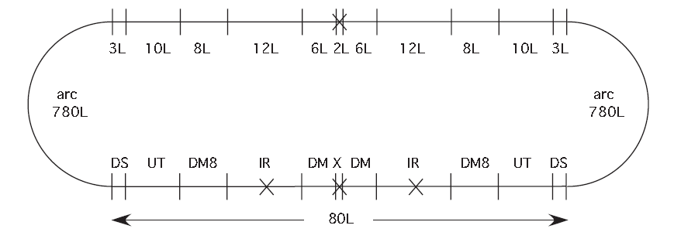
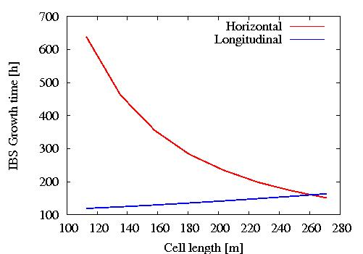
Principles of Design (2013)
50 TeV in a 100 km ring with 16T dipoles.
Synchrotron radiation dominated hadron collider. Damping time ~ 1 hr; integrated luminosity is nearly independent of the initial emittance
All modules in units of half cell length
Cell length = integer multiple of bunch spacing. Ensures bunches collide in all detectors.
Bunch spacing = integer multiple of Tevatron 53 Mhz bucket length.
Cell length affects chromaticity, equilibrium emittance, IBS growth times, sensitivity to field errors,…
VLHC 2001
Intrabeam scattering

Slide 42
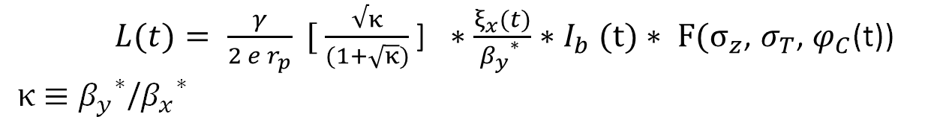
Luminosity
Luminosity
Optimize
β* and aspect ratio κ
Beam-beam parameter ξ
Beam and bunch current : e-cloud, TMCI at injection, ..
Bunch length σ_{z}
Crossing angle ϕ_{c}

Slide 43
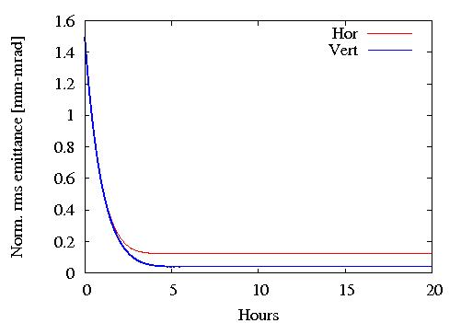
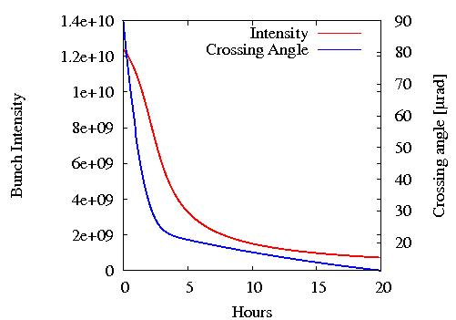
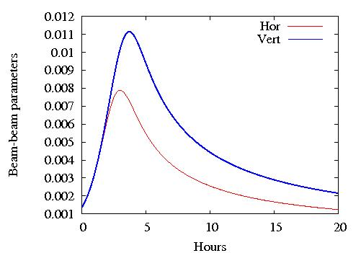
Time Evolution
Transverse emittances
The model includes radiation damping and intra-beam scattering.
Longitudinal emittance is kept
constant by noise injection
Beambeam tune shifts

Slide 44
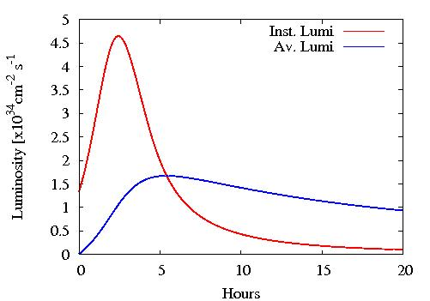
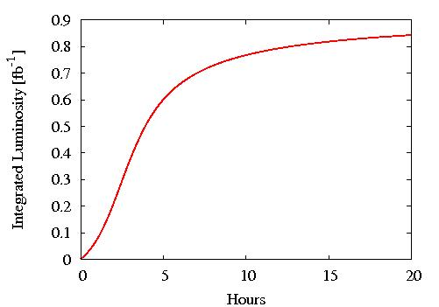
Time evolution - 2
Integrated Luminosity
Peak Luminosity = 4.6 x 10³⁴ cm⁻² s⁻¹
Optimal store time ~ 6 hours
Integrated luminosity over a 10 hr store ~ 0.8 fb⁻¹

Slide 45
Flat beams
Pros
β_{x}* increases by ~ 1/(2 κ_{ε}) for the same luminosity
Early separation with a dipole; fewer long-range interactions.
β_{x}^{max}, β_{y}^{max} smaller; centroid of a doublet is closer to the IP
Lower linear and nonlinear chromaticity with a doublet
Smaller luminosity loss with horizontal crossing;
σ_{x}* (flat) > σ_{x}* (round)
Cons
β_{y}* decreases by ~2 for same luminosity
Design of the first 2-in1 quad is challenging, beam separation is small; affects field quality
Neutral particles from IP are directed to center of 1st quad; ~1/3rd of IP debris power.
- place absorber between dipole and 1st quad
- design two half quads (under study at LHC)

Slide 46
R&D in Accelerator Physics
IR Optics
Implement a local chromaticity correction scheme for low β_{y}*.
Increase the crossing angle (“Large Piwinski angle” regime) while keeping beam-beam tune shift constant and allow lower β_{y}*. Respect beam current and chromaticity limits.
Explore possibility of placing 1st dipole inside detector from the outset.
Beam Dynamics
Resonance free optics – relax field quality and allow smaller aperture, improve operational stability
Crab cavity design and operation .
Electron cloud mitigation

Slide 47
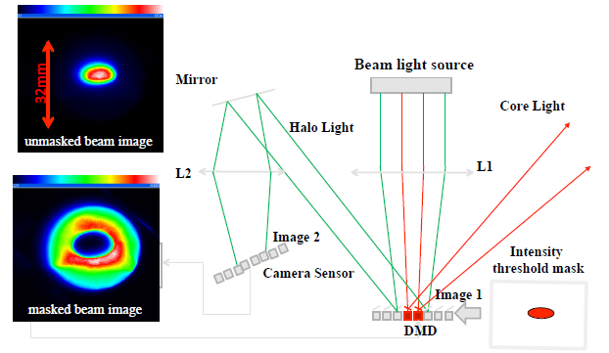
R&D in beam diagnostics
- Beam loss monitor - Require high reliability and large dynamic range. In LHC, particle loss > 2 x 10⁻⁶ will quench a magnet.
- Beam size and position monitors using Optical Diffraction Radiation, and other non-invasive techniques
- Beam halo monitors with high dynamic range. One example
Dynamic range > 10⁵
R. Fiorito et al, Phys. Rev ST-AB July 2012

Slide 48
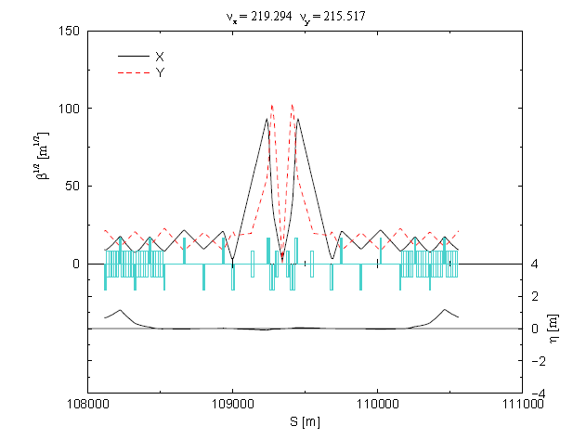
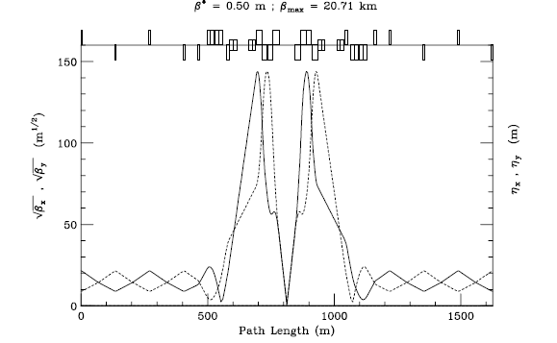
IR concepts
β^{max} = 14.6km
Doublet Optics for flat beams
Symmetric optics about the IP. First quad in doublet on both sides has to be vertically focusing
In a pp collider, this requires 2 apertures for the 2 beams
Dipole before the doublet to separate the beams into the apertures
Tight control on vertical dispersion and coupling to maintain
κ_{ε} = ε_{y}/ε_{x} < 1. Done routinely in e+e- colliders.
Vert β^{max} = 10.8km
VLHC 2001
Designs
Doublet Optics, flat beams
Triplet Optics, round beams

Slide 49
e+e-

Slide 50
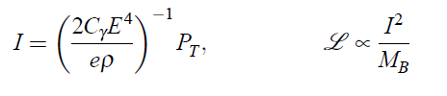

Beam Current and Luminosity (e+e-)
Power limited regime. Synchrotron radiation power from both beams limited to 100 MW. Beam current is determined by
Minimum number of bunches compatible with single bunch intensity limits
Luminosity in terms of beam-beam parameter, beta function and power

Slide 51
Comments on the VLEP design
Rf acceptance set to 3% for mitigating beamstrahlung. If this is enough (requires detailed study), then a full energy injector may not be required.
Rf voltage of 3.9 GV is comparable (~10%) to that in LEP2
There can be two detectors to double the # of Higgs events if IR chromaticity can be well compensated
Synchrotron radiation power load (0.9 kW/m) and high critical energy (314 keV) imply that vacuum system R&D may be needed but these could be comparable to light sources.
Energy could be extended up to 175 GeV/beam at the same rf power, with lower luminosity.

Slide 52
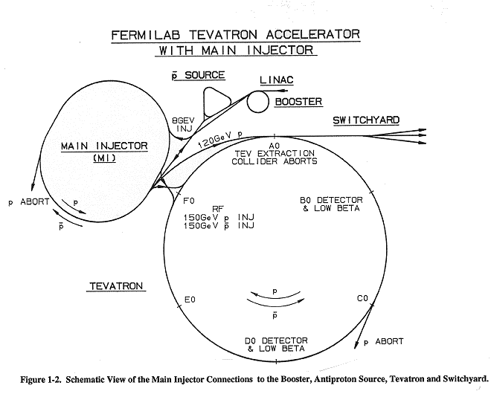
Injection Scenarios
Scenario 1:
400 MeV linac, Accumulator ring, Booster, Main Injector
Scenario 1:
400 MeV linac, Accumulator ring, Booster, Main Injector
Scenario 3:
1 GeV linac, Accumulator ring, Superconducting Fast Ramping Synchrotron
Scenario 3:
1 GeV linac, Accumulator ring, Superconducting Fast Ramping Synchrotron
Scenario 4: Recirculating linac, e+ damping ring
Scenario 2:
3 GeV linac, Accumulator ring, Main Injector
Scenario 4: Recirculating linac, e+ damping ring
Scenario 2:
3 GeV linac, Accumulator ring, Main Injector

Slide 53
e+e- parameters - 2
 | Units | Value
Dipole field Cell length Dipole fill factor Bend angle per cell γ_{t} Beam current Rf frequency Over voltage parameter Longitudinal damping time Critical energy rms energy spread Synchrotron tune rms bunch length | T m mrad mA MHz turns keV mm | 0.03 143.6 0.76 10.6 148 12.9 650 2.6 79 314 9.3x10⁻⁴ 0.223 3.2

Slide 54
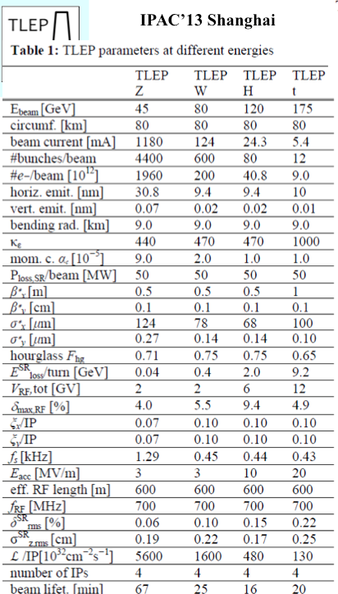
TLEP Parameters

Slide 55
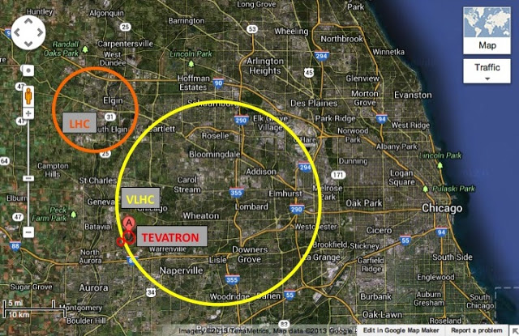
Design Concepts:
Summary
Physics central blog
VLHC: 100 TeV pp collider
Explored parameters for Integrated luminosity ~ 1 fb⁻¹ / store
IR debris power and pile-up impose the strongest restrictions to higher luminosity
R&D on integrable nonlinear optics, beam-beam compensation, novel diagnostics, radiation damage, new tunneling techniques, … to reduce cost.
Machine protection will be critical
120-120 GeV e+e- collider
Explored parameters for ~45000 Higgs events/year/detector
βy* (& luminosity) limited by IR chromaticity.
R&D on beamstrahlung, IR chromaticity compensation, synchrotron radiation management, …
RF requirements similar to LEP2

