Slide 1
Agenda for the PMG Meeting
Status and timeline to close recommendations from the Director's Review
Maturity of the design for MIE components
High level summary of reviews (Final Design Reviews, Procurement Readiness Reviews, etc...) for MIE components
Table with requirements for MIE and how it flows down to the sub-detectors
Status of QA documents for MIE components
Indico page for the PD review

Slide 2
Director’s Review Recommendations (MIE)
Manage all three projects with the same procedures and management practices, in particular the schedule and technical integration. We have implemented this.
MIE Project – Clarify the status of the subsystem designs at WBS Level 3 including the status of completed design reviews. Prepare a convincing case for the Lab Directors Review that the MIE design maturity is adequate for a PD-3 approval. We will do that in the plenary talks.
Clearly articulate requirements flow-down and margin analysis during future plenary sessions. Add to the plenary talks
Review the risk registry and ensure that the top ten risks are accounted for and appropriately categorized. Modify the risk slide in the risk talk.
Address review comments and recommendations relevant to the MIE PD’s and proceed with the Lab Director’s Review of the MIE. We will discuss the status of all important recommendations

Slide 3
Director’s Review Recommendations - continued
To clearly show that the scope of each project is sufficiently defined to support approval of PD-2 and PD-3 and that the specifications, designs and execution plans will likely meet the technical performance requirements, the committee feels it will be critical to develop for the PD-2/PD-3 review a document, which clearly describes how the scientific requirements flow into the detector specifications and performance requirements. The TDR does this.
The technical maturity of the project must be clearly documented and the percent completion of final design for each Level 3 subsystem evaluated. The prototypes, which are real first articles based on final design for each Level 3 subsystem should be identified and their performance should be compared to the detector specifications and performance requirements. Will discuss in the plenary session.
To document that the ES&H/QA aspects have been properly addressed given the current state of the project, every level-3 presentation should discuss what are the hazards, possible safety concerns, and how they are addressed. Further scheduled safety reviews through the different phases of the project should be clearly indicated. We will add an ES&H slide to each L2/L3 talk.

Slide 4
Director’s Review Recommendations- continued
To ensure all L2 and L3 managers are well prepared for the review scheduled in May, practice drill downs for those likely to be chosen at the PD-2/PD-3-Review with a Project Management professional should be scheduled. Practice is May 15, 16
Complete QA plans should be developed for all subsystem components and made publicly available for the PD-2/PD-3 review. The QA plans should show how the technical requirements are verified throughout the production. Not possible prior to PD-2/3 review
All subsystems to be installed in the magnet should be able to articulate how their design integrated robustness and redundancy to account for the difficulty of access to sub system components during a run for the potential limited overall runtime of sPHENIX. Add this to L2 talks.

Slide 5
Director’s Review Recommendations - continued
Clearly articulate requirements flow-down and margin analysis during future plenary sessions. Agreed
Develop a clear methodology for performing verification/validation against specifications and interface requirements. We have such a methodology. A mechanical parts match prints and control docs. All electronics meet performance spec through bench tests.
Have all talks posted at least 1 week prior to start of review. Other materials should be posted 2 weeks prior. We will post back up material May 14 and talks May 21
Reduce the number of plenary talks to only the most important for the Lab Director PD-2/3 review. Restructure the plenary talks to better communicate the key issues. The opening talks should introduce and provide background to major elements and should reference future talks on details but should not go into that detail. Only plenary talks are Overview (EO’B), Project Management (Glenn), Cost/Schedule/Risk/Contingency(Cathy), 6 L2 talks, ES&H. The plenary sessions are May 28, 1:30-5:30 and May 29 8:00 am-noon.

Slide 6
Director’s Review Recommendations - continued
The MIE is ready for PD-2. However, a logical demonstration of readiness for PD-3 was not made to the committee at this review. This is a comment
The MIE will go through another formal review in 7 weeks, this will be an opportunity for the Project team to demonstrate that this area is fully ready for both PD-2 and 3.This is also a comment.
The project team must define a process that justifies moving to PD-3 before May 1. This should include which design review gates must be completed, that Action Items are completed, and that items such as Final Interface Control Docs (ICDs) and Requirements Docs are also under revision control. We plan to meet all BNL requirements for PD-2/3.

Slide 7
Director’s Review Recommendations - continued
Presentation-related recommendations:
Include a clear, brief slide describing the relationship of the sPHENIX program including the MIE, Infrastructure, and Tracking System Upgrade projects. This should acknowledge all contributed scope and labor. Also address the implications of RHIC operations on these projects. This information is needed as background to eliminate potential misunderstandings and issues that this committee has had/still has. We will clearly describe what is and isn’t the MIE.
Alternatively, describe this relationship in a pre-review brief provided to the reviewers prior to the review. Discuss requirements capture and flow-down so that subsystems can discuss their specs and refer back to these requirements. Good suggestion.
Discuss the currently completed reviews (focusing primarily on PDRs, FDRs and PRRs) and the process for completing PRRs before fab begins on major items (PD-2/3). ICDs can fall into the same discussion. Will discuss in the plenary session.
Include in the subsystem talk template the requirements/specs/flow-down, and a list of the substantial hazards/mitigations. Make uniform the presentation of “cost/schedule drivers” Make uniform the presentation of “cost/schedule drivers” (some were $800K items, others $40K items…).Will add those 2-3 slides and set a cost threshold of $100k for cost drivers.

Slide 8
BNL PD-2 Requirements
Project Decision 2 - The Preliminary Design and Project Baseline will be finalized and approved as part of PD-2 (Project Decision 2). A successful PD-2 Review will be attained when the project team has estimated and time-phased the resources required to execute the project against an integrated project schedule, and a risk analysis is conducted to help determine the potential variability in scope, schedule and/or cost which might be encountered in the course of executing the project. To achieve PD-2 the project team should meet the following requirements and produce the following documentation:
Conduct Preliminary/Technical Design Review
Complete Preliminary/Technical Design Report
Update and approve Project Management Plan (PMP)
Develop a Performance Baseline including Resource loaded schedule
Finalize Hazards Analysis Plan
Finalize Quality Assurance Program
Propose Funding changes with funding profile
Continue Monthly Reporting include Cost Performance Report
Implement tailored EVMS and change control
Review Project Risk Registry and assess Contingency
Initiate Annual Status Reviews and monthly reporting

Slide 9
BNL PD-3 Requirements
Project Decision 3 (PD-3) includes Approval of the Project Final Design requirements and specifications and Authorization to start Execution of the Project. A successful PD-3 Review will be attained when it is determined that the state of the development of the project planning is adequately defined to execute the project plan for successful delivery of the project scope with effective management, resource planning, scheduling, risk assessment and progress tracking at a level that ensures project delivery that addresses the expectations of the stakeholders. To achieve PD-3 the project team should meet the following requirements and produce the following documentation:
Conduct Design Review of the final design requirements and specifications.
Update Project Management Plan (PMP)
Generate a preliminary Transition to Operations Plan
Update Hazard Analysis Plan
Continue Quality Assurance Program
Update Project Integrated Safety Management Plan
Continue Monthly Reporting include Cost Performance Report
Implement tailored EVMS and change control
Monitor Project Risks and Contingency
Continue Annual Status Reviews

Slide 10
Preliminary Design Review
A PDR is a subsystem level review held when the subsystem design has coalesced to the extent that the subsystem is ready to proceed towards the final production design and layouts of all subsystem assemblies, subassemblies and components are available, analyses of the subsystem performance, structural integrity, integration with other subsystems, and safe assembly, handling and operation can be defended. The panel of reviewers will be internal to sPHENIX but can include key independent experts as determined by sPHENIX project management. Elements presented at the review are well understood and ready to be detailed as represented by layouts, 3D models, schematics, tooling, fixtures, assembly procedures and support systems. Safety issues shall be addressed and mitigation plans to manage these issues shall be presented. Cost and schedule should be within budget but are generally not presented at the PDR .

Slide 11
Final Design Requirements and Specifications Review
Are the design requirements and specifications comprehensive and final?
Are all technical down-selects complete?
Is only Advanced R&D remaining?
Have all safety related issues have been identified and are they mitigated and resolved.
Have all ICD’s for this subsystem been completed and are they under revision control? Have they been approved by the Office of System’s Integration?
For mechanical designs, is the 3D model finalized and under revision control?
Have vendors been identified for major items?
Is this subsystem’s BOE and RLS ready for PD2/3?
For electronic designs, are there advanced schematics and have all major components have been identified?
Is documentation of analysis and R&D complete? Is it under configuration control?
Are the Risk Registry and RMP for this L2 system up to date and well documented?
Will documentation be available to begin construction procurements within the next 6 months?
Can the relevant KPP’s and UPP’s be met by the L2 subsystem as presented?

Slide 12
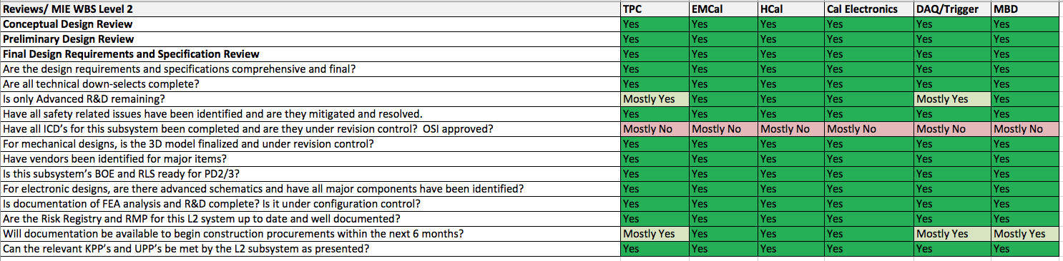
Design Maturity of the MIE

Slide 13
Design Maturity of the MIE
The sPHENIX MIE is 5 subsystems plus Project Management
EMCal design is done and preproduction construction is advanced.
We begun making the EMCal blocks for the first sector to be installed
Production to start within 6 months
HCal design is done and preproduction construction is advanced.
We have 20% of the scintillating tiles for the HCal and 70% of the steel sectors
Production to start within 6 months
Cal Electronics design is done and preproduction construction is advanced.
Quantities produced so far are small.We will start a preproduction build of 20% quantities within 6 months
TPC GEM modules and FELIX cards will start a 20% preproduction build within 6 months
The TPC mechanics and Fee will enter preproduction stage within 6-9 months.
DAQ/Trigger will be in preproduction stage for GL1 and Timing within 6 months
The Local Level-1 trigger is still in preliminary design stage
Min Bias Detector exists
Min Bias electronics in prototype stage. Ready for production within 12 months. Total cost remaining <$100k

Slide 14
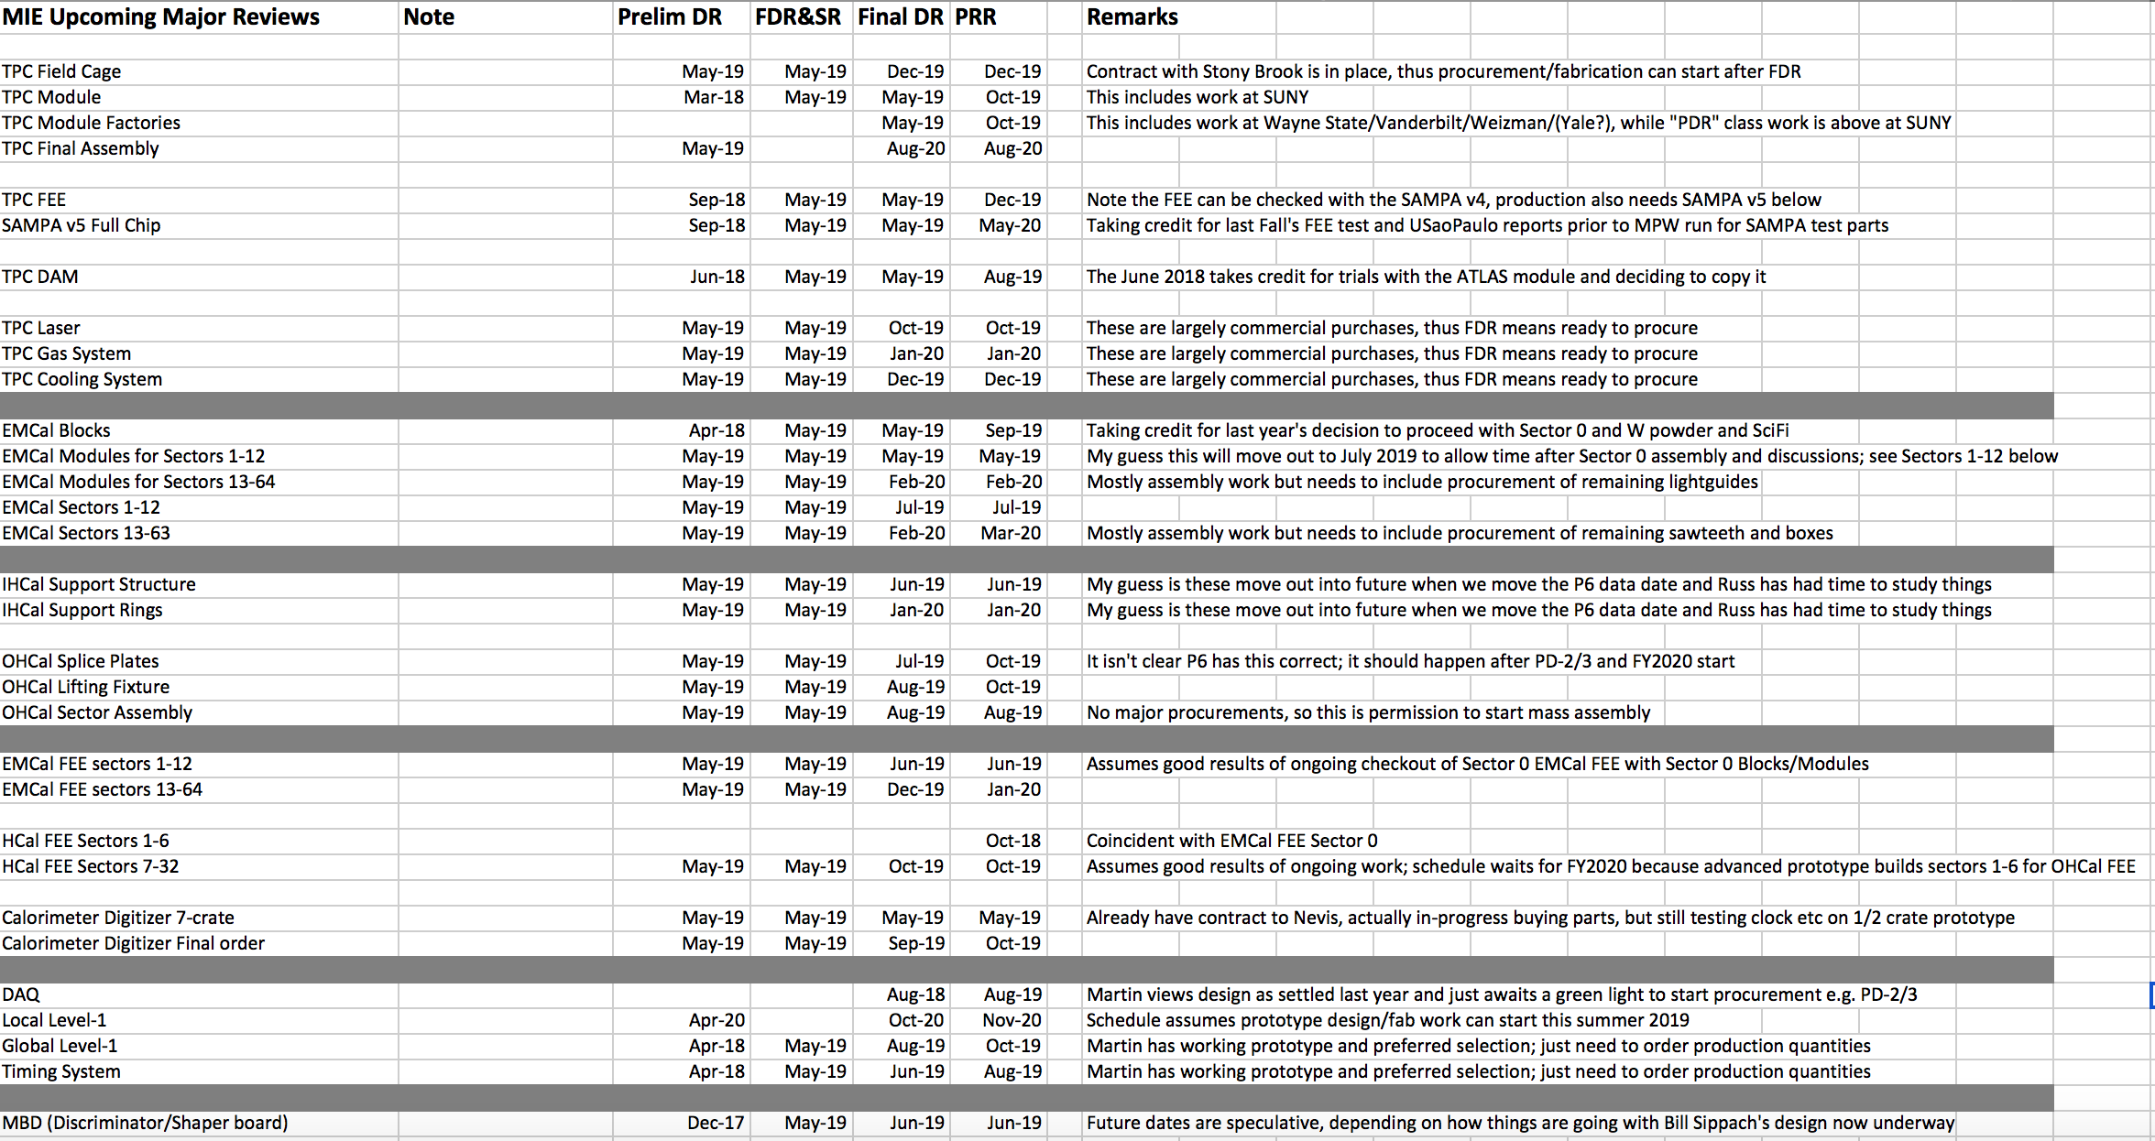
Review Summary

Slide 15
Physics flowdown of requirements for Upsilon(1S) mass resolution < 125 MeV/c²
Detectors | Detector Requirement | Comment | Verification
TPC | Cover 2π in φ and ±1.1 in η | For adequate acceptance of the e⁺e⁻ pair | By design
TPC | Transverse (rφ) pad size ∼2 mm | Necessary to achieve position resolution in 150-200 μ range | By design
TPC electronics | 10 bit precision at 20 Msamples/s | To achieve position resolution < 200 μ in rφ needed for adequate momentum resolution | By design
TPC electronics | 80 ns shaping time from GEM | To minimize pileup in heavy ion collisions | By design, confirmed with simulation
EMCAL/Trigger | Tower size ΔηxΔφ ∼ 0.025 | Necessary for efficient triggering with good rejection | By design, trigger rejection verified by simulation
EMCAL | Energy resolution < 16%/√E ⊕ 5% | Necessary for electron id | Confirmed with simulation backed up by beam tests
DAQ | Data can be collected at 15 kHz with 90% livetime | Necessary to accumulate desired statistics in Au+Au collision | By design, verified by bench tests
Detector requirements in more detail in “sPHENIX Baseline Detector Requirements” document

Slide 16
Status of Quality Assurance Documents for sPHENIX
sPHENIX - Project Level QA Plan - Signed and Released
Subsystems
EMCal Production Block Factory QA Plan - Signed and Released
EMCal Sector Assembly Factory QA Plan - Being Drafted
Quality Assurance Plan For Hadronic Calorimeter Tile Production – Final Draft - Awaiting Signatures
OHCal Sector Assembly Factory - Being Drafted
Electronics QA and Acceptance Testing Procedure – Main Document Exists - Development of Testing Plans for Specific Components Needs To Be Completed
TPC Procedures for GEM Framing and Testing - Draft Plan To Be Reviewed
TPC QA Procedures for GEM foils and TPC readout Chamber Assembling, Testing, and Certification - Draft Plan To Be Reviewed
TPC Main Assembly Procedure - Preliminary
It Is Required that all procurements follow BNL Supplier Quality Assurance Requirements (BNL QA 101) – Referenced in SOW or Spec. as part of Contract Documentation

Slide 17
sPHENIX Project Calendar
Director’s Review (1.X,2.X,3.X) April 9-11
PD-2/3 Review Indico page available May 9
PD-2/3 Review Practice May 15-16
Post back-up documents May 15
Post talks May 21
PD-2/3 Review (MIE only) May 28 (1:00 pm)-May 30

