Slide 1
The Details of Hall Probe Calibration Limitations
Isaac Vasserman, Nikita Strelnikov, Joseph Xu
IMMW-18, June 03-07, 2013, LBNL, NY

Slide 2
Introduction
New 2-axis Senis Hall probe is used now at the APS Magnetic Measurement facility for measurement [1]. Results of the detailed test of this Hall probe are presented in a recent publication [2].
There are clear advantages of this Hall probe compared to the previously used Sentron probe. The most important of them are the cancellation of the Planar Hall effect and stable zero offset.
Most of the devices in the APS are planar with only the vertical component of magnetic field, and use of the Sentron probe is continuing.
Most of the errors with Hall probe measurements are related to the quality of their calibration, and it results in errors of field integral measurements.
The purpose of this research is to compare the results of first field integral measurements using two types of Hall probes recently available at the APS Magnetic Measurement facility: Sentron Hall probes and Senis Hall probes and to find the limitations of their accuracy.
_________________________________________________________________
http://www.senis.ch/magnetics/hall-probes/integrated-hall-probes .
Rev. Sci. Instrum. 84, 025004 (2013); view online: http://dx.doi.org/10.1063/1.4790422.
Notes:
http://www.senis.ch/magnetics/hall-probes/integrated-hall-probes
Rev. Sci. Instrum. 84, 025004 (2013); doi: 10.1063/1.4790422, View online: http://dx.doi.org/10.1063/1.4790422

Slide 3
Senis Hall probe

Slide 4
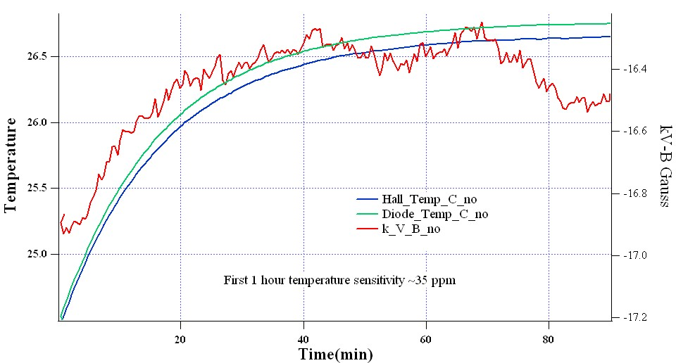
Hall probe voltage and temperature vs. time-no temperature control
Measurements at calibration system with T=1 T field, k- reversed temperature sensitivity of Hall probe: 0.2 T/V, V-voltage, B-NMR field

Slide 5
Discussion
Temperature rise at the beginning is due to the Joule heating of the electromagnet.
Both temperature sensors show this increase with a slight difference ≤0.1°C.
Hall probe sensitivity decreases accordingly with some fluctuations.
Most probable reason for such a behavior is the sensitivity of the transducer to temperature change (Dr. Popovich comments).

Slide 6
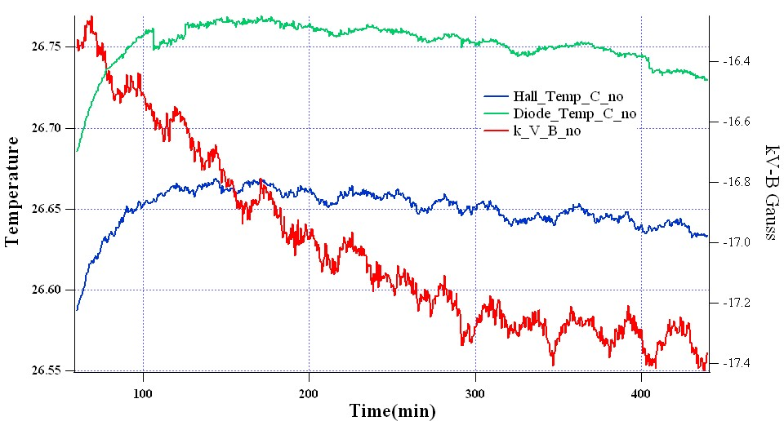
Hall probe voltage and temperature vs. time-no temperature control (cont.)

Slide 7
No temperature control
First 60 minute after 1 T field applied:
Sharp increasing temperature,
Rise of Hall probe output voltage, temperature sensitivity ~ +35 ppm
Next 20 min:
Slow increasing temperature,
Fall of Hall probe output voltage
Next 3 hours:
Slowly decreasing temperatures from both sensors and increasing sensitivity of Hall probe, with oscillations.
Sensitivity temperature coefficient is much higher for short time changes than for a long time average change. Long time sensitivity coefficient is not stable. Partial oscillations of temperature are due to the room temperature oscillations visible from the silicon diode sensor. Additional frequency of oscillation of the Hall probe temperature sensor is most probably induced by electronics.
Temperature control was implemented to make the calibration process more reliable and reproducible.

Slide 8
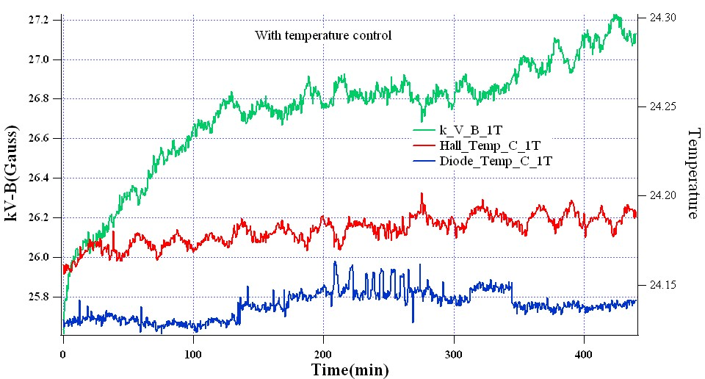
Hall probe voltage and temperature vs. time-with temperature control
k- reversed temperature sensitivity of Hall probe: 0.2 T/V, V-voltage, B-NMR field

Slide 9
Senis Probe Discussion (cont.)
Much more stable Hall probe voltage output readings with temperature control on.
There are still fluctuations of the sensitivity synchronized in time with fluctuations of the Hall probe temperature sensor. These fluctuations are induced most probably by electronics.
During stable temperature time, both cases with temperature control on and off show a change of the Hall probe voltage readout of around 0.01%.
Reference temperature measurements by silicon diode does not show the periodic oscillations; only some random type of noise can be seen.
For details of field integral accuracy using the Senis Hall probe see [2].

Slide 10
Sentron Hall probe

Slide 11
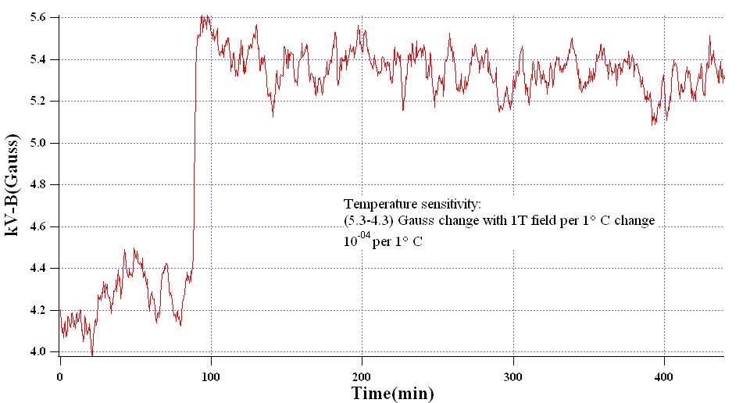
Sentron Hall Probe Time Dependence
Temperature control on, first part T=22.5 C, second part T=23.5 C. Temperature sensitivity: ≈1*10⁻⁰⁴

Slide 12
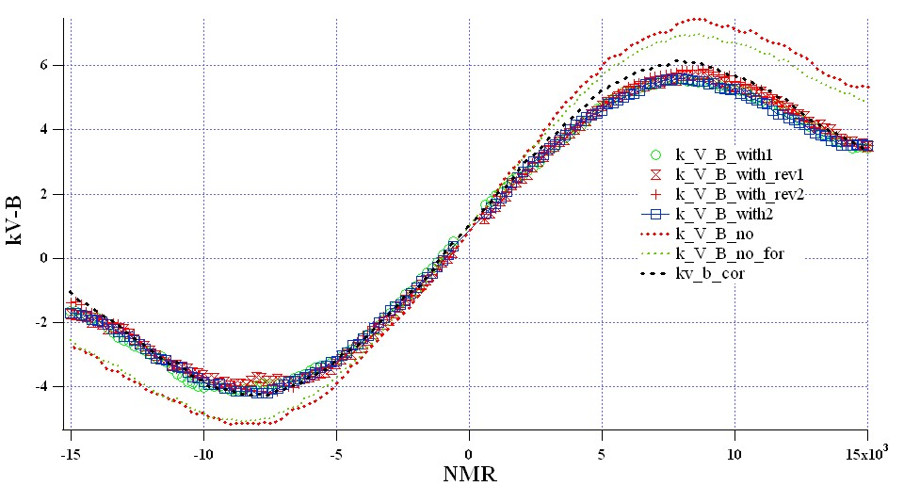
Sentron Hall Probe Calibration
Calibration curves with temperature control on and off. Data with no temperature control corresponds to a different temperature. Kv_b_cor shows correction of this difference.

Slide 13
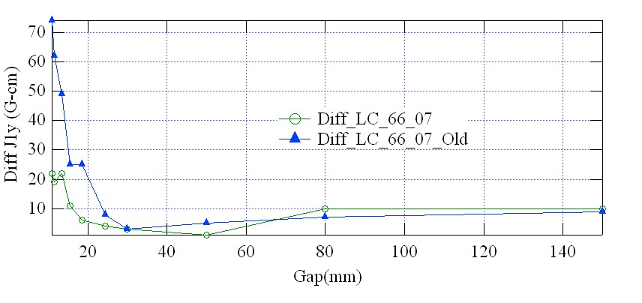
Sentron Hall Probe
Difference of first vertical field integrals between long coil and Hall probe data using calibration files with temperature control on and off.

Slide 14
Sentron Probe Discussion
Random noise of this probe is about ± 0.2 Gauss at the level of the field 1 T.
Average voltage output is stable with temperature control on.
Errors in first field integral measurements are reduced by a factor of ~4 by using the calibration file done with temperature control on.

Slide 15
Conclusion
Temperature control of the sensor allows more reproducible and reliable calibration of Hall probes.
Some minor variation of Hall probe sensitivity still exists and affects the quality of calibration.
Best way to obtain good calibration is to choose from several scans and find the best one by comparison with reference data of field integral measurements with a long stretched coil using an undulator.
Sentron probe field integral measurements with proper calibration and linear regression are as good as those with Senis Hall probe.

Slide 16
Conclusion (cont.)
Reply from Dr. Popovich on the issues found with Senis Hall probe that was described in [2]:
1. The big temperature coefficient that you found in Fig. 3 [1], and the unclear drift (end of section III), are due to the influence of the temperature on the electronic module. We have redesigned the electronic module and so almost eliminated the problem.
2. SENIS adjusts the temperature coefficient (TC) of the probe sensitivity to be less than 25ppm/C at a field of about 0.9T. Unfortunately, TC varies with the field; and it is difficult to cancel the field dependence by hardware means. Therefore, we plan to offer to customers a more detailed calibration table, which will represent the function Vout = f(B, T). We have redesigned the temperature sensor of the probe in order to avoid the inductive signal shown in [1] Fig. 15. The new generation of the low offset and low noise Hall transducers, with these improvements, will be available in about three months.

Slide 17
References
[1]. http://www.senis.ch/magnetics/hall-probes/integrated-hall-probes
[2]. Some Aspects of Achieving an Ultimate Accuracy during Insertion Device Magnetic Measurements by a Hall Probe, I.B. Vasserman, N.O. Strelnikov, J.Z. Xu, Rev. Sci. Instrum. 84, 025004 (2013); view online: http://dx.doi.org/10.1063/1.4790422

