Slide 1
Real-time magnetic field control
applications at CERN: an update
A Beaumont, M Buzio, D Giloteaux, G Golluccio, D Oberson
07.06.2013
1

Slide 2
Overview
Introduction
Why and how to control the field in synchrotrons
Mathematical models, feed-forward control, current pre-cycles
Magnetic measurements with B-train sensors
Examples of tests carried out in CERN Proton Synchrotron (PS)
to investigate the source of beam instabilities
B-train upgrade project
Recent progress in electronic hardware

Slide 3
Introduction

Slide 4



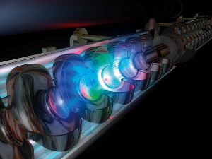
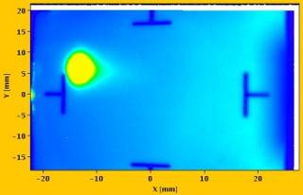
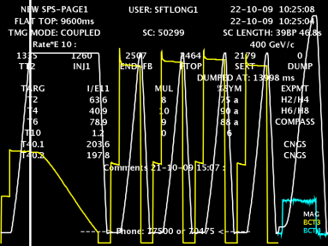

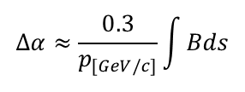
Real-time magnetic field measurements
Precise knowledge in real-time of the magnetic field in the main bending magnets in synchrotrons is important for longitudinal and transversal beam control
Field values are traditionally measured and transmitted as pulse trains to different users
I(t)
magnetic measurement
or field model
B(t)
power supply control
$$∆α≈\frac{0.3}{p_{[GeV/c]}}\int{Bds}$$
RF control (mandatory)
$$f_{rev}≈\frac{β\left(B,R\right)c}{2πR}$$
beam diagnostics & control
(relativistic parameters, emittance,
program tunes, trim supplies…)
qualitative feedback to operators

Slide 5
Analytical magnetic field models
Mathematical models: B(t) = f(I, dI/dt, t, I(t’≤t))
- provide or supplement real-time field information to users
- go from desired B_{n}(t) → I_{k}(t) (inverse problem) e.g. during commissioning
- replace B-train measurements in case of failure or during diagnostic runs
- compare to B-train measurements for diagnostic purposes
Potentially simpler/more reliable than B-trains
(essentially “just” software and commercial computing hardware)
Accurate prediction very difficult, especially for iron-dominated magnets:
- Eddy currents in the magnets, vacuum chamber or surrounding structures
- Other dynamic effects e.g. ageing of iron yoke, magnetic aftereffect
- Hysteresis effects (“Pulse to Pulse Modulation”)
- Temperature drifts
- Errors of I(t) measurement
- Timing jitter
at CERN, only the Antiproton Decelerator can run reliably on the synthetic B-train (very special case: very low-field ring, RF stability is much more critical than field accuracy)
… a different story for high field, superconducting magnets …

Slide 6
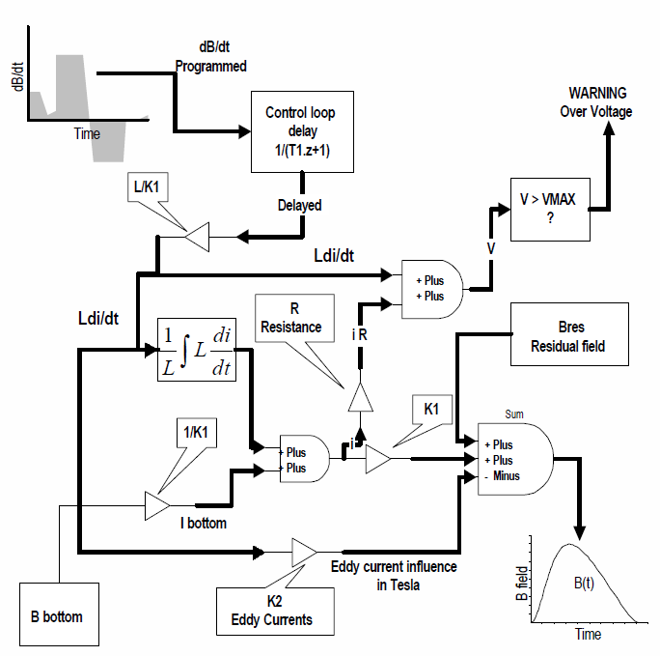
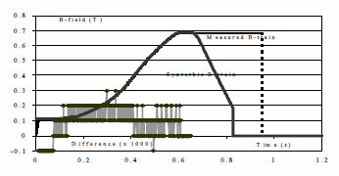
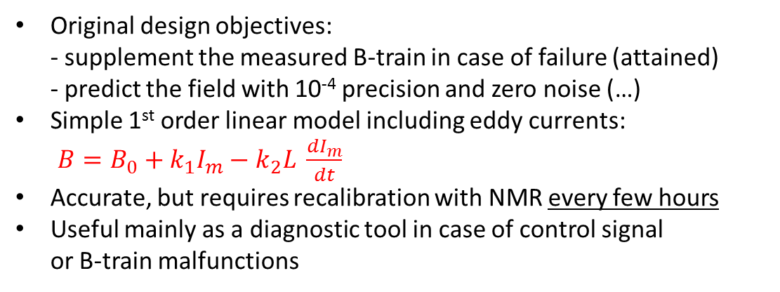
Field model of CERN PS Booster
Original design objectives:
- supplement the measured B-train in case of failure (attained)
- predict the field with 10⁻⁴ precision and zero noise (…)
Simple 1st order linear model including eddy currents:
$B=B_{0}+k_{1}I_{m}−k_{2}L \frac{dI_{m}}{dt}$
Accurate, but requires recalibration with NMR every few hours
Useful mainly as a diagnostic tool in case of control signal
or B-train malfunctions
block diagram of implementation
0.05% short-term error w.r.t. measurement
F. Caspers,et al., An Alternative to Classical Real-time Magnetic Field Measurements using a Magnet Model, ICALEPCS 97

Slide 7
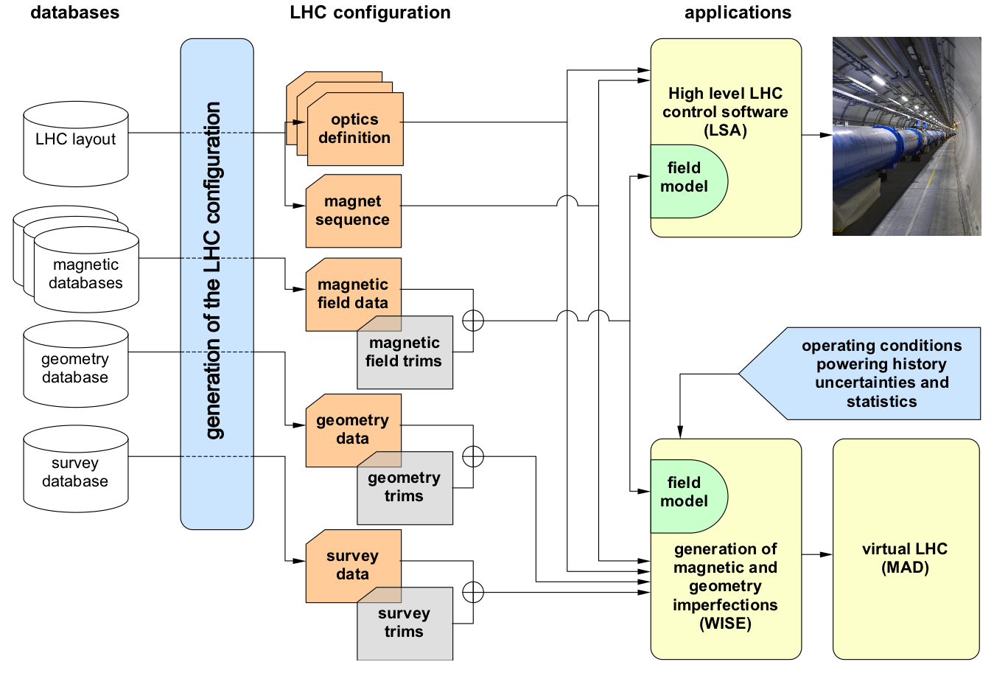

The FIDEL (Field Description of the LHC) model
Aim: predict the state of all magnets, following arbitrary operating cycles, to an agreed accuracy; allow inversion I=I(B); lower requirements on beam-based feedback control
Semi-empirical scaling laws based on extensive statistical knowledge of magnets (25% tested cold + W/C correlation, 100% warm); relies upon permanent magnetic test facilities to measure the effects of novel operating cycles and conditions
Outstanding success, as proved by the unprecedentedly quick commissioning of LHC
Limitations: hysteresis and eddy currents effects (as needed for resistive magnets) are not included
parameterization of transfer function and harmonics of the main magnet and corrector circuits (prepare injection settings, define the ramp, provide trims to follow the field drift at injection and during ramps
LHC model (MAD) provide a snap-shot of the deviations from nominal optics (field errors) in all magnets at an arbitrary time to perform studies on the LHC beams
See also L. Bottura, FiDeL - the Field Description for the LHC, IMMW 16, Bad Zurzach, 2009

Slide 8
FIDEL: mathematical formulation

Slide 9
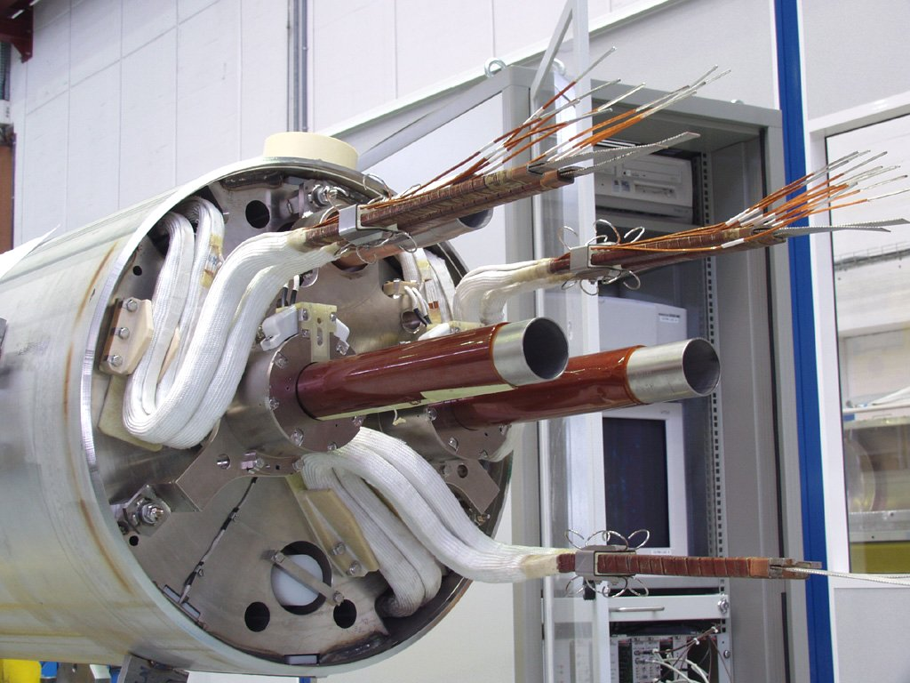
Application of FIDEL: feed-forward B₃ compensation
Example of application: inversion of the current profile needed by the local B₃ correctors (MCS)
to compensate decay and snapback transients
LHC dipole cold mass
MCS spool pieces

Slide 10

Improving field reproducibility: pre-cycles (1/3)
Reproducibility of magnetic field improves by resetting the magnetic state with current pre-cycles
The operating mode of the magnet should be respected:
Bipolar magnets (steerers, correctors, switching dipoles): degaussing
Unipolar magnets (main ring): stabilization precycles
Random cycling → minor cycles → unpredictable errors within the envelope of the limit cycle
Enforce monotonic cycling for critical magnets (at the cost of ∼2× time spent ramping)
maximum
current injected
$$\frac{I_{k+1}}{I_{k}}=−\frac{2}{3}$$
power supply
resolution
NB: full demagnetization requires T≥T_{curie} ≈ 948 °C !!
maximum current
in operation
minimum current
in operation

Slide 11
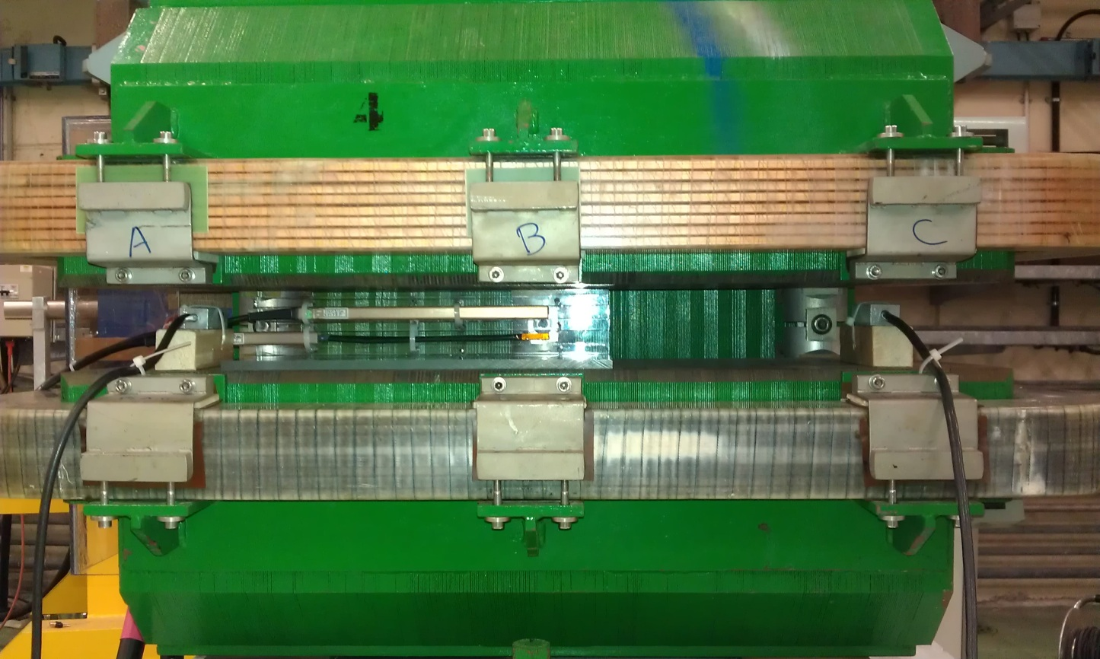
Improving field reproducibility: pre-cycles (2/3)
Example: spectrometer dipole for CERN Linac4
low-energy diagnostic beam line
NMR probe for B₀
hall probe close to the edges (saturation peaks)
to evaluate reproducibility of the integrated field
(easier than using an integral coil)

Slide 12
Improving field reproducibility: pre-cycles (3/3)
σ≈10⁻⁵
σ≈2 10⁻⁶
σ≈7 10⁻⁴
σ≈3 10⁻⁴
I (A)
I_{max}
3×7 cycle sequences between I_{min} and I_{max}, magnet switched off in between
low field = worst case: 3×cycles→ stability better than 10⁻⁵
high field: stability better than 10⁻⁴ even without precycling
I_{min}

Slide 13
Feed-forward control of eddy currents
Eddy currents can be partially, totally or over-canceled by a linear excitation current overshoot at the end of ramp-up
Stable flat-top reached at the time cost of ∼1.4τ (to be compared with exponential decay time ∼3τ)
Caveats:
- power converter needs high dV/dt;
- the maximum working point is increased considerably, at the risk of saturation
I_{m}
I*-I_{m}
Δt
t (s)
Δt
optimal
Δt = 2 ln2 τ
t (s)

Slide 14
Magnetic measurements
of CERN PS magnets
with B-train sensors

Slide 15
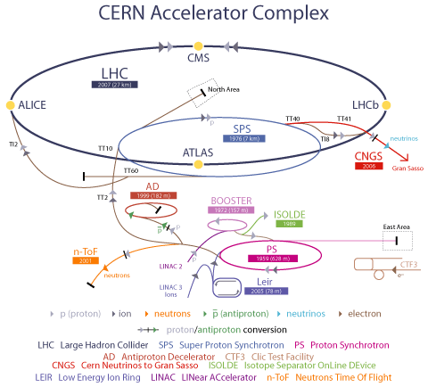
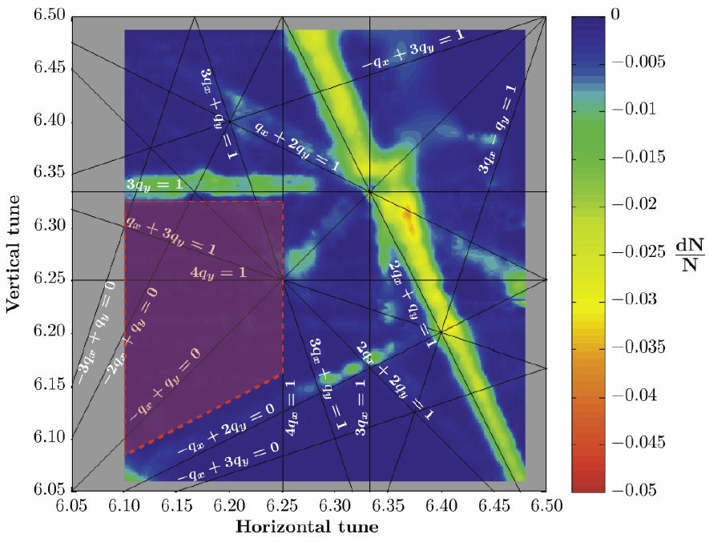
Motivation
PS beam perturbations soon to become a limitation
for high-intensity LHC operation (injection 1.5→2 GeV):
mean beam radial position (MRP) errors associated
to magnet excitation history
tune decay on extraction flat-top
A₃-induced beam resonances
Magnetic source of these errors remains to be fully understood (conventional test campaign in the lab very impractical !)

Slide 16
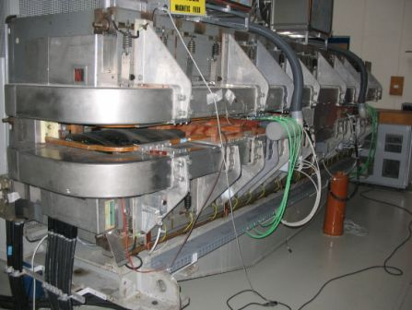
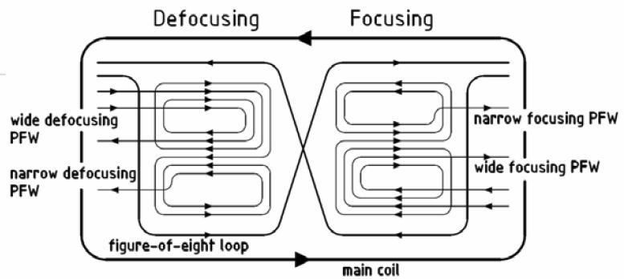
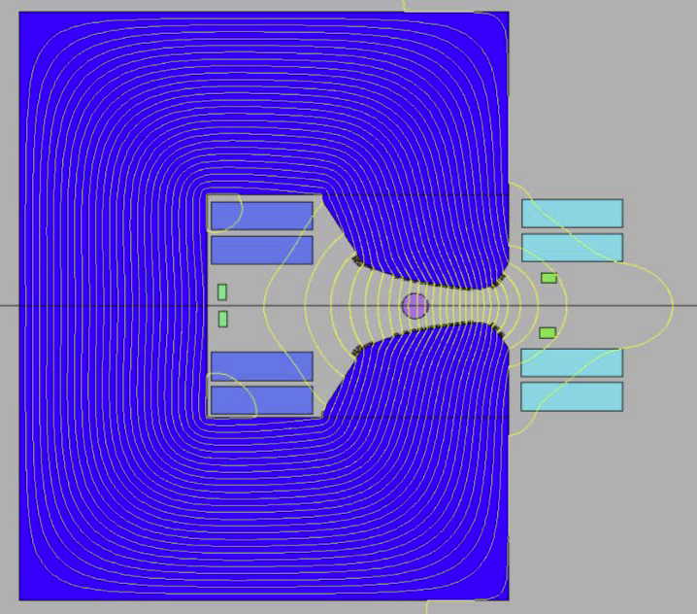
CERN PS combined-function magnet
strongly coupled 1 main + 5×trim excitation circuits
no 10⁻⁴ predictive model
remanent field ≈ 0.2% depends on history
partial sensor set in leads to B-train measurement errors in certain conditions
defocusing half focusing half
4× pole face windings (PFW) affecting B₁ to B₅
main
coils
figure-of-eight loop
(F8L) to control B₂

Slide 17
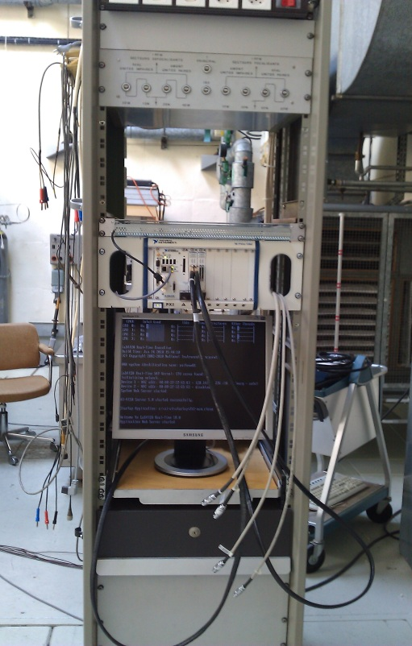
“Spy” system for off-line diagnostics
National Instruments hardware:
- PXIe chassis, NI PXIe-8133 Core i7 controller
- LabView ETS RTOS
- 2× 6366 DAQ cards (16×2 MHz non-multiplexed
16-bit channels + 32×10MHz digital I/O channels)
Acquisition of all sensors and B-train signals:
coils, markers, machine timing
Introduced in 2010 to track the magnetic state in F/D halves
Used to check the consistency of sensor and
B-train signals, timing and currents
Testbed for the design of new sensors and acquisition algorithms
NB: high sample rate ≥ 200 kHz needed for:
accurate integration of coil flux
correlation of current/field within ∼0.02 G

Slide 18
CERN PS: power cycling-induced beam instabilities
asymmetric powering imbalances B_{F} and B_{D}
current B train system is blind to initial B_{F}
B_{avg} measurement error → beam MRP error

Slide 19
PS beam stability test @ injection (1/2)
I_{main}
I_{F8L}
systematic correlation between initial field imbalance (→B-train error) and radial position error

Slide 20
PS beam stability test @ injection (2/2)
  CNGS
  CNGS
  CNGS
  2nd CNGS cycle unstable
  2nd CNGS cycle unstable
  2nd CNGS cycle OK
specific powering cycle sequences lead to reproducible radial position errors
now we can observe correlation with reproducible magnetic errors

Slide 21
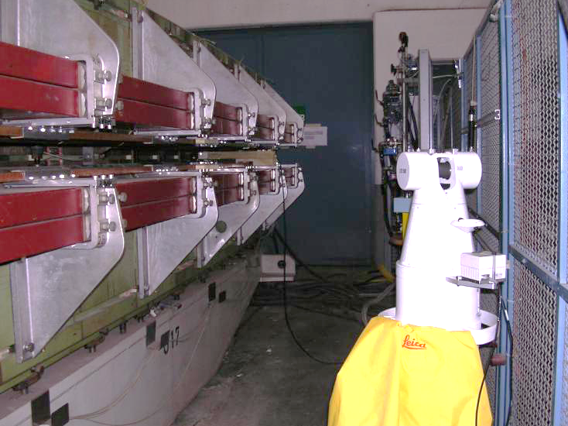
Mechanical side-effects (1/2)
Laser tracker measurements in a spare magnet to test stability of NMR marker support
Closing of magnet gap vs. excitation current
Notes:
(Re)establish clear responsibility boundaries with BE/CO:
- local control racks
- synthetic B-trains
- closed-loop field control regulation (e.g. ISOLDE)
“piquet” service: so far a best-effort approach with three people on-call has been sufficient, what about the long-term ?
standardization of synthetic trains with FIDEL-like algorithms: magnetic measurements+ beam measurements + numerical simulations → mathematical model of magnet behaviour

Slide 22

Mechanical side-effects (2/2)
A₁
Δy
$${A′}_{n−1}={\left(n−1\right)B}_{n}\frac{Δy}{r_{ref}}$$
Vertical displacement of top pole = 0.16 mm @ 5400 A (gap closes due to magnetic forces)
All B-train sensors fixed to bottom pole
Top/bottom asymmetry → possible vertical displacement of sensors w.r.t. to ideal axis
Feed-down → skew spurious harmonics: 0.16 mm → 6 units of A₁ (0.7 mT)
(systematic effect ∝ I²)
No appreciable effects expected on A₃ ≈ 1% of B₄
Notes:
(Re)establish clear responsibility boundaries with BE/CO:
- local control racks
- synthetic B-trains
- closed-loop field control regulation (e.g. ISOLDE)
“piquet” service: so far a best-effort approach with three people on-call has been sufficient, what about the long-term ?
standardization of synthetic trains with FIDEL-like algorithms: magnetic measurements+ beam measurements + numerical simulations → mathematical model of magnet behaviour

Slide 23
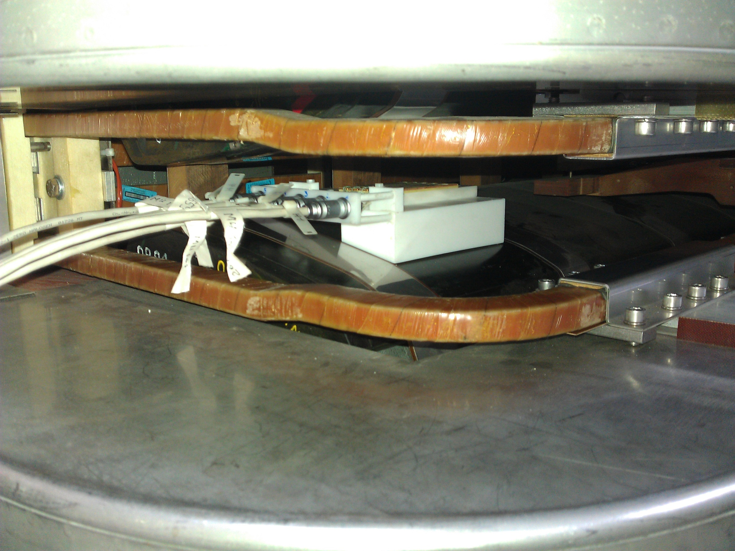
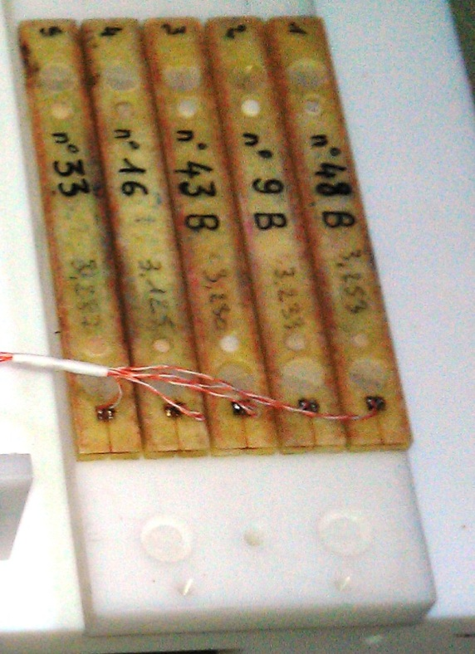
Harmonic fluxmeter (1/2)
New 5-coil, 102 mm long fluxmeter for the dynamic measurement of normal harmonics B₁ → B₅
measure transfer function and time constants
provide real-time feedback to operation (future: power supply control ?)
Notes:
(Re)establish clear responsibility boundaries with BE/CO:
- local control racks
- synthetic B-trains
- closed-loop field control regulation (e.g. ISOLDE)
“piquet” service: so far a best-effort approach with three people on-call has been sufficient, what about the long-term ?
standardization of synthetic trains with FIDEL-like algorithms: magnetic measurements+ beam measurements + numerical simulations → mathematical model of magnet behaviour

Slide 24
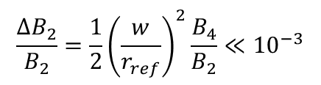
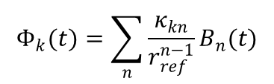

Harmonic fluxmeter (2/2)
5-coil array as used routinely for analog bucking of B₁ and B₂
Digital bucking → inversion of the matrix system
→ off-line measurement of as many normal harmonics as the coils
ill-conditioned matrix (typical for polynomial fitting-type problems) → error amplification
real time measurement of quadrupole component via analog bucking trough an instrumentation amplifier
vanishingly small high-order
residuals if w/r_{ref}<1. In this case:
(truncation error: to be evaluated)
Y
Coil 1 2 3 4 5
$$R_{0k}=\frac{5}{4}\left(k−3\right)w$$
z₁
R₀
z₂
X
w
$$Φ_{k}(t)=\sum_{n}{\frac{κ_{kn}}{r_{ref}^{n−1}}B_{n}(t)}$$
$$\frac{ΔB_{2}}{B_{2}}=\frac{1}{2}{\left(\frac{w}{r_{ref}}\right)}^{2}\frac{B_{4}}{B_{2}}≪{10}^{−3}$$

Slide 25
Harmonic fluxmeter: raw output
Φ₁(t) ∼ Φ₅(t)
«zero» cycles @ 200 A for PS capacitor recharge
example of result: measurement during a PS supercycle
Notes:
(Re)establish clear responsibility boundaries with BE/CO:
- local control racks
- synthetic B-trains
- closed-loop field control regulation (e.g. ISOLDE)
“piquet” service: so far a best-effort approach with three people on-call has been sufficient, what about the long-term ?
standardization of synthetic trains with FIDEL-like algorithms: magnetic measurements+ beam measurements + numerical simulations → mathematical model of magnet behaviour

Slide 26
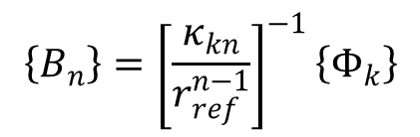
Harmonic fluxmeter: reconstructed field harmonics
$$\left\{B_{n}\right\}={\left[\frac{κ_{kn}}{r_{ref}^{n−1}}\right]}^{−1}\left\{Φ_{k}\right\}$$
short-term waveform depends
on trim circuits excitation
B₅
B₄
low-frequency noise increases
with harmonic order
B₂
B₁
B₃
non-constant drift
cannot be corrected by imposing
dB_{n}/dt=0 when dI/dt=0
integrator drift increases with n → only B₁ and B₂ usable for the moment
solutions to be tested:
- more accurate calibration (amplification of errors)
- multipole field marker for drift correction (Hall probe array)
- analog bucking using a PCB array with more degrees of freedom (arbitrary R_{k}, w_{k}, A_{k})
- circular array of tangential coils (well conditioned calibration + skew harmonics + possibility of rotation to measure accurately remanent harmonic components )

Slide 27
Harmonic fluxmeter: eddy currents (low field)
relative field error
3.5⋅10⁻³ (quadrupole)
1.0⋅10⁻³ (dipole)
τ ≈ 50 ms (quadrupole)
τ ≈ 25 ms (dipole)
At 0.6 T (linear range) eddy current effects are relatively small and fast
Quadrupole effects are significantly larger than on dipole (!)
Notes:
(Re)establish clear responsibility boundaries with BE/CO:
- local control racks
- synthetic B-trains
- closed-loop field control regulation (e.g. ISOLDE)
“piquet” service: so far a best-effort approach with three people on-call has been sufficient, what about the long-term ?
standardization of synthetic trains with FIDEL-like algorithms: magnetic measurements+ beam measurements + numerical simulations → mathematical model of magnet behaviour

Slide 28
Harmonic fluxmeter: eddy currents (high field, high dI/dt)
I*₂(t) (quadrupole)
quadrupole relative field error ≈ 5⋅10⁻³
τ ≈ 100 ms
I(t) (zoom-in)
dI/dt≈ 9000 A/s
I*₁(t) (dipole)
2 x time constant and effect amplitude on the quadrupole
no appreciable change on the dipole
expected effect of saturation ≈ -20% drop of τ → some other effect becomes dominant (increased magnetic circuit length due to flux leakage ?)
Notes:
(Re)establish clear responsibility boundaries with BE/CO:
- local control racks
- synthetic B-trains
- closed-loop field control regulation (e.g. ISOLDE)
“piquet” service: so far a best-effort approach with three people on-call has been sufficient, what about the long-term ?
standardization of synthetic trains with FIDEL-like algorithms: magnetic measurements+ beam measurements + numerical simulations → mathematical model of magnet behaviour

Slide 29
Harmonic fluxmeter: eddy currents (high field, low dI/dt)
B₁(t)
quadrupole relative field error ≈ 2⋅10⁻³
τ ≈ 100 ms
B₂(t)
I(t) current-controlled, B-train off
dI/dt = 3300 A/s
(zoom-in)
I*₂(t) (quadrupole)
Results at 1.2 T with reduced ramp rate show smaller relative field error, same τ
→ behaviour consistent with eddy currents
Equivalent current plot shows much higher saturation effects on quadrupole than on dipole
I*₁(t) (dipole)
Notes:
(Re)establish clear responsibility boundaries with BE/CO:
- local control racks
- synthetic B-trains
- closed-loop field control regulation (e.g. ISOLDE)
“piquet” service: so far a best-effort approach with three people on-call has been sufficient, what about the long-term ?
standardization of synthetic trains with FIDEL-like algorithms: magnetic measurements+ beam measurements + numerical simulations → mathematical model of magnet behaviour

Slide 30
B-train upgrade
hardware developments

Slide 31
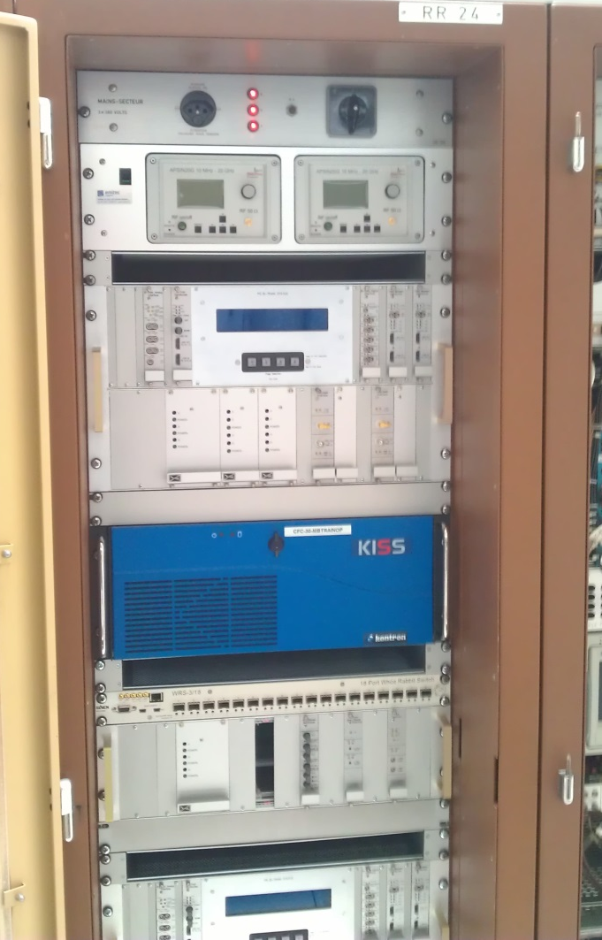
B-train upgrade (1/2)
Objectives of the project:
long-term consolidation of the LHC injector chain
improve performance for more demanding regimes + upcoming projects
remove operation constraints and improve reliability
Status: optimization R&D of FMR marker* ongoing,
prototype electronic components being tested
signal
distribution
& timing
upgraded B-train systems specifications
multifunction
diagnostic
display
power
supplies
industrial PC
* see also M.Buzio, talks in IMMW 16 and 17
Prototype B-train electronics ×2

Slide 32
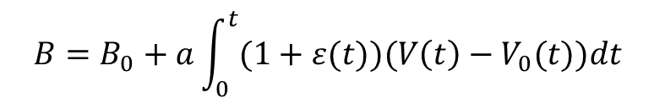
B-train upgrade (2/2)
New concept: continuous digital distribution of B(t) on a fast serial line to replace old pulse train
Output stream continuously updated with current B(t) values
→ no need for complex triggering and reset logic; no B₀ initialization burst
Adaptive auto-calibration of gain and offset using field markers on flat-top and flat-bottom
→ fully transparent correction of measurement error
fast and robust transmission, no more timing conflicts
but: drift correction must be applied continuously on-the-fly
ADC offset (→ integrator drift)
updated every time the same marker level is reached
$$B=B_{0}+a\int_{0}^{t}{(1+ε(t))(V\left(t\right)−V_{0}(t)})dt$$
Integrator gain
updated every time a different marker level is reached
N different marker levels → up to 4 N corrections per cycle
Corrections smeared over a certain Δt to avoid sudden jumps

Slide 33
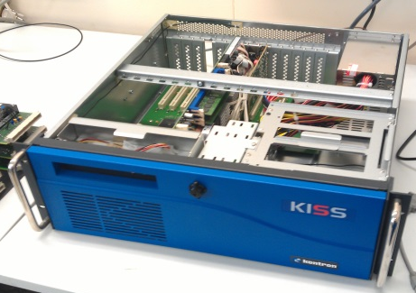

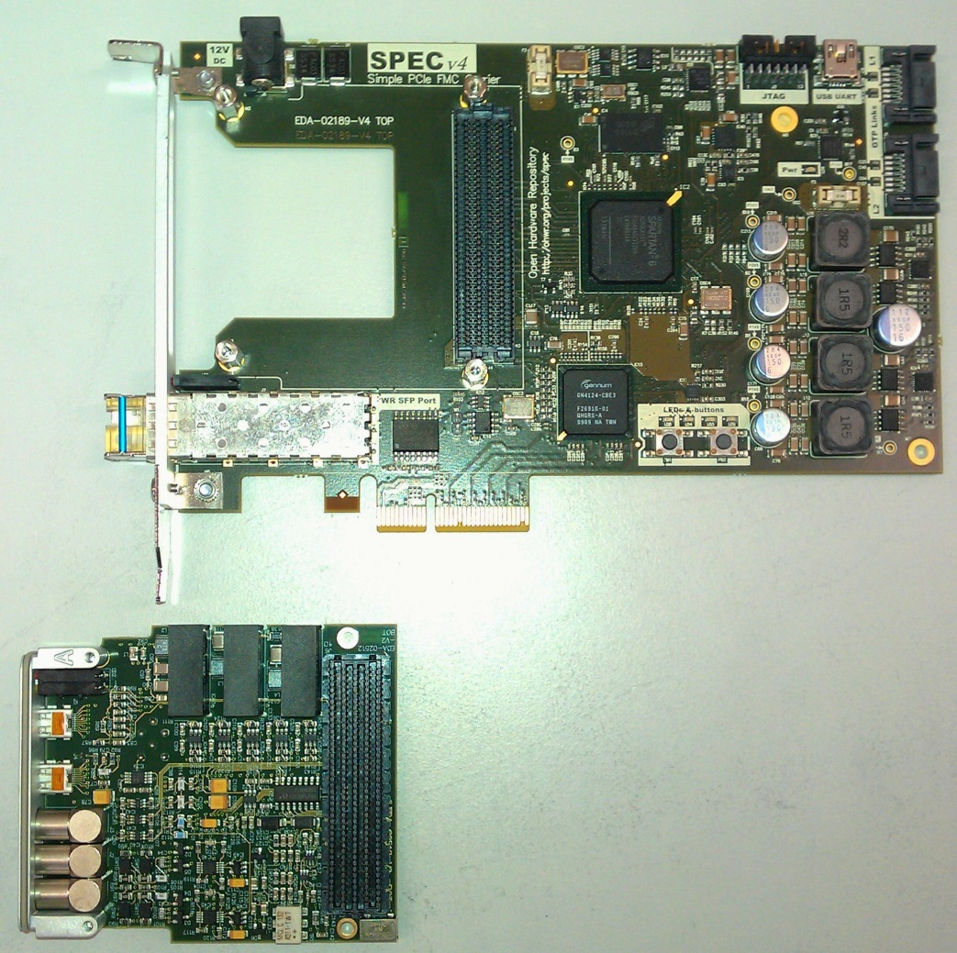

New electronic hardware platform
CERN standard platform, based on the Open Hardware concept, compatible with all planned accelerator control upgrades
PICMG1.3 – (Open Modular Computing Specification): industrial PC bus standard
SPEC (Simple PCIe FMC carrier) +
FMC (FPGA mezzanine cards) for modular custom electronics, easily portable to other bus standards e.g. VME64x
Wishbone serializer bridge FPGA core
(used for PC DMA access)
White Rabbit serial link
Scientific Linux with C/C++, optional
real-time kernel

Slide 34
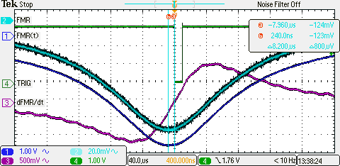
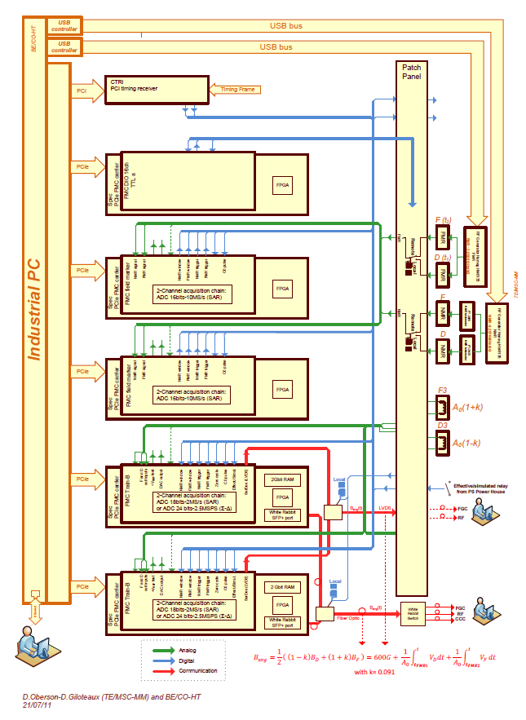

New FPGA Mezzanine Cards
Two cards with no commercial equivalent developed:
FMR peak detection card: based on 16-bit, 10 MHz ADC
Function: produce a trigger corresponding to the FMR resonance peak via differentiation/threshold comparison.
Compatible with NMR demodulated signal (to be tested)
Trigger validation (today done via error-prone synchronization with the timing system) will be done in software (e.g. by comparison with expected values B(I))
Dual integrator card: based on a 18-bit, 2 MHz ADC carries out the coil voltage integration. Fully floating input for better CM rejection. Calibration coefficients are expected to be computed in software by the host controller (much less stringent timing needed, more flexibility to adapt software algorithms). General purpose ADC functions

Slide 35
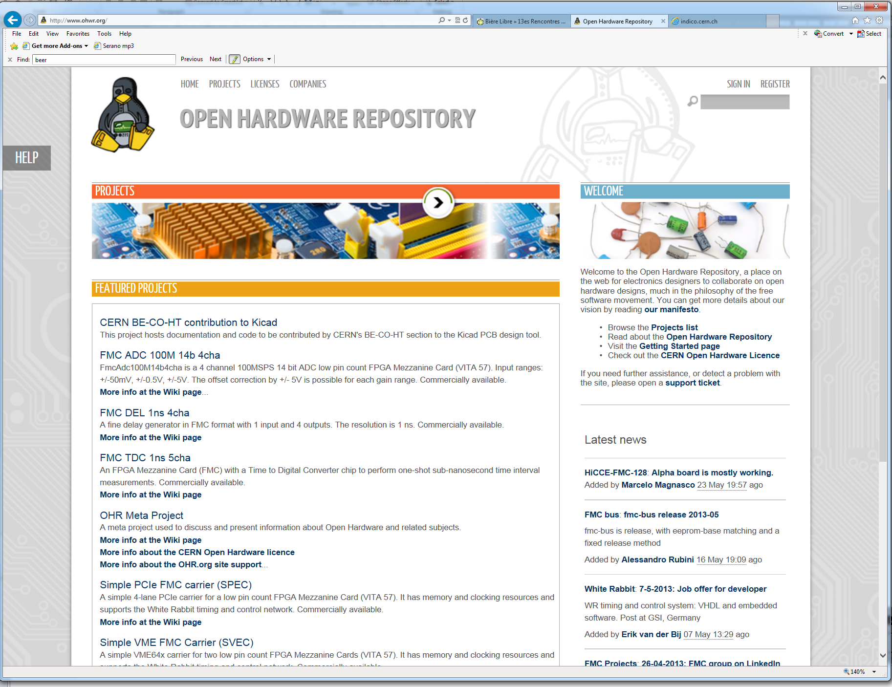
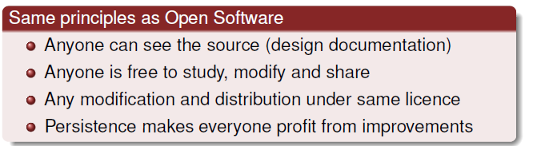
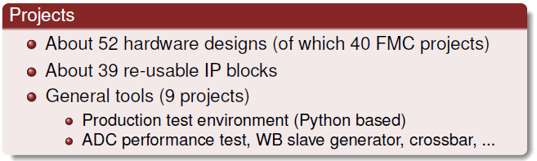

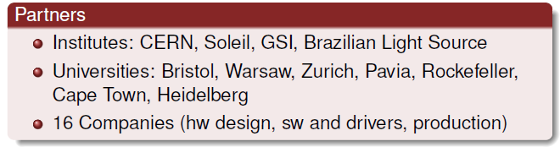
Open hardware repository: www.ohwr.org
A CERN-developed web-based collaborative tool for electronics designers
Key points: dissemination of knowledge, peer-review, no vendor-lock, encourage re-use, stimulate small firms, exploit the support and R&D capability of big firms

Slide 36

New White Rabbit distribution
New CERN/GSI deterministic fieldbus network standard = Gbit Ethernet + sub-ns-accurate timing
cheap, robust, scalable, fast over standard multimodal fiber
Ethernet standard → maintainability and interoperability
with future control systems
commercial partner products already on the market
new electronics needed downstream by B-train users
impact of switches on latency and jitter to be assessed
Base design targets: 250 kHz broadcast of B(t) and dB/dt, as required by RF (other users happy with 10 kHz or less). Ample headroom for scalability
http://www.ohwr.org/projects/white-rabbit
min. length ∼0.6 μs (f ≤ 1.7 MHz)
standard
MAC Ethernet frame
payload

Slide 37
Conclusions

Slide 38
Summary and outlook
Different methods exist to predict and control the field, but the most demanding accelerators based on iron-dominated magnets require B-trains (measurements have always the last word … ☺)
CERN B-train upgrade project is well on its way to provide the foundation for robust injector chain field control throughout the LHC’s lifetime.
In the next 12-24 months we expect to finalize the design and test new electronic components and sensors. Series production and deployment to all six CERN machines will follow.
Key electronic components (integrator, ADC, marker trigger, White Rabbit fieldbus) are already publicly available through the Open Hardware Repository.
CERN welcomes collaboration in this field, as is already the case with hadronteraphy machines CNAO and MedAustron, as a way to disseminate our results and stimulate our own progress

