Slide 1
Magnetic Fields:
Hazards and Effects on Human Health
M Buzio
07.06.2013
1

Slide 2
Overview
Contents: subset of a safety training course held at CERN since 2010 to alert all categories of personnel about the risks inherent in working close to strong magnetic field.
Technical hazards
Indirect, linked to materials and equipment
Health hazards
Interaction between magnetic field and human health

Slide 3
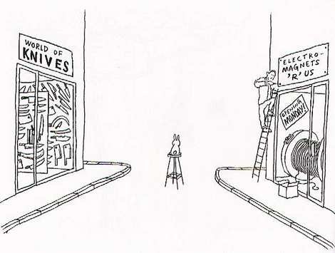
Part I - Technical hazards

Slide 4
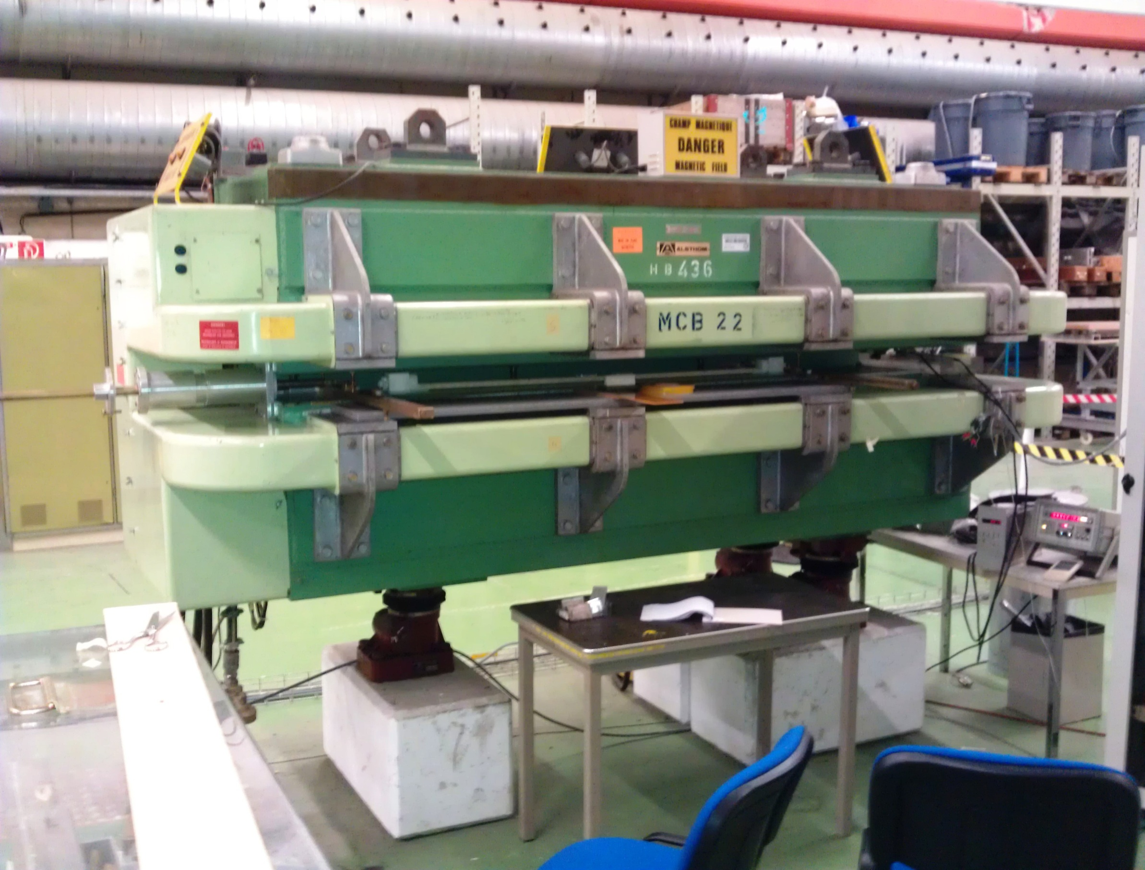
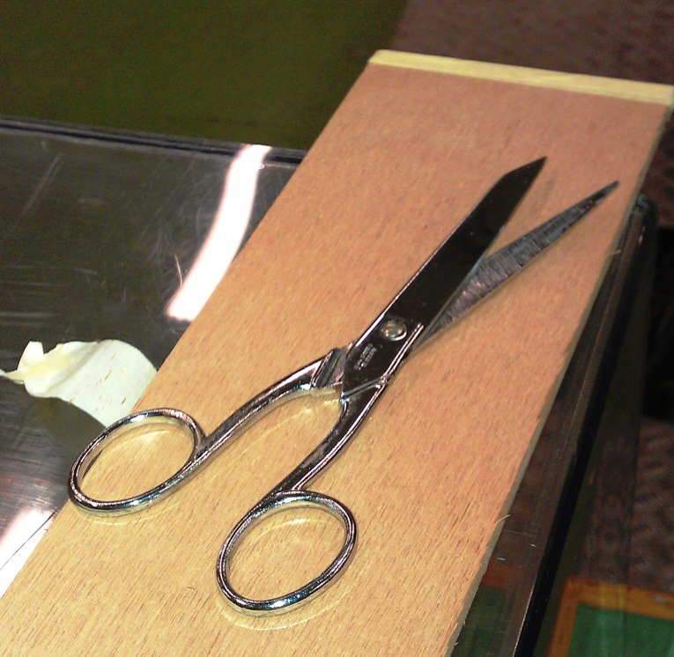
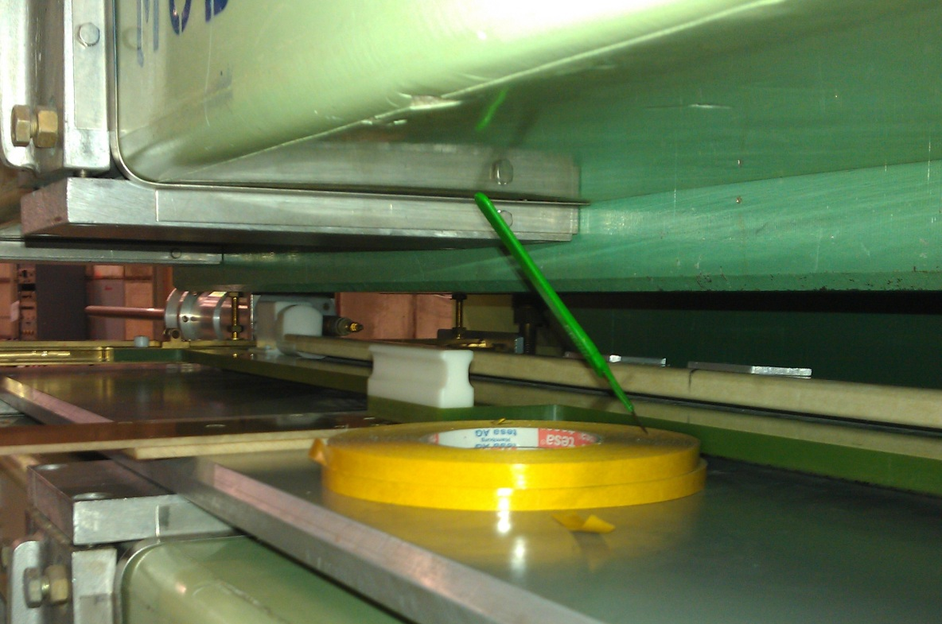
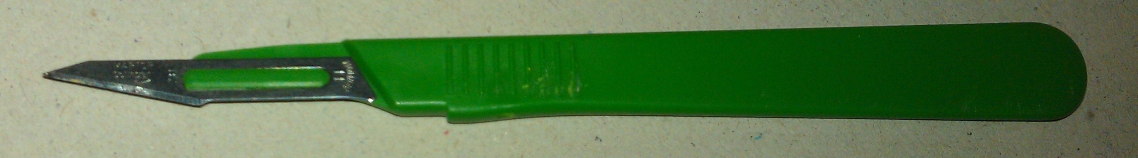
Projectile effect – what can happen ?

Slide 5
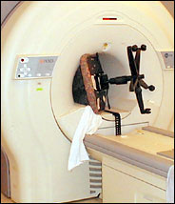
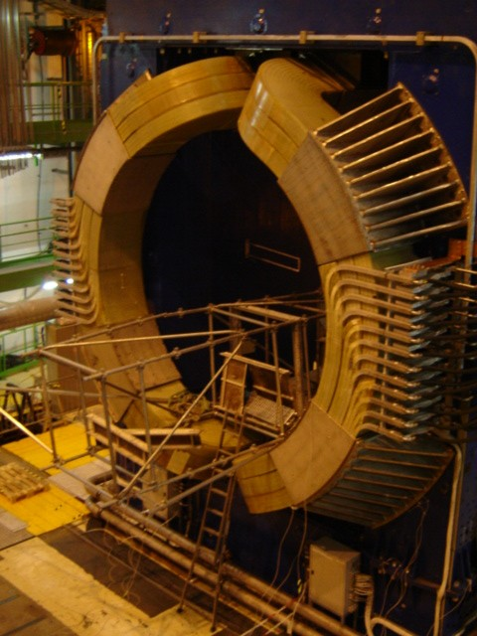
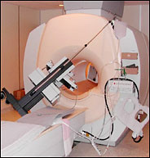
Collision hazard examples
Relatively common accidents in the MRI (Magnetic Resonance Imaging) field.
One fatality on record
(O₂ bottle)
Worst case at CERN:
LEP’s L3 0.5 T magnet
(currently in ALICE)
none injured.

Slide 6
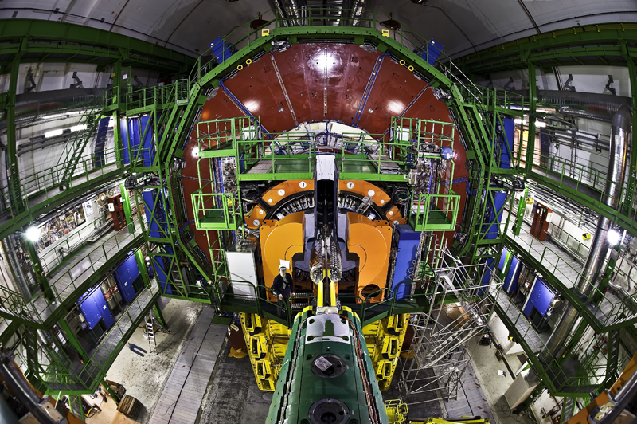
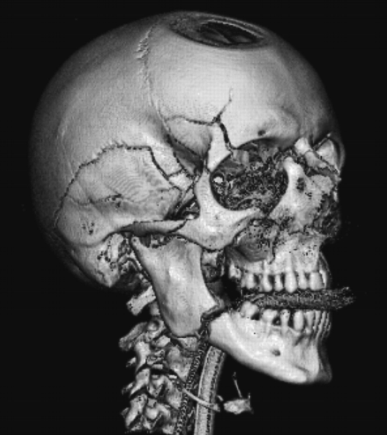
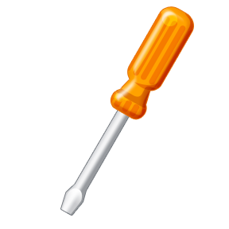
Example: projectile effect in CERN’s CMS experiment
Courtesy B. Dalena in L.P. Sun, LHC PN 426
max. BdB/dz ≈ 3 T²/m
100 g magnetic steel screwdriver
(μ_{r} = 500)
Peak force ≈ 50 kgf × 0.5 m
Kinetic energy ≈ 250 J
Max. speed ≈ 70 m/s
Skull fracture energy
∼ 50 J

Slide 7
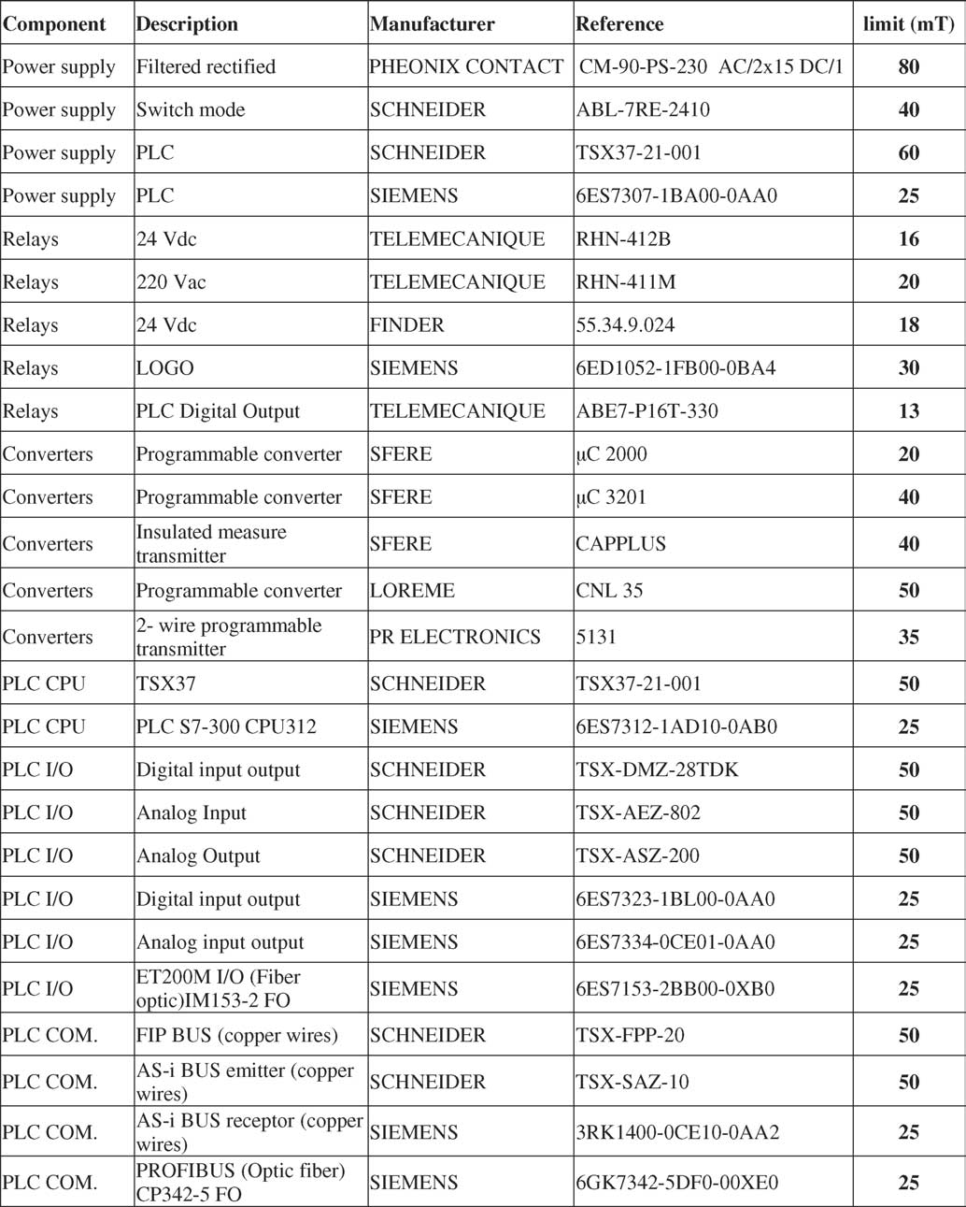
Electronic equipment tolerance in a magnetic field
Examples of results from:
ITER component tests
tests of tilt sensors (error: ~1 mrad) and angular encoders (OK) in LHC dipoles up to 9 T
J. Hourtoule, “Magnetic compatibility of standard components for electrical installations”, Fusion Engineering & Design, 2005

Slide 8
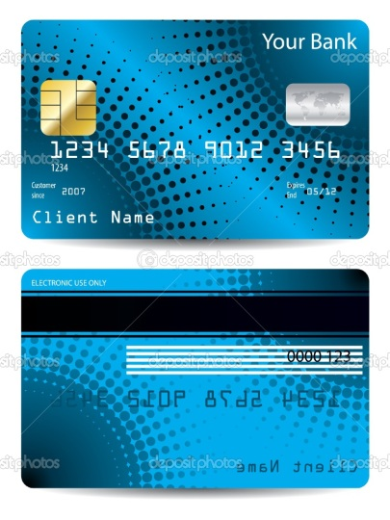
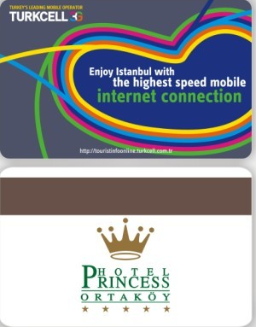


Vulnerability of magnetic stripe cards
$\frac{dΦ}{dl}$ [μTm ]
Magnetic stripe cards come in two basic varieties (as per ISO 7810-7813)
Low-Coercivity (300 Oe) Fe₂O₃ stripe, usually light-brown: shorter lifespan, frequent rewrites, cheap writing device; e.g. membership cards, tickets, hotel cards …
High-Coercivity (2750 Oe) BaFe₁₂O₁₉ stripe, usually black: frequent usage e.g. access badges, ID cards, bank cards
$\frac{dΦ_{r}}{dl}$=1.4 ± 10%
H
[Oe]
2750
300
 | Min. | Typ. | Max.
Coercivity [Oe] | 300 | 2750 | 4000
Full demagnetization [mT] | 30 | 275 | 400
Max. tolerable field [mT] | 3 | 27 | 40
HiCo stripe
LoCo stripe

Slide 9
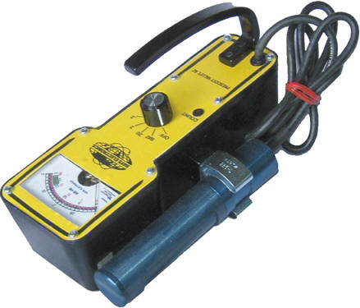
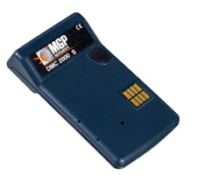
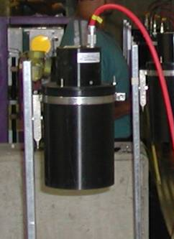
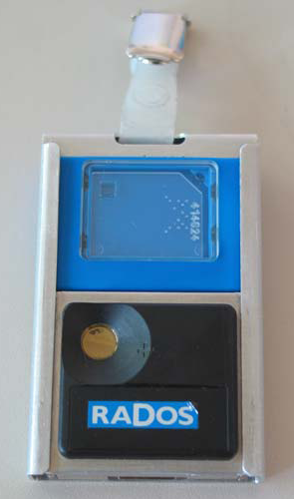
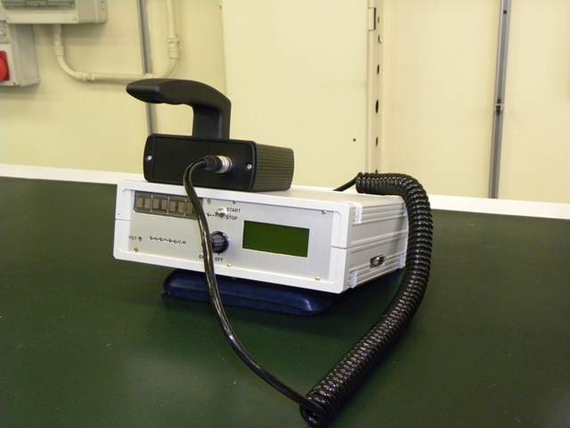
Radioprotection instrumentation and magnetic fields
fixed induced
activity monitors
may be affected
(e.g. CERN ATLAS)
→ calibrated in situ
portable survey meters, electronic dosimeters:
impact of B varies by type
→ may fail or give inaccurate readings
CERN + Politecnico di Milano are developing field-compatible dosimeters (≤ 1 T for now)
→ 4 prototypes made
individual dosimeters = passive sensors → no problem

Slide 10
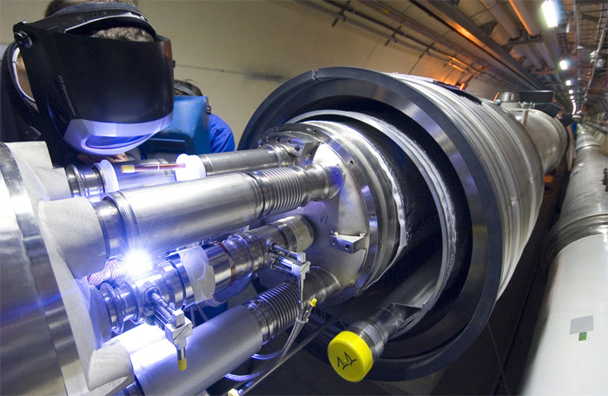

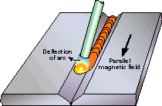
Interference with welding process
example: moderate arc blow
(source www.twi.co.uk)
plasma arc- or electron beam-based welding processes are sensitive to local and
ambient magnetic field
lower-current methods (e.g. TIG) tend to be most sensitive
problems appear already between 1 and 4 mT: instability, “arc blow” (deflection),
molten metal spray → arc welding impossible above 20 mT

Slide 11

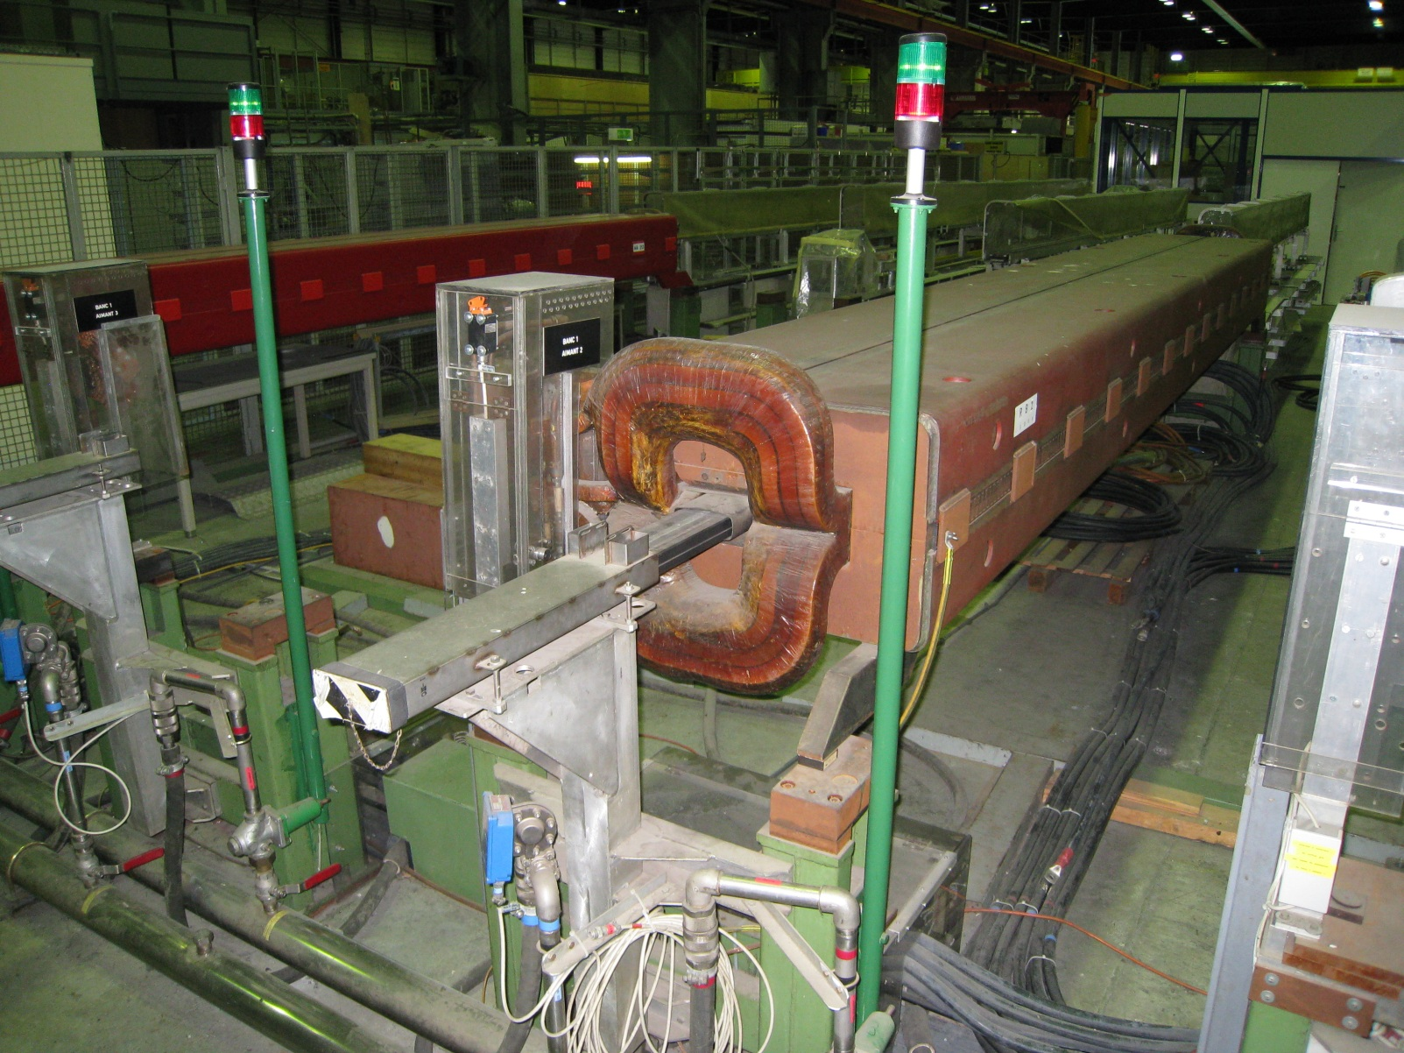
Faulty current lead connection (1/2)
Accident occurred on a CERN SPS main dipole test bench in bldg. 867, during a 6kA rampup (2012)
6kA copper
connection box
MB dipole
6kA current leads
fluxmeter

Slide 12
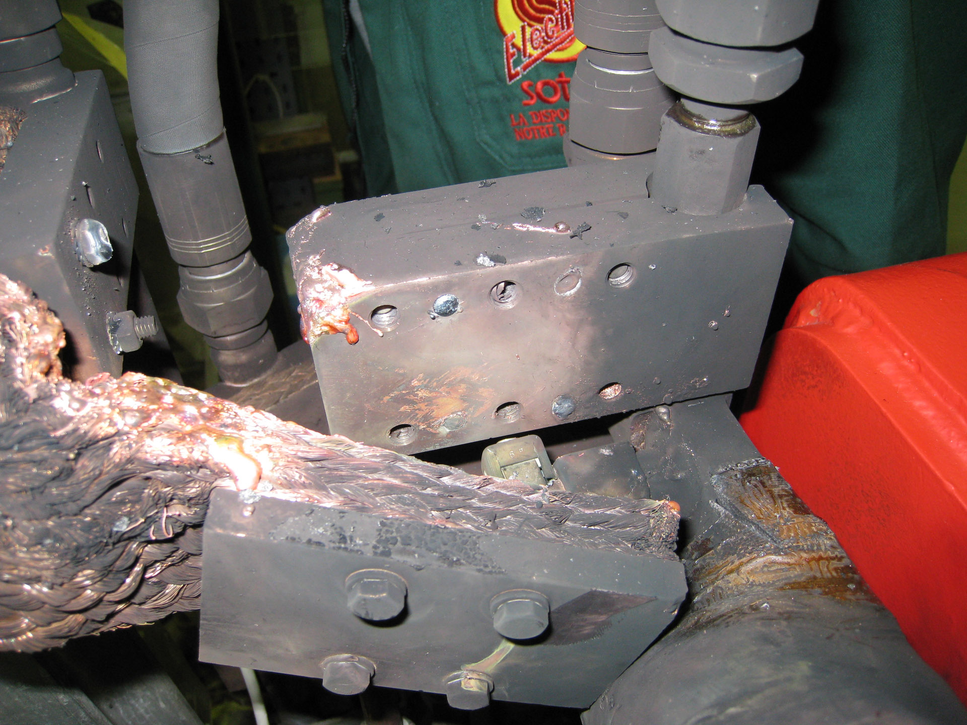
Faulty current lead connection (2/2)
connection fault → copper melts → circuit opens → electrical arc → explosion, flame
molten Cu
just broken
broken since a long time
(cause of the fault)
fastening bolts

Slide 13
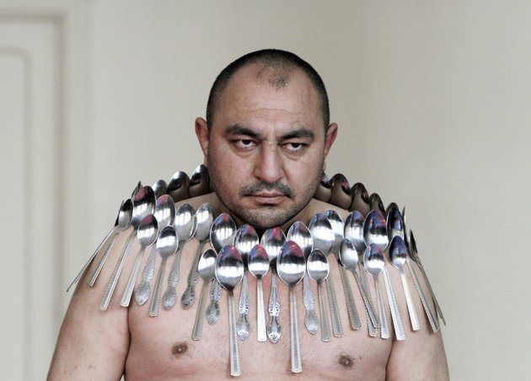
Part II – Magnetic fields and human health
Etibar Elchiyev , “human magnet”

Slide 14

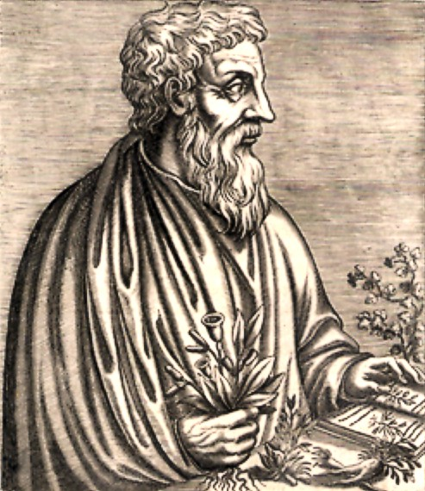
How magnets affect human health: an old concern …
Lodestone (magnetite, Fe₃O₄) first documented to attract iron by Thales of Miletus (585 BC)
Many weird medical applications based on attraction/repulsion analogies thru the ages
Effective treatments: lodestone powder used as a styptic or laxative, or for surgical extraction of iron shards from the eyes
B ut of ye Load-stone that which draws iron easily is ye best, & of an azure-like colour & thick, but not too heavy. It hath a faculty of drawing out gross humors being given with melicrate ye weight of 3 Oboli.
They say that this hath a discerning faculty of a woman that is chaste & of her that plays ye adulteress with another man, for if any do set it secretly upon the beds for ye chaste woman, who loves her husband, she being overborne into sleep, with a certain natural faculty of ye stone both opens her hands towards her husband, and cleaves close to him; but the other being troubled in dreams with foul labours, falls out of ye bed.
Also when two men carry this, it freeth them from all strife, & it causeth concord, and being born on ye breast, it assuageth people.
Dioscorides of Anazarbus, 40-90 AD
Excerpt of “De Materia Medica” from:
R.T. Gunther, The Greek Herbal of Dioscorides, 1934 (transl. by J. Goodyer, 1655)

Slide 15
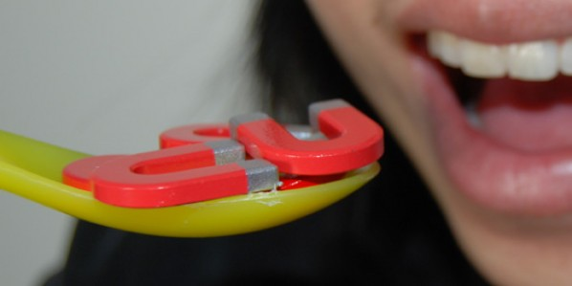
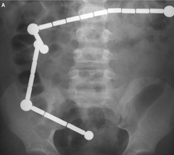
Can you eat (permanent) magnets ?
No particular harm from a single permanent magnet
Two or more may pinch the bowels→ obstruction, volvulus, necrosis, peritonitis
Surgery is needed, the outcome may be fatal
5 cases/y in the USA only ⎯ more and more frequent due to increasing popularity of rare-earth PM based toys

Slide 16
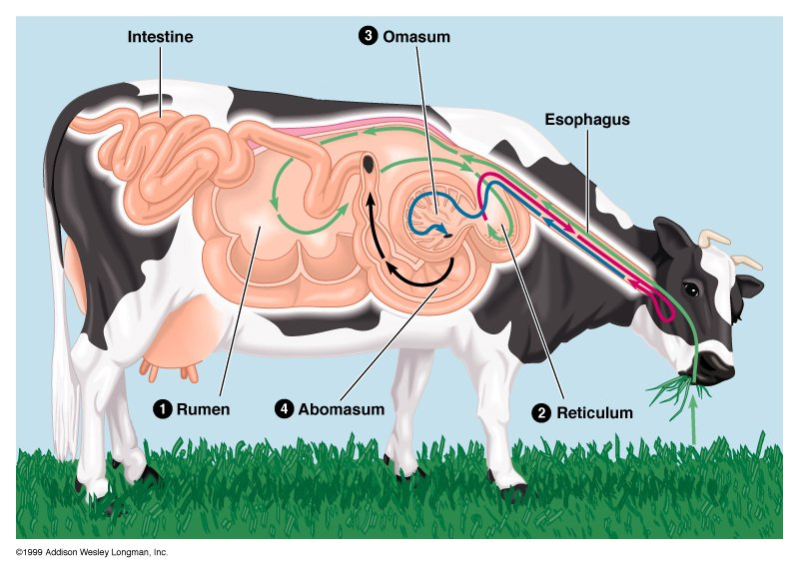
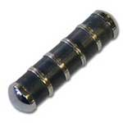
… YES if you are a bovine
“cow magnets” trap tramp iron, barbed wire, nails etc.. and prevent the so-called hardware disease

Slide 17

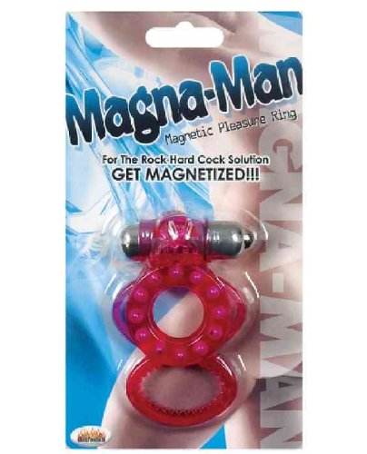
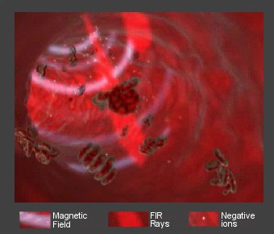
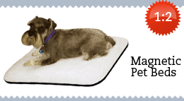
Magnetic field and human health
Magnetic therapy: many references online …
Most advertised effect is blood supply increase - is it true ?
“When blood flows through this magnetic field, the blood cells spin then separate from each other giving each cell more surface area to carry much more oxygen and vital nutrients. The magnetic field also widens your blood vessels allowing more blood to flow through.
The second benefit comes from Germanium which emits negative ions (also known as "Air Vitamins") and Far Infra-Red Rays (also known as "Growth Rays")”
use at your own risk … but what happens in reality ?

Slide 18
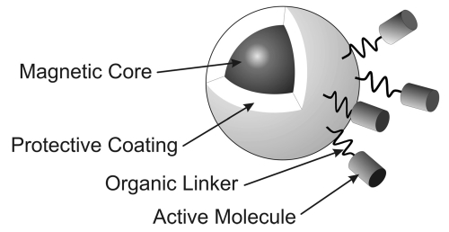
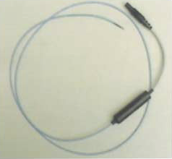
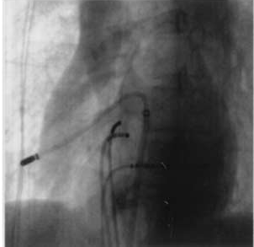
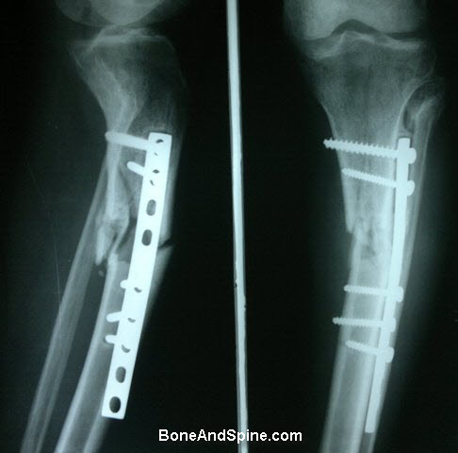
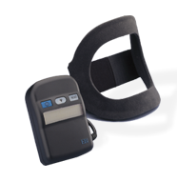
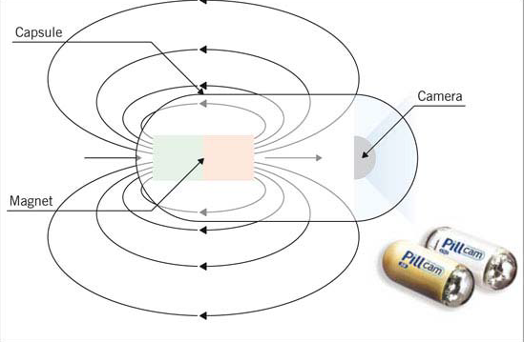
Medical applications of magnetic fields
Established medical applications and therapies :
Magnetic imaging (e.g. monitoring magnetic nanoparticle markers to study motility in the digestive system)
Drug delivery (capsules operated magnetically) and targeting (drug associates with magnetic nanoparticles)
Device guidance (e.g. catheters for cardiac electrophysiology, capsule endoscopy)
Transcranial Magnetic Brain Stimulation (localized eddy currents to activate specific neuronal circuits)
Pulsed EMF for bone nonunions (fractures that do not heal): inductively generated E field in connective tissue has similar effects to mechanical stress → promotes bone cell growth

Slide 19
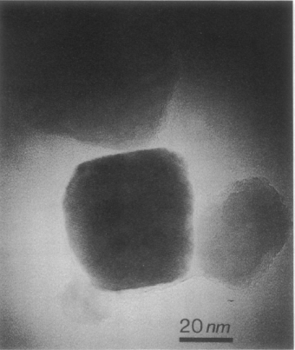
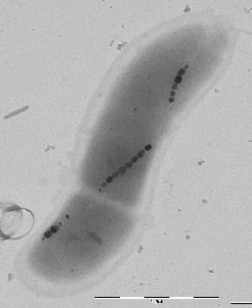
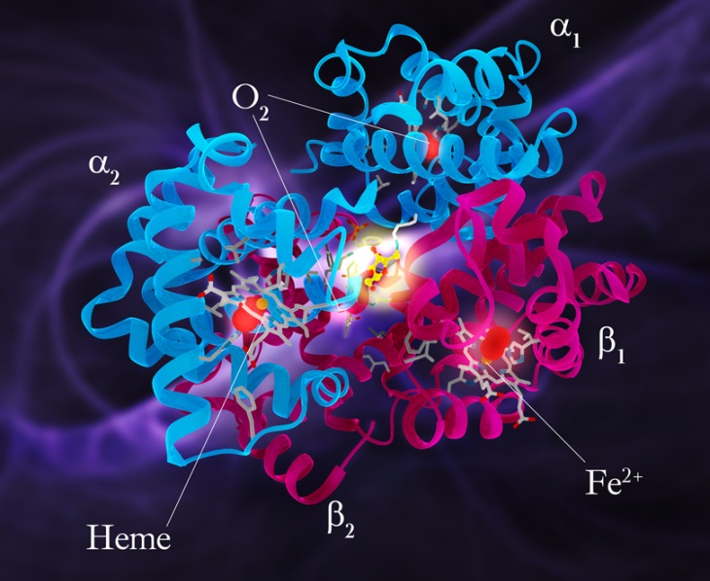
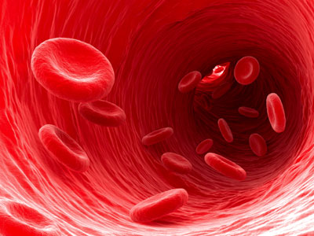
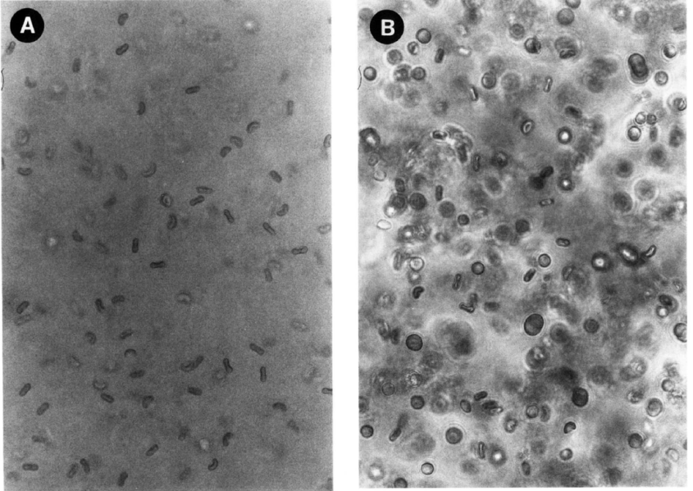
Forces on magnetic tissues
Magnetite crystals in many animal and human tissues
possible role as sensors (e.g. for homing)
Iron in human blood: ∼3 g (red cells) ∼1 g (ferritin) (typ. adult male values)
isolated atoms, no ferromagnetic domains → small forces
Magnetite (Fe₃O₄) crystals in human cerebellum and magnetotactic bacteria
B
Haemoglobin contains 4 × Heme groups with Fe
μr ≈ 1+3.5×10⁻⁶ (venous) , 1-6.6×10⁻⁷ (arterial)
Erythrocytes in a field orient with their disk plane parallel to the field (A)
Apparently due to the shape (diamagnetic membrane)
small mechanical effects → no health hazard at CERN field levels
T. Higashi et al., “Orientation of erythrocytes in a strong static magnetic field,” J. Blood 82, 1328 1993

Slide 20
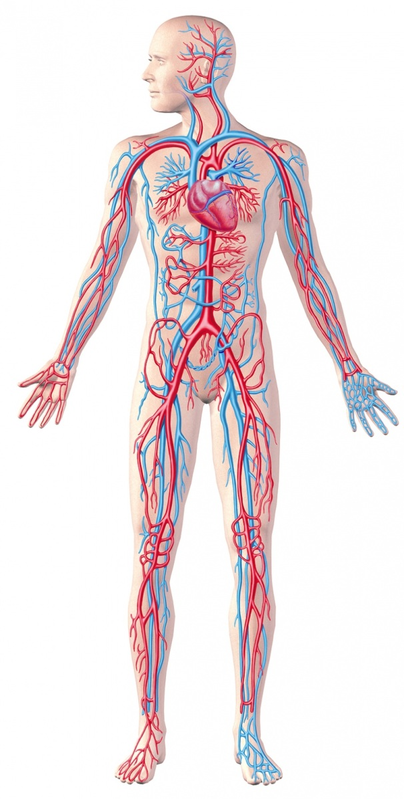
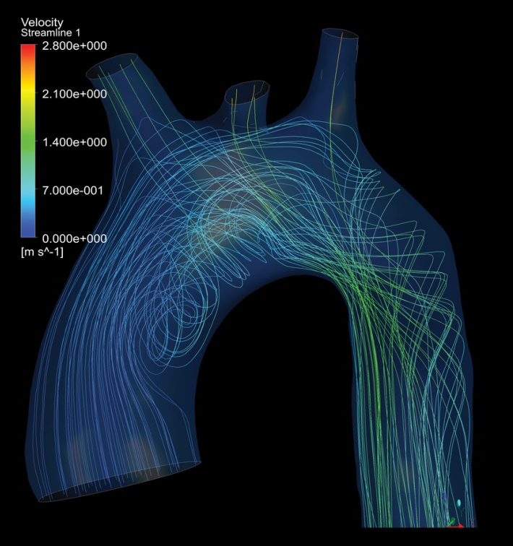
Voltage across blood vessels
Conducting medium moving in a magnetic field → electric voltage
blood is an electrolyte moving in a field → charge separation (Hall effect)
v = flow speed
(max ≈ 2-3 m/s in the ascending aorta)
E=v×B
electric field
B = magnetic field
(worst case = horizontal)
ΔV=E∅ induced voltage
(experimental: 40 mV @ 2.5 T)
no voltage drop across nerves or muscle cells
no biological effects
Heart J. et al., Evaluation of blood flow velocity in the ascending aorta and main pulmonary artery of normal subjects by Doppler echocardiography, 1984

Slide 21
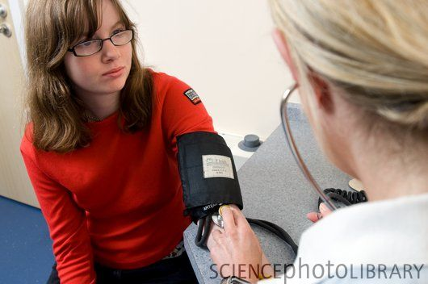
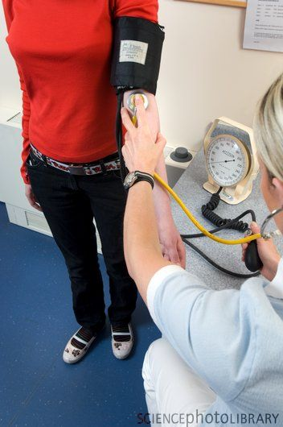
Slowing down the bloodstream
fluid elements see variable field vector → induced currents → magnetic friction
pressure gradient ∇p=σvB²→ flow slows down (1% @ 5T) → blood pressure increases (3% @ 8T)
v
v
v
B
physiologic rise
+ 6%
slight increase of systolic pressure to compensate for viscous drag
no change to diastolic pressure, heart rate, body temperature
World Health Organization - Environmental Health Criteria 232, 2006
DW Chakeres, “Effect of static magnetic field exposure up to 8T on sequential human vital sign measurement”, J. Magn. Reson. Imaging, 2003

Slide 22
Other interaction mechanisms
Free radical chemistry
Vast class of reactions involving highly reactive species with unpaired electrons as intermediate products. Well-known effect: rates of certain radical pair recombination reactions can be affected by magnetic fields up to 50%. However, no known biochemical reaction meets the necessary requisites (one exception observed in a type of photosynthetic bacteria)
Ion cyclotron resonance of enzymatic metal cofactors
Inconclusive evidence
Magnetic field driven DNA damage
investigated in vitro, on animal models and in humans: inconclusive evidence
very subtle effects, inconsistent experimental evidence
no reason to believe in a health hazard

Slide 23
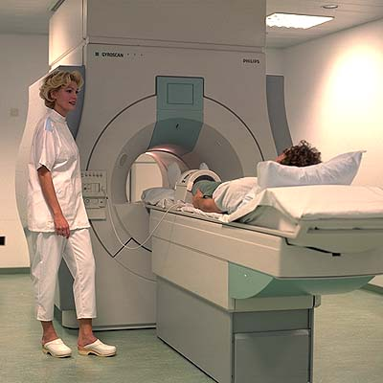
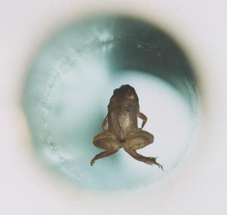
Safety of Magnetic Resonance Imaging
Large body of safety-related evidence from MRI community
0.5~3.0 T widespread, up to 7 T commercially available
400 M scans since 1985, 20 M scans/year (2.5% of population in industrialized countries)
no long term/delayed effects epidemiologically observed
patient/occupational exposure deemed safe up to 8 T (US FDA)
full-body MRI trials @ 9.4 T ongoing
11.7 T foreseen end 2014
small vertebrates
routinely tested up to 21 T
no harm observed or expected even at those levels

Slide 24
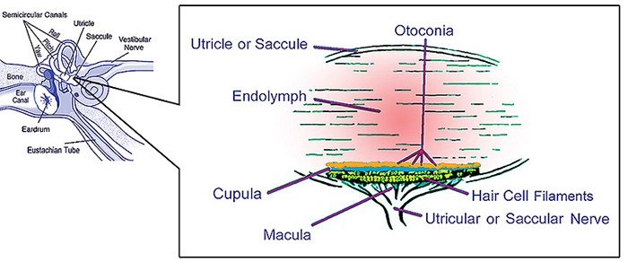

Interaction of AC field with human tissues (1/2)
Basic mechanism:
dB/dt in a conducting medium (ρ≈1 Ωm) → induced voltage → eddy currents →
excitation of nerve cells (E ≥ 6 V/m) and muscles (ΔV ≥ 40 mV)
Possible subjective reversible effects:
Dizziness/vertigo/headache: AC: typical thresholds is 2T/s for 1 s.
DC mechanism: differential susceptibility of vestibular structures (46 T²/m → perceived 1% g)
Acidic/metallic taste: provoked presumably by electrolytic reactions due to eddy currents in the tongue, effect felt by 15% of test subjects @3T. Threshold dB/dt≥2.3 T/s (e.g. shaking head @ 0.6 Hz in a 0.5 T fringe field). May be contrasted by opening the mouth.
Magnetophosphenes: perceived flickering lights caused by electrical stimulation of the retina/optical nerve. (0.2 mV). Threshold dB/dt≥ 2T/s for 50 mS (max. sensitivity 20 Hz)

Slide 25

Interaction of AC field with human tissues (1/2)

☹
extra systoles, fibrillation
😐
Eddy current
density:
☺
OK
peripheral nerve stimulation
fast movement inside experimental magnets
sensation threshold
ATTENTION: moving in a DC field = standing in a AC field

Slide 26


DC effects on implants

vascular clips
(e.g. for aneurysms)
eye implants
splinters
orthopedic implants
plates, screws, rods
hearing aids
Co-Cr implants
braces
neural/bone
stimulators
heart valves,
pacemakers

infusion pumps
IUD
needles
magnetic anus
bullets, shrapnel
jewelry, piercings
implants may malfunction or dislodge (especially if recent)

Slide 27


Magnetic fields and pacemakers
Normal pacemaker function: sense electrical cardiac pulses, if needed provide pulses at an appropriate intensity and rate
A reed switch can be magnetically closed from outside to:
- disable pulse sensing and go into fixed-frequency mode (asynchronous pacing)
- go into programming mode
Uncontrolled switch behavior if B > 0.7 mT →
competitive rhythms → discomfort, arrhythmia, death
AC fields may interfere with pulse detection/generation electronics
reed switch
external field → magnetization and closure of contacts
pacemakers, implantable defibrillators (ICD) etc
exposure to B > 0.5 mT is absolutely forbidden
field sources > 0.5 mT are ubiquitous (office magnets, electrical components, machinery ….)

Slide 28
AC effects on implants
large implants may give rise to heating and mechanical loads
dental fillings
heart valves
orthopedic implants:
plates, screws, rods
also: high current → burns
when touching conducting objects
real concern only for fast-pulsed MRI fields
generally safe at detector levels (≤4T)

Slide 29


Summary: CERN rules
heart implant
(pacemaker, defibrillator)
general public
(generic implants)
employees
(all categories)
(need authorization)
B ≤ 0.5 mT
B ≤ 10 mT
B ≤ 200 mT
B > 200 mT

