Slide 1
Application of PCB and FDM Technologies to Magnetic Measurement Probe Development
J. DiMarco
June2013
IMMW18

Slide 2
Acknowledgements:
John Tompkins, Tom Wokas, Don Mitchell, Andrzej Makulski, George Velev, Guram Chlacidze, Mike Tartaglia, Marc Buehler, Nina Moibenko, Cosmore Sylvester, Darryl Orris, Xiaorong Wang (LBNL)

Slide 3
Outline
Introduction
PCB probes
Support structures
Recent probes, projects, and results
Assessment
Conclusions

Slide 4
INTRODUCTION

Slide 5
Rotating coil probes:
Indispensable – provide the necessary sensitivity, range, speed, size, and convenience for many measurements characterizing magnetic fields.
Ubiquitous - in laboratories and test facilities, with a variety of geometries and sensitivities, they remain a workhorse for precise measurements of harmonic field quality
But … in many ways challenging – need good control of mechanical motion, wire placement and density, stiffness, etc.

Slide 6
Motivation which led to recent probe development at Fermilab:
Rotating coil harmonics probes were expensive, required extensive and experienced labor to create, and had long lead times.
Probes often remained behind the necessity of measurement requests, with existing choices of probes providing a sub-optimal choice of diameter or length, and the construction of a new probe requiring too much cost or time

Slide 7
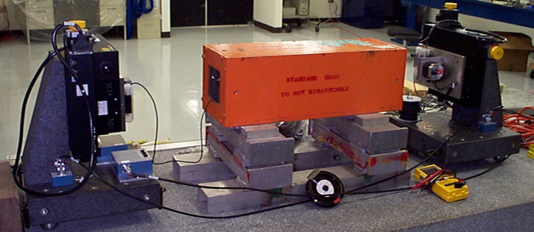
For comparison:
Alignment measurements at Fermilab
SSW technique substituted a single alignment device, the precision of which could be obtained commercially (1um accuracy), for all other techniques. As such, able to replace a set of ‘alignment benches’ for different type and size of magnets with a single portable system with high accuracy.

Slide 8
“Would be nice to do a similar thing with harmonics measurements…”
A paradigm similar to the SSW seemed to be needed for the rotating coils, in order to ‘look around the corner’ and be able to respond to measurement needs rapidly while improving accuracy.
The idea of developing printed circuit board (PCB) magnetic measurements probes was explored with this end in mind.

Slide 9
PCB PROBES

Slide 10
PCB probe features:
Good analog bucking (suppresses fundamental by factor ~1000)
Mitigates vibration effects
Provides signals which can be amplified to match dynamic range of data acquisition device
Allows in-situ calibration in any quadrupole field
Sensitivity (Kn) comparable to other probes
Multiple probes per pcb (e.g. for examining twist pitch effects)
Probe radius can be adjusted by mounting the PCB accordingly
(will give examples of these as we go along…)
See also:
Presentations in IMMW15, IMMW17
“A Fast-Sampling, Fixed Coil Array for Measuring the AC Field of Fermilab Booster Corrector Magnets”, IEEE Transactions on Applied Superconductivity, June 2008
“Application of PCB and FDM Technologies to Magnetic Measurement Probe System Development”, proceedings of ASC 2012

Slide 11
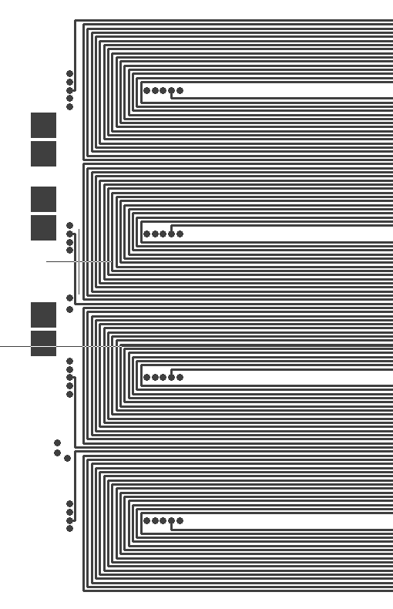
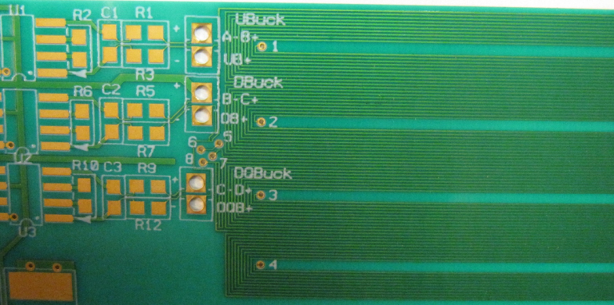
Typical PCB Layout for dipole and quad measurements probe
UnBucked (UB)
Typical
Trace width 0.1mm
Space between 0.15-0.25mm
Track 1
Sensitivity:
Track 2
DipoleBucked (DB)
DipQuadBucked (DQB)
Track 3
Track 4
Inner layer of 10 layer quad probe PCB
Wire placement accuracy typically 2-4μm Expect good bucking of fundamental fields

Slide 12
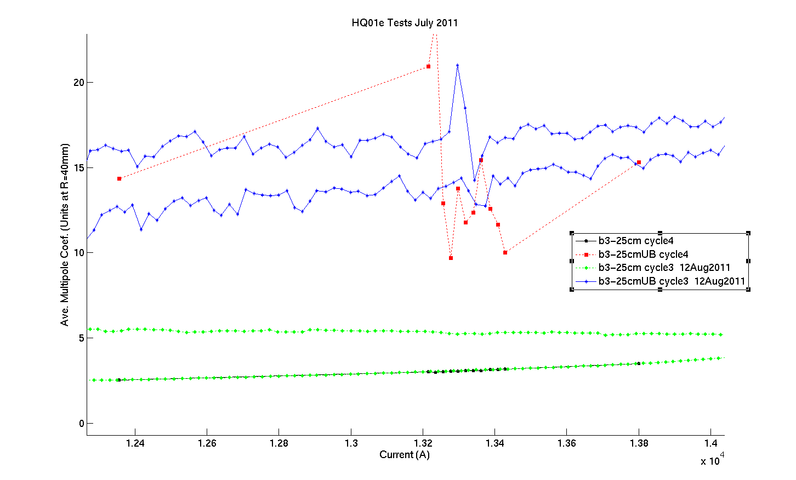
Probe rubbing during rotation
Bucking important to help mitigate vibration effects
UnBucked b3, no rubbing
UnBucked b3, WITH rubbing
Bucked b3 results (with and without rubbing)
Analog bucking ratio indicates level of ‘in situ calibration’ possible in quad field – bucking ratio ~1000 constrains errors in quad strength at the level of ~20 units independent of mounting radius… ➔

Slide 13
Gradient meas by using dipole buck winding on a typical PCB
The ‘racetrack’ windings of an RBR probe is shown schematically below.
Dipole bucking is achieved by connecting 2 racetracks in opposition. Since their areas are known and are the same, and the distance between them is precisely known, the gradient can be determined from the DBuck winding independent of the axis of rotation of the board.
+
A= w*L
w
UBuck loop
D
x2’
-
A
w
x1’
x2
DBuck loop
x1
Allow for errors in the position of each wire of the loops and calculate error in gradient…

Slide 14
Then with respect to the unprimed winding:
the three error terms are:
radial separation error (distance between the primed loop and unprimed loop)
error stemming from imperfect bucking (relative size btw primed and unprimed loops)
the error in the absolute loop width.
where
If bucking ratio is high, DBuck signal should have good absolute measurement of quad field (and be insensitive to radial positioning) at a level 10-20 units (i.e. with no calibration)
For example:
$$D=15mm, {{ x}_{1}^{}}^{′}=9mm,$$ $ε=2μm$, $w=5.5mm, buckRatio=500−1000$
$$\frac{g_{err}}{g_{abs}}=\left(2+\frac{0.6∗1e4}{buckRatio}+5\right)units$$

Slide 15
Calibration of PCB position
Mounting a rigid circuit board in cylindrical support, two types of error can occur:
radial error
vertical displacement error
Both can be determined from a measurement in any quad field (‘in situ calibration’)
dy
dr
Radial calibration - compare UB strength to DB (radius independent) strength
dy calibration - compare fundamental field phase in UB signal to that in DB signal
Effective rotation radius
Effective Y-offset
UB
Calculated Quad Strength from flux
Quad Field Angle
DB
DB
UB
Probe radius used in Kn
Vertical pcb offset used in Kn

Slide 16
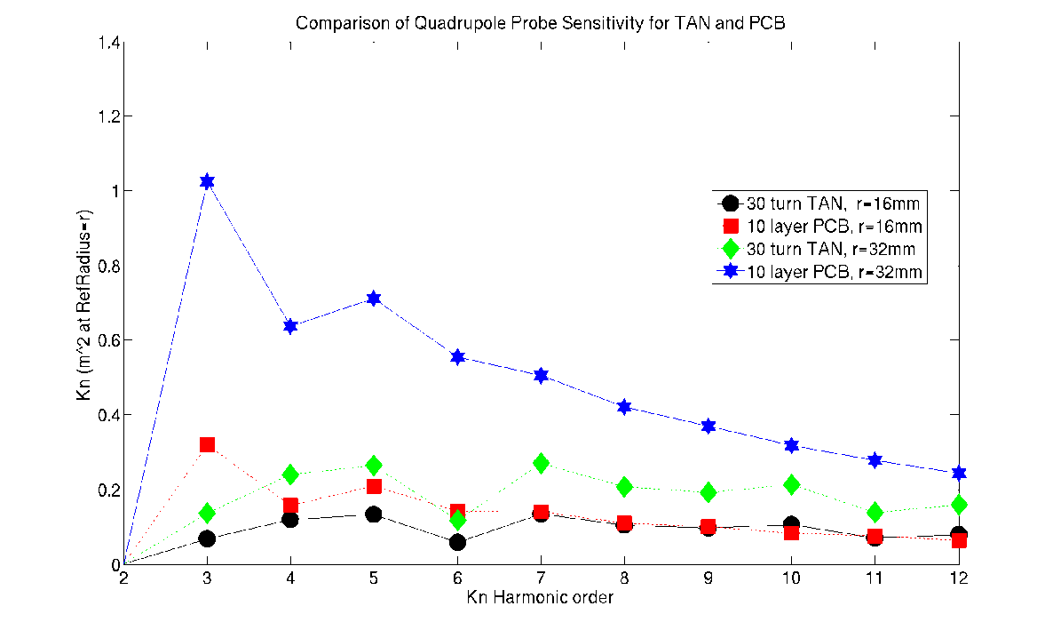
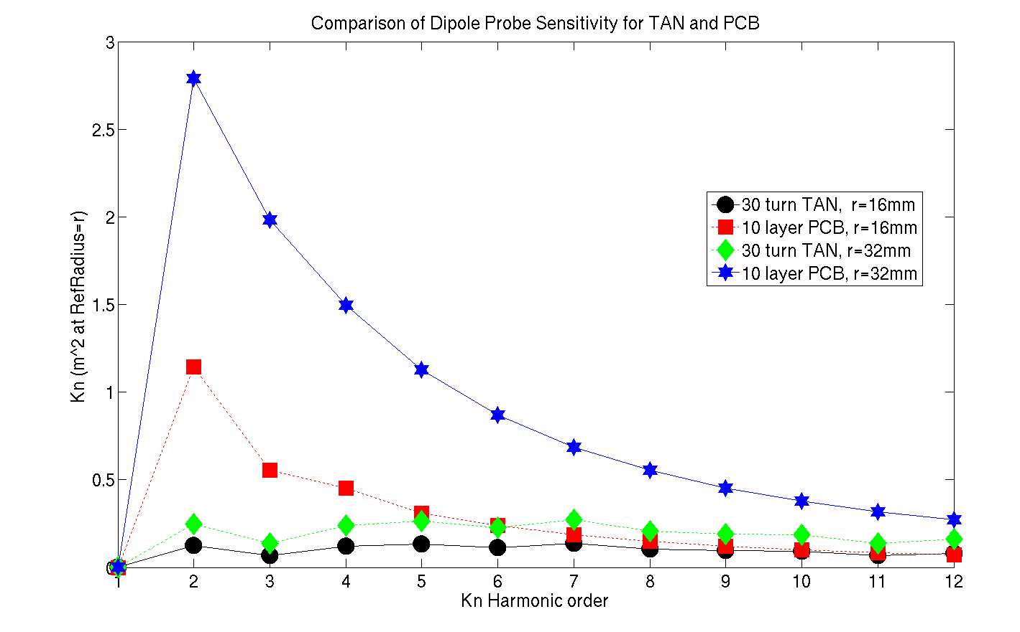
PCB sensitivity compared to Tangential probe
Quad
Dipole
PCB r=32mm
PCB r=32mm
PCB r=16mm
PCB r=16mm
For given radius, a 10 layer PCB will have sensitivity ~equal to or greater than a 30 turn tangential style probe (and moreso as probe radius increases).
Effective gains may also be made because high analog bucking ratio allows amplification of signals before electronics.

Slide 17
SUPPORT STRUCTURES

Slide 18
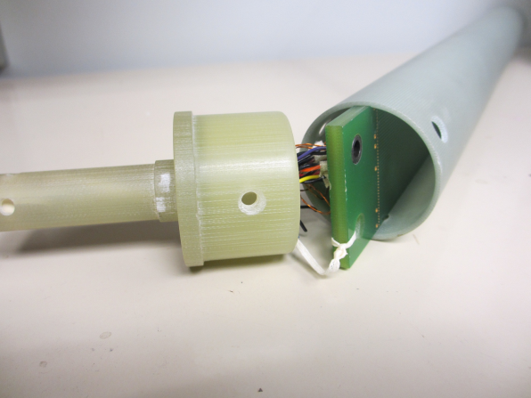
Several methods have been successfully developed to control the stiffness and trajectory of the PCB probe as it rotates in the magnet aperture.
A. Probe in Tube
Broaching the inside of a G10 cylindrical tube so that a circuit board can be inserted and held by the inside diameter proved to be a very effective way of supporting the circuit board. Since most of the non-PCB probes at Fermilab are wound directly on G10 cylinders with machined end-plugs, this also was a natural extension of our standard probe manufacturing.
Two drawbacks
Broaching needs to leave some thickness remaining on the cylinder, and thus the outermost traces of the probe (which are crucial for measurements of the higher orders) would lose ~2-3 mm of radius;
Every change of circuit board diameter would require a new tube and machined end plugs.

Slide 19
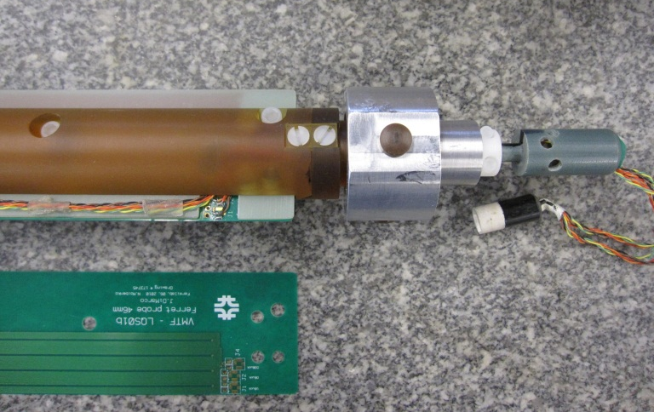
B. Strongback
Another successful effort was to have a strongback built to support a PCB at its midplane. Any width PCB with thickness less than 4mm could then be rigidly captured and rotated. This allows a variety of PCBs to be tested easily, adapting to various apertures via spacers on the bearings.
The drawback here is that the strongback requires extensive machining to fabricate. Since replication is costly, PCB probes would need to be changed in and out frequently for various measurements, increasing the risk of damage to the probes or their wiring. This also causes only a single probe to be available at a given time.

Slide 20
C. Fused Deposition Modeling (FDM)
Most recently, FDM (i.e. 3D printing) has been used to fabricate support structures for the PCB probes.
The 3D printer at Fermilab uses ABS Plus thermoplastic and stereo lithography (STL) files to generate parts of cubic size up to 225 mm a side.
Typical probe pieces have been broken up into lengths of about 100 mm and connected together with full probe length, 6.4 mm diameter, carbon fiber support rods.
The stated resolution of the printer is reasonably good, 0.15 mm, but still short of high-quality machining (note STL printers can have 0.025mm resolution). However, inspection of printed pieces show that the average position of a hole through a 100 mm long piece deviates from its intended position on average by less than 0.05 mm, and so with straight and stiff support rods (ceramic rods can be used to insure greater straightness and rigidity), the parts are more than adequate for rotating coil probes that incorporate bucking.
FDM enables easy replication so each PCB has its own support
Can incorporate features that would be difficult or impossible to machine (e.g. allows us to place the outer PCB traces right at the probe radius)

Slide 21
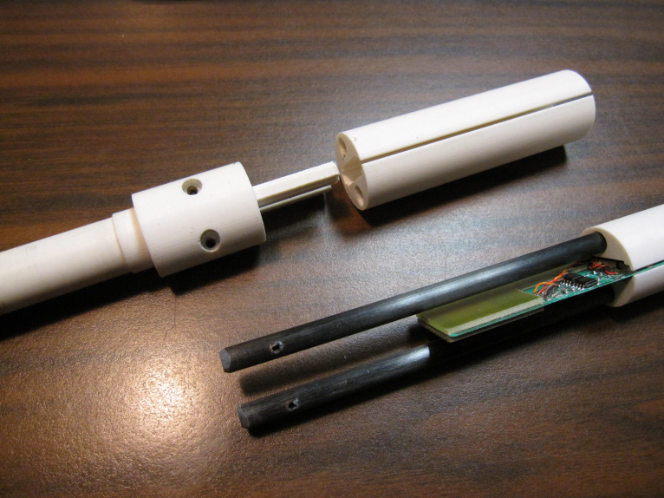
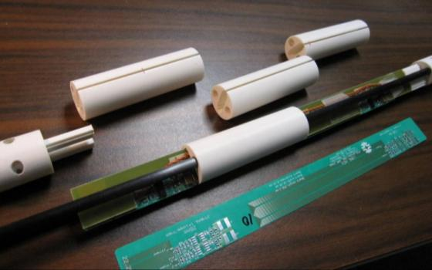
There are also companies that provide 3D printing service
(can find more variety of materials – Ultem (high temperature , high strength), etc.)
An example of current support layout shown below. Lots of ideas still to be tried…
Note that the holes and the threads in the holes are also printed

Slide 22
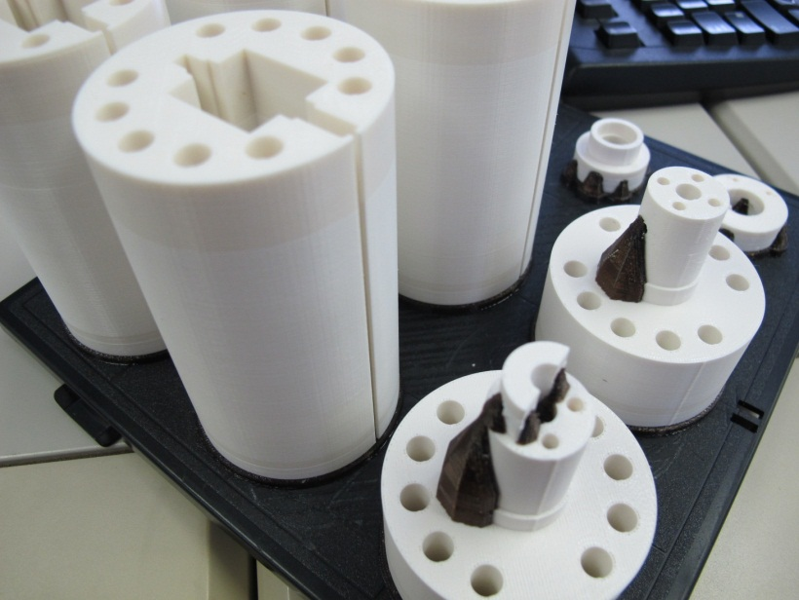
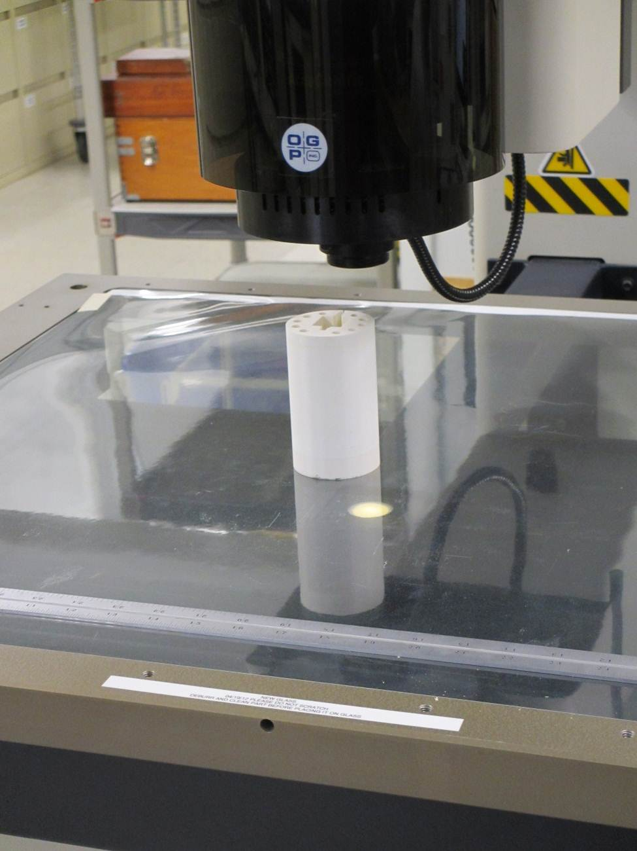
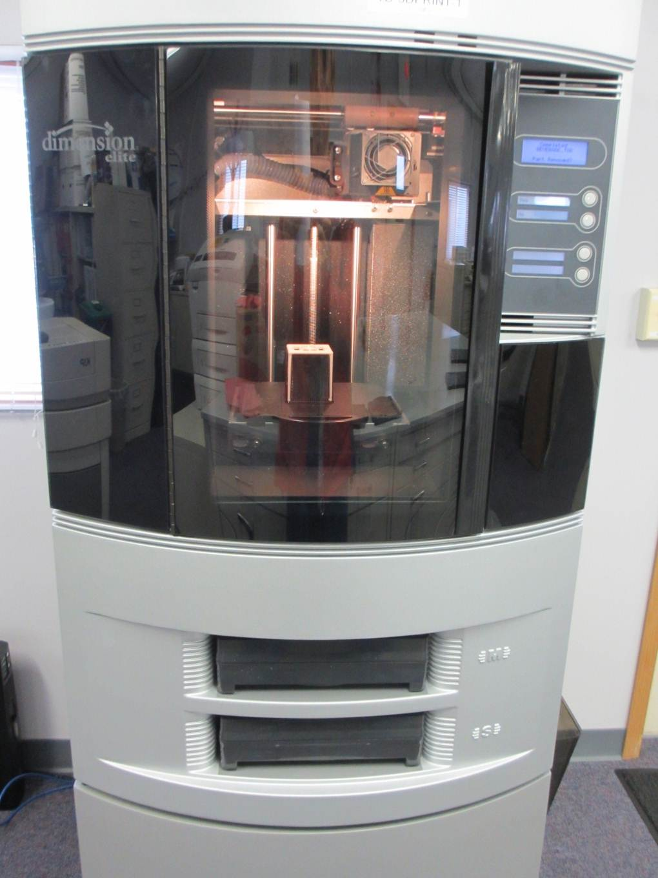
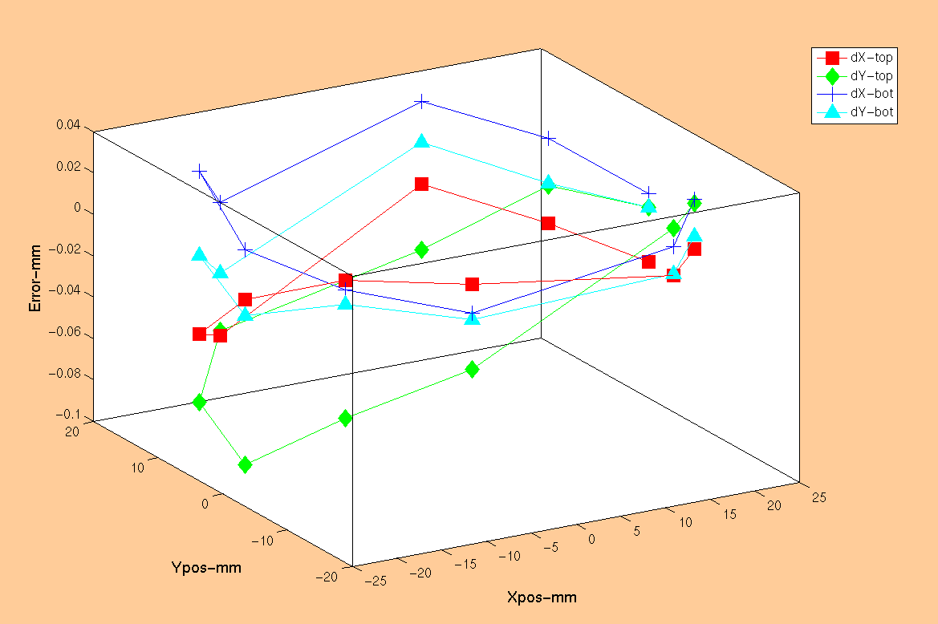
Fused-Deposition Modelling (FDM)
Newly printed probe
Microscope inspection
Average deviation for a hole from its intended position is typically less than 50 microns
Average over the 10 holes is less than 25 microns
3D printer
Inspection results

Slide 23
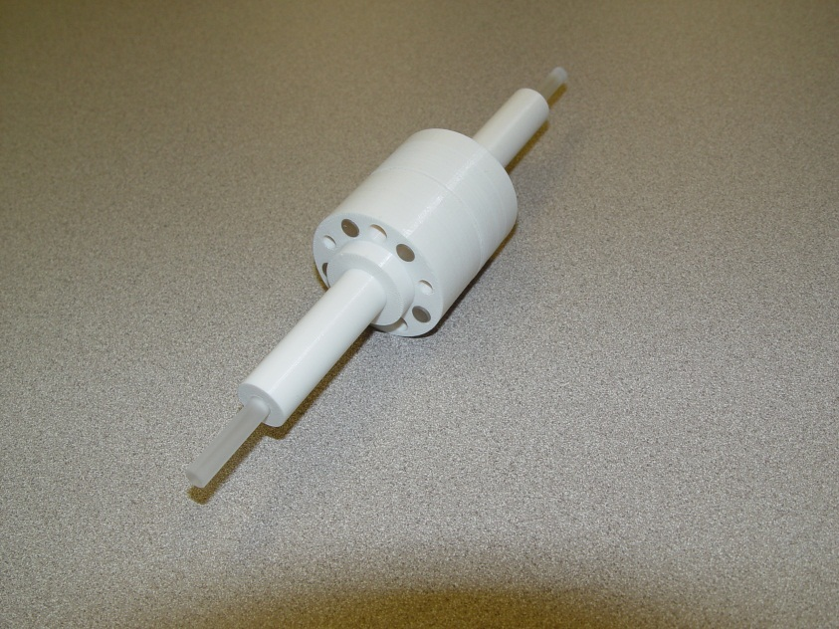
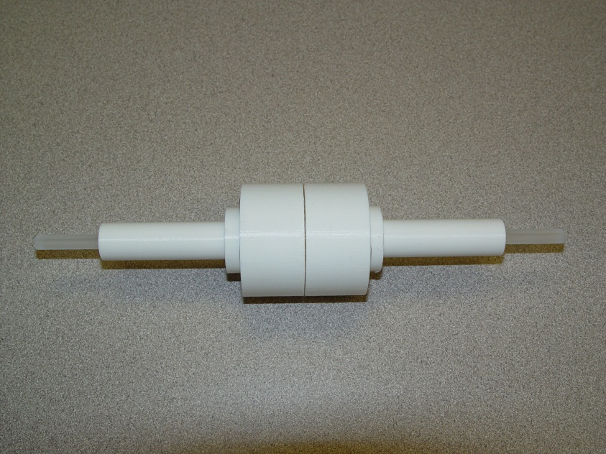
FDM tolerancing test
Performed the following inspection:
Placed precision 6.35mm quartz rods between two end plugs
Additional quartz rods at ends of plugs
measure alignment of these end rods wrt each other on CMM
Note:
As parts came off printer, no filing, etc.
Holes sized 10μm larger than rods – results in press fit of rods in plugs.
Quartz rods align with each other with concentricity 11um (!)
(This is nice, but not relying on this as being typical – the accuracy comes from the pcb – the point is that it is ‘not bad’ on the scale of machined parts)
Quartz rods between plugs
Quartz rods in ends of plugs

Slide 24
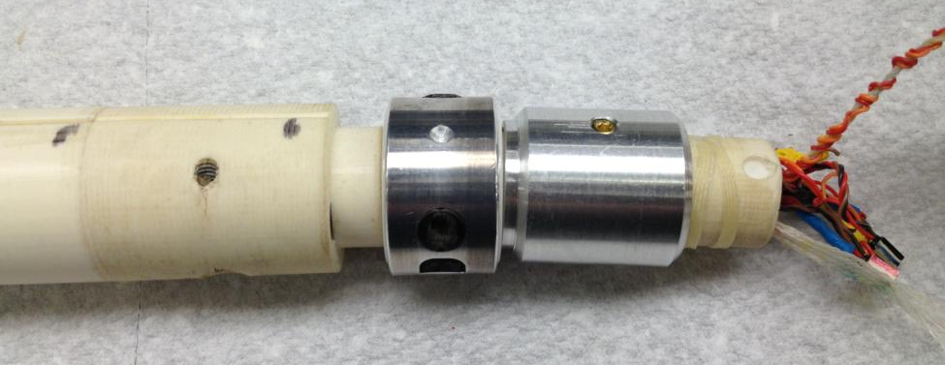
Some problems…
1) Aluminum gets hot in a magnet ramping to 10T - The end plug started to soften and got bent. (A recurring lesson - avoid metal in magnetic field !)
The bearing restraint was replaced with a different material …
Al bearing restraint
Heat deflection point of ABSPlus is only ~100C
2) While being driven down into vertical cryostat, the edge of the probe caught on the warm bore tube edge – the force was enough to break the end plug.
In both cases the end plug was replaced with a spare.

Slide 25
Recent probes, projects, results

Slide 26
Recent Probes (Fall 2011- Spring 2013)
Traces can be positioned on both sides of probe rotation axis to further push sensitivity
For dipole+quad bucking need 4 tracks, but for dipole bucking, 2 are sufficient, so use space to increase # of traces on small width pcb
Same board but mounted at 2 different position to maximize radius in different size warm bore tubes
Mostly dual length probes
Recent boards have been multi-layer for higher sensitivity and larger spacing to make manufacturing easier
Have been replicating probes made for both LBNL and FNAL programs

Slide 27
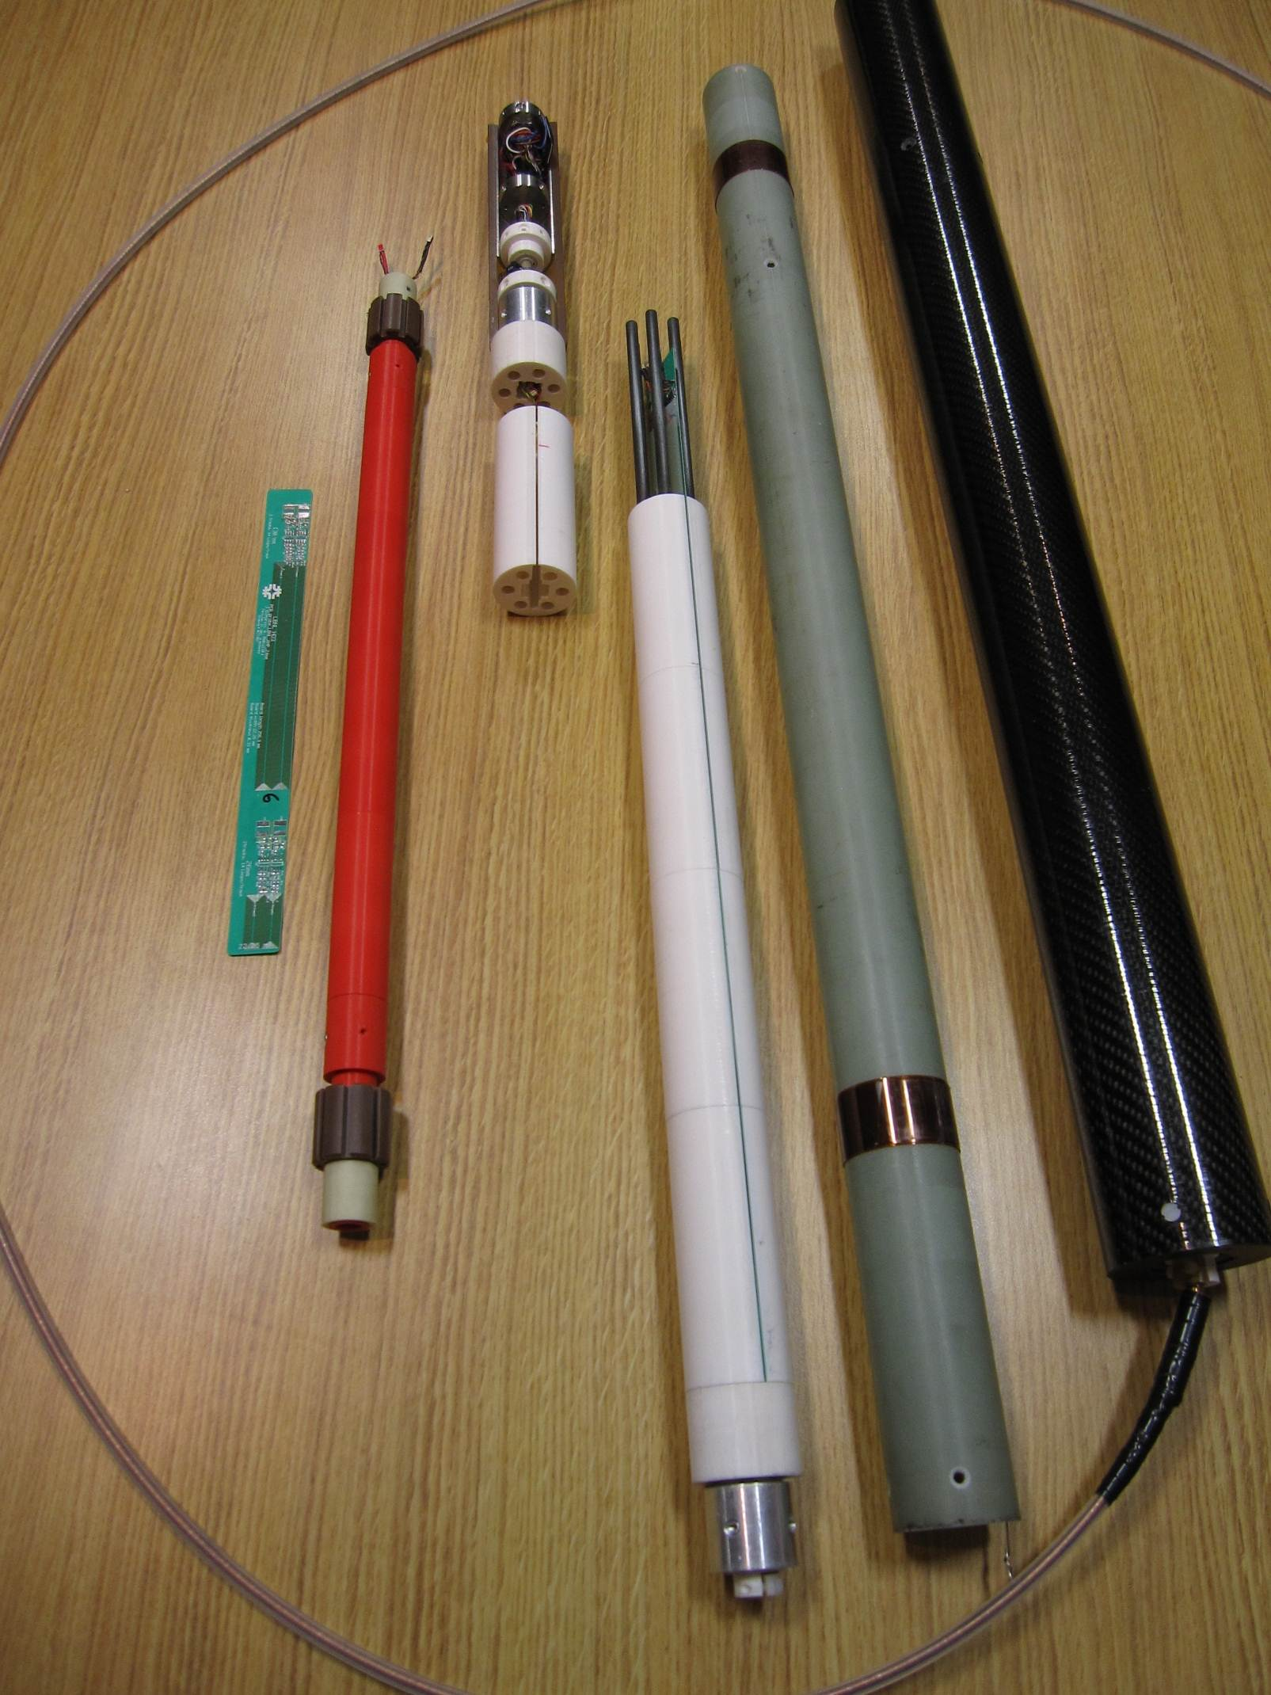
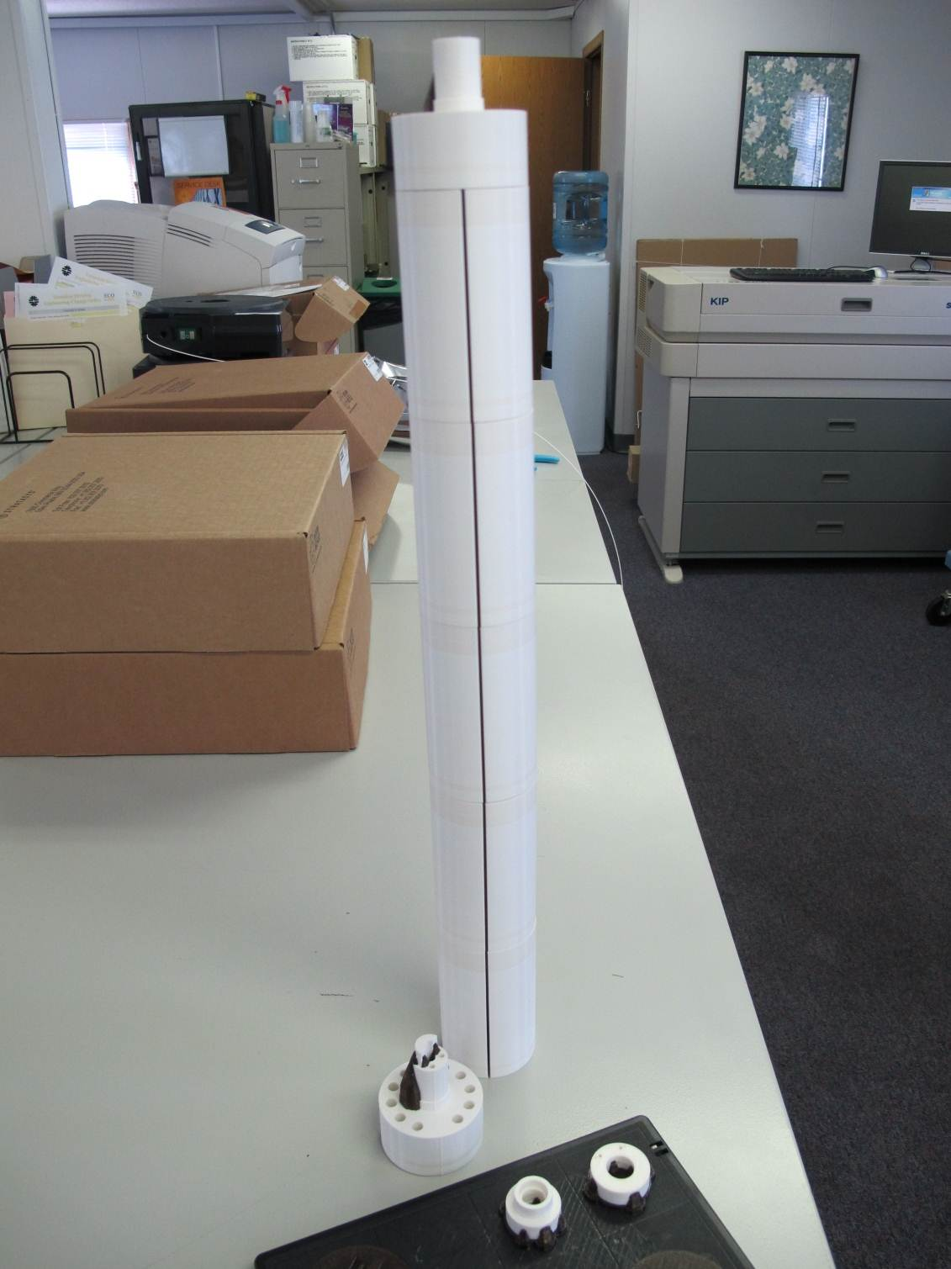
Stack-up of FDM parts for the 63.5mm ferret PCB support structure
63.5mm ferret with non-magnetic flex drive attached (for LQS warm measurements)
24mm rotating coil
45mm ferret (disassembled to show internal components). Note that half-cylinder stainless steel outer tubes were replaced with G10 or carbon fiber

Slide 28
US LHC Accelerator Research Program (LARP)
Nb3Sn Quadrupole program
LQS03 (90mm aperture)
HQ01e3 (120mm aperture)
HQ02 (120mm aperture with cored cable)
Nb3Sn Dipoles for high-luminosity upgrade (demonstrators)
MBHSP01
MBHSP02 (cored cable)
LBNL baseline program
High-field dipole
HD3
Have been replicating probes made for both LBNL and FNAL programs
(Thanks to Xiaorong Wang for sharing slides of LBNL results for this talk!)
Probes made have 2 lengths of circuits to match twist pitch and look at finer structure.

Slide 29
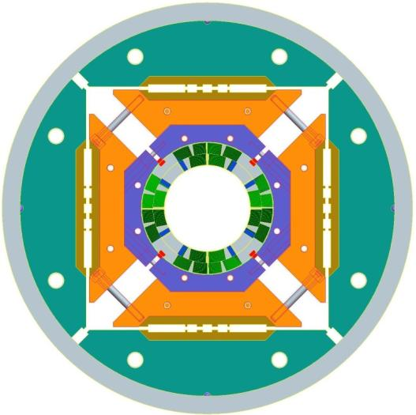
HQ01-2
HQ01-2 – LARP quadrupole magnet for Hi-Luminosity LHC
Cos(2θ) design
Nb₃Sn conductor
120 mm aperture
Short sample limit at 4.5 K
17.3 kA, 195 T/m gradient
HQ01 magnet cross section
H. Felice et al., Design of HQ - a high field large bore quadrupole magnet for LARP, IEEE Trans. Appl. Supercond. 19, 1235-1239 (2009).
Notes:
- Some results from the LARP HQ01e magnetic measurement that can demonstrate the performance of the measurement system.

Slide 30
HD3 at LBNL LBNL baseline program- block-type Nb₃Sn dipole magnet End region harmonics not optimized (very large numbers…) 40 mm available aperture (R.ref = 13 mm)
Assembled magnet
Cross section (same as HD2)
P. Ferracin, IEEE TAS, 19(3), 2009, pp. 1240 – 1243.

Slide 31
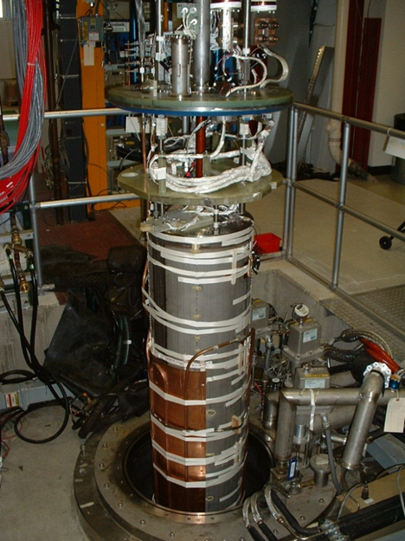
MBHSP01-02
CERN and FNAL have a joint R&D program with the goal of developing a 5.5m long twin-aperture Nb₃Sn dipole for the LHC upgrades by 2015. The program started with the design and construction of 2 m long 60 mm bore single-aperture demonstrator magnets

Slide 32
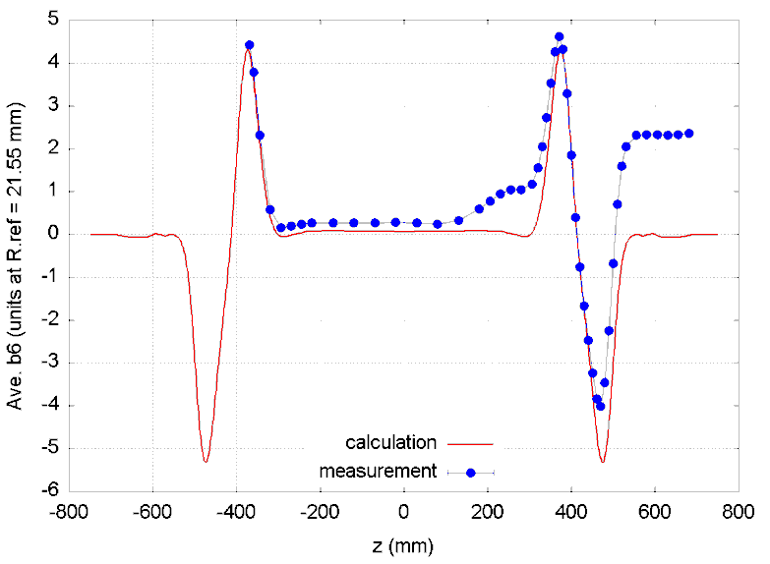
HQ01d comparison with calculation
HQ01d quadrupole with calculation (note that the calculation did not account for the ramp splice region whose effect is seen on the measured data between 150-300mm on the z scale). Probe is 100mm long, 47mm diameter PCB.

Slide 33
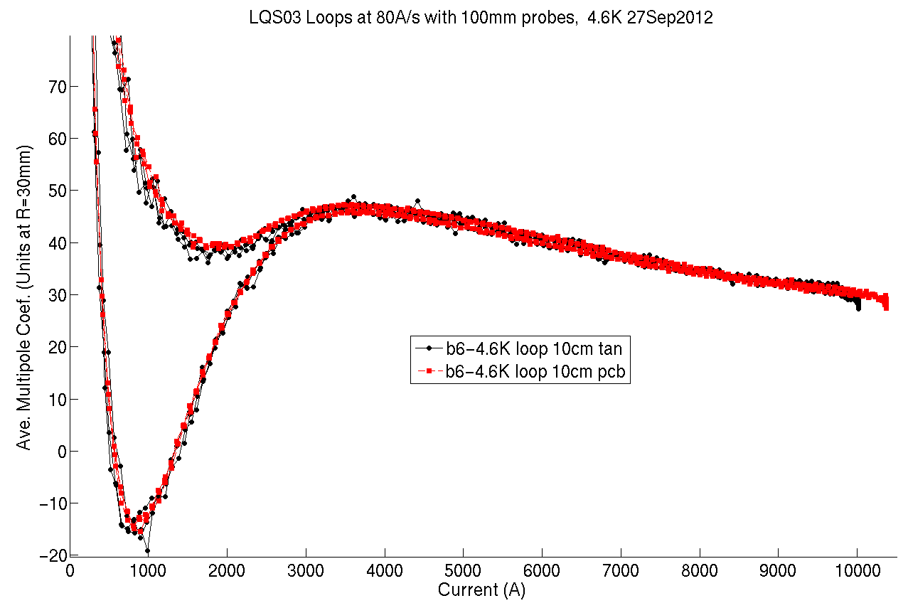
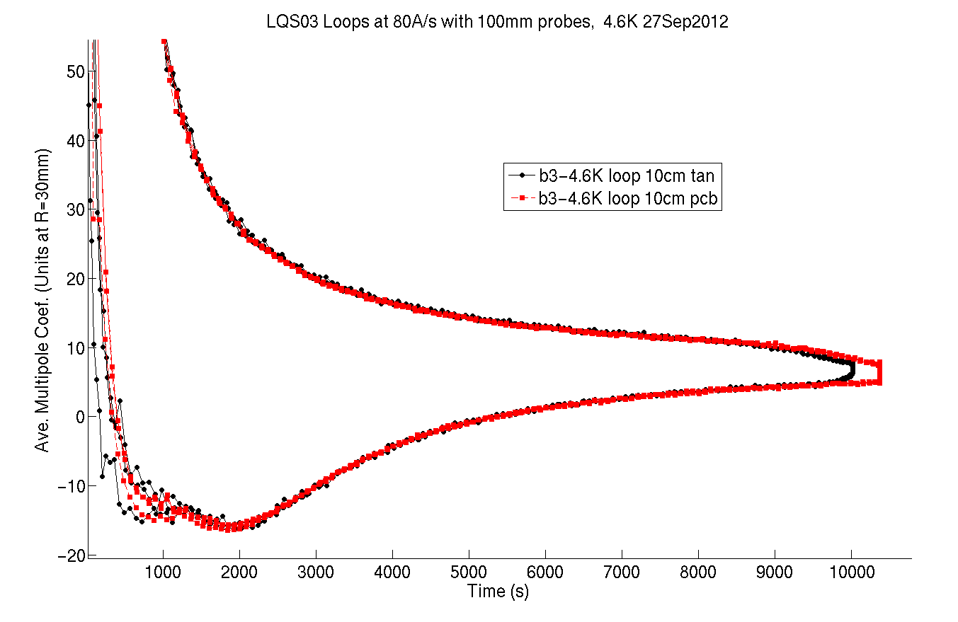
LQS03 (90mm LARP quad prototype) – comparison of 100mm long Tangential and PCB probes
b6
b3
Slightly different peak currents
Note that measurements were made to slightly different peak currents. Agreement is very good, and random scatter is slightly better in the PCB results

Slide 34
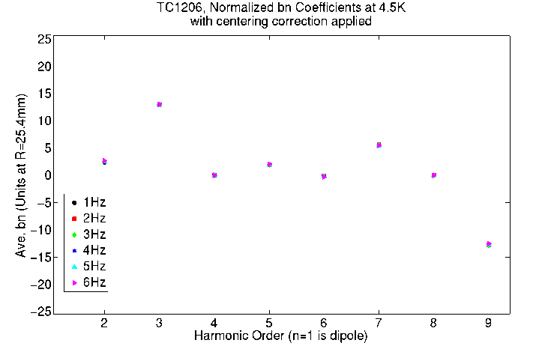
43mm Ferret in Tevatron Dipole TC1206, 4.5K
Measurements were made with the Ferret at rotation rates of up to 6Hz, with 5m of non-magnetic shaft in the 4T field (total flex shaft length 10m)

Slide 35
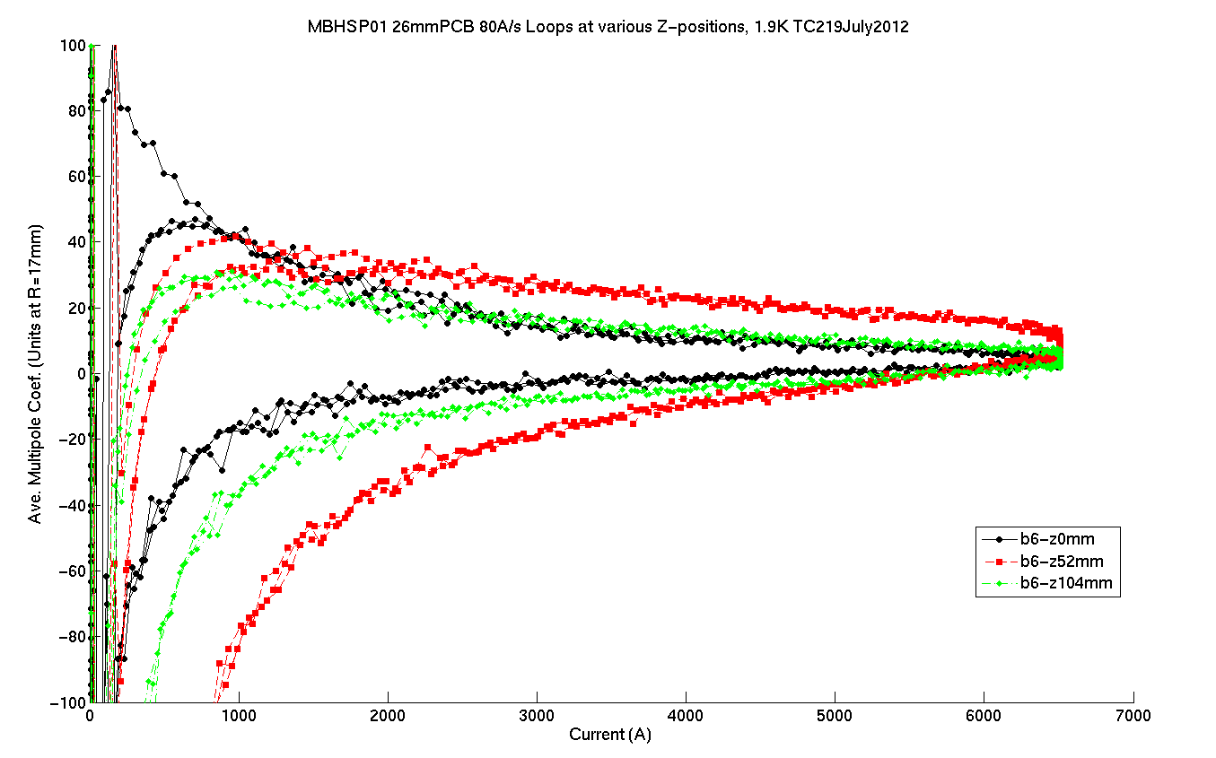
MBHSP01 26mm PCB probe at Fermilab
Variation of dynamic effects with at different Z locations (positions separated by 52mm)

Slide 36
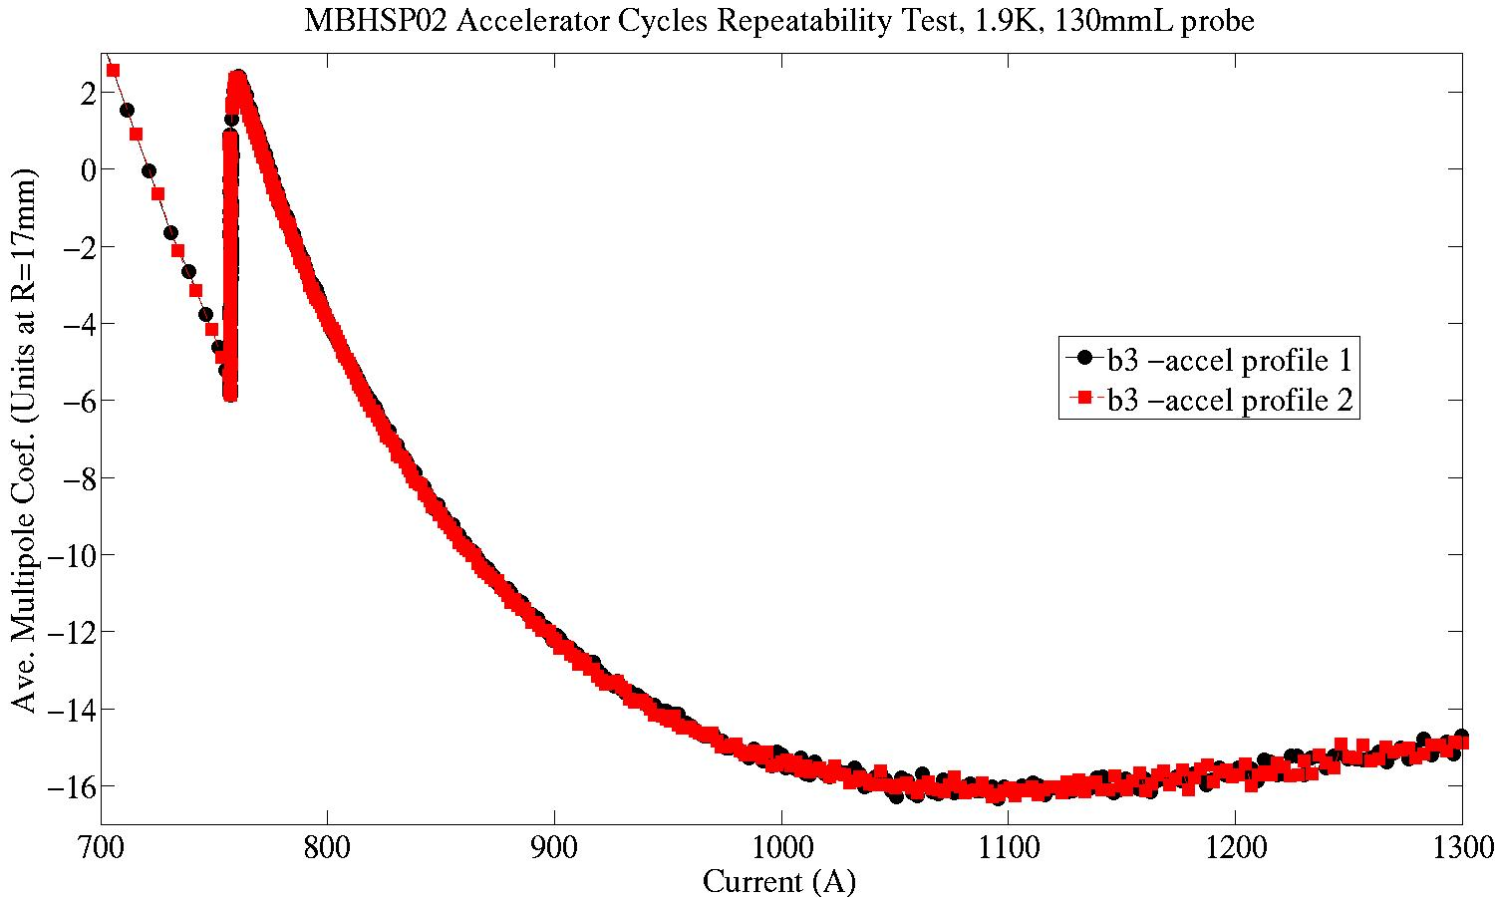
Decay and snapback at injection (760A)– Accelerator Cycle
~8 units b3 drift
MBHSP02 130mm PCB repeatability results during accelerator cycle

Slide 37
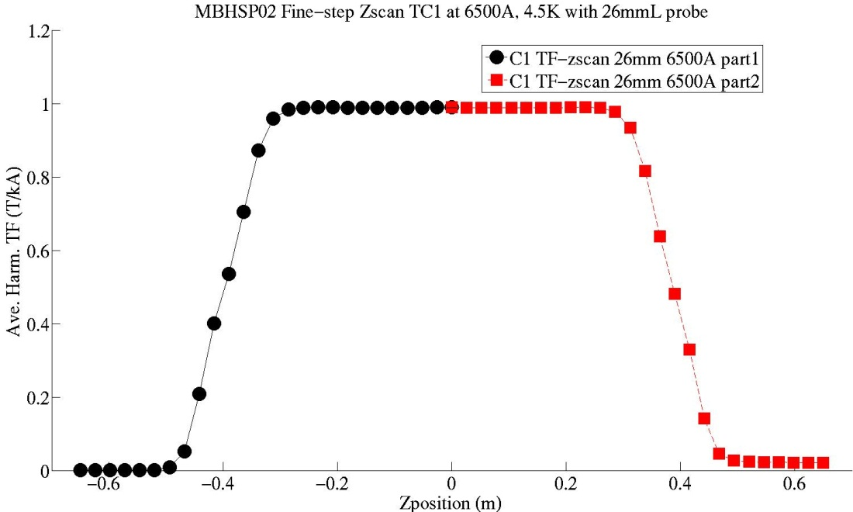
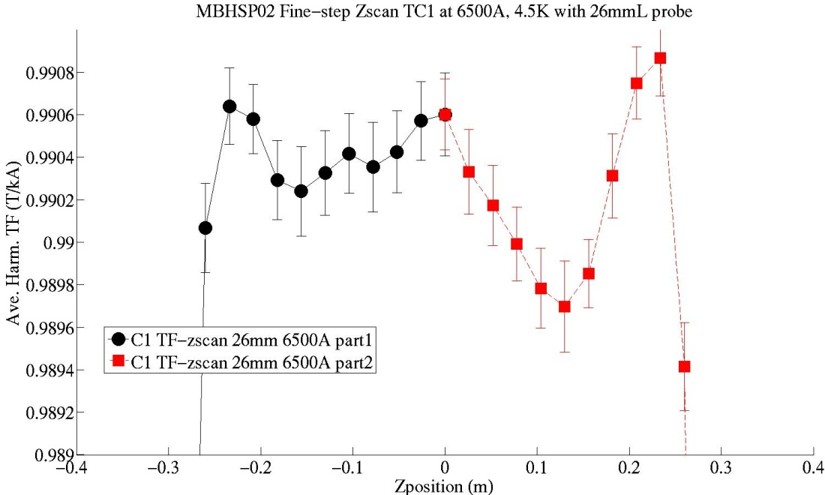
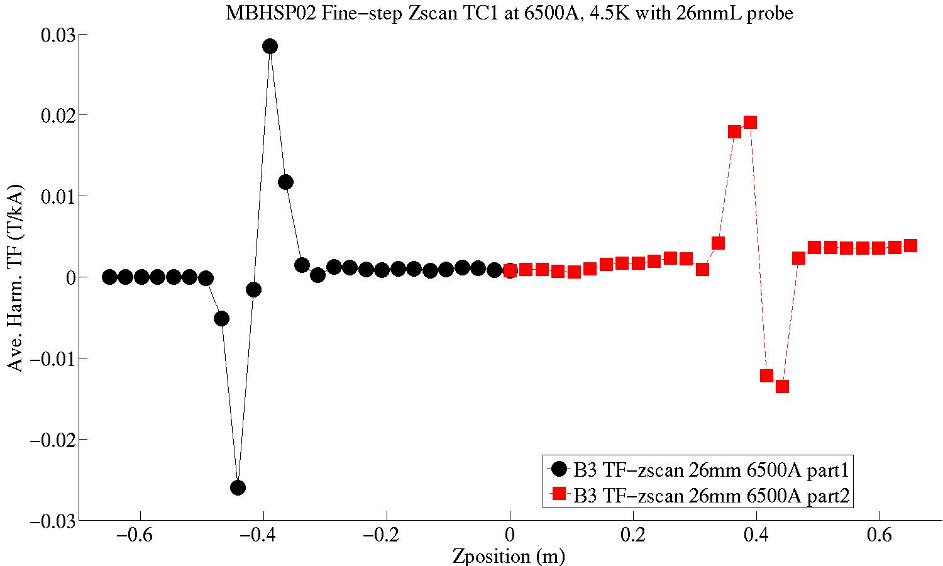
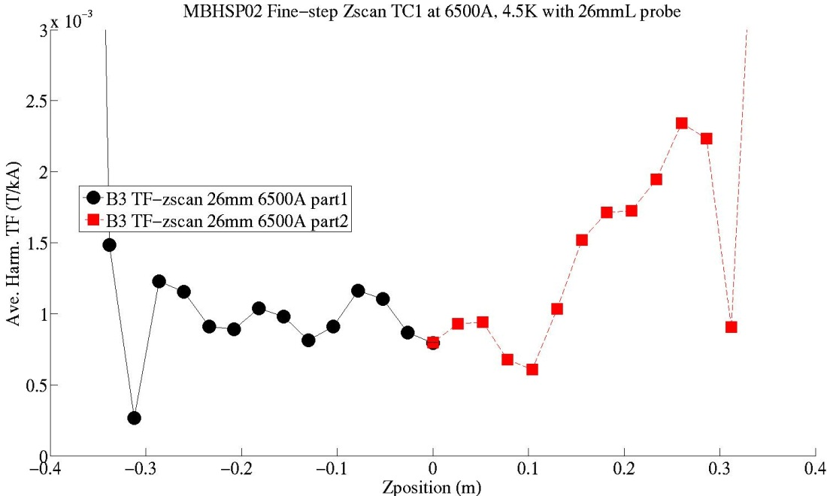
MBHSP02 Fine-step Zscan at 6500A, 4.5K with 26mmL probe
Zoom
Zoom
Splice region
Periodic variation from cable twist pitch ~10cm

Slide 38
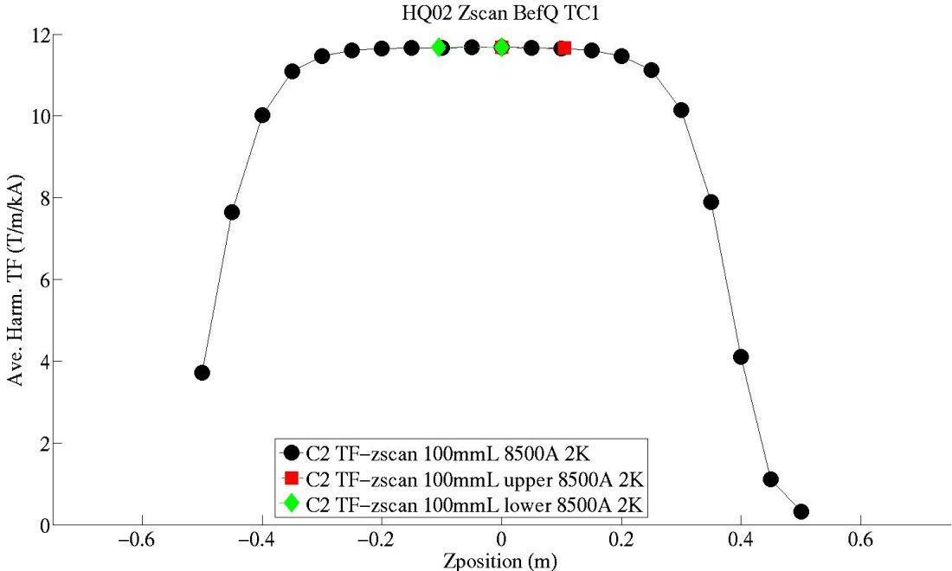
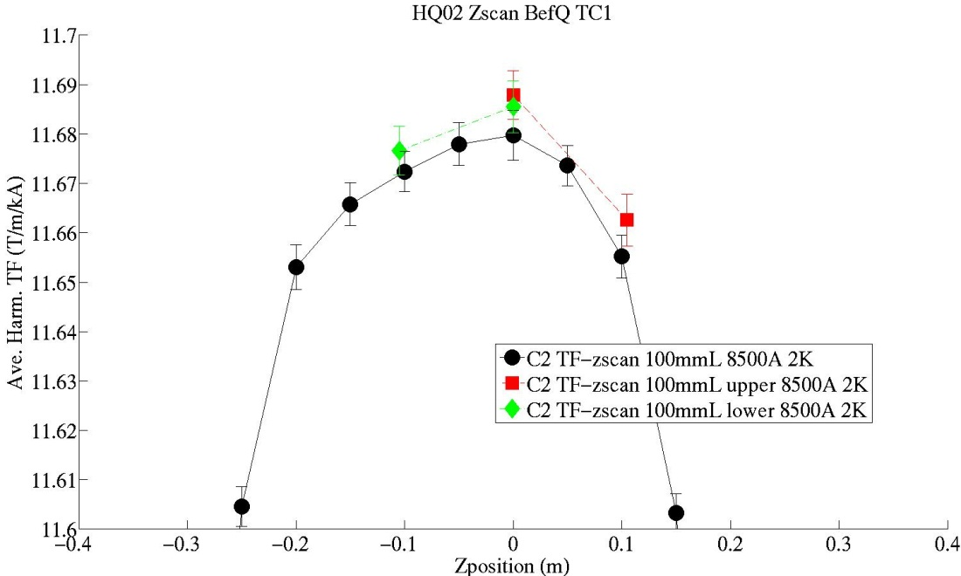
HQ02 comparison of Quad strength measured with different 100mm probes
About 9 unit difference in strength measurements between 2 probes (without calibration)

Slide 39
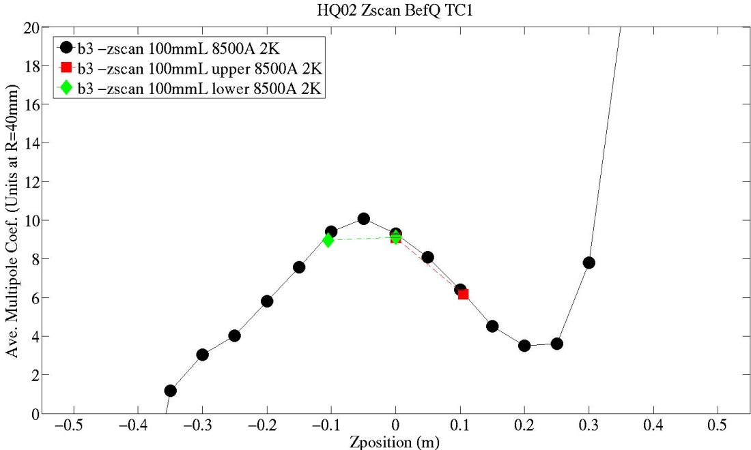
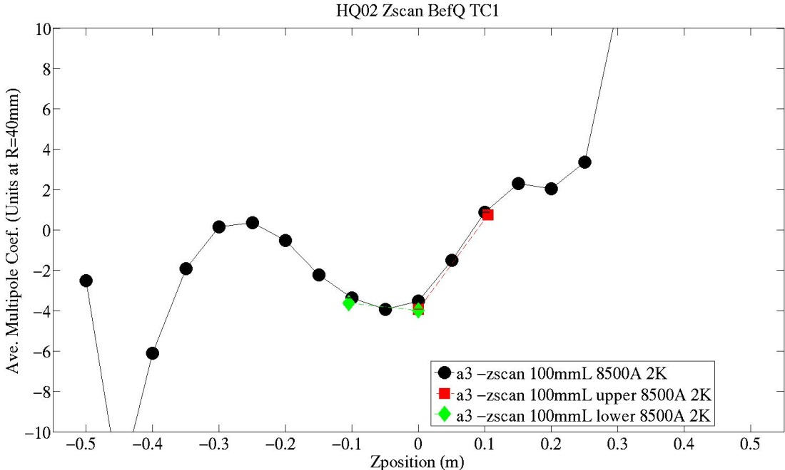
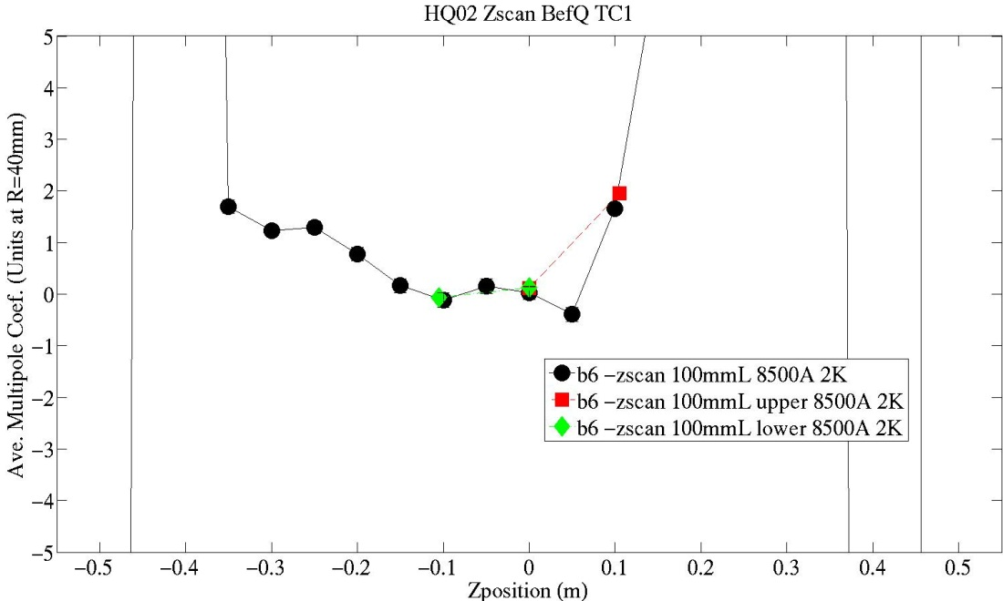
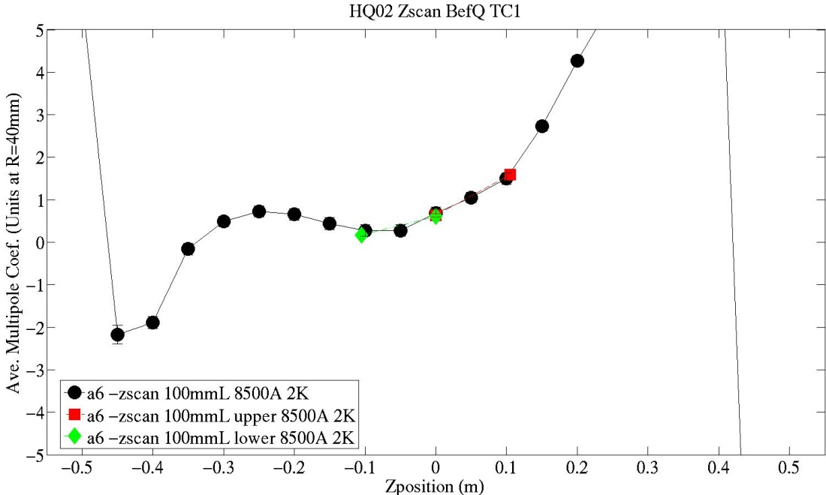
HQ02 comparison of Quad harmonics measured with 3 different 100mm probes at z=0
The z0 pos has all 3 probes

Slide 40
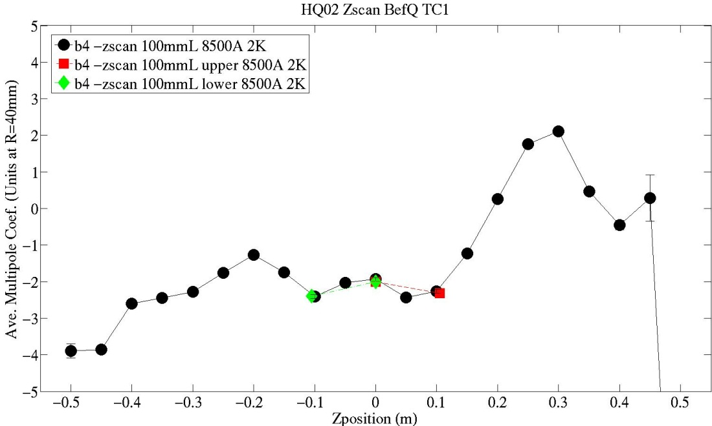
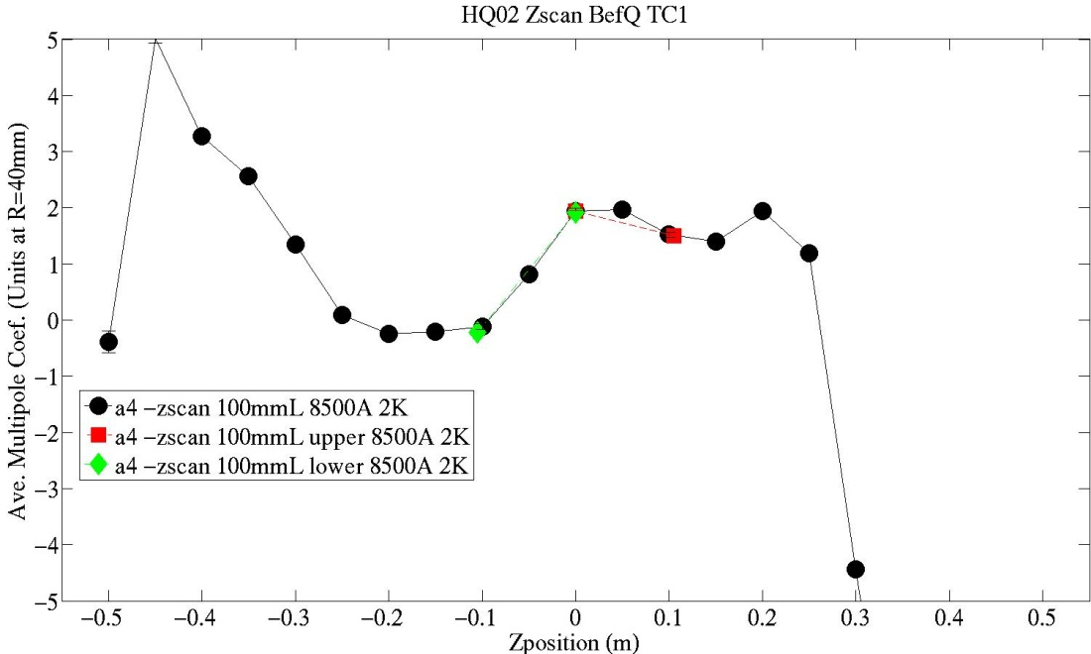
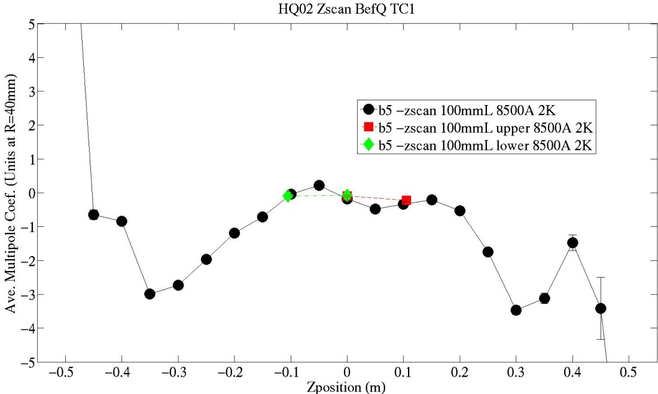
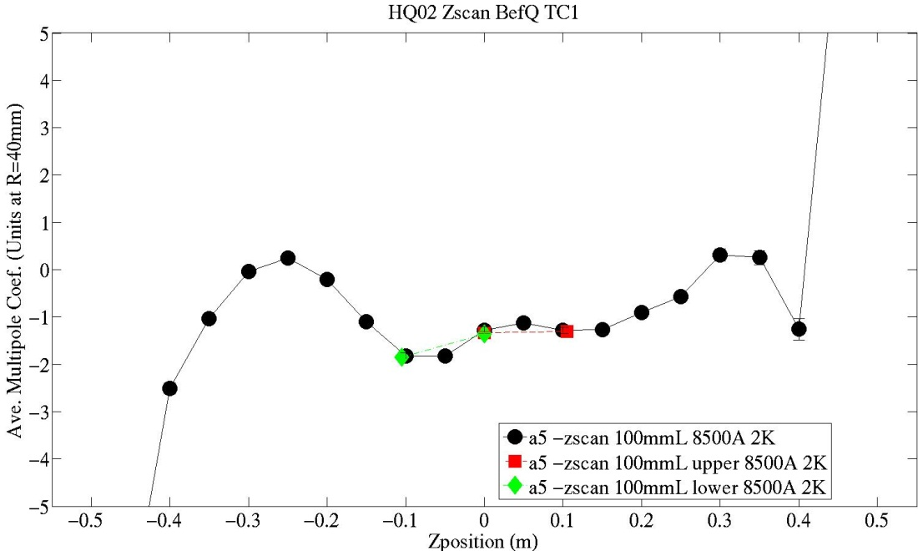
HQ02 comparison of Quad harmonics measured with 3 different 100mm probes at z=0
Here also…

Slide 41
HQ01e3 - example of multi-layer pcb improvement in resolution over 2 layer.
warm scan
15 A, 0.5 Hz rotation speed
100 mm long probe
Measurement variation improved significantly (from 2 to 0.11 units, gain of ~17).
The error bar for HQ01e3 data is plotted but invisible in the current scale.

Slide 42
HD3 measurement with multi-layer probe during magnet training
130 mm at the straight part
Spikes from the flux jump
uncertainty ~ 0.03 units for both circuits (peak-to-peak noise level)

Slide 43
ASSESSMENTS

Slide 44
Analog Bucking Ratio for recent probe measurements (un-bucked signal flux/bucked signal flux component)
Magnet | Probe | DB ratio | QB ratio
MBHSP02 | 130mmL_16Layer_28mmD | 855
MBHSP02 | 26mmL_16Layer_28mmD | 470
MBHSP01 | 130mmL_2Layer_24mmD | 202
MBHSP01 | 26mmL_2Layer_24mmD | 212
HQ01d | 100mmL_2Layer_46mmD | 50 | 355
HQ01d | 250mmL_2Layer_46mmD | 110 | 420
HQ01e3 | 100mmL_10Layer_47mmD | 100 | 2300
HQ01e3 | 200mmL_10Layer_47mmD | 67 | 482
HD3 | 130mmL_2Layer_24mmD | 78
HD3 | 26mmL_2Layer_24mmD | 210
HD3 | 130mmL_16Layer_24mmD | 1700
HD3 | 26mmL_16Layer_24mmD | 500
HQ02 | 200mmL_10Layer_47mmD | 7000 | 1050
HQ02 | 100mmL_10Layer_47mmD | 978 | 475
HQ02 | 100mmL_b_10Layer_47mmD | 960 | 3250
HQ02 | 100mmL_c_10Layer_47mmD | 1225 | 1800

Slide 45
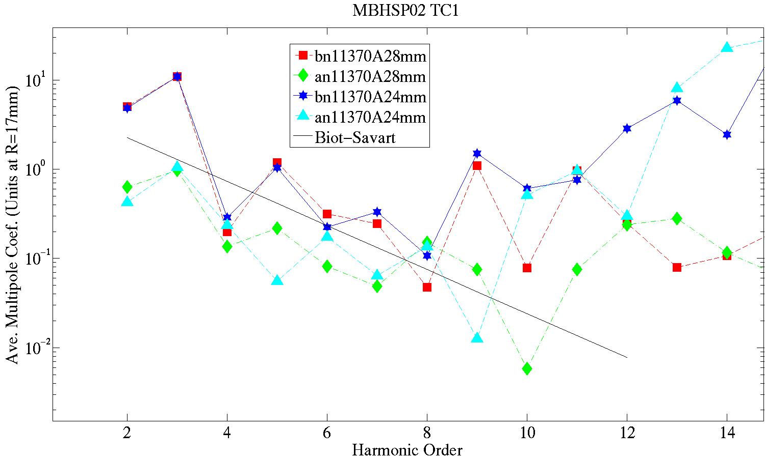
Harmonics Coef. Noise Est.
Resolution to at least 0.1 unit to n=~9

Slide 46
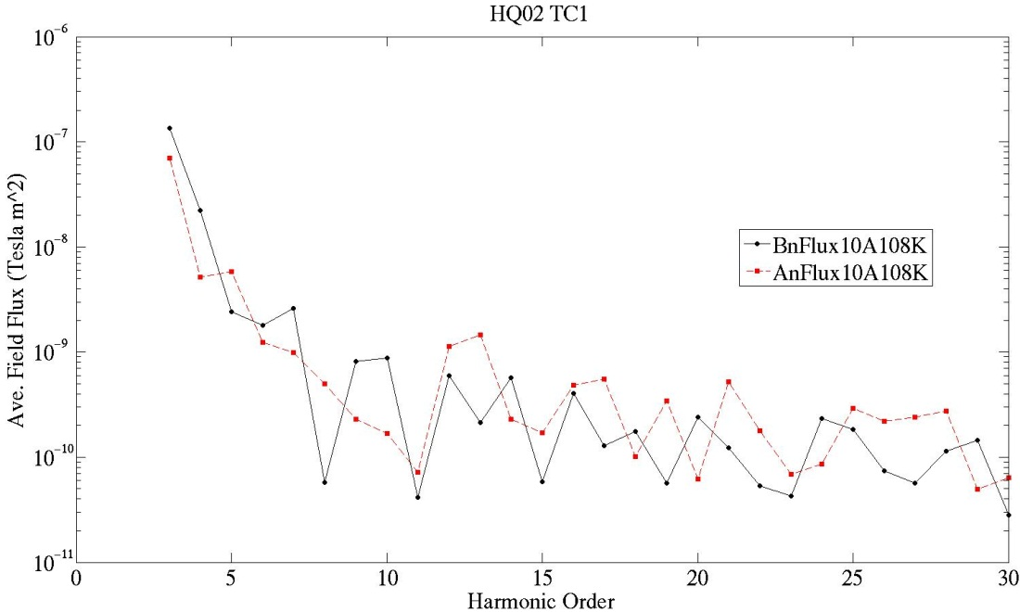
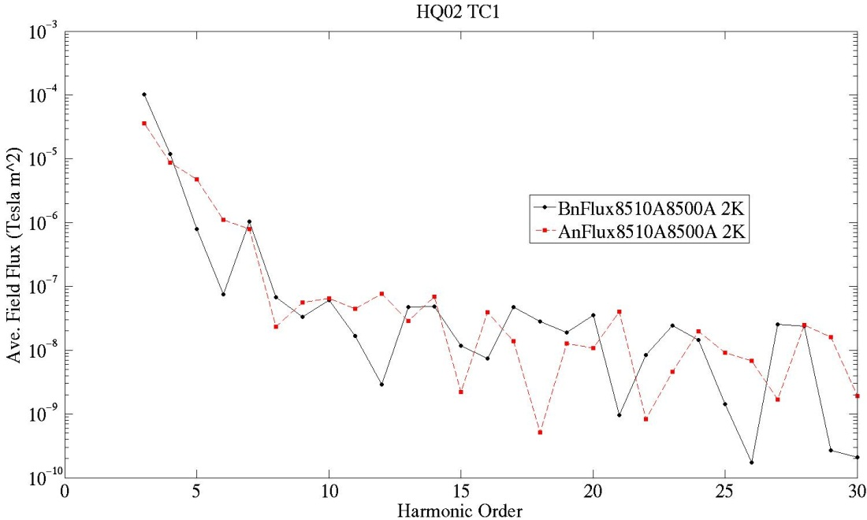
Not as much improvement in resolution with increased signal size as expected
Flux signal up by factor 1000 in cold (8500A) vs warm (10A)…
Warm
~2e-10 Vs
…But flux noise floor also grows by factor ~100
WHY?
Can it be related to magnet ? …
~5e-8 Vs
Cold

Slide 47
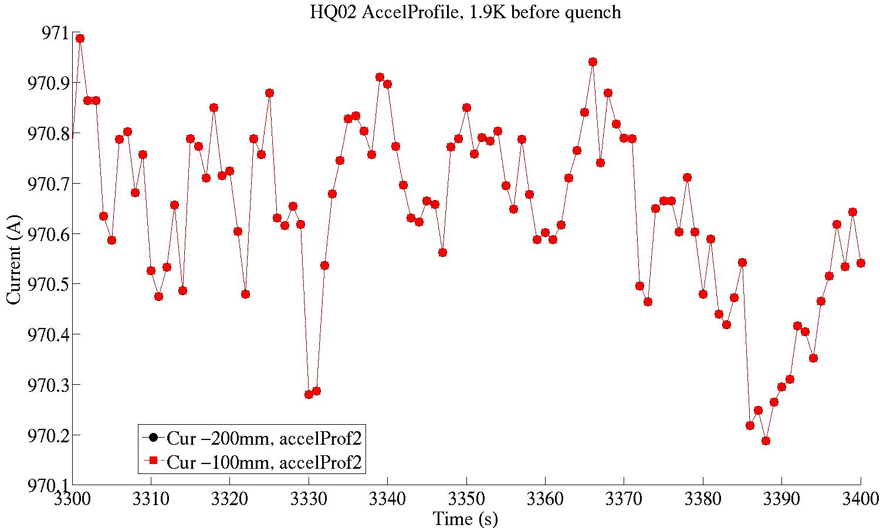
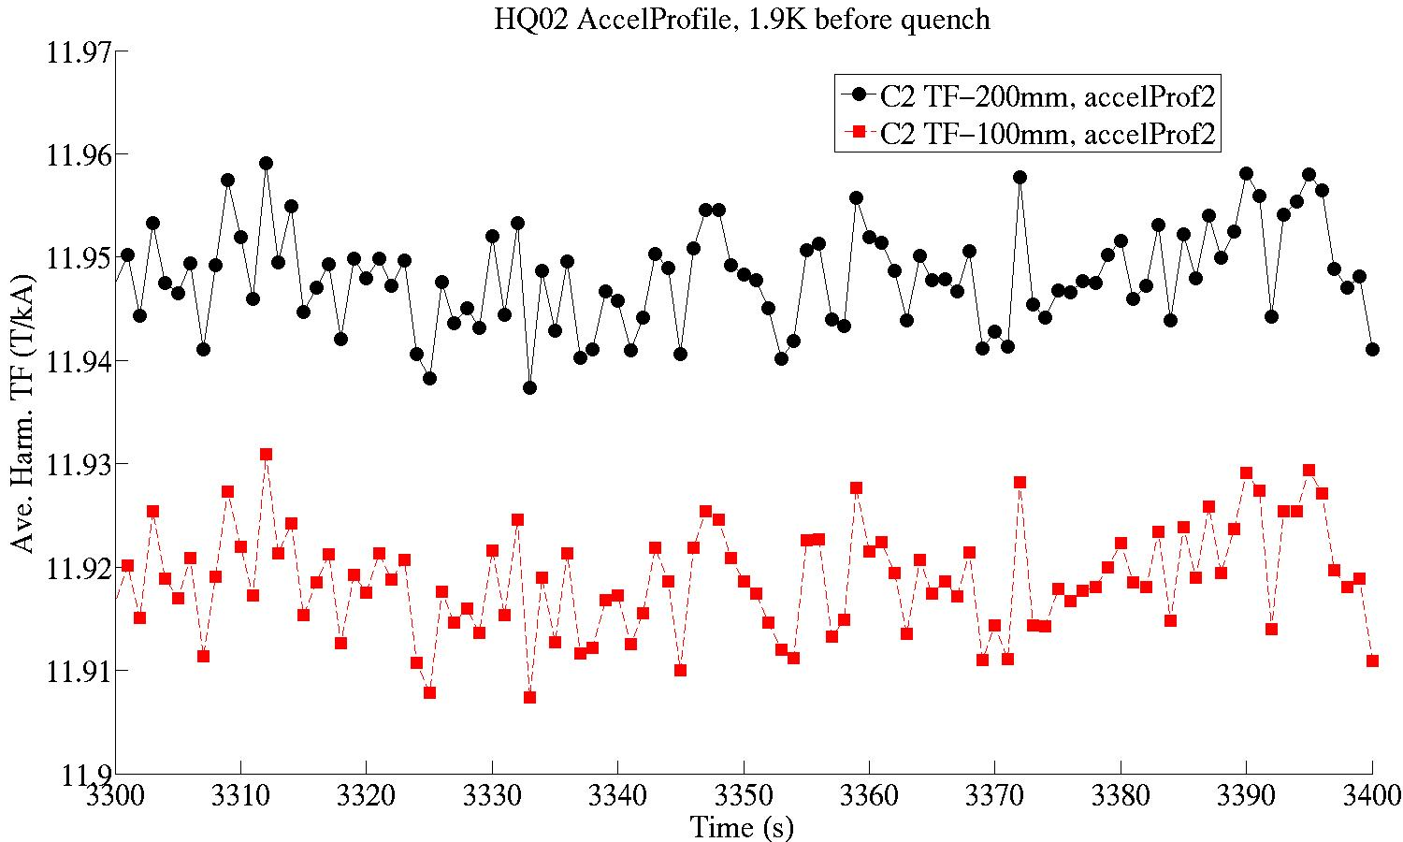
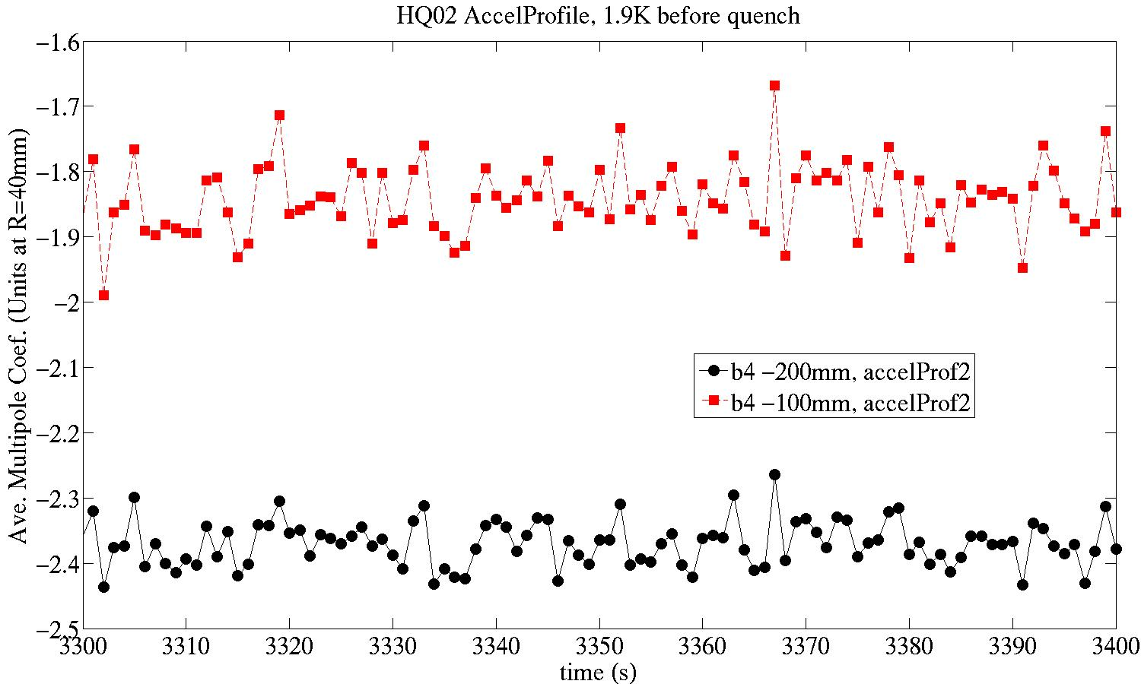
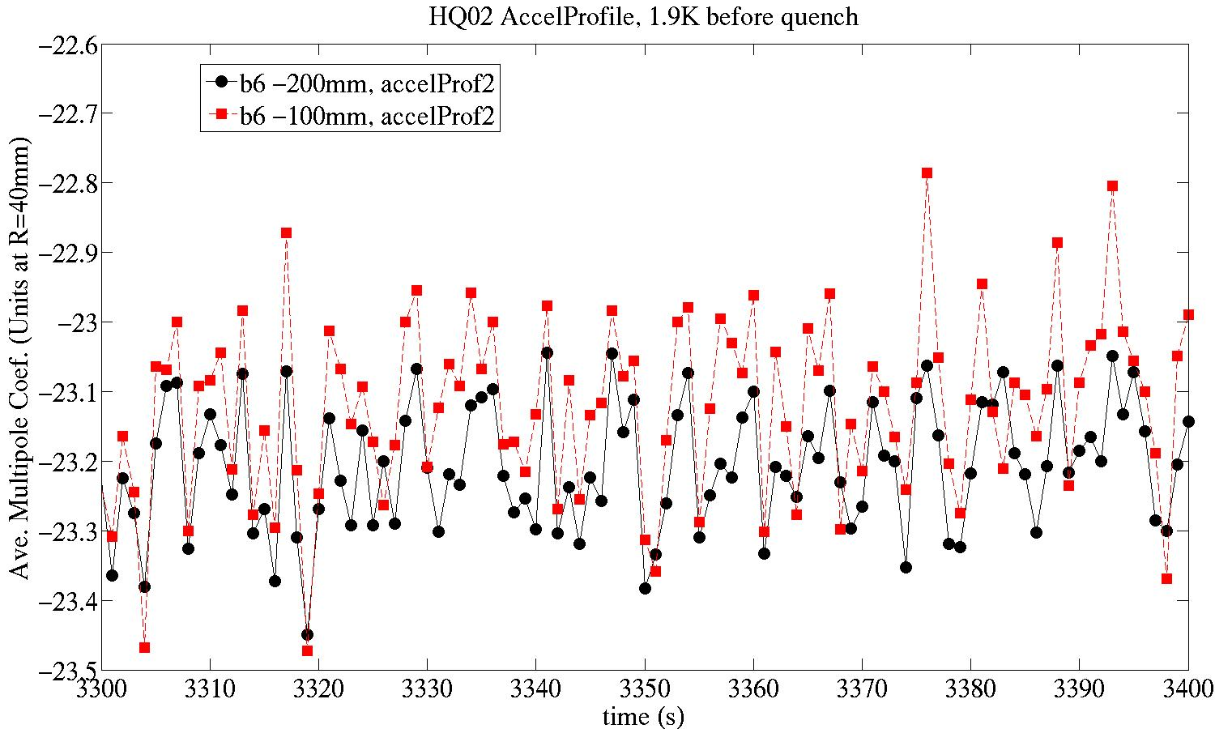
But TF varies at ~10 unit level and does not track current
Current stable at ~3 unit level
The scatter in transfer function and harmonics seems to track between the two probes …

Slide 48
CONCLUSIONS

Slide 49
Magnetic measurement probes using PCBs have been developed with a number of advantages in terms of sensitivity, bucking, and accuracy of winding placement. These, coupled particularly with the FDM technology for mechanical support, allow us to build a variety of probes with great facility, including the stand-alone ‘Ferret’ system.
Have arrived at the goal of having probes are both accurate and ‘easy’ to procure – allowing us to develop optimized probes for measurement needs quickly and flexibly.
Results of measurement comparisons among several PCB probes, as well as comparison with other probes and simulations have been encouraging.

