Slide 1
Magnetic Measurements At SLAC
Zachary Wolf
Yurii Levashov
Scott Anderson

Slide 2
Overview Of Recent Efforts
Conventional Magnets
We are between major projects
Just starting LCLS-II
LCLS-I Undulators
Radiation damage checks – Yurii’s talk
SHAB undulators
Self seeding magnets
LCLS-II
Getting lab ready for construction
Designed and tested phase shifter
Designed and tested beam pipe corrector
SSRL Undulator
Interesting coil straightness problem
Delta Undulator
Building undulator
Measurement Challenges

Slide 3
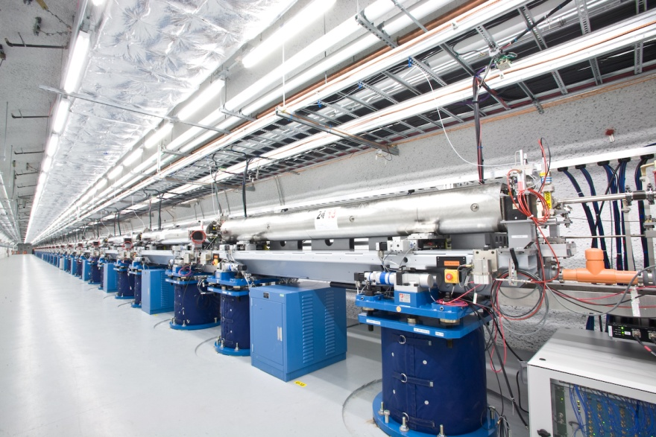
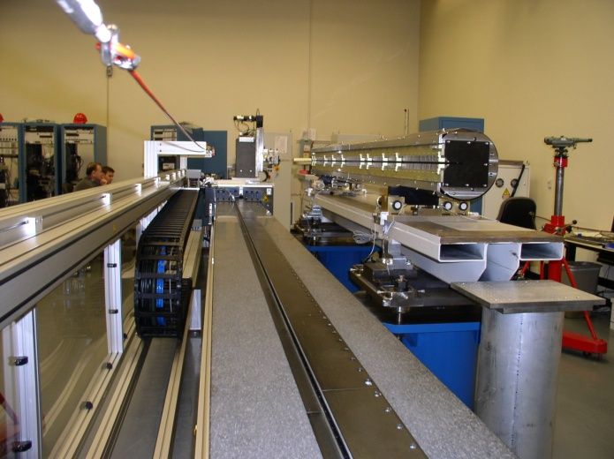
LCLS
Gun
Accelerator
Drift
Undulator Tunnel
Undulator
Near Hall
Far Hall
Site Overview
Measurement Lab

Slide 4
LCLS-II

Slide 5
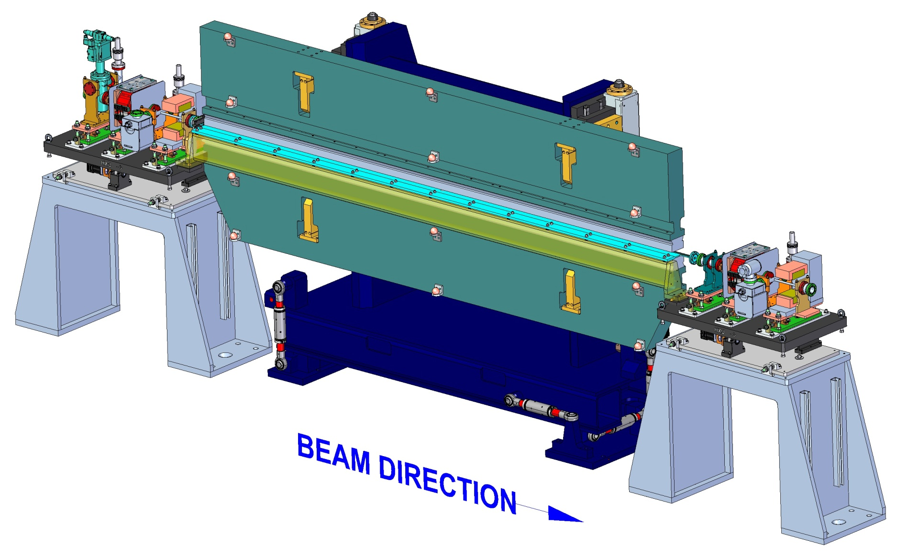
LCLS-II Undulators

Slide 6
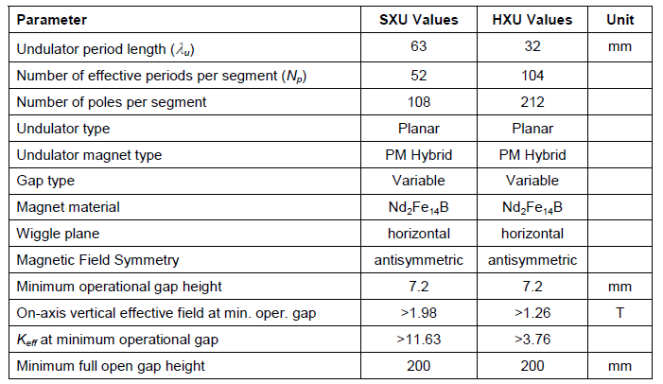
LCLS-II Undulators
Parameters:

Slide 7
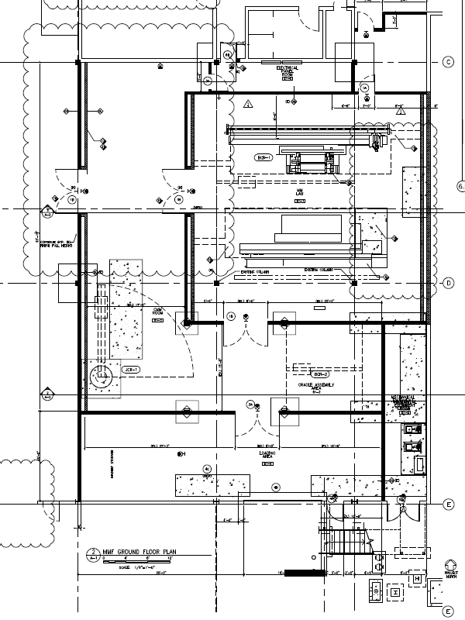
LCLS-II Lab Upgrade
Rotate bench
Pad for reference undulator
Add doors to
bring undulators in
Two benches
Extend pad for bench

Slide 8
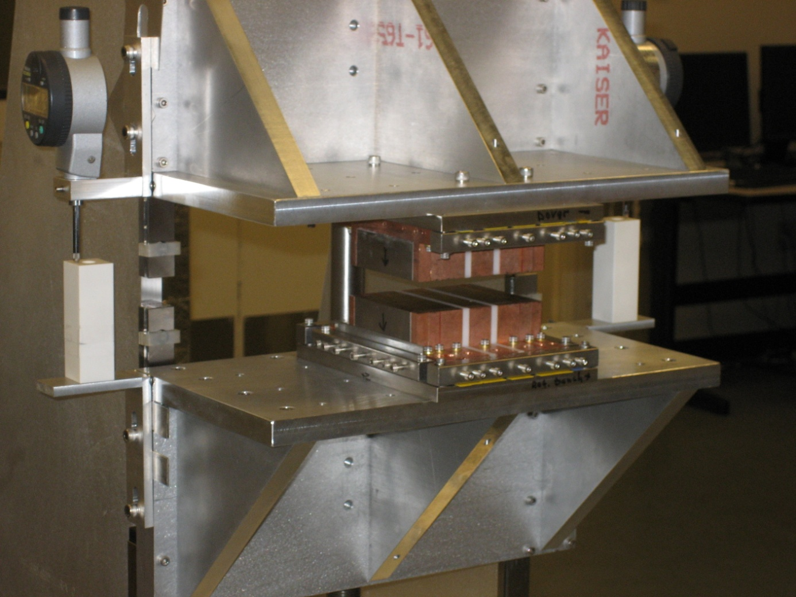
LCLS-II Phase Shifters
Magnet Assembly Prototype

Slide 9
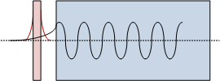
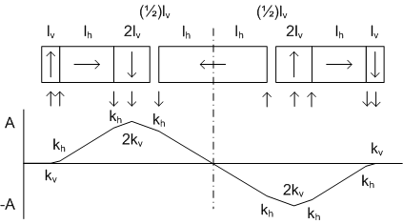
LCLS-II Phase Shifters
LCLS-TN-11-2, LCLS-TN-12-3
Simulated
By vs z
PPM, no coupling to undulator or quadrupole
Simulated
X-trajectory
Magnetic design based on trajectory kicks

Slide 10
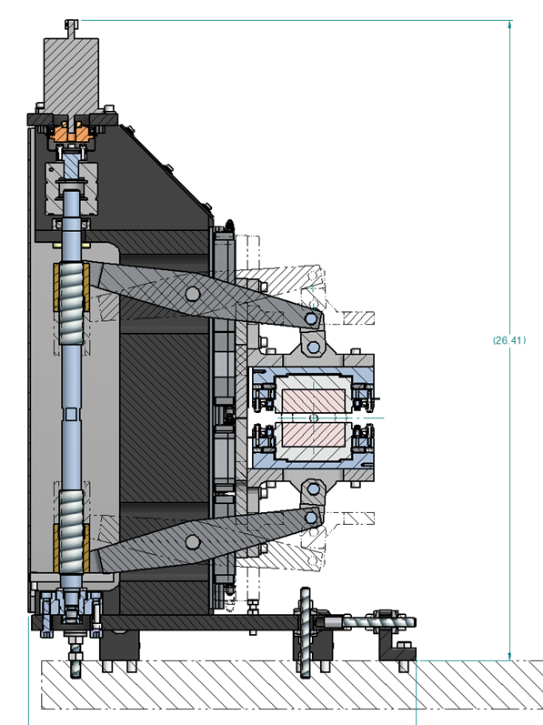
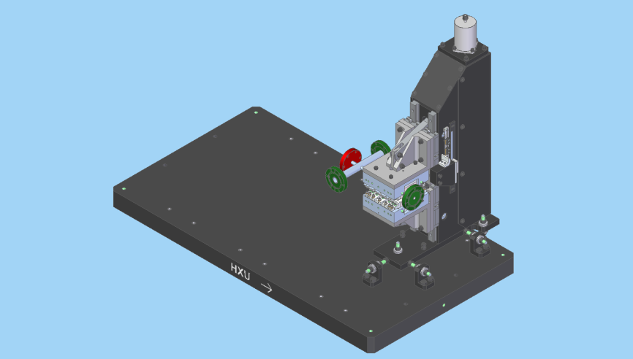
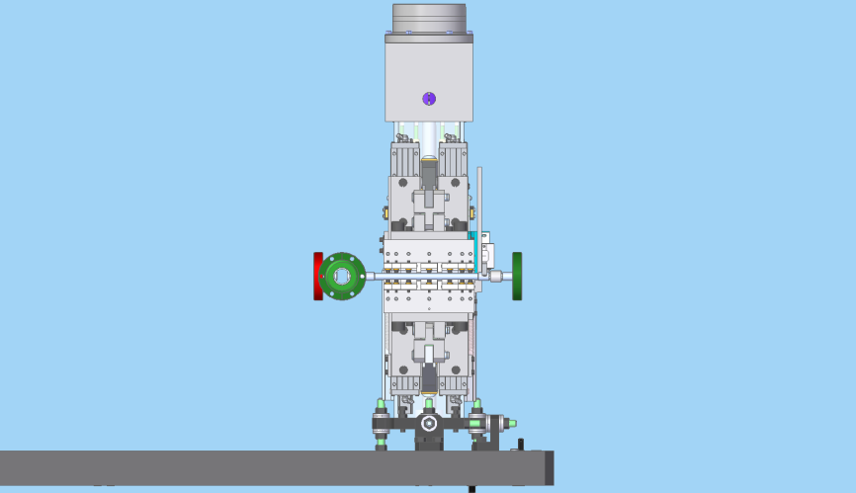
LCLS-II Phase Shifters
Phase shifter on interspace stand
Moment-free drive

Slide 11
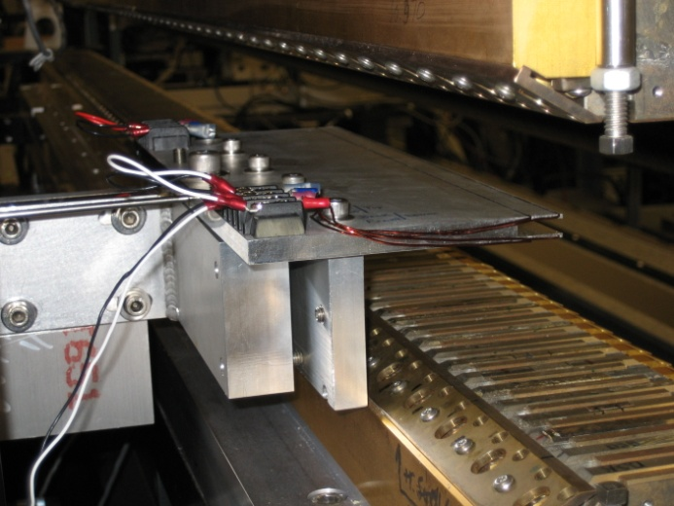
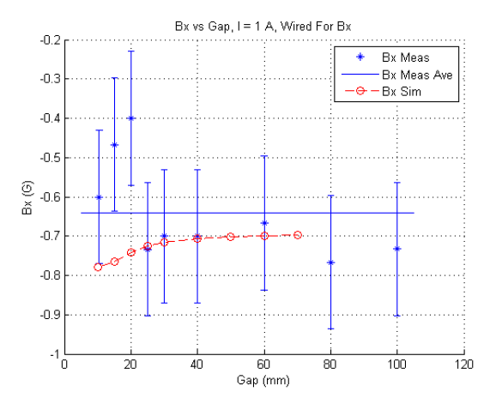
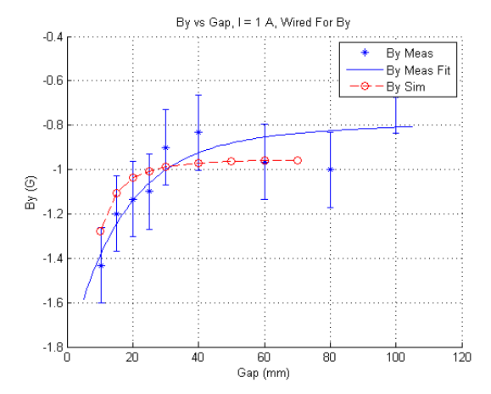
LCLS-II Beam Pipe Corrector
LCLS-TN-12-1
2 Power Supplies For Bx and By
Included image currents
in simulation
Simulation and Measurements Agree

Slide 12
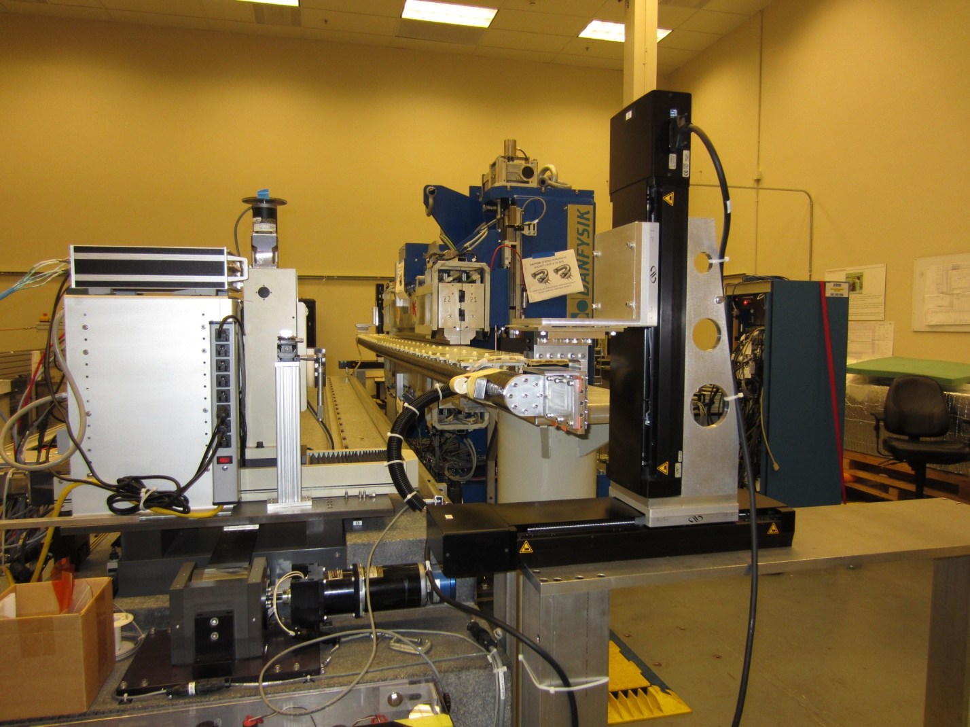
SSRL BL5 Undulator

Slide 13
Bx Field Integral Measurements
SLAC long coil Bx field integral measurements did not agree with Danfysik measurements.
Started investigation to find out why.

Slide 14
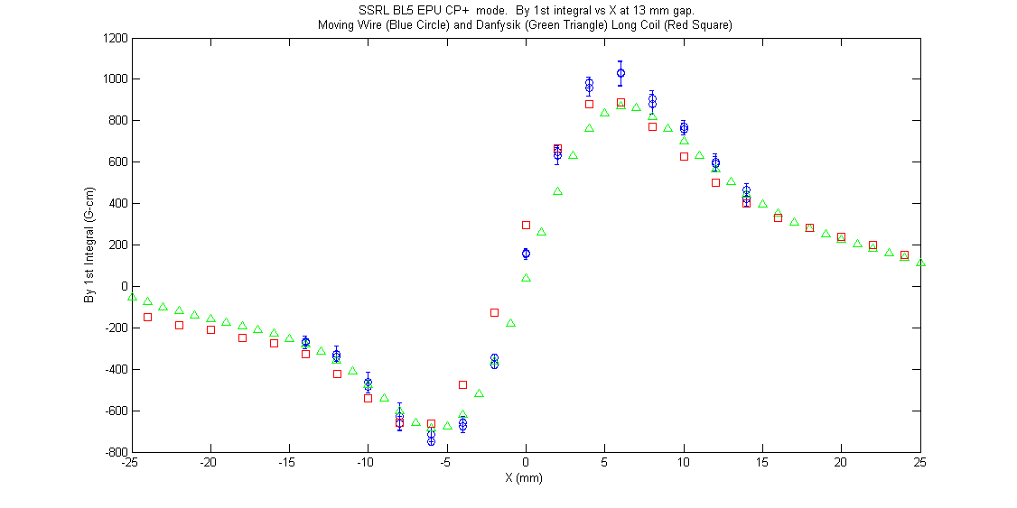
Problem Only In Bx, Not By
By integrals agreed. Only Bx integrals did not agree.

Slide 15
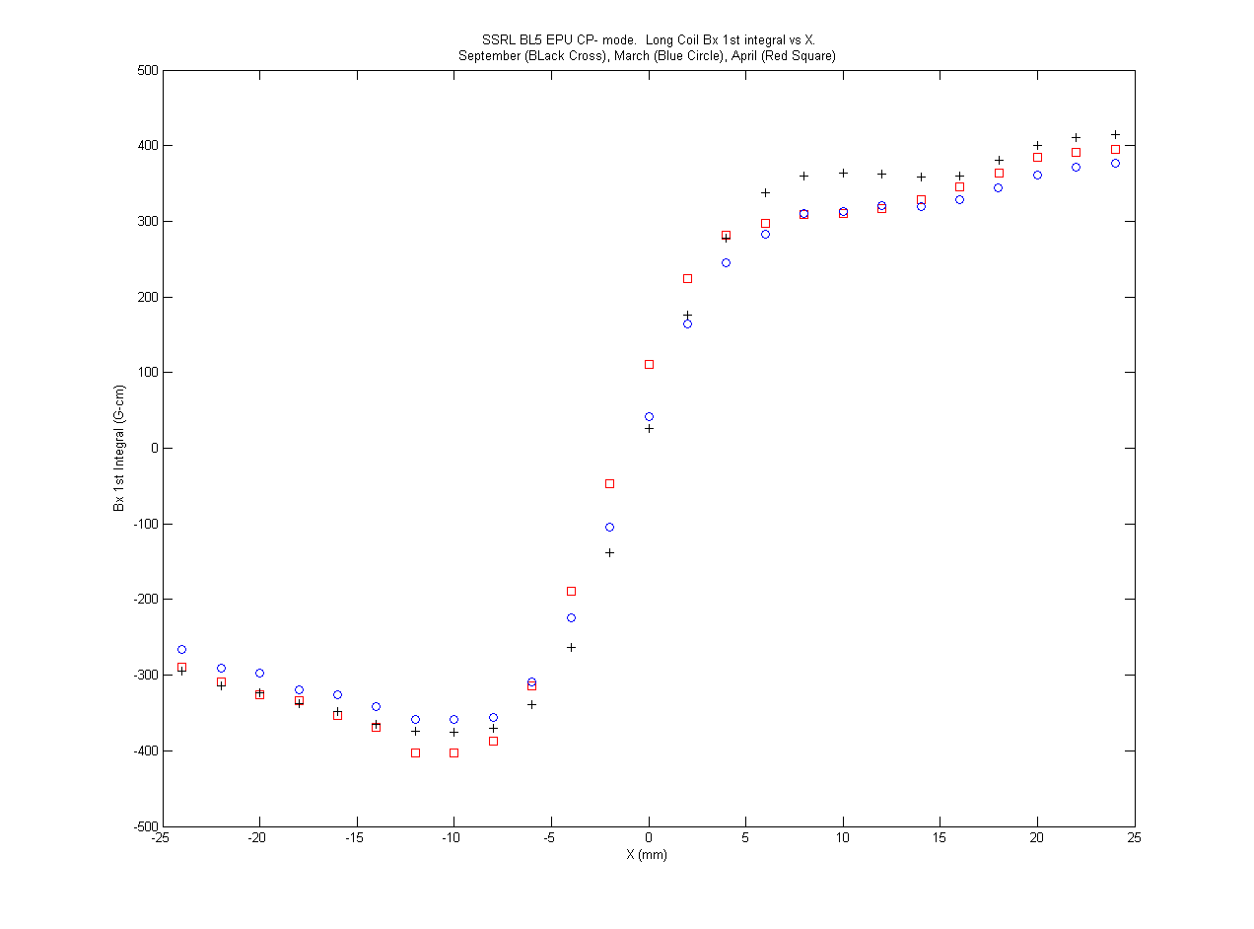
Measurements Repeatable
The odd looking Bx integral measurements were very repeatable.
They also were consistent with Maxwell’s equations.

Slide 16
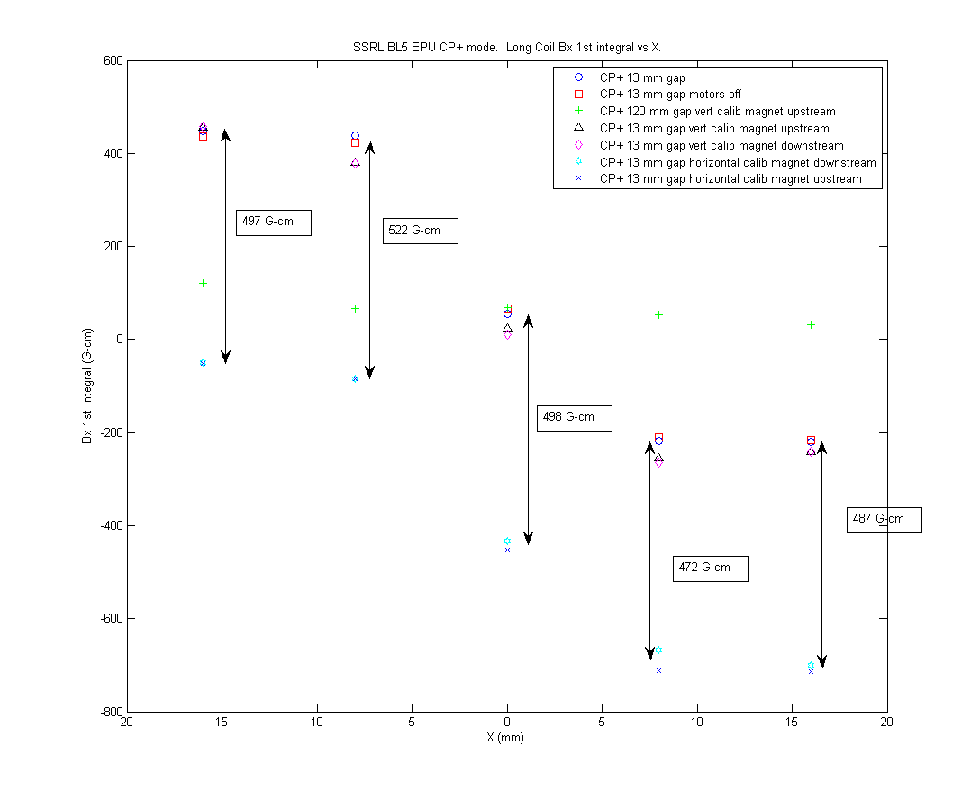
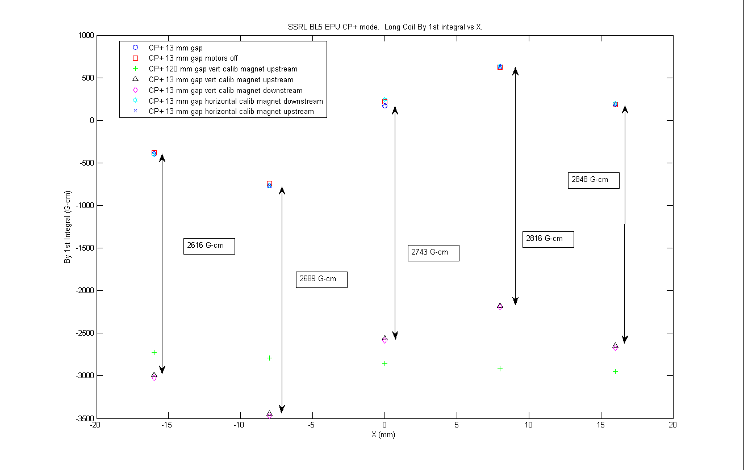
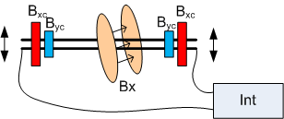
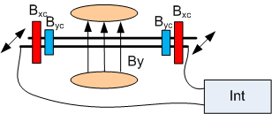
Calibration Magnet Checks
When a calibration magnet was added, the field integrals changed by the
right amount. Implies stages moving ok, software correct, calibration correct.
When undulator motors off, measurements don’t change. Not noise problem.

Slide 17
Moving Wire and Pulsed Wire Check
Set up moving wire and pulsed wire measurements to find the right answer.
The Danfysik measurements were correct.

Slide 18
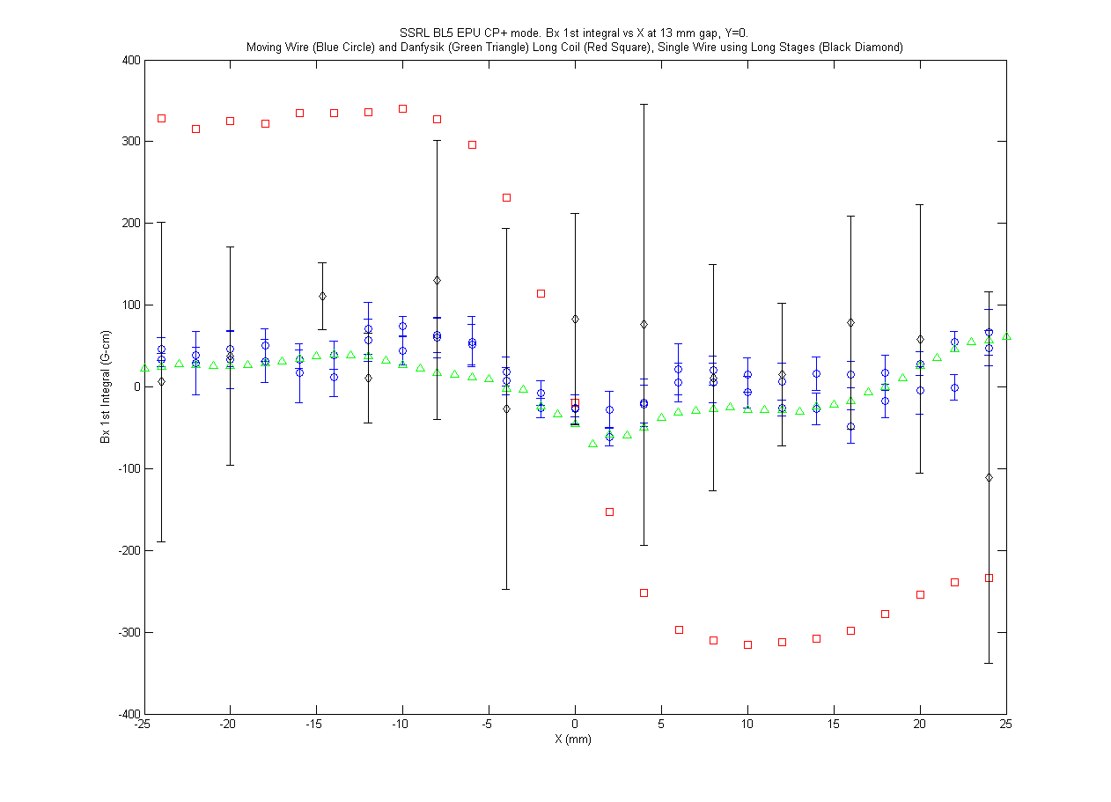
Replace Coil With Single Wire
Replaced long coil with a single wire. Odd behavior is coming from the coil.

Slide 19
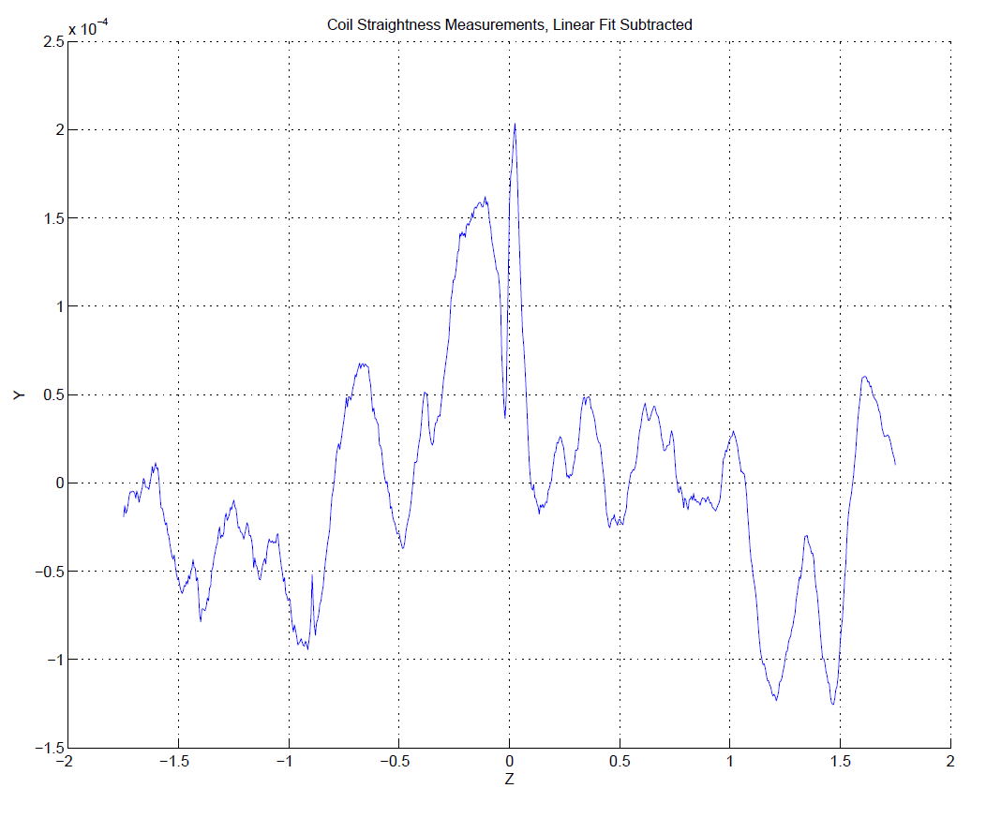
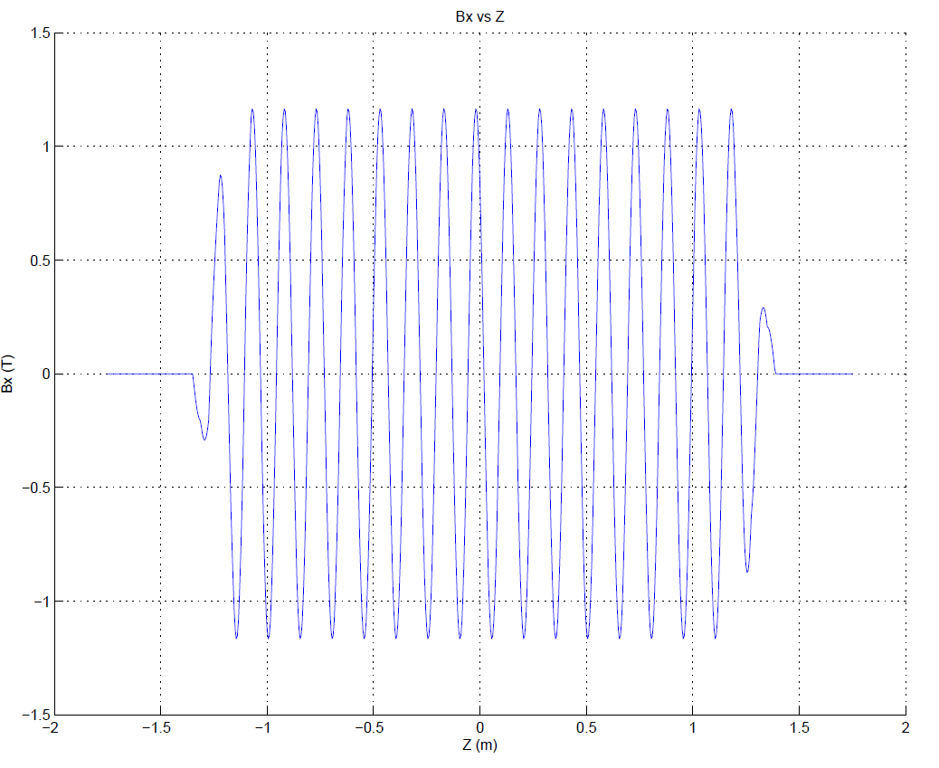
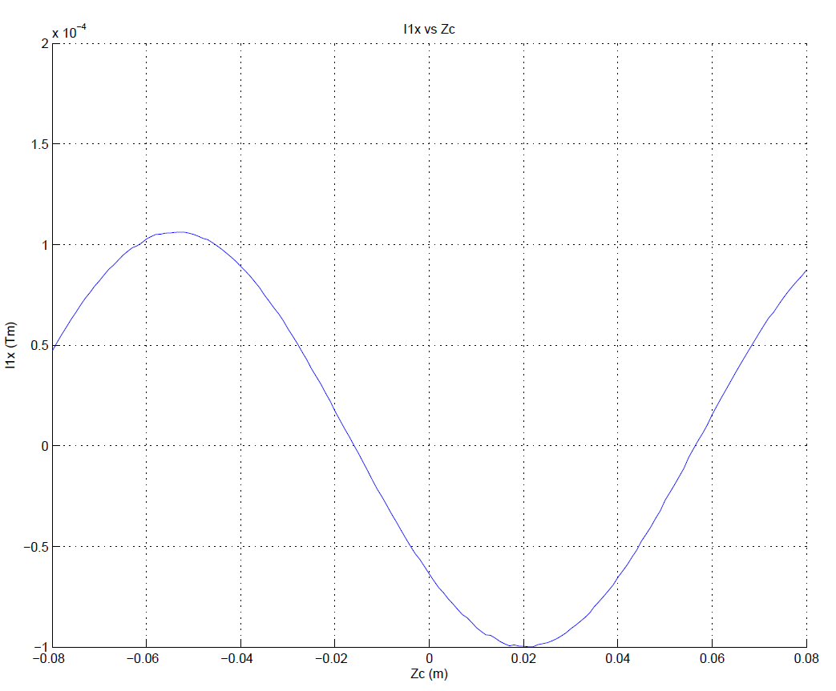
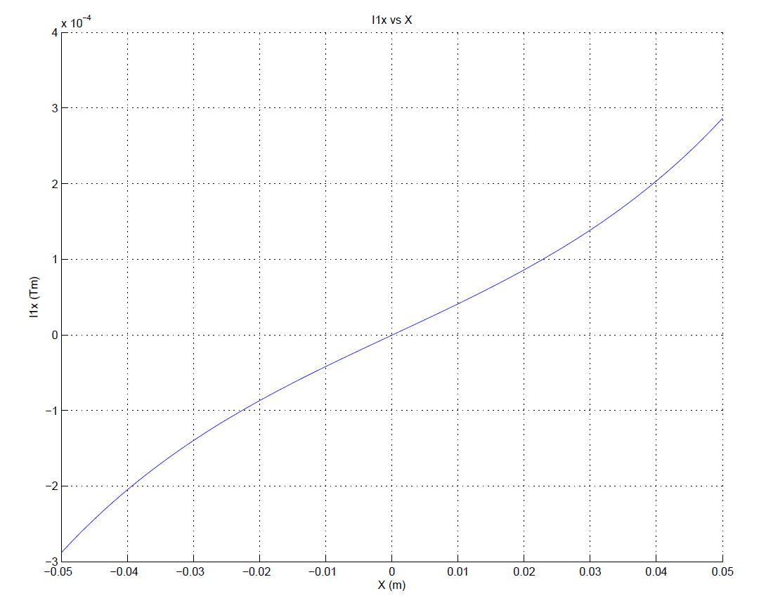
Coil Straightness Plausible Explanation
Coil
Straightness
In y
Simulated
CP Field,
no L-shims
Bx Integral
vs x
Changes
Sign At
Center
Scan
Coil
Position
In z

Slide 20
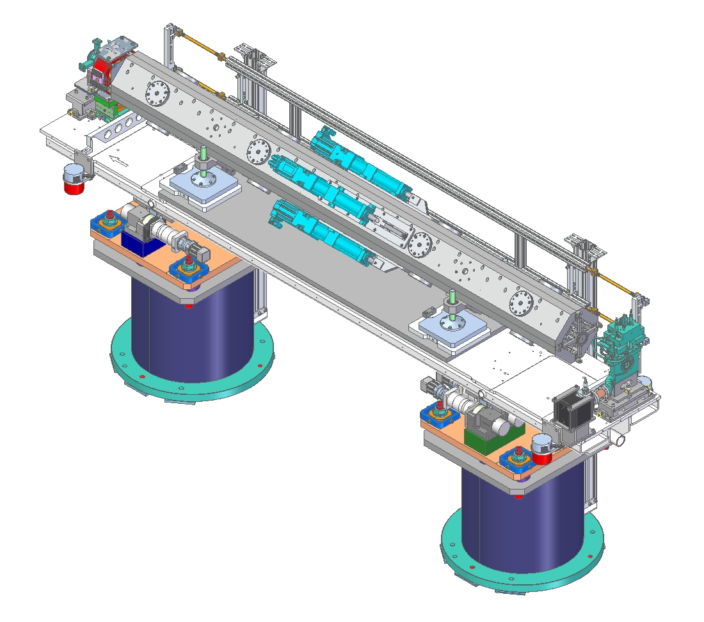
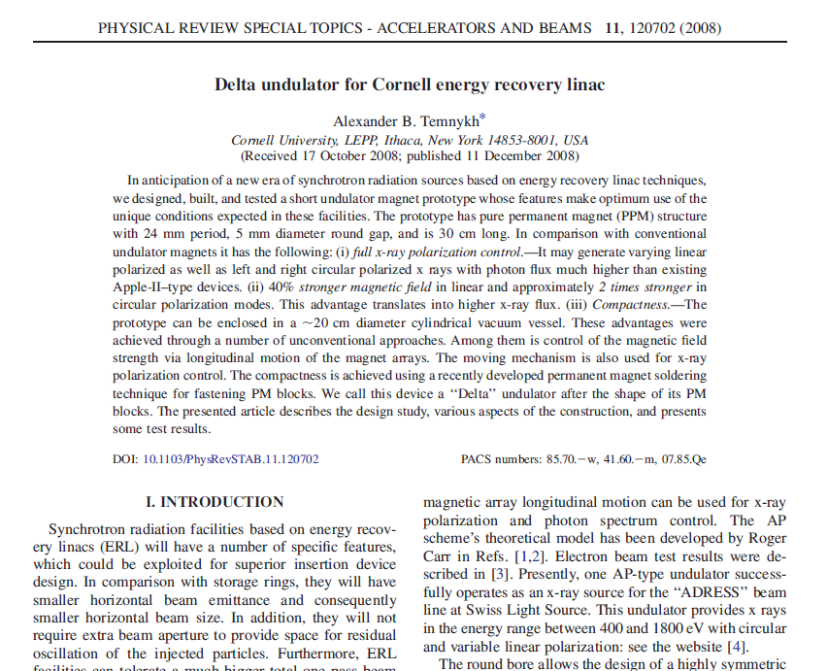
Delta Undulator
EPU in a package compatible with LCLS

Slide 21
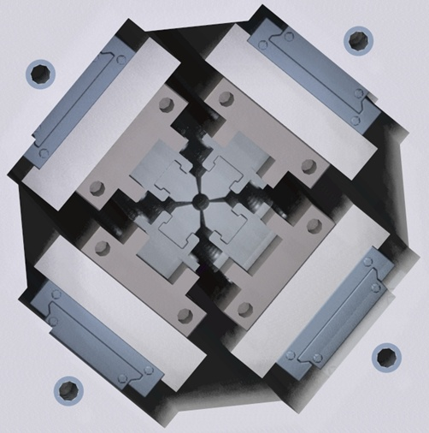
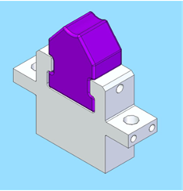
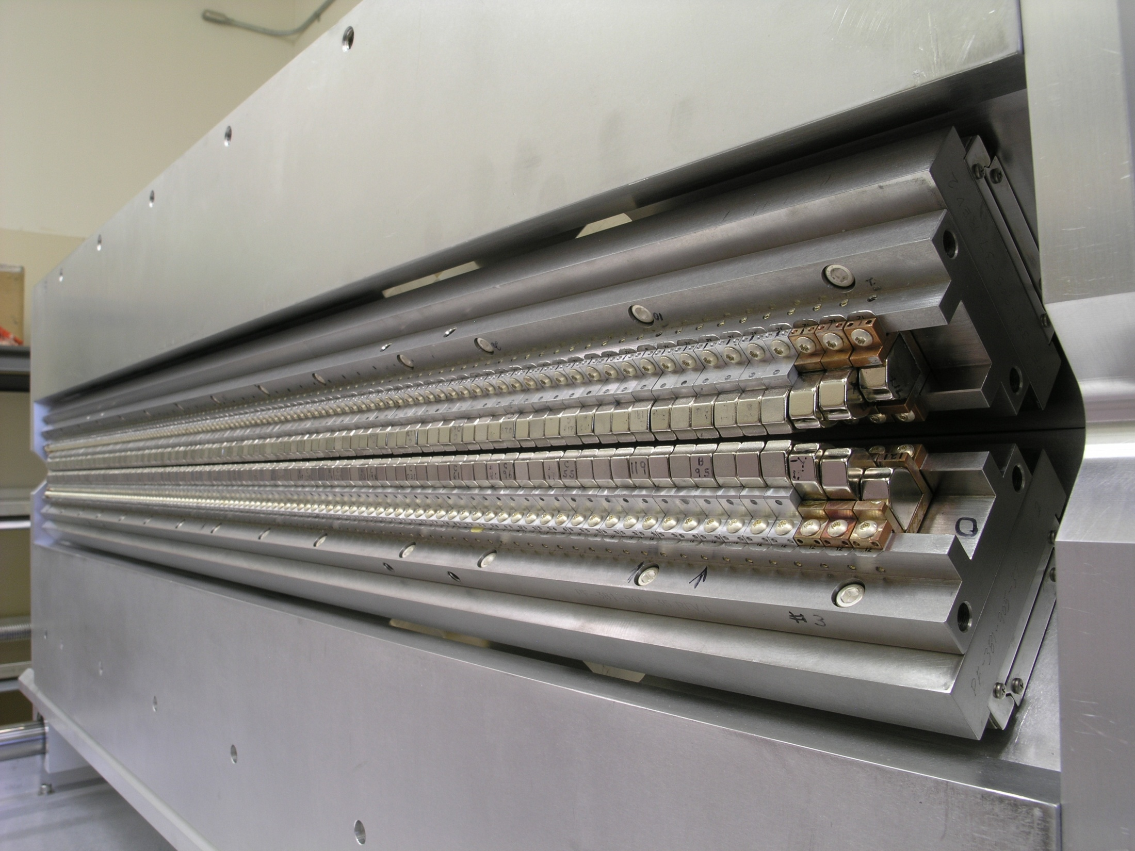
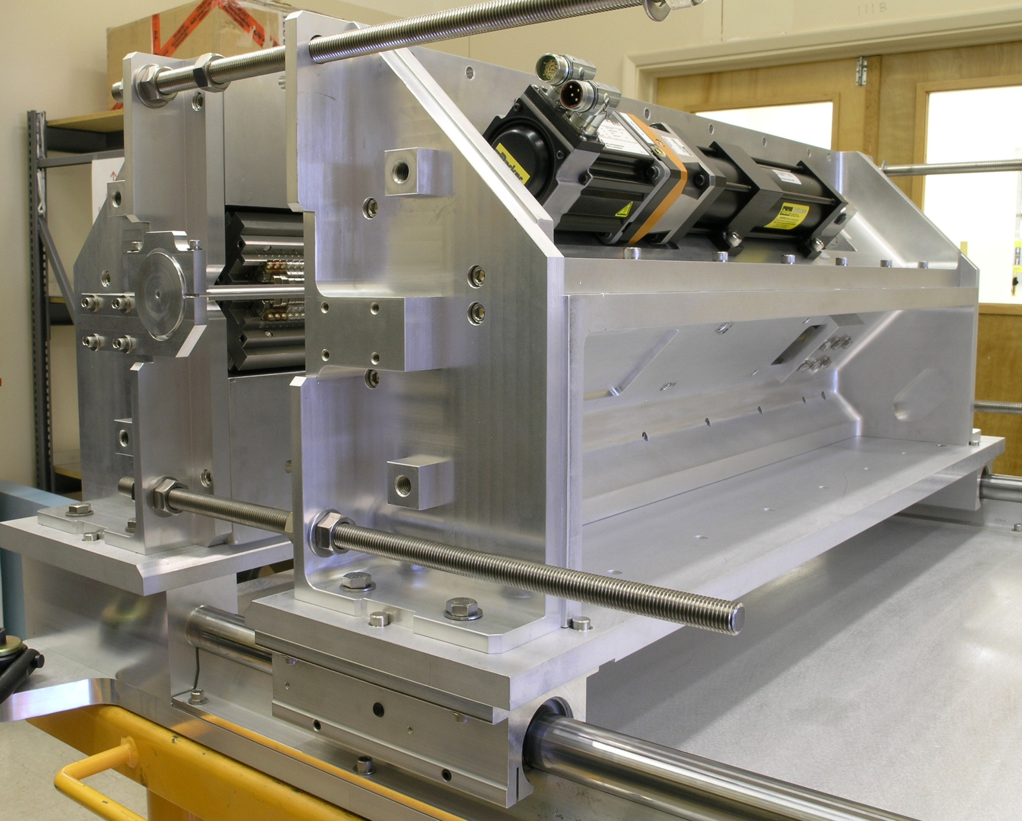
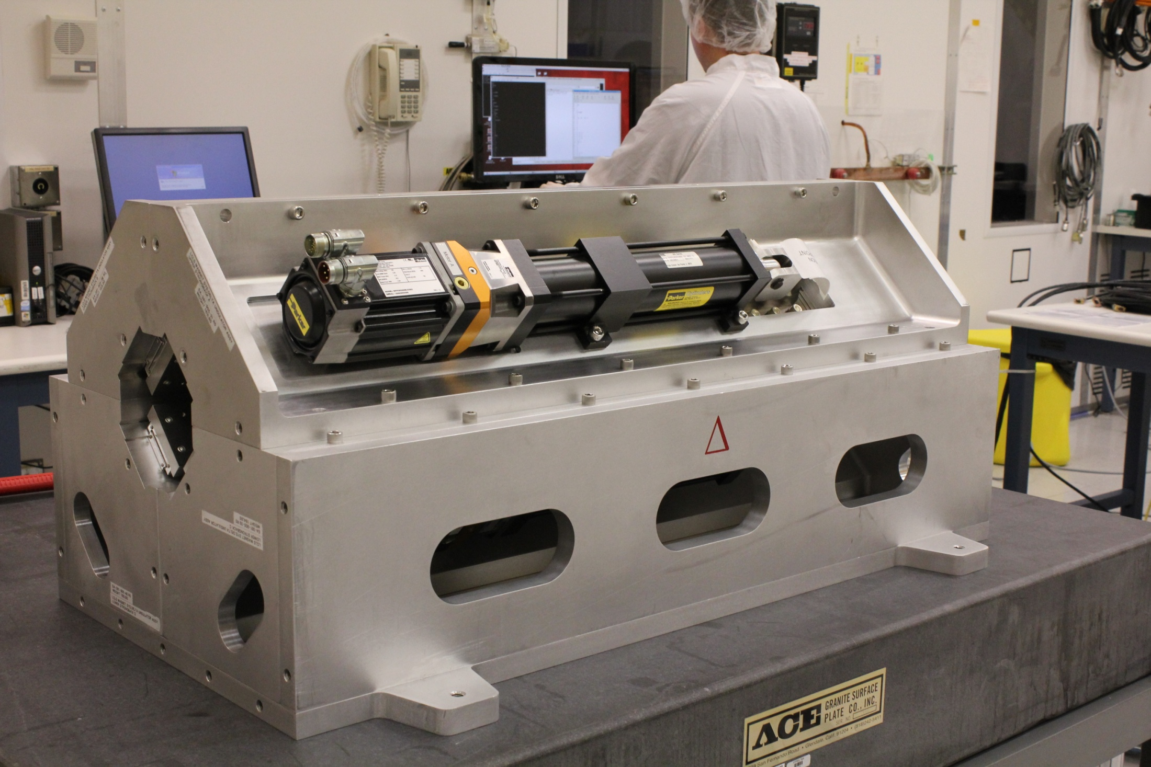
Delta Undulator
Prototype under
construction

Slide 22
Delta Magnetic Measurements
The measurements of the Delta undulator are an R&D effort.
Eventually, we wish to make measurements with LCLS accuracy
in the 6.6 mm diameter bore of a 3.2 m long undulator
with no side access.
We anticipate making an FEL from Delta undulators in the future.
Our goal is to achieve FEL type measurement accuracy:
trajectories straight to 2 microns
rms phase errors below 10 degrees
phase matching errors below 10 degrees
first field integrals below 40 μTm
second field integrals below 50 μTm²
K value accurate to 10⁻⁴, measured at many row phases
beam axis fiducialized to 20 μm
We measure on the curved path of a guide tube in the assembled
undulator, not on the beam axis.
We can only tune quadrants. The assembled undulator can only
only be measured. Do as much tuning as possible before assembly.

Slide 23
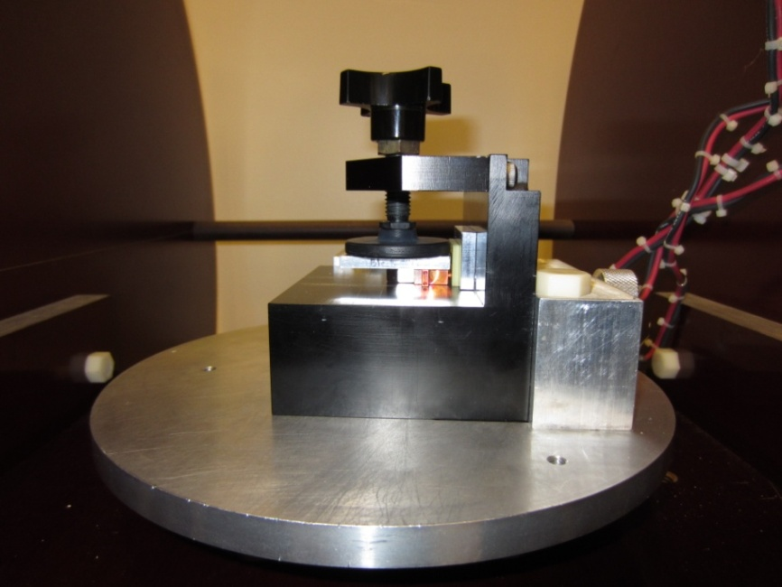
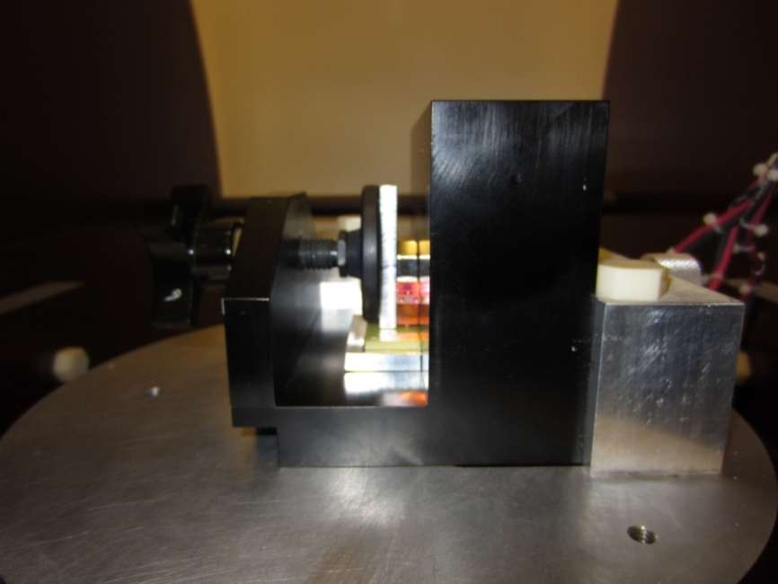
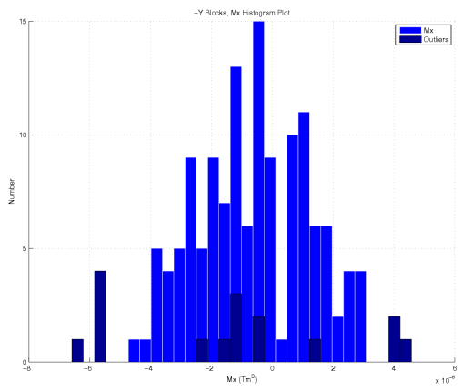
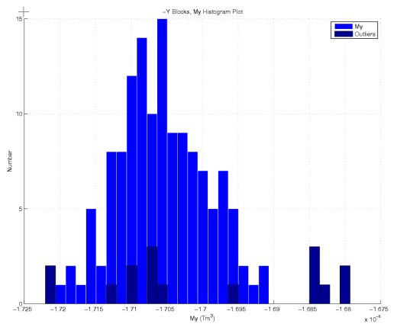
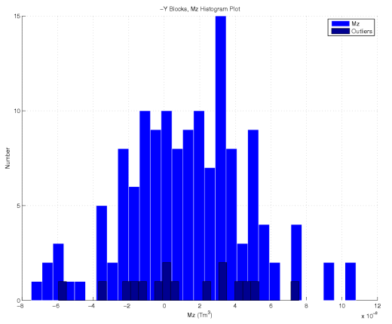
Magnet Block Sorting
LCLS-TN-13-1
Measure:
Mx
My
Mz

Slide 24
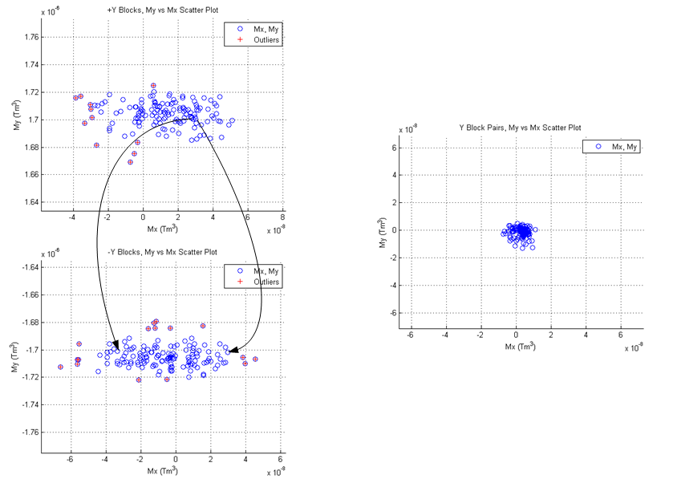
Block Sort, Vertical Blocks
Pair blocks and put pairs into periods to match My (no steering in a period)
and cancel Mx (no vertical kicks in a period).
Put pairs into quadrants so quadrants can be tuned. Place strong pairs in a period
next to weak pairs to minimize phase errors.
(all plots have same scale)

Slide 25
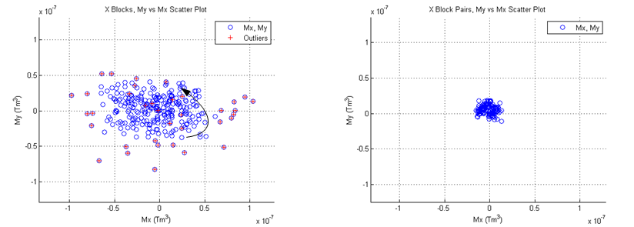
Block Sort, Horizontal Blocks
Horizontal blocks are paired to cancel My and Mx. Pairs are put into undulator
periods. The periods are assembled to make the quadrants.
(both plots have same scale)

Slide 26
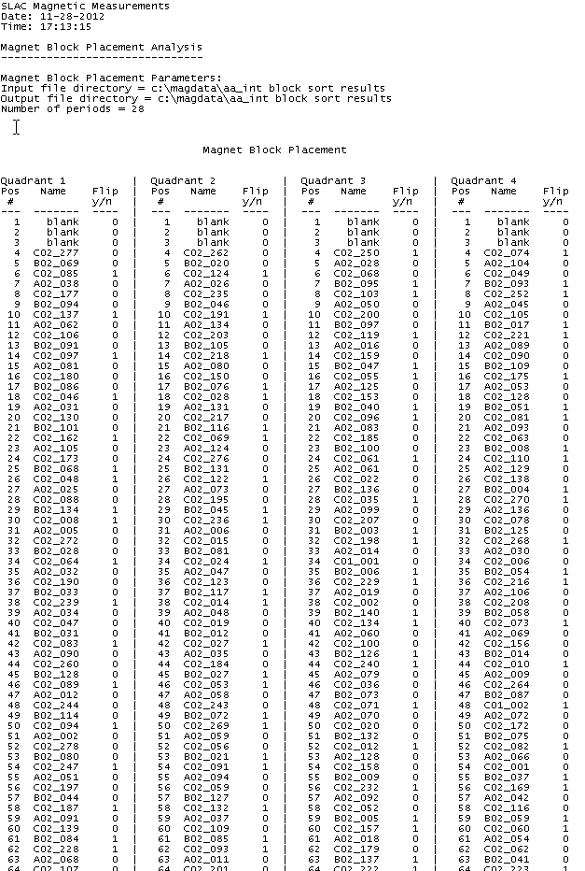
Assemble Quadrants
Use matched pairs in each period to minimize local errors and overall field integrals
Use strong pair, then weak pair to minimize phase errors
Produce printout of what block goes in each slot, indicate block flips

Slide 27
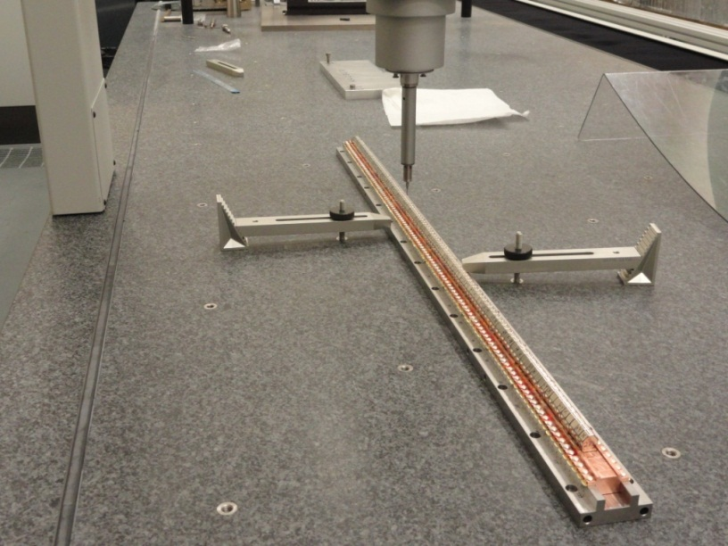
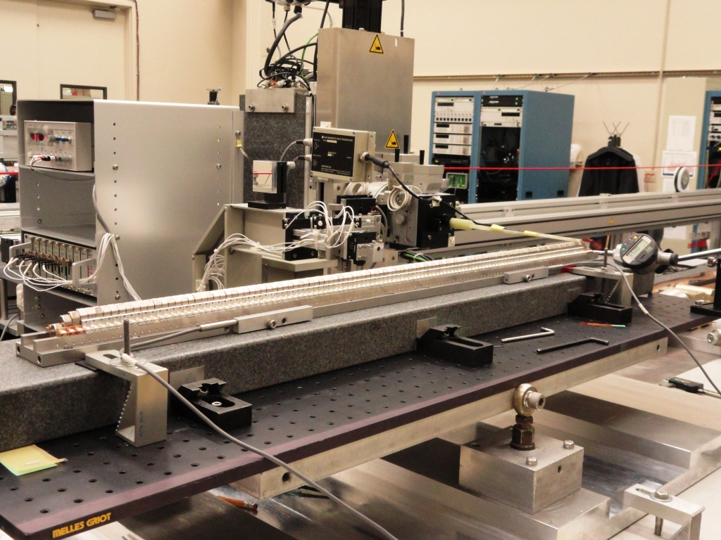
Delta Quadrant Tuning
Mechanically align blocks
using CMM.
Move blocks using magnetic
measurements to straighten
trajectories and minimize
phase errors.

Slide 28
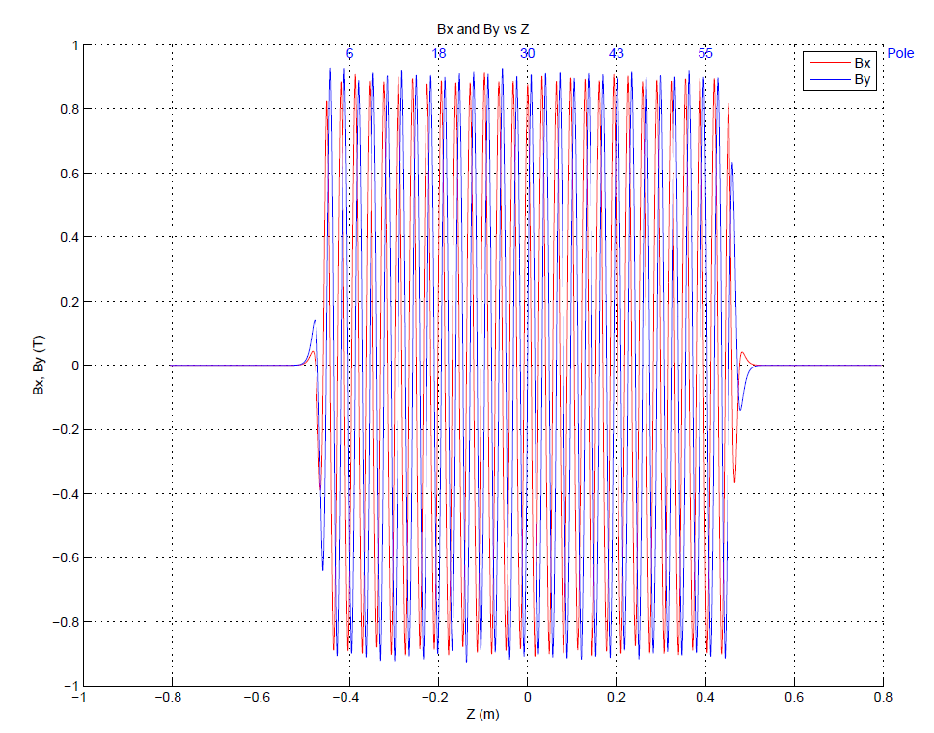
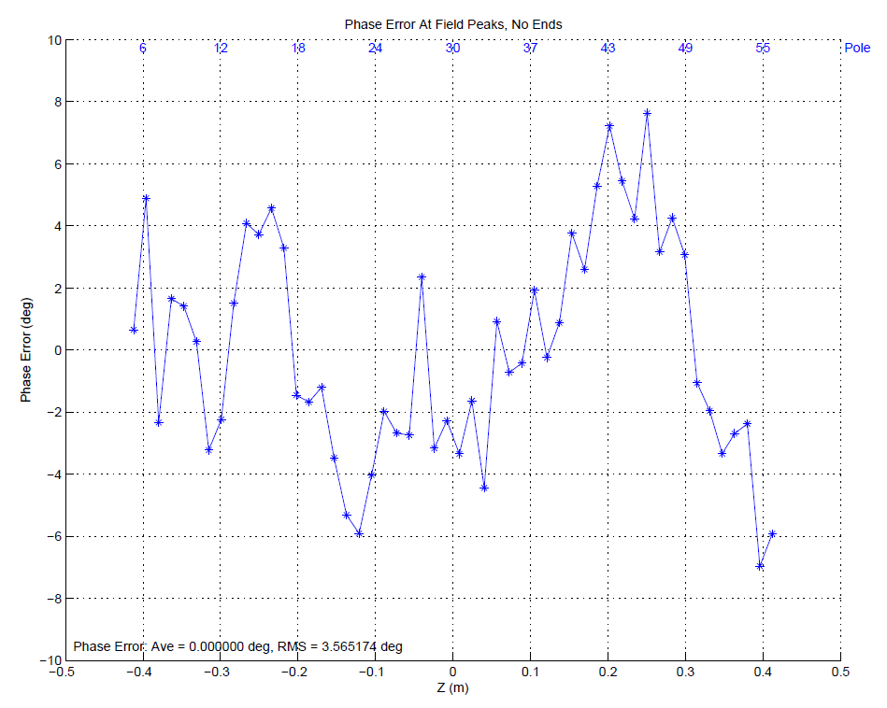
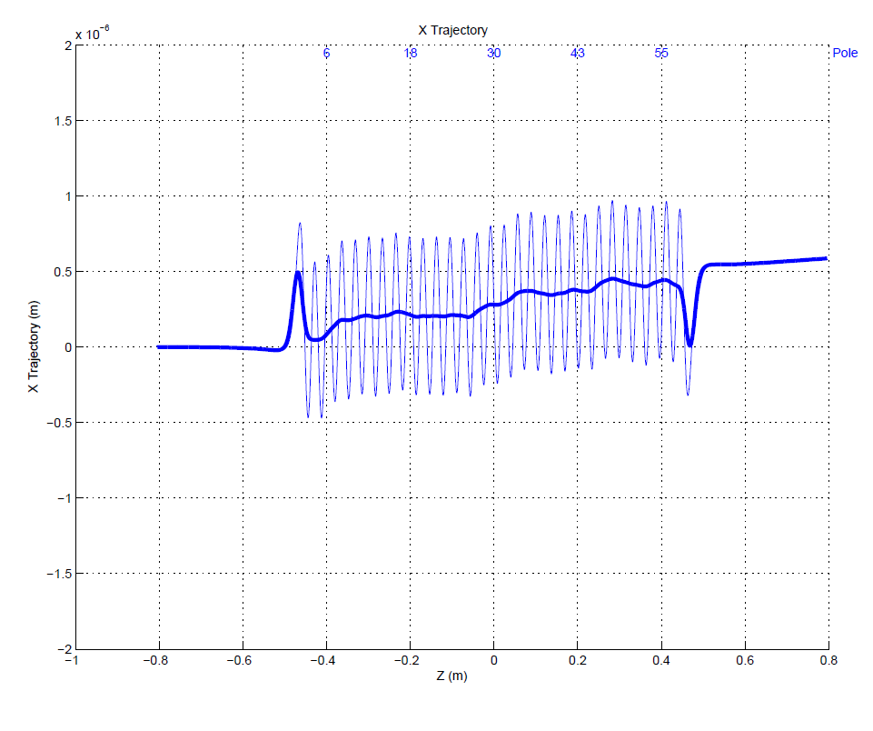
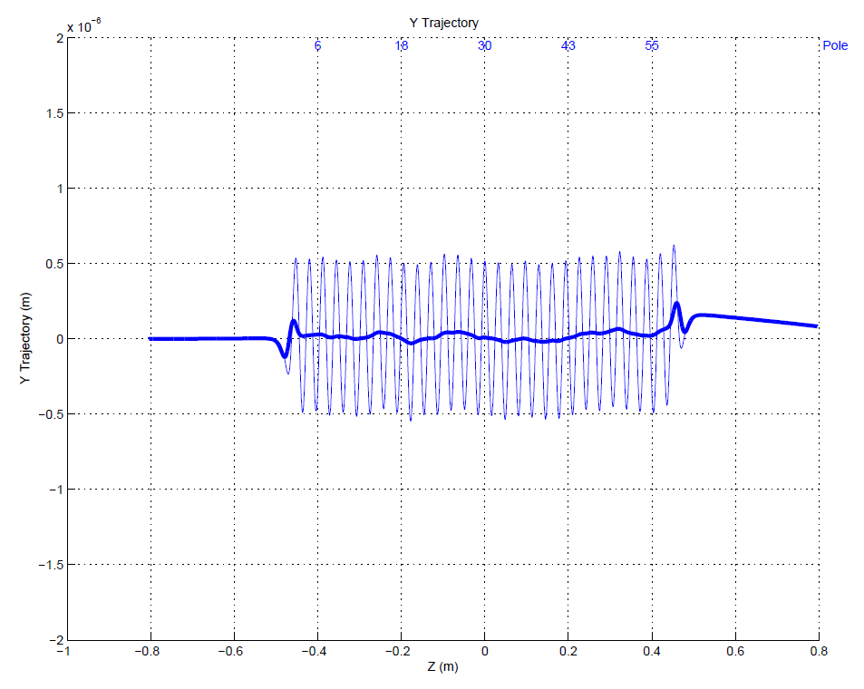
In Software Superpose Quadrant Fields To Simulate Assembled Undulator
Example CP+. Expect undulator within tolerance, but no permeability effects in superposition.

Slide 29
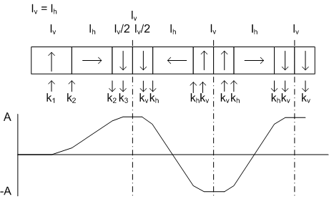
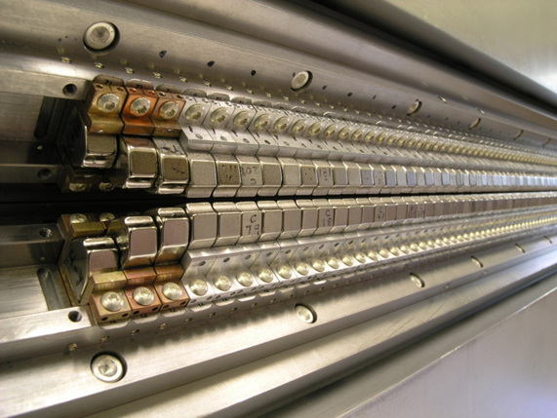
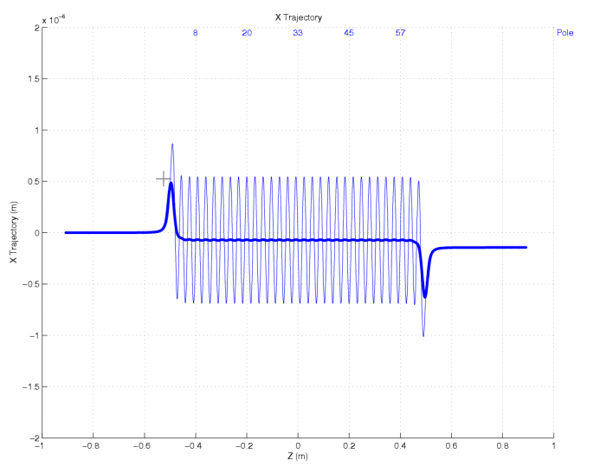
Delta Ends
LCLS-TN-13-2
If K_{v} is kick from full vertical block
and K_{h} is the kick from a full
horizontal block:
k₁ = (3/14)K_{v}
k₂ = (1/2) K_{h}
k₃ + k_{v} = (5/7) K_{v}
Simulation
Block 3 homogenizes the two half
blocks, this leaves a small trajectory
offset. Correct by shifting block 2.

Slide 30
Delta Field Integrals
Moving Wire
Pulsed Wire

Slide 31
Two Senis Probes To Measure Fields
Each probe measures Bx, By, and Bz.
2 Senis probes
Small planar hall effect
Accurate measurements
∆y = 200 microns
Take out ∆z in software

Slide 32
Probe Location
Transverse location from corner cube. Longitudinal location from interferometer.
G. Gassner

Slide 33
Locate Magnetic Center
Center relative to probes.
Use linear field mode.
Measure Bx and By.
Can rotate probes to measure
at two points along x or y.
Assume field shape
is first term in field
expansion near the
center.

Slide 34
Calculate Fields On Beam Axis
LCLS-TN-13-4
Measure on curved trajectory
Find magnetic center relative to probes
Find probes relative to straight line
Find magnetic center relative to straight line
Fit magnetic centers with line to get beam axis
Fiducialize beam axis
Assume that close to the magnetic center, the
field has the form of the fundamental term
in the field expansion
Calculate the field on the beam axis from the field
at the measurement location, the location of the
magnetic center, and the form of the field

Slide 35
Conclusion
LCLS-I measurements continue to check for radiation damage and to
do experiments such as opening the gap for the second harmonic.
We are preparing to upgrade the lab to handle the large LCLS-II undulators.
We are working on the LCLS-II phase shifter. We built a magnetic test piece
that we successfully tuned. We are starting to build a prototype.
We simulated and tested an LCLS-II beam pipe corrector.
We are building a Delta undulator. A 1 meter prototype is built. We are
starting to measure it. This involved measuring the magnetic moments
of the blocks and sorting them. Mounting the blocks in keepers,
mechanically adjusting them, and tuning the quadrants. We
just put the 4 quadrants together.
We have a plan to accurately determine the fields in the Delta undulator
on the beam axis. Our goal is to make measurements accurately enough
to someday make an FEL out of Delta undulators.

Slide 36
Extra Slides

Slide 37
LCLS
Gun
Accelerator
Drift
Undulator Tunnel
Undulator
Near Hall
Far Hall
Site Overview
Measurement Lab

Slide 38
Hall Probe
Hall probe measurements begin and end in a zero gauss chamber.
Probe offsets are removed. The probes are periodically calibrated
with an NMR system. A reference dipole which accepts an NMR
probe is measured with each undulator to check for probe drift.

Slide 39
Coil Measurements
Short coils measure both the horizontal
and vertical field. The measurements
begin and end in a zero gauss chamber.
The short coils are used to check the hall
probe measurements.
Long coil measurements are used to
determine the field integrals. Integrator
drift is minimized by the short
measurement time. The field integrals
are more accurate than those of other
methods.
Long coil in use

Slide 40
Align Undulator To Bench
Capacitive sensor measurements
start in a reference pole which
determines the transverse position
and roll. Pitch and yaw are set by
making the undulator parallel to the
bench.
Capacitive sensors measure
undulator position relative
to the bench.
Cam movers move the undulator
parallel to the bench, take out roll,
and move to the proper transverse
location.

Slide 41
Undulator Shims
Horizontal trajectory shims.
Vertical trajectory shims.
Horizontal trajectory shim
and phase shims.
The horizontal trajectory shims weaken a pole, giving the beam a
horizontal kick. Pole polarity determines the kick direction.
Vertical trajectory shims introduce a small horizontal field component,
giving the beam a vertical kick.
Phase shims weaken two poles, increasing the average forward
velocity of the beam. This introduces a negative phase shift.
Tapered shims set the cant angle of the poles. They are used to
adjust the gap in order to set the K value. Phase adjustments are
also done with these shims.
Tapered shims.

Slide 42
Tuning Automation
Measured x-trajectory
Line segments fit to
the trajectory
One shim per segment calculated to
make the segments into a straight line
Shims combined to
reduce their number
Trajectory modeled with
shims applied
Trajectory measured
after shims were applied
A number of straight line segments are fit to the measured trajectory. The slope change for each segment
is calculated which makes the segments into a straight line. Shim strengths are calculated from the slope
changes. Shims are combined to reduce their number, resulting in a trajectory which is no longer ideal, but
it exceeds the tolerances. The trajectory with the added shims is modeled. The shims are added and the
corrected trajectory is measured.

Slide 43
Fiducialization
Pointed magnets with same sign poles are added to the ends of the undulator. These magnets have a well
defined zero field point in the center. The distance from the measurement axis to the zero field point is
determined. A calibration gives the distance from the zero field point to tooling balls on the pointed magnet
fixture. The distance from the tooling balls on the pointed magnet fixture to tooling balls on the undulator is
measured with a coordinate measuring machine.

Slide 44
Undulator Quadrupoles
Magnetic Center
Field Quality

