Slide 1













Measurement of the Superconducting Magnets for the European XFEL Project at DESY
H. Brueck
DESY, Hamburg, Germany
XFEL Project working group WP 11

Slide 2
Topics
The European XFEL project
Cold magnets
Test equipment
Some first results

Slide 3
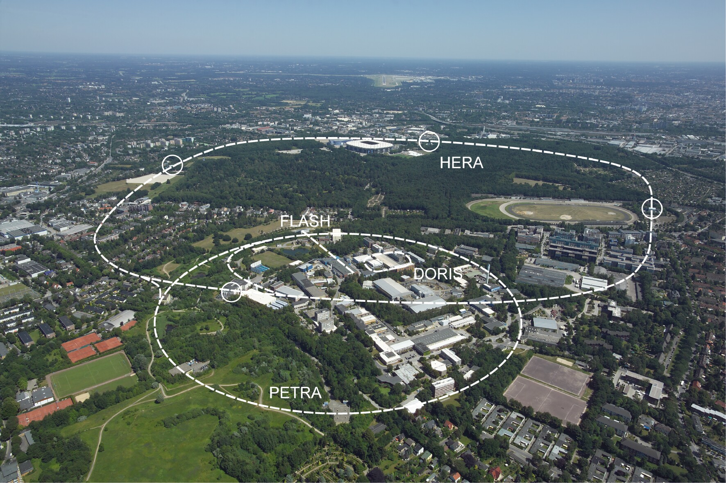
DESY - Deutsches Elektronen Synchrotron Hamburg
DESY
XFEL

Slide 4
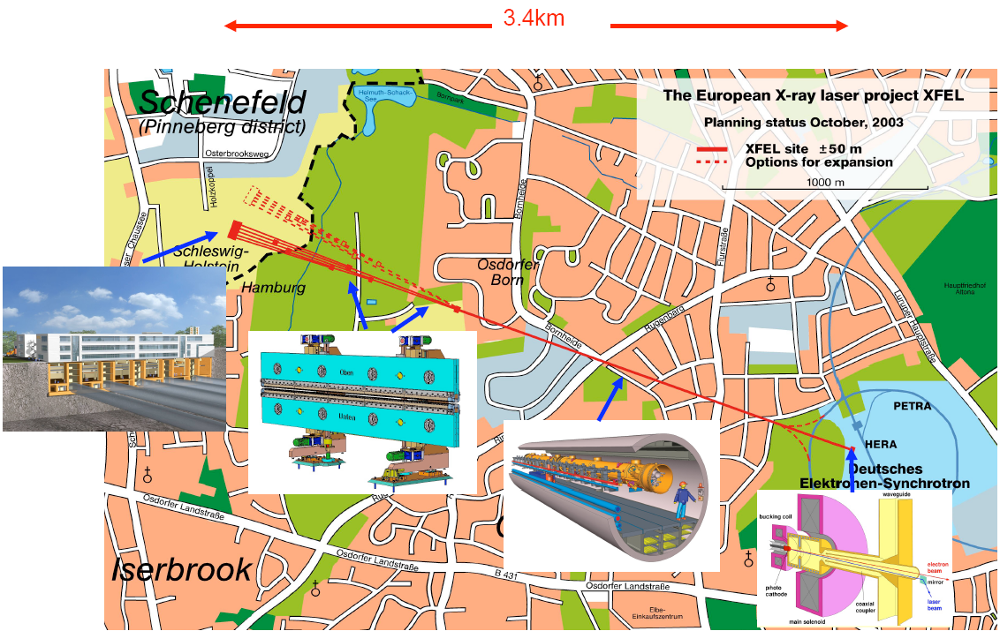
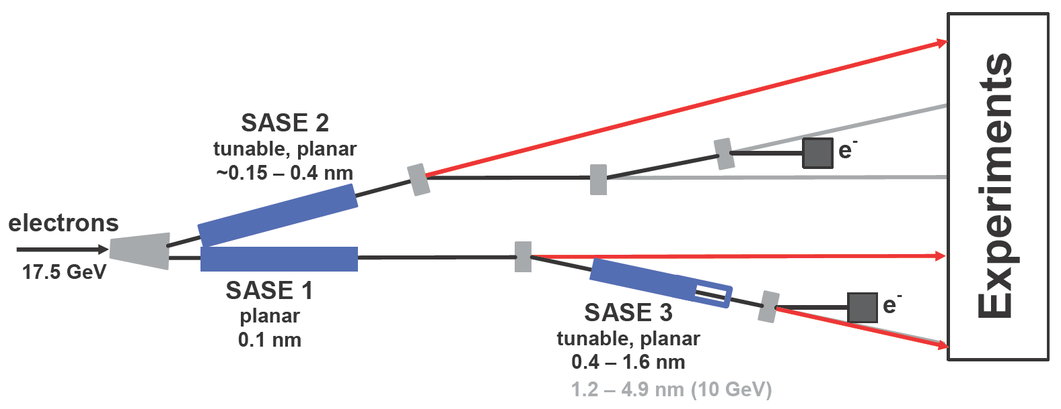
The European XFEL
Some specifications
Photon energy 0.3-24 keV
Pulse duration ~ 10-100 fs
Pulse energy few mJ
Superconducting linac. 17.5 GeV
10 Hz (27 000 b/s)
5 beamlines / 10 instruments
  Start version with 3 beamlines and 6 instruments
Several extensions possible:
  More undulators
  More instruments
  …….
  Variable polarization
  Self-Seeding
  CW operation
First beam late 2015
SASE2
(= SASE1)
17.5 GeV
SASE1, λ_{u}= 40 mm
0.2 – 0.05 nm
SASE3, λ_{u}= 68 mm
1.7 – 0.4 nm

Slide 5
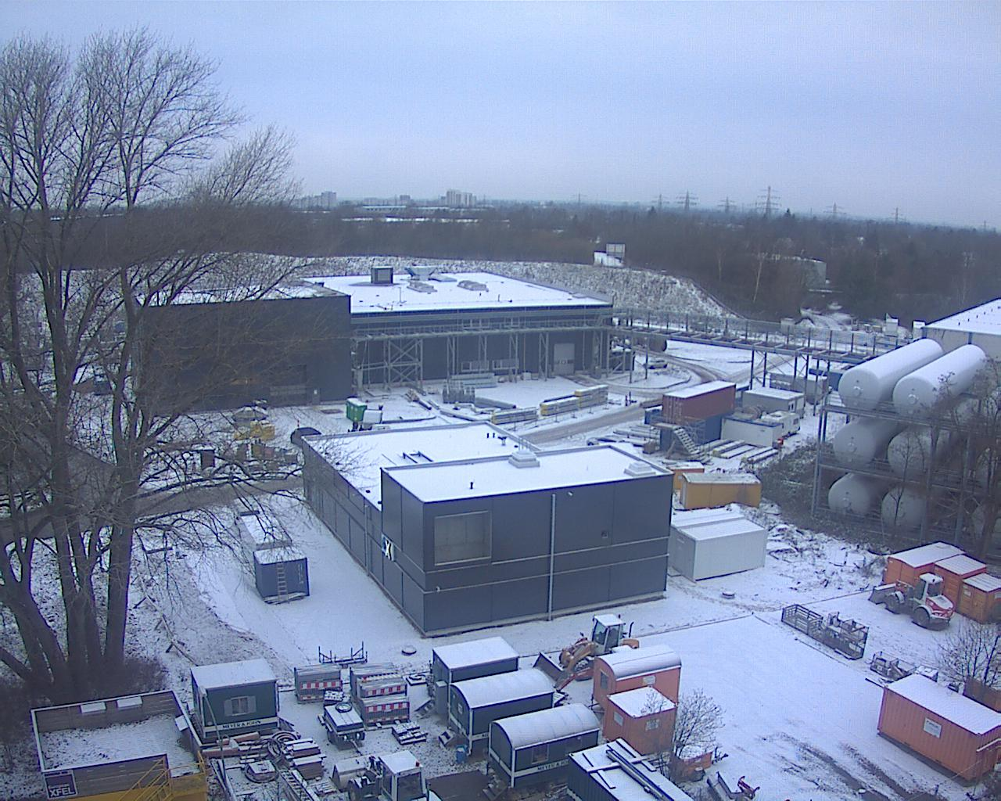
Civil Engineering Progress
18 January 2013

Slide 6
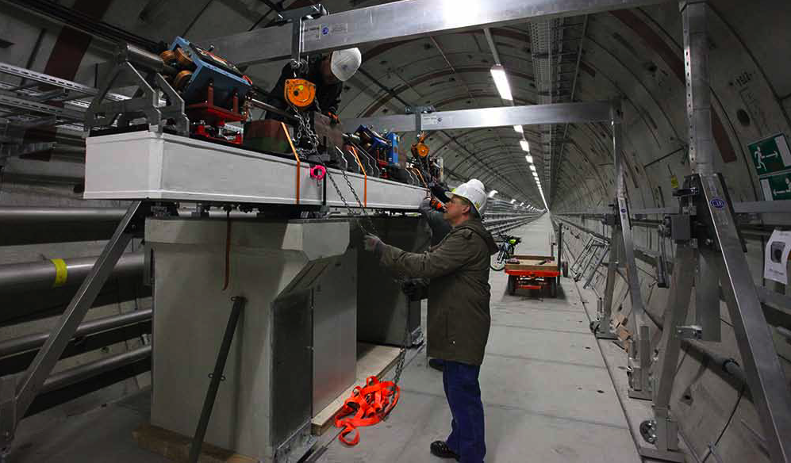
Prototype Linac girder installed in tunnel

Slide 7
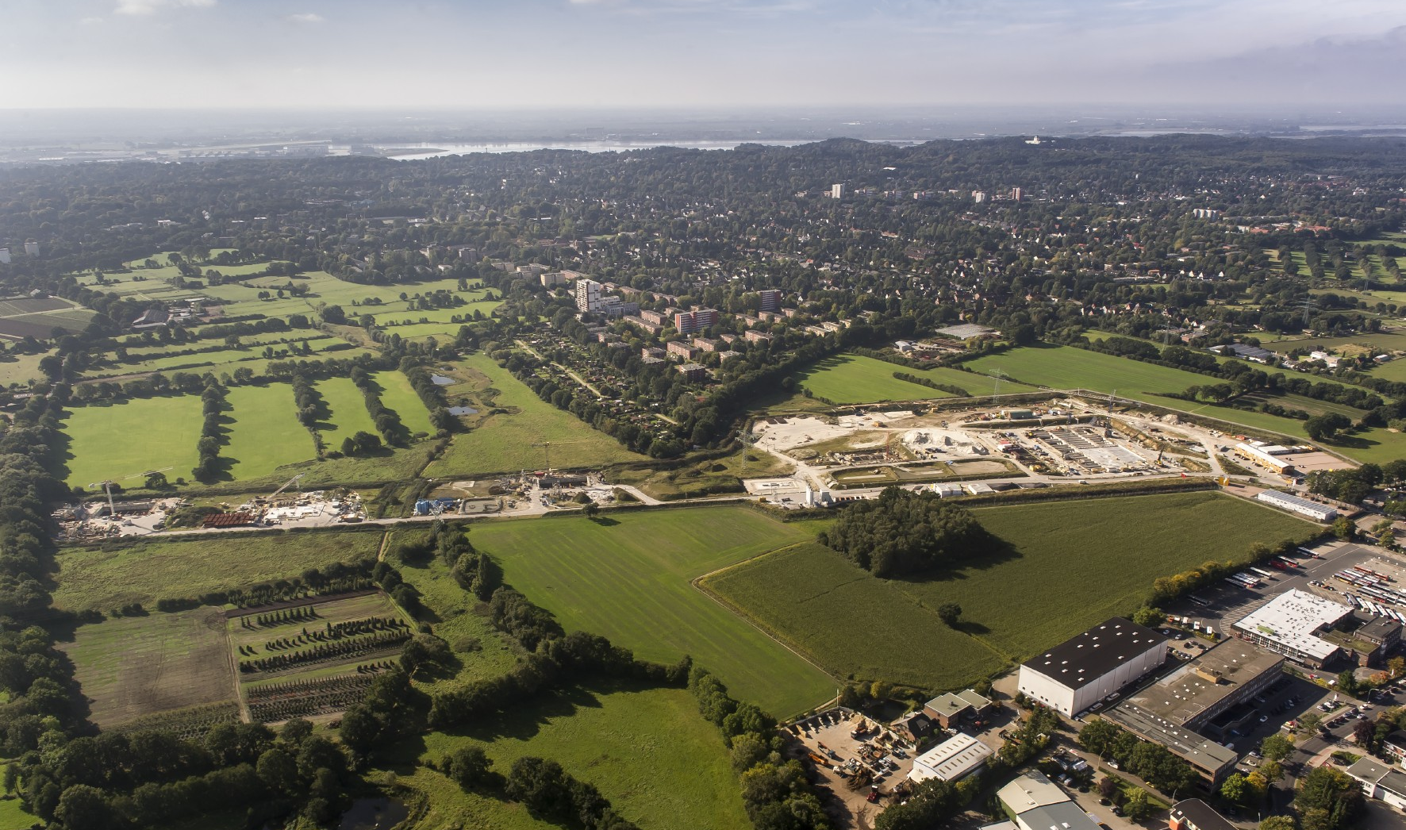
Schenefeld Campus

Slide 8
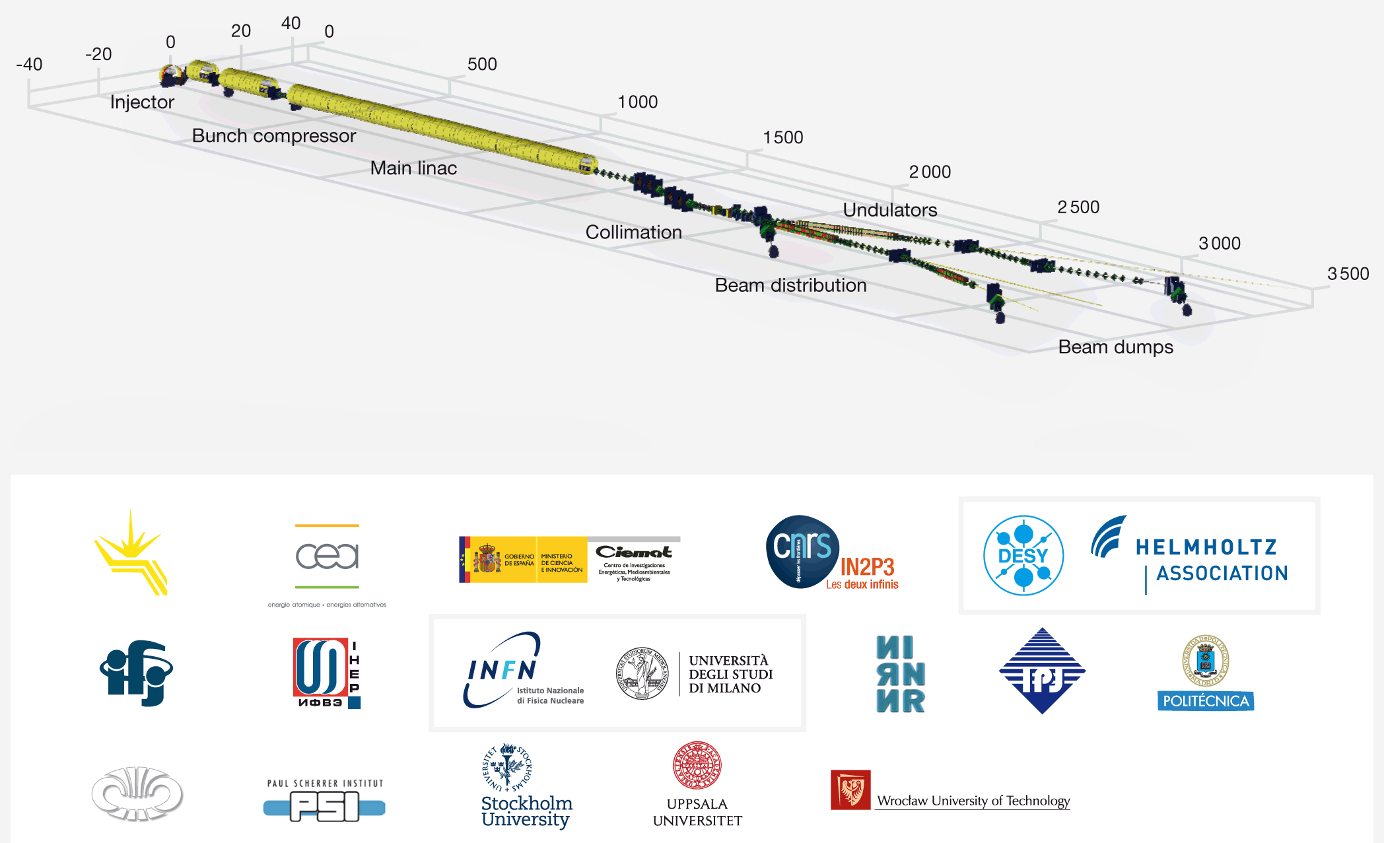
Linac and Beamlines

Slide 9
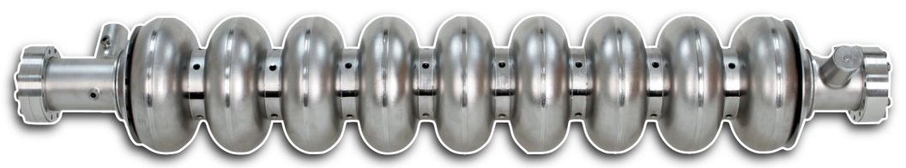
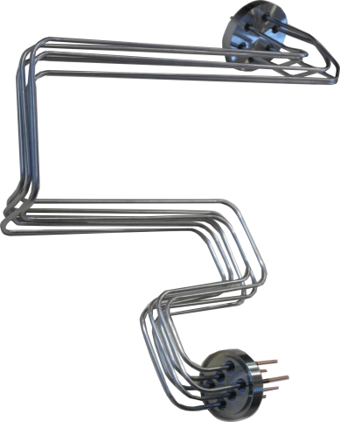
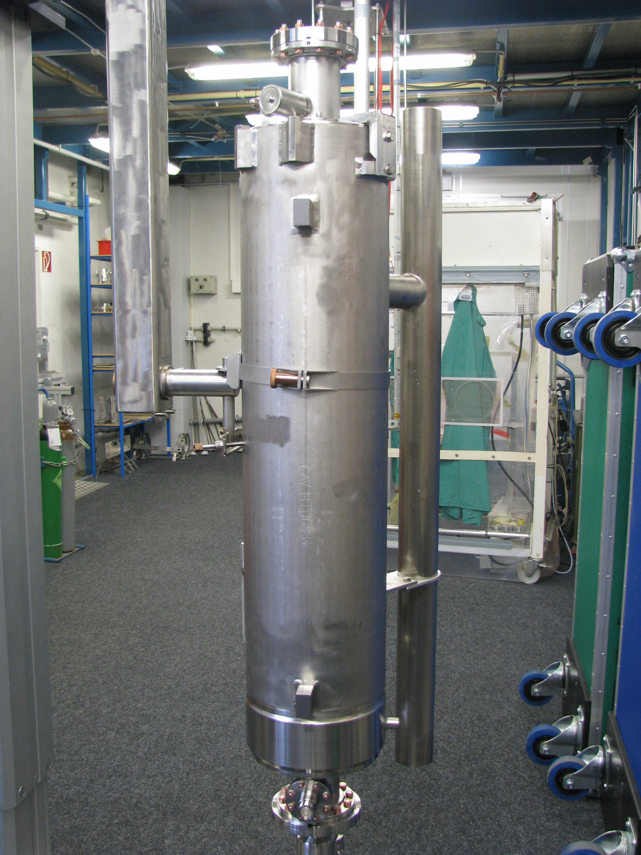
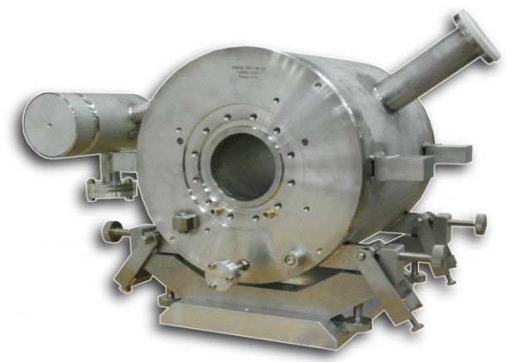
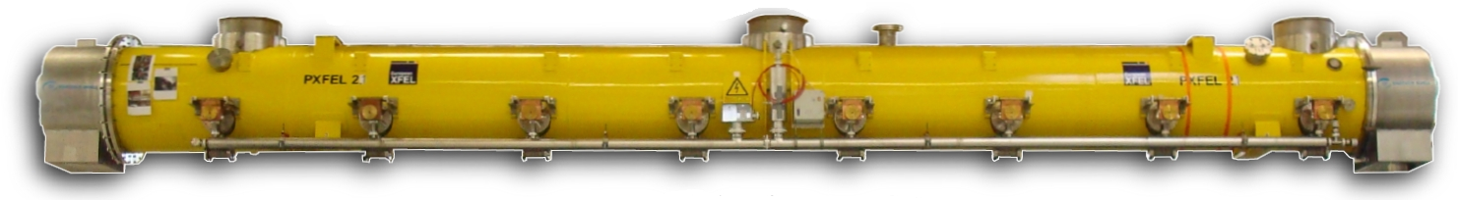
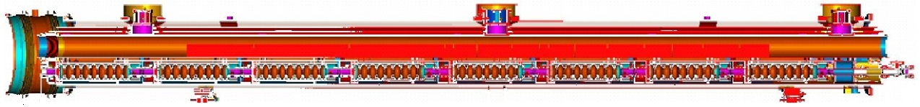
Accelerator Modules with Cavities and Magnets
cavity
current leads
cavity in vessel
magnets
8 cavities in module
103 accelerator modules in the XFEL LINAC

Slide 10



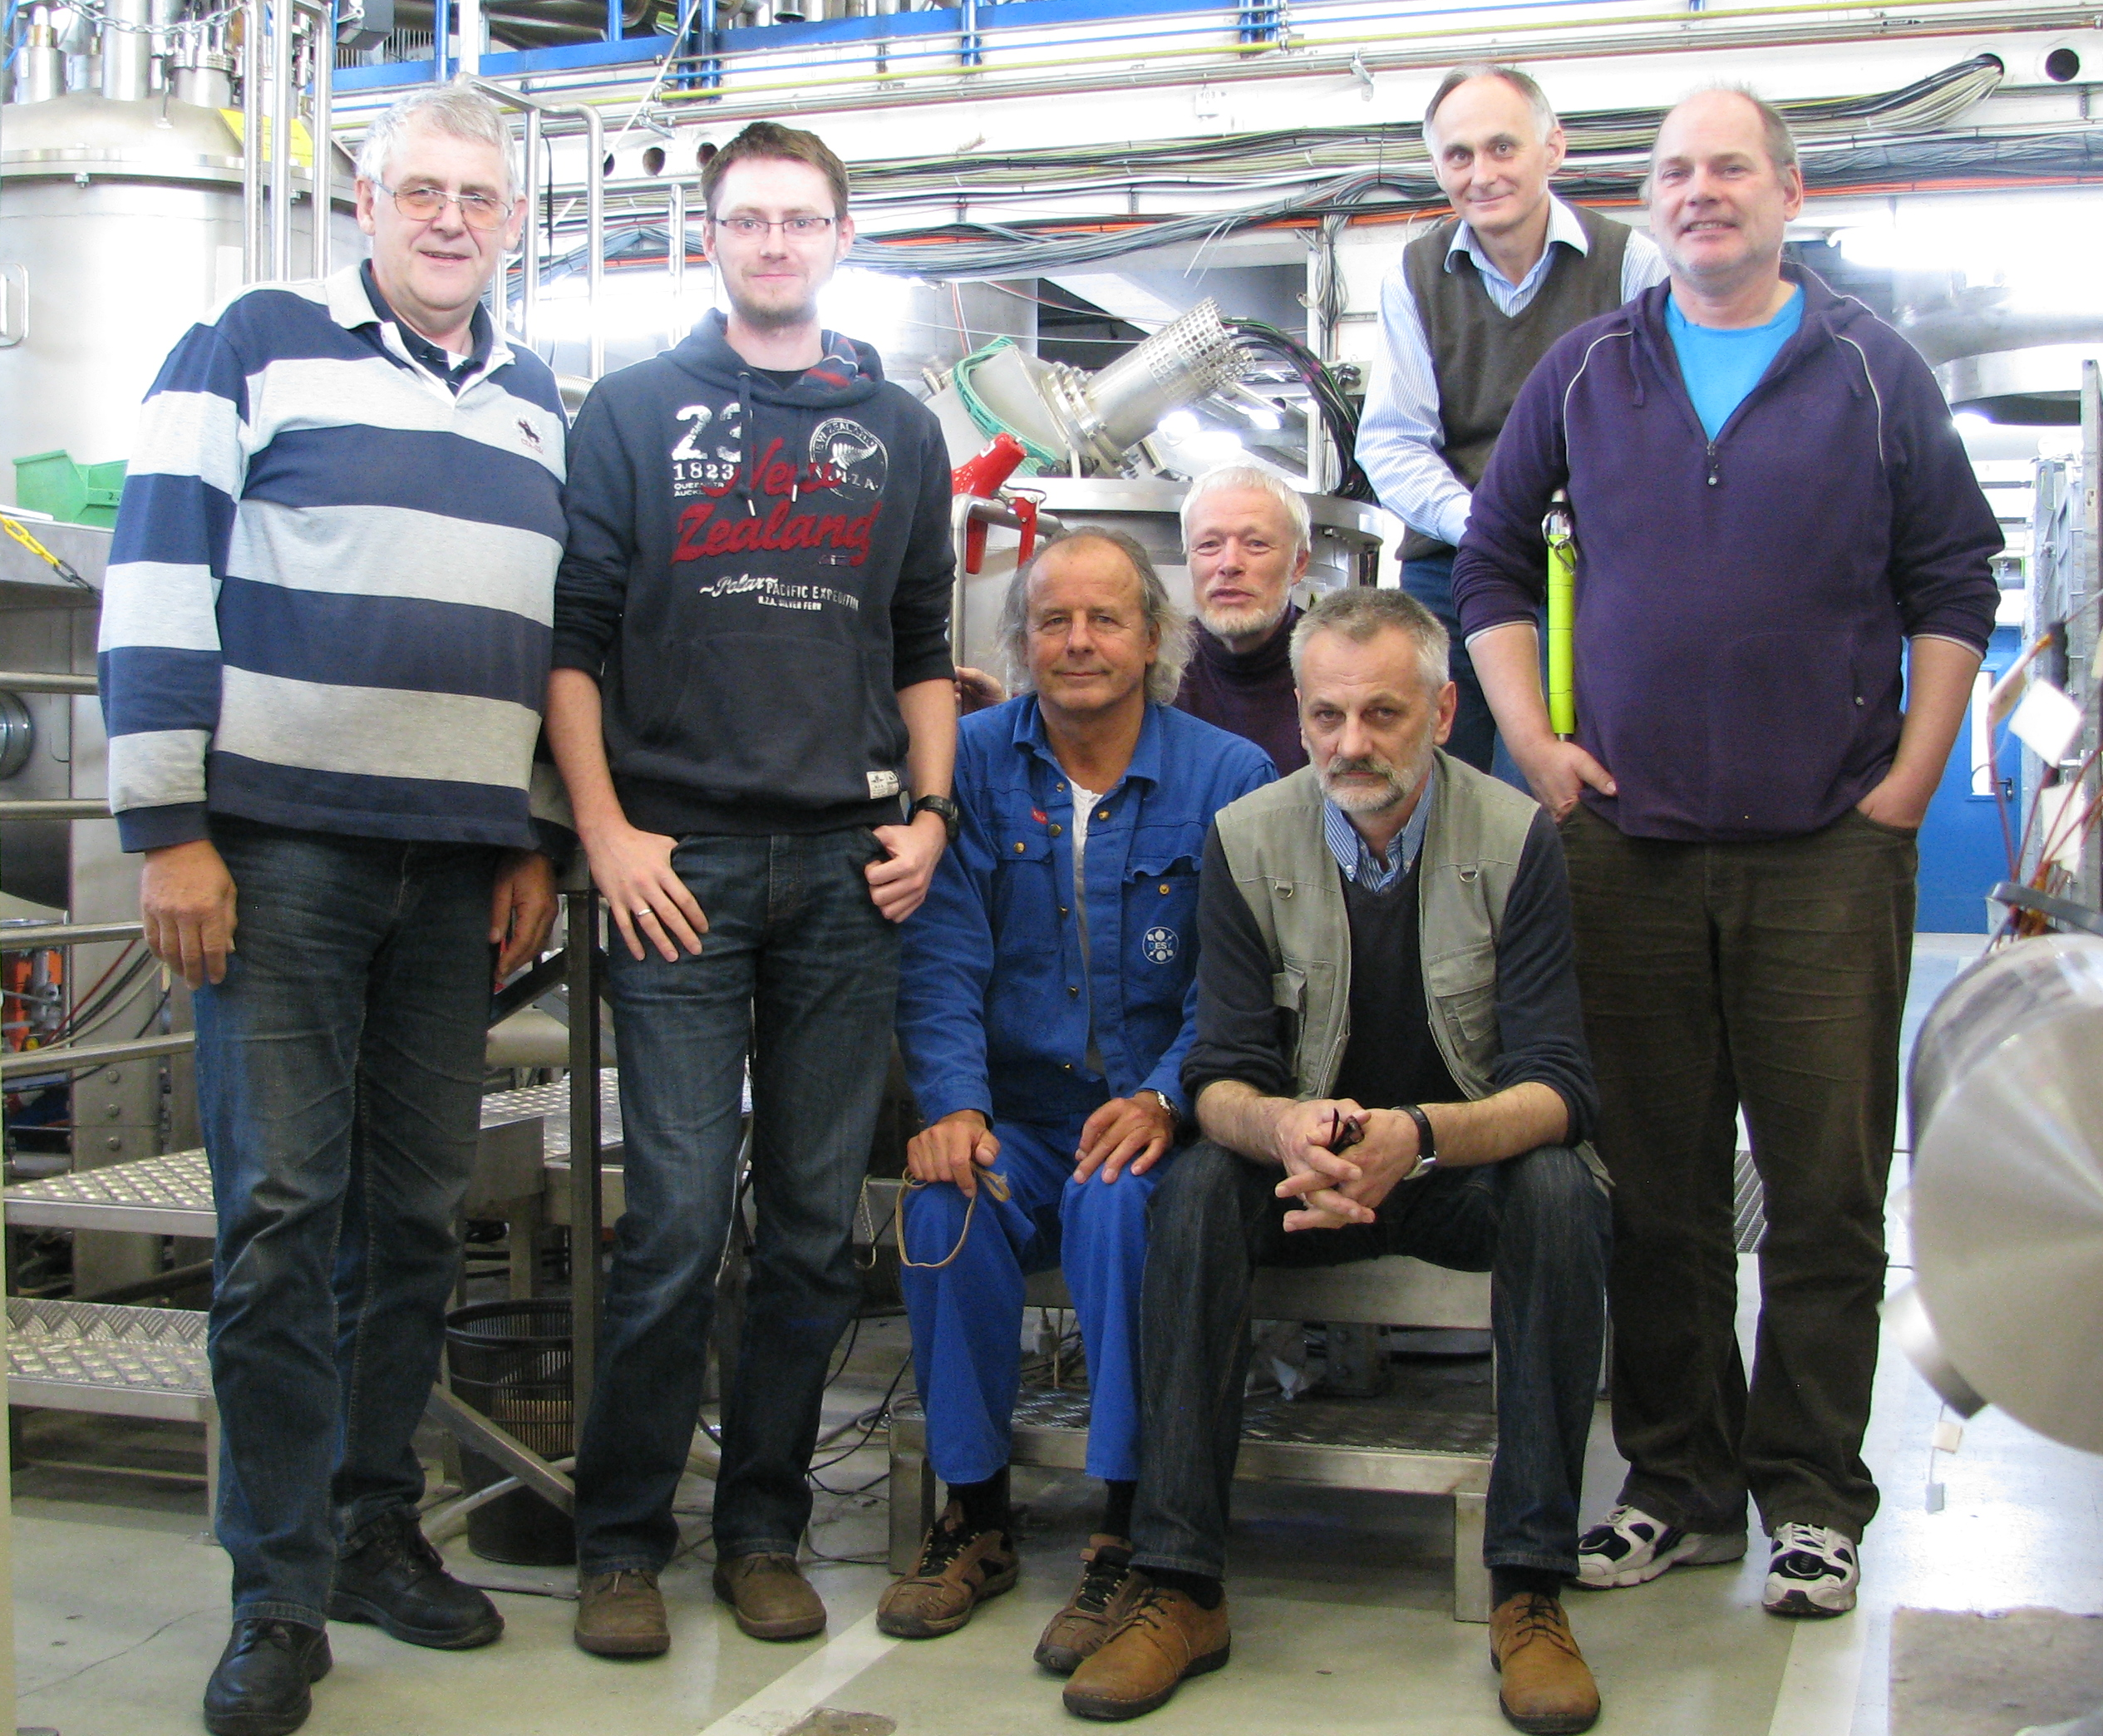
Magnet & Lead Production and Acceptance Tests (WP-11)
103 magnets produced in Spain under supervision of CIEMAT as Spanish in Kind contribution
103 current leads produced in Italy as part of German in kind contribution
Warm and cold tests of all parts at DESY together with IFJ-Pan as part of Polish and German in Kind contribution
IFJ PAN
Measurement Team
From left to right: Heiner Brueck, Michal Duda, Bernd Hentschel, Matthias Stolper, Zbigniew Szklarz, Edward Gornicki, Jens Fischer.
Missing on photo: Ruediger Bandelmann, Andrzej Kotarba and Tomasz Pieprzyca

Slide 11
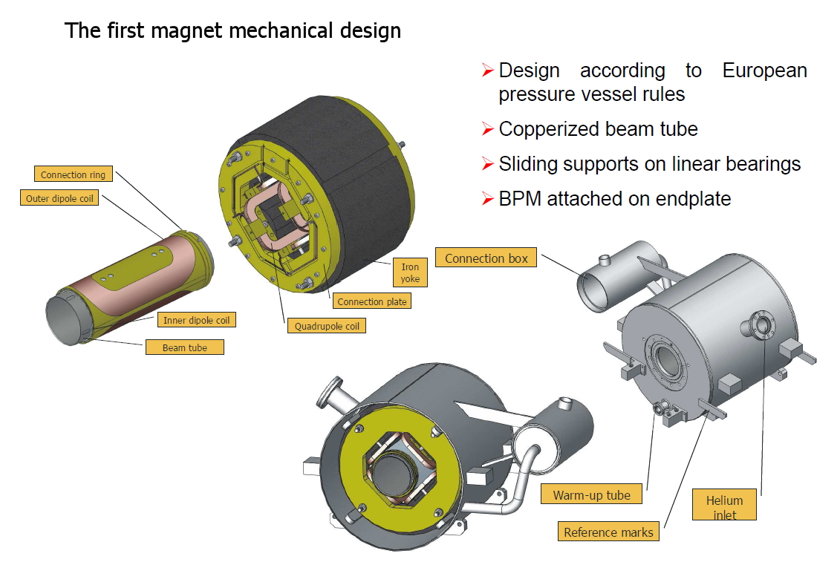
Three nested Magnets in Helium Vessel
Superferric Quadrupole
Dipole 2
Dipole 1

Slide 12
Conduction Cooled Current Leads
Braid connections and warm feed through
Current from room temperaturedown to 2K
Design current up to 50A, three lead pairs
Conduction cooled, two thermal sinks at 4-8K and 40-60K connected via copper braids
Brass bars with copper coating of different thickness, Kapton isolated inside thin stainless steel tubes
No cold feed through
Based on CERN design for LHC correctors
300K
Welding sleeve
Terminals for power cables
300K
40-60K sink
2K
2K
4-8K sink

Slide 13
Magnet and Lead Tests at DESY
Incoming Inspections, dimensional checks
Warm tests
  Leak test
  High pot test
  Field tests
    Warm Stretched Wire (AC)
      Field angle and axis alignment of the Quad
      Relative angle Dipole 1 and 2 w. r. t. quad
    Warm Harmonics (DC + and – current)
      Quad, Dipole 1 and 2
Cold tests
  Assembly magnet + current leads
  Installation in XMTS
  Cool down to 2K
  Cold high pot test
  Field tests
    Cold Stretched Wire
      Transfer functions -50A to 50A Quad, Dipole 1 and 2
    Cold Harmonics
      Transfer functions and harmonics
      -50A to 50A
      Quad, Dipole 1 and 2
      Current lead performance
Warm up and de-installation

Slide 14
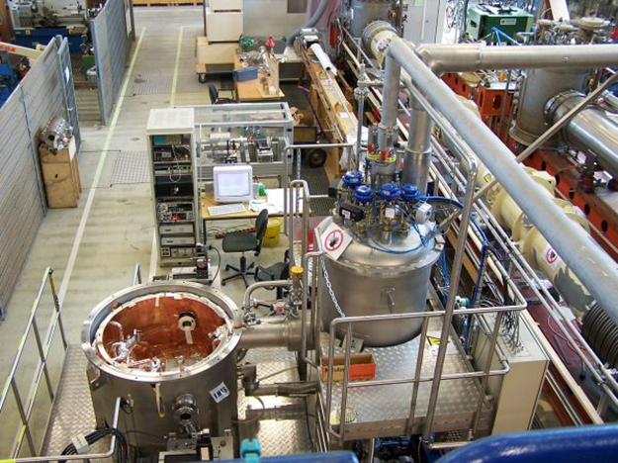
Magnets Test Area
XMTS

Slide 15
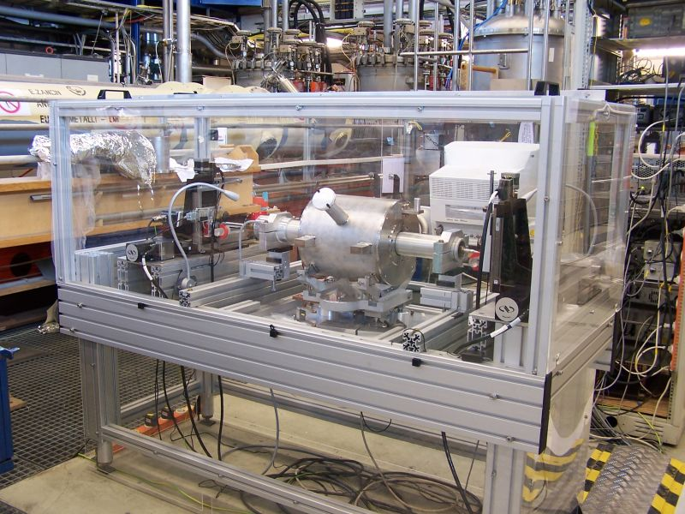
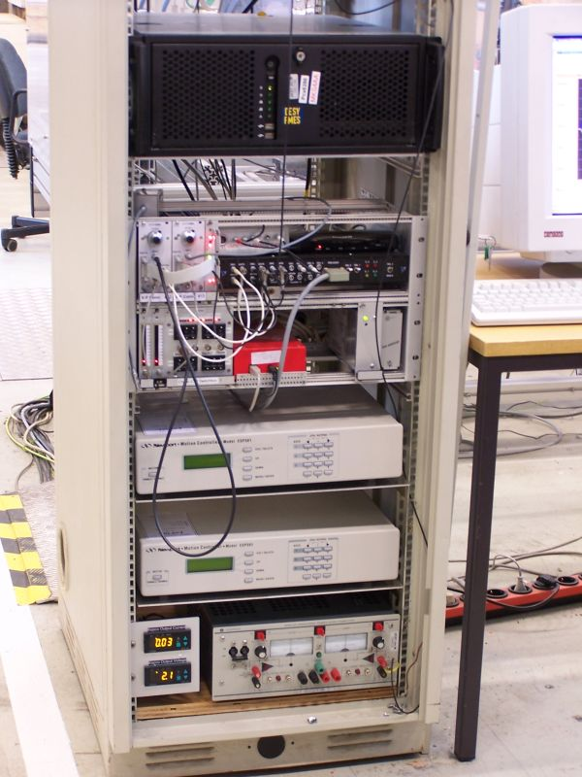
Warm Field Measurement Equipment
Harmonics
  Rotating coil, + and – DC current, earth field correction, analogue bucking, v/f converters with up/down counters
Stretched Wire
  Single wire, motion control, AC current ~5.5 Hz, v/f converters with up/down counters, at 32 angle points fft in time domain, fft on 32 angle steps

Slide 16
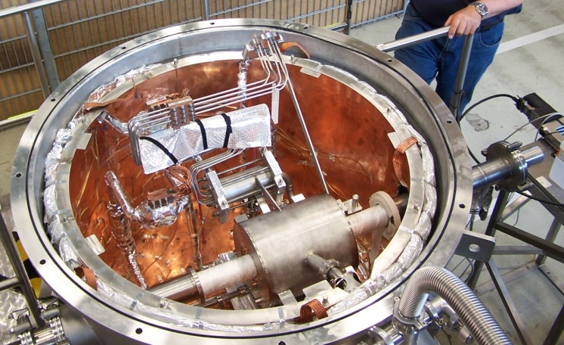
XFEL Cold Magnet Test Stand (XMTS)
Test stand for magnets in Helium vessels with current leads, 40-60K shield, isolation vacuum, 4-8K level for thermal sink of current lead, anti cryostat for warm field measurement equipment
Harmonics
  Rotating coil, ±50A analogue bucking of quad and dipole, v/f converters with up/down counters
Stretched Wire
  Single wire, motion control, ±50A , v/f converters with up/down counters, wire moved on circle, stop for flux measurement at 32 angle steps

Slide 17
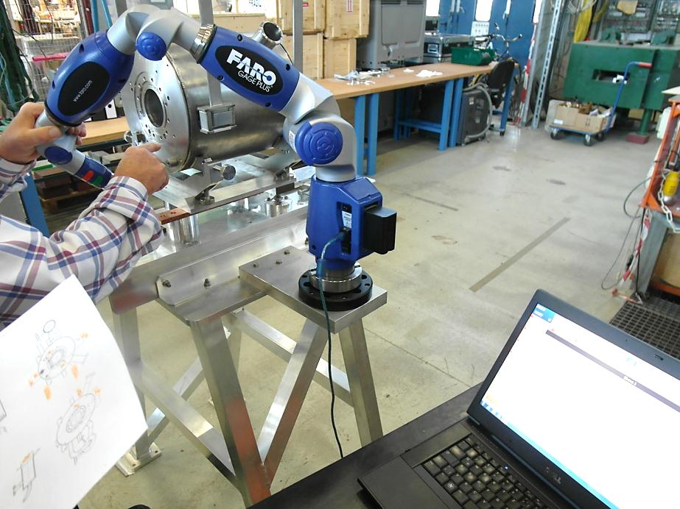
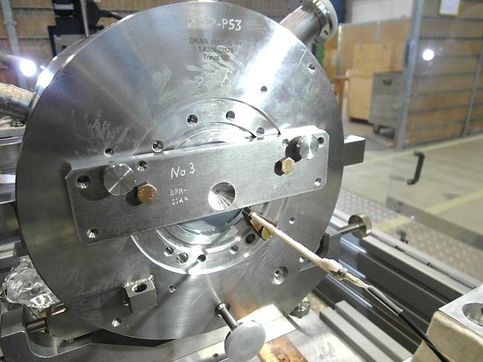
Mechanical dimensions and transfer of the coordinate systems
Checks of mechanical dimensions
and transfer of the magnetic coordinate system to the magnet system on special support using a FARO arm
“Alignment Plate” for the transfer of the mechanical axis to the Stretched Wire System using dowel pins

Slide 18
Hard and Software
Voltage frequency converters (in house developed hardware) and commercial Up/Down counters
Harmonic radial coils
Single stretched wire on precise moving tables
DAQ software in Agilent Vee
Oracle database with many Web tools (PHP) (Michal Duda)
DB loading using Agilent Vee with Oracle drivers
Analysis Mathcad, Matlab and Web tools

Slide 19
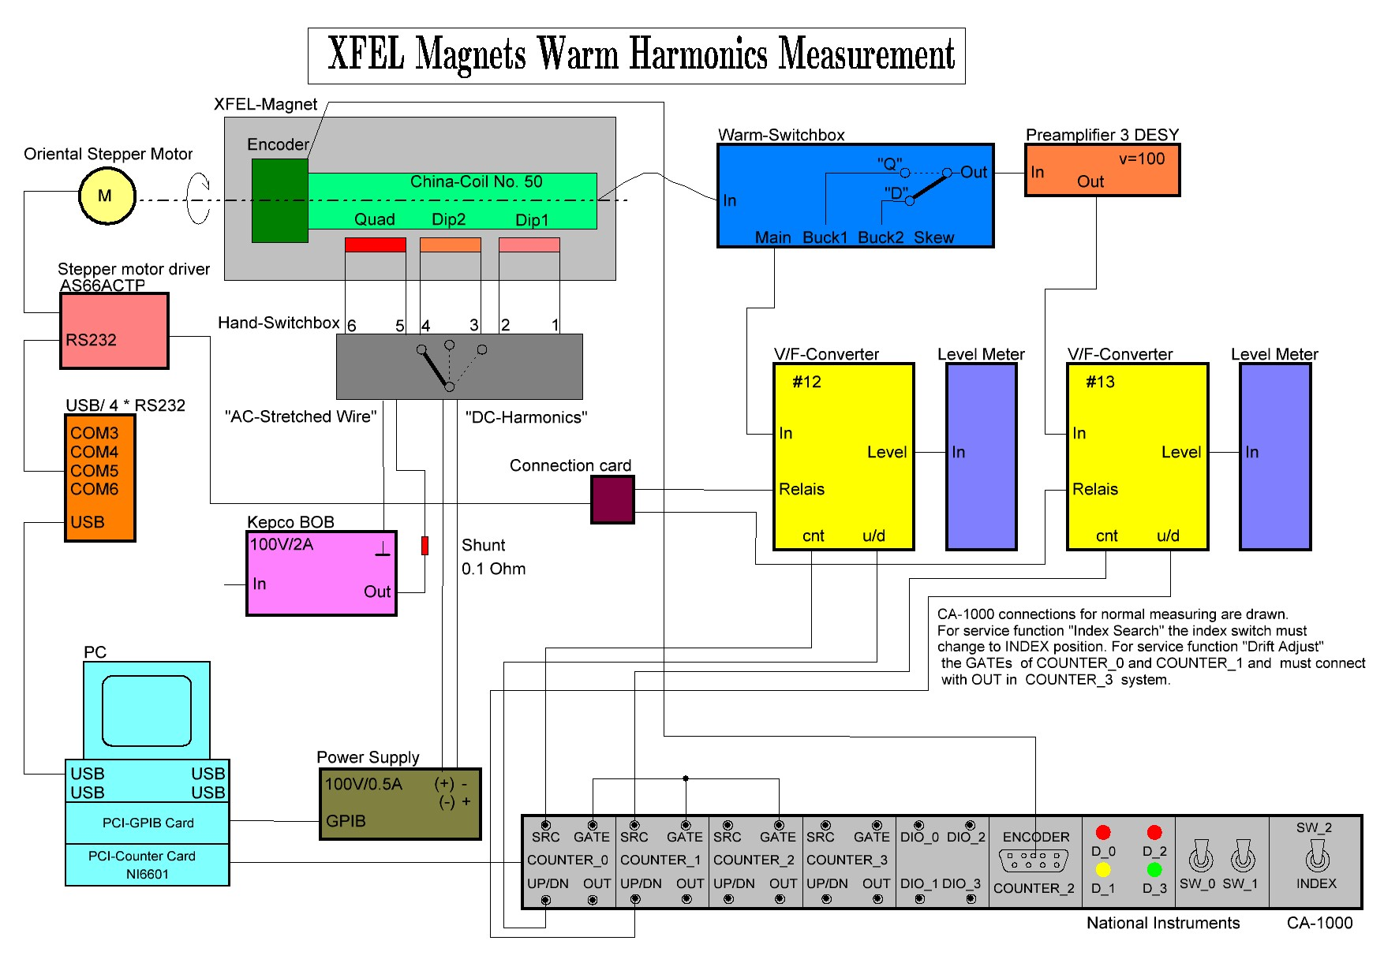
XFEL Warm Harmonics Measurements

Slide 20
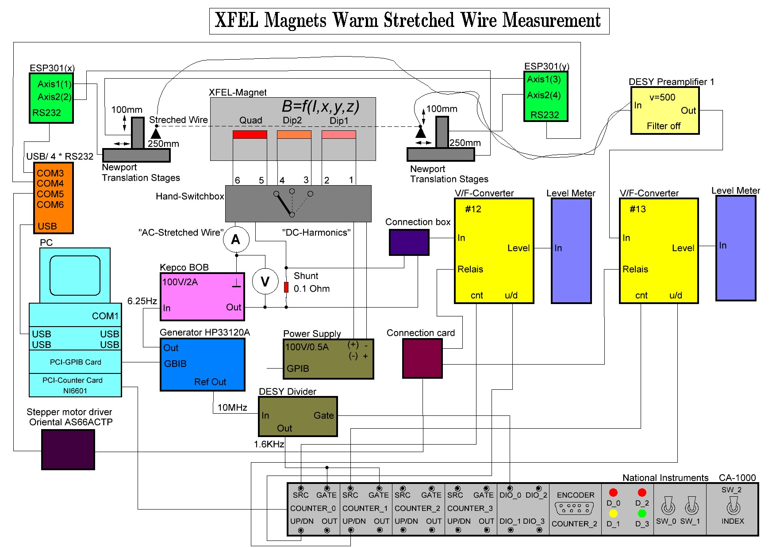
XFEL Warm Stretched Wire Measurements

Slide 21
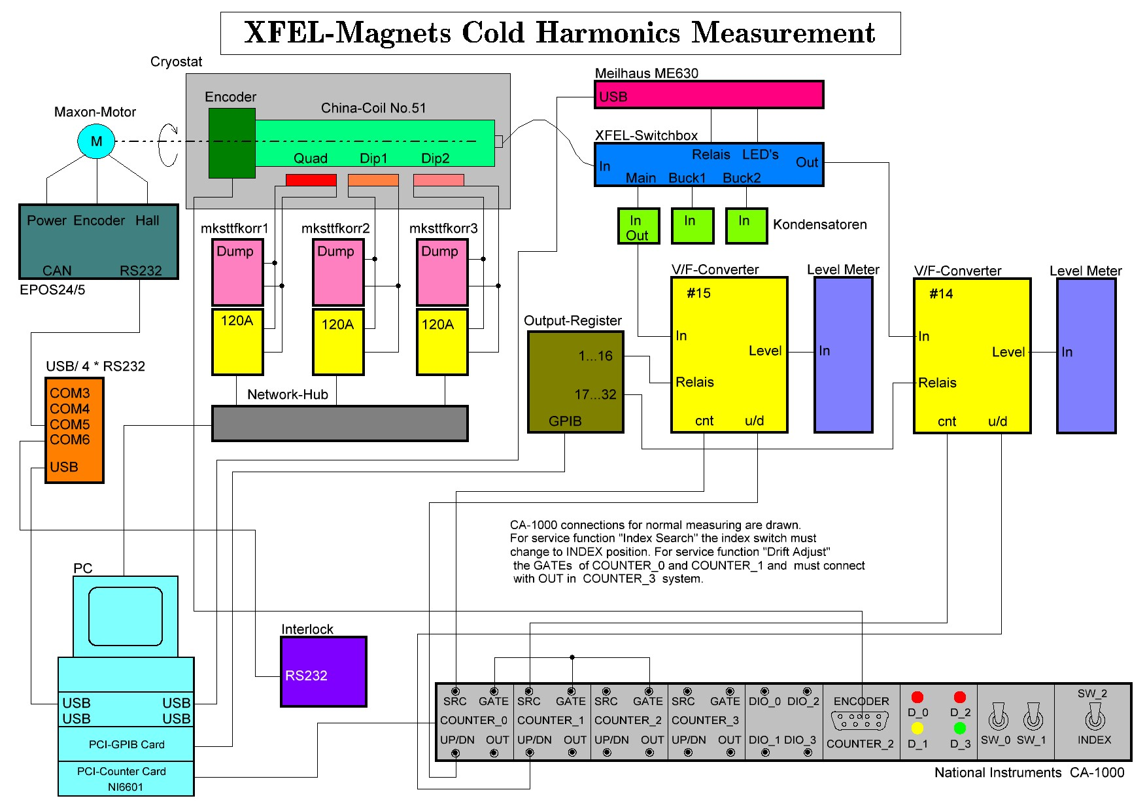
XFEL Cold Harmonics Measurements

Slide 22
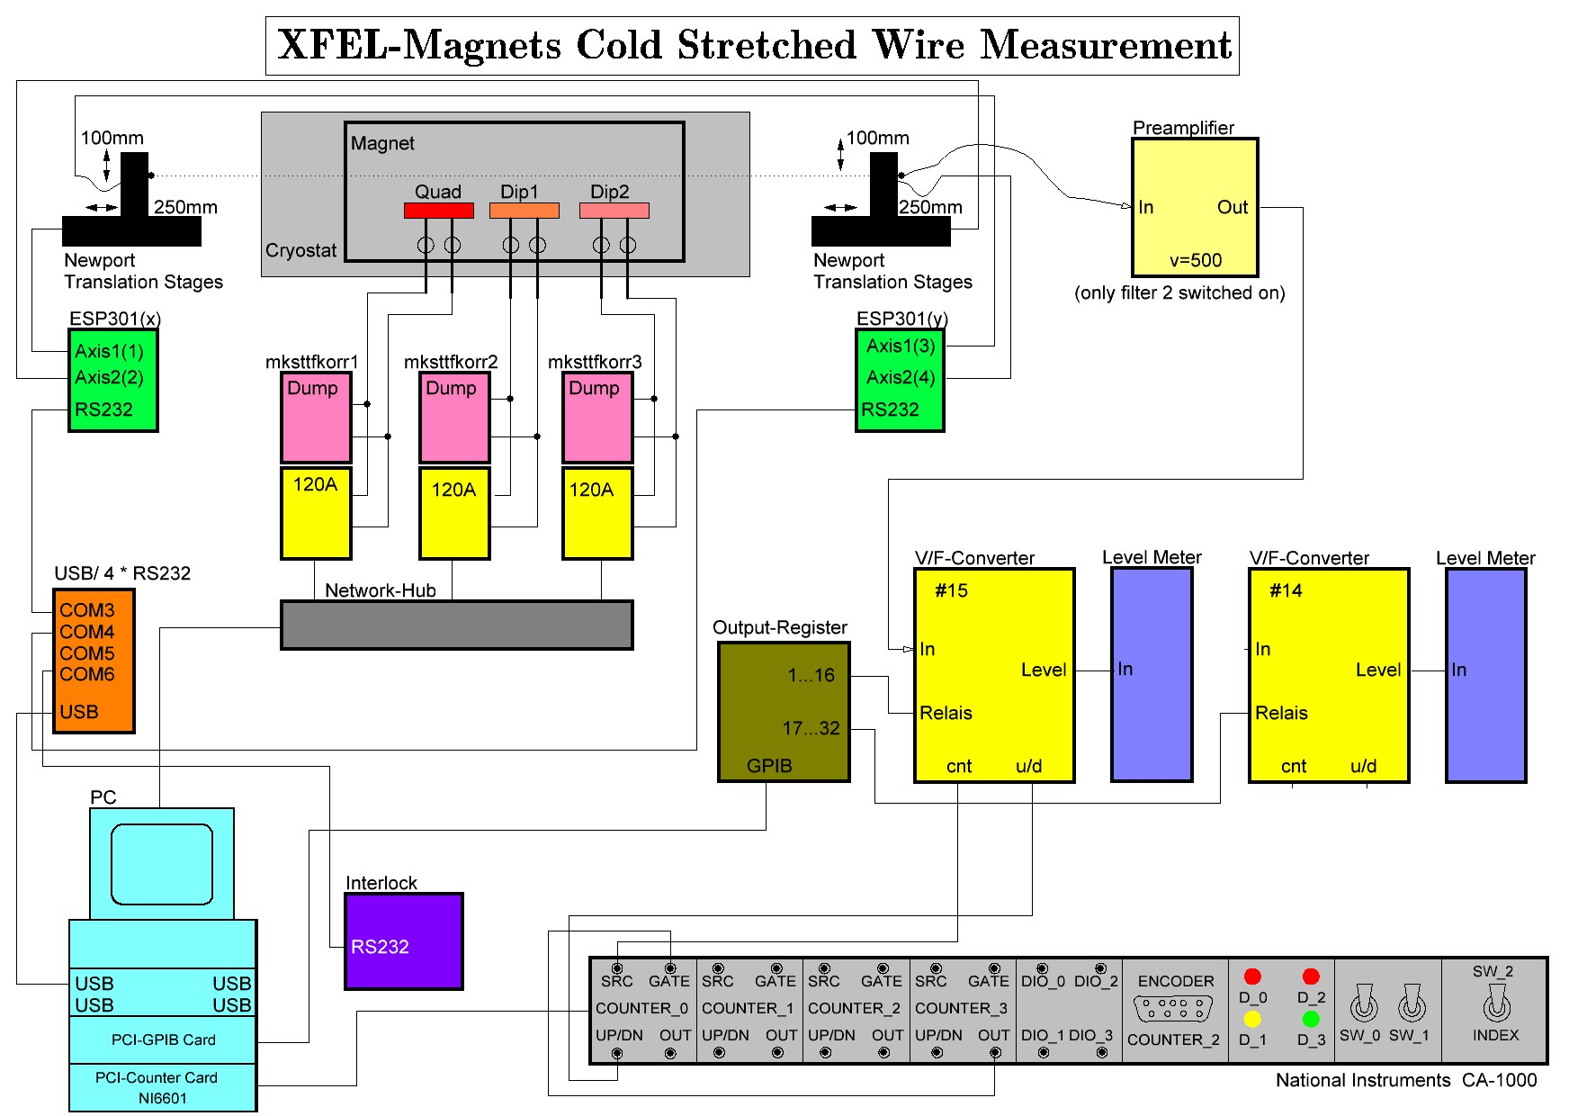
XFEL Cold Stretched Wire Measurements

Slide 23
Test Results and next Steps
More then 35 magnets and 28 leads at DESY
30 tested so far

Slide 24
Integrated Field @30mm / Current and Angle (warm SW)
30 Magnets
Quadrupole
Quadrupole
[mTm/A]
[mTm/A]
Dipole 1
Magnet No. 7 different yoke laminations!
[mTm/A]
Dipole 1
Dipole 2
[mTm/A]

Slide 25
Warm Harmonics for about 30 Magnets
All coils 230mm
The quadrupole is a superferric magnet
The dipole coils are cos(Q)
  one layer
  no spacers
  B3 minimized
  B5 therefore large but acceptable
Limits

Slide 26
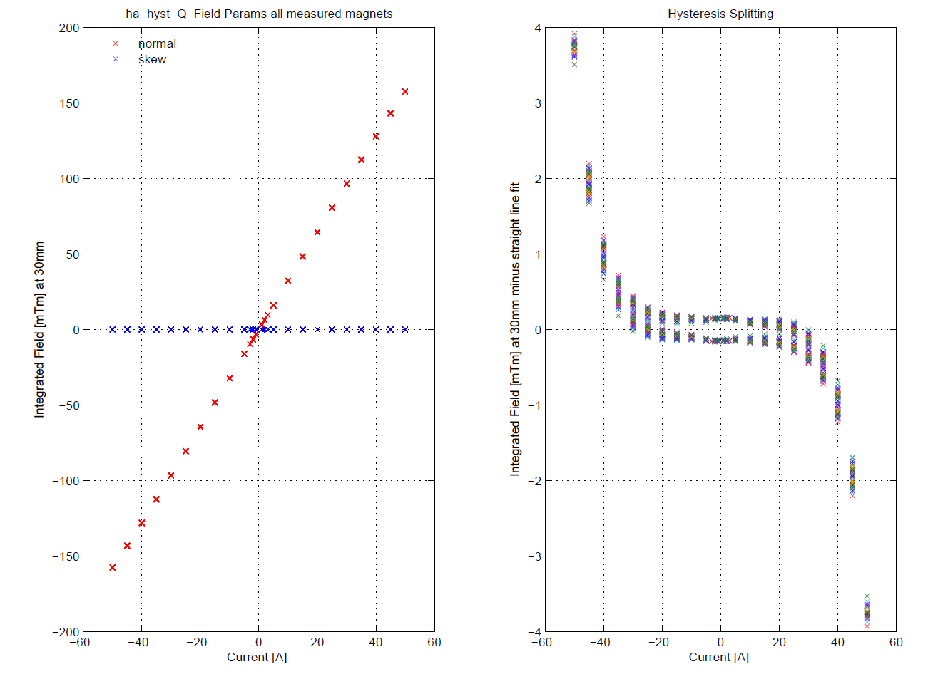
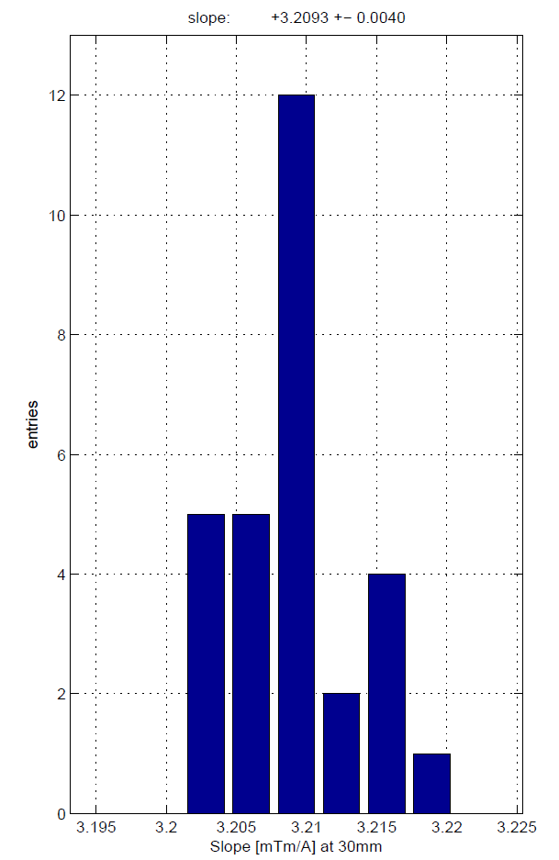
Transfer Function Quadrupole at 30mm (30 magnets), cold
Right plot
  Fit between ±20A (without zero current)
  Slope 3.209 ±.004 mTm/A @30mm
Left plot
  Individual fits subtracted
  Iron saturation about 2.3%
  Hysteresis splitting due to iron and persistent current effects
  Effect large but acceptable

Slide 27
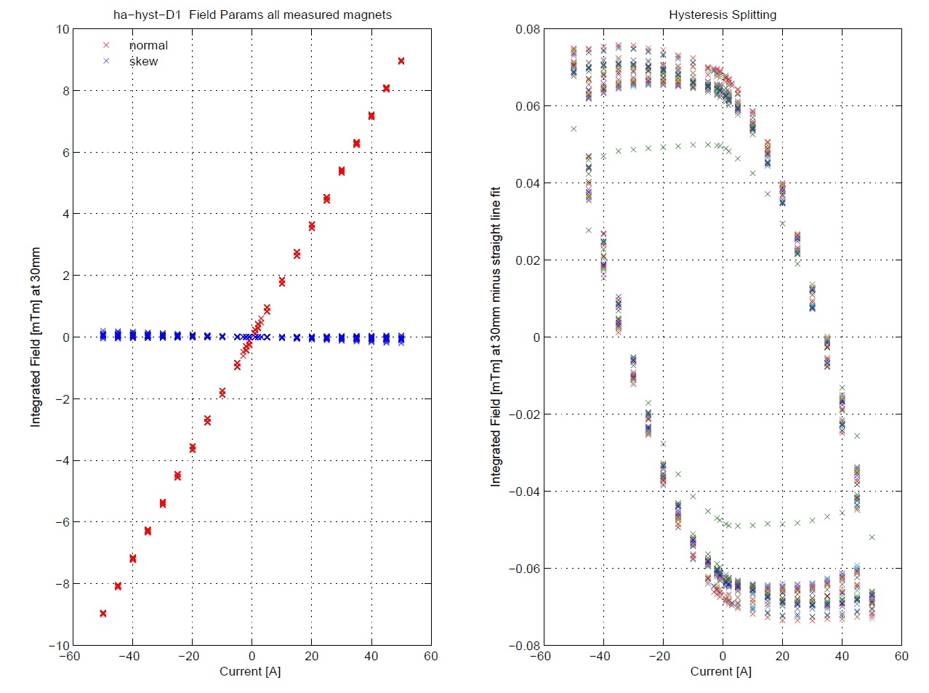
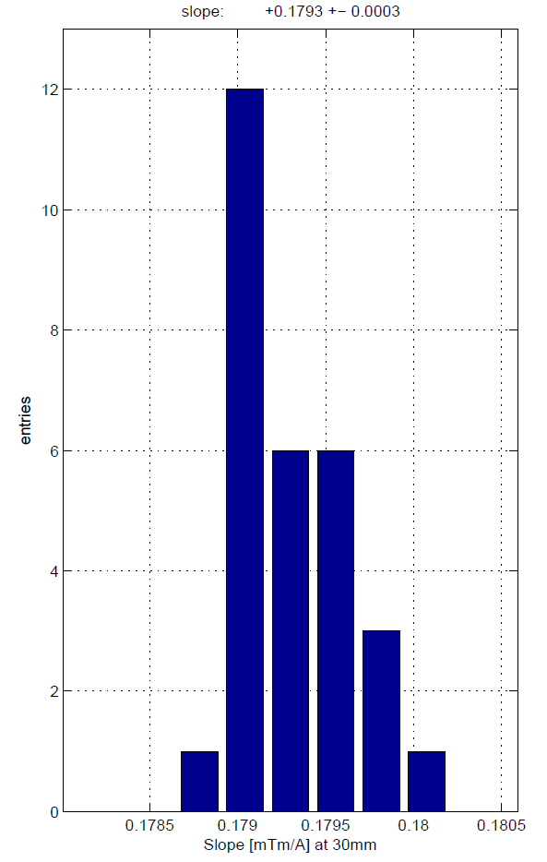
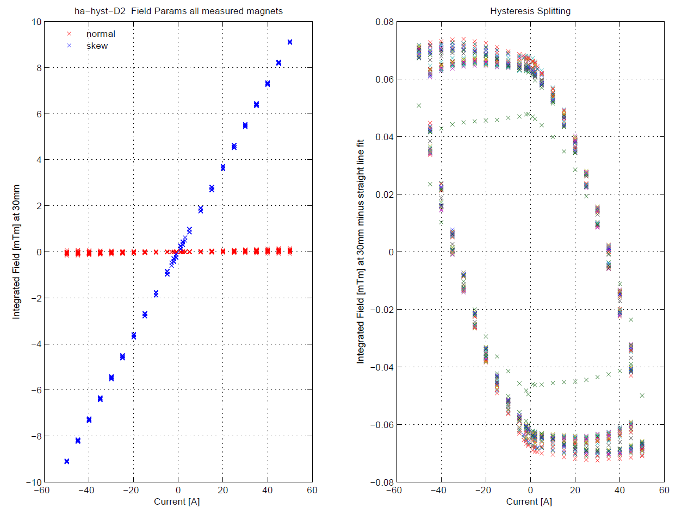
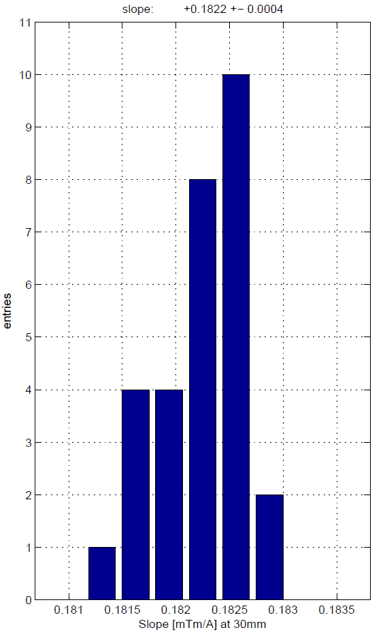
Transfer Function Dipole 1 and 2 (30 magnets) , cold
Right plots
  Fit between ±50A (without zero current)
  D1 Slope .1793 ±.0003 mTm/A
  D1 Slope .1822 ±.0004 mTm/A
Left plots
  Individual fit subtracted
  No iron saturation
  Hysteresis splitting due to iron and persistent current effects
  Effect large but acceptable
  Green curve: magnet with different yoke
Normal dipole
Skew dipole

Slide 28
Cold 50A

Slide 29
Cold 25A

Slide 30
Cold 2A

Slide 31
Next Steps after Tests
After magnet testing copper plating of the inner vessel wall (beam pipe) outside DESY
Final cleaning at DESY
Clean room pre-assembly with BPM and HOM
“clean” shipping to Saclay (Paris) for module assembly
Final cold test of each accelerator module at DESY
Installation in the tunnel
First beam expected end 2015

Slide 32
Thank you for your attention!

