Slide 1
Magnet Mass Production and Field Measurements Results for TPS
C. S. Hwang, NSRRC, Hsinchu, Taiwan
IMMW 18, NSLSII (Long Island), 3 June 2013
Notes:
Change name, proton, neutron, heavy iron & carbon therapy, I will try to give a overall introduction of magnet measurement system at NSRRC

Slide 2
Outline
Field measurement system
- Hall Probe, Rotating coil, search coil
Magnet alignment method
Inspection of Storage ring magnets
Inspection of Booster ring magnets
Injection Magnets
Summary
Notes:
Before the introduction, I will report the status of the new project of 3 GeV TPS.

Slide 3
Major Milestones of TPS project
June 2005 | TPS Proposal to Government
Oct. 2007 | Lattice (circ. 518.4m) approved by BOT
Dec. 2007 | TPS final approval by Legislative Yuan
May 2008 | EPA approval; site plan completed
June 2008 | Accelerator Design Book (DRAFT) issued
Dec. 2008 | TPS budget (Civil + Accelerator + BL) lock in
Dec. 2009 | Contract out of the civil construction
Feb. 2010 | Ground Break
Dec. 2013 | Civil construction completed
Sep. 2014 | Installation completed & start to commission
Sep. 2015 | Open to users

Slide 4
Status of the sub-components
Civil and utility construction will be completed before end of 2013.
The storage ring installation has been started and will be finished in the third quarter of 2014 and then start the commissioning.
150 MeV linac system has been completed and prepare to move into TPS location.
3 sets of superconducting RF system has been finished and the high power test is processing in house.
700 kW Cryogenic system is already and prepare to move to TLS location.
All magnets has been finished 80% by BSL company and will be done at the end of September.
All the vacuum chambers of the 24 sections will be finished before September.
All the power supply will be delivery to NSRRC before this year.
Control system were developed and will be installed and tested next year.

Slide 5
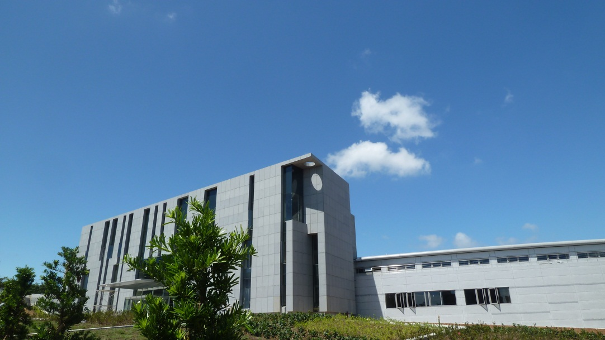
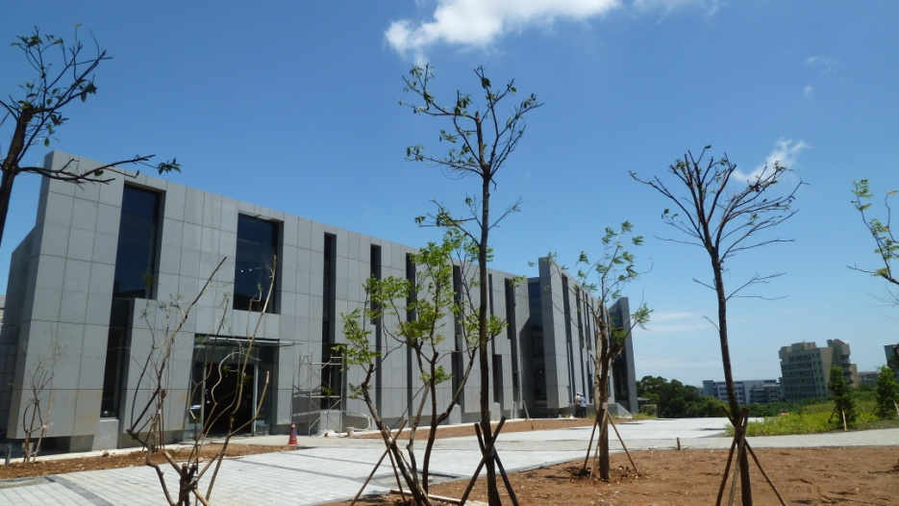
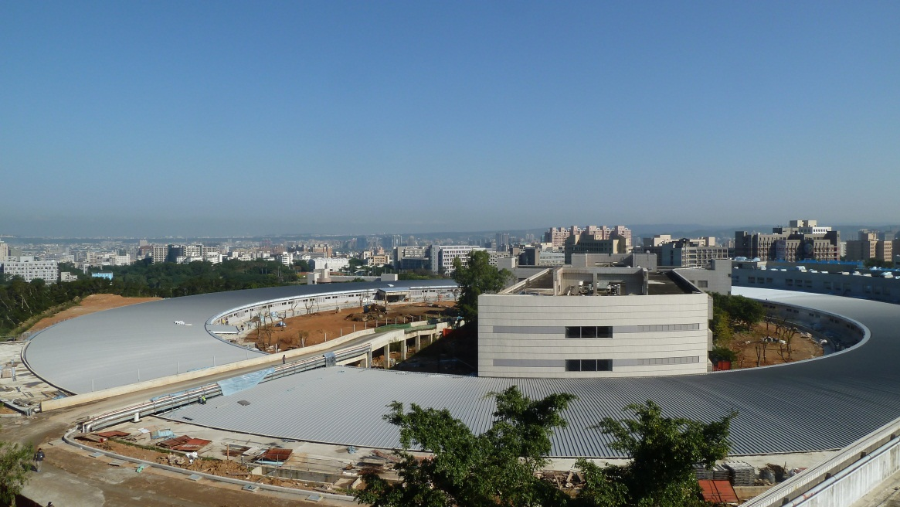
Activity center &TPS outside view
TPS building
Academic & Activity center

Slide 6
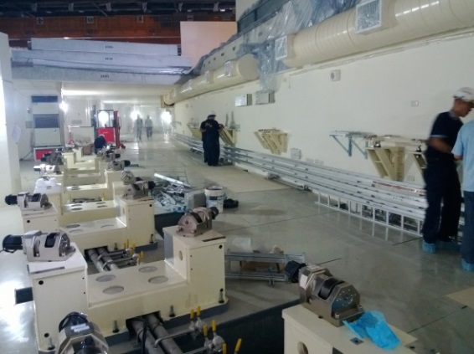
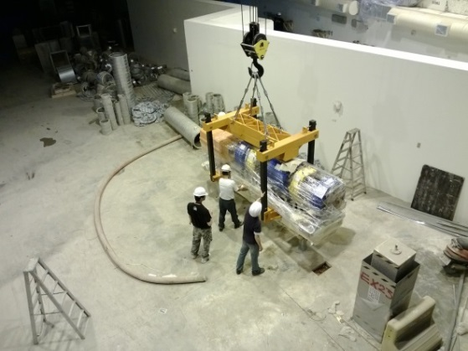
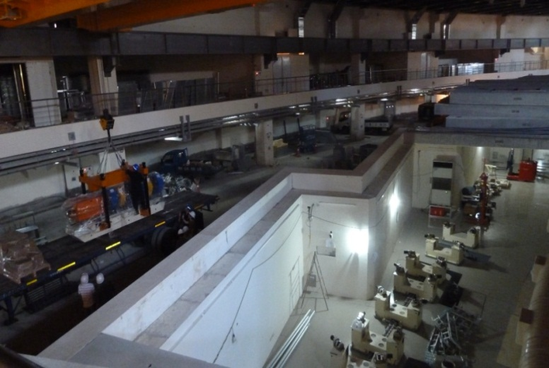
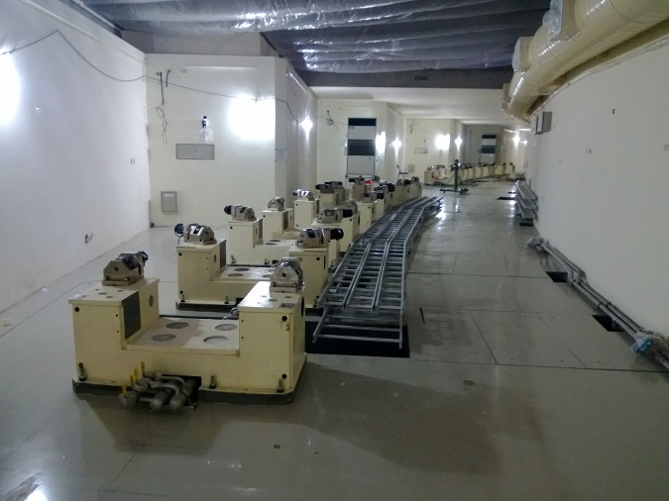
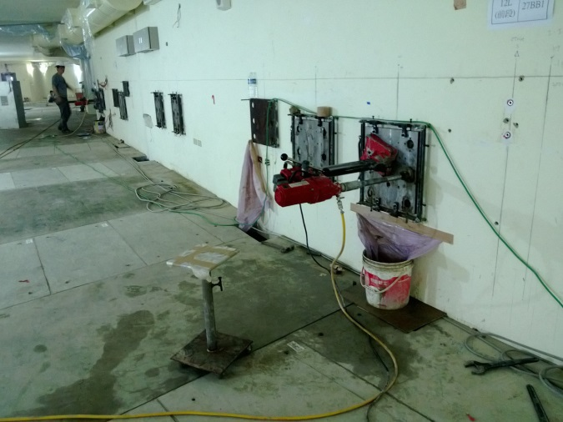
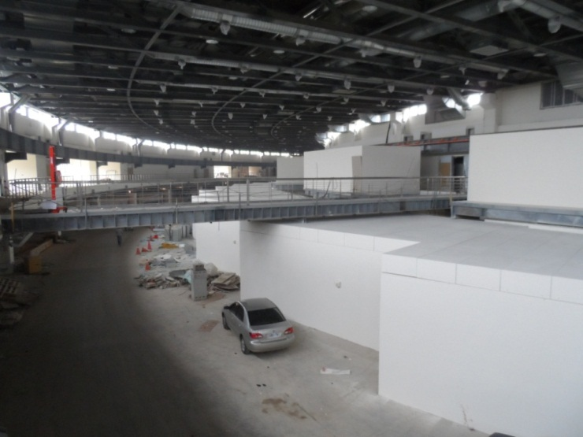
The inside view of TPS

Slide 7
Overview of magnet Lab.
Measurement system | Measurement dimension | Purpose | Note
Hall probe (bench) | 6 m | ID and EPU | Pulley driven by DC motor
 | 5.4 m | Wiggle, Undulator & EPU | Linear motor with air bearing
 | 1.5 m | Superconducting undulator | In vertical dewar
 | 2 m | For Lattice magnet | Mechanical precision 20μm
Rotating coil | 840 cm | QM and SM-storage ring
 | 570 cm | QM and SM-boost ring
NMR ESR | 0.043-13.7T | Hall sensor calibration
 | 0.55-3.2 mT
Search coil | Wire OD=0.12mm, 30turns Wire OD=0.05mm 30turns | Kicker and septum
Stretch wire | - | Insertion Devices | Measure 1st & 2nd field integral
Long loop coil | 5-axes | Insertion Devices | Measure 1st field integral
Helmholtz Coil | 3-axis rotation | Magnet block
Notes:
We have many different length of Hall probe bench for different purpose of field measurement.

Slide 8
Field measurement system for TPS magnets
Two Hall probe system (HPS):
Main field strength of HPS was calibrated by NMR & ESR (Nuclear magnetic resonance & electron spin resonance system) using dipole magnet.
This system used for all dipole magnet measurement and the inspection all of the prototype magnets.
Two Rotating coil system (RCS):
Main field strength of RCS was calibrated by HPS using quadrupole and sextupole magnets.
Field center of magnet was calibrated by CMM (3-D mechanical measurement system) using quadrupole and sextupole magnets.
Long coil & Search coil system
This system was used to measure Kicker and Septum. The pulse field and pulse current were recoded to be compared.

Slide 9
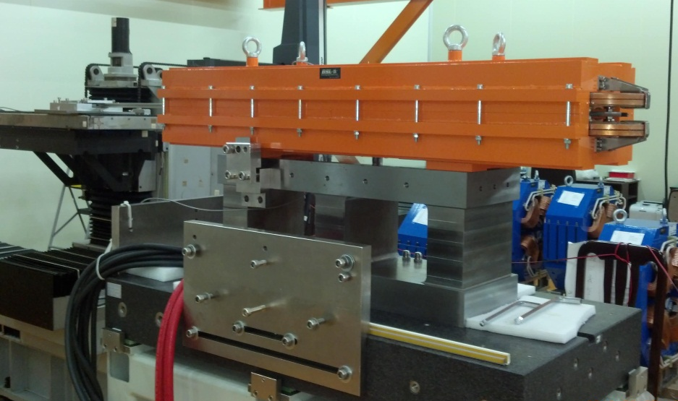
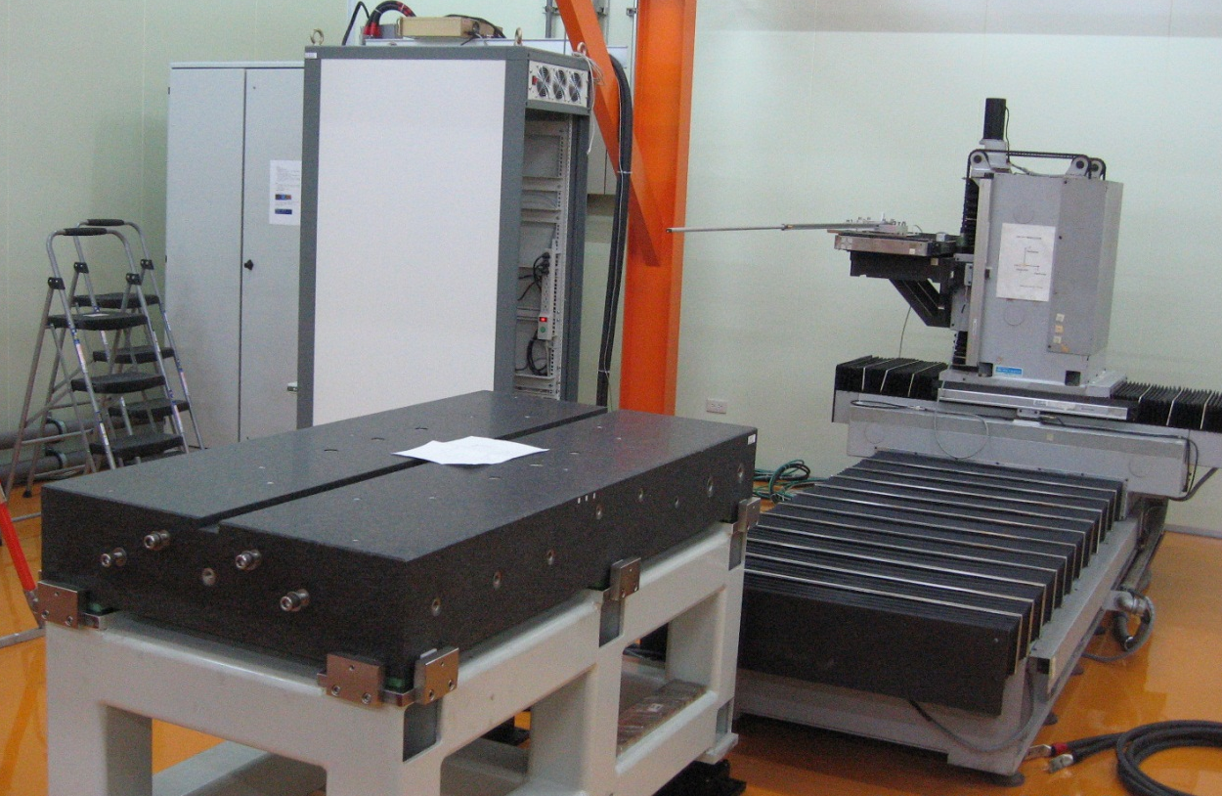
HPS and measurement bench
SR-dipole magnet adapter
BR-dipole magnet adapter
Granite bench
Probe: 2m long

Slide 10
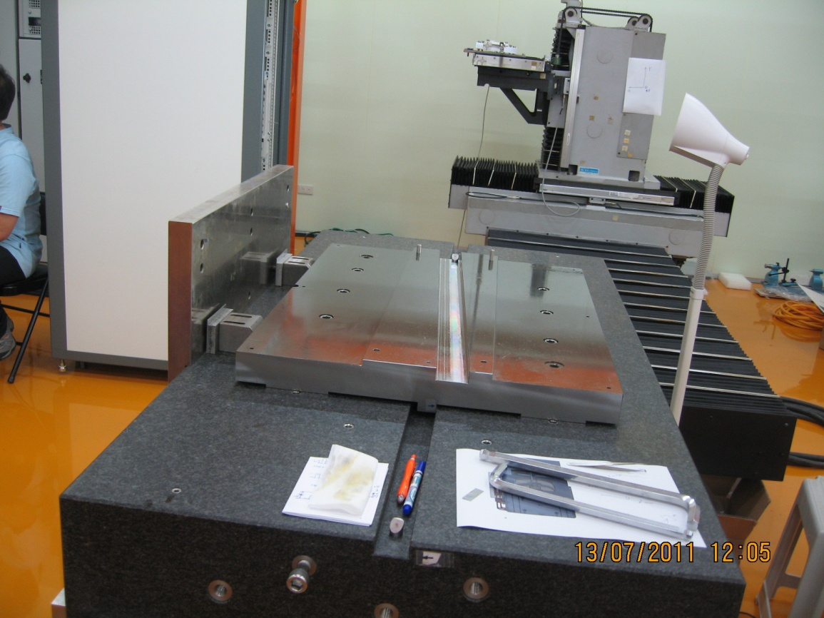
SR-Dipole alignment on the HPS bench
SR-dipole position check: Hall probe, Tarage_2, Target_3, Target_4 and Targer_5 in alignment.
Vertical height check: Hall probe, Line_1 (yoke seam) and Line_2 in alignment.
Adapter position check before SR-dipole installation. Hall probe, Tarage_1, Target_2 and Targer_3 in alignment.
Hall Probe
Target_4
3.75º trough
Target_1
Target_5
Line_2
Line_1
Target_2
Target_3
Target_2
+y
SR-dipole adapter (3.75º): Rotate the SR-dipole magnet to parallel the Hall probe.
The magnet and adapter are located by the stop-pin and stop-surface.
The horizontal alignment is checked by the l theodolite.
The vertical height of magnet is checked by the eveling.
Target_3
◉
+x
+z
Stop-pin for z-axis
Stop-surface for x-axis
(touch surface)

Slide 11
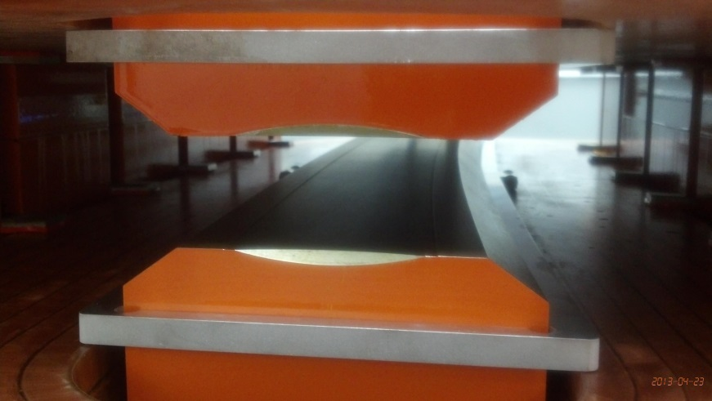
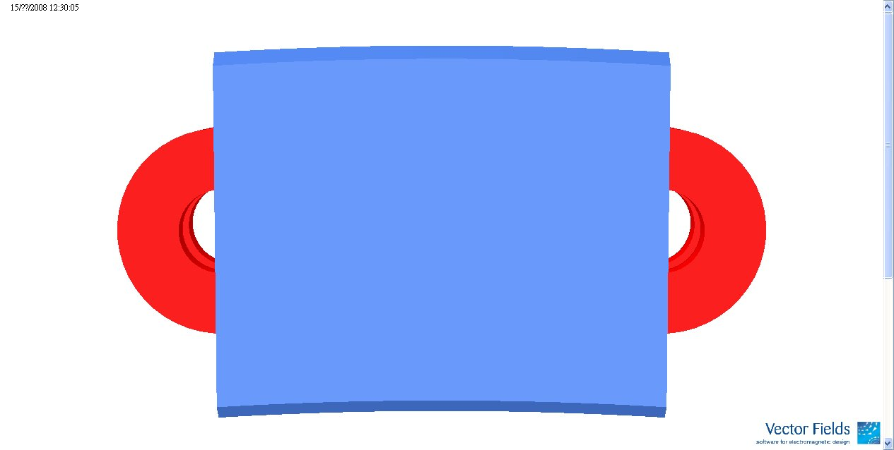
HPS measurement and analysis
3D mapping: XY-Z
(circular & elliptical)
Hall probe mapping trajectory: Curve and lamina
Hall probe trajectory
Hall probe
Normal (Skew) multipoles distribution along Z-axis.
Normalized multipoles.
+x
◉
+z
+y
2D mapping: X-Z
(plane)
1D mapping: Z
(on axis)
Hall probe
Hall probe
◉
IB curve
Trim coil
Field homogeneity Δb0/b0 and Δb0L/b0L

Slide 12
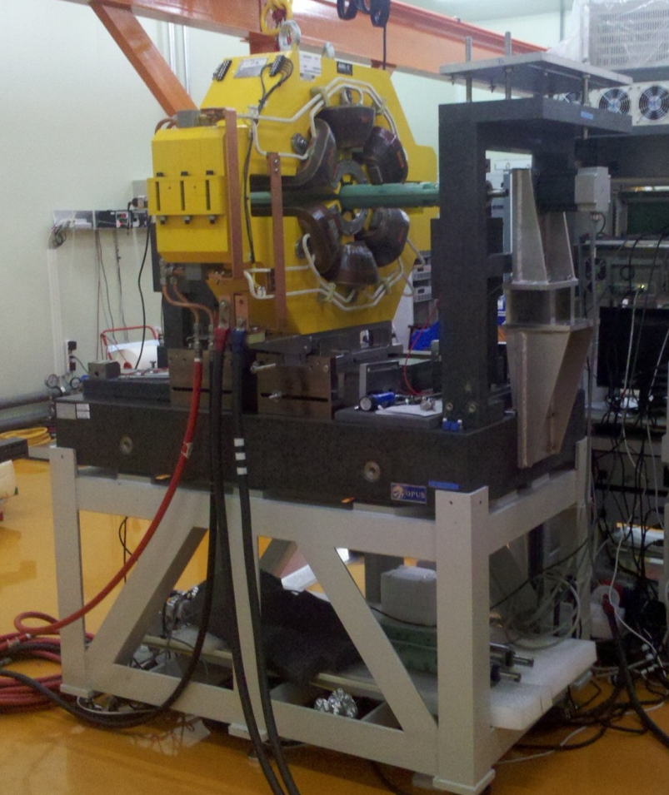
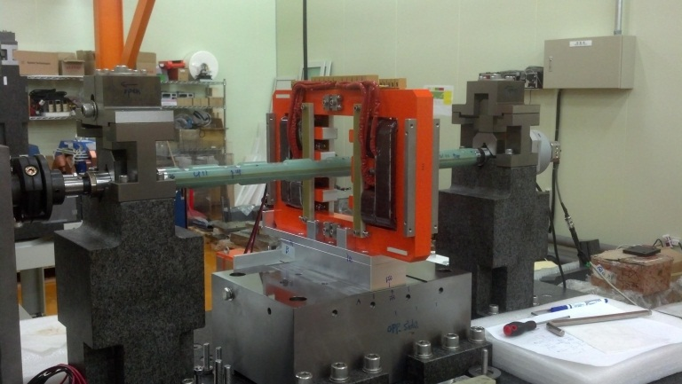
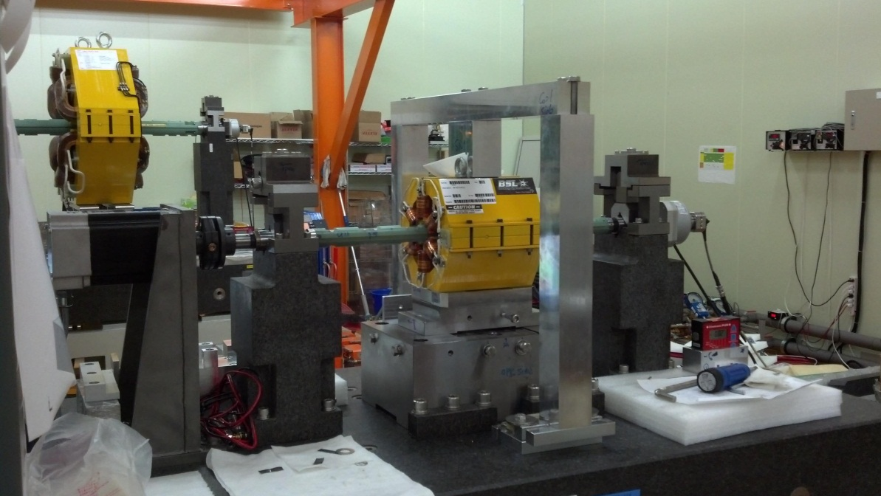
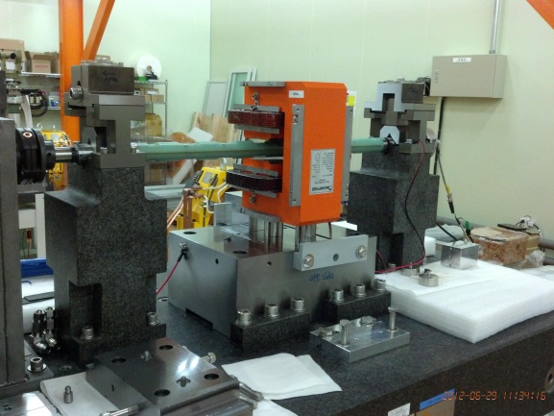
Rotating coil system (RCS)
SR-FFC magnet measured by BR-RCS
SR-QM/SM magnet measured by SR-RCS
Corrector magnet measured by BR-RCS
Magnet measured by BR-RCS

Slide 13
Rotating coil - vertical offset calibration
Magnet | Q1 | Q1 | Q9 | Q1 | Q5 | Q6 | R4Q8 | S1 | S2 | S3
SN | P01 | P02 | P01 | P03 | P01 | P01 | P01 | P01 | P01 | P01
CMM V-offset | 0.003 | 0.002 | -0.002 | -0.006 | -0.002 | 0.003 | -0.001 | -0.005 | 0.002 | 0.004
RCS V-offset | 0.106 | 0.098 | 0.084 | 0.085 | 0.087 | 0.100 | 0.085 | 0.089 | 0.099 | 0.106
Different | 0.103 | 0.096 | 0.086 | 0.091 | 0.089 | 0.097 | 0.086 | 0.094 | 0.097 | 0.102
Average offset = 94 μm
STD = 5 μm
The calibration value of RCS unit is -0.094 mm in the vertical offset.
The precision of magnet center measurement of this system in vertical axis is 5 μm.

Slide 14
Rotating coil - horizontal offset
 | Q1 | Q10 | Q1 | Q9 | Q5 | Q6 | R4Q8 | S1 | S2 | S3
Note | P01 | P01 | P02 | P01 | P01 | P01 | P01 | P01 | P01 | P01
H nor. side | 0.005 (A) | 0.060 | 0.021 | 0.060 | 0.048 | 0.070 | 0.066 | 0.012 | 0.002 | 0.030
H opp. side | 0.018 (B) | 0.038 | 0.000 | 0.038 | 0.014 | 0.029 | 0.036 | 0.002 | 0.009 | 0.015
Decision | X1+X2 >> 2U | X1+X2 >> 2U | X1+X2 >> 2U | X1+X2 >> 2U | X1+X2 >> 2U | X1+X2 >> 2U | X1+X2 >> 2U | X1-X2 <<2U | X1-X2 << 2U | X1+X2 >> 2U
H offset | 0.012 (A+B)/2 | 0.049 (A+B)/2 | 0.011 (A+B)/2 | 0.049 (A+B)/2 | 0.031 (A+B)/2 | 0.050 (A+B)/2 | 0.051 (A+B)/2 | 0.005 (A-B)/2 | 0.004 (A-B)/2 | 0.023 (A+B)/2
Bench offset | 0.007 (A-B)/2 | 0.011 (A-B)/2 | 0.011 (A-B)/2 | 0.011 (A-B)/2 | 0.017 (A-B)/2 | 0.021 (A-B)/2 | 0.015 (A-B)/2 | 0.007 (A+B)/2 | 0.006 (A+B)/2 | 0.008 (A-B)/2
Test
差異<0.01mm
Average offset= 11 μm
STD= 5 μm
The calibration value of RCS unit is 11 μm in the horizontal offset.
The precision of magnet center measurement of this system in horizontal axis is 10 μm.

Slide 15
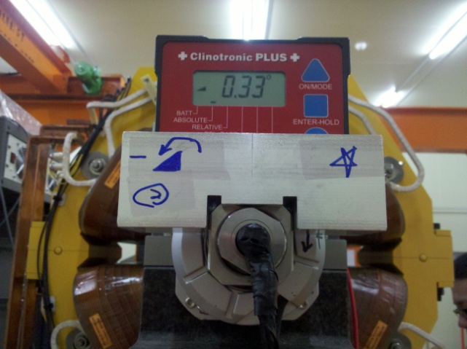
Roll Angle Measurement-QM
S
All symbol is ABS
Normal side: θ_{N}
Opposite side: θ_{O}
PCB effective angle: θ_{P}
Real angle: θ_{s}
N
α
θ_{N}
θ_{P}
S
N
θ_{N} = θ_{s} + θ_{p} ------(1)
Normal side of magnet
(1)-(2)
θ_{s} = (θ_{O}+θ_{N})/2
N
α
S
The resolution of rotary encoder is 9000.
The precision of the roll angle measurement is 0.01º.
θ_{O}
θ_{P}
S
N
θ_{O} = -θ_{s} + θ_{p} ------(2)
Opposite side of magnet

Slide 16
Roll Angle measurement by CMM
512.291
512.305
512.314
512.285
487.681
487.693
487.694
487.682
θ=0.006º
487.694 - 487.682
= 0.012 mm
124.6
(124.6+104.9)/2
= 114.75mm
104.9
θ=0.014º
512.314 - 512.285
= 0.029 mm
(124.6+104.9)/2
= 114.75mm
The roll angle of this magnet is 0.01º

Slide 17
Magnet alignment & position check

Slide 18
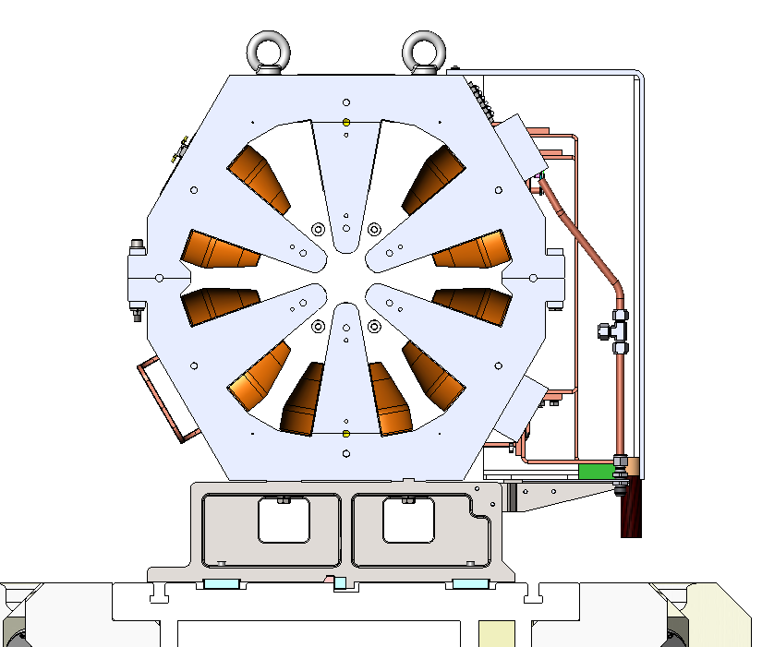
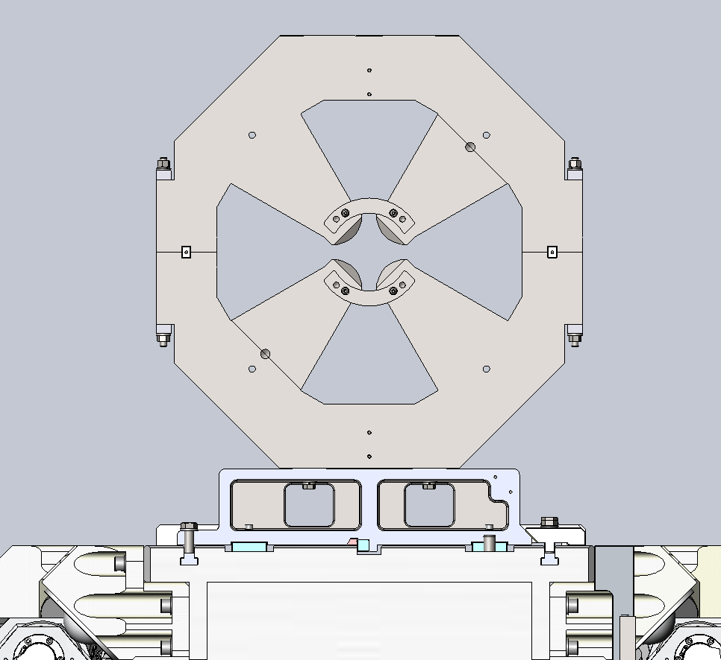
Positioning method of Quadrupole & Sextupole
Horizontal
reference
Horizontal
reference
Vertical reference
Vertical reference
The positioning precision of this method is within few μm.
A PSD with laser is used to double check the system position.
Notes:
Before the field measurement, the magnet should be align at the exact position. There are two touch reference plane to determine the horizontal transverse plane and four touch reference plane to determine the vertical plane.

Slide 19
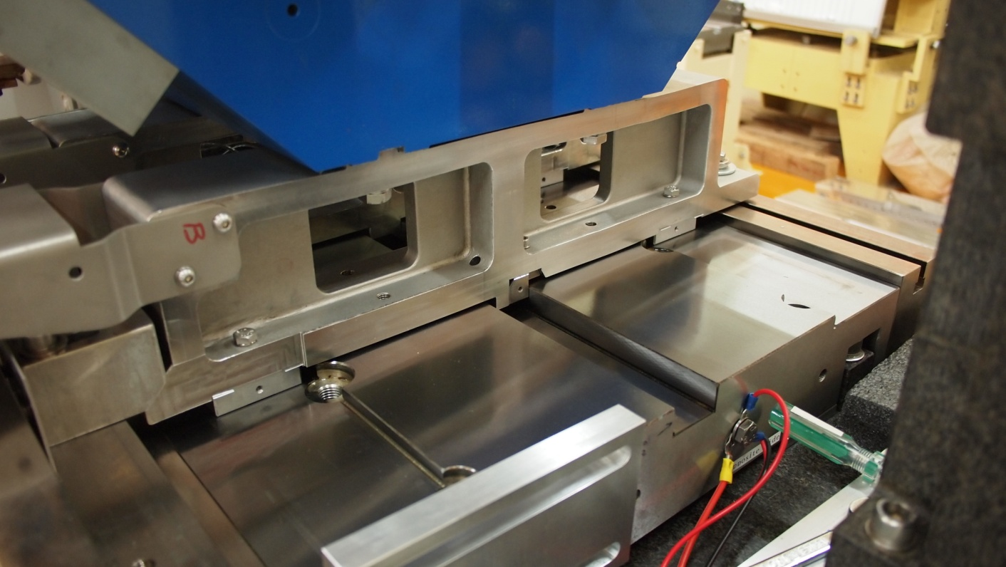
Position shimming method of Quadrupole &
Sextupole

Slide 20
Positioning method of SR-DM
-z
Type I
-z
Type II
+y
+z
+z
+x
+z
Two reference plates are for defining the horizontal position and four reference plates are for defining vertical position.
45 degree clamper was used to push magnet to touch reference plane and fixed by the torque range tool.
The positioning precision of this method is also within few μm.

Slide 21
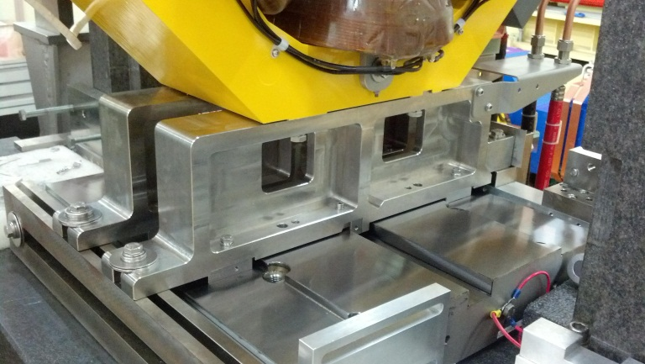
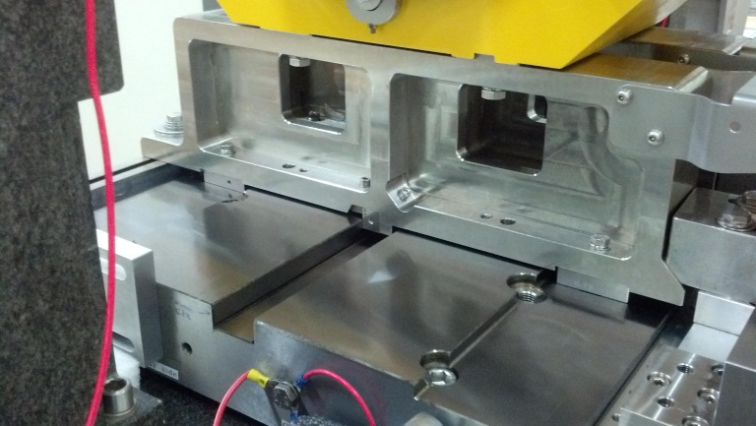
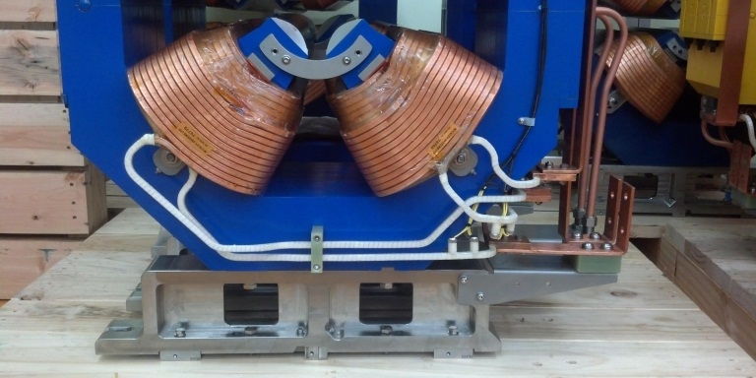
Magnet alignment method
45º bolt
RCS bench (similar as girder)
Both side measurement of RCS to indicate the field center of magnet.
Retractable block
Tape-key block
Lift bolt
Magnet on girder

Slide 22
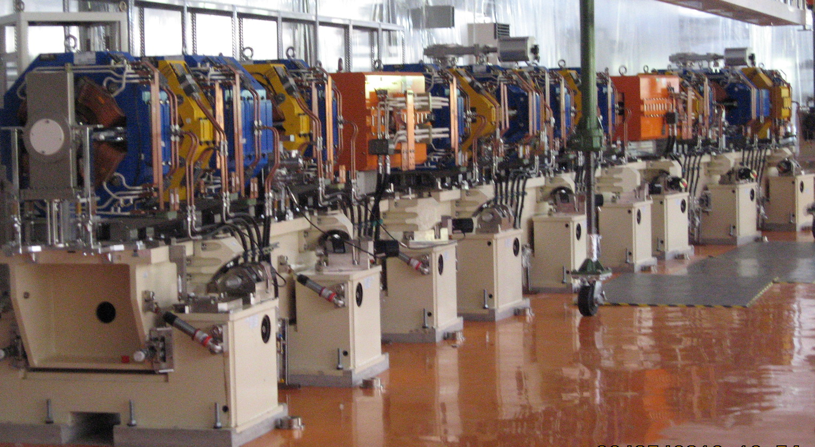
1/24 section magnets

Slide 23
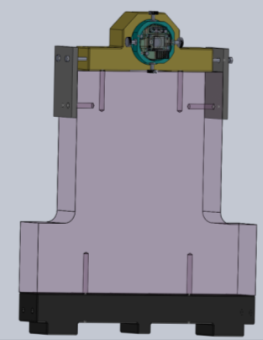
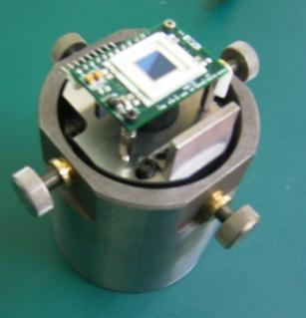
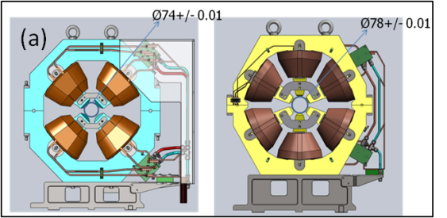
TPS Magnets Alignment Inspection
A laser positioning system for TPS magnet alignment inspection is developed.
System is composed of a Laser and 2 PSD with 2 granite blocks.
PSD module is designed to install in quadrupole and sextupole magnet
Position jig is designed to symbolize magnet
PSD module
PSD
Position Jig
PSD1
PSD2
Laser
Position Jig1
(granite block)
Position Jig2
(granite block)
Girder
The optical axis of Laser is adjusted to parallel to girder through reference to position jig
Notes:
t
23

Slide 24
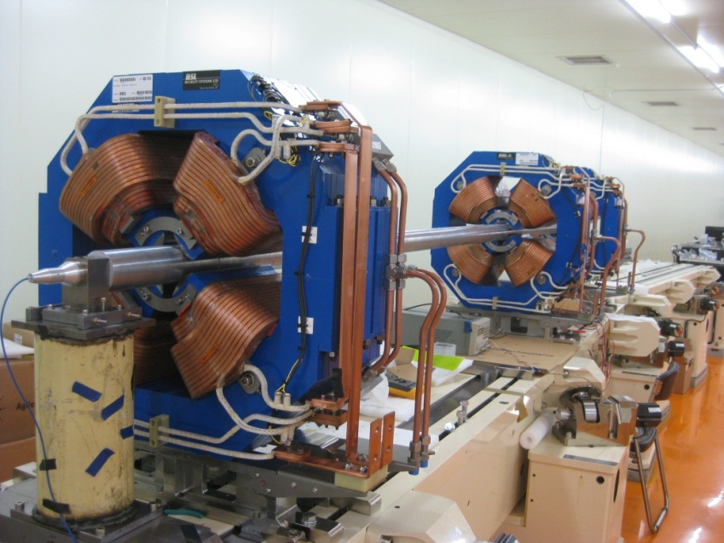
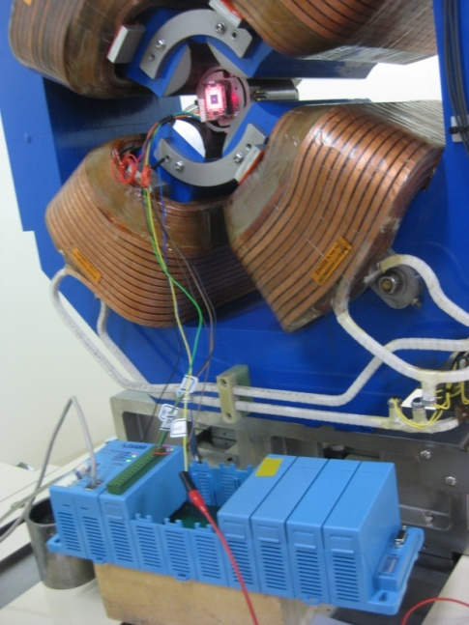
Magnets alignment on the girder
PSD module
Shielding
Laser
circular jig
A PSD module with circular jig was developed to check the magnet center of all magnet in the same girder.
The measurement result was confirmed that all the magnet center is within 30 μm.

Slide 25
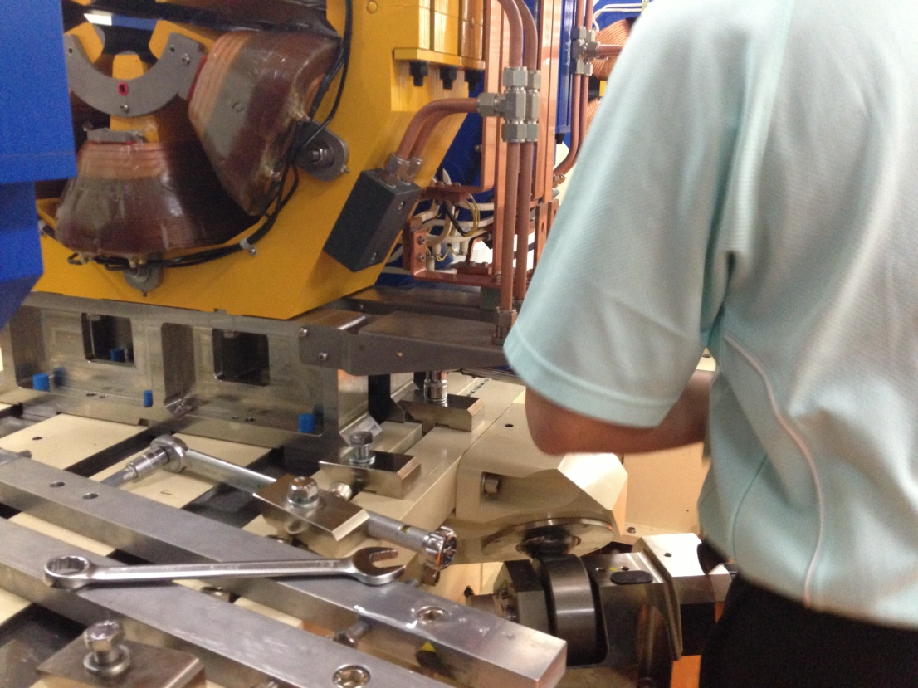
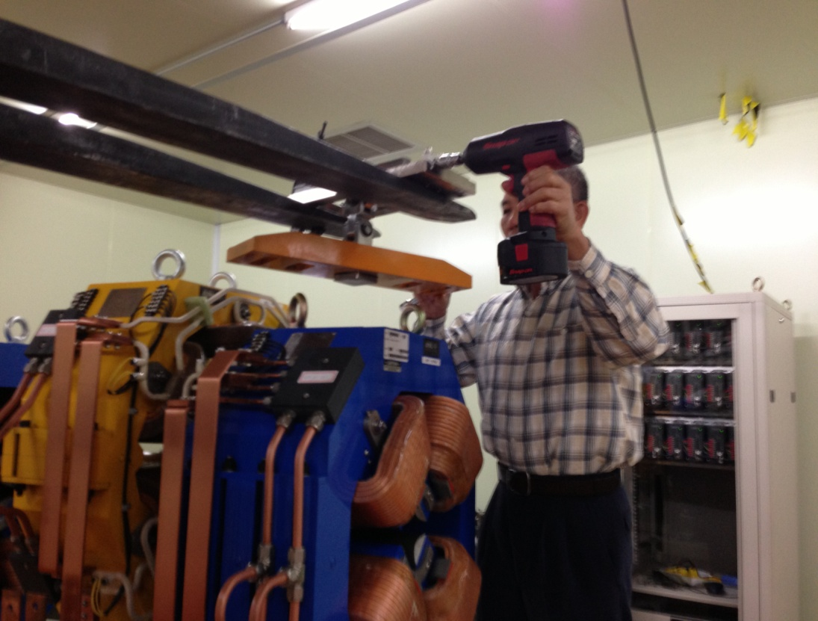
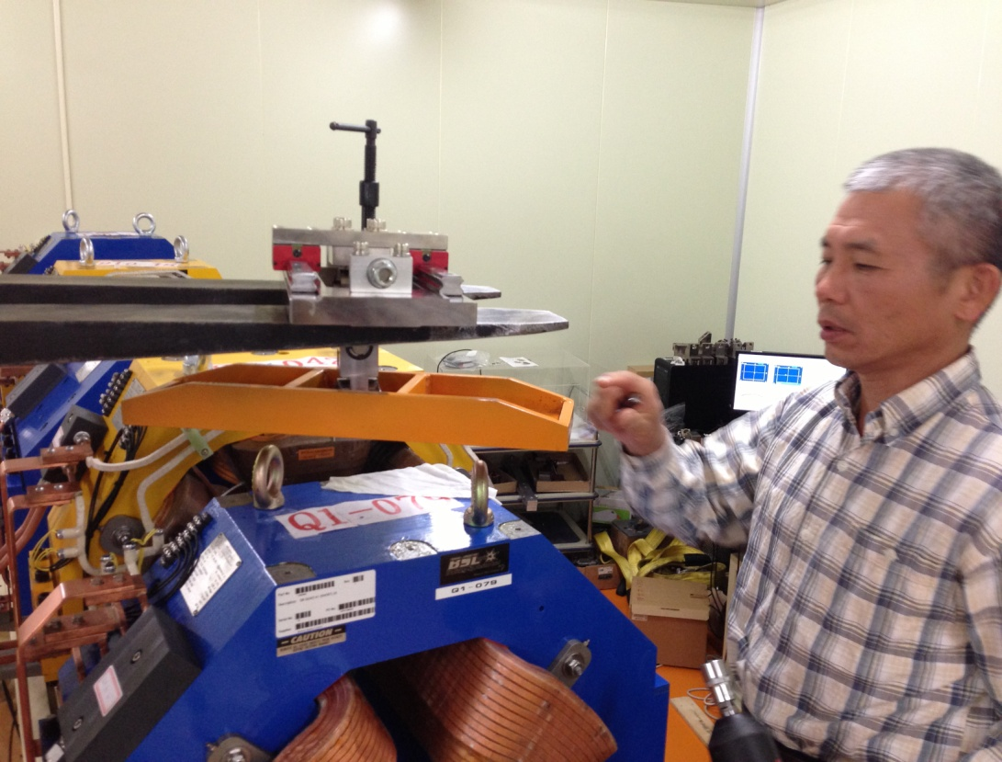
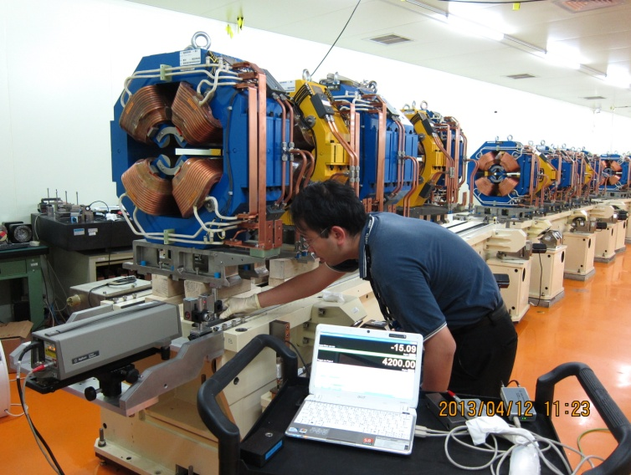
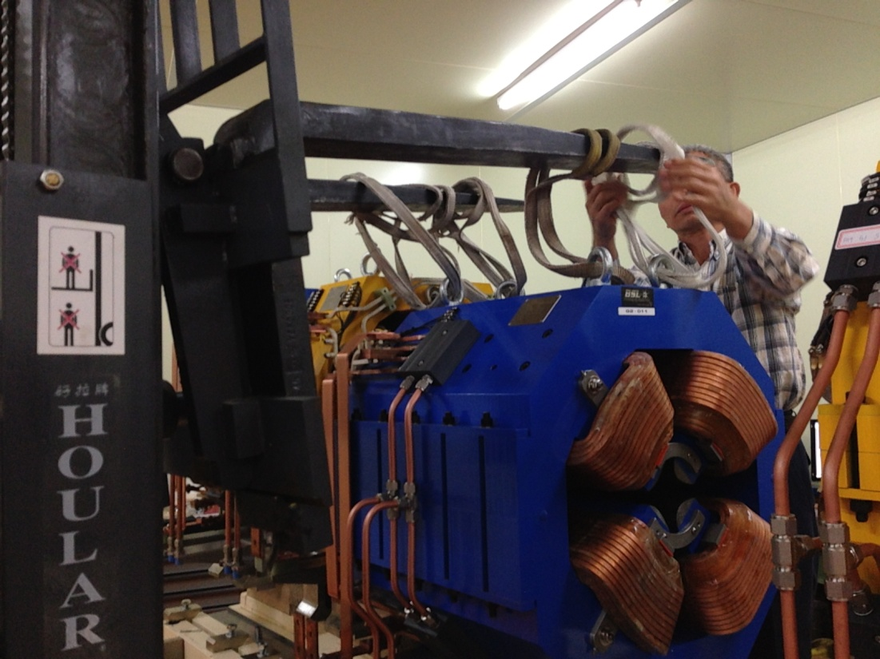
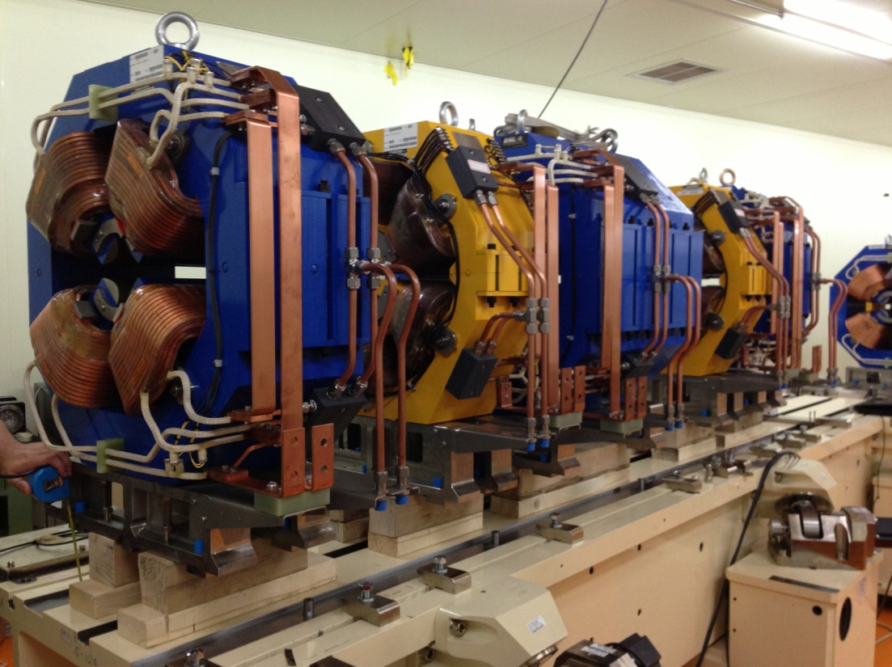
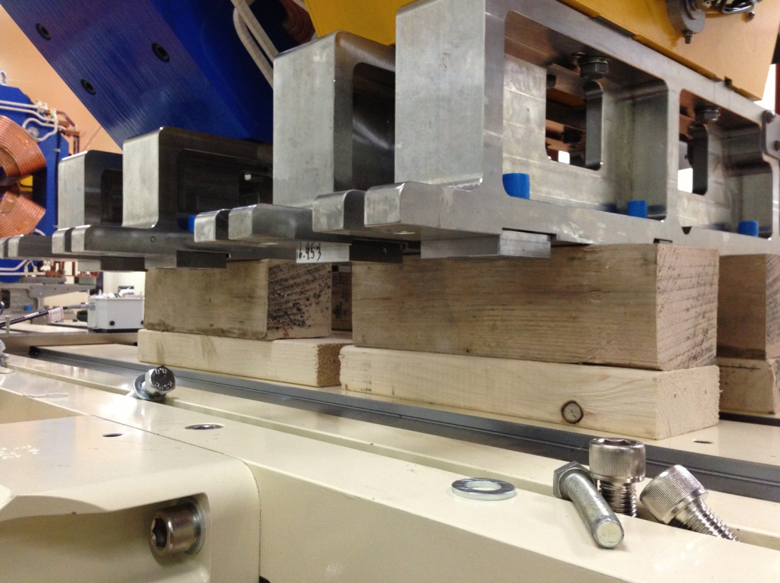

Slide 26
Measurement of Storage ring magnets

Slide 27
SR-magnet specification
(x10⁻⁴) | SR-DM
n | BnL/B0L
0 | 10000
1 | ±3
2 | ±3
3 | ±2
4 | ±3
Normalized at 25mm Δb0/b0<1E-4 Δb0L/b0L<0.5E-3
(x10⁻⁴) | SR-QM
n | BnL/B1L | AnL/B1L
1 | 10000 | -
2 | ±2 | ±2.0
3 | ±2.0 | ±1.0
4 | ±0.5 | ±0.3
5 | ±0.8 | ±0.3
6 - 8 | ±0.3 | ±0.3
9 | ±0.3 | ±0.3
10 - 29 | ±0.3 | ±0.3
Normalized at 25mm
(x10⁻⁴) | SR-SM
n | BnL/B2L (x10⁻⁴) | AnL/B2L (x10⁻⁴)
0 | ±15 | ±10
2 | 10000 | -
3 | ±2 | ±2
4 | ±3 | ±1
5 - 7 | ±0.5 | ±0.5
8 | ±0.5 | ±0.3
9 | ±0.3 | ±0.3
10 - 13 | ±0.3 | ±0.3
14 | ±0.3 | ±0.3
15 - 29 | ±0.3 | ±0.3
Normalized at 25mm

Slide 28
SR-DM-I and SR-DM-II
Field strength
21 SR dipole magnets were examined at NSRRC.
(50 magnets required)
The dispersion of b0L is better than 0.11%.

Slide 29
SR-DM-I and SR-DM-II
Homogeneity Δb0/b0 and Δb0L/b0L
The Δb0/b0 and Δb0L/b0L are meet spec within good field region (GFR).

Slide 30
SR-short QM
Field strength
159 SR short-QM magnets were examined at NSRRC until 2013/05/30. (195 magnets required)
The dediation of b1L will be compensated by independent power supply.

Slide 31
SR-short QM
Normalized multipoles
The mostly normalized multipoles of SR-short QM are within spec.

Slide 32
SR-short QM
Center offset and roll angle
 | 159 short_QM magnets
 | Mean | Std. Dev.
Magnetic center, Vertical-offset (mm) | 0.002 | 0.009
Magnetic center, Horizontal-offset (mm) | 0.005 | 0.012
Magnetic Roll angle (degree) | -0.0063 | 0.012
Mechanical center V-offset (mm) | -0.002 | 0.004
Mechanical center H-offset (mm) | -0.002 | 0.006
Mechanical Roll angle (degree) | 0.003 | 0.005
The mean value of magnetic center offset & magnet roll are within 0.01mm in the vertical (horizontal) direction and 0.012º.

Slide 33
SR-long QM
Field strength
28 SR long-QM magnets were examined at NSRRC until 2013/05/30. (50 magnets required)
The prototype magnet have a large field dispersion.

Slide 34
SR-long QM
Normalized multipoles
The mostly normalized multipoles of SR-long QM are within spec.

Slide 35
SR-long QM
Center offset and roll angle
 | 28 long_QM magnets
 | Mean | Std. Dev.
Magnetic center, Vertical-offset (mm) | 0.003 | 0.008
Magnetic center, Horizontal-offset (mm) | -0.008 | 0.012
Magnetic Roll angle (degree) | -0.004 | 0.009
Mechanical center V-offset (mm) | -0.004 | 0.003
Mechanical center H-offset (mm) | -0.004 | 0.006
Mechanical Roll angle (degree) | 0.003 | 0.004
The mean value of magnetic center offset & magnet roll are within 0.01mm and 0.012º in the vertical and horizontal direction.

Slide 36
Multipoles distribution of Q-magnet along Z-axis

Slide 37
Multipoles distribution of Q-magnet along Z-axis
Exact Skew quadrupole term can be obtained after the angle calibration of Hall probe .

Slide 38
SR-Sextupole Magnet (SM)
Field strength
132 SR-SM magnets were examined at NSRRC until 2013/05/30. (174 magnets required)
The large dispersion is dominated by prototype magnet.

Slide 39
SR-SM
Normalized multipoles
The mostly normalized multipoles of SR-SM are within spec.

Slide 40
SR-SM
Center offset and roll angle
 | 132 SM magnets
 | Mean | Std. Dev.
Magnetic center, Vertical-offset (mm) | 0.004 | 0.009
Magnetic center, Horizontal-offset (mm) | 0.000 | 0.011
Magnetic Roll angle (degree) | 0.008 | 0.017
Mechanical center V-offset (mm) | -0.001 | 0.003
Mechanical center H-offset (mm) | -0.002 | 0.005
Mechanical Roll angle (degree) | 0.006 | 0.006
The mean value of magnetic center offset & roll are within 0.011mm in the vertical (horizontal) direction and 0.017º.

Slide 41
Measurement of Booster ring magnets

Slide 42
BR-magnet specification
x10⁻⁴ | BR-DM
n | BnL/B0L
0 | 10000
1 | *
2 | **
3 | ±3
4 | ±2
Normalized at 15mm Δb0/b0<5E-4 Δb0L/b0L<0.5E-3 *b1L/b0L= -2.1043 **b2L/b0L= -7.5331
x10⁻⁴ | BR-combined QM
n | BnL/B1L | AnL/B1L
1 | 10000 | -
2 | - | -
3 | ±4 | ±2
4 | ±4 | ±1
5 | ±2 | ±0.5
6 | ±1 | ±1
7 | ±1 | ±0.5
8 | ±5 | ±0.5
9 | ±2 | ±0.5
10 | ±4 | ±0.5
11 | ±0.5 | ±0.5
12-13 | ±2 | ±0.3
14-17 | ±0.5 | ±0.3
18-19 | ±0.3 | ±0.3
20 | ±0.5 | ±0.3
Normalized at 15mm b2L/b1L=1.145
x10⁻⁴ | BR-SM
n | BnL/B2L | AnL/B2L
0 | ±45 | ±30
2 | 10000 | -
3 | ±15 | ±6
4 | ±9 | ±6
5-7 | ±3 | ±1.5
8 | ±10 | ±1.5
9-13 | ±3 | ±1.5
14 | ±6 | ±1.5
15-20 | ±3 | ±0.6
Normalized at 15mm
x10⁻⁴ | BR-Pure QM
n | BnL/B1L | AnL/B1L
1 | 10000 | -
2 | ±4 | ±10
3 | ±4 | ±2
4 | ±1 | ±1.5
5 | ±3 | ±0.5
6-7 | ±1 | ±0.5
8 | ±0.5 | ±0.5
9 | ±4 | ±0.5
10-12 | ±0.5 | ±0.3
13 | ±1.5 | ±0.5
14-16 | ±0.5 | ±0.3
17 | ±1.7 | ±0.5
18-20 | ±0.3 | ±0.3
Normalized at 15mm

Slide 43
BR-combined function dipole magnet
Homogeneity of BR-BH-001 and BR-BD-002 magnets
Increase the slope of pole profile to increase the quadrupole component.
Cancel the end-chamfer of pole.
Yoke length of BH dipole magnet reduce 4 mm from 758 mm to 754 mm.
Magnet | Items | b1L/b0L |  | b2L/b0L
 |  | Design | Measure | Design | Measure
 | Spec. | -2.1043 | - | -7.5331 | -
BD (1.6m) | Original simulation | -2.0365 | -2.049 | -7.5524 | -8.480
 | Optimized simulation | -2.1041 | - | -7.6129 | -
BH (0.8m) | Original simulation | -1.9758 | - | -7.1151 | -
 | Optimized simulation | -2.1050 | - | -7.7164 | -

Slide 44
BR-combined function dipole magnet
Homogeneity of BR-BH-001 and BR-BD-002 magnets
The Δb0/b0 of BR-BH-001 and BR-BD-002 is better than 4.5×10⁻⁴ and -3.0×10⁻⁴, respectively
The Δb0L/b0L of BR-BH-001 and BR-BD-002 is better than 1.9×10⁻⁴ and -5.3×10⁻⁴, respectively.

Slide 45
BR-combined function dipole magnet
Field strength
The measurement of ByL/I is confirmed by the calculated value with ignore μ_{r} and B_{r} between 100 A to 900 A.
The ByL/I of BR-BH-001 magnet has clearly increasing is due to the remnant field effect in the low current.
The ByL/I of BR-BH-001 magnet has slowly decreasing is due to the yoke situation over 900A.

Slide 46
BR-combined function dipole magnet
Combined multipoles along electron-beam trajectoy (Z-axis)
The multipole distributions of measurement are agreement with the simulation result.

Slide 47
Combined function quadrupole magnet
Field strength: Pre-measurement at vendor site
<b1L> @ 82A = 3.3647 T , Std @ 82A = 0.0032T
<b1L> @ 5A = 0.2280 T , Std @ 5A = 0.0004T
<b2L> @ 82A = 3.7871 T, Std @ 82A = 0.0356T
<b2L> @ 5A = 0.2602 T, Std @ 5A = 0.0161T
<b2L/b1L> @ 82A = 1.1256 T, Std @ 82A = 0.0101T
<b2L/b1L> @ 5A = 1.1409 T, Std @ 5A = 0.0695T
The b2L/b1L deviation of 5 A is larger than 82 A, because the remnant field obviously influence in the low current.

Slide 48
Combined function quadrupole magnet
Normalized multipoles: Pre-measurement at vendor site
Dominated by remnant field in the low current.
The b3 component is same in the 0A ~ 5A
All of multipoles distribution, exclude B3L/B1L and B5L/B1L, are quite similar in the 82 A and 5 A.

Slide 49
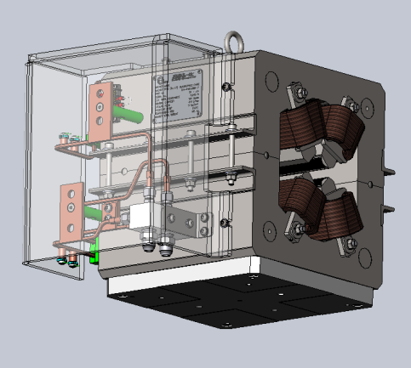
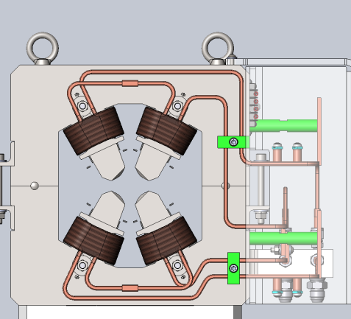
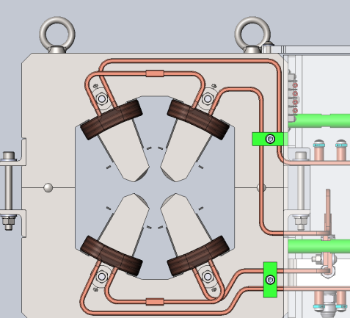
Remnant field improvement of BR-QP magnet
Coil turns: 12
Coil turns: 6
Coil turns: 18
 |  |  | Original |  | Improved
Magnet L=0.3 (m) |  | Spec. b1L (T) | Coil turns | Energy @ current | Coil turns | Energy @ current
QP | Q1 | 4.2985 | 18 | 3GeV @ 104A | 18 | 3GeV @ 104A
 |  | 0.2149 |  | 150MeV @ 5.1A |  | 150MeV @ 5.1A
 | Q2 | -2.7174 | 18 | 3GeV @ 66A | 12 | 3GeV @ 99A
 |  | -0.1359 |  | 150MeV @ 3.3A |  | 150MeV @ 5.0A
 | QM | -1.2623 | 18 | 3GeV @ 30A | 6 | 3GeV @ 90A
 |  | -0.0631 |  | 150MeV @ 1.5A |  | 150MeV @ 4.5A
The excitation current of BR-pure quadrupole magnet will be increased after coil no. reduced.
The remnant field effect will be solved by reducing length for the low-current (150MeV) increase.

Slide 50
Pulse magnet measurement

Slide 51
Pulse Magnet Type
Half-sine Kickers
SR injection kickers x 4
Half-sine Septum magnet
Booster injection septum x 1
Booster extraction septum x 1
SR injection septum x 1
PFN Kickers
Booster injection kicker x 1
Booster extraction kicker x 1

Slide 52
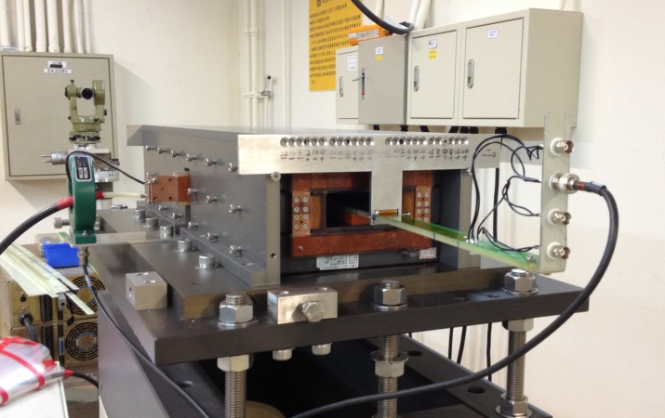
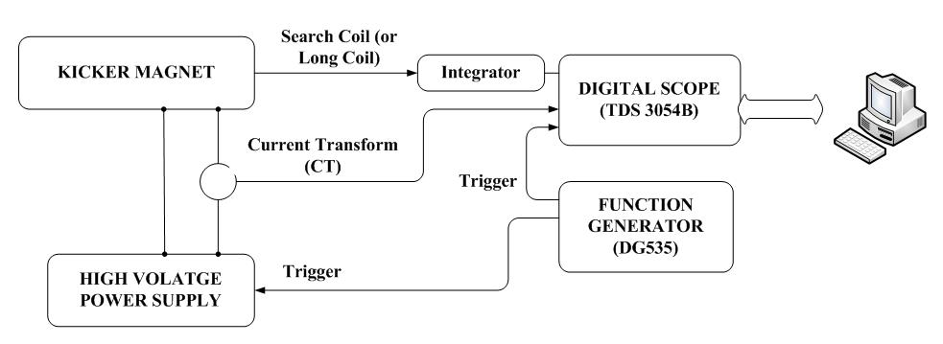
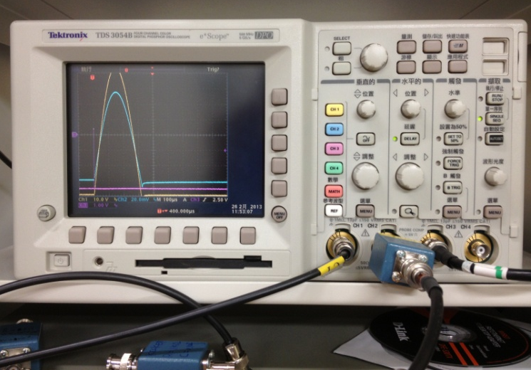
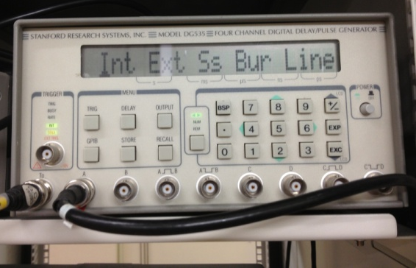
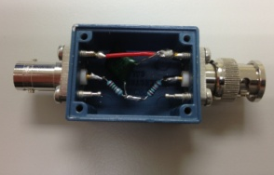
Long Coil and Search coil Measurement system for Storage Ring Kicker Magnet
Long coil : One turn loop of length 1000 mm and width 1.7 mm
Search coil : The is 5 mm, from winding thirty turns of enamel wire (thickness 0.5 mm)
Long Coil
Search Coil
SCOPE
Function Generator
Integrator

Slide 53
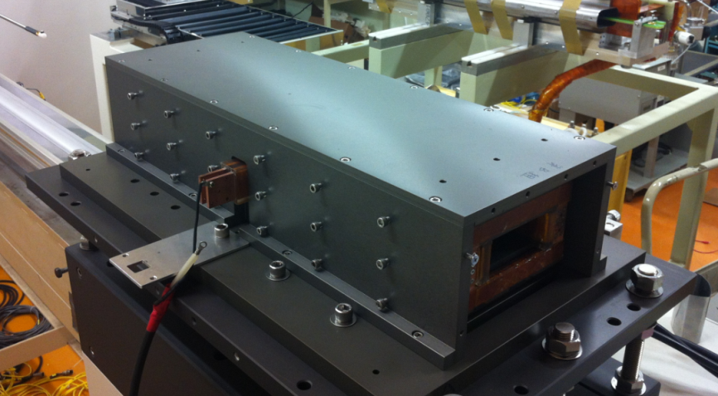
Storage ring Kicker Magnet
B-I Curve
Integral Bfield Roll-Off

Slide 54
Long Coil and Search coil Measurement Systems for SR Injection and BR Extraction Septum
Long coil :
Bending curve : Measures the on-axis magnetic field of the septum magnet
Straight curve : Measures the leakage magnetic field of the bumped orbit and stored orbit
One turn loop of length 1000 mm and width 1.7 mm.
Search coil : The is 5 mm, from winding thirty turns of enamel wire (thickness 0.5 mm)
Long Coil
Search Coil
Bending curve probe
Straight curve probe
SCOPE
Function Generator
Integrator

Slide 55
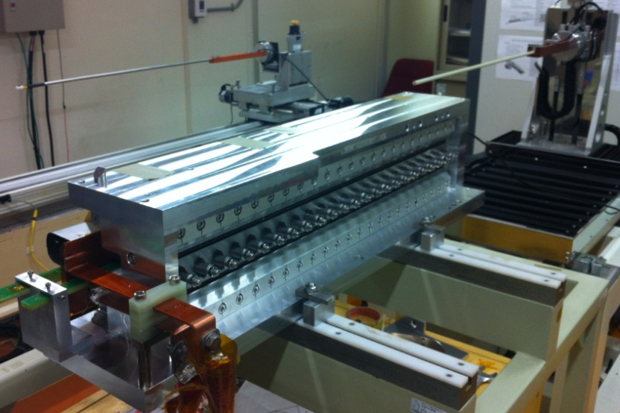
Storage ring Injection Septum Magnet
By leakage field
By Leakage field
Bumped orbit (G-cm) | 90 (0.15%)
Stored orbit (G-cm) | 18 (0.03%)
Bx leakage field
Bx Leakage field
Bumped orbit (G-cm) | 15 (0.03%)
Stored orbit (G-cm) | 4 (0.01%)

Slide 56
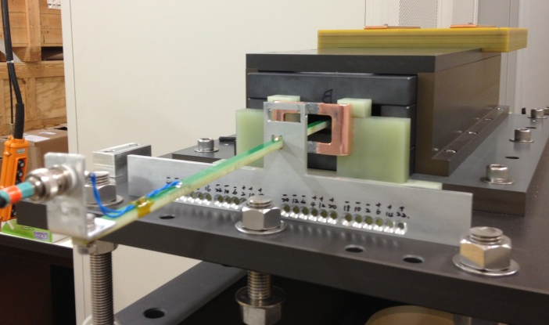
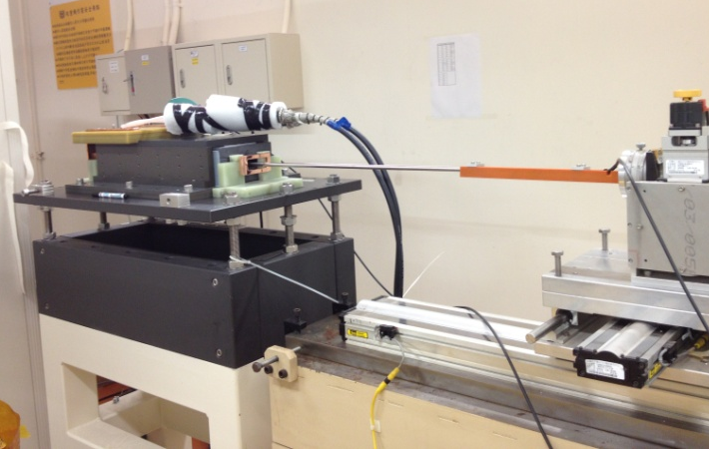
Field measurement of Booster Injection and Extraction Kicker Magnet
Long coil : One turn loop of length 1000 mm and width 1.7 mm
Search coil : The is 5 mm, from winding thirty turns of enamel wire (thickness 0.5 mm)
Long Coil
Search Coil
SCOPE
Function Generator
Integrator

Slide 57
Booster Injection Kicker Magnet
Current output
Integral Bfield Roll-Off
Parameters | Measurement
Pulse shape | Flat top
Fall time (ns) | 400
Flat top (us) | 1
Flatness (%) | ± 1

Slide 58
Summary
Most of the magnet can be meet the specification. However, much effort to solve the technique problem is necessary.
The deviation of b0L of SR-dipole magnets is better than 0.1 %.
Deviation of magnetic center & roll angle are within 0.02 mm and 0.02º.
A PSD module with circular jig can be used to check all the magnet center on the same girder.
The ratio of quadrupole and sextupole of the combine dipole magnet is quite consistence between the TOSCA simulation and the construction results.
The deviation of b2L/b1L of QF magnet with current below 5 A is much larger than 82 A, because the remnant field exist in the hysteresis behavior.
The coil turns and length of booster magnets should be as small as possible to avoid the current ripple and the remnant field effect in the low energy injection region.

Slide 59
Thanks for your attention

