Slide 1
Magnets for a new low emitance storage ring at ESRF
J. Chavanne ,G. Le Bec, P. N’Gotta, J.F. Bouteille

Slide 2
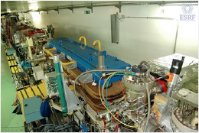
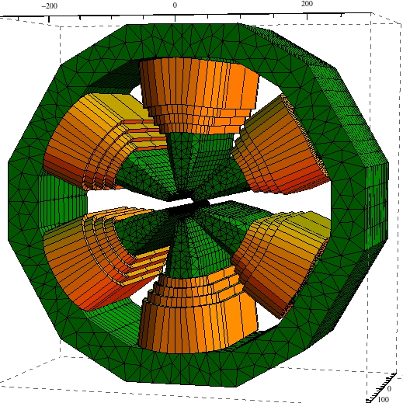
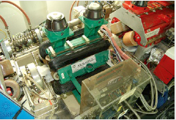
Outline
New magnet lattice
Why?
Magnet requirement
Magnet design
Specifications
Constraints
Magnetic measurements
Integral
local
Summary

Slide 3
Electron Beam Parameters
Reduction of horizontal emittance by a factor of 25
Parameter | Existing lattice | New lattice
Energy [Gev] | 6.03 | 6.03
Circumference [m] | 844 | 844
Beam Current [mA] | 200 | 200
Horizontal emittance [nm] | 4 | 0.16
Vertical emittance [pm] | 5 | 3
Energy Spread [%] | 0.1 | 0.1
Beta at ID center , H x V [m] | 37.6 x 3 (high Beta) 0.37 x 3 (low Beta) | 3.35 x 2.79
Beam Size at ID center H x V [µm] | 400 x 3.9 50 x 3.9 | 23.5 x 3.7
Beam Divergence at ID H x V [µrad] | 10 x 1.3 107 x 1.3 | 6.9 x 1.3

Slide 4
Higher brilliance
Electron beam:
6 GeV
I=0.2 A
 | H emittance | V emittance | Energy spread [%]
Present | 4 nm | 5 pm | 0.1
New lattice | 0.16 nm | 3 pm | 0.1

Slide 5
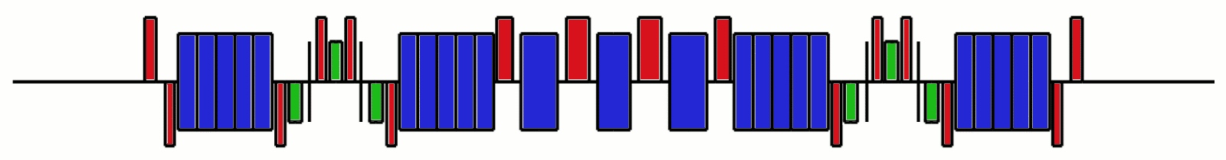
Emittance reduction
Electron energy
Number of identical dipoles
ESRF magnet lattice today: DBA (2BA)
New Lattice 7BA
Constraint:
same energy
fit new magnet lattice in existing ring (844 m)
Keep existing BM sources

Slide 6

ESRF S10 Lattice
Quadrupole
55 to 80 Tm⁻¹
High gradient quadrupoles
100 Tm⁻¹
Octupoles ( ~ 50 000 Tm⁻³)
Dipoles with
longitudinal gradient
0.6 -> 0.15 T
0.4 -> 0.15 T
Combined dipole quadrupoles
0.85 T / 45 Tm⁻¹
and 0.3 T / 50 Tm⁻¹
Sextupoles
~1500Tm⁻²

Slide 7
Compact magnet lattice
ESRF Accelerator upgrade: 1056 magnets to build
Magnet type | Quantity | Total magnetic length[m] | share
Dipole | 7 | 11.38 | 65%
Quadrupole | 16 | 4.17 | 24%
Sextupole | 6 | 1.68 | 10%
Octupole | 4 | 0.4 | 2%
All magnets | 33 | 17.6 | 100%
Total length of a cell: 26.376 m
Length of ID straight section: 5.8 m
~ 3 m of drift space distributed between magnets
~ 8 m presently
Limited longitudinal space is a specificity of the new ESRF lattice

Slide 8
Aperture and good field region
S10 centre
Initial parameters for preliminary study
S10 All | Horizontal [mm] | Vertical [mm]
Vacuum chamber aperture (radius) | 15.1 | 10.1
Good field region (radius) | 8.3 | 5.5
S10 Centre (high gradient) | Horizontal [mm] | Vertical [mm]
Vacuum chamber aperture (radius) | 8.3 | 5.5
Good Field Region (radius) | 7 | 5

Slide 9
Road map
Project not yet funded (decision early 2015)
Go ahead with prototype development and magnetic measurements
2013-2015
  Magnetic design
  Mechanical design
  First prototypes
  Improvement/development of magnetic measurement systems
    stretched wire/vibrating wire benches
    Local field mapping
    Other …
…… 2019 all magnet installed

Slide 10
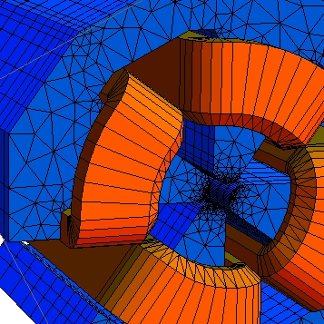
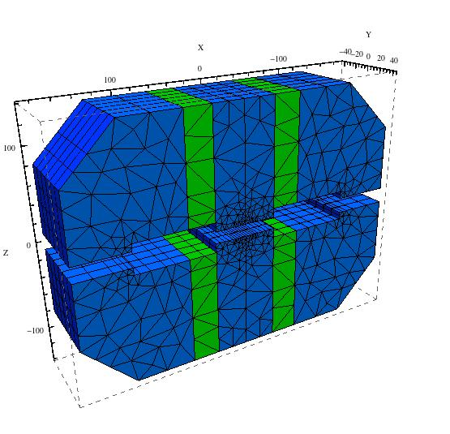
Magnet design approach
Achievable Magnet performance/ field quality in defined aperture
Impact on vacuum chamber technology
Impedance issue,….., etc
Energy efficiency
3D magnetic modeling using RADIA
  Native field integral calculation
  Electron beam tracking in magnet
  Efficient parameterization for various optimization
    Pole shape
    Geometrical errors budget
    Electrical power
    ….
P.M dipole

Slide 11
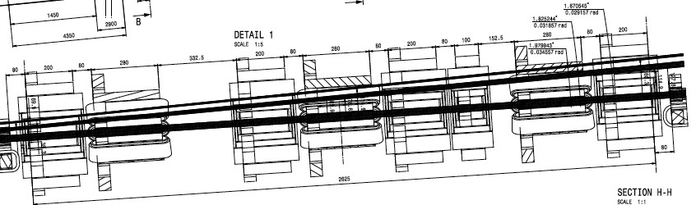
Geometrical design constraints
Insertion Device Photon Beam
Electron Beam
Small bore radius = tight mechanical tolerances
Mechanical length (limited space) → short coils
Photon beam path specific to SR sources (open magnets)
… etc

Slide 12
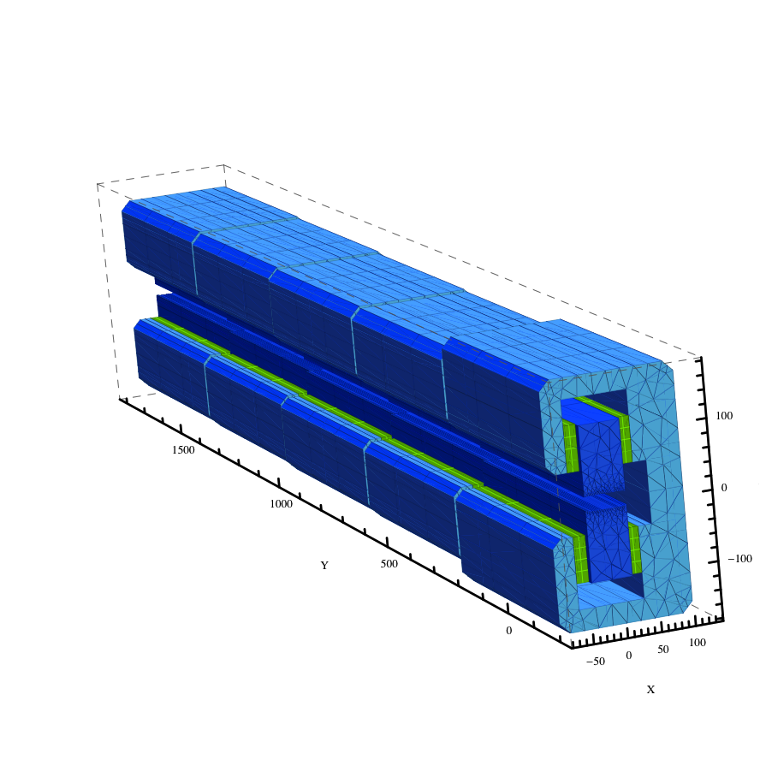
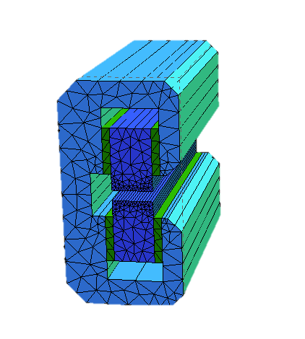
Dipole with longitudinal gradient
ESRF has a long experience with Permanent magnet systems (Insertion Devices)
Iron yoke
Sm₂Co₁₇ Magnet
Min. gap 90 mm
Pole
Vertical field along beam path
(3D simulations)
Field tuning
Dedicated movable shims : ± 3 %
Coil: ± 100 A.turns ± 1.5 % of total
Deflection angle
Building Block
PM weight ~ 25kg
Total weight 400 ~500 kg
Magnetic length: 2.07 m

Slide 13
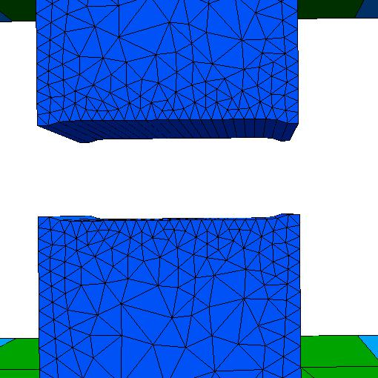
Pole shape optimization
60 mm
Max field 0.6 T
∆B/B0
x
20 mm
x
∆B/B,<10⁻⁴ (-15 mm <x<15 mm)

Slide 14
Magnet modules arrangement
Whole magnet oriented along mean beam path
Modules translated horizontally by few millimeters
Residual offsets vs local magnetic axis ±2.5 mm
All magnets with longitudinal gradient= 640 modules with similar shape and different amount of magnet blocks
~ 3.2 tons ( 380 dm³) of Sm₂Co₁₇ permanent magnets needed for all 128 magnets

Slide 15
Combined dipole/quadrupoles
Purpose : restore exiting BM source points for the new lattice
0.4 T soft end
0.85 T
Existing lattice
6mrad @ 0.4 T
6mrad @ 0.85 T
0.334 T / 50 Tm⁻¹
0.85 T / 45 Tm⁻¹
New lattice
6mrad @ 0.334 T
6mrad @ 0.85 T
Magnetic design under study
Possibly based on Permanent Magnets as other dipoles
Field tunability …..

Slide 16
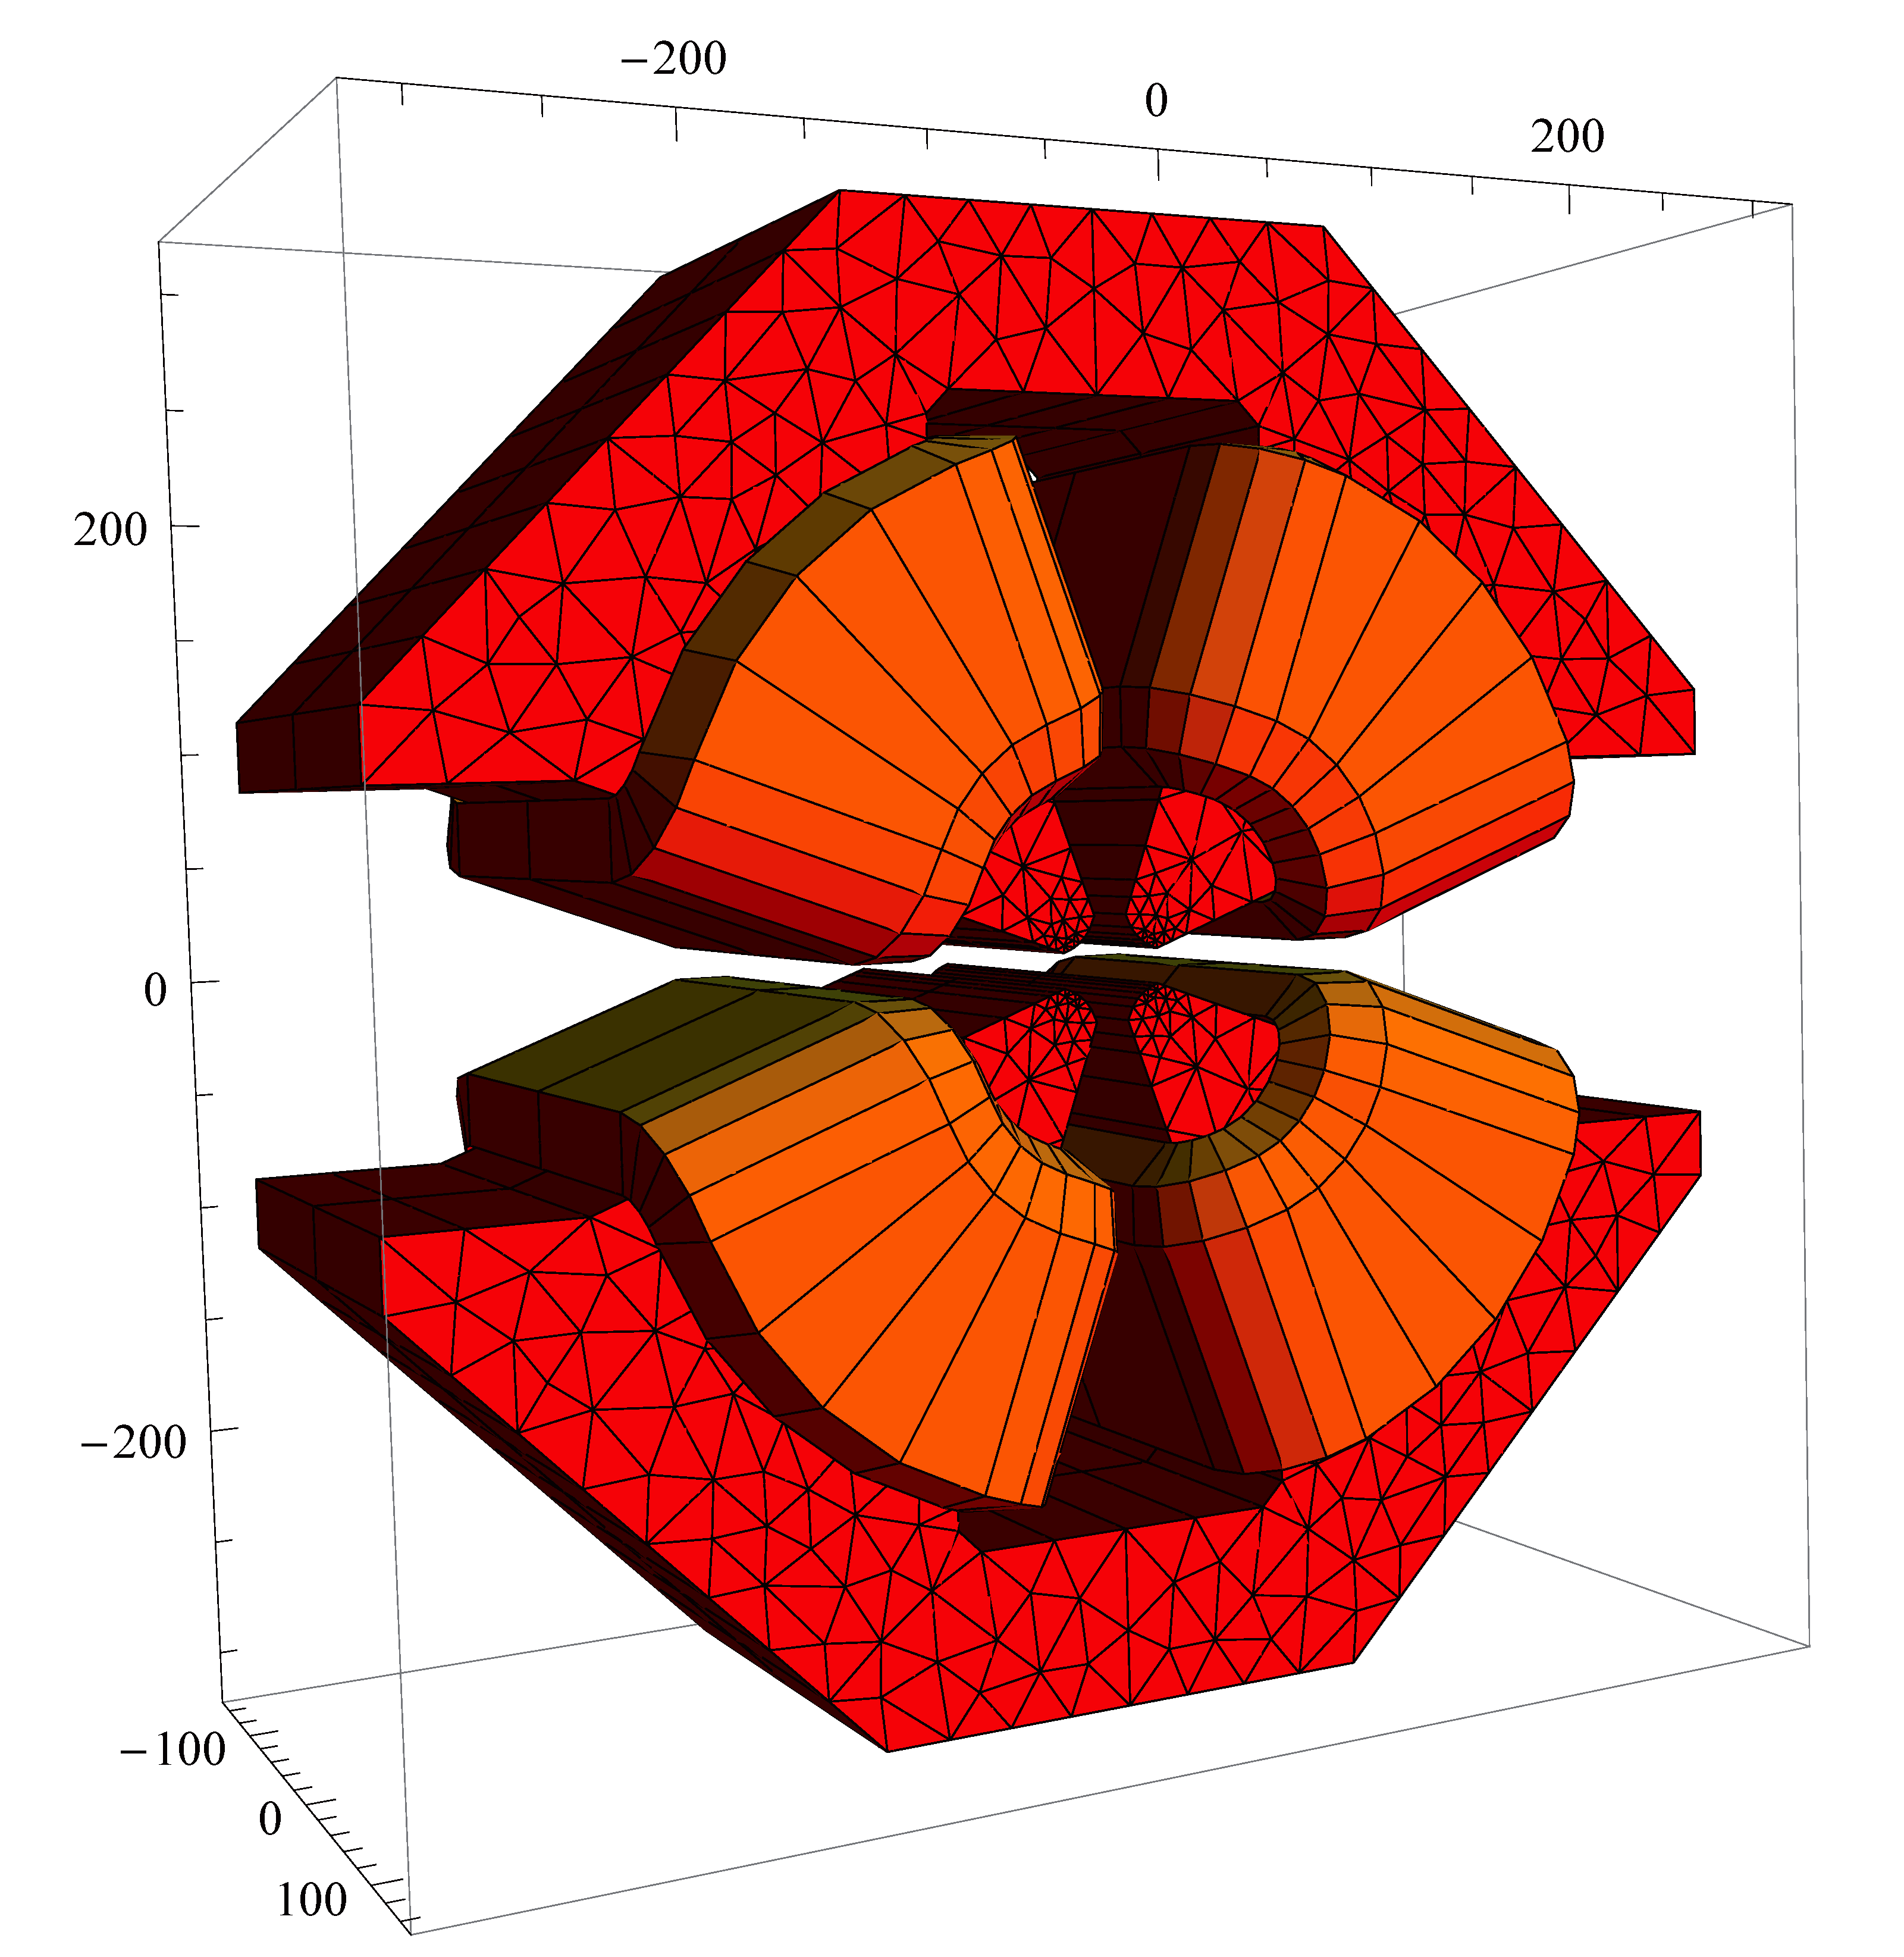
High gradient quadrupoles
No laminations
Storage ring→ Constant field
Stringent mechanical tolerances
Demanding alignment
Field quality
Asymmetric GFR (∆G/G<10⁻³)
Optimization of the pole profile
Optimization criteria
Field quality in GFR
Power consumption
Compactness

Slide 17
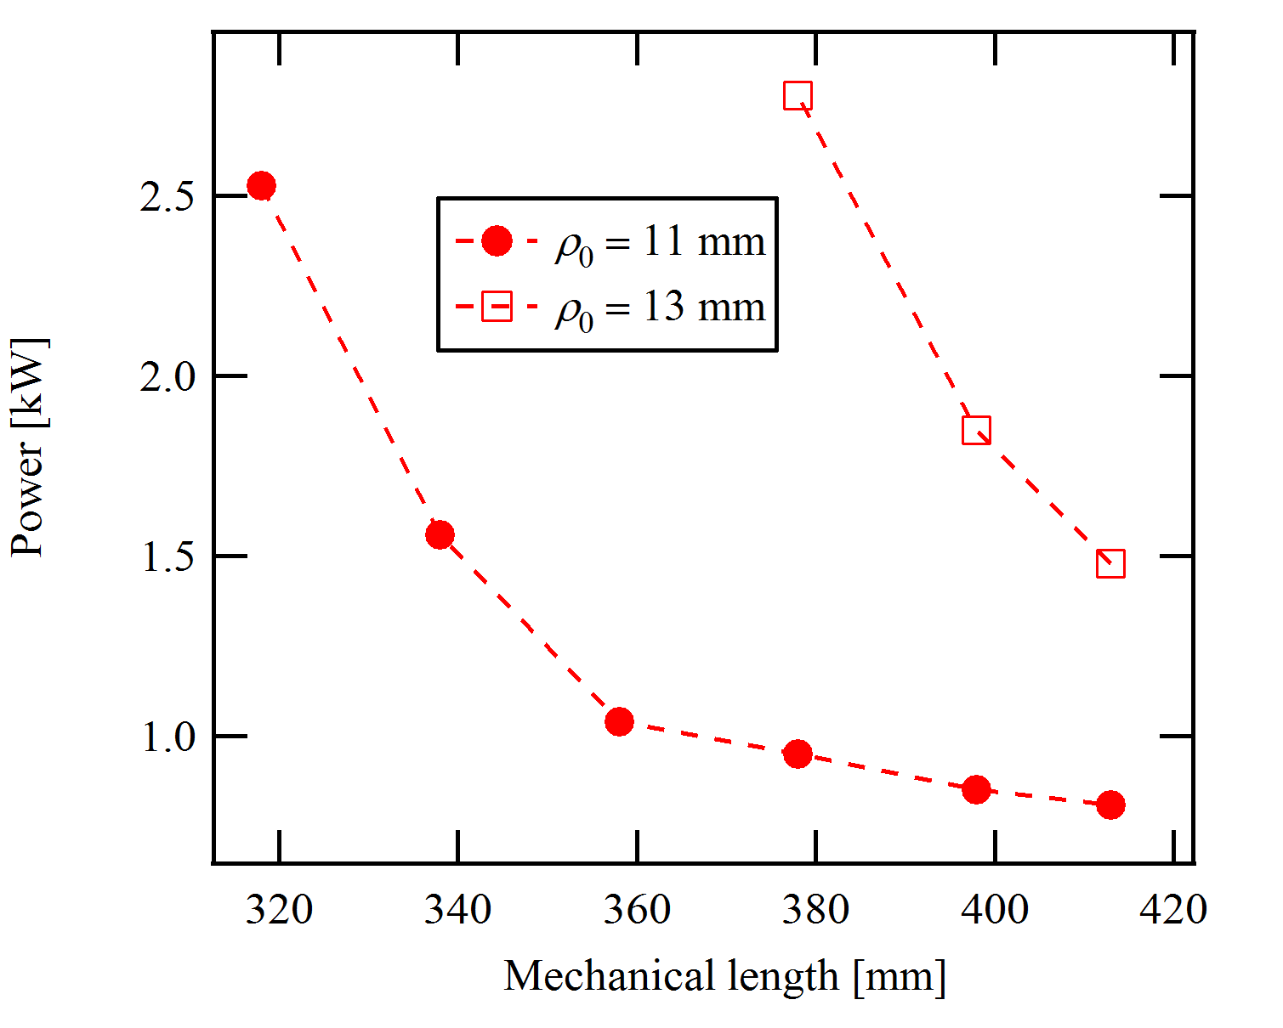
High gradient quadrupole design
Design parameters
Spec: 100 T/m x 335 mm
Bore radius: 11 mm
Magnet length
Mechanical length: 360 mm (iron+coils)
1 kW

Slide 18
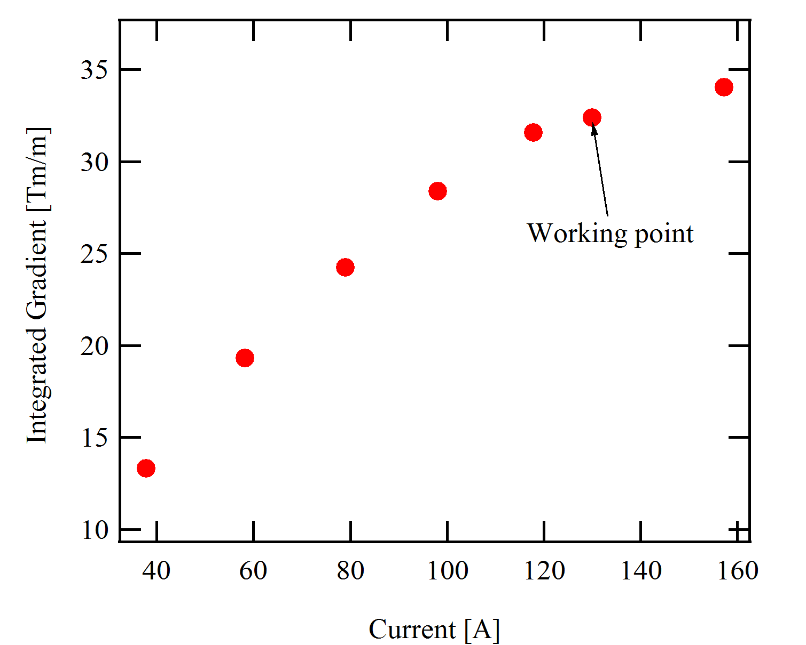
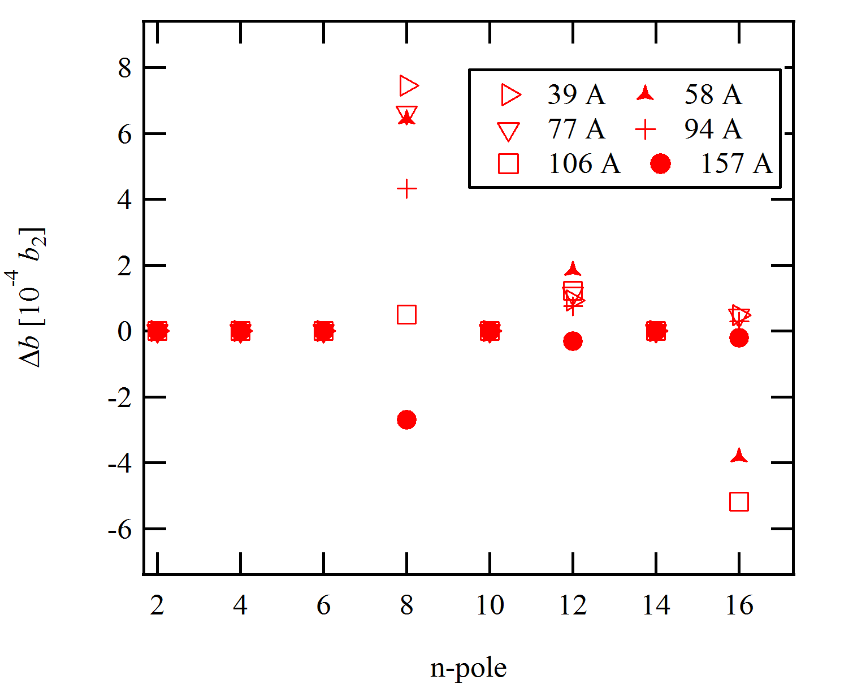
High gradient quadrupole design
Magnet close to saturation
Gradient vs. current
Variation of multipole content
(reference: 130 A)

Slide 19
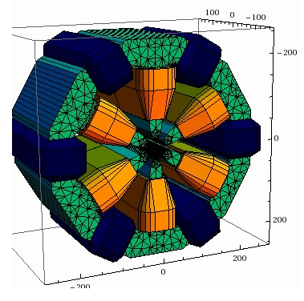
Sextupole magnet
Bore radius 19 mm
Sextupole homogeneity < 1% in GFR
Integrated sextupole : 420 T/m nominal
2D sextupole: 1500 T/m²
Laminate yoke
correctors
Mechanical length < 300 mm

Slide 20
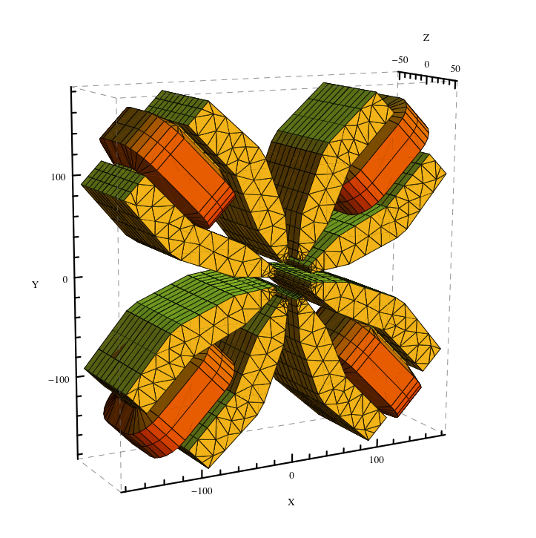
Octupoles
Mechanical length ≤ 100 mm
Needed for this lattice
Integrated octupole> 5000 T/m²
Horizontal homogeneity of integrated octupole
< 10 % in GFR

Slide 21
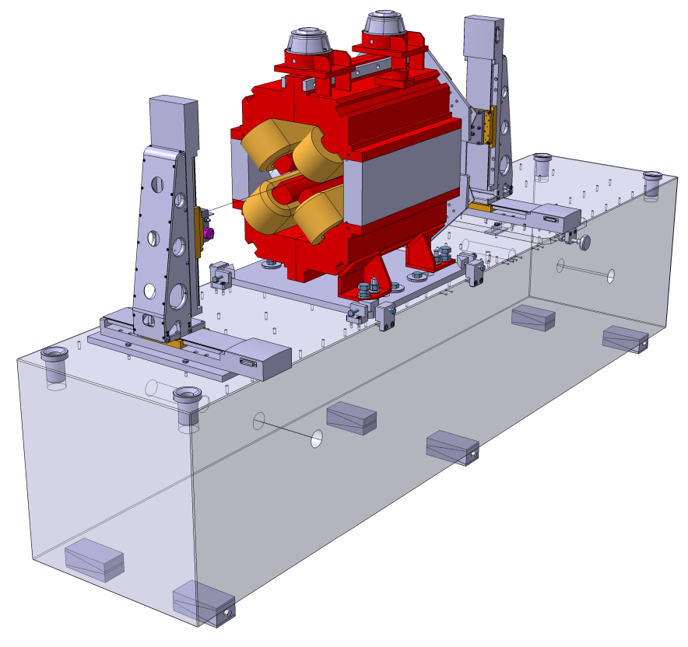
Magnetic measurements
Integral measurements
Stretched wire:
  Integrated multipoles analysis
  magnetic center
  Other variants (vibrating wire)
  Adequate for
    Quadrupoles
    Sextupoles
    Octupoles
    Dipole modules
Curved magnets will need dedicated curved coils
ESRF stretched wire bench

Slide 22
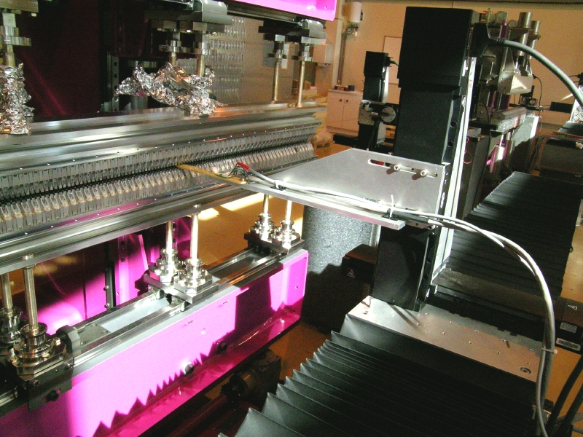
Local field measurements
Rely on existing experience with Insertion Device Hall Mapping
Several units in operation
  Modern mutli-axis control
  High positioning accuracy
  Appropriate for open magnets
  Search coil vs hall sensors
Used for
  Curved magnets (dipole)
  Combined dipole/quadrupole
To be probably adapted for dipoles & combined function magnets

Slide 23
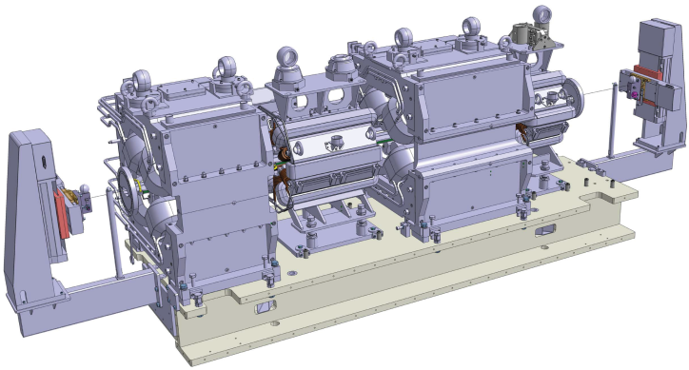
Magnet alignment
Difficult and essential part
Usual alignment based on fiducialisation not sufficient
In situ alignment on girder with
stretched wire/ vibrating wire seems better option
RMS alignment error of 20 µm looks feasible ( wire length ~ 3m)
(see Stretched wire measurements of magnet girders, G. Le Bec on Wednesday)
Appropriate for straight magnet assembly (eg. quadrupoles sextupoles, etc)
Magnet girder with combined dipole/quadrupole need other approach

Slide 24
Summary
Very challenging magnets in focus @ ESRF
  Field performance close to magnetic saturation for quadrupoles, sextupoles
  High stability permanent magnet materials must enter in the process
  Preliminary magnetic design to be completed (combined function magnets)
Magnetic measurements
  Stretched/vibrating wire is a good option
  Local field mapping to be refined
More to come at next IMMWs …..

