Slide 1
JLAB 12GeV Upgrade Measurement Overview Ken Baggett for the Metrology and Magnet Measurement Department
IMMW 18 June 3-7 2013 BNL

Slide 2
What’s happening at JLAB
Jlab is in the final stages of a major upgrade of the accelerator which will increase the energy from 6GeV to 12GeV to accommodate the experimental program in the new hall (Hall D).
For magnet measurement this means:
Complete the modifications to the magnets in the recirculation arcs, spreader/re-combiners and other accelerator areas to keep the higher energy beam confined to the existing beam path.
Finish measurement on the tenth arc-beamline to provide an extra pass through the North Linac.
QC and measure magnets for the new beamline connecting Hall D to the baseline accelerator
Challenge for Magnet Measurement Group:
Meet throughput requirements for the upgrade project and
Meet measurement specifications

Slide 3
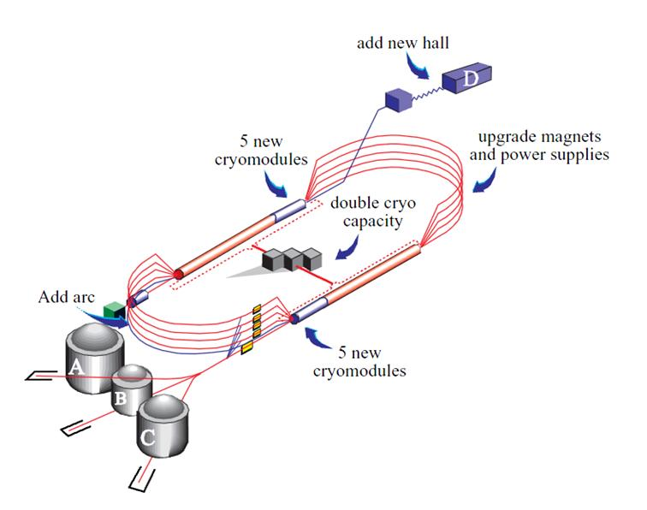
Design overview: 6mo Down Scope
Refurbish and Measure
Spreaders and Re-combiners,
Extraction, & BSY: ~70 Dipoles
Arc 10
Install 32 Quad Girders & 32 4m Dipoles
Complete: Refurbish and measure arcs 2,4,5,6,7,8,&9

Slide 4
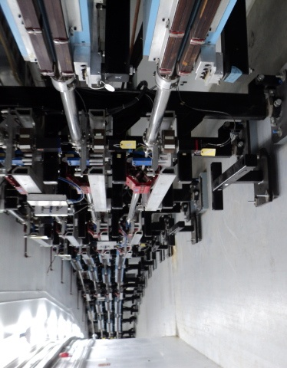
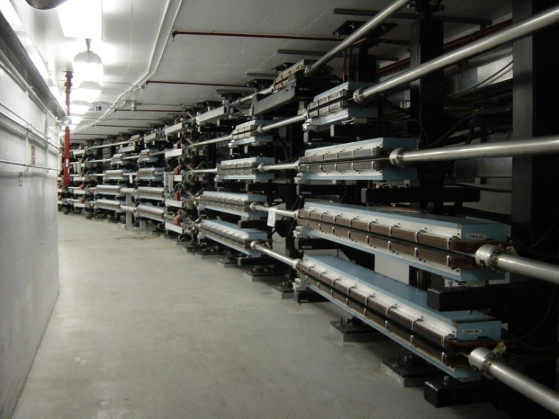
Last Time - Production Measurements (2011)
Magnet work timeline ~2.5 months
Removed, refurbished, measured and re-installed a total of 208 dipoles.
*No safety incidents
All ARC dipoles
Matching of dipoles on a string important.
Used a combination of full grid data and BL data on all dipoles to determine matching
West Arc
East Arc

Slide 5
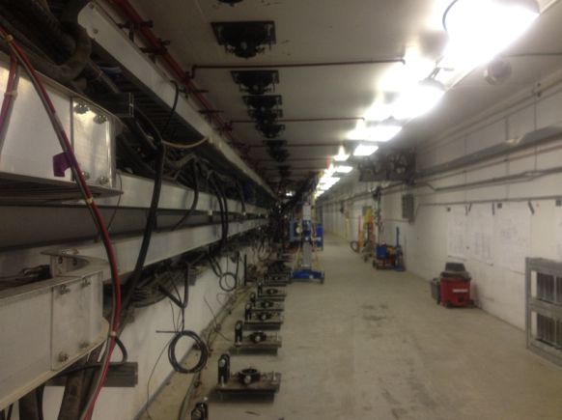
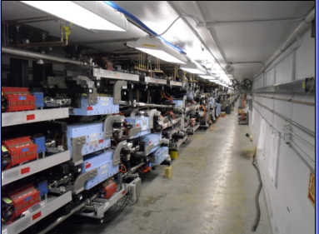
This Time - Production Measurements
Magnet work timeline 1 year
Goal
Remove, refurbish, measure and reinstall:
48 Arc Dipoles
27 Hall line dipoles
69 Spreader and Re-combiner Dipoles
8 New 3m Septas
~12 re-used Septas
What’s different this time?
All spreader and re-combiner dipoles required full maps
Excitation at 11 currents
Field quality at 50%, 75% and 100% 12GeV operating currents
August 2, 2012
May 21, 2013

Slide 6
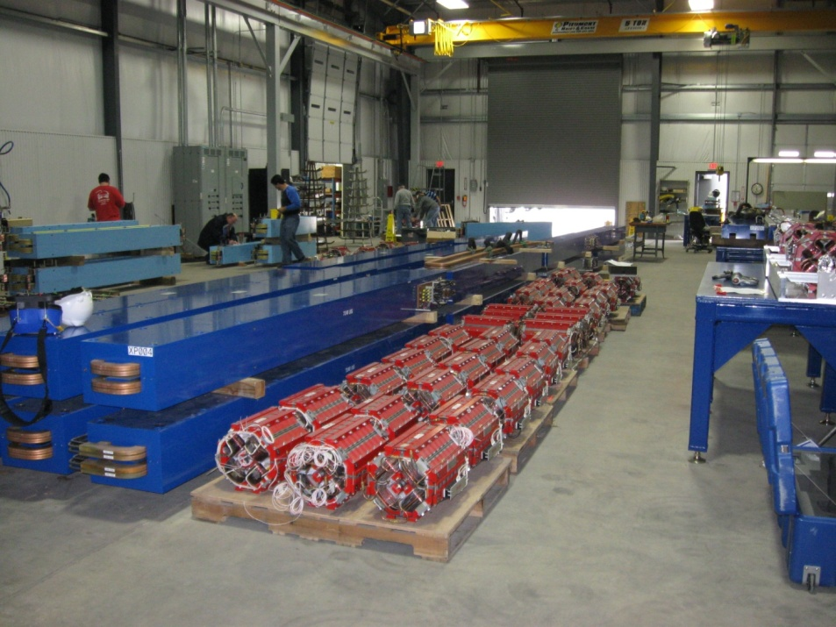
Our New Magnet “Challenge Opportunity”
Lots of unique dipoles to process
Need measurement throughput rate of ~1/day
Need to create fixturing on measurement tables for quick and accurate positioning
Mechanical stops for magnets and measurement stages

Slide 7
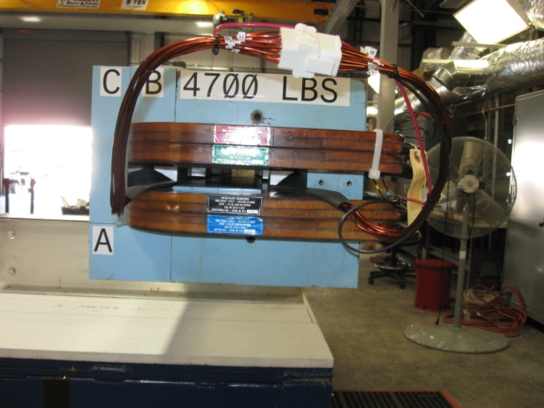
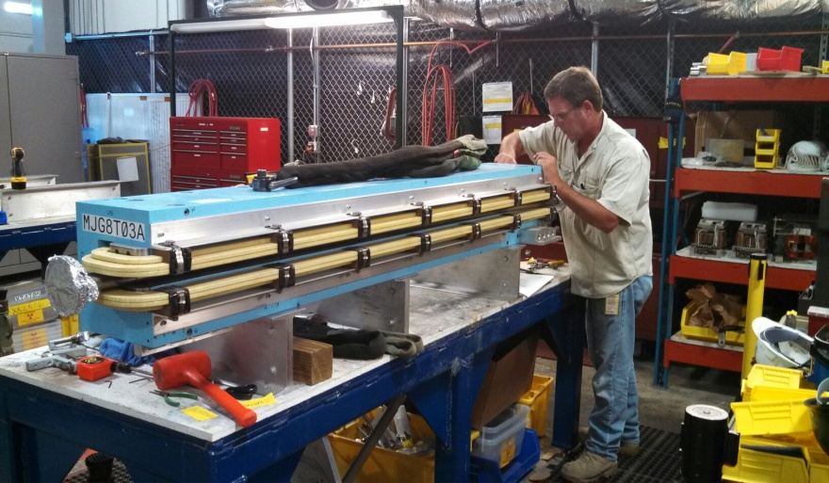
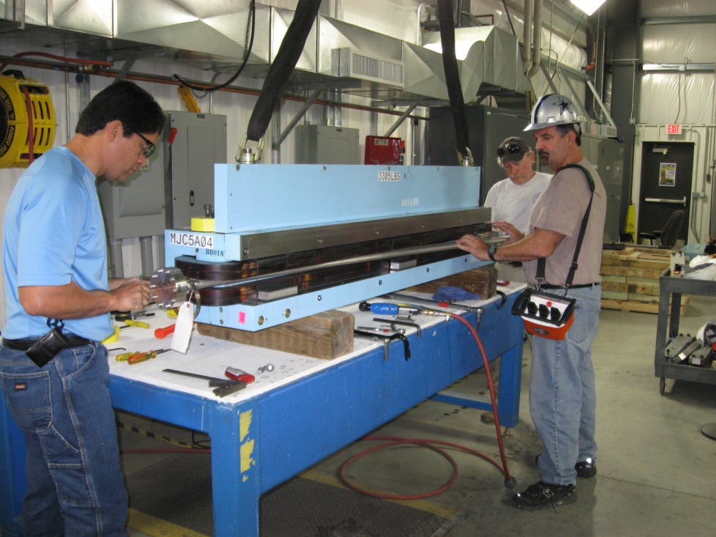
Arc Dipole Upgrade Process
Remove Dipoles from Tunnel
Separate Magnet Cores
Remove Vacuum Chamber
Replace Insulation (EPDM), Thermal Switches, Coil Spacers
Add “H-Steel”
Add synchrotron radiation coils (3m and 4m dipoles)
Flow Check
Hi-pot
Magnetically Measure
Remove cover plate and re-install chamber
Final QC
Re-install
Lots of potential for magnets to change during process

Slide 8
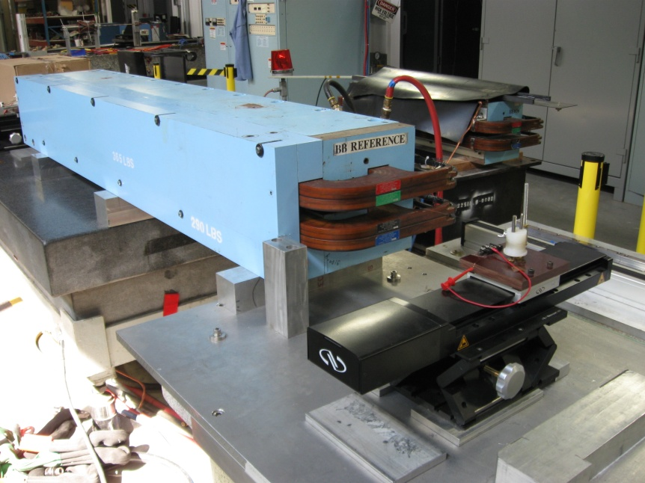
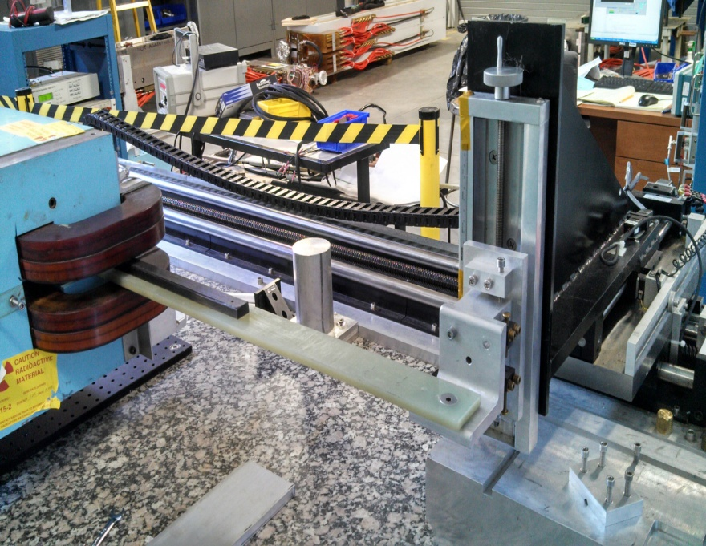
Measurement Stands
SW System
Stretched Wire was used for the excitation curve mapping (BL vs. I)
System core: 4 μm Newport stages / HP3458A voltmeter
Cross checked matching between the SW and Hall probe systems
Stepper Stand
Stepper Stand used for field quality measurements
Group 3 Hall probes
Linear Encoders
Automated Calibration Routine

Slide 9
System Matching Checks
Field integral (BL) matching between measurement systems was acceptable
Hall probe grids and SW matched at the 0.01% level at 12GeV operating levels throughout production

Slide 10
Dipole Mapping Specs
Spec for accuracy of absolute strength (BL) is fairly loose (0.4%)
Spec for precision of strength measurements for matching along an arc are pretty tough (0.03%). Thankfully, most of that was done last time…
Need field quality (gradient) to fall within specs (given for each arc)
Approach used to meet specs and throughput:
Stretched wire used to get BL vs I for all magnets
Detailed maps with Hall probes and NMRs used to build map along curved trajectory.
Done for 10% sampling of arc dipoles.
Done for all spreader and re-combiner dipoles

Slide 11
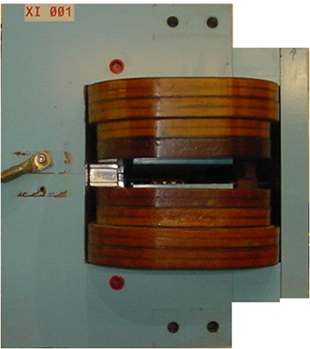
Typical 1m dipole

Slide 12
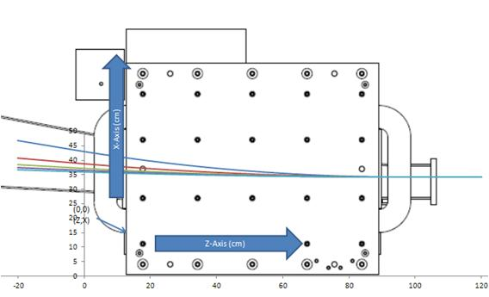
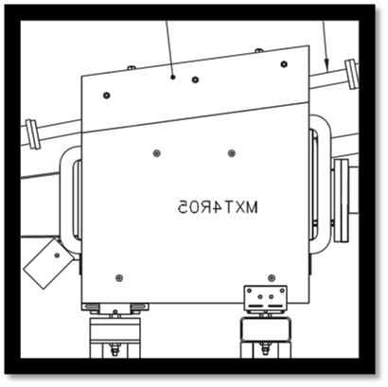
BCOM Dipole
Beam-combiners
Take beam from the 5 arcs and combine them into a single path to go through the linacs and cryomodule acceleration process
Lots of measurements
Project required strength and gradient information on each trajectory

Slide 13
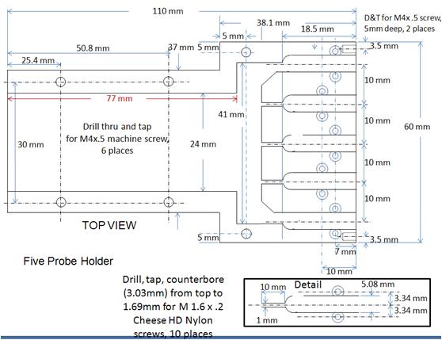
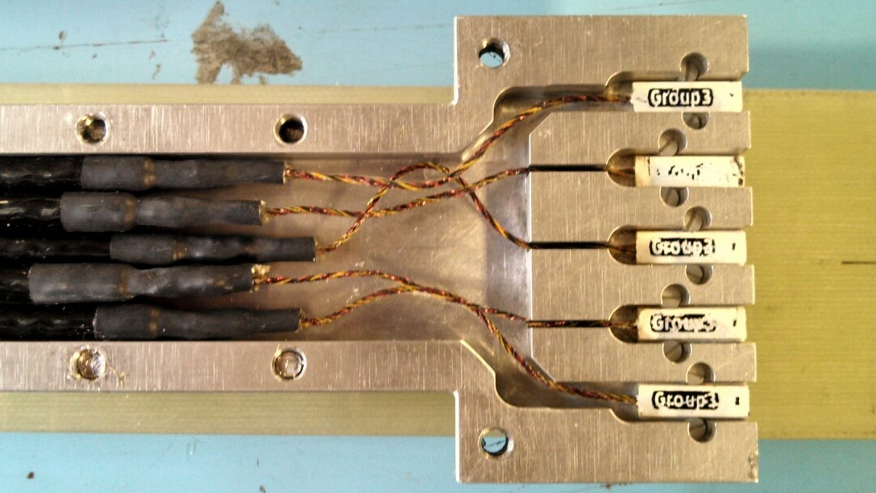
New 5 Probe Holder
New probe holder built for multiple Hall probes.

Slide 14
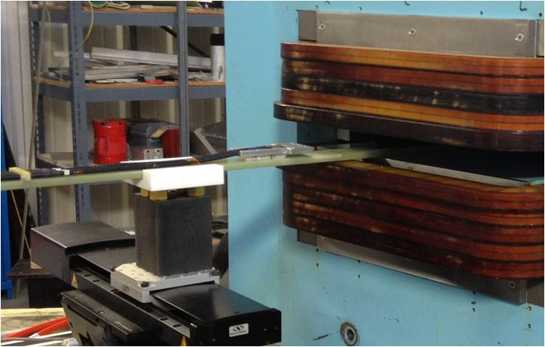
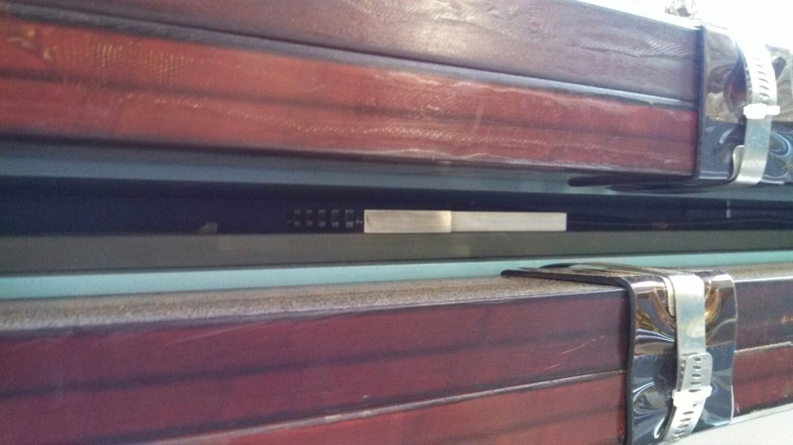
Dipole Grid Mapping
5 Probe Holder
(1 cm spacing)
Teflon Guide
G-10 probe cart
Needed way to efficiently map 1m “H” dipoles
Single probe on a stick method was slow
Some dipoles (BCOMS) needed over 25cm of x coverage
Solution
Hall probe holder for 5 probes
G-10 mounting cart for probe holder
Synchronized x stages on both ends of dipole
Z axis stage pushes cart through the x stages

Slide 15
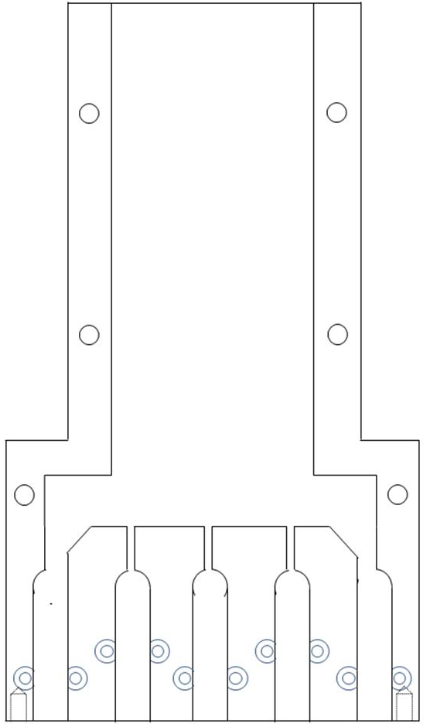
Probe Automated Calibration
Used a simple procedure with every dipole to check calibration.
Hall probes checked to a reference Hall probe
Reference Hall probe calibrated against NMR
1
2
1
3
2
1
4
3
1
2
1
5
4
2
3
2
5
3
4
3
4
5
4
5
5
NMR Reference Position

Slide 16
Long Term Stability and Calibration
Errors at the ~0.02% level between probes at different excitation.
Need to do a calibration at each operating current
All probes are not created equally.
Some probes have more noise.
Lots of potential to jiggle probes around.

Slide 17
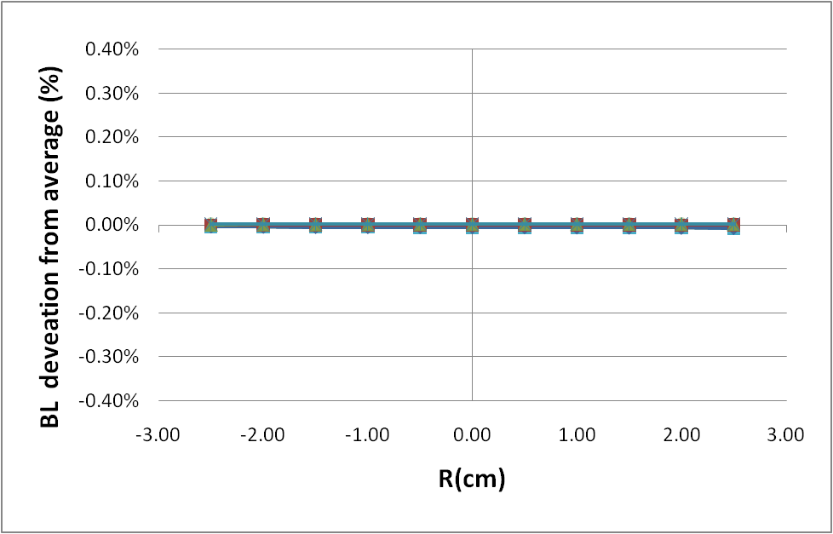
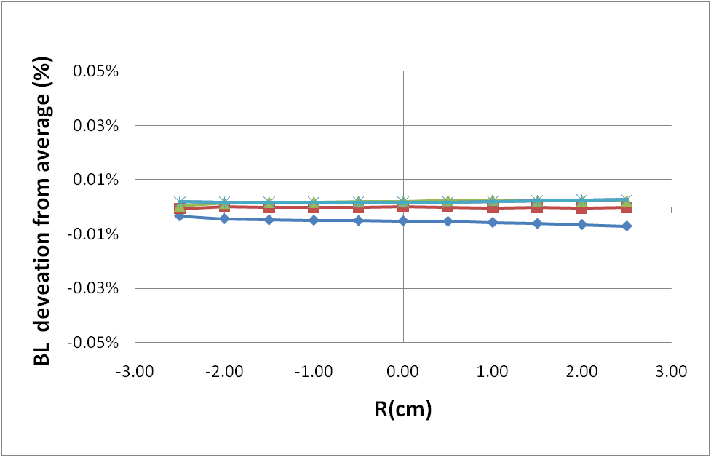
Probe Qualifications: XI Dipole at 385A (6 Run deviations from average)
BL_{n}/BL_{avg} (trajectory path at multiple radius positions)
Should be noted that this is short term stability
Good for gradient measurements that depend on relative precision.

Slide 18
12 GeV Dipoles: “Small Families”
Grid Measurement using Hall Probes
Measure grid of field strengths over median plane of magnet
Get field integrals along any path thru magnet
Use interpolation for locations that are not part of grid
Then use numerical integration.
By choosing beam path and radially translated paths, can calculate field integral along beam path and the profile around the beam path.
Automated stepper system moves a Hall probe to multiple X and Z dipole locations.
Hall probes are cross-calibrated with an NMR with every dipole

Slide 19
Non-linear Components in Field Profile
Spec uses
Need B’L and BL along trajectory
B’ must be taken normal to the trajectory ⇒ dB/dx isn’t enough
To get dB/dr:
Z and X derivatives are computed using a formula correct to 2nd order in the coordinate:
Values are between grid points are calculated using a linear interpolation of the on-grid values
Note: interpolation in z is not needed as all integrals use points on the z-grid

Slide 20
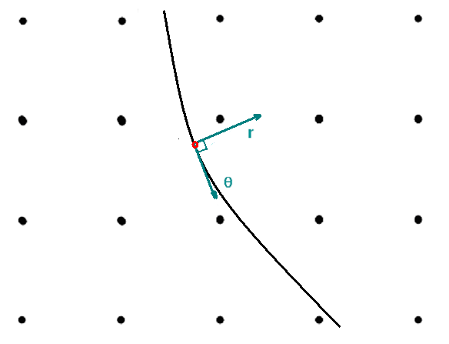
B’L from Detailed Grid Data
Software was written to calculate B’ normal to the trajectory using grid data by calculating x and z derivatives at each point and then applying a rotation matrix to the x and z derivatives.
B’L is computed by integrating dB/dr along trajectory
This accounts for end effects
φ= 0°
is at center of magnet

Slide 21
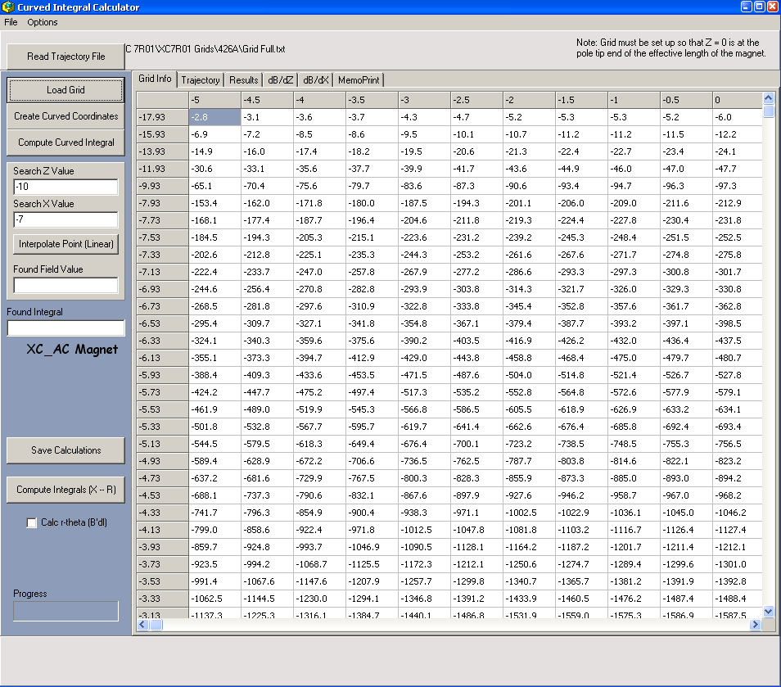
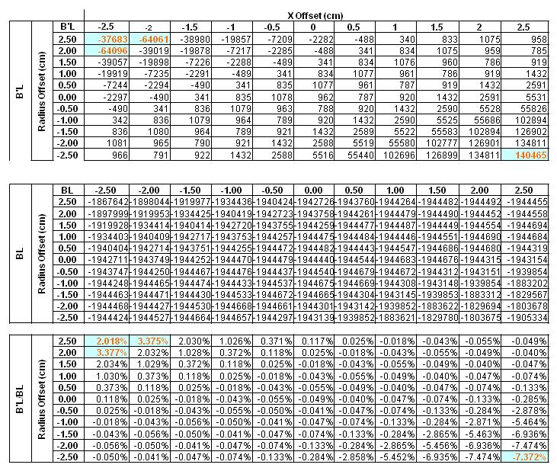
Beam Trajectory Software
“Grid-Fit” software and output files
Automates the BL and B’L calculation along beam trajectories.
Can read a trajectory file or calculate trajectory itself*

Slide 22
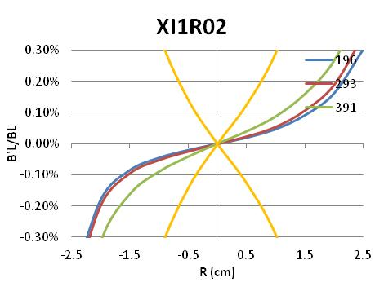
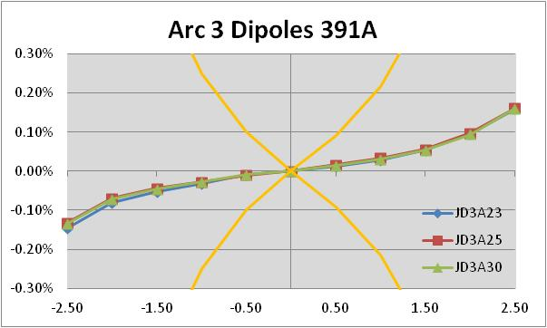
B’L/BL : Perpendicular to Curved Trajectory
B’L/BL calculated at different radius values
Results for each arc found to be well within specified acceptability range
Results for most S/R dipoles were fine also

Slide 23
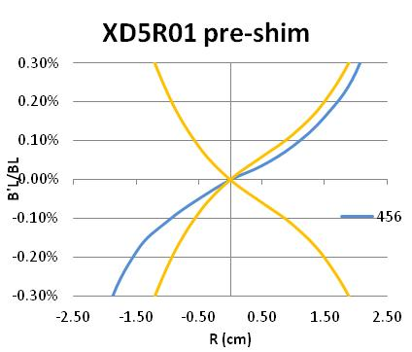
No – Dipoles don’t always behave
XD dipole (1m – H style) dipole operated at higher field and current (~1 Tesla / 450A)
Narrow pole + saturation = poor field quality
Solution – Add field shaping shim

Slide 24
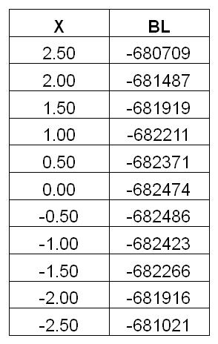
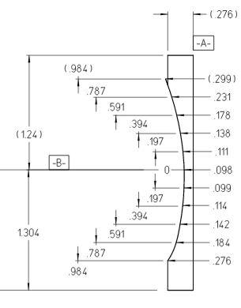
Parabolic Shim Design
Built a simple polynomial to fit the data.
Find the core field
(here it was 12700 gauss)
Derive the value of the equation for each position using the higher order terms. Omit the constant.
Divide result (BL) for each position by central field (B) for shim thickness for each position.
i.e. G-cm/G gives shim thickness in cm

Slide 25
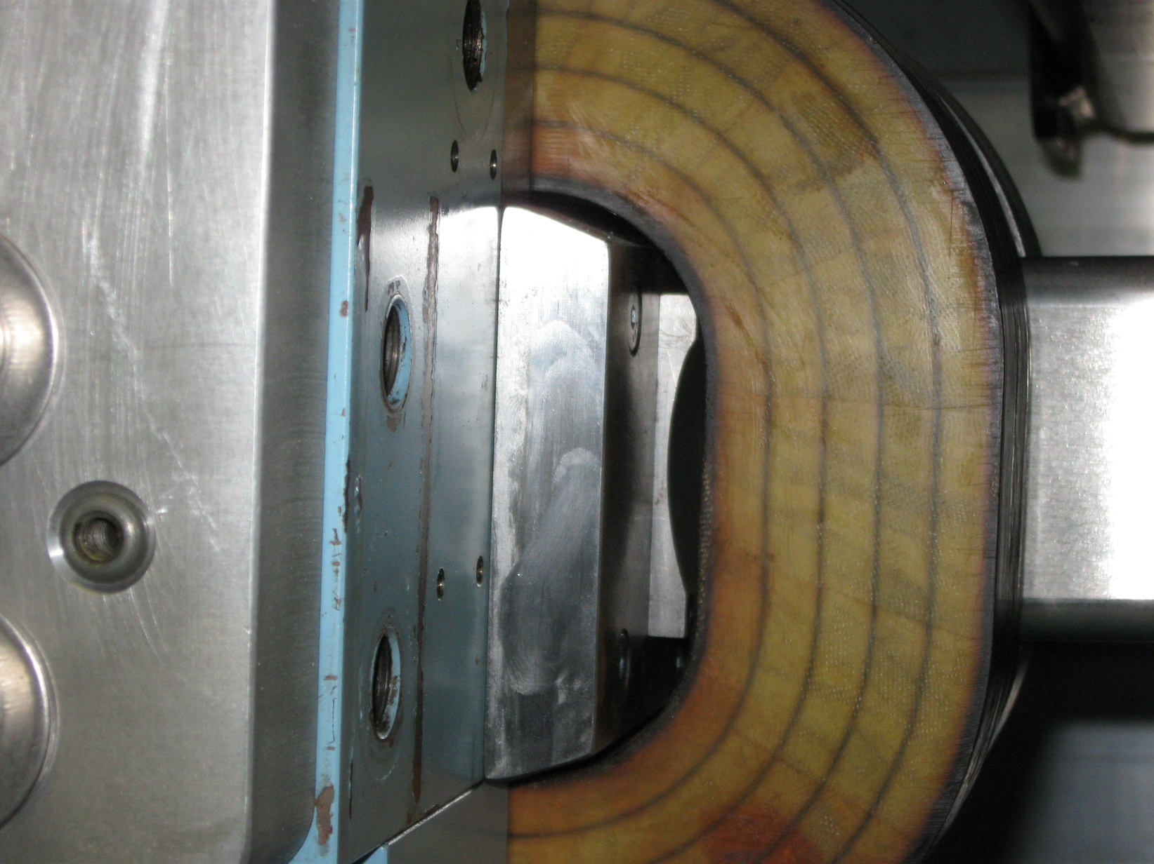
XD shim installed

Slide 26
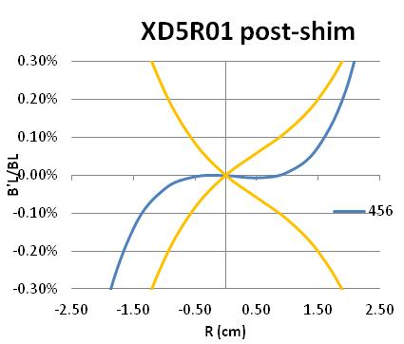
Results from applying shim
XD was re-measured with new shim.
Results showed that the correction works appropriately over the area that the beam “sees”
Wider corrections require more data in X
Field smoothing around the curved shim tends to make the corrections less pronounced
Applying a constant multiplier to the parabolic shape can help

Slide 27
Summary & Moving Forward
Complete the measurement process from the 12GeV upgrade (ETA end of this month)
~400 large dipoles
117 quads
>100 correctors
Measure hall line dipoles (~18 remain)
Continued development of the linear stages
Develop vibrating wire system for magnetic centers.
Integrate into super-conducting magnet measurements for experimental halls.

