Slide 1
Preliminary metrological characterization of the Fast Digitial Integrator FDIv.5
P. Arpaia, B. Celano, P. Cimmino, L. Fiscarelli, C. Giaccio, L. Walckiers
06.06.2013
1

Slide 2
Overview
History of the Fast Digital Integrator and FDIv.5 Project
Requirements of FDIv.5
Architecture
First working prototypes
Analogue front end
Design
Characterization
Self-calibration
Design
On-field test results
PXI bus interface
Conclusions

Slide 3
Fast Digital Integrator
A bit of history:
2004/5 FDIv.1-2 partial proto boards
2007 FDIv.3 first working prototype
2008 FDIv.3 series of ~30 boards
2010 FDIv4 3 intermediate prototype
2011 FDIv.4 FDIv.4 and FDIv.5 merging
2013 FDIv.5 first two working prototypes
FDIv.5 Project is funded by CERN and was entirely developed by UniSannio
P. Arpaia: Project Leader and Product Conceiver
P. Cimmino: Senior System Engineer
L. Fiscarelli (when UniSannio): Junior System Engineer
B. Celano: Hardware Designer
C. Giaccio: FPGA Designer
Louis Walckiers/Marco Buzio: CERN Specifications

Slide 4
FDIv.5 requirements [1]
Main requirements :
higher throughput
self-calibration upgrade
on-board memory
Additional requirements:
optimization of the analogue front-end
new display and reset management
fast gain change
DSP firmware update from cPCI
[1] L. Fiscarelli, The new Fast Digital Integrator with increased throughput and upgraded self-calibration, IMMW17

Slide 5
FDI v5 architecture
Fast Digital Integrator FDI.v5 is based on:
New high-performance analogue front-end with programmable gain (0.1 to 100)
New fully automatic self-calibration with high-precision on-board voltage reference
New cPCI interface with high throughput
New on-board RAM memory
Fast- and high-resolution ADC (670 kS/s, 18 bit)
High-resolution time base (40 ns based on a 25 MHz crystal oscillator)
DSP for integration algorithm (trapezoidal rule with interpolation between samples)
FPGA as I/O processor

Slide 6
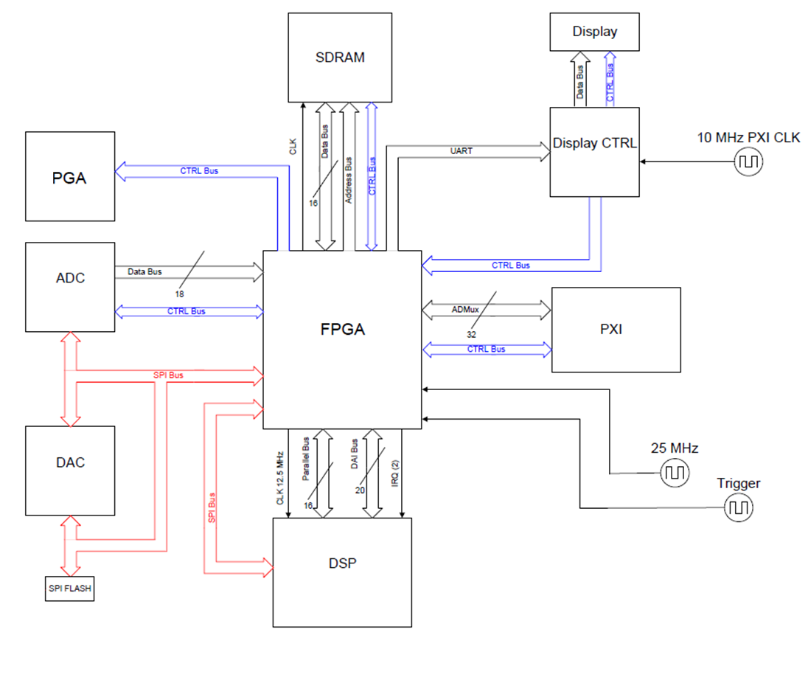
FDI v5 architecture
new
redesigned

Slide 7
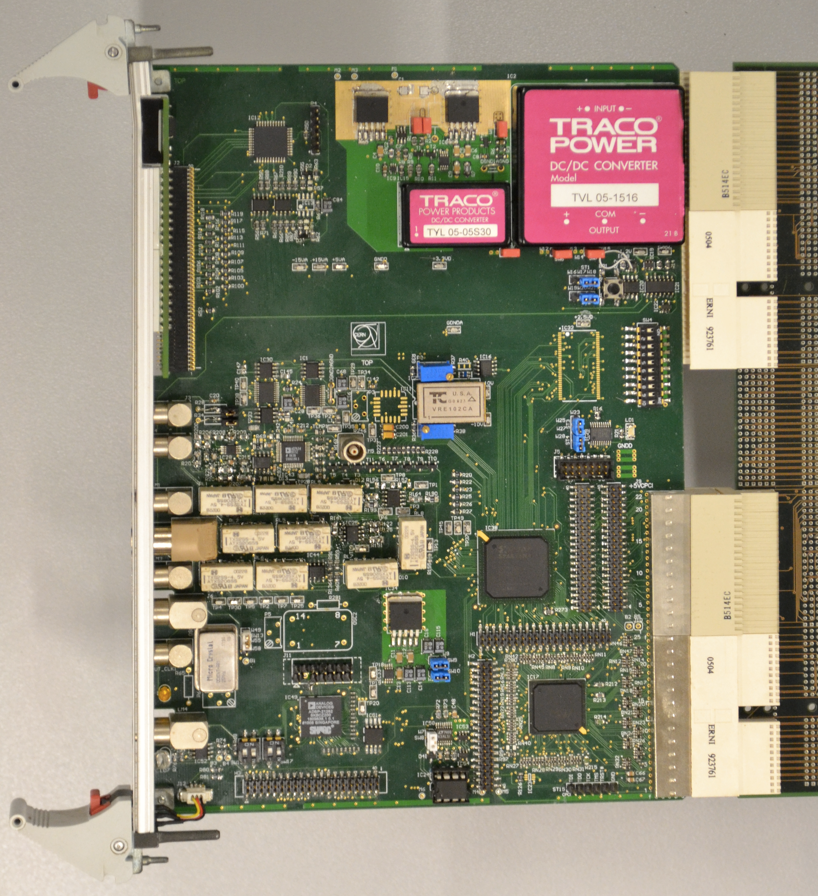
First working prototypes

Slide 8
Analogue front-end design
Analogue front-end based on:
High input impedance (1 MΩ for gain 0.1, > 1 GΩ for higher gains)
Low-noise low-distortion fully-differential instrumentation amplifier
Programmable gain (0.1, 1, 10, 100) with low thermal-emf relays
AD8599 (noise 1.1 nV/√Hz, THD -120 dB)
OPA1632 (noise 1.3 nV/√Hz, THD -130 dB)
3rd order active antialiasing filter

Slide 9
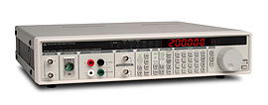
Analogue front-end characterization
Stanford DS360 function generator:
10 mHz to 200 kHz range
< -100 dBc distortion (to 20 kHz)
20 µVpp to 40 Vpp output range
25 ppm frequency accuracy
GAIN | Vpp (V) | f(Hz) | SNR* (dBc) | THD** (dBc)
0.1 | 30 | 7.351 | 101 | -95
1 | 8 | 7.351 | 109 | -96
10 | 0.8 | 7.351 | 103 | -95
100 | 0.08 | 7.351 | 96 | -85
*Signal-to-Noise Ratio
**Total Harmonic Distortion
Acquisitions were made with an internal synchronous trigger of 5 kHz:
ADC @ 500 kS/s, OSR = 100
SNR and THD are computed:
as average of 30 data sets with duration ~300 s
by applying a Blackman-Harris window

Slide 10
Self-calibration design [1]
VRE102CA
±10 V precision voltage source
1.09 ppm/°C
6 ppm/1000 h
DAC AD5791
20 bits
1-ppm INL
0.19 LSB long-term linearity
0.05 ppm/°C
DAC AD5791
±10 V ref. source
Vref +
DAC AD5791
Vref -
Availability of a large set of precise V_{ref} allows more effective calibration algorithms.
The expected offset and gain errors are in the order of tens of ppm (gain 1).
[1] L. Fiscarelli, The new Fast Digital Integrator with increased throughput and upgraded self-calibration, IMMW17

Slide 11
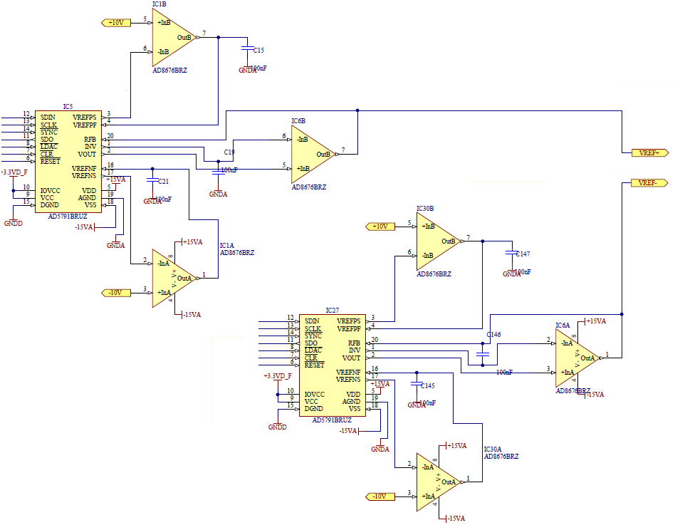
Self-calibration design
Full chain from precision V_{ref} source
to input pins with:
unitary-gain amplifiers
any resistances
very low-accuracy losses

Slide 12
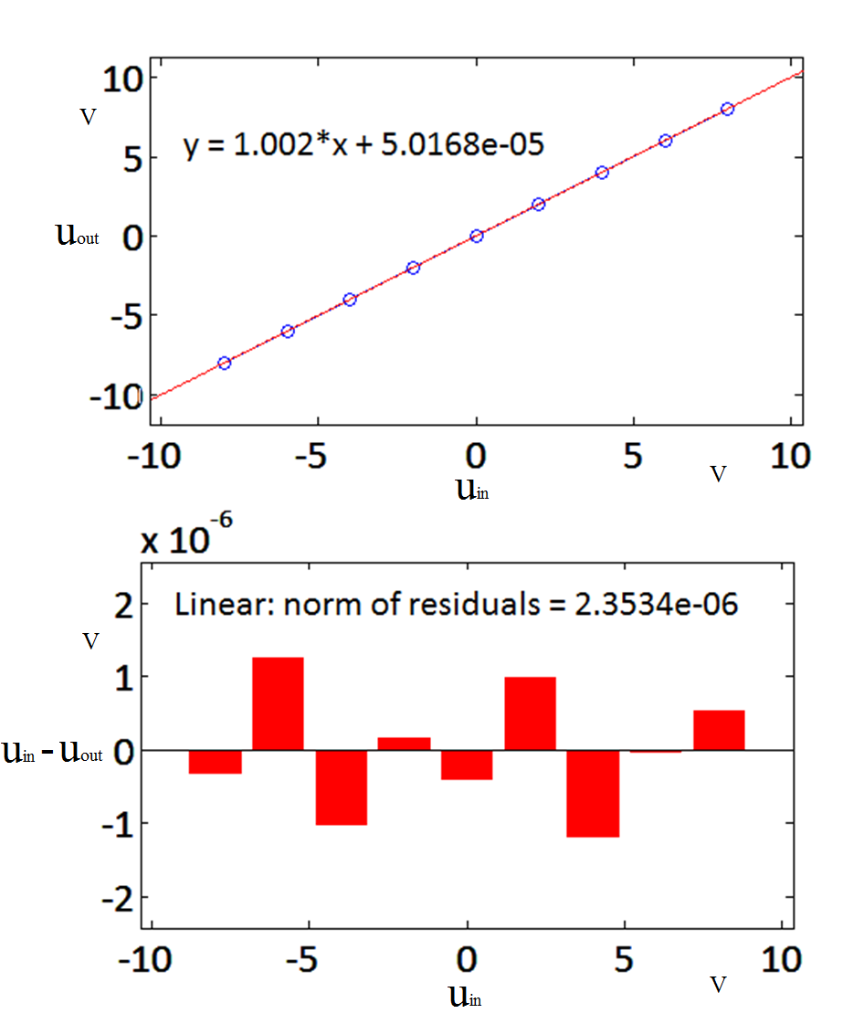
Self-calibration algorithm
DAC-based references allow more effective calibration
Self-calibration procedure:
Set gain
Switch input to V_{ref}
Loop:
Generate the i^{th} V_{ref}
Acquisition
Linear regression
Evaluate the norm of residuals
If > threshold “ERROR”
Switch to external input
Acquisition
Evaluate offset
u_{out} = 1.002000•u_{in}+5.0•10⁻⁵
Nonlinearity: 2 μV (residual norm)

Slide 13
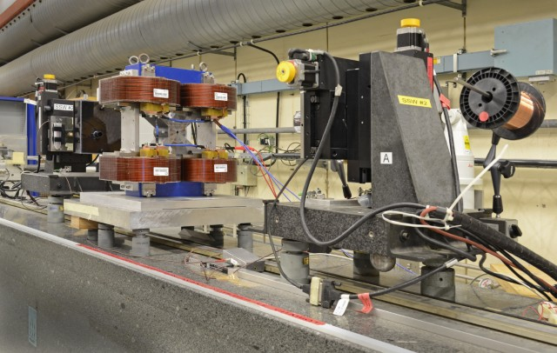
Self-calibration on-field test results
Single-Stretched Wire (SSW)
SSW (see G. Deferne IMMW18) was selected as a qualifying case study because:
Accuracy is affected by deterministic error on integration (this not happens to differential measurements)
Uncertainty is low, therefore gain calibration is important.
CLIC short model of final focus quadrupole (QD0):
high-gradient quadrupole
hybrid design
(see J.G.Perez IMMW18)
QD0 Main Parameters
Iron Length | 100 mm
Aperture Ø | 8.25 mm
Gradient | ~500 T/m
Current | 15.4 A
Voltage | 13.8 V
Weight | ~ 130 kg

Slide 14
Self-calibration on-field test results
Comparison of three integrator cards:
PDI recently calibrated by Metrolab (gain 1000)
CERN FDIv.3 with self-calibration (gain 100)
Prototype of FDIv.5 (gain 100)
 | Integral G (Tm/m)* | sigma* | Difference vs PDI
PDI | 50.995 | 5 10⁻⁴ | #
FDIv.3 | 50.840 | 4 10⁻⁴ | -3.0 10⁻³
FDIv.5 | 51.000 | 4 10⁻⁴ | < 10⁻⁴
* average and standard deviation of 5 consecutive measurements
With the same set-up (stages, displacement, magnet, current)
Same repeatability for all (slightly better for FDI’s)
Same results for PDI and FDIv.5
~30 units of difference for FDIv.3 (typical accuracy of precision resistances)
FDIv.5 provides better repeatability results even with a gain 10x lower

Slide 15
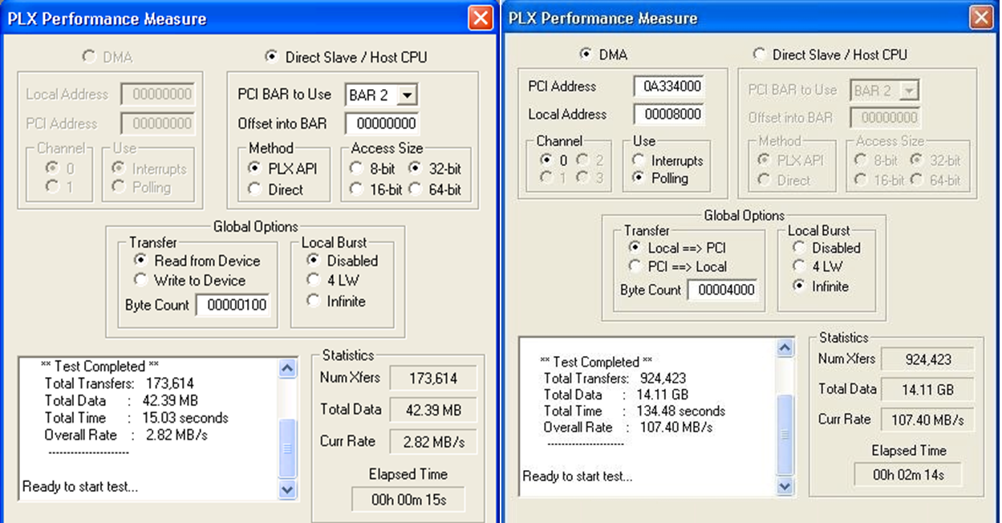
Throughput test
Improvement is achieved by PLX 9056:
Bus master
Direct Memory Access
PLX Performance Measure of PLXMon, a tool provided by company PLX for assessing the bus transfer speed.
FDIv.3 (with PCI9030)
FDIv.5 (with PCI9056)
FDIv.5 vs FDIv.3:
40 x bus transfer speed

Slide 16
Conclusions
Fast Digital Integrator FDIv.5:
First 2 working prototypes were assembled and tested
The throughput is better than required
The analogue front-end results suitable for such a fast and accurate instrument
Stability and temperature influence have to be tested (future work)
Self-calibration was improved and the results are compatible with lab calibrated instruments
with the advantage of fault check before each measurement
Further target to be assessed (noise background, reliability)

