Slide 1
Magnetic measurements on superconducting magnets by using the FAME system
L. Fiscarelli, P. Arpaia, G. Deferne, O. Dunkel, L. Walckiers
04.06.2013
1

Slide 2
Overview
Introduction: what is FAME?
Case study 1: large-aperture high-field quadrupoles for LHC upgrade
  HQ and MQXC
  Vertical cryostat station
  Improved bucking
  Unidentified noise source
  Correction for shaft at cryogenic temperature
Case study 2: fast cycled superconducting magnet (FCM)
  FCM
  Measurement setup
  Longitudinal scan and field profile reconstruction
Standardization of Flexible Framework for Magnetic Measurement

Slide 3
Introduction
What is FAME?
FAst Magnetic measurement Equipment is a magnetic measurement platform
  designed for superconducting magnet test
  based on fast rotating coils (time resolution suitable for snapback)
  software:
    Flexible Framework for Magnetic Measurement (FFMM)
    set of analysis tools (ramp rate and drift corrections, harmonic analysis, sensitivity factors calculation)
  hardware:
    Fast Digital Integrators (FDI)
    Mini Rotating Unit (MRU), a compact motor/encoder unit
    Search coil shaft (standard design)
Fully validated on LHC superconducting dipoles
  LHC Field Model (FiDel) consolidation

Slide 4
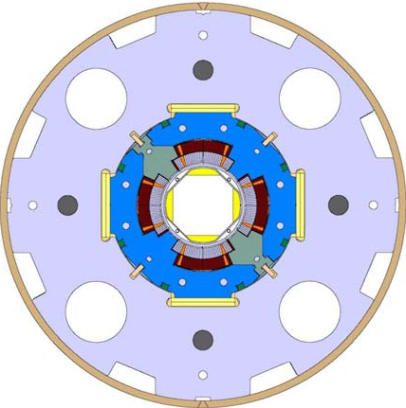
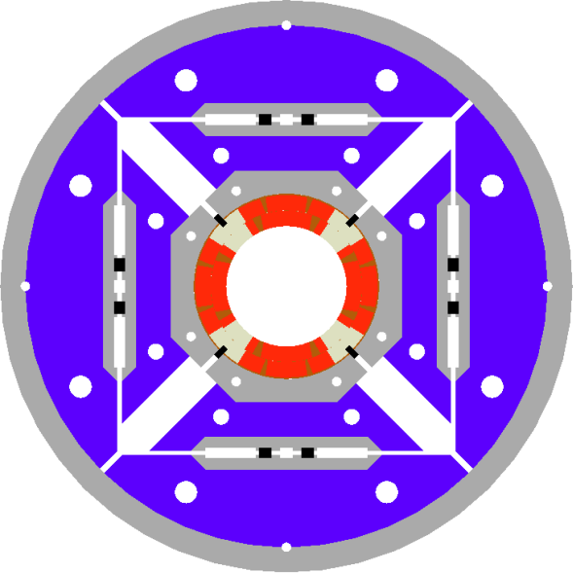
Case study 1: HQ and MQXC
Superconducting quadrupoles for LHC upgrade
  large aperture (120 mm)
  high field (12 T)
    MQXC (CERN-CEA Collaboration), Nb-Ti cable
    HQ - MQXE (US LARP Collaboration), Nb₃Sn cable
MQXC
HQ

Slide 5
Case study 1: HQ and MQXC
First short models measured at CERN, other magnets to be measured in the future, by using the vertical cryostat station of SM18
CHALLENGE
Keep the measurement quality in terms of precision (main field + multipoles) and time resolution on a more burdensome setup.

Slide 6
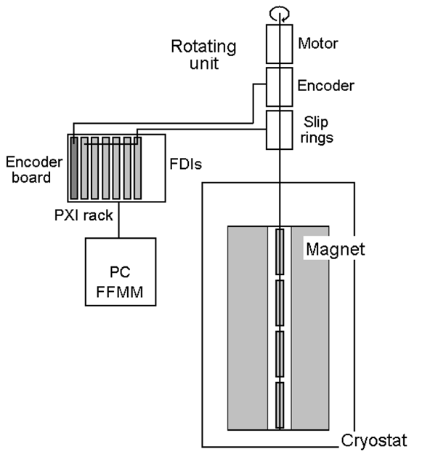
Case study 1: Vertical Cryostat Setup
Rotating shaft in the helium bath
Advantages:
Larger measurement radius
No conditioning tube need
Off-center handling
Critical components:
Extension shaft motor unit
  Off-center between magnet and cryostat cover
Bearings
  No ball bearings
Search coil shaft [1]
  calibration
[1] O. Dunkel, “Standardization of the CERN Equipment to cope with the Magnetic Measurement Requests from a Variety of Accelerator Projects”, this workshop

Slide 7
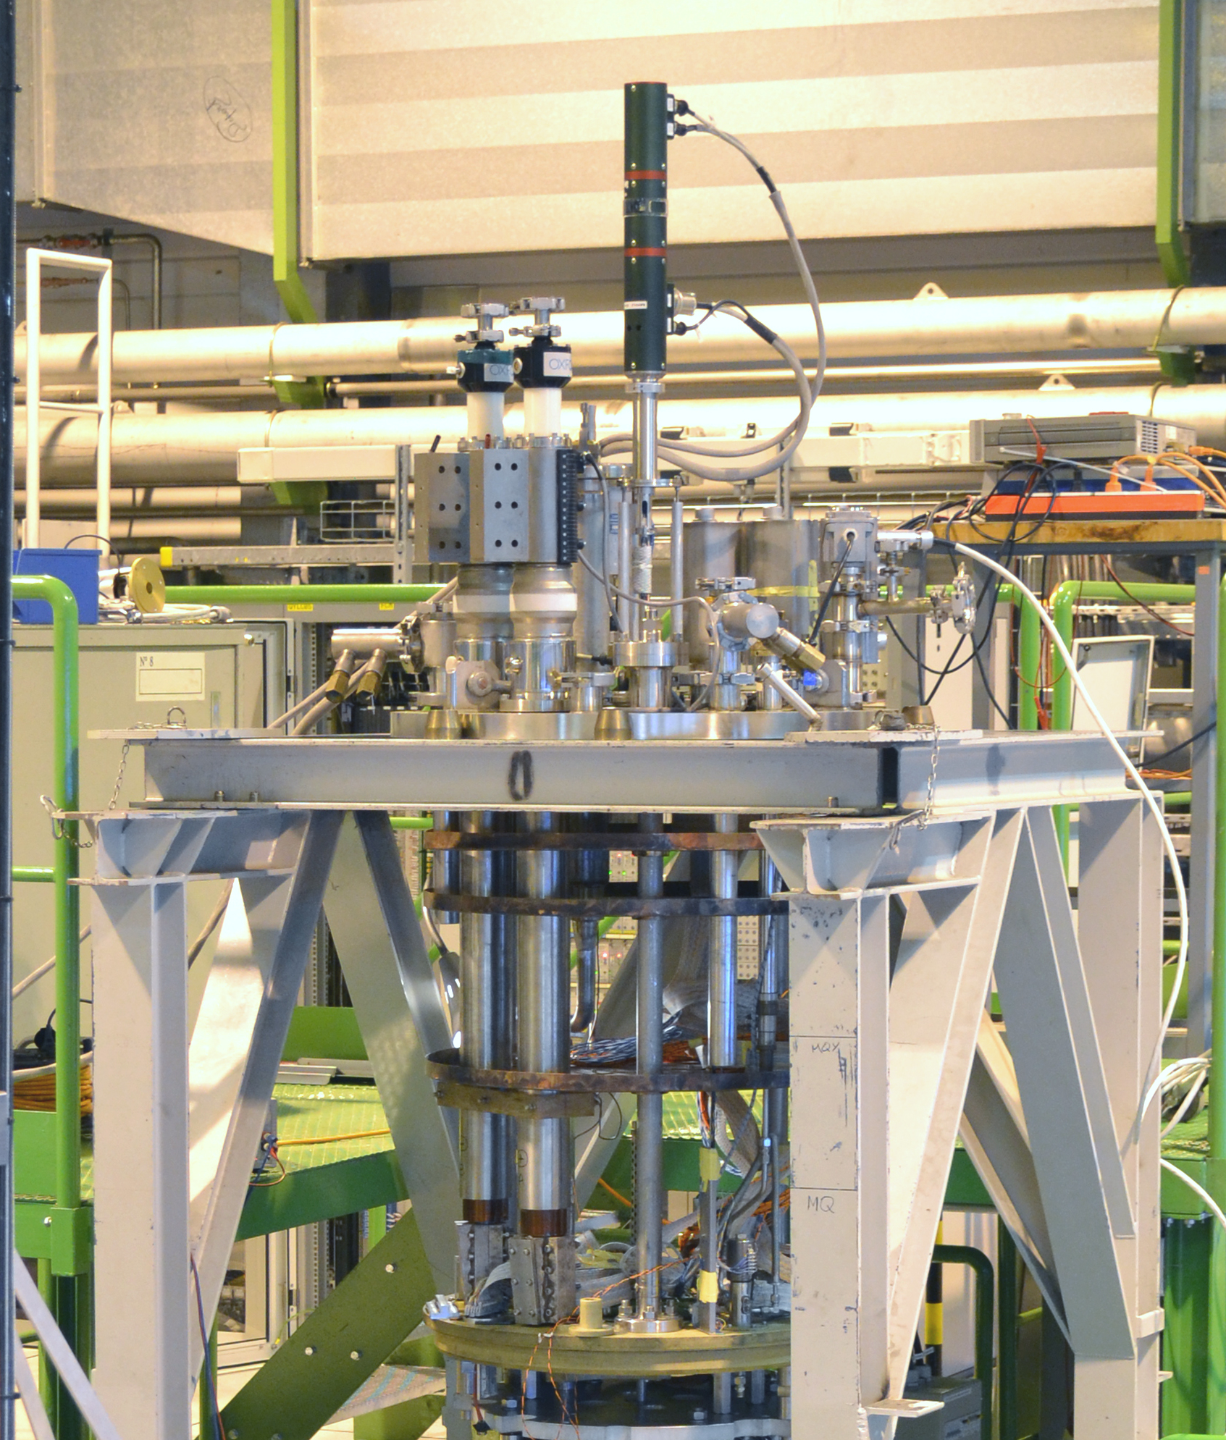
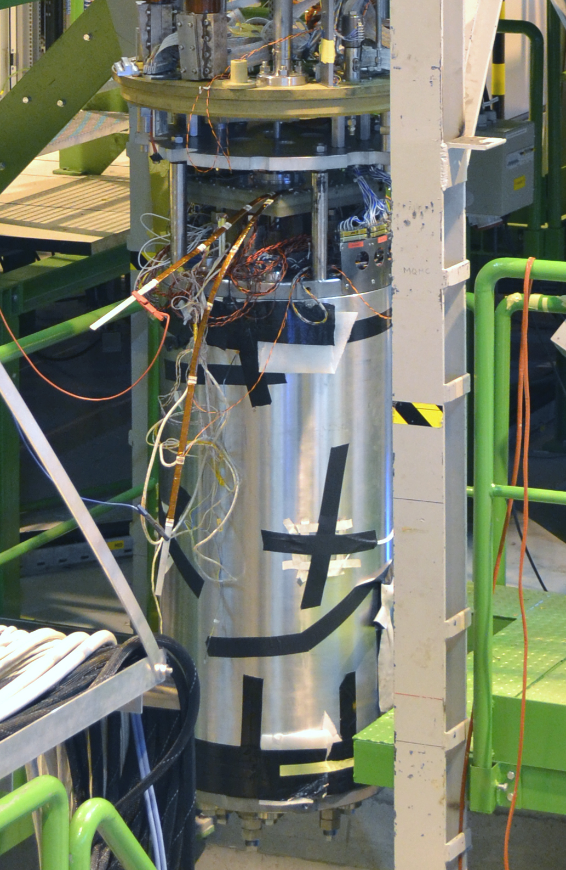
Case study 1: Vertical Cryostat Setup

Slide 8
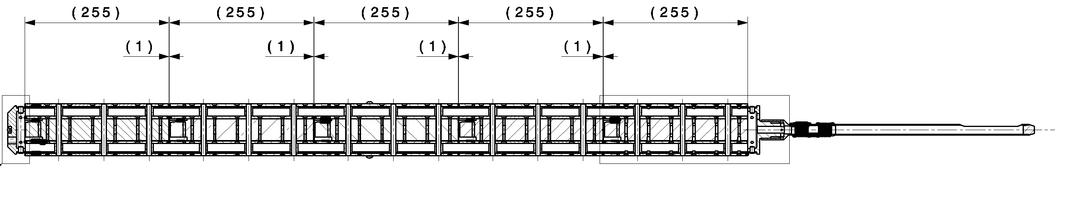
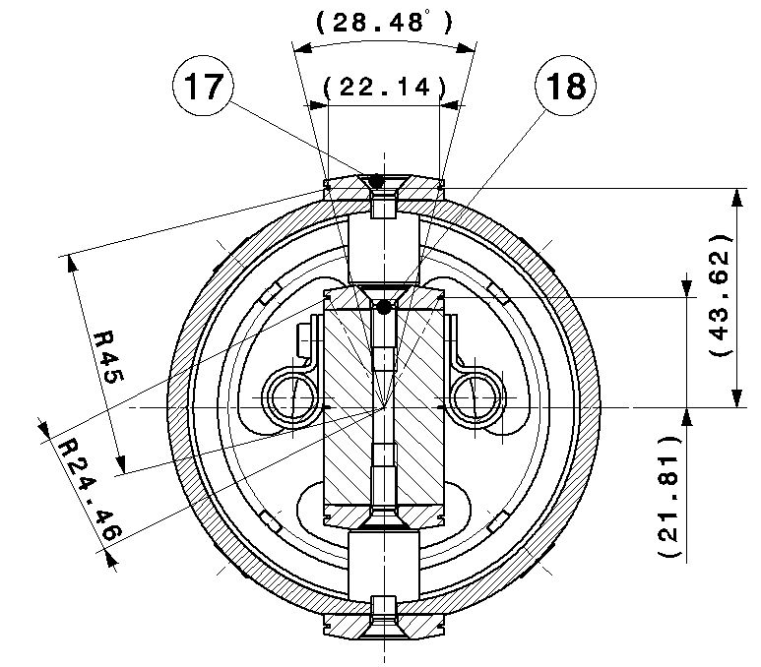
Case study 1: HQ measurement shaft
Standard design for the shaft [1]:
5 segments
segment length 255 mm
inter-segment space 1 mm
5 coils per segment (4 used + spare)
quadrupole and dipole compensation
[1] O. Dunkel, “Standardization of the CERN Equipment to cope with the Magnetic Measurement Requests from a Variety of Accelerator Projects”, this workshop

Slide 9
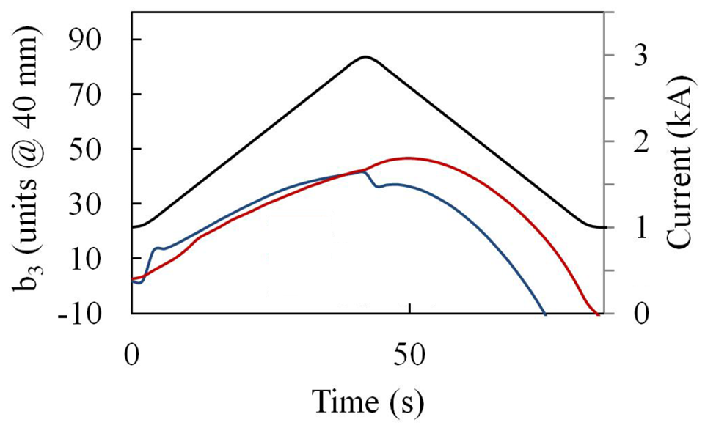
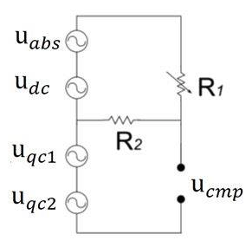
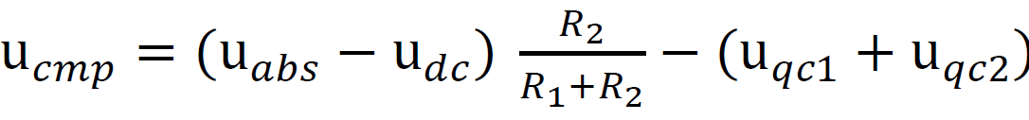
Case study 1: first experience and improved bucking
current
b3 before
b3 after
Natural bucking ratio was ~10
The achieved bucking-ratio for the main field (quadrupole) is ~200
The resistance network must be calibrated

Slide 10
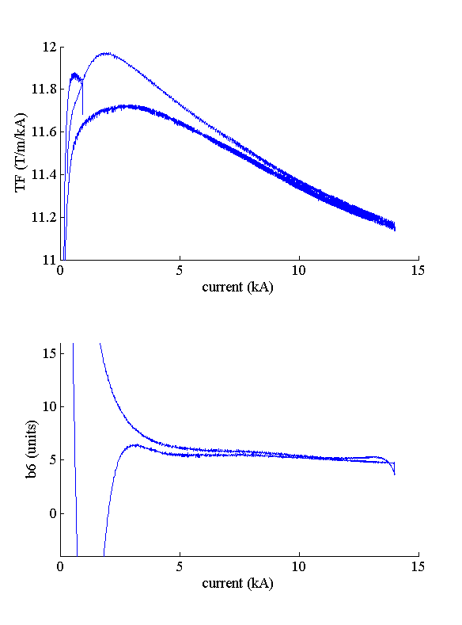
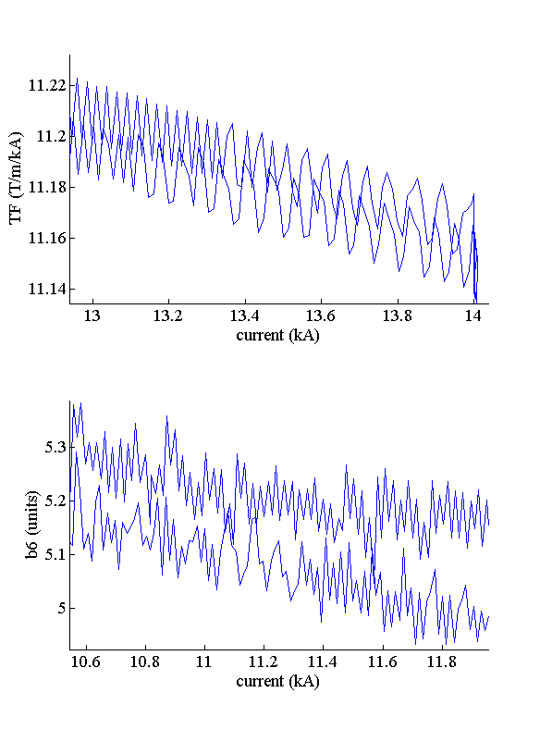
Case study 1: HQ first experience and noise

Slide 11
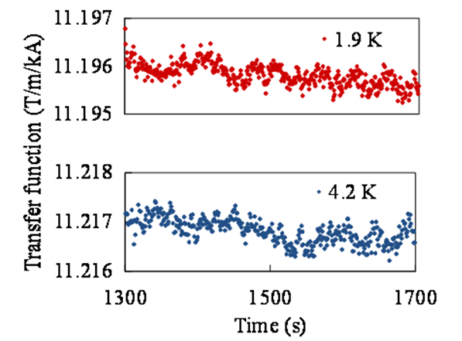
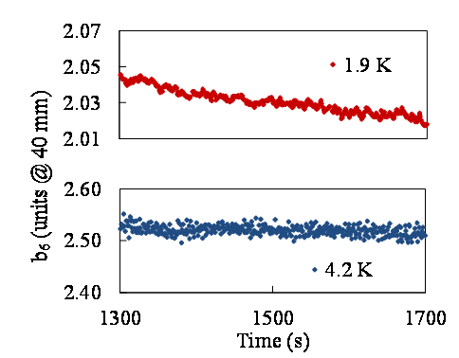
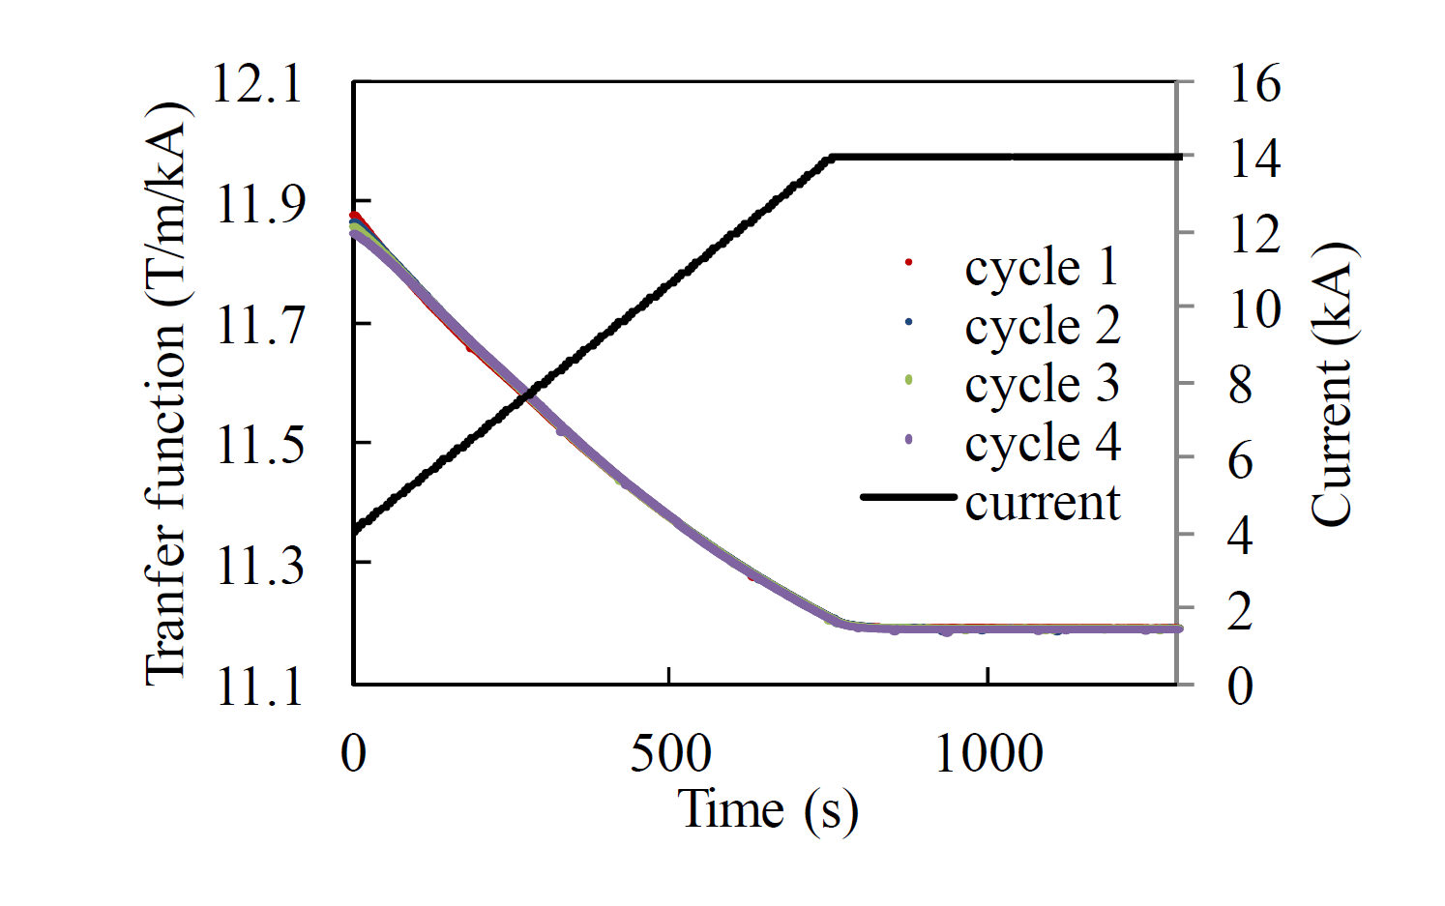
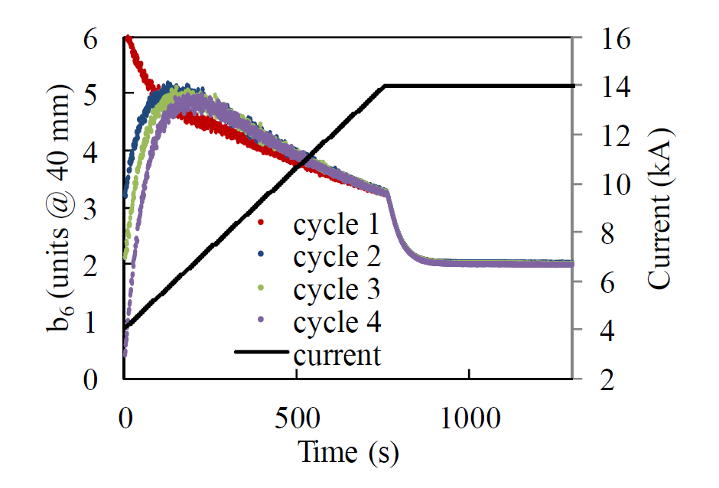
Case study 1: HQ results
 | TF | b₆
Precision (same cycle) | ~0.01% | 1 ppm
Repeatability (cycle to cycle) | ~0.01% | 10 ppm
Time resolution | from 0.5 to 2 s

Slide 12
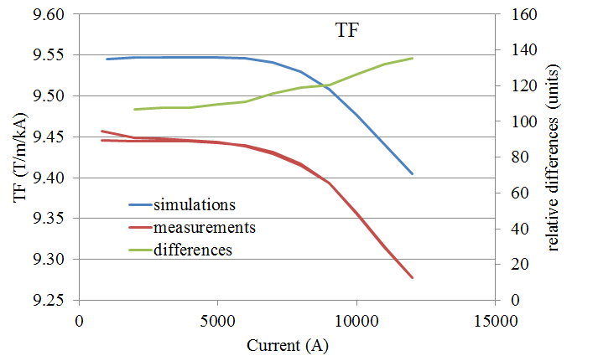
Case study 1: Correction for shaft at cryogenic temperature
Stair-step test on MQXC at 1.9 K
A difference with simulation of 1.2% on the TF by applying the room-temperature coil sensitivity factors.
To increase the accuracy we need for calibration at cryogenic temperature.
The correction factor [2] usually used at CERN for dipoles (0.9975 linear) seems to be not enough accurate for quadrupole measurement shaft.
But a more careful analysis could help…
[2] L. Denieau, “Coil Calibration – Computation and storage of sensitivity factors”, MTA-IN-98-021

Slide 13
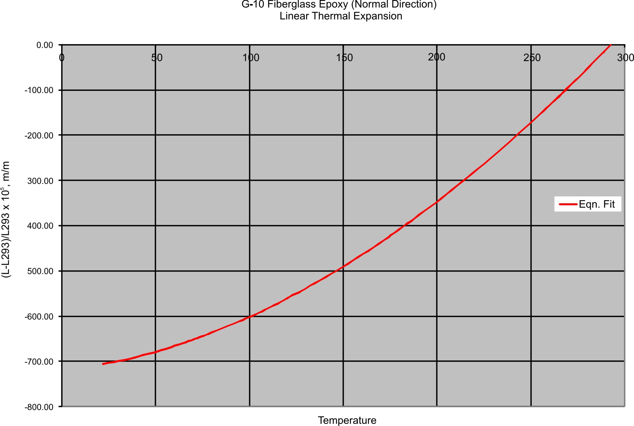
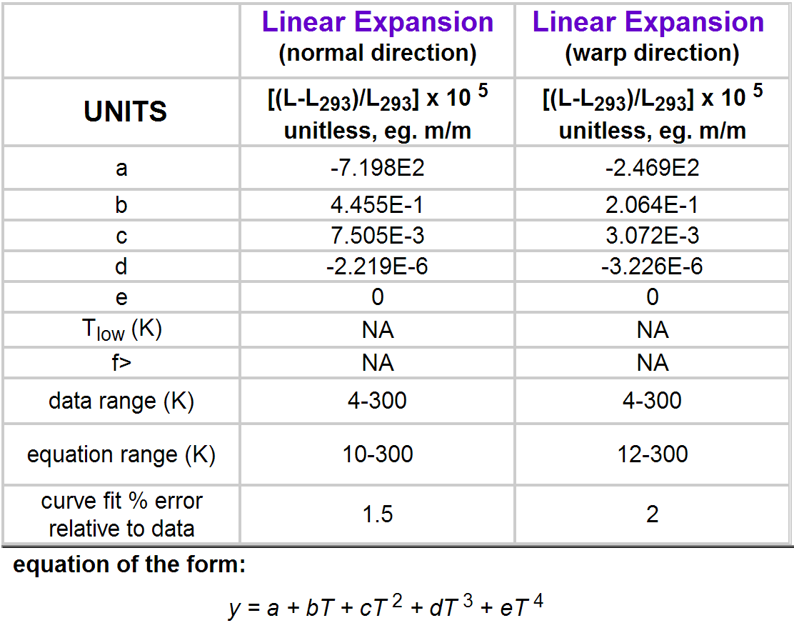
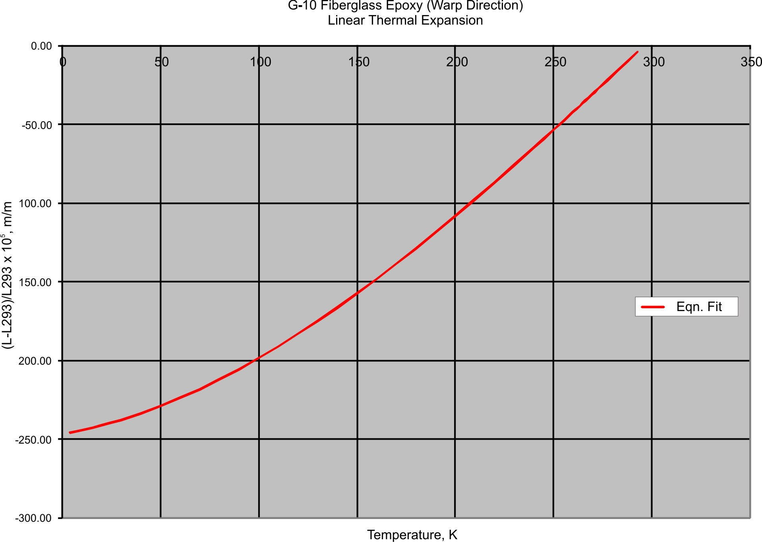
Case study 1: Correction for shaft at cryogenic temperature
Material Properties: G-10 CR (Fiberglass Epoxy) [3]
We range from 300 K to 1.9 K
  our linear thermal coefficient is ‘a’
But a shaft is a 3D object
  a_{normal} , a_{warp} , a_{warp}
[3] http://cryogenics.nist.gov/MPropsMAY/G-10%20CR%20Fiberglass%20Epoxy/G10CRFiberglassEpoxy_rev.htm

Slide 14
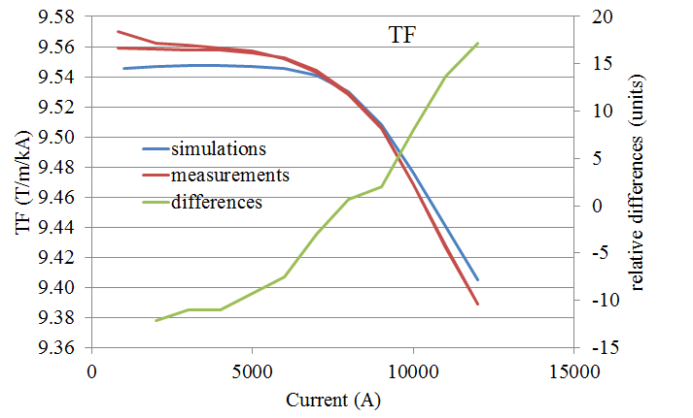
Case study 1: Correction for shaft at cryogenic temperature
Stair-step test on MQXC at 1.9 K
The correction factor, computed by using values reported on the NIST tables, is 0.9879
A difference wrt simulation of few units on the TF by applying the corrected coil sensitivity factors
A test of a sample shaft in liquid nitrogen (some practical difficulties) could give a confirmation.

Slide 15
Case study 1: summary
Exploitation of FAME on the vertical cryostat station
  bucking improvement on HQ shaft
  noise triggered by high fields
  thermal constriction correction
In general:
  suitable precision for main field measurement (constriction correction)
  high precision for multipoles (large radius)
  suitable time resolution (up to 2 turn/s)

Slide 16
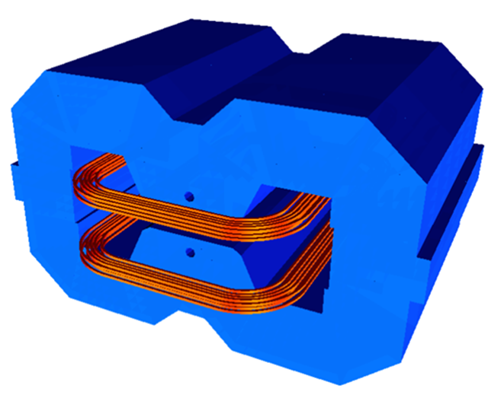
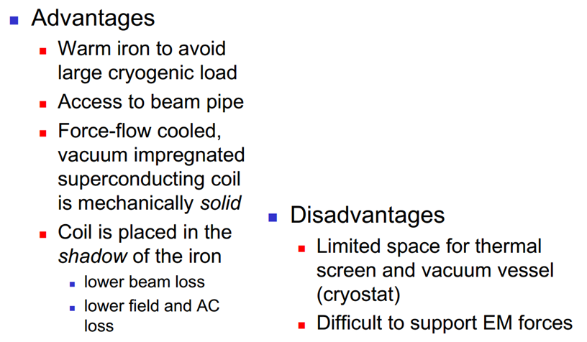
Case study 2: Fast-cycled superconducting magnet (FCM)
Fast-cycled superconducting magnet
Goal: produce and test a representative model of a PS2 magnet
  B_{max} = 2.3 T (minimum 1.8 T)
  dB/dt_{max} = 2.3 T/s (B_{max} in 1 s) (minimum 1.5 T/s)
Courtesy of L. Bottura

Slide 17
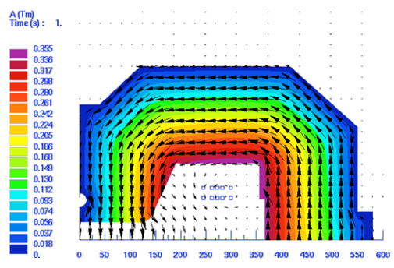
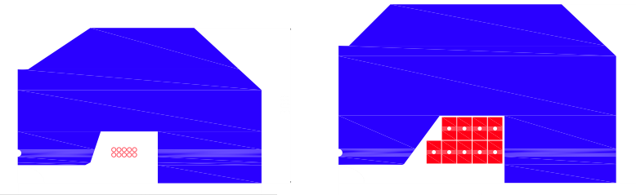
Case study 2: Fast-cycled superconducting magnet (FCM)
Superferric design vs normal conducting design
super
conducting
normal
conducting
Iron weight [tons] | 10
Peak voltage [V] | 34
AC loss power [W] | 1.3
Iron weight [tons] | 15
Peak voltage [V] | 41
Resistive power [kW] | 27
Warm iron
Cryostated superconducting coil
Potential for saving 7 MW of the 15 MW estimated total power consumption of PS2 complex
Courtesy of L. Bottura

Slide 18
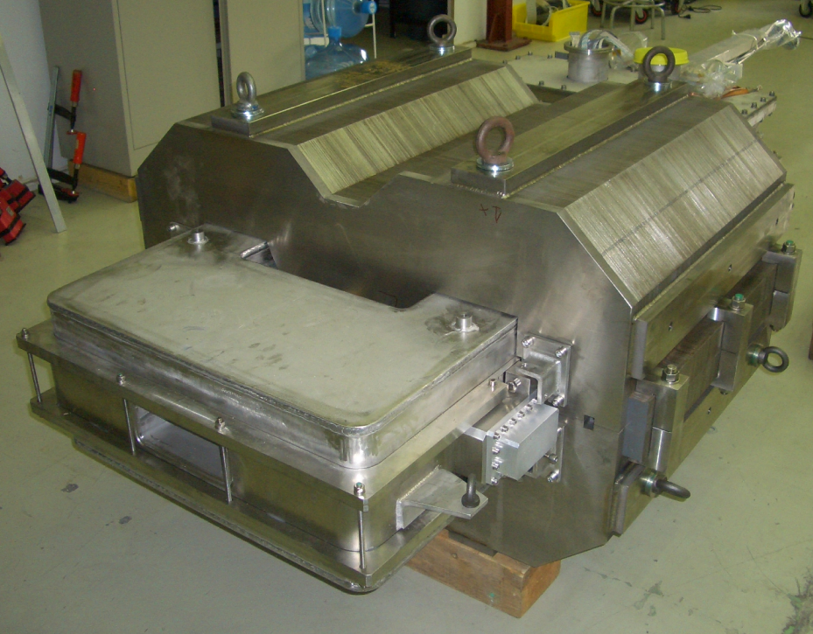
Case study 2: Fast-cycled superconducting magnet (FCM)
Current and
helium
feeding
Warm iron
Cryostat
Aperture

Slide 19
Case study 1: Fast-cycled superconducting magnet (FCM)
Demonstration model measured at CERN by using a special cryogenics bench developed for the Superconducting Link (SLink) at SM18
CHALLENGE
a fast and not expensive solution, reuse of existing tools, for measuring a single prototype magnet and assure a suitable design verification

Slide 20
Case study 2: FCM measurement setup
Warm iron
Cryostat
Shaft
Rotating coil: the setup is an sub-optimal adaption of an old LHC quadrupole shaft
(+) Mini Rotating Unit mounted on a horizontally-sliding bench
    (+) possibility to translate the shaft horizontally
    (-) the length of segments (700 mm coil / 850 mm magnet) is
  too long for measuring the homogeneous region of the magnet
  too short for an integral measurement
    (-) measurement radius too small (17 mm for a GFR of ±42 mm, ±30 mm)

Slide 21
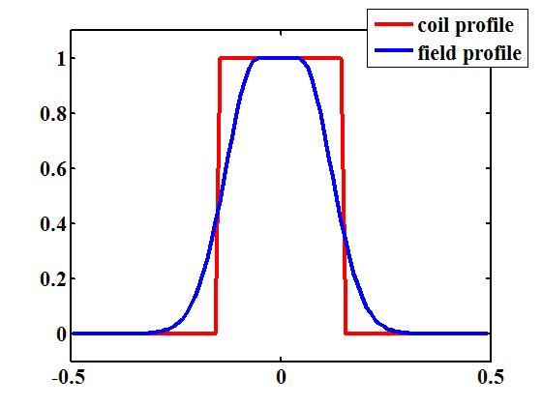
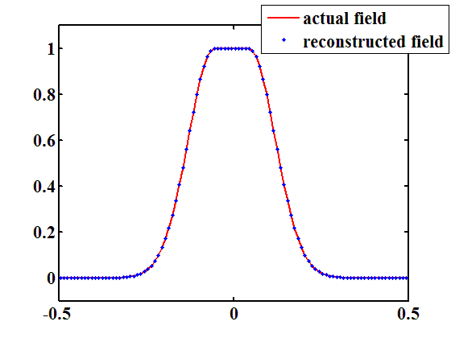
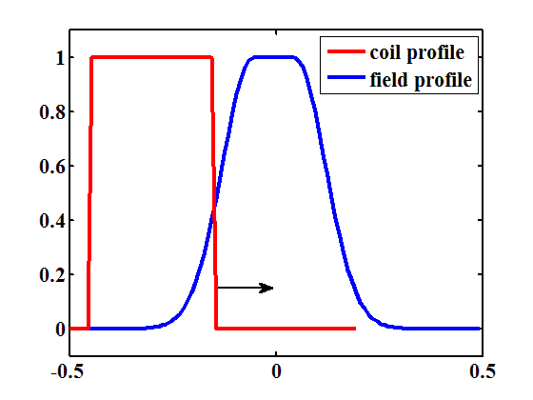
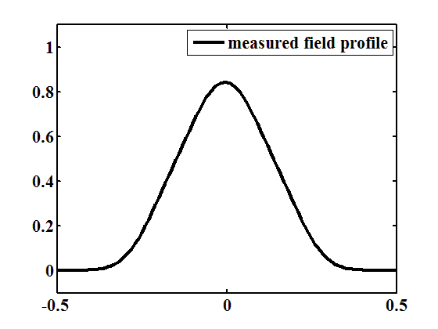
Case study 2: Field profile reconstruction
Under the hypothesis of coil homogeneity along z, the measurement given by a search coil shaft can be seen as the convolution of the field profile versus the shaft profile (rectangular window).

Slide 22
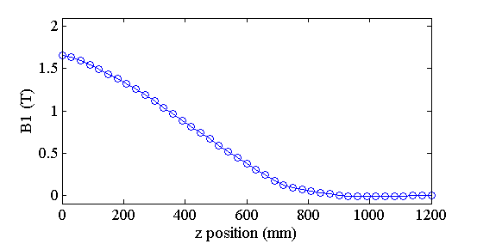
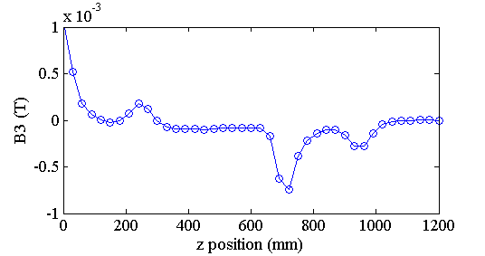
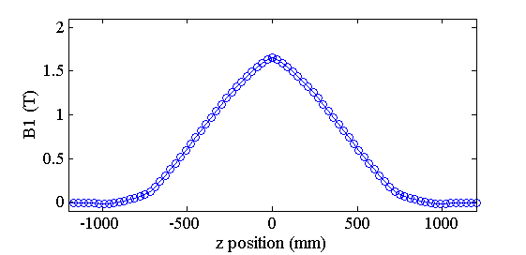
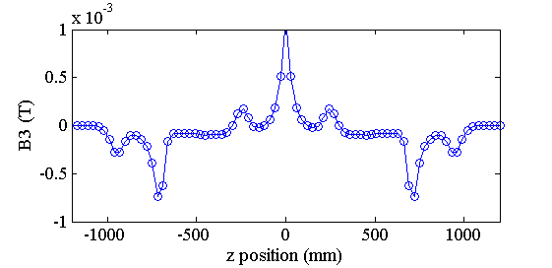
Case study 2: Field profile reconstruction
Measurement of the field profile for comparing to calculations:
  longitudinal scan with 3-cm steps then deconvolution of measurements versus coil profile

Slide 23
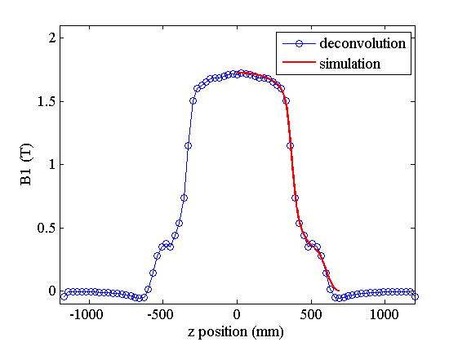
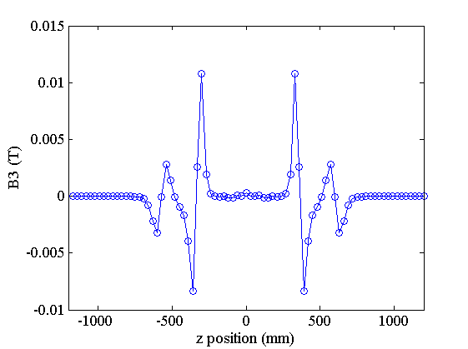
Case study 2: Field profile reconstruction
Estimated accuracy in the order of 2% for the main field
deconvolution is based on differences
accuracy of displacements (~ 0.5 mm / 3 cm)

Slide 24
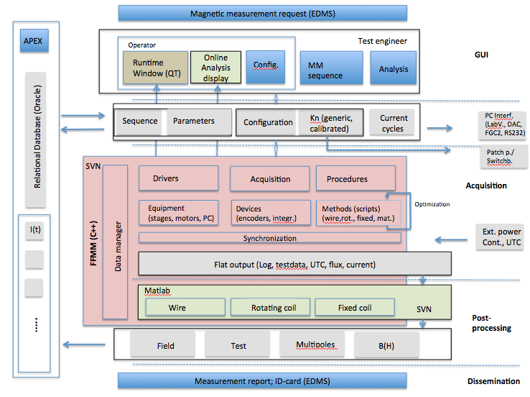
Flexible Framework for Magnetic Measurement standardization

Slide 25
Conclusions
Flexibility of FAME system
    software + acquisition + motor/encoder + shaft design
  vertical and horizontal setup
  high and moderate fields
  stationary and sliding shafts
  cryogenic and room temperature
Problems on first applications
  error in shaft design, poor bucking
  calibration at cryogenic temperature
  unidentified noise source
Standardization effort also on management/analysis/storage of measurement data

Slide 26
  Thank you!

