Slide 1
Magnetic measurements at Danfysik
IMMW 18
Christopher W. Ostenfeld
Application Physicist, Ph.D.

Slide 2

1964 - Danfysik A/S was founded by Ejnar Jespersen
DANFYSIK 1964

Slide 3
Company history – headlines
1964 – Founding of Danfysik A/S
1964 – First power supplies
1967 – First ion accelerator system
1974 – First synchrotron magnet system
1995 – First insertion device
1997 – First turnkey synchrotron
2001 – First synchrotron X-ray beam line
2006 – First particle therapy synchrotron( Siemens agreement)
2007 – X-ray beam lines business sold off
2008 – Particle therapy business sold off to Siemens
2009 – New owner – Danish Technological Institute
    27 people at Danfysik at this time…

Slide 4
Since 2009
Key (large) projects
  NSLS-II Standard Sextupoles
  ASTRID-II complete girder sections
  NSLS-II Damping Wigglers
  Maxlab 3 GeV girders
  Maxlab 1.5 GeV girders
  Solaris 1.5 GeV girders
  Service agreement with Siemens towards Shanghai accelerator installation and service
Currently 104 people are employed
  Engineers, physicists, administration, production staff

Slide 5








Location
Aalborg
Århus
Taastrup,
~ 20 km west from downtown CPH
Approx. 30 min from
CPH airport
Copenhagen
Odense

Slide 6
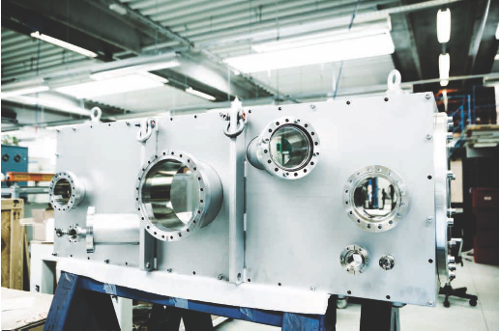

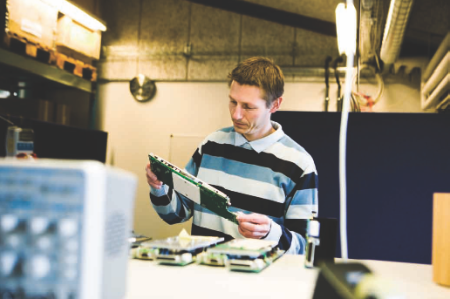
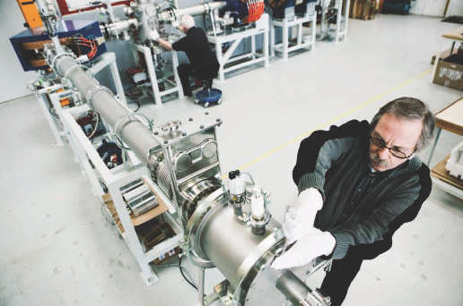


Danfysik today
Staff : 104
Design & Projects: 30
Production and Logisitics: 40
Admin., Sales & Service: 20
Particle Therapy: 14
Annual turn-over:
approx. 15 M€
Ownership:
100% subsidiary of Danish Technological Institute

Slide 7
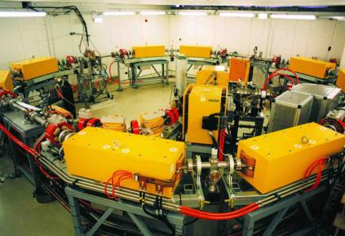
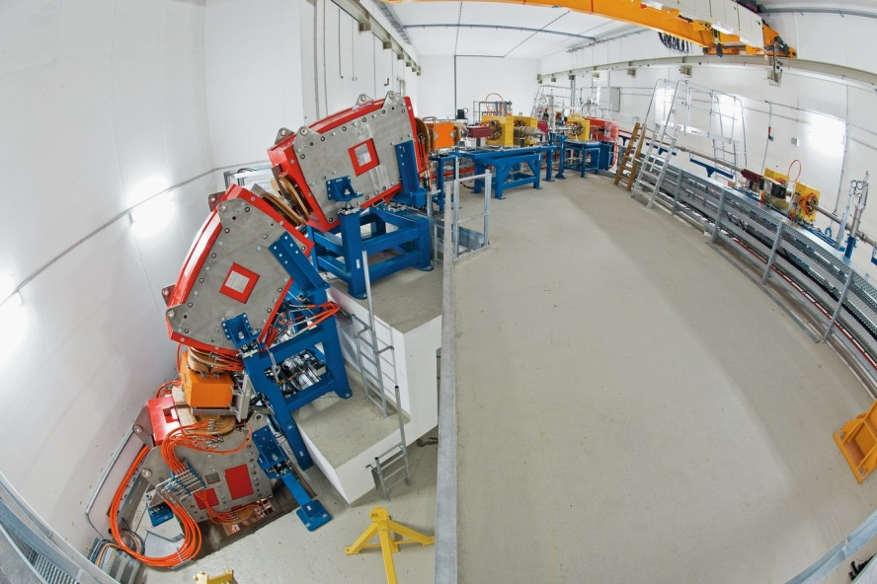
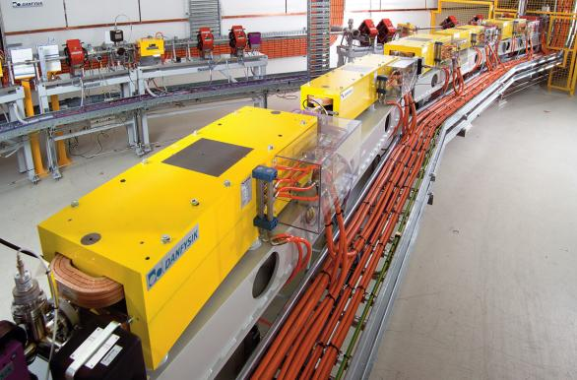
Danfysik turn-key accelerator systems
Danfysik turn-key accelerator systems
Ion implanters and isotope separators (many systems)
Booster synchrotrons and microtrons
  ANKA (Karlsruhe, Germany)
  CLS (Saskatoon, Canada) 2.9 GeV, Ø 35 m
  Australian Synchrotron (Melbourne, Australia), 3 GeV, Ø 42 m
Particle therapy systems
  RKA/Siemens Healthcare in Marburg, GER, 450 MeV/n, Ø 21 m
  Siemens Healthcare in Shanghai, China, 450 MeV/n, Ø 21 m

Slide 8
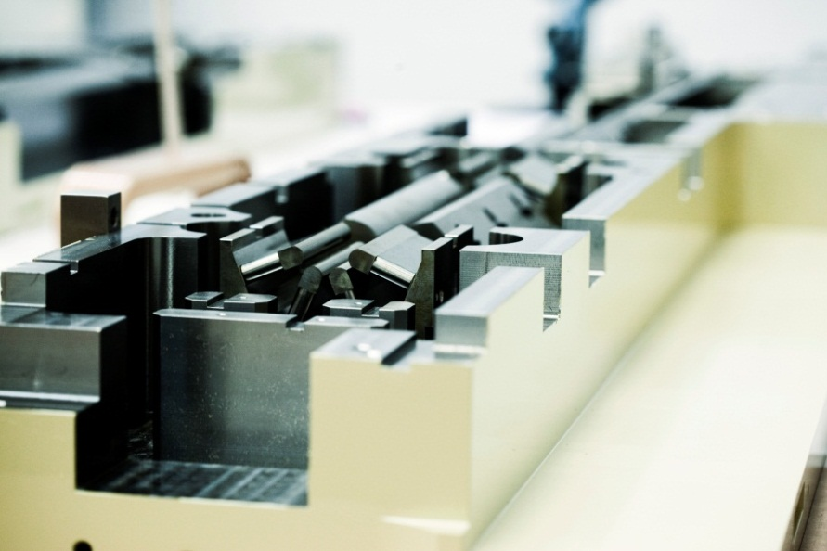
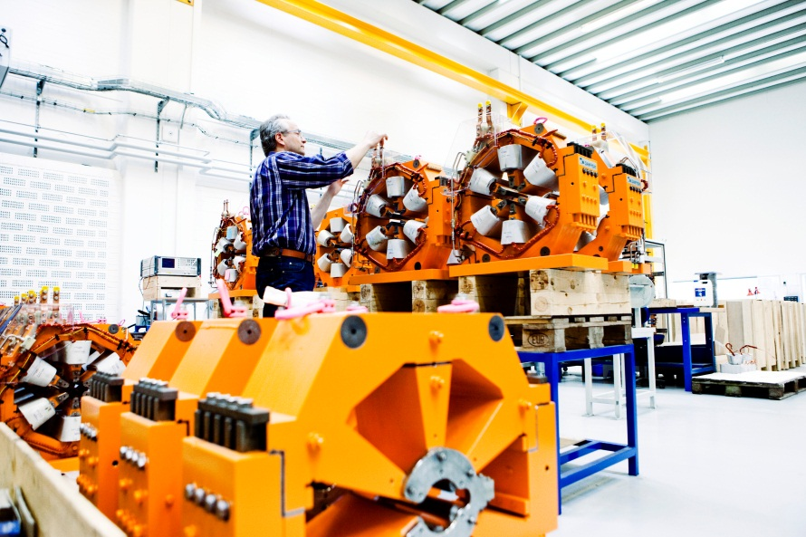

DANFYSIK products
Magnet technology
Normal and superconducting magnets
State-of-the-art magnetic field calculations 2D, 3D
Manufacturing design
Coil winding and yoke lamination
Assembly (clean room)
Magnetic testing (2D, 3D and harmonic content)
Magnet measurement systems
MaxLab
NSLS-II

Slide 9
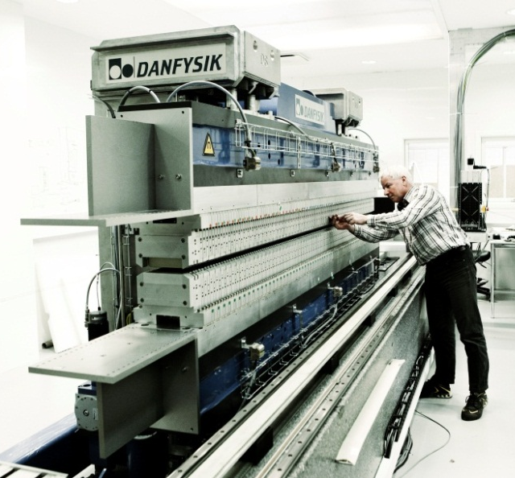

Accelerator products, services & systems
Magnets (fast & slow), electrostatics + related equipment
Ultrastable power supplies + converter technology
Insertion devices, undulators and wigglers
Ion sources and beam diagnostics
Ion accelerators, ion implanters and isotope separators
Turn-key systems, electron & ion synchrotrons, microtrons
Installation, commissioning and after-sales service

Slide 10
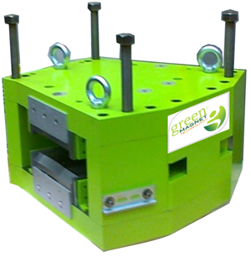

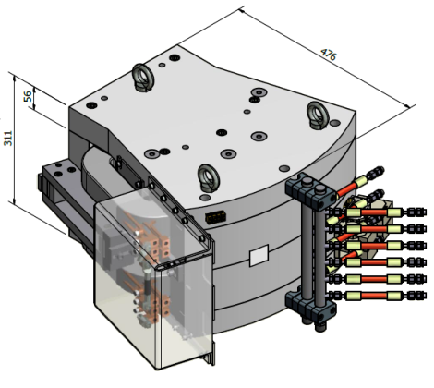
GREEN MAGNETS®
Green Magnets project
Sustainable accelerator systems
Reduction of total cost of ownership of
magnet solutions
New generation of highly efficient and
reliable power supplies

Slide 11
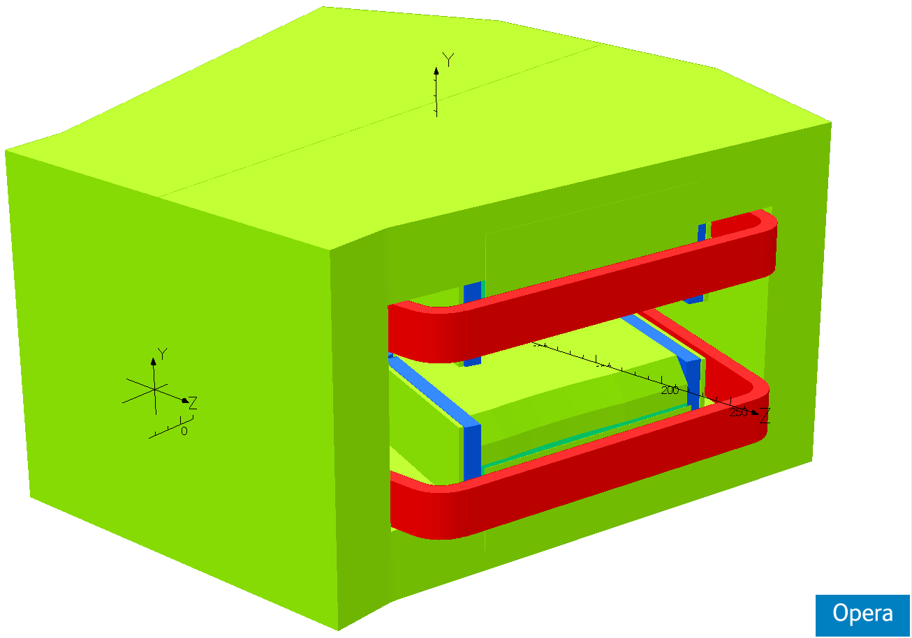

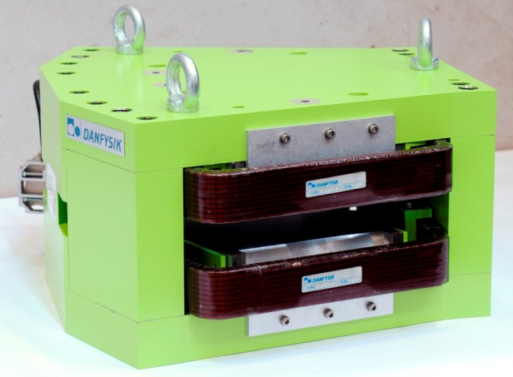
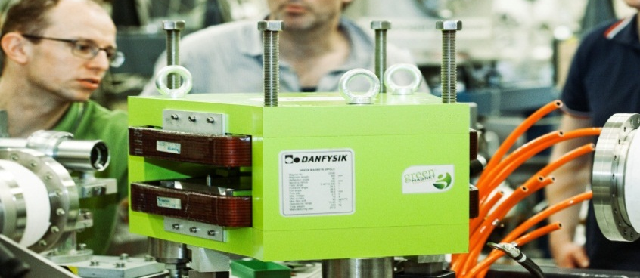
GREEN MAGNETS®
Permanent magnets generate a fixed field
Trim coils for magnetic field adjustment
Negligible power consumption
No cooling water infrastructure
Easy installation
Compact design
Lower total lifetime cost
Green Magnet was installed in an AMS facility at ETH
Installation was found to be easy
“We could not observe any difference to the normal operation condition using conventional electromagnets”

Slide 12
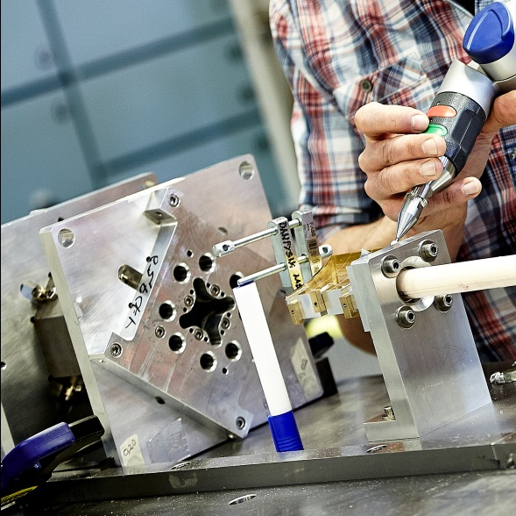
Temperature stability
Normal NdFeB drift
Thermal drift of permanent NdFeB magnets is about 1000 ppm/°C
Reduced to 10-50 ppm/°C
Temperature drift can be negligible in about a 10°C range around optimum.
Test result is shown
Similarly for calibration quadrupole(PMQ)
Very good for calibration purposes
Passively compensated
NdFeB

Slide 13
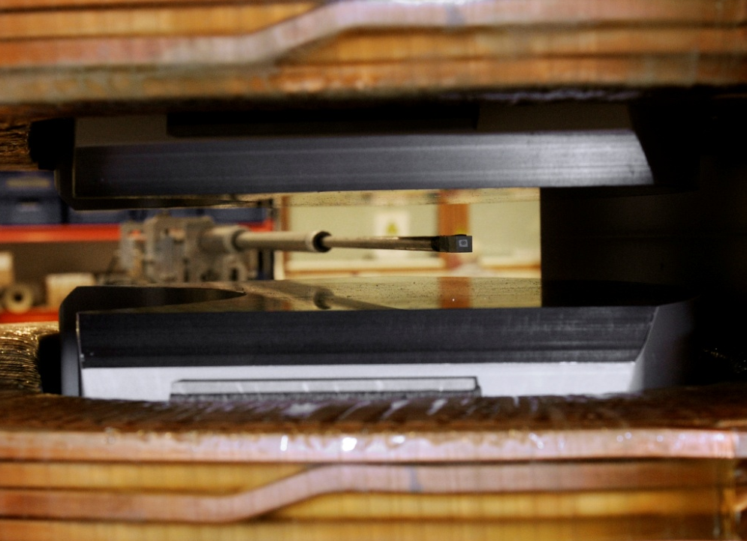
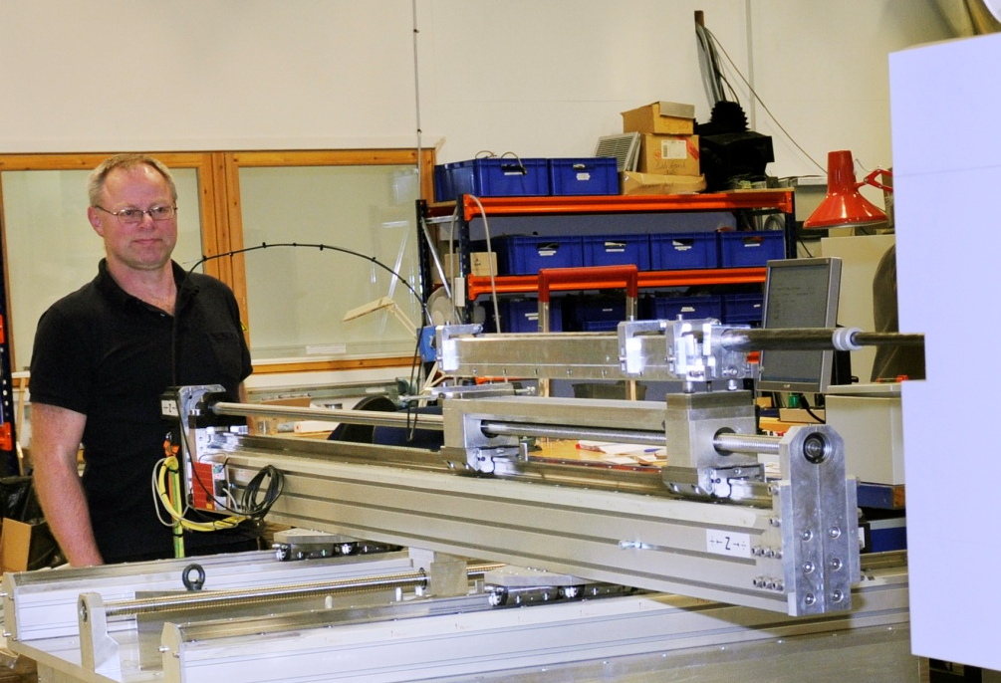
3D field mapping with Hall
Hall probe field mapping
Step-by-step or on-the-fly
Mainly dipole mapping
  Center field homogeneity
  Shim angles
Positioning accuracy < 0.1 mm
Large rectangular grids can be programmed, as requested
  MedAustron solenoid grids
Group3 Hall probes:
Digital: ± (0.01% of reading
+ 0.006% of full scale) up to 3 Hz
Analog: ± 0.01%
(of reading +0.02% of full scale) up
to 10 kHz

Slide 14
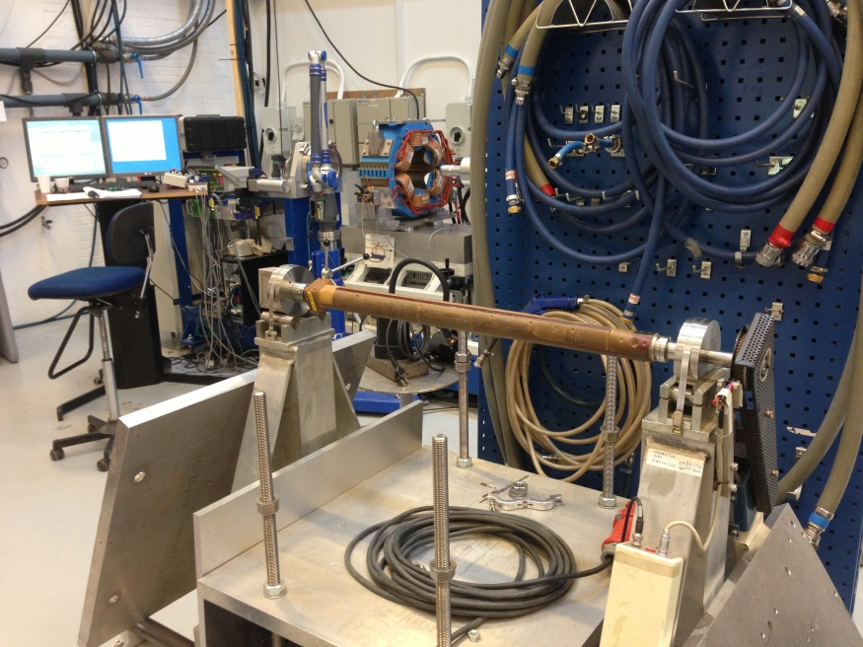
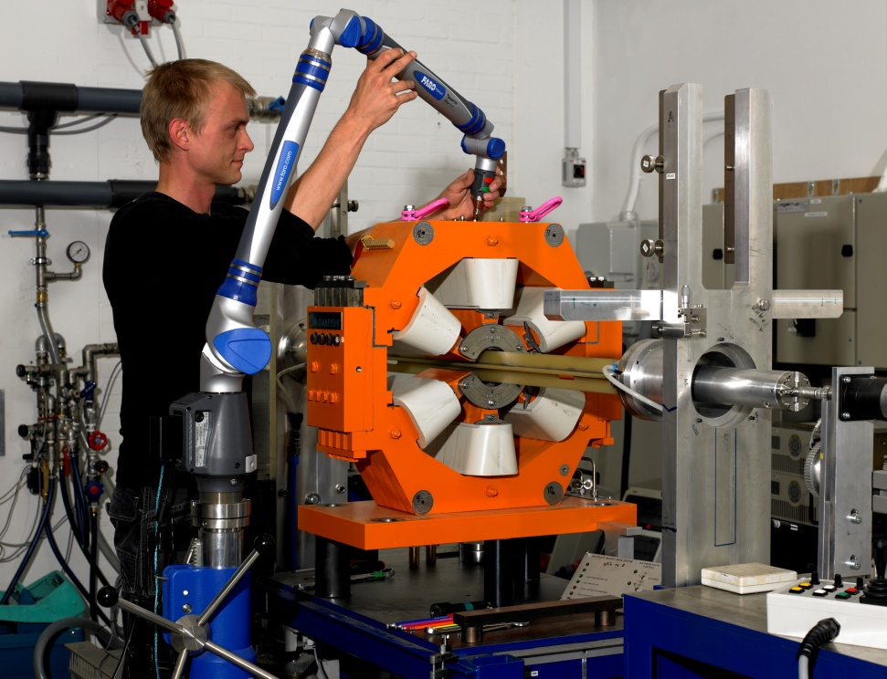
Rotating coil measurements
Fast rotating multipole
test system 690:
Coil length range: 500 – 1100 mm
Existing measuring rod radii:
  7.6 … 44.5 mm( compensated and non-compensated)
Measuring in the magnet center
Amplitude measurement
Sold units to Bessy, RRCAT
Analyzes voltage
Slow rotation multipole
test system 692:
Coil length range: Custom-built for
specific magnet application.
Tangential and radial coils
Existing measuring radius:
  17, 24.5, 30, 47 , 80.5 mm
    Quadrupole and sextupole compensated
Magnet alignment within:
±0.03 mm, ±0.2 mrad
Sold units to INFN, SSCL, Argonne, Bessy,
RRCAT, and others
Analyzes integrated voltage

Slide 15
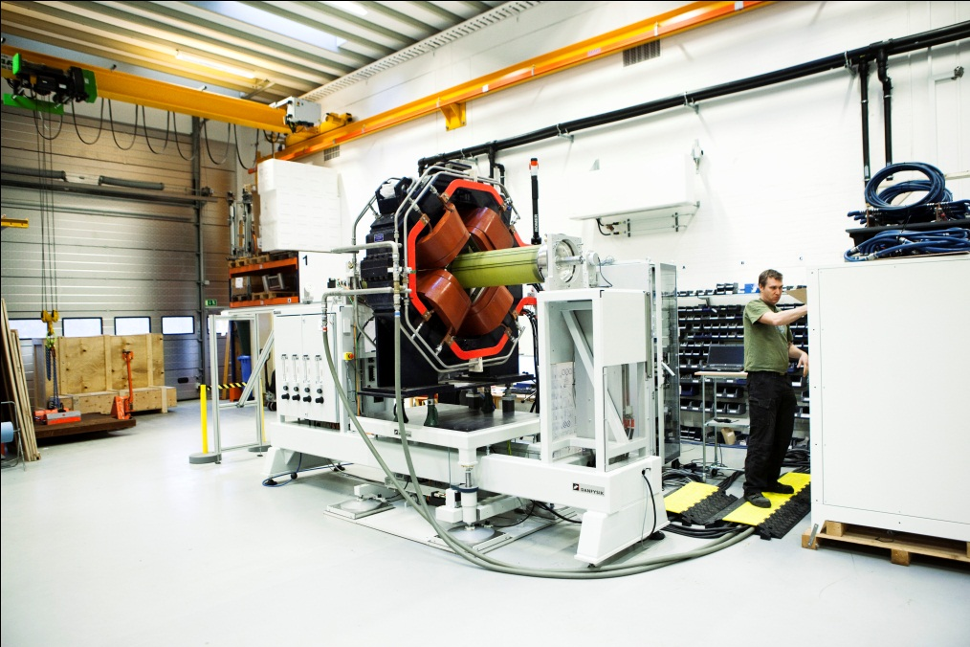
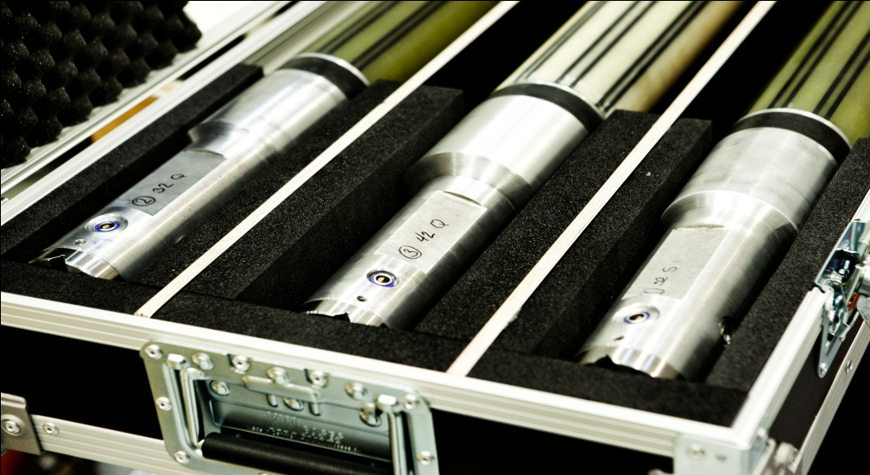
Measuring bench 692
Based on design from CERN, technology transfer
Latest order(RRCAT) was scaled up to handle large magnets
Coil radius up to 138 mm
Coil length around 2000 mm
Voltage integration using Metrolab new FDI 2056 with 2 channels and encoder module
”Seamless” integration of FDI into our old software

Slide 16
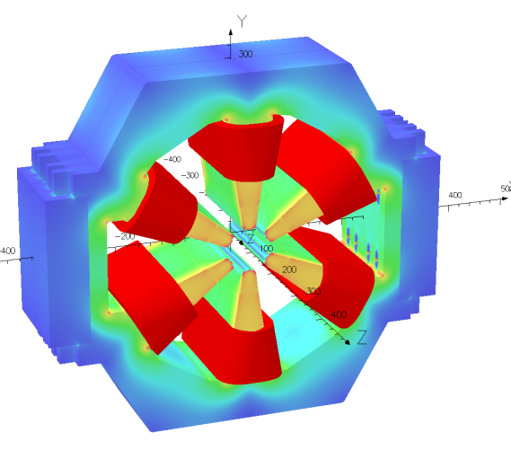

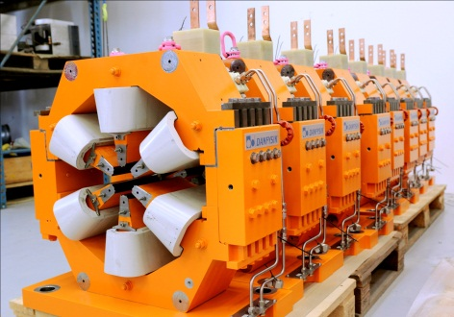
Recent measurement campaigns
169 Standard sextupole magnets for NSLS-II
Tight specifications for harmonic content, and magnetic mid-plane.
Asymmetric design
Removable central pole( for inserting coil)
Optimized in Vectorfields OPERA
Coil and raw yoke production by Scanditronix

Slide 17
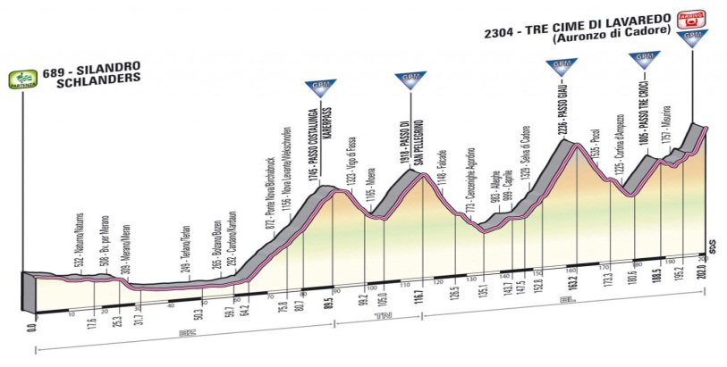
Measurement results
Initially produced 3 ”First Article” magnets
Pending approval of these, the rest could be produced
First Article 1 and 2 were shimmed to within specifications.
First Article 3 was flawless.
Machining process was refined for Article 3 and remaining magnets
166 more sextupoles to go

Slide 18
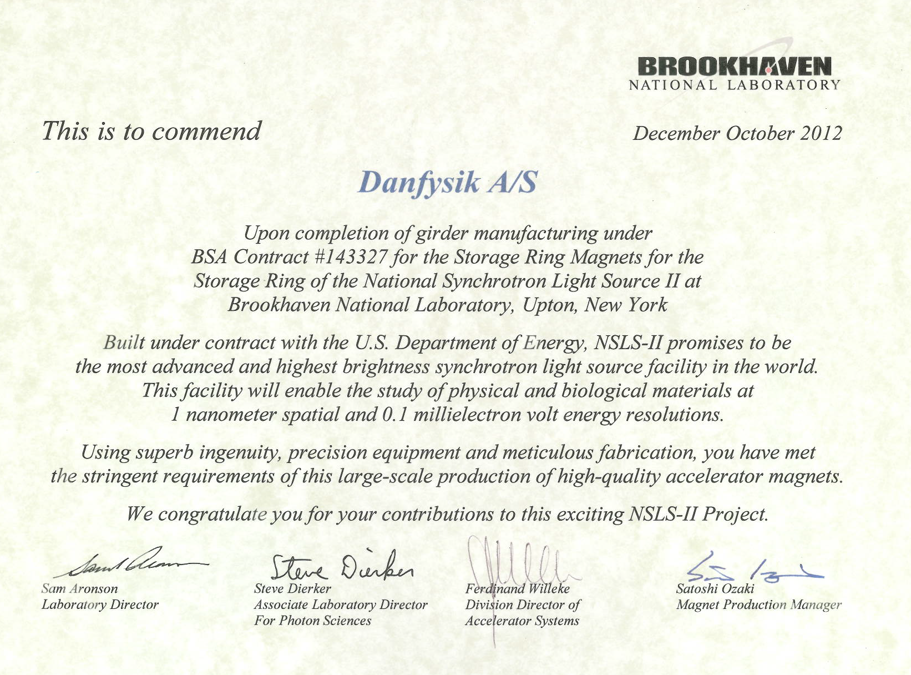

Slide 19
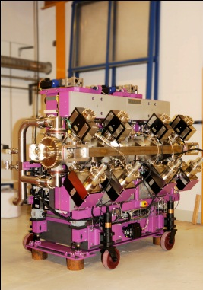
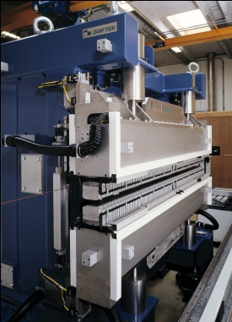
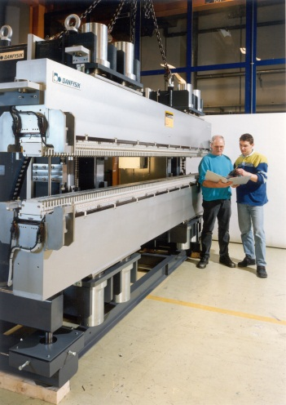
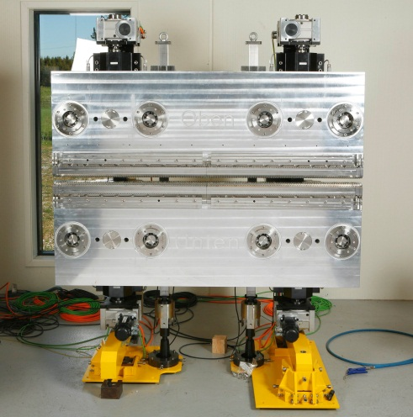
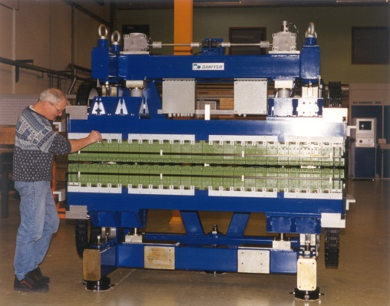
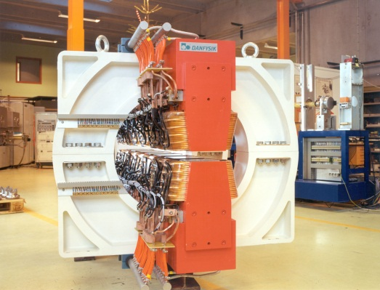
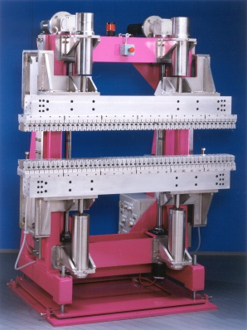
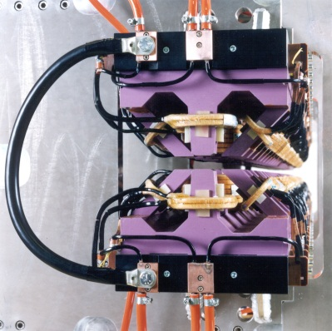
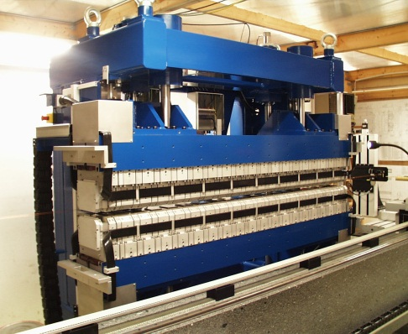
Insertion devices
Insertion device group within Danfysik
  Project manager, design engineers, physicists, shim technician
All kinds of insertion devices have been produced
  Undulators: PPM and hybrid
  Hybrid wigglers
  Electromagnet wigglers
  In-vacuum devices
  Cryogenic hybrid device for Diamond
  Apple-II type
2 wigglers results to present today

Slide 20
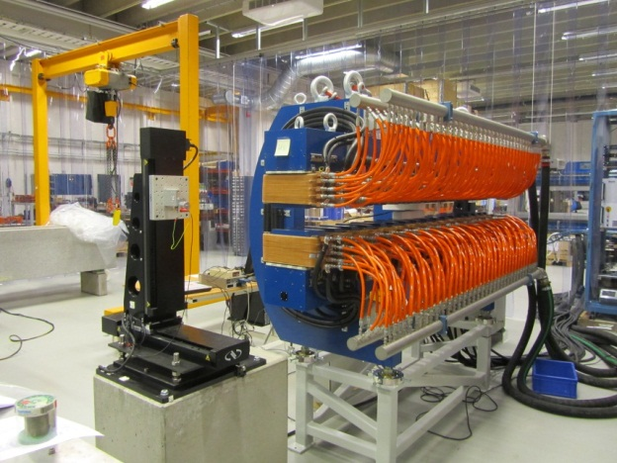
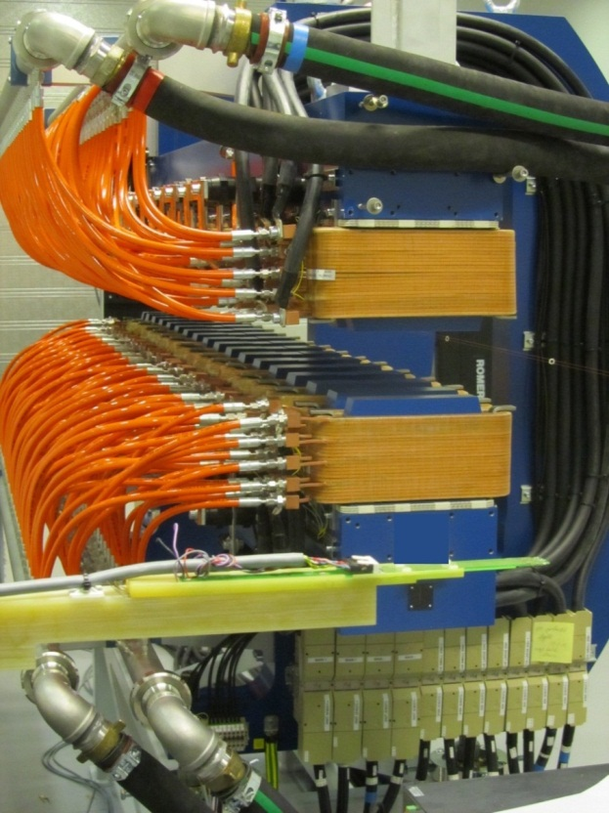
Electromagnetic wiggler for Helmholz Zentrum Dresden-Rossendorff
Wiggler specifications
Period length | 300 mm
Number of full-size periods | 8
# poles, including end poles | 16+2
K_{RMS} | 7.76
Peak field | 0.38 T
Minimum clear gap | 102 mm
Field flatness (x<20 mm) | +0.2 %
Independent powering of end poles
 | MPS type | Quantity | Stability | Max. Current
Central poles | 854 | 1 | 10 ppm | 625 A
Large end poles | 854 | 2 | 10 ppm | 235 A
Small end poles | 9100 | 2 | 10 ppm | 200 A

Slide 21
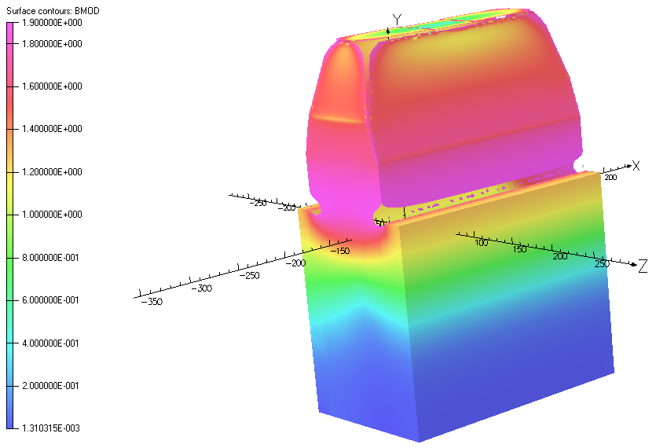
Modelling and results
K=7.76
K=3.99
Wiggler was shimmed by adjusting end polevcurrent, long coils
High saturation of thin end poles at high power
Low phase error: 1.2°
K=2.0
K=1.0

Slide 22
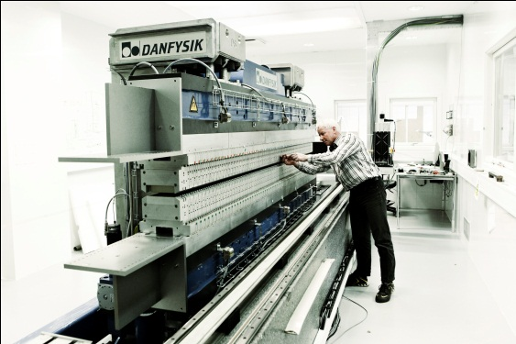
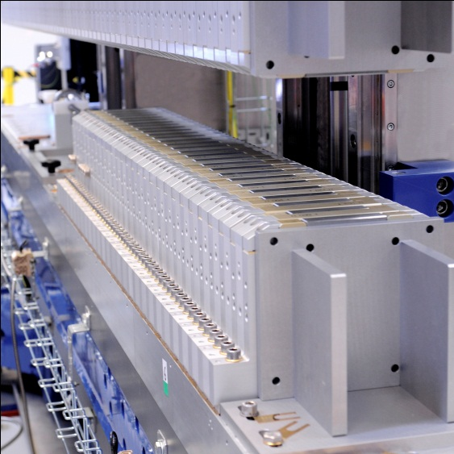
Movable gap damping wigglers for NSLS-II
Wiggler specifications
Period length | 100 mm
Number of full-size periods | 34
# poles, including end poles | 74+2
Peak field | 1.8 T
Minimum clear gap | 15 mm
Minimum pole width | 90 mm
First integral(x<15 mm) | 20 Gcm(Horizontal) 50 Gcm( Vertical)
Second integral(x<15 mm) | 2000 Gcm²(Horizontal) 5000 Gcm²(Vertical)

Slide 23
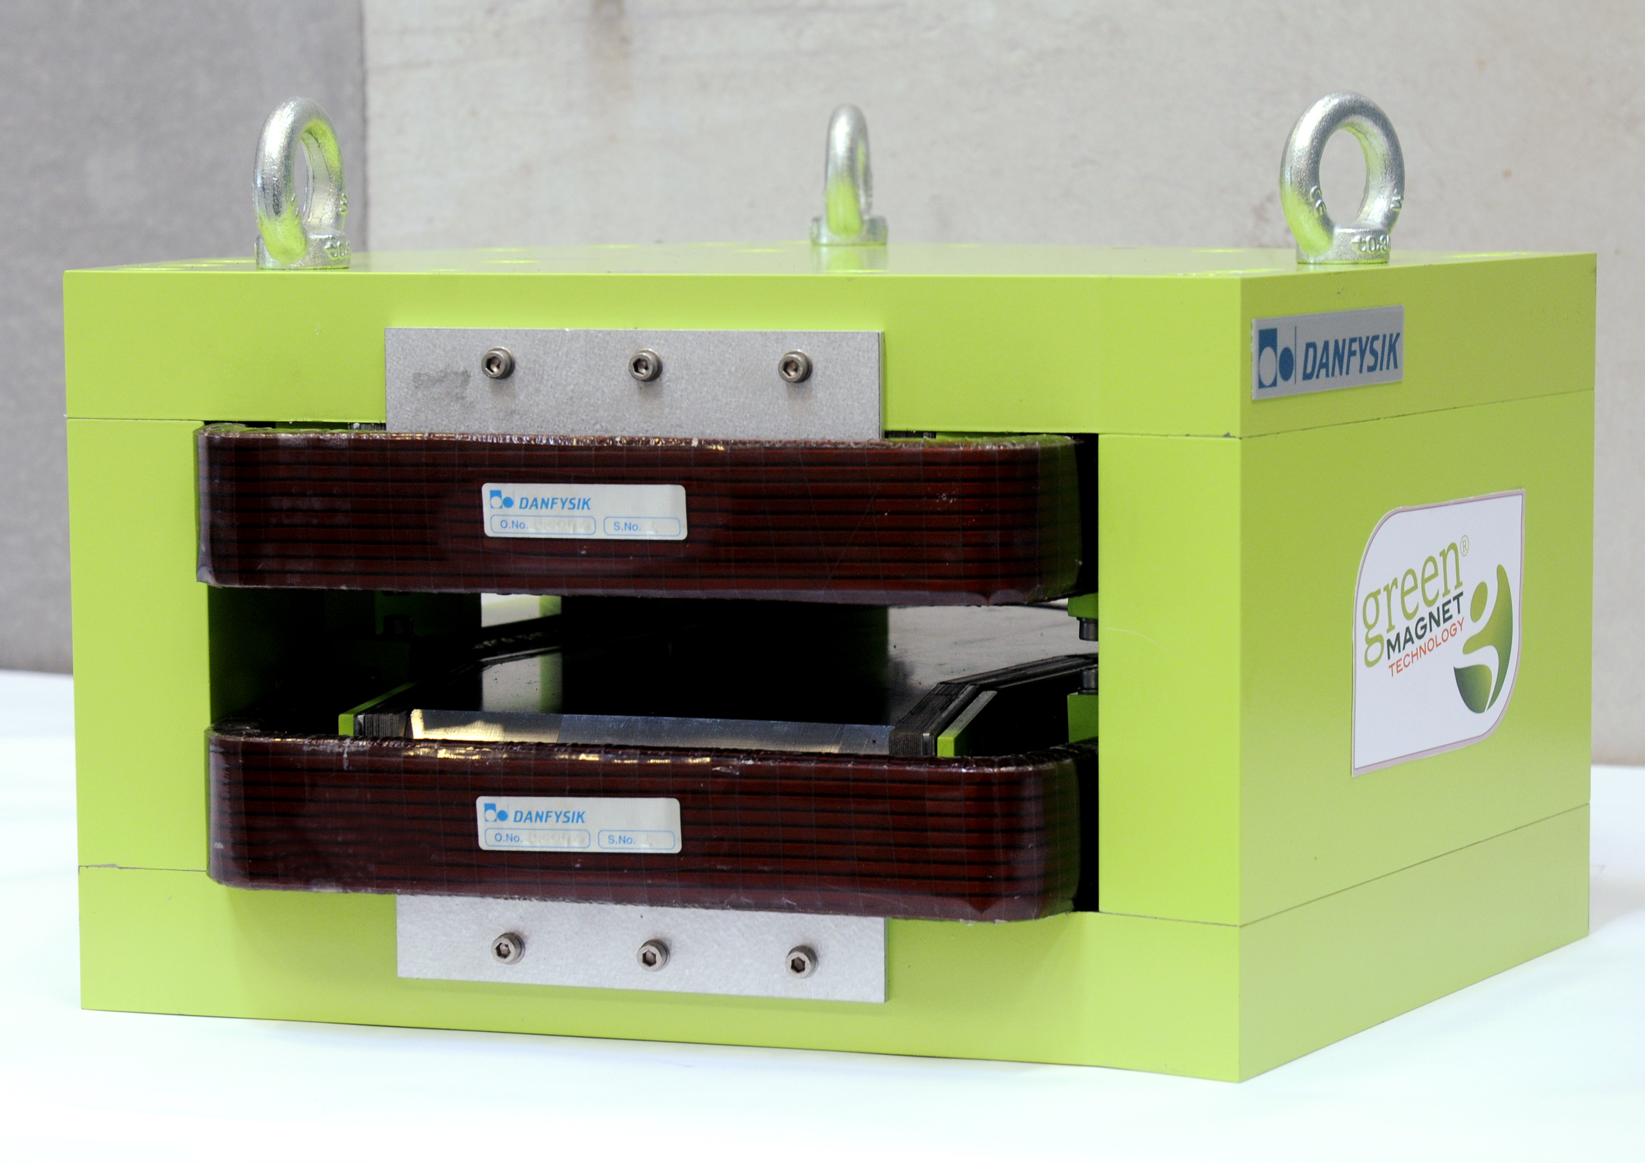
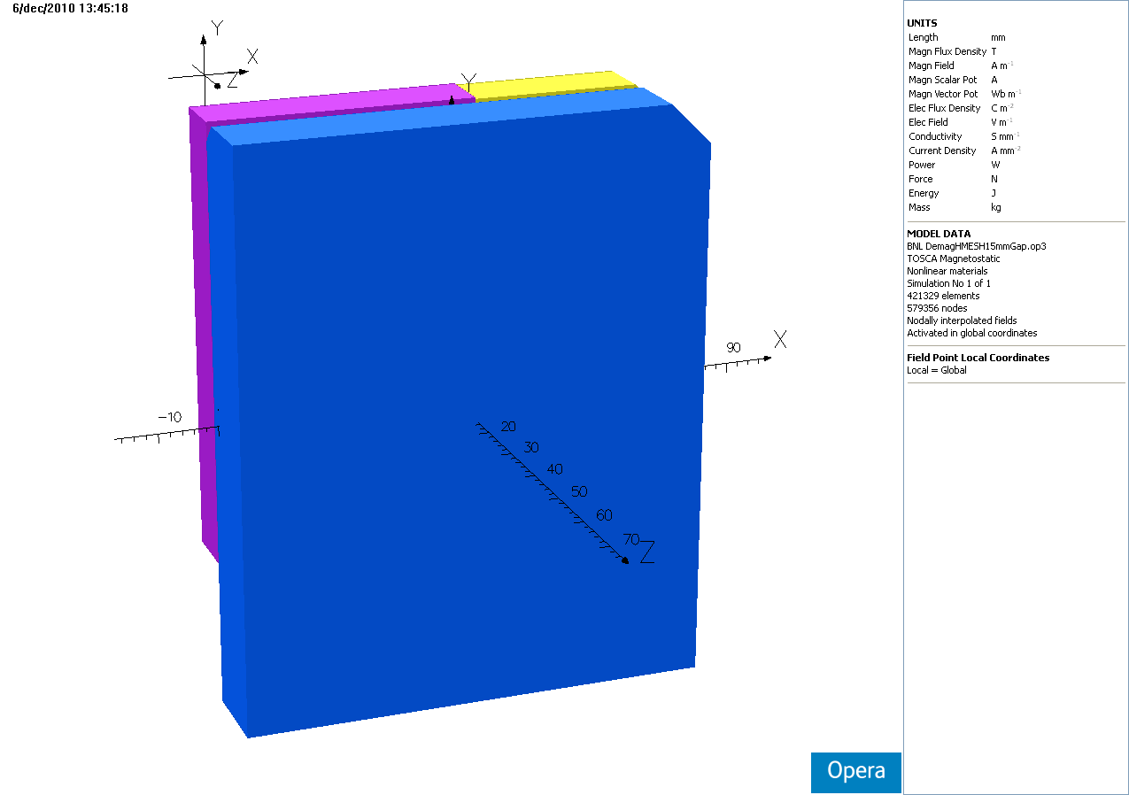
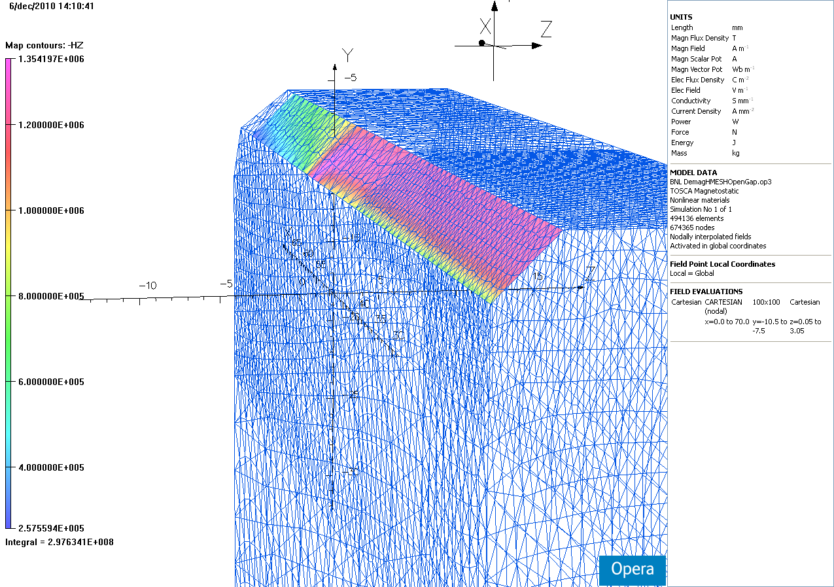
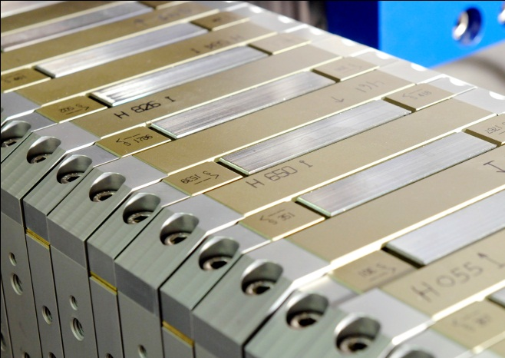
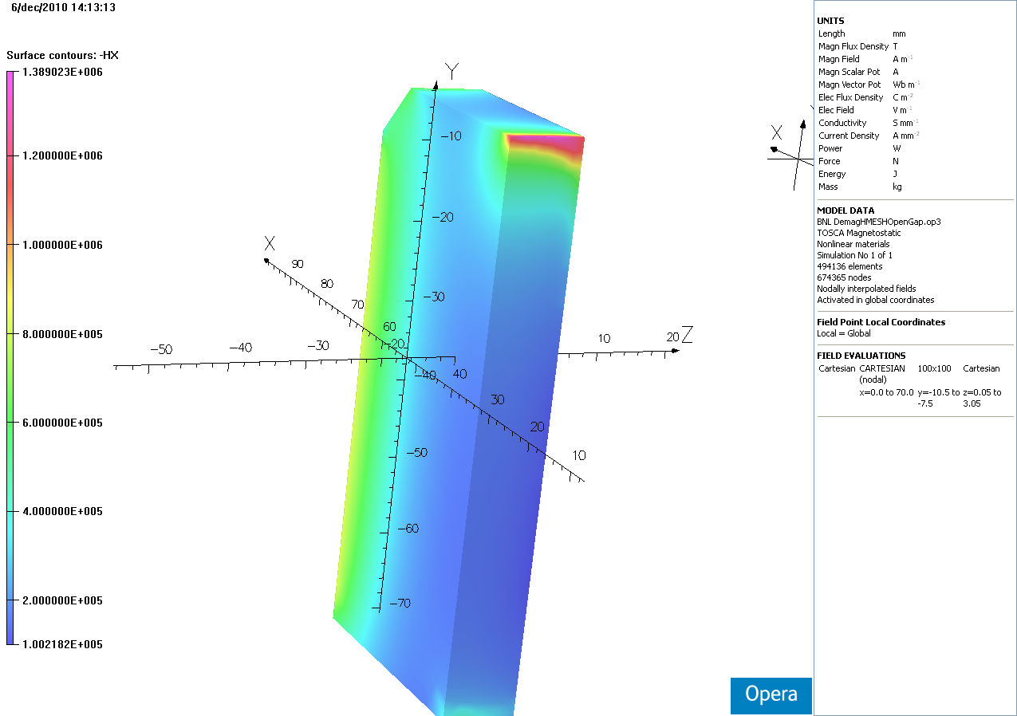
Modelling
Central section and demagnetization(open, closed gap) modelled using Vectorfield OPERA
End termination modelled using RADIA
Adjustable side magnets

Slide 24
Results
Trajectory
Average peak field: 1.819 T
Mounting and shimming time is improving
4th wiggler has completed magnet assembly, and is ready for shimming
2nd integrals
1st integrals

Slide 25
Conclusion
Many different projects since last IMMW
Upcoming challenges
  Completion of damping wigglers for NSLS-II
  In-vacuum undulator for NSLS-II
  Completion of compact girder systems for MaxLab
  Measurement of 1.5 GeV complete girder systems for MaxLab/ Solaris projects
Continued efforts to improve automatization of measuring processes, in ID and general magnetic measurements

