Slide 1
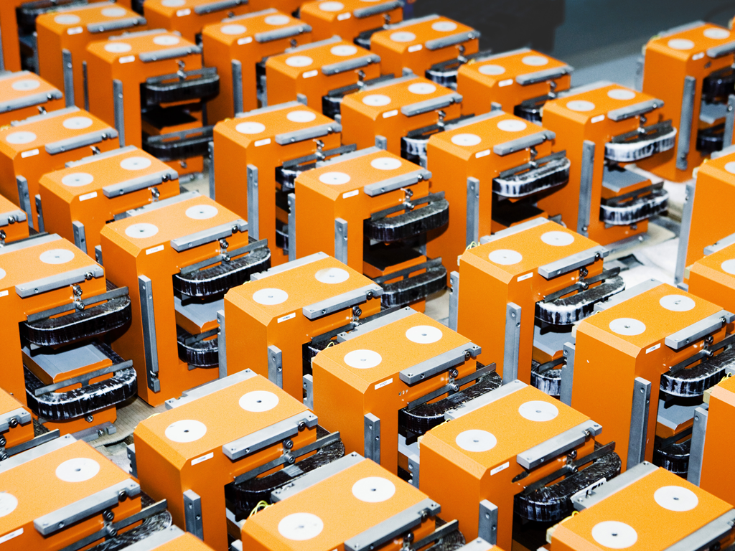
Measurements of Max-IV girder systems
Christopher W. Ostenfeld
Danfysik A/S, Denmark
IMMW 18
June 2013

Slide 2
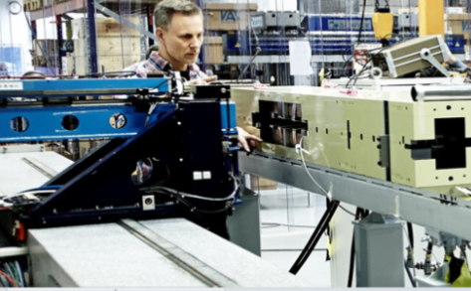
Outline
MAX IV magnet girders
Description of Max IV girders
Hall probe field mapping
Description of concept
Stability of alignment
Some measurements results
Harmonic coil measurements
Description of concept
Stability of the measurements
Some measurement results

Slide 3
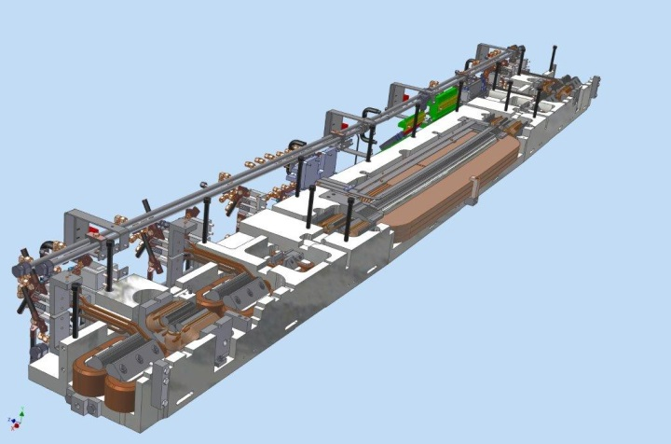
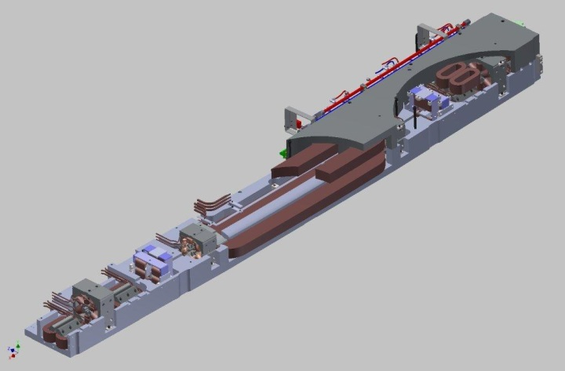
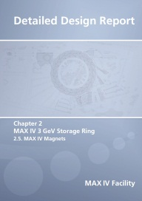
Production of MAX IV magnet girders
MAX IV designed for 3 GeV with very low emittance( multi-bend achromat)
Danfysik is producing 20 each of M1, M2 and U3 with 10-13 magnets
Designed by Maxlab*
In total 60 dipoles, 220 steerers, 160 quads, 120 sextupoles, 120 octupoles
680 magnets in total
Small Ø25 mm aperture in the multipoles
Girder positions in the ring achromats
U3
M1
M2
M1
U3
*

Slide 4
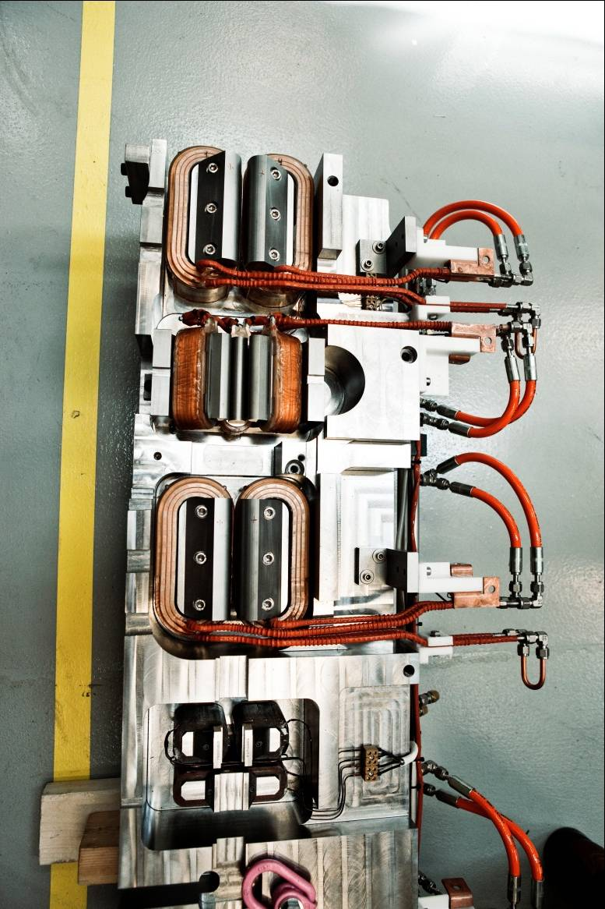
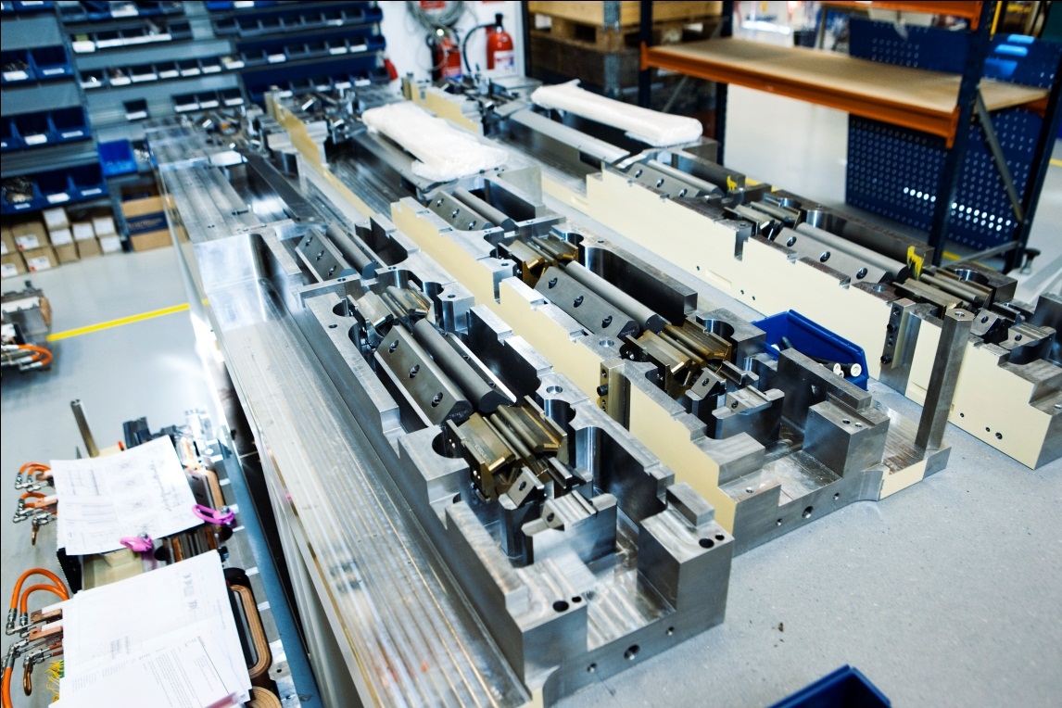
Girders as produced

Slide 5
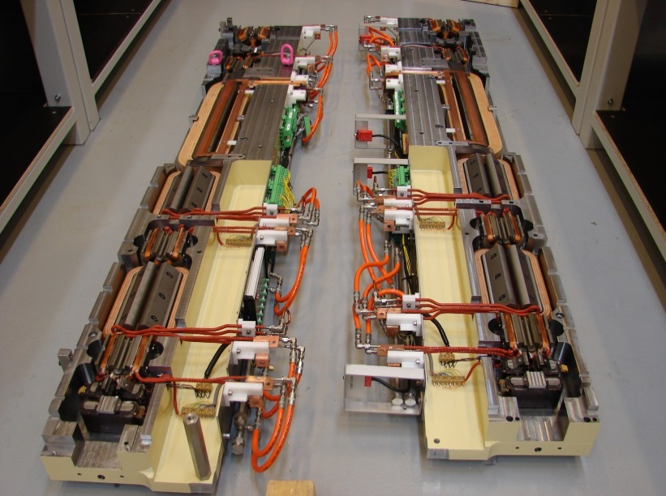
Top/bottom M1 girder as produced
Combined function
dipole with
pole face strips
Soft ends
Quadrupole
Octupole
Quadrupole
Octupole
Skew corrector
Normal corrector

Slide 6
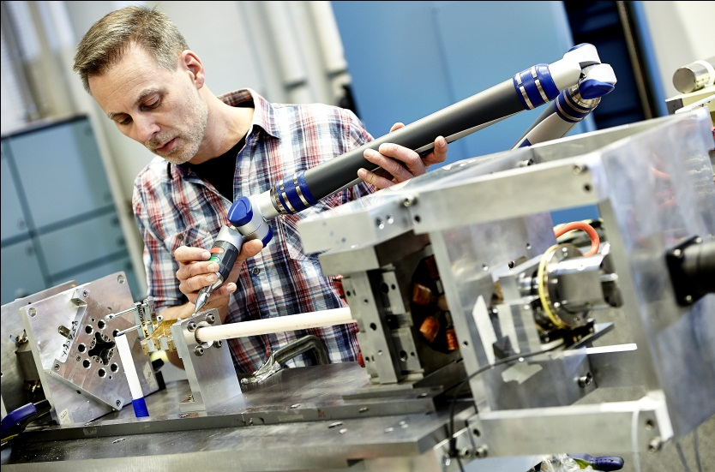
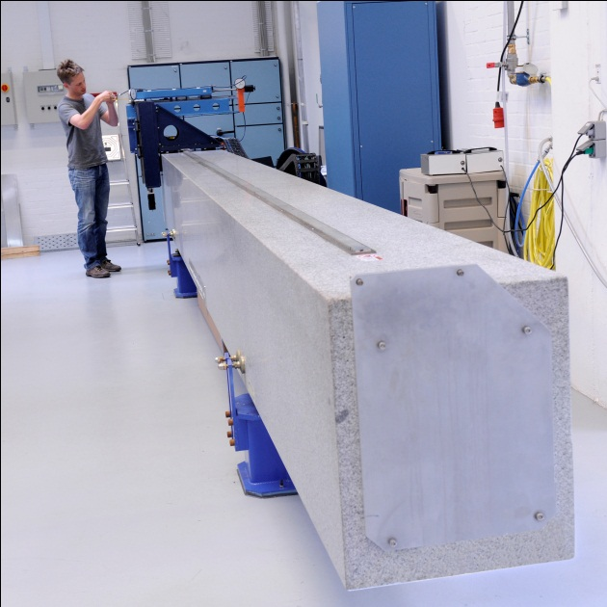
Measuring challenge
Harmonic coil measurement
How to affix coil assembly
Choice of bearings
Hall mapping
Purchase of new 7 m Hall bench
Build Hall probe( KSY 14) with temperature correction, and Hall supply
Long measurement campaigns
Large volume of measurements
680 individual sub segments in total
Demands for data handling
Requirements for automatisation, to measure all of this efficiently

Slide 7
Extensive tests for First Articles
Extended set of measurements
(coil and Hall)
Extended set of measurements
(coil and Hall)
Remove magnet
from bench
Remove top of magnet girder,
reinstall and remeasure
from bench
Extended set of measurements
(coil and Hall)

Slide 8
Hall measurement requirements
Hall scans along the nominal trajectory, ± 15 mm(Dipole)
Accomplished by scanning rectangular grid, followed by interpolation
On-the fly( like insertion device mapping)
Time for complete dipole map. Around 3 hours
Excitation curves(Dipole)
Excitation curves(Quadrupoles)
Through available access holes
S=0, x= ± 5 mm
Horizontal scans of quadrupoles
X=±15 mm. S=-115,0,115

Slide 9
Hall measurement of quadrupoles
Arrows show measurement lines

Slide 10
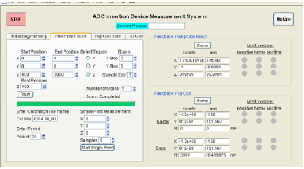
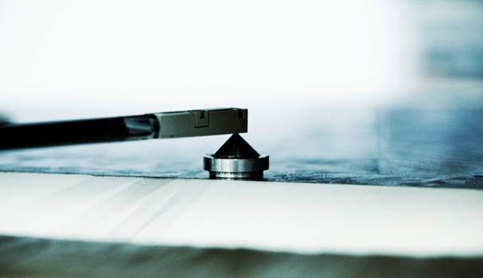
Details on software for Hall bench
Fully automated measurements
Magnet is powered up, and held for appropriate wait time
Hall probe is zeroed in mu-metal shield prior to measurement
Probe is homed on magnetic cone
Measurement is carried out
Dipole map, excitation, etc.
Probe zero is checked in mu-metal after measurement, and data is corrected for drift
Off-line correction for temperature
Voltage/NTC logged with Keithley 2701
Power supply control and motion control within Igor

Slide 11
Hall probe mapper setup
Precision Hall mapper on long granite table
Laser feed back on longitudinal z-axis and linear encoders on x,y-axes
Alignment by scanning over magnetic pins, knife-edges
Short term position st.dev. < 2 μm, long term drift <10 μm
Alignment with magnet tip
Scanning dipole from side & quadrupoles through small holes in yoke
Short term repeatability
 | Z (mm) | X (mm)
Round 1 | 2888.7707 | -61.7454
Round 2 | 2888.7697 | -61.7483
Round 3 | 2888.7695 | -61.7465
Round 4 | 2888.7698 | -61.7491
Round 5 | 2888.7709 | -61.7448
St. Dev. | 0.0006 | 0.0016

Slide 12
Hall probe field mapping
High stability temperature calibrated Hall probe allows on-the-fly mapping
Large field grid measured on-the-fly of the combined function dipoles
Interpolated on-the-fly data agree with step-and-go data within 1.6·10⁻⁴
Repeated measurements of field integral stable within 7·10⁻⁵
Very good alignment and stability
Field map on-the-fly in 1.5 h
Interpolated field values along trajectory

Slide 13
Harmonic coil measurements
Several things to consider
Single long coil vs short segmented coils
Compensated vs non-compensated
Integration vs voltage measurements
Radial vs tangential coil
Other
Support material
Choice of bearings

Slide 14
Harmonic coil measurements
Several things to consider
Single long coil vs short segmented coils
Compensated vs non-compensated
Integration vs voltage measurements
Radial vs tangential coil
Other
Support material
Choice of bearings

Slide 15
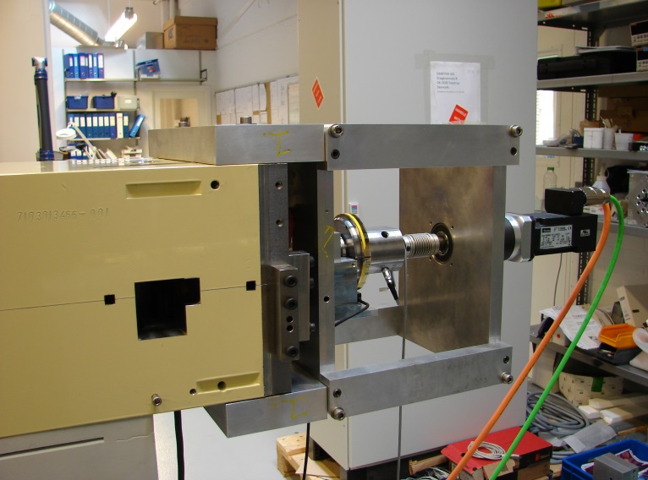
Harmonic insertion coil concept
New concept ( For us, anyway……)
Coil inserted from girder end with external encoder and motor
Precision Heidenhain encoder(scale drum) ERA 4202 C
Mechanical coil positioning from girder reference surfaces
15 º tangential coil with a 10.7 mm measurement radius
One short harmonic coil segment for each magnet
Coil lengths between 150 mm and 250 mm
3-5 coil segments per support rod, 13 segments in total
Calibration of each segment → phase and gradient strength
Voltage integration using 1 channel Metrolab 5150 with Trigger module
Coil segment positions for long M1 & M2 ends

Slide 16
Sub coil calibration
Phase and strength calibration
Due to differing coils lengths, several reference magnets are needed
For 150 mm segments, 100 mm EM sextupole is used
For 200-250 mm segments, temperature stabilized permanent magnet quadrupole is used
Magnet is rotated 180 degrees to find coil phase error relative to mechanical reference.
Compare with Hall/ stretch-wire results
Appropriate Gain/Phase chosen when measuring sub-magnets
Magnet | Segment | Gain | Phase [Grad]
QDE | 1 | 1.00113 | -65.507
OXY | 2 | 1.01146 | -65.516
QFE | 3 | 1.01083 | -19.868
OXX | 4 | 1.00818 | -65.429
COA (By/Bx) | 5 | 1.02909 | -19.892
Calibration data for sample 5 segment coil

Slide 17
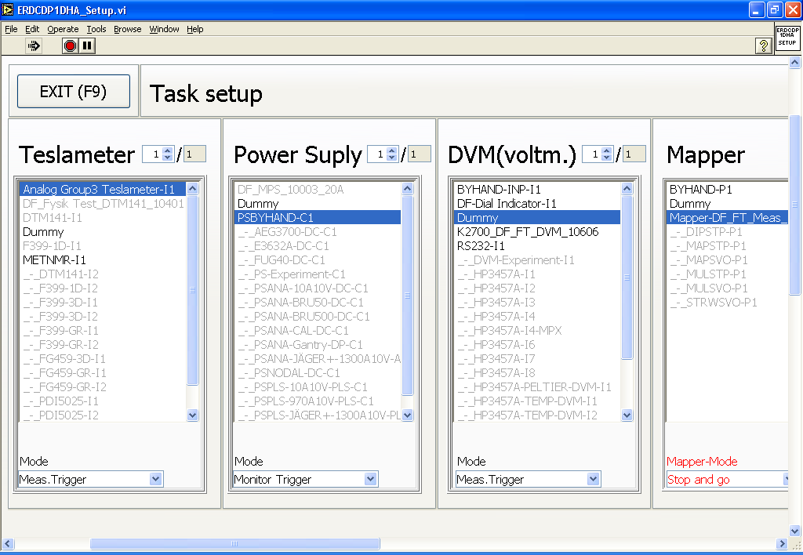
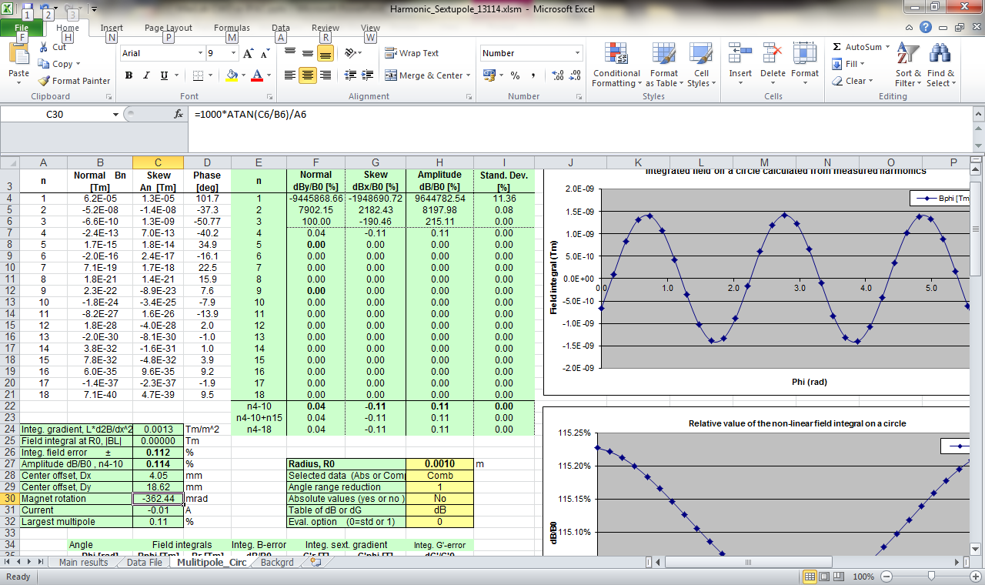
Details on software for coil bench
Running under Labview
Each coil segment is saved, with reference, to intrinsic phase and strength
User chooses appropriate coil to measure correct magnet sub segment.
Power supply control within Labview, and excitation cycle runs automatically
EXCEL templates developed
Traceability to calibrations and coils used

Slide 18
Stability of the harmonic measurements
Short term repeatability test
Field gradient variation 0.4·10⁻⁴
Higher harmonics below 0.1 unit
Magnet rotation variation 0.01 mrad
Very stable
Simple test of thermal stability
Field gradient drift 0.2 unit/°C
Magnet rotation drift -0.03 mrad/°C
Low thermal drift
Long term stability, average for 6 quads
Disassembly of test jig and yoke
Three measurements over several days
Field gradient variation 2·10⁻⁴
Short term repeatability test on a quad
Test on M1 quad | Repeatability | Thermal change/°C
Field gradient strength | 0.4 | 0.2 | Unit, 10⁻⁴
Higher harmonics, n3-4 | < 0.1 | 0.2 | Unit, 10⁻⁴
Higher harmonics, n≥5 | < 0.03 | 0.2 | Unit, 10⁻⁴
Magnet center dX, dY | < 0.001 | < 0.001 | mm
Magnet rotation | 0.01 | -0.03 | mrad
Long term stability with jig/yoke disassembly
Average result, 6 quads | Stability
Field gradient strength | 2 | Unit, 10⁻⁴
Higher harmonics, n3-6 | < 0.4 | Unit, 10⁻⁴
Higher harmonics, n≥7 | < 0.1 | Unit, 10⁻⁴
Magnet center dX,dY | 0.004 | mm
Magnet rotation | 0.14 | mrad

Slide 19
Higher harmonics of a M2 quadrupole
Pole end contributions n=6,10,14 -> reduced for U1-5 quads by chamfering
Remaining harmonic errors: mainly sextupole (n=3) and octupole (n=4)
Remaining terms typically below 1 unit = 0.01%
Measuring noise level is low
Similar pattern for sextupole and octupole magnets
Sextupole
Pole end contribution (n=6,10,14)
Low noise
Octupole

Slide 20
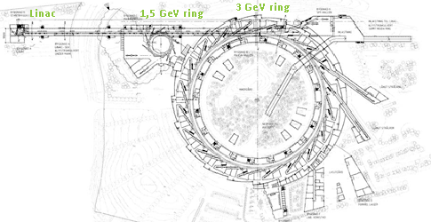
Next Project: Max IV 1.5 GeV
Element | Description
SQFo | Combined function quadrupole/sextupole
SCo | Trim sextupole with skew quad, x- and y-corr windings
SDo | Sextupole
DIP | Gradient dipole with pole face strips
SDi | Sextupole
SCi | Trim sextupole with skew quad, x- and y-corr windings
SQFi | Combined function quadrupole/sextupole
Same concept
12 identical double-bend achromats
96 m circumference
6 nm horizontal emittance
These magnets are much larger( around 4.5 m)
Exotic combined-function elements
Same exact order for Solaris in Krakow

Slide 21
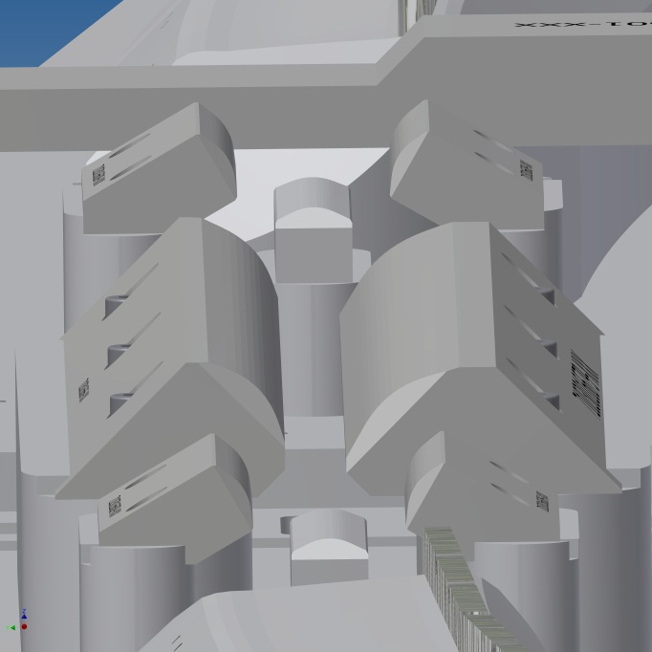
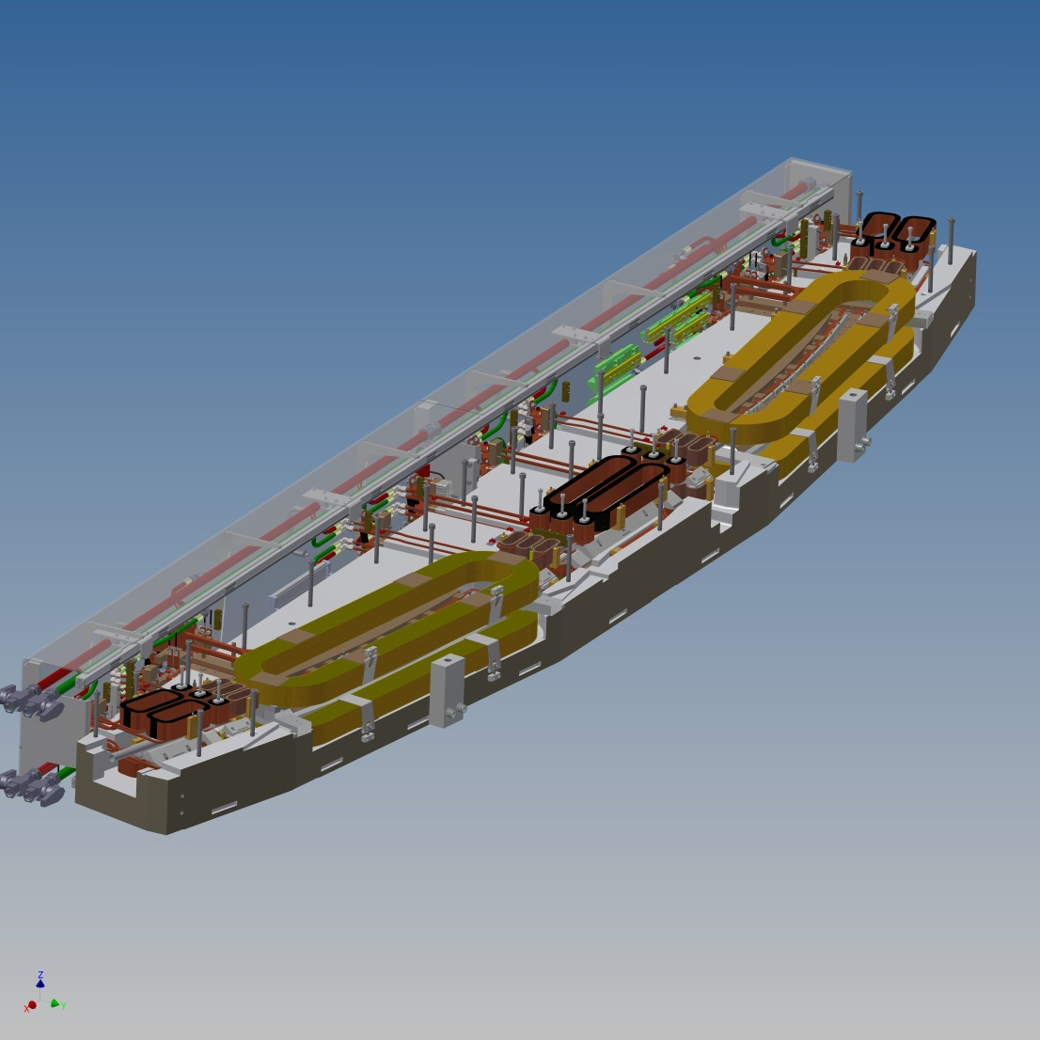
Still in design phase
Trim sextupole with
skew quad,
x- and y-corr windings
(Sci)
Combined function
quadrupole/sextupole(SQFI)
4.5 m
Challenge related to measuring
central multipoles, due to limited access

Slide 22
Summary
We have devised a measurement scheme to measure Maxlab girders with high stability
Hall system shows high positional reproducibility, and stability
Succesful implementation of tangential, segmented coils
Harmonic coils can be reproducibly “lodged” in the girder
High degree of automatization implemented in Igor and Labview
Awaiting MaxLab 1.5 GeV girders for measurement

Slide 23
Acknowledgements
Claus Hansen: Project Manager
Dan Kristoffersen: Project engineer
Franz Bødker: Physicist
Gunver Nielsen: Physicist
Esben Krauthammer: Physicist
Christian Glarbo: Physicist
Kristoffer Andersen: Measurement Technician

