Slide 1
Investigation of the Earth Field Effect on Insertion Device Performance at the Advanced Photon Storage Ring (SR)
Isaac Vasserman, Nikita Strelnikov
IMMW-18, 3-8 June 2013

Slide 2
Introduction
The earth field propagation through an insertion device (ID) can affect the performance of the device and has to be taken in account. It is especially true for free electron laser (FEL) applications [1].
First horizontal and vertical field integrals were measured at the APS magnetic measurement facility 6m bench (IDs: APS27#5s-27mm period, Una33#6-33mm period) with normal orientation of the device West-East, and again after rotating by 180° to see the propagation of the Earth field to the gap. These orientations are sensitive both to the horizontal and vertical components of the Earth field.
Contribution of the horizontal Earth field component at the median plane of the ID was calculated and compared with measurements; as shown on slide 4.
Contribution of the vertical field component was calculated, and the difference of the first vertical field integrals was measured.
Simulation was done using Radia and the results of the comparison are shown below. First field integrals were measured by a long stretched rotating coil (L=4.2 m). With no device the measured fields and field integrals were: B_{x}=-0.15 G, J1_{x}=-63 G-cm; B_{y}=-0.4 G, J1_{y}=-167 G-cm.
_______________________________________________________________
[1]. S. Sasaki, I. Vasserman, “Modeling of the effect of the Earth field and an iron plate on the LCLS undulator trajectory,” Proceedings of the 27th International Laser Conference, 21-26 August 2005, Stanford, CA, USA.

Slide 3
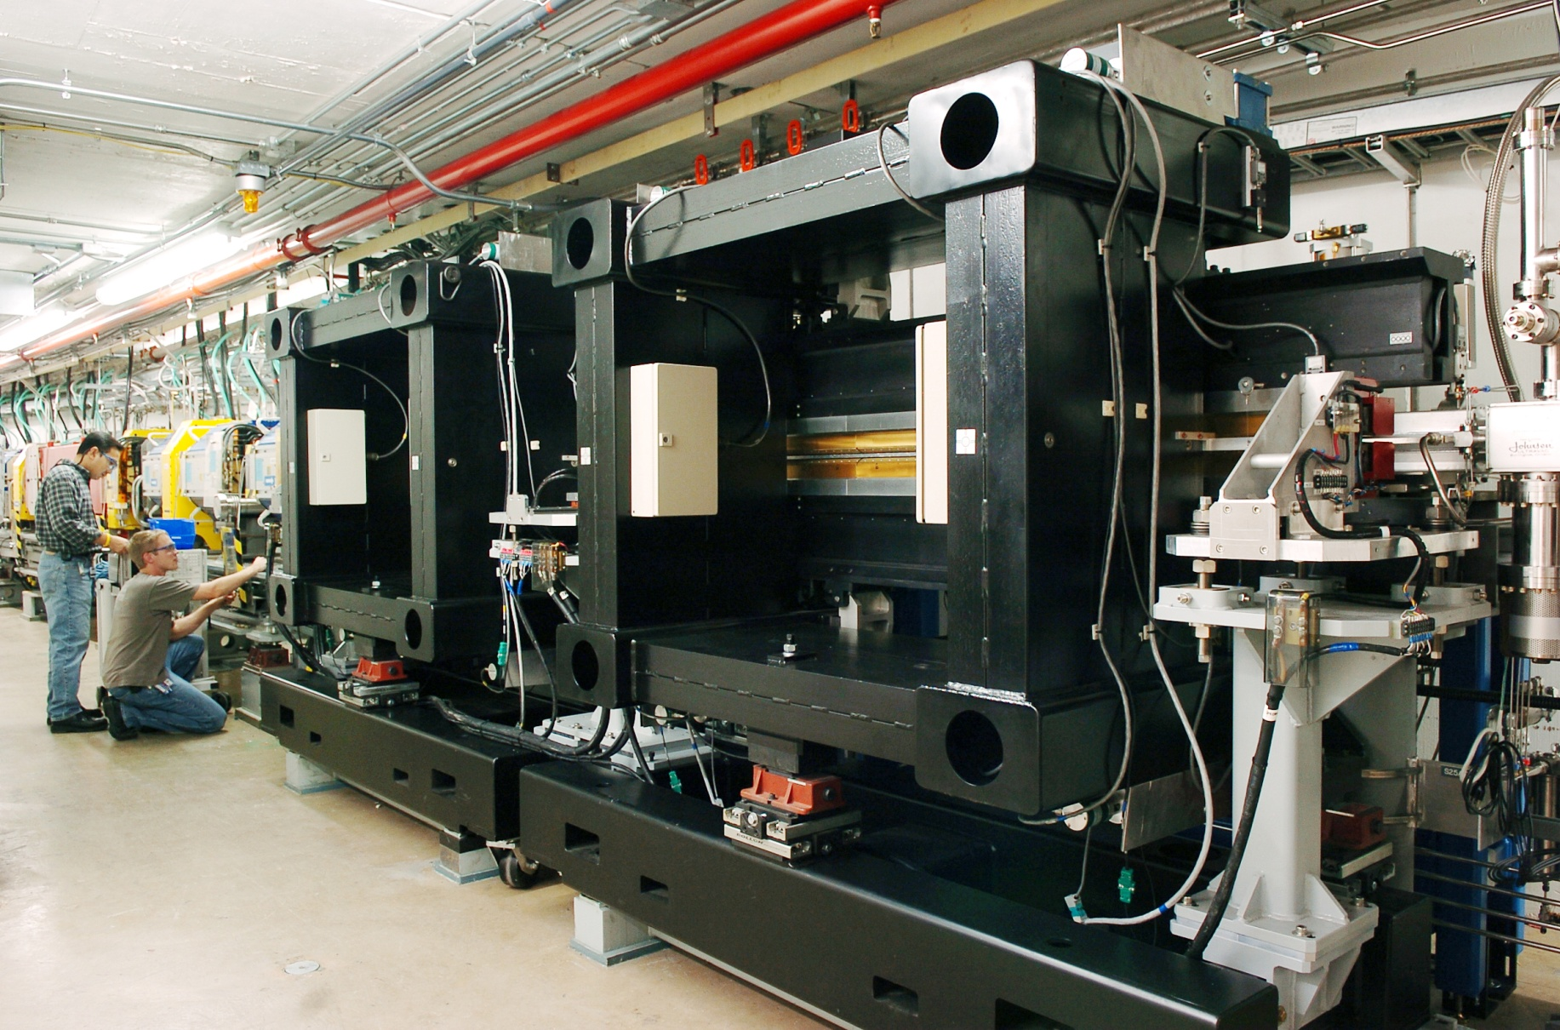
APS Devices with Magnetic Frames

Slide 4
Calculation of the Horizontal Earth Field from Measured Data
J_{1x}(0)=J_{u}+J_{e} First field integral, normal orientation
J_{1x}(180)=-J_{u}+J_{e} First field integral, rotated 180˚,
Here J_{u} is undulator magnetic structure contribution, J_{e} is the Earth field contribution
J_{e}=[ J_{1x}(0)+ J_{1x}(180)]/2
Vertical Earth field component(J_{ye}) contribution can not be extracted from this type of measurement. J_{ye} and first vertical field integral of the device itself does not depend on the orientation in the ideal case. Existence of magnetic structures non-symmetrical in X can introduce J_{ye} dependence on the device orientation.

Slide 5
Horizontal Earth Field Propagation
Und A-33 mm period device
APS-27 mm period device

Slide 6
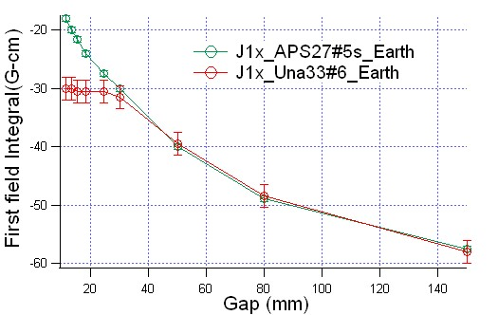
The Horizontal Earth Field Comparison (different devices)
Green curve: 27-mm period, magnetic frame; red: 33-mm period, non-magnetic frame.

Slide 7
Discussion
Frame effect on the horizontal Earth field propagation is very small (slide 6).
Difference between measured and calculated data (slide 5) most probably can be explained by existence of additional magnetic material, which is not included in the simulations.
Horizontal Earth magnetic field integral measured without device was used for simulations (J1_{x}=-63 G-cm).

Slide 8
Vertical Earth Field Propagation

Slide 9
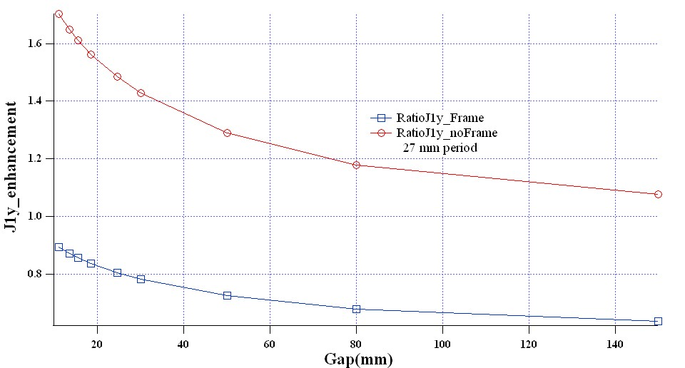
Vertical Earth Field Enhancement
Difference J1_{y}: normal-rotated orientation
Difference normal-rotated

Slide 10
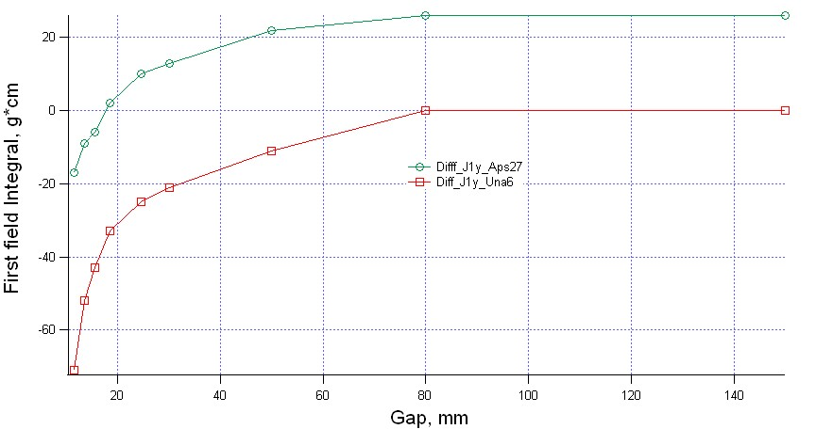
Measurements: Difference J1y Normal-Rotated

Slide 11
Discussion
J_{ye} for non-magnetic frame device is enhanced by the poles of the ID. In the case of the device with a magnetic frame, which works as a shield, this effect is compensated, and we see decreasing J_{ye} (slide 9).
Strong difference between total vertical field integral (J1_{y}) for normal and rotated device most probably can be explained by existence of magnetic material like slides, supports, etc. that affect the symmetry of the device in the X-direction (slide 12).

Slide 12
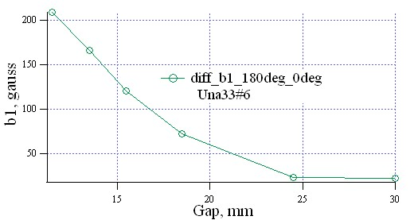
The Earth Field Contribution to the Multipoles
Difference of quadrupole component between rotated and non-rotated devices. Non-rotated device quadrupole component is compensated and has b1<50 Gauss for all gaps.

Slide 13
Vertical Earth Field Propagation with Magnetic Frame 2.7-cm period Device

Slide 14
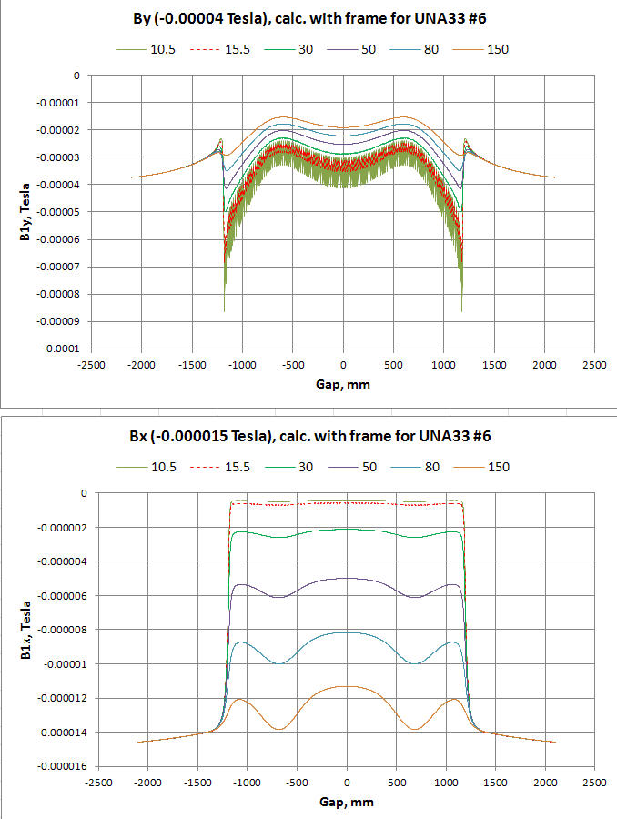
Horizontal and Vertical Earth Field Propagation with Frame 3.3-cm period Device

Slide 15
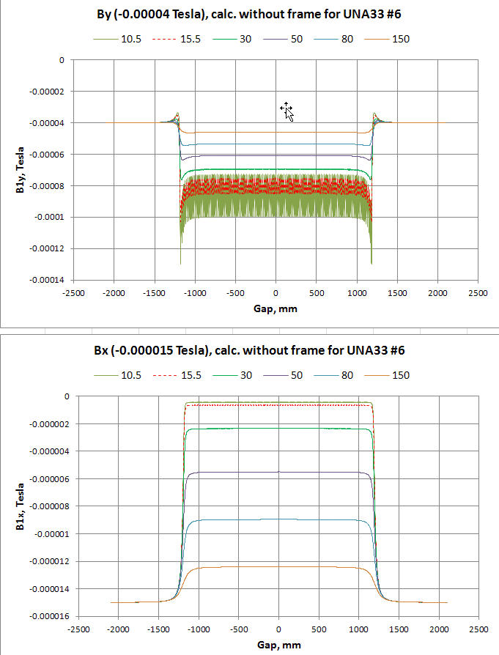
Horizontal and Vertical Earth Field Propagation-no Magnetic Frame

Slide 16
Conclusion
Propagation of the Earth field depends strongly on the gap.
Even at a gap of 150 mm shielding of the horizontal Earth field by a magnetic structure can be seen.
Calculation and measurements of this effect were performed; some minor differences in the results of measurements and simulations can be explained by limitations of the simulation procedure.
Orientation of the device in a storage ring affects the field integrals. The change is as much as 55 G-cm for J1_{x} at open gap, 30 G-cm for closed gap, and 70 G-cm for J1_{y} at closed gap due to the Earth field contribution. As a result, the tuning at MM1 remains valid only for devices with the same orientation at the SR, and is different (up to 55 G-cm for J1_{x} and 70 G-cm for J1_{y}) for other orientations. Multipole components of field integrals are affected as well, especially for the vertical direction.

Slide 17
References
[1]. S. Sasaki, I. Vasserman, “Modeling of the effect of the Earth field and an iron plate on the LCLS undulator trajectory,” Proceedings of the 27th International Laser Conference, 21-26 August 2005, Stanford, CA, USA.

