Slide 1
A 100-ppm Cryogenic DC Current Transformer for 100-kA Superconducting Cable Testing
Pasquale Arpaia,^{1,2} Amalia Ballarino,²
Luca Bottura,² and Giuseppe Montenero^{1,2}
06.06.2013
¹University of Sannio, IT
²CERN, Technology Department, CH
1

Slide 2
OUTLINE
CONTEXT
DCCT: Principle of Operation
STATE OF THE ART
REQUIREMENTS
PROPOSED SOLUTIONS
  Sensing Element
  Superconducting Shield
RESULTS
CONCLUSIONS

Slide 3
CONTEXT
Unisannio Team at CERN (Yesterday)
    Operating RD since 2005
    4 Research Projects with Magnetic Measurements
      Fast Digital Integrator (FDI): 8/2005 - now
      Flexible Framework for Magnetic Measurements: 12/2006 - 4/2008
      Integrating/experimenting FAME Platform: 5/2008 - 5/2010
      New measurement techniques (wires, FMR, DCCT): 6/2008 - now
Results
    1 license to Metrolab for FDIv.3
    About 30 FDIv.3 at CERN + 2 new FDIv.5 (further 6 in pre-series)
    Software framework FFMM in use at CERN
    56 scientific papers (19 Journals, 37 Conferences)
    Completed 10 MD thesis, 8 PhD thesis
    Total 26 students (15 PhD, 12 MD, 5 Stagers)+ 10 professionals

Slide 4
CONTEXT
Unisannio Team at CERN
  Now: Ongoing RD Projects
      Superconducting Devices: cryogenic DCCT, controller for SC trasfo
      Power Supply Metrology: +10-ppm repeatability pulse instrument
      Cryogeny Control: smart machine for Active Magnetic Bearings
      Magnetic Meas.: field mapper, pulsed magnets, and axial magnets
    Tomorrow: Unisannio Team on IM for Particle Accelerators
  New RD Projects
    CERN: PACMAN (PCB coil, wires)
    Contacts to be formalized with UA9, ATLAS, and UniGeneva
  CH spin-off company (instrumentation technologies for security)
  Idea for a Joined IMEKO/IEEE Scientific Working Group on Instrumentation and Measurement for Particle Accelerators:
    Please, join as a founding member!

Slide 5
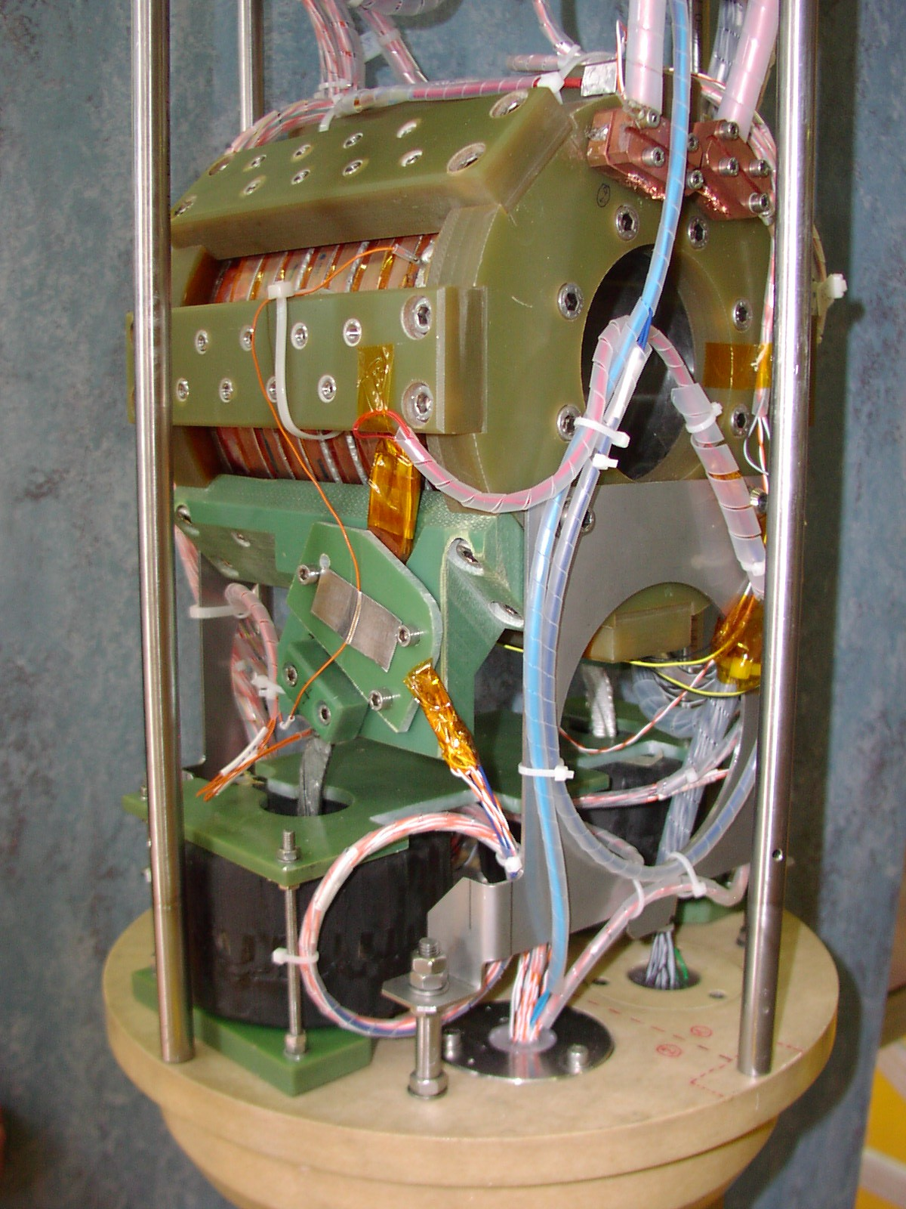
CONTEXT
Facility for Research on Superconducting Cables (FReSCa)
    Testing temperatures from 1.9 to 4.5 K
    Background field up to 10.3 T
Cable testing using superconducting
transformers
  Secondary current I_{2max} of 32 kA
  (70 kA Dec. 2013,
  installed by Unisannio)
Superconducting Transformer Insert

Slide 6
CONTEXT
Secondary Current: Measurement System
    Rogowski Coils
    Fast Digital Integrator
Drawbacks
  Relative measurements
    Need for knowledge of starting current
      Reset secondary current after each run
  Drift limits integration accuracy for long runs
Superconducting Transformer Insert

Slide 7
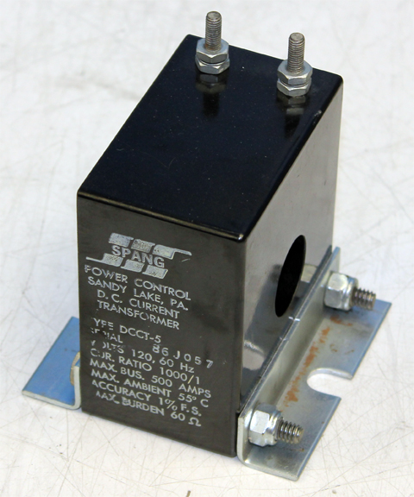
CONTEXT
Market obvious solution
    DC Current Transformer (DCCT)
    Better stability
    Better resolution
    Absolute measurements
But not available for cryogenic applications

Slide 8
DC CURRENT TRANSFORMER
Principle of Operation
DC Current Transformer combines [Appelo, 1977]:
      Compensated transformer
      Magnetic modulator
H. C. Appelo, “The Zero-Flux DC Current Transformer A High Precision Bipolar Wide-Band Measuring Device”, IEEE Trans. Nuc. Scien., 24 (3), 1977.

Slide 9
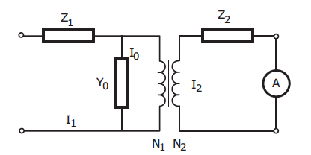


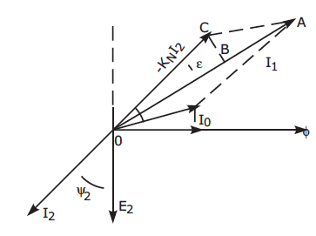
DC CURRENT TRANSFORMER
Current transformer principle
Magnetization current I₀
intrinsic error source

Slide 10


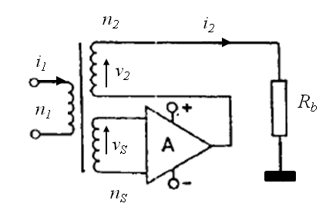
DC CURRENT TRANSFORMER
Compensated transformer
Principle
  Sensing coil (n_{s})
  Voltage-controlled current amplifier: A→ [A][V⁻¹]
Zero-Flux condition → I₀ = 0
  Ideally A=∞ → i₂=-(n₁/n₂)i₁
In practice
  Decreasing error due to magnetizing current
  Extending low bandwidth limit
1)
2)
NEEDED SOMETHING ELSE FOR DC MEASUREMENT
TE-MSC-MM

Slide 11
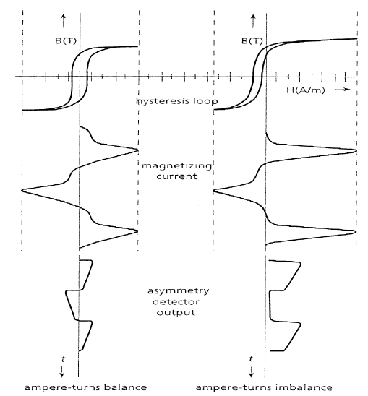
DC CURRENT TRANSFORMER
Magnetic Modulator
Magnetic Modulator for DC detection
  Two twins ferromagnetic cores
    Excited in AC phase opposition
    Driven in saturation
Operation
  I₁=0 → i_{d1} and i_{d2} symmetric
  I₁≠ 0 → i_{d1} and i_{d2} loss of symmetry
i₁
I₁
Asymmetric Condition
Symmetric Condition
n₁
n_{d}
n_{d}
i_{1d}
i_{2d}
i_{d1}
i_{d2}
v_{in}

Slide 12
Requirements for a Cryogenic DCCT
Maximum rated current: 100 kA
Accuracy: 100 ppm
Temperature: from 4.3 down to 1.9 K
Bandwidth: 10 kHz
Maximum background field: 1 T
Measuring head volume: 1400 cm³
Pressure from 1.0 bar down to 1.6 mbar

Slide 13
STATE OF THE ART
CEA-Saclay laboratory [Berriaud, 2002]
  Based on a commercial DCCT (MACC+ 600 A by Hitec)
Achievements
  Maximum measured current 50 kA
  Background field 0.5 T
C. Berriaud and A. Donati, “ A Device fo Measuring High Current at Cryogenic Temperatures”, IEEE Trans. Appl. Superc. 12 (1), 2002.

Slide 14
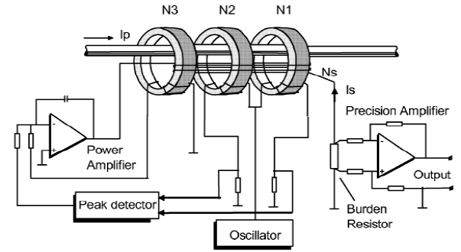
CEA-Saclay Approach
Basic Idea: Exploit MACC+ Sensing Element but cooled at 4.2 K
Initial problems
  μ- metal magnetic cores
    Loss in magnetic performance
    Saturation of the cores
  Low compensation for 100-kA rated current
MACC+ Architecture
DCCT Sensing Element
Design solutions
  Magnetic Modulator: increased magnetization current for N₂ and N₃
  FeSi shell for off-centering and shielding 0.5 T background field
  New power stage for higher compensation current
  Increased N_{s} for transformer secondary (10,000 turns of superconducting wire)

Slide 15
CEA’s approach drawbacks
  Loss in precision (more than 50 %) due to increased losses
  Saturation for a background field of 0.5 T, owing to geometrical cores’ constraint
  Efficiency of DC compensation decreased by a factor 4
  Decreased dynamic (and bandwidth)
    Fe-Si shell (too bulky), combined with 10,000 compensation coil windings, leads to high inductance in feedback loop
  Overall output noise increased (power amplifier, 5 transistors in parallel)

Slide 16
PROPOSED SOLUTIONS
Follow the footprints left by Saclay
But overcoming drawbacks:
  Magnetic material losses: Use a permalloy for cryogenic application
  Saturation:
    Re-design cores for rated current of 100 kA
    Superconducting shield for 1 T of background field
  Dynamic performance and noise level
    8,000 turns for the compensation coil with reduced section
    20-A power amplifier with design equivalent to MACC+

Slide 17
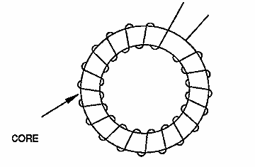
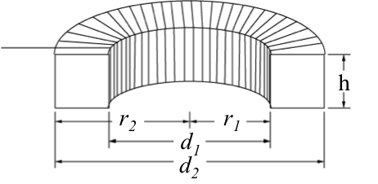
SENSING ELEMENT
Design Basic Ideas
V
I
1
2
r₂
r₁
N
µ
  CryoPhy core material with µ @ 4.2 K comparable with µ-metal cores @ 300 K
  h*ln(r₂/r₁) geometric term as for Berriaud cores, but suitable for rated 100 kA

Slide 18
SENSING ELEMENT
  “CryoPhy”: Cryogenic Permalloy Ni81 Fe Mo5 [Aperam, 2013]
  working at 4.2 K as μ-metal at 300 K
“Nickel Iron and Cobalt Iron Cold Rolled Strips”, http://www.aperam.com/alloysandspecialities/fileadmin-/pdf/Aperam/Brochure/cold_rolled_strip_web.pdf overview available since 13/02/2013.

Slide 19
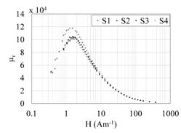
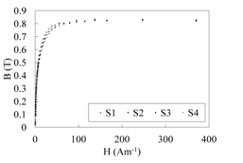
SENSING ELEMENT
CryoPhy experimental characterization
  Magnetic properties of CryoPhy @ 4.2 K
    DC magnetic permeability measurements (4 samples, S_{i})
  Hysteresis loop measurements
CryoPhy @ 4.2 K
µ-metal @ 4.2 K

Slide 20
SENSING ELEMENT
Conceptual Design
  2D Electromagnetic Simulations
    Identify optimal field region generated by cable under test
      To design cores dimensions by avoiding saturation
    Simulation with compensation coil
      To validate the design
    Verify pure-iron shell effect for off-centering sensitivity

Slide 21
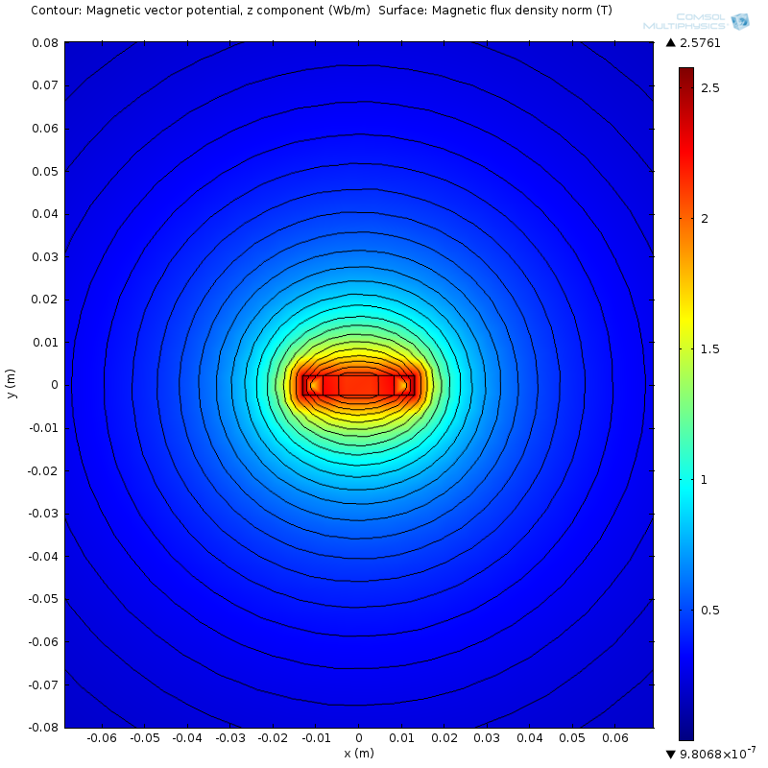
SENSING ELEMENT
Optimal Field Region
  Identification of optimal field region generated by cable under test
    Worst-case cable 26.26 mm x 4.60 mm, 100 kA
y
x

Slide 22
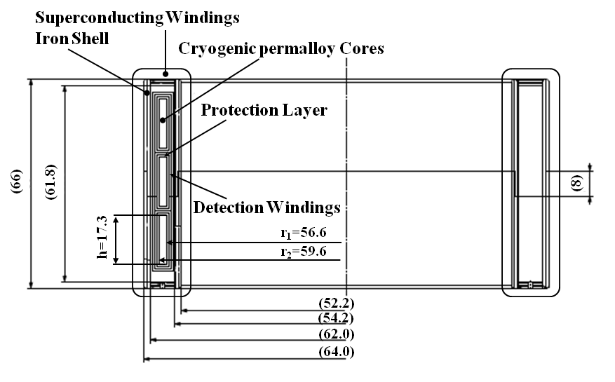
SENSING ELEMENT
Physical Design
  Optimization of the available space
    h*ln(r₂/r₁) = 0.893 mm (as for the MACC+)
    N_{s}=8000 for
    compensation
    Shell of pure iron
    “ARMCO” (2-mm
    thick) to keep as low
    as possible inductance
    for compensation

Slide 23
SUPERCONDUCTING SHIELD
Basic Ideas
  Shell of pure iron works up to 0.3 T
  Superconducting cylinder
    extending shield efficiency up to 1.0 T
  Shield design for 70 % efficiency at 1.0 T

Slide 24
SUPERCONDUCTING SHIELD
Material
  MgB₂ (magnesium diborid) composite [Rabbers, 2010]
    High critical current at 4.2 K (J_{c} ≈ 100 kAcm⁻² )
    Low-cost shield realization
    Better mechanical resistance
J. J. Rabbers, M. P. Oomen, E. Bassani, G. Ripamonti, and G. Giunchi, “Magnetic shielding capability of MgB2 cylinders”, Supercond. Sci. Technol. 23, 2010.

Slide 25
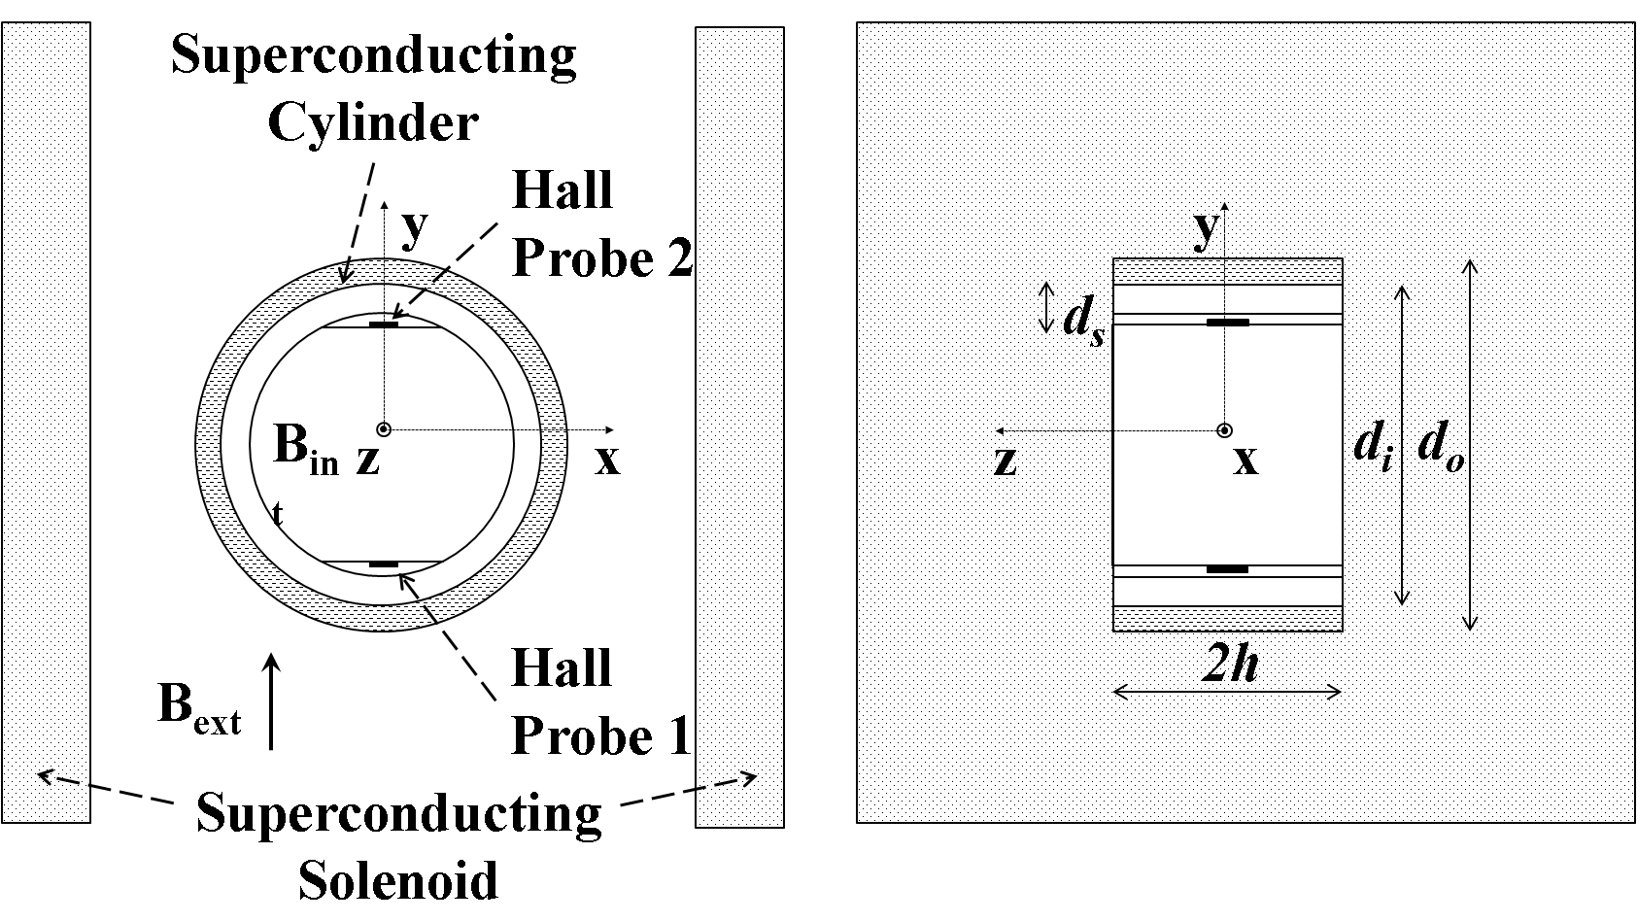
SUPERCONDUCTING SHIELD
Material Characterization
MgB₂ sample cylinder
(d_{i}=56 mm; d_{o}=65 mm; h=40 mm)
Longitudinal shield assessment not required (~100 % Efficiency)
Transversal field configuration
  should show low efficiency
Set up with 2 Hall probes
Measurements setup

Slide 26
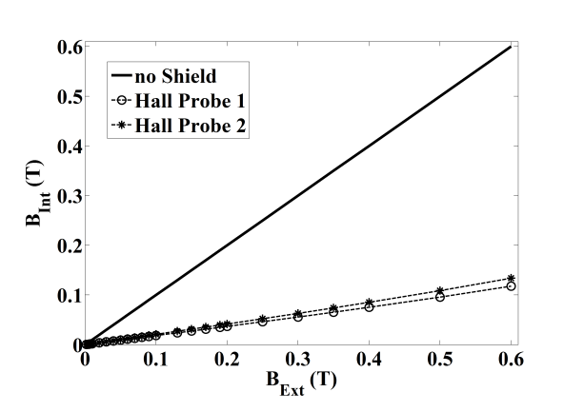
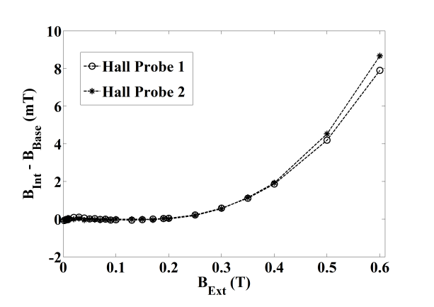
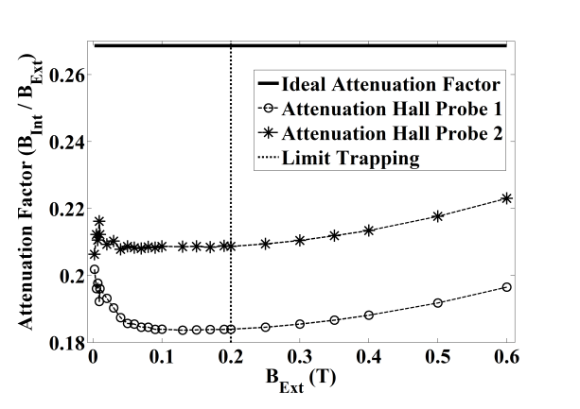
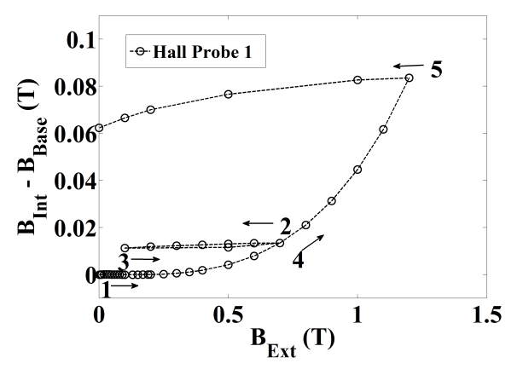
SUPERCONDUCTING SHIELD
Sample Characterization
  Transversal field B_{Ext} from 0.0 to 1.2 T
  Efficiency:
  80% up to 0.2 T
    Efficiency:
    72% at 1.0 T

Slide 27
SUPERCONDUCTING SHIELD
Conceptual Design
  Requirements for dimension
    d_{i}=140 mm d_{o}=152 mm h=76.4 mm
  Design based on experimental data
    Longitudinal design → height identification
      Solenoid Model [1-3]
    Transversal design → refinement if required
      Current-loop model [4]
[1] J. J. Rabbers, M. P. Oomen, E. Bassani, G. Ripamonti, and G. Giunchi, “Magnetic shielding capability of MgB2 cylinders”, Supercond. Sci. Technol. 23, 125003 (2010).
[2] Y. Iwasa, Case Studies in Superconducting Magnets, (Springer Science, NY, 2009) p. 71-218.
[3] M. Wilson, Superconducting Magnets, (Oxford University Press, Oxford, 1987) p. 35-40.
[4] D. J. Frankel, “Model for Flux Trapping and Shielding by Tubular Superconducting Samples in Transverse Fields”, IEEE Trans. Mag. 5, 1349 (1979).

Slide 28
NUMERICAL RESULTS
Intrinsic error of sensing element
  Centered cable 100 kA
  current ratio of 8000:1→12.5 A
    for compensation
  Cores maximum field 0.017 T
    Residual field of ~ 0.3 Am⁻¹
    Required compensation current 13.3 µA (residual current thus intrinsic error)
  Intrinsic accuracy of about 1 ppm

Slide 29
NUMERICAL RESULTS
Sensitivity analysis to cable off-centering
  Cable off-centering 2 mm (x and y directions)
  Maximum field inside cores 0.25 T:
  Intrinsic accuracy of 10⁻⁵
  Operational margin
  for off-centering
  0.4 T

Slide 30
NUMERICAL RESULTS
Superconducting Shield
  Longitudinal Design
    For J_{c}=100 kAcm⁻², shielding current penetration: 1.2 mm
    Max allowable cylinder height: 120 mm [Rabbers, 2010]
      longitudinal efficiency ≥ 80 % upon the iron shell region
  Transversal Design
    Required shield current J_{c}=47 kAcm⁻² for 70 % efficiency
    Shield uniformity upon the cores 90 %

Slide 31
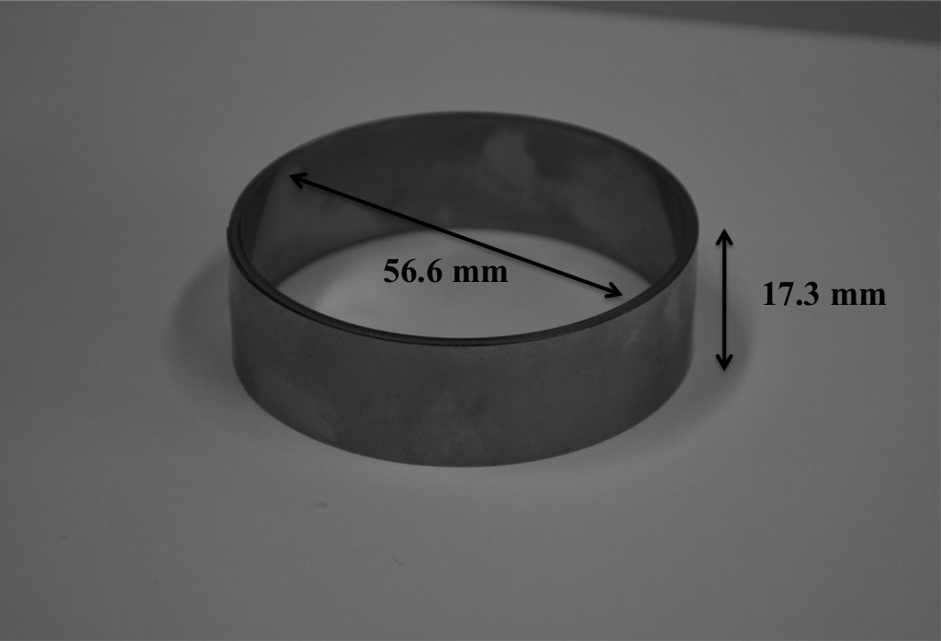
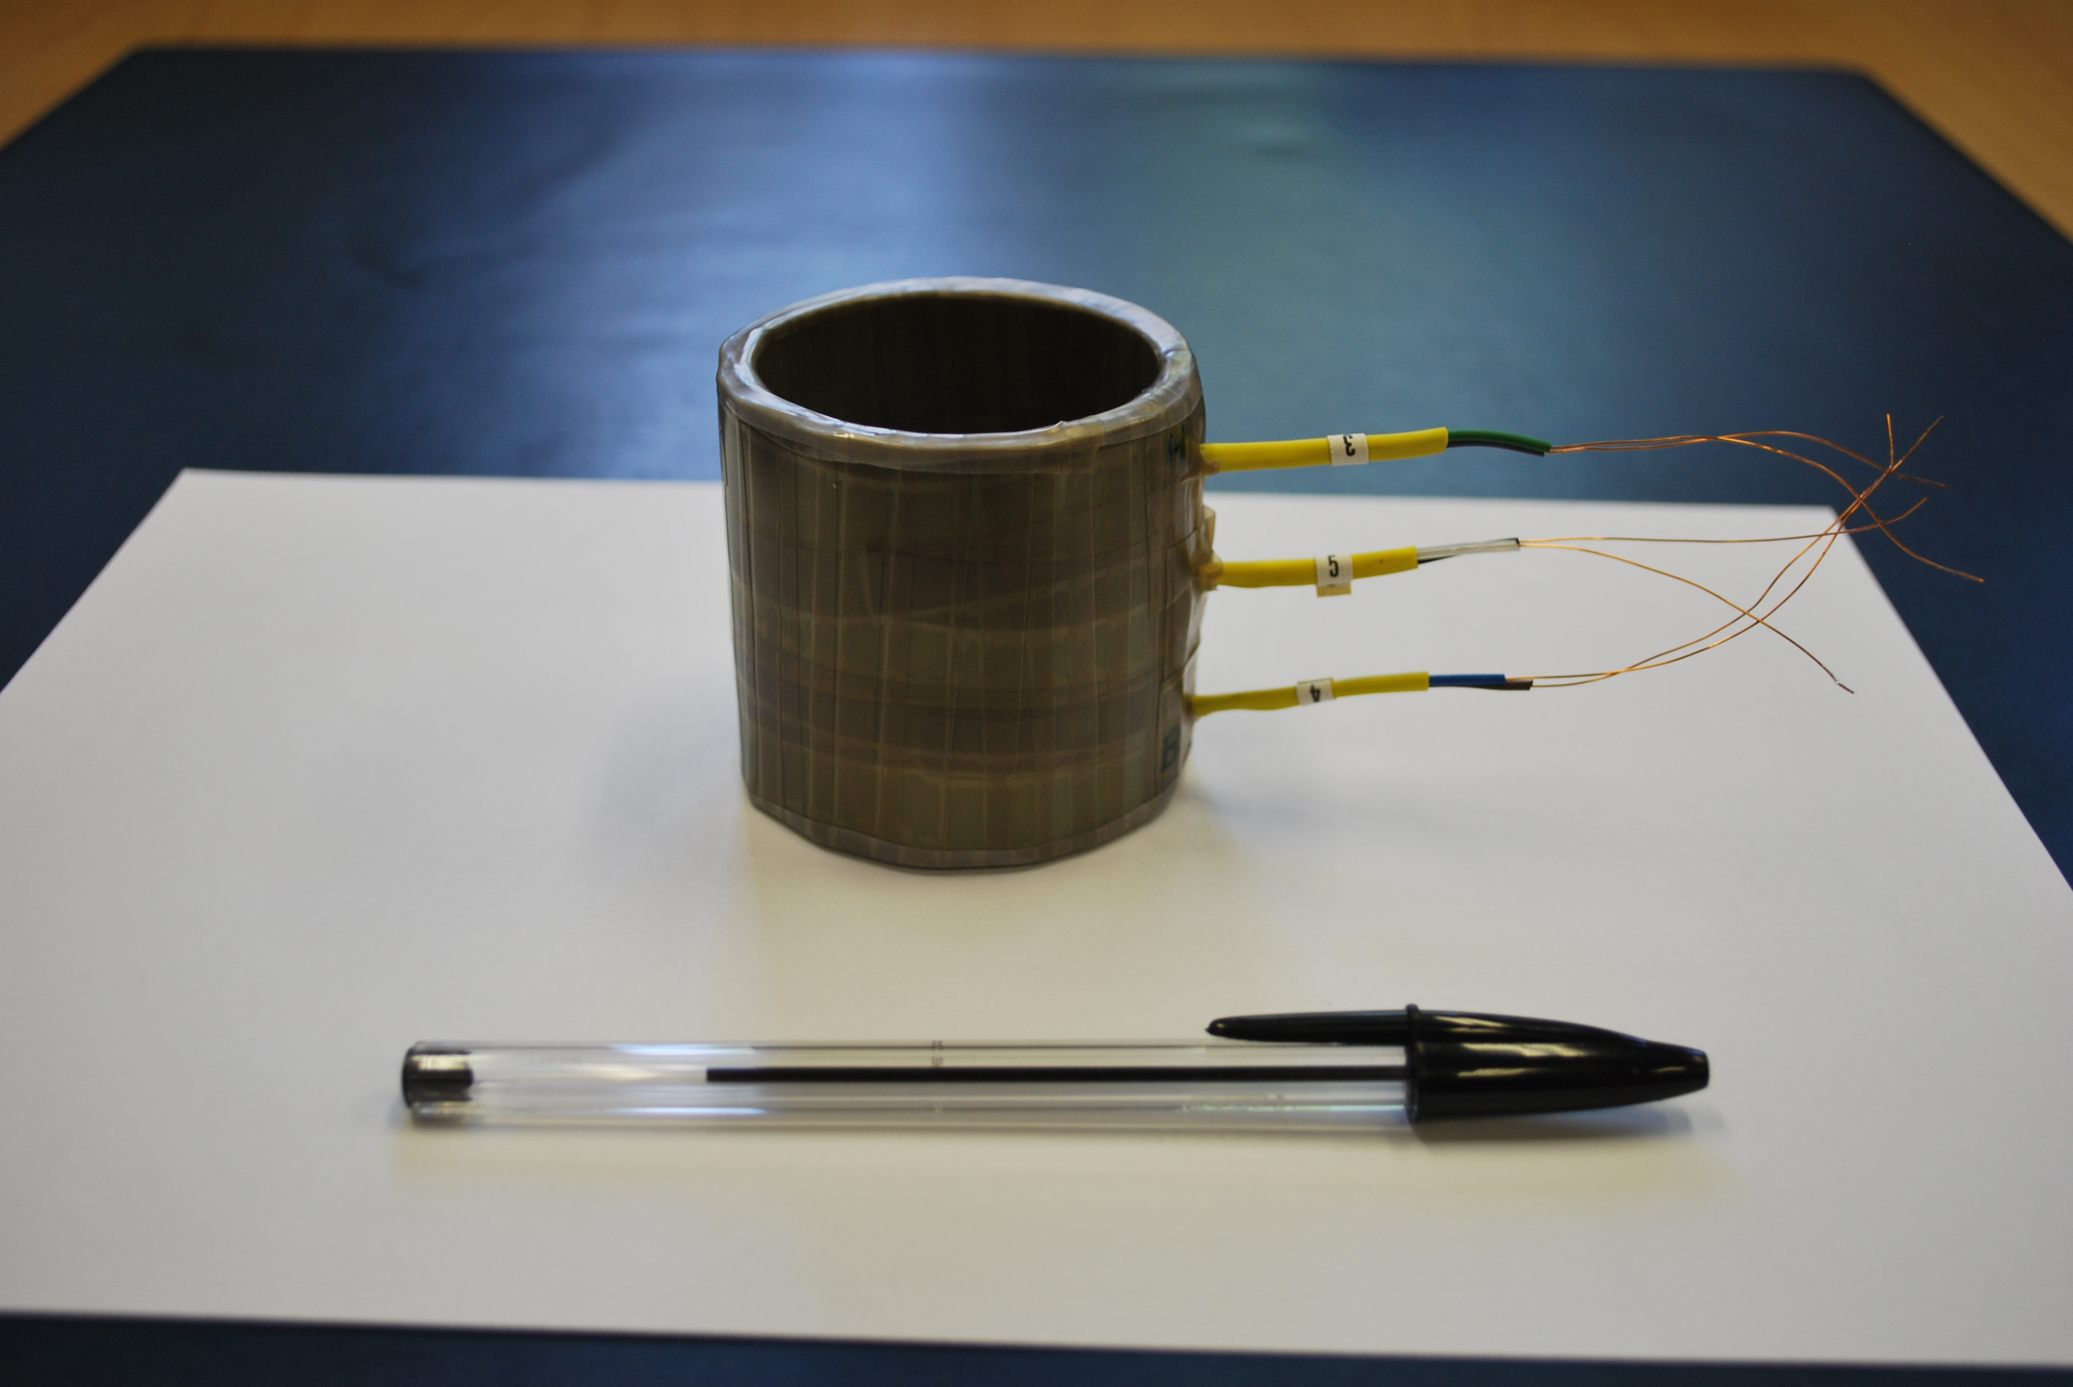
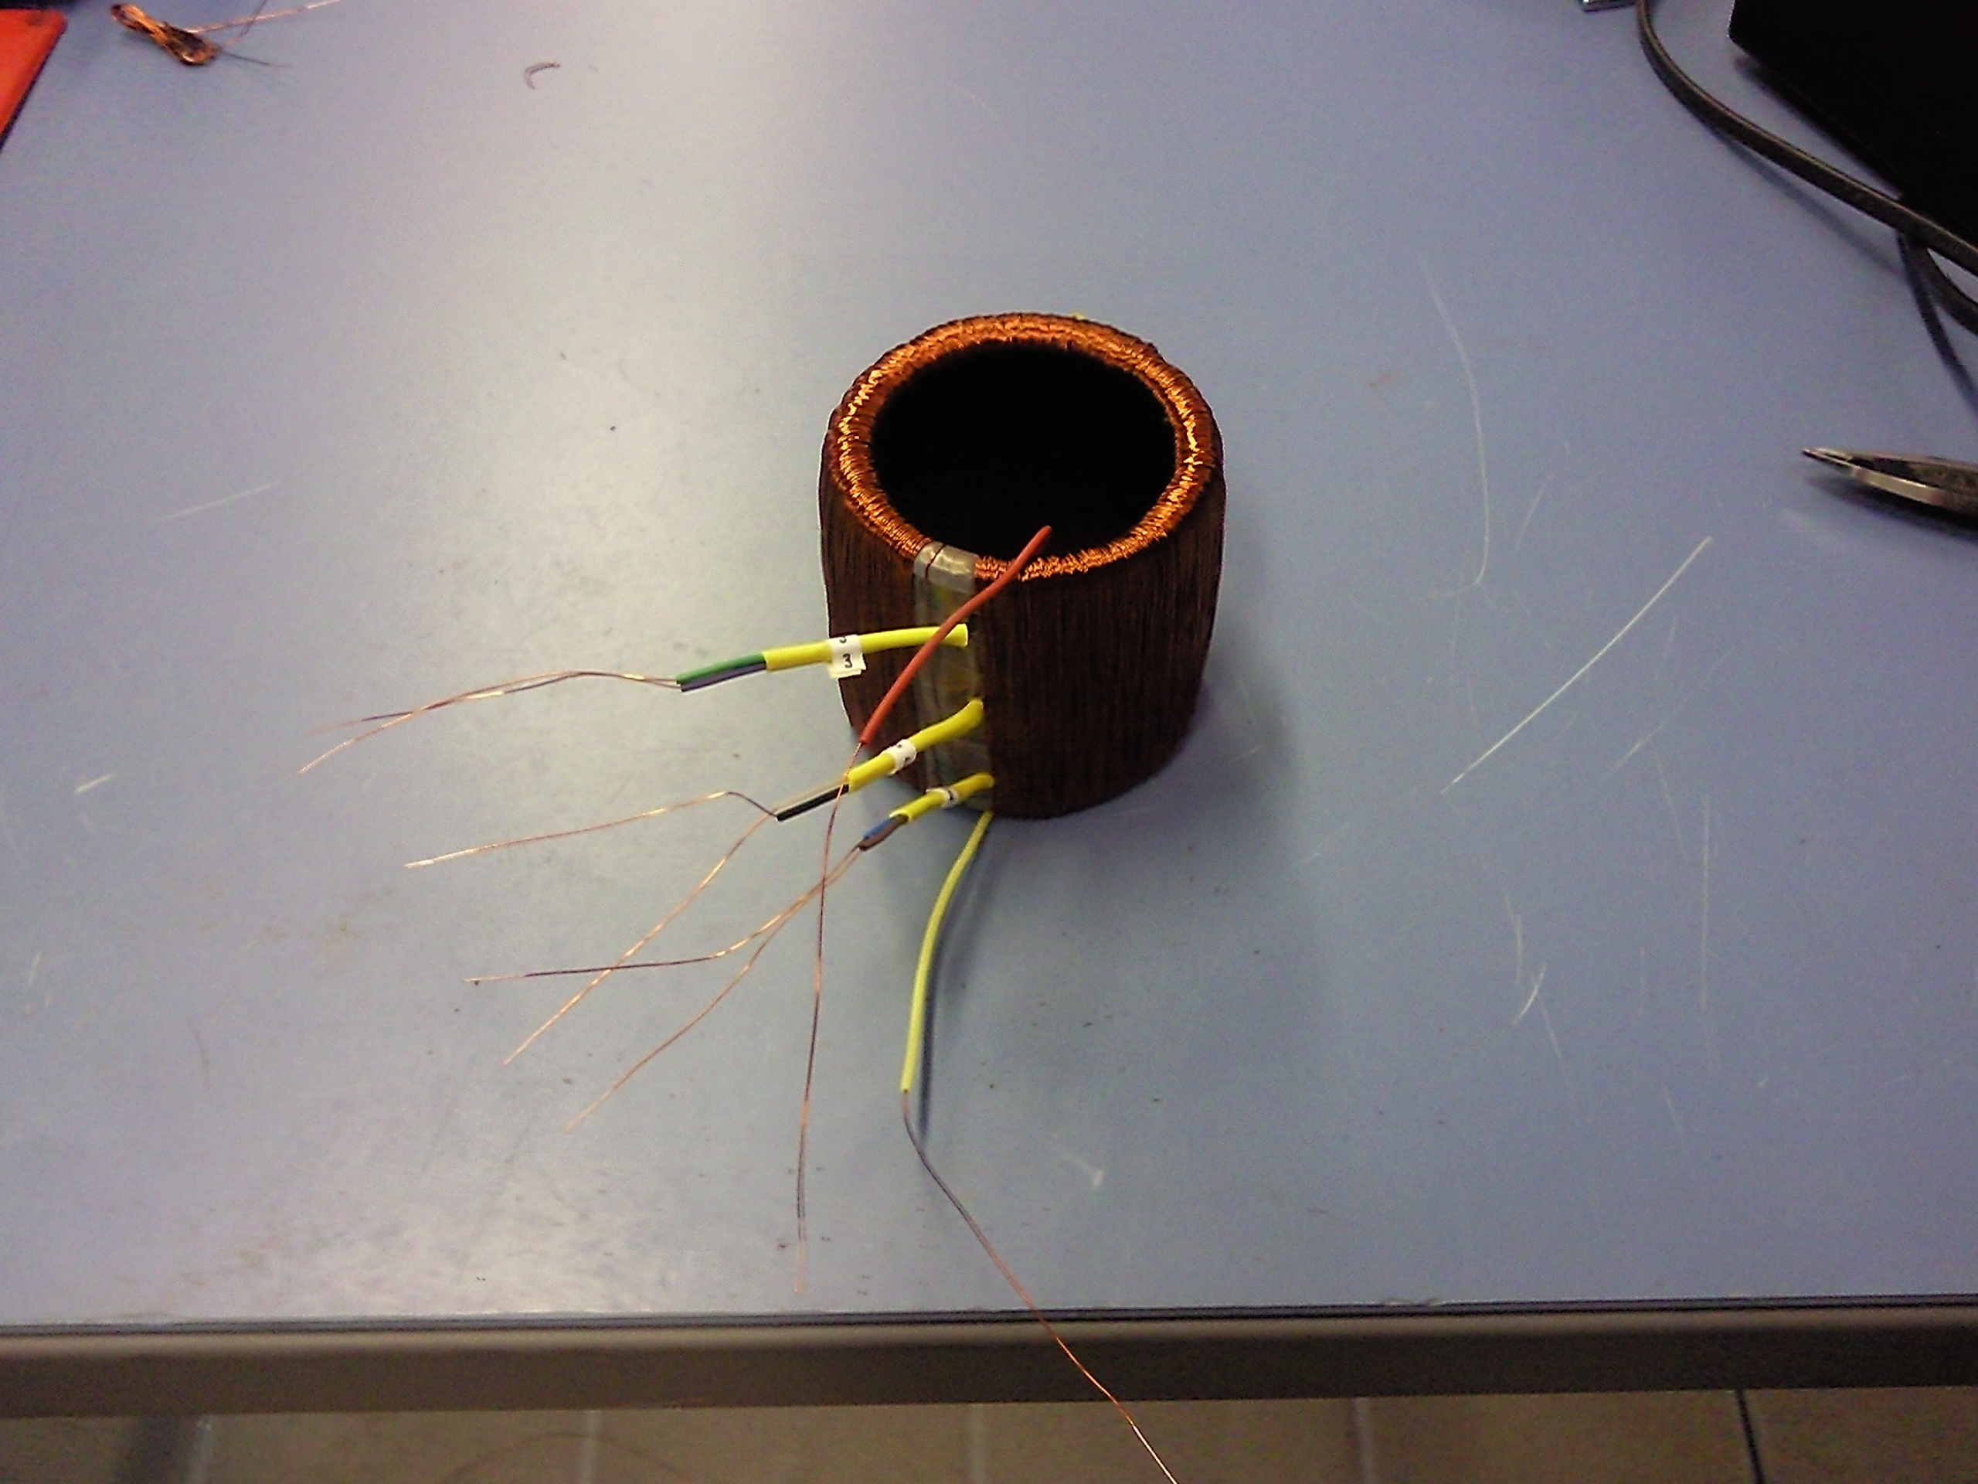
PROOF DEMONSTRATOR
Prototype
  Cores
    N₂ 2000 (Cu cable), N₁ 1000
  Target
    Primary equivalent max current 20 kAt (20 A×1000 turns)
    Max compensating current 10 A

Slide 32
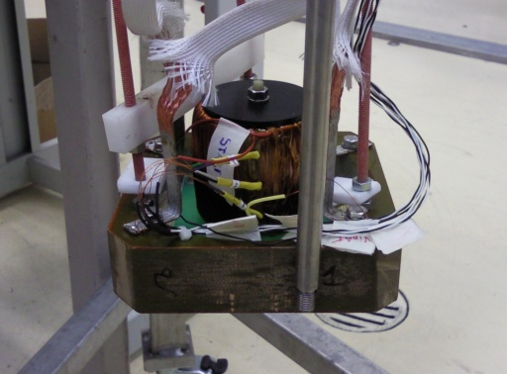
PROOF DEMONSTRATOR
Preliminary results
  Experimental Setup
  Sensing element with primary in a cryostat at 4.2 K
  Power Supply: SM 7020-D DELTA ELEKTRONIKA
  Burden resistor: 50 mΩ
  Instrumentation amplifier gain: 16
  Reference MACC+: ±10 V, ±120 A
  Current Cycle Primary
  Ramp up current at several plateaus
  Max reached current 17 A (17kAt)
CryoDCCT sensing element

Slide 33
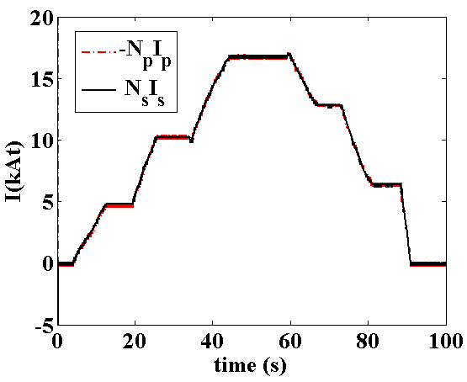
PROOF DEMONSTRATOR
Preliminary results
  Current Cycle Primary
  Ramp up current at several plateaus
  Max reached current 17 A (17kAt)
-I_{p}/I_{s} → 2000

Slide 34
CONCLUSIONS
    A DCCT of nominal current of 100 kA, 4.2 K, background field of 1 T, and performance comparable to the room temperature was designed
    Cryogenic permalloy CryoPhy for cores implementation
    Shield of MgB2 for improving costs and engineering
    Shielding efficiency improved combining ferromagnetic and superconducting shield
    Design validated both in simulation and by a proof demonstrator

Slide 35
FUTURE WORK
    Ongoing electronics debug
    Experimental characterization of the proof demonstrator
    Realization and test of the final 100-kA prototype

Slide 36

THANK YOU
FOR YOUR ATTENTION!

