Slide 1
Long Term Monitoring of the LCLS-I Undulators
Yurii Levashov for SLAC MMF group
IMMW 18, BNL, June 3-7 2013

Slide 2
Outline
  LCLS -1 undulators
  Long-term magnetic measurements:
  Temperature control
  Hall probe calibration
  Reference magnet
  Reference undulator
  Results:
  Accumulated radiation dose
  Undulator re-measurement results

Slide 3
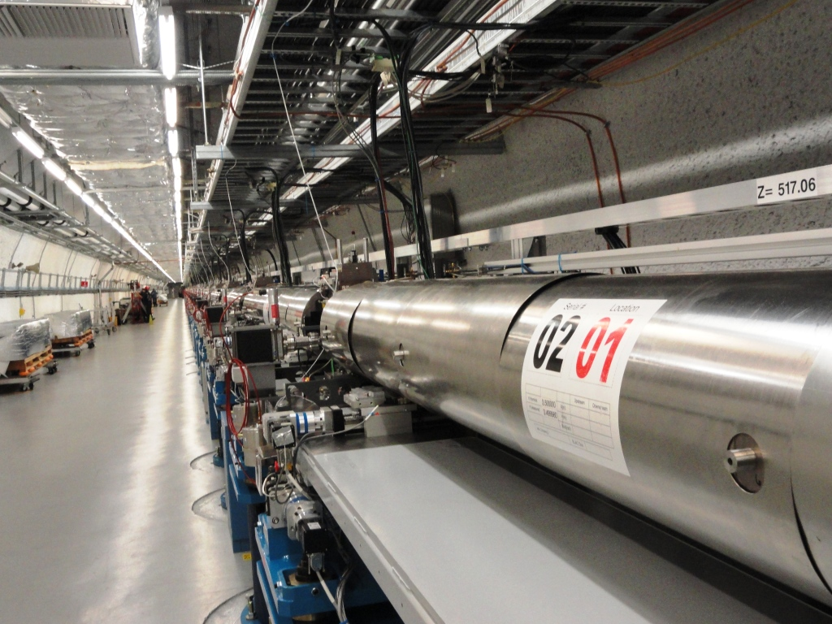

LCLS-1 Undulator Hall
LCLS – 1 operated since April 2009.
Number of photons > 10¹² , Energy range 0.7keV ÷ 11.9 keV.
Undulator segments:
Fixed gap, hybrid
1.Undulator line tapered, 1%
Each segment tuned for
a specific position with
accuracy of 10⁻⁴ (1μm gap).
2.Canted poles, 4.5mrad
Installed - 33
Spare - 6
Reference - 1
Total - 40
Tuning time ~ 1.5 years.
Location
S/N
Spare
undulators

Slide 4
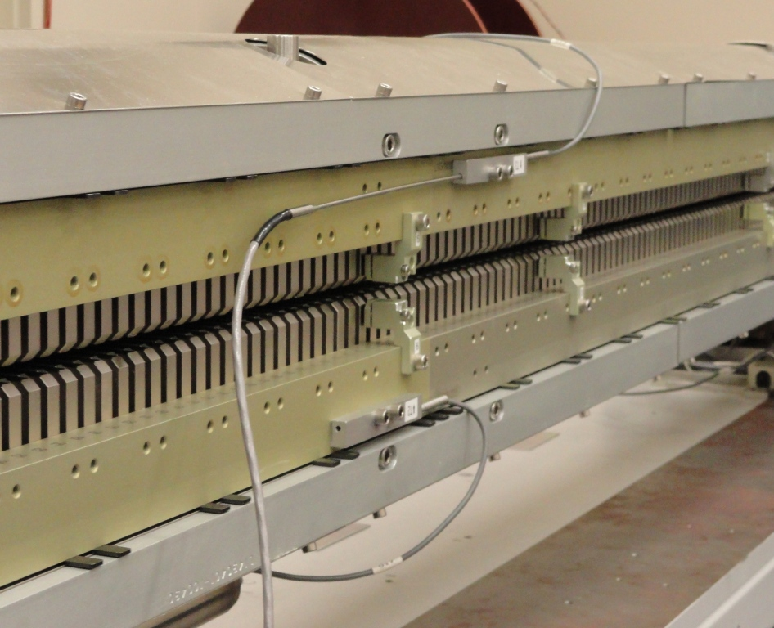
Temperature measurements
Temperature compensation built in the undulator design. Temperature K dependence measured – 0.00043/°C.
Temperature variations limited to ±2°C due to possible undulator damage. In the tunnel – 0.5 °C temperature
difference, end to end. Temperature corrections applied.
Tuned at constant room temperature 20±0.1°C.
5 RTD attached to the face, distributed along the undulator.
RTD calibration checked with reference probe.
Reference temperature probe,
(Hart Scientific probe 1504, calibrated in ice bath )
4-wire RTD
(Therm-X)
Aluminum block

Slide 5
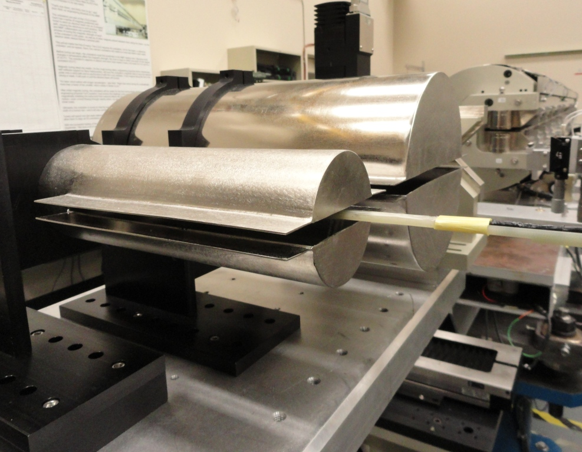
Hall probe measurements
Sentron XZM12, 5V/T, 2-D probe with HP3458A voltmeters.
Measurements at 8cm/sec, start and finish inside zero Gauss chambers, corrections for zero drift applied.
Triggering every 200μm, 2ms integration time.
The probe is re-calibrated periodically w.r.t. NMR in a calibration magnet.
Probe calibration checked in a reference magnet.

Slide 6
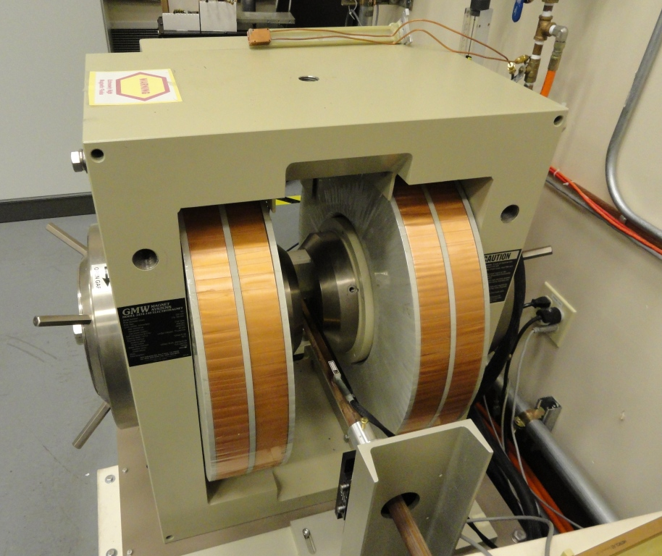
Hall probe calibration
Wide, 20 cm dia. poles
Copper HP cooling block.
Probe calibrated at
constant temperature 20 °C
NMR Probe
Metrolab PT2025 NMR probe (1 of 5)

Slide 7


Hall probe calibration, continue
Remove zero offset:
Fit polynomial of 10-th order:
Subtract linear part:
Calculate residuals:
Do calibration 2 times, compare,
take average.
Calibration accuracy – 0.2G.

Slide 8
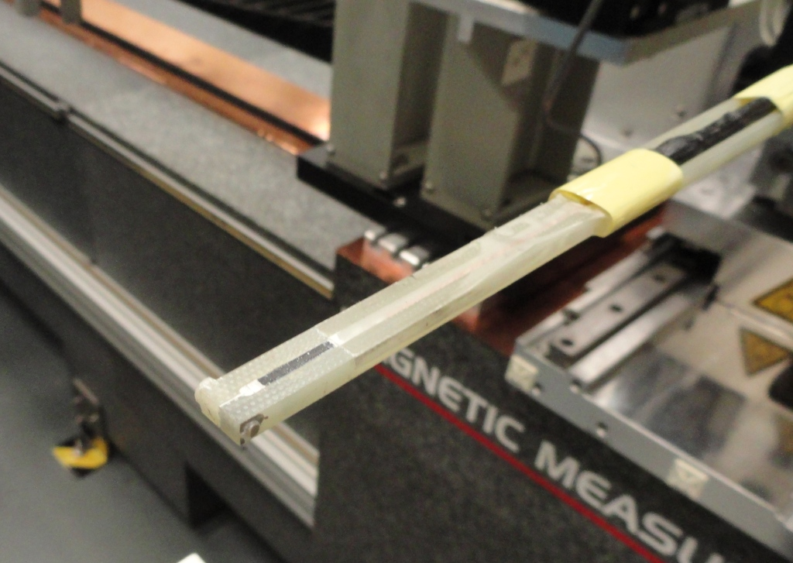
Hall probe gain drift
Probe clamped in, never removed from G-10 holder.
Plastic screw
Probe
G-10 holder

Slide 9
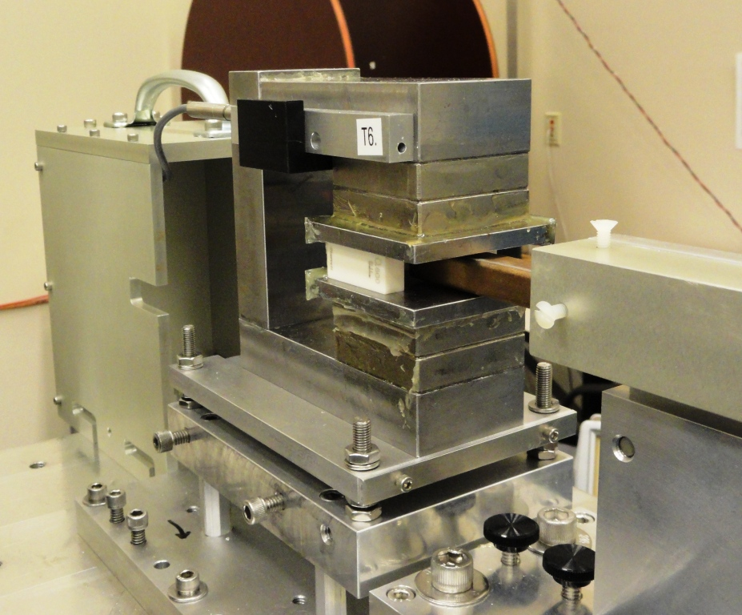
Reference magnet
Ceramic spacer
Temperature sensor
Iron yoke
PMs
Measured with every undulator:
1. Scan in Z, fit parabola, find maximum.
2. Scan in X, fit parabola, find maximum.
3. Scan in Y, fit parabola, find minimum.
4. Move into Zero-Gauss chamber,
measure and subtract probe zero offset.
5. Put NMR probe in, measure field.
6. Calculate difference Hall probe – NMR.
Y
Z
X
Iron poles
B = 0.36889T at 20°C
NMR probe

Slide 10
Reference magnet, continue
±0.5 G
Measured for every undulator, before final dataset is taken.

Slide 11
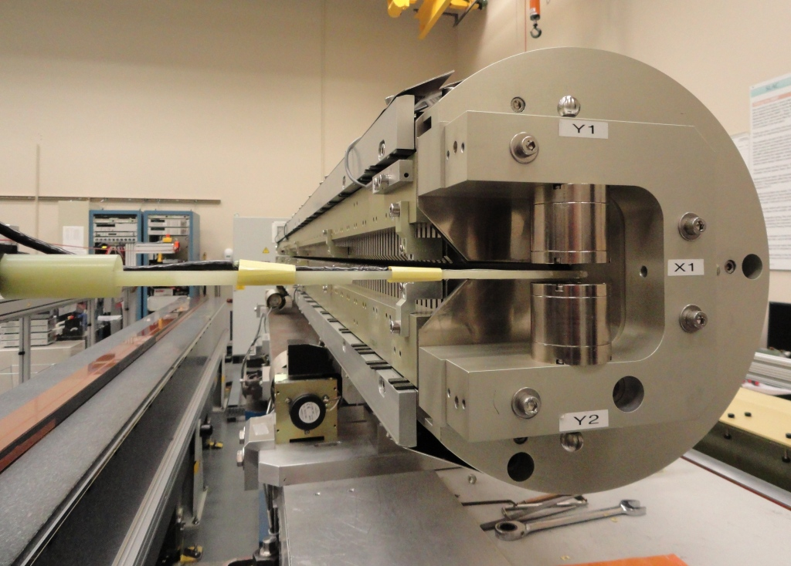
Fiducialization
Hall Probe
Tooling ball
Undulator tooling ball
PM tooling ball
Hall probe positioning accuracy 2μm in Y and 6μm in X.
PM calibration ±5μm.
CMM measurement ±5μm.
Fiducialization accuracy:
5μm in Y,
10μm in X.
PM center
MA
Fiducialization magnets.
2 assemblies attached to each end of the undulator. Distances from center to tooling balls are known from calibration.
Y.Levashov “LCLS Undulator Fiducialization.” Proc. IMMW14, Geneva, 2005

Slide 12
Reference undulator
A special undulator. Stays inside the Lab
Re-measured after 3 regular undulators and after Hall probe re-calibration.
Production run
Voltmeters re-calibrated
(∆K/K = 4.4⋅10⁻⁴)
Voltmeters are checked with Valhalla Scientific 2701C voltage standard.
* K is calculated at the same x position and corrected for temperature differences.

Slide 13
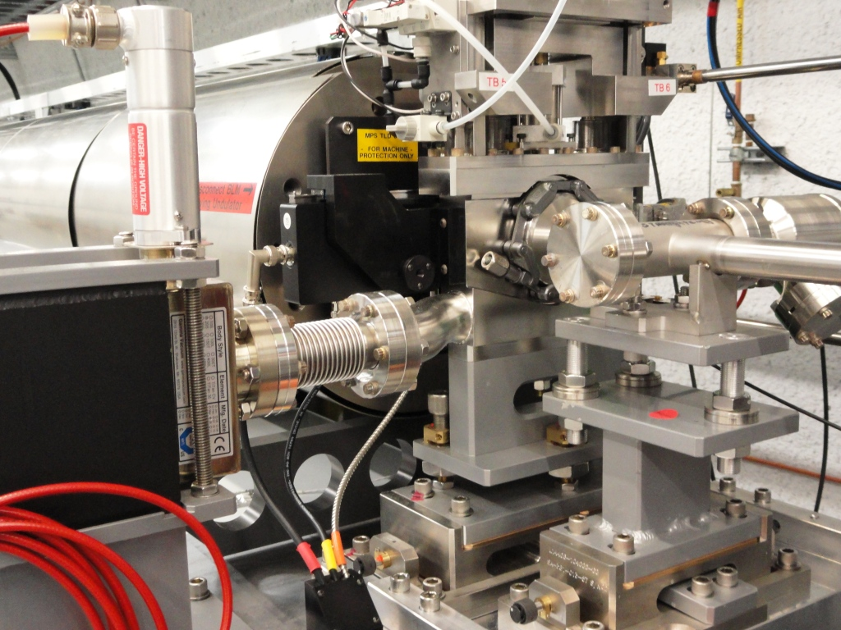
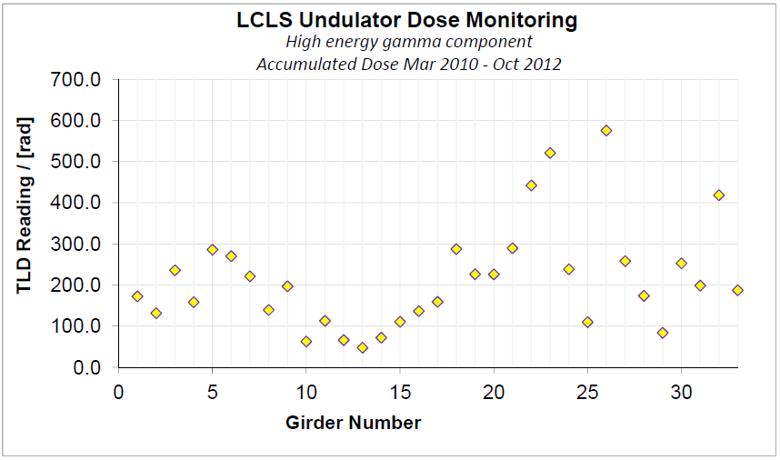
Measurement of Radiation dose
Each segment has TLD detector on
upstream end, close to the beam.
Detector readings - every 4 months.
TLD
Max. radiation dose ~ 5rad/week.
Expected detectable radiation
damage in ~20 years.
Courtesy of H-D Nuhn (nuhn@slac.stanford.edu)

Slide 14
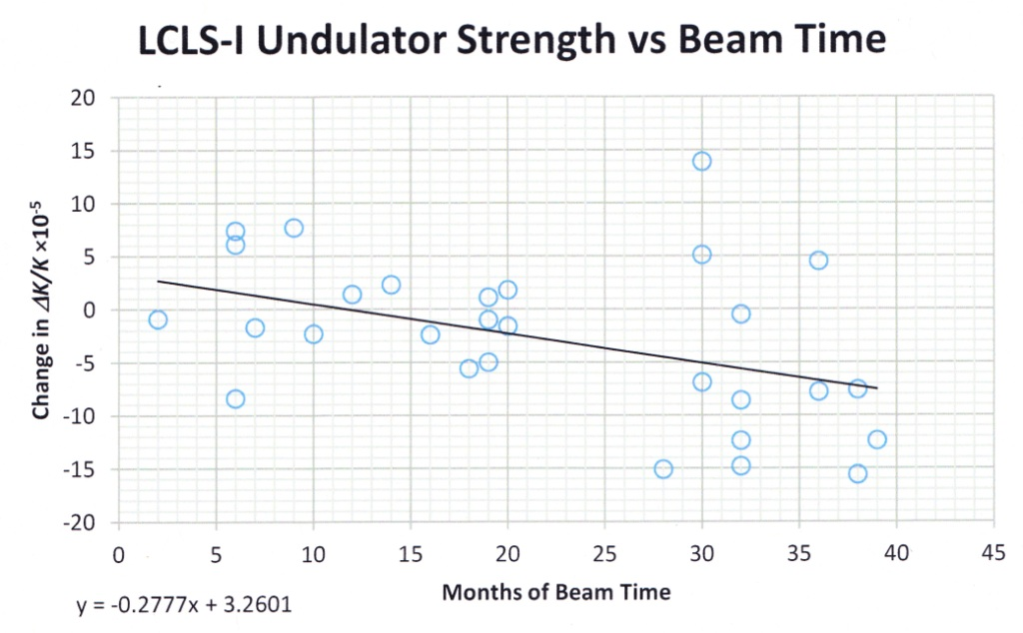
Change in undulator strength
50 times faster than predicted?!
Courtesy of H-D Nuhn (nuhn@slac.stanford.edu)

Slide 15
Results of magnetic measurements
Total 25 undulators re-measured

Slide 16
Summary
Long – term undulator monitoring program is in place for 4 years.
Had a problem with voltmeters. Have to apply correction to K measurements.
Accumulated radiation dose is small. Magnetic measurements show faster damage than predicted. Our measurement system is not as accurate as we thought. Error bars to be re-evaluated.
To early to report radiation damage.

Slide 17

Thank you.

