Slide 1
sPHENIX Project Calendar
Post PD-2/3 review documents May 14
PD-2/3 Review Practice May 15-16
Pre-review Phone call with Tom Cormier May 17
Special PMG May 20
Post talks May 21
DOE Monthly May 22
PD-2/3 Review (MIE only) May 28 (1:00 pm)-May 30

Slide 2
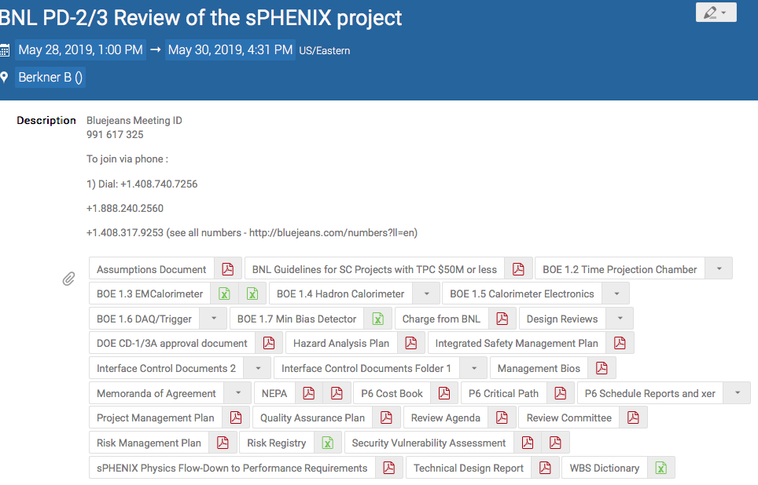
All Documents Posted – 70 Total
https://indico.bnl.gov/event/6145/

Slide 3
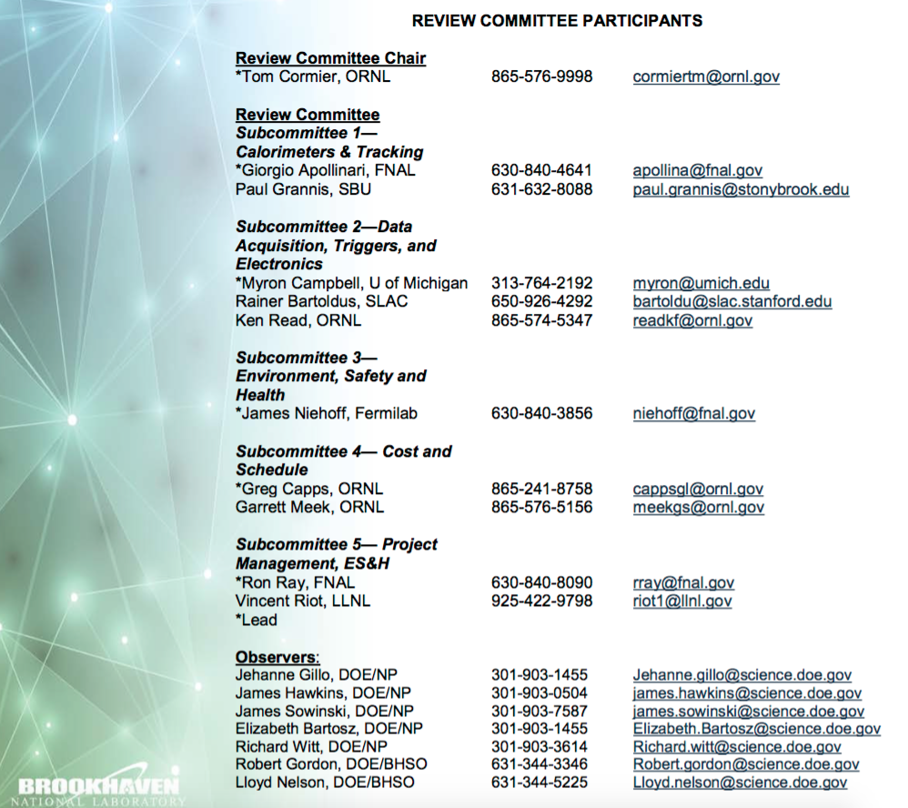
Review Committee

Slide 4
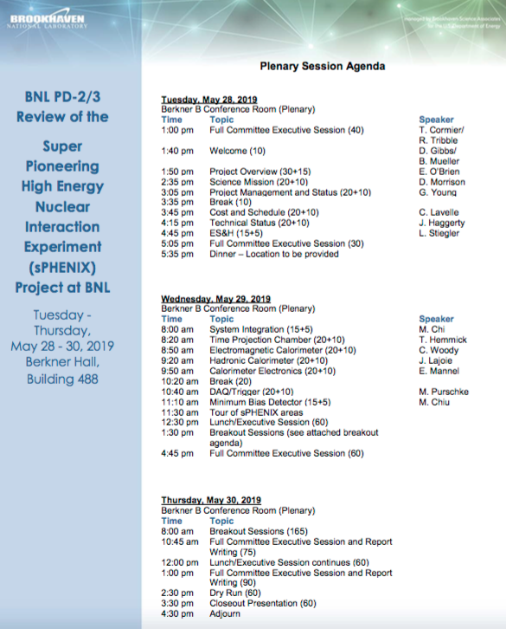
Review Agenda - Plenary
Plenary talks Tuesday afternoon and Wednesday morning
Tour of sPHENIX Labs in 510 and HCal Factory in 912 Wednesday at 11:30 am -Stefan Bathe is giving the tour
Three breakout session:
  Project Management
  TPC, Calorimeters
  Electronics, DAQ/Trigger
Close Out Thurs mid-afternoon

Slide 5
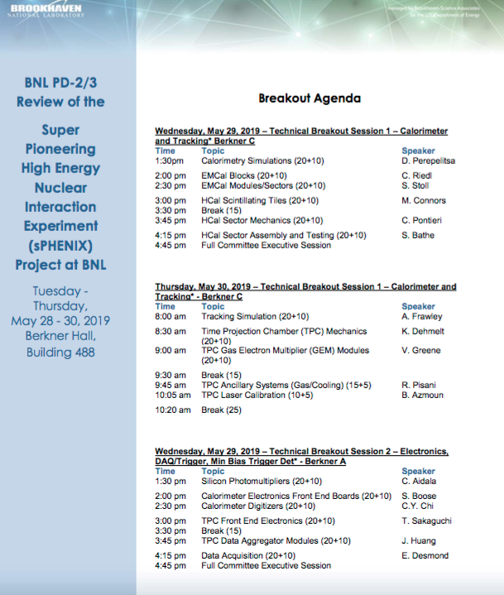
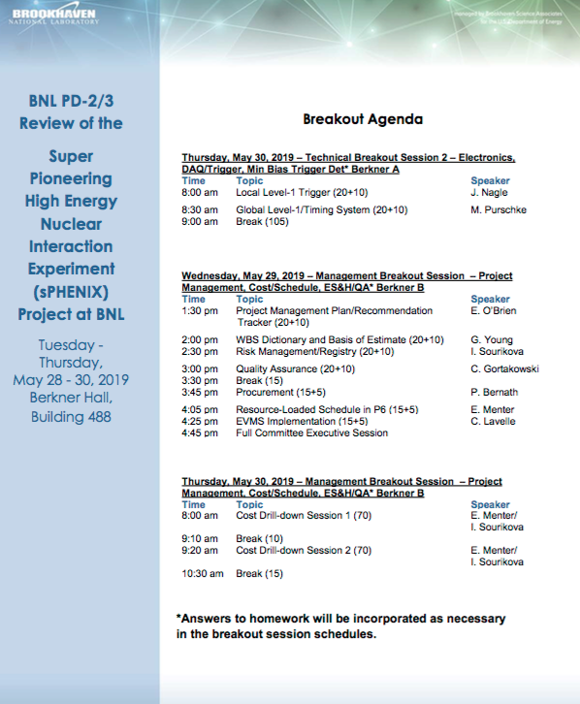
Review Agenda - Breakout

Slide 6
Review Charge
Project Scope: Do the proposed technical design and associated implementation approach satisfy the performance requirements? Are the technical designs sound and sufficiently mature to support the performance expectations for PD 2/3? EO’B, D. Morrison, G. Young, J. Haggerty, L2 Managers, Technical breakout sessions
Management: Is the project being properly managed at this stage? Is there a capable team in place, and required resources identified, to effectively manage the production phase including all the procurements, major interfaces, technical issues and risks to ensure successful delivery of the project? Is the project ready for PD 2/3? EO’B, G. Young, C. Lavelle, M. Chiu, L2 Managers, Breakout sessions
Cost and Schedule: Are the cost and schedule estimates complete, adequate, and reasonable to support the performance baseline? C. Lavelle, L2 Managers, Project Management breakout session

Slide 7
Review Charge - continued
Risk and Contingency: Are the project risks properly identified and appropriate mitigation strategies in place? Do the cost and schedule estimates include adequate contingency based on a sound and reasonable risk analysis? C. Lavelle, I. Sourikova, Project Management breakout session.
Environment, Safety & Health and Quality Assurance (ES&H/QA): Are the ES&H/QA requirements being properly addressed given the project’s current state of development? L. Stiegler, C. Gortakowski
Prerequisites: Have all the prerequisite activities and documents (see attached definition) necessary to support PD 2/3 approval been completed? All
Recommendations: Have the recommendations from past reviews been appropriately addressed? EO’B, Project Management breakout session.

Slide 8
BNL PD-2 Requirements
Project Decision 2 - The Preliminary Design and Project Baseline will be finalized and approved as part of PD-2 (Project Decision 2). A successful PD-2 Review will be attained when the project team has estimated and time-phased the resources required to execute the project against an integrated project schedule, and a risk analysis is conducted to help determine the potential variability in scope, schedule and/or cost which might be encountered in the course of executing the project. To achieve PD-2 the project team should meet the following requirements and produce the following documentation:
  Conduct Preliminary/Technical Design Review (complete , see Glenn Young’s talk)
  Complete Preliminary/Technical Design Report (complete, posted on review site)
  Update and approve Project Management Plan (PMP) (complete w/o signatures, posted on review site)
  Develop a Performance Baseline including RLS (complete, posted on review site, see Glenn Young’s talk)
  Finalize Hazards Analysis Plan (complete, posted on review site, see Lori Stiegler’s talk)
  Finalize Quality Assurance Program (complete, posted on review site, see Chuck Gortakowski’s talk)
  Propose Funding changes with funding profile (complete in PMP, see EO’B and Cathy Lavelle talks)
  Continue Monthly Reporting include Cost Performance Report (monthly reporting to DOE for 2 years)
  Implement tailored EVMS and change control (complete, see Cathy Lavelle’s talk)
  Review Project Risk Registry & assess Contingency (complete, see Irina Sourikova and Cathy Lavelle talks
  Initiate Annual Status Reviews & monthly reporting (Annual BNL reviews 2017-2019 will continue)

Slide 9
BNL PD-3 Requirements
Project Decision 3 (PD-3) includes Approval of the Project Final Design requirements and specifications and Authorization to start Execution of the Project. A successful PD-3 Review will be attained when it is determined that the state of the development of the project planning is adequately defined to execute the project plan for successful delivery of the project scope with effective management, resource planning, scheduling, risk assessment and progress tracking at a level that ensures project delivery that addresses the expectations of the stakeholders. To achieve PD-3 the project team should meet the following requirements and produce the following documentation:
  Conduct Design Review of the final design requirements and specifications (complete, see talks by Glenn Young and John Haggerty. Review reports posted on review site)
  Update Project Management Plan (PMP) (complete, posted on review site)
  Generate a preliminary Transition to Operations Plan (complete, posted on review site)
  Update Hazard Analysis Plan (complete, posted on review site, see Lori Stiegler’s talk)
  Continue Quality Assurance Program (complete, posted on review site, see Chuck Gortakowski’s talk)
  Update Project Integrated Safety Management Plan (complete, posted on review site)
  Continue Monthly Reporting incl Cost Performance Report (complete, monthly reporting to DOE ongoing)
  Implement tailored EVMS and change control (complete, see Cathy Lavelle’s talk)
  Monitor Project Risks and Contingency (complete, monitor at monthly L2 Managers’ meetings)
  Continue Annual Status Reviews (Annual BNL reviews 2017- 2019 will continue.)

Slide 10
sPHENIX Technical Progress
All LLP’s approved at CD-3A have been placed. They are: 100k SiPMs, 2500km of Scintillating fiber for EMCal, 7000 Scin tiles for HCal, 19 metric tons of tungsten powder for EMCal
The preliminary project baseline is set and EVMS practice has proceeded since start of January.
Partial delivery of LLP-1 orders, 25k SiPMs, have arrived at Univ. of Michigan. Partial deliver of LLP-2 scintillating fibers, 100 km, have arrived at UIUC.
Test of SAMPA v5 prototype chip for TPC readout ongoing at U Sao Paulo. All tests positive to date.
1560 Preproduction scintillating HCal tiles complete. Testing ongoing at GSU. Yield >95% to date.
EMCal preproduction Sector 0 assembly advanced. Sector 0 blocks complete, Sector 1 blocks fab started.
Preproduction boards exist for Calorimeter electronics.
Fab has started on preproduction FELIX boards for TPC readout
Fab has started on preproduction GEM modules for TPC.
Preproduction boards exist for DAQ/Trigger GL1 and Timing module.
R&D work progressing on all sPHENIX detector components.

Slide 11
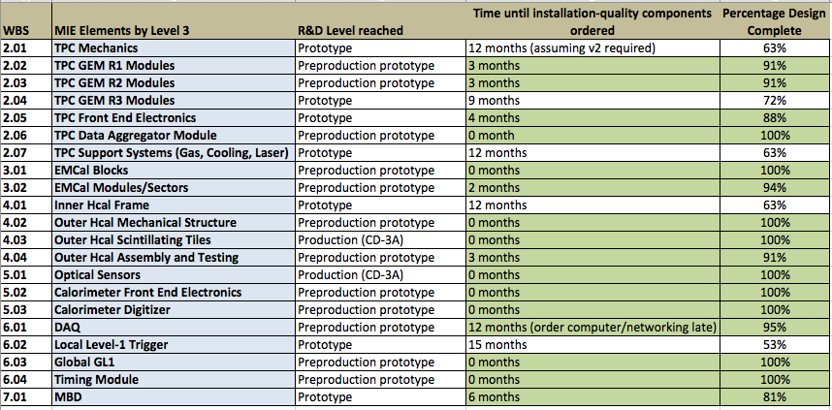
Design Maturity
Each WBS L3 with design > 80% done shown in green.
Aggregate maturity based on weighting by WBS L3 cost ~91%

Slide 12
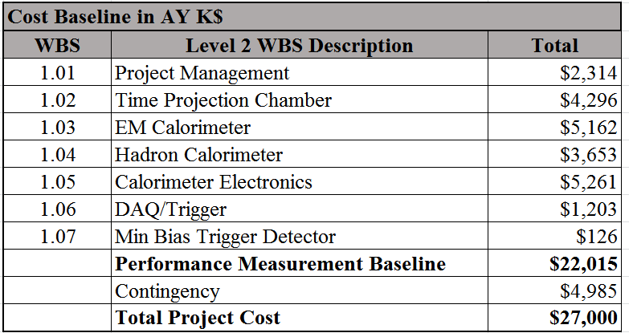
Cost Baseline
Baseline cost is within the range approved by DOE at CD-1/3A and in the PPMP

Slide 13
Level-1 Milestones
Milestone Level 1 | Schedule Date
CD-0, Approve Mission Need | 9/16/2016 (A)
CD-1/3A, Approve Conceptual Design, Alternative Selection and Cost Range, and Long Lead Procurements | 8/16/2018 (A)
Approve PD-2/3, Approve Performance Baseline/Approve Project Production | Q4 FY 2019
Approve PD-4, Approve Project Completion | Q1 FY 2023
Level-1 milestones are unchanged from the ones approved by DOE at CD-1/3A and in the PPMP

Slide 14
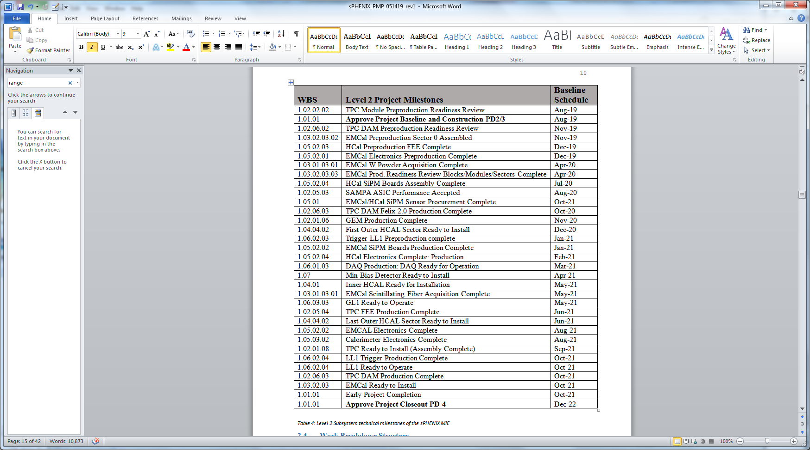
Level-2 Milestones
Baseline milestones from current sPHENIX RLS

Slide 15
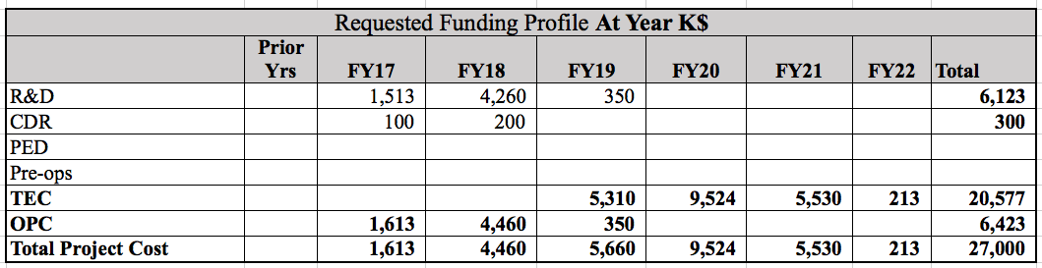
sPHENIX Baseline Funding Profile
Funding integral is within the range approved by DOE at CD-1/3A and the PPMP. Profile has increased by $450k in FY21 from the one in the PPMP. All other years the same.

Slide 16
Remaining Review Preparations
Check all talks and post them
Work with the Berkner AV people to check equipment in rooms A, B and C
Answer any pre-review questions from the committee.

