Slide 1
Polarized Proton Acceleration
Thomas Roser

Slide 2
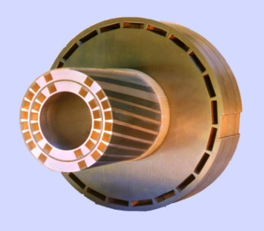
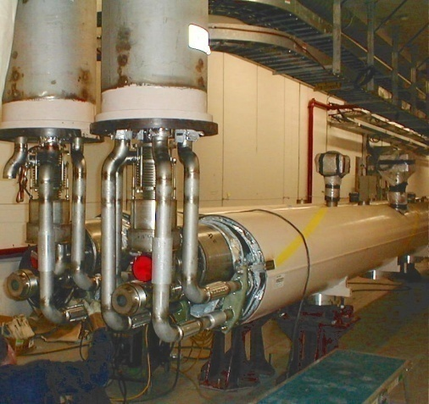
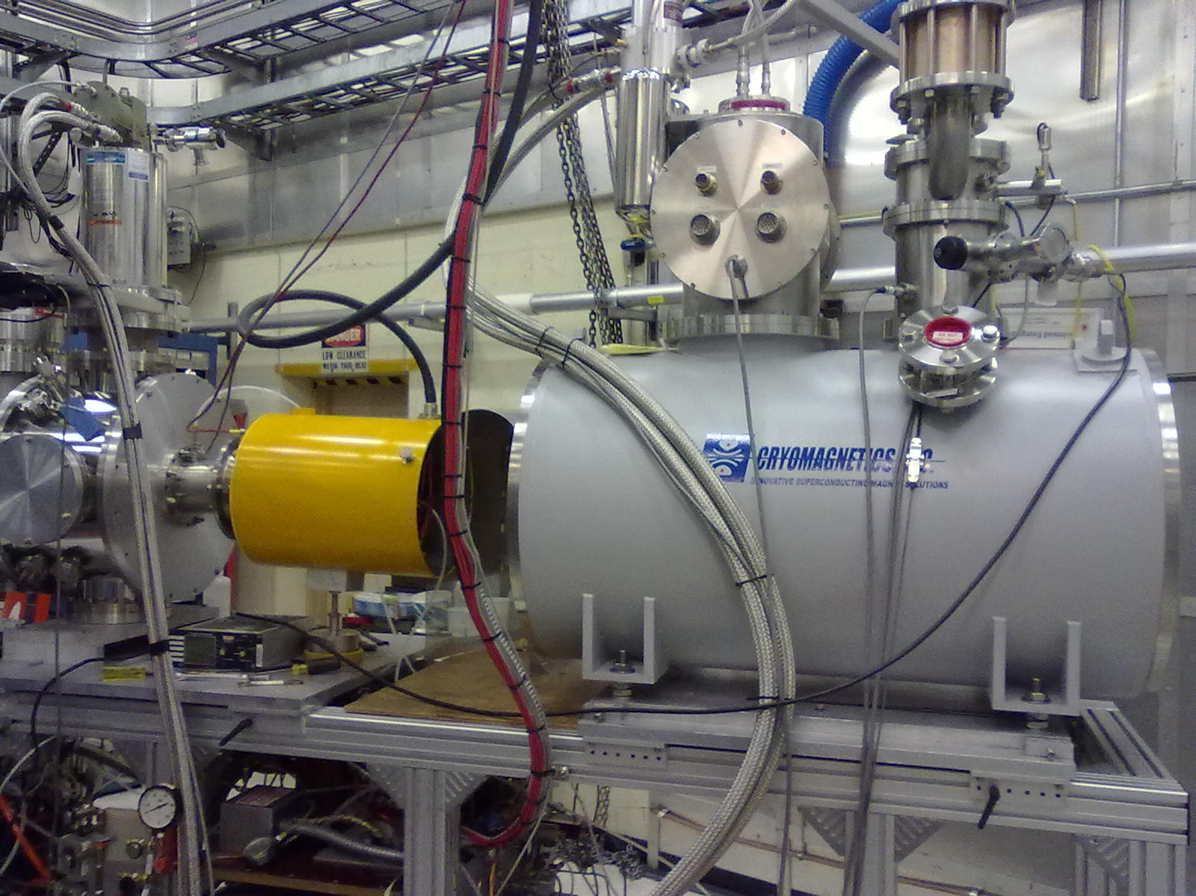
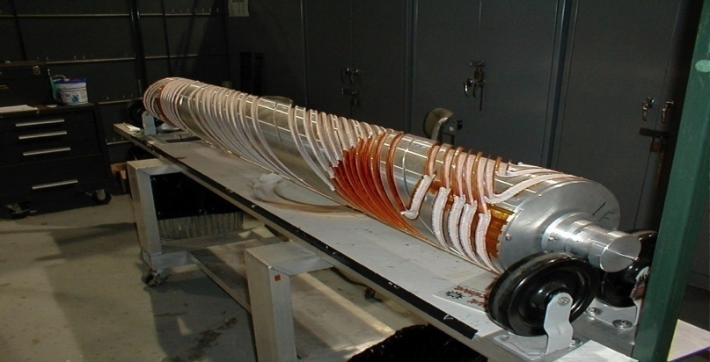
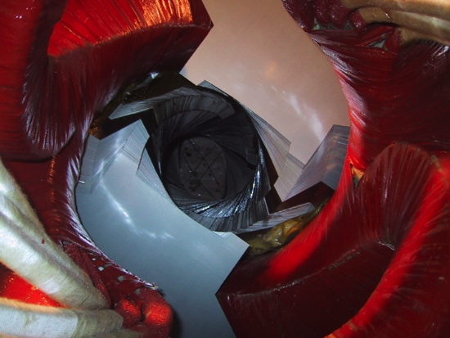
RHIC – First Polarized Hadron Collider
Absolute Polarimeter (H↑ jet)
pC Polarimeters
Spin flipper
Siberian Snakes
Siberian Snakes
PHENIX
STAR
Spin Rotators
(longitudinal polarization)
Spin Rotators (long. pol.)
LINAC
5.9% Helical Partial
Siberian Snake
BOOSTER
Pol. H⁻ Source
AGS
Int. Polarimeter
200 MeV Polarimeter
pC Polarimeter
10-25% Helical Partial Siberian Snake

Slide 3
Spin Dynamics in Rings
Precession Equation in Laboratory Frame:
(Thomas [1927], Bargmann, Michel, Telegdi [1959])
dS/dt = - (e/γm) [(1+Gγ)B⊥ + (1+G) B_{II} ] × S
Lorentz Force equation:
dv/dt = - (e/γm) [ B⊥ ] × v
For pure vertical field:
Spin rotates Gγ times faster than motion, ν_{sp} = Gγ
For spin manipulation:
At low energy, use longitudinal fields
At high energy, use transverse fields

Slide 4
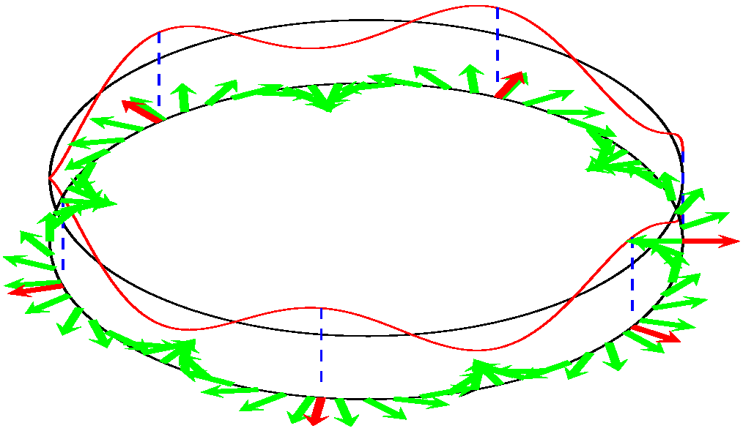
Spin tune and Depolarizing Resonances
Depolarizing resonance condition:
Number of spin rotations per turn = Number of spin kicks per turn
Spin resonance strength ε = spin rotation per turn / 2π
Imperfection resonance (magnet errors and misalignments):
ν_{sp} = n
Intrinsic resonance (Vertical focusing fields):
ν_{sp} = Pn ± Q_{y}
P : Superperiodicity [AGS: 12]
Q_{y} : Betatron tune [AGS: 8.75]
Weak resonances: some depolarization
Strong resonances: partial or complete spin flip
Illustration by W.W. MacKay

Slide 5
Spin Resonance Crossing
Froissart-Stora: [α: crossing speed]
Non-adiabatic (ε²/α << 1) ↔ Adiabatic (ε²/α >> 1)
P_{f} /P_{i} = 1 P_{f} /P_{i} = − 1
ε
Gγ−K
Gγ−K
ε
ε
K−Gγ
K−Gγ
Gγ=K
ε

Slide 6
Spin Resonance Crossing
Non-adiabatic (ε²/α << 1)
P_{f} /P_{i} = 1
Imperfection resonances:
  Correction dipoles (ε small)
Intrinsic resonances:
  Pulsed quadrupoles (α large)
  Lattice modifications (ε small)
Adiabatic (ε²/α >> 1)
P_{f} /P_{i} = − 1
Imperfection resonances:
  Partial Siberian snake(s) (ε large)
Intrinsic resonances:
  RF Dipole (ε large)
  Strong partial Siberian snake(s)
  (ε large)

Slide 7
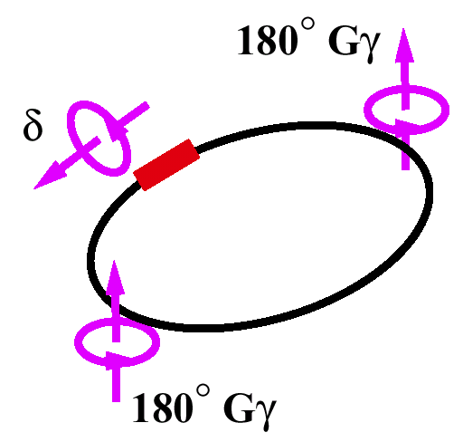
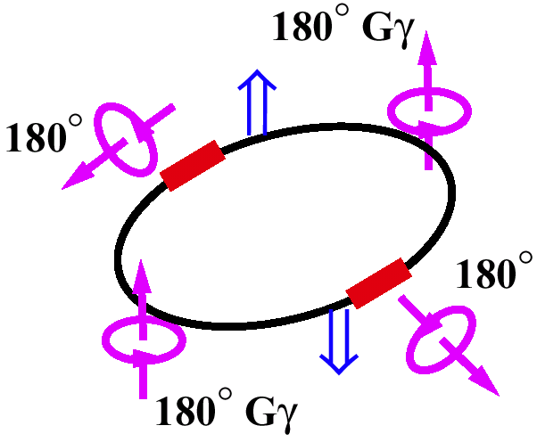
Siberian Snakes (Local Spin Rotators)
cos(180○ ν_{sp}) = cos(δ/2) · cos(180○ Gγ)
δ ≠ 0○ → ν_{sp} ≠ n
No imperfection resonances
Partial Siberian snake (AGS)
δ = 180○ → ν_{sp} = ½
No imperfection resonances and
No Intrinsic resonances
Full Siberian Snake
(Ya.S. Derbenev and A.M. Kondratenko)
Two Siberian Snakes (RHIC):
ν_{sp} = (α₂−α₁)/180○ (α_{1,2}: angles between snake axis and beam direction)
Orthogonal snake axis: ν_{sp} = ½ and independent of beam emittance (SRM, S. Mane)

Slide 8
Beam Polarization Near a Single Strong Intrinsic Resonance
Without snakes:
  Full spin flip, width ~ ± 5ε
With snakes:
  Opening/closing of “spin cone”, nodes at ± 2
  Resonance crossing during acceleration is adiabatic with no polarization loss.
Resonance strength:
ε = 0.3, 0.6
ΔGγ

Slide 9
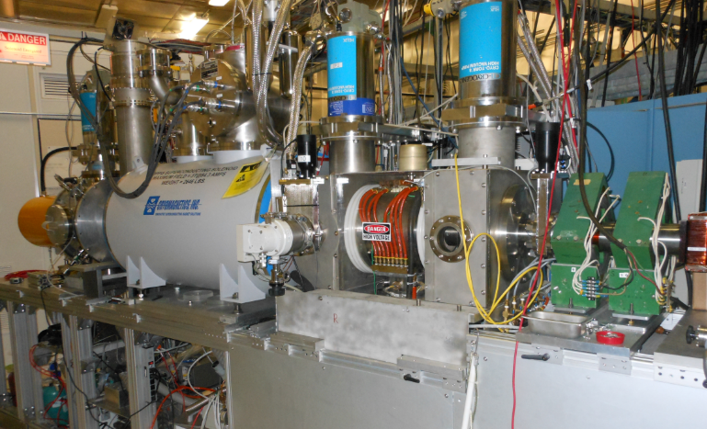
BNL - High intensity polarized H- source
Developed as BNL, TRIUMF, KEK, INR collaboration
1.0 mA in 300 μs (1.8 x 10¹² protons per pulse); 83% polarization
One source pulse is captured and accelerated for one bunch in RHIC
With inefficiencies and scraping to lower emittance and higher polarization bunch intensity in RHIC is 2.5 x 10¹¹ polarized protons

Slide 10
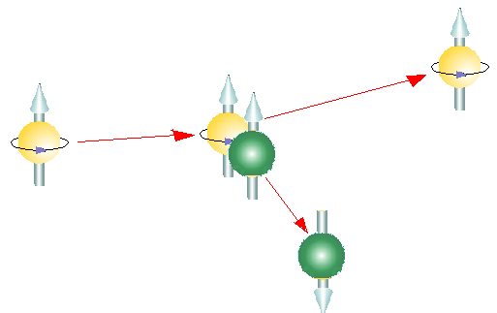
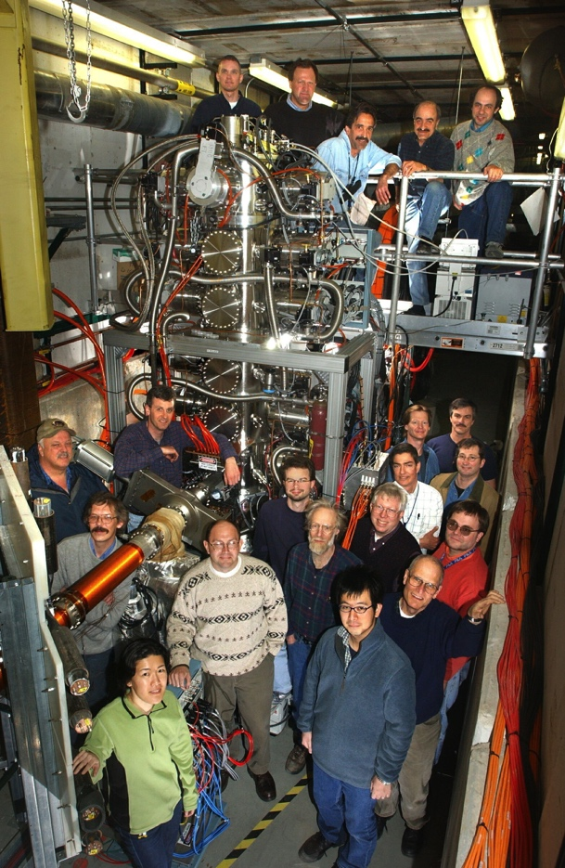
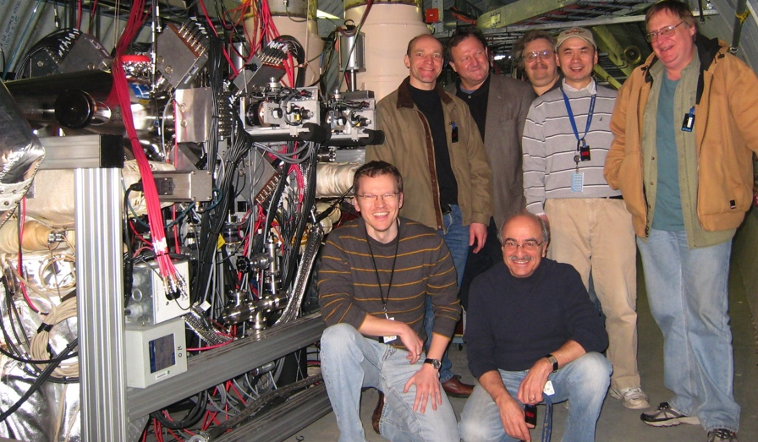
RHIC polarimetry
Absolute polarimeter (Pol. Hjet)
  Polarized hydrogen jet target allows for
  absolute beam polarization measurement:
  Jet target thickness of ~ 1×10¹² cm⁻² achieved
  Jet pol. 92 ± 2 % measured with Breit-Rabi polarimeter
  Analyzing power A_{N} ~ 0.044 (24 – 255 GeV)
Relative polarimeters (proton-carbon)
  Measure horizontal and vertical polarization profiles
  Fast measurements (~ 2 minutes)
Local IP polarimeters (forward neutron production)
  Significant asymmetry,
  calibrated with Hjet
  Used to adjust
  transverse polarization
  component to zero
scattered
proton
(polarized)
proton beam
polarized
proton target
or Carbon target
recoil proton
or Carbon

Slide 11
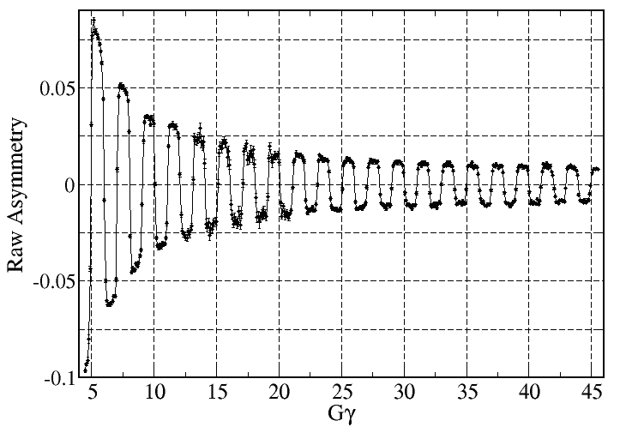
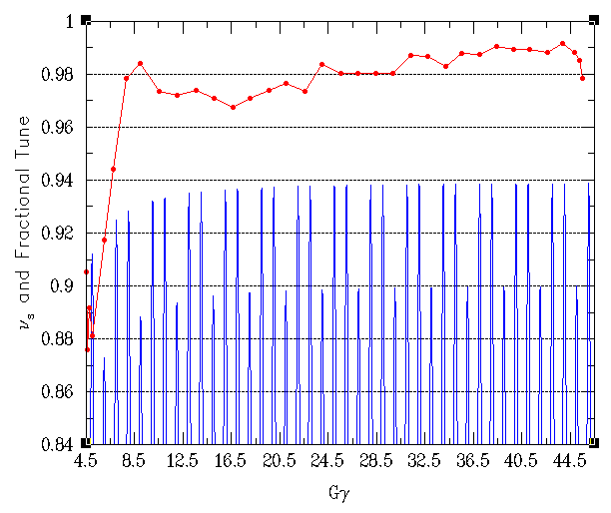
Polarized proton acceleration in the AGS
warm
snake
5.9%
10%
9.00
cold snake
During acceleration in AGS polarization flips 40 times
To avoid intrinsic resonances vertical betatron tune is placed very close to 8.98!
8.95
0+Q_{y}
24-Q_{y}
12+Q_{y}
36-Q_{y}
24+Q_{y}
48-Q_{y}
36+Q_{y}
ν_{sp} and Q_{y}
8.90
8.85
Gγ

Slide 12
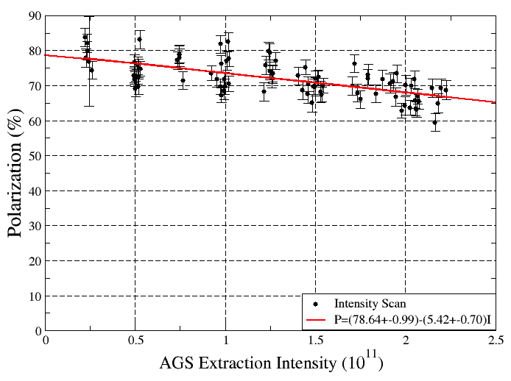
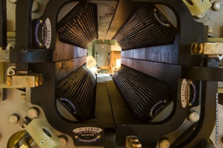
Horizontal spin resonances
Partial snakes generate ~ 80 weak horizontal spin resonances
Use two fast quadrupoles, pulsing them 40 times during the half second ramp, to overcome all the horizontal resonances.
Reached 90% polarization transmission and 70% polarization at high intensity (2 x 10¹¹ ppb)
N+1
N

Slide 13
Spin Resonances in RHIC w/o Snakes
Imperfection resonance strength for uncorrected orbit (σ = 28 mm)
Intrinsic resonance strength for 10 π mm mrad particle
Imperfection resonance strength for corrected orbit (σ = 0.15 mm)

Slide 14
Beam Polarization Near a Single Strong Intrinsic Resonance
Without snakes:
  Full spin flip, width ~ ± 5ε
With snakes:
  Opening/closing of “spin cone”, nodes at ± 2
  Resonance crossing during acceleration is adiabatic with no polarization loss.
Resonance strength:
ε = 0.3, 0.6
ΔGγ

Slide 15
Snake Resonances
Higher order resonance condition ν_{sp} + mQ_{y} = k (m, k = integer) driven by interaction of intrinsic resonance Gγ + Q_{y} = k with large spin rotations of dipoles and snakes.
No non-linear drive term necessary – combination of rotations is already non-linear.
“Snake resonance strength” depends on intrinsic resonance strength and therefore energy
For ν_{sp}=1/2+Δν_{sp} → Q_{y} = (2k-1)/2m-Δν_{sp}/m
  First analytical solution of isolated resonance with snakes by S.R. Mane, NIM A 498 (2003) 1
single snake
or two snakes with orbit errors
two snakes (m: odd)
RHIC tune working point
1/12
3/10
3/14
1/8
3/8
3/10
1/10
1/6
1/4
1/10
1/6
Stable polarization
on resonance, ε = 0.3
Stable polarization
on resonance, ε = 0.3
0.9
0.8
0.7
0.6
0.9
0.8
0.7
0.6
Q_{y}
Q_{y}

Slide 16
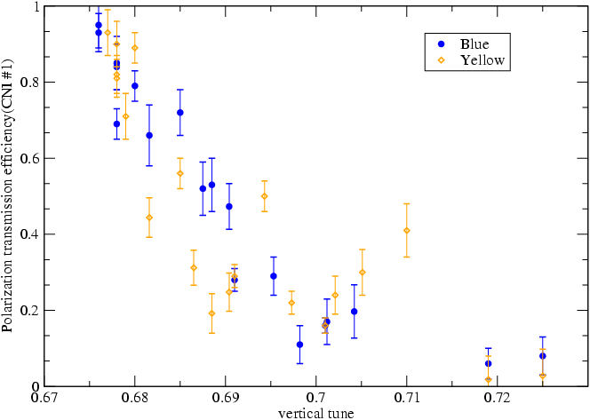
Accelerating polarized protons in RHIC
15/22
11/16
7/10
19/28
Snake resonances:
x,y_{rms} ≈ 25 μm (!)
RHIC vertical tune during acceleration
Tune/coupling feedback on every ramp allows for:
  Acceleration between Q_{y} = 0.667 and Q_{y} = 0.7 with best polarization transmission
Slow orbit feedback on every ramp allows for:
  Smaller y_{rms} (smaller imperfection resonance strength)
  Ramp reproducibility (have 24 h orbit variation)
Continuous fast 10 Hz orbit feedback eliminates effect of vibrating triplets

Slide 17
Polarized proton collisions at 255 GeV beam energy
Reached ~57% average polarization in 14 best stores
Little polarization loss on ramp and during store
Peak luminosity: 2.5 × 10³² cm⁻² s⁻¹
Requires excellent control of orbit, tune and coupling

Slide 18
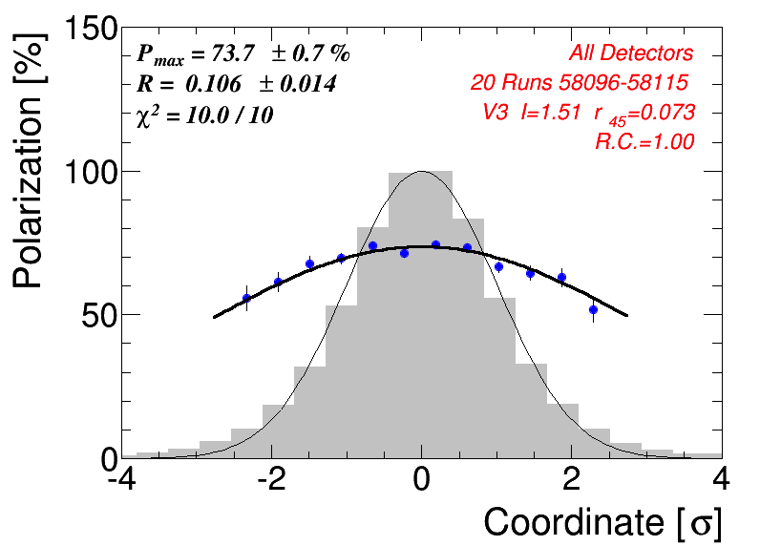
Depolarization and polarization profiles
Polarization loss from intrinsic resonances: polarization lost at edge of beam → polarization profile
  Impact of polarization profile on beam polarization at collisions P_{coll.}:
  For R_{H} ≈ R_{V} ≈ R and small: P₀ = <P> (1+R)²; P_{coll.} ≈ <P> (1+½R)
  <P> measured with H jet polarimeter; R measured with pC polarimeter
  Typical values at RHIC 255 GeV: P₀= 80%; <P>=57%, R=0.18, P_{coll}.=62%
Note that P₀, the polarization of the core
particle, should be equal to the maximum
achievable polarization.
Loss of average polarization is compatible
with development of polarization profiles
→ all remaining polarization loss in AGS
and RHIC is due to intrinsic resonances.
(no coherent polarization loss)

Slide 19
Summary
RHIC – the most flexible, high luminosity hadron collider
World’s only polarized proton collider
Amplitude dependent intrinsic depolarizing resonances will produce polarization profiles

Slide 20
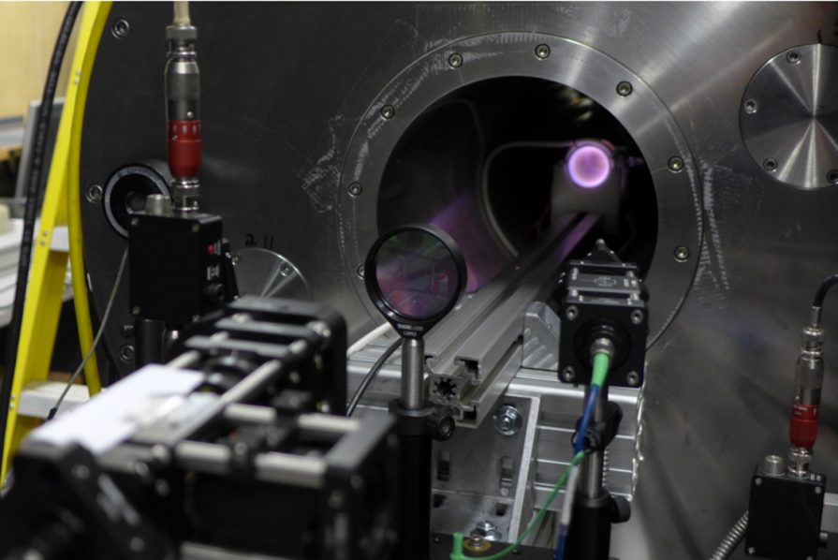
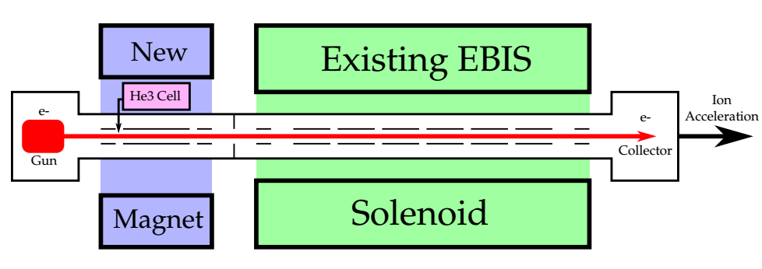
High brightness polarized ³He source
Optically pumped polarized ³He gas in high field EBIS solenoid
Feed into electron beam of EBIS for ionization to ³He²⁺ without depolarization: ~ 2 x 10¹¹ polarized ³He²⁺ per bunch
Optical pumping in
High magnetic field
J. Maxwell, C. Epstein, R. Milner, MIT
J. Alessi, E. Beebe, A. Pikin, J. Ritter
A. Zelenski, BNL
5.0 T
5.0 T
³He⁺
Ionization to ³He⁺⁺
Up to 2×10¹¹
³He⁺⁺ ions/pulse

Slide 21
Polarized ³He in RHIC
Polarized ³He possible from new EBIS (J. Maxwell, Tue., 3:30 pm)
Max. energy in RHIC: 170 GeV/n
Depolarizing res. are stronger, however no depolarization expected with six snakes in RHIC
Accelerated unpolarized ³He from EBIS in AGS
Relative pol.: ³He-C CNI polarimeter; successfully tested with unpolarized ³He
Absolute pol.: ³He-³He CNI polarimeter using polarized ³He jet?
He3-C Polarimeter
Spin flipper
Abs. Pol. (He3↑ jet)
Siberian Snakes
Siberian Snakes
PHENIX
Spin Rotators
(longitudinal polarization)
STAR
Spin Rotators (long. pol.)
Pol. He-3 Source (EBIS)
BOOSTER
15 % Helical Partial
Siberian Snake
Pol. H⁻ Source
LINAC
AGS
He3-C Polarimeter
20-50% Helical Partial Siberian Snake

Slide 22
CeC for RHIC: High Luminosity with large Piwinski angle
  If head-on collisions are at beam-beam limit
  large Piwinski angle collisions with very small
  emittance can increase luminosity (Super B factory)
  Needs strong cooling: synchrotron rad. or CeC
  Separate bunches outside high luminosity region
  to avoid beam-beam from low luminosity region.
  Reducing beam emittance back to beam-beam limit
  Smaller emittance and shorter overlap region allows
  for smaller beta-star
  RHIC: overlap length ~ 10 cm, ε_{n} (95%) ~ 1 π μm ,
  β* ~ 10 cm  ~ x10 luminosity increase ( ~ 5 x10³³ cm⁻² s⁻¹ !)
Head-on collisions
Collisions with
crossing angle
Kicker for Yellow
Kicker for Blue
FEL for Yellow
Modulator for Blue
FEL for Blue
Modulator for Yellow
Beam dump 1
Beam dump 2
ERL dual-way electron linac
2 Standard eRHIC modules
Gun 2
Gun 1

