Slide 1
Fitting Polarization Profiles in RHIC

Slide 2
Outline
Direct tracking results in RHIC
Simplified Polarization Profile Model for System with two Snakes.
Fitting Models for RHIC PP Runs FY12-17
  Data Analysis Approach:
    Handling Measured Rx,Ry and Average Pol. By CNI and Jet
    Handling conflicting missing data and conflicting data
    Emittance measurements
  Fit to Model parameters

Slide 3
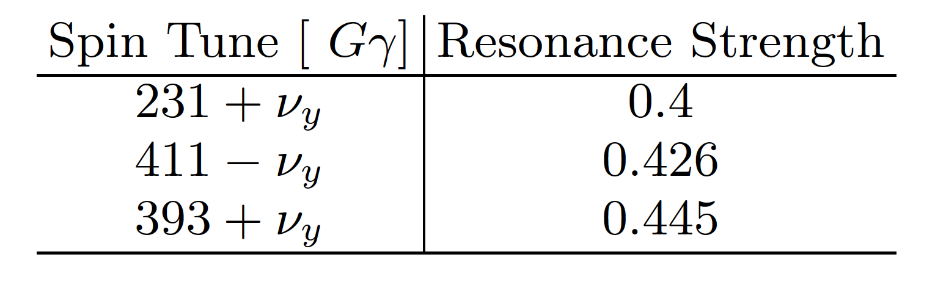
Review of Resonances Structure in RHIC

Slide 4
Results from Direct tracking 393+Nu Tune Scan:

Slide 5
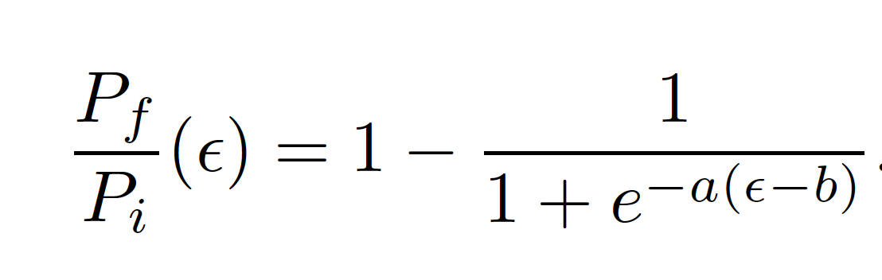
Simplified Polarization Response Model:
Models a Step or heavy-side function, but with smooth step. Here b controls the general location of the step and a the slope of the step. Captures Step features unique to crossing resonance with snakes. Different from FS.
The good thing about this simple model is that it still works for the ’cumulative effects’ of several resonance crossings. Here we see how the effects of three strong resonances crossings can still be modeled by this equation. Looks to

Slide 6
Results from Direct Tracking 411-Nu:

Slide 7
Results from Direct Tracking effect of Imp Res:

Slide 8
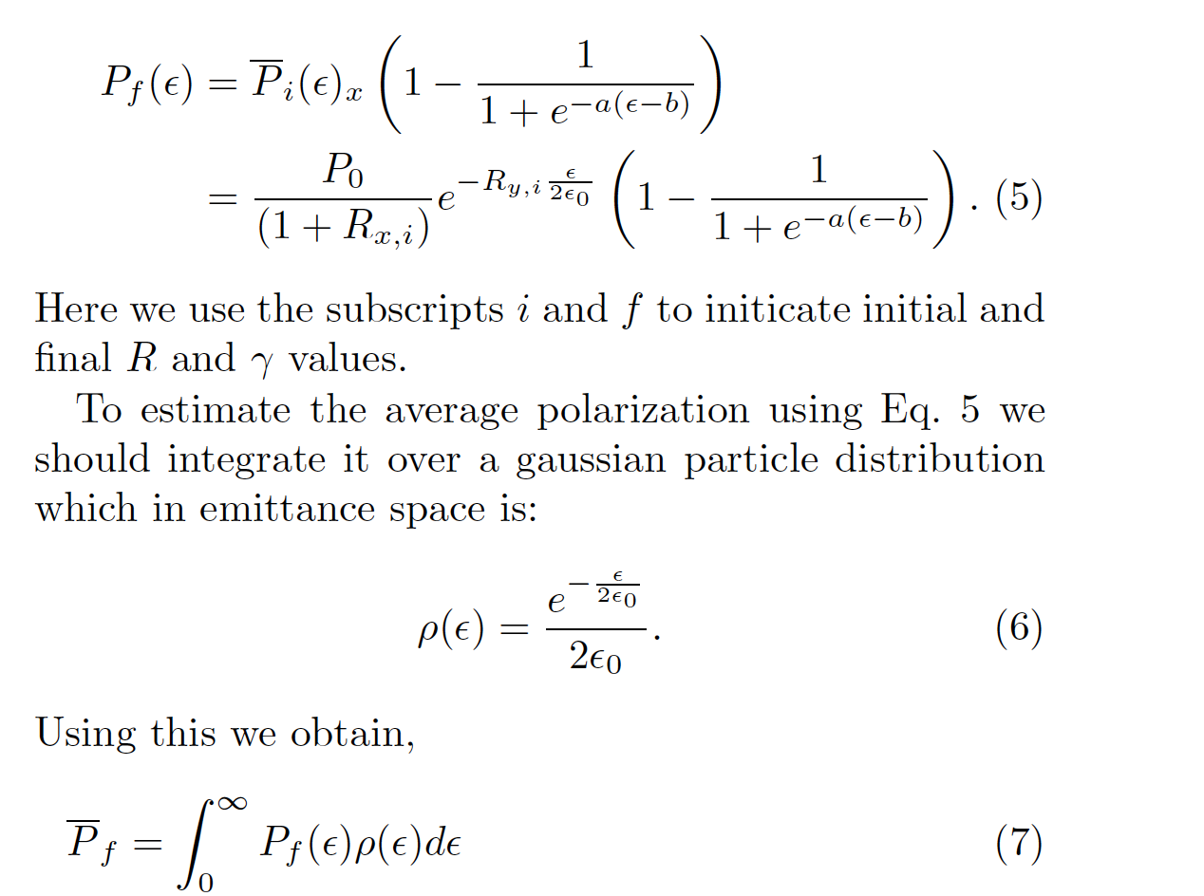
Integrating with beam distribution and initial profile from AGS:

Slide 9
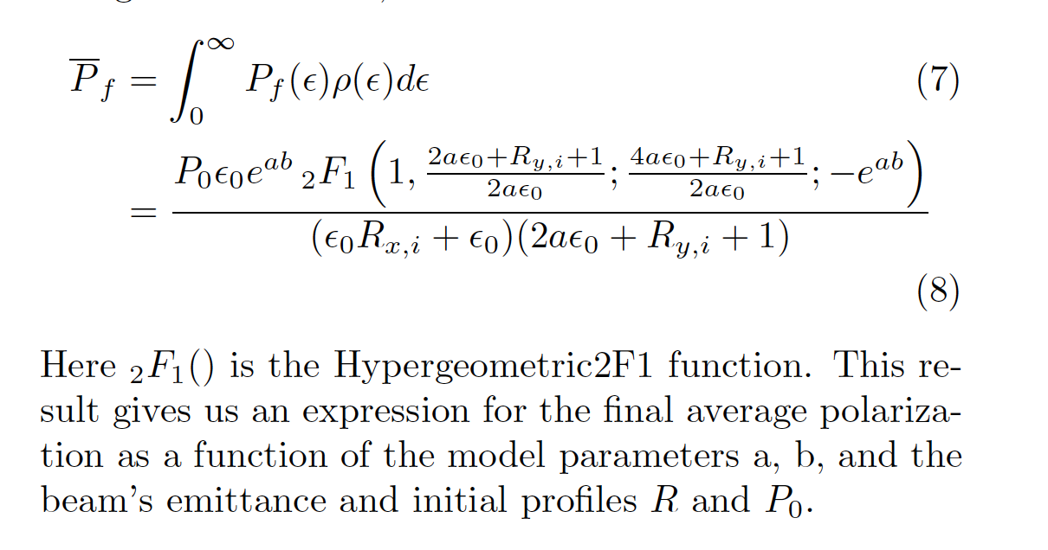
New Integrated Profile Function for RHIC

Slide 10
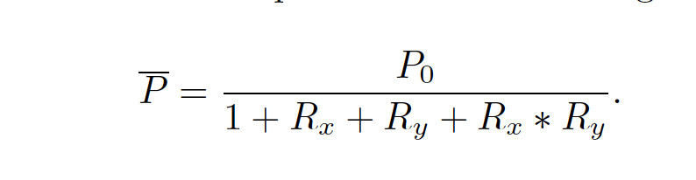
RHIC Data:
Carbon Target measurements:
  At injection and top energy
  In horizontal and vertical plane
  Rx and Ry profiles
  Average Polarization measurements
Jet Measurements at top energy only over whole Store
Problems:
  Missing or bad measurements
  Measurement not all self-consistent: Average Polarization can be deduced from
    Carbon target in each plane
    From Jet
    From Profiles:

Slide 11
Our Approach:
Assumes P₀ is stable and 80% for all fills
R_{x,y} at injection is determined:
  Calculate super average polarization (P_{avgS}) by averaging the following: Horizontal, Vertical avg. and average polarization deduced using profiles
  Using the new super average polarization and the R_{x,y} from one plane we can solve for the other R_{x,y} using: R_{i} =(P₀/P_{avgS}-1-R_{j} )/(1-R_{j}) then we average these two profiles: the directly measured and the other estimated from the average polarization and the other directly measured profile.
For P_{f} the top energy polarization we use the jet measurement if available. If there is no jet measurement then we average the direct carbon target measurement in both planes with the average calculated from the final profiles R_{x,y}
The emittance used is the average of the injection and top energy vertical emittance measurement if available. If not then we use the average horizontal injection and top energy measurement.
Using the R x and y values, emittance and assuming a=0.4 I do a best fit to the new profile formula to extract b.
We also do several logic and error checks:
  Throw out measurements where the ratio of the top energy polarization to initial polarization as calculated by R values is greater than 0.99
  If the estimated b value is > 25 or < 0

Slide 12
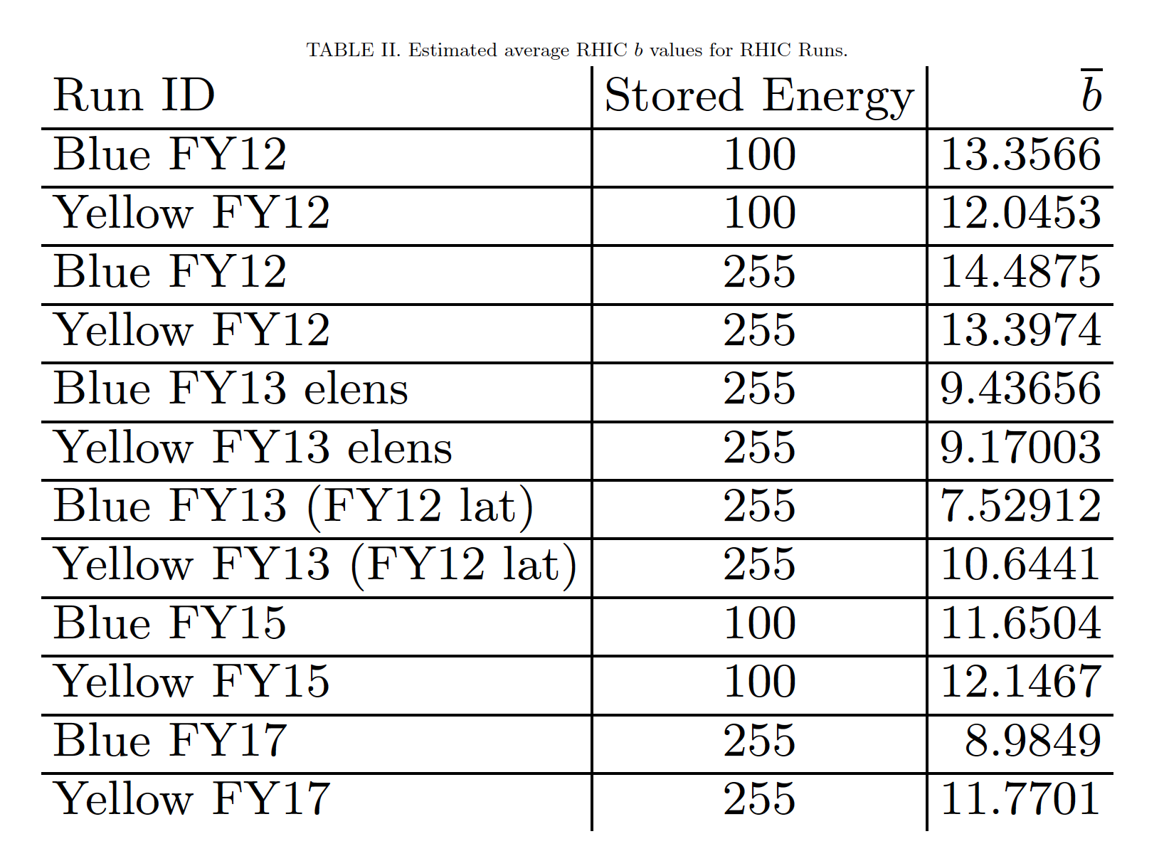

Slide 13
Analysis and Summary
For 255 GeV Run best efficiency was Blue FY12 lattice run b=14.4 which means the ‘effective’ imperfection was < 0.028. The worst was Blue FY12 using the FY12 lattice with b=7.5 which means the ‘effective’ imperfection was greater than 0.1
For Yellow 255 Run the best was also FY12 with b= 13.4 and worst FY13 using elens lattice with b= 9.17
For the 100 GeV the best was Blue FY12 with b=13.35 and the worst Blue FY15 with b= 11.65
  We need more tracking studies to better understand how b values correlate with imperfection strength for energies < 100 GeV and intrinsic resonances < 0.2

