Slide 1
Welcome to
Brookhaven National Laboratory
Brookhaven National Laboratory Overview
Peter Bond
February 22, 2013
Brookhaven Forum
May 1, 2013

Slide 2
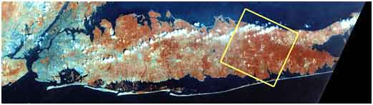
Long Island and Brookhaven

Slide 3
Brookhaven’s Mission
Design, build and operate large research facilities for the international scientific community
Carry out forefront scientific research in both basic and applied areas
Contribute to the technology base of the nation through research, technology transfer and science education
While the specific facilities and focus areas have changed over 65 years, the basic mission has remained steady

Slide 4
Brookhaven at a glance
~2950 employees;
Budget – about $750M
>4000 scientific facility users annually
Seven Nobel Prizes garnered
  12 Scientists honored (users & staff)
  First in 1957, latest in 2009
Work for
Others 12%
High Energy
Physics 9%
Other DOE
3%
National Nuclear Security
Administration 8%
Nuclear
Physics
31%
Environmental
Management 3%
Other Office of
Science 2%
Safeguards &
Security 2%
Basic Energy
Sciences 26%
Biological &
Environmental Research
4%
  ~3/4 from Department of Energy (DOE) Office of Science ; others NASA, NIH, NRC
4
Notes:
4
4
4

Slide 5
BNL Programs
User Facilities
  RHIC/AGS Complex
    RHIC/ATLAS Computing Facility (RACF) High Throughput Computing
  NSLS and NSLS II
  NASA Space Radiation Laboratory
  Several other smaller ones such as the Accelerator Test Facility (ATF)
Research and Technology
  Physics
    Riken BNL Research Center – partnership on RHIC spin and LQCD
  Chemistry
  Biology
  Medicine (program winding down)
  Energy & Climate Sciences
    Nanoscience
    Environmental Science
  National Security
Education/Training
  School tours, Undergraduate and Graduate training

Slide 6
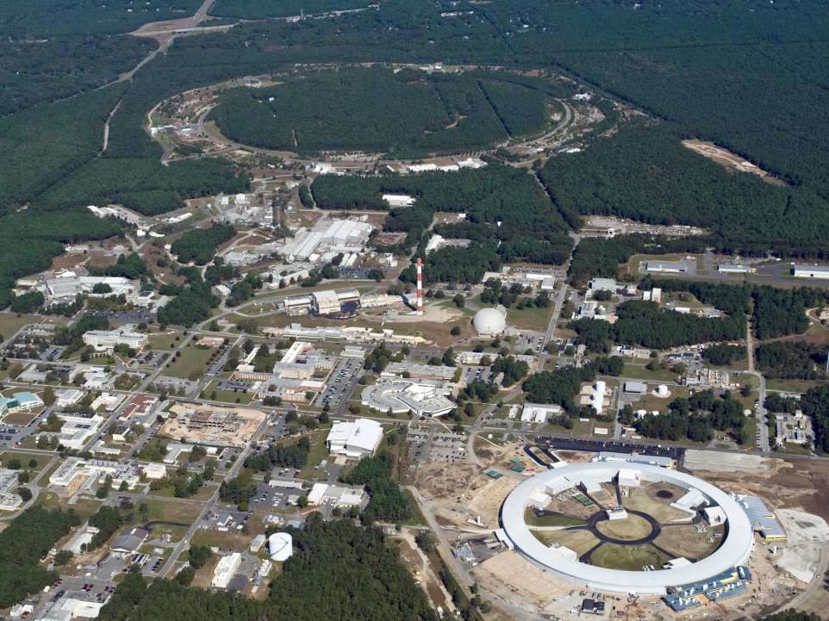
Brookhaven National Laboratory
RHIC
New York Blue Supercomputer
Interdisciplinary Energy Science Building
NSLS
CFN
NSLS-II
Long Island Solar Farm
October 2011

Slide 7
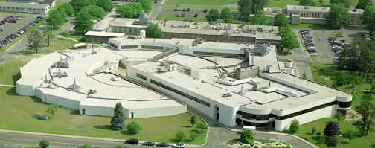
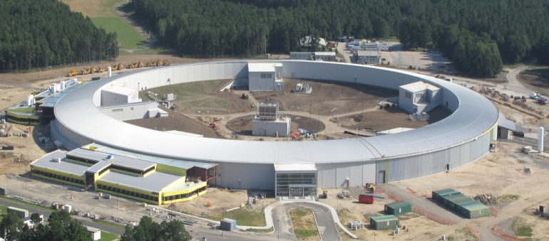
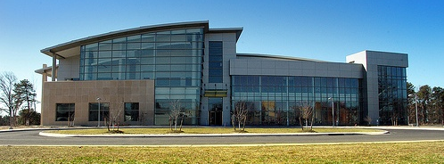
Major Research Facilities
National Synchrotron Light Source
Industrial and academic users
Researching battery storage, Alzheimer’s disease, breast cancer, HIV/AIDS, environmental cleanup technology, and more
National Synchrotron Light Source
National Synchrotron Light Source II
Soon to be world’s most advanced x-ray source
$960 million project - hundreds of local jobs
Will deliver research advancements in energy,
nanotechnology, medicine and other fields
National Synchrotron Light Source II
Center for Functional Nanomaterials
Exploring energy science at the nanoscale
Building new materials atom-by-atom to achieve desired properties and functions
Center for Functional Nanomaterials

Slide 8
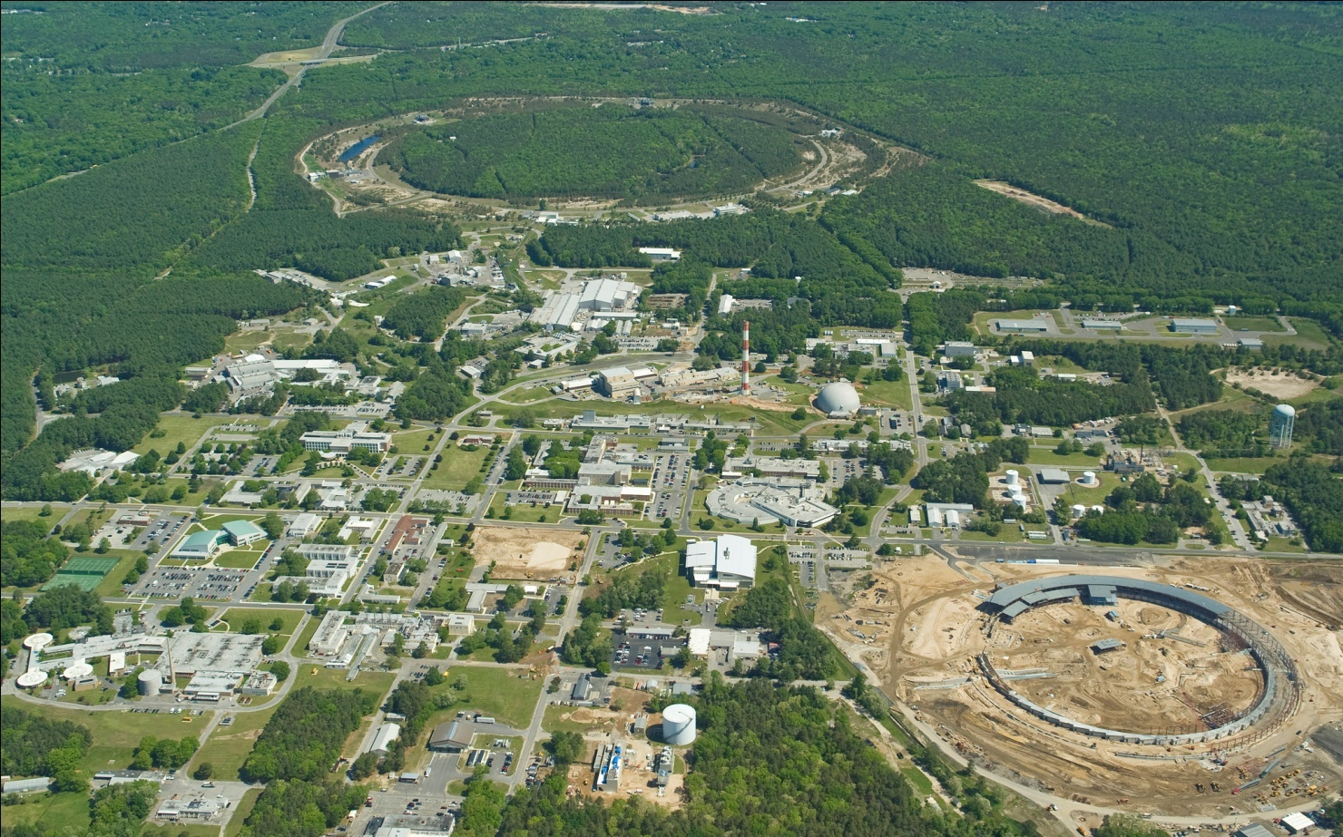
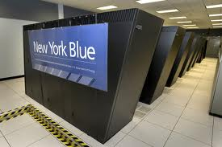
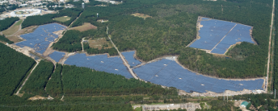
Major Research Facilities
RHIC
2.4 mile circumference
Studying the origins of the universe through
particle collisions revealing make up of matter
Discovery of the ‘perfect liquid’
Relativistic Heavy Ion Collider (RHIC)
New York Center for Computational Science
Partnership between BNL & Stony Brook University
Two IBM supercomputers
Supports broad range of research
New York Blue Supercomputer
Long Island Solar Farm
Partnership between BNL, LIPA and BPSolar
32MW Peak to power 4500 L.I. homes
Unique opportunity to study renewables in the Northeast and test new Grid technologies
Long Island Solar Farm

Slide 9
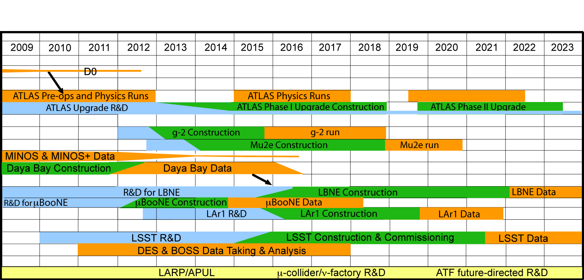
Long-Term Vision for BNL HEP
Goal: technical & intellectual leadership in key experiments at the three frontiers (energy, intensity, cosmology), supported by theory, advanced accelerator and detector R&D, and computing.
ATLAS, LBNE, LSST are our physics priorities in the three frontiers for the coming decade.
Notes:
You see here the time line for the experiments that BNL is committed to.
In the Energy frontier it is based on the ATLAS experiment.
In the Intensity frontier our main thrust is in neutrino physics but we have a strong contributions and interest in Rare process.
The Cosmic frontier our main thrust is toward LSST – but our experimentalists are busy analyzing BOSS and DES data.
We aim to have some ongoing analysis, construction and planning for future experiments and or upgrades.
To maintain our technical infrastructure we need to have a balance between R&D, Construction and analysis at any given time. While the analysis part is supported mainly from the base the technical part is supported mainly from the R&D and Projects.

Slide 10
Synergy
Even Broader Leveraging for Overall HEP Efforts
Instrumentation
Division
C-A Department
BNL
Detectors,
Electronics
Incl. LSST
focal plane
sensors
LDRDs,
Program Development
Mech. & Elec.
Engineering; ATF support; collab’n on LARP, Proj. X; BLIP, NSRL
Magnet Division
Chemistry Department
BNL Synergies
Magnets, Cryogenics, LARP & APUL leadership
Material Studies, Purification, liquid scint development
RIKEN-BNL Research Center
BNL/SBU Center for Accelerator Science & Education
Lattice QCD
Light Sources
High Energy Physics
Nuclear Physics
RHIC & RHIC Computing
Cross-hatched boxes reside in Nuclear and Particle Physics Directorate
10
Notes:
10
BNL has many advantages in this area by virtue of being a multi-disciplinary lab. There are lots of resources that can be accessed outside the direct KA1503 support.
10

Slide 11
Nuclear Physics programs
RHIC Heavy Ions
  Collide nuclei together (Au-Au) at high energies to create conditions similar to those in the early universe
  Most recently U-U!
RHIC Spin
  Collide polarized protons together to understand the “spin” of the proton
Theory
Produce Medical Radioisotopes
User facility for NASA radiobiology
National Nuclear Data Center

Slide 12

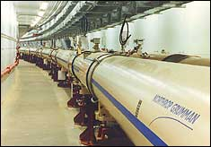
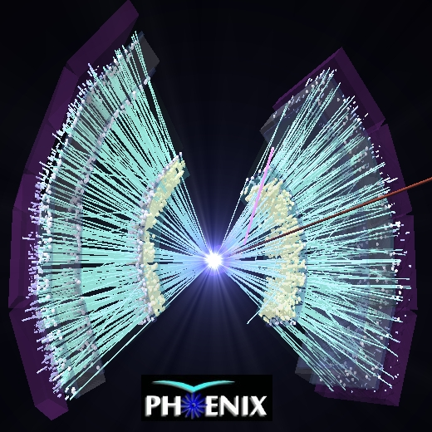
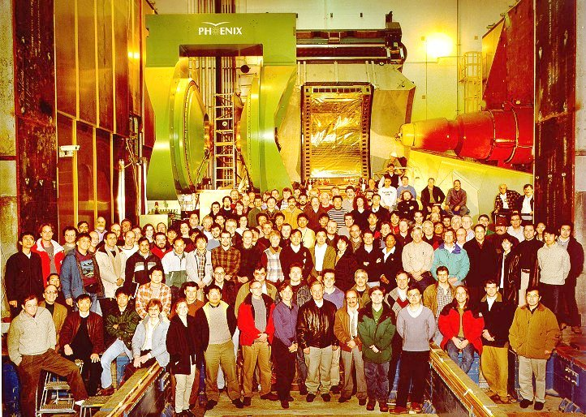

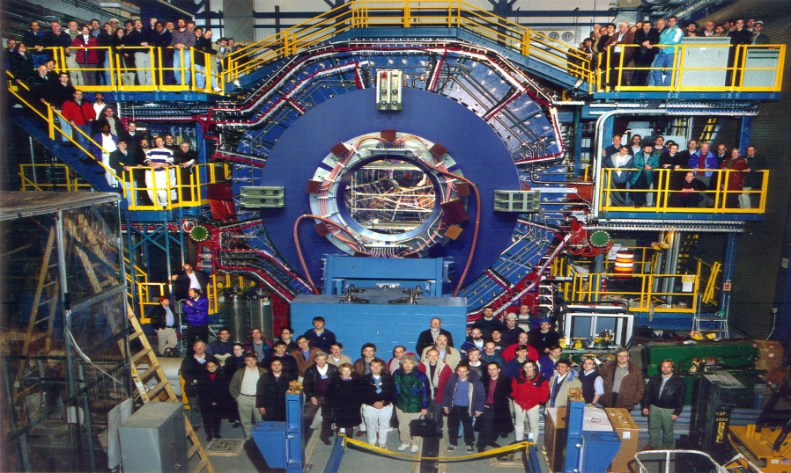
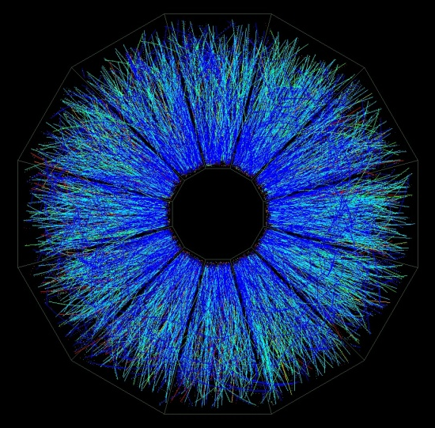
RHIC Overview
7 coupled accelerators
Nucleus –nucleus collider from
  10-200 GeV/nucleon
  Symmetric or asymmetric species
Polarized p-p collisions up to 500 GeV
Capabilities unique world-wide
STAR

Slide 13
Basic Energy Sciences
National Synchrotron Light Source facility
Center for Functional Nanomaterials
  Rational design of catalysts
  Strongly correlated and complex systems
  Interface of life and physical sciences
  Focus on Solutions to Energy Problems
New Light Source NSLS II

Slide 14
NSLS X-ray and VUV Beamlines

Slide 15
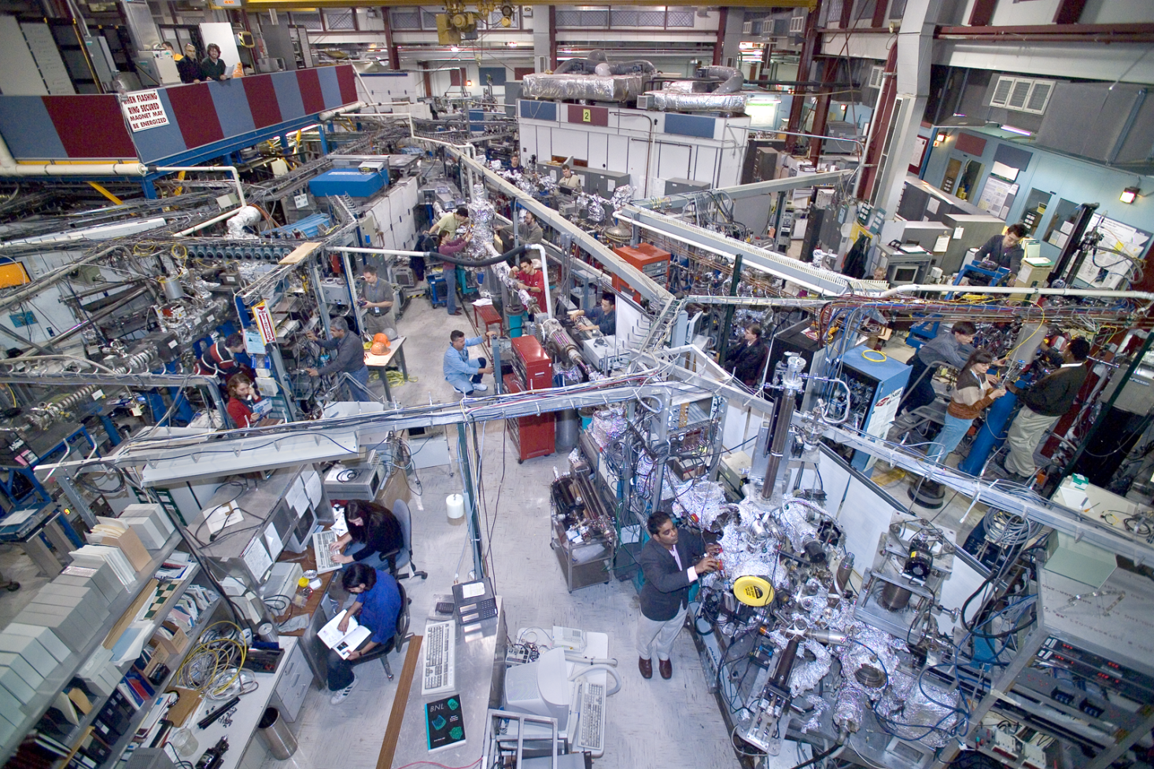
NSLS Experimental areas

Slide 16
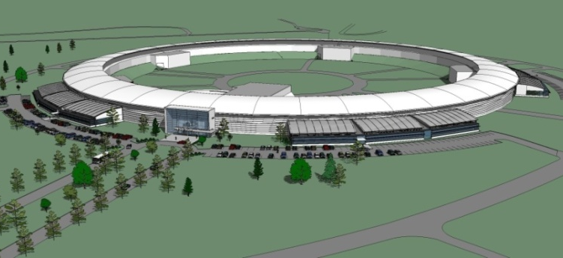
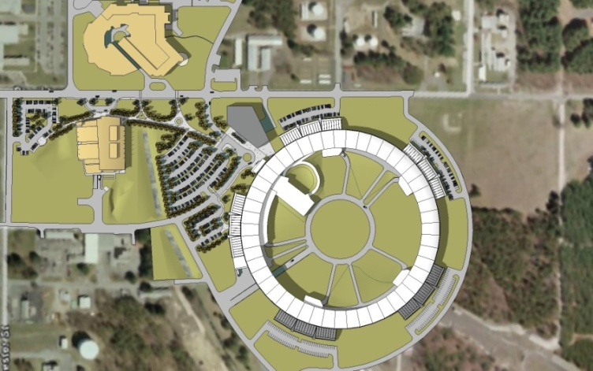
NSLS-II: Enable the
Nanoscience Revolution
World-leading performance
  10,000 brighter than NSLS
  1 nm spatial resolution
  0.1 meV energy resolution
  Synergy with the CFN
    Dynamical characterization of new materials, reactions, processes
  $925M
  Full operations in FY2015
Notes:
16

Slide 17
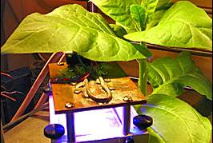
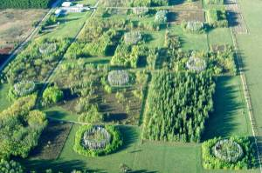

Climate, Environment, Bio-Sciences
Understand the effects of -
  CO₂, and O₃ levels → genetic, epigenetic changes in crops
Multidisciplinary initiative that integrates BNL leadership areas in:
  Plant biology – imaging, genetics, plant-endophyte systems
  Climate science – cloud & aerosol science, FACE technology, climate modeling
  Energy policy – MARKAL program
Leverages NYCCS, NSLS, NSLS-II
  Large climate modeling effort

Slide 18
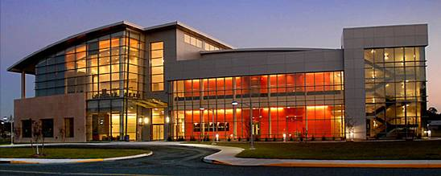
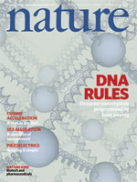
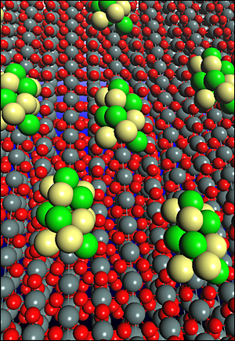
Nanoscience – CFN
Nanomaterials (small clusters of atoms)
act differently than bulk materials
BNL focus - Nanoscale materials to address
  the Nation's challenges in energy security
Full CFN operations began in FY08
  Over 300 users
Research highlights
  Self-assembled 3-D crystalline structures of gold nanoparticles using single-strand DNA
  Breakthrough in catalysts for ethanol fuel cells

Slide 19
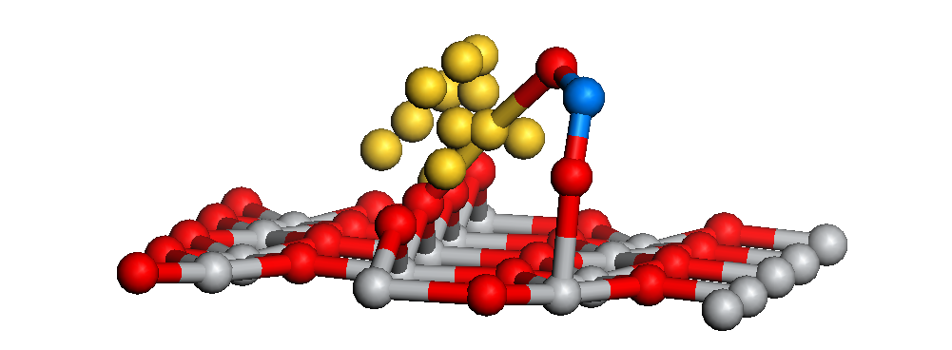
NanoCatalysis Research: 3D Nanoparticles
Supported metal nanoparticles can exhibit reactivity not characteristic of the bulk metal or support
SO₂
SO₂
S
Calculations show that SO₂ binds to both Au particle and TiO₂support
Au
TiO₂
Au
particle
size
Au nanoparticles supported on TiO₂ are extremely reactive towards SO₂.
3-5 nm
2-3 nm
Au/TiO₂ catalyst is 7-10 times more active than commercial catalyst.
> 1 nm
Bulk metallic Au and TiO₂ exhibit a
low reactivity for the dissociation
of SO_{2.}
Notes:
As I mentioned earlier, coordinating multiple facilities will be a powerful approach to address the complex functionality of nano-materials. A good example of how this will work is in the area of catalytic behavior of nanoparticles. As we all know, gold is a very inert material in the bulk. However, nanoparticles of Au behave quite differently from the bulk. For instance Jan Hrbek and his collaborators have shown that nanometer sized gold particles deposited on TiO2 exhibits a remarkably strong ability to decompose SO2. In fact particles in the 2-5nm size range are 7-10 times more active than commercial catalysts. The origin of this functionality is still unresolved, however it is clear that to answer how this works and to control it will require coupling photoemission spectroscopy of reactivity to electron and scanning probe characterization of the nanoparticles and an understanding of the charge transfer mechanisms of the reaction. In conjuction, synthesis and patterning techniques need to be developed optimize the functionality of these nanoparticle systems. Using the our CFN capabilities in such coordinated research is an important aspect of what we will offer to users.

Slide 20
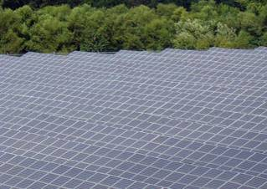
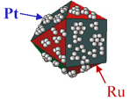
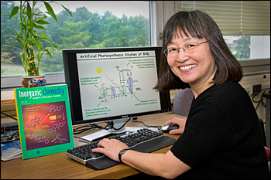
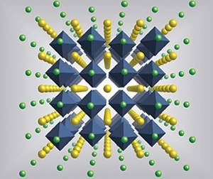
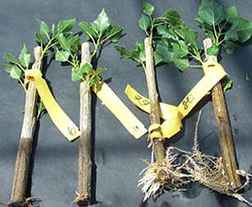
Energy
Advancing the effective conversion and use of renewable energy
  Superconductivity, catalysis, solar energy utilization, energy storage, and biofuels
DOE Energy Frontier Research Center
  BNL-led Center for Emergent Superconductivity funded ($22.5M over 5 years)
Host site for 32 MW solar PV power station
  Complete 2011
  Power plus research components
Increasing interactions with Federal, State and Industrial partners

Slide 21

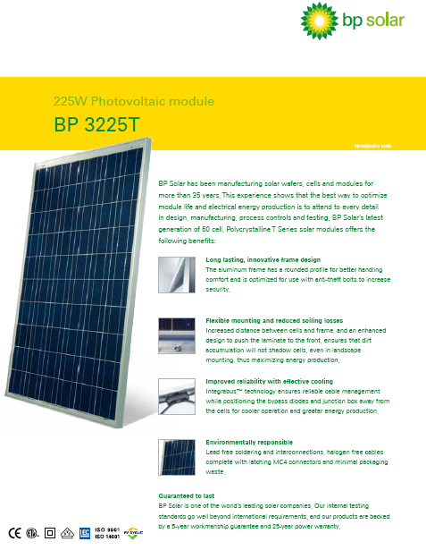
Long Island Solar Farm, LLC constructed a Large Solar Plant on the BNL Campus
32 MWac grid-connected solar PV plant
Located on 195 acres on BNL campus
A unique research opportunity
BNL is developing a research agenda to leverage this opportunity
Collaborations with other interested parties being pursued
  Sponsors: DOE-EERE, NYSERA, EPRI…
  Industry: BPSolar, GE, AMSC, First Solar…
  Utilities: NYPA, LIPA…
  National Labs: NREL, Sandia..
  Universities: SBU, UCSD, Clarkson…
  Industry Associations: SEPA, EPRI…
Notes:
21

Slide 22
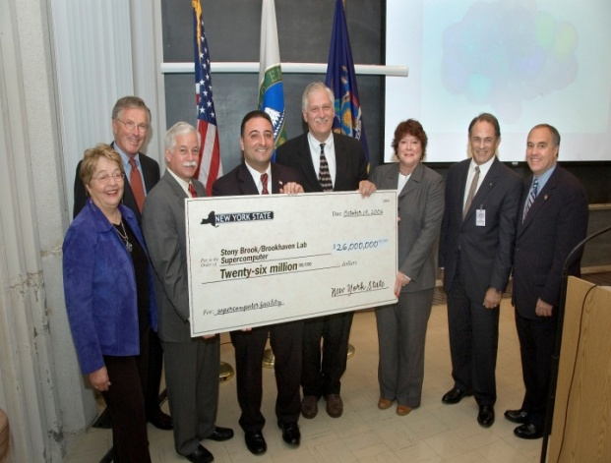
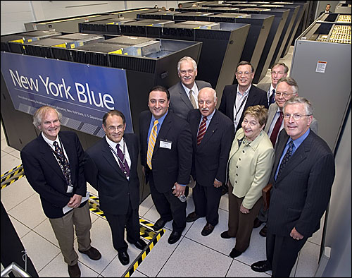
SBU/BNL New York Center for Computational Sciences
New York State Initiative for Computational Science
Funded two regional centers: SBU/BNL NYCCS and Computational Center for Nanotechnology at RPI
Promotes a state-wide program for collaborative research (academia, national laboratories, and industry) and education
in computational science and its applications
$26M Grant for hardware
  100 teraflop IBM BlueGene/L now
  28Tflops of BG/P coming later
Immediate Research Applications
  QCD – lattice gauge theory
  Astrophysics/fluid dynamics
  Nanoscience/Materials Science
Future Research
  Computational biology/drug design
  Climate modeling/energy modeling
www.sunysb.edu/nyccs/
www.bnl.gov/newyorkblue/
Notes:
22

Slide 23
Other Applied Research
Environmental Studies
  Innovative cleanup methods
Energy Research
  Efficient Oil burners
  Nuclear plant risk assessments
Nuclear Non-proliferation studies
Detector Studies for Homeland Security

Slide 24
Summary
BNL has a lot of interesting and exciting research
If you are interested in learning more about any of these areas or touring some of the facilities, let me know

