Slide 1



B → τ ν / D τ ν
B decays to τ leptons
Toru Iijima
Kobayashi-Maskawa Institute
Nagoya University
May 2, 2013
Brookhaven Forum 2013

Slide 2
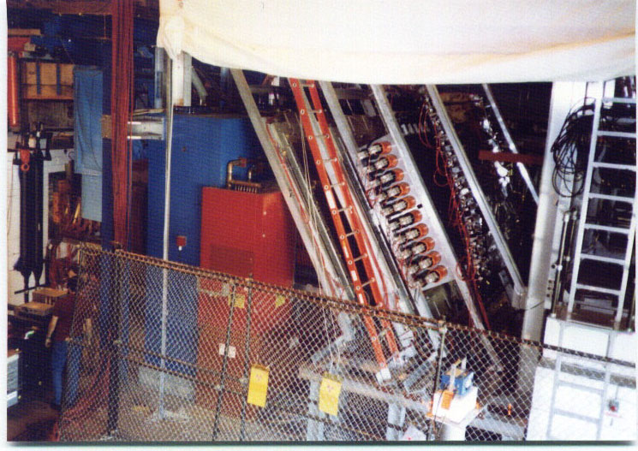
Talk Outline
Introduction
Purely leptonic decay B → τ ν
Semileptonic decay B → D^{(*)} τ ν
Future Prospect
Summary
BNL-E813/836
Search for “H particle”
My PhD experiment
Special thanks to Dr. Y. Horii (cf. his talk at Beauty2013)
B → τ ν / B → D^{(*)} τ ν
Sensitive for NP (H⁺,…)
Key flavor physics observables in the LHC era !
Notes:
This is outline of my talk.
After brief introduction with one slide, I present the Belle results on the purely leptonic decay,
B→tau nu, and the semileptonic decay, B→D(*) tau nu.
Then I give a few words on future prospect, and summarize the talk.

Slide 3
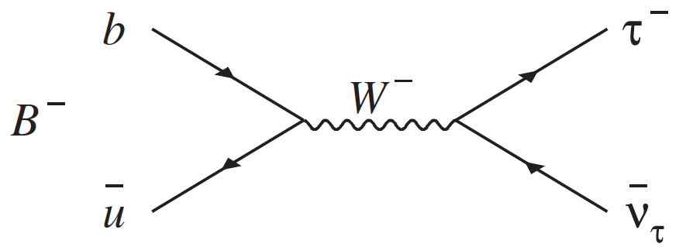
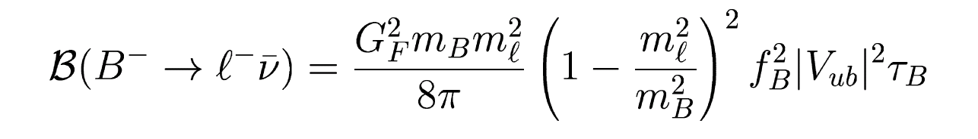
B⁻→ τ ⁻ ν in SM
Proceed via W-exchange, helicity suppressed.
Parameters
  B decay constant:
  CKM matrix:
HPQCD, PRD86
b→ulν, PRD86
Can be obtained also from a global CKM fit
Notes:
First, I talk on the B → tau nu decay.
Within the SM, the decay proceeds via W annihilation, and the branching fraction is calculated as shown in this
formula.
Its branching fraction is estimated to be 1.2 x 10^-4, using the most recent calculation for the B decay constant
by HPQCD and |Vub| as determined by HFAG based on the inclusive charmless semileptonic B decay..
It is noted however, if we reply on the global CKM fit, then the expected branching fraction becomes about
0.8, slightly depending on the party who provides the fit.

Slide 4
Charged Higgs Effect in B→τ ν
Charged Higgs exchange interferes with the helicity suppressed W-exchange.
Example of Br modification
Type II 2HDM, W. S. Hou,
PRD 48, 2342 (1993),
Notes:
If charged Higgs exists, the charged Higgs exchange interfere with the helicity suppressed W-exchange,
and the branching fraction may becomes larger or smaller, as a function of tan beta / Higgs mass, as
shown in this formula and figure.

Slide 5
Analysis for B → τν
e⁺
Tagging side:
B_{tag}
B_{sig}
S/N
Υ(4S)
Hadronic tags
B_{tag}→D^{(*)}π/ρ etc.
e⁻
π
K
Signal side: B_{sig}→ τ ν
π
Detect charged track(s)
Missing energy due to ν’s
No extra activities in EM calorimeter
(E _{ECL(extra)} )
Semileptonic tags
B_{tag}→D^{(*)}lν etc.
D^{(*)}
Semileptonic tag
MC expectation
BG
Arbitrary Unit
Inclusive tags
Used for Belle B→D*τν
signal (Br=1.79x10⁻⁴)
Eff
Notes:
Experimentally it is very challenging to detect the B→tau nu decay, since it has more than two neutrinos in
the final state, and the decay cannot be kinematically constrained. And, there would be large background
from the track belonging to the other B meson.
To solve these issues, the idea of the analysis at the e+e- B factory is the following.
We reconstruct one the B mesons (recoiling B meson against the signal B), either by hadronic decays
or semileptonic decays.
Then the B->tau nu signal is searched on the other side (signal side), where we detect charged tracks
from the tau decay, require relatively large missing energy due to neutrinos, and then require no extra
activities in the EM calorimeter.
The figure shows the extra energy distribution (from MC) . For signal, it distributes near zero, but for
the background, it tends to distribute in the higher region because of extra tracks (neutrals or charged
undetected by the drift chamber).

Slide 6
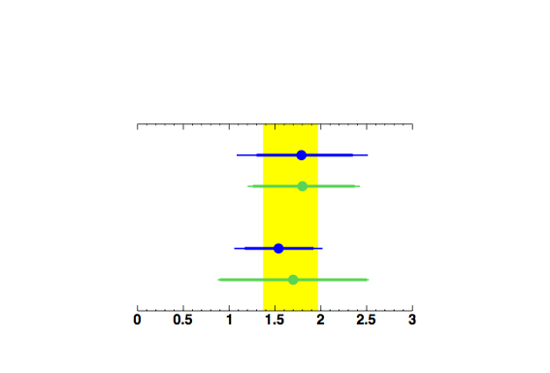
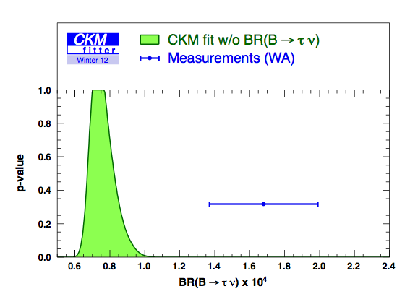
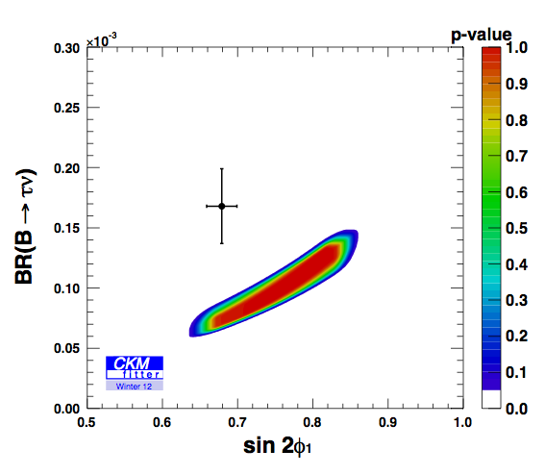





Status for B→τν before ICHEP 2012
Belle
Hadronic tag
BaBar
Semileptonic tag
Belle
BaBar
WA (HFAG): B = (1.67 ± 0.30) x 10⁻⁴
Relation with sin2Φ1.
Direct Meas.
Tension (2.8σ)
with CKM fit prediction.
CKM fit
Notes:
Here I show the status for... Belle and BaBar obtained results for had and semil, consistent. WA from HFAG is ... If we compare this result with a SM expectation from CKM global fit, ... Since CKM fit is strongly contributed from sin2phi1, we see a clear correlation. We thought one of B-<taunu and sin2phi1 might be affected...

Slide 7
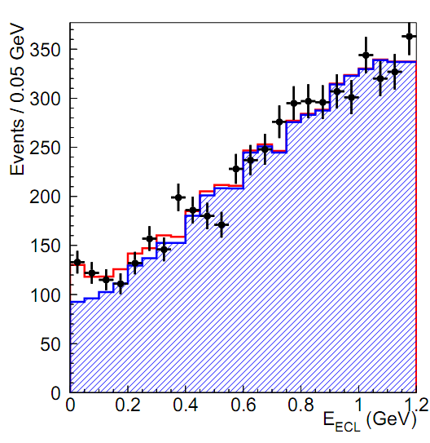
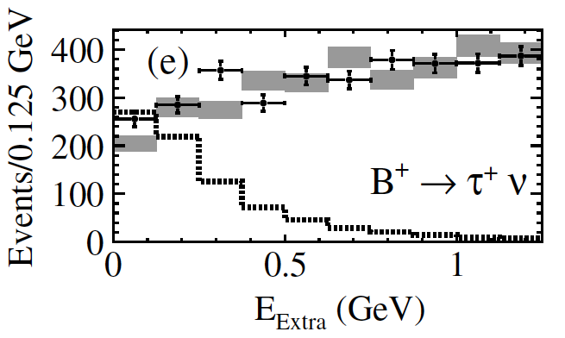
B →τν by Semileptonic Tag
Belle
BaBar
PRD 82, 071101(R) (2010).
Use 657 M BB.
B=[1.54^{+0.38}−0.37^{+0.29}−0.31]x10⁻⁴.
PRD 81, 051101(R) (2010).
Use 459 M BB.
B=[1.7±0.8±0.2]x10⁻⁴.
signal (3.6σ)
expected signal x 10
background
(Counting method employed.)

Slide 8
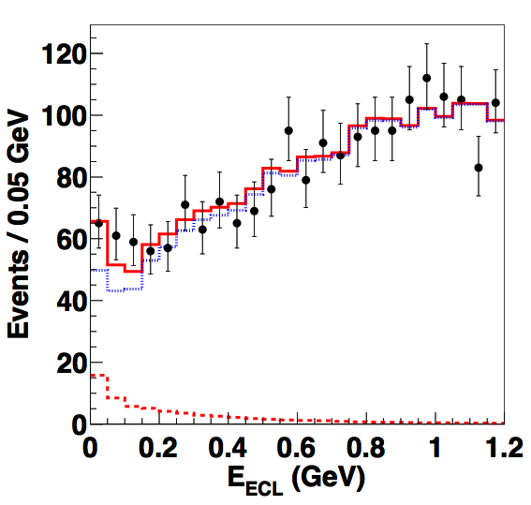
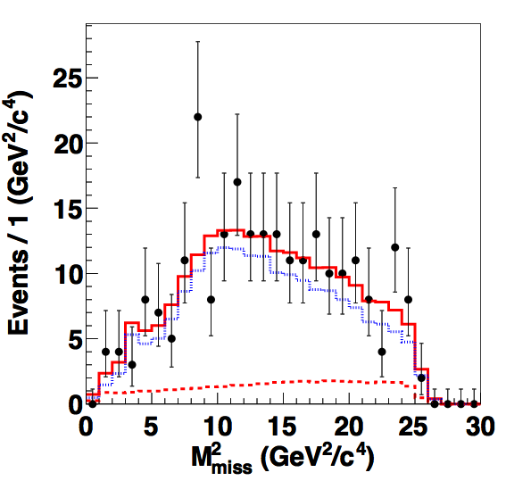
Belle at ICHEP2012
(Projected in all Mmiss² region.)
(w.r.t. Belle2006)
Use 772M BB (full) data
Improved tracking eff. by reprocessing data
Improved hadronic tags (NueroBayes algorithm)
Improved signal selection efficiency
(in trade of S/N)
Newly added K_{L} veto
Better understanding of peaking background
2D fit in (E_{ECL}, M_{miss}²) for signal extraction
x 1.7
background
x 2.2
signal (3.0σ)
x 1.8
(Projected in EECL<0.2 GeV.)
Published in PRL110, 131801 (2013)!

Slide 9
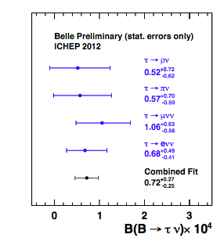
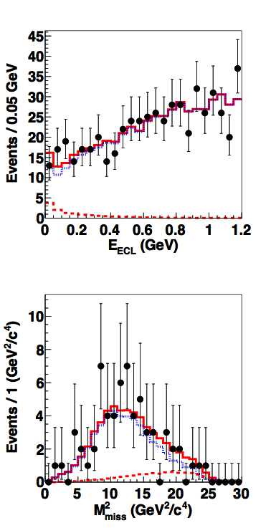
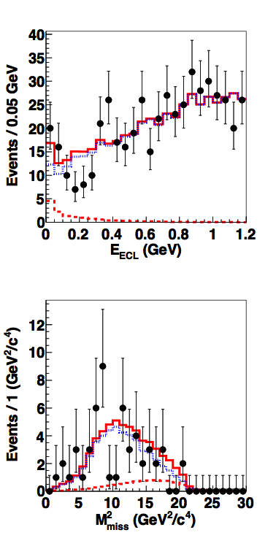
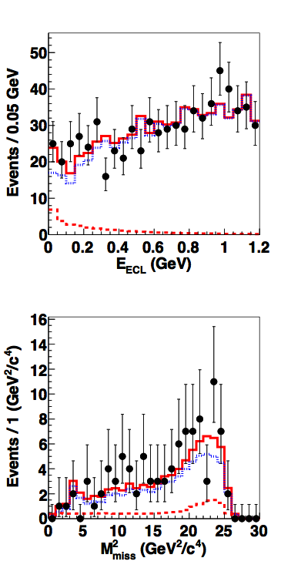
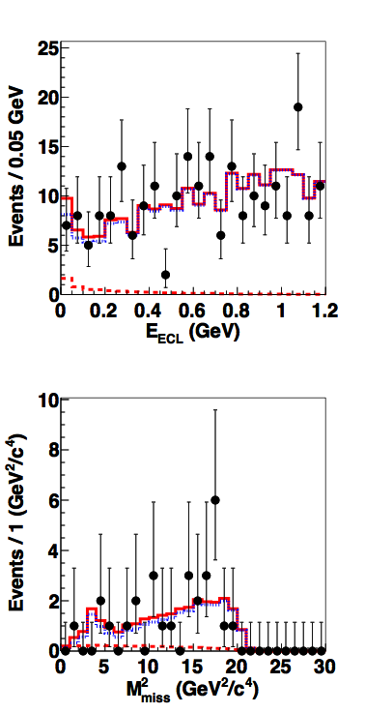
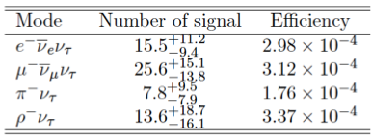
B→τν by Hadronic Tag at Belle, Mode Independence
As a check, we fit by floating the yields for different τ modes.
τ→eνν
τ→μνν
τ→πν
τ→ρν
Take τ→eνν, μνν, ρν cross-feeds in τ→πν candidates as signal.
Consistent results.
Rare unobserved BG decays (e.g. B→μνγ) would show up in individual signal modes.

Slide 10
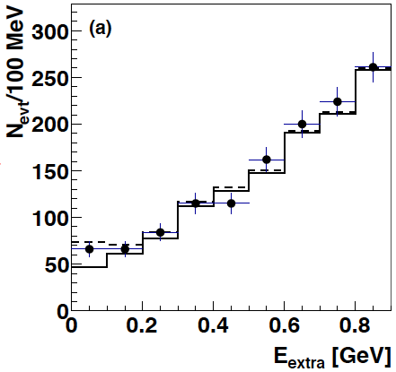
BaBar at ICHEP2012
arXiv: 1207.0698
Use 468M BB (full) data sample
Use four τ decay channels
  eνν, μνν, πν, ρν
Expanded set of hadronic tag modes
  including B→J/ψ X
  ~x 2 w.r.t. BaBar2008
Signal (3.8σ)

Slide 11
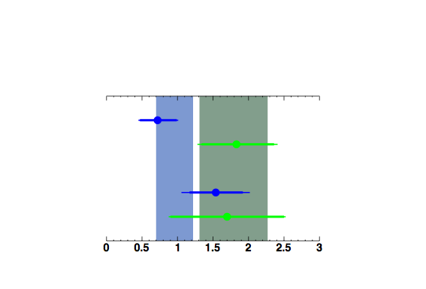
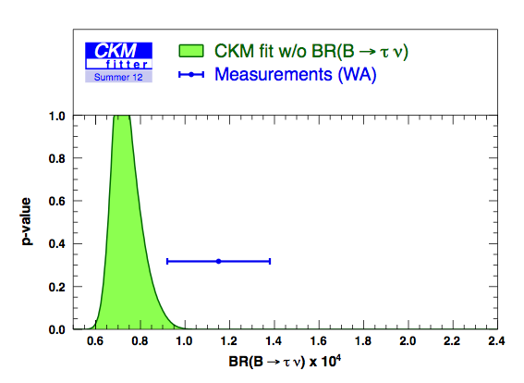
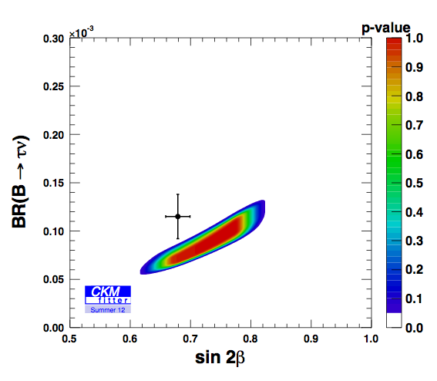
Status for B→τν after ICHEP 2012
Belle
Hadronic tag
BaBar
Belle
Semileptonic tag
BaBar
Belle combined: B=(0.96±0.26)x10⁻⁴ BaBar combined: B=(1.79±0.48)x10⁻⁴
A naive world average: B=(1.15±0.23)x10⁻⁴
Direct Meas.
1.6σ
CKM fit
Tension weakened.
Notes:
Here is a summary after ICHEP. Belle’s result is slightly smaller but consistent within the errors. WA becomes smaller due to Belle’s result, and is ...
Comparing with the CKM fitter prediction, we see a deviation of 1.6s.
The tension is weakened. It can also be seen in the 2-D plot with sin2phi1.

Slide 12
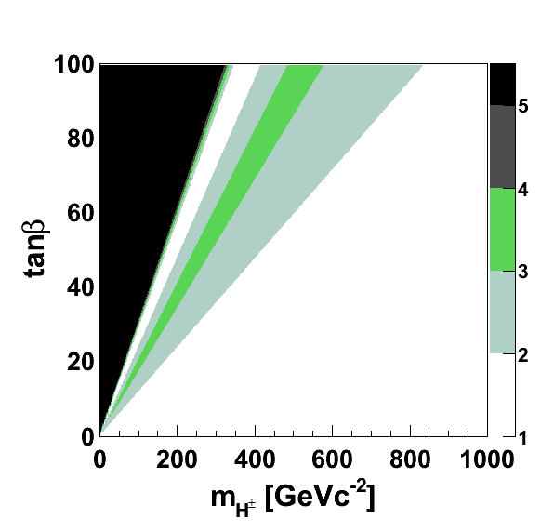


Constraint on Charged Higgs from B→τν
Assume Type-II 2HDM.
Excl. at
2σ
Use
  B(B→τν) = (1.15±0.23)×10⁻⁴
  B(B→τν)SM = (1.11±0.28)×10⁻⁴
where B(B→τν)SM is obtained from
3σ
5σ
Personal figure by Y. Horii.
Stringent constraint on tanβ and mH obtained.
    fB = (191±9) MeV (HPQCD, PRD86)
    |Vub| = (4.15±0.49)×10⁻³ (PDG, PRD86)
Note: constraint strongly depends on fB and |Vub|.
Notes:
Then, I want to discuss about the constraint on charged Higgs from B->taunu.
Here I assume type-II 2HDM. BR is related to mH and tan beta.
For exp value, we use WA. For SM value, we use 1.11 obtained from fB from lattice and Vub from b->ulnu, conservative than CKM fit. Fig. shows... Stringent... Note...

Slide 13
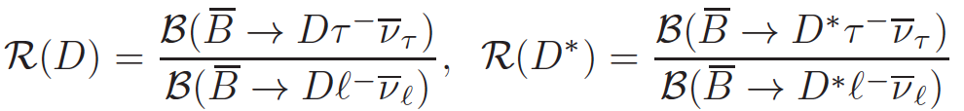
B→D τ ν
B→D τ ν is another process sensitive to the charged Higgs, and complementary to B→τ ν.
  Relatively large Br ~0.8%
  Different theory systematics:
    free from V_{ub} and f_{B} ambiguity.
    depends on the B→D form factors,
    which can be deduced from D l ν data.
|Vcb| and a part of QCD effects canceled by taking ratios.
Possible observables additional to the ratios:
  τ polarization, D* polarization, q² distribution, ...
b
c
H⁺/W⁺
τ ⁺
ν_{τ}
B→Dlν decay is measured precisely; Br(B⁻→D⁰lν) = (2.26±0.11)%
M. Tanaka, R. Watanabe, PRD87, 034028 (2013)

Slide 14
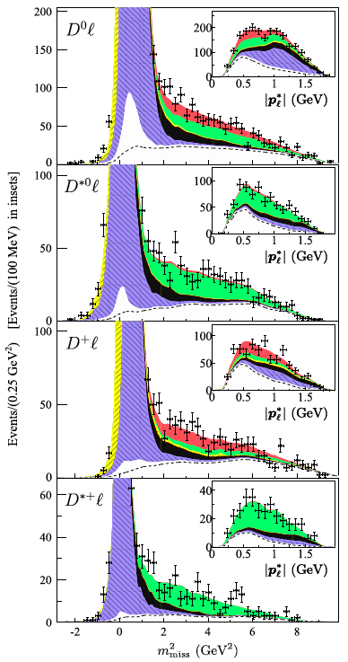


B→D^{(*)}τν from BaBar
D*lν
Dlν
Dτν
PRL 109, 101802 (2012).
arXiv:1303.0571, submitted to PRD.
Use 471 M BB (full data).
Improved hadronic tag by more modes.
Boosted decision tree for event selection.
D*τν
D*lν
Dlν
D*τν
D*lν
Dlν
Dτν
D*τν
R(D) = B(Dτν) / B(Dlν) = 0.440±0.058±0.042
R(D*) = B(D*τν) / B(D*lν) = 0.332±0.024±0.018
Systematic uncertainties from
D** BG, BG PDFs, BG yields, etc.
D*lν
D*τν
Notes:
The most precise measurements of B->D(*)taunu are given by BaBar.
Published in PRL and longer paper has been submitted to PRD.
Analysis based on full data. Hadronic tag is improved. Signal selection also improved.
The figure mmiss2... Resulting R values are. Syst. from...

Slide 15
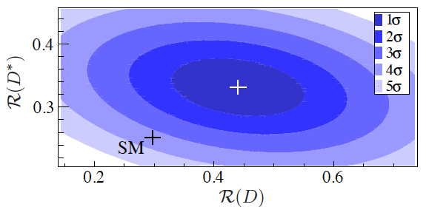
B→D^{(*)}τν from BaBar and SM
2.0σ
2.7σ
SM expectations in S. Fajfer, J. Kamenik, I. Nisandzic, PRD 85, 094025 (2012).
The possibility that the measured R(D) and R(D*) both agree with the SM predictions is excluded at the 3.4σ level.
(σ for 1-D Gaussian function)
Notes:
The results for R(D) and R(D*) are higher than the SM expectations.
The deviation is 2.0s for R(D) and 2.7s for R(D*).
The two experimental results have a negative correlation of about 30%.
Taking the correlation into account, the possibility...

Slide 16
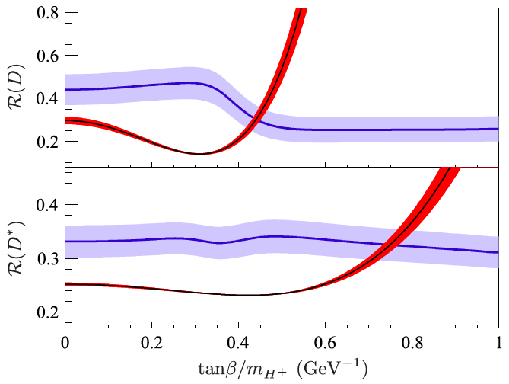
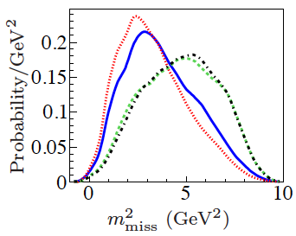



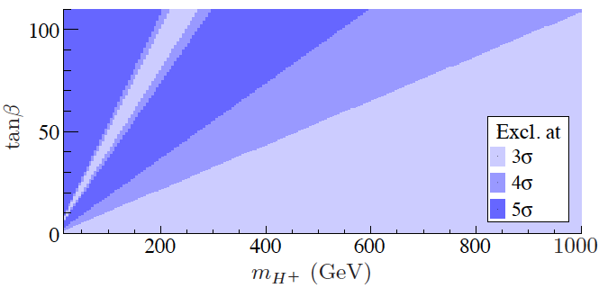

B→D^{(*)}τν from BaBar and Type-II 2HDM
0.5 GeV⁻¹
1.0 GeV⁻¹
SM
0.3 GeV⁻¹
(The values indicated for tanβ/mH.)
Exp. R(D^{(*)}) dependency mainly from mmiss² dependency (reflection of q² dependence).
Blue: this result, red: Type-II 2HDM.
The combination of R(D) and R(D*) excludes the Type-II 2HDM at 99.8% C.L. for any value of tanβ/mH.
tanβ
Note: Type III and q² spectra in arXiv:1303.0571.
mH [GeV/c²]
Notes:
Then we discuss about a constraint on type-II 2HDM.
Figure shows theoretical calculation for Type II and experimental results, depending on tan beta / mH. Experimental tanbeta/mH dependency, due to different spin between W and H... Combining R(D) and R(D*) results, 2-D plot is obtained. The ...

Slide 17
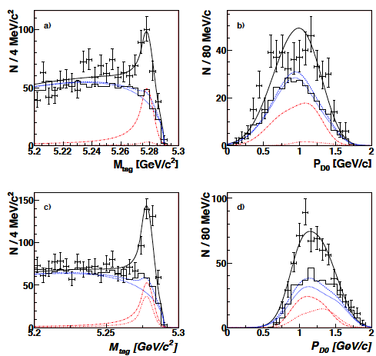
B→D^{(*)}τν from Belle
Inclusive tags
  B_{tag}’s are reconstructed by the four-vector sum of the tracks w/o recon. of the intermediate mesons.
  PRL99, 191807 (2007), 535M BB
    First observation of B⁰→D^{*-} τ⁺ ν (5.2σ)
  PRD82, 072005(2010), 657M BB
Hadronic tags
  Hep-ex/0910.4301, 657M BB,
  Preliminary
B⁻ →D*⁰τ⁻ν
B⁻ →D⁰τ⁻ν

Slide 18
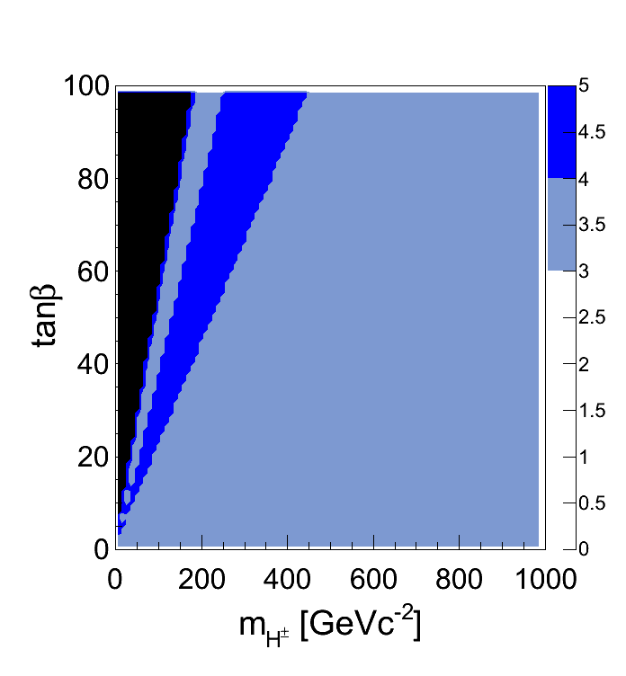
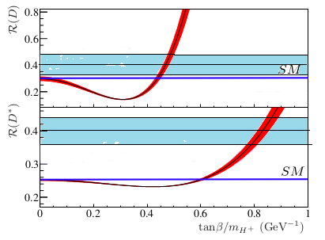
B→D^{(*)}τν from Belle
A. Bozek’s averages (KEK-FF 2013):
(naive averages for inclusive and exclusive hadronic tags)
Deviation from SM
R(D) = 0.430 ± 0.091 1.4 σ
R(D*) = 0.405 ± 0.047 3.0 σ
Combined 3.3 σ
Correlation btw R(D) and R(D*) neglected conservatively.
Constraint on Type-II 2HDM:
Y. Horii personal,
private communication
with Y. Sakaki, R. Watanabe,
and M. Tanaka.
R(D)
Experimental R(D^{(*)}) dependence on tanβ/mH not considered.
Experimental correlation between R(D) and R(D*) not considered.
Excl. at
3σ
R(D*)
4σ
5σ
0 0.4 0.8
tanβ / mH [GeV⁻¹]
Notes:
Unfortunately Belle does not have a final result on B->D(*)taunu and also official result for the constraint on Type II. Here we use Andrej Bozek’s averages for Belle’s inclusive and exclusive hadronic tags. Do not mention details about tag. The values are higher than SM. Here are plots for Type II. Dependency not checked. 2-D......

Slide 19
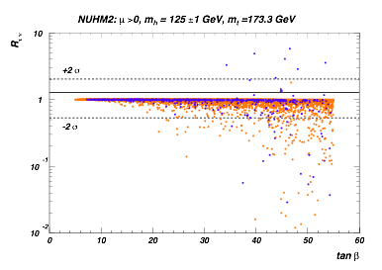
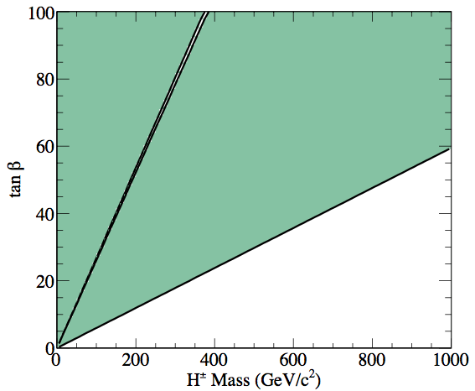
Prospect at Belle II
2-parameter nonuniversal Higgs model
H. Baer, V. Barger, and A. Mustafayev,PRD85, 075010
10
7GeV e⁻ ×4GeV e^{+,}
L_{peak} = 8 ×10³⁵cm⁻²s^{-1,}
L_{int} = 50ab⁻¹
B → τν
  Precision ~ a few %
  Need better precision for f_{B} |V_{ub}|.
B → μν, eν
  5σ observation expected for B(B→μν)SM at ~10 ab⁻¹.
  O(10⁻⁸) sensitivity at 50 ab⁻¹.
  Interesting to compare w/ B→τν
Belle II (50 ab⁻¹)
+2σ
1
−2σ
Rτν = B(B→τν)MSSM / B(B→τν)SM
WA (2007)
10⁻¹
μ>0, mh = 125±1 GeV, mt = 173.3 GeV
blue: m0 < 5 TeV, orange: m0 < 20 TeV
10⁻²
0 10 20 30 40 50 60
tanβ
Charged Higgs constraint (Type-II 2HDM)
50 ab⁻¹
Assume
Δexp ~ 1/√L,
Δf_{B}|V_{ub}| = 4 %

Slide 20
Request for theory
It is of great importance to improve precision for the SM prediction;
  f_{B} |V_{ub}| for B→τν
  Form factors for B→Dτν
Present error
Δf_{B} ~ 5%
Δ|V_{ub}| ~ 10% + incl. vs excl. saga
Recent Lattice QCD (FNAL/MILC)
Predicts R(D)=0.316(12)(7)
~1s higher than the previous estimates

Slide 21
Summary
B→τν and B→D^{(*)}τν are powerful tools for both testing the SM and searching for NP (charged Higgs,…).
Key flavor physics observables in the LHC era !
Recent B→τν results have weakened the tension with CKM fit.
Recent B→D^{(*)}τν results disfavor SM and type-II two Higgs doublet model at a level of >3σ.
    Final result from Belle using full data coming soon.
It is very important to measure B→ τν /D*τν with a few % precision.
Belle II will start physics run in 2016 !

Slide 22
Backup

Slide 23
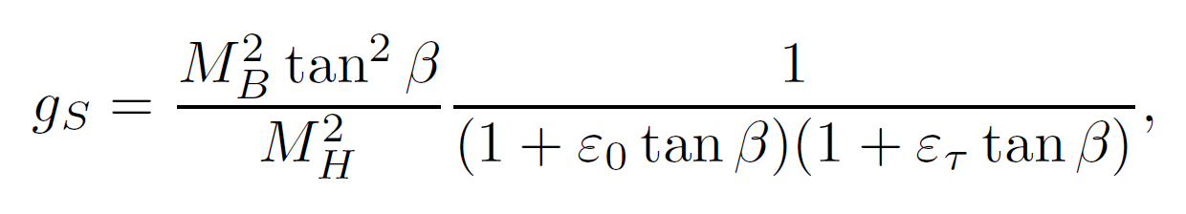
Charged Higgs in b → τ
Extensions of the SM, which require >2 Higgs doublets, generate new flavor-changing interactions at tree-level via exchange of a charged Higgs.
The H⁺ coupling is proportional to the fermion mass, and it is natural to look at (semi-)leptonic B decays into a τ in the final state.
B → τ transition (MSSM)
Effective scalar coupling;
SUSY Loop correction
ε₀=ε_{t}=0 in Type-II 2HDM
H⁺/W⁺
τ ⁺
Notes:
The tau lepton discussed in this conference is a good probe to NP. But it is not only in decays of tau leptons
Themselves, but also in heavy meson decays involving tau leptons in the final state.
For example, B decay to the tau lepton final state is of great interest to search for the charged Higgs boson.
Extension of the SM, which require more than two Higgs doublets, generate new flavor-changing interactions
at tree-level via exchange of a charged Higgs. As shown in the effective Hamiltonian, the H⁺ coupling term is
proportional to the fermion mass, therefore, it is natural to look at (semi-)leptonic B decays into a ταυ in the
final state. The effective scalar coupling is a function of the ratio of tan beta / charged higgs mass, therefore,
If you measure such decays, it provides information on tan beta/ charged higgs mass.

Slide 24
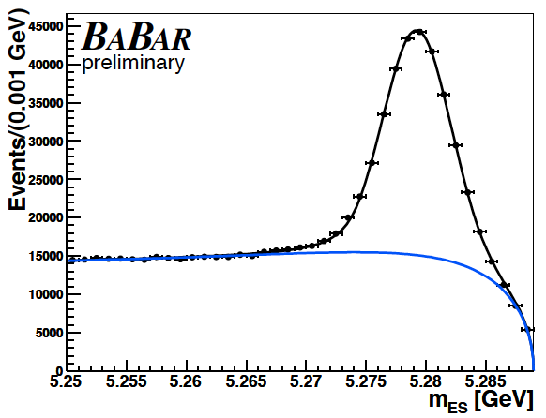
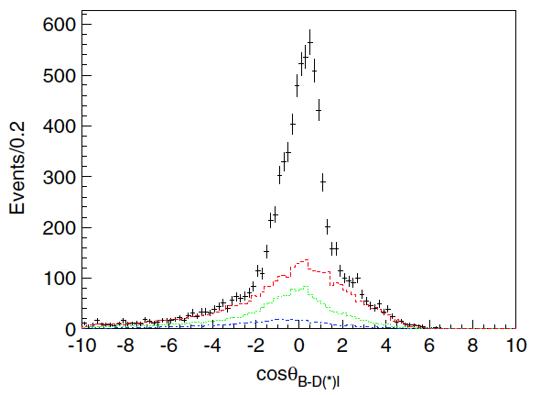


Tag for B→τν
Hadronic tag for B→τν by BaBar
Semileptonic tag for B→τν by Belle
Modes: B→D^{(*)}π, etc.
Efficiency = ~0.2%.
Less background.
pBsig determined.
Modes: B→D^{(*)}lν.
Efficiency = ~1%.
More background.
pBsig not determined.

Slide 25
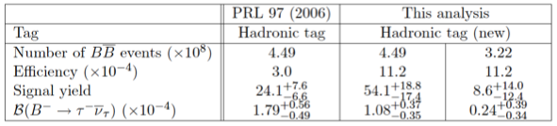
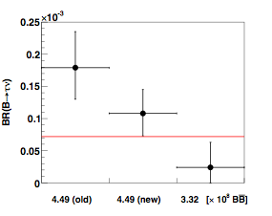
Comparison for B→τν Using Hadronic Tag at Belle
New analysis is based on improved tag, loose event selection, and reprocessed data.
Most of the data after the selection are independent from old analysis.
Assuming that all events in old analysis are included in new analysis, the remaining data sample in NBB = 4.49 × 10⁸ provides BR ~ (0.6±0.4) × 10⁻⁴ (1.9σ from old result).

Slide 26
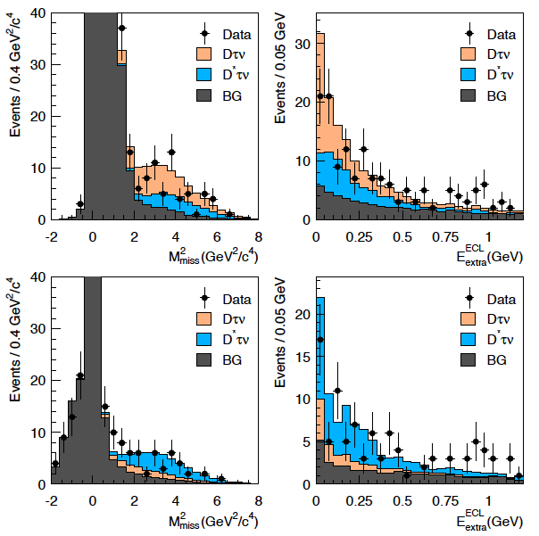


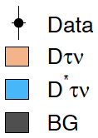
B±→D^{(*)}τν by Hadronic Tag from Belle
Using 657 M BB.
Simultaneous fit to both subsets.
D^{(*)}lν as control sample and normalization.
Evidence for signals.
3.8σ
3.9σ
BG: Dlν, D*lν, D**lν, DX, ...
Syst. from PDFs and cross-feeds.
arXiv:0910.4301

Slide 27
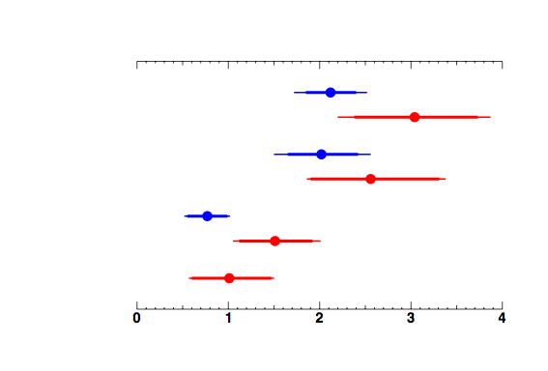
Summary for B→D^{(*)}τν from Belle
{
D*τν
{
SM
Dτν
inclusive tag
hadronic tag
SM
inclusive tag: PRL 99 (535M BB), PRD 82 (657M BB).
hadronic tag: arXiv:0910.4301 (657M BB).
Good agreement btw the results for inclusive and hadronic tags.
Not significant but slightly larger than SM expectations.

