Slide 1
A Simple, Yet Subtle “Invariance” of Two-body Decay Kinematics
Doojin Kim
Maryland Center for Fundamental Physics (MCFP)
University of Maryland, College Park
Brookhaven Forum May 2, 2013
K. Agashe, R. Franceschini, and DK, arXiv:hep-ph/1209.0772
K. Agashe, R. Franceschini, DK, and K. Wardlow, arXiv: hep-ph/1212.5230
K. Agashe, R. Franceschini, and DK, To appear soon

Slide 2
1. Introduction
Mass measurement: techniques so far
Invariant mass: “invariant” in any frame
Resonance production: Breit-Wigner, (most) clean if fully visible and lucky!
Not so clean fully visible channel, e.g., hadronic top, but combinatorics challenging
Endpoint method: nice upper edge, but edge could be lost depending on the distance of visible particles, combinatorics challenging
Transverse momentum/mass (Jacobian peak): nice upper edge, the other decay product irrelevant, but restricted to a single production of resonance
M_{T2} method: works for pair-produced mothers, but MET should be measured accurately and quite involved
Goal: Proposing a simpler technique (hopefully) taking the above advantages and avoiding the disadvantages

Slide 3
1. Introduction
Two-body decay kinematics
A simple 2-body decay of a heavy resonance B into (massive invisible) A and massless visible a
Rest frame of
particle B
Energy of visible particle a is fixed,
Its expression depends only on the masses of particles A and B,
a
E*: Energy of visible particle measured in the rest frame of particle B,
E* is measured, mass of A is known → mass of B can be measured! and vice versa.
It would be great to go to this special frame.
B
A

Slide 4
1. Introduction
Two-body decay kinematics
A simple 2-body decay of a heavy resonance B into (massive invisible) A and massless visible a
Energy of particle a should be Lorentz-transformed,
Its expression depends on the masses of particles A and B plus boost factor and emission angle of particle a from the axis of ,
Laboratory frame
a
β
B
β
Energy of particle a measured in the lab is no longer fixed, but a function of . → We get a distribution due to variation in . → information loss?
A
No need to get disappointed!
Peak of such an energy distribution = rest frame energy

Slide 5
Outline
Introduction
Notations/assumptions
Existence of peak
Fitting function
Proof of principle: top mass measurement
Applications
Summary

Slide 6
2. Notations/assumptions
Notations
Starred quantities → measured in the rest frame of the associated mother particle
: Lorentz boost factor of the mother particle in the lab frame
: probability distribution/density of boosts of mother particles
: energy distribution of visible particle in the lab frame
Assumptions
Visible particle (denoted by a) is massless,
Mother particles (denoted by B) should be produced unpolarized,
→ either scalar or all polarization states equally produced
Boost distribution of mother particle is non-zero near .

Slide 7
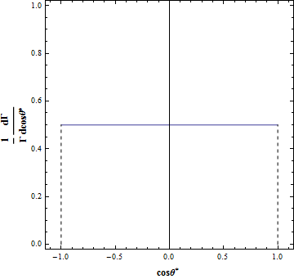
3. Existence of peak
Step 1: flat variable
Unpolarized mother particles
→ No OVERALL preference of the direction
of emission
→ is a flat variable .
Lorentz-transformed energy of the visible particle
→ E is also a FLAT variable.
→ The distribution in E is a simple rectangle/box for any given boost factor.

Slide 8
3. Existence of peak
Step 2: E* is always included
→
Two observations
Lower(upper) limit is always smaller(greater) than E*.
→ Any rectangle must contain E=E*
Lower limit is closer to the axis of E=E* than upper limit.
→ Asymmetric with respect to the axis of E=E*
For any given Lorentz factor ,

Slide 9
3. Existence of peak
Step 3: “stacking up” rectangles
Distribution in E → summing up the contributions from all relevant boost factors
→ “Stacking up” the rectangles weighted by (i.e., height is determined by )
For any generic with non-zero values around ,
E* must be the location of the peak!
Increasing
contribution from near

Slide 10
3. Existence of peak
Formal proof
First derivative
Vanishing derivative gives the extrema → this is the same as solving .
For simplicity, assume that does not vanish for any finite value of greater than 1.
→ This is typical for particles produced at colliders.
Two possibilities:
g(1)=0 : f’(E=E*) ∝ g(1)=0 → f has a unique extremum at E=E*.
g(1)≠0 : f’(E) flips its sign at E=E* due to the sign function (from + to -). → the distribution has a cusp at E=E* which appears as a peak.

Slide 11
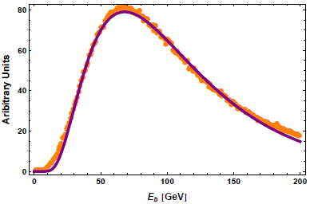
4. Fitting function
Shape f(E) derivable?
We want to measure the peak.
Of course, the peak in the energy distribution can be seen by eye.
Applying it for precision mass measurement, the peak should be
extracted from data as accurately as possible.
Also, knowing shape helps in the presence of background.
To obtain (theoretical) f(E), the boost distribution of mother g(γ) should be known.
g(γ) depends on the structure functions, actual decay vertex of mother particles, mother particle mass, collider, production mechanism etc. → process-dependent
But… keep moving → can investigate a few constraints that the generic f(E) must satisfy, → look for good candidates capturing such properties, → test them and employ the best one.

Slide 12
4. Fitting function
Functional properties of generic f(E)
f is a function with an argument of , i.e., even under .
← clear from the expression of f(E)
f is maximized at E=E*.
← proven heuristically and formally
f vanishes as E approaches 0 or ∞.
← the integral expression of f(E) becomes trivial in those limits.
f becomes a δ-function in some limiting case.
← if any of mother particles are NOT boosted, i.e., the rest frame, then f should return a
δ-functionlike distribution.

Slide 13
4. Fitting function
Proposal of a “simple” ansatz
K₁(p) : modified Bessel function of the second kind of order 1
p : fitting parameter which encodes the width of the peak
E* as a fitting parameter can be extracted by fitting!
All four properties are satisfied. → for the last property, use the asymptotic behavior of K₁(p)
Proposed ansatz does not develop a cusp so that it is more suitable for the case of g(1)=0, e.g., pair-production of mothers (cf. the case of g(1)≠0, single production of mothers).

Slide 14
5. Proof of principle: top mass measurement
b-quark is NOT massless!
Process to be chosen :
So far, the argument have gone through based on the assumption of a massless visible particle.
b-quark is not massless! (even if its effect typically can be negligible in most of the high energy experiments)
It is expected that the theory will break down to a certain degree.
The effect will be negligible for the top pair production.
→ Possible to quantify such an effect?

Slide 15
5. Proof of principle: top mass measurement
A brief look into the massive case
Energy of the visible particle should be Lorentz-transformed in a modified way.
Each rectangle’s coverage becomes shrunken.
One modification : the lower bound is NOT smaller than E* for some boost factors! (while the upper bound is still greater than E* for any boost factor)
→ Our argument is not applicable for such boost factors, and E* cannot be the location of the peak. : E_{peak} ≥ E* → The critical boost factor can be calculable.
with being the boost factor of the visible particle in the rest frame

Slide 16
5. Proof of principle: top mass measurement
A brief look into the massive case
For the top decay,
→ This value is not accessible given the current LHC-14TeV.
→ The peak still stays at E=E*.
Another modification : symmetry property w.r.t E=E* does NOT hold!
Such a symmetry property implies for any .
→ One possible estimator for deviation :
→ δ_{m} can be large for large m_{b} and .
For the top decay,
and typical of top quarks is roughly 1.2-1.4
→ Violation of the symmetry property is negligible.

Slide 17
5. Proof of principle: top mass measurement
Test of ansatz
We check whether or not the proposed ansatz can reproduce the theory prediction by Monte Carlo simulation.
The channel for test :
MadGraph5, LHC 7-TeV, PDF of CTEQ6L1
Infinite statistics
No cuts are imposed.

Slide 18
5. Proof of principle: top mass measurement
Detector level test
The proposed fitting function successfully reproduces the theory prediction.
→ The ansatz may be used for extracting the peak position and thus mass relation.
→ To be more realistic, we do a detector level test with cuts and realistic statistics processing each event further with Pythia and Delphes.
The process for test :
Realistic cuts are employed (according to ATLAS collaboration¹⁾ ).
Two hardest jets are selected as b-jets.
We perform 100 pseudo-exp’s each of which is equivalent to 5fb⁻¹ of data from LHC-7TeV.
1) ATLAS Collaboration, Tech. Rep. ATLAS-CONF-2012-097, CERN, Geneva, Jul, 2012

Slide 19
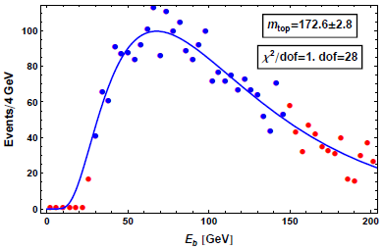
5. Proof of principle: top mass measurement
Detector level test
(Assuming W mass is well-known,) the result is quite good.
<m_{top}>=173.1±2.5 GeV [1.1]
Our method does NOT compete with the traditional method of m_{top} measurement.
Compared with the traditional method, ours is simpler. : purely based on the kinematics and not rely at all on the detailed knowledge of underlying dynamics of top decay such as matrix element of the process.

Slide 20
6. Applications
Mass measurement of new particles
Two step cascade decay: 3 unknowns ( m_{A}, m_{B}, and m_{C} )→ three equations are needed.
b a
C B A
Peaks can be extracted even in the presence of background → describing background by a simple analytic function → fitting full data with signal and background templates
Example process: → → (work in progress)

Slide 21
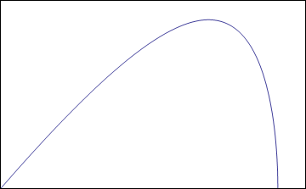
6. Applications
2 body vs. 3 body
A 3-body decay of a heavy resonance B into (massive invisible) A, A’ and massless visible a
Rest frame of
particle B
Energy of particle a is not fixed unlike the 2-body decay.
It is given by a
distribution.
a
B
A
E*_{max}
A’

Slide 22
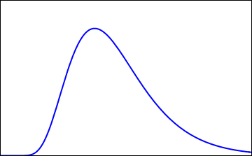
6. Applications
2 body vs. 3 body
Each value of the rest-frame energy goes through similar argument in 2-body kinematics.
The peak value is lower than the maximum rest-frame energy. (cf. the peak value is the same as the fixed rest-frame energy in 2-body kinematics)
Reference values (E*_{max} for 3-body vs. E*_{fixed} for 2-body) can be measured by other observables such as M_{T2}.
Peak = Reference value → 2-body decay
Peak < Reference value → 3-body decay
E*_{peak}
E*_{max}

Slide 23
7. Summary
Existence of the peak
In the lab frame, the rest-frame energy of the visible particle can be reconstructed by finding the peak position in the lab-frame energy distribution assuming that such a visible particle comes from a two-body decay of a heavy resonance. E^{peak}_{lab frame}=E_{rest frame}
In order to use this information for mass measurement, such a peak position must be extracted from data accurately.
Even if it is hard to have the analytic expression for the shape of the lab energy distribution, based on a few functional properties, we can propose a well-motivated ansatz for it.
The goodness of the proposed ansatz is tested with the top decay process, and it turns out that the ansatz can reproduce the theory prediction well.
The potential for mass measurement is also tested with the same top decay sample considering cuts, detector effects, and realistic statistics, and it gives a reasonable result.
Various applications are possible such as mass measurement and determination of decay topologies.

Slide 24
Thank you for your attention

Slide 25
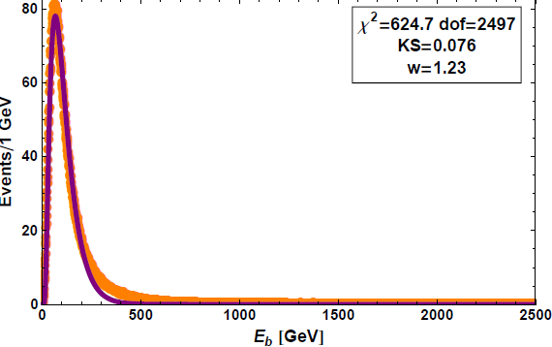
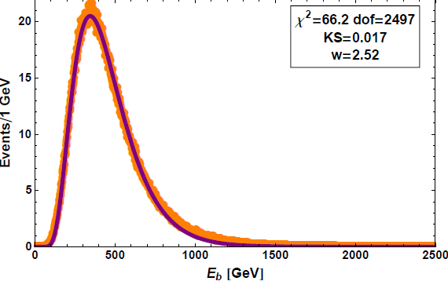
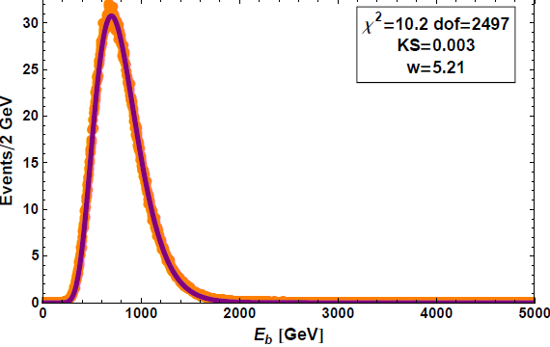
Back-up
Mass-sensitivity of fitting
m_{top}=173 GeV
m_{top}=700 GeV
m_{top}=1.4 TeV

Slide 26
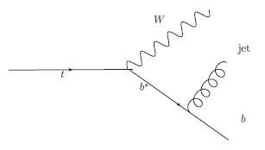
Back-up
NLO effect, combinatorics, and production mechanism
Neglect hard radiation from bottom quarks → suppressed by + jet-veto
Safe from soft radiation off bottom
Safe from initial state radiation
No combinatorics
Independent of production mechanism as far as the mother particles are unpolarized
(cf. matrix element method)

Slide 27
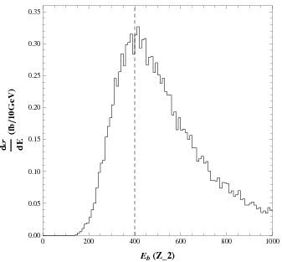
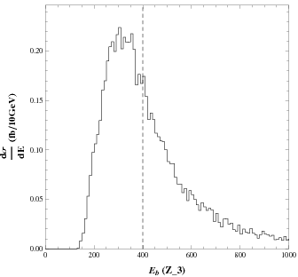
Back-up
Three-body decay kinematics
2-body decay
3-body decay

