Slide 1
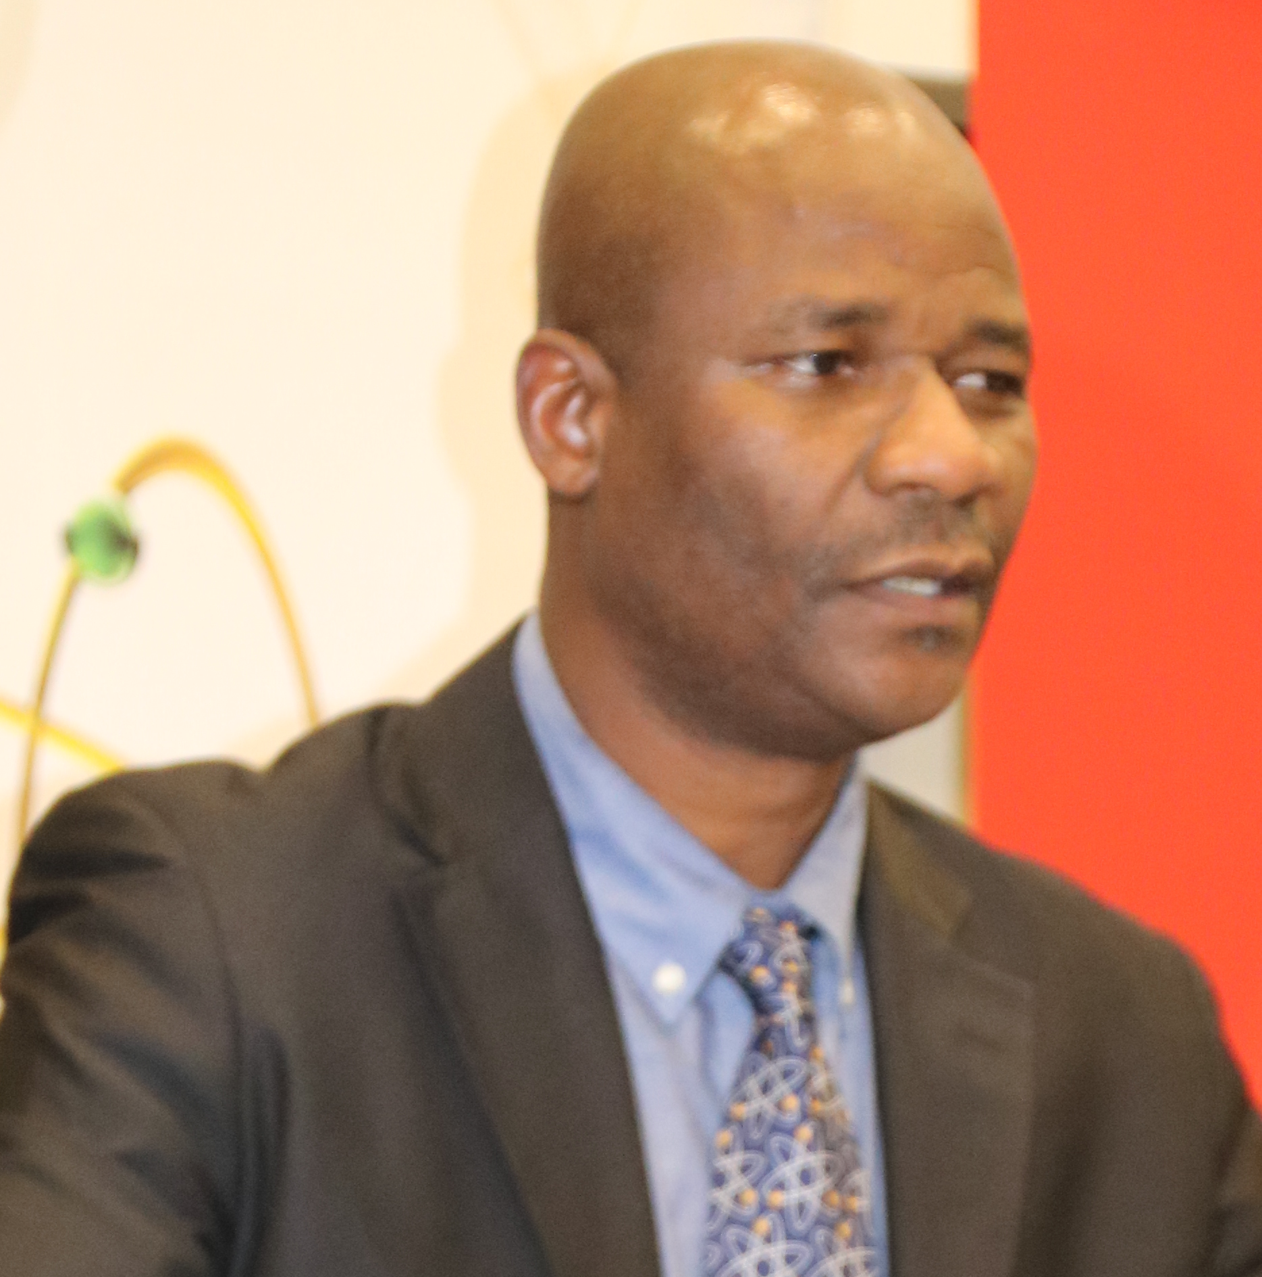
Search for a new particle in the decay of the Higgs boson
Dr. Kétévi A. Assamagan
BNL

Slide 2
Outline
Brookhaven National Laboratory
CERN, the Large Hadron Collider (LHC) and the ATLAS Experiment
Motivation: The discovery of the Higgs boson has opened new frontiers in the searches for physics beyond the Standard Model (SM)
  Through searches for additional Higgs bosons — not discussed here
    An observation of a charged Higgs signal would constitute an irrefutable proof of physics beyond of the SM
  Or in the decays of the discovered Higgs boson —the “new physics” might show up here
  Or for Super Symmetry where the discovered Higgs boson is used as a “handle” in the searches —not discussed here
International Outreach: African School of Fundamental Physics and Applications

Slide 3
Some fundamental Questions in Particle-astro Physics
What is mass?
  Newton told us that an object’s weight is proportional to its mass
  Einstein explained that energy is proportional to mass
  But neither Newton nor Einstein explained to us what mass is. The search for the Higgs boson may provide the answer
Why is the visible universe only 4% of the total?
  96% is invisible. What is the nature of Dark Mark?

Slide 4
Some fundamental Questions in Particle Physics
Why is there more matter than anti-matter in the university?
  They should have been created equally
Why do we have 4 fundamental forces?
  Was there a unique single force at the beginning, which later split into 4 different forces? Were the 4 forces unified in the beginning?
What was matter like when it was first created?
  Primordial plasma?

Slide 5
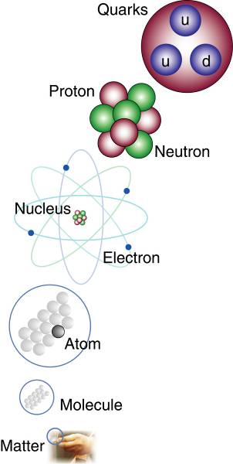
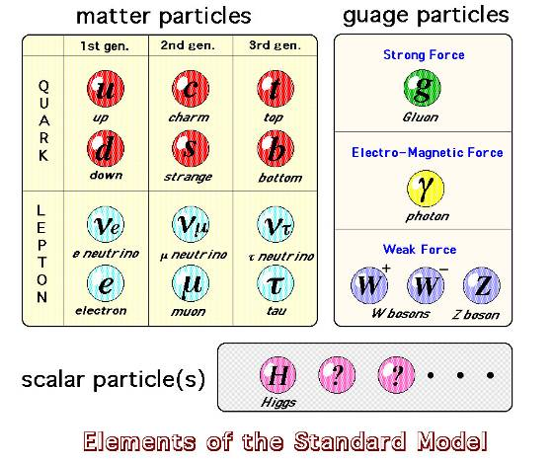
The study of elementary particles and fields
and their interactions
gauge
x8
All the particles in the Standard Model
Have been found

Slide 6
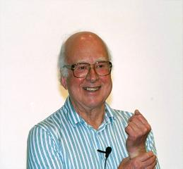
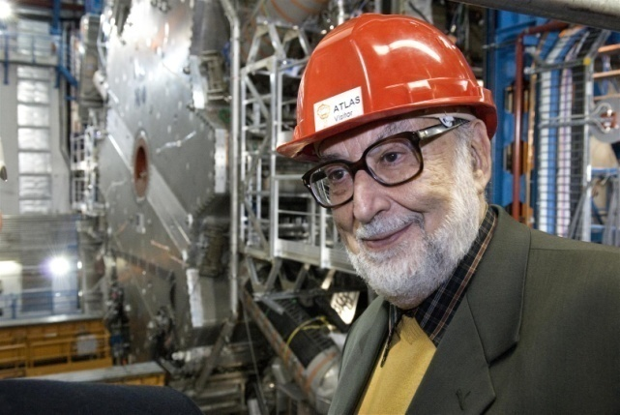
A most basic question is why particles (and
matter) have masses (and so different masses)
Peter Higgs
The ‘Higgs mechanism’ solves the mass mystery. Predicts a new particle, the Higgs boson, discovered in 2012
The Higgs (H) particle has been searched for since decades at accelerators, and found in 2012
Announced on July 4, 2012 is the Higgs boson
Francois
Englert

Slide 7
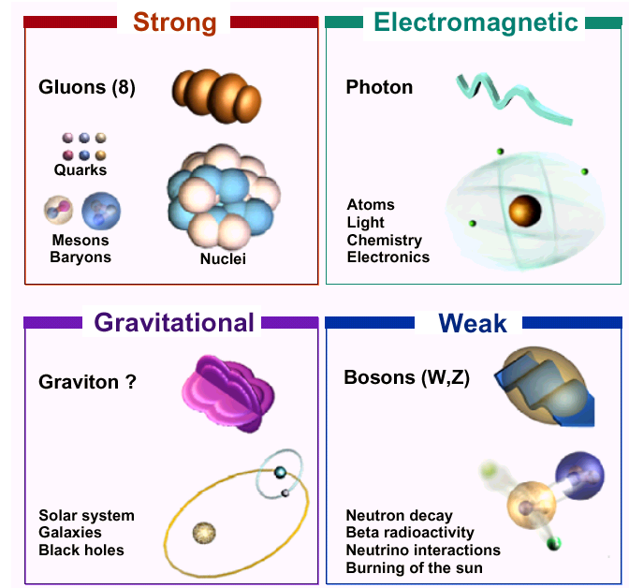
The Four Fundamental Forces

Slide 8
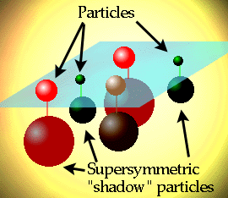
Supersymmetry (SUSY)
Symmetry between fermions (matter) and bosons (forces):
Each particle p with spin s has a SUSY partner p with spin s -1/2
~
Our known world
Maybe a new world?
Motivation:
Provide candidate for
dark matter and
force unification
SUSY particles have
not been found yet

Slide 9
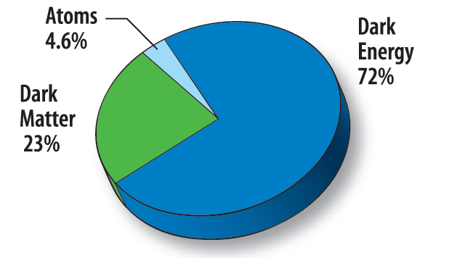
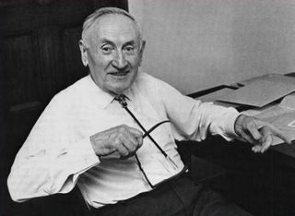
Astronomers say
that most of the matter in the Universe is
Invisible Dark Matter
We shall look for them with the LHC
‘Supersymmetric’ particles ?
F. Zwicky 1898-1974
Composition of the Universe

Slide 10
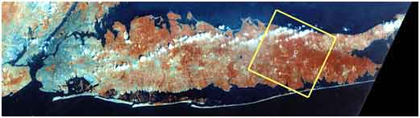
Long Island and Brookhaven

Slide 11
Brookhaven at a glance
~2950 employees;
Budget – about $750M
>4000 scientific facility users annually
Seven Nobel Prizes garnered
  12 Scientists honored (users & staff)
  First in 1957, latest in 2009
Work for
Others 12%
High Energy
Physics 9%
Other DOE
3%
National Nuclear Security
Administration 8%
Nuclear
Physics
31%
Environmental
Management 3%
Other Office of
Science 2%
Safeguards &
Security 2%
Basic Energy
Sciences 26%
Biological &
Environmental Research
4%
  ~3/4 from Department of Energy (DOE) Office of Science ; others NASA, NIH, NRC
11
Notes:
11
11
11

Slide 12
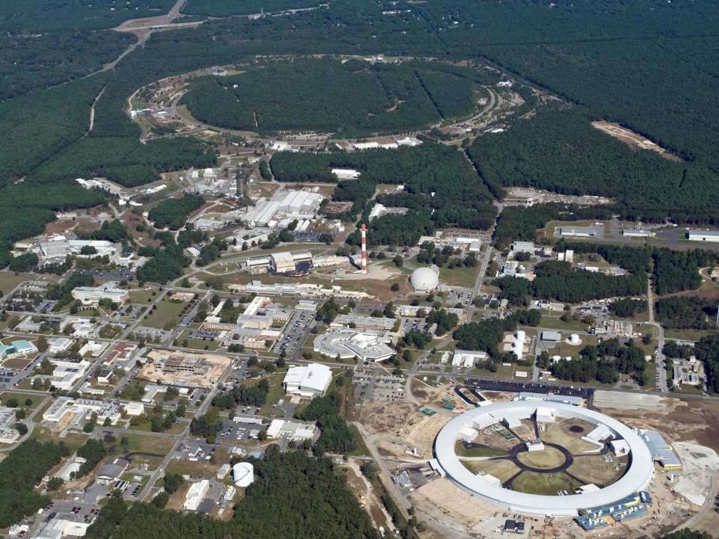
Brookhaven National Laboratory
RHIC
New York Blue Supercomputer
Interdisciplinary Energy Science Building
NSLS
CFN
NSLS-II
Long Island Solar Farm
October 2011

Slide 13
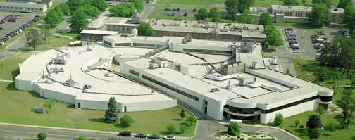
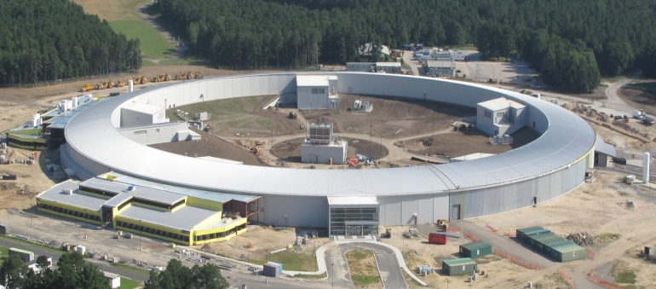
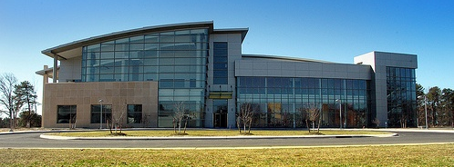
Major Research Facilities
National Synchrotron Light Source
Industrial and academic users
Researching battery storage, Alzheimer’s disease, breast cancer, HIV/AIDS, environmental cleanup technology, and more
National Synchrotron Light Source
National Synchrotron Light Source II
World’s most advanced x-ray source
$960 million project - hundreds of local jobs
Deliver research advancements in energy,
nanotechnology, medicine and other fields
National Synchrotron Light Source II
Center for Functional Nanomaterials
Exploring energy science at the nanoscale
Building new materials atom-by-atom to achieve desired properties and functions
Center for Functional Nanomaterials

Slide 14
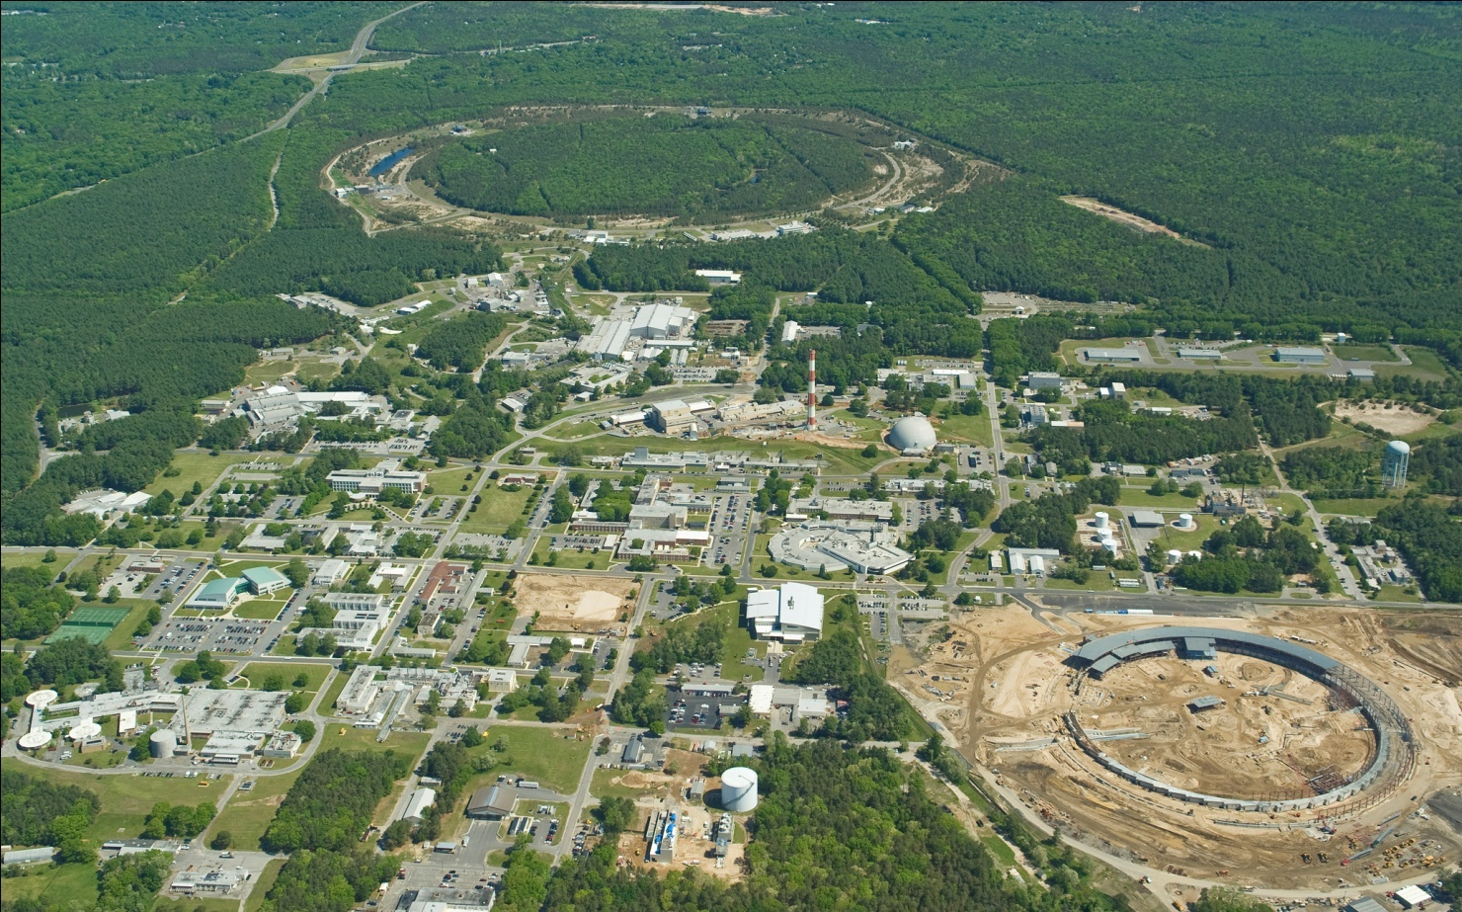
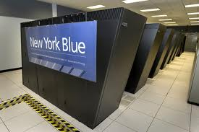
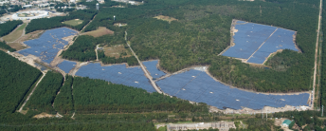
Major Research Facilities
RHIC
2.4 mile circumference
Studying the origins of the universe through
particle collisions revealing make up of matter
Discovery of the ‘perfect liquid’
Relativistic Heavy Ion Collider (RHIC)
New York Center for Computational Science
Partnership between BNL & Stony Brook University
Two IBM supercomputers
Supports broad range of research
New York Blue Supercomputer
Long Island Solar Farm
Partnership between BNL, LIPA and BPSolar
32MW Peak to power 4500 L.I. homes
Unique opportunity to study renewables in the Northeast and test new Grid technologies
Long Island Solar Farm

Slide 15
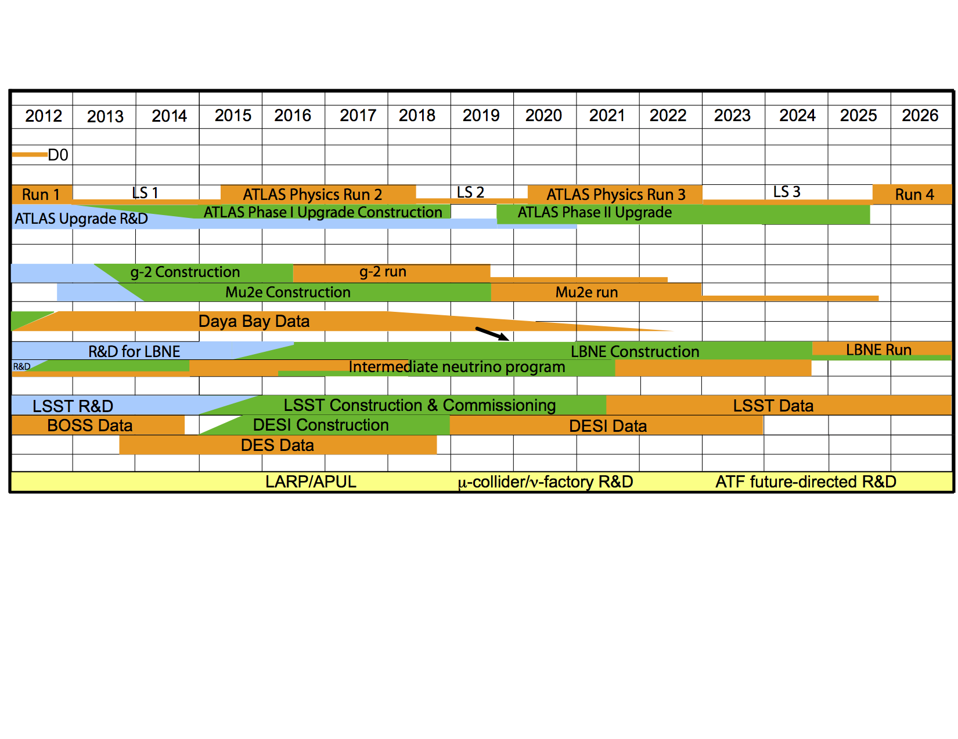
Long-Term Vision for BNL HEP
Goal: technical & intellectual leadership in key experiments at the three frontiers (energy, intensity, cosmic), supported by theory, advanced accelerator studies, detector R&D, and computing.
ATLAS, LBNE, LSST are our physics priorities in the three frontiers for the coming decade.
Notes:
You see here the time line for the experiments that BNL is committed to.
Read : “our goal is…”
In the Energy frontier our program is based on the ATLAS experiment with the Phase I and Phase II upgrades. Taking us all the way to the end of the next decade.
In the Intensity frontier our main thrust is in neutrino physics but with critical contributions to contributions to g-2 and mu2e.
The Cosmic frontier our main thrust is toward LSST – with a small but amazingly effective contributions to BOSS and DES.
To maintain our technical infrastructure we need to have a balance between R&D, Construction and analysis at any given time.

Slide 16
Synergy
Even Broader Leveraging for Overall HEP Efforts
Instrumentation
Division
C-A Department
BNL
Detectors,
Electronics
Incl. LSST
focal plane
sensors
LDRDs,
Program Development
Mech. & Elec.
Engineering; ATF support; collab’n on LARP, Proj. X; BLIP, NSRL
Magnet Division
Chemistry Department
BNL Synergies
Magnets, Cryogenics, LARP & APUL leadership
Material Studies, Purification, liquid scint development
RIKEN-BNL Research Center
BNL/SBU Center for Accelerator Science & Education
Lattice QCD
Light Sources
High Energy Physics
Nuclear Physics
RHIC & RHIC Computing
Cross-hatched boxes reside in Nuclear and Particle Physics Directorate
16
Notes:
16
BNL has many advantages in this area by virtue of being a multi-disciplinary lab. There are lots of resources that can be accessed outside the direct KA1503 support.
16

Slide 17

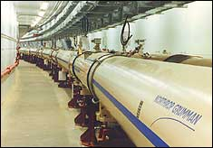
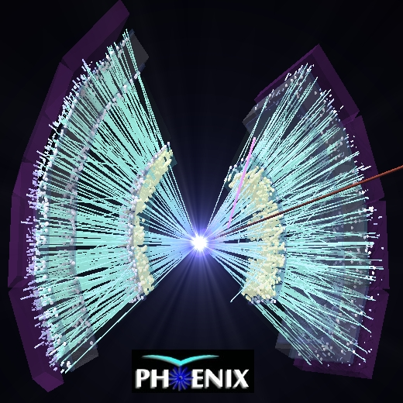
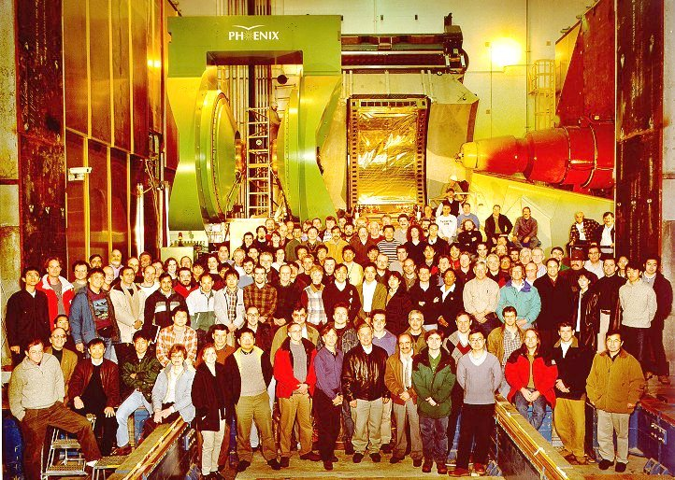

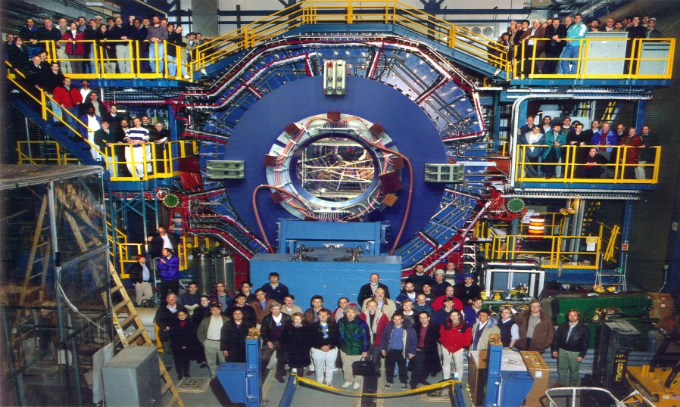
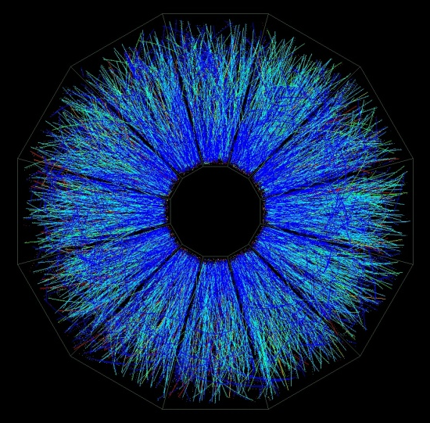
RHIC Overview
7 coupled accelerators
Nucleus –nucleus collider from
  10-200 GeV/nucleon
  Symmetric or asymmetric species
Polarized p-p collisions up to 500 GeV
Capabilities unique world-wide
STAR

Slide 18
My Research …
I am a physicist at BNL
I do experimental particle physics with the ATLAS Experiment at CERN in Geneva
  This is what I will talk about now …

Slide 19
Large Hadron Collider Project:
A Journey to Discover the Physics
A dream became reality…

Slide 20
Proton-proton physics at the LHC corresponds
to conditions around here
Heavy Ion physics at the LHC corresponds
to conditions around here

Slide 21

The LHC machine
Proton-Proton Collisions
Heavy Ion Collisions
Large Hadron Collider
Lake of Geneva
CMS
LHCb
Airport
ALICE
ATLAS
The LHC is a 27 km long collider ring housed in a tunnel about 100 m underground near Geneva

Slide 22
pp √s = 14 TeV L_{design} = 10³⁴ cm⁻² s⁻¹ (after 2013)
7 TeV L_{initial} < few x 10³³ cm⁻² s⁻¹ (before)
Heavy ions (e.g. Pb-Pb at ~ 1150 TeV)
ATLAS and CMS:
general purpose
TOTEM
LHC 27 km ring (previously
used for the LEP e⁺e⁻ collider)
Plus 3 much smaller
experiments with very
forward detectors at
Point-1: LHCf
Point-5: Totem
…
ALICE:
Heavy Ions
LHCb:
B-physics, CP-violation

Slide 23
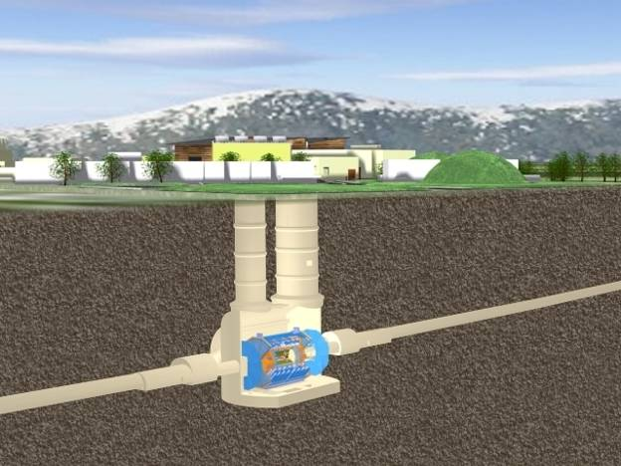
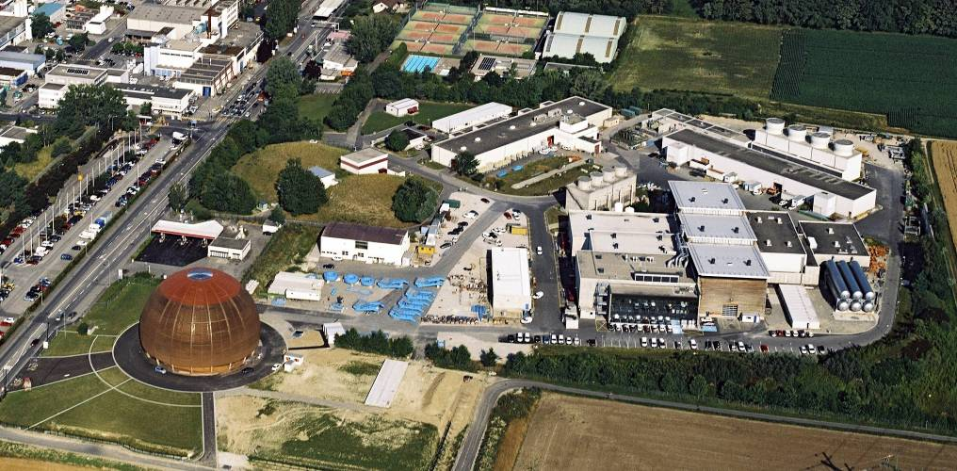
The Underground Cavern for the ATLAS Detector
Length = 55 m
Width = 32 m
Height = 35 m
Side C
Side A
Side C
Side A

Slide 24
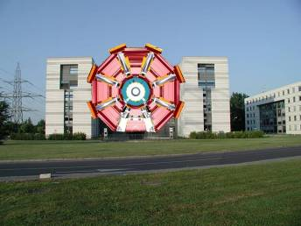
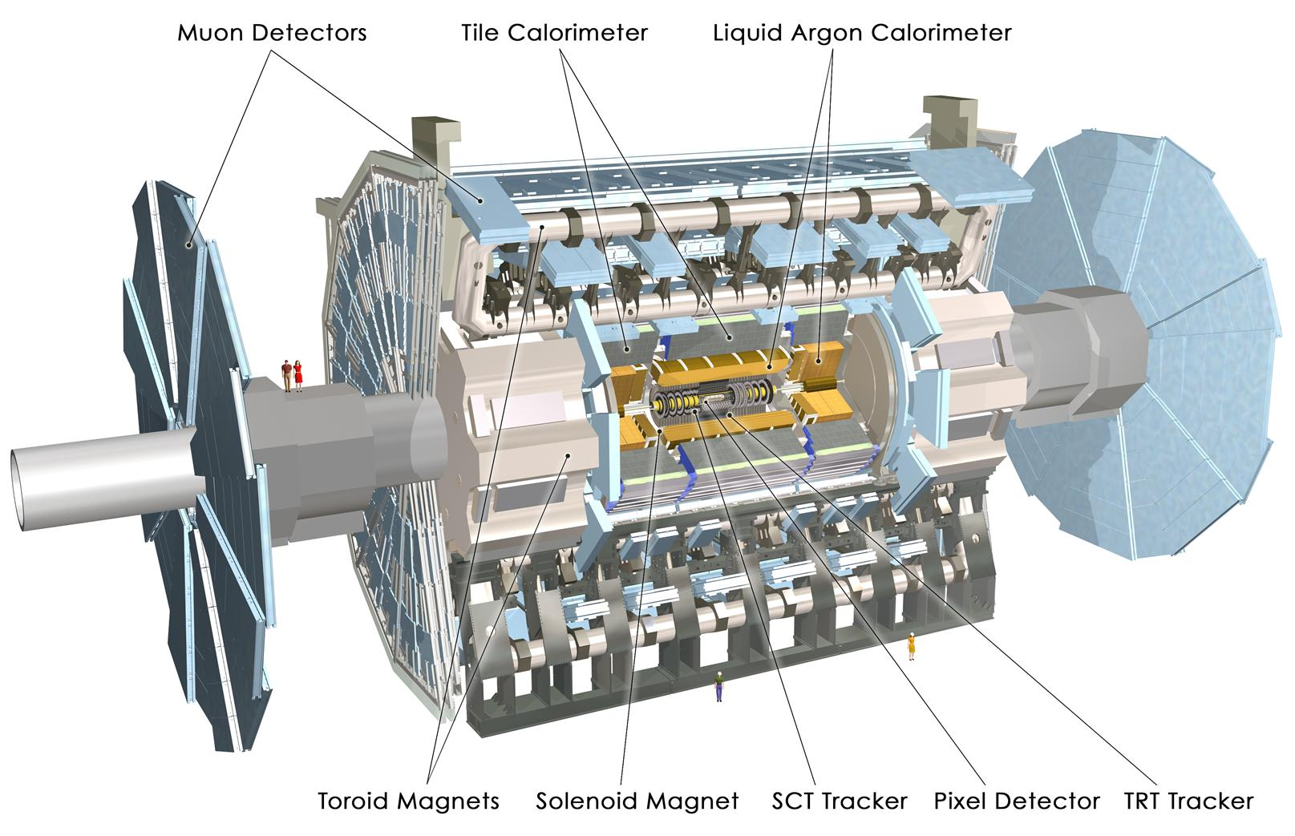
ATLAS Detector at the LHC
3300 Physicists
550M Swiss Franks
45 m
24 m
7000 Tons

Slide 25



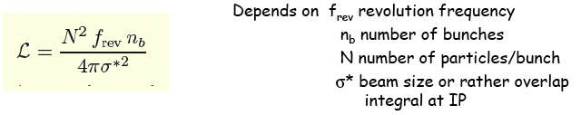
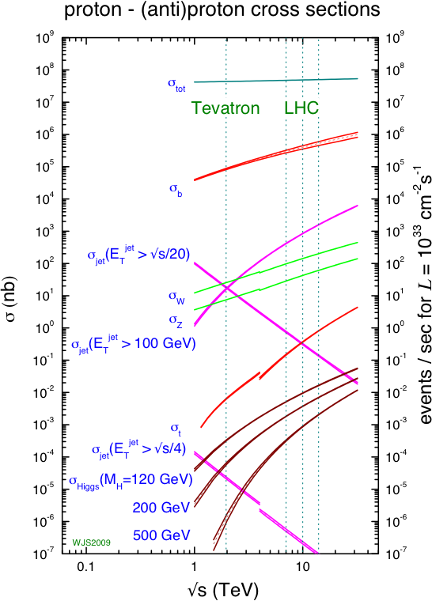
Luminosity
In scattering theory and accelerator physics, luminosity is the number of particles per unit area per unit time, times the opacity of the target, usually expressed in cm⁻² s⁻¹. The integrated luminosity is the integral of the luminosity with respect to time. The luminosity is an important value to characterize the performance of an accelerator.
The following relations hold
Number of measured events
Rate
Differential cross section
1000 evts (1fb⁻¹@7TeV)

Slide 26
25 ns
Event rate:
N = L x σ (pp) ≈ 10⁹ interactions/s
Mostly soft (low p_{T}) events
Interesting hard (high-p_{T}) events are rare

Slide 27
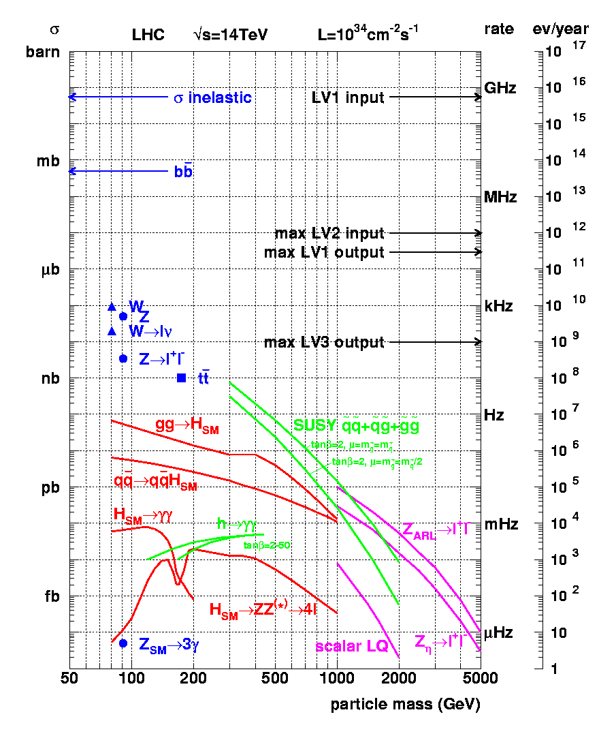
Cross Sections and Production Rates
“Well known” processes, don’t need to keep all of them …
New Physics
This we want
to keep!

Slide 28
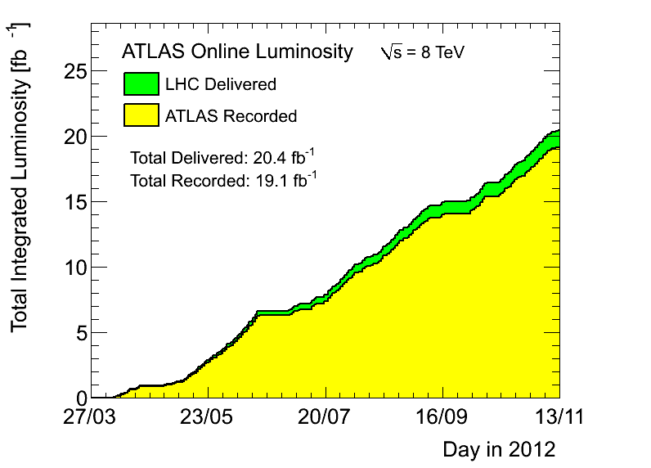
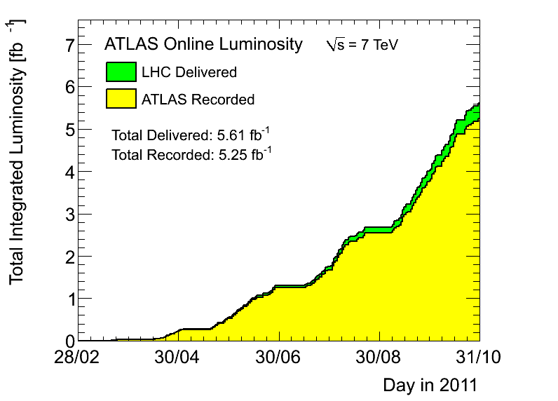
LHC – 2012 when the Higgs was discovered
2011 goal set in spring
  Goal for 2011: 1 fb⁻¹
  Accomplished: 5 fb⁻¹
  Delivered: 5.6 fb⁻¹
  Recorded: 5.3 fb⁻¹
90%-96% of recorded data usable for analysis

Slide 29
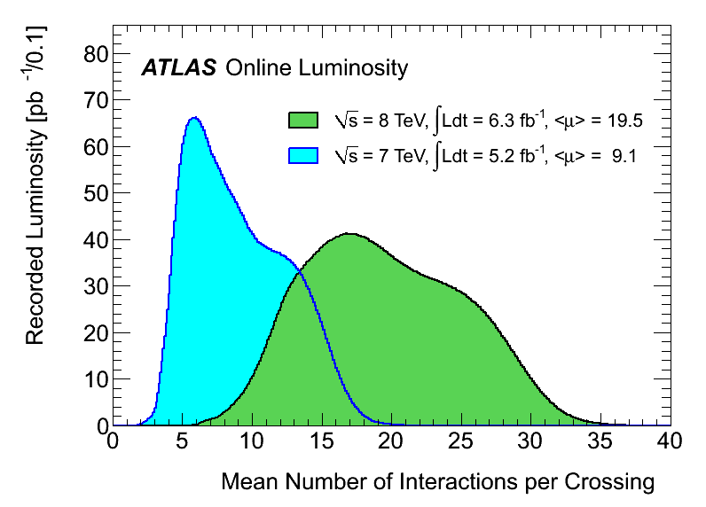
Pileup
Higher luminosity means more interactions per beam crossing: pileup. Up to ~20. Worse than expected for this luminosity
  2 (20) events/beam crossing for L = 10³³ (10³⁴)
  50 ns bunch spacing
Challenge for Reconstruction, Trigger and computing. Good model for pileup simulation

Slide 30
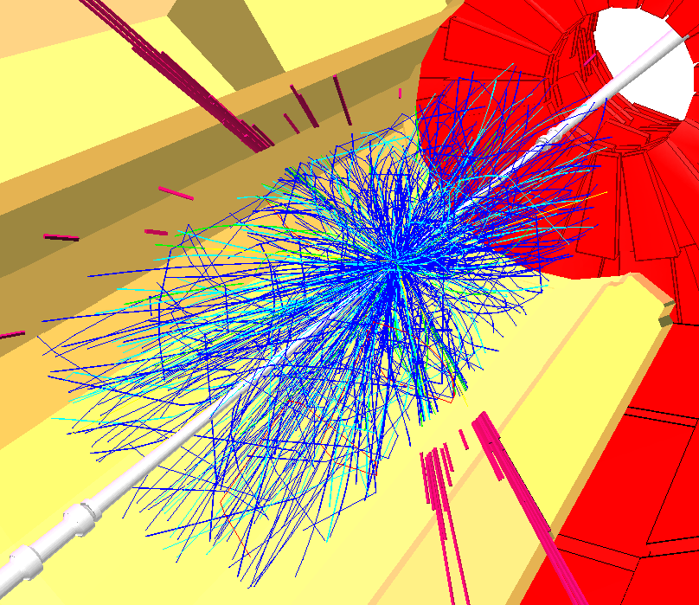
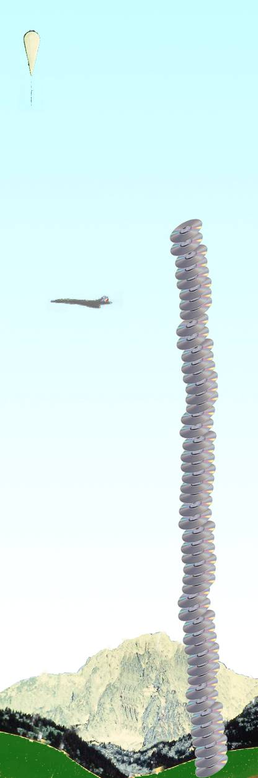
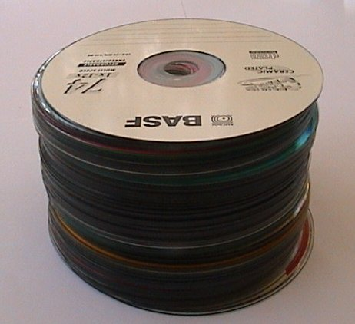
Worldwide LHC Computing Grid (wLCG)
WLCG is a worldwide collaborative effort on
an unprecedented scale in terms of storage and CPU requirements, as well as the software project’s size
Balloon
(30 Km)
CD stack with
1 year LHC data!
(~ 20 Km)
Concorde
(15 Km)
GRID computing developed
to solve problem of data storage
and analysis
LHC data volume per year:
10-15 Petabytes
One CD has ~ 600 Megabytes
1 Petabyte = 10⁹ MB = 10¹⁵ Byte
(Remember: the WWW is from CERN... )
Mt. Blanc
(4.8 Km)
6 cm
50 CD-ROM
= 35 GB

Slide 31
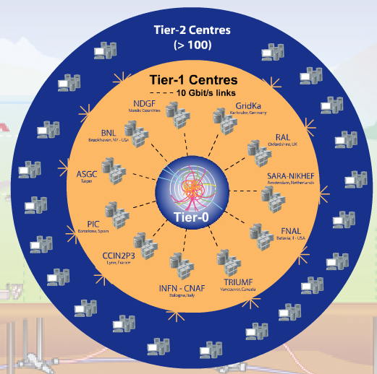
The Worldwide LHC Computing Grid (wLCG)
Tier-0 (CERN):
  Data recording
  Initial data reconstruction
  Data distribution
Tier-1 (11 centers):
Permanent storage
Re-processing
Analysis
Tier-2 (federations of ~130 centers):
Simulation
End-user analysis

Slide 32
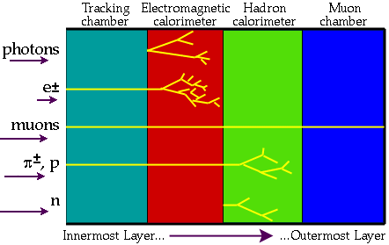
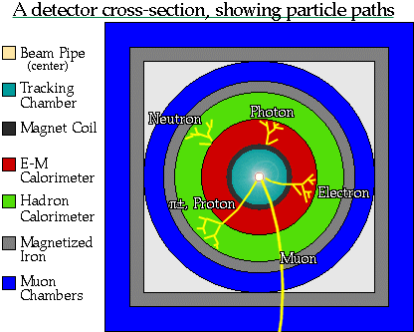

Slide 33
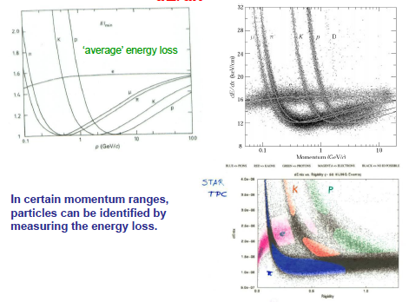
Particle Identification by Energy loss

Slide 34
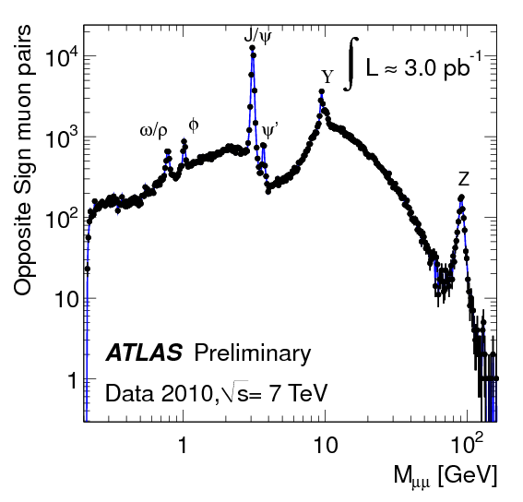

Confirming previous measurements or discoveries
Before we do new searches, we have to show that we measure accurately what is already known

Slide 35
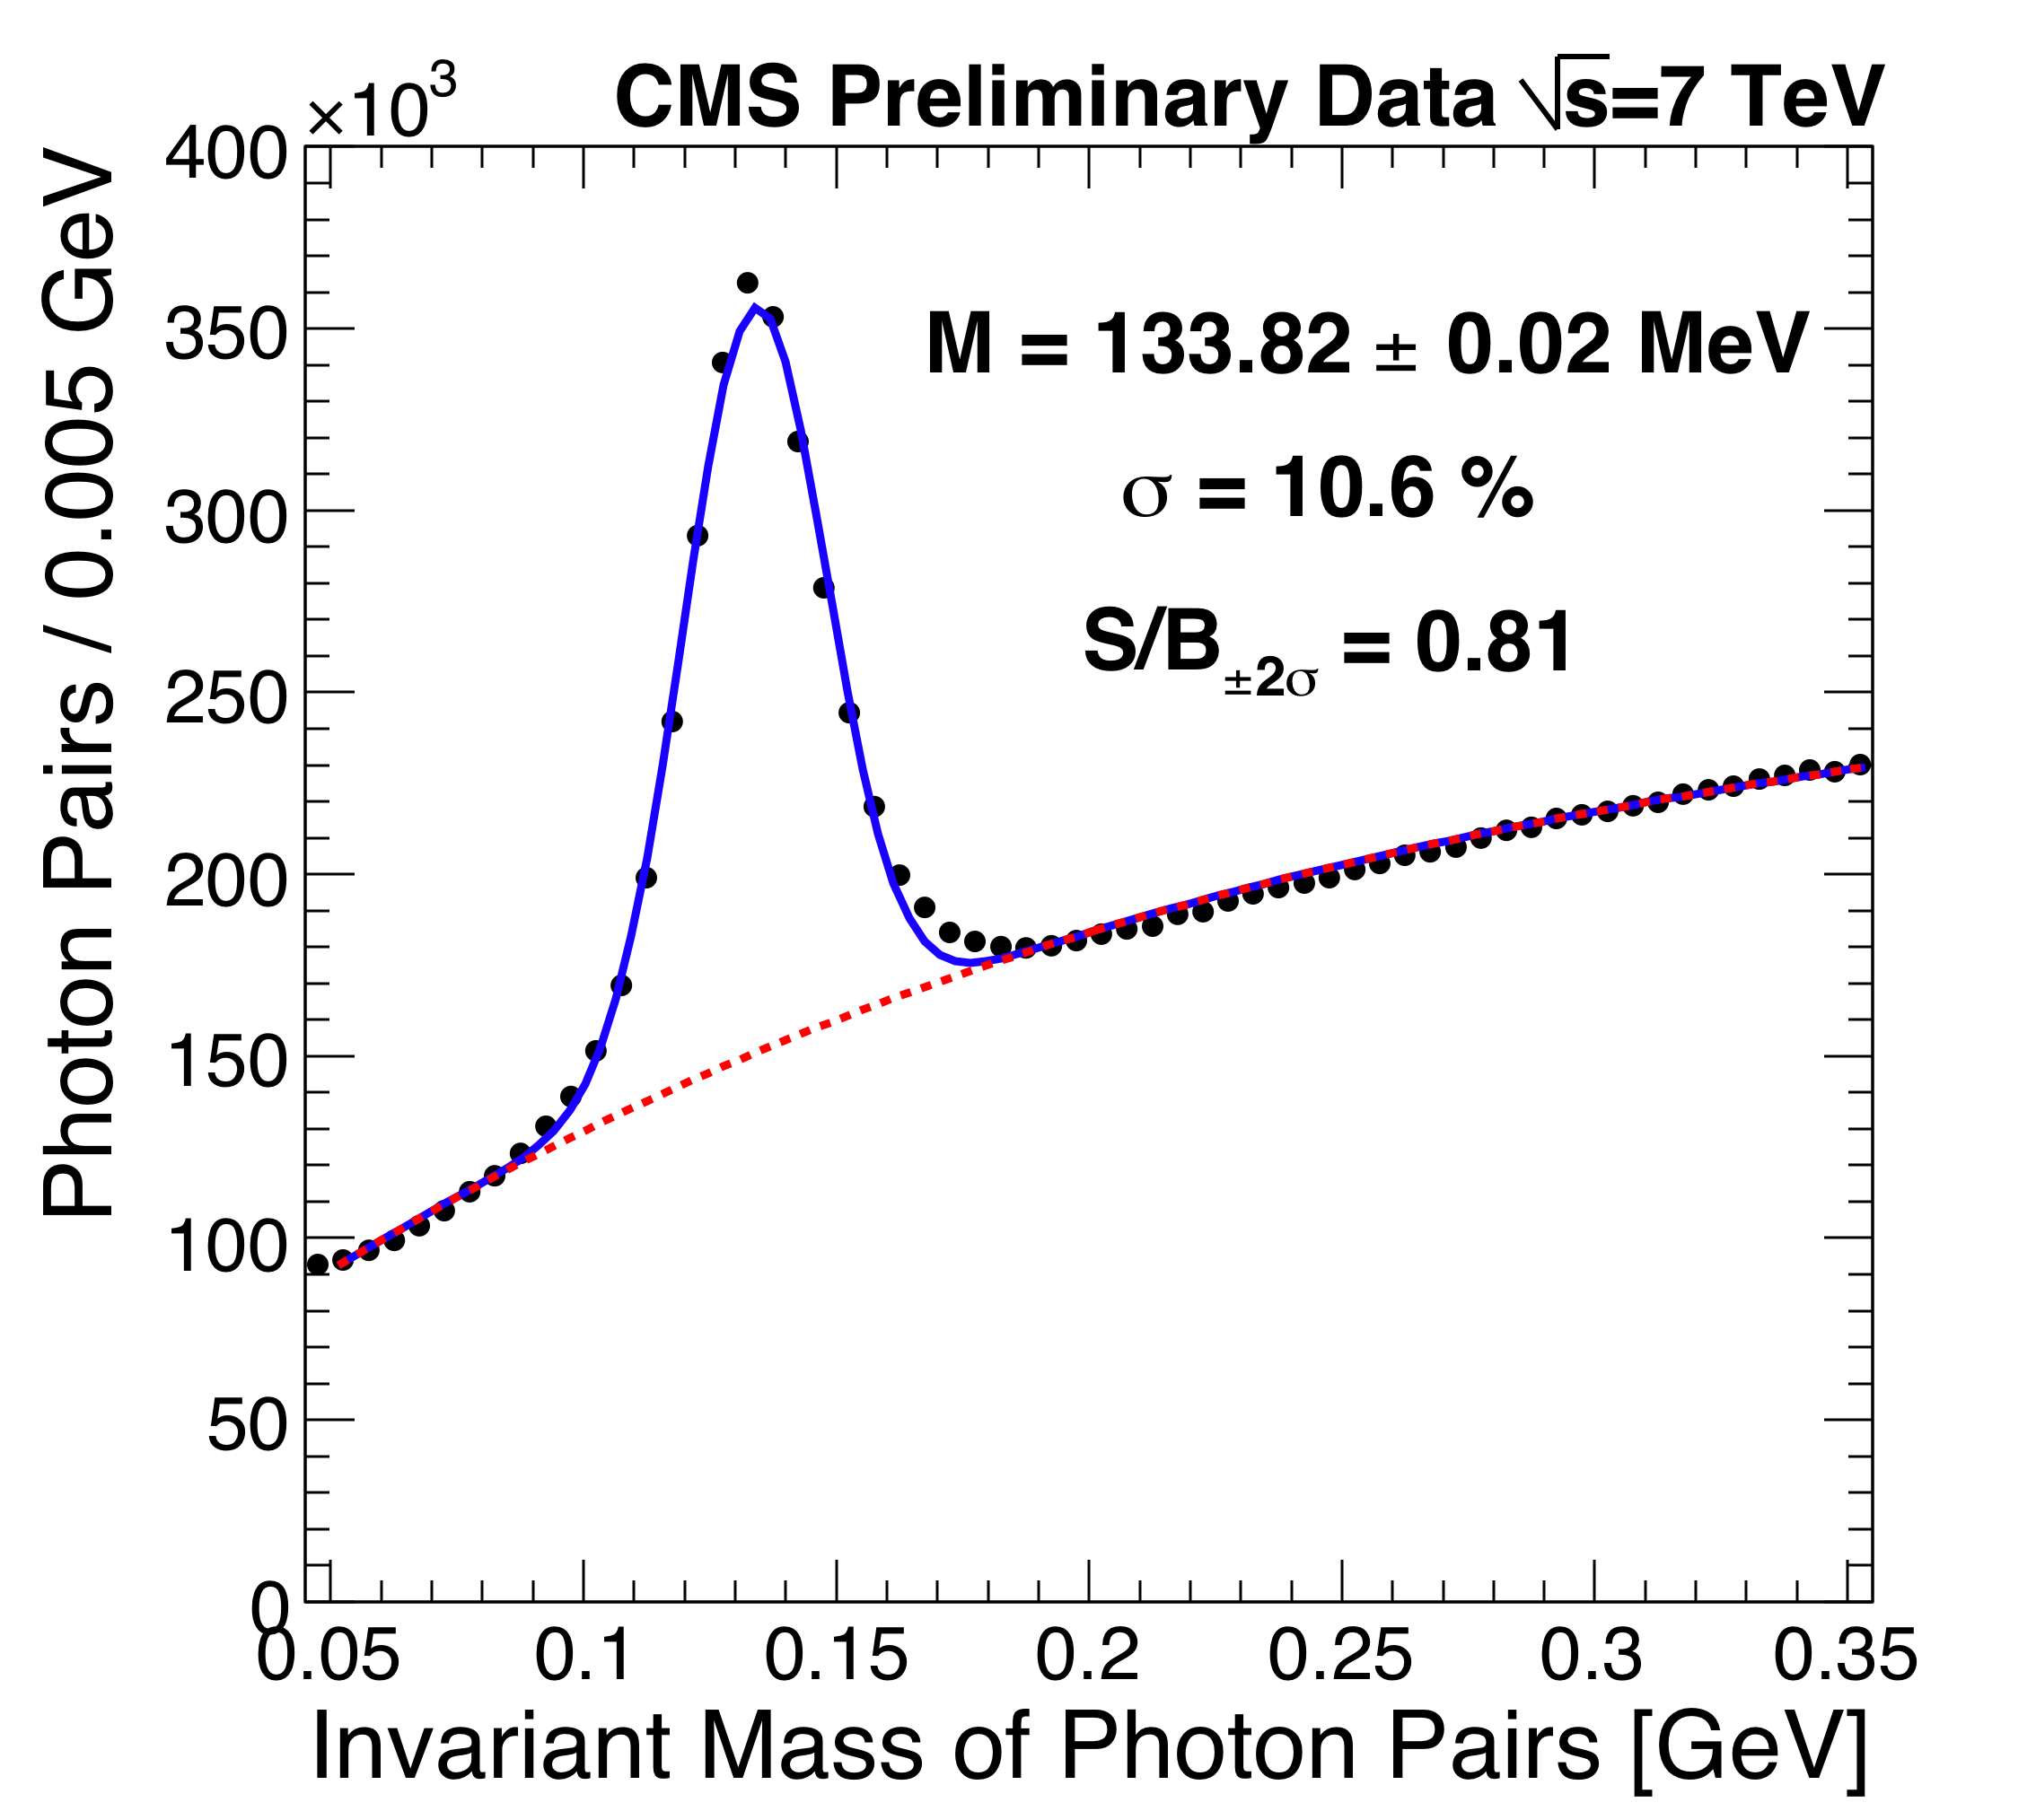
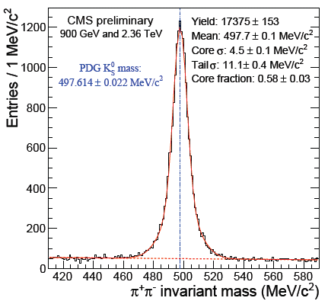
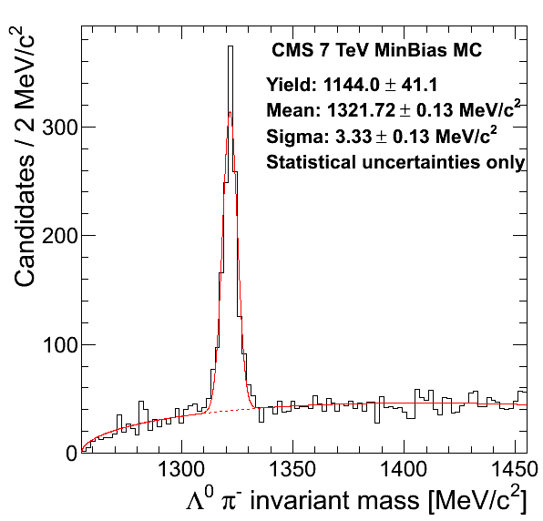

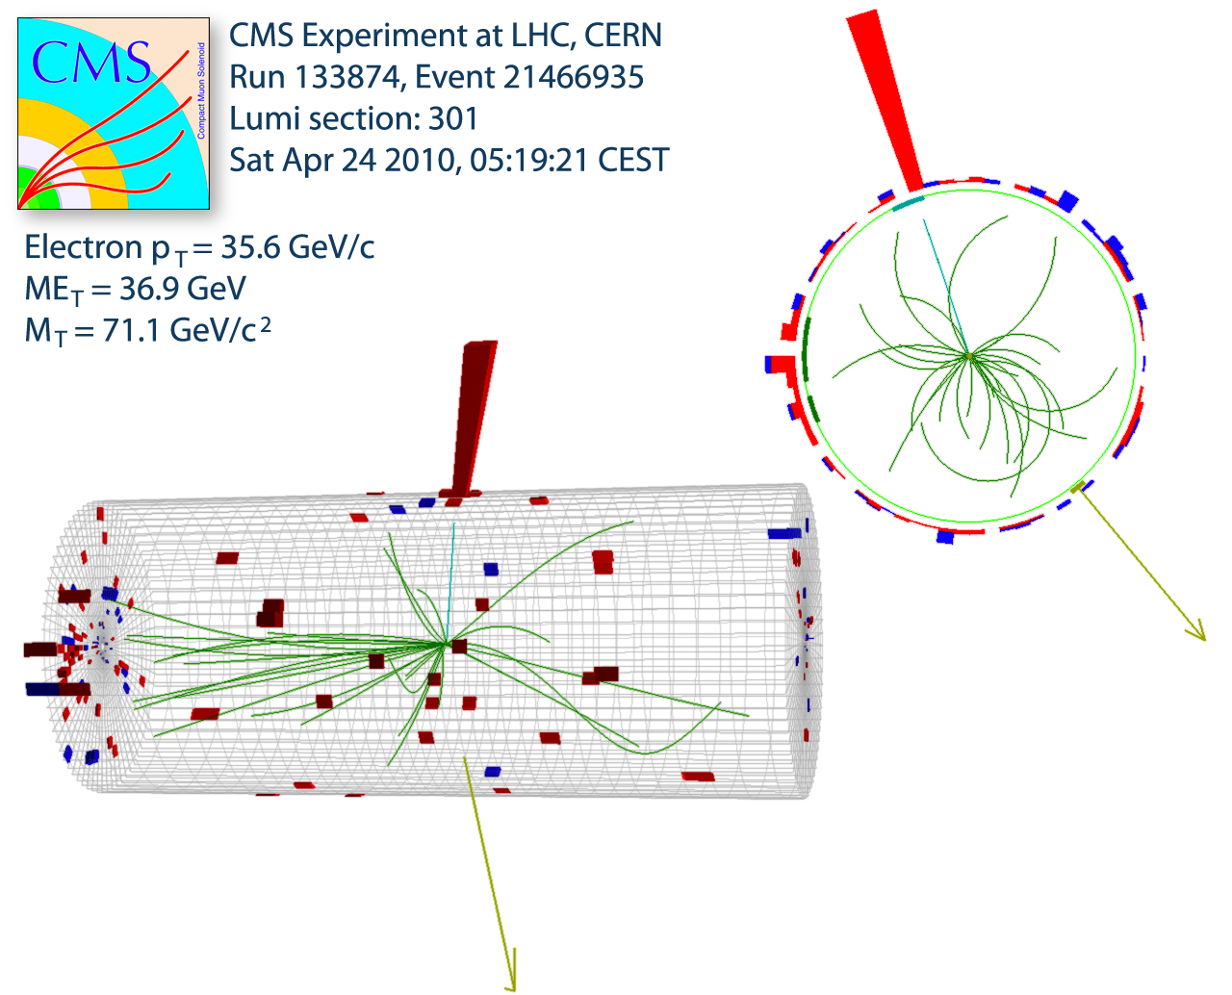
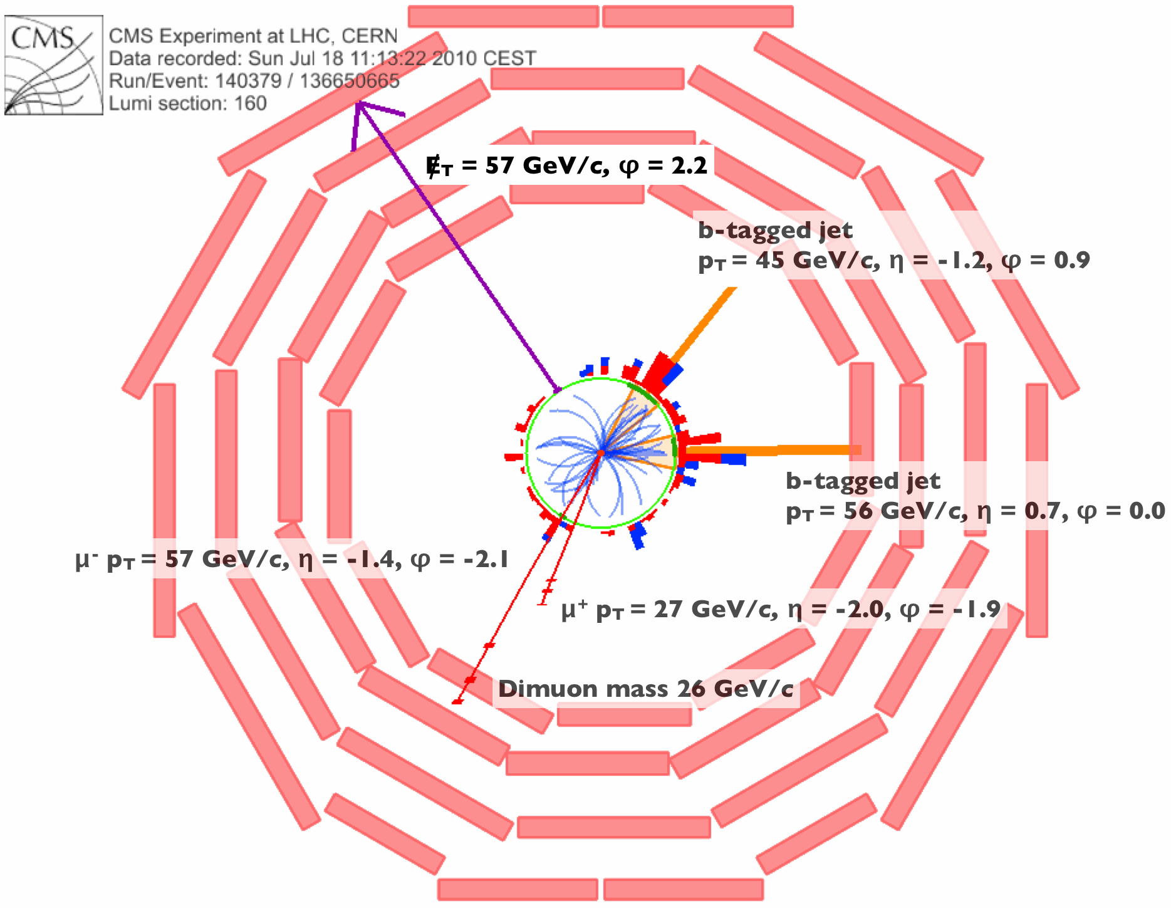
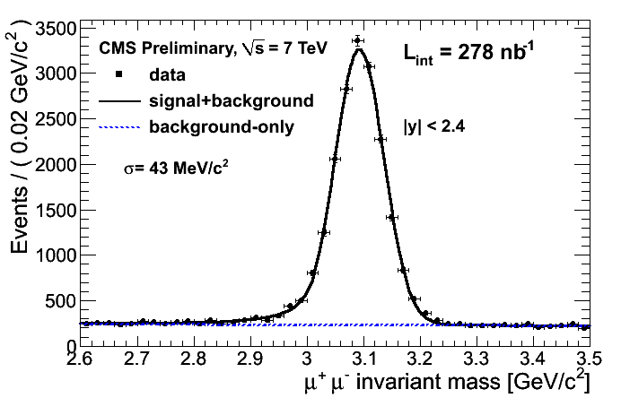
50 Years of Particle Physics; e.g. CMS
Ω⁻
π⁰
N
N
Top
J/psi
W
N
N
Sophisticated software and computing systems in place and functioning

Slide 36
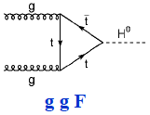
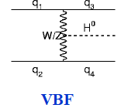
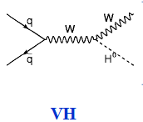



Higgs Boson Production and Decay at the LHC
A lot of progress in theoretical computations. Up to NNLO in most cases; uncertainties < 20%

Slide 37

Higgs → 4 muons Candidate

Slide 38



The Higgs Boson Discovery
Single channel discovery: 7.4σ
Single channel discovery: 6.6σ
Discovery confirmed in later measurements
Measurement of properties consistent with expectations from the SM
Now, the questions are :
  Can we search for new physics in the decay of the Higgs boson?
  Or in association with it?
  Or in the small deviations in the properties with respect to the SM expectations?
Mass measurement, m_{H} = 125.5 ± 0.2 (stat) ^{+0.5} _{-0.6} (syst) GeV

Slide 39
  I will now focus on the searches for new phenomena in the decays of the Higgs bosons

Slide 40
Dark Sector States
Search for dark sector states in the decays of the Higgs boson
  Higgs boson decays to Invisible particles and interpretation for Dark Matter. Using Higgs production in association with a vector boson or in the vector-boson-fusion channel, and their combination
  Search for dark vector bosons in H → 4l events: Search for H → 4l events not associated to the SM H → ZZ*→ 4l

Slide 41
Search for dark sector states
A hidden or dark sector can be introduced with an additional U(1)d dark gauge symmetry
  The dark sector could couple to the SM through kinetic mixing with the hypercharge gauge boson
  If, in addition, the U(1)d symmetry is broken by the introduction of a dark Higgs boson, then there could also be a mixing between the SM Higgs boson and the dark sector Higgs boson
Exotic Higgs boson decays have been proposed as a way to search for evidence of new physics
  In the decay of the discovered Higgs boson
  To measure the coupling strengths between the SM and the dark sector
Such decays predicted in many extensions to the SM to explain
  Muon g-2 discrepancy
  Astrophysical observation of positron excess
This search was carried out in collaboration with the BNL theory group
  H. Davoudiasl et al., Higgs Decays as a Window into the Dark Sector, Phys.Rev. D 88.1 (2013) 015022
  H. Davoudiasl, H.-S. Lee and W. J. Marciano, ’Dark’ Z implications for Parity Violation, Rare Meson Decays, and Higgs Physics, Phys.Rev. D 85 (2012) 115019

Slide 42
H → Z Zd → 4 leptons
Analysis done collaboration with Yale University and
BNL Theory group
Search for events with 4 leptons (e, μ) whose invariant masses are consistent with m_{H}
  Lepton-pairs must of opposite signs and same flavor
  One lepton-pair, with mass m₁₂ should be consistent with the SM Z-boson
  In the mass distribution, m₃₄, of the other lepton-pair, search for a narrow resonance that might be interpreted as a Z_{d} signal

Slide 43

H → Z Zd → 4 leptons
No excess of events found
A constraint of the kinetic mixing parameter between the SM and the dark sector could be derived

Slide 44
H → Zd Zd → 4 leptons
Analysis done collaboration with
the University of Johannesburg and
BNL Theory group
Search for events with 4 leptons (e, μ) whose invariant masses are consistent with m_{H}
  Lepton-pairs must of opposite signs and same flavor
  Both lepton-pairs, with masses m₁₂ and m₃₄, must be consistent in mass, Δm =|m₁₂-m34| minimal
  Veto events where m₁₂ or m₃₄ is consistent with Z-boson, J/psi or Upsilon

Slide 45


H → Zd Zd → 4 leptons
Analysis continues with searches for
generic scalar of mass up to 1 TeV
decaying into 4l, with dark vector
bosons in the intermediate state
No excess of events found
A constraint on the mixing parameter between the SM Higgs boson and the dark sector Higgs boson could be derived

Slide 46
H → invisible particles
Analysis done collaboration with
Other ATLAS Institutes
Example of the vector boson fusion (VBF) case, which is the most sensitive channel
  Veto events with isolated leptons
  Keep events with 2 hard jets and no additional jets
  Event must have a large missing transverse energy
  The jets must satisfy VBF topology
    Large di-jet mass
    Jets in opposite hemisphere
    Large rapidity gap between the jets
  The Z(→νν)+jets and W(→lν)+jets background estimated from data control regions with transfer factor derived from Monte Carlo simulation
  The multi-jet background is relatively very small but estimated estimated from data
Other searches done in associated productions ZH, VH, monojet. And a statistical combination carried out. BNL involved also in these other searched and led the combination
efforts

Slide 47


H → invisible particles
Di-jet invariant mass
Missing Energy

Slide 48


H → invisible particles – coupling combination
Observed likelihood scans of the Higgs boson invisible decay branching ratio using direct searches for invisible Higgs boson decays, rate measurements in visible Higgs boson decays, and the overall combination of invisible and visible decay channels.
The (1-CL) versus BR(h→invisible) scan for the combined search for invisible Higgs boson decays. The horizontal dashed lines refer to the 68% and 95% confidence levels.

Slide 49
Interpretation for dark matter / cross section limit
No excess of events found
A constraint on the spin-independent WIMP-nucleon scattering cross section as a function of the WIMP mass
Upper bound on the production cross section of a scalar decaying into invisible particles
13 TeV Analysis in progress

Slide 50
Dark Interactions Workshop Series
Dark Interactions Workshops – organized by BNL biennially. To review and discuss the status and future of the searches for dark sector states, their implications for the mystery of Dark Matter, and new associated theoretical developments. Topics:
  Theoretical Motivation for Dark Sectors
  Experimental Constraints from High Energy Colliders
  Constraints from non-Collider Experiments
  Cosmological Constraints
  Implications for Dark Matter
  Prospects for LHC and future Intensity Frontier Experiments

Slide 51
Dark Interactions workshop series at BNL
Started in 2014
It is biennial
70-80 experts in the field gather for 3.5 days
  Talks and discussions
  Exchanges of ideas
  Networking and scientific collaboration
3rd in the series planned for October 2018
Organized at BNL
  In collaboration with BNL theory group and other institutes
Next Workshop in 2020

Slide 52
My Outreach efforts in Africa
The African School of Fundamental Physics and Applications
https://www.africanschoolofphysics.org/
ASP-IOC@CERN.CH

Slide 53
Overview
ASP2018
Fifth Edition in Namibia
June 24 to July 14, 2018
523 Applications and 85 students
selected from 26 countries
Expansion
- Pupils Outreach
(30 schools, 1500 learners, 1 week)
- Teachers Workshop (63 teachers, 1 week)
- Professional Physics Conference (1 week)
ASP2020 Morocco
Host countries selected
2.5 years earlier
through a bidding process
ASP2010
First Edition in South Africa
August 1-21, 2010
125 Applications and 65 selected
from 17 countries
Serious efforts to advertise widely
ASP Mentorship / Coaching Program
Introduced since 2016. Runs continuously.
Permanent assistance to students even
when there is no formal school
ASP2016
Fourth Edition in Rwanda
August 1-19, 2016
429 Applications and 80 students
selected from 28 countries
Expansion:
- Pupils Outreach added
(3 schools, 150 pupils, 3 days)
- Teachers Workshop Added
(20, 2 days)
ASP2012
Second Edition in Ghana
July 15 to August 8, 2012
138 Applications and 50 students
selected from 15 countries
ASP2014
Third Edition in Senegal
August 3-23, 2014
330 Applications and 70 students
selected from 21 countries
Feedbacks to improve future ASPs

Slide 54
Organization
Objective:
Increase capacity development in fundamental physics and related applications in Africa
International Advisory Committee (IAC)
Representatives of funding agencies
Advise on the program
Advise of the host country selection
Local Organizing Committee (LOC) – in the host country
Local logistics
Liaise with Education and Research branches of host country government
International Organizing Committee (IOC)
Overall management
Fund raising
Coordination of activities
Assessment of Impact
Survey of students
Survey of their Professors
Follow academic developments
Spin-Offs
ASP Mentorship/Coaching Program
Networking and sharing of information
Align ASP with educational priorities
Improve future editions of ASP
Promote research collaborations
Promote research consortia
International Lecturers (IL)
Design the scientific Program
Help with the student selections
Mentor and Coach students continuously

Slide 55
Scientific Program
ASP Conference
1-week International Conference
Participation of ASP Alumni
Participation of Research Faculties
Networking and collaborations
Student Program
3-week intensive school
3rd year of University to Ph.D.
Mostly African Students
70-80 Students
High School Teachers Program
1-week intensive workshop
Train High School Teachers for improved physics teaching
Fundamental Physics and Applications
Astrophysics and Cosmology;
Nuclear and Particle Physics;
Accelerator, Medical and Radiation Physics;
High Performance Computing;
Renewable Energies and Energy Efficiency;
Material Physics;
Physics Education;
Physics Communication.
Mentorship / Coaching Program
At all times
Work with Academic Advisors
Connect Students with Researchers
Place students at Laboratories
Listen to students and help address their academic needs if possible
Learners Program
1-week learners Outreach
10-12th grade learners
Encourage learners to develop and maintain interests in Physics and Applications

Slide 56
ASP2018 Students Profile
Best Female : Male Ratio
523 Applications
Total Selected: 85
There were 30 good students on the waiting list
  Selections constrained by budget and logistics
  Replace early declinations

Slide 57

Workshop to train high school teachers
Teachers Workshop
63 teachers, 1 week
BNL staff lecturing to Namibian high school teachers at ASP2018

Slide 58

ASP2018 – High School learners Program
Objective:
Motivate high school pupils to develop and maintain interest in Physics
University of Notre Dame staff doing physics demonstration to Namibian high school pupils at ASP2018

Slide 59


Sponsorships for Student Participations
ASP2018 Sponsors In addition to USA DOE Labs (BNL)
African Contributors:
- Namibia
- SA DST/NRF
- IUCEA
Integrated: ~40% ASP2018 budget
ICTP Support major
Student participation
Management of application database
Arrange student travels
Fund Management
Funds centralized and managed by the South African Institute of Physics (SAIP)
Host Country Support Significant
In-kind support
Direct Financial contributions
Human Resources toward ASP Organization
IOC
Writes Proposals, Requests for Supports
Produces Final Reports of Activities
Seeking permanent financial backing
Lecturers and Organizers Supported by External Sources - Significant
Support received then used to maximize student participation

Slide 60
Video Clips and Interview
Video clips of ASP2012 in Ghana
  https://videos.cern.ch/record/1472184
Recent Interview by the Voice Of America
  https://www.africanschoolofphysics.org/voiceofamerica-interview/

Slide 61
Conclusions
BNL is playing a significant role in various Higgs BSM searches
  Search for dark sector states in the decays of the Higgs boson
    Higgs boson decays to Invisible particles and interpretation for Dark Matter. Using Higgs production in association with a vector boson or in the vector-boson-fusion channel, and their combination
    Search for dark vector bosons in H → 4l events: Search for H → 4l events not associated to the SM H → ZZ*→ 4l
  Dark Interactions Workshops – organized by BNL biennially. To review and discuss the status and future of the searches for dark sector states, their implications for the mystery of Dark Matter, and new associated theoretical developments
BNL also has significant contributions to international outreach
  One example is the African School of Physics

