Slide 1
Astronomical CCDs and other light sensitive sensors
Andrei Nomerotski
2 July 2019 @ BNL

Slide 2
outline
CCD primer
CCD effects
Image processing
Fast imaging

Slide 3
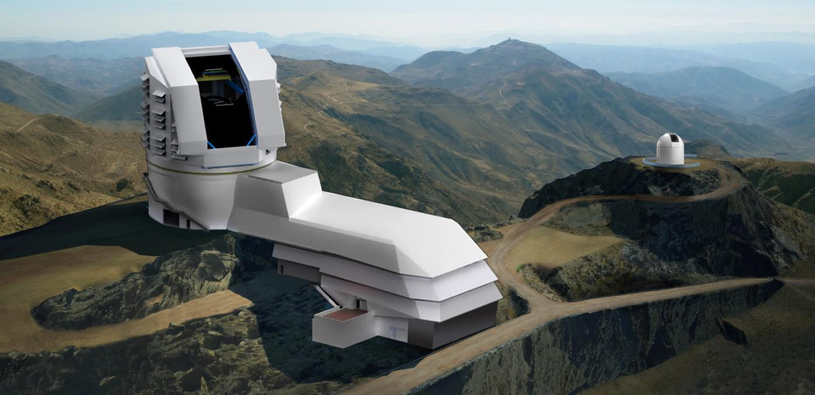
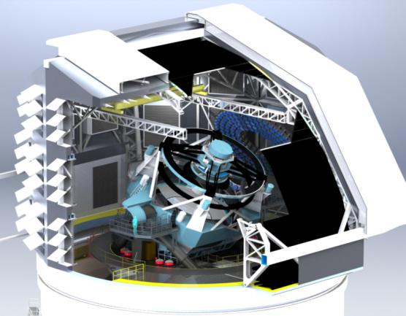
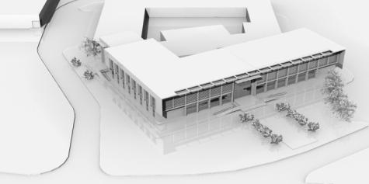
LSST Telescope and Site
30 m diameter dome
1.2 m diameter atmospheric telescope
Control room and heat producing equipment (lower level)
1,380 m² service and maintenance facility
Calibration Screen
Stray light and Wind Screen
350 ton telescope
Base Facility

Slide 4
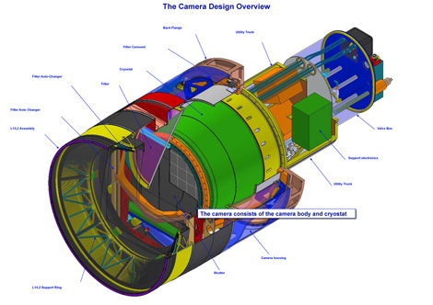
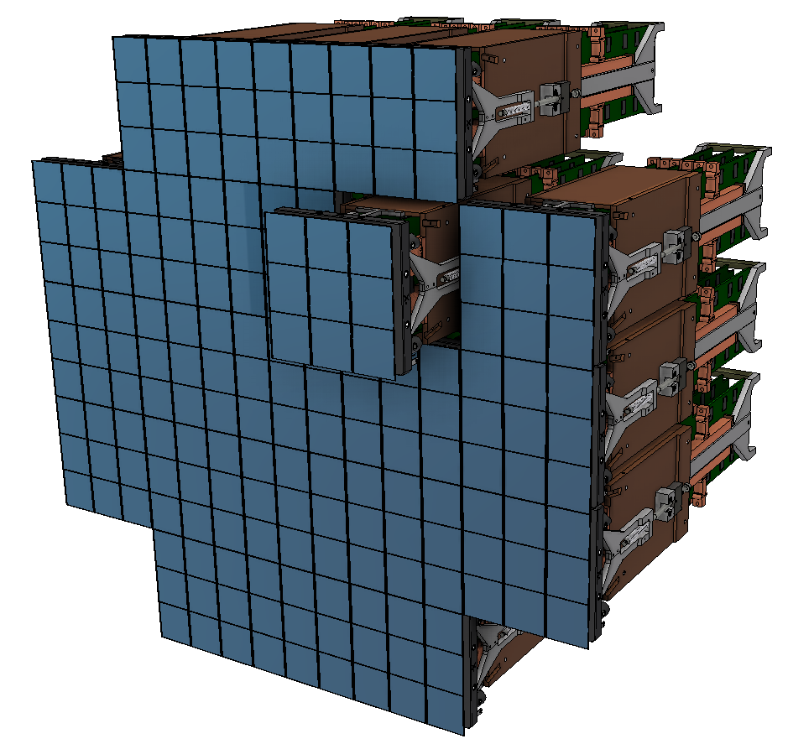
LSST Camera
LSST Focal Plane
64cm diameter → 3.5°
189 4K × 4K CCDs → 3 Gigapixels
21 “rafts” with integrated electronics for nine CCDs in shadow of sensor focal plane
At -100 deg C

Slide 5
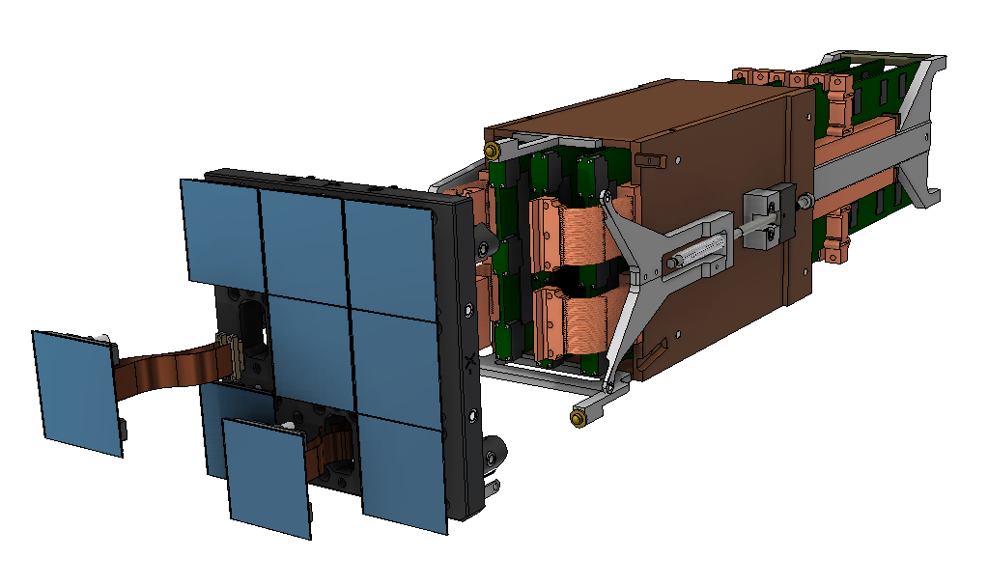
Raft Tower Module (RTM)
T = −40C
S.Bellavia
T = −100C
3 Raft Electronics Boards (REB)
Raft Sensor Assembly (RSA)
Science Raft Comprises 9 CCDs

Slide 6
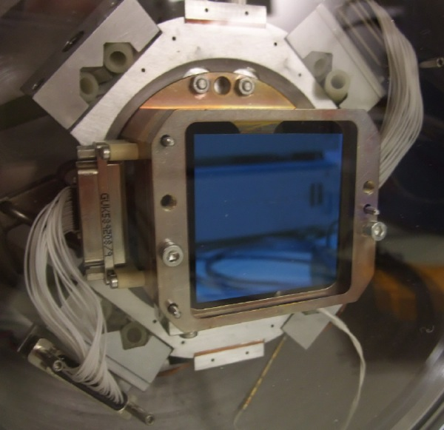
LSST Prototype CCDs
CCD250
STA3800

Slide 7
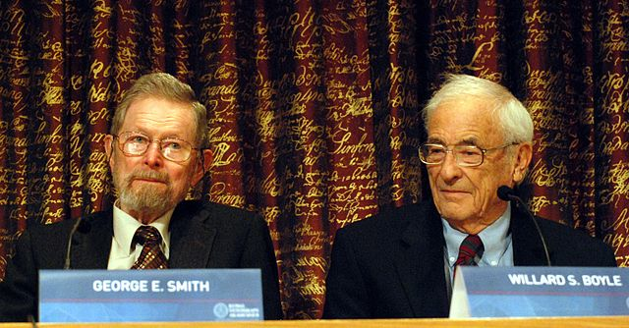
Charged Coupled Device: CCD
CCDs invented in 1970 – widely used in cameras and telescopes
2009 Nobel prize - Boyle and Smith

Slide 8
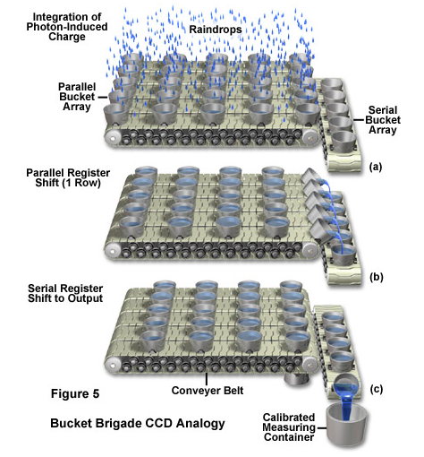
CCD as bucket brigade

Slide 9
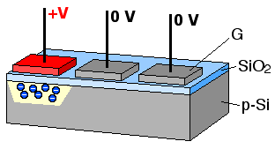
3-phase CCD

Slide 10
Charge Transfer in a CCD 2.
+5V
0V
-5V
2
+5V
0V
-5V
1
+5V
0V
-5V
3
1
2
3
Time-slice shown in diagram

Slide 11
Charge Transfer in a CCD 3.
+5V
0V
-5V
2
+5V
0V
-5V
1
+5V
0V
-5V
3
1
2
3

Slide 12
Charge Transfer in a CCD 4.
+5V
0V
-5V
2
+5V
0V
-5V
1
+5V
0V
-5V
3
1
2
3

Slide 13
Charge Transfer in a CCD 5.
+5V
0V
-5V
2
+5V
0V
-5V
1
+5V
0V
-5V
3
1
2
3

Slide 14
Charge Transfer in a CCD 6.
+5V
0V
-5V
2
+5V
0V
-5V
1
+5V
0V
-5V
3
1
2
3

Slide 15
Charge Transfer in a CCD 7.
+5V
0V
-5V
2
Charge packet from subsequent pixel enters
from left as first pixel exits to the right.
+5V
0V
-5V
1
+5V
0V
-5V
3
1
2
3

Slide 16
Charge Transfer in a CCD 8.
+5V
0V
-5V
2
+5V
0V
-5V
1
+5V
0V
-5V
3
1
2
3

Slide 17
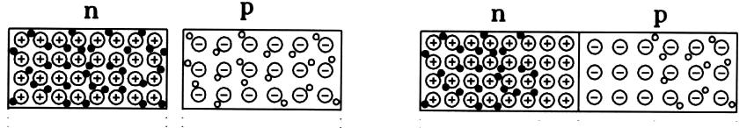
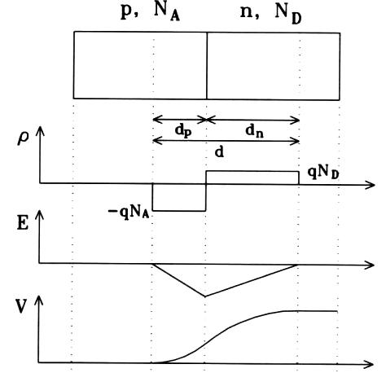
P-N Junction or Silicon Diode
Two doped p- and n- pieces of silicon are brought into contact
Space charge region will appear due to diffusion
Will have electric field and build-up potential even without external voltage

Slide 18
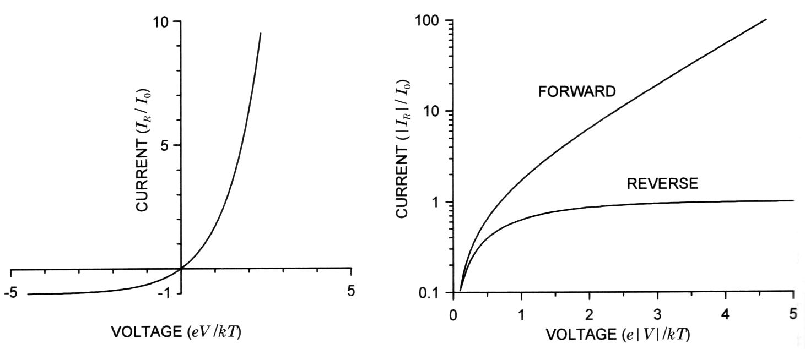
Silicon Diode
Forward external voltage causes exponential current
Reverse external voltage causes depletion
Depletion is THE REASON why the charge in silicon sensors lives long and can be efficiently moved around!

Slide 19
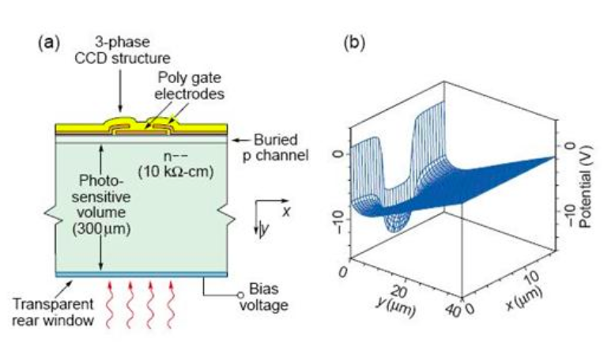
Electric field in CCD
S.Holland

Slide 20
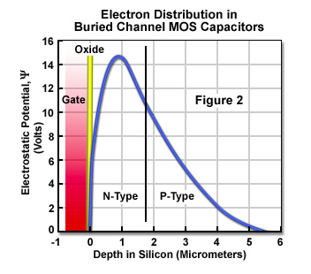
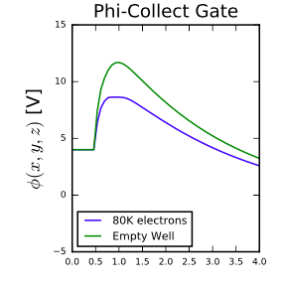
CCD: Buried channel
C.Lage

Slide 21
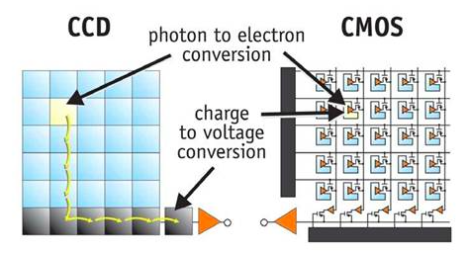
CCD vs CMOS
one amplifier vs many amplifiers

Slide 22
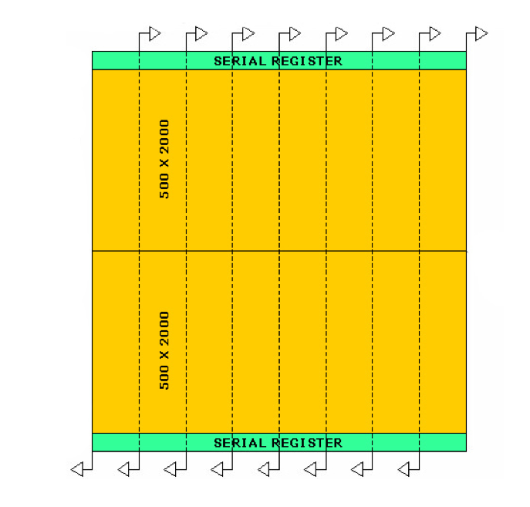
LSST CCD Sensor
2 second readout time spec → 16 amplifiers per 16 Mpix CCD
Noise spec 8 e-, based on anticipated sky noise; limits pixel rate
Pixel read rate is 550 Kpix/s
4k x 4k = 16 Mpixels
10x10 microns pixel
Si thickness 100 micron →
Enhanced infrared response
Anti-reflective coating

Slide 23
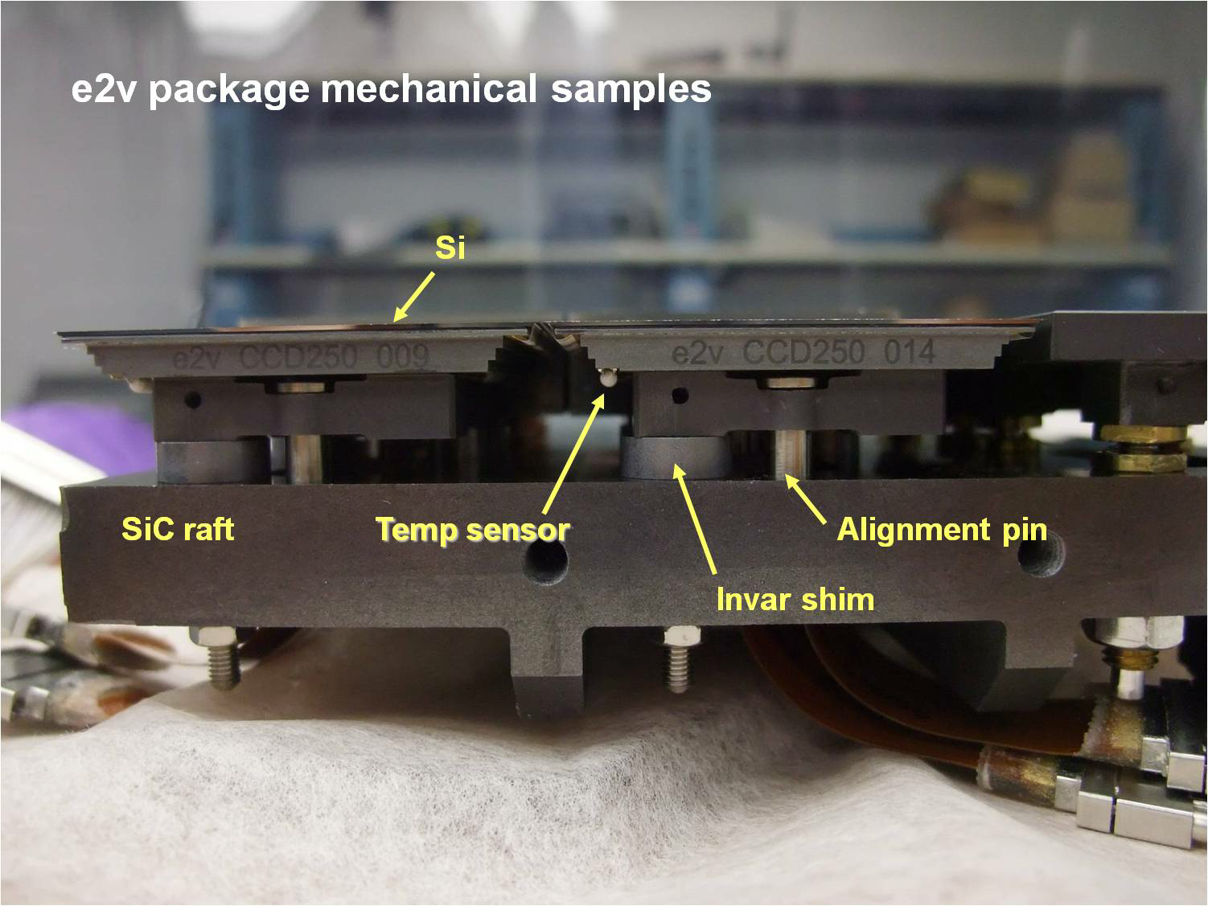

Slide 24
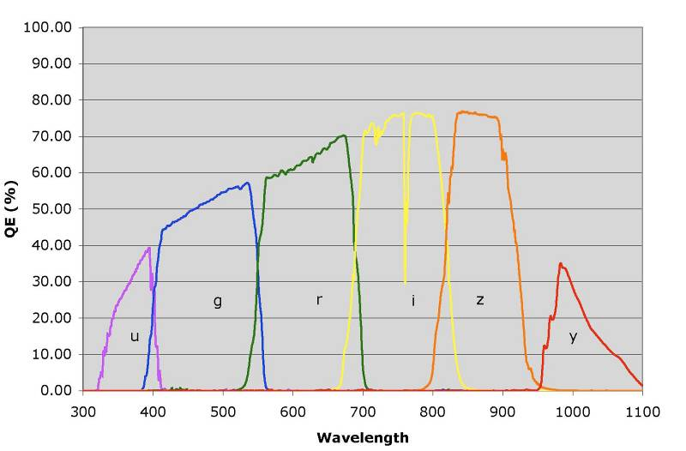
LSST six color system: redshifts
Includes sensor QE, atmospheric
attenuation, optical transmission functions
Relative system throughput (%)
Wavelength (nm)

Slide 25
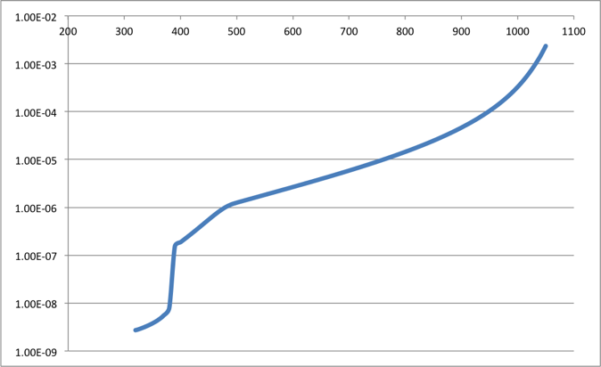
Photon absorption in silicon
Blue photons are absorbed near the surface (~0.25 um for 430 nm)
Longer wavelength penetrate deeper (~1 um for 500 nm, ~10 um for 800 nm)
λ, nm
d, m

Slide 26
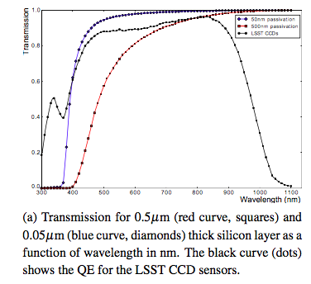
Quantum Efficiency (QE)

Slide 27
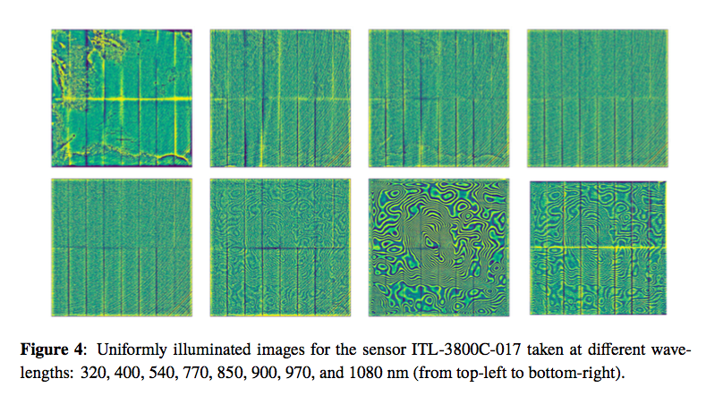
Flats vs wavelength

Slide 28
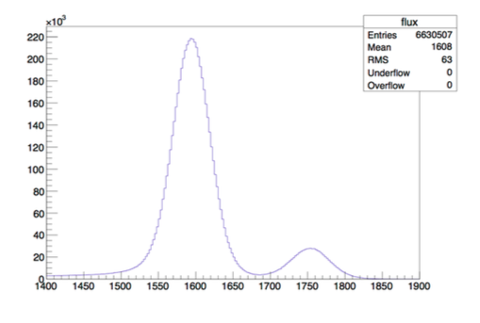
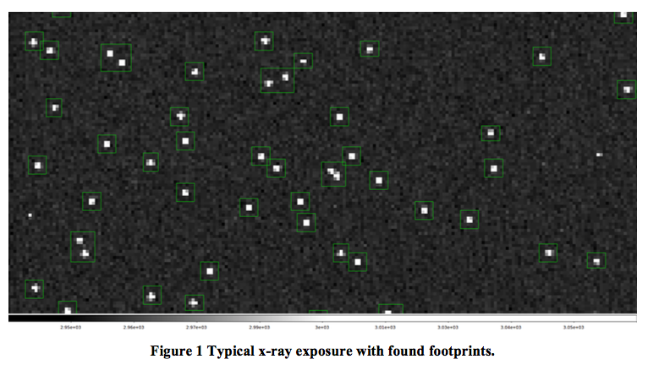
CCD gain from x-rays
Fe55: 5.9 keV

Slide 29
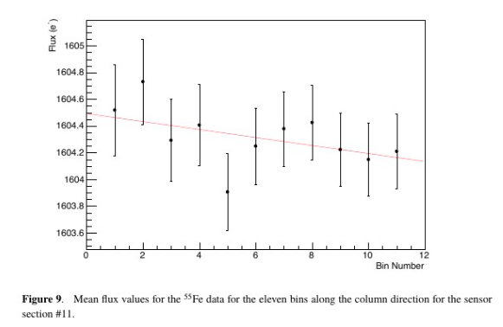
Charge Transfer Efficiency

Slide 30
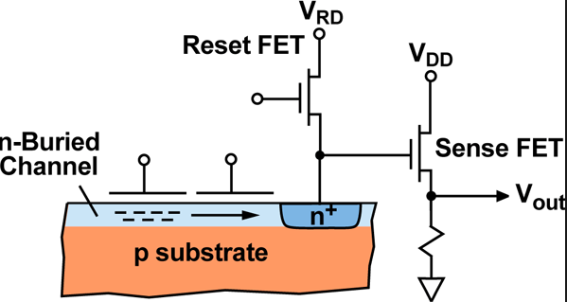
Sensing node & noise
V = q/C
Noise 4-5 e in LSST rafts

Slide 31
Sensor effects

Slide 32
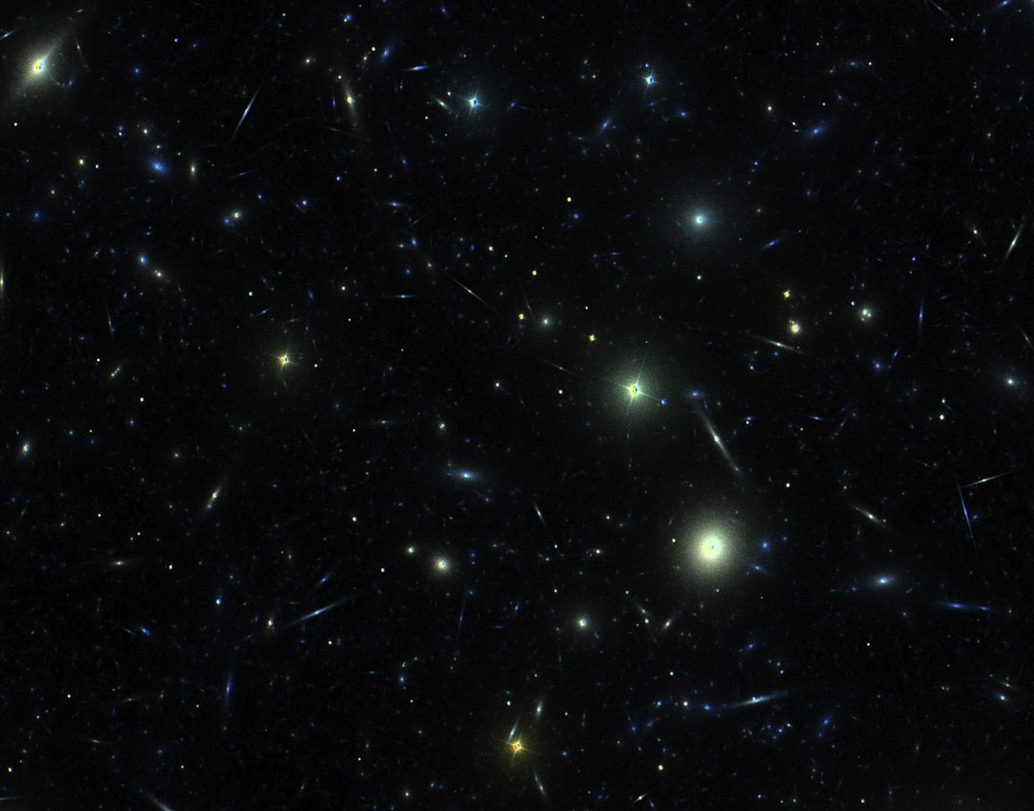
LSST Wide-Fast-Deep survey
4 billion galaxies with redshifts
10 billion stars
Time domain:
1 million supernovae
1 million alerts per night

Slide 34
Want to know ellipticity of PSF to 0.1 %

Slide 35
LSST pixel : 10 x 10 x 100 micron³
→ Pixels are skyscrapers
Want to know ellipticity of PSF to 0.1 %

Slide 36
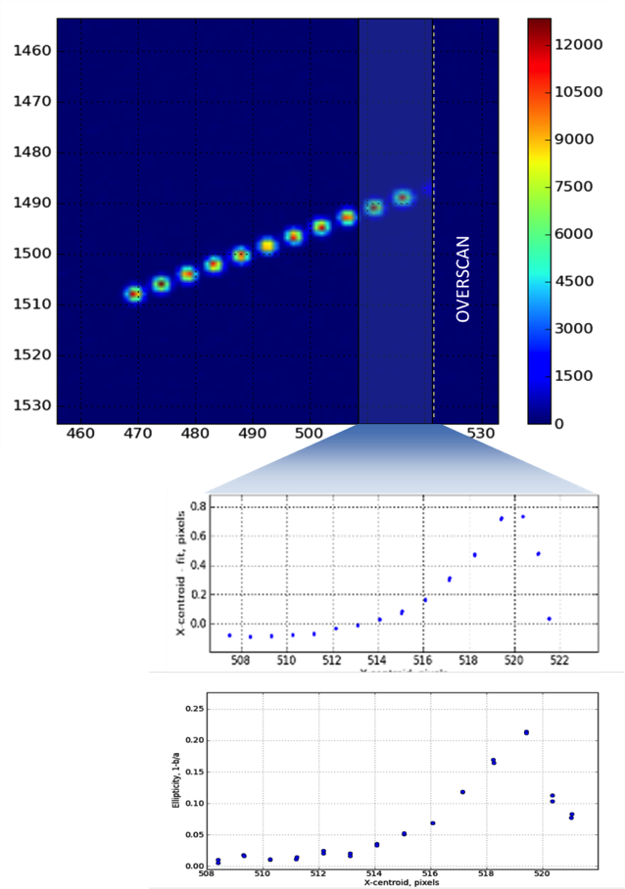
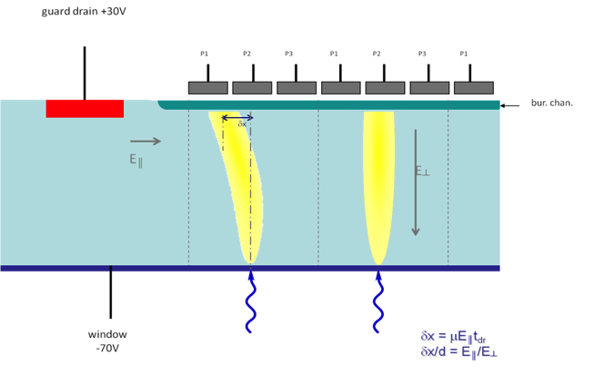
Astrometric Distortions in Thick CCDs
On the egde:
  Non-linearity up to 50%
  Ellipticity up to 20% → necessary to correct
P.O’Connor

Slide 37
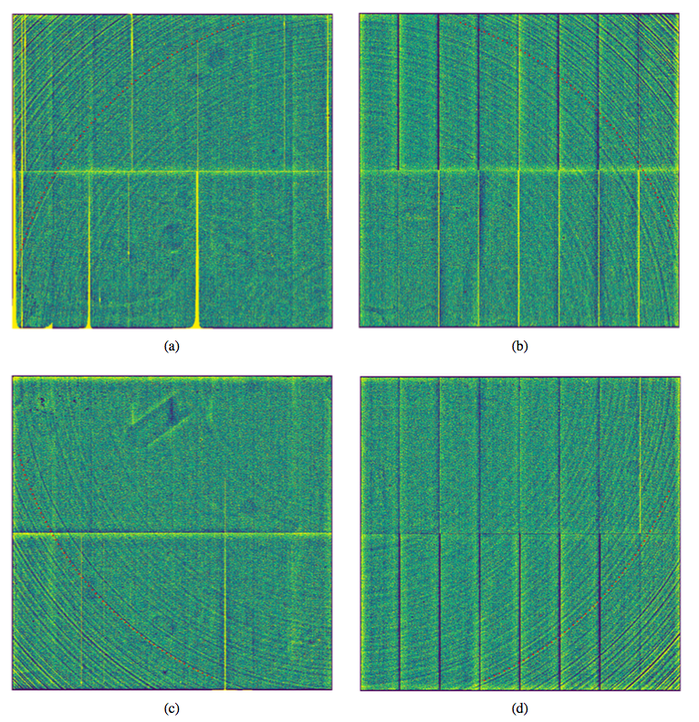
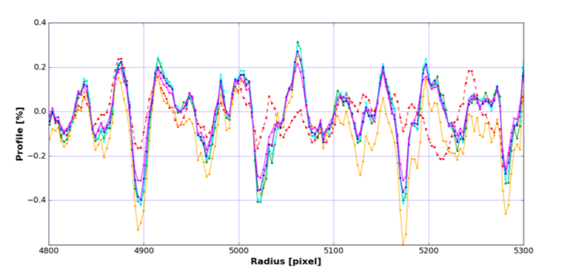
Tree Rings
H.Park

Slide 38
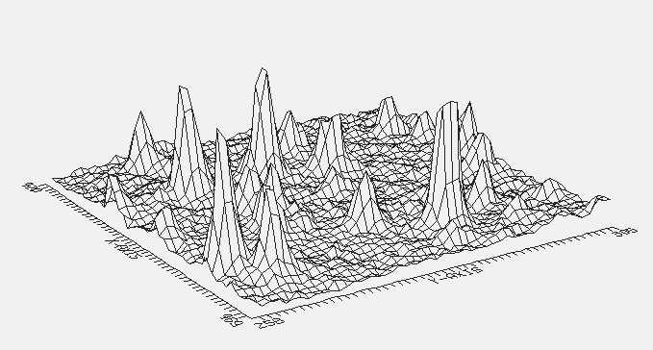
Point Sources Appear as 2-d Gaussians, on a “flat” sky background

Slide 39
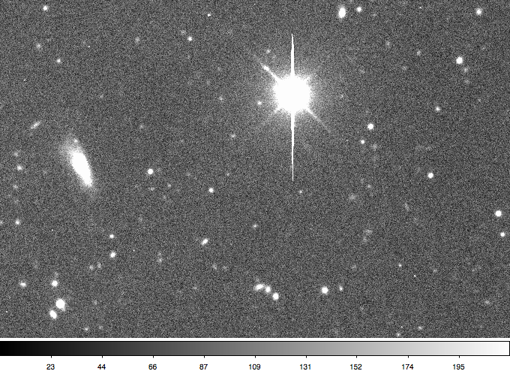
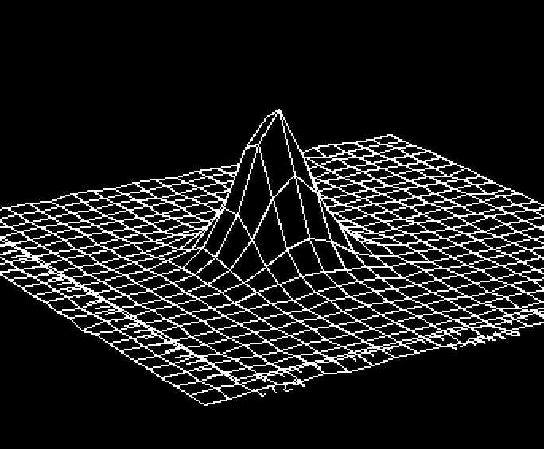
Point Spread Function
How many parameters needed?

Slide 40
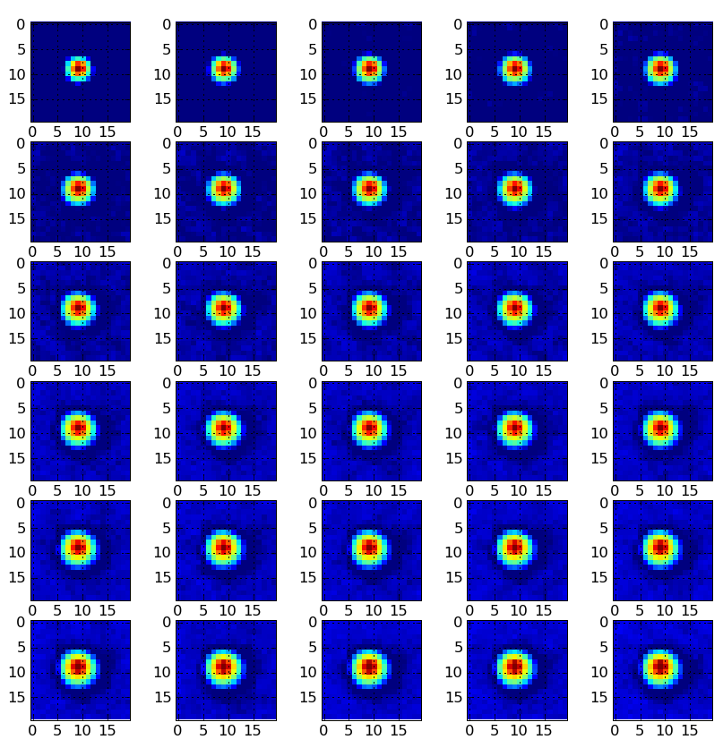
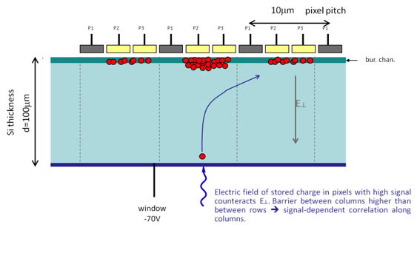
Brighter-Fatter Effect:
PSF Intensity Dependence
P.O’Connor

Slide 41
Brighter-Fatter Effect and Pixel Correlations
LSST, P.Astier et al

Slide 42
Don’t forget optics and atmosphere

Slide 43
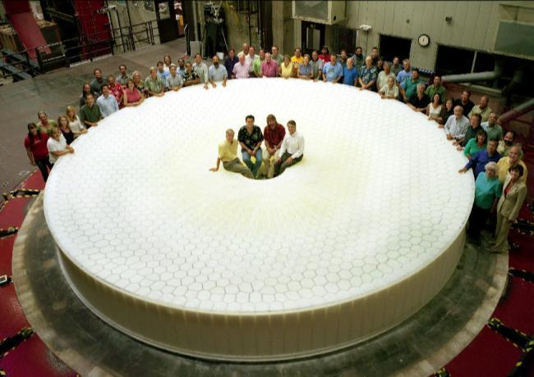
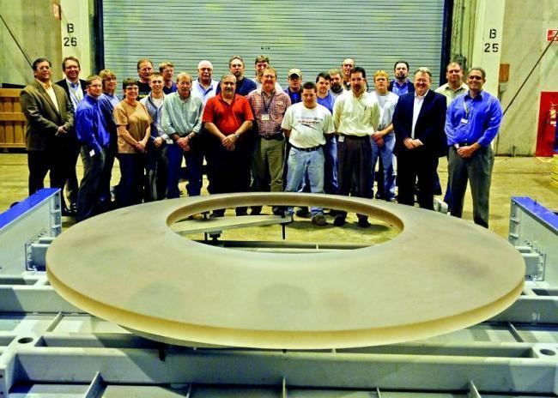
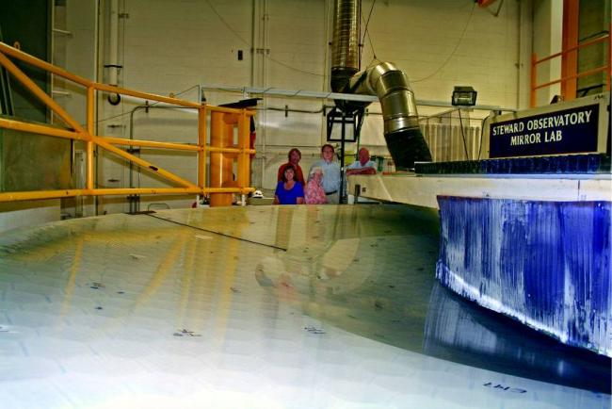
Mirror fabrication is advanced - Private funding enabled early start of both reflective optics
Primary-Tertiary was cast in 2008 and completed in 2013
Secondary substrate fabricated by Corning in 2009.

Slide 44
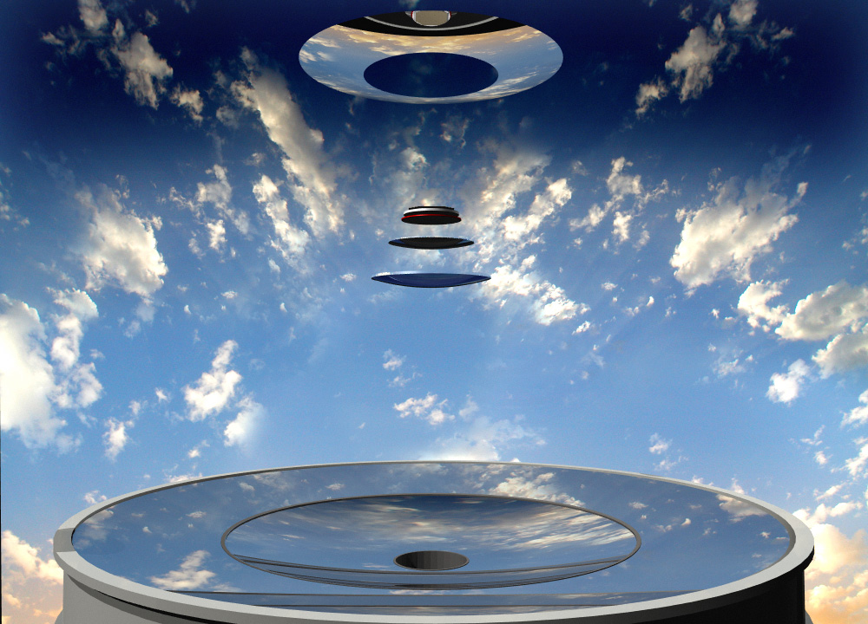

Slide 45
Seeing
Blurring due to turbulence of atmosphere

Slide 46
Space: Hubble Space Telescope

Slide 47
Ground: Subaru Telescope

Slide 48
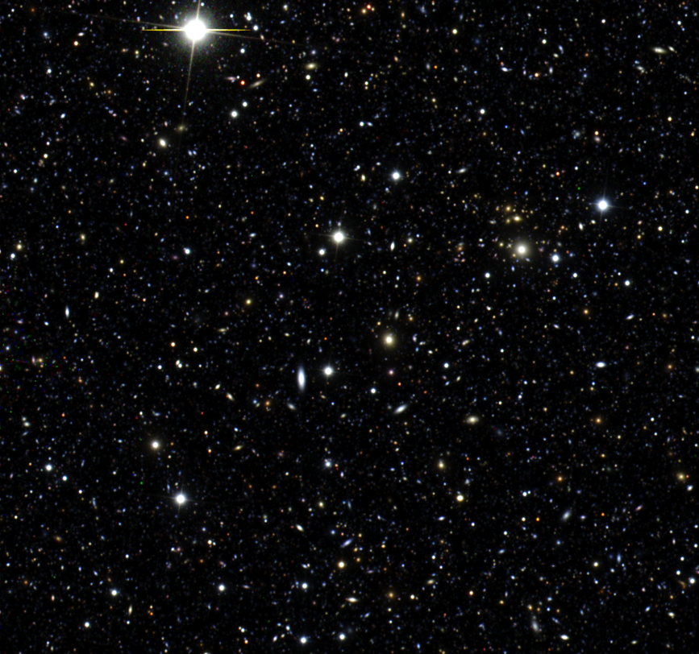
Simulated LSST image
(one exposure, 3 bands)
Composite image, representing 10⁻⁹ of the LSST data
A single 15-sec exposure
Connolly

Slide 49
Image Processing

Slide 50
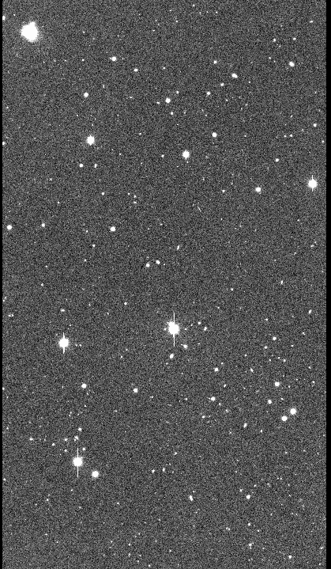

Image Processing
actual sky
fuzzy, distorted,
warped, noisy,
vignetted image
with cosmic rays, diffraction spikes, and crosstalk
artifact-suppressed processed image

Slide 51
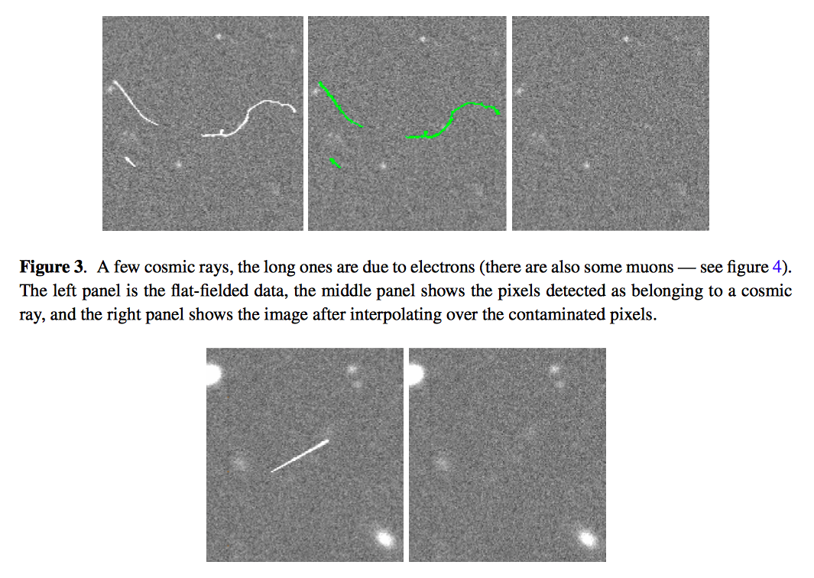
R.Lupton

Slide 52
Galaxies
Saturated star:
Charge blooming down CCD columns
Diffraction spikes from optics support

Slide 53
Image Processing
artifact-suppressed processed image
RA | Dec | time | flux | σ flux | sky | ellipticity
36.01454 | -30.22013 | 54078.889 | 5687.2 | 103 | 1004 | 0.01, 45 deg
37.02567 | -29.09872 | 54078.890 | 543 | 405 | 1002 | 0.2, 98 deg
Weak lensing DE signature is ellipticity (shear) map vs.RA, DEC, z
Supernova DE signature is peak flux vs. redshift

Slide 54
LSST

Slide 55
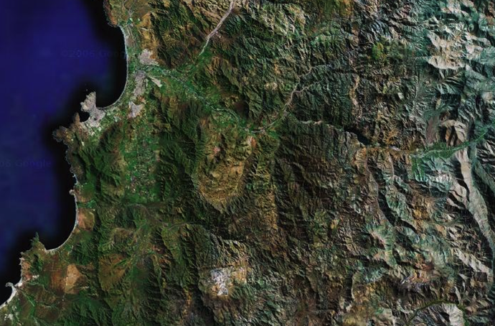
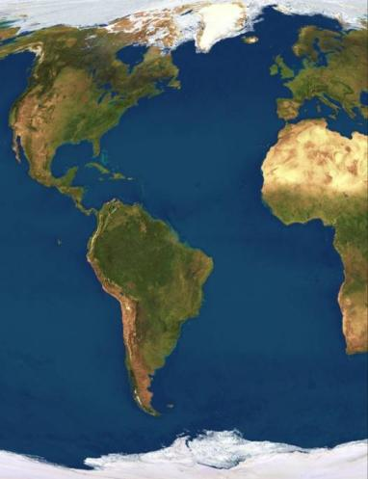
Site selection based on weather, seeing conditions and existing infractructure
La Serena
La Serena airport
port
50 km paved highway
LSST
Base Facility
Coquimbo
Vicuña
CTIO
Pan-American Highway
40km dirt road
Gemini & SOAR
N
0
10
20 km
LSST SITE

Slide 56
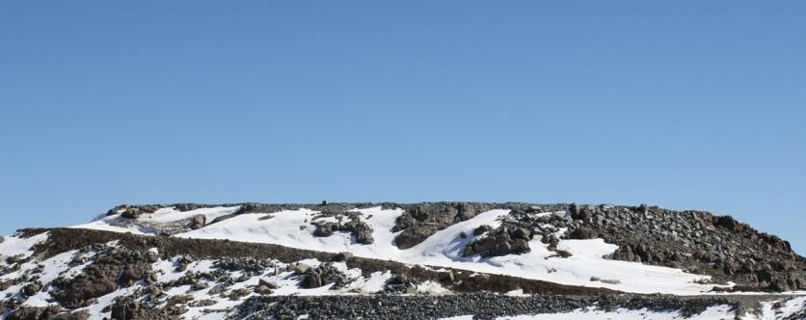
LSST Site in 2013

Slide 57
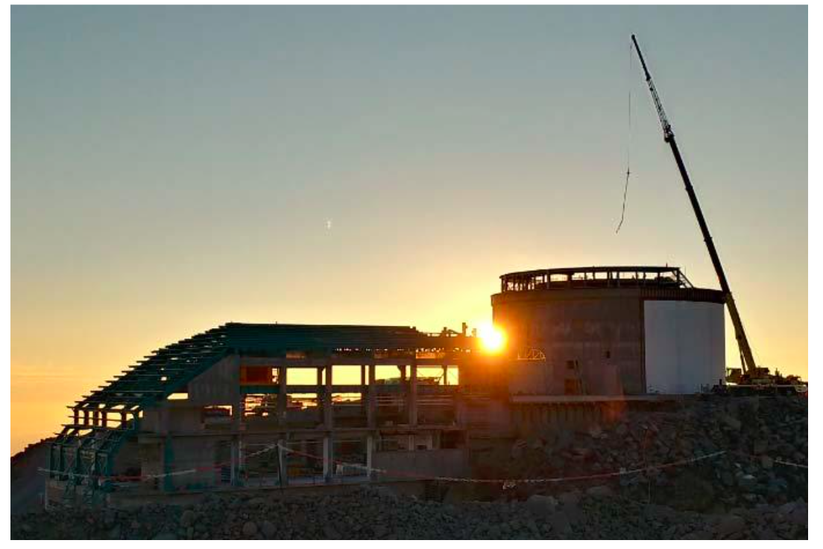
LSST Site: in February 2017
February 2017

Slide 58
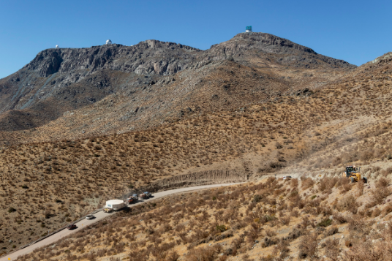
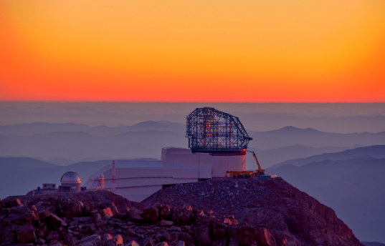
2019

Slide 59


Slide 60

LSST at BNL
BNL is involved in LSST since 2004
Dedicated LSST cleanroom class 1000 and 10000
  Tests of all LSST sensors and production of all Science Rafts in 2016-2019

Slide 61


LSST cleanroom at BNL
Status: produced all rafts

Slide 62


Slide 63


Slide 64


Slide 65
Optical Cameras with photon counting

Slide 66
Types of fast Imaging
“normal” cameras: 0.1 ms → 10 μs
Burst mode cameras: 1 μs → 10 ns
Self-triggered cameras: 10 → 0.01 nsec
Streak cameras: 1 psec
Repetitive “pump/probe” cameras : fsec
10⁻⁴ sec
10⁻⁶ sec
10⁻⁹ sec
10⁻¹² sec
10⁻¹⁴ sec

Slide 67

Modern CMOS Imagers
Ever increasing complexity and data rate
One example (ix-cameras.com)
  2048x1536: 8 kfps → 26 Gpix/sec
  510x19: 1000 kfps → 10 Gpix/sec
BUT: Not fast enough! 1000 nsec → 1 nsec

Slide 68
Normally signal is integrated in a slice of time
1 msec

Slide 69
Can achieve faster imaging (ex. by gating)
1 ns
Smaller time window = Less signal = Lower occupancy
→ ultimately resolve single photons
Need to deal with huge data volumes → sparse readout
  Keeping back-end rate the same ~ 10Gb/s

Slide 70



Imaging with photon counting
Single frame
Integrated image
Many parallels with particle detectors and x-ray imaging

Slide 71
“New” Approach to Optical Imaging
Detect and time stamp photons, one by one, using intelligent pixels
Accumulate statistics for images, also for more complex analysis (coincidences, correlations etc)
Depart from the frame-by-frame imaging and move to continuous stream of time stamped single photons
Tpx3Cam: time-stamp 10 MHz flux of photons with 1 ns precision

Slide 72


Thin window optical sensors
High QE
Developed at BNL, surface preparation inspired by astronomical CCDs (LSST)

Slide 73

Timepix3 Camera
Camera = sensor + ASIC + readout
Timepix3 ASIC: spin-out of R&D for LHC at CERN
256 x 256 array, 55 x 55 micron pixel
  14 mm x 14 mm active area
1.5 ns timing resolution
Data-driven readout, 80 Mpix/sec, no deadtime
each pixel measures time and flux
  arxiv: 1707.06253
  1902.01357
Sensor is bump-bonded to chip
Use existing x-ray readouts:
SPIDR (Nikhef, ASI)
www.amscins.com

Slide 74


Single Photons: Image Intensifier
PhotoCathode
pixel sensor
MCP Scintillator
Image intensifier (Photonis)

Slide 75



Single Photons in Tpx3Cam
1 ms slice of data
1.5ns time-stamping
TOT
TOA
Tpx3Cam + intensifier by Photonis
data taken by J. Long (ASI)
TOT

Slide 76



TOT
TOA
Each photon is a cluster of pixels
3D (x,y,t) centroiding
Spatial resolution: 0.1 pixel / photon
Time resolution: < 1 ns / photon

Slide 77
Quantum Information Science: Entangled Photons

Slide 78

BNL – SBU Collaboration
(Figueroa group at SBU)
Goals:
  Development of elements of a room temperature quantum computer
  Quantum network with quantum repeater
  Demonstration of scalability

Slide 79

BNL-SBU quantum network
Attenuation in fibers → need quantum repeater to reproduce qubits
  Simple amplification will not conserve the quantum state
Qubit teleportation: produce entangled photons and send them to two locations
Bell State Measurement (BSM) on one photon will collapse the wave function of the other one
  Still need to communicate the measurement result via classical channel so the causality is conserved
A.Zeilinger

Slide 80


Characterization of Single Photon
Down-Conversion Source
Figueroa lab
qubit: use H, V photon polarization states

Slide 81


Slide 82


Results
Find coincidences, plot as function of two polarizations
Figure of merit: S-value
  If > 2: photons are entangled
  max value: 2 $\sqrt{2}=2.82$
Measurement:
S-value = 2.72$±$0.02
Time resolution: 2ns
Time difference between photons

Slide 83


Spatial characterization of entanglement
Measure S-value
for 81 combinations of subareas
arXiv:1808.06720

Slide 84

Scalability
can send multiple beams (up to 16x16) to the sensor
QE ~ 35% but room temperature operation
Other applications in QIS which require fast single photon imaging: OAM, ghost et al.

Slide 85


Characterization of entanglement for long-distance network
ΔT = 2068 ns
0.8 & 0.3 km
P.Svihra
ΔT = ~100 ns
~ 9 & 9 km
P.Stankus

Slide 86




White Rabbit
fiber box
Signal from fiber
fiber from BCF
Tpx3Cam
optics
intensifier
S-value = 2.41$±$0.06
P.Stankus, P.Svihra, D.Katramatos, J.Haupt,
A.Elger, S.Gera, Y.Kim, M.Flament
Stokes parameters

Slide 87


Direct view of SBU hospital from BNL
~20 miles
Telescope with fiber coupled adaptive optics

Slide 88
Other applications

Slide 89

Optical readout for LAr TPC
Image light from avalanches in gas phase
hep.ph.liv.ac.uk/ariadne/index.html
Kostas Mavrokoridis, Adam Roberts et al
Tpx3Cam can measure drift time
→ converts 2D to 3D

Slide 90


5.5 MeV alphas in CF₄ gas
Using Tpx3Cam
Color = TOA
Color = TOT

Slide 91




Alphas and cosmics
TOT color scale
A. Roberts, P. Svihra, A. Al-Refaie, K. Majumdar, K. Mavrokoridis, A. Nomerotski, B. Philippou and J. Vann: 'First demonstration of 3D optical readout of a TPC using a single photon sensitive Timepix3 based camera'. https://arxiv.org/abs/1810.09955
(x,y,z)

Slide 92
Future directions in imaging

Slide 93

by Medipix4 collaboration
X. Llopart

Slide 94
Single Photon Sensitivity without intensifier?
So far needed outside amplification (MCP) to have a detectable signal
Limitation: QE ~ 35%
GaAs
Photonis photocathodes

Slide 95
Single Photon Imaging without intensifier?
Can the amplification be integrated into the sensor? Silicon QE can be >90%. At room temperature.
SPAD imagers
Currently PDE ~30-60% and high DCR but there are no fundamental limits, the technology is improving

Slide 96



100 ps 32x32 pixel SPAD Camera
fully digital 8×16 pixel SPAD array
Superb time resolution
BUT high dark count rate,
difficulties in integration of complex designs
in a monolithic sensor

Slide 97
Questions?

