Slide 1
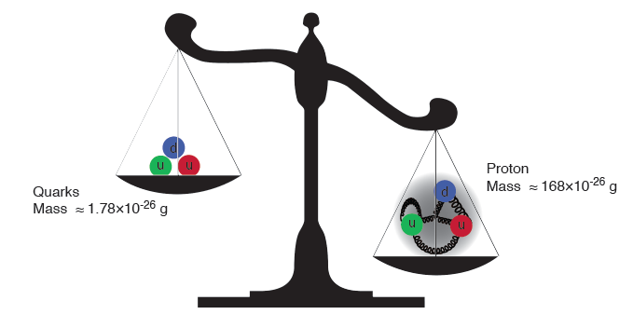
QCD as a many-body theory: an existential tale in four acts
Raju Venugopalan
Brookhaven National Laboratory
Student lecture, July 16, 2019

Slide 2
Act 1: The mysterious gluon

Slide 3
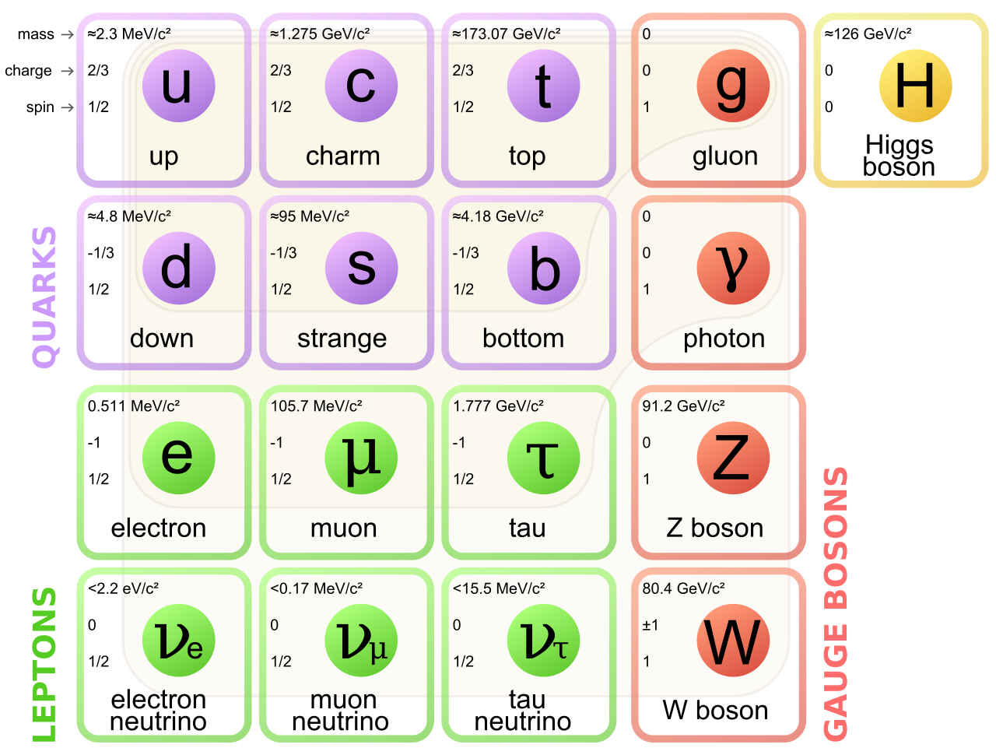
Gluons, the force carriers of the strong force,
are a fundamental building block of the standard model

Slide 4
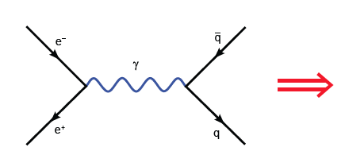
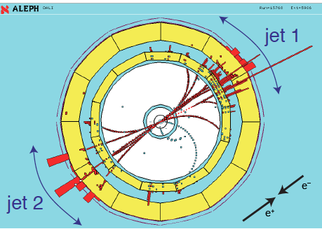
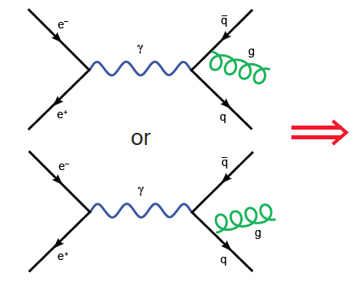
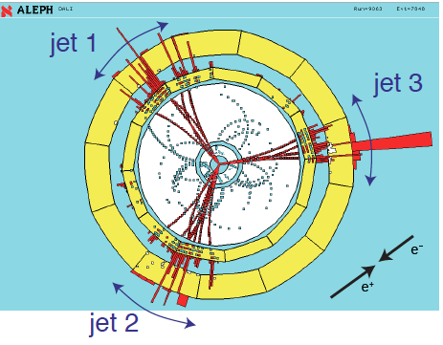

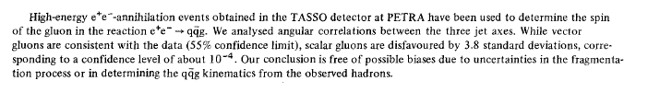
Discovery of the gluon
Physics Letters B, 15 December 1980

Slide 5
Gluons are massless…yet their dynamics is responsible for
(nearly all) the mass of visible matter
The Higgs “God particle” is responsible for quark masses
~ 1-2% of the proton mass.

Slide 6
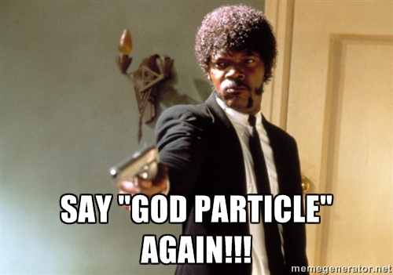

Slide 7
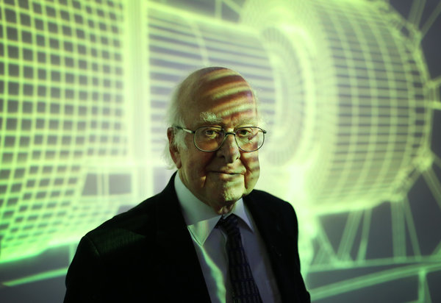
Higgs and the strong force
When he invented his boson in 1964, he said, “I wasn’t sure it would be important.”
He explained, “At the time the thought was to solve the strong force.”
NY Times, Sept. 15, 2014

Slide 8
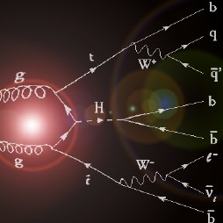
Higgs from Gluon fusion

Slide 9
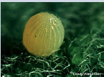


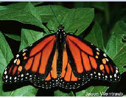

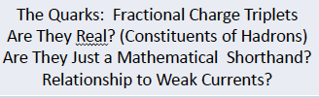


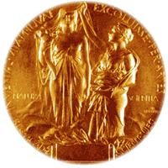
Quantum Chromodynamics
First QCD paper: Gell-Mann, Fritzsch, Leutwyler (1973)
From Gell-Mann’s 8-fold way to QCD: A lepidopteral metaphor
Jeffrey Mandula, Creutz-Fest 2014, BNL
N. P. Samios
M. Gell-Mann

Slide 10
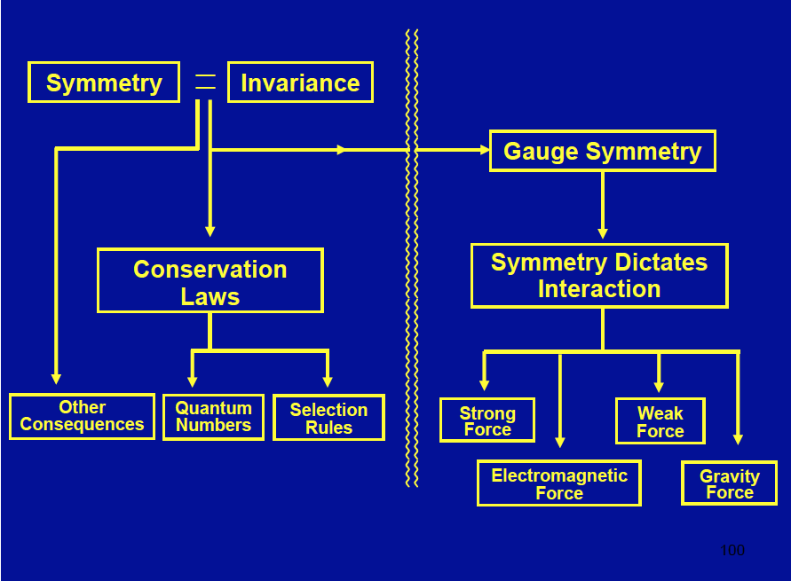
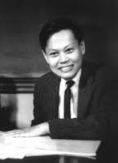
Symmetries dictate interactions
C. N. Yang

Slide 11
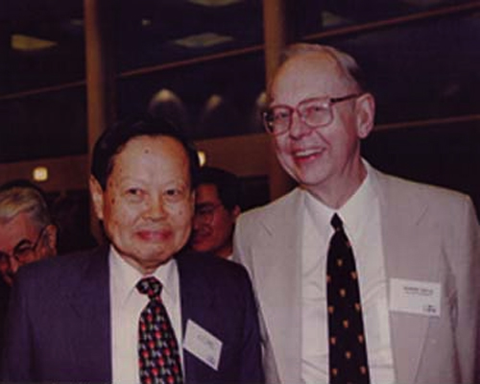
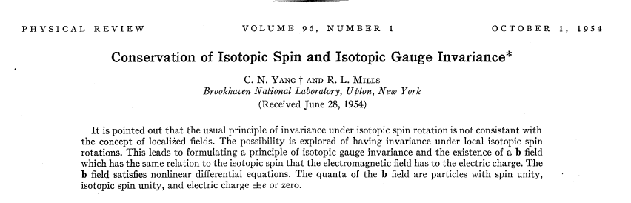
Fundamental feature of QCD:
Yang-Mills Theory
Possibly the most important paper from BNL

Slide 12
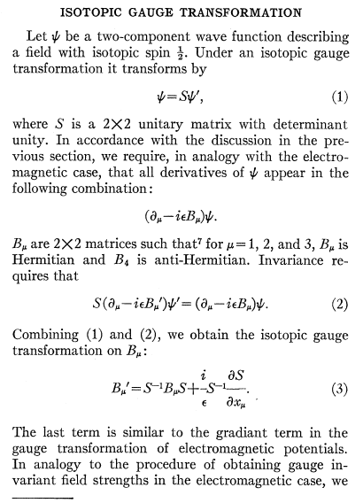
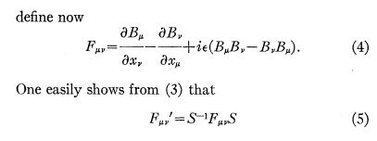
From the Yang-Mills paper,

Slide 13
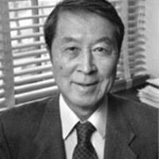
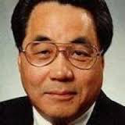
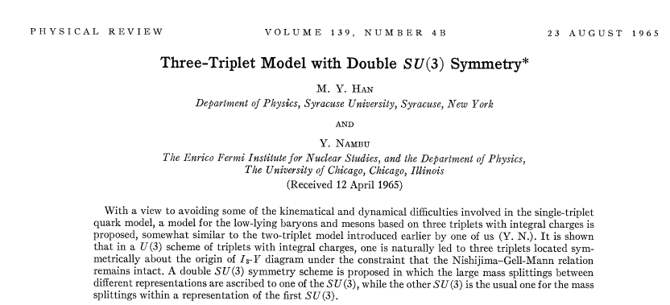
All the elements, except…color
SU(3) gauge symmetry
Y. Nambu
M.-Y. Han
Also, earlier work by O. Greenberg on the quark model

Slide 14
Quantum Chromodynamics (QCD)
QCD - “nearly perfect” fundamental quantum theory of quark
and gluon fields F.Wilczek, hep-ph/9907340
Theory is rich in symmetries:
“Symmetries dictate interactions” – C.N Yang
i
ii
iii
Gauge “color” symmetry: unbroken but confined
Global “chiral” symmetry: exact for massless quarks
Baryon number and axial charge (m=0) are conserved
Scale invariance of quark (m=0) and gluon fields
Discrete C,P & T symmetries
Chiral, Axial, Scale and (in principle) P &T broken by
vacuum/quantum effects - ”emergent” phenomena
Inherent in QCD are the deepest aspects of relativistic Quantum Field Theories (confinement, asymptotic freedom, anomalies, spontaneous breaking of chiral symmetry)

Slide 15
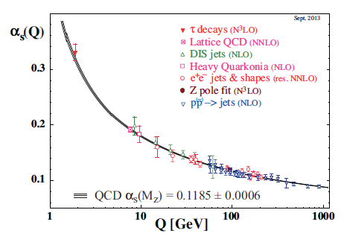
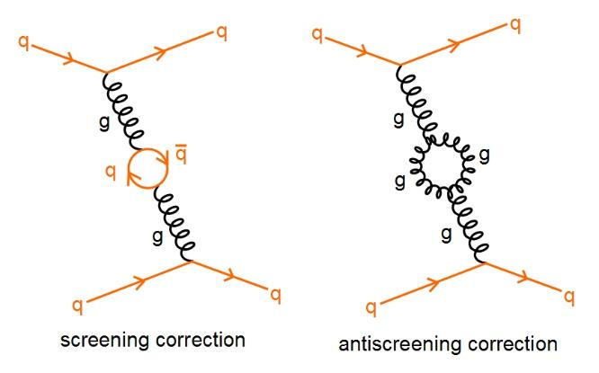
Asymptotic freedom: the role of glue
David Politzer
2004
David Gross
Frank Wilczek
The self-interaction (of color charged) gluons is fundamentally responsible for
the asymptotic freedom of quarks and gluons in Quantum Chromodynamics (QCD)

Slide 16
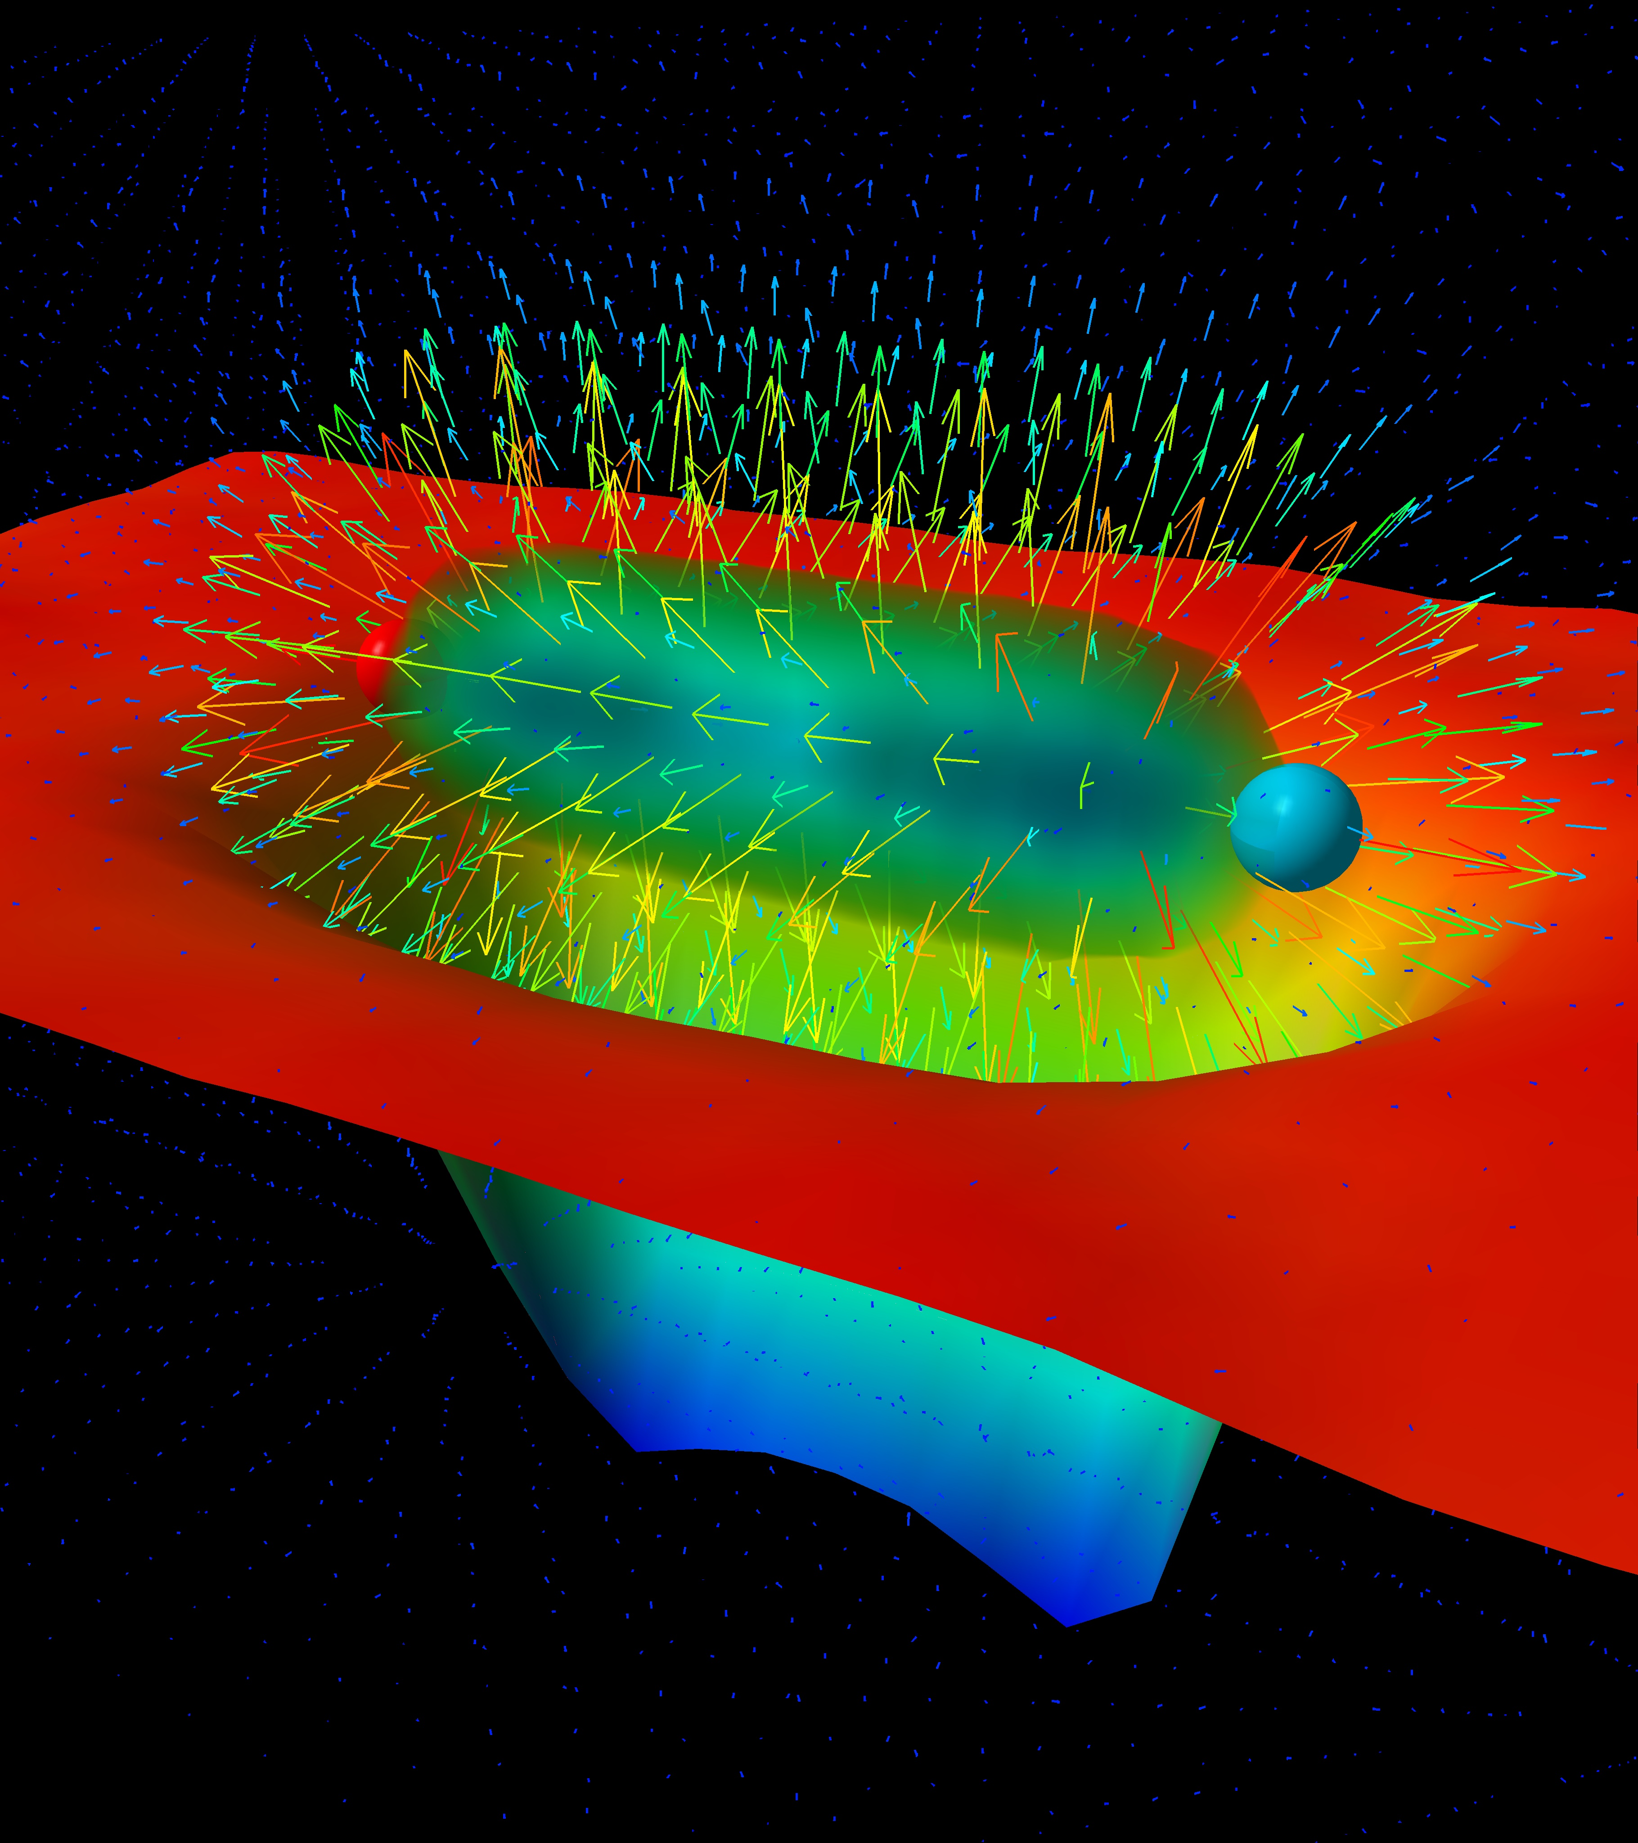
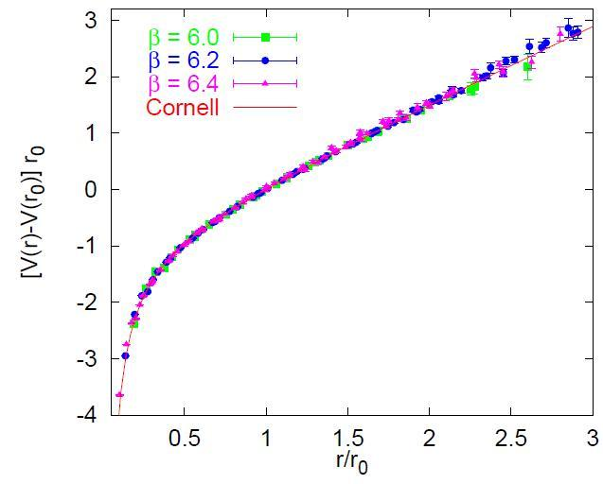
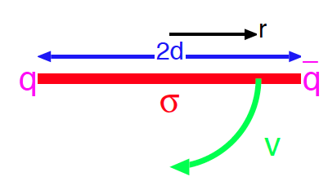
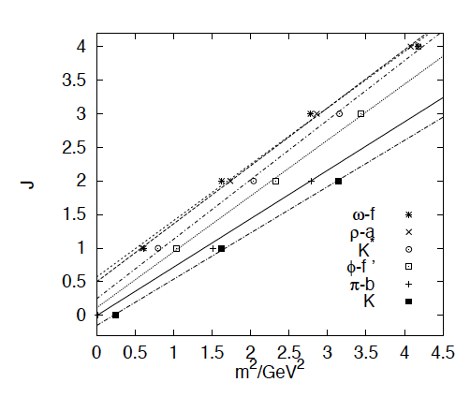
Quark (and Gluon) confinement: the role of glue ?
“Gluon” potential between
heavy quark-antiquark pair
Quarks experience force of 16 tons at
distances of ~ 1 Fermi (10⁻¹⁵ m)
Bali, hep-ph/0001312
“Regge” trajectories
Intuitive picture of quark confinement and
stringy pictures of mesons

Slide 17
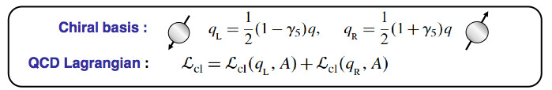
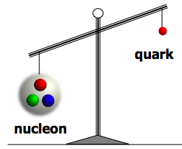
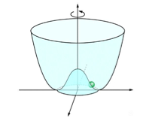


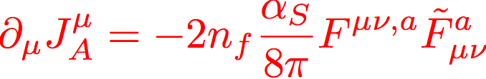
QCD: Chiral symmetry breaking
Quantum QCD vacuum:
Chiral condensate: spontaneously generate mass via the
Nambu-Goldstone mechanism
m_{q} ~ 10 MeV ; m_{N} ~ 1 GeV
Axial anomaly:
Quantum violation of U(1)_{A}

Slide 18
The essential mystery
(Nearly) all visible matter is made up of quarks and gluons
But quarks and gluons are not visible
All strongly interacting matter is an emergent consequence of
many-body quark-gluon dynamics.
Example: Mass from massless gluons and (nearly) massless quarks
There is an elegance and simplicity to nature’s strongest force we do not understand
Understanding the origins of matter demands we
develop a deep and varied knowledge of this emergent dynamics

Slide 19
Act 2. QCD: The Power and the Glory

Slide 20
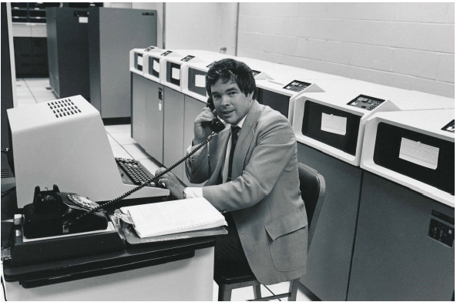
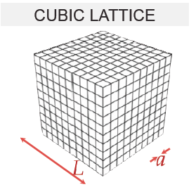
Numerical realization: Lattice QCD
(1982)
Kenneth G. Wilson
Lattice regularization (UV&IR) of QCD
First principles treatment of static
properties of QCD: masses, moments,
thermodynamics at finite T (& μ_{B} ?)

Slide 21
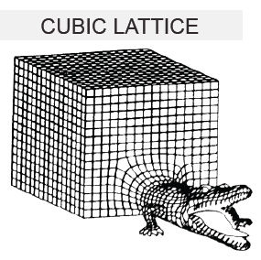
Numerical realization: Lattice QCD
(1982)
Kenneth G. Wilson
Formidable computational problem
Very challenging for dynamical
processes…

Slide 22
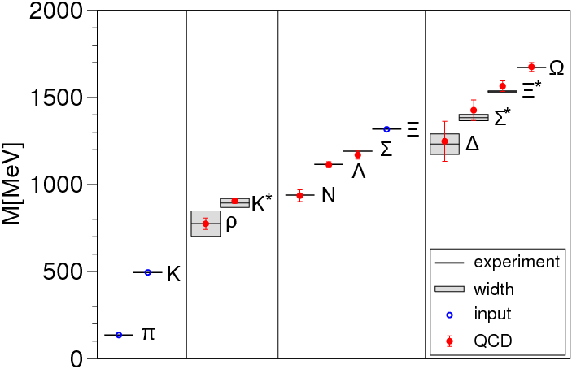
Precision QCD on the lattice
Durr et al., Science, 322 (2008)

Slide 23
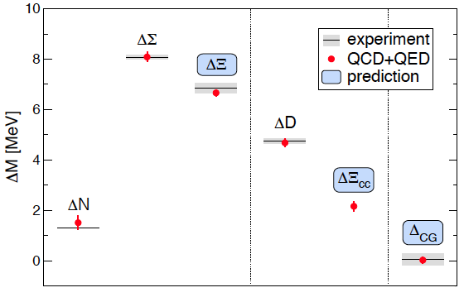
Precision QCD+QED on the lattice
Coleman-Glashow
relation among
mass splittings
Budapest-Marseille-Wuppertal (BMW) Coll., arXiv:1406.4088

Slide 24

The deeply inelastic scattering (DIS) femtoscope
Measure of resolution power
Measure of inelasticity
Bjorken variable: Measure of momentum fraction of struck quark
quark+anti-quark
momentum distributions
gluon momentum distribution

Slide 25
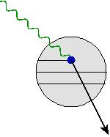
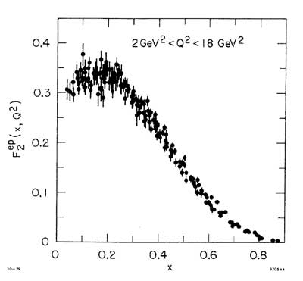
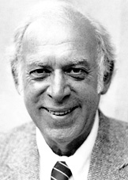
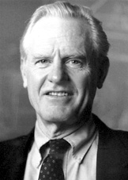
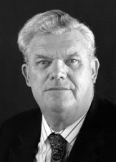
The deeply inelastic scattering (DIS) femtoscope
From SLAC fixed target
DIS… (late 1960s)
Discovery of quasi-free point-like quarks!
(1990)
Friedman
Kendall
Taylor

Slide 26

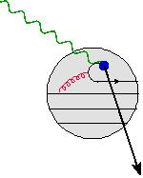
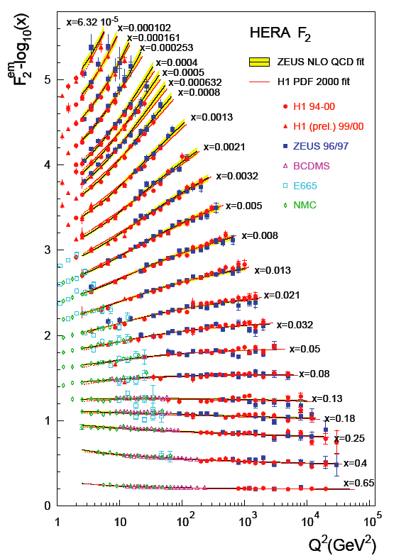
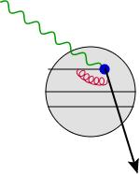
The deeply inelastic scattering (DIS) femtoscope
…to the HERA DIS collider (1990s)
Gluons and “sea” quarks
SLAC
expts.
The proton at high energies
(small x) is dominated by glue!

Slide 27
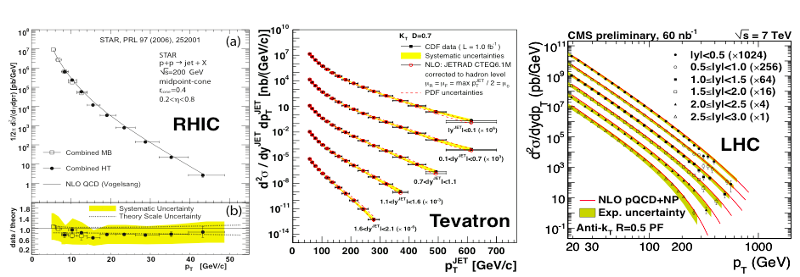
Perturbative QCD: now benchmark for new physics
Structure functions measured at
HERA electron-proton collider
Jet cross-sections: proton-proton collisions (RHIC &LHC)
and proton-antiproton collisions at Fermilab
At large momenta, the weak QCD coupling
(asymptotic freedom!) enables
systematic computations

Slide 28
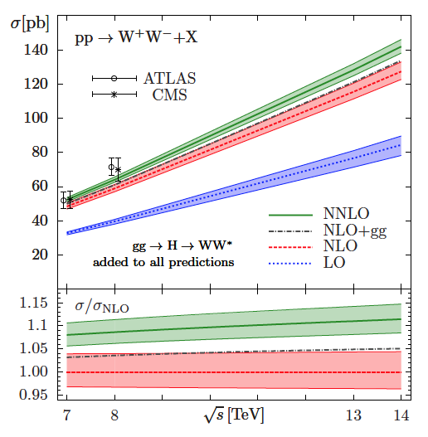
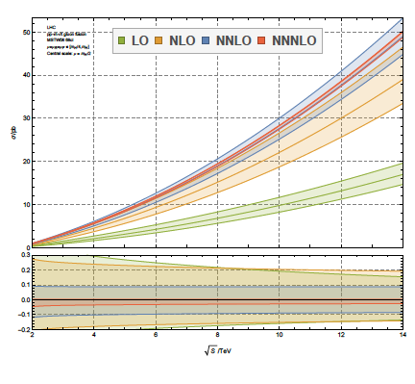
Perturbative QCD: benchmark for new physics
Gluon fusion to Higgs cross-section
Gehrmann et al., arXiv:1408.5243
Anastasiou et al., arXiv:1503.06056

Slide 29
F. Wilczek , “Quarks (and Glue) at the Frontiers of Knowledge”
Talk at Quark Matter 2014
Are we done ?

Slide 30

Act 3: Surprises from boiling the QCD vacuum
Nuclei as heavy as bulls
Through collisions
Generate new states of matter
TD Lee, Nobel Laureate (1957)

Slide 31
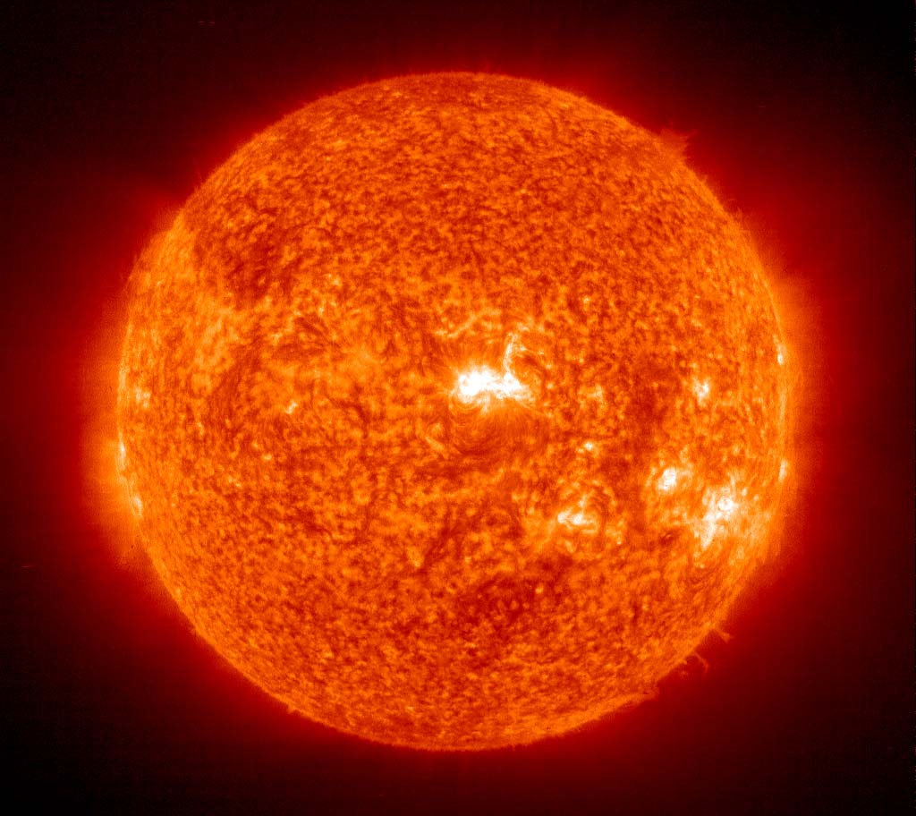
What happens to matter when it is heated up to temperatures 100,000 times hotter than the center of the sun?
center of sun 15,000,000 Celsius (27,000,000 Fahrenheit)

Slide 32


Matter in unusual conditions
E. Fermi: “ Notes on Thermodynamics and Statistics ” (1953)
Pre-QCD: Thus, our ignorance of the microscopic physics
stands as a veil, obscuring our view of the very beginning
Steven Weinberg, The First Three Minutes (1973)

Slide 33

Early Universe
QCD lifts the veil

Slide 34



QCD: asymptotic freedom
Gross,Wilczek, Politzer
Coupling grows weaker
with increasing momentum
transfer (shorter distances)
Super-dense and Super-hot QCD matter is a weakly coupled gas of quarks and gluons – “lifting the veil” to the early universe
-- analytical computations feasible
Collins-Perry (1974)
Cabibo-Parisi (1975)

Slide 35







QCD: Infrared Slavery
Wilson
Potential between static
quark-anti-quark pair
grows linearly at large distances -
intuitive picture of confinement
QCD matter is strongly interacting at low Temperature and Density
- static properties computed using numerical lattice methods

Slide 36

QCD: Chiral symmetry breaking
Nambu
Quantum QCD vacuum:
Chiral condensate: spontaneously generate mass via
Nambu-Goldstone mechanism
m_{q} ~ 10 MeV ; m_{N} ~ 1 GeV
Axial anomaly:
Quantum violation of U(1)_{A}
Chiral symmetry restoration at large T:

Slide 37
Summit, built by IBM, occupies floor space equivalent to two tennis courts, slurps 4,000 gallons
of water a minute around a circulatory system to cool its 37,000 processors. Oak Ridge says its
new baby can deliver a peak performance of 200 quadrillion calculations per second (that’s 200 followed by 15 zeros) using a standard measure used to rate supercomputers, or 200 petaflops. That’s about a million times faster than a typical laptop
From Wired magazine

Slide 38

Finite temp. lattice results: hadron gas to QGP

Slide 39

QCD at finite T: Chiral Symmetry Restoration
O(4) scaling of chiral susceptibility
Chiral susceptibility
Crossover temperature from Hadron Gas to Quark-Gluon Plasma
$T_{c}$ = 156 $±1.5 MeV$
≈ 1.8 Trillion Kelvin!
1 eV = 11,600 Kelvin
Hot QCD collaboration, Bazavov et al., arXiv:1812.08325

Slide 40

QCD phase diagram
Much more on the phase diagram in the lectures by Pisarski

Slide 41

the universe a micro-second after the Big Bang was similar stuff and had the same temperature
“The early universe was “liquid-like”

Slide 42




Perfect fluidity across energy scales
“Bjorken Hydrodynamics”
Viscous term smaller than ideal term for
From kinetic theory
H₂O
⁶Li
sQGP
⁴He
Schafer,Teaney, Rep.Prog.Phys.72 (2009) 126001

Slide 43

Perfect fluidity across energy scales
“Bjorken Hydrodynamics”
Viscous term smaller than ideal term for
From kinetic theory

Slide 44

Perfect fluidity across energy scales
“Bjorken Hydrodynamics”
Viscous term smaller than ideal term for
From kinetic theory
QGP is ~ 10⁴ times more viscous than pitch tar…

Slide 45

Viscosity of strongly coupled relativistic fluids
AdS/CFT conjecture:
Duality between strongly coupled
N=4 supersymmetric Yang-Mills theory
at large coupling and Nc
& classical 10 dimensional gravity in the
background of D3 branes
KSS bound:
Conjectured lower bound for
a ``perfect fluid”
Derived using classical absorption cross-section of a graviton
with energy ω on a black brane and Bekenstein’s formula relating its
Entropy to its area
Kovtun,Son,Starinets (2006)

Slide 46

Deconstructing lumpiness to find a perfect fluid

Slide 47


Slide 48

Heavy Ion phenomenology: IP-Glasma model

Slide 49










P
Flow moments: analogy with the Early Universe
Mishra et al; Mocsy- Sorensen;
Floerchinger, Wiedemann
The Universe
HIC
distributions and correlations of produced particles
kinetic
freeze-out
lumpy initial energy density
hadronization
QGP phase
quark and gluon degrees of freedom
Credit: NASA
Δρ/√ρ_{ref}
Δφ
WMAP

Slide 50


HEAVY ION EVENT, ATLAS DETECTOR
Color Glass
Condensates
Overlap of
wavefunctions
Glasma
sQGP - perfect fluid
Hadron Gas
time
Color Glass Condensate: Highly dense gluon matter in nuclear wavefunction
Glasma: Out of equilibrium QGP formed from decay of CGCs

Slide 51

QGP

Slide 52

How does quark-gluon plasma thermalize in a HI-collision ?
t
Properties independent of
initial conditions
Self-similar evolution characterized
by universal scaling exponents

Slide 53

Turbulence is everywhere yet baffles deep thinkers
I am an old man now, and when I die and go to heaven there are two matters on which I hope for enlightenment. One is quantum electrodynamics, and the other is the turbulent motion of fluids. And about the former I am rather optimistic.
Horace Lamb

Slide 54

Universality: hotness is also cool
Wolfgang Ketterle, Nobel Prize (2001)
For the achievement of Bose-Einstein condensation in dilute gases of alkali atoms, and for early fundamental studies of the properties of the condensates

Slide 55



The Glasma and overoccupied quantum gases
Remarkable universality of longitudinally expanding world’s hottest and coolest fluids
Berges,Boguslavski,Schlichting,RV, PRL (2015)
Editor’s suggestion
τ
In a wide inertial range, scalar & gauge fields
have identical scaling exponents & functions
τ
τ
⁸⁷Rb BEC in a quasi 1D optical trap
Only isotropic geometry thus far
α = 0.33±0.08
β = 0.54±0.06
Oberthaler BEC Labs
Prüfer et al, arXiv:1805.11881, Nature (2018)

Slide 56



Topology in heavy-ion collisions: The Chiral Magnetic Effect
Kharzeev,McLerran,Warringa (2007)
L or B
+
N_{CS} = -2 -1 0 1 2
External (QED) magnetic field
- As strong as 10¹⁸ Gauss !
Over the barrier (sphaleron) transitions between different
topological sectors of QCD vacuum…analogous to proposed mechanism
for Electroweak Baryogenesis
=
Chiral magnetic effect

Slide 57

Topology in heavy-ion collisions: The Chiral Magnetic Effect
10¹⁴ Tesla !!
External B field dies rapidly…effect most significant, for transitions at early times
Consistent (caveat emptor!) with results from STAR and ALICE…active searches underway
Chiral Magnetic Effect seen in condensed matter systems
Q. Li et al., Nature Physics (2015)

Slide 58

Topological transitions in the Glasma
“Cooled” soft Glue configurations in the Glasma are topological !
Mace,Schlichting,Venugopalan, PRD (2016)

Slide 59

Act 4. Towards EIC: The ultimate IMAX experience

Slide 60

Terra-incognita (mostly) of scattering in the strong interactions
Energy
(
)
Aschenauer et al., arXiv:1708.01527
Rep.Prog. Phys. 82, 024301 (2019)

Slide 61

Structure of matter: Microscopes to Femtoscopes
Light Microscope
Wave length: 380-740 nm
Resolution: > 200 nm
SLAC,EMC,NMC,E665,BCDMS,
HERMES,JLab,COMPASS…
JLab 12 GeV
Electron Microscope
Wave length: 0.002 nm (100 keV)
Resolution: > 0.2 nm
HERA,
EIC,LHeC
Fixed Target Particle
Accelerator Experiments
Wave length: 0.01 fm (20 GeV)
Resolution: ~ 0.1 fm
Collider Experiments
Wave Length: 0.0001 fm
(EIC: 20 GeV + 100 GeV)
Resolution: 0.01-0.001 fm

Slide 62
The glue that binds us all:
Imaging matter below the Fermi scale with an Electron-Ion Collider
Raju Venugopalan
Brookhaven National Laboratory
The glue that binds us all:
Imaging matter below 10⁻¹⁵ m with an Electron-Ion Collider

Slide 63

What does the proton look like ?
Static pictures
Glue dominated
boosted proton

Slide 64

The boosted proton
In QCD, the proton is made up of quanta that fluctuate in and out of existence
Low Energy
or large x
High Energy
or small x

Slide 65

The boosted proton

Slide 66











Boosted protons: classical coherence from quantum fluctuations
Saturation
BFKL
DGLAP
1/Q_{S}²
Stability of QCD matter requires saturation of over-occupied gluons:
Emergent dynamical saturation scale grows with energy

Slide 67



The proton’s spin puzzle
Fixed target deep inelastic scattering experiments
showed that quarks carry only about
30% of the proton’s spin
“Spin crisis” – a failure of the quark model
picture of three relativistic “constituent” quarks

Slide 68
3-D imaging in semi-inclusive reactions
x

Slide 69

Projected images of spatial gluon distributions
High precision spatial tomography of gluon and sea quark distributions !

Slide 70

Quark–gluon wave patterns: Diffraction for the 21st Century
M_{X}
Colorless
exchange
A TeV electron hits a nucleus (binding energy of 8 MeV/nucleon)
Day 1 prediction: nucleus remains intact in at least 1 in 5 events

Slide 71
Recent endorsement of EIC by an NAS panel
How does the mass of the proton arise?
How does the spin of the nucleon arise?
What are the emergent properties of dense systems of gluons
Awaiting Critical Decision zero – this year

Slide 72


Scientific American
May 2015 issue

