Slide 1
Introduction of Statistics in High Energy Physics
Xin Qian
BNL

Slide 2
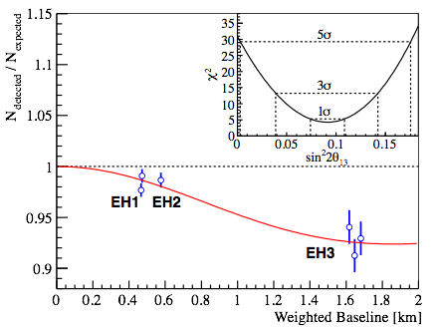
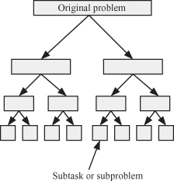
About Statistics
What’s statistics?
To physicist, statistics is a language
A language that we can use to communicate with each other in a clear and concise way
“Daya Bay discovered the non-zero value of θ13 with a statistical significance > 5σ”
Daya Bay 2012
A tool that help us to organize our thoughts (e.g. convert problem → questions, divide a big question → many small questions)

Slide 3
Basic Concept: Experimental Uncertainties

Slide 4
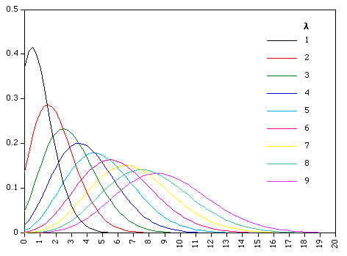
Basic Concept: Experimental Uncertainties
Being a physicist, the first thing that we learnd is that everything is associated with uncertainties
Statistical Uncertainty
Arise random fluctuations in a measurement
Poisson Distribution
Approaching to Normal (Gaussian) distribution at large λ (expected number of events)

Slide 5
Systematic Uncertainties
Arise from inaccuracy intrinsic to the measurement system (e.g. instrumentation)
Correlated and uncorrelated systematic uncertainties
Example:
Use a ruler for two measurements
The systematic uncertainties due to the inaccuracy of this rule are correlated
Uncertainty will not become smaller even you measure many times
Use two rulers, each for one measurement
The systematic uncertainties due to inaccuracies of these rulers are not correlated

Slide 6
Error Propagation: first derivative
Assuming “A” and “B” are uncorrelated
Assuming “x” and “y” are uncorrelated, but “f” and “g” are not
Underlying assumption: (random) fluctuations and variations follow Normal (Gaussian) distribution

Slide 7
Covariance Matrix
Define operator “E” to be the expectation
Covariance matrix K_{XX} = E[(X_{i}-E[X_{i}])(X_{j}-E[X_{j}])]
With Gaussian approximation, the covariance matrix incorporates all (statistical + uncorrelated/correlated systematic) uncertainties

Slide 8
Power of the Covariance Matrix
Given vectors X, Y with their mean and covariance matrix
We can calculate the conditional mean with Linear Algebra and conditional variance
Expectation on Y given the measurement of X
Uncertainties on Y given the measurement of X and X’s uncertainties
E. L. Morris “Multivariate Statistics: a Vector Space Approach” 1983.
Also the math behind the “Gaussian Process”

Slide 9
One Simple Example
Two detectors with isotropic neutrino flux (10% uncertainty)
Assume perfect measurement of neutrino flux at ND (X)
Assume 1% measurement of neutrino flux at ND (X)
Detector Related
Perfect constraint at FD predicted flux (Y)
Far Detector flux (Y) is constrained to < 1%

Slide 10
Basic Concept: Test Statistics

Slide 11
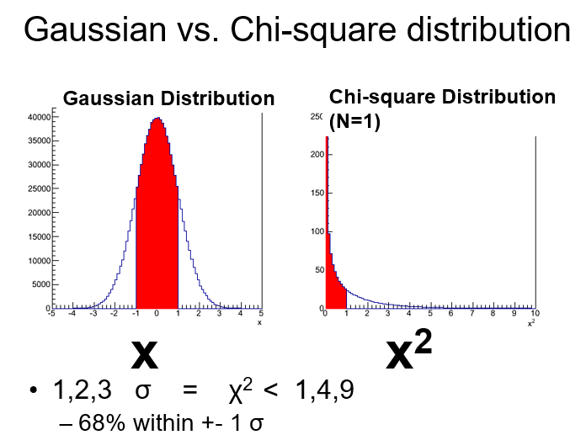
Basic Concept: Test Statistics
“Test statistics” in the field of statistics is equivalent to “price” in the field of finance
A way to condense information into a single number, so that it can be compared
Typically, likelihood function (or likelihood) representing the probability of a observation given a set of parameters (θ) is used in test statistics
e.g. the θ value with the highest (maximal) likelihood value is the best estimation

Slide 12
Example of Test Statistics for Poisson Distribution
At large statistics, the Poisson distribution can be approximated as a Normal distribution with mean μ_{i} and standard deviation σ_{i}²= μ_{i}

Slide 13
Additional Test Statistics
In practice, the variance (standard deviation) of the Normal distribution can be further approximated by the measured value
A new “Combined Neyman and Pearson” (CNP) Chisquare, an improved approximation (X. Ji et al. arXiv:1903.07185)

Slide 14
A Simple Example
A set of “n” independent counting experiments to deduce a common expected value “μ”:
The best estimation of “μ” can be obtained through minimization of χ² (maximization of likelihood)

Slide 15
n=100 and μ=15
Taken from arXiv:1903.07185
CNP is an improved approximation to Poisson Chisquare. In certain occasions, CNP has significant advantages in computation

Slide 16
Test Statistics: Weighted Least Squares (WLS)
A. C. Aitken Proc. R. Soc. Edinburgh 55, 42 (1935)
An approximation or a special case of the maximum likelihood approach
With unbiased measurements, this solution is the best linear unbiased estimator (BLUE)

Slide 17
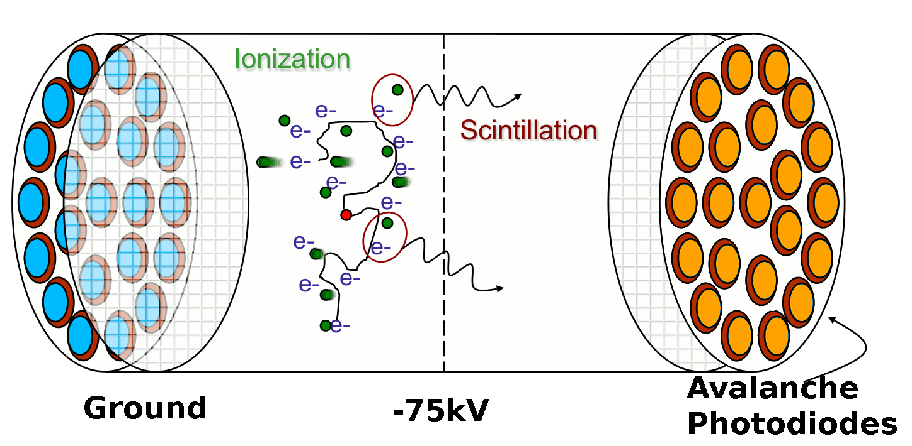
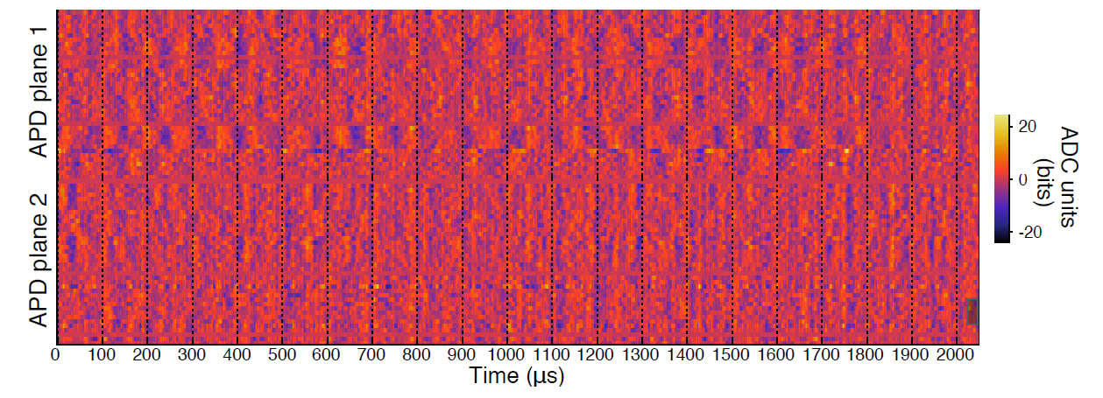
Improved Energy Estimator in EXO-200
Search for 0νββ with ¹³⁶Xe
During the initial operation, observed correlated noise in the APD light readout
An optimal energy estimator based on linear algebra to reduce correlated noise: JINST 11, P07015 (2016)
Liquid Xe Time Projection Chamber
Light waveform of an example noise event
Nature 510, 229 (2014)

Slide 18
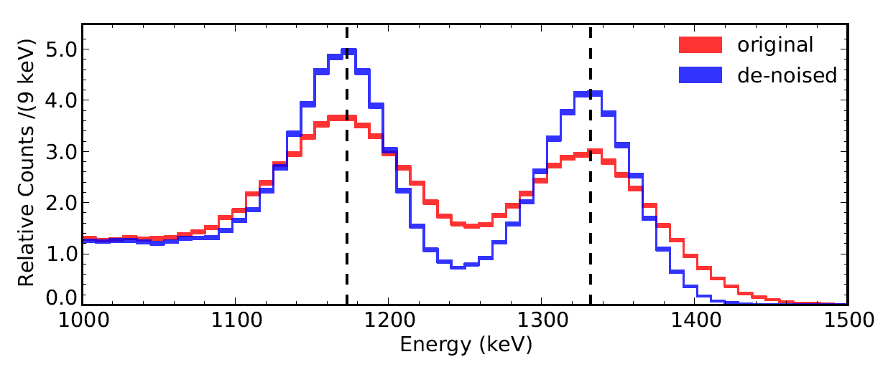
Improved Energy Estimator in EXO-200
Major challenge: large dimension: 2048 (time bins) x 70 (APDs) ~ 1.43x10⁵ → difficult to calculate (R^{T}C⁻¹R)⁻¹
More details in JINST 11, P07015

Slide 19
Some Basic Questions in High Energy Physics Hypothesis Testing Parameter Estimation

Slide 20
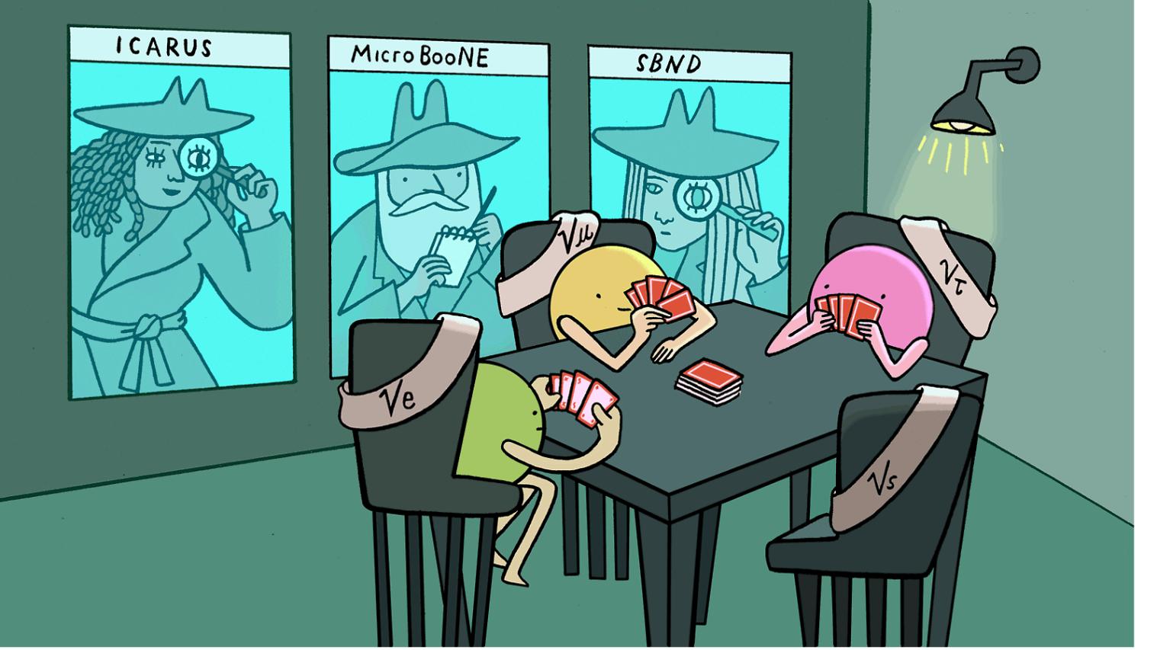
Common Questions in HEP
Hypothesis testing
Is there a sterile neutrino?
Is dark matter a particle?
Is Higgs boson a fundamental particle?
…
Hypothesis is something that you can pretend to be true
So that you can predict
Comparing the results and prediction can tell you how likely a hypothesis is true
Close connection with Parameter Estimation
Symmetry magazine

Slide 21
Common Questions in HEP
Parameter estimation
What’s the mass of Higgs boson?
What’s the mass of neutrino?
What’s the fraction of dark matter in our universe?
…
Basically, given a model which contains one or more parameters, how to estimate the true value of them?
So that we can use the model to make prediction

Slide 22
Confidence Interval and Credible Interval

Slide 23
Credible Interval and Credible Level (Bayesian way)
Credible interval is a range
In which the probability of truth inside this range is represented by the credible level
For example, if we say the credible interval is 95 +- 5 (@ 68%), it means the probability of containing the true parameter inside [90,100] is 68%
This is natural, but HEP physicists do not use this much …

Slide 24
Confidence Interval and Confidence Level (Frequentist Way)
P-value: probability of obtaining a test statistic more extreme than the one actually observed
Naively, a small p-value → less likely to be the truth
Confidence Interval is a range
In which, the p-value of model with parameters inside is larger than 1 – “Confidence Level”
Note: there is no truth mentioned at all, just based on experimental data

Slide 25
P-value and Test Statistic
P-value: probability of obtaining a test statistic more extreme than the one actually observed
Test statistic: reduce data to a single number
Given a Gaussian (Normal) distribution:
 | Area inside | 2-sided p-value | 1-sided p-value
1-σ | 68.27% | 31.73% | 15.87%
2-σ | 95.45% | 4.55% | 2.28%
3-σ (evidence) | 99.73% | 0.27% | 0.13%
4-σ | 99.994% | 6.4e-4 | 3.2e-4
5-σ (discovery) | ~1 | 6e-7 | 3e-7
σ is the standard deviation of the Gaussian distribution.

Slide 26
Back to Experimental Uncertainties
When we see something like “a = 95 +- 5”, what does this mean in HEP?
First, it is always a confidence interval, NOT a credible interval
Second, when the confidence level is not mentioned, it implies 68%
Third, although it is a confidence interval, people always try to understand it as credible interval

Slide 27
Procedure to Deduce Confidence Interval

Slide 28
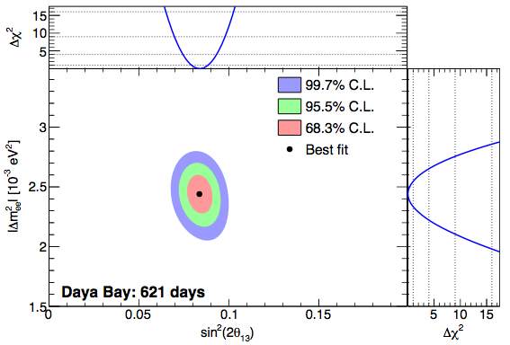
Parameter Estimation & Confidence Interval
Assume a parameter θ and a nuisance parameter η (Gaussian approximation)
What do we want?
Best estimation of θ and η are and
Confidence interval of θ and η
Basically a range of θ and η
Daya Bay Oscillation

Slide 29
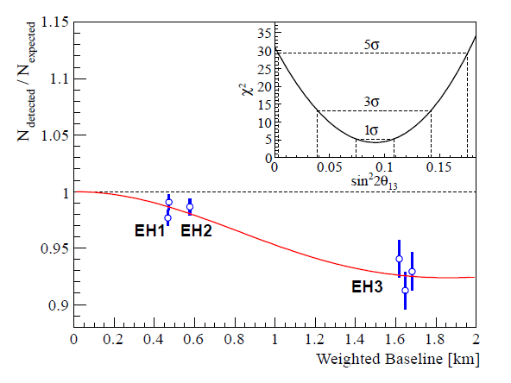
Procedure
Let denotes the (global) minimum
For any given θ, minimize χ² to get
Take 1, 2, 3 … -σ confidence intervals with confidence levels of 68.27%, 95.45%, 99.73% (2-sided)…
The 1, 2, 3 … -σ confidence interval are determined by
This procedure can be expanded to cases with number of degree of freedom > 1
PRL 108, 171803 (2012)
Daya Bay’s 5.2 σ discovery of non-zero of θ₁₃ !

Slide 30
What’s the mathematical basis of this procedure?

Slide 31
Wilks’ Theorem
S. S. Wilks, The Annals of Mathematical Statistics 9, 60 (1938)

Slide 32
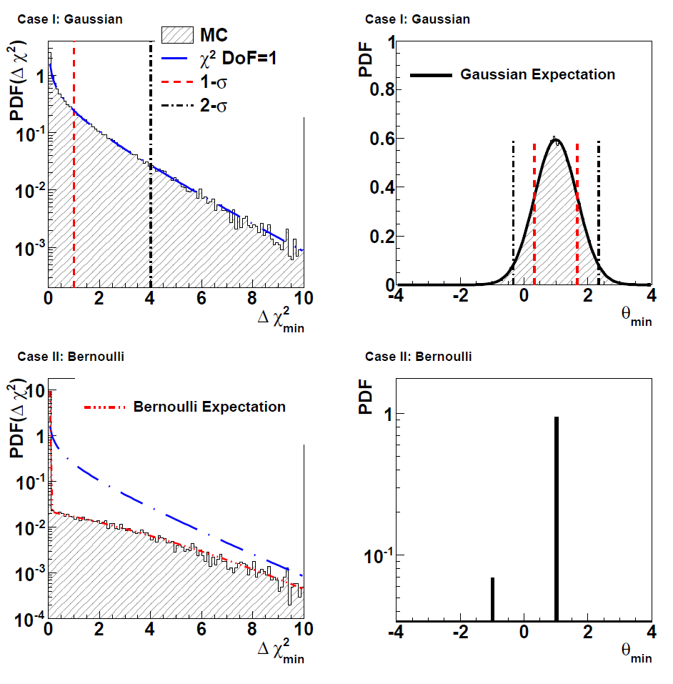
Let’s translate it
If the best estimation roughly follow a Gaussian distribution around true θ
The would asymptotically follow a chi-square distribution
This can be extended any number of degrees of freedom
Example:
10 bins, each bin
The count in each bin follows a Gaussian distribution
Given true θ = 1

Slide 33
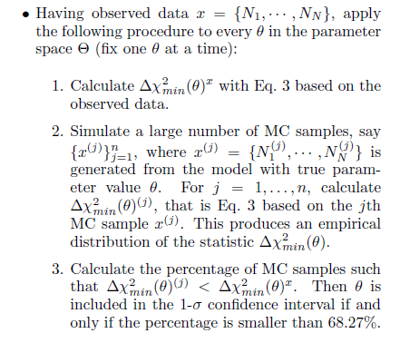
What about a Non-Gaussian Example
Assume θ is limited to two cases: 1 and -1
Feldman-Cousins Approach (likelihood ratio test): PRD 57, 3873 (1998)
Δχ² is not a chi-squared distribution any more!
MC method to determine the confidence interval, directly follow the definition of confidence intervals.

Slide 34
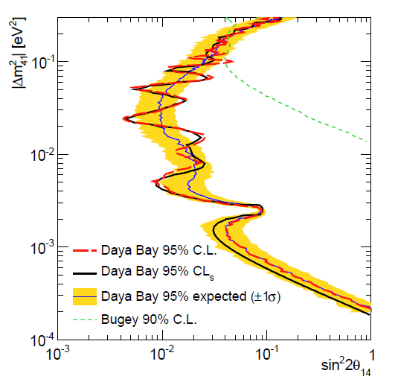
Discussion I
The choice of test statistics is decoupled from the procedure in deducing confidence interval
There are many different ways to choose test statistics (e.g. Poisson likelihood, Neyman, Pearson, CNP chisquares)
Generally, the likelihood (ratio) is the best as it incorporates the most information, but sometimes this can leads to significant challenges in computation (e.g. with Feldman Cousins procedure)
Advanced technique to speed up the procedure: using “Gaussian Process”: L. Li et al. arXiv:1811.07050
Example: Gaussian CLs approach with a different test statistics
X. Qian et al. NIMA 827, 63 (2016)
In this example, “Gaussian CLs” is two orders magnitude less computation than the standard Feldman-Cousins C.L. approach

Slide 35
Discussion II
Generally, data unfolding, which is to remove the known detector response from the measurement, is a special case of the parameter estimation
Wiener SVD unfold: X. Li et al. JINST 12, P10002
Fast Fourier Transformation (FFT) based unfolding procedure
PMT waveform analysis: NIMA, 895, 48
LAr TPC signal processing: JINST 13 P07006/7
Measured waveform
2-D deconvolution
JINST 13 P07006/7 (2018)

Slide 36
Summary
In this lecture, we covered the concepts of
Experimental uncertainties (e.g. covariance matrix)
Test statistics (e.g. Poisson likelihood and CNP chisquare)
Credible (Bayesian) and Confidence Interval (Frequentist and p-value)
We reviewed the procedure in deducing the confidence interval (asymptotic approach and Feldman Cousins method)
We touched on some advanced topic:
Data unfolding (e.g. Wiener SVD approach)
Selection of test statistics (e.g. Gaussian CLs method in searching for new physics)
Usage of Linear Algebra in reducing computation (e.g. Gaussian Process and FFT)

Slide 38
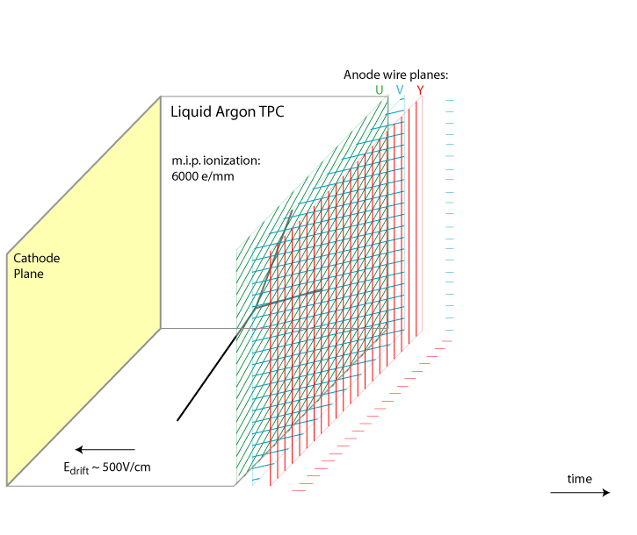
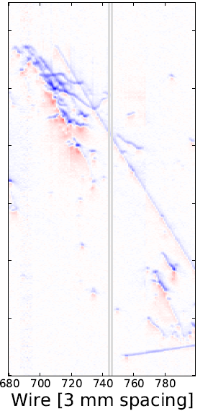
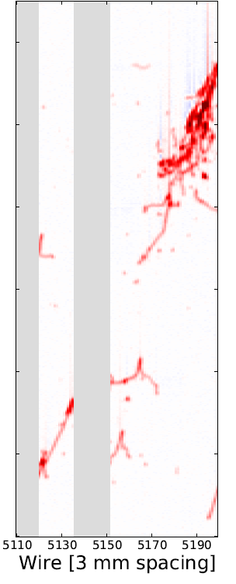
Signal Processing in Single-Phase LArTPC
Induction (U,V) bipolar shape
Collection Y unipolar shape
Number of ionized electrons
Field Response
Signal on Wire Plane
Electronic Response
Signal to be digitized by ADC
(Signal Processing)
Number of ionized electrons
time
Goal of signal processing is to reconstruct the distribution of ionization electrons from TPC waveforms
JINST 13 P07006/7 (2018)

Slide 39
Matrix Inversion and Deconvolution
Tensor R is Toeplitz
Response only depends on the relative positions between signal and measurement
(R^{T}R)⁻¹ can be achieved through the deconvolution technique with fast Fourier transformation (FFT)
O(N^{2.4~3}) → O(N logN)
One of top 10 algs. in 20th century
Immense dimension of M and S: 2400 (chs.) x 8256 (time bins) ~ 2 x 10⁷
Extreme challenge in matrix inversion!
1D deconvolution SP in LArTPC described in B. Baller JINST 12, P07010

Slide 40
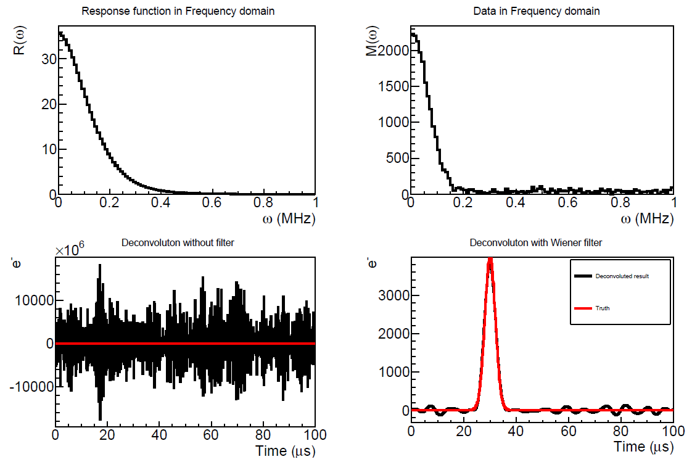
Deconvolution Technique
Time domain
Fourier transformation
Frequency domain
Back to time domain
Inverse Fourier transformation
Wiener filter: optimized by power of signal and noise in freq. domain
N. Wiener (1964)
Example taken from X. Li et al. JINST 12, P10002
Also PMT SP in Daya Bay: NIMA, 895, 48

Slide 41
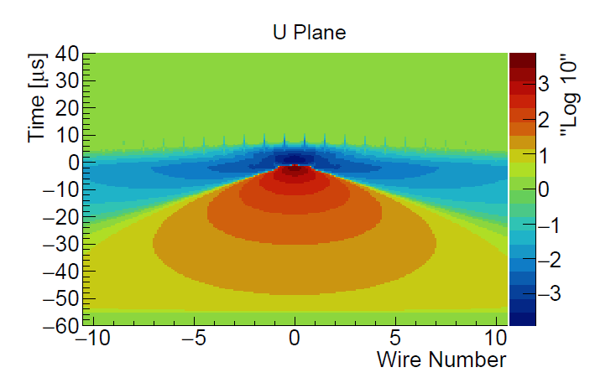
2D Deconvolution
Measured waveform
1-D deconvolution
2-D deconvolution
R₁ represents the induced signal from (i+1)th wire signal to ith wire
The inversion of matrix R can again be done with deconvolution → 2-D Fast Fourier Transformation
JINST 13 P07006/7 (2018)

Slide 42
Wiener-SVD Unfolding Approach
LArTPC Signal Processing
SVD Unfolding Approach
Unfold the ionization electron distribution from measured TPC waveforms
High-frequency electronic noise and the finite resolution of detector response leads to unstable deconvolved results
Wiener filter is added to stabilize the results, minimizing
Statistical (and systematic) uncertainties and smearing of finite response function leads to unstable unfolded results
Regularizations (e.g. constraining smoothness) is added to stabilize results (limiting variance)
Regularization → Bias
Optimize the strength of regularization to balance between bias and variance
Strictly speaking, should also optimize the choice of binning (multi-dimensional scan)

Slide 43
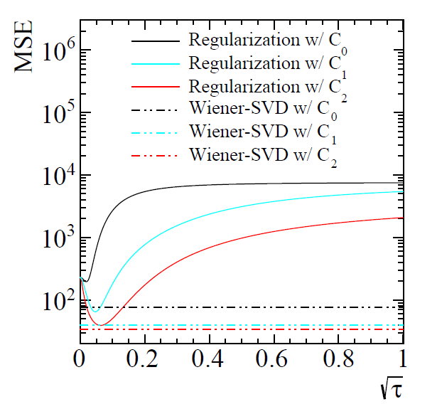
Wiener-SVD Unfolding Approach
When the expected signal is known , Wiener filter can be used in SVD unfolding to obtain an optimized result without scanning
Choose binning < smearing resolution
Apply Wiener filter
Naturally balances bias (sys.) and variance (stat.) leading to a smaller total uncertainty
More details in X. Li et al. JINST 12, P10002

