Slide 1
Update of U+U and Cu+Au results from PHENIX
Shengli Huang
Vanderbilt University
For PHENIX Collaboration

Slide 2
Outline
Introduction and Motivation
Energy density and elliptic flow in UU
Anisotropic flow(v₁,v₂) in CuAu
Particle production in CuAu collisions
Summary

Slide 3
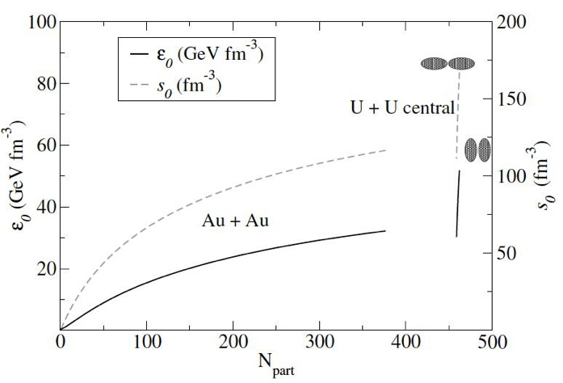
Elliptic Flow in UU The geometry and density effect
U + U 193 GeV
Body-body
The geometry is significantly different for body-body and tip-tip collisions
Theory predicts that maximum medium density from tip-tip is around 60% higher than that of central AuAu
Tip-tip
U. Heinz and A. Kuhlman,
PRL 94, 132301 (2005)
3

Slide 4
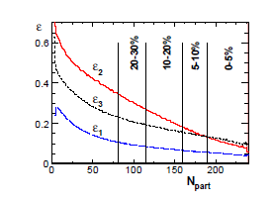
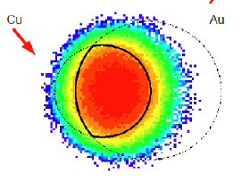
Flow in Cu + Au Initial geometry and its fluctuation
Piotr Bozek Phys. Lett. B717 (2012) 287
An asymmetric initial geometry has been produced in Cu + Au
Odd order collective flow such as v₁, v₃ come not only from fluctuation as they do in Au+Au, but also from original geometry

Slide 5
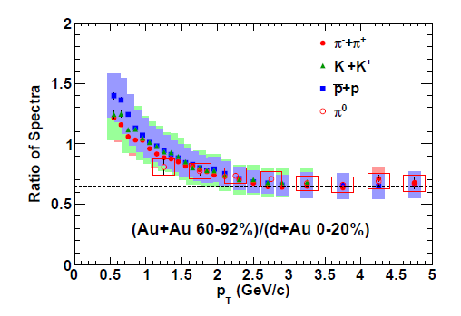
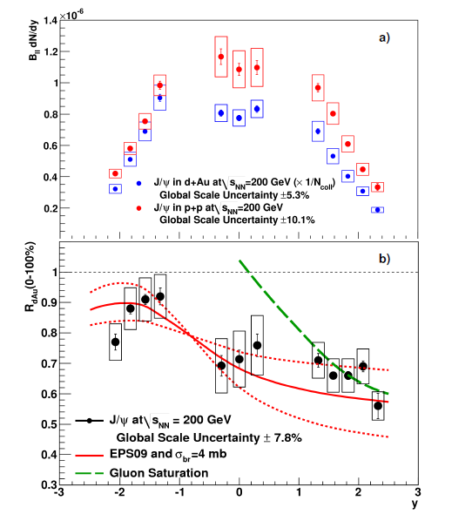
Particle production dAu
PHENIX: arXiv:1304.3410
PHENIX: PRL(107) 142301 (2011)
At middle rapidity, the spectra ratio of AuAu(60-92%)/dAu(0-20%) has no species dependence. The J/Ψ production is asymmetric at forward/backward rapidity
Measurement of the identified particle production in CuAu will help us to further study the initial state and final state effect, which play different roles in particle production in dAu and AuAu collisions

Slide 6
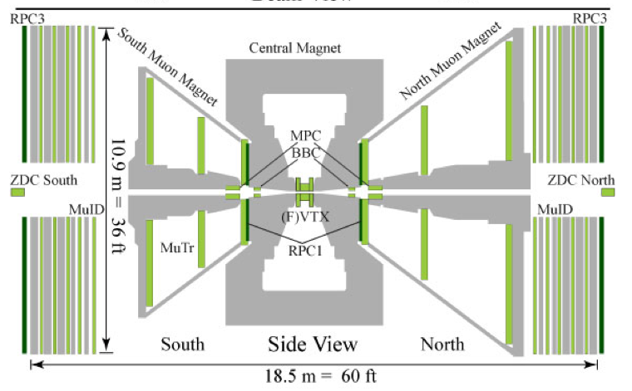
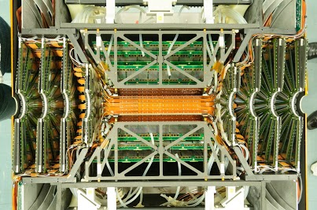
PHENIX in Run 2012
1.2B and 7.6B MB events are recorded in |bbcz| <30cm for UU and CuAu collisions respectively.
The key FVTX upgrade performs well in its first heavy ion run such as CuAu
FVTX :
Separate the muon from C/B decay
Enhance S/B for J/Ψ andψ’
Event plane
VTX
FVTX (S)
FVTX (N)
VTX

Slide 7
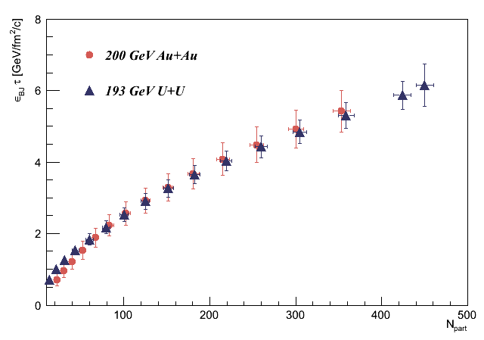
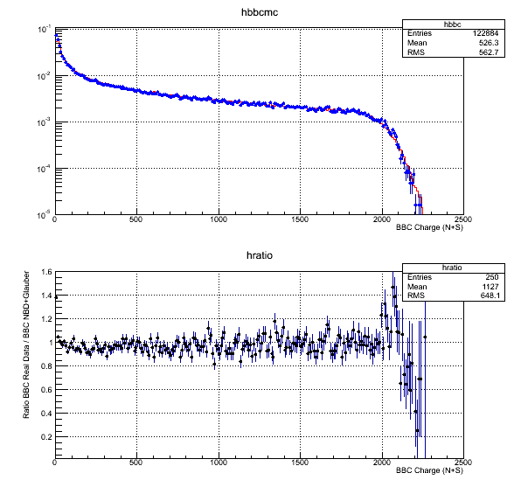
Energy density and Multiplicity in UU
0-1% UU
Glauber+NBD fitting
ετ (GeV/fm²/c)
BBC charge distribution
ratio
preliminary
N_{part}
60% higher ετ from theory prediction for TT
A tail is expected due to extra Ncoll
The top 1% central UU ετ is only 20% higher that of AuAu.
NBD(negative binominal distribution) fold only with Npart can reproduce the BBC charge distribution well.
Event-by-event flow is required for the TT and BB separation
Notes:
Add BBC distribution

Slide 8
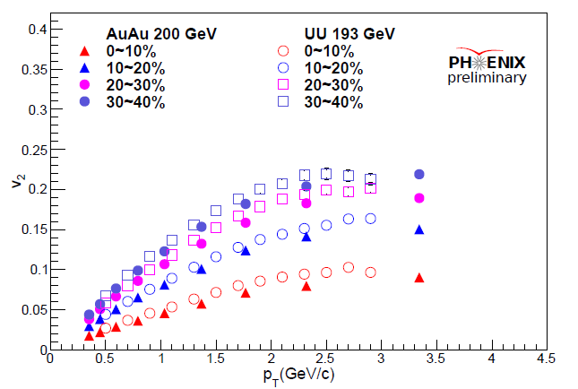
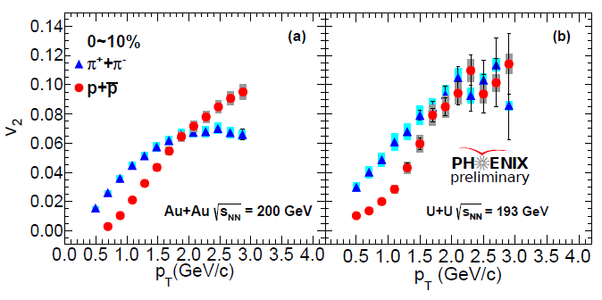
Elliptic Flow in U + U collision
The v₂ of charged hadron in UU collisions are higher than that of AuAu in different centrality
Strong mass ordering for π & p v₂ in central U + U collision at 193 GeV are observed even though the increase in ετ is relatively small.
Radial flow or geometry?
C. Shen, U. Heinz et al
Phys.Rev. C84, 044903 (2011)

Slide 9
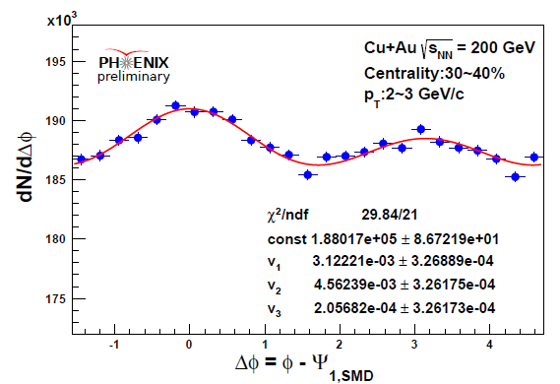
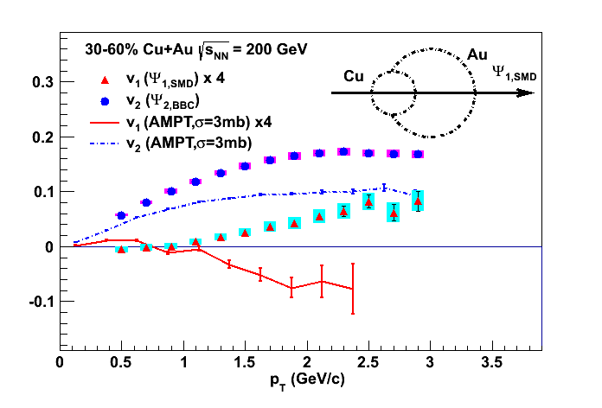
The direct flow measurement in CuAu
AMPT (v1.21) σ = 3 mb
An asymmetric azimuthal distribution with respect to Ψ₁ plane from Au-going spectators
Both data and AMPT show sizeable v₁ but with opposite signs at p_{T}>1 GeV/c
3 mb string melting cross section is not enough to reproduce the measured v₂

Slide 10
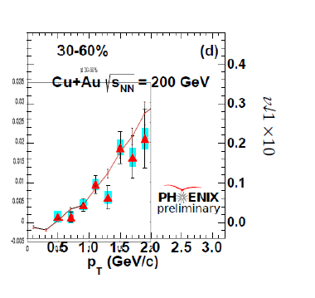
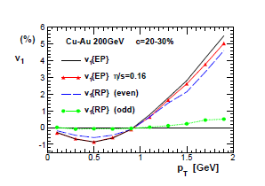
Hydro-dynamics calculation
V₁x 10
Event by Event Hydro
Hashimoto, Murase and Hirano, JPS13
Piotr Bozek Phys. Lett. B717 (2012) 287
1. Two groups can reproduce the v₁ sign by E-by-E hydro calculations 2. The asymmetric medium density in transversal plane plays an important role
3. The v₁ of proton/anti-proton will provide more information since the baryon/anti-baryon densities are quite different

Slide 11
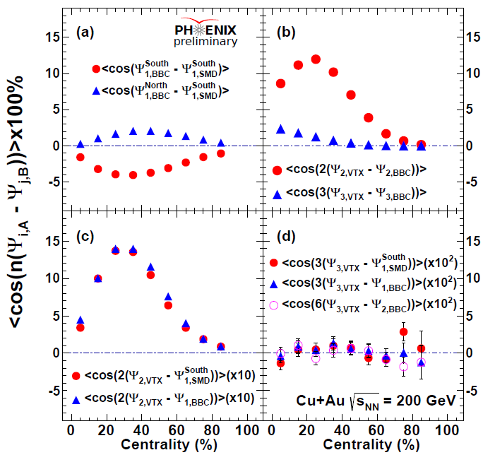
Event plane correlation in Cu+Au Collision
South : Au-going
North: Cu-going
${(Ψ}_{1,BBC}^{South},Ψ_{1,SMD}^{South})$ correlation is stronger than ${(Ψ}_{1,BBC}^{North}$ ,$Ψ_{1,SMD}^{South})$. It indicates that v₁ is larger in the Au-going direction
Ψ₃ is expected to correlated with Ψ₁ and Ψ₂ due to the initial asymmetric geometry, while data shows a pretty weak raw correlation.
The event-plane resolution correction and FVTX event plane will be helpful for further study

Slide 12
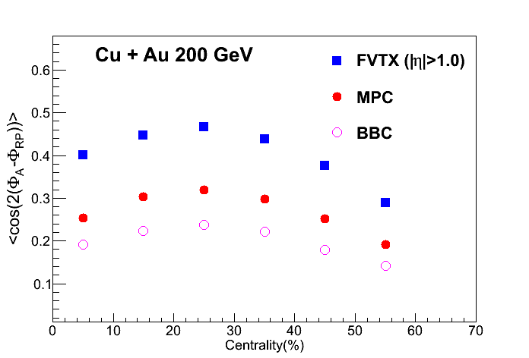
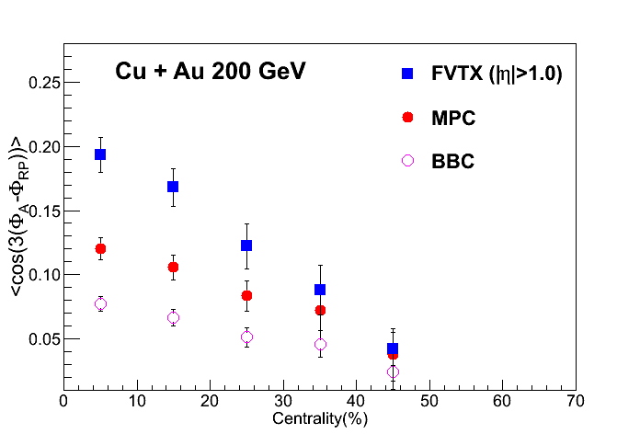
FVTX Event Plane
1.Event plane resolutions are significantly improved by FVTX detector for Ψ₂ and Ψ₃
2. The measurements of v₃ and v₄ in CuAu will come out soon with FVTX EP and full statistics

Slide 13
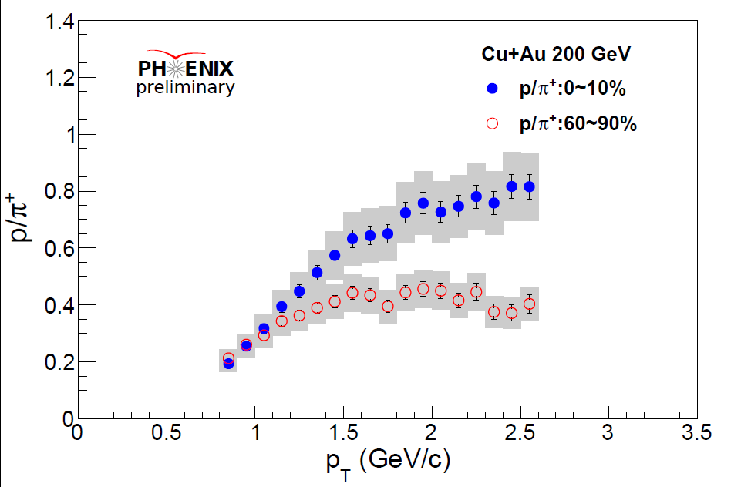
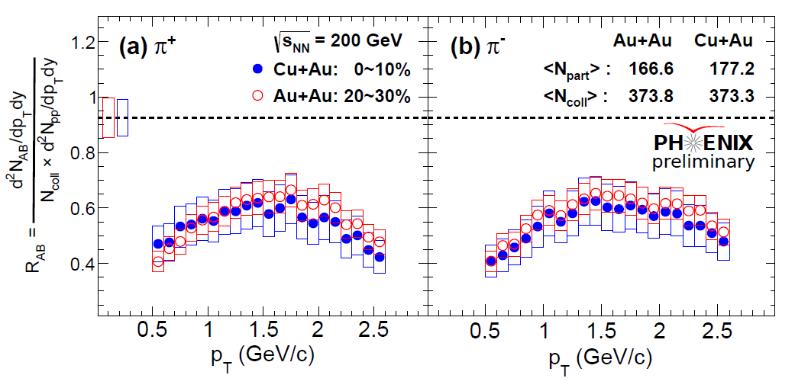
Identified particle(π/p) production in CuAu
p/π ratio in 0-10% central CuAu collision is significant higher than that of peripheral collisions
The R_{AB} of π in 0-10% central CuAu collision is similar to that of 20-30% AuAu Collisions (similar Ncoll and Npart)
The particles production in CuAu and AuAu is similar at mid-rapidity

Slide 14
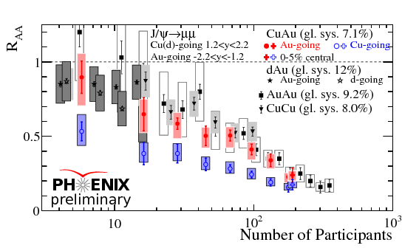
J/ψ production in Cu+Au
In the Au-going direction, the J/ψ suppression is comparable with that of AuAu and CuCu collision
In the Cu-going direction, slightly more suppression is observed
No significant suppression in completely swallowed-Cu (top 5%) events, which is contradicted with core-corona model expectation
Currently, a full analysis with FVTX is going to further investigate the results in Cu-going direction

Slide 15
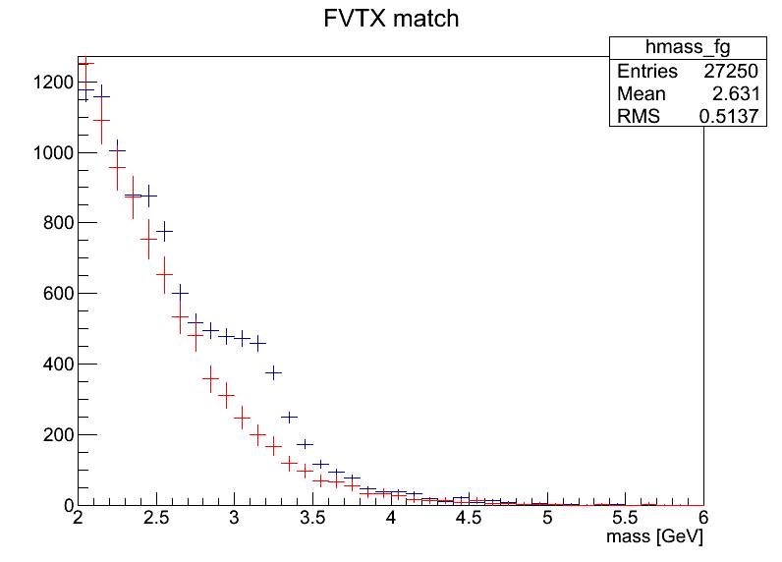
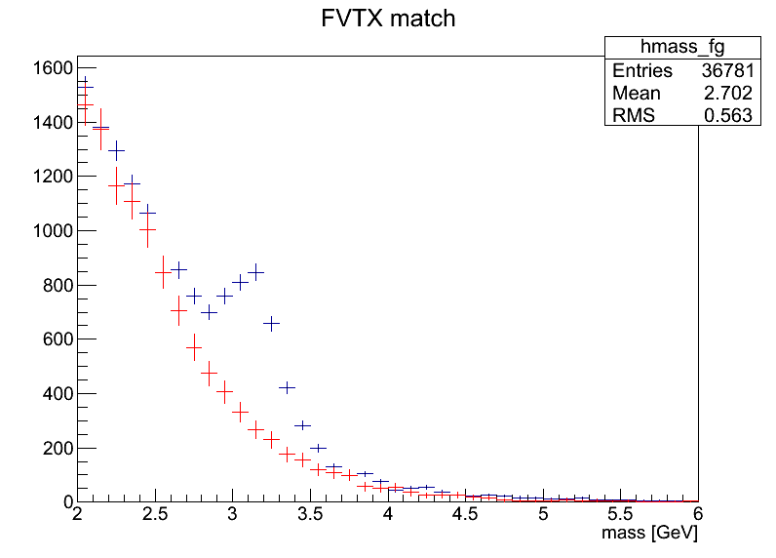
FVTX improvement for J/ψ
A. U.
A. U.
Basic muon cut
Add DCA_{R} < 2cm
Basic muon cut + DCA_{R} < 2cm
Cu-Au run sample
The signal to background ratio is improved by FVTX cut for primary muon trackers
The v₂ of J/ψ and open charm will be measured at both forward and backward rapidity by FVTX, which will shed the light on the charm production

Slide 16
Summary
In the central UU collision, strong mass ordering is observed for the v₂ of pions and protons
With the Ψ₁ measured by Au-going spectator, a positive v₁ is observed for the charged hadrons as p_{T} > 1 GeV/c. The sign of v₁ is different with AMPT calculation but consistent with other hydro calculations
The Ψ₁ plane correlation between BBC and SMD indicates a larger v₁ in the Au-going direction. And the raw Ψ₃ plane is weakly correlated with Ψ₁ and Ψ₂ plane.
The pion and proton production at mid-rapidity in Cu Au is similar to that of AuAu collision. But an asymmetric J/Ψ suppression is observed at forward/backward rapidity in CuAu. On the Cu-going side, the suppression is little bit stronger than that on the Au-going side
Notes:
V1 to Psi1

