Slide 1

Prepare (e)STAR as an EIC detector
Zhangbu Xu (BNL)
Physics Cases (EIC white paper)
Kinematics and Acceptance
Detector Configuration and Capabilities
  Current STAR Configuration
  Upgrades
R&D Projects
Simulations
Summary

Slide 2
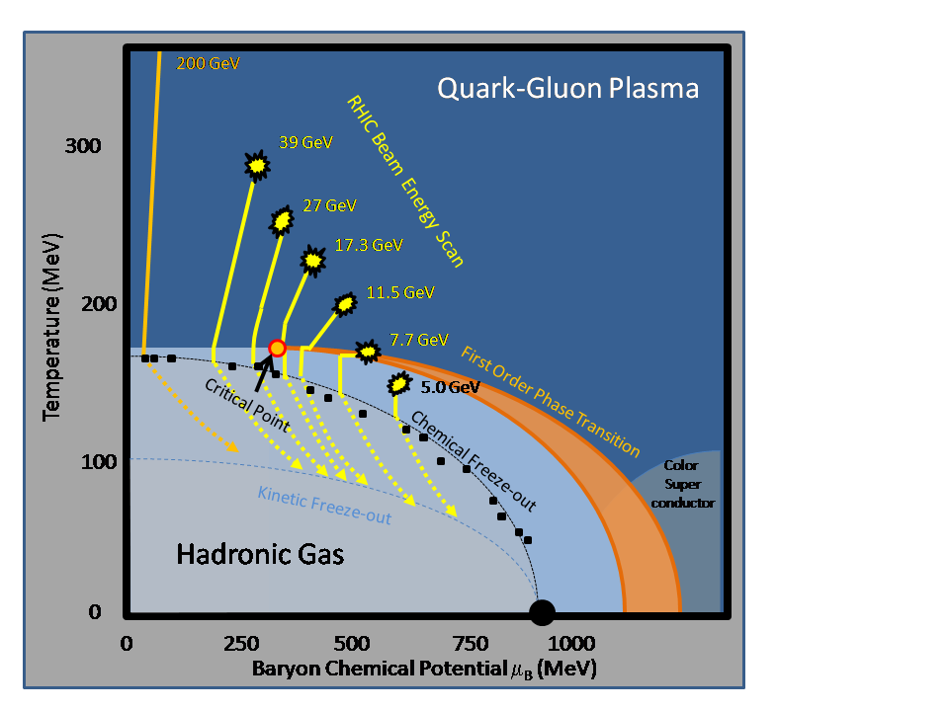
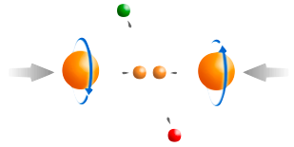
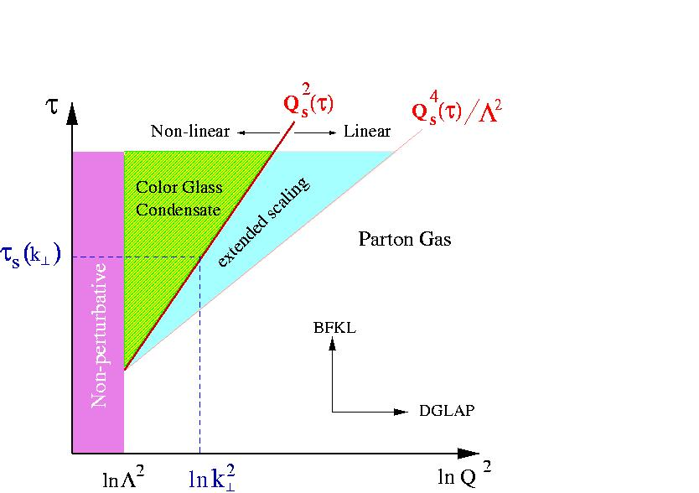
RHIC: eight key unanswered questions
Hot QCD Matter
Partonic structure
6: Spin structure of the nucleon
7: How to go beyond leading twist
and collinear factorization?
1: Properties of the sQGP
2: Mechanism of energy loss:
weak or strong coupling?
3: Is there a critical point, and if so, where?
4: Novel symmetry properties
5: Exotic particles
8: What are the properties of
cold nuclear matter?
STAR Decadal Plan

Slide 3
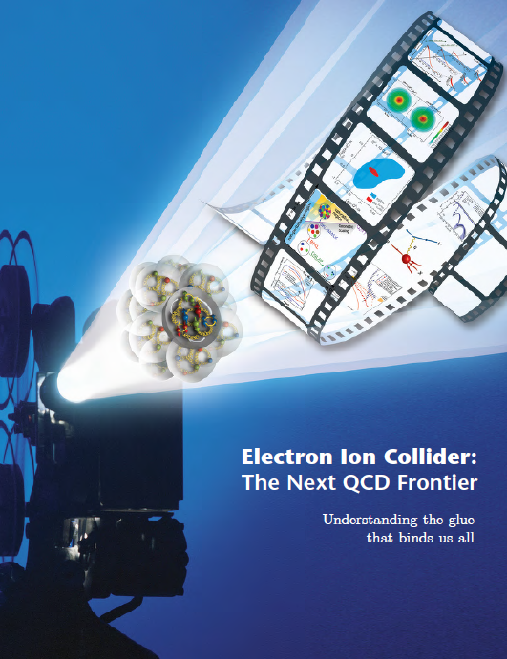
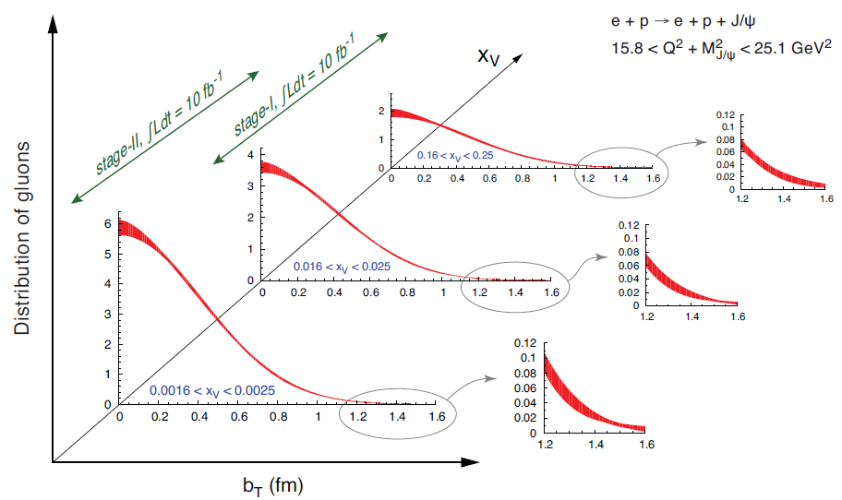
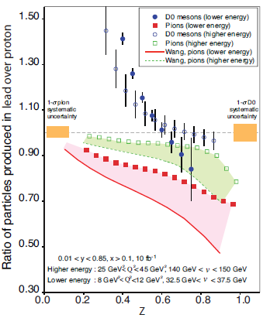
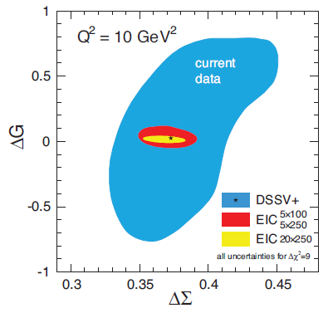
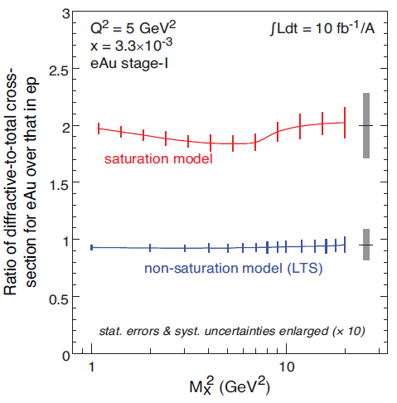
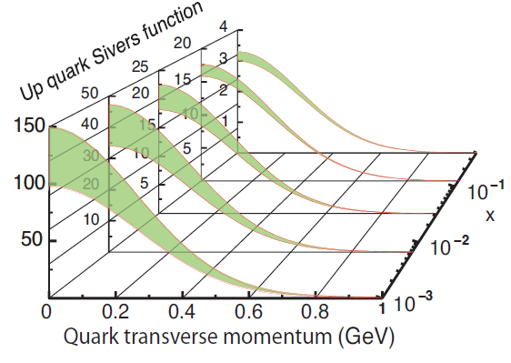
Physics Deliverables (EIC whitepaper)
Proton Spin
Motion of partons
Imagining
Dense Gluonic
QCD matter
Quark
Hadronization

Slide 4

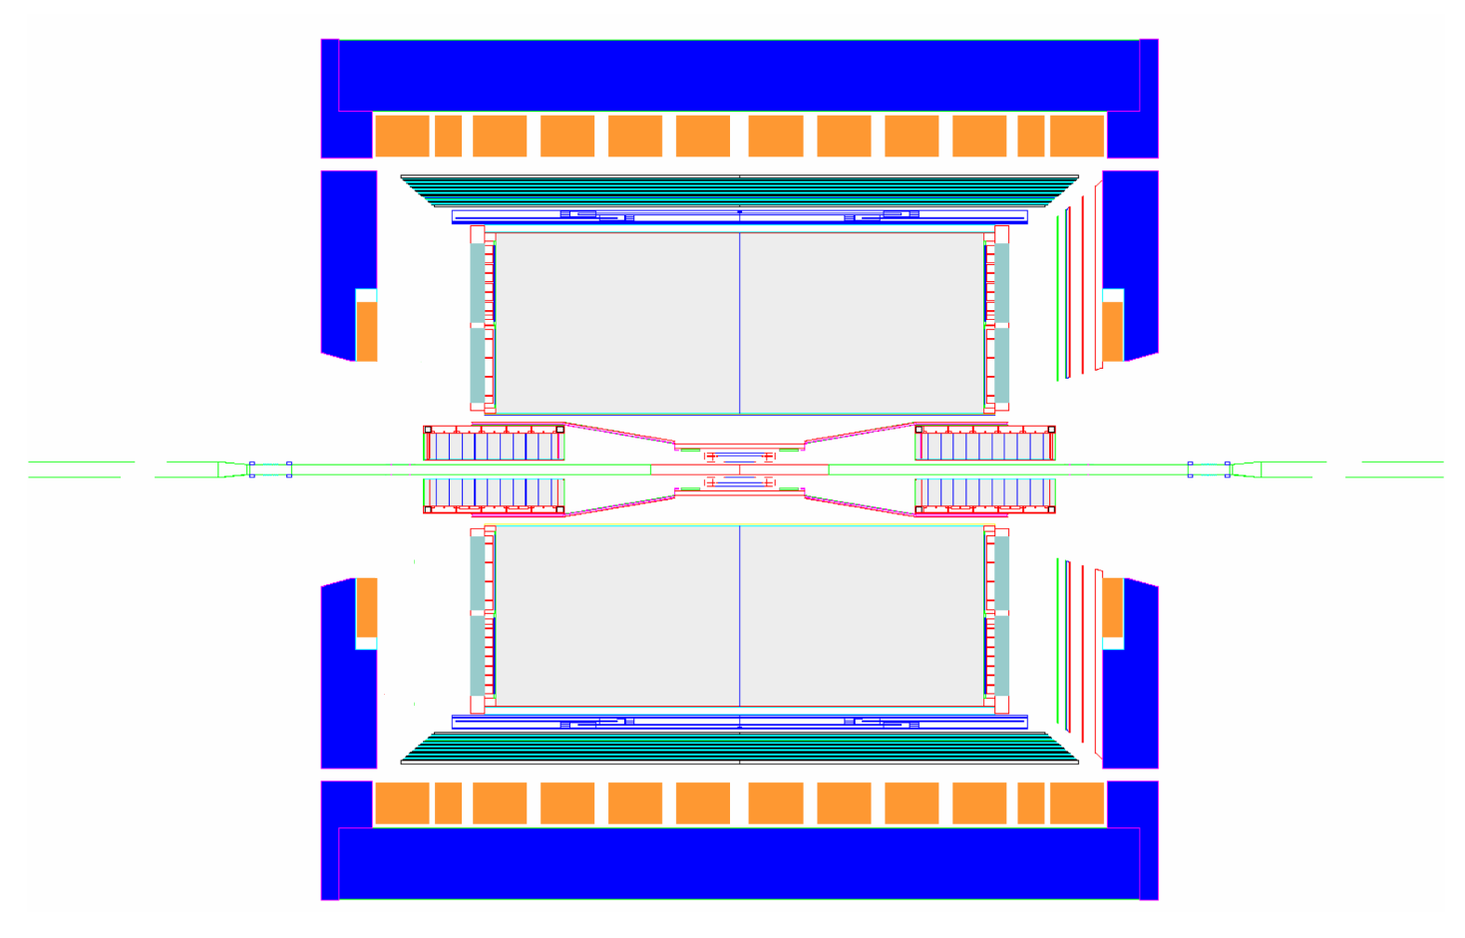
Current STAR Experiment
MRPC ToF Barrel
MTD
EMC Barrel
EMC End Cap
FMS
BBC
FPD
TPC
pp2pp’
pp2pp’
PMD
trigger
computing
DAQ1000
COMPLETE
HLT
HFT
FGT
Ongoing
R&D

Slide 5
STAR Concept
Large Coverage
Low Material
Electron and hadron ID with gas detector and TOF, EMC
Extend this concept to hadron direction
  GEM tracker (VFGT)
  Forward Calorimetry
Extend this concept to electron direction
  Re-instrument inner TPC
  TRD+TOF
  Crystal Calorimeter (BSO)

Slide 6
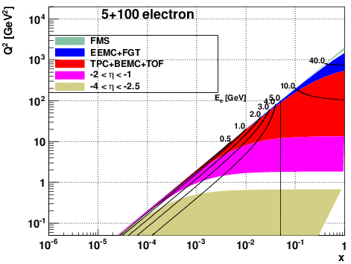
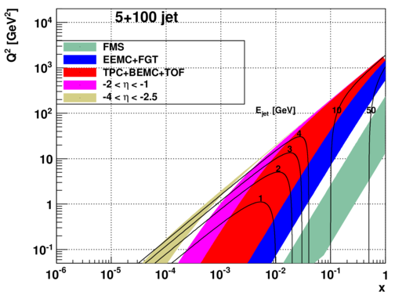
DIS – eSTAR Kinematics
-2<η<-1
Electron side TPC Endcap upgrade
for electron PID and hadron tracking
Jets, hadrons (hyperons)

Slide 7
STAR forward instrumentation upgrade
nucleus
electron
>2016
Tracking: 2.5 < η < 4
Forward Calorimeter System (FCS)
iTPC
Pb-Sc HCal
BSO
ETTIE
W-Powder EMCal
Baryon/meson separation?
eSTAR specific upgrades:
EToF: e, π , K identification,
ETRD: electron ID and hadron tracking
BSO: 5 GeV, 10 GeV electron beams
Re-instrument HFT
Forward instrumentation optimized
for p+A and transverse spin physics
  Charged-particle tracking
  e/h and γ/π⁰ discrimination
  Baryon/meson separation

Slide 8
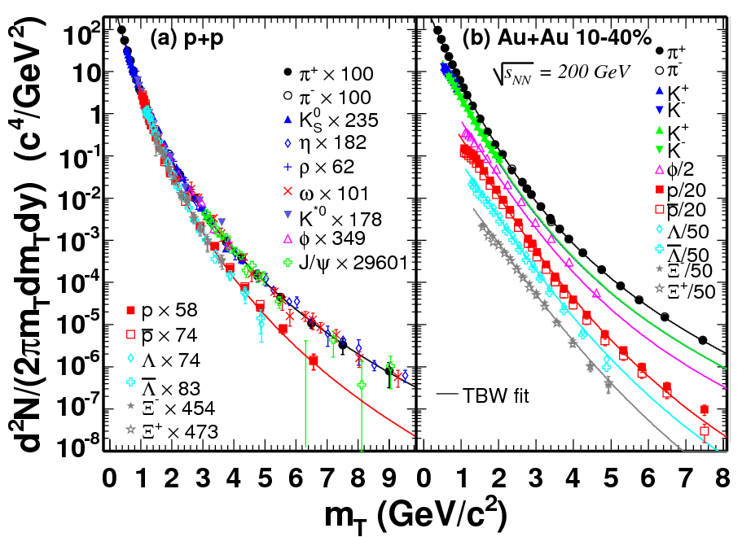
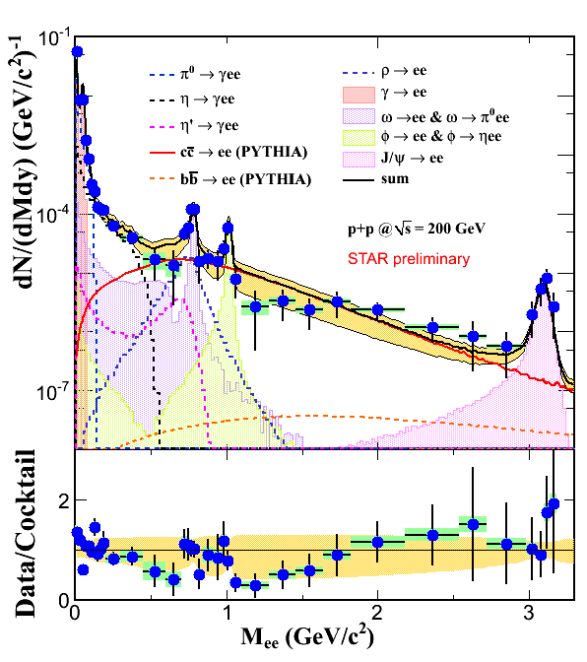
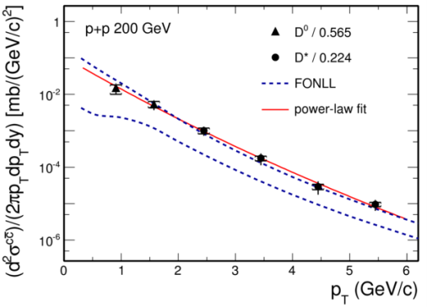
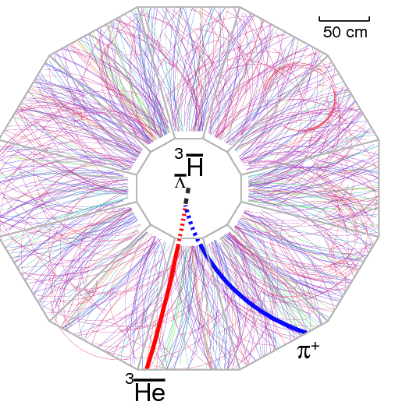
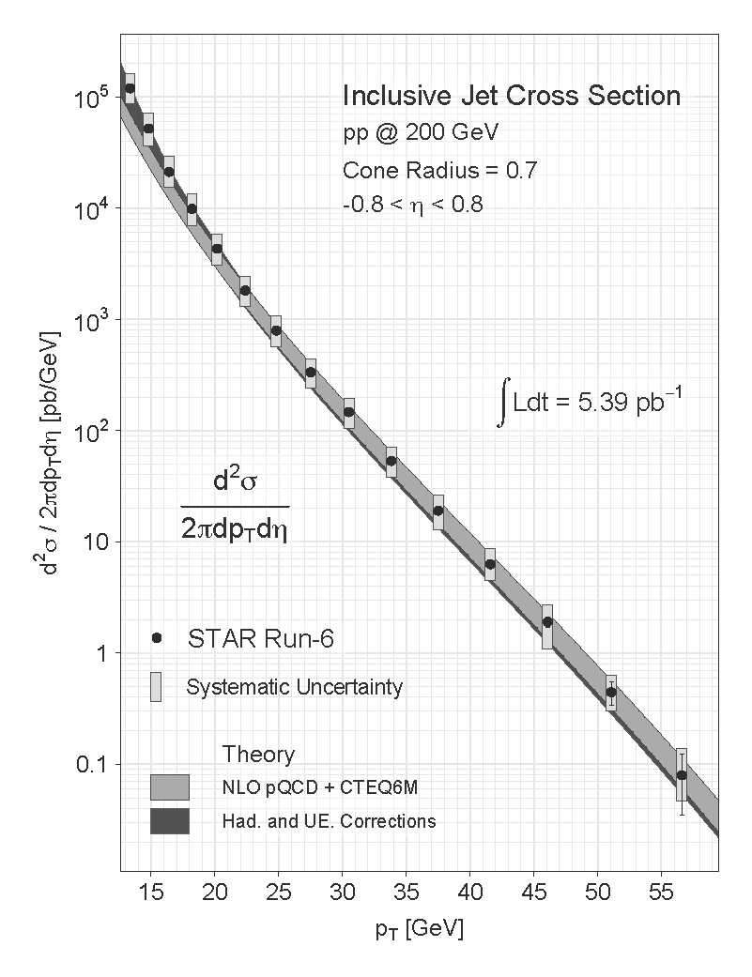
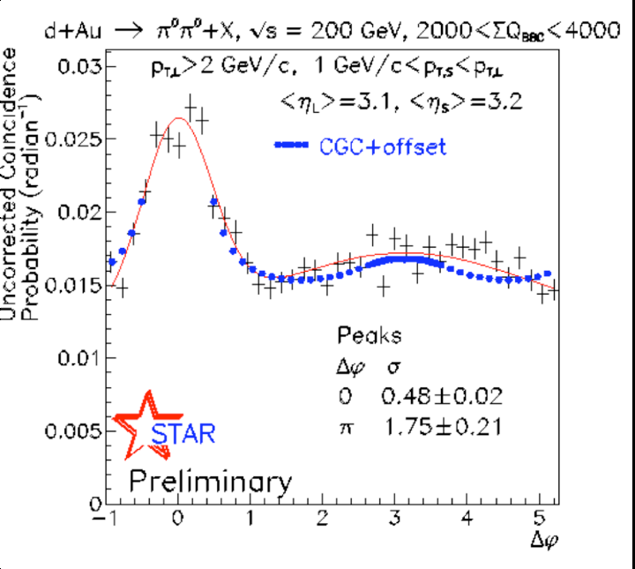
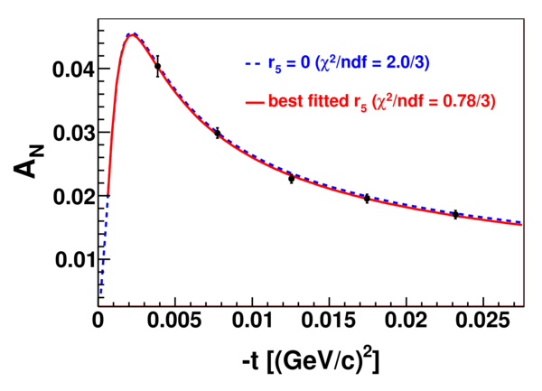
Proven STAR Capabilities

Slide 9
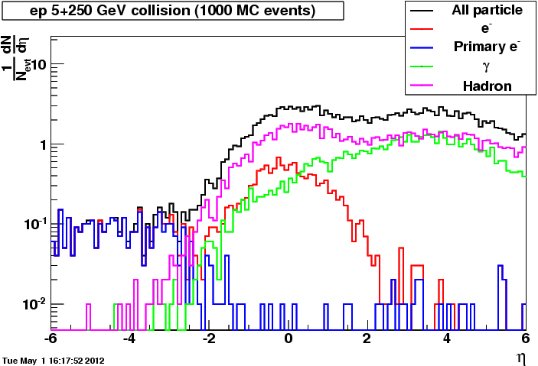
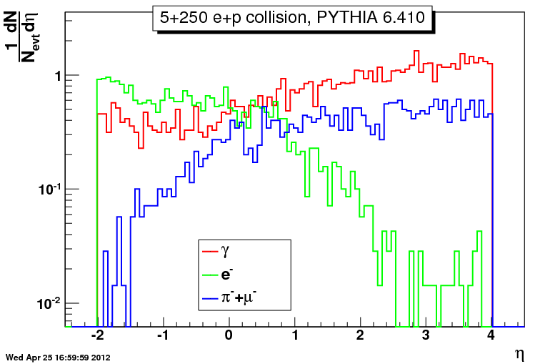
Occupancy and pile-up
DIS: Q²~>1 GeV²
QED α=1/137 and low multiplicity ➔ an order of magnitude lower pile-up than RHIC
Beam species | Sqrt(s) | Peak Luminosity (cm⁻²s⁻¹) | Cross section (cm²) | Nch/dη | Track density (dNch/dη MHz) | Hit density impact hit finding | Space charge impact tracking
e+p | 5x250 | 10³⁴ | 10⁻²⁸ | 0.7 | 0.7
Au+Au | 100x100 | 5x10²⁷ | 7x10⁻²⁴ | 161 | 6 | Minor | Corrected to good precision
p+p | 100x100 | 5x10³¹ | 3x10⁻²⁶ | 2 | 3 | Minor | Corrected to good precision
p+p | 250x250 | 1.5x10³² | 4x10⁻²⁶ | 3 | 18 | Significant for inner | Corrected to acceptable

Slide 10
STAR forward instrumentation upgrade
nucleus
electron
>2016
Tracking: 2.5 < η < 4
Forward Calorimeter System (FCS)
iTPC
Pb-Sc HCal
BSO
ETTIE
W-Powder EMCal
Baryon/meson separation?
eSTAR specific upgrades:
EToF: e, π , K identification,
ETRD: electron ID and hadron tracking
BSO: 5 GeV, 10 GeV electron beams
Re-instrument HFT
Forward instrumentation optimized
for p+A and transverse spin physics
  Charged-particle tracking
  e/h and γ/π⁰ discrimination
  Baryon/meson separation

Slide 11
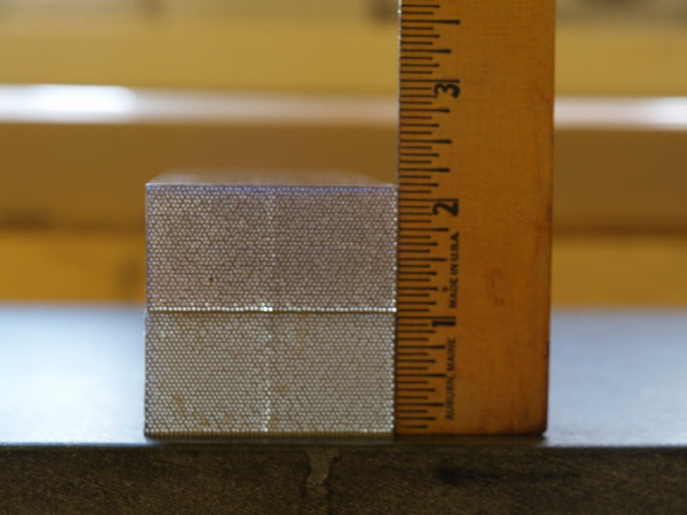
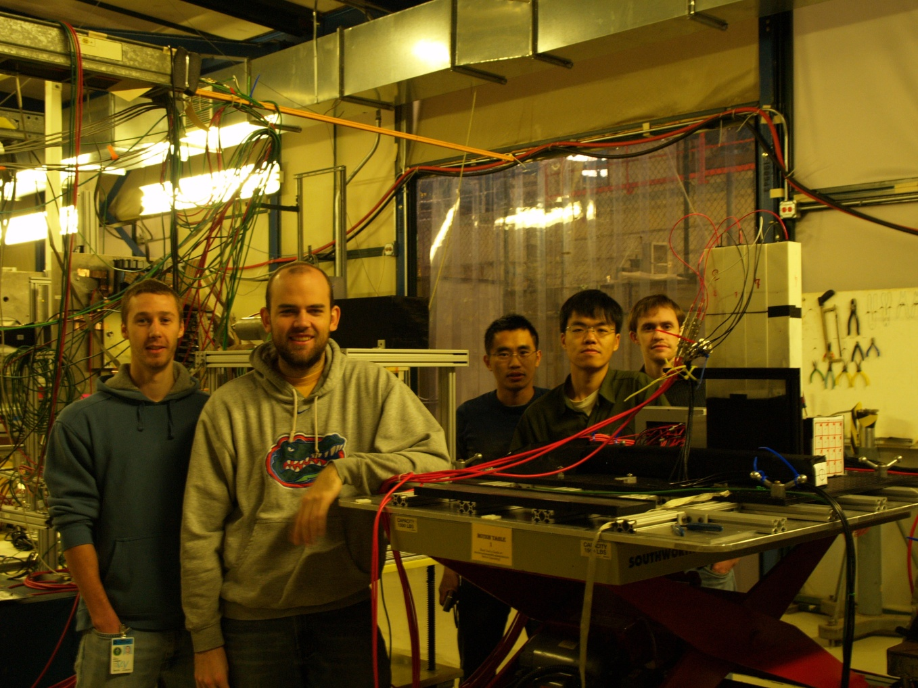
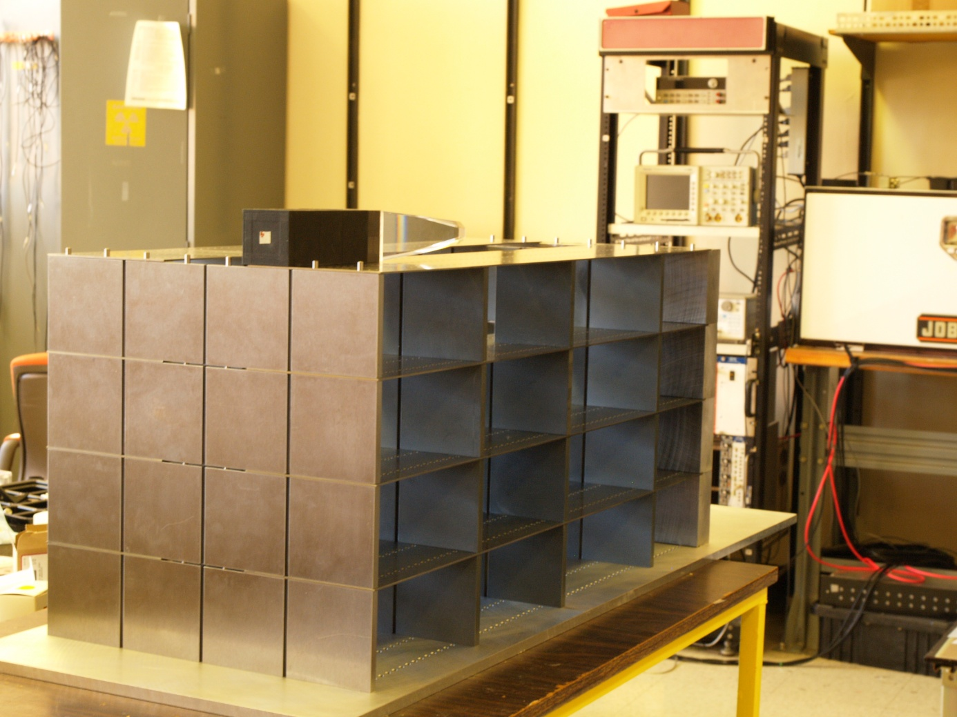
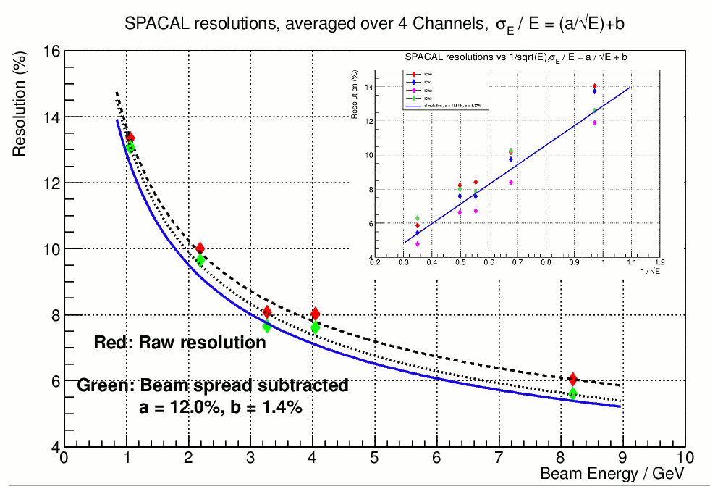
Calorimeter Test Beam and Simulations
Approved EIC R&D project from May 2011
UCLA, TAMU, PSU
Simulations on jets, photons and hyperons
HAD Prototype for STAR

Slide 12
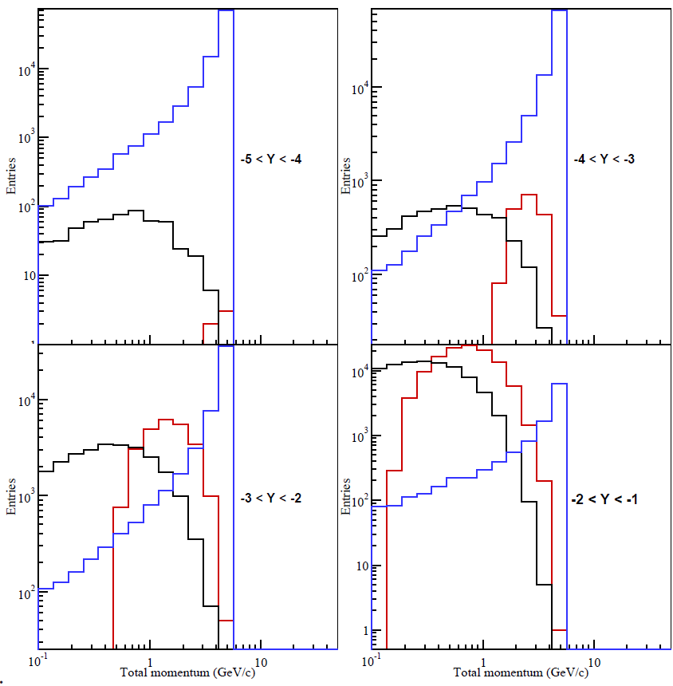
First Stage eRHIC electron/hadron PID
INT report (arXiv:1108.1713) Fig.7.18.
e
γ
h
Electron coverage: 1>eta>-2.5
PID e/h: 1000
Low material: photon conversion

Slide 13
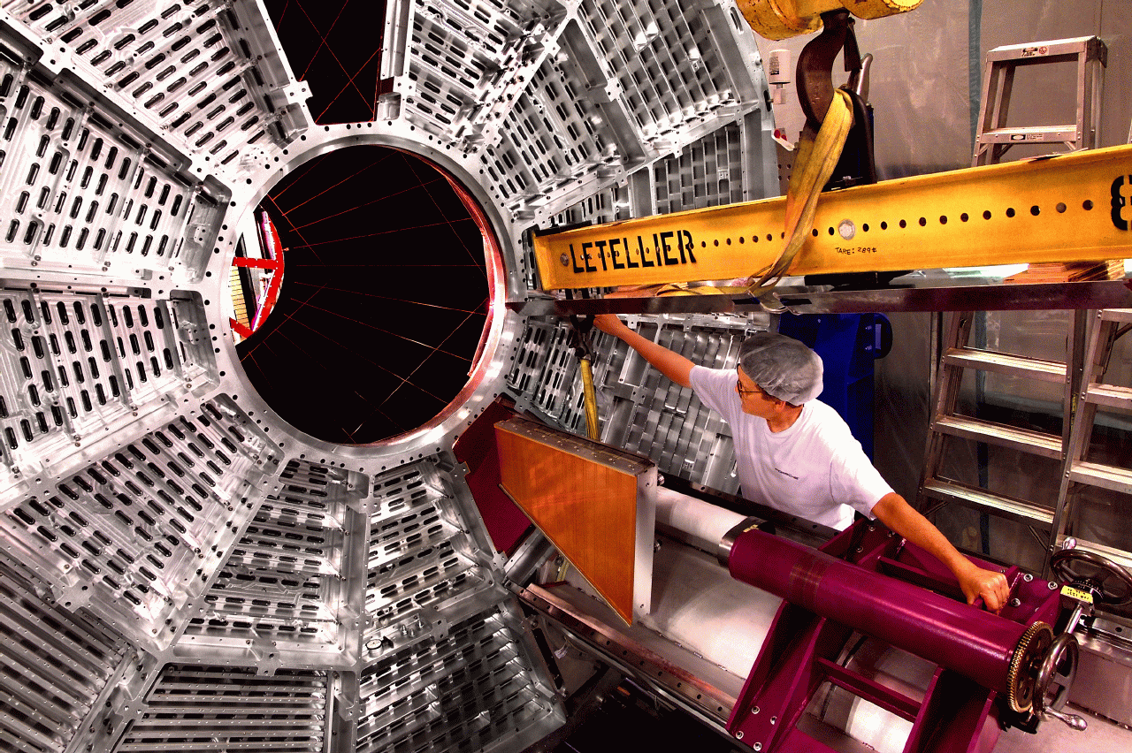
TPC Inner Sector Upgrade
Staggered readout
  Only 13 maximum possible points
    Issues in Tracking: recognition and resolution
  Only reads ~20% of possible gas path length
    Inner sectors essentially not used in dE/dx
Essentially limits TPC effective
acceptance to |η|<1
η=±1 η=±1.2 η=±2

Slide 14
TRD+TOF at Endcap (-2<η<-1)
TRD
Inner tracking
TPC (endcap region):
TRD +
TOF/Absorber sandwich
TPC
TOF / Absorber
IP
Iron Endcap
Within <70cm space inside endcap
TOF as start-time for BTOF and MTD
TOF + dE/dx for electron ID
TOF for hadron PID
Extend track pathlength with precise points
High-precision dE/dx (Xe+CO2) TRD
Ming Shao (USTC)

Slide 15
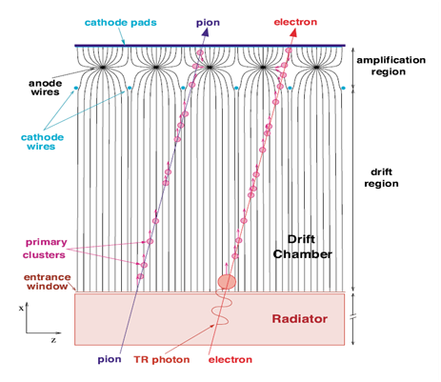
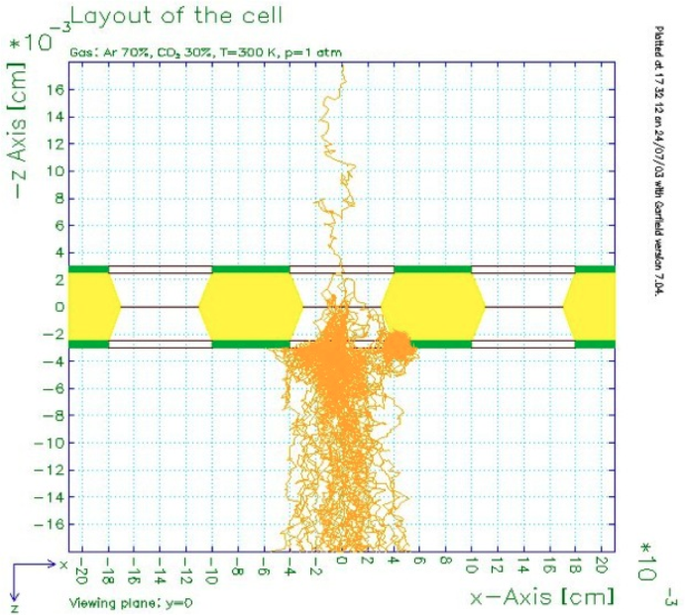
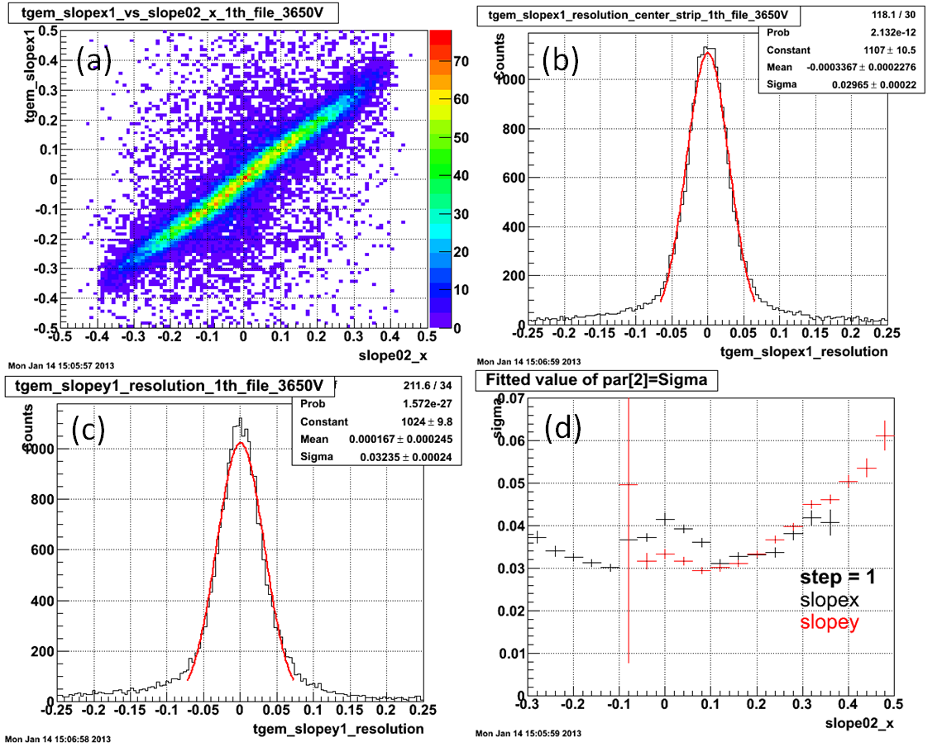
GEM based TRD – R&D
Advantage
  Few ion feedback to drift volume
  High rate
  Better position resolution
  Less space charge effect
  dE/dx
  Drift along magnetic field
MWPC ➔ GEM
EIC R&D support
(BNL/USTC/IU/Yale)
https://wiki.bnl.gov/conferences/index.php/June_2013
Prototype TRD with miniDrift GEM (27 time bins)
Cosmic ray test results
Plan test beam at FermiLab with other EIC R&D projects in October (T1037)
Setups at USTC and BNL
Notes:
Rim in Thick GEM prevents sparking

Slide 16
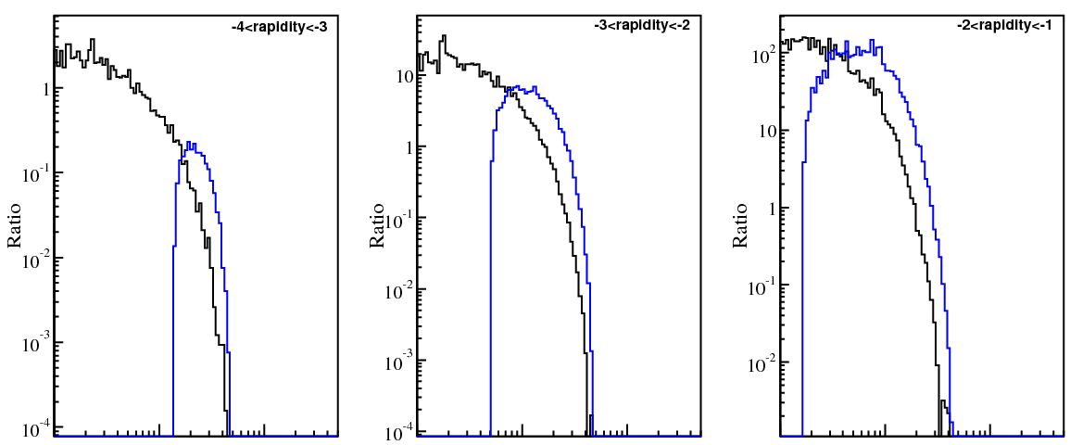
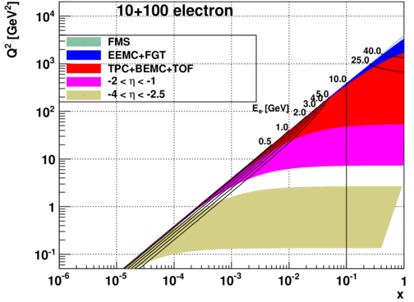
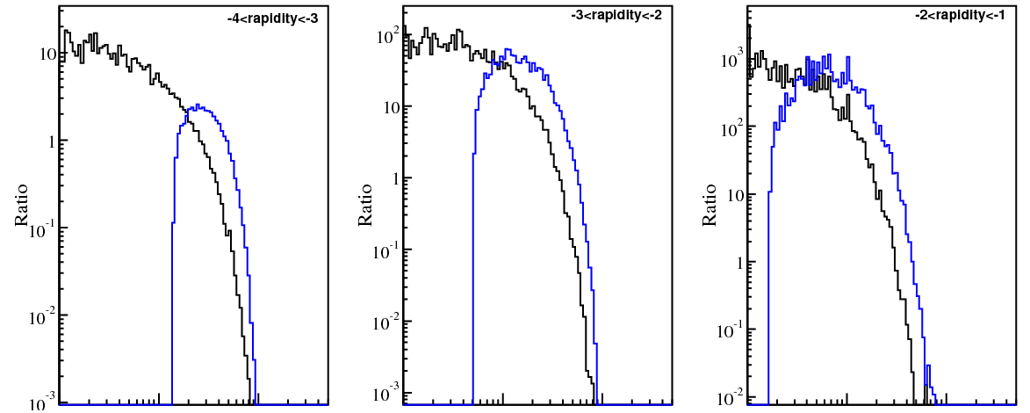
First Stage eRHIC electron/hadron PID
Electron Energy 5➔10 GeV
Momentum (GeV/c)
EIC task force
γ/e
h/e
0.1 1 10

Slide 17
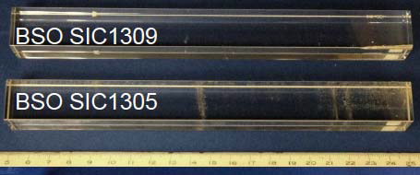
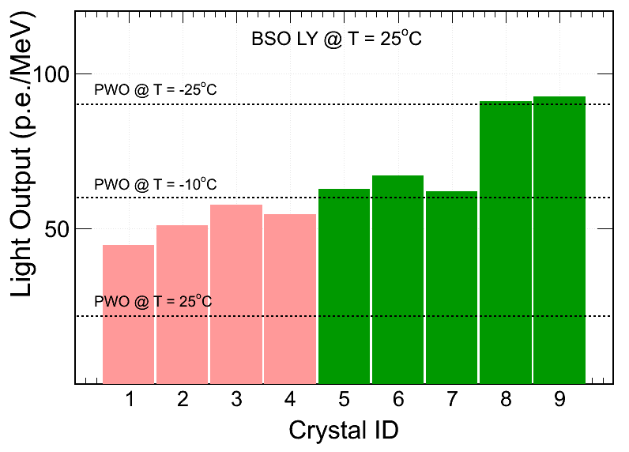
BSO Crystals for Forward Electron
Crystal | Long_BSO | Short_BSO | Long_PWO | Short_PWO
ID | BSO_{L} | BSO_{S} | PWO-B | PWO-A
Size | 20*20*200mm | Φ=25mm,L=30mm | 25*25*220mm | 30*30*45mm
Very Forward Electron Detection (eta<-2.0)
BSO is produced by replacing Ge in BGO with Si, the material cost for BSO reduced by x3-4.
Collaborators: USTC,SINAP,THU,UCLA
Vendor: Shanghai SICCAS High Technology Coorporation (USTC/UCLA/SICCAS)
R&D proposal partially funded by BNL/DOE
Production Getting better over time

Slide 18
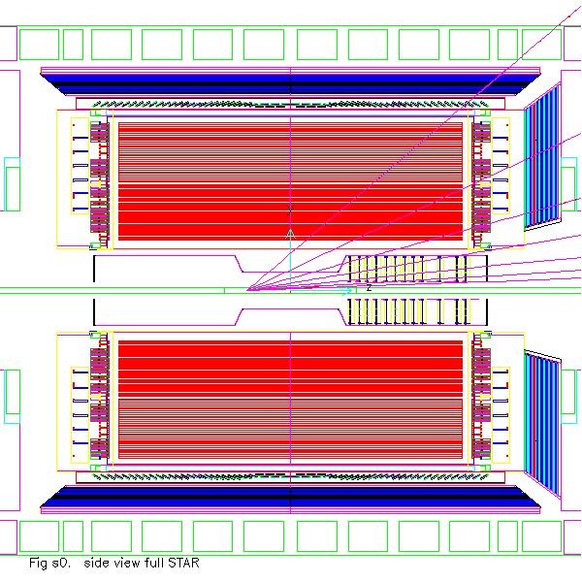
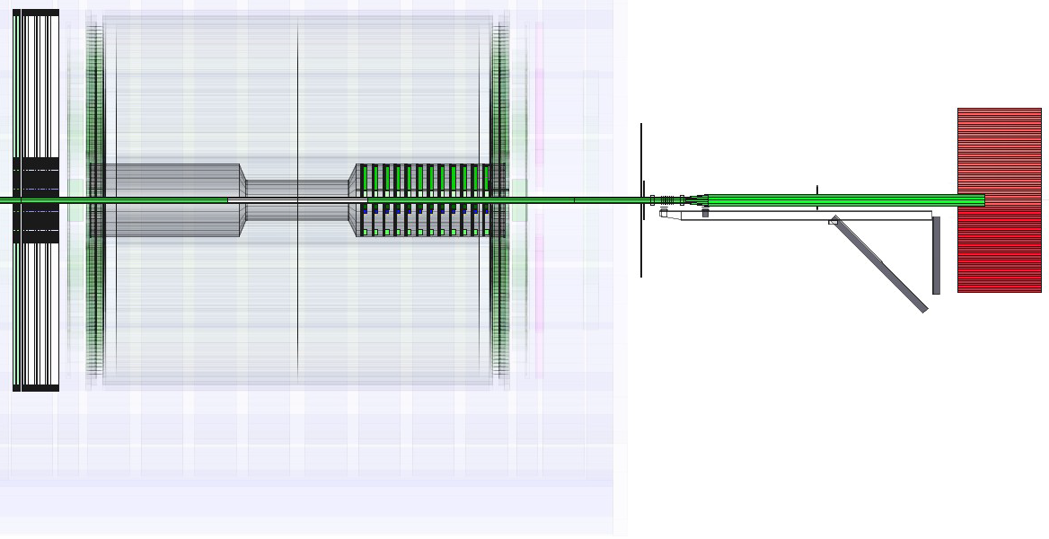
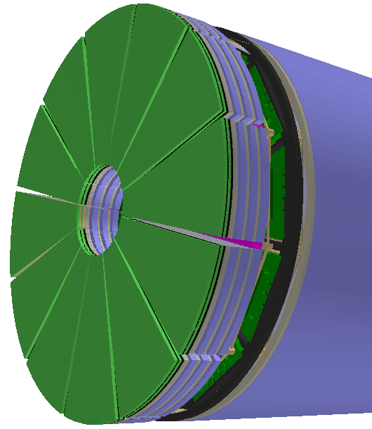
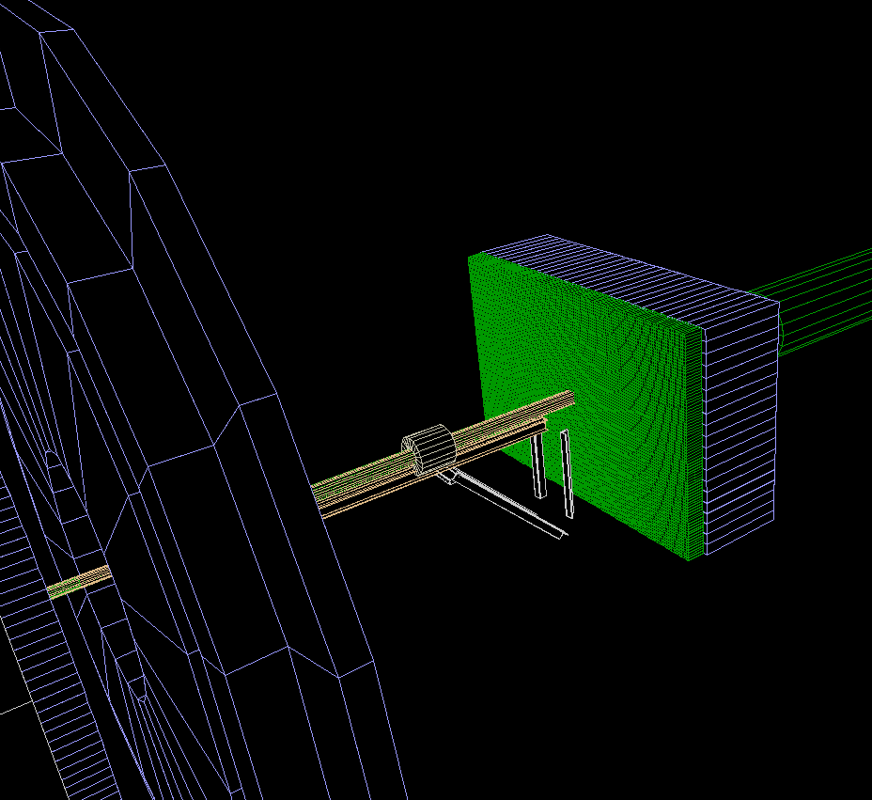
Simulation Geometry
EEMC
VFGT
Possible option
FCS
ETTIE

Slide 19
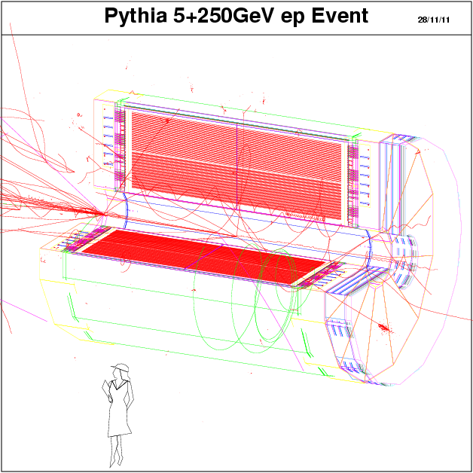
A Pythia Simulation Event
Only TPC and ETTIE are shown

Slide 20
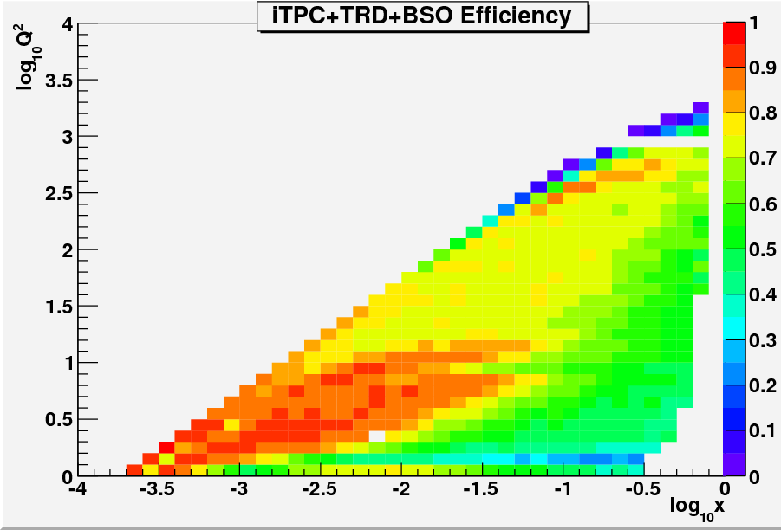
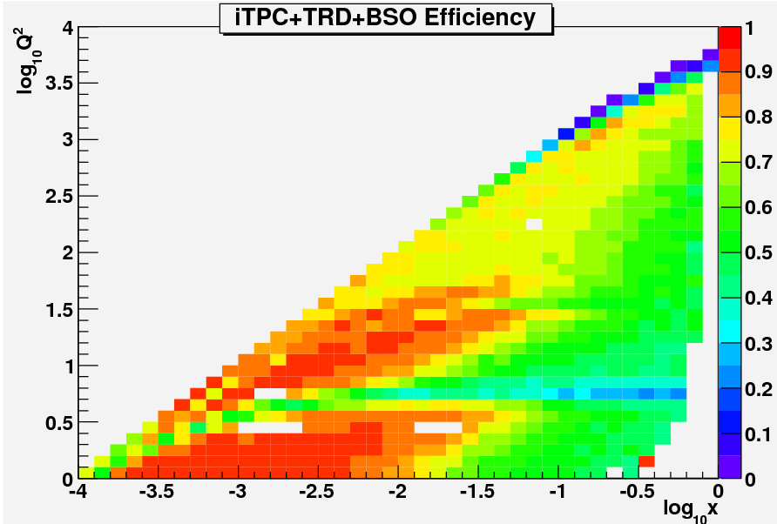
eSTAR Acceptance
5x250
10x250
GEANT Simulation with eSTAR geometry
Inclusive Acceptance:
Scattered Electron in x-Q²
TPC hits>15
BSO and TRD Efficiency assumed 90%

Slide 21
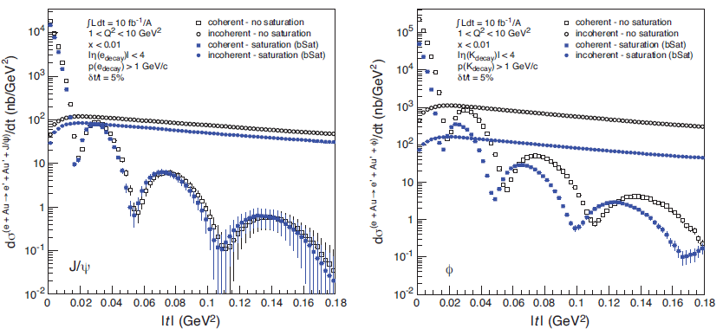
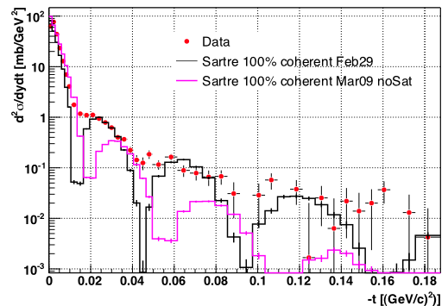
Physics Simulations in Progress
5(10)x250 ep collisions:
g₁ vs (x,Q²), generator PEPSI
Semi-inclusive with PID: ΔG vs (x,Q²)
eA (electron+Pb):
F₂, F_{L} 5(10)x50, 5x75, 5x100 (DJANGOH)
dφ of di-hadron for given (x,Q²) relative to virtual photon direction (as z): PYTHIA
Semi-inclusive R(eA/ep) (ν,Q²,z, p_{t}) PID (PYTHIA6.x)
J/Ψ exclusive (SARTRE)
STAR Preliminary Au+Au UPC
γ*+Au➔Au+ρ
For event generators, see EIC-TF webpage:
https://wiki.bnl.gov/eic/index.php/Simulations#Event_Generators

Slide 22
Plans
Continue to map the physics cases from EIC whitepaper to eSTAR
Possible R&D projects:
  Tracking (hadron side, pA/pp)
  Calorimetry (hadron side, pA/pp)
  Tracking+eID (electron side, eSTAR)
  End-Cap TOF (electron side, eSTAR)
  Very forward electron ID (eSTAR)
  Roman Pots (pA/pp)
Simulation of feasibilities
Discuss with CAD and EIC TF on IR design and detector R&D

Slide 23
Summary
eSTAR a possible option for first-stage EIC detector (Electron E<~10 GeV)
Near-term upgrades for RHIC have optimized to be suitable for eRHIC (eSTAR)
R&D projects and EIC simulation in progress
LoI Writing Committee
Inputs/helps from groups (theorists and experimental colleagues)

Slide 24
