Slide 1
PMG Update Topics
Status of recommendations from the PD review. See slides in this talk.
Submit the document addressing the PD review recommendations to the PMG one week prior to submission to the POB sub-panel. Target is mid-August for submission to BNL. Agreed
Appoint a standing committee with experts from STAR and ALICE to provide advice on sPHENIX technical aspects.
We will do this for the TPC. Was this requested for the Calorimeters as well or can the PMG handle this? Right now sPHENIX is consulting with the ALICE TPC experts on TPC performance issues.
Provide information on the status of the upgrade of the infrastructure at the PMGs. See slides in this talk.

Slide 2
PMG Update Topics
Open Recommendations:
Discuss with the magnet division the possibility to perform the field map of the sPHENIX magnet. Mapping done by the ATLAS magnet mapping group is a better match because of their existing mapper equipment and experience mapping large bore magnets but John Haggerty will pursue discussions with SMD on the possibility of their participation.
Open accounts for MVTX and estimate the funds needed until end of CY19 in view of a CR. Berndt, Maria and Jamie agree that the accounts will not be open until a Director’s Cost and Schedule review.
Finalize the MoU with C-AD before PD-2/PD-3 review. It is very close to ready. Being worked on by Jim Mills, Charlie Folz, Rob Pisani, Bill Christie, Brian Steckenbach.
Inform the PMG as soon as the first results of the SAMPA v5 chip are available. Takao Sakaguchi presented the initial results from the tests of the MPR SAMPA v5 components at the PD-2/3 review. That talk is posted. The v5 engineering run won’t be submitted to TSMC until early fall with the first complete chips back for testing at the end of the CY2019.

Slide 3
PD-2/3 Report Recommendations
We expect the review report from Tom Cormier this week
Perform a comprehensive status update prior to PD-2/3.
Statused the RLS until June 1 w/ the L2/L3 managers. Need a final clean up of known changes in the RLS logic.
Before PD-2/3, cleanup, review and status the project schedule, cost estimate and risk register.
The RLS statusing tells us that the schedule will remain the same. Early completion back to Oct 2021.
Work on any cost impact due to statusing or logic clean up.
DOE tells us that only FY21 can change and Jim Hawkins indicated that he would prefer that there is no change in from $27.0M.
Before PD2/3, re-evaluate the contingency associated to large procurements such as the W powder, in view of the recent cost increase and pending tariff situation. We have started looking at this.

Slide 4
PD-2/3 Report Recommendations
Before PD2/3, the TPC group needs to use their first set of pre- production chambers to simultaneously study the actual Ion Back Flow (IBF), energy resolution and discharge stability for their proposed gas mixture as a function of possible operating point settings for the full range of GEM voltages and transfer fields. This is to be done with the front mesh in place (if that continues as an option) to confirm that an operating point exists that meets all sPHENIX requirements with their proposed gas mixture. Measurements for the operating point have started at test set-up at Yale. Testing will continue with Yale set-up into July.
As indicated in last year’s review, all components on the TPC FEE board need to be radiation-qualified; this has been largely achieved but some tests remain. Demonstrate the performance of (two) full TPC FEE boards with SAMPA V4 ASICs versus dose up to a TID of at least 100 kRad. Once available, repeat this demonstration using full TPC FEE boards with SAMPA V5 ASICs. To be done at BNL ⁶⁰Co facility after the FNAL beam test completes next week.

Slide 5
PD-2/3 Report Recommendations
There should be a dedicated ES&H Manager for the project.
We are following all BNL standard practices for ES&H. We have an assigned person for sPHENIX ES&H, Lori Stiegler. All ES&H matters are reviewed and approved by the ES&H people located at the site of the specific activities, i.e. PO or CAD.
ES&H should periodically visit universities and/or collaborators, possible look at Office of Quality Management frequency of visits. We agree. We have visited SBU and will have ES&H and QA visits to UIUC and GSU as soon as they can be scheduled.
Proceed to PD-2/3

Slide 6
MIE To Do List
Address all recommendations and write a response report to be submitted to BNL, DOE-ONP and BHSO.
We will write a response report and submit it to Bob Tribble. He will appoint a Project Oversight Board committee to evaluate our response report and recommend approval if satisfied.
Status the RLS and make any P6 corrections prior to setting the baseline
Revise the PMP, if necessary, to reflect the project baseline and get BNL, DOE-ONP and BHSO approval/concurrence on the PMP.

Slide 7
2.X and 3.X To Do List
Address all 2.X and 3.X recommendations from the Director’s review.
Set the date for the MVTX review and prepare.
Working to get the RLS integrated with sPHENIX 1.X and 2.X
Complete the Cryo order (2.X)
Prepare for the Carriage/Cradle order (2.X)

Slide 8
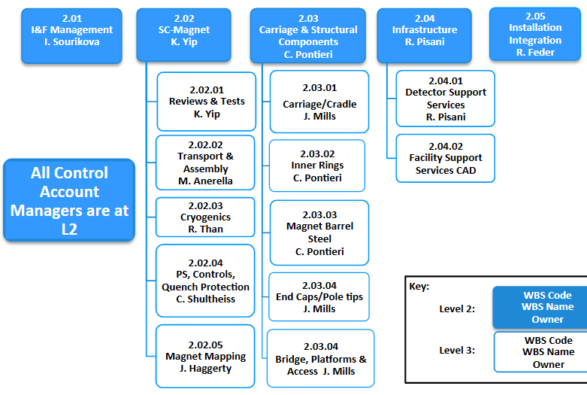
I&F Management Structure
2.04.02
Facility Support Services
B. Streckenbach

Slide 9
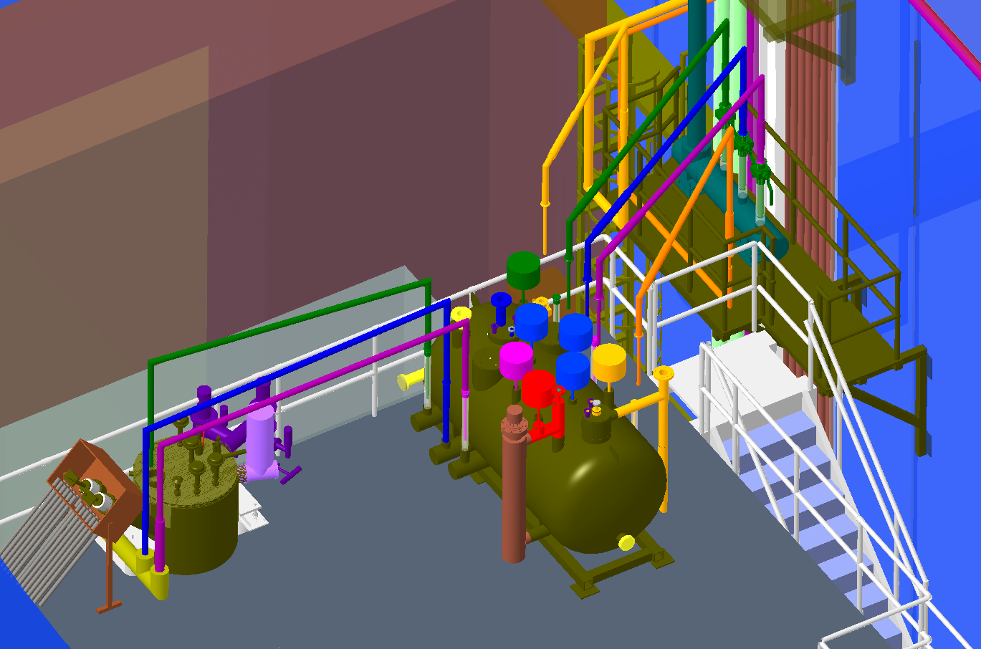
WBS 2.2 Superconducting Magnet Status
Cryo. Equipment on Upper Platform
RFP in final approval state at PPM.
As of Jun 19 waiting for Management and Legal approval. Expected to be released this week.
RFP will be sent to know potential vendors and posted on Fed Biz Ops
RFP will be open for 6 weeks.
Award in 8-10 week.
Cryo installation will begin at the start of RHIC 2020 shutdown

Slide 10
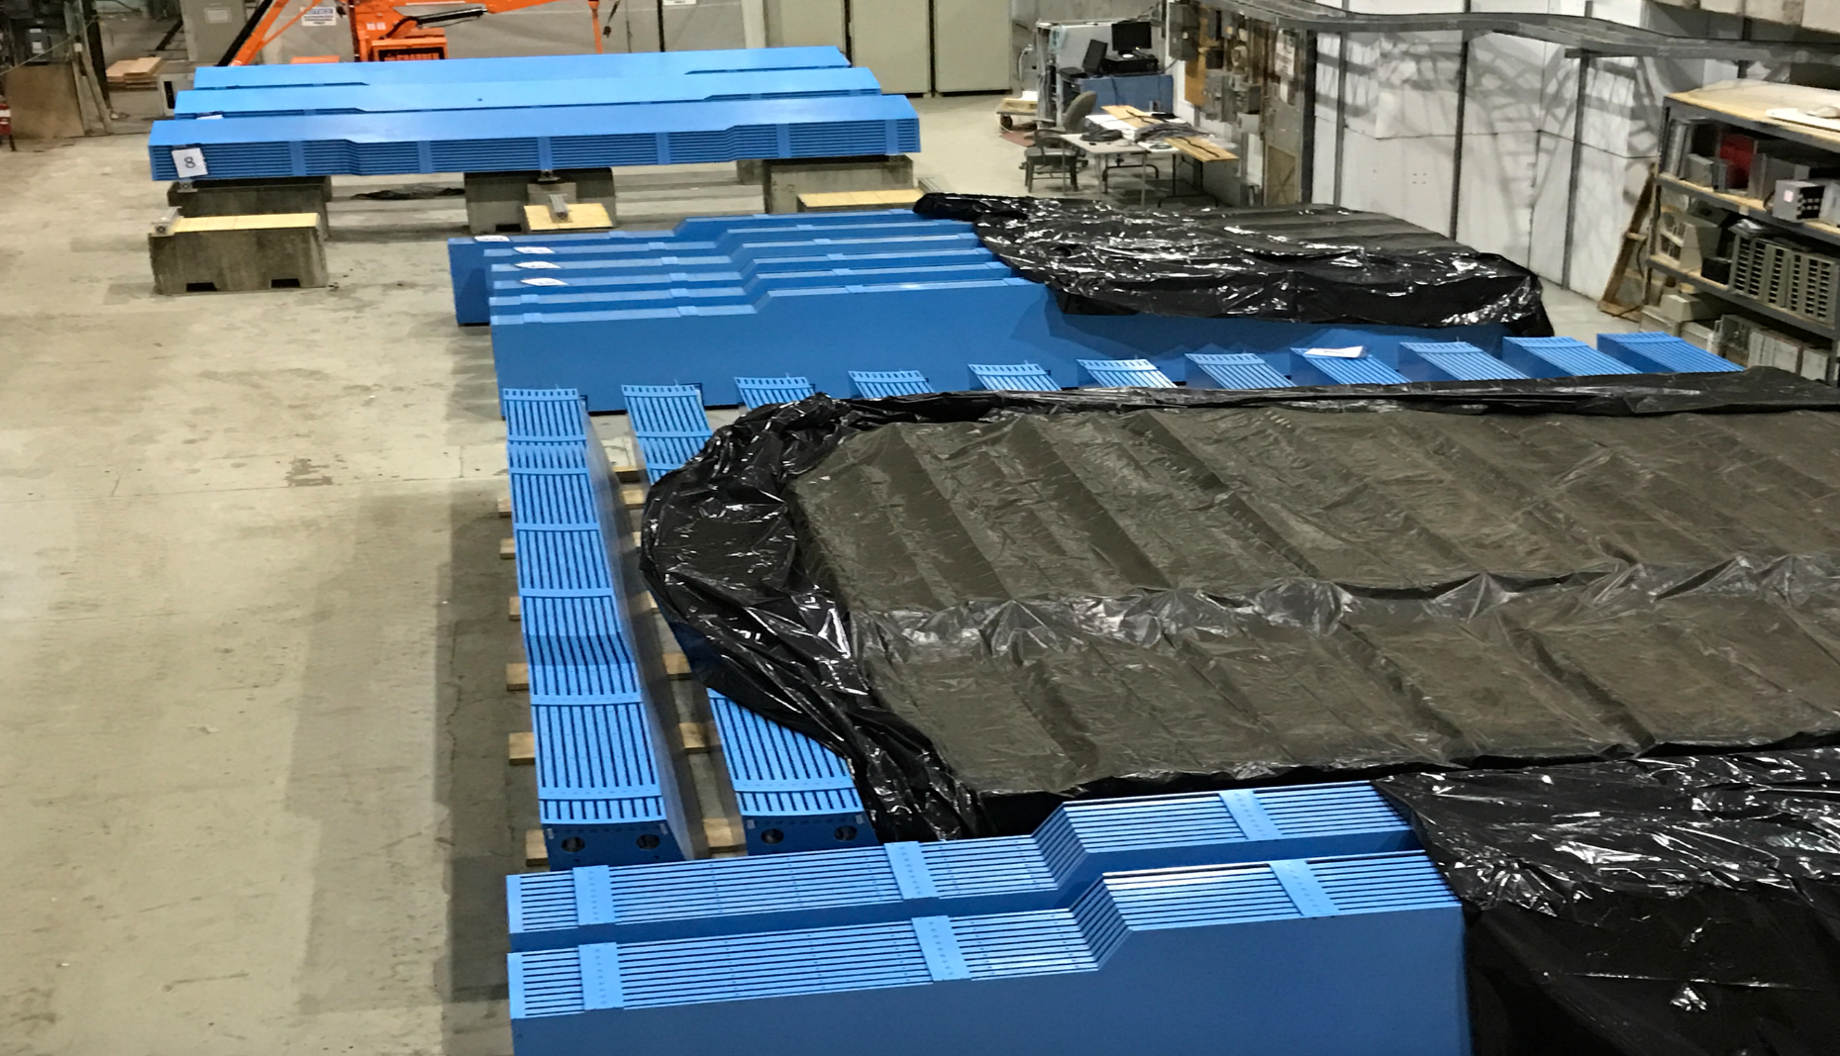
29/32 Barrel Magnet Steel Sectors at BNL. WBS 2.03.03

Slide 11
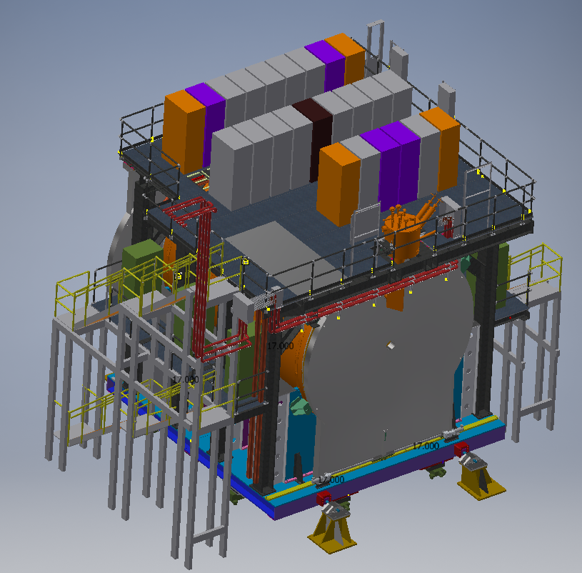
Status of WBS 2.3.1, 2.3.4, 2.3.5 – Cradle/Carriage System
Top and Mid Platforms
Access Stairs
End Caps/Pole Tips
Drive, and Alignment System
CARRIAGE assembly
Seismic Supports

Slide 12
Status of WBS 2.3.1, 2.3.4, 2.3.5 – Cradle/Carriage System
Design - Ongoing design and drawing development of:
Base
Electronics Platforms
Magnet Pole Tips
Engineering
Support of design effort – engineering check of design drawings
Identifying potential vendors
Finishing stress analysis for system
Priority given to Base
Longest procurement time
Closest to Critical Path
Most complicated component
Most expensive component
Upper Platform
Base – Half Assembly

Slide 13
Carriage/Cradle System Drawing Status
DRAWING STATUS as of Jun11:
BASE PLATFORM 90% COMPLETE
CURRENTLY GETTING MORE BUDGETARY QUOTES
UPPER PLATFORM 60% COMPLETE
END CAPS 35% COMPLETE

Slide 14
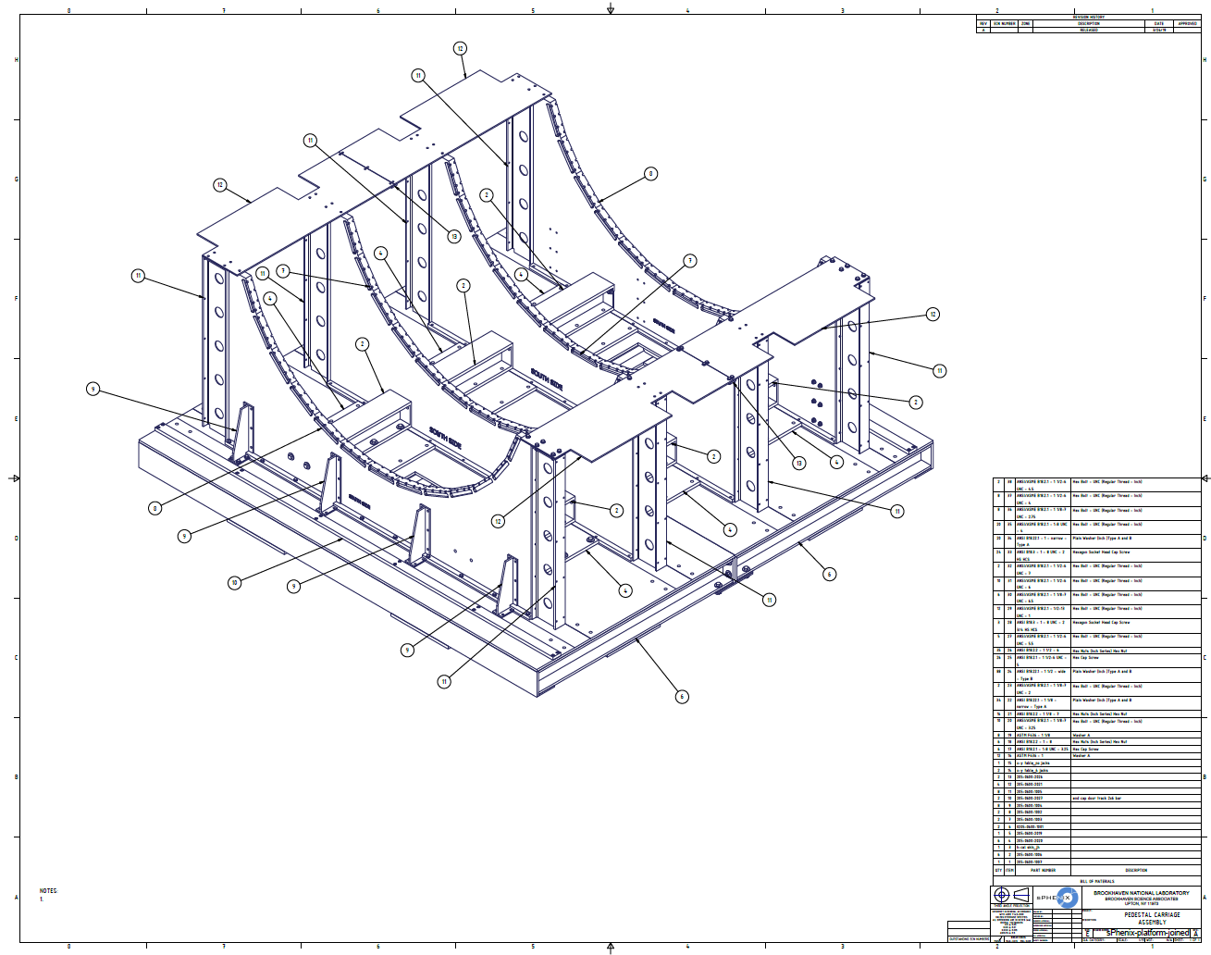
Cradle/Carriage System

Slide 15
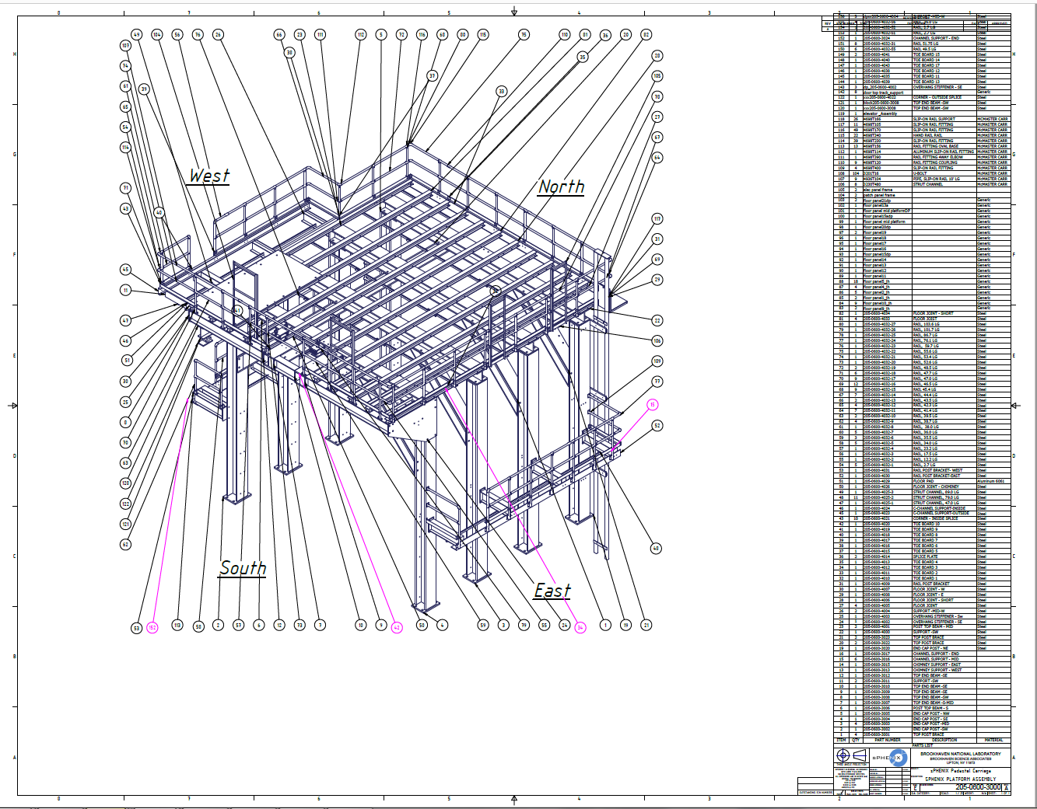
Electronics Platform

Slide 16
Critical Path(2.X) – Cradle & Installation
Cradle/Carriage Production
Cradle/Carriage Assembly
OHCal – 1
SC Magnet Install
OHCal – 2
Platforms
IHCal and EMCal also Install now
Magnet Infrastr.
Magnet Comm.

Slide 17
Critical Path(2.X) – Cradle & Installation
TPC Install
Beampipe Install
INTT/MVTX Install
MBD Install / INTT&MVTX Commissioning
Full sPHENIX Commissioning
Schedule Contingency

Slide 18
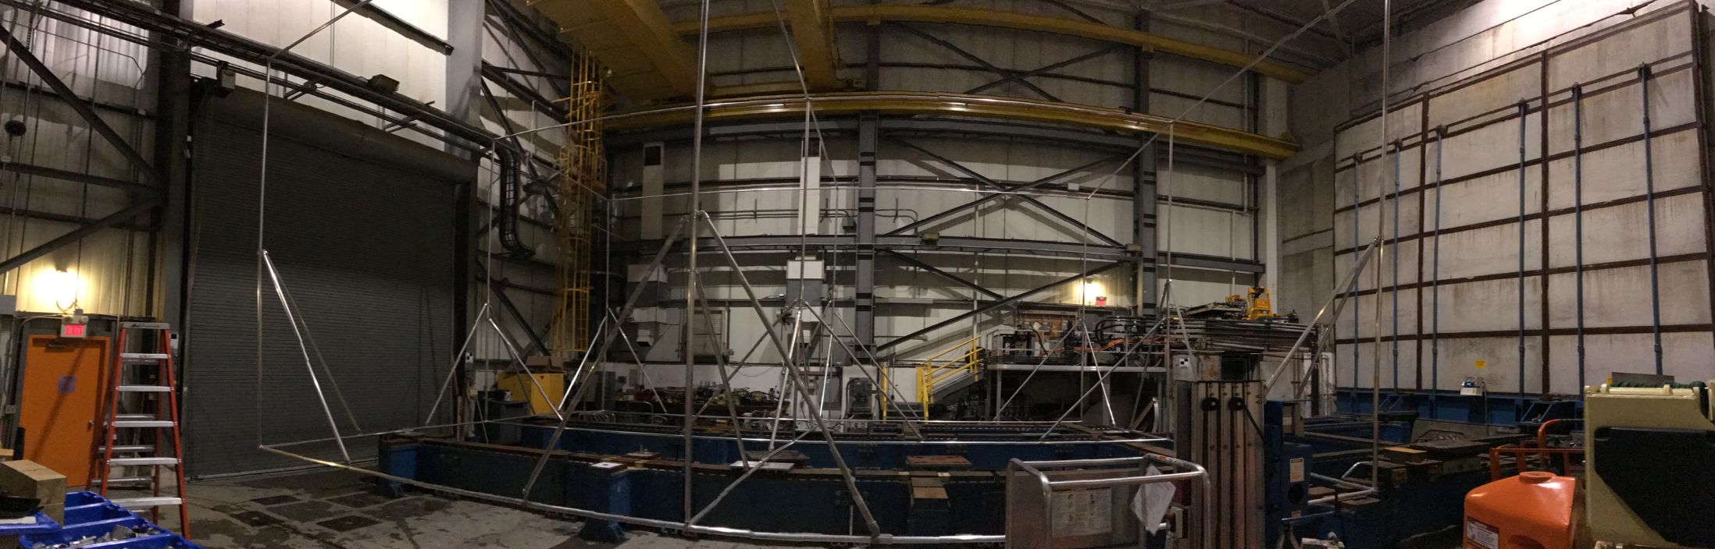
sPHENIX Assembly Preparation: Frame with 3D Footprint of sPHENIX
We’ve built a frame using aluminum components that matches the expected volume of sPHENIX during assembly. We will test whether we can take down the 1008 shield wall with the aluminum frame in place to determine the feasibility of installing/removing the shield wall during sPHENIX assembly

