Slide 1
Update on HepSim
Sergei Chekanov
José Repond
Argonne National Laboratory
EIC Software Consortium
Brookhaven National Laboratory
July 10, 2019

Slide 2
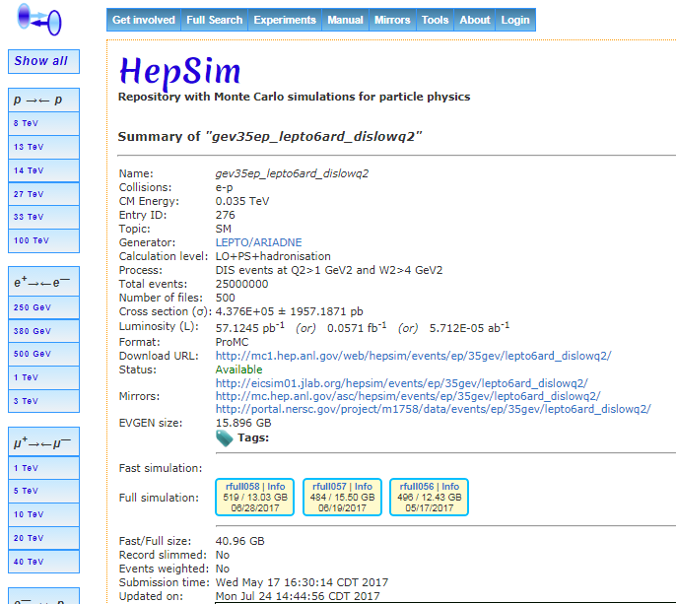
What is HepSim
A database and interface for detector simulations
https://atlaswww.hep.anl.gov/hepsim/
Developed at Argonne by Sergei Chekanov
Used for various projects
LHC, FCC, CLIC, ILC, and now EIC
A documentation and organizational tool
Stores and documents input MC data (from EG)
Stores input configurations
Geometry, digitization and reconstruction parameters
Stores and documents full detector simulation
Stores tagged containers of the full software tool-chain

Slide 3
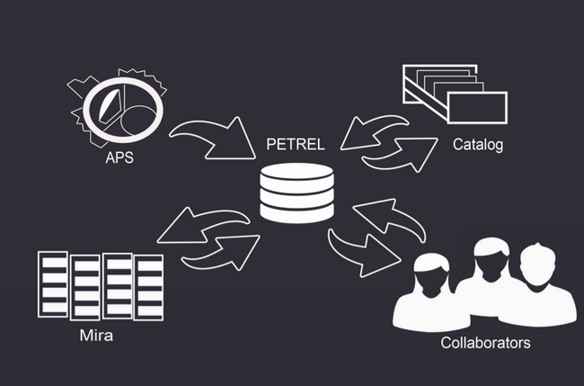
Moving HepSim Data to Petrel
Petrel
Data Management and Sharing Pilot, providing a mechanism to store and share research data
Total capacity of 17 PB of usable space on 32 nodes
Eliminates need for a dedicated web server
https://press3.mcs.anl.gov/petrel
All HepSim data files will be moved to Petrel
The HepSim interface
Still centrally supported
https://atlaswww.hep.anl.gov/hepsim

Slide 4
Moving Files to Petrel
Details about the move
For security reasons: https and not http
Petrel currently a ‘mirror’ and not the main server
PHP cannot be used. HepSim has its own way to display files
After additional checks → Petrel will become the default storage
Example of data stored on Petrel
141 GeV ep collision data
https://atlaswww.hep.anl.gov/hepsim/show.php?item=156&site=3

Slide 5
How to use HepSim with Petrel
Create your own Monte Carlo files
Get a Petrel account
https://atlaswww.hep.anl.gov/hepsim/doc/doku.php?id=hepsim:dev_hepsim
C1. Find a server visible by Globus (e.g. OSG login mode)
or
C2. Install Petrel on your personal computer
https://press3.mcs.anl.gov/petrel/
D1. Request to join the HepSim group on Petrel
https://press3.mcs.anl.gov/petrel/
This will allow you to move data to the HepSim file storage (100 TB) with enabled https
or
D2. Create a new Petrel project ‘MyEIC’ and enable https
E. Provide link to HepSim (e-mail to hepsim@anl.gov)

