Slide 1

Kolja Kauder
Eic-Smear and its parameterizations
A Walkthrough
EICUG Ad Hoc Simulation Meeting
BNL, July 2019

Slide 2
Eic-smear – What it is and isn’t
Utility for unifying EIC MC output in ROOT
And for smearing said output
NOT a replacement for Geant!
But, if you are asking...
“Given a (known) detector performance, how well can I measure some physics observable(s)?”
“If I need to measure X with to some precision, what detector performance do I need?”
or
… then it is an excellent tool

Slide 3
Work Flow
PYTHIA
DPMJet
Install packages
Run MC
PEPSI
gmc_trans
Djangoh
Milou
Rapgap
LEPTO
Build ROOT tree
Build “Detector”
Perform Smearing
Standard Format: analyze different generators without change
Truth ⬌ Smeared: Friend Trees
Analyze Output

Slide 4
Installation
Can link to existing PYTHIA library:
-DPYTHIA6_LIBDIR=…
Generally not recommended
$ git clone git@gitlab.com:eic/eic-smear.git
$
$ cd eic-smear
$ mkdir build ; cd build
$
$ cmake ../ -DCMAKE_INSTALL_PREFIX=<path>
$ make -j 2 install
auto_ptr warnings need fixing
Prerequisites:
cmake 3.1+
ROOT
c++11 support if using ROOT6
Generator installation can be a bit trickier
(LHAPDF, CERNLIB, …)
Available MCs at
wiki.bnl.gov/eic/index.php/Simulations

Slide 5
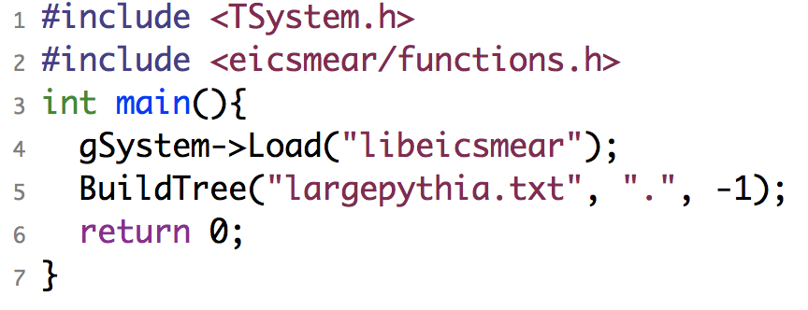
Generation and Transformation
Generated 1M PYTHIA6 events, MinBias, Q² = 10 – 100 GeV²
  ~ 1 hr to generate
Transformed with BuildTree
  ~ 17 min to transform
From
wiki.bnl.gov/eic/index.php/PYTHIA
soon on public repo
Large files (9GB). Consider including gz,bz2 streams
$ root -l
root [0] gSystem->Load("libeicsmear")
root [1] BuildTree("pythia.txt",".", -1)
Or compile:
$ g++ `root-config --cflags` \
`root-config --libs` \
-I<…>/include -L<…>/lib -leicsmear …

Slide 6
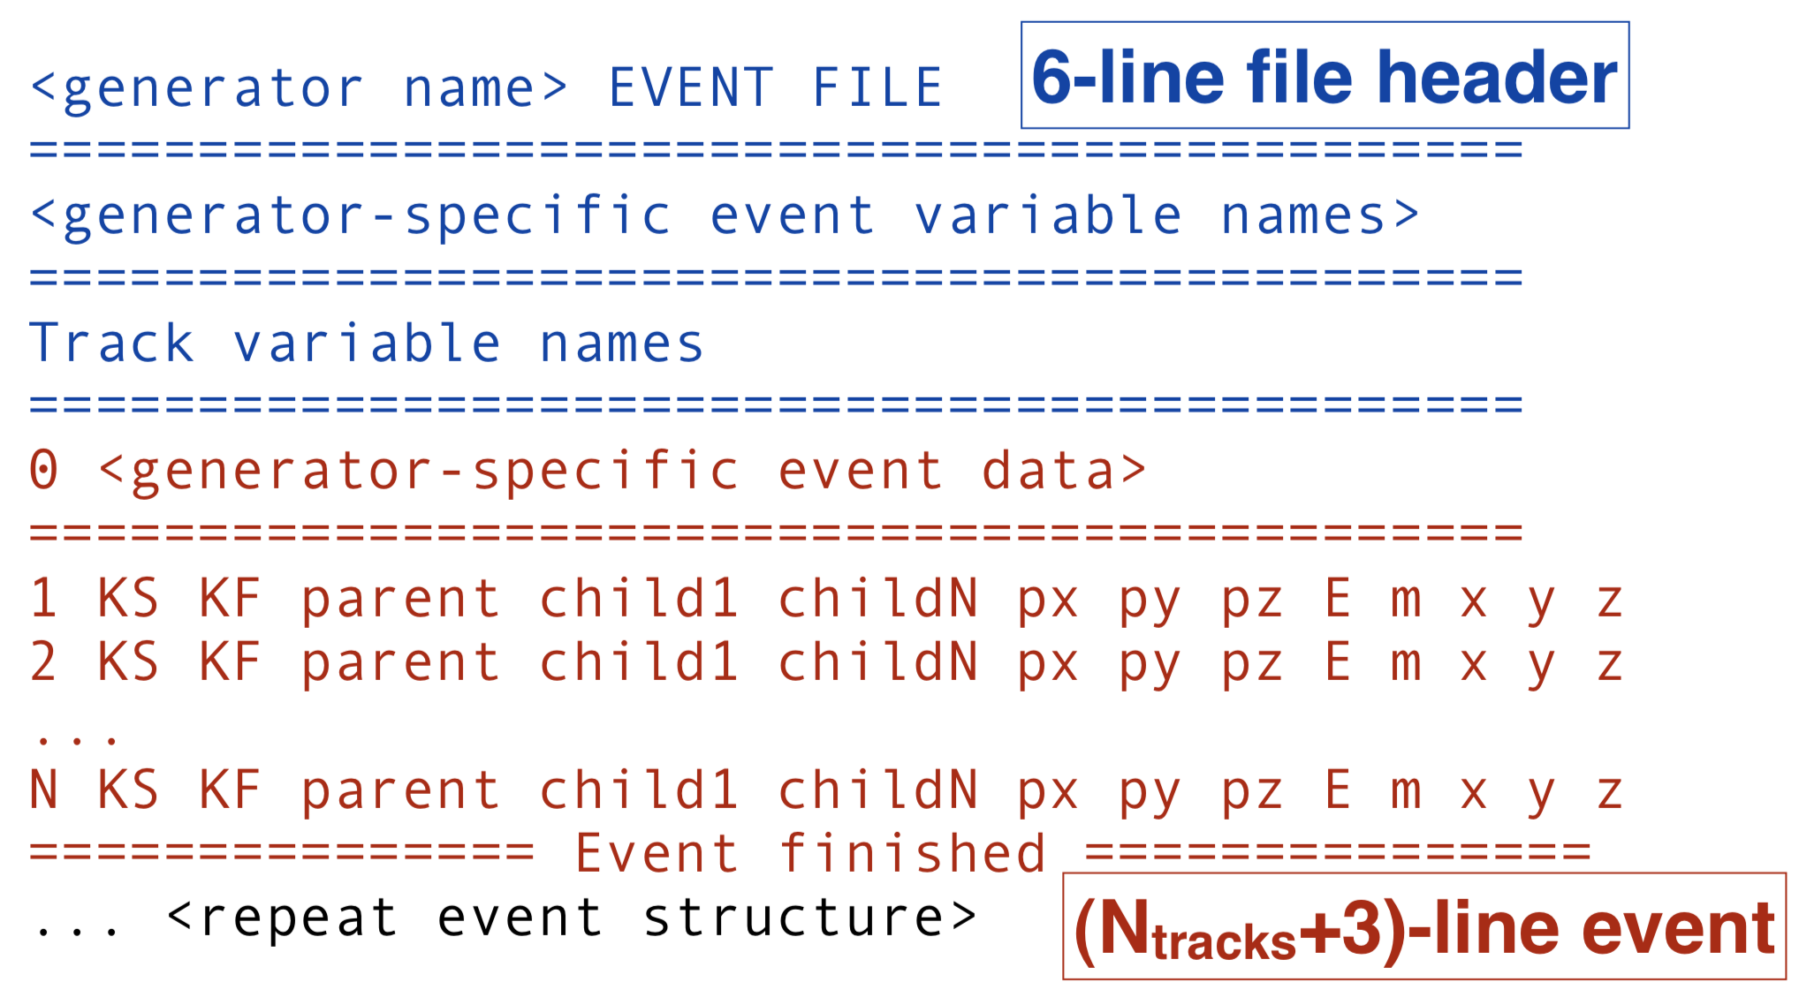
Common ASCII Format
HepMC? 2? 3?
Based on PYTHIA6
wiki.bnl.gov/eic/index.php/PYTHIA

Slide 7
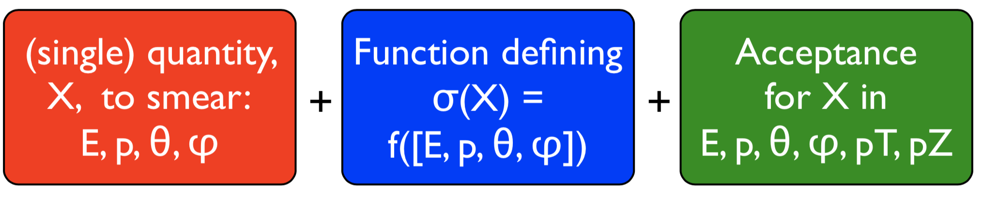
Smearing
“Smearer” defines some element of performance
+ acceptance
Standard Smearers are provided
Define your own via inheritance
NOT a “physical detector”
Represents the overall performance in measuring a quantity.
Smearer
“Detector”
Smearer
Smearers applied to
each final particle
Optionally, recalculate derived values e. g. x, Q²
Smearer
Smearer
Smearer

Slide 8
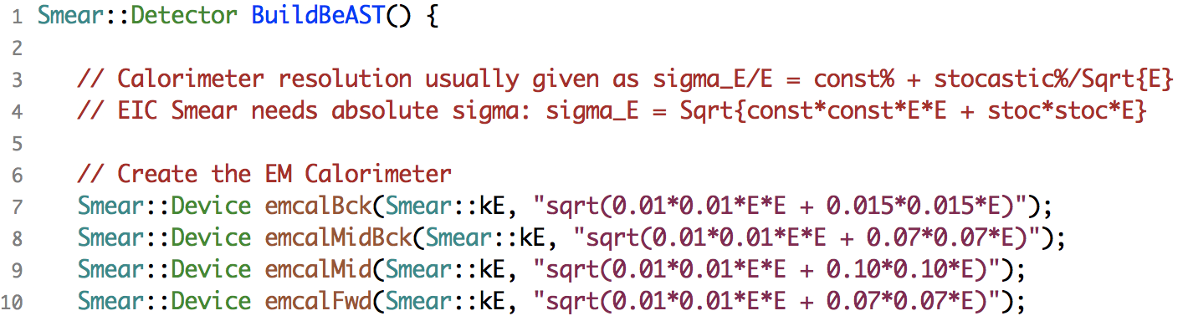
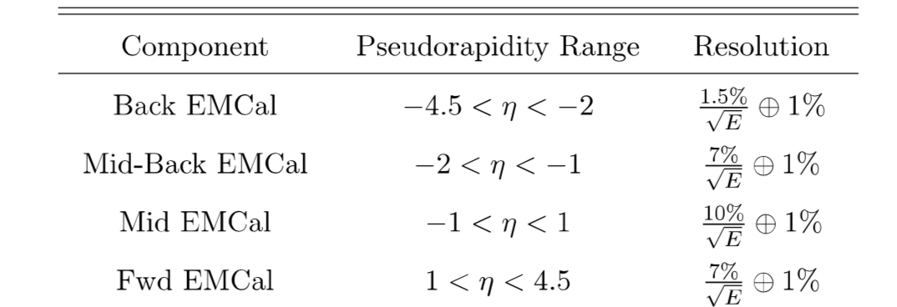
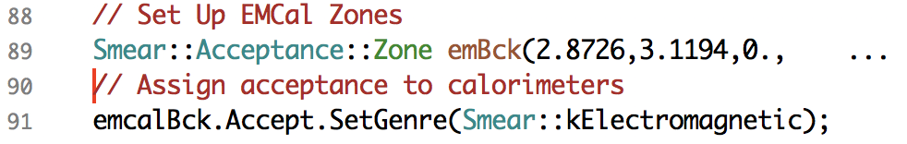
In Practice
BeAST Calo parameters
from eRHIC design study
Function returning a Smear::Detector
Acceptance (in θ)
Genre selects set of PIDs
→ can be customized
… same for HCal

Slide 9
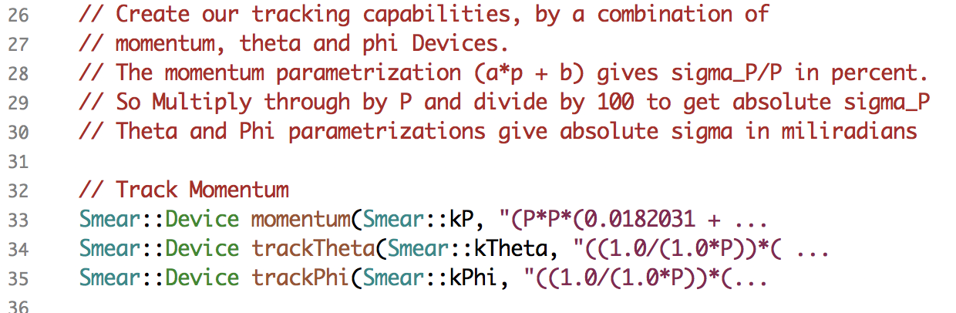
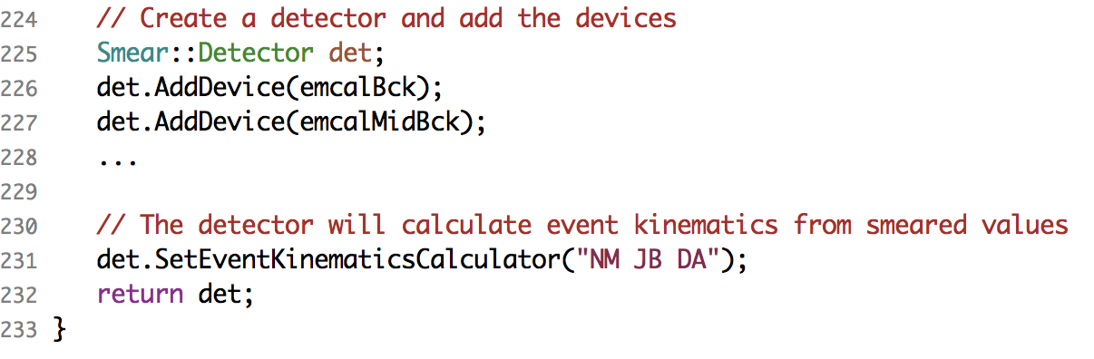
Example Continued
Tracking follows similar TFormula's.
Assemble devices
Kinematics options

Slide 10
Execution and Output
Smeared with SmearTree
  ~ 10 min to Smear (1.5k evts/sec)
root [0] .L smearBeAST.cxx
root [1] SmearTree(BuildBeAST(), "pythia.root", "smeared.root")
Load and befriend!
root [0] TFile mcf ("pythia.root")
root [1] TTree* mc=(TTree*)mcf.Get("EICTree")
root [2] mc->AddFriend("Smeared","smeared.root")
Smeared particle is stored if final and in acceptance
Otherwise store NULL → 1-to-1 matching

Slide 11
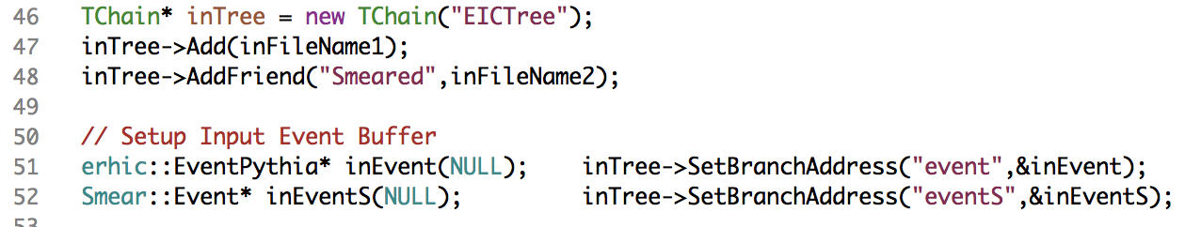
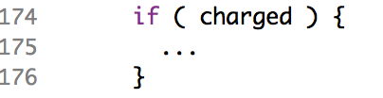
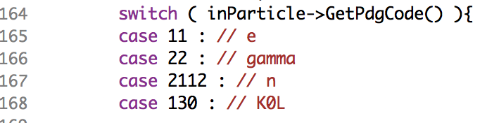
Analysis
Befriend and get matched branches
Particle Loop
Some additions at analysis level:
Tracking efficiency
Assign π mass to EMCal "hits"
Add convenience functions?

Slide 12
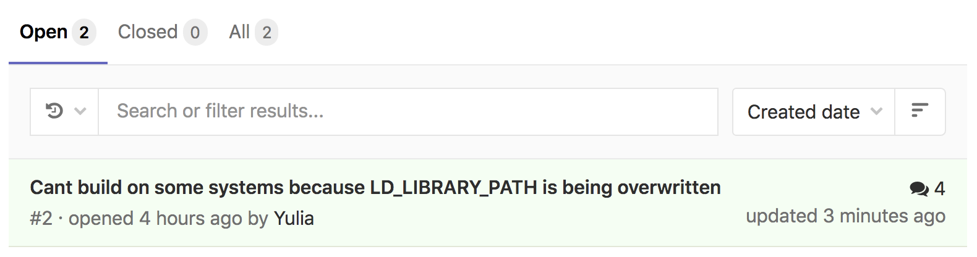
Resources
Includes examples for ZEUS, ePHENIX, …
Download from
https://gitlab.com/eic/eic-smear
Contact kkauder@bnl.gov, ayk@bnl.gov
or use gitlab issue tracker and pull requests
Online users’ guide:
https://wiki.bnl.gov/eic/index.php/Eic-smear
Class documentation:
http://www.star.bnl.gov/~tpb/eic-smear/index.html
Includes examples for specialized devices
Excellent doxygenization
Doxyfile needs to be added back

Slide 13
Summary
eic-smear is fast, light-weight, extensible, well-written
No dependencies beyond ROOT
First stage unifies a host of EIC-relevant MC output
Cannot replace a full simulation
– but gives a good estimate of detector effects on observables in <10% of the time it takes to generate PYTHIA6.

Slide 14
BACKUP

Slide 15
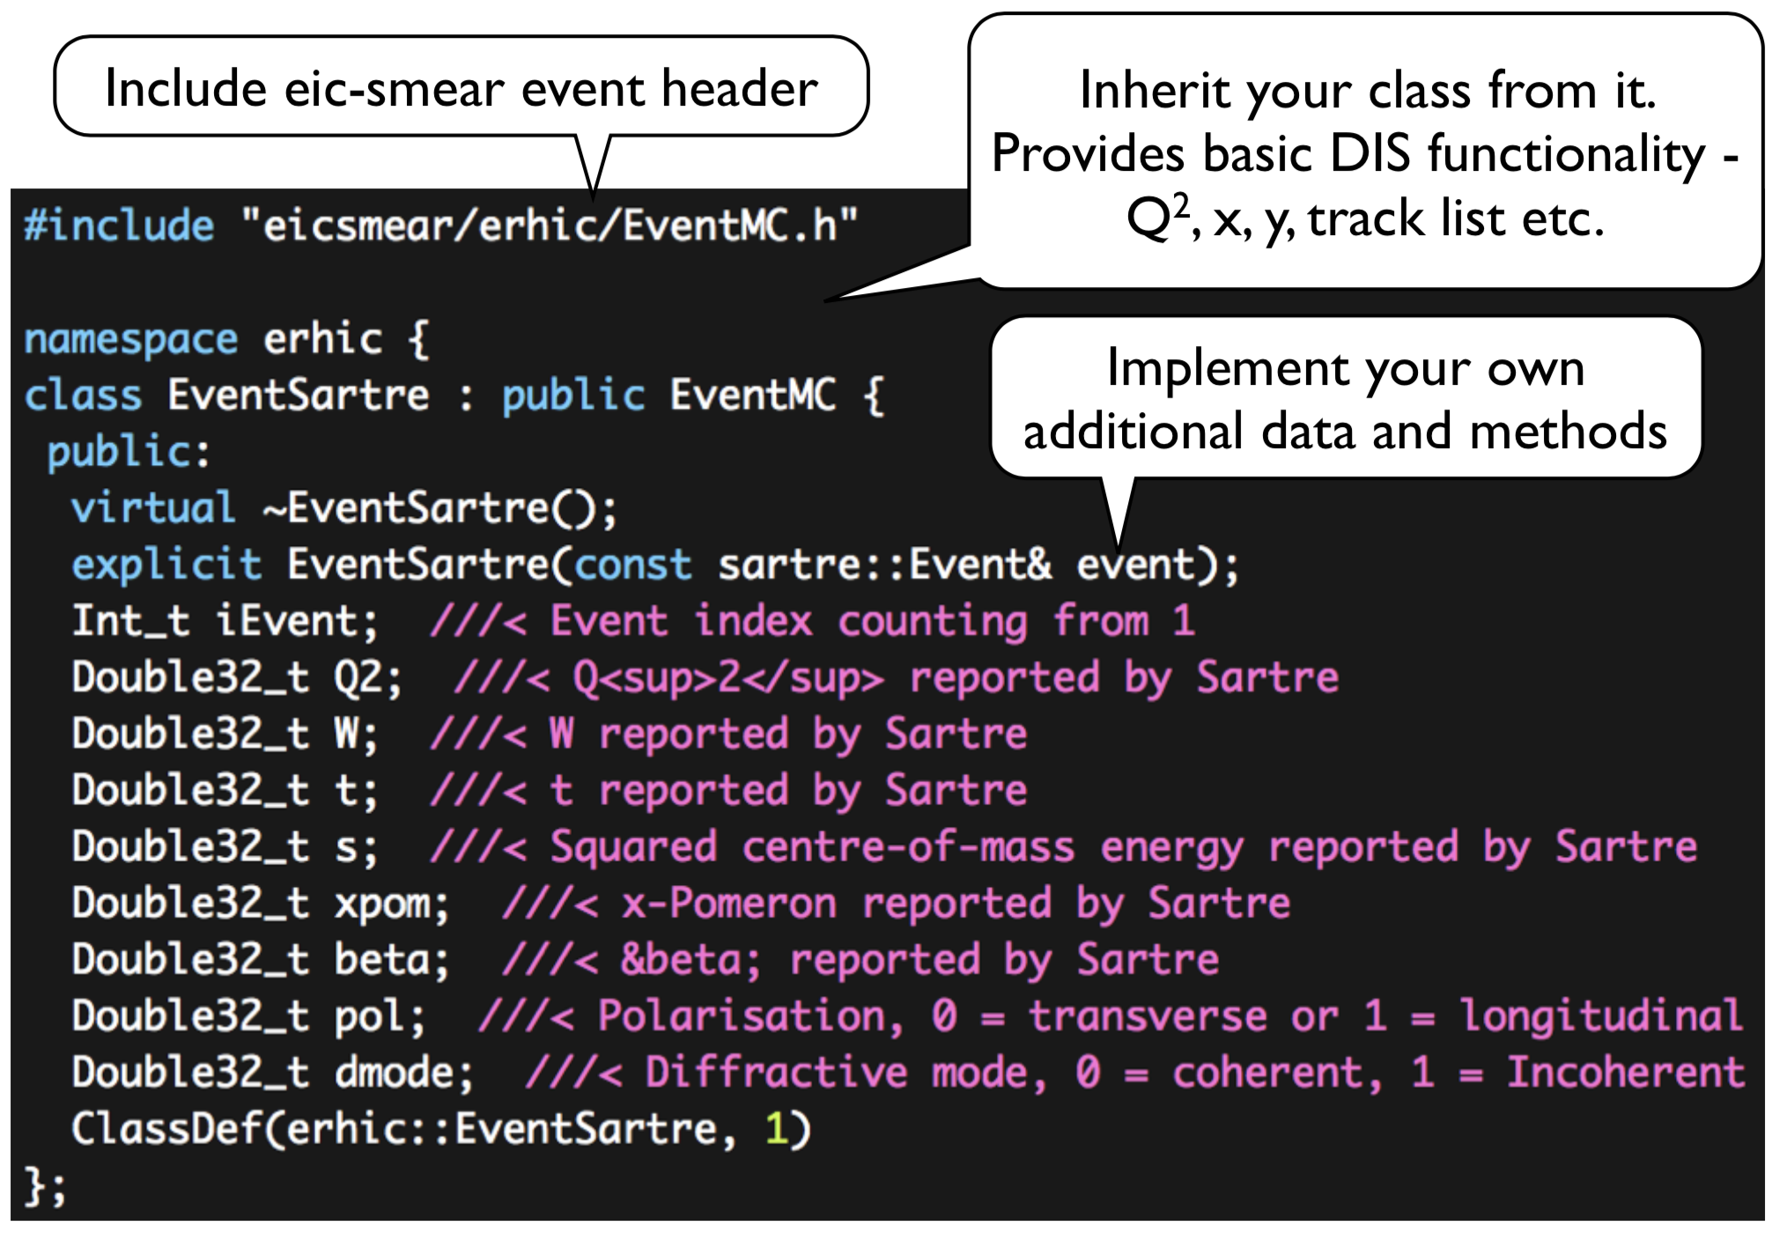
Extending (e.g., to Sartre)

Slide 16
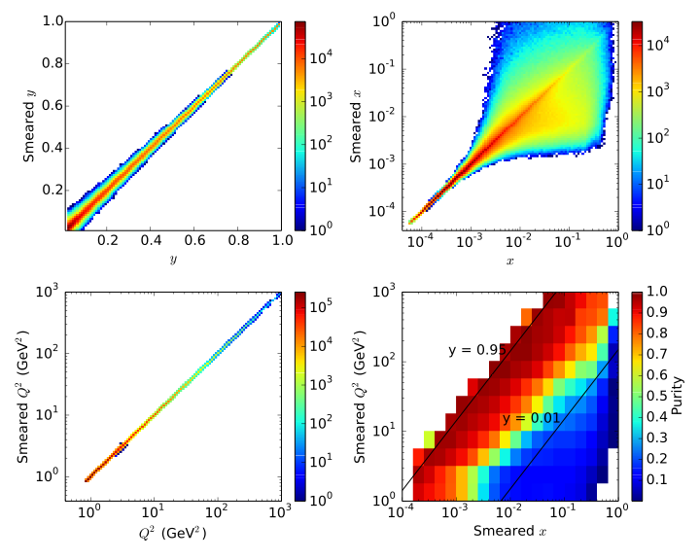
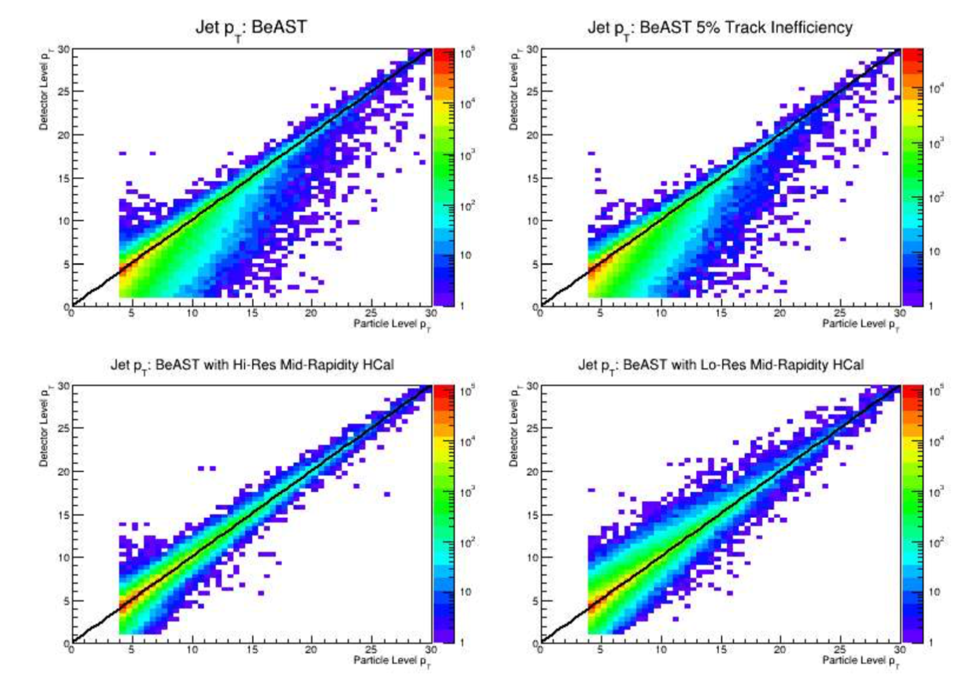
Some Physics Examples
y, x, Q² response and resulting purity
Jet p_{T} Performance study for various HCAL options
eRHIC Design Study
From B. Page

Slide 17
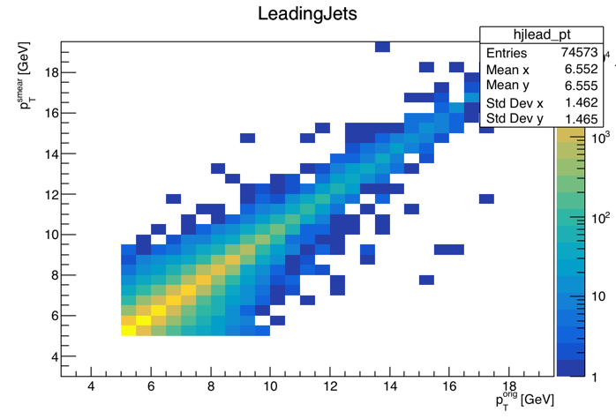
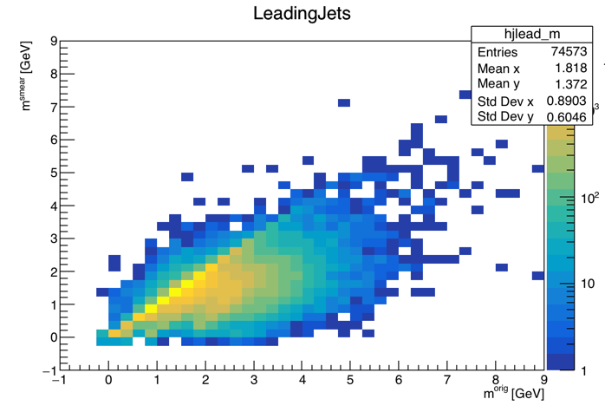
My Quick Result
Jet p_{T}
Jet Mass
No claims to correctness of these; main points of this slide:
This took ~two days to put together from scratch,
and I could now run many detector design variations in O(minutes)

Slide 18
A Brief History
Originally written by Michael Savastio (student)
Long-time main developer Thomas Burton
Current maintainers are Alex Kiselev … and as of late, me
With Annotations
Walk with me through a full analysis
And potential future development

