Slide 1


Tracking software tools
for EIC PID community
& related topics
Alexander Kiselev
EIC PID Workshop Stony Brook
July,9 2019

Slide 2
Contents
Requirements
Existing solutions
Future plans
Discussion?

Slide 3
What does PID need from tracking?
Track fits and parameterization at various locations
Forward RICH
Backward RICH
DIRC
...
Vertexing (charm)
Path length estimates (ToF)
Estimates of magnetic field distortions (forward RICH)
...

Slide 4
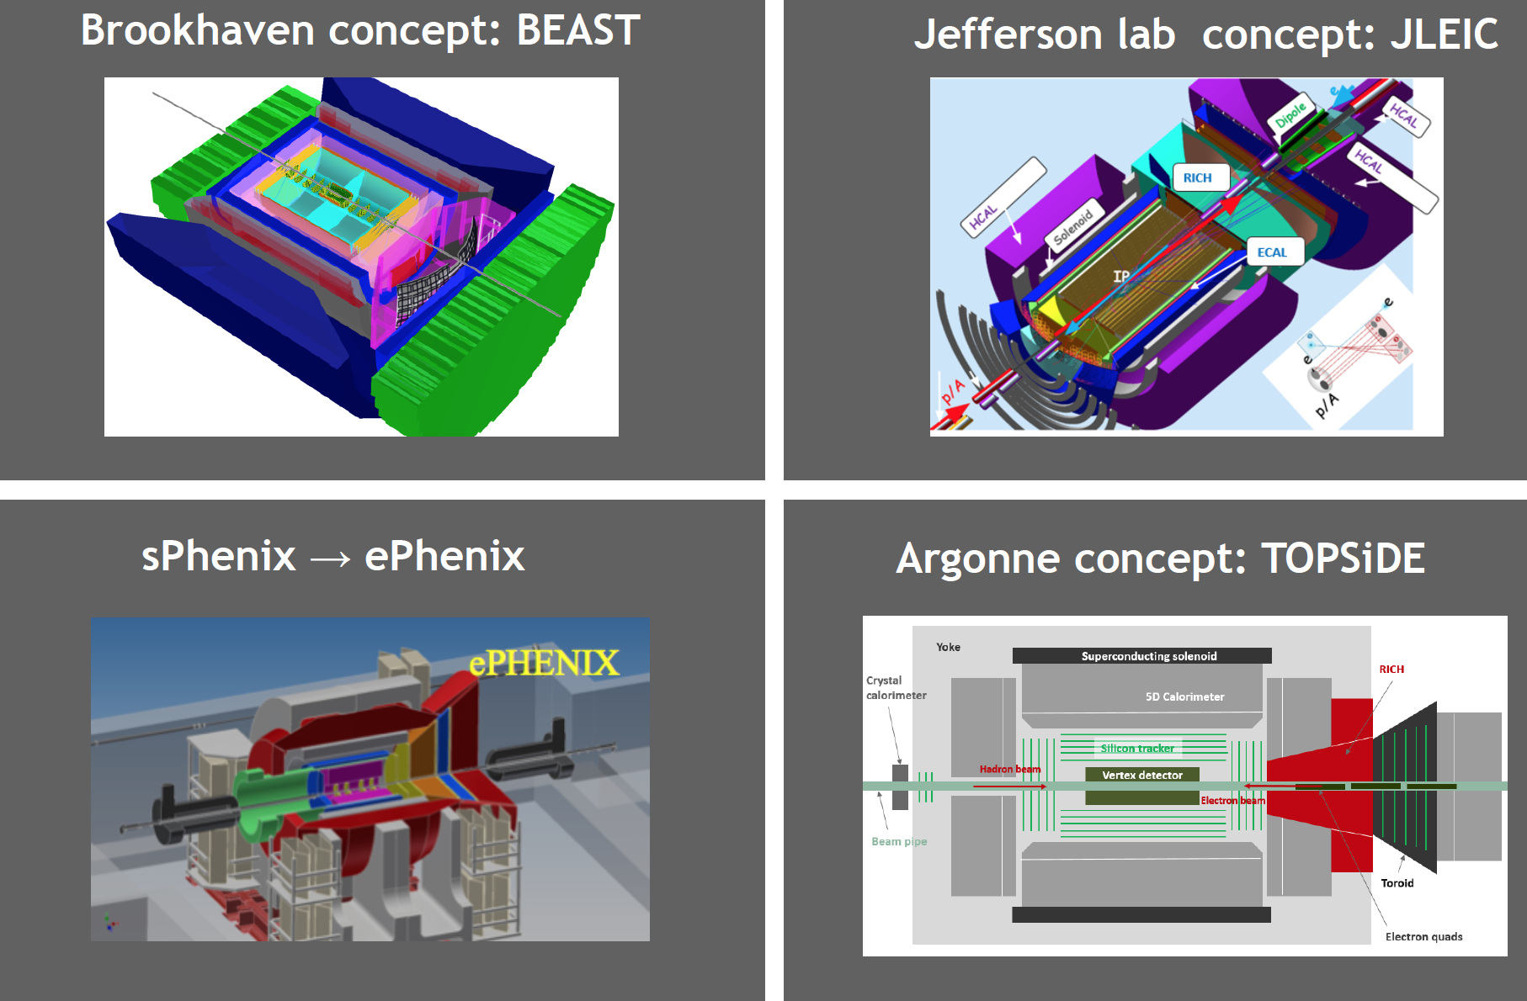
General purpose detector concepts
-> software frameworks are strictly bound to the detector concepts

Slide 5
Existing software

Slide 6
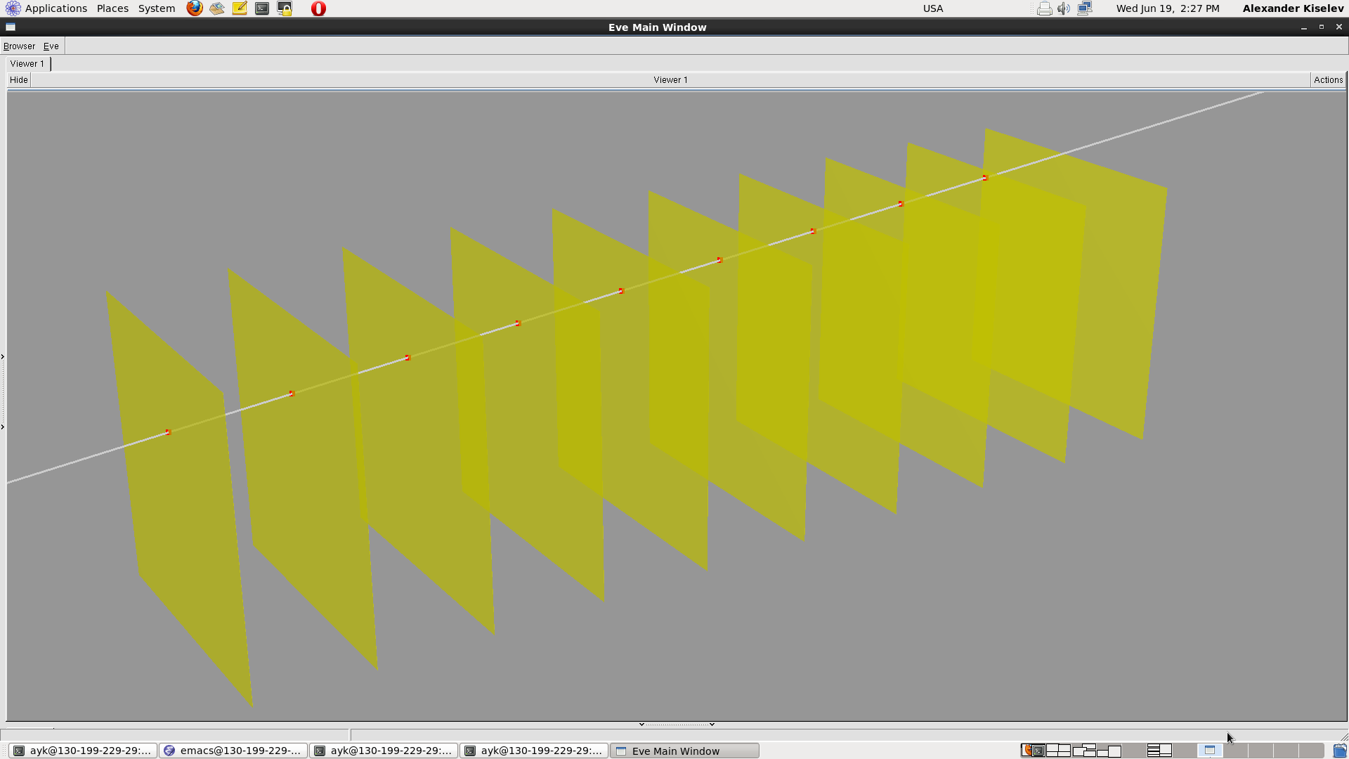
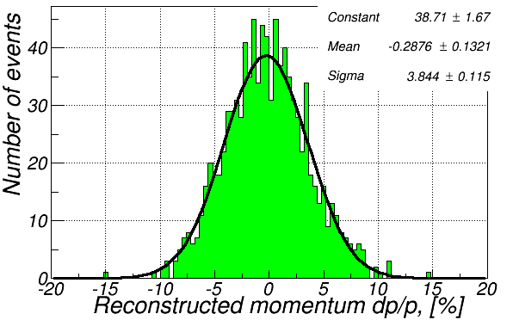
EicRoot example #1: basic forward tracker
Which momentum resolution for 10 GeV/c pions will I get
in ~3T field with 10 MAPS layers at η=3?
Configurable geometry, material budget & resolutions
Complete Kalman filter track fit
-> see examples/tracking/config.1 directory for details

Slide 7
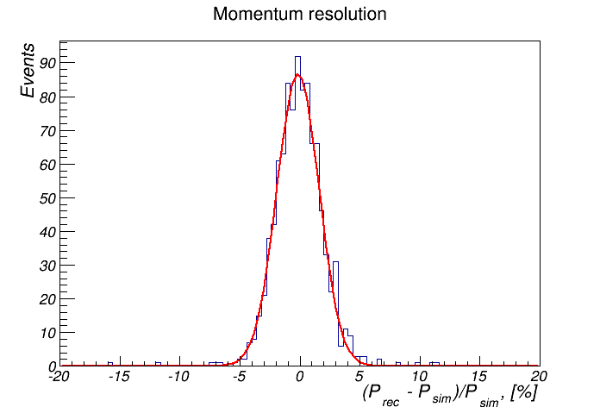
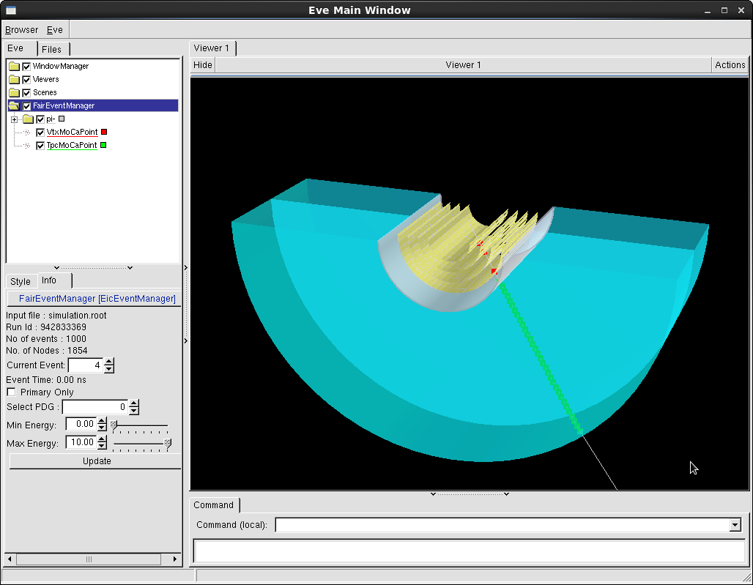
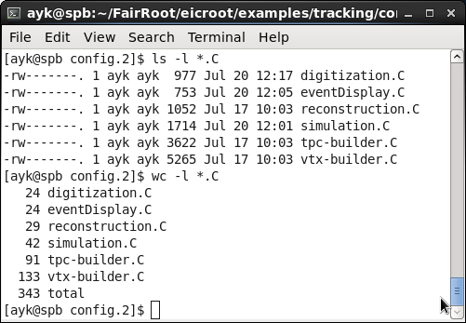
EicRoot example #2: vertex+barrel tracker
Consider now vertex tracker + TPC in 3T field; shoot 10 GeV/c pions at θ=75º
-> see examples/tracking/config.2 directory for details

Slide 8
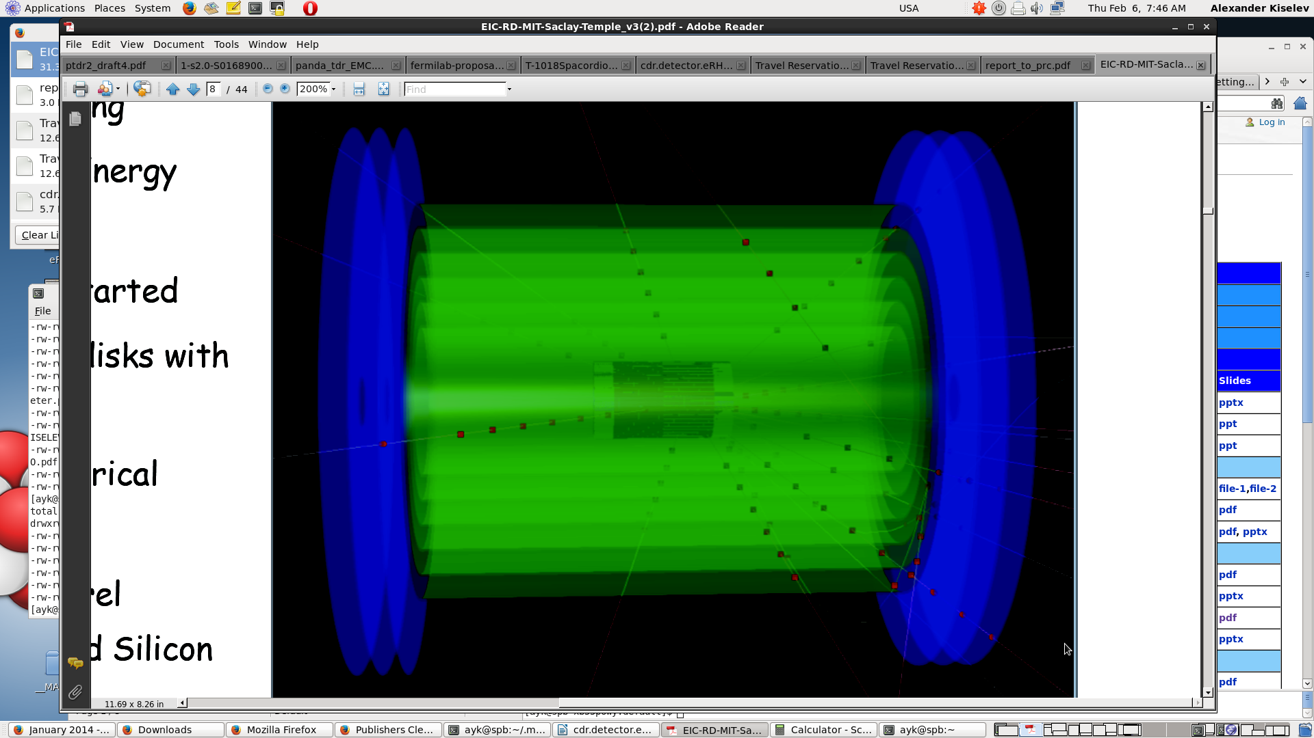
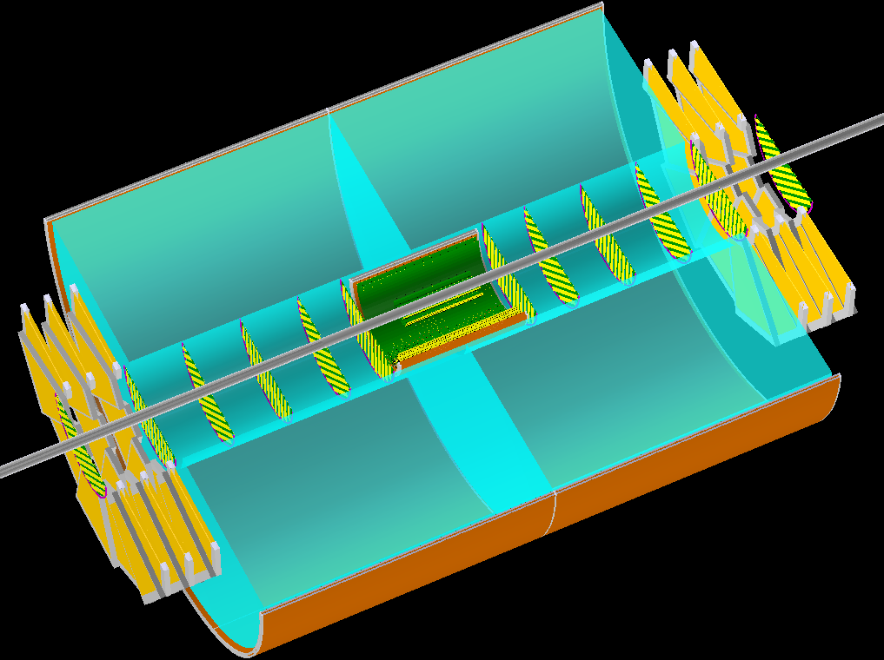
EicRoot: modular geometry
TPC completely replaced by 6 layers of cylindrical micromegas
No-structure GEM disks in the endcap
TPC with reduced outer radius is just appended by few micromegas layers
-> reconstruction codes will work the same way as before once
respective ROOT steering scripts modified accordingly

Slide 9
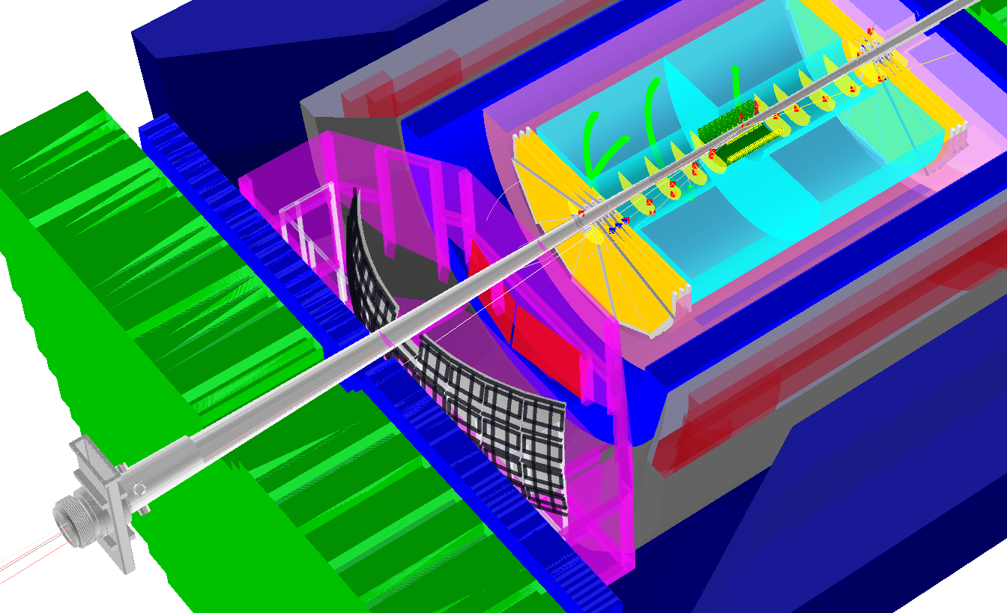
EicRoot: BeAST momentum resolution
-> be aware: IR geometry is
a fast moving target!
hadronic calorimeters
e/m calorimeters
RICH detectors
silicon trackers
trackers
GEM trackers
TPC

Slide 10
fun4all: a complete software suite
Fully developed G4 model, including digitization and reconstruction
by Chris Pinkenburg

Slide 11
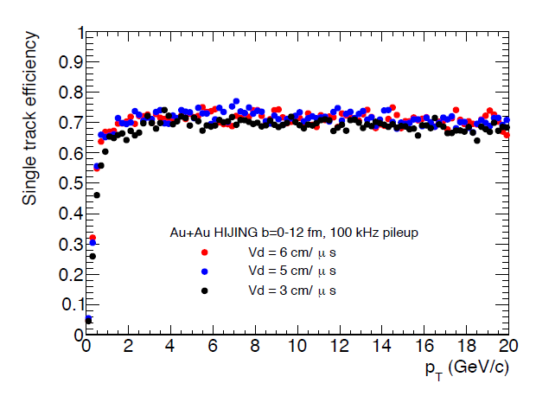
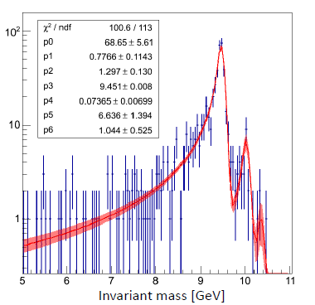
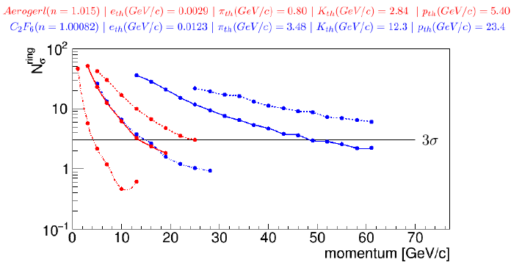
fun4all: case study examples
Tracking Efficiency
Upsilon Reconstruction
Hadronic Calorimeter Test Beam
Jet Reconstruction
EmCal Test Beam
Contains all you need to
simulate and analyze data NOW
EmCal Hadron Rejection
Rich PID
by Chris Pinkenburg

Slide 12
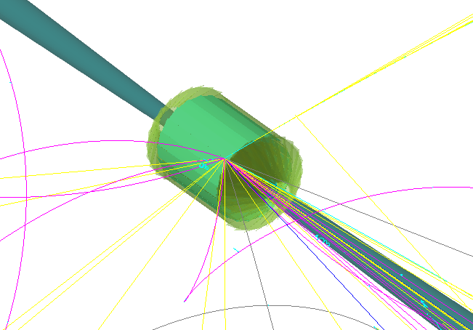
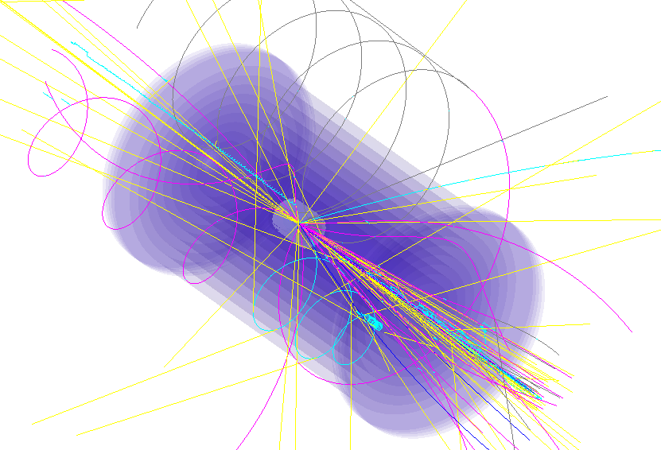
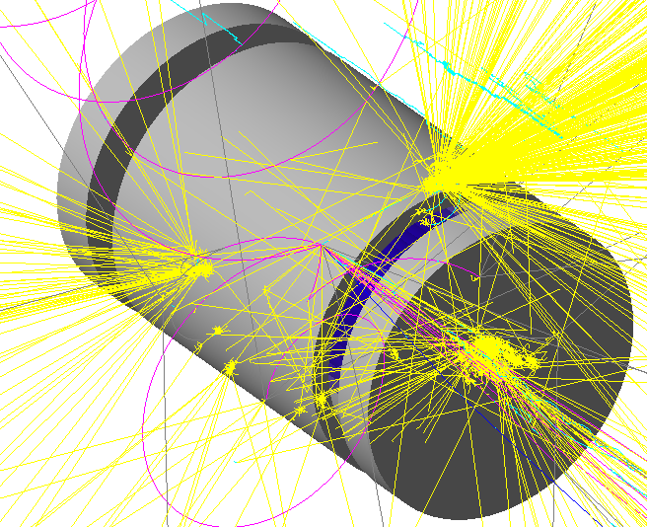
Reconstruction Chain (for LDRD)
This chain has been developed to validate tracking and vertex parameters and was used for JLAB LDRD- 1601/1701 project (“Nuclear gluons with charm at EIC”) to estimate a detector effect on a charm reconstruction. (Many thanks to “software consortium”, especially to Whitney Armstrong, for ideas and discussions)
Track and momentum
reconstruction
Primary and secondary vertices
(Full)
Geometry description
(TGEO, GDML…)
File with hits, orig. MC tracks
and reconstructed tracks and vertex
(ROOT)
GEANT4
GENFIT
Track fit
RAVE
Vertex fit
File with hits, orig. tracks
(ROOT)
Your
physics analysis
mass spectra
Decay length
Event Generator
(Fast)
Smearing
Momentum,vertex
Vertex
Geometry created/described inside GEANT4, and then distributed via Root TGEO
All parts are connected via intermediate Root files (ntuples)
Event generators (Pythia6, Herwig 6 and 7) HEPMC, Lund format.
Original (MC) tracks are traced down to analysis
No pattern recognition ! Only track fit and vtx!
Calorimeter
Outer tracker
Yulia Furletova
https://wiki.jlab.org/nuclear_gluons/
Notes:
Interior Page Design 2

Slide 13
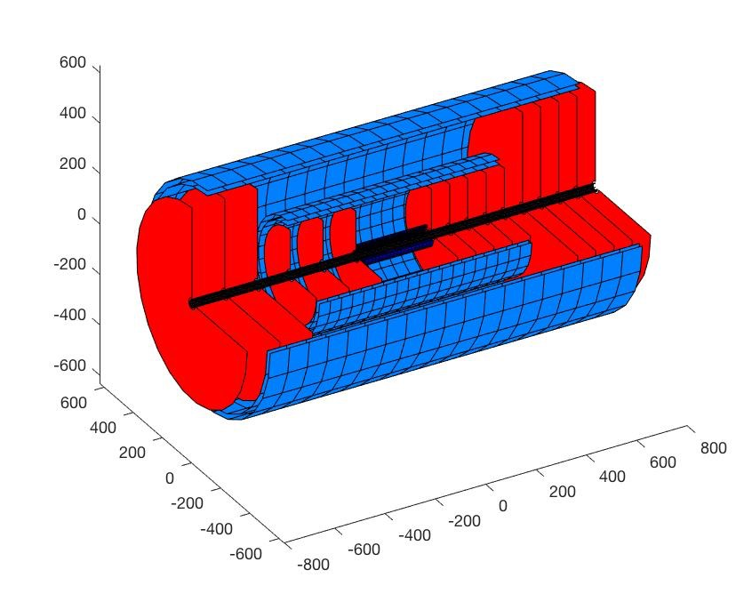
Silicon tracker Simulation Tools
LiC Detector Toy enables fast, initial optimizations of tracking detector configuration concepts
Originally developed for ILC
studies (Regler et al, 2008),
Helix track model,
Multiple scattering,
Full track reconstruction
from digitized hits using
a Kalman filter.
Successfully used by eRD16 for their thin silicon (MAPS) efforts,
(being) extended to vertexing and timing studies.
slide provided by Ernst Sichtermann

Slide 14
Path forward:
Docker containers

Slide 15
eRD20 container project
Container technology
Container := very lightweight Virtual Machine
Main players
  Docker industry standard, requires admin privilege on host
  Singularity standard on OSG, can run entirely in unprivileged mode
  Shifter (NERSC only)
Benefits for EIC user community
Allow EIC users to run the same software under standardized environment on any Linux, Mac OS or Windows machine, eventually including GRID sites, commercial cloud systems, and HPC resources
Provide consistency between software generated at different facilities
Make it easier for new users to start working on the physics program and detector design for the EIC, by minimizing the pain of “installation overhead”
Community document draft released few weeks ago by D. Blyth (ANL), W. Deconinck (William & Mary), MD (Jlab), A. Dotti (SLAC), AK (BNL), and D. Lawrence (JLab)

Slide 16
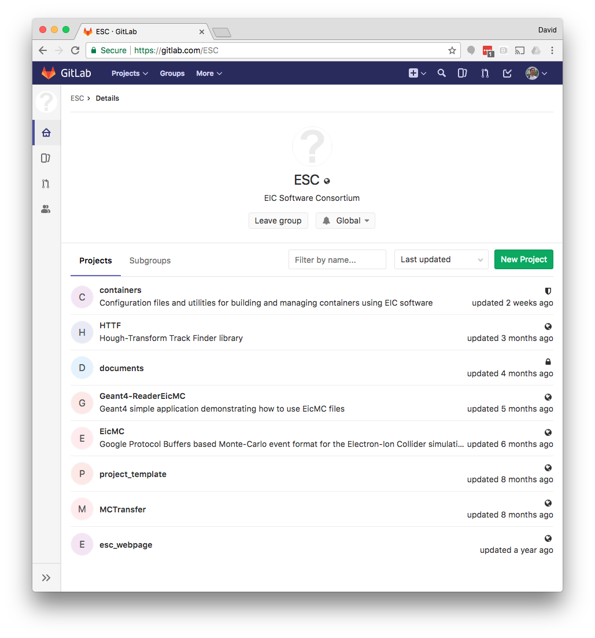
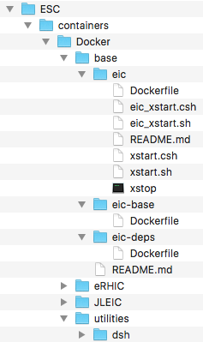
eRD20 container repository on GitLab
Source files for generating EIC containers are available: https://gitlab.com/ESC

Slide 17
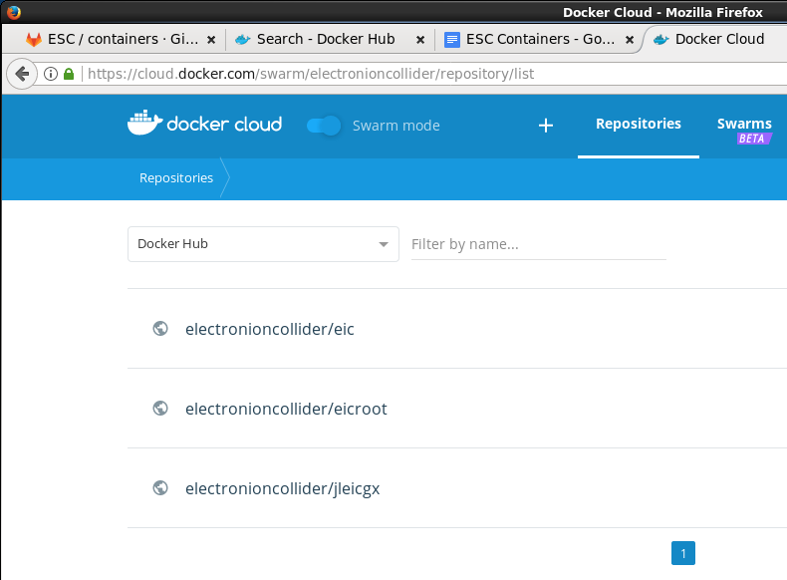
eRD20 container images on Docker cloud
https://cloud.docker.com/swarm/electronioncollider/repository/list
Generic base image
based on CentOS 7
includes:
  ROOT 6
  Geant4 10.3.3
  CLHEP 2.3.4.5
  support for OpenGL graphics
eRHIC software
EicRoot
JLEIC software
GEMC

Slide 18
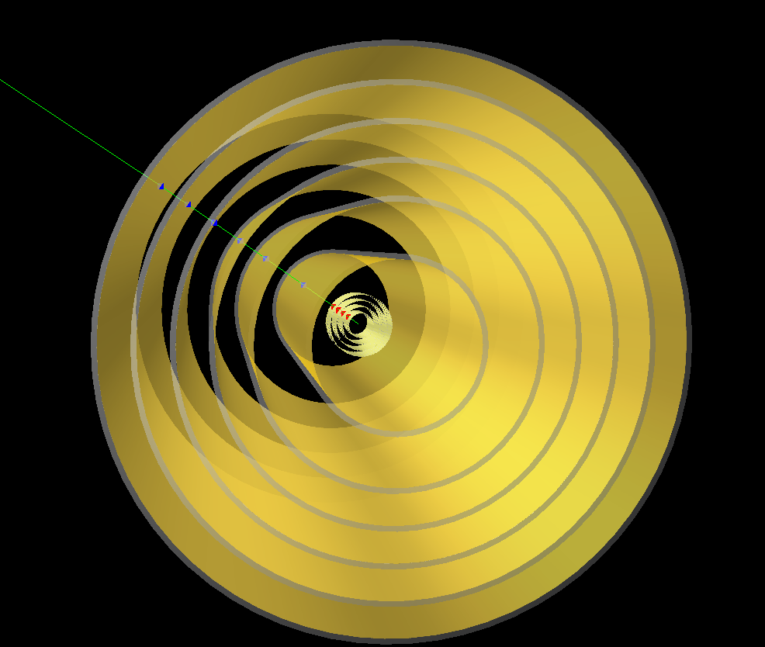
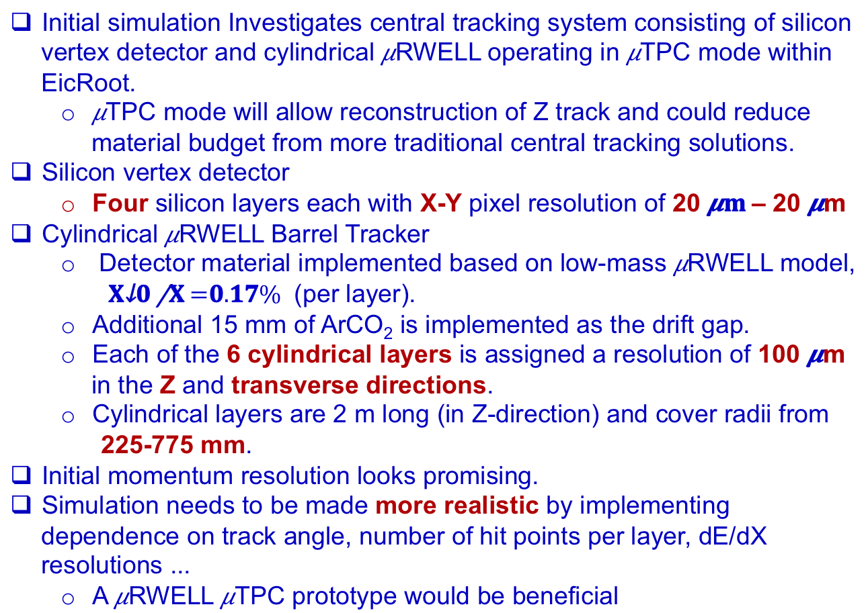
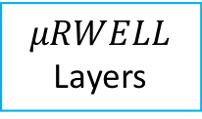

Does it work in general? YES!
Initial simulation Investigates central tracking system consisting of silicon vertex detector and cylindrical $μ$RWELL operating in $μ$TPC mode within EicRoot.
  $μ$TPC mode will allow reconstruction of Z track and could reduce material budget from more traditional central tracking solutions.
Silicon vertex detector
  Four silicon layers each with X-Y pixel resolution of 20 $μm$– 20 $μ$m
Cylindrical $μ$RWELL Barrel Tracker
  Detector material implemented based on low-mass $μ$RWELL model,
  $\frac{Χ_{0}}{Χ}=0.17\%$ (per layer).
  Additional 15 mm of ArCO₂ is implemented as the drift gap.
  Each of the 6 cylindrical layers is assigned a resolution of 100 $μ$m in the Z and transverse directions.
  Cylindrical layers are 2 m long (in Z-direction) and cover radii from
  225-775 mm.
Initial momentum resolution looks promising.
Simulation needs to be made more realistic by implementing dependence on track angle, number of hit points per layer, dE/dX resolutions ...
  A $μ$RWELL $μ$TPC prototype would be beneficial
Momentum resolution
$$μRWELL$$
Layers
Vertex
Layers
Calorimeters
by Matt Posik

Slide 19
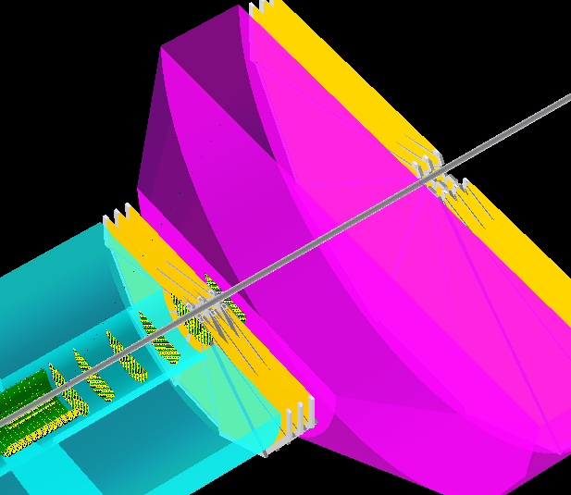
Does it work in general? YES!
Impact of the outer forward GEM detectors on seeding the RICH ring reconstruction in BeAST geometry
Momentum resolution
Outer
forward
GEMs
Momentum resolution
Inner
forward
GEMs
TPC
RICH
Vertex detector
Si tracker
Calorimeters
by Matt Bomberger

Slide 20
Grand unification,
yet another try
by Dmitry Romanov, David Lawrence & others (JLAB)

Slide 21
Overview
Generators
Database
Generators
Database with various
MC samples
Pythia
Beagle
Herwig
…
(1)
Fast simulation
Full simulation
BNL & Jlab effort on
Fast detector prototyping
Eic smear
Geant4
Fast mode
g4e
JLEIC in Geant4
g4e = Geant 4 EIC
C++ genue GEANT4 with
JLEIC detector in it
(2)
ejana = EIC Jana
Community reference
reconstruction
Reconstruction & analysis
ejana – EIC JANA(2)
(3)
MC events
Digitized hits + magnetic field + material distribution
Reconstructed events
by Dmitry Romanov

Slide 22
Software distribution
NO EFFORT AT ALL
Novice
Some effort
Experts
Efforts required axis
Cloud
Containers
Jlab farm
Conda
Workstation
Compilation
EJPM
by Dmitry Romanov

Slide 23
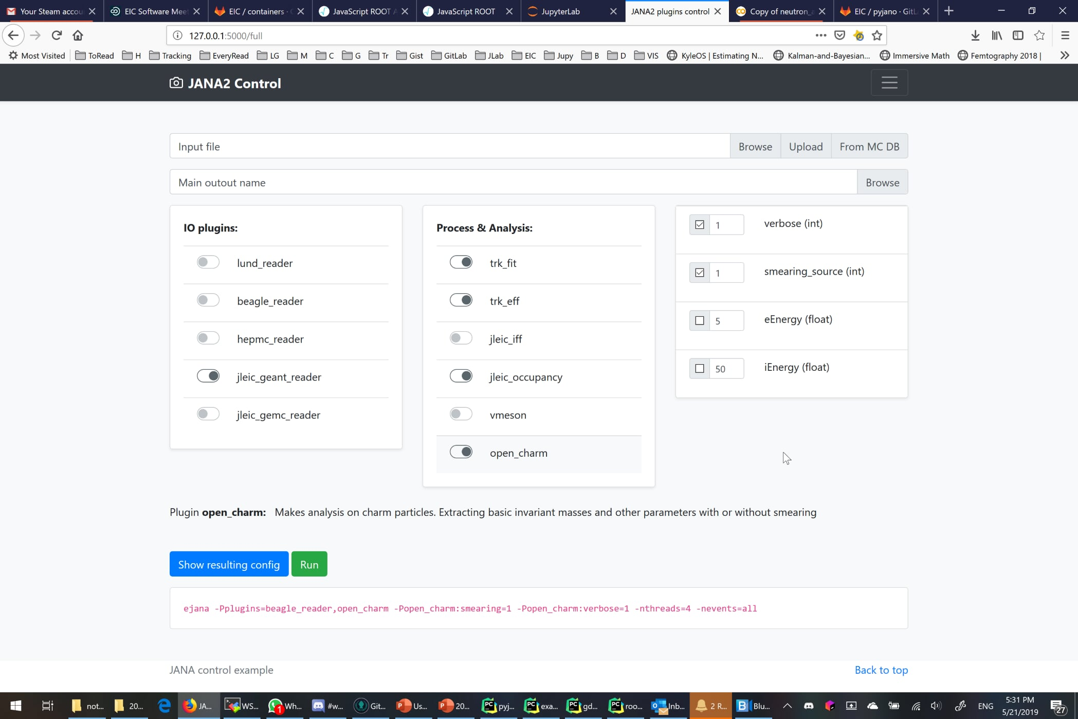
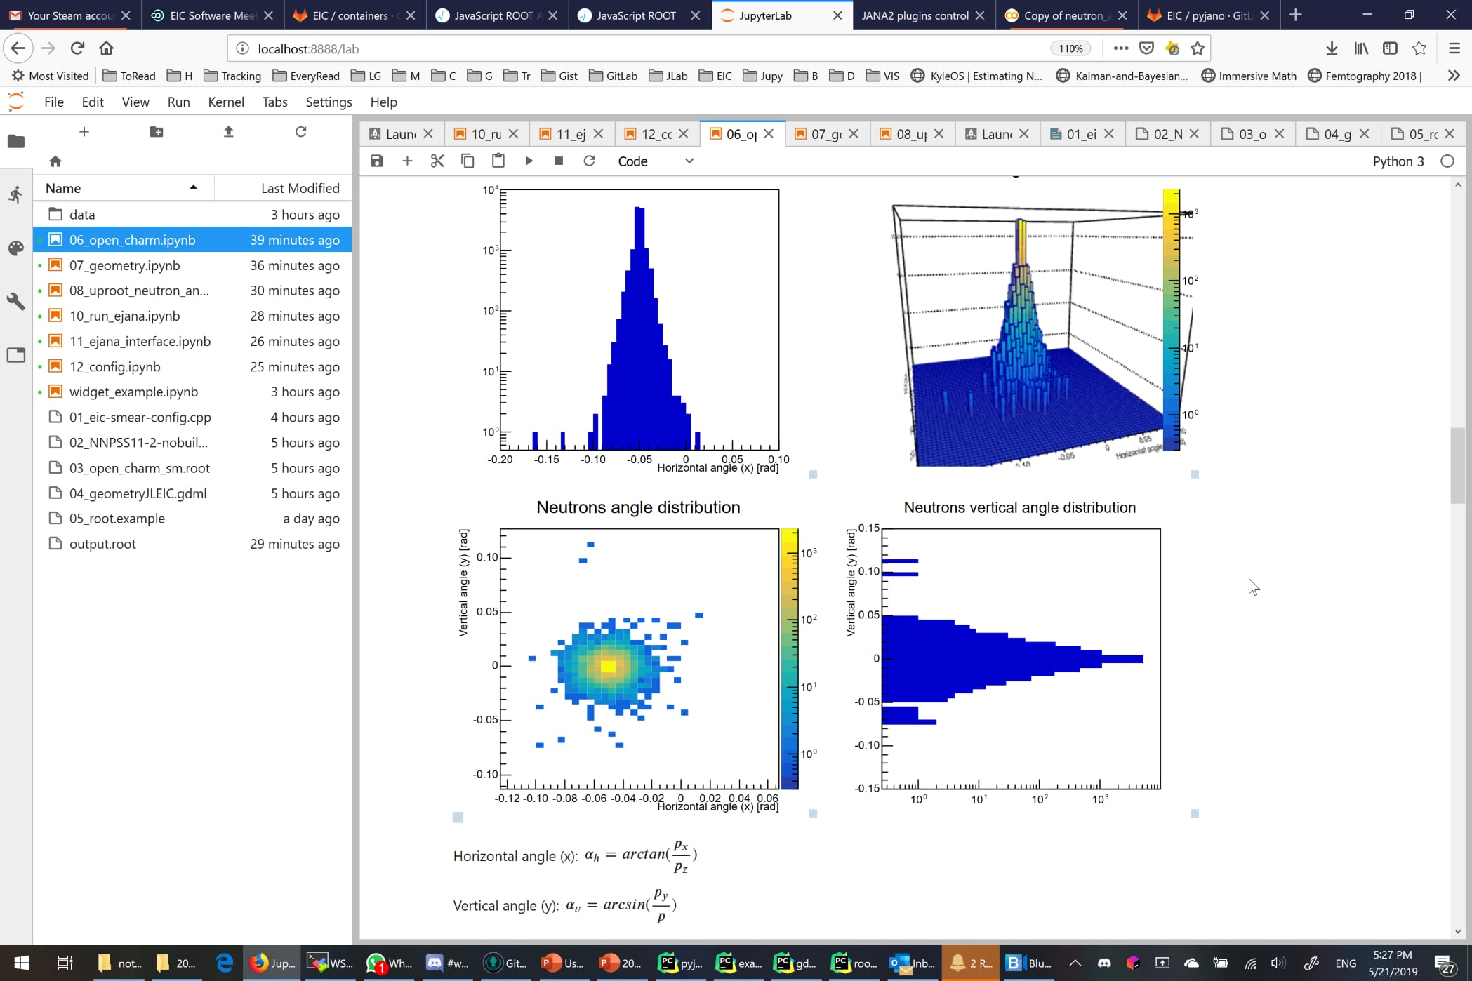
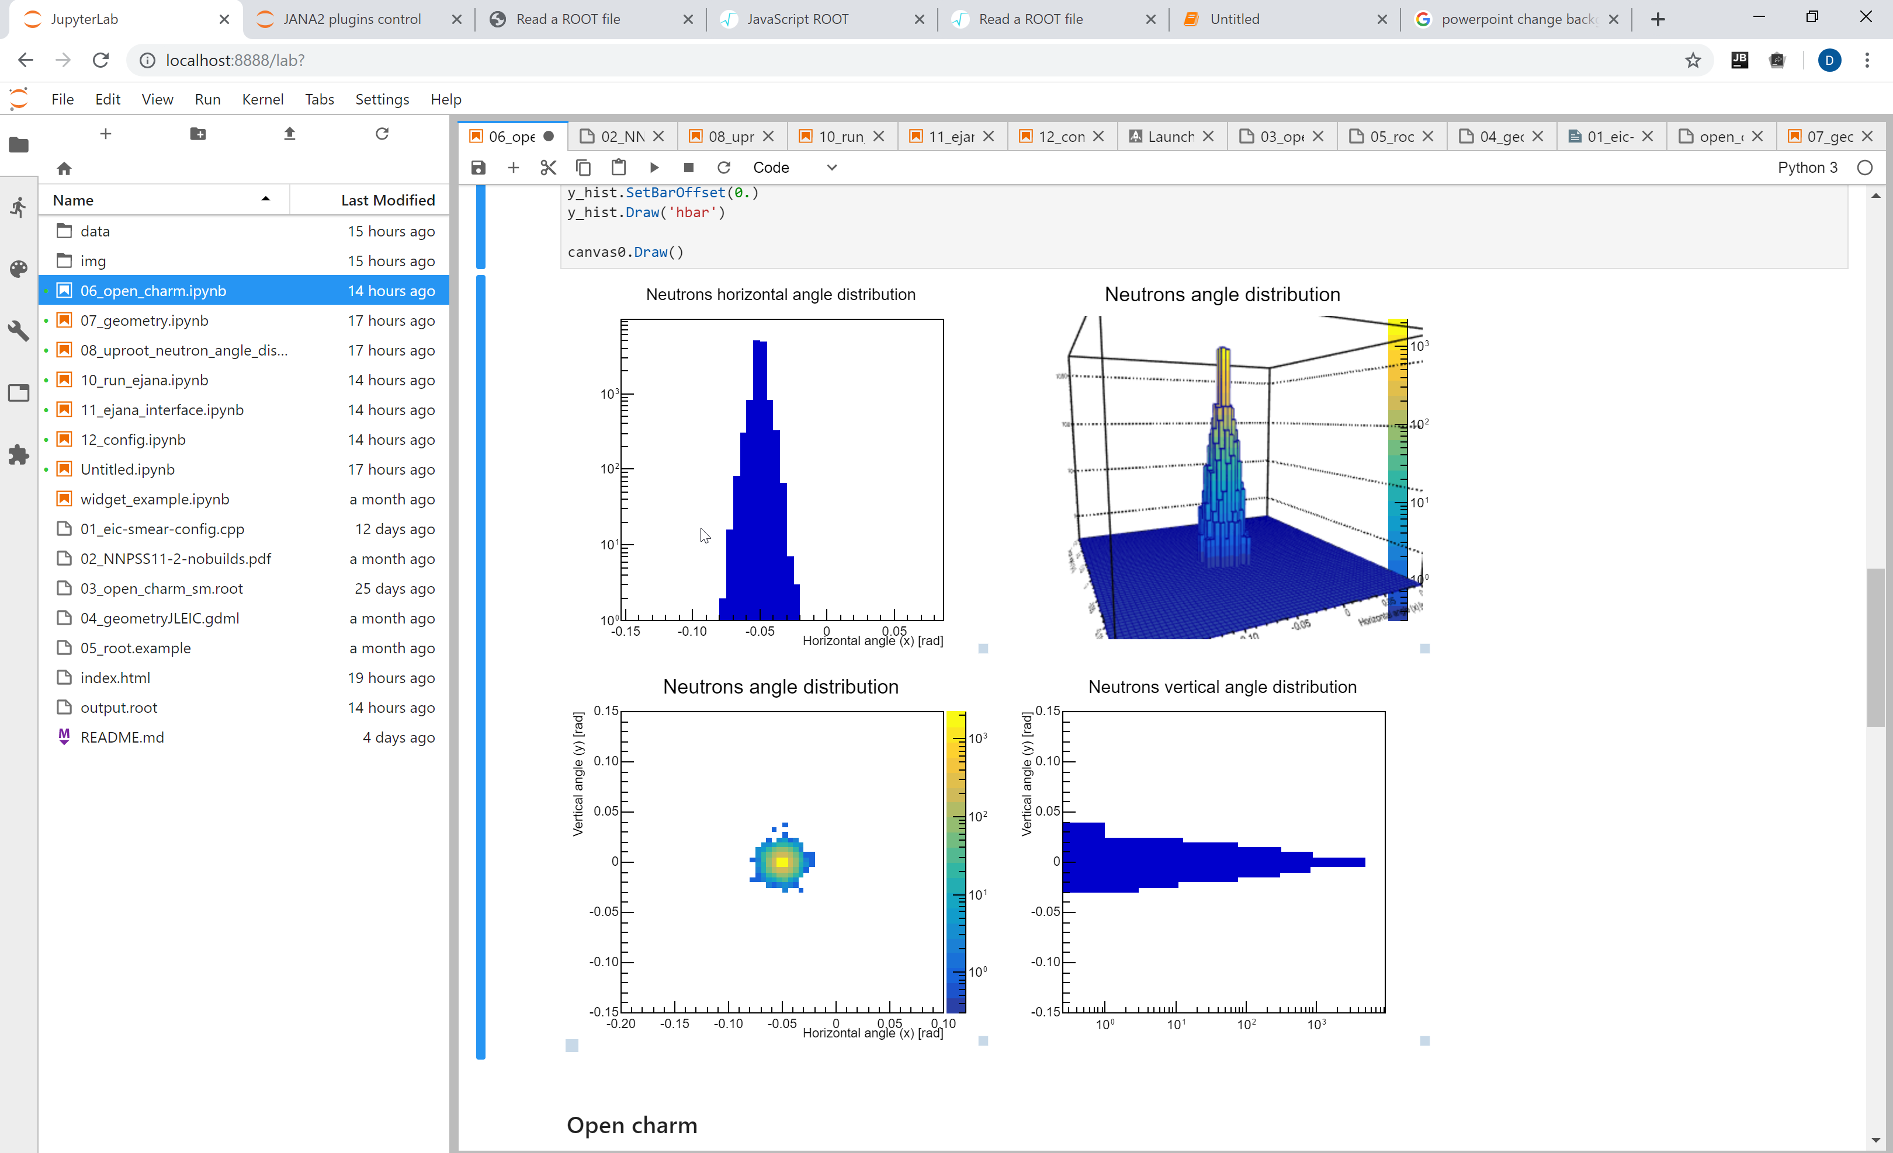
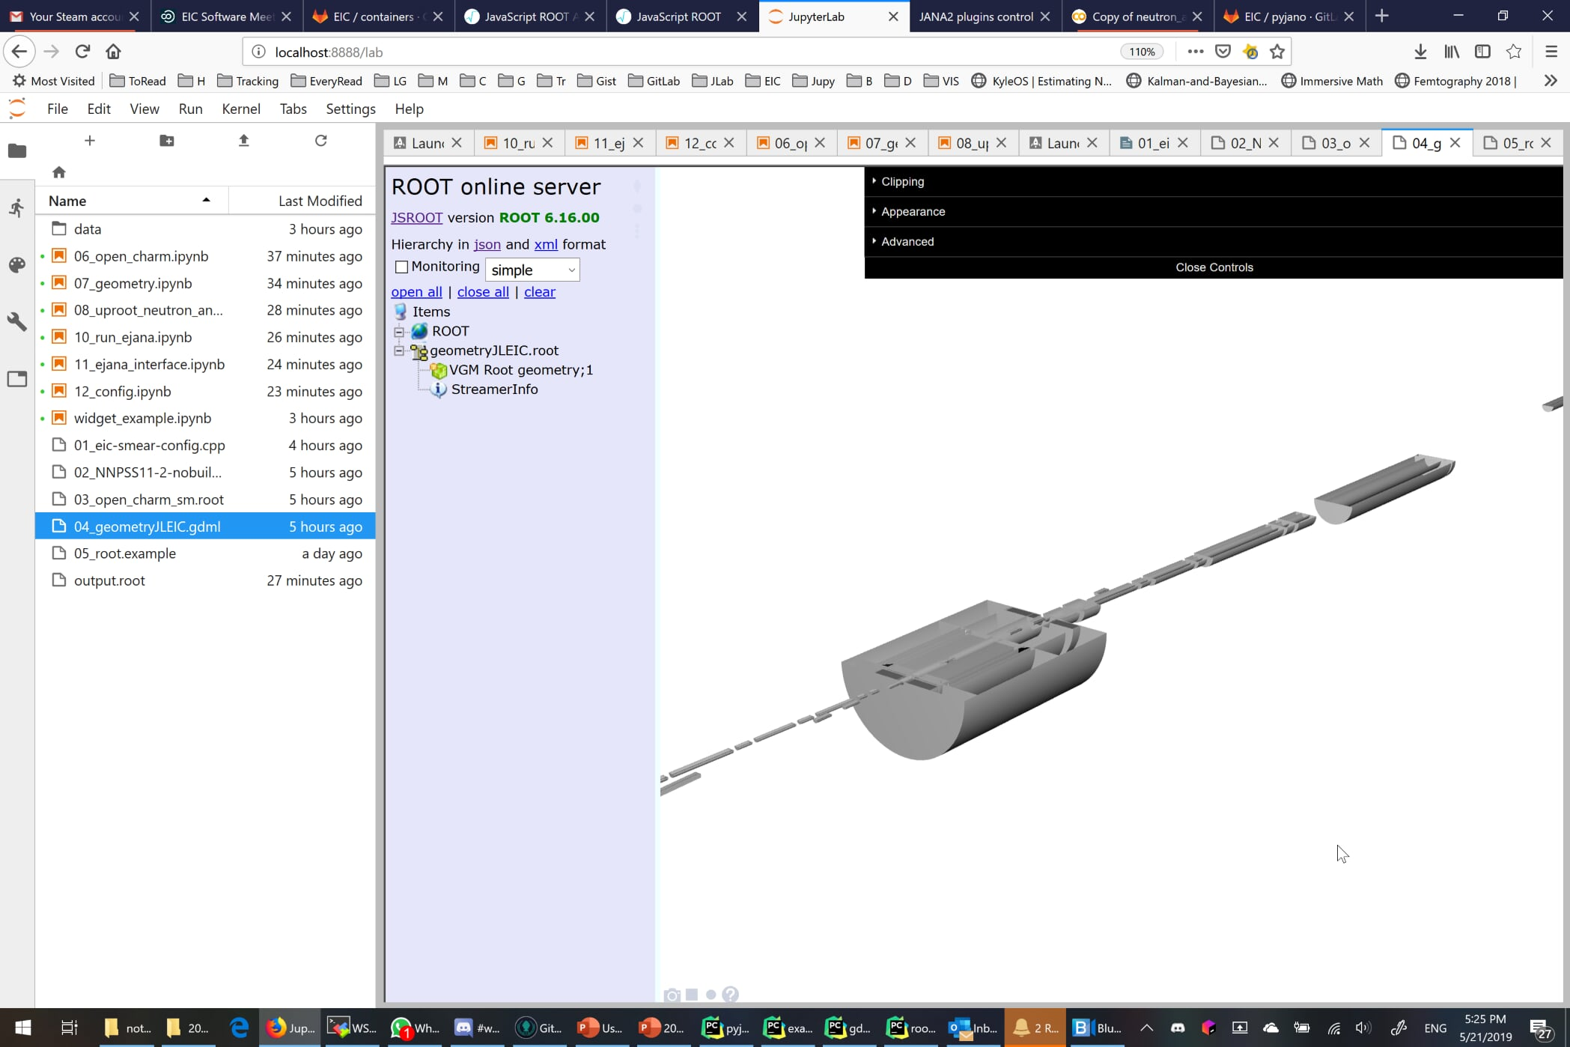
User interface
Workflow oriented interactive environment based on Jupyter
by Dmitry Romanov

Slide 24

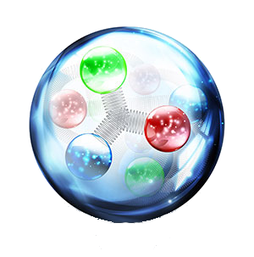
Community reference reconstruction
e^{JANA} - stands for EIC JANA
Basic reconstruction
Physics analysis
Users detector codebase integration
Reconstruction
Tracking - Genfit
Vertex finding – Rave
Physical analysis:
  ROOT C++ or
  Python data science tools
  (Jupyter, Seaborn, Pandas, etc)
Any existing C++ (or even others) code can be:
- compiled as JANA plugin
- run parallelized in eJANA
- accessed by other plugins
EIC jana
by Dmitry Romanov

Slide 25
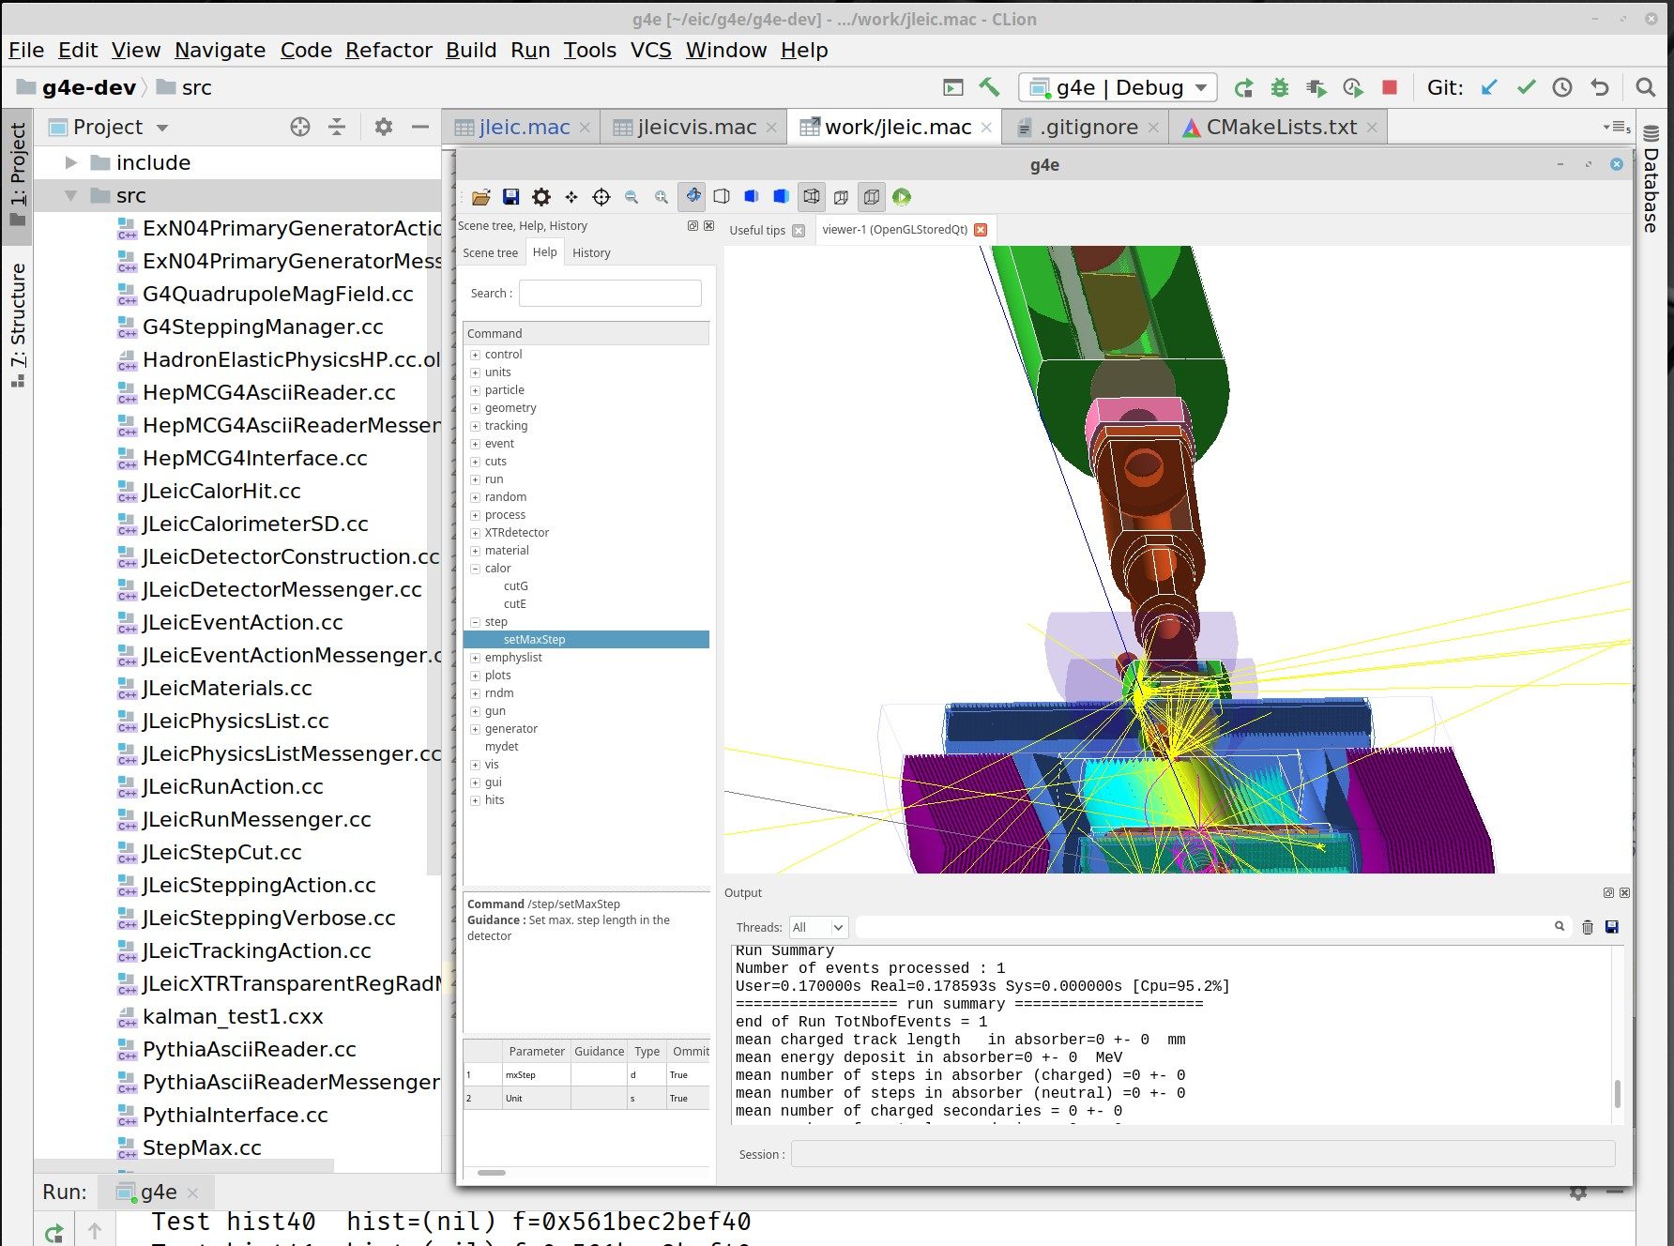
Geant 4 EIC
The codename g4e – stands for Geant 4 EIC
Beta stage
√s 100 GeV design is implemented
Imports CAD, accelerator group data
Exports final Geometry in various formats
Plain flattened analysis ready ROOT files
For those who prefer scripting over compilation
Geant 4 python can be used
by Dmitry Romanov

Slide 26
JANA(2)
Task Queue
parse
Task Queue
thread
analyze
Source
(file)
entangled event task
recon. evnt task
thread
recon. evnt task
thread
entangled event task
recon. evnt task
recon. evnt task
entangled event task
recon. evnt task
recon. evnt task
read
recon. evnt task
thread
JANA2 generalizes the “event” queue to allow multiple queues.
Threads are now responsiible for moving data between queues
Histograms/Trees
(file)
by David Lawrence

Slide 27
JANA(2)
Provide mechanism for many physicists to contribute code to the full reconstruction program
Implement multi-threading efficiently and external to contributed code
Provide common mechanisms for accessing job configuration parameters, calibration constants, etc...
by David Lawrence

Slide 28
 | Analysis / Event Reconstruction
dRICH
mRICH
DIRC
psTOF
general: standalone c++ and ROOT
Input: GEMC root file and Fun4All root file, others can be supported
Algorithm: Inverse Ray Tracing algorithm in c++ class
Future: easy integration for any c++ based framework
general: standalone c++ and ROOT
Input: GEMC root file, others can be supported
Algorithm: Hough Transform Algorithm in c++ for simple study
Likelihood Analysis in c++ for real experiments
Future: easy integration for any c++ based framework
general: standalone c++ and ROOT
Input: customized root file, others can be supported
Algorithm: geometrical reconstruction, time-based imaging
Future: easy integration for any c++ based framework
general: standalone c++ and ROOT
Input: Fun4All root file, others can be supported
Algorithm: Time reconstruction parametrized from data, path-length using
Runge-Kutta in a Kalman-Filter track fit in c++
Future: easy integration for any C++ based framework

Slide 29
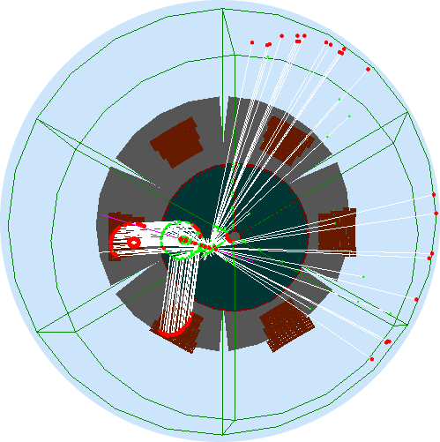
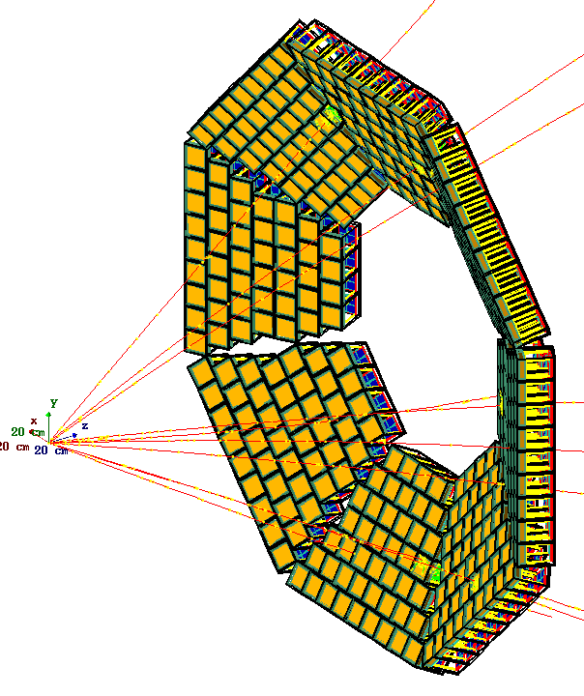
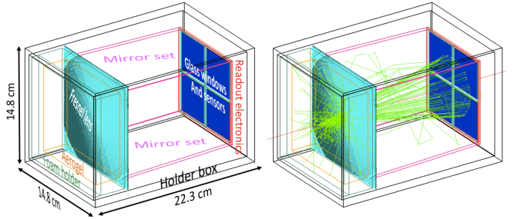
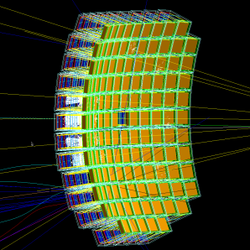
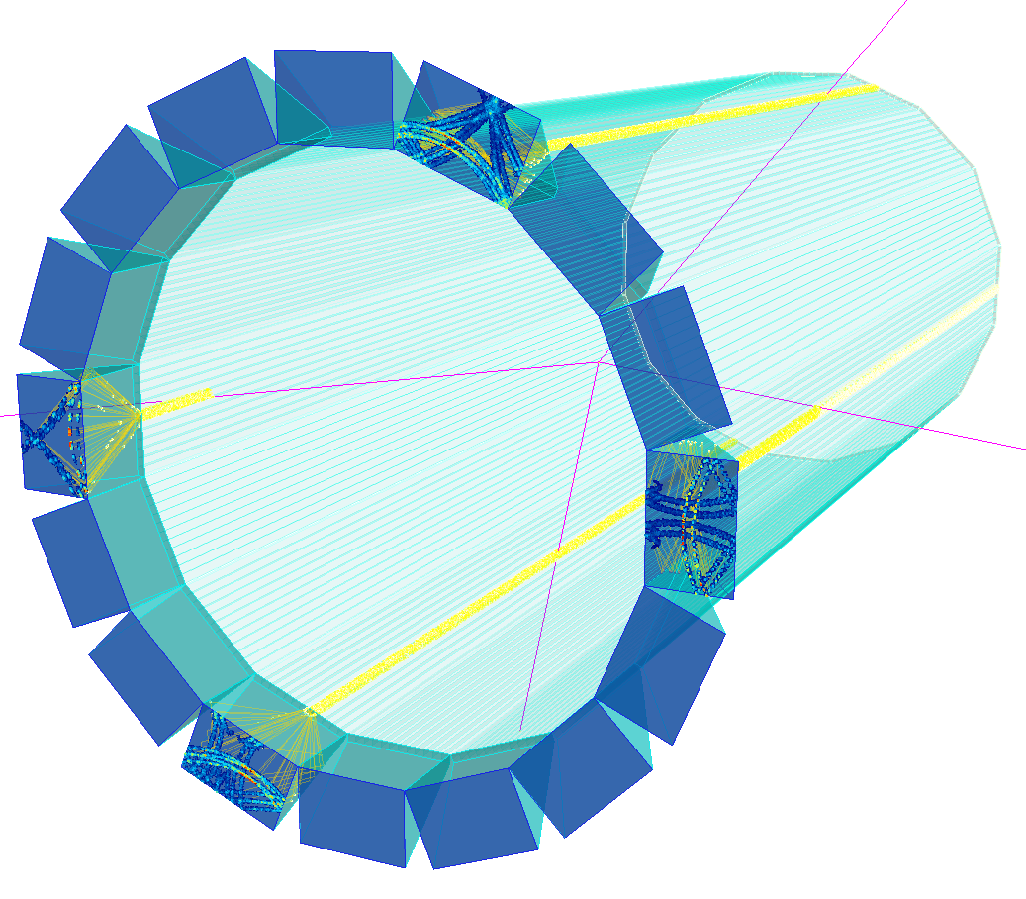
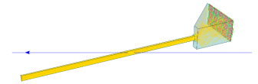
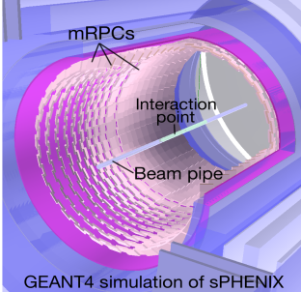
 | Simulation
 | Generic Geant4 | GEMC | Fun4all | eicROOT
dRICH |  |  | planned
mRICH |  |  |  | in progress
DIRC |  | planned | planned | straightforward (from FairROOT)
psTOF
for JLEIC and PHENIX
for JLEIC
single module
for sPHENIX
Full setup
prototype
for sPHENIX

Slide 30
Conclusions
Some “tracking for PID” tools do exist: help yourself & use them (or ask experts to provide the tracking estimates)
Write & contribute your own detector component codes ...
... but be aware that EIC software paradigm may change in the near future
Momentum resolution
Calorimeters

Slide 31
Backup

Slide 32

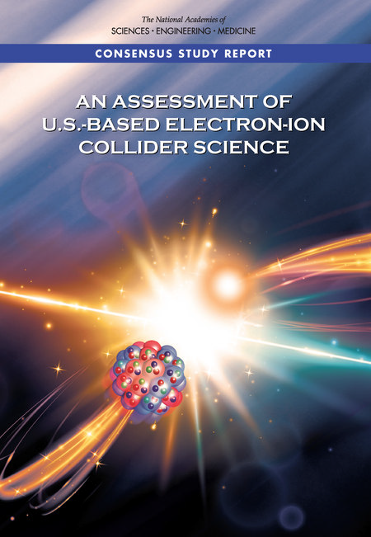
EIC timelines
2015 NSAC (NP) Long-Range Plan:
“We recommend a high-energy high-luminosity polarized EIC as the highest priority for new facility construction.”
2018 NAS review:
“The committee finds that the science that can be addressed by an EIC is compelling, fundamental and timely.”
President’s budget request for FY2020:
Critical Decision-0, Approve Mission Need, is planned for FY2019

Slide 33
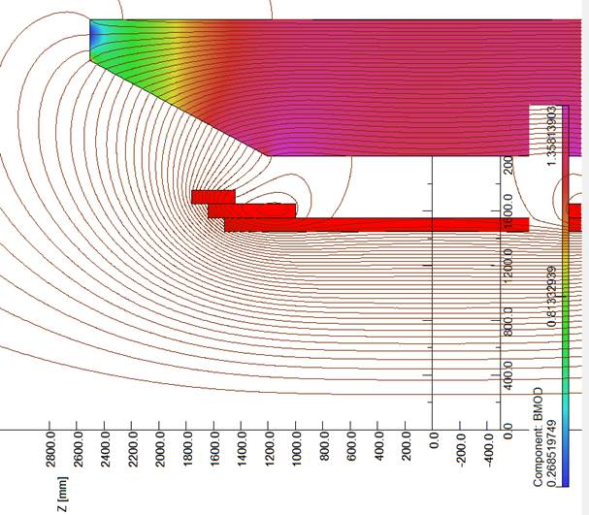
Main detector magnet
Prefer open solenoid with a large (3T) field:
ideal for a TPC
sufficient B*dl integral at |η| ~ 3.0..3.5
almost azimuthally-symmetric acceptance
minimal adverse effect on the electron beam
no passive material in the acceptance
However:
too high low-momentum particle cutoff
large inhomogeneous fringe field ...
... causing severe problems for the gaseous RICH ...
... which one can try to mitigate by shaping up the field
large stray fields, which may require clamping ...
... therefore causing field degradation in the RICH ...
... and large asymmetric forces on the support system
photo-sensors do not like magnetic field in general ...
... and there is a huge difference between say LAPPD performance in 1.5T and 3.0T magnetic field ...
... but modern MCPs with <10μm pores may work well?
η = 1.0
η = 1.5
RICH
location
TPC volume
η = 3.5
Expected magnetic field effect: ~1mrad
is “bearable”

