Slide 1
Particle identification at an EIC
- Why is it so important?
Pawel Nadel-Turonski
Stony Brook University
EIC PID workshop, CFNS, Stony Brook University, July 9-10, 2019.

Slide 2
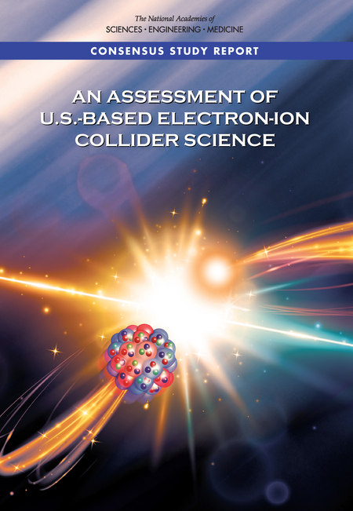

The EIC in the 2015 NSAC LRP and the recent NAS review
arXiv:1212.1701
(2012)
NSAC: “We recommend a high-energy high-luminosity polarized EIC as the highest priority for new facility construction following the completion of FRIB.”
NAS: “The committee unanimously finds that the science that can be addressed by an EIC is compelling, fundamental, and timely.”

Slide 3
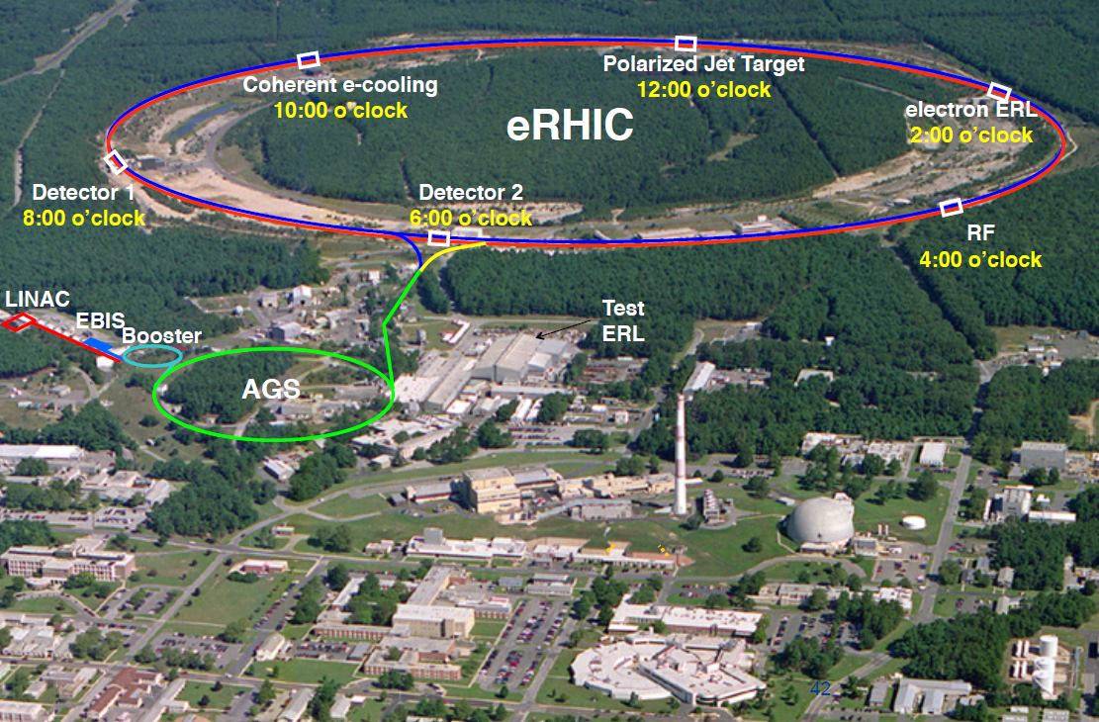
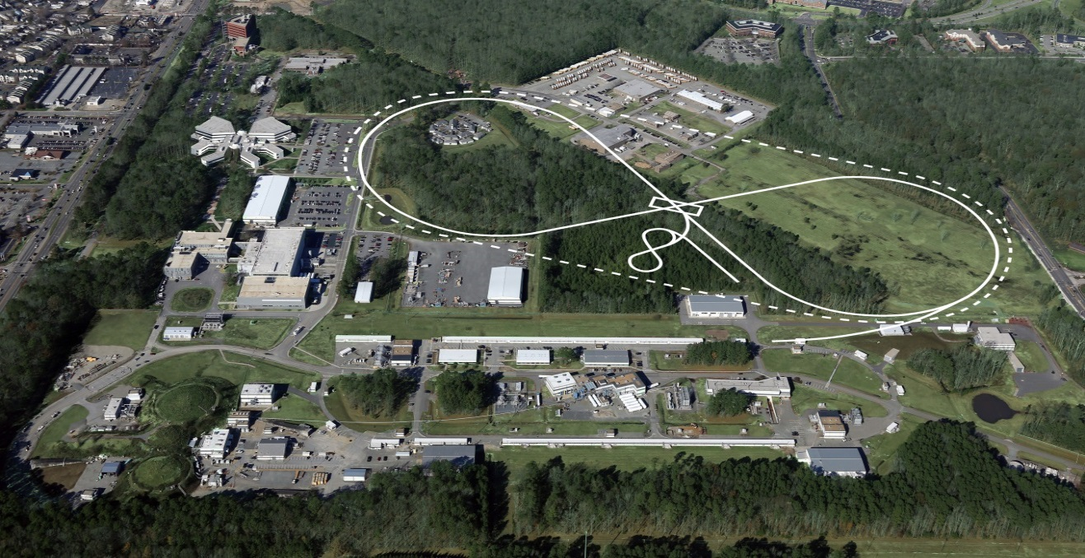
Proposed EIC implementations at JLab and BNL
BNL EIC at RHIC (eRHIC)
18 GeV e (10 GeV lumi max) on 275 GeV p
Parameters are similar
12 GeV e (5 GeV lumi max) on 200 GeV p
JLab EIC (JLEIC)
JLEIC
Both concepts support 2 detectors
CEBAF (0.9 mile racetrack)

Slide 4
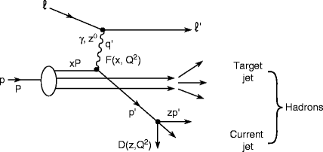
What do we measure?
Current jet (or hadron)
Scattered electron
Lepton scattering on a proton
p/A
e
Target fragments
Inclusive DIS: only electron is detected
Semi-Inclusive DIS (SIDIS): electron and current jet (hadron) are detected.
Exclusive reactions: all particles are detected

Slide 5
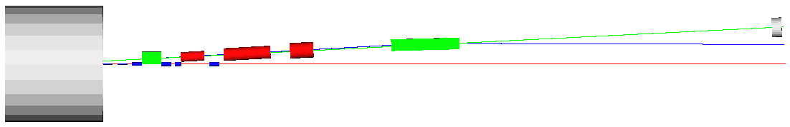
Detection of target fragments
”near” detection
”far” detection
Analyzing dipoles (green) and accelerator quadrupoles (red)
high-res. ZDC
(n, γ)
Detection space
p/A
solenoid
Forward hadron spectrometer
e
Spectator protons
Recoil protons (roman pots at focal point with high dispersion
A large part of the EIC program relies on detecting recoil baryons and target fragments
  Spatial imaging through exclusive meson/photon production on the proton, and in coherent diffraction on nuclei
  Neutron structure through spectator tagging in light nuclei
  Various incoherent processes on heavy nuclei, including SRC and EMC studies
Forward detection requirements for the EIC are very demanding
  Need to detect particles very near the beam (down to p_{T} = 0 for dp/p > 1%)
  Need to detect protons with p_{T} up to at least 1 GeV/c and spectators with A/Z very different from that of the beam (e.g., spectator protons from deuterium)
  Need excellent momentum resolution, detection of neutrals, and PID for ions

Slide 6
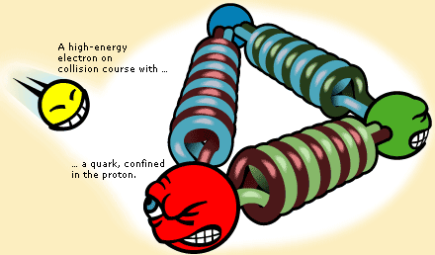
Electron scattering: x, t, and Q²
Q² is the (four-)momentum transfer from the electron, and is a measure of the resolving power of the probe.
t is the (four-)momentum transfer to the nucleon.
In elastic scattering, t and Q² are equivalent.
photon
x is the fraction of the nucleon momentum carried by the struck quark in a frame where the nucleon is moving quickly. With 3 quarks, one would naively expect x = 1/3.
photon
1
p
2
3
Reaching smaller values of x requires higher energy!
x = p₁ / p_{proton}
x = Q² / sy

Slide 7
Inclusive DIS: Momentum distributions of quarks and gluons
small probe
Gluons saturate?
large probe
photon
many gluons
few gluons
1
Parton Distribution Functions (PDFs) tell us about the densities of quarks and gluons inside the proton as function of their momentum (fraction) x.
To reach saturation at the lowest x, the inelasticity y needs to be large (~1), producing low-energy scattered electrons in the lab frame.
p
2
3
x = p₁ / p_{proton}
x = Q² / sy
mRiCH & DIRC eID

Slide 8
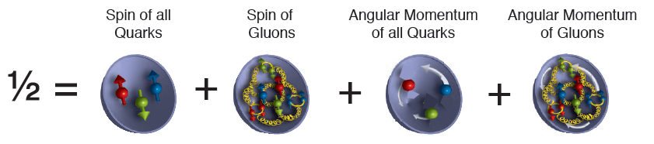
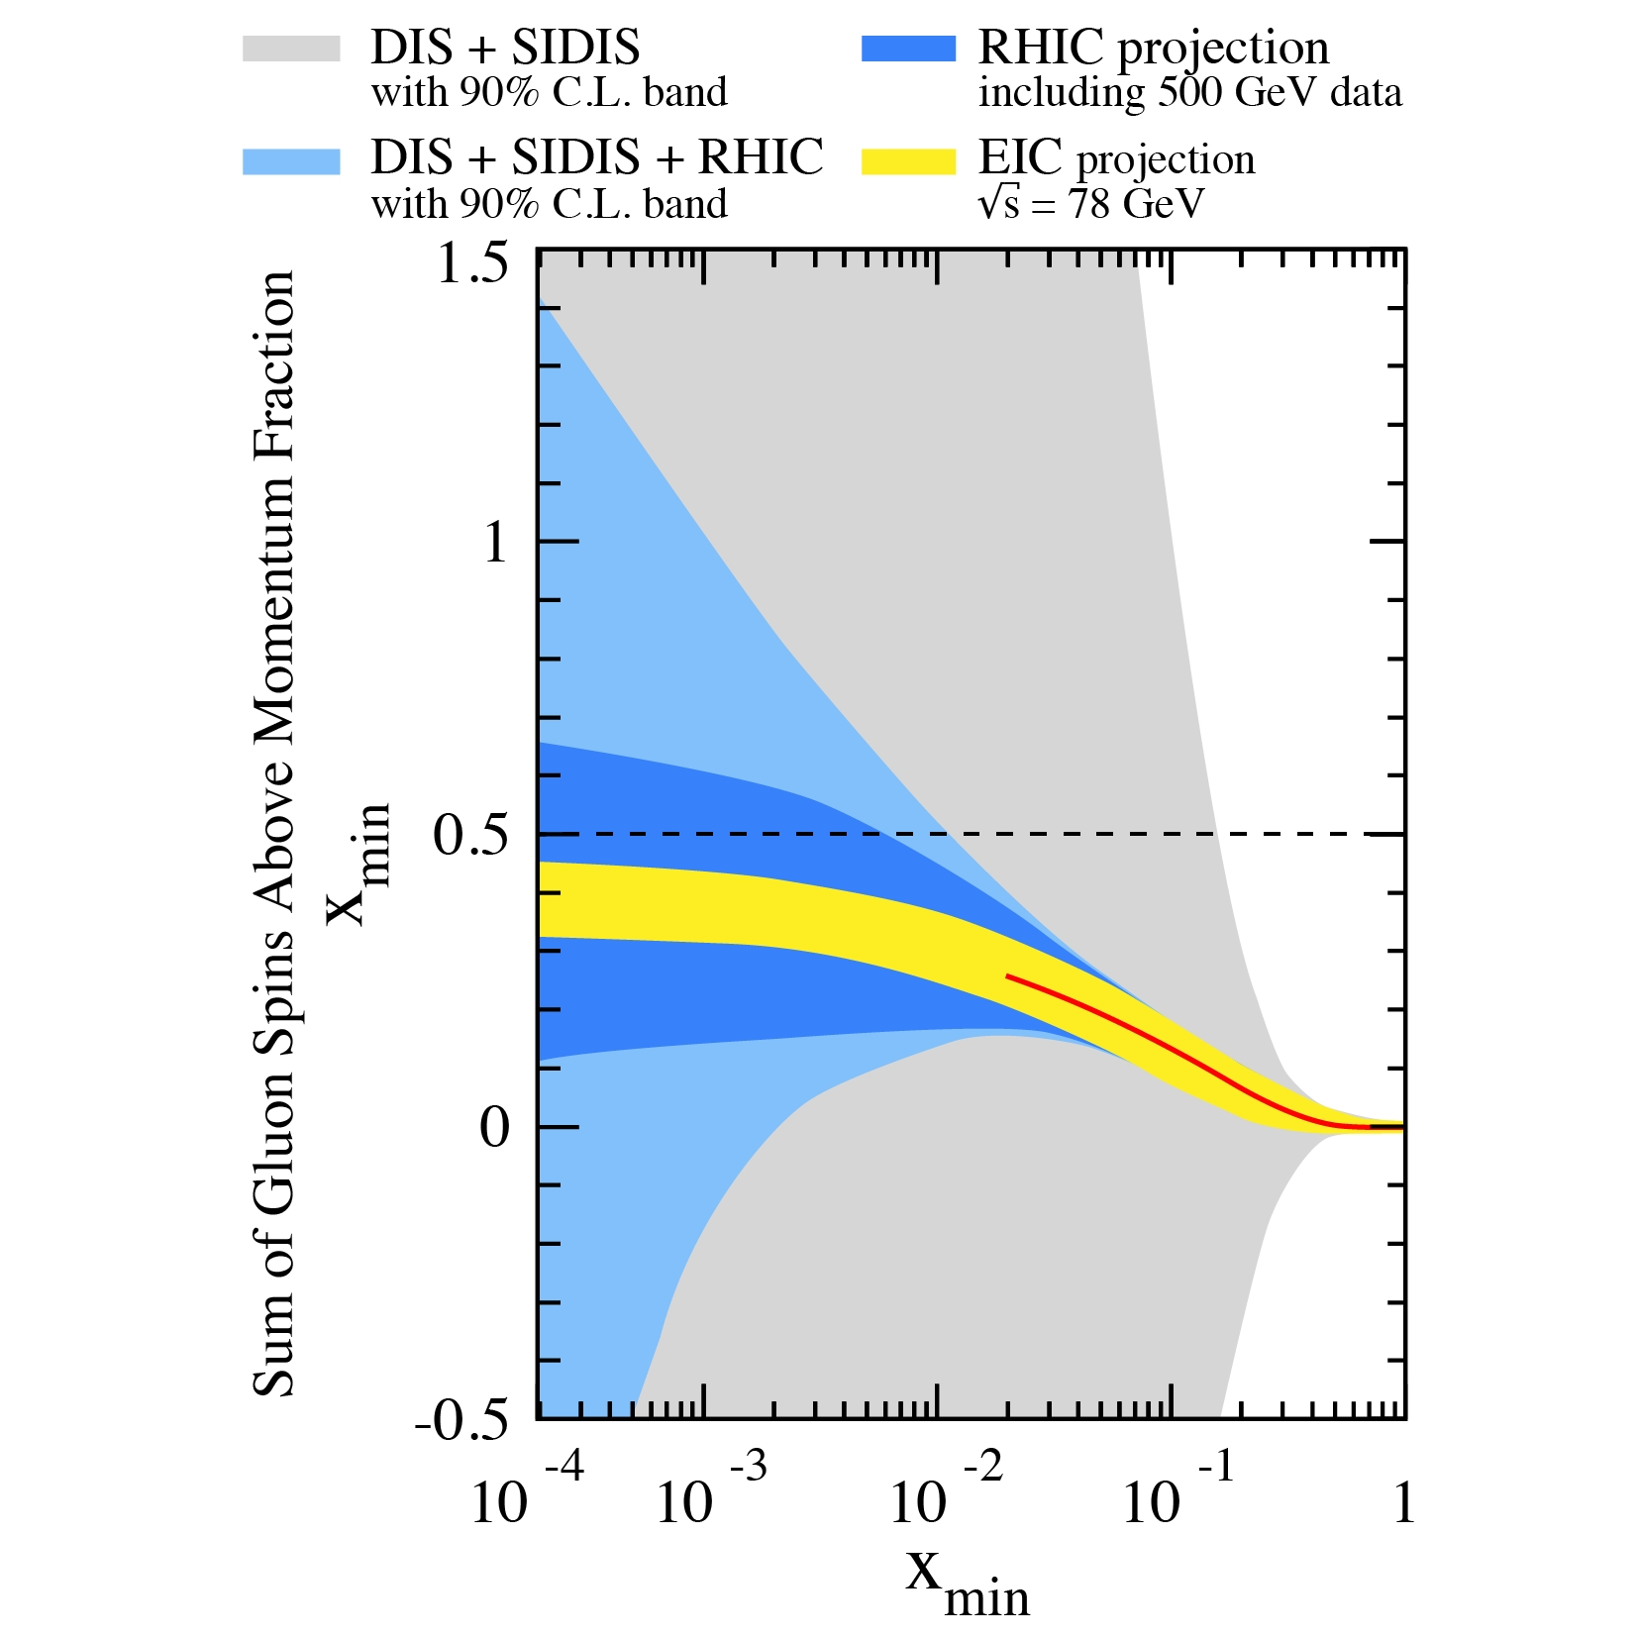
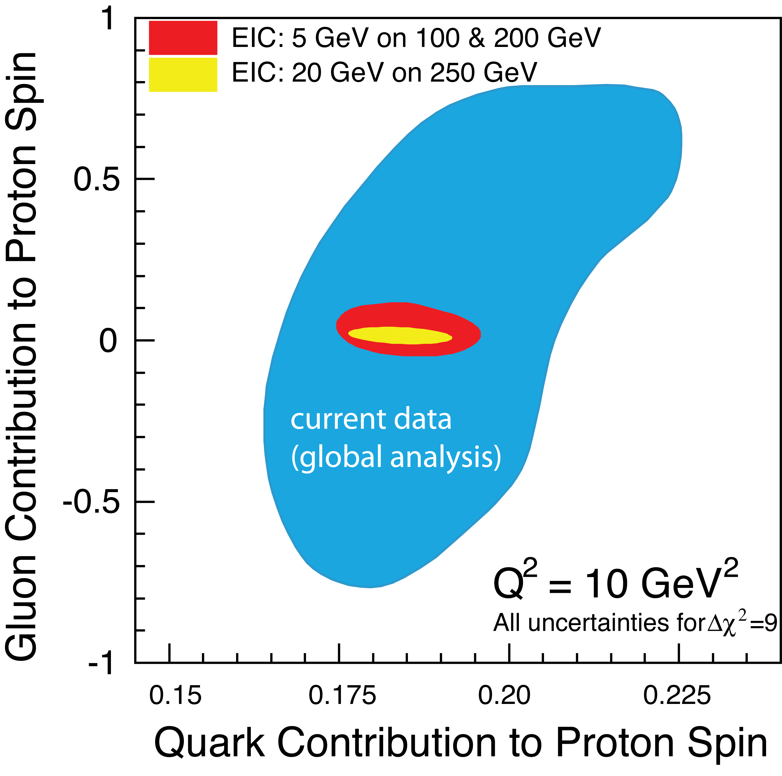
Inclusive DIS: Gluon polarization
(ΔΣ/2)
(ΔG)
(ΔG)
Uncertainty
(ΔΣ/2)
Large uncertainties at low x require input from the EIC in addition to RHIC spin

Slide 9
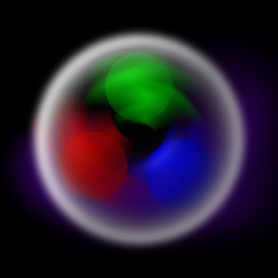
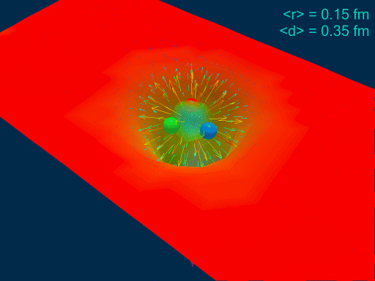
Exclusive: spatial structure of nucleons
300 MeV constituent quarks
Few-MeV QCD current quarks
Understanding the spatial structure of nucleons and nuclei is a key goal of the EIC
For instance, do the gluons form “clouds” around the quarks, or are they mostly in-between?
The transverse spatial structure can be probed through exclusive diffractive processes

Slide 10
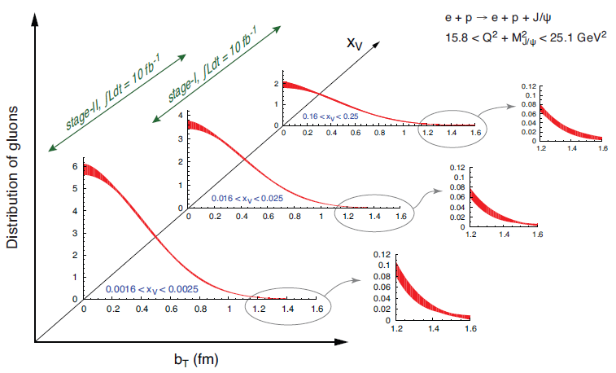
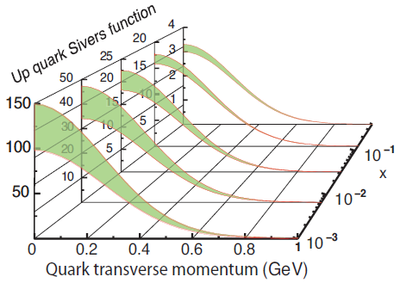
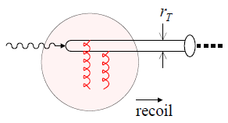
3D imaging the nucleon and light nuclei in coordinate and momentum space
GPDs (exclusive)
TMDs (SIDIS)
2+1 D picture in impact-parameter space
2+1 D picture in momentum space
Transverse gluon distribution from J/ψ production
γ
Projections from EIC white paper
J/ψ
Decays into leptons dRiCH eID

Slide 11
2D spatial gluon imaging in heavy nuclei through coherent diffraction
Fragment detection and ID important for efficient veto
Important input for the initial state in heavy ion collisions
Sensitivity to gluon saturation

Slide 12
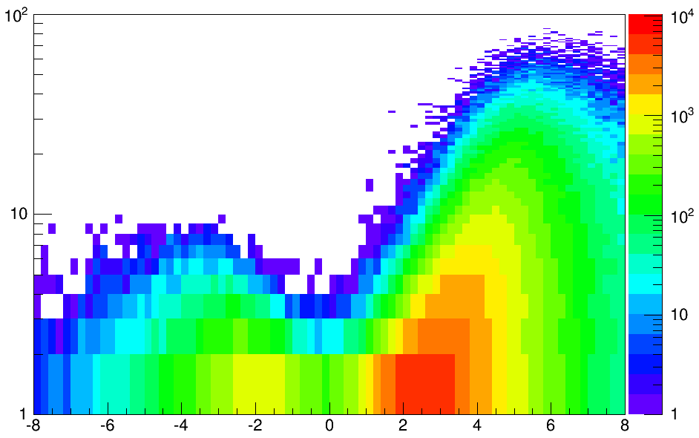
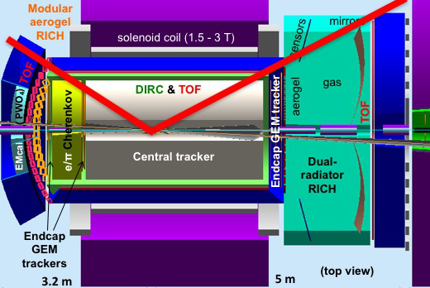
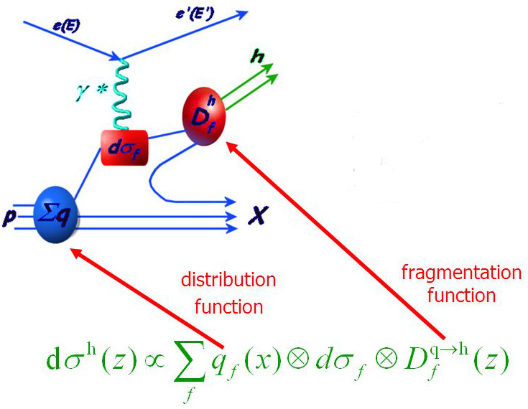
PID for the EIC
(SIDIS shown)
e
p/A
GeV
10x100 GeV
Q² > 1 GeV²
h-endcap
barrel
Semi-Inclusive DIS (SIDIS)
e-endcap
Dual-radiator RICH
DIRC
Aerogel RICH
rapidity
h could also be a jet
Particle ID is an essential capability required for the EIC physics program
  also beyond SIDIS and open charm
Imaging Cherenkov detectors are the primary technology
  Photosensors and electronics are also key R&D areas for the consortium

Slide 13
Hadron kinematics at an EIC
C. Hyde
DIRC hID
e
p/A
GeV
10x100 GeV
Q² > 1 GeV²
h-endcap
The maximum hadron momentum in the endcaps is close to the electron and ion beam energies, respectively.
The momentum coverage need in the central barrel depends on the desired kinematic reach, in particular in Q² – important for QCD evolution, etc.
  Weak dependence on beam energies
barrel
e-endcap
Dual-radiator RICH
DIRC
Aerogel RICH
rapidity

Slide 14
Two existing 1.5 T solenoids – both ideal for the EIC
The solenoids also have identical dimensions: 4 m long and 3 m diameter
The Babar solenoid is now at BNL for use in the sPHENIX detector, which would be available from the beginning of EIC operations.
The CLEO solenoid is now at JLab for use in the SoLID detector. It will be available upon completion of the SoLID program.

Slide 15
EIC central detector
p/A
e
BaBar: EIC-sPHENIX (2018)
CLEO: JLab (2015)
Need 4pi acceptance to catch the electron and the hadron(s) from the struck parton (and the target at very small angles).
Low multiplicities mean that tracking and particle identification (also for electrons) are essential
  Hadronic calorimetry is important on the (outgoing) hadron endcap
Doubly asymmetric design makes more efficient use of available space
  IP is shifted within the solenoid and the solenoid within the IR
Very asymmetric collisions lead to very different requirements in different parts of the detector.

Slide 16
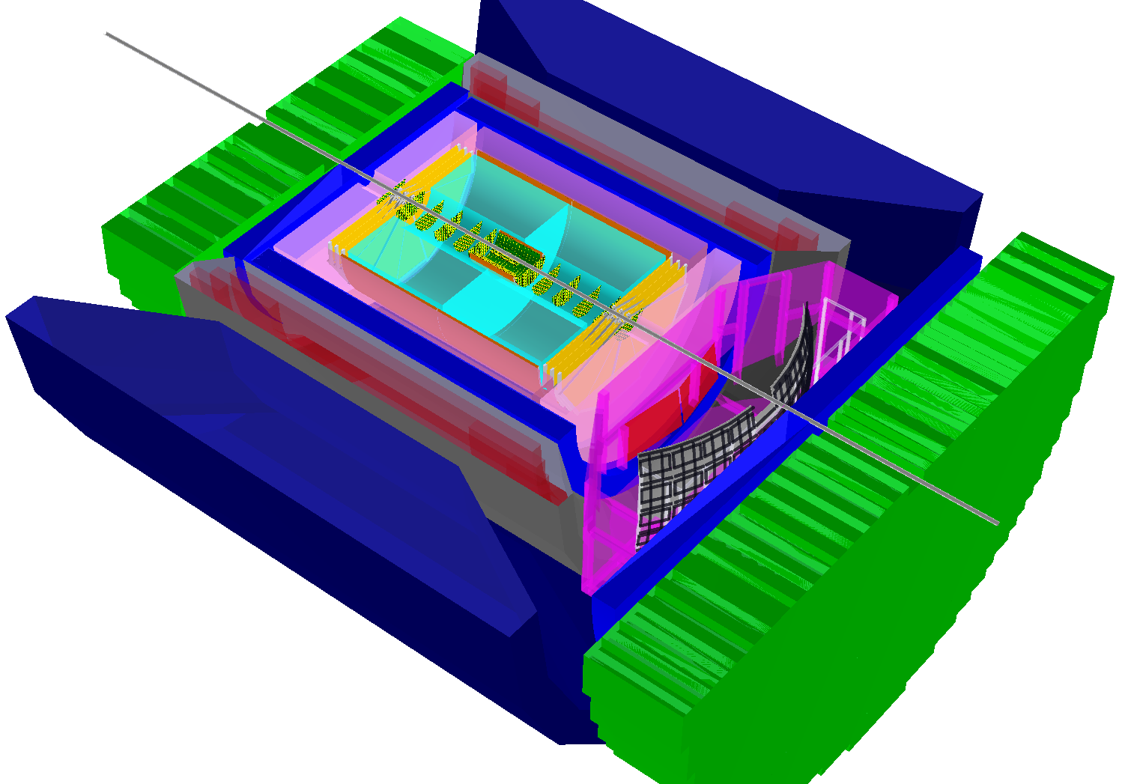
BNL BeAST detector concept
Post-2016
Pre-2016
The original BeAST was a very different, completely symmetric detector using a new, small 3 T solenoid
Today, BeAST looks much more similar to the JLab and sPHENIX detectors, and has room for all the PID systems developed in the EIC R&D program. The 3 T field could easily be changed to 1.5 T.
In the future, two central detectors based on BaBar and CLEO could share features of all three concepts.

Slide 17
A PID solution for the EIC central detector (eRD14)
e
p/A
h-endcap
h-endcap: A RICH with two radiators (gas + aerogel) is needed for
  π/K separation up to ~50 GeV/c
e-endcap: A compact aerogel RICH which can be projective
  π/K separation up to ~10 GeV/c
barrel: A high-performance DIRC provides a compact and cost-effective way to cover the area.
    π/K separation up to ~6-7 GeV/c
TOF and/or dE/dx in a TPC: can cover lower momenta.
Photosensors and electronics: need to match the requirements of the new generation devices being developed – both for the final system and during the R&D phase
GeV
10x100 GeV
Q² > 1 GeV²
barrel
e-endcap
Dual-radiator RICH
DIRC
Aerogel RICH
rapidity

Slide 18
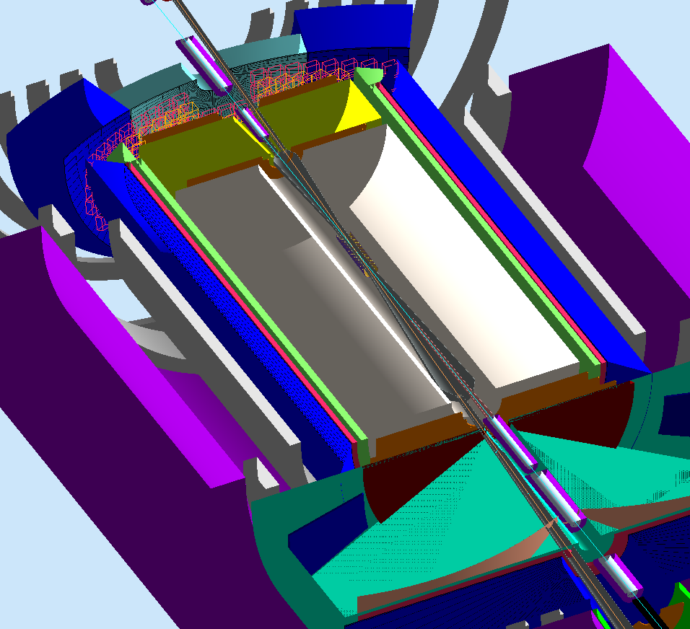
PID in the JLab/BNL EIC detector concepts
All Cherenkov detectors developed by the PID consortium (DIRC, mRICH, dRICH) are the baseline options for the three detector concepts developed at JLab and BNL
  Only exception is EIC-sPHENIX which has a gas-only RICH
Modular aerogel RICH
EMcal
PWO₄
DIRC camera
BeAST (2016)
JLab (2015)
e/π Cherenkov
TOF
EIC-sPHENIX (2018)
EMcal
DIRC & TOF
Vertex (Si pixel)
Central tracker
Solenoid coil
tracker
aerogel
gas
Dual-radiator RICH
EMcal

Slide 19
New opportunities: Rare isotopes at an EIC

Slide 20
Importance for astrophysics
All elements heavier than iron (the most tightly bound nucleus) have been created in stellar events like supernovae
The most important mechanism is the rapid neutron capture (r-process) in equilibrium with beta-decay
The drip-line difficult to reach on the neutron-rich side, which means that “all” produced isotopes are bound.

Slide 21
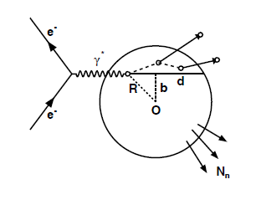
Deep Inelastic Scattering on nuclei
DIS on nuclei is a multi-stage process.
First, there is a scattering on a parton
Debris from the interaction will propagate out of the nucleus, interacting along the way, causing an intra-nuclear cascade typically leading to the knock-out of several nucleons
The daughter nucleus will usually be left in an excited state, leading to evaporation of nucleons and light nuclei, and sometimes fission.
At high excitation energies there is no strong preference for emitting charged particles or neutrons, but at low energy neutrons are preferred.
Finally, when below the nucleon separation energy, the nucleus will emit photons. These transitions between bound states offer detailed insight into the structure of the produced nucleus.

Slide 22
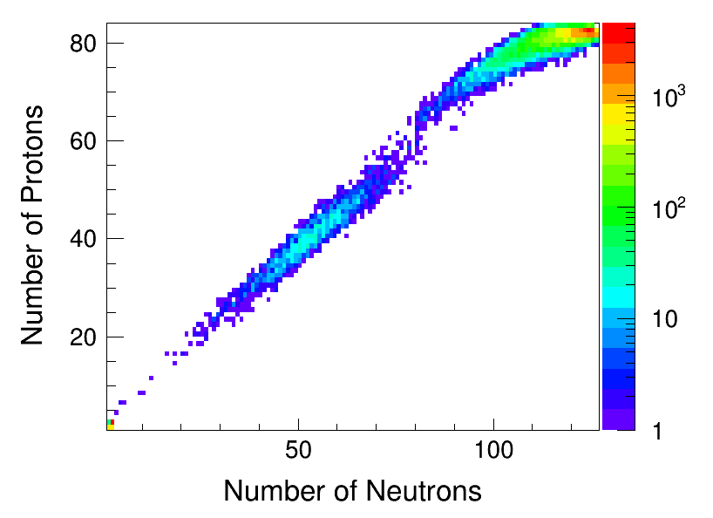
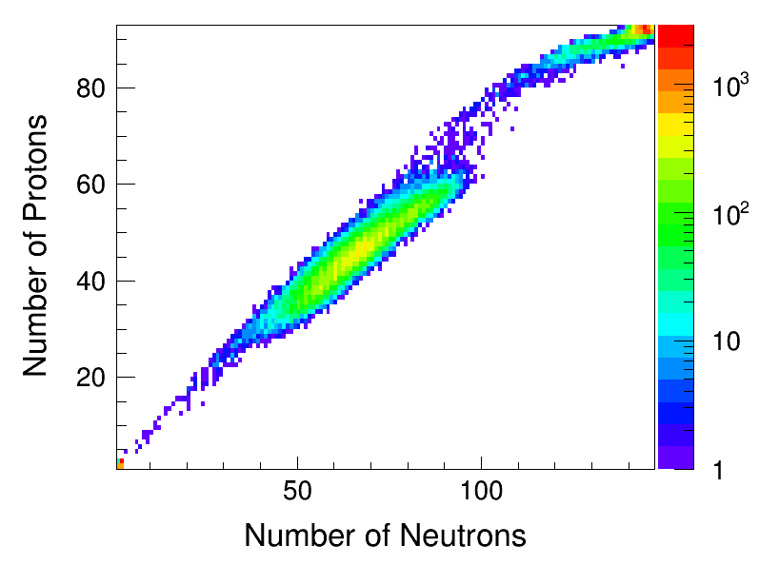
Nuclei from ²⁰⁸Pb and ²³⁸U (1s of simulated beam time)
cascade + evaporation
Neutron-rich fission fragments
fission
²⁰⁸Pb
²³⁸U
²⁰⁸Pb (left) produces mainly heavy isotopes from evaporation
²³⁸U (right) produces fewer, but heavier isotopes from evaporation. It also produces very neutron-rich fission fragments (medium-mass nuclei have fewer neutrons).

Slide 23
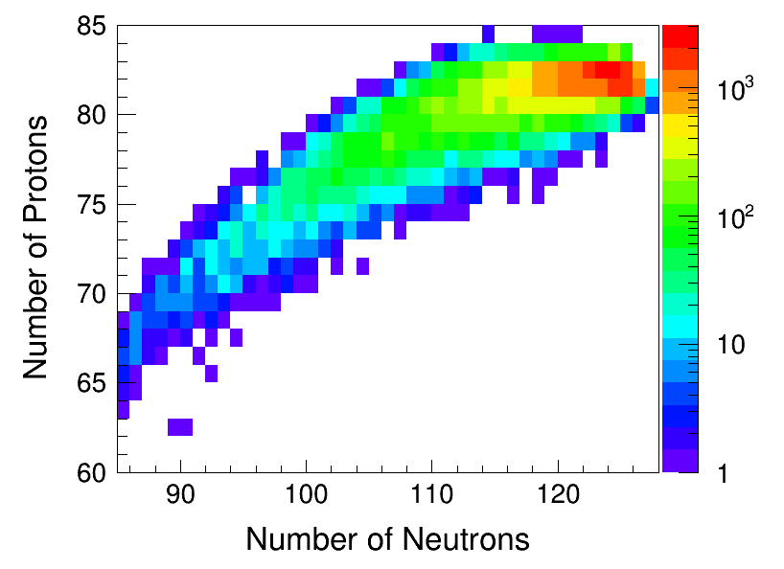
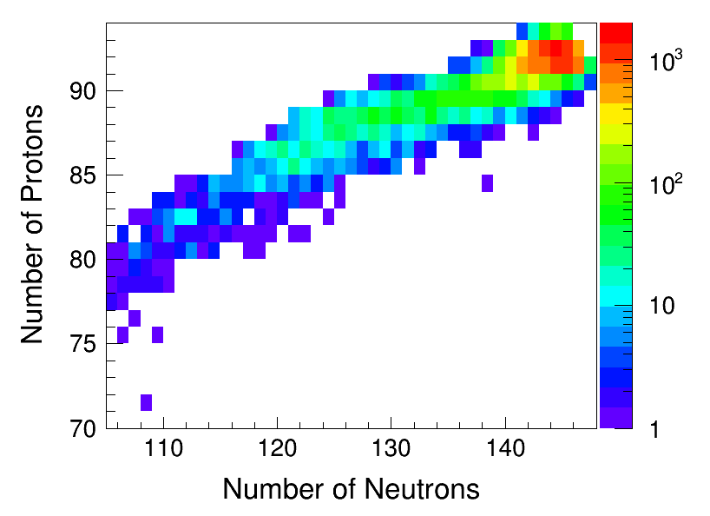
Nuclei from ²⁰⁸Pb and ²³⁸U (1s of simulated beam time)
U-238
Pb-208
Pa-219
Tl-195
Rn-202
Fr-229
Os-194
(stable)
Ir-201
Po-222
²⁰⁸Pb
²³⁸U
Lu-180
²⁰⁸Pb (left) produces mainly heavy isotopes from evaporation
²³⁸U (right) produces fewer, but heavier isotopes from evaporation. It also produces very neutron-rich fission fragments (medium-mass nuclei have fewer neutrons).

Slide 24
How does this compare with FRIB?
With very large uncertainties, a year of heavy-ion running at the EIC should make it possible to probe parts of the neutron-rich red area on the right where FRIB plans to measure half lives.
It will also at the same time provide information on proton-rich isotopes

Slide 25
Detection and identification of the produced nuclei
(n, γ)
“near” detection
“far” detection
high-res. ZDC
A
solenoid
Forward hadron spectrometer
e
Spectator protons
Recoil protons and heavy ions
Detection of nuclei with rigidities (A/Z) close to that the beam require a dedicated “far” spectrometer where the beam is small and dispersion large.
But to identify the ion we need both A/Z and an independent measurement of Z (since all fragments travel with the same velocity, TOF is not ideal). The requirement for sensitivity in Z² is a little more than 2%.
A ”mini-DIRC” can produce close to 100,000 photons (<< 1% error) in a few mm of fused silica – but which photosensor would be best at counting them precisely?
A pilot study will be proposed as a new R&D project this year by the EIC PID consortium.
A “mini-DIRC” inside a Roman pot at the downstream focus can identify ions to ~1% in Z²

Slide 26
Future of precision TOF for the EIC?
The luminosity of a collider with a crossing angle between the beams can be increased by using a crab cavity, which orients the bunches ”head on” near the collision point.
The crab cavity acts as dipole with a time-dependent strength, providing more kick at the edges and none in the middle.
For measurements within the crab cavities, this creates a p_{T} smearing – unless one can know where in the bunch the collision took place (a vertex tracker does not help since it tells you where in the detector the collision took place, but not where in the bunch).
Electron bunches are short and carry little momentum, so they key challenge is to resolve the structure of the ion bunch, which would typically require ps timing resolution.

Slide 27
Thank you!

