Slide 1
Exploring the Nu Frontier with Liquid Argon Time Projection Chambers
Brooke Russell
Wright Laboratory at Yale University
Gertrude Scharff-Goldhaber Prize Seminar
Brookhaven National Laboratory
July 3rd 2019

Slide 2
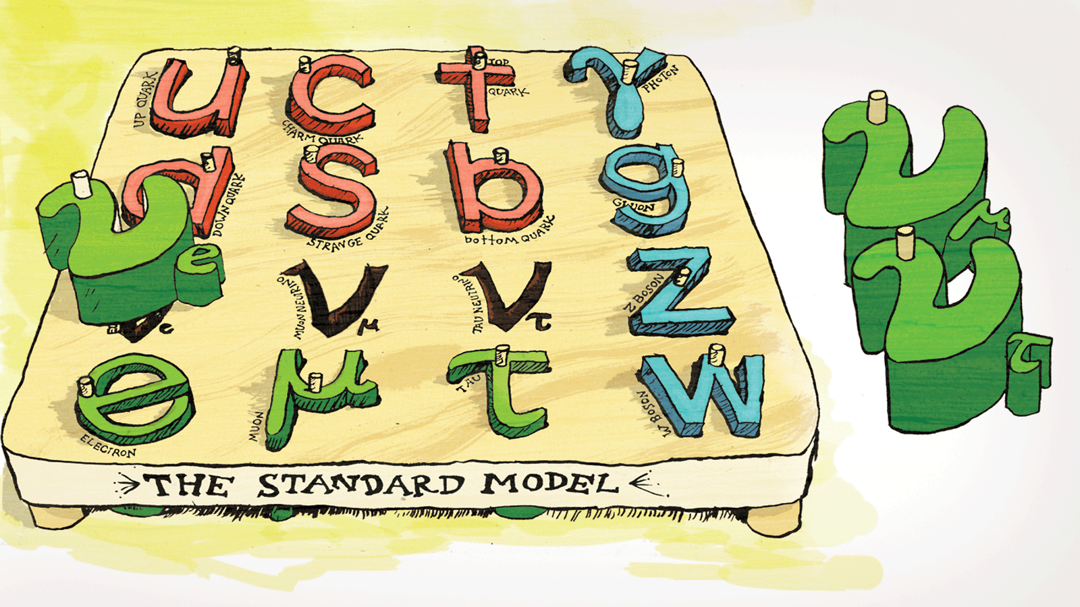
Figure credit: Symmetry magazine / Sandbox studio, Chicago

Slide 3
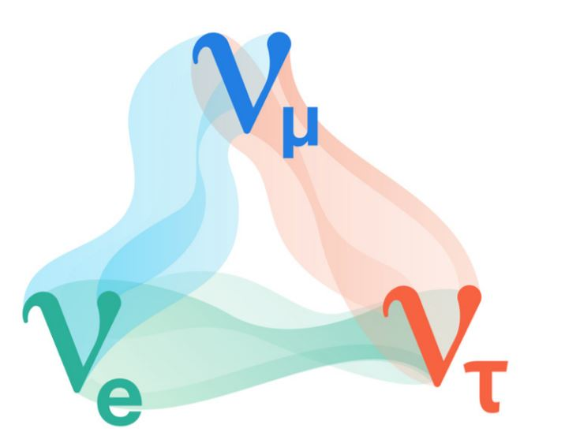
$ν$ oscillation
Complimentary ability to explore the nature of $ν$ oscillation physics with solar, atmospheric, reactor, and accelerator oscillation experiments
Broad scientific program actively being explored:
Precise measurement of known parameters
Neutrino mass ordering
Charge-parity symmetry violation in lepton sector
Existence of sterile neutrino
Figure credit: Symmetry magazine
Employ LArTPC technology to investigate

Slide 4
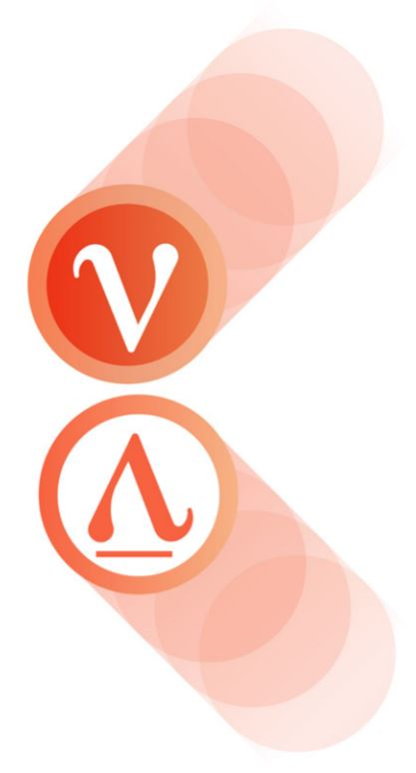
Is charge parity invariance (CP) violated in neutrino oscillations?
Ramifications for whether neutrinos are responsible for the matter-antimatter asymmetry in the universe
Compare $P(ν_{μ}→ν_{e})$ versus $P({\overline{ν}}_{μ}→{\overline{ν}}_{e})$ to study CP-violation
Figure credit: Symmetry magazine

Slide 5
Deep Underground Neutrino Experiment (DUNE)
Figure credit: dunescience.org
Search for CP violation in the leptonic sector
Resolve the neutrino mass hierarchy
Test grand unified theories (GUTs) with the detection of proton decay
Observe neutrinos from core collapse super nova

Slide 6
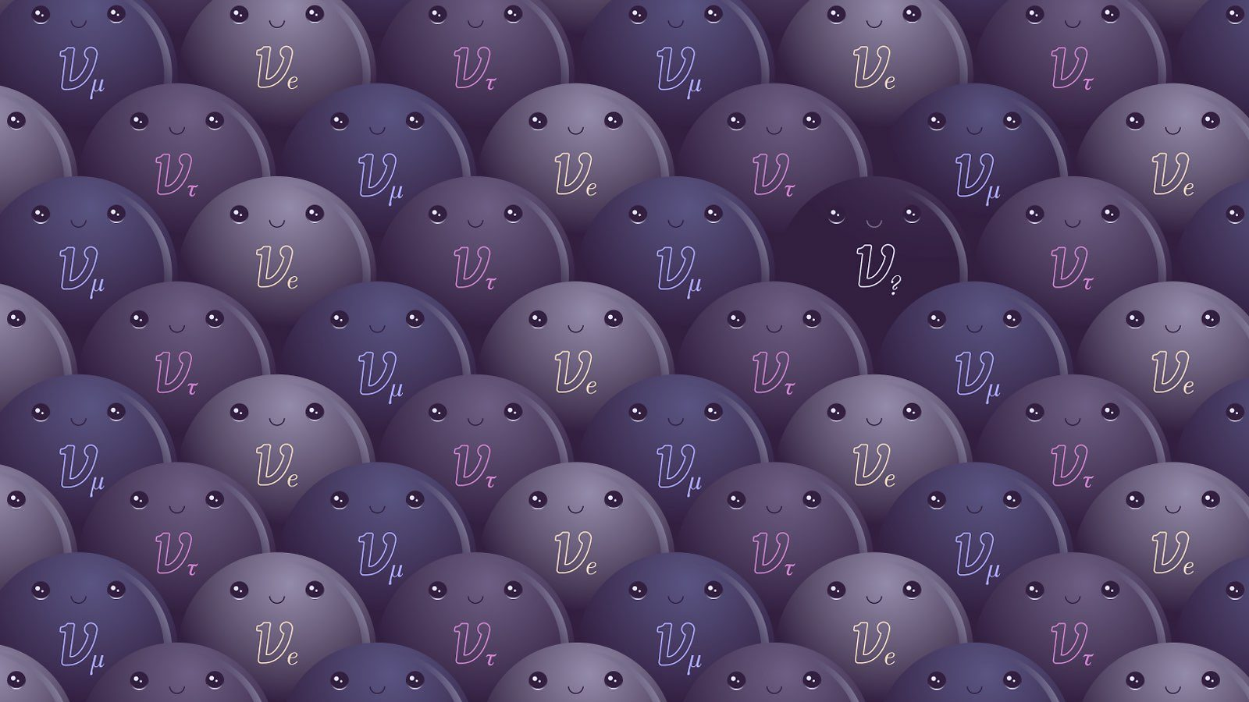
How many neutrino species are there?
Figure credit: Symmetry magazine / Sandbox studio, Chicago with Ana Kova

Slide 7
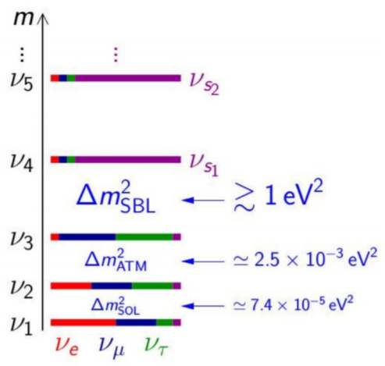
Sterile $ν$ landscape
Three flavor neutrino states are well established
However, there exist a number of hints of additional neutrino states with masses at the eV scale
LSND and MiniBooNE anomalies
Gallium anomaly
Reactor antineutrino anomaly
Do sterile neutrinos exist?
Disappearance: $P(ν_{μ}→ν_{μ})$ or $P(ν_{e}→ν_{e})$
Appearance: $P(ν_{μ}→ν_{e})$

Slide 8
Short-Baseline Neutrino (SBN) Program
Staged approach to address short baseline anomalies
Phase 1: MicroBooNE – definitive test of the MiniBooNE low energy excess
Phase 2: SBND + MicroBooNE + ICARUS – $ν_{e}$ appearance and $ν_{ μ}$disappearance searches
Aerial view of Fermilab short-baseline neutrino campus
MiniBooNE
SBND
112 ton
110 m
ICARUS
476 ton
600 m
MicroBooNE
85 ton
470 m
Reduce statistical uncertainties with large mass far detector
Reduce systematic uncertainties with same detector technology

Slide 9
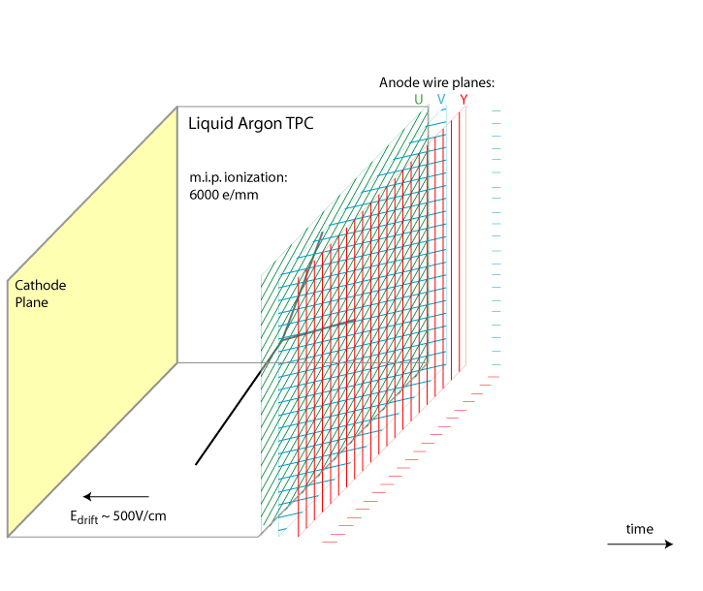
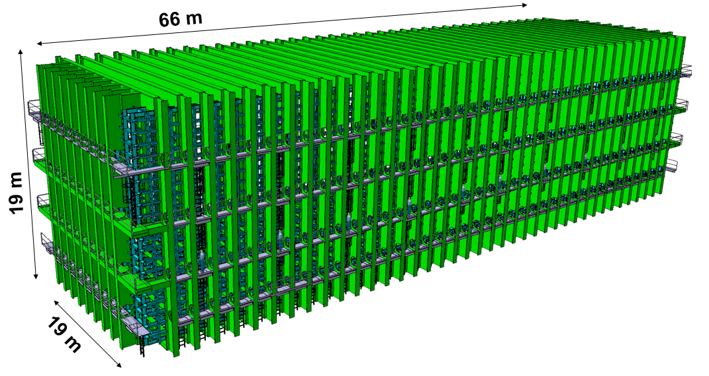
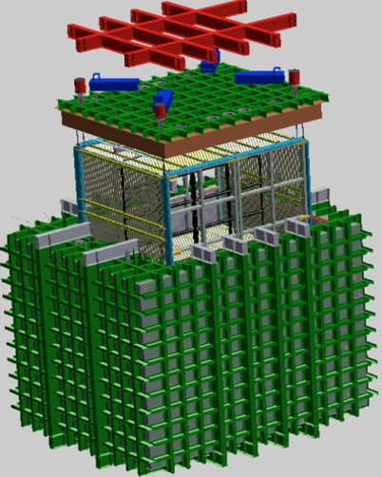
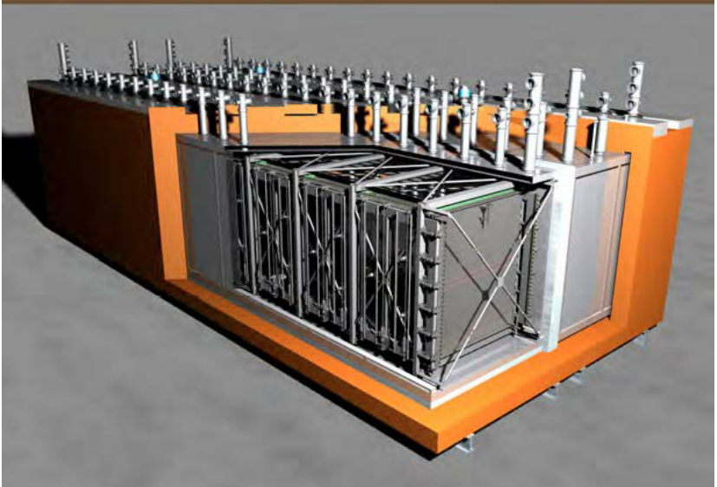
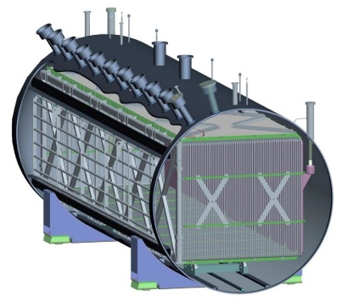
Single-Phase Liquid Argon Time Projection Chamber (LArTPC)
Massive - fully active multi-ton target volume
Topology - fine-grained 3D tracking
Calorimetry - local dE/dx information
DUNE FD 10kt module
Detector technology for DUNE & SBN experiments
SBND
Icarus
MicroBooNE
Figure from Bo Yu (BNL)

Slide 10
Single-Phase Liquid Argon Time Projection Chamber (LArTPC)
Massive - fully active multi-ton target volume
Topology - fine-grained 3D tracking
Calorimetry - local dE/dx information
DUNE FD 10kt module
Detector technology for DUNE & SBN experiments
SBND
Icarus
MicroBooNE
Figure from Bo Yu (BNL)

Slide 11
BNL MicroBooNE group
With MicroBooNE data, work to bring to fruition LArTPC capability for near-term and long-term neutrino oscillation physics
Photo from BNL press release: “Extracting Signals of Elusive Particles from Giant Chambers Filled with Liquefied Argon”

Slide 12
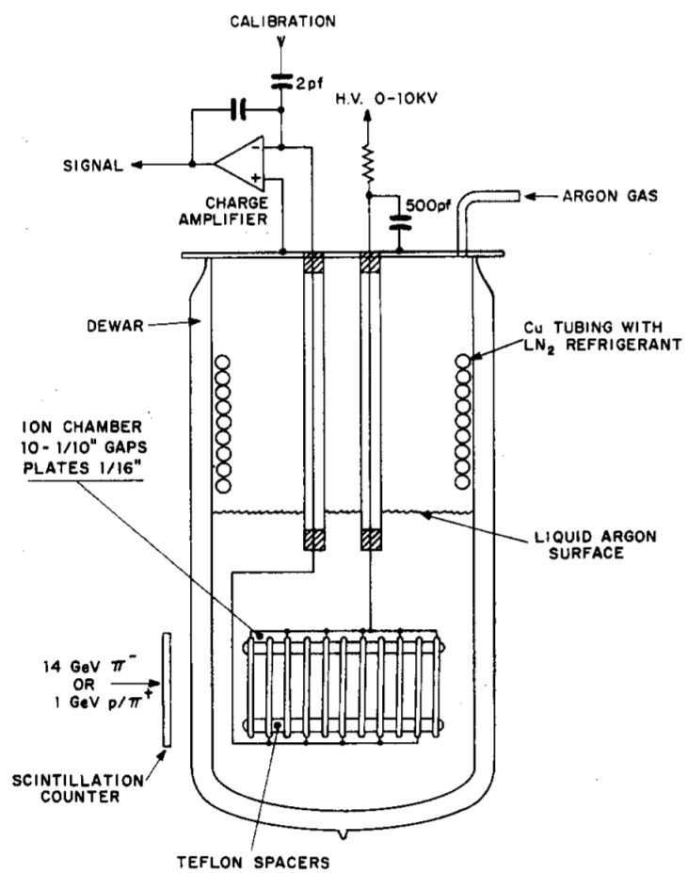
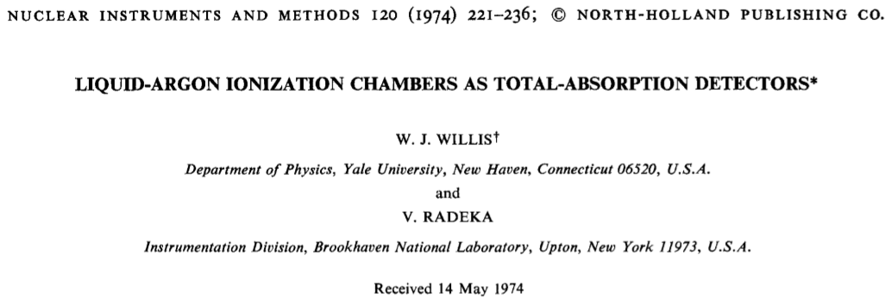
LAr as total absorption calorimeter
1974
In anticipation of scaling LAr ionization chambers to large detectors, emphasized early on that capacitance matching of the detector and the amplifier is essential to reach the fundamental lower limit of noise (higher signal-to-noise ratio)
LAr is an attractive active target medium:
High electron mobility
Cheap
Abundant
Inert
Many nucleons

Slide 13
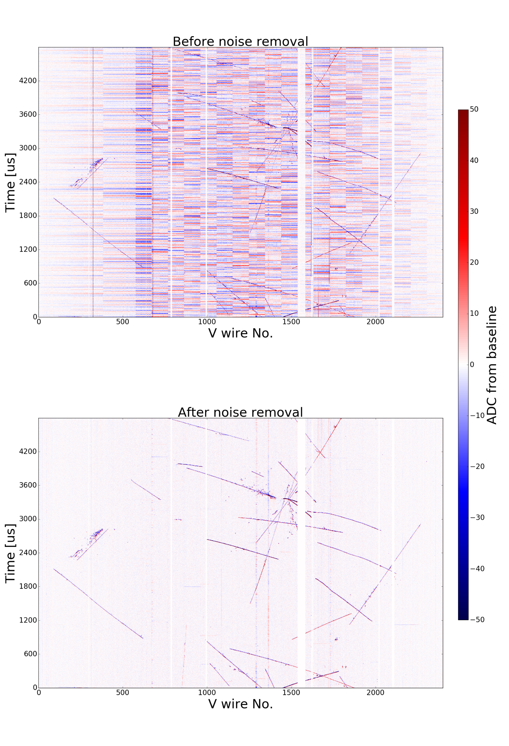
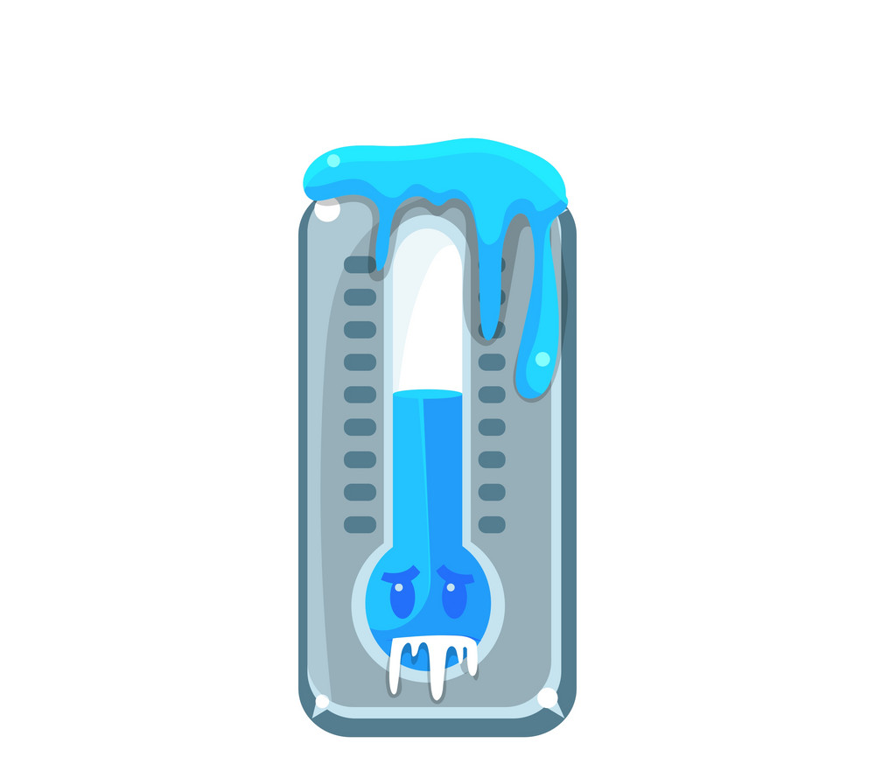
Mitigate excess noise
Low inherent electronics noise
Lessons learned from MicroBooNE have led to improvements in cold ASIC design for SBND & DUNE, imperative for scaling to O(kt) masses
Liquid argon boiling point -186$℃$
JINST 12 P08003 (2017)

Slide 14
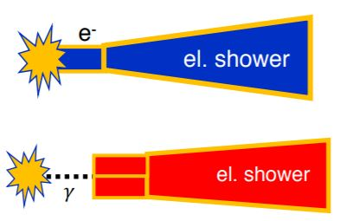
$e^{−}/γ$ discrimination
PRD 95 072005 (2017)
critical for $P(ν_{μ}→ν_{e})$ and $P({\overline{ν}}_{μ}→{\overline{ν}}_{e})$ measurements
ArgoNeuT
electron
photon
gap
$e^{−}$ or $γ$ ?

Slide 15
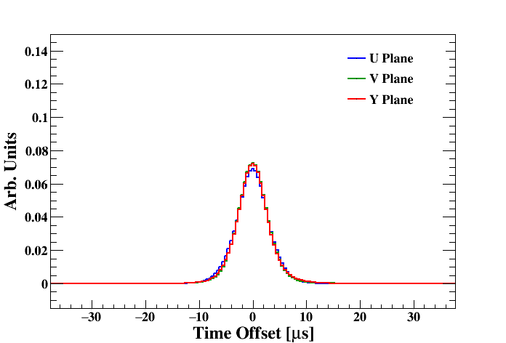
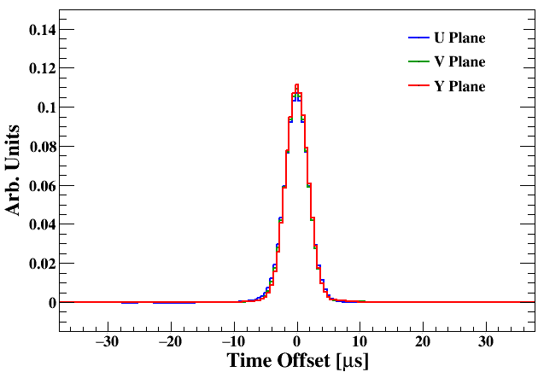
Careful signal extraction
Pioneered novel signal processing techniques for single-phase LArTPCs, critical for topology agnostic reconstruction of neutrino final states
$${50}^{°}<θ_{xz}<{70}^{∘}$$
$$5^{°}<θ_{xz}<{15}^{∘}$$
JINST 13 P07006 (2018)
JINST 13 P07007 (2018)

Slide 16
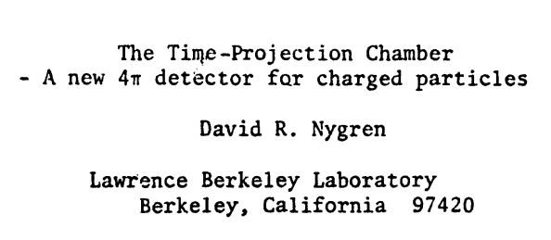
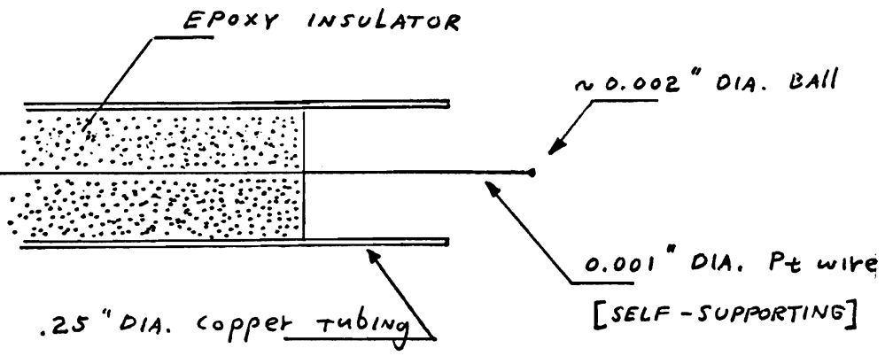
TPC as $4π$ charged particle detector
1976
Ubiquitous application in modern experimental physics
Neutrino-less double beta decay
Dark matter direct detection
Etc.
“The absence of the ambiguities associated with spatial projections should have an enormously beneficial impact on the problem of pattern recognition in high multiplicity events.”

Slide 17
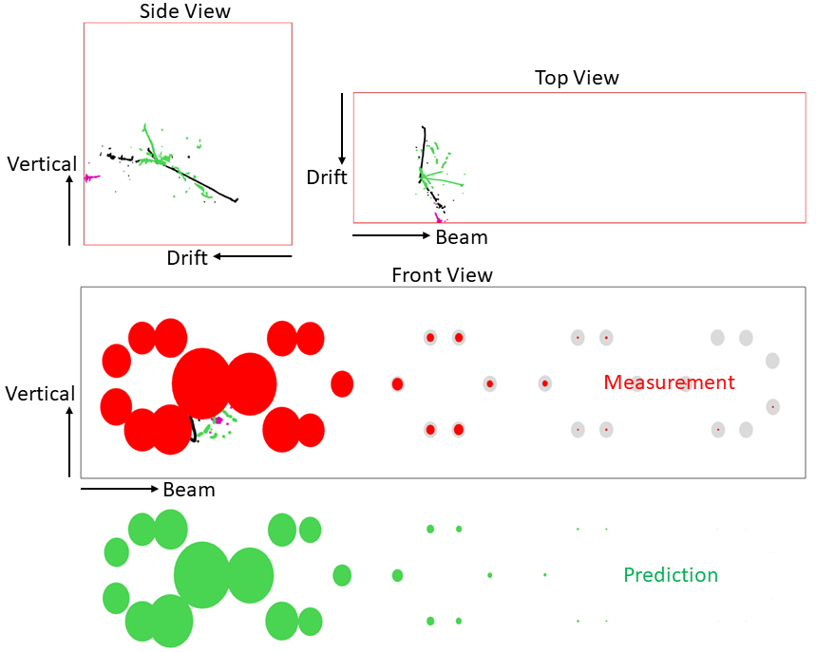
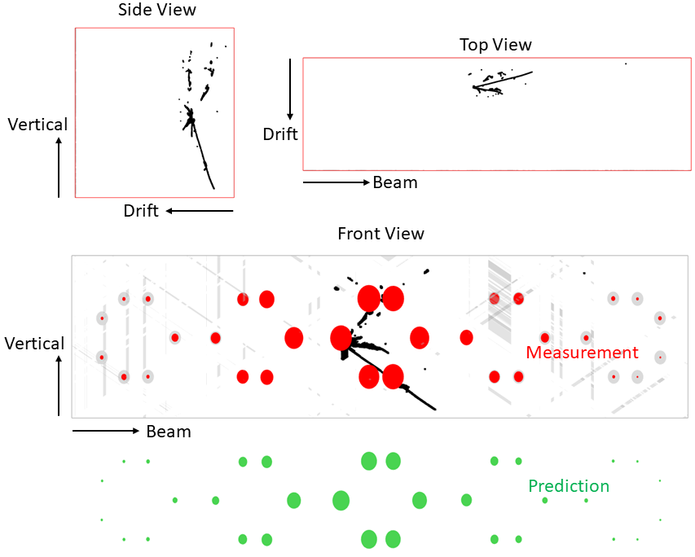
Wire-Cell tomographic event reconstruction X. Qian, C. Zhang, B. Viren, M. Diwan JINST 13 P05032 (2018).
$ν$ candidate with 3 $π^{0}$s
$ν$ candidate with a $π^{0}$

Slide 18
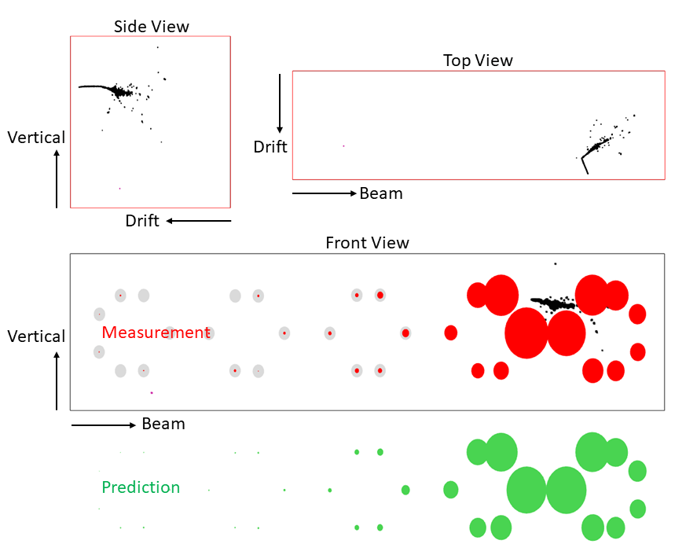
Bringing to fruition LArTPC capability for $ν$ oscillation physics
$ν_{e}$CC candidate
Employ LArTPCs to answer critical questions in neutrino physics
CP violation in lepton sector?
Existence of sterile neutrino?
In the era of precision $ν$ oscillation physics, MicroBooNE is blazing the trail
Near term SBN program seeds the success for flagship long baseline DUNE experiment
Demanding technical requirements are needed to make these ambitious measurements
Run 5906 Event 3710

